Slide 1
Introduction to CEPCSW and performance study
Gang LI

Slide 2
Outline
CEPC
CEPC software & detectors
Generator samples
Some useful information

Slide 3

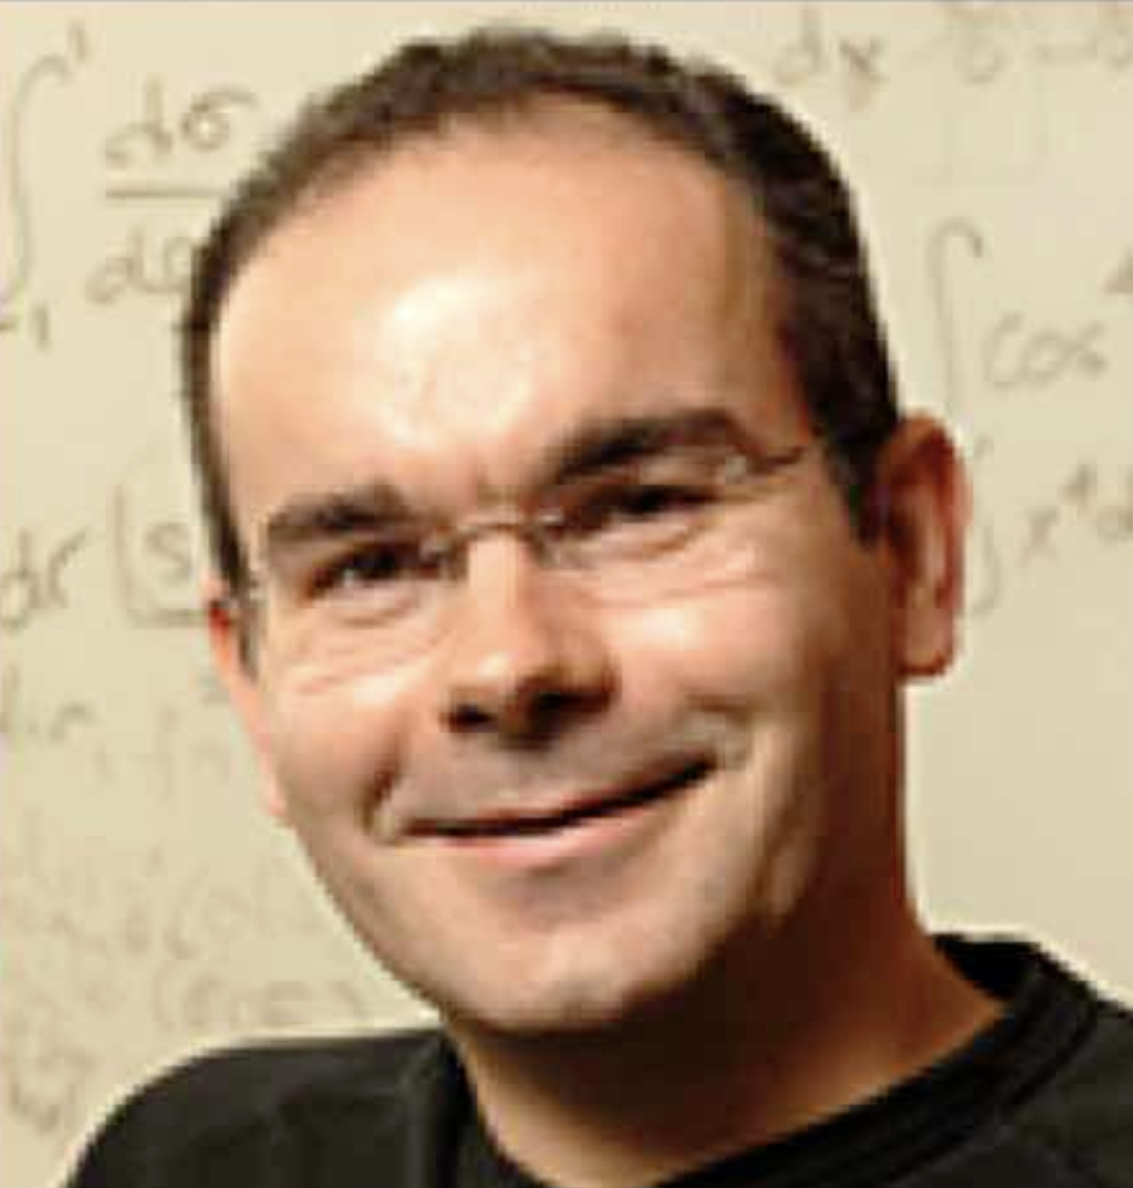

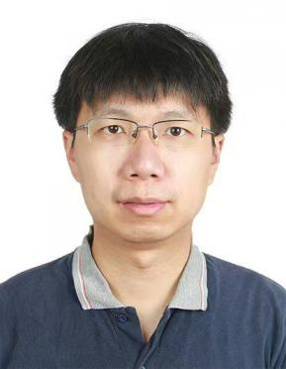
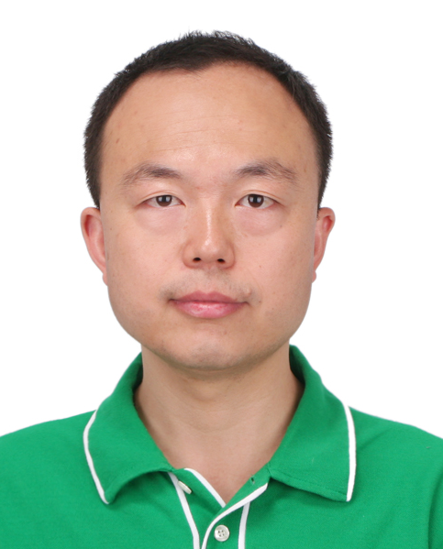
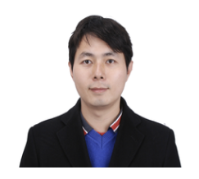
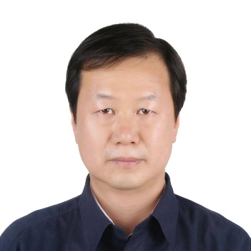
Attendances of IHEP
Jianchun Wang
co-convener of detector group
Joao Costa
co-convener of detector group
Mingshui Chen
physics performance
Yong Liu
(crystal) ECal
Huirong Qi
(pixelated) TPC
Manqi Ruan
White papers
Gang Li
software, physics generators, tracker

Slide 4
General introduction

Slide 5
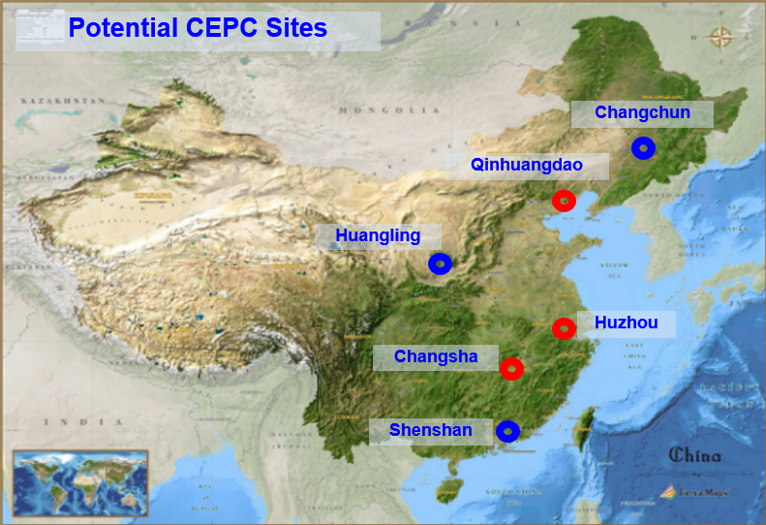
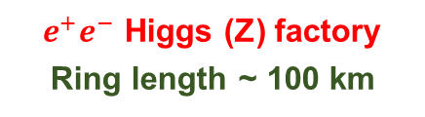
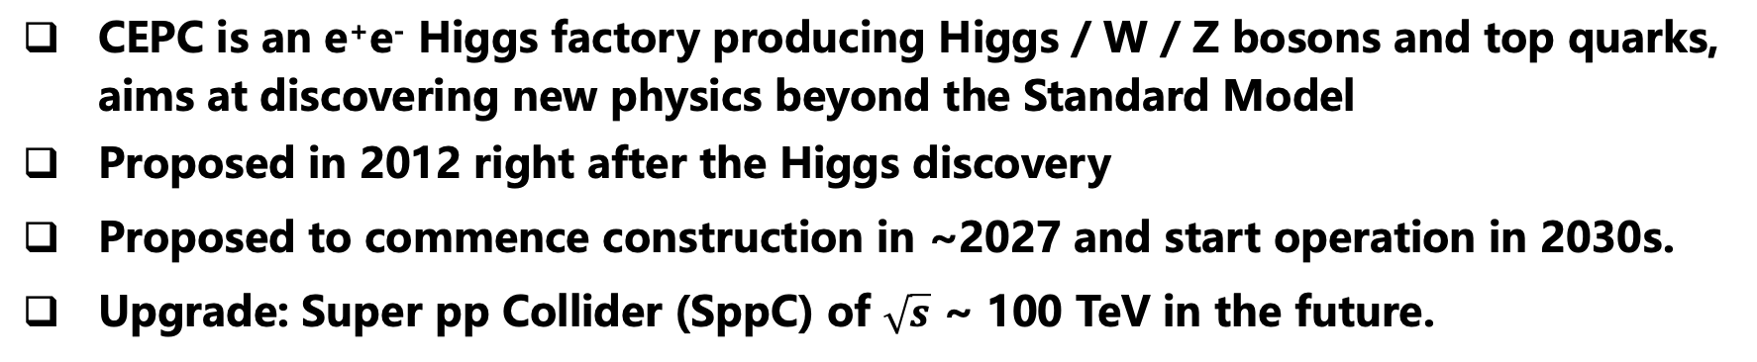
Circular Electron Positron Collider (CEPC)
CEPC is an e⁺e⁻ Higgs factory producing Higgs / W / Z bosons and top quarks, aims at discovering new physics beyond the Standard Model
Proposed in 2012 right after the Higgs discovery
Proposed to commence construction in ~2027 and start operation in 2030s.
Upgrade: Super pp Collider (SppC) of $\sqrt{s}$ ~ 100 TeV in the future.
IP 2
$e^{+}e^{−}$ Higgs (Z) factory
Ring length ~ 100 km
IP 1
arXiv:1809.00285, arXiv:2203.09451

Slide 6
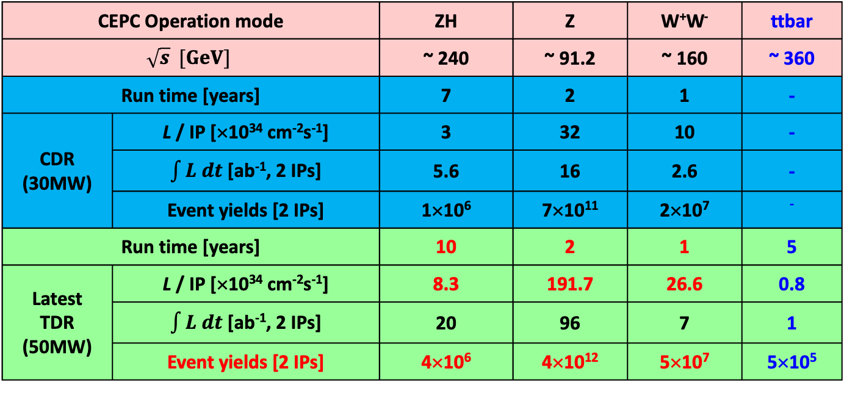
CEPC Physics Program
CEPC Operation mode |  | ZH | Z | W⁺W⁻ | ttbar
$$\sqrt{s} [GeV]$$ |  | ~ 240 | ~ 91.2 | ~ 160 | ~ 360
Run time [years] |  | 7 | 2 | 1 | -
CDR (30MW) | L / IP [×10³⁴ cm⁻²s⁻¹] | 3 | 32 | 10 | -
 | $\int{L dt}$ [ab⁻¹, 2 IPs] | 5.6 | 16 | 2.6 | -
 | Event yields [2 IPs] | 1×10⁶ | 7×10¹¹ | 2×10⁷ | ⁻
Run time [years] |  | 10 | 2 | 1 | 5
Latest TDR (50MW) | L / IP [×10³⁴ cm⁻²s⁻¹] | 8.3 | 191.7 | 26.6 | 0.8
 | $\int{L dt}$ [ab⁻¹, 2 IPs] | 20 | 96 | 7 | 1
 | Event yields [2 IPs] | 4×10⁶ | 4×10¹² | 5×10⁷ | 5×10⁵
Systematically examine the SM and search for new physics beyond SM
Higgs&EW, QCD, Flavor, new hadron states, new phenomena, …
Not only number counting, but differentials, even probe new physics via some new technologies, such as AI.

Slide 7
CEPC Physics(selected)
e⁺e⁻ annihilations at the CEPC
CEPC can make detailed study of various physics processes
Higgs bosons are detected via recoil mass of the reconstructed Z, allowing for model independent & full investigation of the Higgs and any new physics that Higgs may reveal
Very challenging events with missing neutrinos and jets are well reconstructed and identified

Slide 8
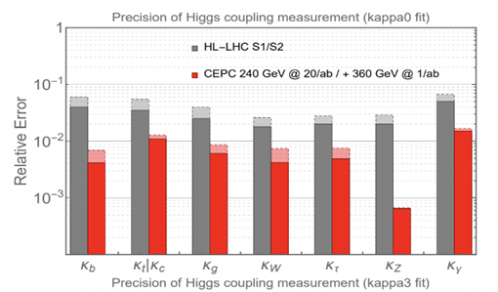
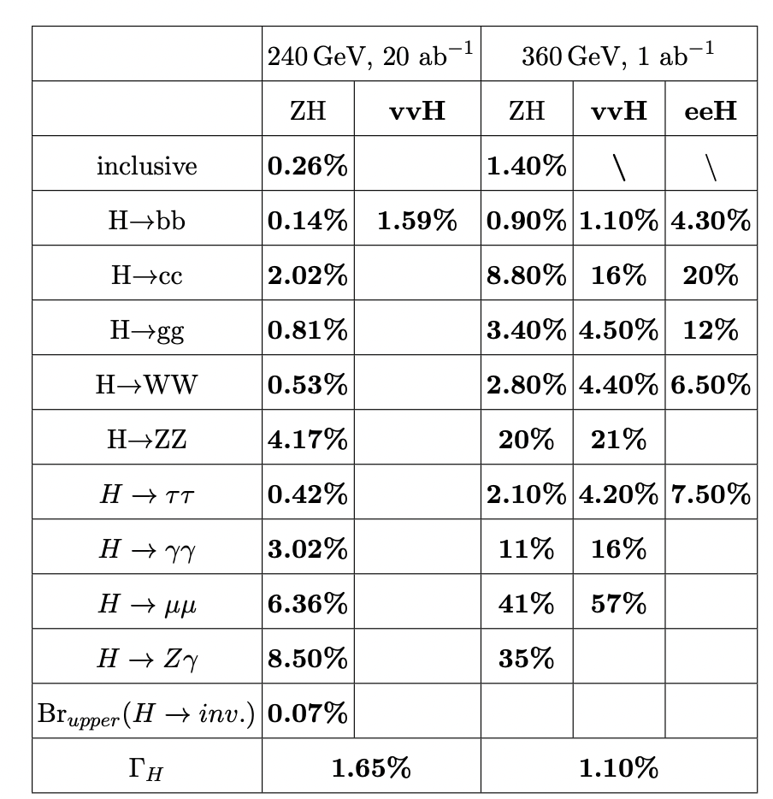
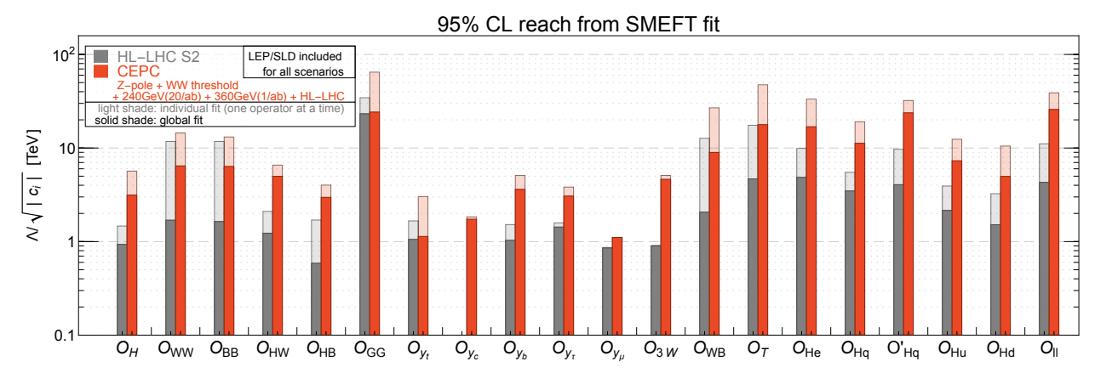
CEPC Physics(selected)
Precision Higgs, EW, flavor physics & QCD measurements at unprecedented precision
BSM physics (e.g. dark matter, EW phase transition, SUSY, LLP, …) up to ~ 10 TeV scale
Energy scale probed
arXiv:2205.08553
CEPC can reveal new physics at energy ~ 10 TeV or higher

Slide 9
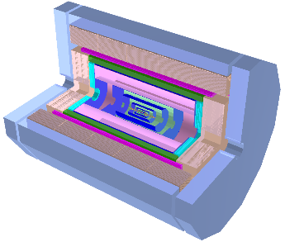
CEPC Conceptual Detectors: development
(Baseline Design)
Particle Flow Approach
IDEA concept
(also proposed for FCC-ee)
Magnet
(3T/2T)
2T Magnet
Yoke + Muon (RPC or μ-RWELL)
Preshower (μ-RWELL)
LumiCal
Dual-readout calorimeter
Silicon wrapper
Drift chamber
PFA HCAL
Yoke + Muon (μ-RWELL)
PFA ECAL
Si Pixel Vertex
Si Pixel Vertex
The 4th Concept
SIT TPC SET
FTD ETD
PFA HCAL
Partially Yoke
Magnet (3T/2T)
FST concept
(Full Silicon Tracker)
PID (DC+ToF)
Silicon Tracker
Crystal ECAL
(Transverse bar)

Slide 10
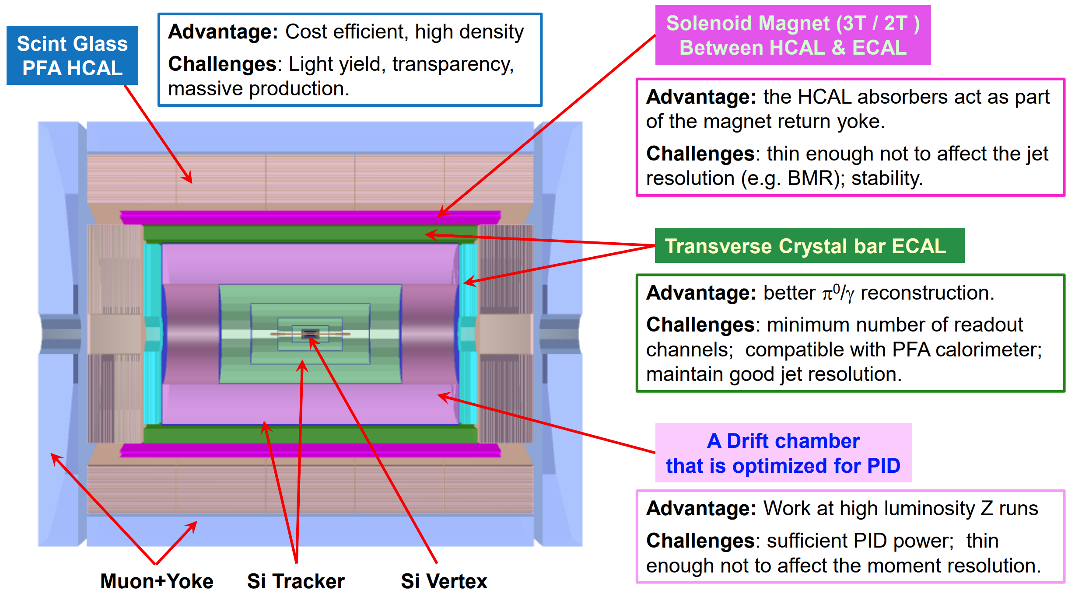
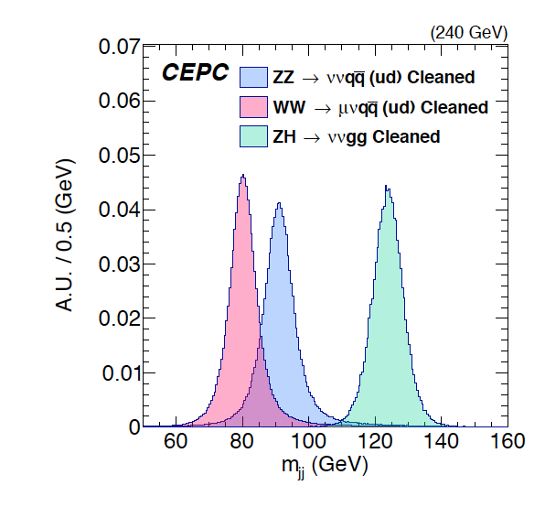
Novel Conceptual Detector Design
Novel detector design based on PFA calorimeter. Aim at improving BMR 4% → 3%
Detector | World-class level | CEPC design
PFA based (ECAL) | ～ 15% / √E | < 3% / √E (Crystal ECAL)
PFA based (HCAL) | ～ 50% / √E | ～ 40% / √E (Scintillating glass HCAL)

Slide 11
CEPC offline software

Slide 12
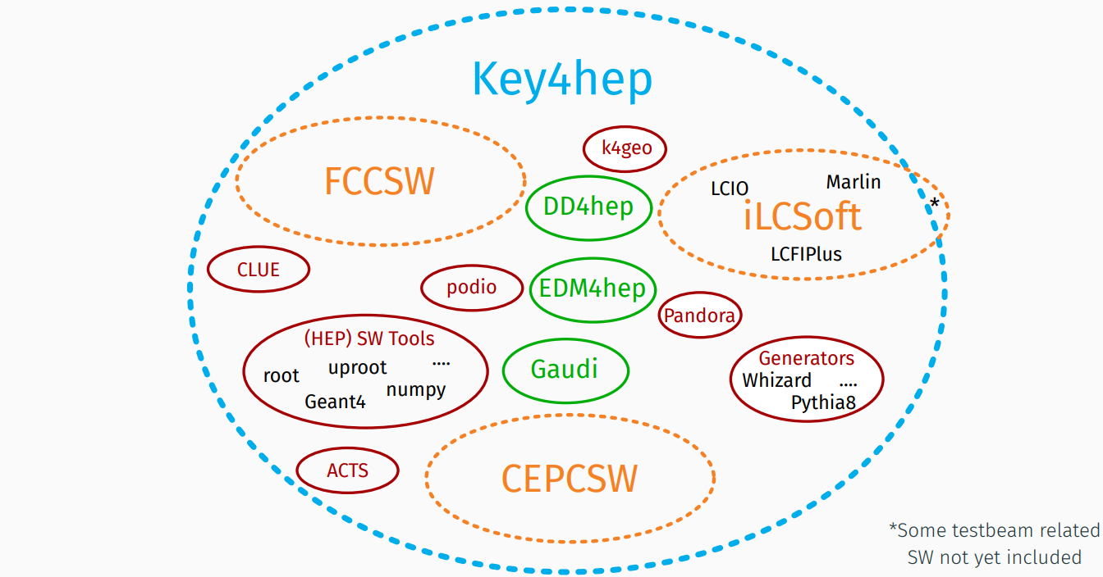
CEPCSW
T.Madlener | Key4hep & EDM4hep
CEPC workshop, Edinburgh
The development of CEPC software started with the iLCSoft
  Developed CEPC components for simulation and reconstruction
  Generated M.C. data for detector design and physics potential studies
  Particularly, CEPC CDR studies done with the iLCSoft
The consensus among CEPC, CLIC, FCC, ILC and other future experiments was reached at the Bologna workshop in June, 2019.
  Develop a Common Turnkey Software Stack (Key4hep) for future collider experiments
  Maximize the sharing of software components among different experiments
Key4hep project: https://github.com/key4hep
CEPCSW is the first application based on Key4hep.

Slide 13
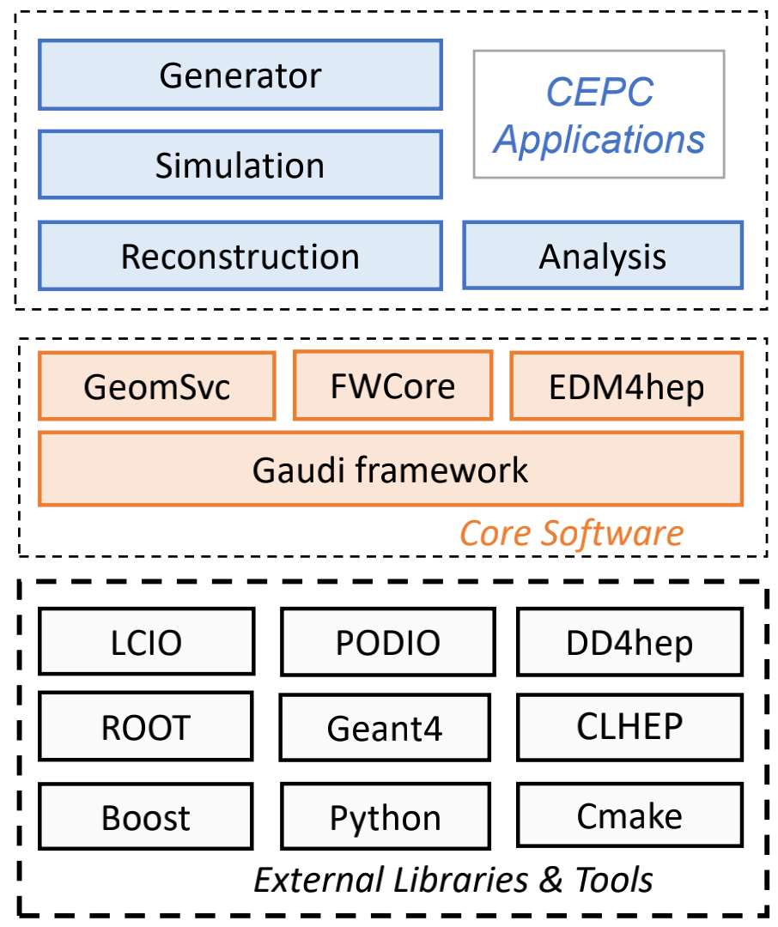
CEPCSW: Architecture
CEPCSW is organized as a multi-layer structure
  Applications: simulation, reconstruction and analysis
  Core software
  External libraries
The key components of core software include:
  Gaudi: defines interfaces to all software components and controls their execution
  EDM4hep: generic event data model
  K4FWCore: manages the event data
  DD4hep: geometry description
  CEPC-specific framework software: generator, Geant4 simulation, beam background mixing, fast simulation, machine learning interface, etc.
https://code.ihep.ac.cn/cepc/CEPCSW

Slide 14
Generator samples
Whizard+pythia6 is the main generator
Pythia 8, madgraph5, Herwig, … also used
For more detail information, please follow the meetings in
https://indico.ihep.ac.cn/category/1043/
Dedicated tutorial on simulation production and analysis
https://indico.ihep.ac.cn/event/25350/
https://indico.ihep.ac.cn/event/24004/

Slide 15
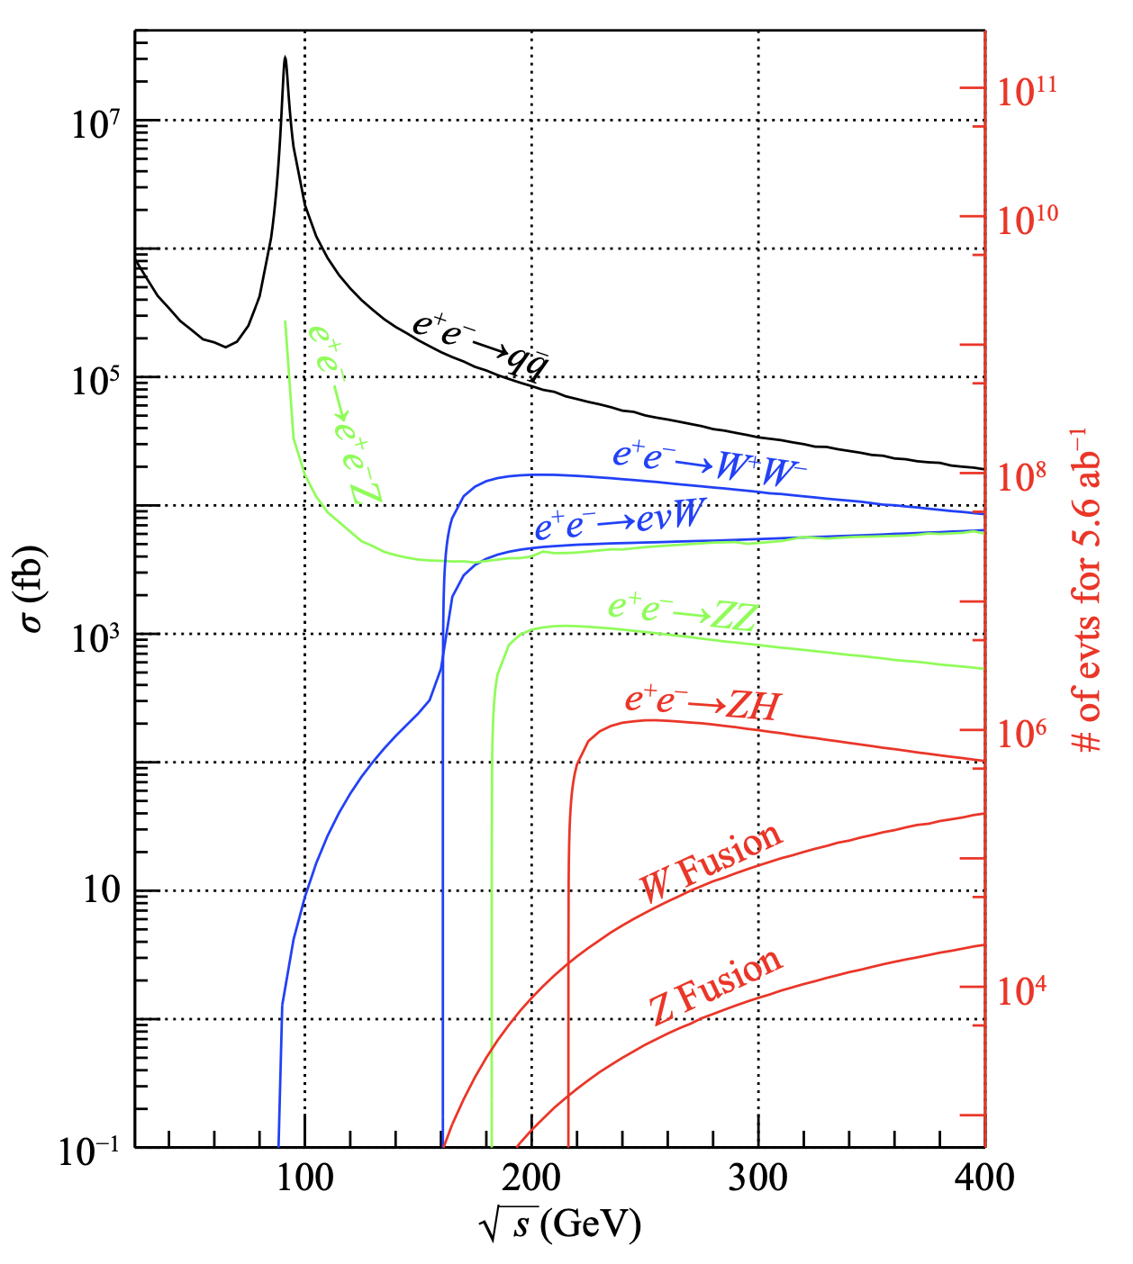
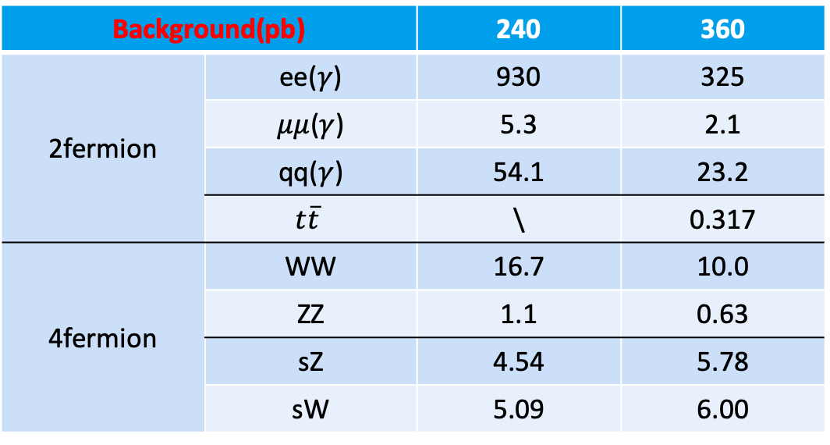
For Higgs study
20/ab in 240GeV, 1/ab in 360GeV.
?? In 91 GeV and 160 GeV
Signals(fb) | 240 | 360
ZH | 196.9 | 126.6
WW fusion | 6.2 | 29.61
ZZ fusion | 0.5 | 2.80
Total | 203.6 | 159.0
Total Events | 4M | 0.16M
Background(pb) |  | 240 | 360
2fermion | ee($γ$) | 930 | 325
 | $μμ$($γ$) | 5.3 | 2.1
 | qq($γ$) | 54.1 | 23.2
 | $$t\overline{t}$$ | \ | 0.317
4fermion | WW | 16.7 | 10.0
 | ZZ | 1.1 | 0.63
 | sZ | 4.54 | 5.78
 | sW | 5.09 | 6.00

Slide 16
Z-pole and W threshold study
  Z pole
    Hadron cross section ~ 30nb --- 4 Tera Z boson events
    Generate samples on demanding
  W threshold scan for W mass measurement
    Various energy points
    Moderate statistics
    Also on demanding

Slide 17
Some useful information

Slide 18

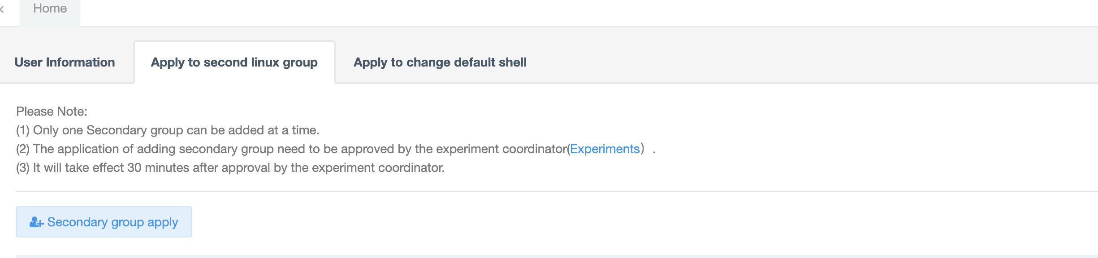
How to apply an computing account of IHEP
If you do not have IHEP SSO
  Step 1: Apply SSO account on login.ihep.ac.cn by click the “register” button
  Step 2: Apply AFS computing account once you have an SSO account and login to login.ihep.ac.cn
If you already have an AFS account but in higgs group
  Login ccsinfo.ihep.ac.cn to request to join the second linux group : higgs
Contact person:
Gang Li
ligang@ihep.ac.cn

Slide 19
Websites and github repos.
CEPC website: http://cepc.ihep.ac.cn/
Internal wiki: http://cepc.ihep.ac.cn/~cepc/cepc_twiki/index.php/Main_Page
Internal docs: http://cepcdoc.ihep.ac.cn/cgi-bin/DocDB/DocumentDatabase
CEPCSW gitlab repo: https://code.ihep.ac.cn/cepcsw/CEPCSW
  Github repo: https://github.com/cepc/CEPCSW
  Github key4hep repo:
    https://github.com/key4hep/k4FWCore
    https://github.com/key4hep/EDM4hep
Previous CEPC software documentation: http://cepcsoft.ihep.ac.cn/

Slide 20
Summary
General introduction to CEPC detector, software, and physics study
Some useful information
More you want to know about the CEPC?

