Slide 1
Momentum resolution of a tracking system
Gang Li

Slide 2
径迹测量在做什么？
位置测量空间
径迹寻找
径迹拟合
径迹参数空间
测量误差
测量点的分布（layout）和范围 L
磁场强度
物质的散射
测量值
协方差矩阵
把空间测量结果变换到径迹参数空间
影响因素：空间测量本身、散射效应、变换矩阵

Slide 3
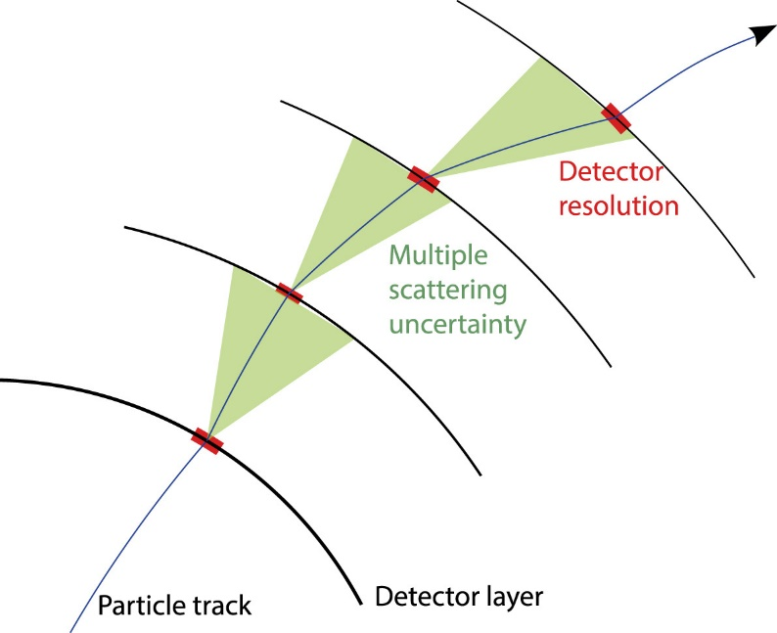
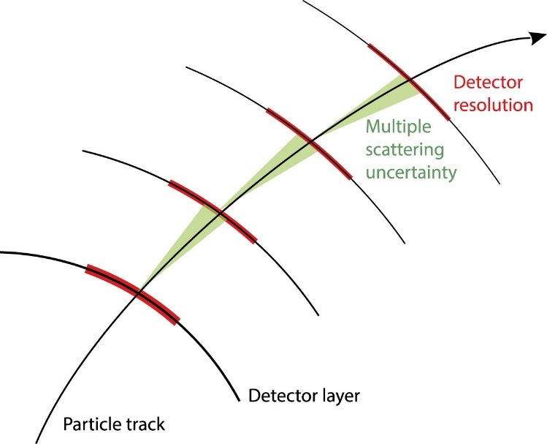
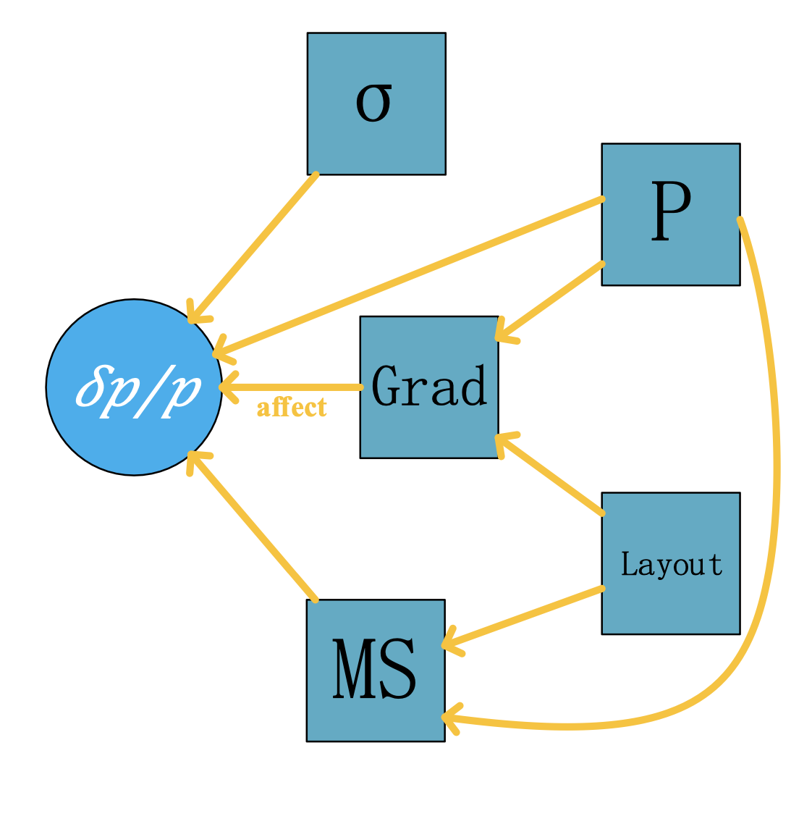
Momentum resolution
σ > MS
MS > σ
Complicated, when MS is taken into account
Quite a few factors affect the momentum resolution

Slide 4
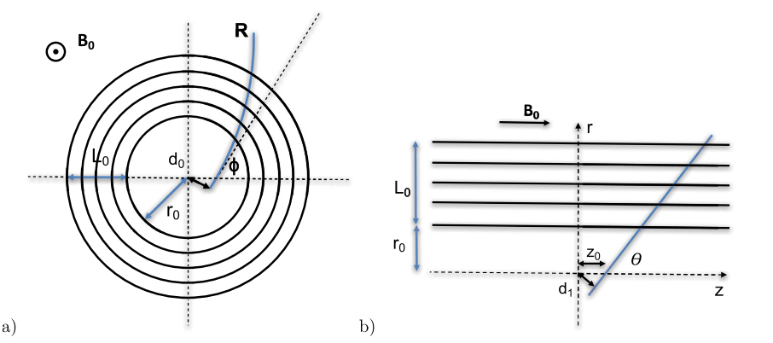
$${\left(C_{y}\right)}_{mn}=σ_{n}^{2}δ_{mn}+\sum_{j=0}^{Min\left[m,n\right]−1}{σ_{α_{j}}^{2}}\left(x_{m}−x_{j}\right)\left(x_{n}−x_{j}\right)$$

Slide 5
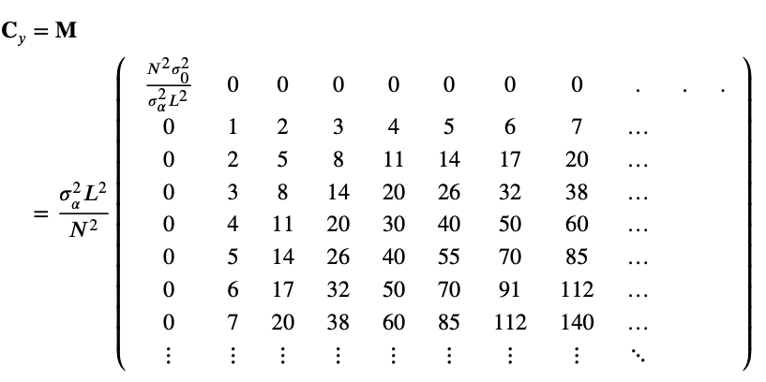

Slide 7
Let`s recall least square fit (Neglecting the correlations among hits )
It achieves the minimum when the derivatives are zeros

Slide 8
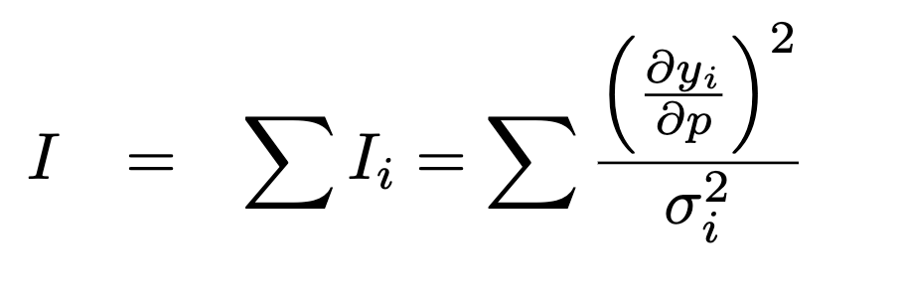
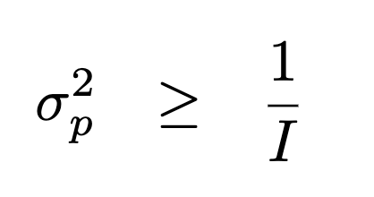
In textbook，the Fisher information (FI) is defined as
Weighted sum of the squared derivatives
Weights: inverse squared errors
Advantage of FI: related to variance directly
Two ingredients of FI
Nominator : Derivatives of helix to measurements y_{i}
Denominator: The σ_{i} including both spatial resolutions(SP) and MS

Slide 9
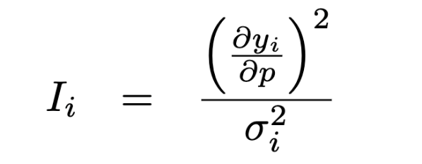
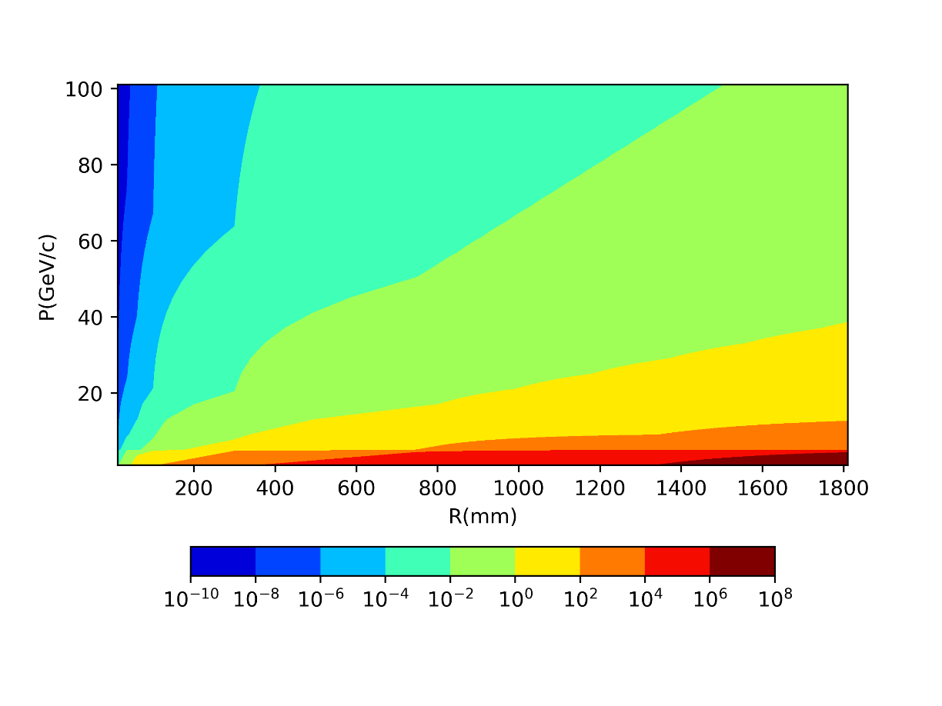
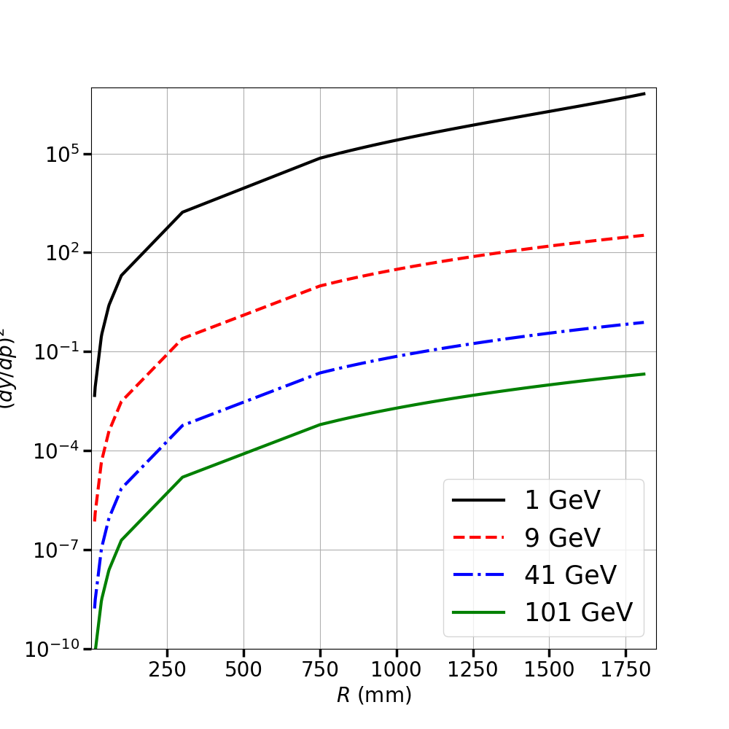
Nominator: Squared Derivatives (SD)
~10⁸
Varies in a huge range ( vs. R & momenta)
~ 8 orders of magnitudes difference @ R= 1.8 m

Slide 10
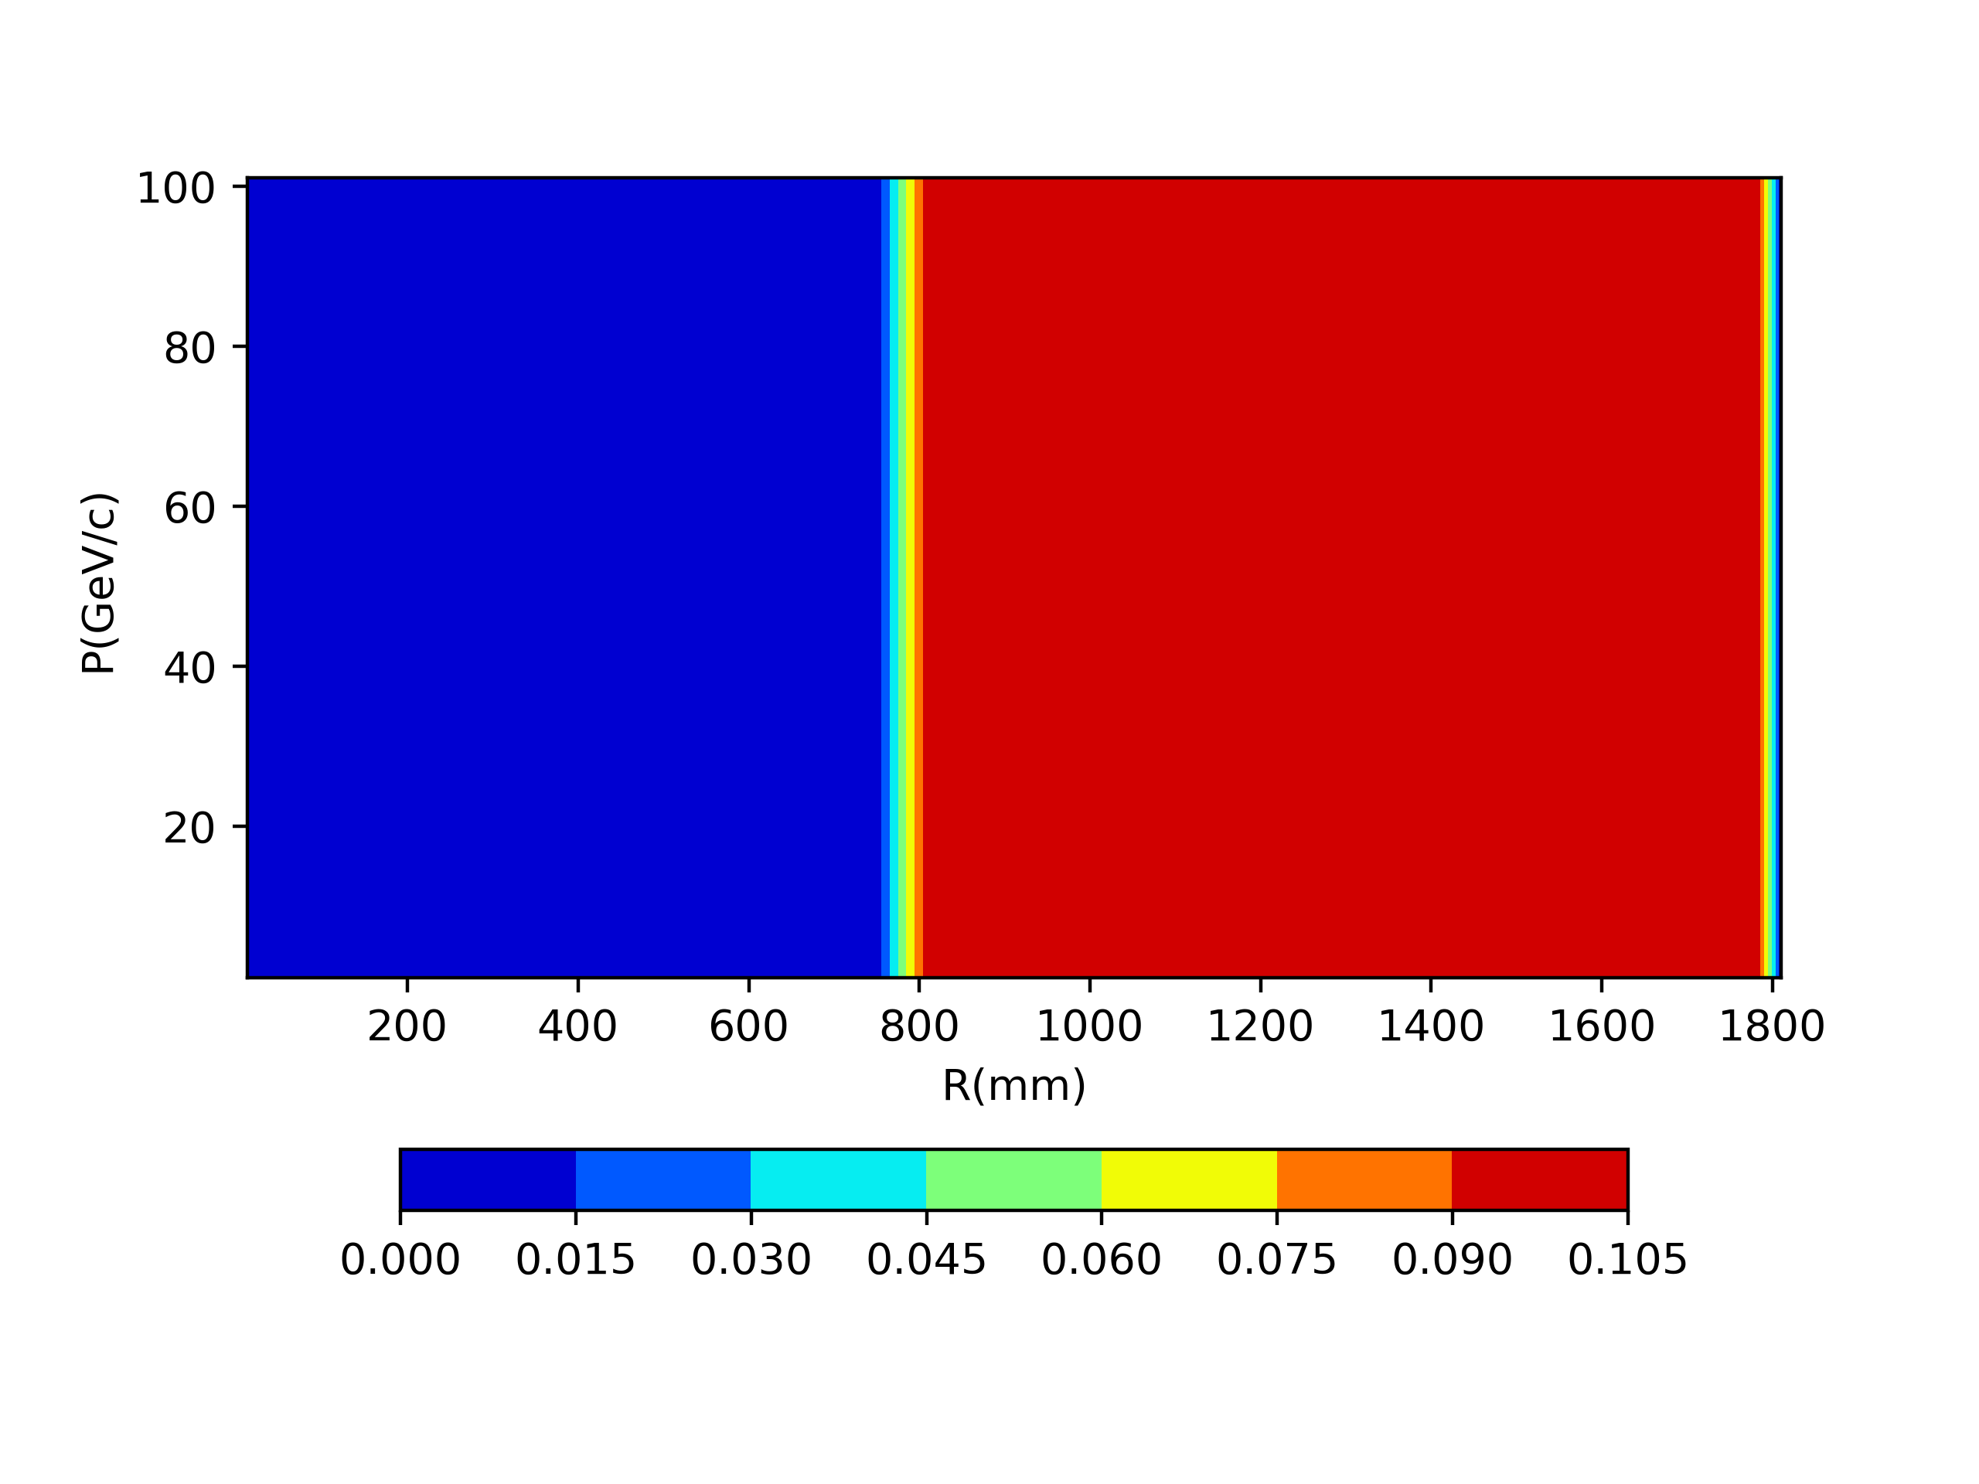
Denominator: spatial resolution(SP)
Independent on p
(while MS depends on p)

Slide 11
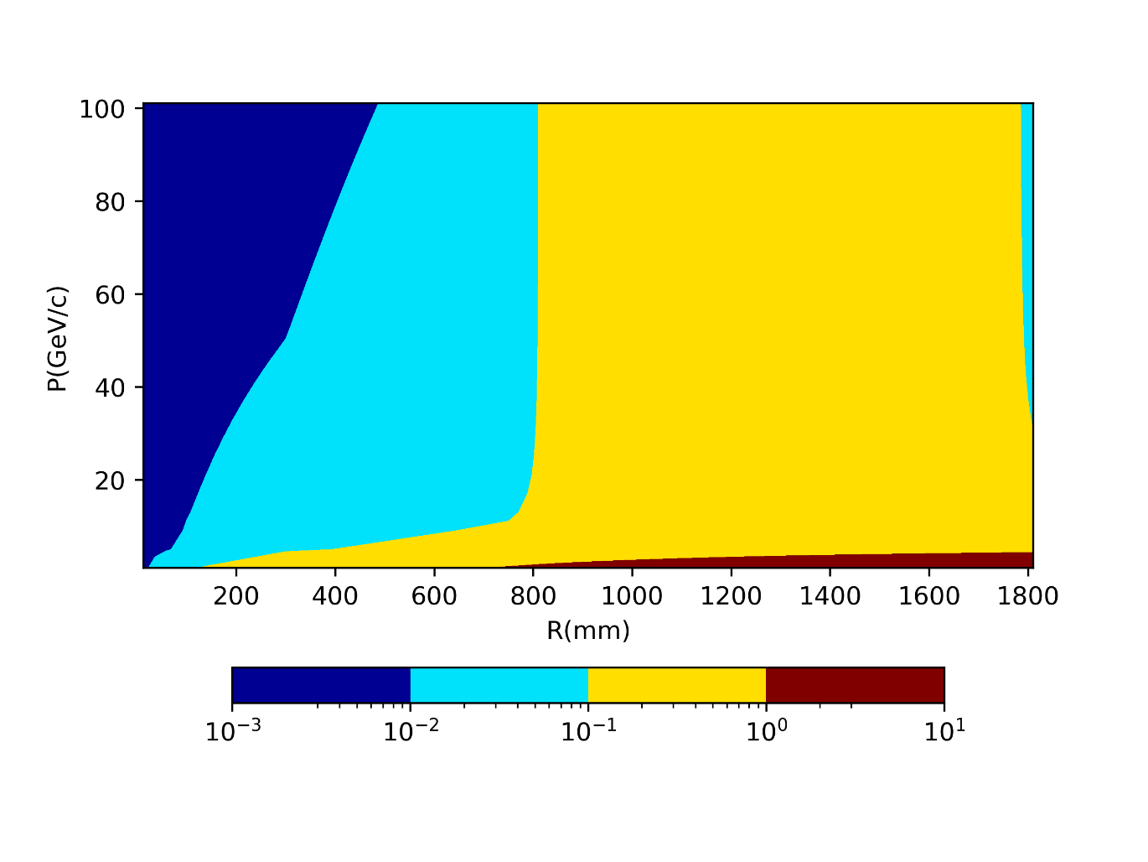
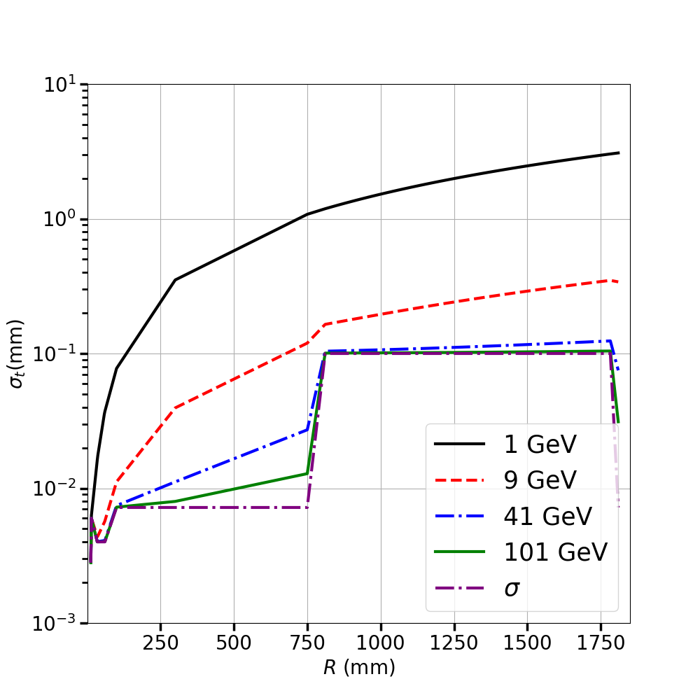
Denominator: combined MS and SP
~10²
(~10⁴)
Complicated but understandable
MS: negligible for sufficiently high pt (>10 GeV)
MS: ~3 order of magnitudes between 1 and 100 GeV at R = 1.8 m

Slide 12
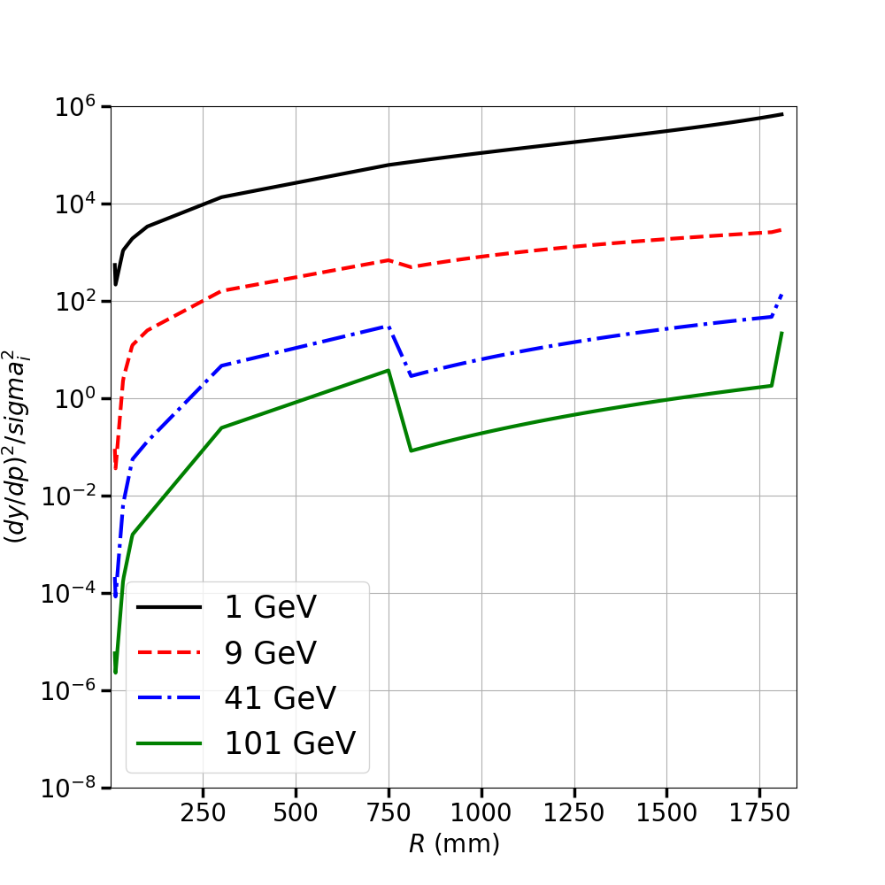
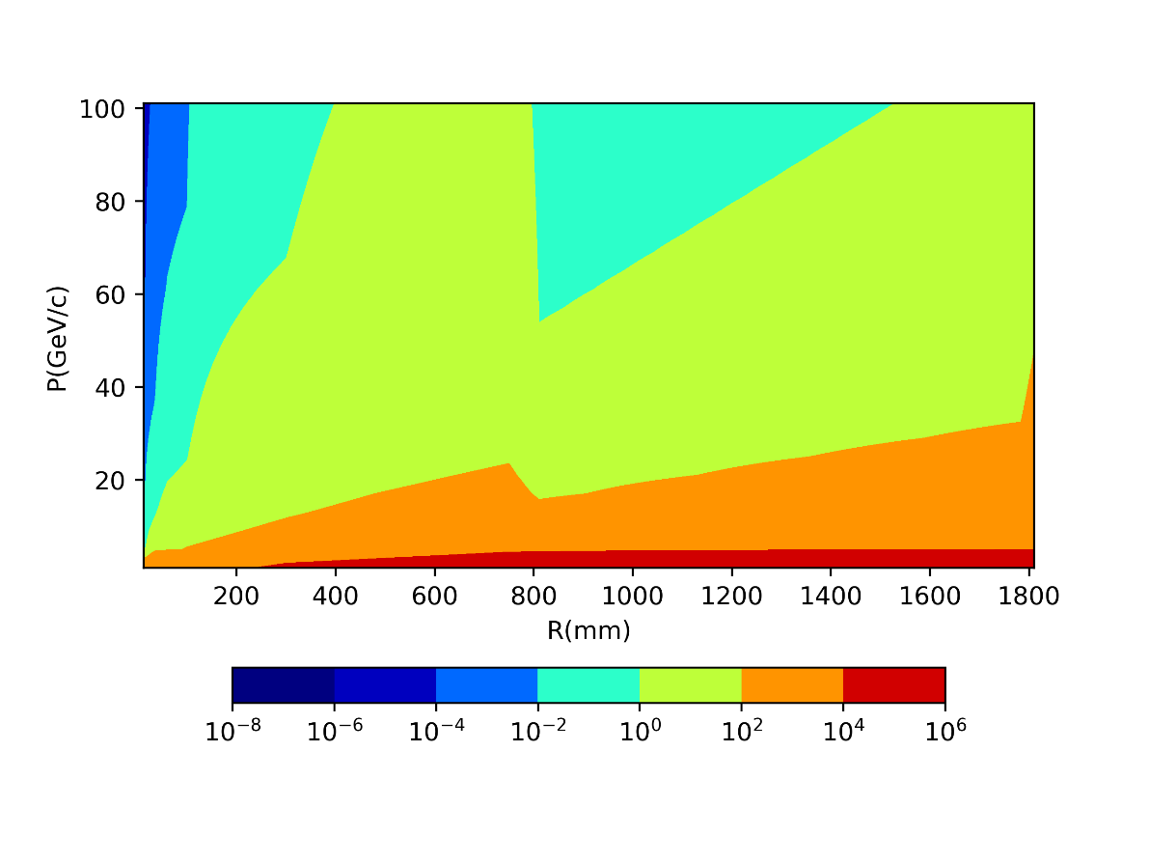
FI= SD/(SP²+MS²)
~10⁵
Though taking MS into account, DC contributes more information to low pt tracks → derivates dominant.

Slide 13
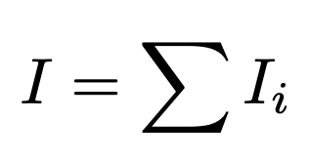
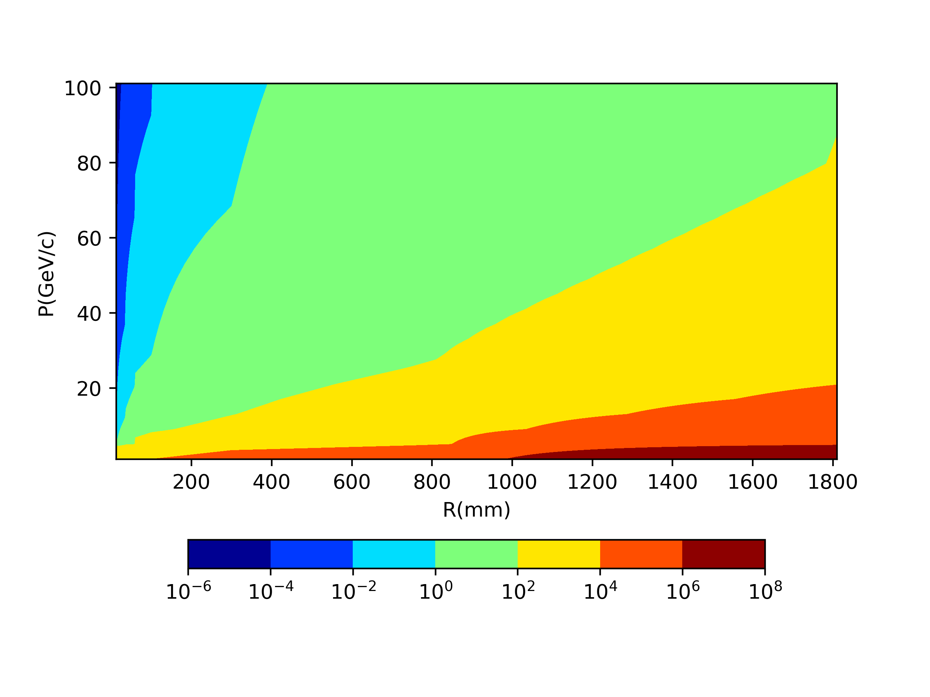
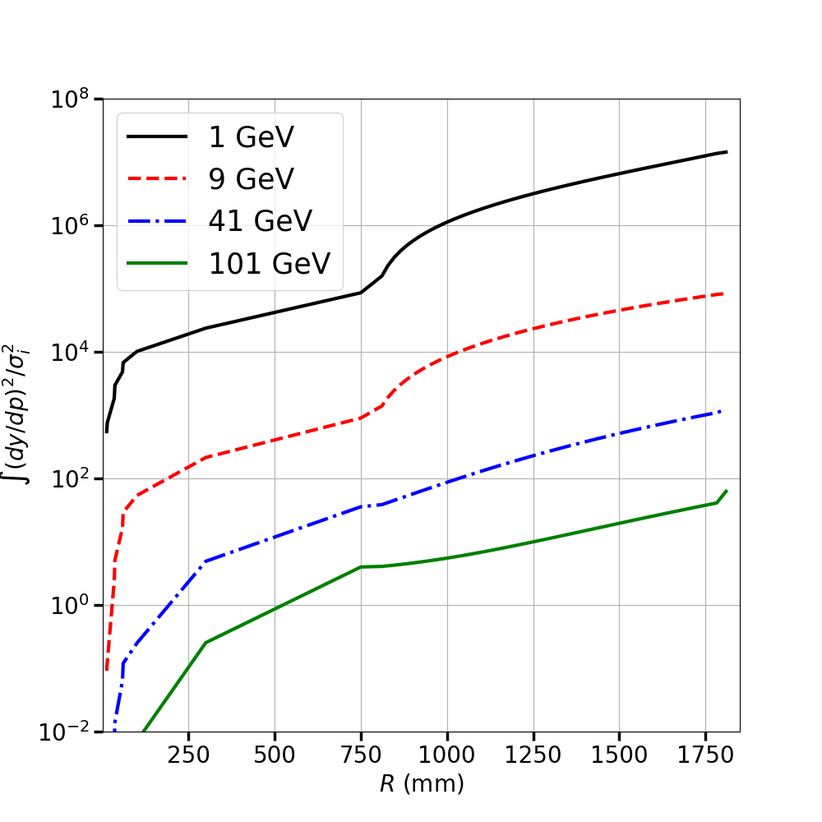
Accumulated FI: sum of the first n layers
~10⁵
Same conclusion
DC does play an important role for low pt due to large derivatives

Slide 14
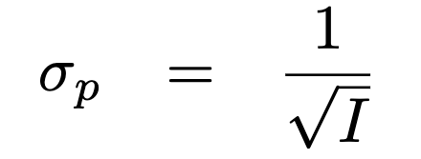
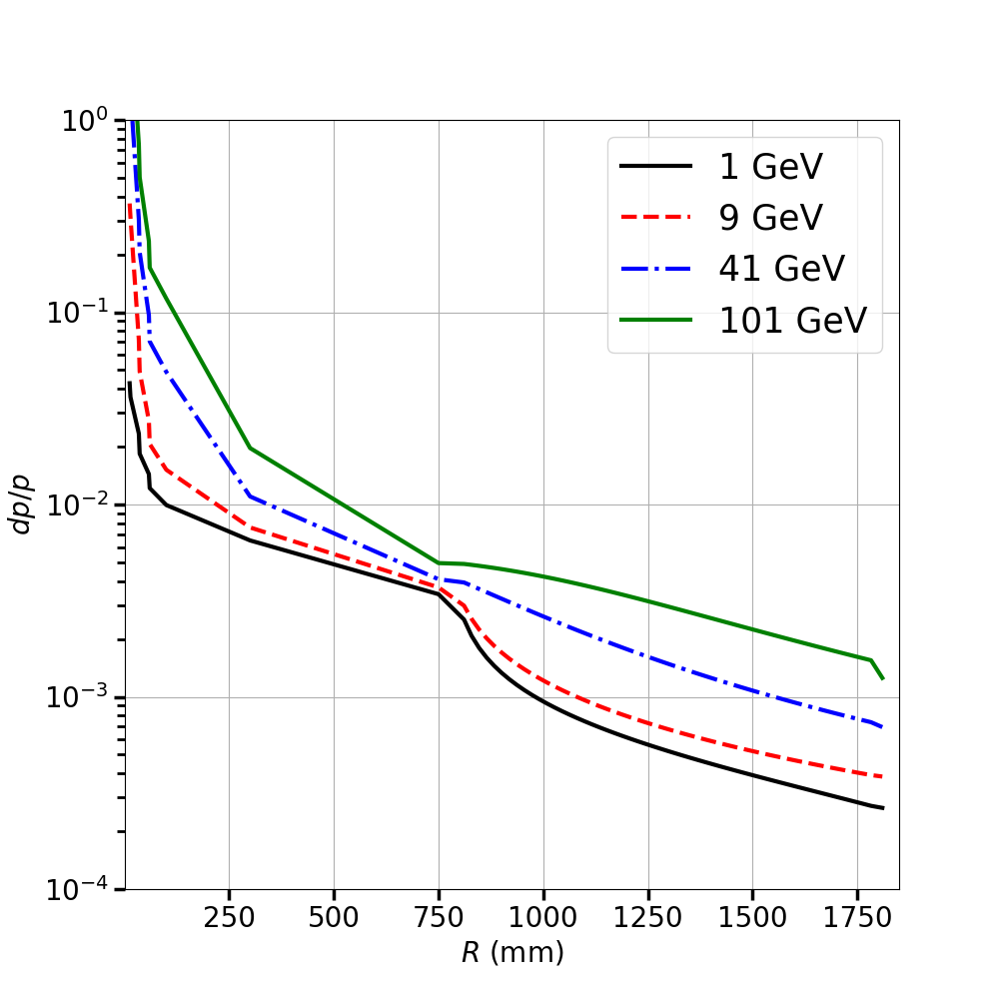
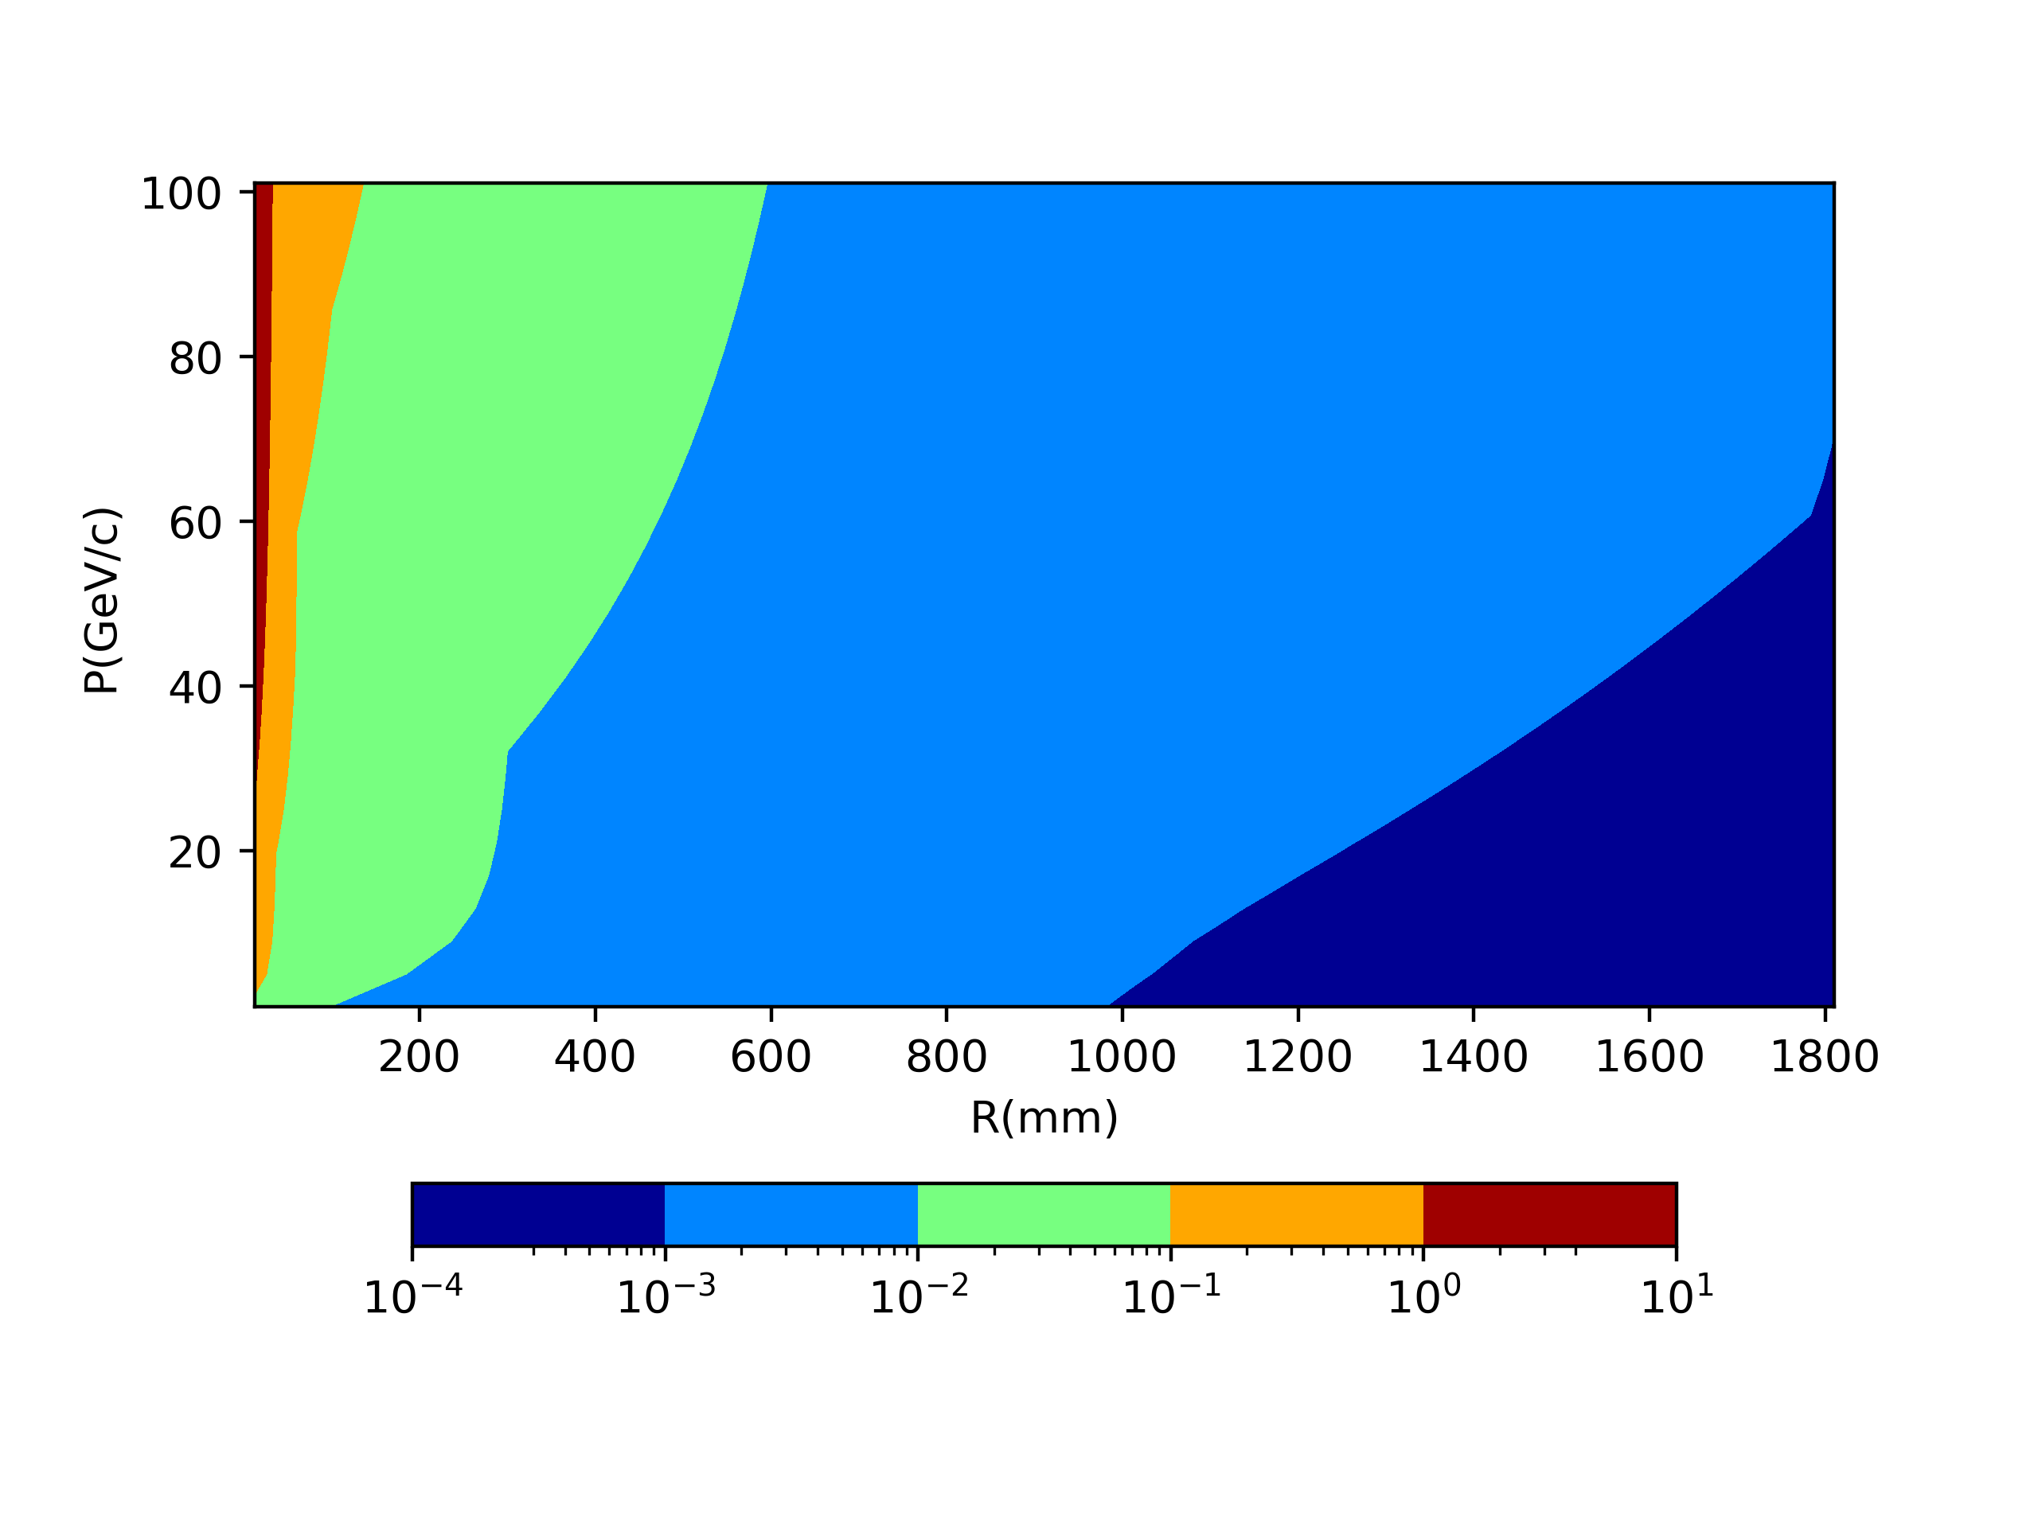
P_{t} resolution
Low pt tracks gain more information from DC
~ 10 times difference because that it is square root and relative resolution

Slide 15
Optimal layout of a toy silicon tracker with Multiple-scattering

Slide 16
$$σ$$
Equal to
$$σ$$
$$\frac{σ}{sqrt(4)}$$
$$σ$$
$$σ$$

Slide 17
Summary
Mathematical test shows that various factors affects the resolutions of track parameters
L
B
X0
Layout
Derivatives
…

Slide 18
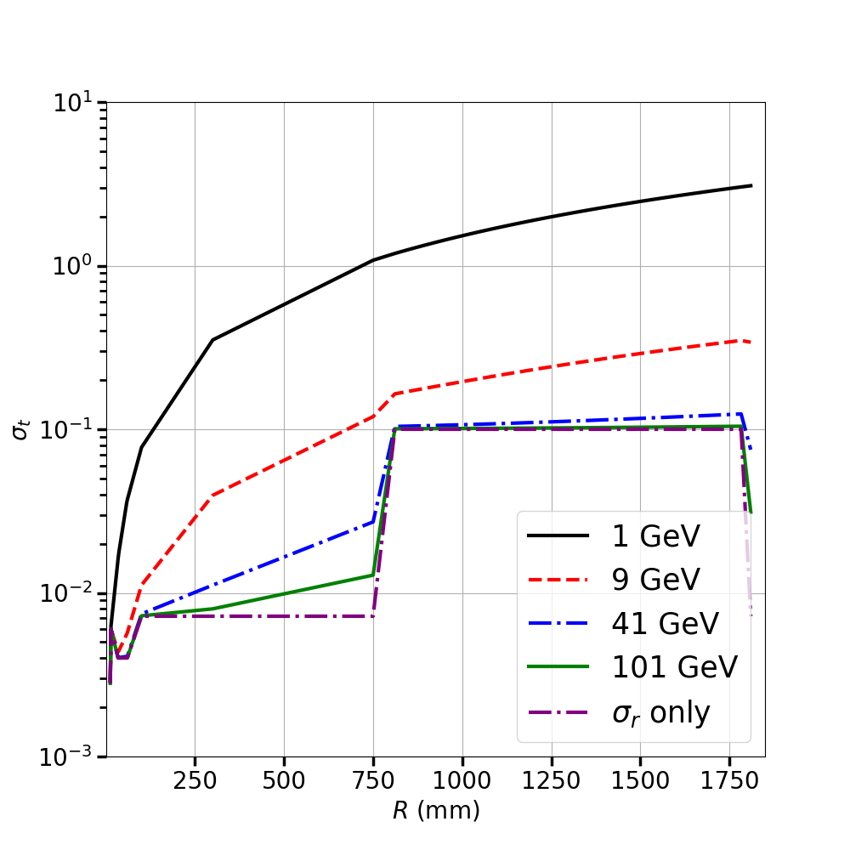
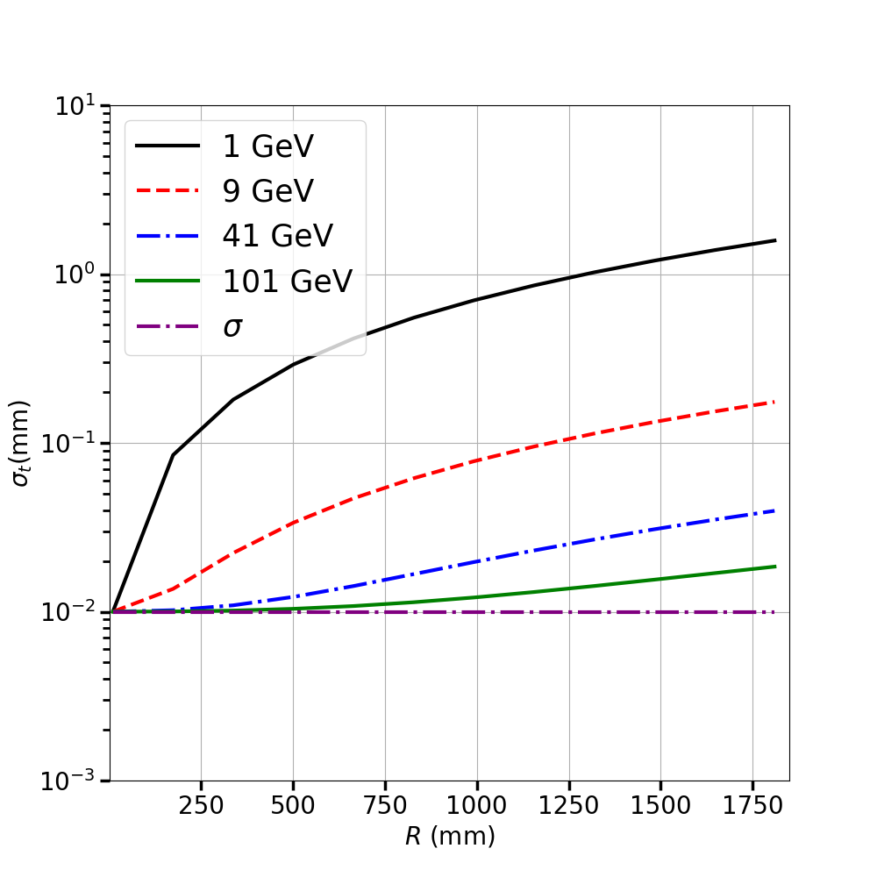
DC+Silicon
Toy FST

Slide 19
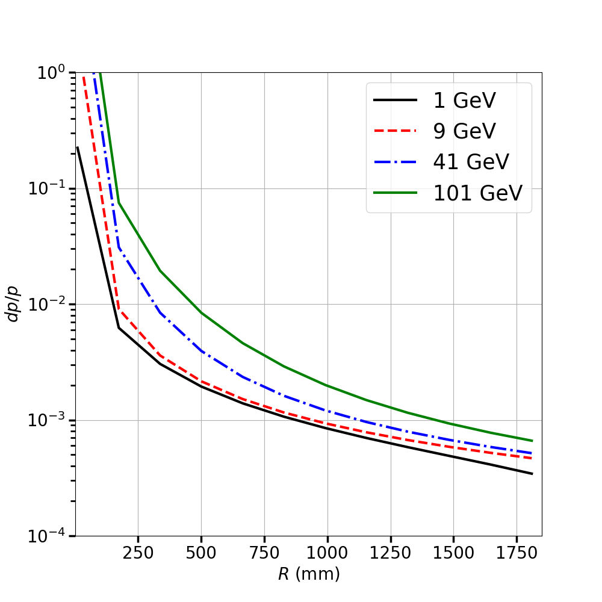
Our tracker vs a toy FST (uniformly distributed 12 layers of silicon with 10 microns σ & 0.002X0 )
DC+Silicon
Toy FST

