Slide 1
CGEM DAQ Status and Plan
Tingxuan Zeng
2025-03-08

Slide 3
More Event number check results
RUN number BES3/CGEM | Event rate | Is CGEM trigger number consistent with BES3 ? | Is trigger number of each GEMROC the same? | Is this run have check bit error? | remarks
84530 | 1.57KHz | No | No | No
84529 | 3.5KHz | No | No | No
84528 | 3KHz | No | No | No | BES3 DAQ report error when stop
84527 | 3.4KHz | No | No | No
84526 | 3.4KHz | No | No | No
84524 | 3~3.4KHz | No | No | No | BES3 DAQ report error when stop
84523 | 3.65KHz | No | No | No
84521 | 3.4KHz | No | No | No
84520 | 3.4KHz | No | No | No
84517 | 3KHz | No | No | No
84515 | 5.5~7KHz | No | No | No
Note: Full cable is connected during these runs， noise trigger.

Slide 4
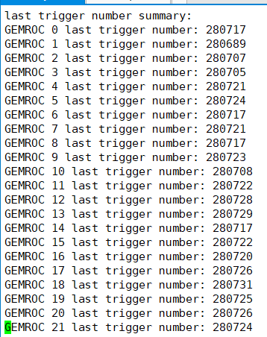
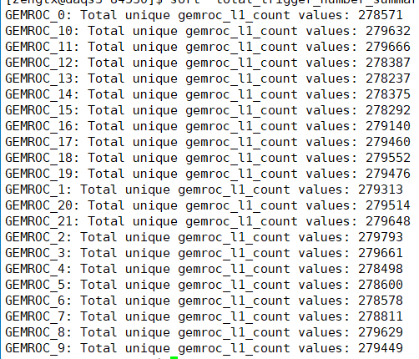
RUN 84530 @1.57KHz
CGEM ：
Total trigger number:
Last trigger number:
BES3:
Total trigger number: 280740

Slide 5
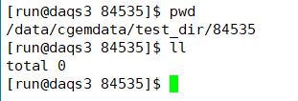
RUN 84535 @5.7KHz no cgem data
CGEM ：
Total trigger number:
Last trigger number:
BES3:
Total trigger number: 2030952

Slide 6
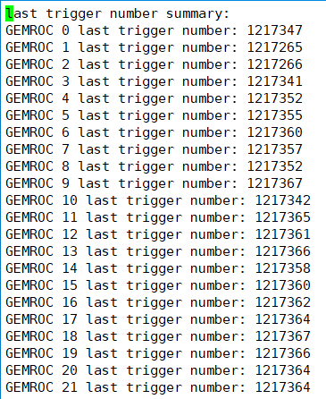
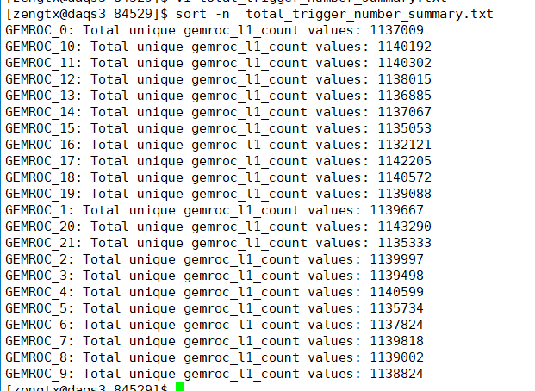
RUN 84529 @3.5KHz
CGEM ：
Total trigger number:
Last trigger number:
BES3:
Total trigger number: 1217383

Slide 7
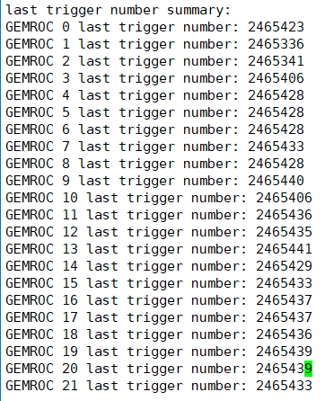
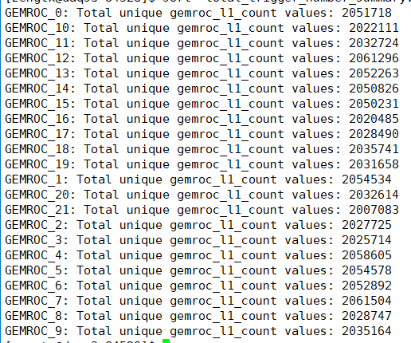
RUN 84528 @3KHz
CGEM ：
Total trigger number:
Last trigger number:
BES3:
Total trigger number: 2465459

Slide 8
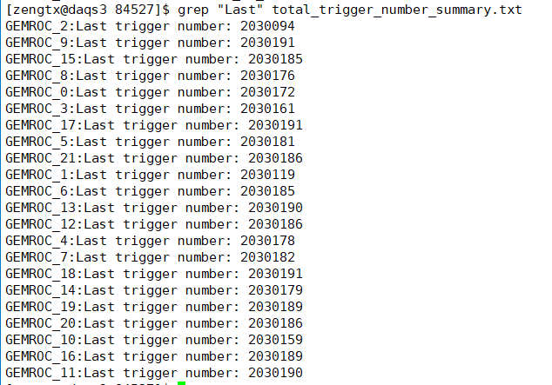
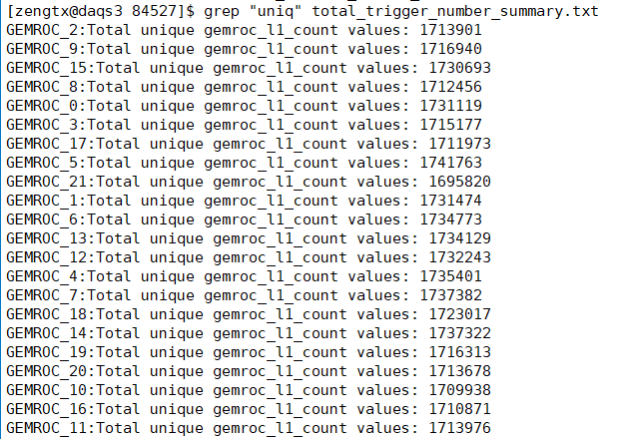
RUN 84527 @3.4KHz
CGEM ：
Total trigger number:
Last trigger number:
BES3:
Total trigger number: 2030209

Slide 9
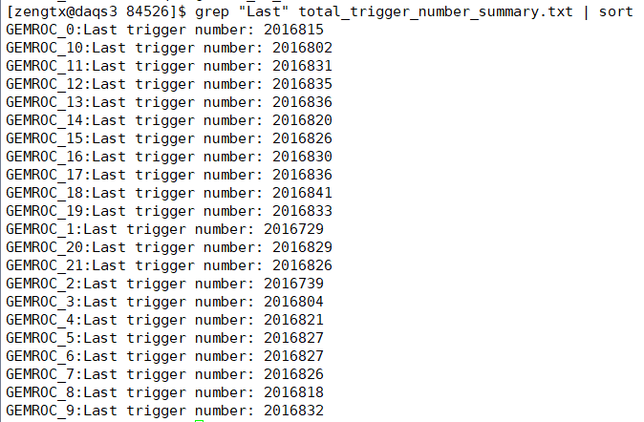
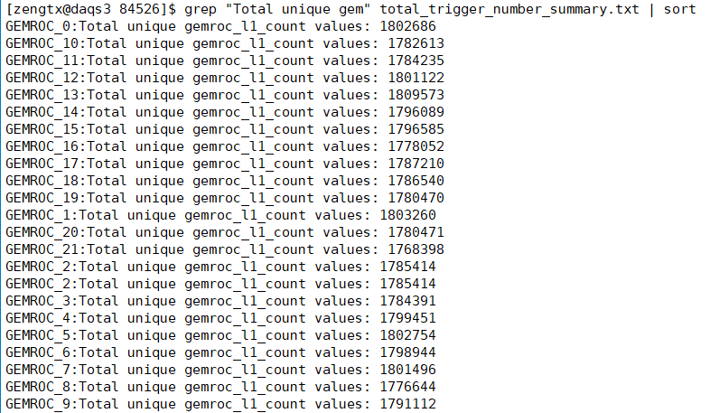
RUN 84526 @3.4KHz
CGEM ：
Total trigger number:
Last trigger number:
BES3:
Total trigger number: 2016850

Slide 10
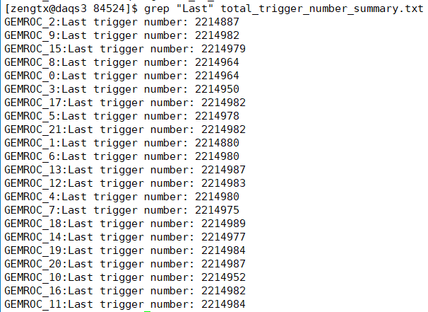
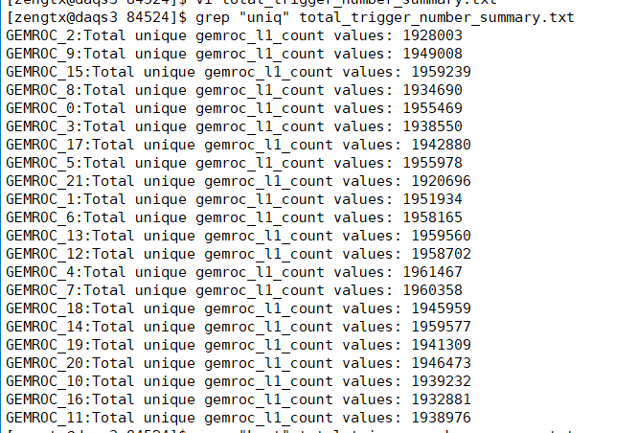
RUN 84524 @3~3.4KHz
CGEM ：
Total trigger number:
Last trigger number:
BES3:
Total trigger number: 2215005

Slide 11
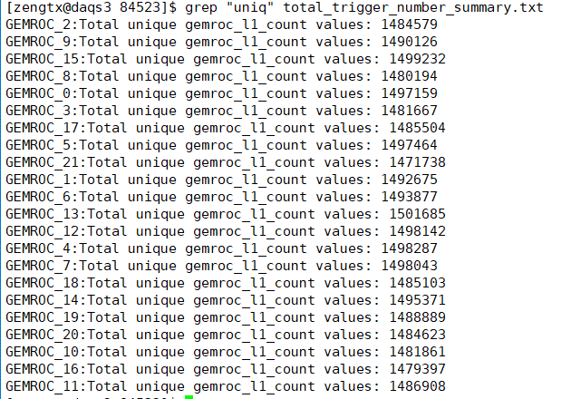
RUN 84523 @3.65KHz
CGEM ：
Total trigger number:
Last trigger number:
BES3:
Total trigger number: 1690835

Slide 12
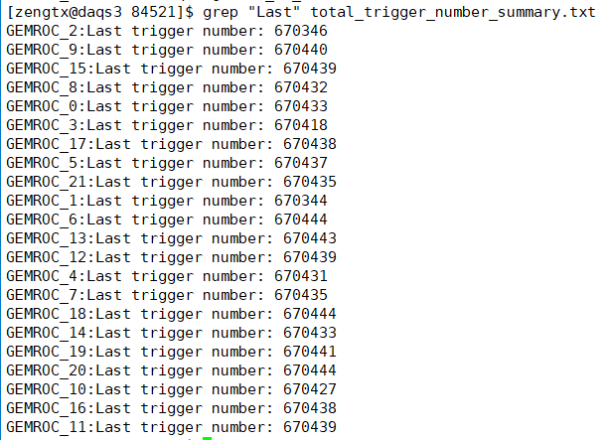
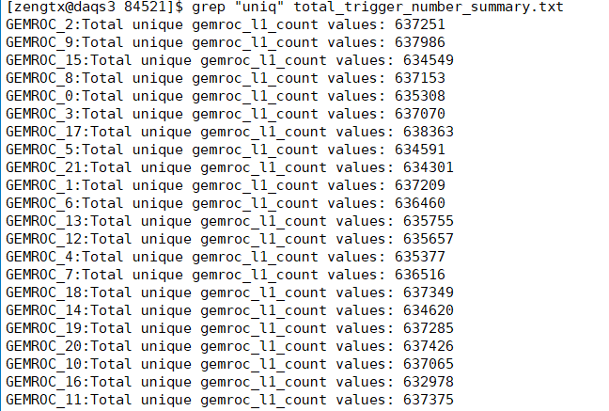
RUN 84521 @3.4KHz
CGEM ：
Total trigger number:
Last trigger number:
BES3:
Total trigger number: 670457

Slide 13
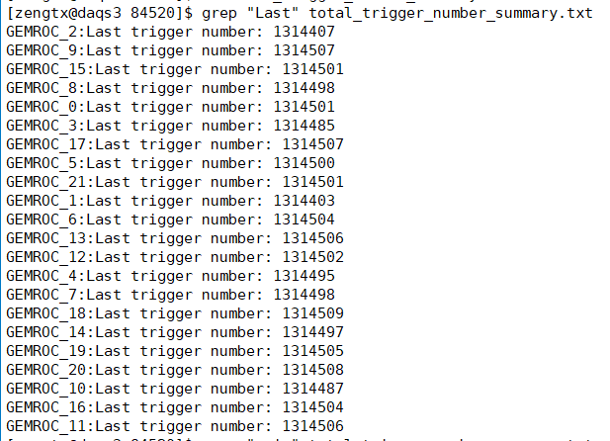
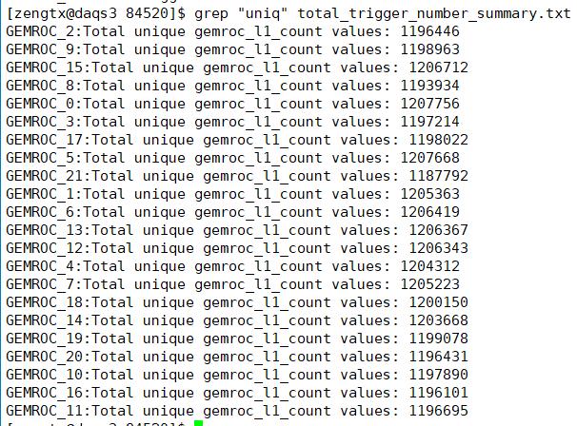
RUN 84520 @3.4KHz
CGEM ：
Total trigger number:
Last trigger number:
BES3:
Total trigger number: 1314525

Slide 14
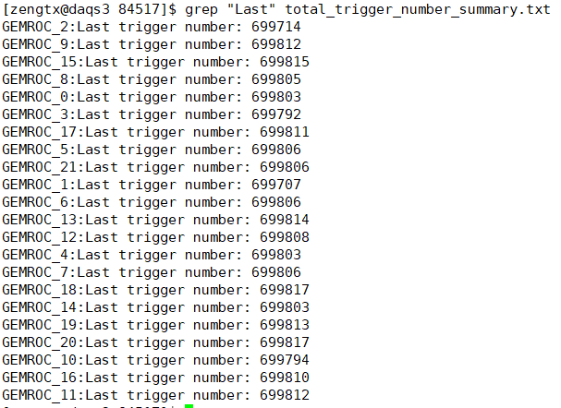
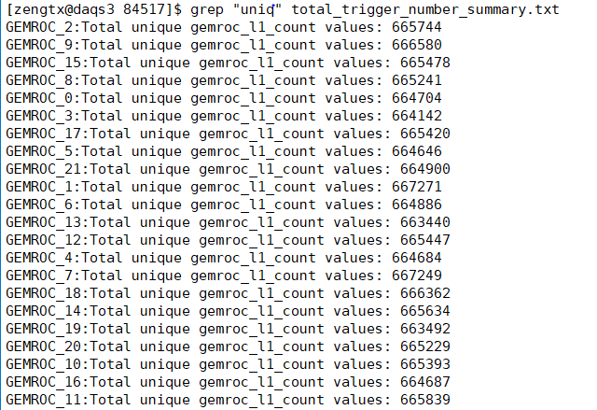
RUN 84517 @3KHz
CGEM ：
Total trigger number:
Last trigger number:
BES3:
Total trigger number: 679000

Slide 15
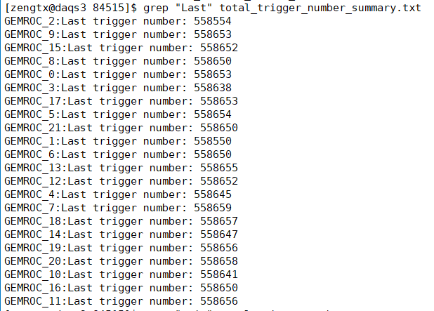
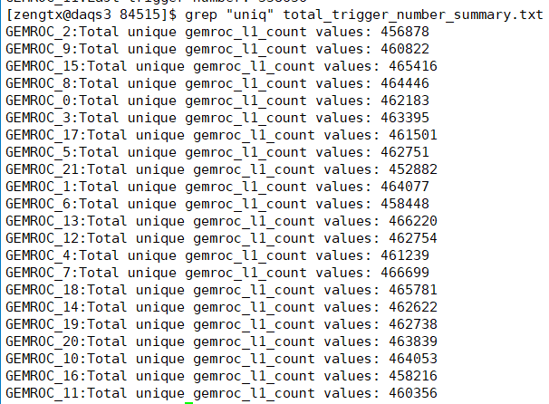
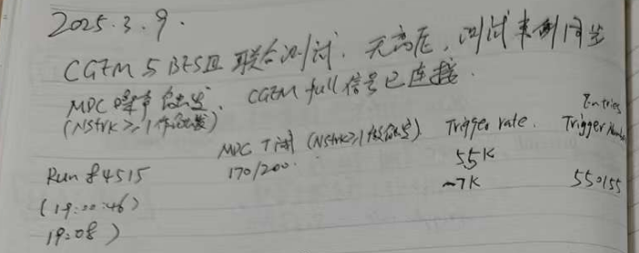
RUN 84515 @5.5~7KHz
CGEM ：
Total trigger number:
Last trigger number:
BES3:
Total trigger number: 550155

Slide 16
Check bit error check
Find “CCCC” pattern in all run logs. No check bit error during these runs.

Slide 17
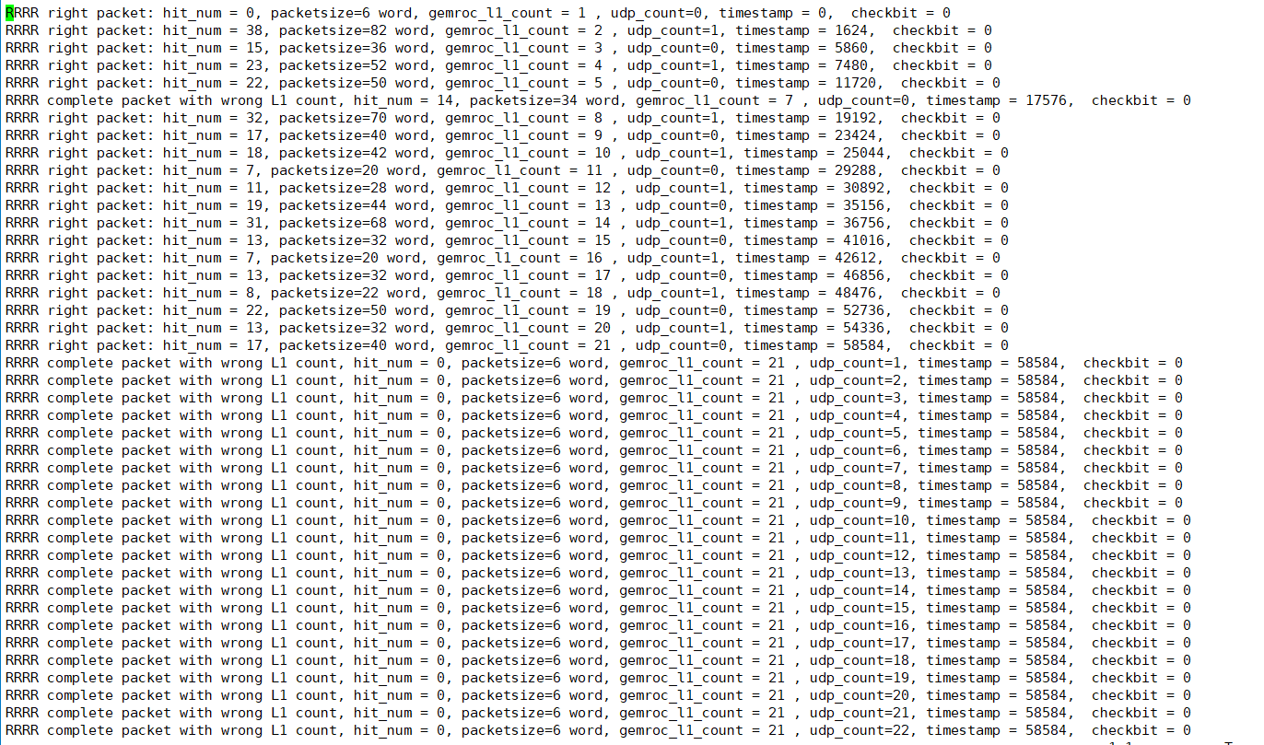
UDP Sequence Count different from before.
Before: increase sequentially like gemroc l1 count
Current: 1 or 0. or increase from 1 to 60 in same L1 count empty packets.

