Slide 1
2024.7.10

Slide 2
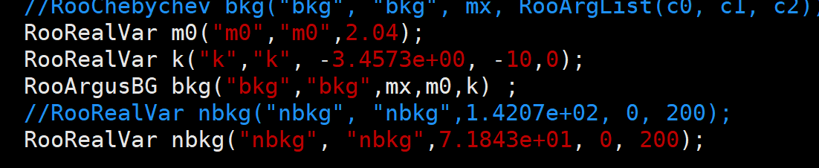
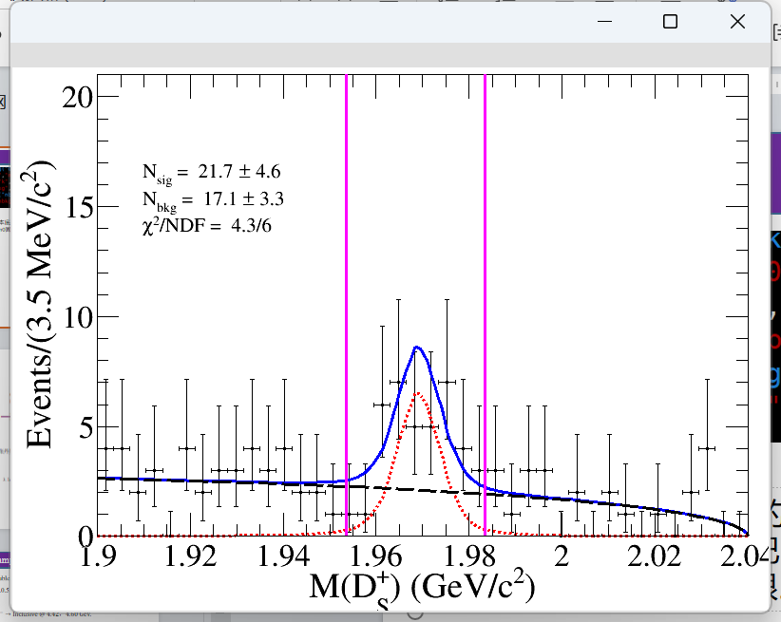
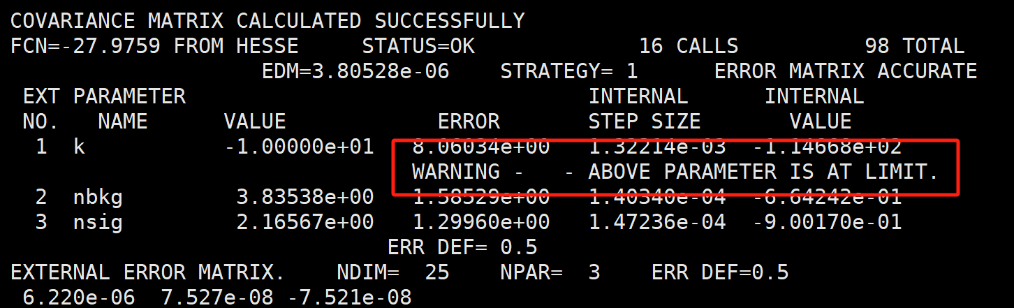
argus
1、可以用argus拟合我们的本底吗？几个参数（程序对错）
2、参数怎么确定？若想把m0固定。
3、k若小于0经常达到上限。

Slide 3
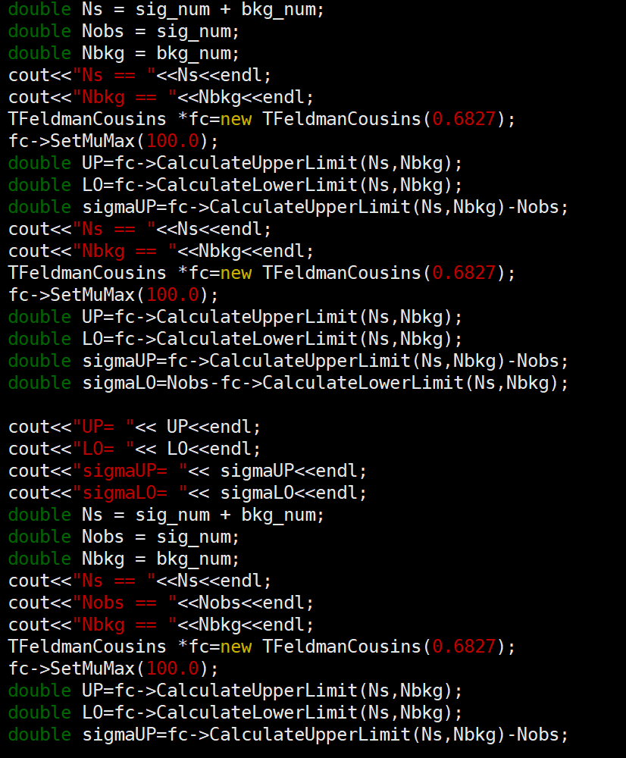
不对称误差（怎么求不对称误差）
1、什么方法求不对称误差？
2、目前是feldman的方法

Slide 4
2024.7.11

Slide 5
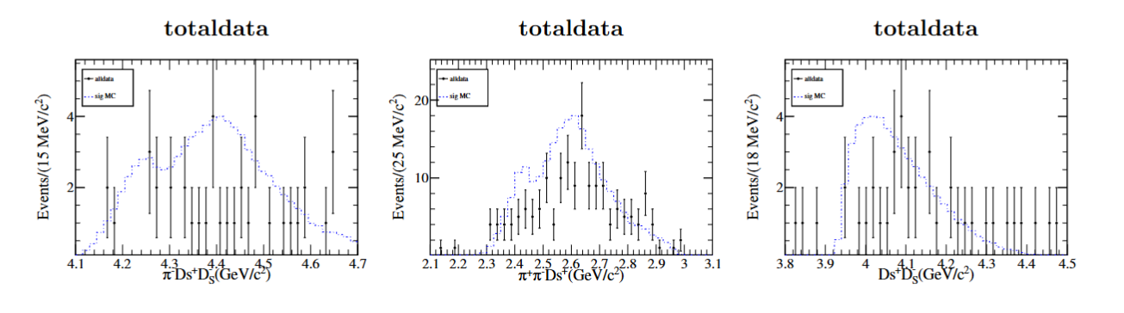
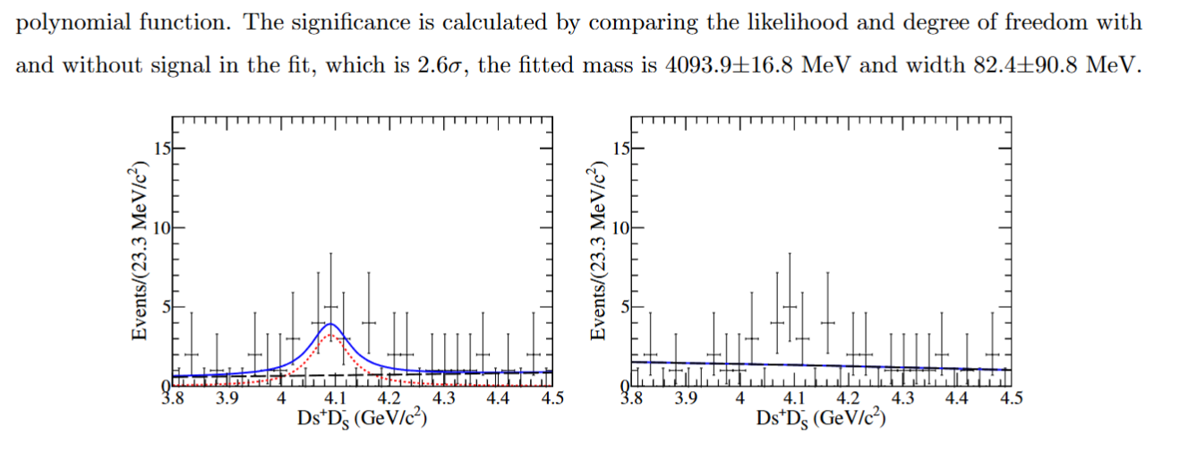
DsDs
1、探测器分辨？0宽度信号mc需要改变吗？
2、2.6sigma还写上去吗？拟合结果正确？
3、pipids的bin？
4、这部分的系统误差包括？

Slide 6
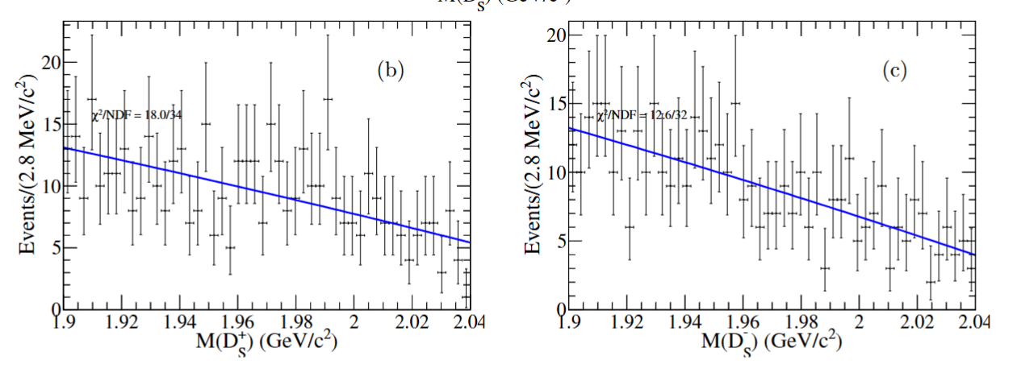
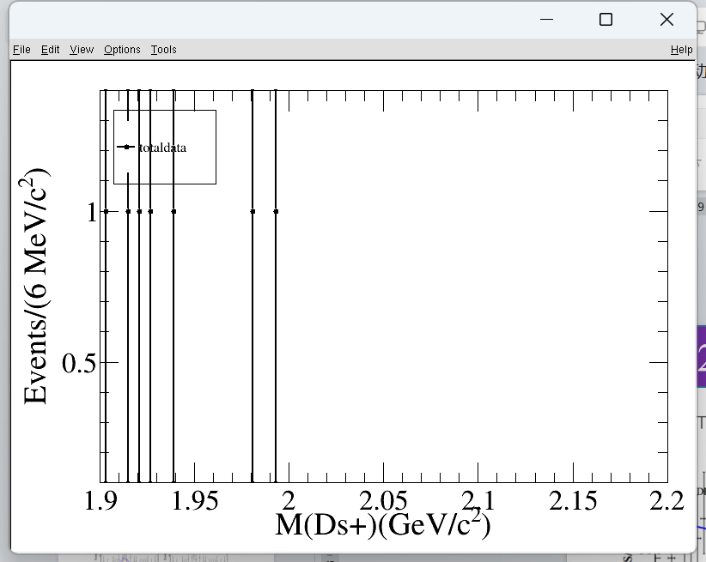
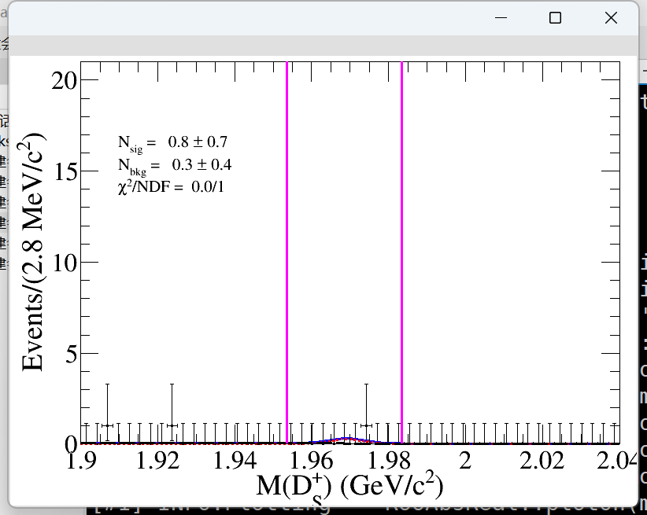
inc@4420(4440没有inc）
1.99025

Slide 7
ISR系统误差
总得信号数不能扫描上下限，不对称误差怎么做？
平均截面也给不对称误差吗？总信号数可以给对称误差吗？
总信号数的阈值？

Slide 8
2024.7.11

Slide 9
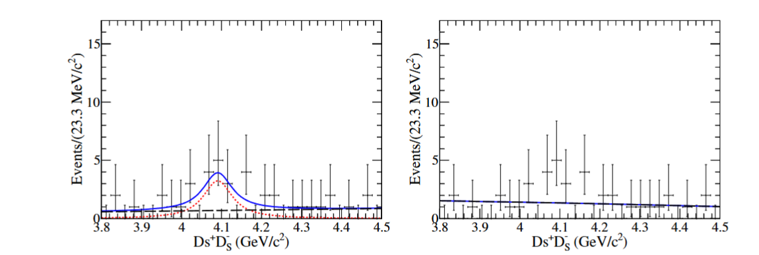
dsds误差
1、拟合区间（变化0.02）
mean（max）：0.04%
width（max）：22.6%
2、信号形状
原来：BW卷积gaus
现在1：BW
0.09% && 1.8%
BW卷积双高斯：
mean：negligible
width：0.7%
3、本底形状
二阶多项式
一阶多项式
mean：negligible
width：6%
4、total
mean：0.1%
width：23.4%

Slide 10
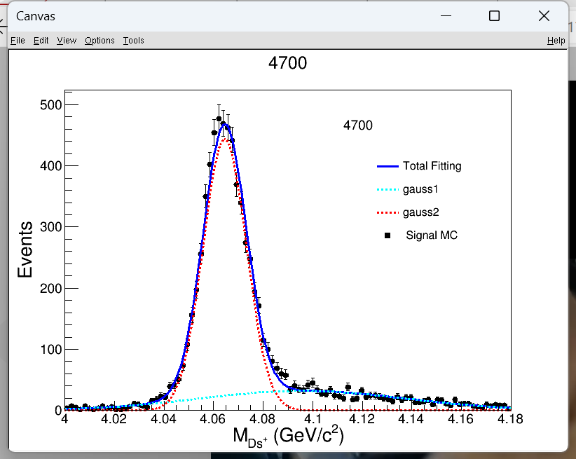
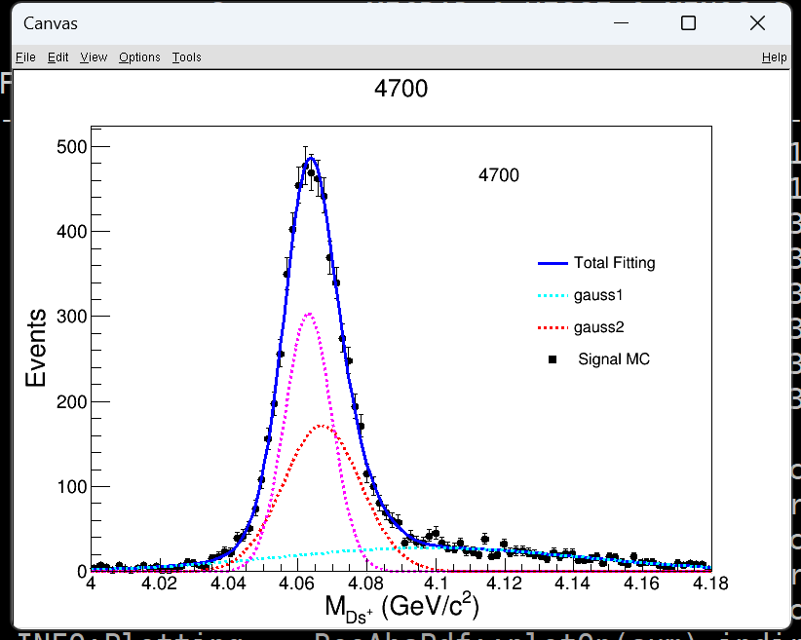
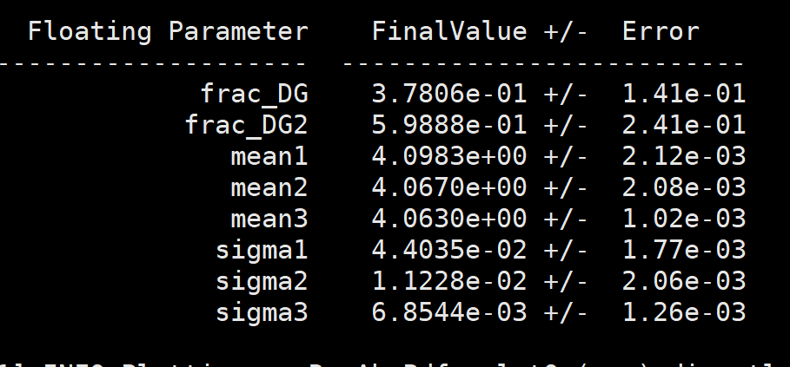
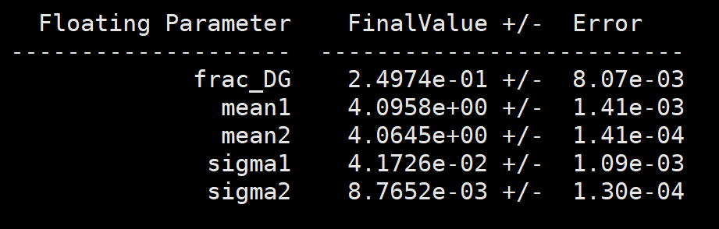
高斯 双高斯

Slide 11
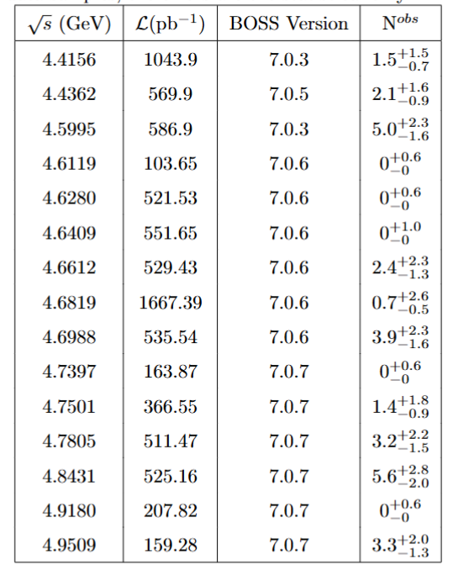
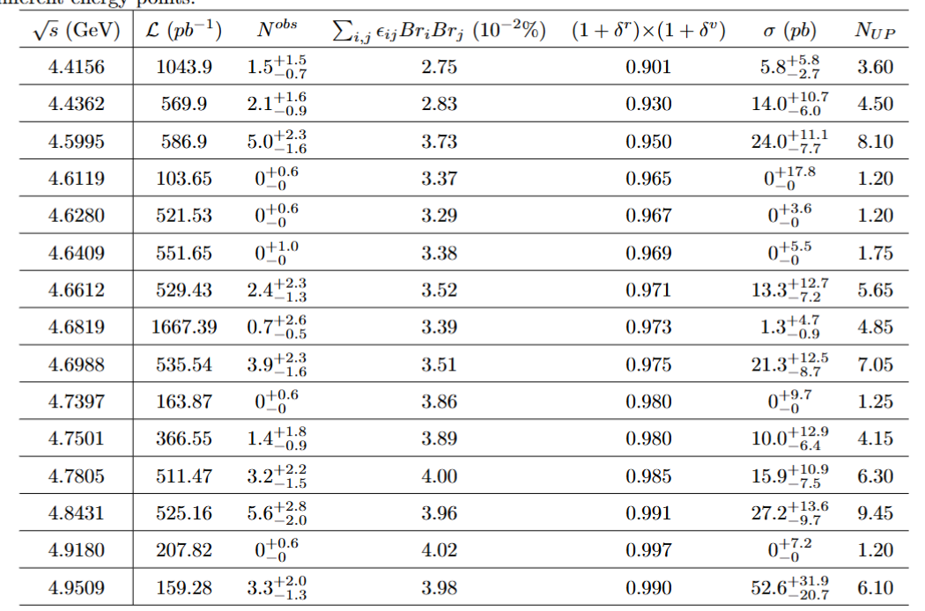
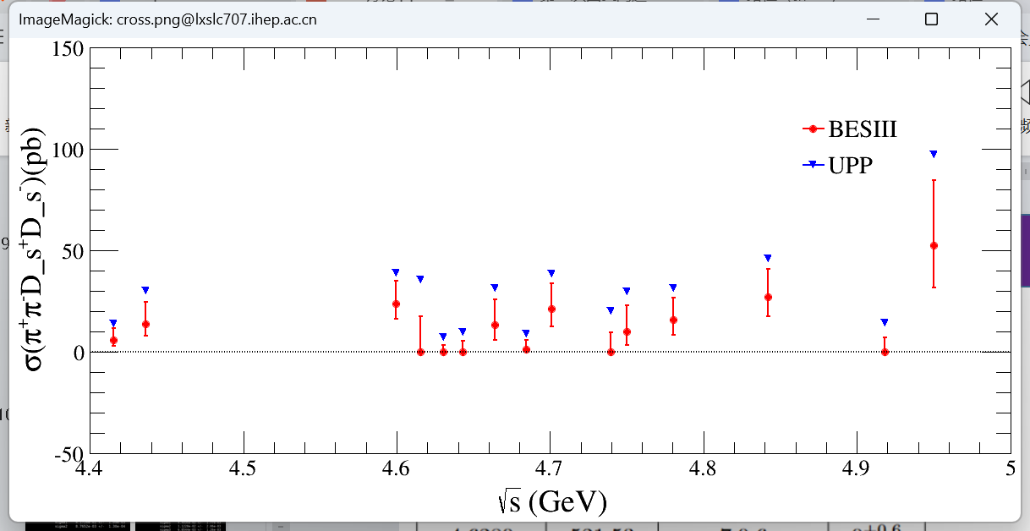

Slide 12
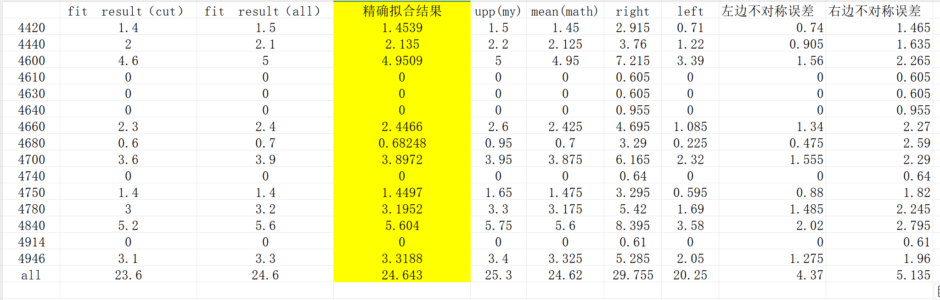
1、中心值加起来不等于总的信号数
2、保留一位小数？

Slide 13
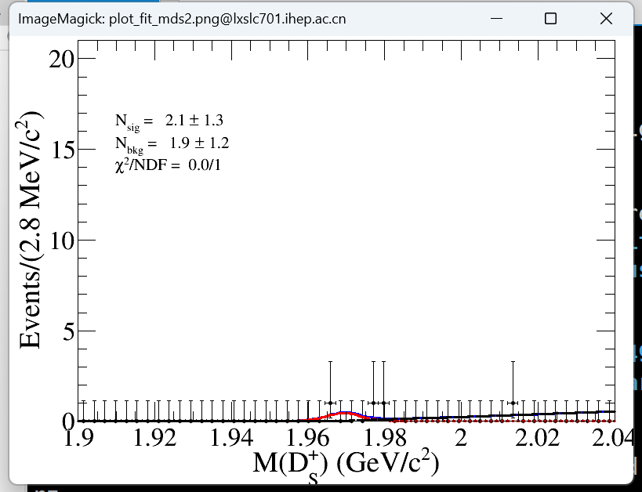
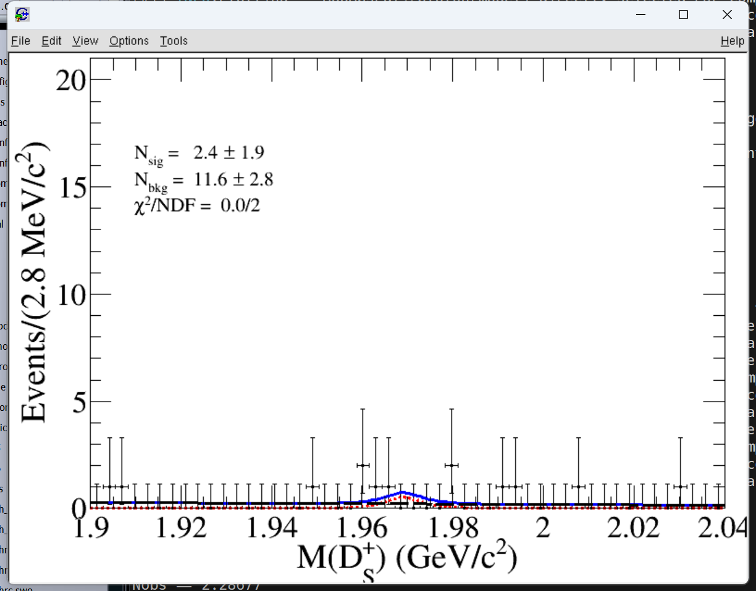
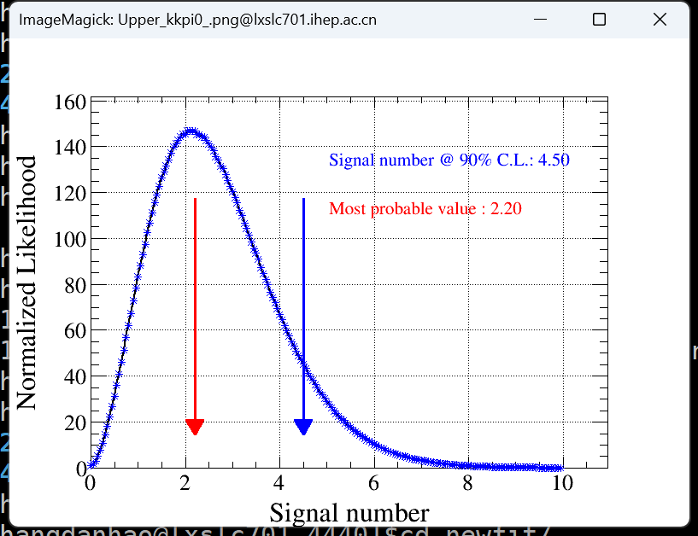
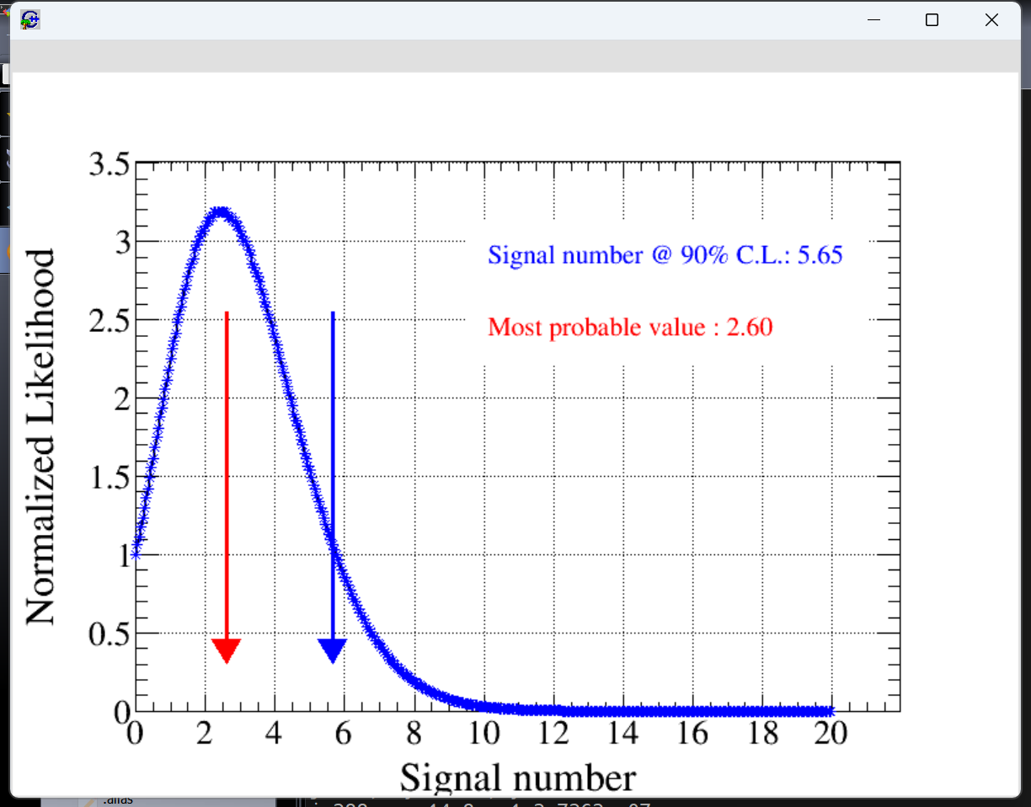
4440

Slide 14
2024.7.22

Slide 15
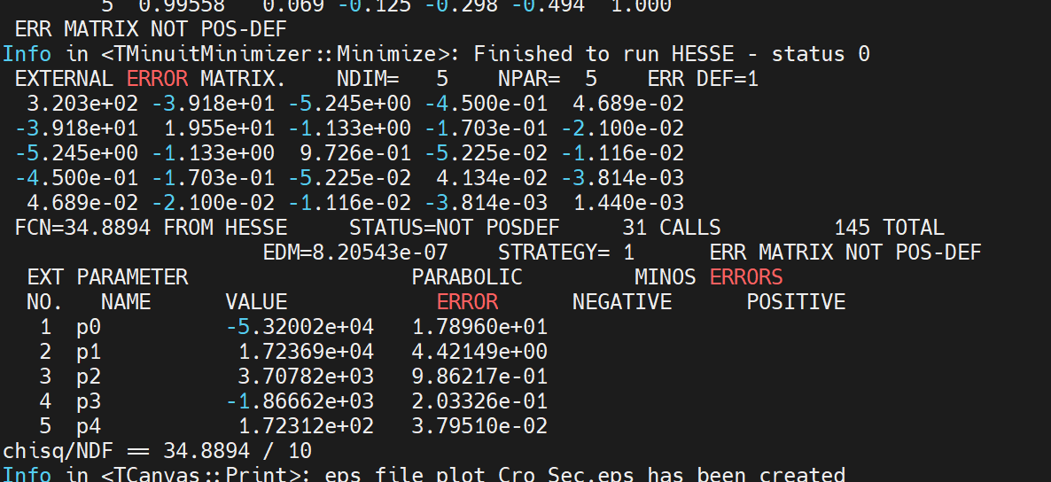
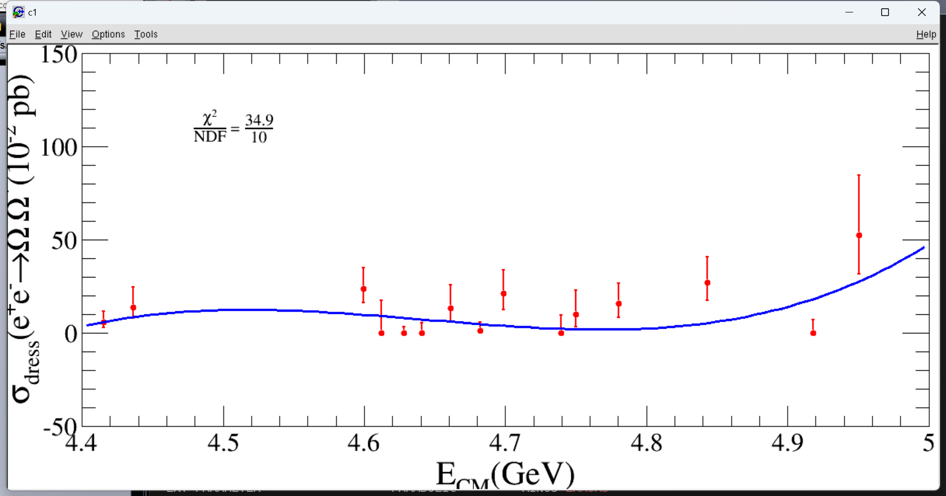
线形 （五阶-最优）

Slide 16
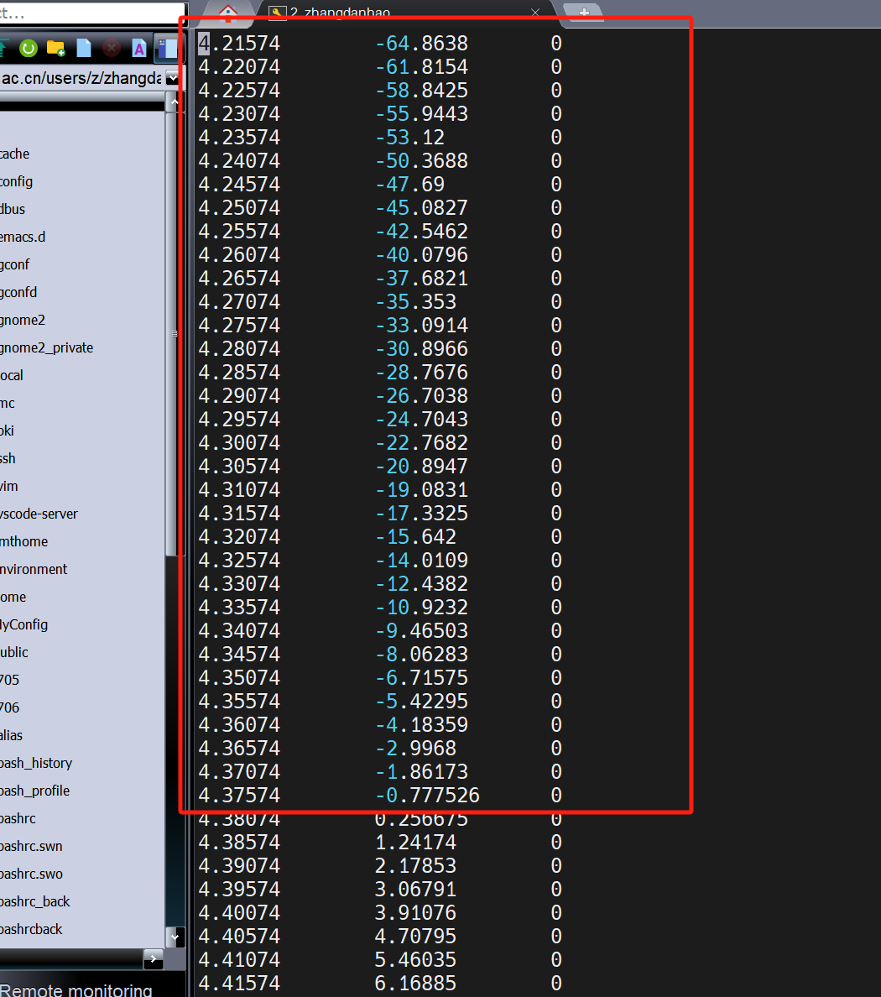
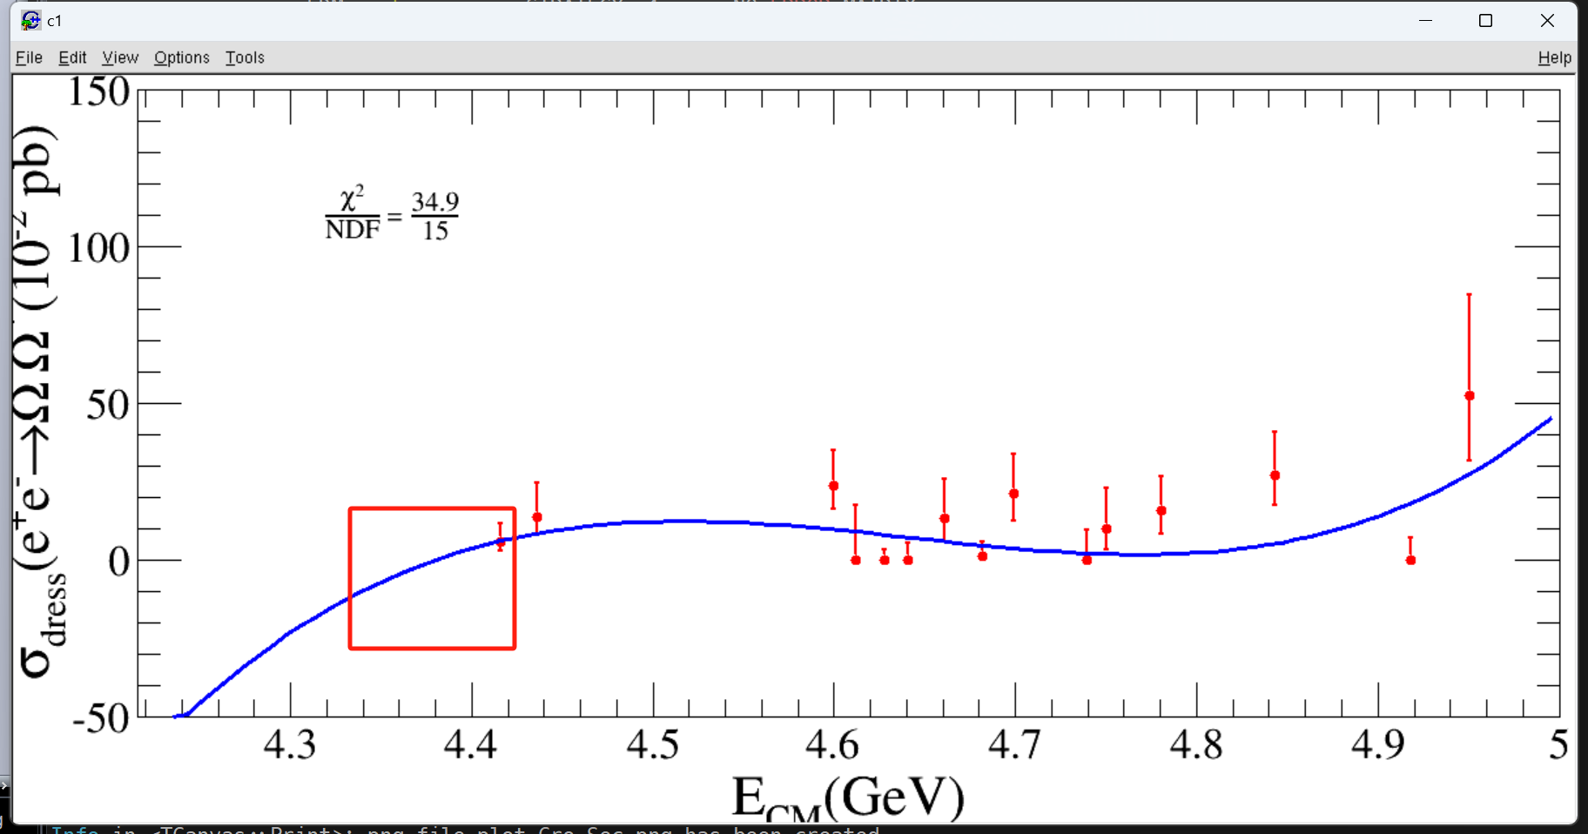
线形 （五阶-最优）

Slide 17
2024.8.13

Slide 18
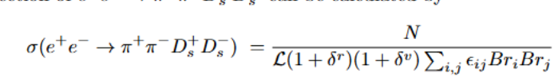
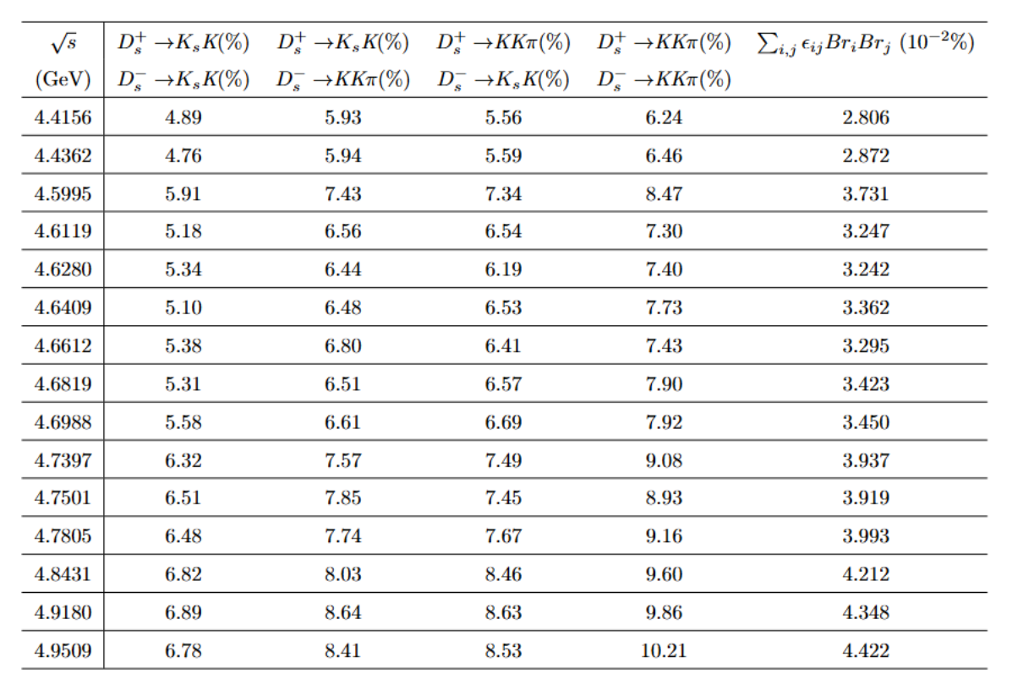
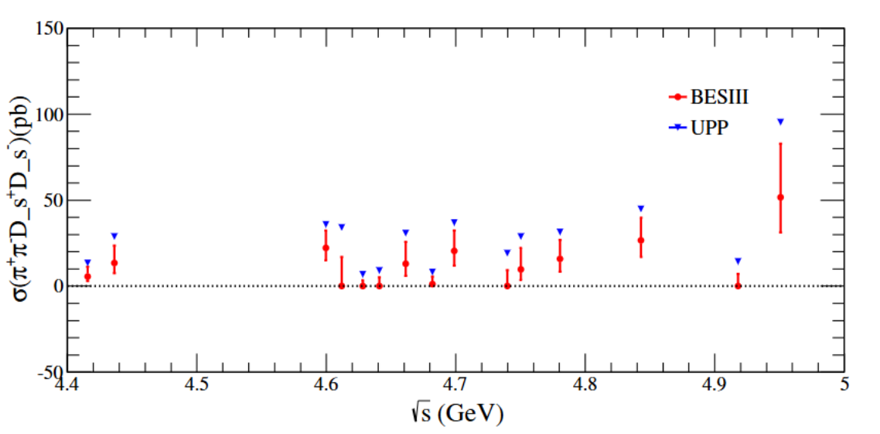
分开产生信号mc 四个道分别weight

Slide 19
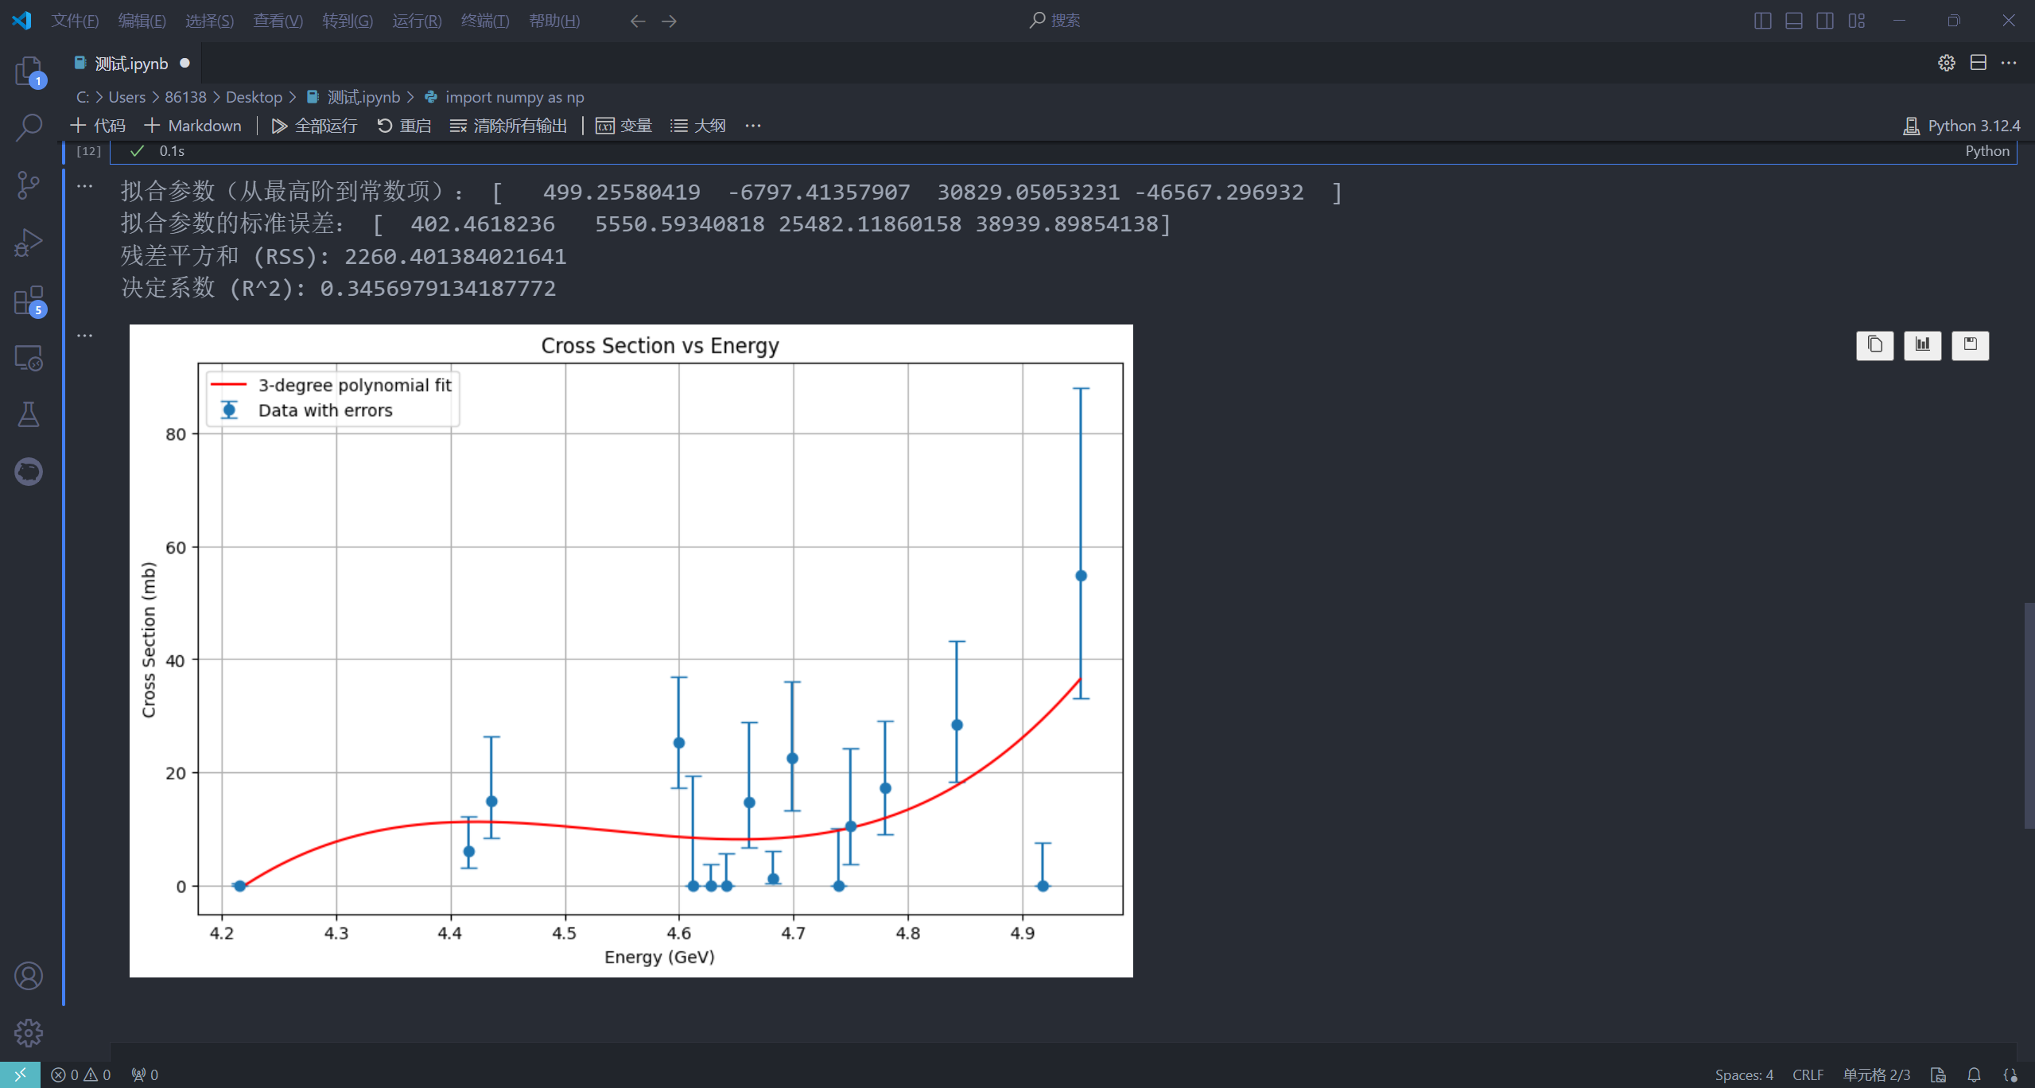
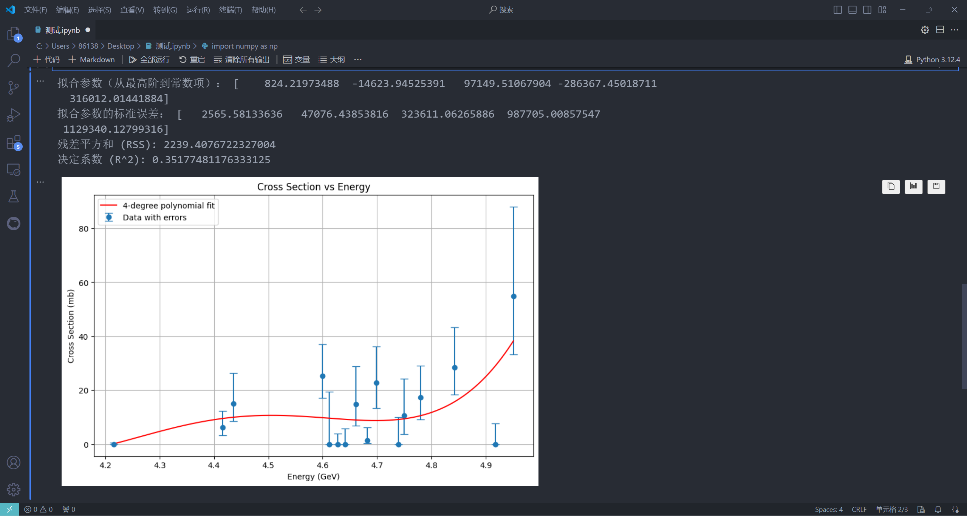
weight
三阶
（平均截面8.80）
四阶
（平均截面8.79）
误差0.11%

Slide 20
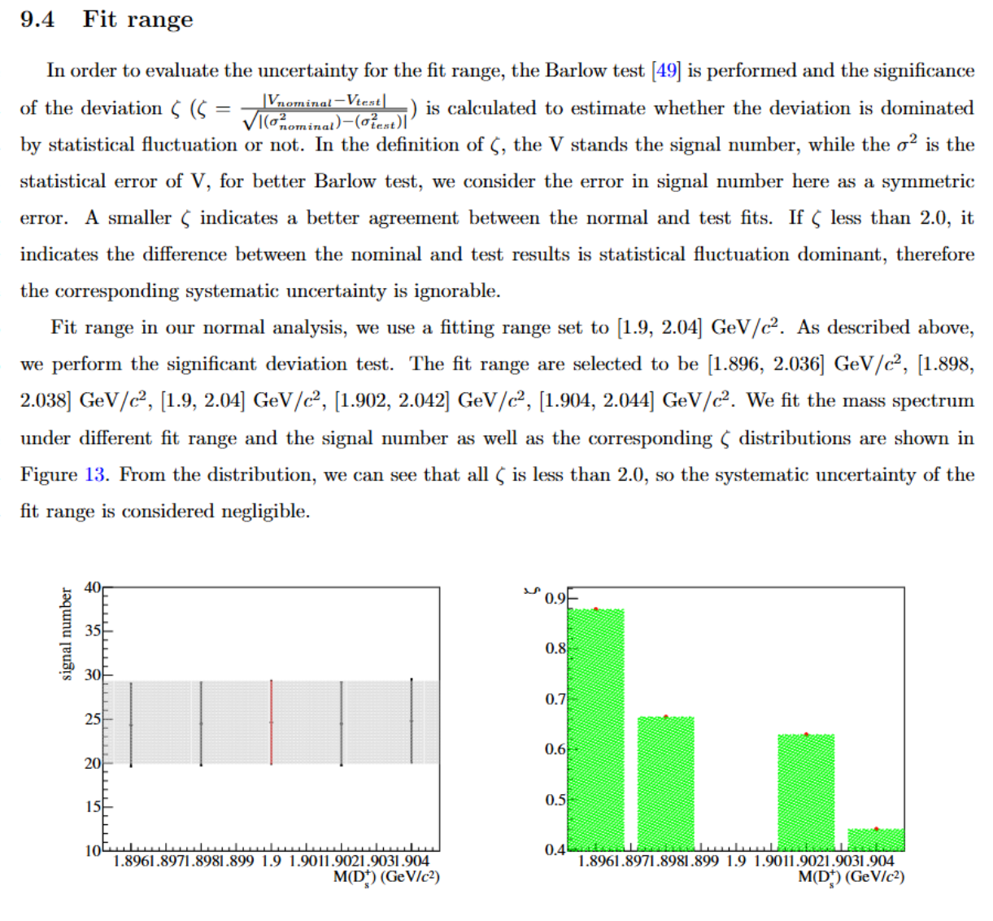
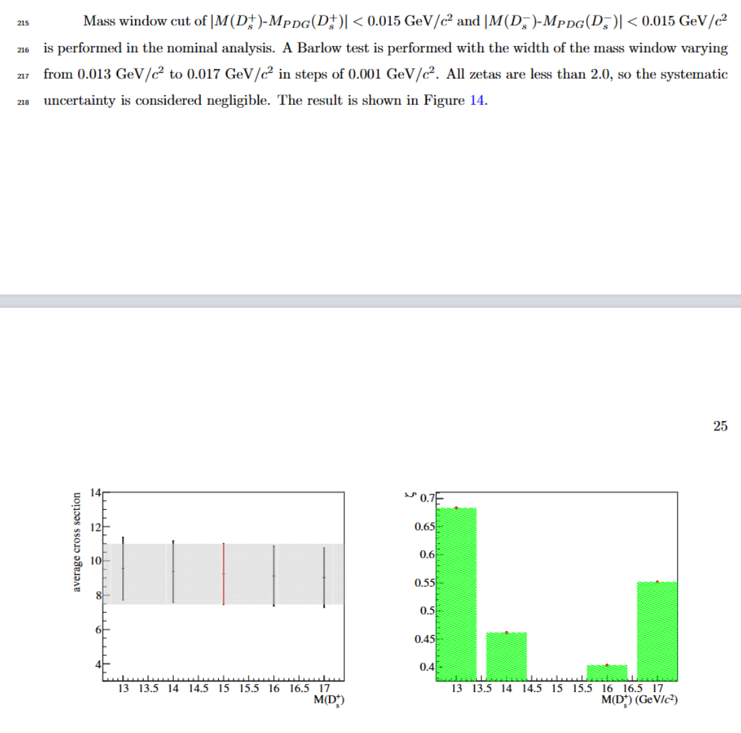
barlow test

Slide 21
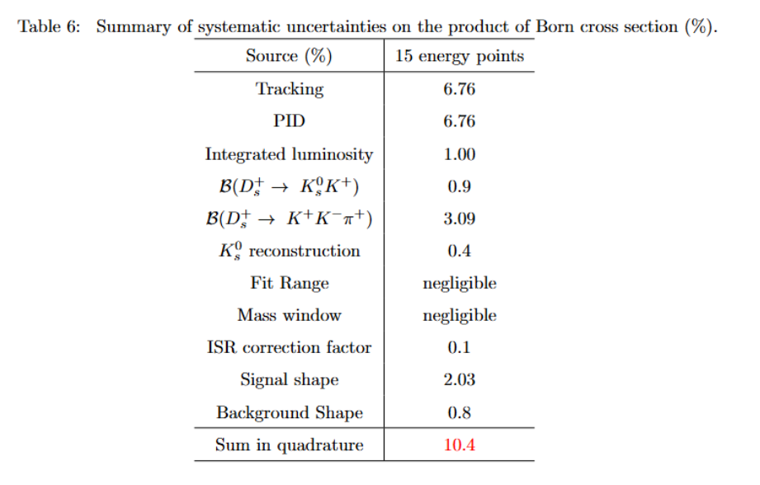
system uncertainties

Slide 22
2024.9.3

Slide 23
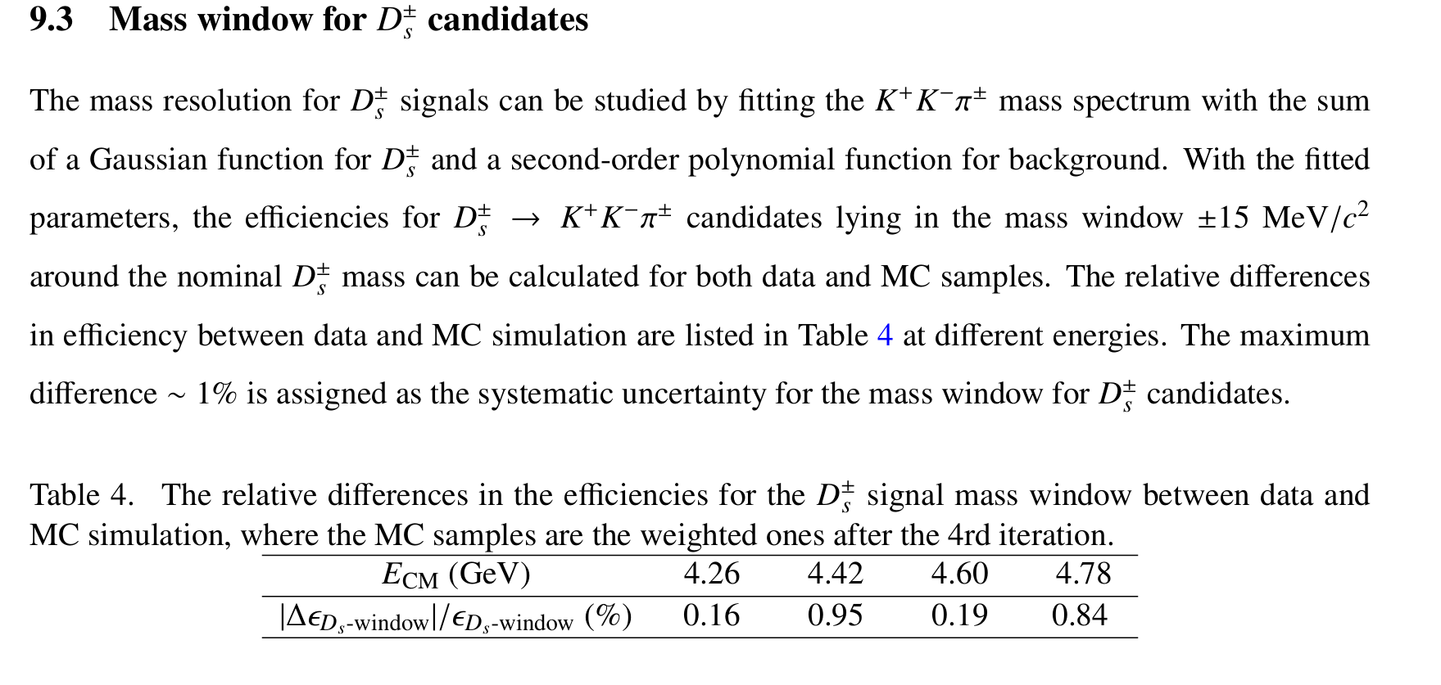
Ds mass window systematic uncertainty
kkpi—26053

Slide 24
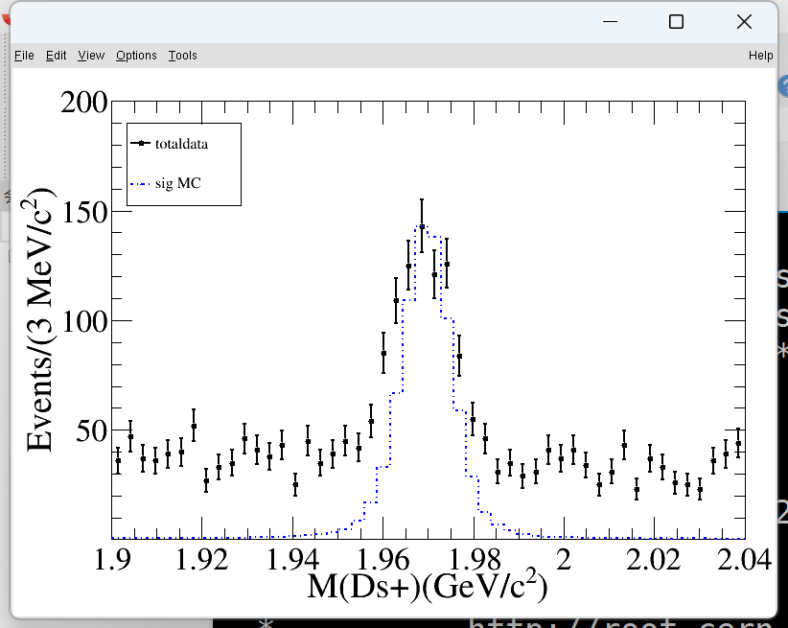
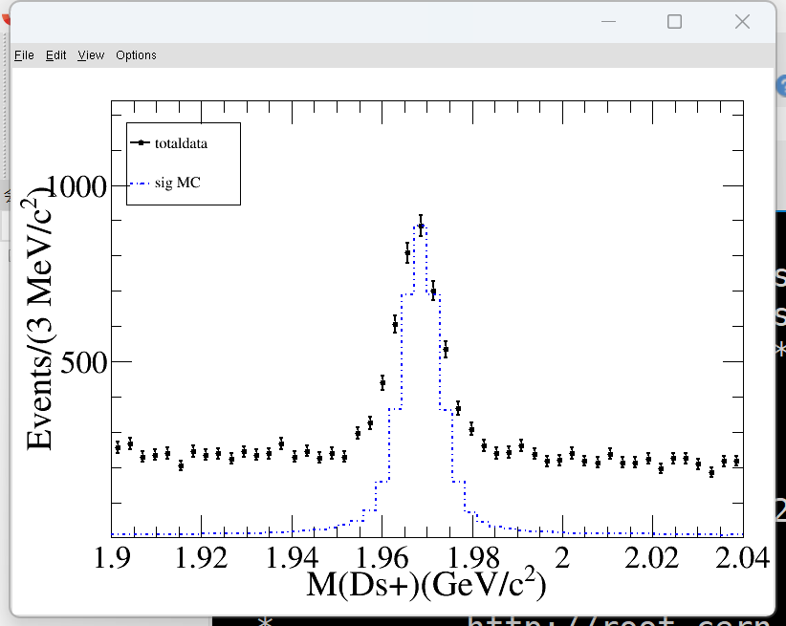
Ds mass window systematic uncertainty
ksk—4245
kkpi—26053

Slide 25
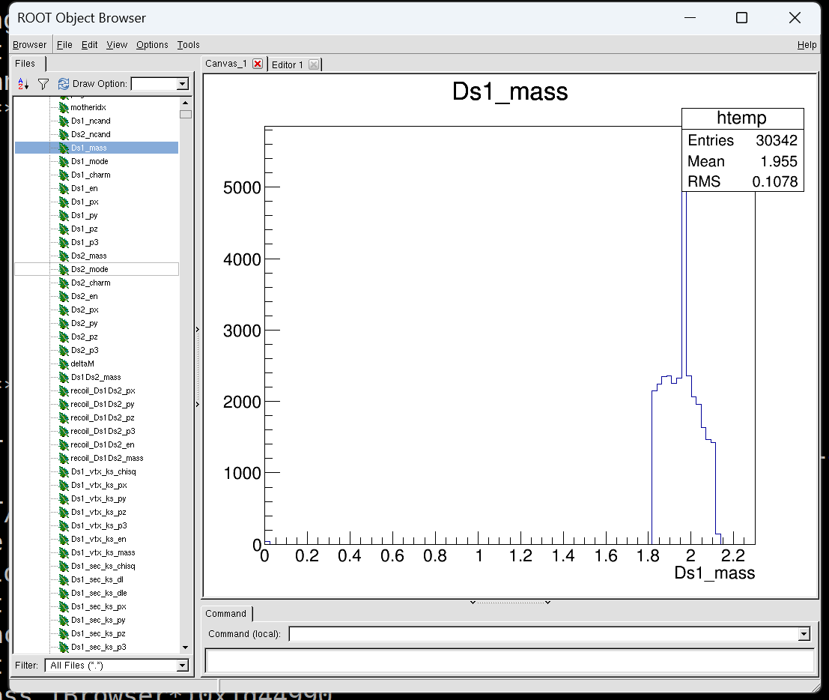
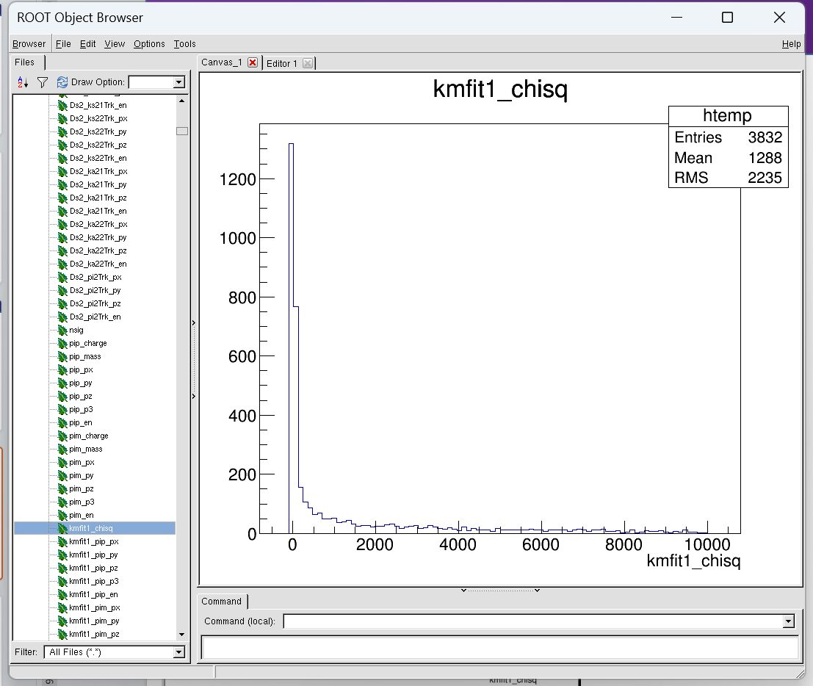
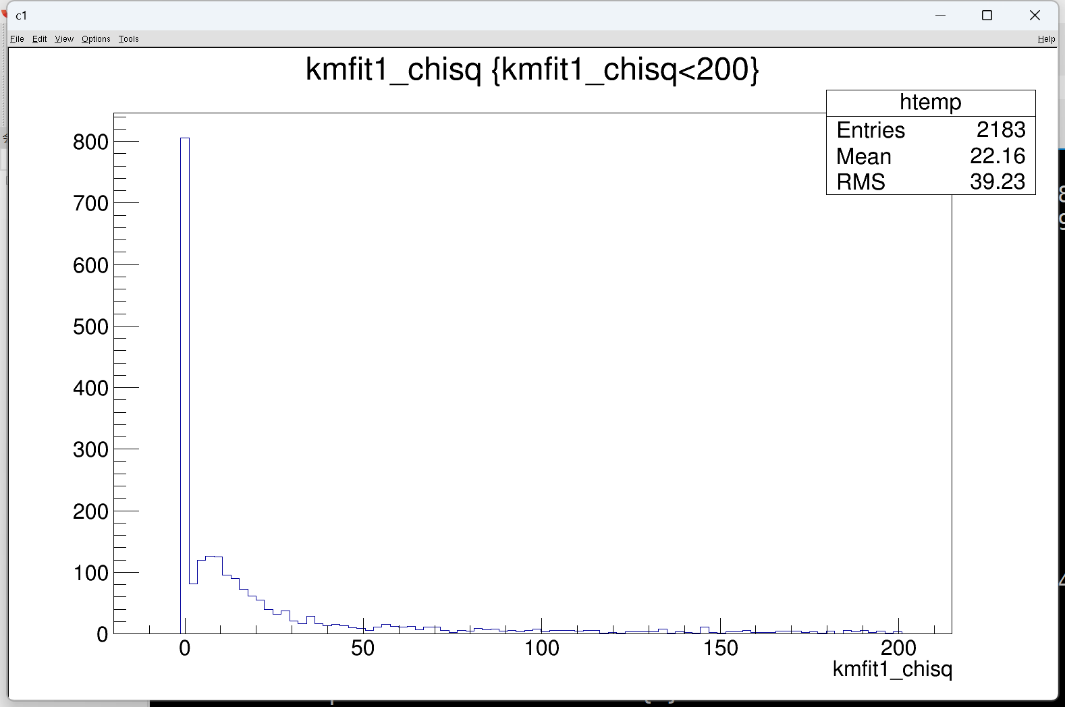
data

Slide 26
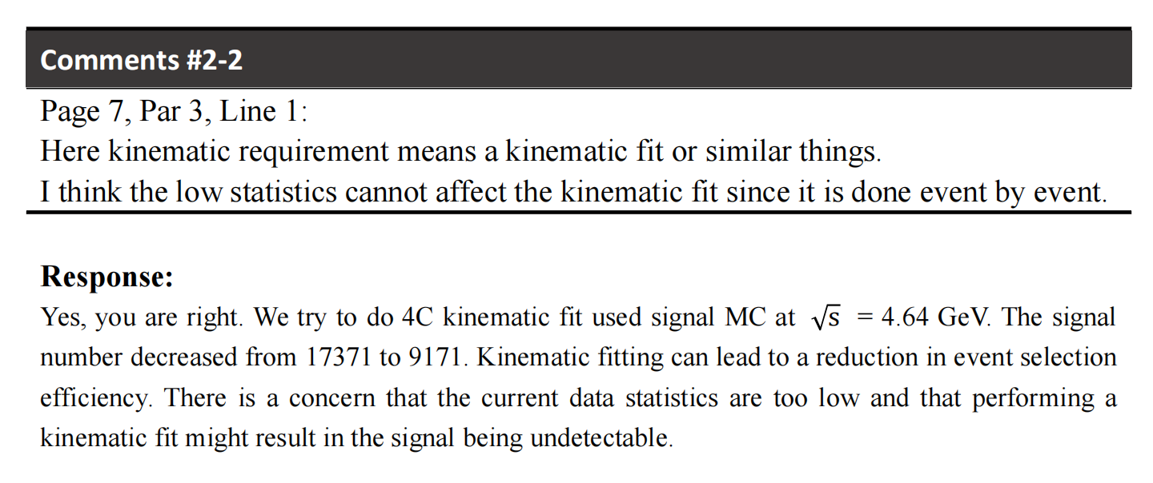
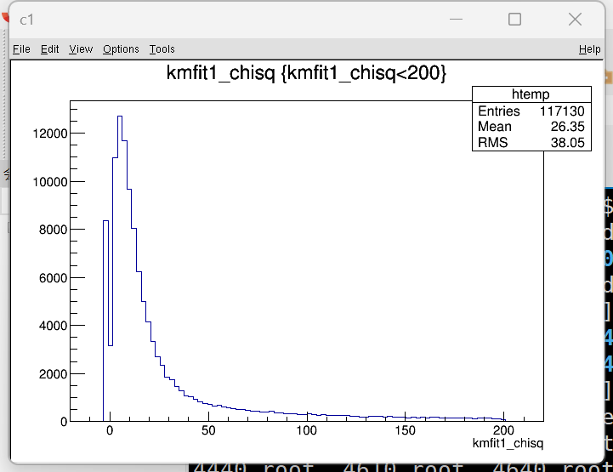
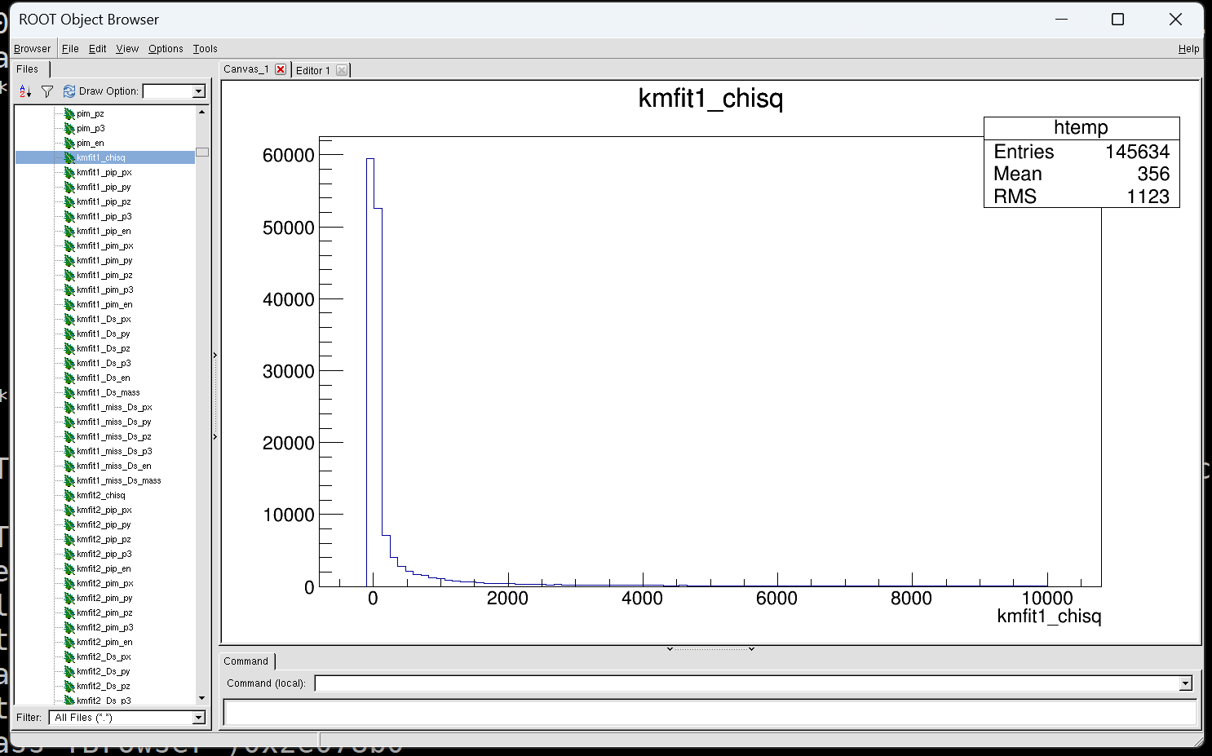
signal mc

Slide 27
2024.9.10

Slide 28
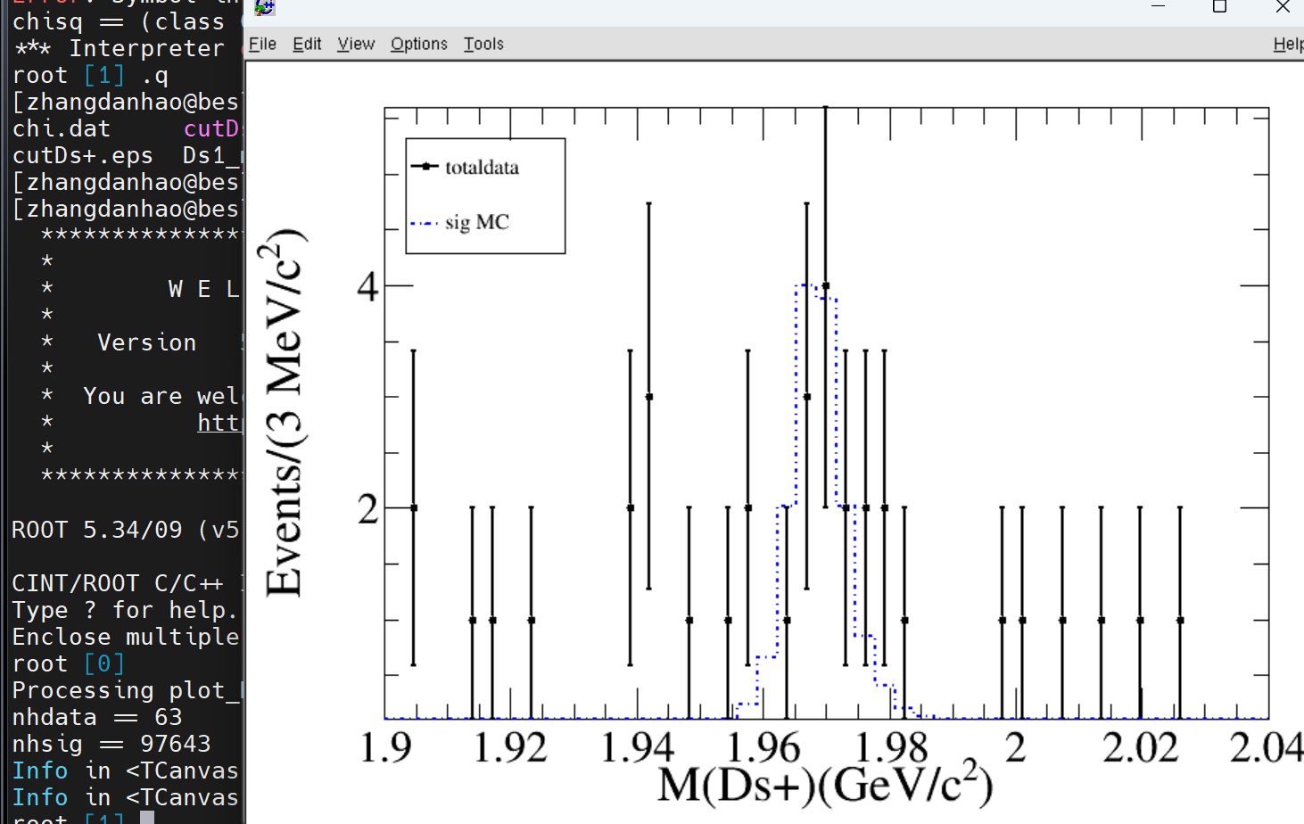
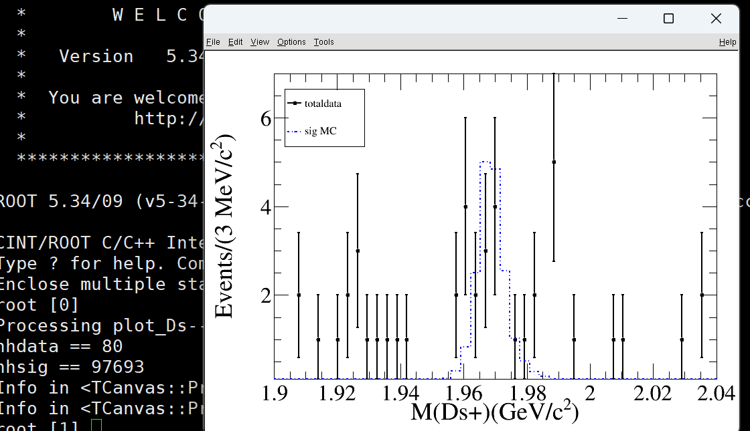
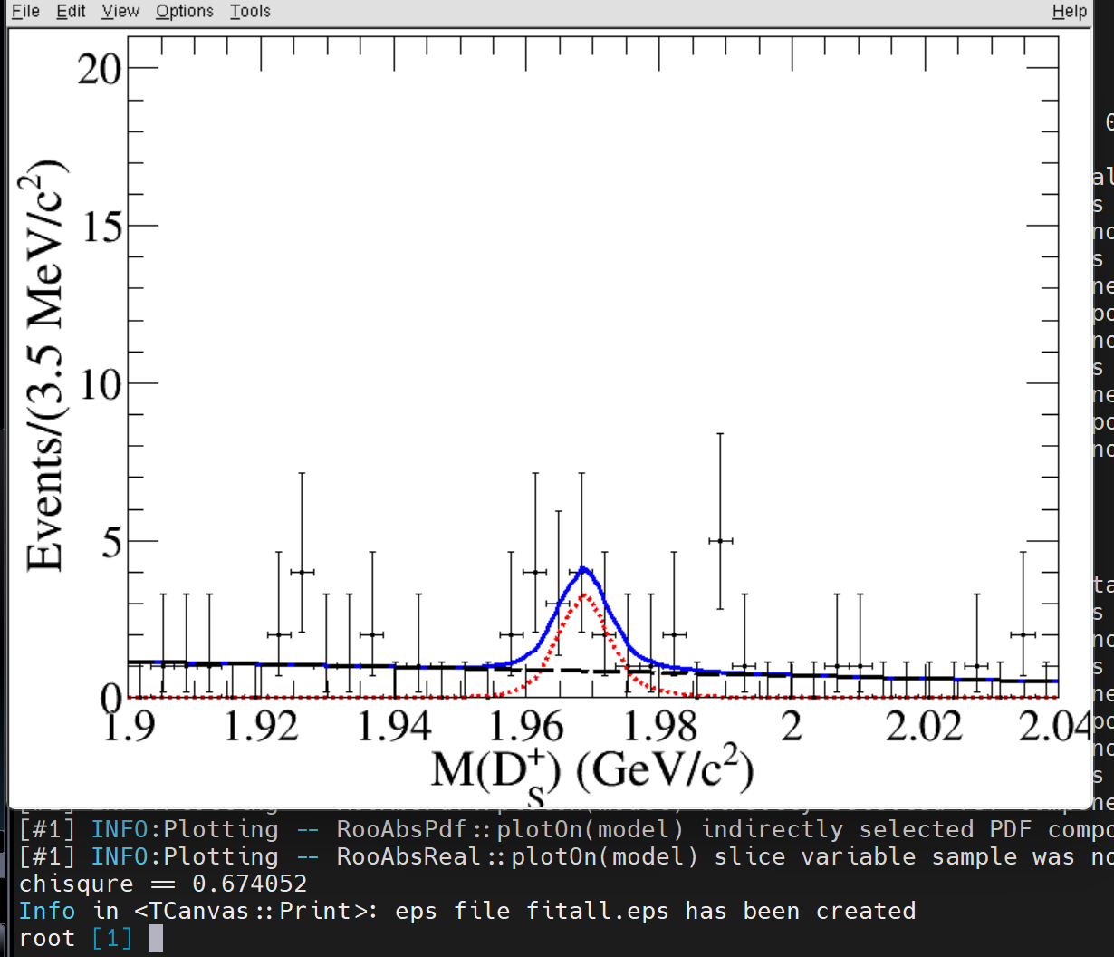
4C (chisq<200)
significance = 3.2

Slide 29
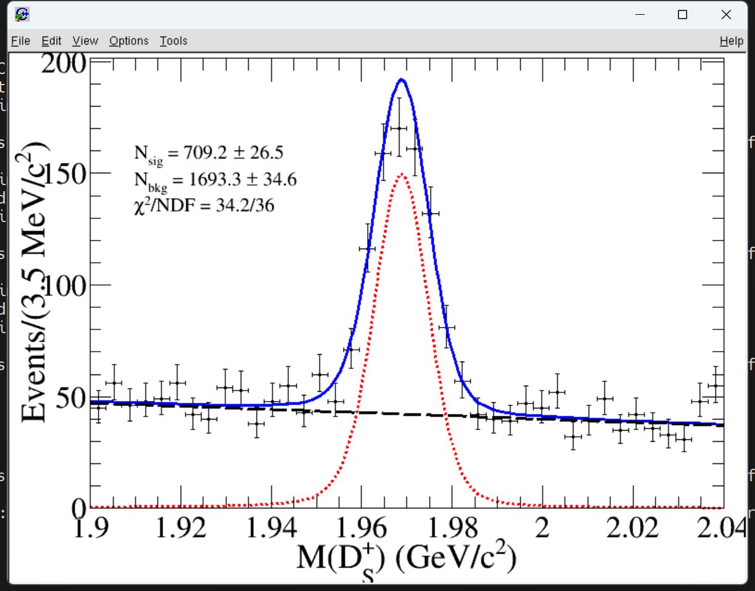
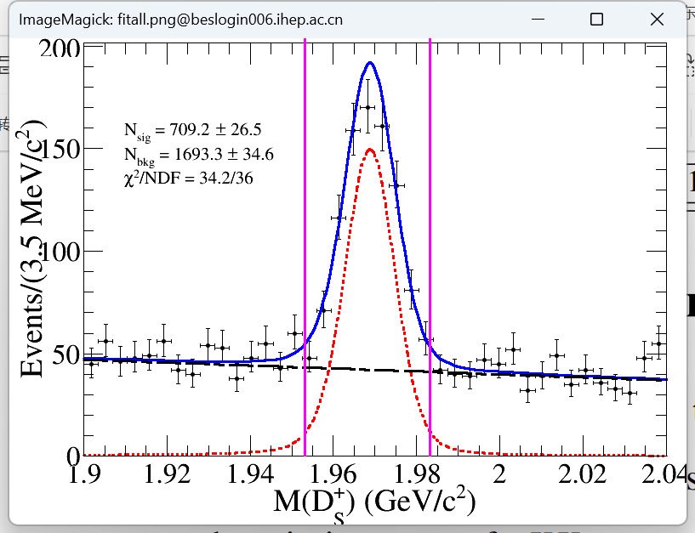
Ds mass window systematic uncertainty-data
Ds⁺—> KsK⁺
The signal component is modeled by convolving the signal MC with Gaussian fuction.
The background is modeled using a first-order polynomial.
We perform integration within the mass interval.
result (area)——0.92/1

Slide 30
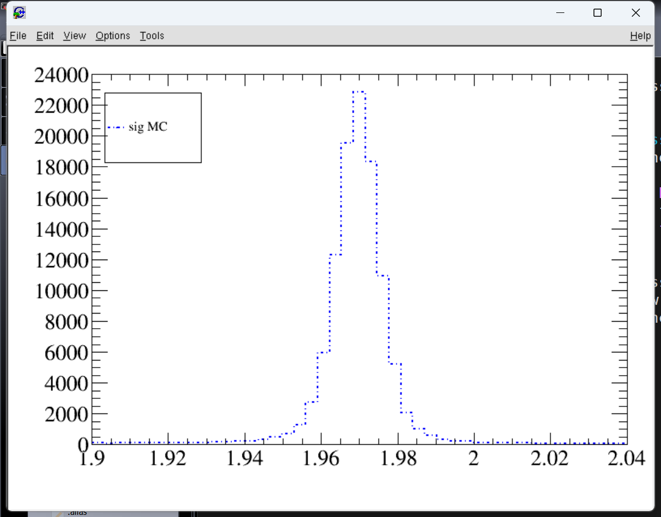
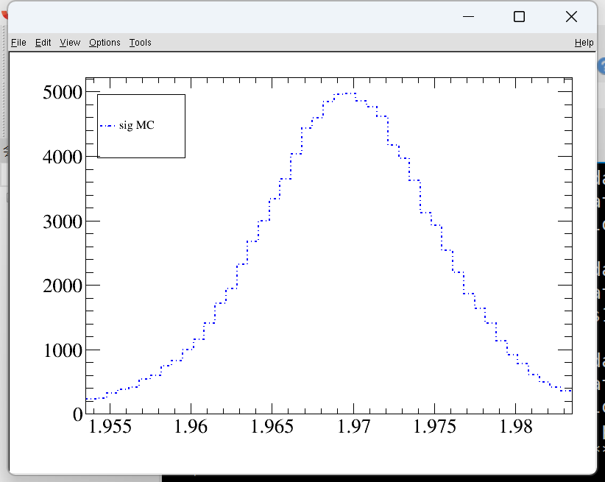
Ds mass window systematic uncertainty-signal mc
Ds⁺—> KsK⁺
The number of signals is obtained through integration.
result (area)——105583/111763=0.94
systematic uncertainty = (0.94-0.92)/0.92=2.2%

Slide 31
2024.10.29

Slide 32




background
inc mc
data
(sideband)
Notes:
no peaking background

Slide 33

DsDs
check possible PHSP effect on the DsDs/piDsDs mass distribution.
Notes:
phase space

Slide 34



fit(1D)
--515.358
-584.557
-500.758
-574.721

Slide 35


fit(2D)
1、Asymmetric error in two-dimensional fitting
2、Significance
3、likelihood

Slide 36




DsDs
4420
4440
4600
4610

Slide 37




DsDs
4630
4640
4660
4680

Slide 38




DsDs
4700
4740
4750
4780

Slide 39



DsDs
4840
4914
4946

Slide 40

DsDs

Slide 41
fit(1D)
-515.343
-584.557
-500.758
-574.721

Slide 42
fit(2D)
1、Asymmetric error in two-dimensional fitting
2、Significance
3、likelihood

Slide 43
2024.11.05
fit

Slide 44

fit(1D)
584.477
574.721
The signal PDF is described by the shape of signal MC.
The background is described by a first order polynomial function.
Notes:
memo中把拟合结果都保留

Slide 45




The background is described by argus function.
The parameters of argus function is set to the maximum of PHSP MC.
ECM-m(pi+)-m(pi-)-m(Ds)

Slide 46




fit result
4420
4440
4600
4610

Slide 47




fit result
4630
4640
4660
4680

Slide 48




fit result
4700
4740
4750
4780

Slide 49



fit result
4840
4914
4946

Slide 50









upper limit

Slide 51







upper limit

Slide 52




asymmetric errors&isr

Slide 53


asymmetric errors
signal shape
信号形状误差：信号形状卷高斯（参数固定）
Notes:
固定高斯！

Slide 54


asymmetric errors
background shape
本底形状误差：一阶变二阶

Slide 55



Ds mass window（不涉及拟合，不用改？）
Fitting the $K_{s}^{0}K$ mass spectrum with the sum of $Ds$ signal MC convoluted with a Gaussian function and a first-order polynomial function for background as a control sample.
The efficiencies for candidates lying in the mass window ±15MeV/c² can be calculated for both data and MC.
The same method for $Ds→ KKπ$.
Notes:
The mass resolution for $Ds→ K_{s}^{0}K$ signals can be studied by f
字多，简洁一些！
The relative difference in efficiency between data and MC simulation is assigned as the systematic uncertainty.

Slide 56
2024.11.1
fit

Slide 57
fit result
4420
4440
4600
4610

Slide 58


PHSP的这个边界，也就是这个M_{Ds}的右边界，对应的就是ECM减去另外所有粒子的不变质量。

Slide 59

PHSP MC

Slide 60
2024.11.13
fit

Slide 61



Question 1
The current fit is not correct. Please try 2D fit method, or 1D fit considering sideband background
The signal PDF is described by the shape of signal MC.
The background is described by a first order polynomial function.

Slide 62
asymmetric errors&isr

Slide 63

Question 1

Slide 64

Question 2
Check possible PHSP effect on the DsDs/piDsDs mass distribution.

Slide 65


Question 2
Check possible PHSP effect on the DsDs/piDsDs mass distribution.

Slide 66


Question 1
how to draw the sideband?

Slide 67
2024.12.10
fit

Slide 68
Question 1
how to draw the sideband?

Slide 69


Question 1

Slide 70


Notes:
error unce...
用什么方法估计，we consider the

Slide 71


The memo and reply is ready

Slide 72
2024.1.7

Slide 73
The memo and reply is ready

Slide 74


Question

Slide 75



Question
1、The scale factor is obtained according to the cross section formula.

Slide 76
2024.1.14

Slide 77


Question
1、The scale factor is obtained according to the cross section formula.

Slide 78


Question

Slide 79
2024.2.18

Slide 80



Slide 81

Question

Slide 82


Question

Slide 83





Question
4c前？cut条件？
pi+？pi-？p？anti -p？

Slide 84

4c后没存

Slide 85
2024.3.11

Slide 86




Question

Slide 87





Question
Fit range
signal shape

Slide 88



Question
Background shape
1、updata the memo
2、The reply to the referee (sun wenyu) is ready.
Notes:
the resolution differences between the data and the MC

Slide 89




Study of
$$e^{+}e^{−}→π^{+}π^{−}{Ds}^{+}{Ds}^{−}$$
Danhao Zhang¹ (张丹昊), Bin Wang², Aiqiang Guo³, Chunxu Yu¹
1. Nankai University
2. IHEP
3. Institute of Modern Physics
Notes:
1. 时间记得改

Slide 90

Datasets and MC samples
Analytical method：Double Dtag; DTagAlg-00-01-05;DTagAlg-00-01-09.
BOSS Version：7.0.3 ,7.0.5 ,7.0.6 , and 7.0.7
MC samples：
    Inclusive MC：$e^{+}e^{−}→Inclusive @ 4.42，4.60$GeV.
    Exclusive MC：$e^{+}e^{−}→π^{+}π^{−}{Ds}^{+}{Ds}^{−}，$
    ${Ds}^{+}→K^{+}K^{−}π^{+} or K_{s}^{0}K^{+}$ ,
    ${Ds}^{−}→K^{+}K^{−}π^{−} or K_{s}^{0}K^{−}$.
    E_{CMS}:4.6842 Gev
    Data samples：
    XYZ data（4.42，4.44，4.60，4.61，4.63，4.64，4.66，4.68，4.70，4.74，4.75，4.78，4.84，4.914，4.946 GeV)
Notes:
颜色部分的电荷没有，Ks也不是标准写法。

Slide 91
联合拟合

Slide 92





Some distributions of total data (nsig=1)
The obvious enhancement can be seen in the scattering plots for both data and signal MC.
The below two figures are the corresponding projections of the scattering plots.
In ${Ds}^{−}$ invariant mass distribution, we can see a clear signal.

Slide 93



Signal events
  To improve the significance of the signal, we require a mass window of Ds⁺, to show the invariant mass of Ds⁻ ,which is $\left|M({Ds}^{+}/{Ds}^{−})−m(Ds)(PDG\right|≤15$MeV/c².
Notes:
你这公式是图片啊，想办法弄成正常公式，你不是也有高能所的账号吗？应该也在正版软件平台上下载office。
这里的文字改成，To improve the significance of the signal, we require a mass window of Ds+, to show the invariant mass of Ds-.

Slide 94



Signal extraction
6.1sigma
The signal is described by a signal MC .
The background is described by a second order polynomial function.
A simultaneous fit is performed to fit both invariant mass distributions.
The signal yield is fit to be $27.1±5.7$ for all datasets.
Notes:
效率应该是在信号提取之后。

Slide 95



Signal events
6.9sigma
Notes:
你这公式是图片啊，想办法弄成正常公式，你不是也有高能所的账号吗？应该也在正版软件平台上下载office。
这里的文字改成，To improve the significance of the signal, we require a mass window of Ds+, to show the invariant mass of Ds-.

Slide 96







Notes:
0.02 0.035

Slide 97
单独拟合

Slide 98


Signal extraction
5.4sigma
4.4sigma
The signal is described by a signal MC .
The background is described by a second order polynomial function.
Notes:
效率应该是在信号提取之后。

Slide 99
Backup

Slide 100

Efficiency
Summary of the effciency at different energies

Slide 101


Signal extraction
$\sqrt{s}$（GeV） | $$N^{obs}$$ | $\sqrt{s}$（GeV） | $$N^{obs}$$ | $\sqrt{s}$（GeV） | $$N^{obs}$$
4.4156 | 1.4±1.0 | 4.6431 | 0±0.8 | 4.7501 | 1.4±1.3
4.4362 | 2.0±1.2 | 4.6639 | 2.3±1.8 | 4.7804 | 3.0±1.8
4.5995 | 4.6±1.8 | 4.6842 | 0.6±2.1 | 4.8421 | 5.2±2.3
4.6152 | 0±0 | 4.7008 | 3.6±1.8 | 4.9180 | 0±0.3
4.6304 | 0±0.3 | 4.7397 | 0±0.3 | 4.9503 | 3.1±1.5
Signal yields at all data samples, the errors are the statistical only.
Notes:
这页很不错，看过去又简洁又清楚。

Slide 102


Upper Limit
$$\sqrt{s}$$ （GeV） | N_{UP} | $\sqrt{s}$（GeV） | N_{UP} | $\sqrt{s}$（GeV） | N_{UP}
4.4156 | 3.60 | 4.6431 | 1.75 | 4.7501 | 4.15
4.4362 | 4.45 | 4.6639 | 5.65 | 4.7804 | 6.30
4.5995 | 8.10 | 4.6842 | 4.80 | 4.8421 | 9.45
4.6152 | 1.2 | 4.7008 | 7.05 | 4.9180 | 1.20
4.6304 | 1.2 | 4.7397 | 1.25 | 4.9503 | 6.10
The simultaneous fits are performed with different hypotheses of signal yields.
We then scan the signal yield to find a value, denoted as N_{UP.}
N_{UP} is exactly the upper limit of the signal yield at the 90% confidential level (C.L.).

Slide 103




Search for the charmoniumlike states
We draw the${ π}^{−}{Ds}^{+}{Ds}^{−}$,$π^{+}π^{−}{Ds}^{+}$,${Ds}^{+}{Ds}^{−} mass spectrum.$
No significant resonance structures were observed.

Slide 104



Born Cross Section Measurement
The Born cross section can be calculated by:
Notes:
表格太大，图太小。

Slide 105


Systematic Uncertainties
Integrated luminosity(1%)
Branching fraction
    $Ds→ KsK$ (1.453 ± 0.035 )%
    $Ds→ K^{+}K^{−}π^{+}$ (5.38 ± 0.1 )%
PID
Charged tracks
Fit Range
Mass window
Background Shape

Slide 106




Branching fraction
    $Ds→ KsK$ (1.453 ± 0.035 )%
    $Ds→ K^{+}K^{−}π^{+}$ (5.38 ± 0.1 )%
The average Born cross section can be calculated by：
The largest difference to the average Born cross section result is taken as systematic uncertainty.

Slide 107


Charged Tracks
$$err=\frac{\left|\overline{σ_{new}^{B}}−\overline{σ}\right|}{\overline{σ}}$$
We also use the average Born cross section to calculate the systematic uncertainty.
Similar methods used for PID.

Slide 108



Fit method
The systematic uncertainties due to the fitting range are studied by varying the fit range from (1.9, 2.04) GeV/c² to (1.904, 2.04) GeV/c².
The uncertainty of background shape is determined by changing the background shape from second order polynomial to third order polynomial in the fit.
In order to obtain the systematic uncertainty related to the selection of the signal region of M(Ds+) & M(Ds−), we repeat the whole analysis by changing the signal region of M(Ds+) & M(Ds−) within from 15 MeV/c² of m(Ds+) & m(Ds−) to 20 MeV/c². The difference on the average cross section is taken as the systematic uncertainty.

Slide 109



Summary and to do list
Summary:
A clear is observed in the selected data samples;
The signal yields is calculated to be $22.1±5.4$.
We also measured the Born Cross Section and the upper limit for data samples.
Next to do :
Memo has been prepared;
$$e^{+}e^{−}→π^{+}π^{−}{Ds}^{+}{Ds}^{−}$$

Slide 110
Thanks for your attention!

Slide 111





Motivation
In recent years, many charmoniumlike states have been observed in the systems.
Vector charmonium-like states, such as Y(4260) and Y(4360), their masses are measured to be well above the open-charm threshold. In contrast to the conventional states in the same energy region, they have large decay widths into hidden-charmfinal states.
BESIII has observed two enhancements between 4.05 to 4.6 GeV in the process $e^{+}e^{−}→π^{+}D^{0}D^{∗−}$,and also measured the processes $e^{+}e^{−}→π^{+}π^{−}D^{0}{\overline{D}}^{0}$ and $e^{+}e^{−}→D_{2}^{∗}(2460)\overline{D}$ in which observing $Ψ(3770)$ and $Ψ(4415)$,respectively, which provides new ideas to theorists.
Notes:
第一行的挤在一块了，我估计是ppt版本的问题，你下次记得同时发个pdf给我。
底下那两个图应该是一个分析，你保留右边那个期刊里的图，左边那个去掉。可以把最近那个pipiDD的截面文章那个图拿过来。

Slide 112






Motivation
In the March 12th, 2021, the BESIII collaboration reports the discovery of an exotic multi-quark structure , that is produced in the process of
at an ${ e}^{+}e^{−}$ center-of-mass energy of 4.68 GeV.
Recently,the LHCb experiment has discovered a novel and peculiar hadronic state candidate in the ${Ds}^{+}{Ds}^{−}$ system of bottom meson three-body decays.
We used the BESIII detector to collect experimental data from 4.42 to 4.946GeV to research${ e}^{+}e^{−}→π^{+}π^{−}{Ds}^{+}{Ds}^{−}$process. We will search for new resonance in
our mass spectrum.
Notes:
1. 关于咱们这个过程你是否可以和学校的理论老师问一下我们这个过程为什么截面会这么低，我到现在都还一直纳闷。

Slide 113
Datasets and MC samples
Analytical method：Double Dtag; DTagAlg-00-01-05;DTagAlg-00-01-09.
BOSS Version：7.0.3 ,7.0.5 ,7.0.6 , and 7.0.7
MC samples：
    Inclusive MC：$e^{+}e^{−}→Inclusive @ 4.42，4.60$GeV.
    Exclusive MC：$e^{+}e^{−}→π^{+}π^{−}{Ds}^{+}{Ds}^{−}，$
    ${Ds}^{+}→K^{+}K^{−}π^{+} or K_{s}^{0}K^{+}$ ,
    ${Ds}^{−}→K^{+}K^{−}π^{−} or K_{s}^{0}K^{−}$.
    E_{CMS}:4.6842 Gev
    Data samples：
    XYZ data（4.42，4.44，4.60，4.61，4.63，4.64，4.66，4.68，4.70，4.74，4.75，4.78，4.84，4.914，4.946 GeV)
Notes:
颜色部分的电荷没有，Ks也不是标准写法。

Slide 114
Datasets (BOSS 7.0.3 & 7.0.5 & 7.0.6 & 7.0.7)
Energy (MeV) | luminosity (1/Pb) | Run Number | BOSS Version
4420 | 1028.89±0.13±10.29 | 31327-31390，36773--38140 | 7.0.3
4440 | 569.9 | 62286-62823 | 7.0.5
4600 | 566.93±0.11±5.67 | 35227-36217 | 7.0.3
4610 | 103.83±0.05±0.55 | 64314-64360 | 7.0.6
4630 | 521.52±0.11±2.76 | 63075-63515
4640 | 552.41±0.12±2.93 | 63516-63715
4660 | 529.63±0.12±2.81 | 63718-63852
4680 | 1669.31±0.21±8.85 | 63867-64015，64365-65092
4700 | 536.45±0.12±2.84 | 64028-64313
4740 | 164.27±0.07±0.87 | 65208-65321
4750 | 367.21±0.10±1.95 | 65322-65494
4780 | 512.78±0.12±2.72 | 65495-65645 | 7.0.7
4840 | 527.29±0.12±2.79 | 65646-65864
4914 | 208.11±0.08±1.10 | 65867-65935
4946 | 160.37±0.07±0.85 | 65938-66224

Slide 115

Event selection
Charged tracks
  |$R_{xy}|<1cm，|R_{z}|<10cm，|cosθ|<0.93$
PID
  $π：Prob(π)>0.0，Prob(π)>Prob(K)$
  $K$：Prob($K$) > 0.0，Prob($K$) > Prob($π)$
${Ds}^{+}{Ds}^{−}$:
  Use the DTagAlg toolbox to reconstruct double tag candidates with average mass closest to the PDG value of Ds mass in each mode.
Bachelor $π^{+}π^{−}$ reconstruction: ncharge =2, i.e. a pair of $π^{+}π^{−}$.
Notes:
这里的pi和k用公式编辑来，写标准。

Slide 116






${Ds}^{+}{Ds}^{−}$ reconstruction
Data
Signal MC
  The below two figures are projections of the scattering plots .
  A clear signal of the pair of ${Ds}^{+}{Ds}^{−}$ is observed.

Slide 117




Background Study
Background study (using inclusive MC at $4.42，4.60$GeV)
There is no signal from us in the inclusive MC.
No obvious enhancement can be seen in the scattering plots of the inclusive MC.
The shape of backgrounds appears to be continuous.
There is no peaking background in our signal region.
Second polynomials are also utilized to fit the background.
Notes:
这里的排版你最好还是在开头用一行文字重复一下是哪个能量点的inclusive MC的结果，具体看看其他人的报告。
你好喜欢用we … 落在文字上。你口头上可以这么说，文字上最好不要。

Slide 118

Background Study
No special process was seen in our topology analysis.
Notes:
这里应该是有东西的，eta Ds+Ds-，你把所有这个过程的圈出来，然后通过后面的内容把这个本底veto掉。

Slide 119



Background Study
The right figure is the process of $e^{+}e^{−}→η{Ds}^{+}{Ds}^{−} and η →π^{0}π^{+}π^{−}.$
We can’t see obvious enhancement in the right scattering plots in our signal region.
There is no peaking background in our signal region.
Notes:
这里这么看的话，etaDsDs或许是一个很不错的题目。

Slide 120







Scattering plots of ${Ds}^{+}$ vs. ${Ds}^{−}$ invariant mass
4420
4440
4600
4610
4630
4640

Slide 121






Scattering plots of ${Ds}^{+}$ vs. ${Ds}^{−}$ invariant mass
4660
4680
4700
4740
4750
4780

Slide 122



Scattering plots of ${Ds}^{+}$ vs. ${Ds}^{−}$ invariant mass
4840
4914
4946

Slide 123


Bachelor pi+pi- reconstruction
  We require nsig =1 for further study.
Notes:
这两个图是root里直接拿出来的，不是特别的标准。不过这里不是重点，无所谓就是。

Slide 124



average Born cross section
lum*isr*vp*$∈$
$$\sum{L_{i}}∈_{i}C_{i}$$
Ntot=（1.4+2.1+4.6+2.3+0.6+3.6+1.3+3+5.2+3.1）=27.2
average Born cross section=（27.2）/0.7028 =38.886
(上面15个能量点的数据累加）

Slide 125



分支比系统误差$Br\left( {Ds}^{+}→K^{+}K^{−}π^{+}\right)$
$Br\left( {Ds}^{+}→K^{+}K^{−}π^{+}\right) ：（$1＋0.1/5.38） 平均截面=37.73 系统误差=2.97%
$Br\left( {Ds}^{+}→K^{+}K^{−}π^{+}\right) ：（$1 - 0.1/5.38） 平均截面=40.095 系统误差=3.1%

Slide 126


分支比系统误差$Br\left( {Ds}^{+}→ KsK\right)$
$Br\left( {Ds}^{+}→KsK\right) ：（$1＋0.035/1.453） 平均截面=38.546 系统误差=0.87%
$Br\left( {Ds}^{+}→KsK\right) ：（$1 - 0.035/1.453） 平均截面=39.23 系统误差=0.88%

