Slide 1
Comparison for Detector Sample
Comparing distribution of detector samples for Run3/4/5.

Slide 2
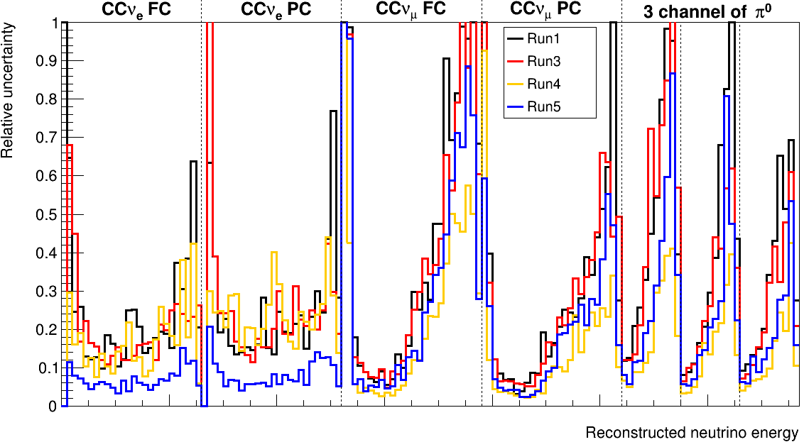
Detector relative uncertainty
Run1 and Run3 are well consistent.
All seven channels of Run5 are smaller than those of Run1/3.
7 channels of Run4 (except CC $ν_{e}$) are smaller than the result of Run1/3.
Run4 and Run5 are not consistent.
Notes:
Here is the detector relative uncertainty of Run1-5
We can see run1 and run3 are well consistent
But all 7 channel of run5 are smaller than those of run1/3
CCnumu and pi0 channel of run4 are smaller than those of run1/3
Meantime Run4 and Run5 are not consistent

Slide 3
Methodology for Drawing Detector Sample’s Distribution
Retrieve the data as follows：
$$TTree ∗T_eval = (TTree ∗)file−>Get("wcpselection/T_eval");$$
$$TTree ∗T_KINEvars = (TTree ∗)file−>Get("wcpselection/T_KINEvars");$$
$$T_KINEvars−>SetBranchAddress("kine_reco_Enu",\&kine_reco_Enu);$$
$$T_eval−>SetBranchAddress("weight_cv", \&weight_cv);$$
$$T_eval−>SetBranchAddress("weight_spline", \&weight_spline);$$
Filling in the data as follows:
$$hQE_w−>Fill(truth_nuEnergy, weight_cv ∗ weight_spline);$$
According to pot, reduce the histogram to pot 1e+20:
$$temp_cv−>Add(hQE_w, 1e+20/pot_of_sample);$$
Draw the histogram.
Note:last time ,I used $truth_nuEnergy$(in T_BDTvars) as Xaxis variable.

Slide 4
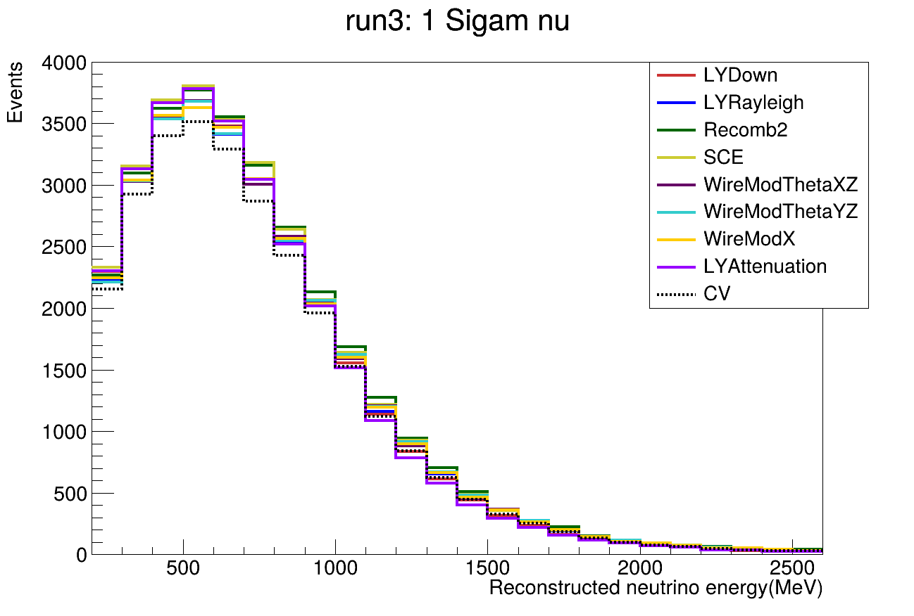
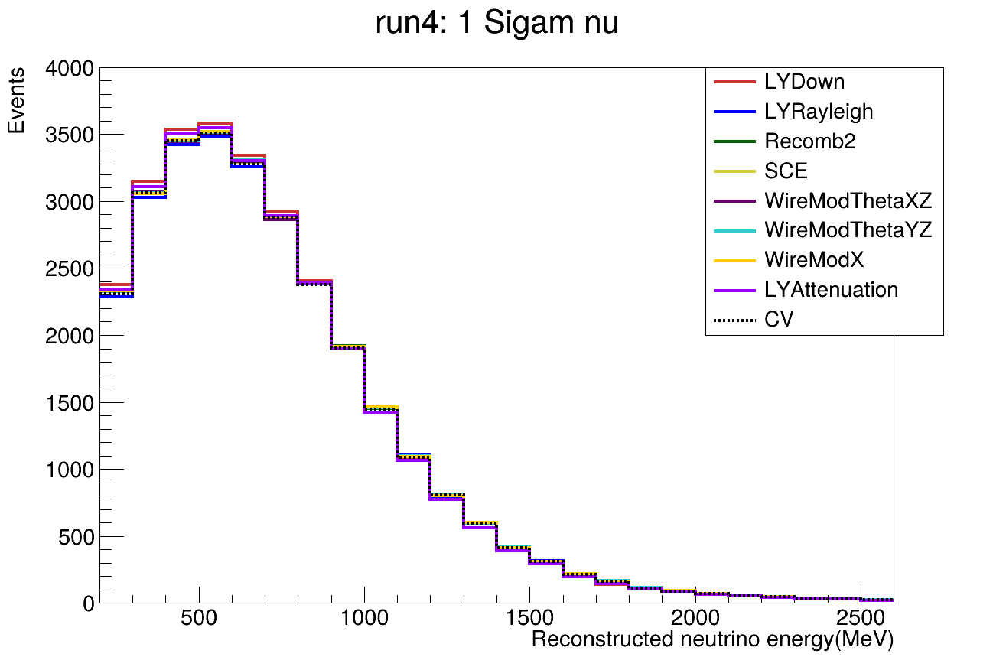
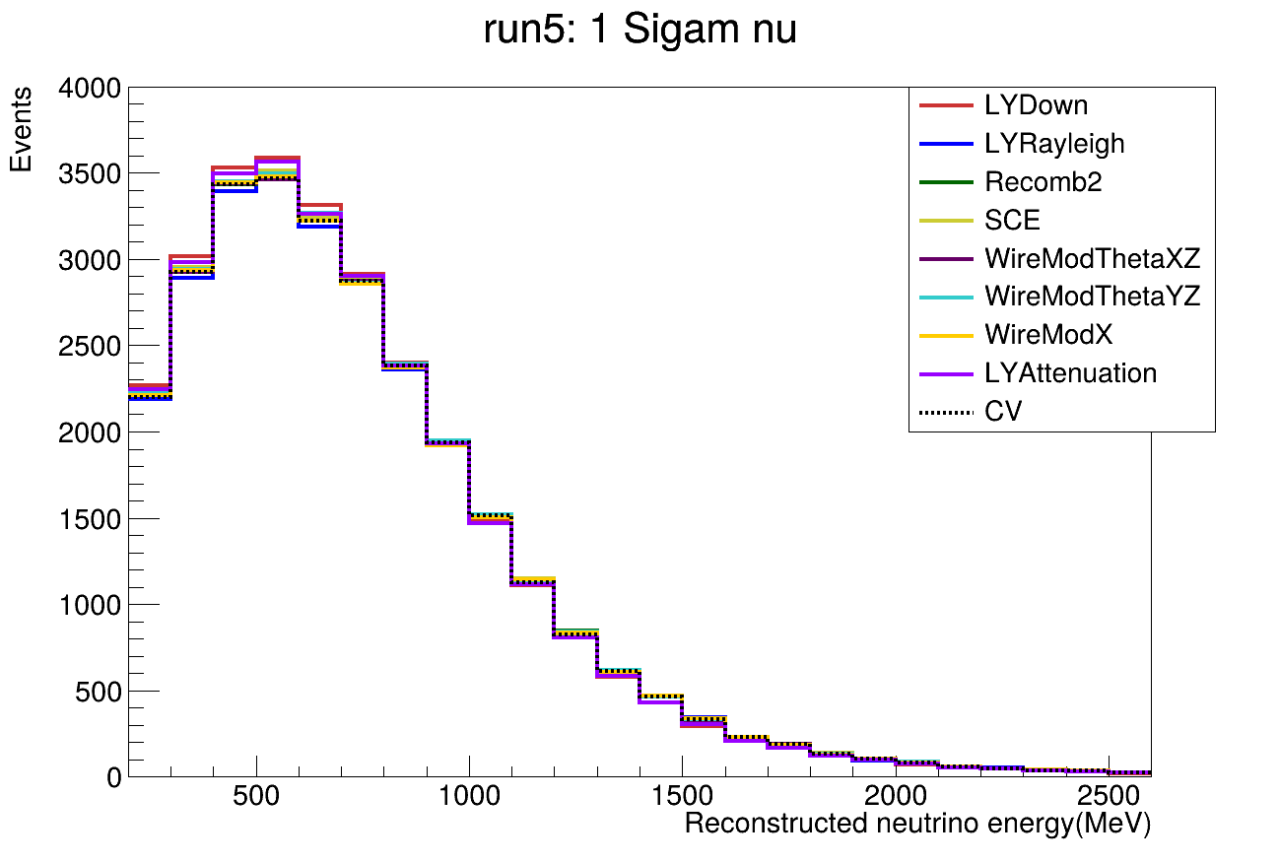
Distribution of each detector $ν_{μ}$ sample
Run3: $ν_{μ}$
POT=1e+20
Run4: $ν_{μ}$
POT=1e+20
Run5: $ν_{μ}$
POT=1e+20
Distribution in Run3/4/5 are similar between each samples.
CV’s distribution in Run3 is slightly less than others.

Slide 5
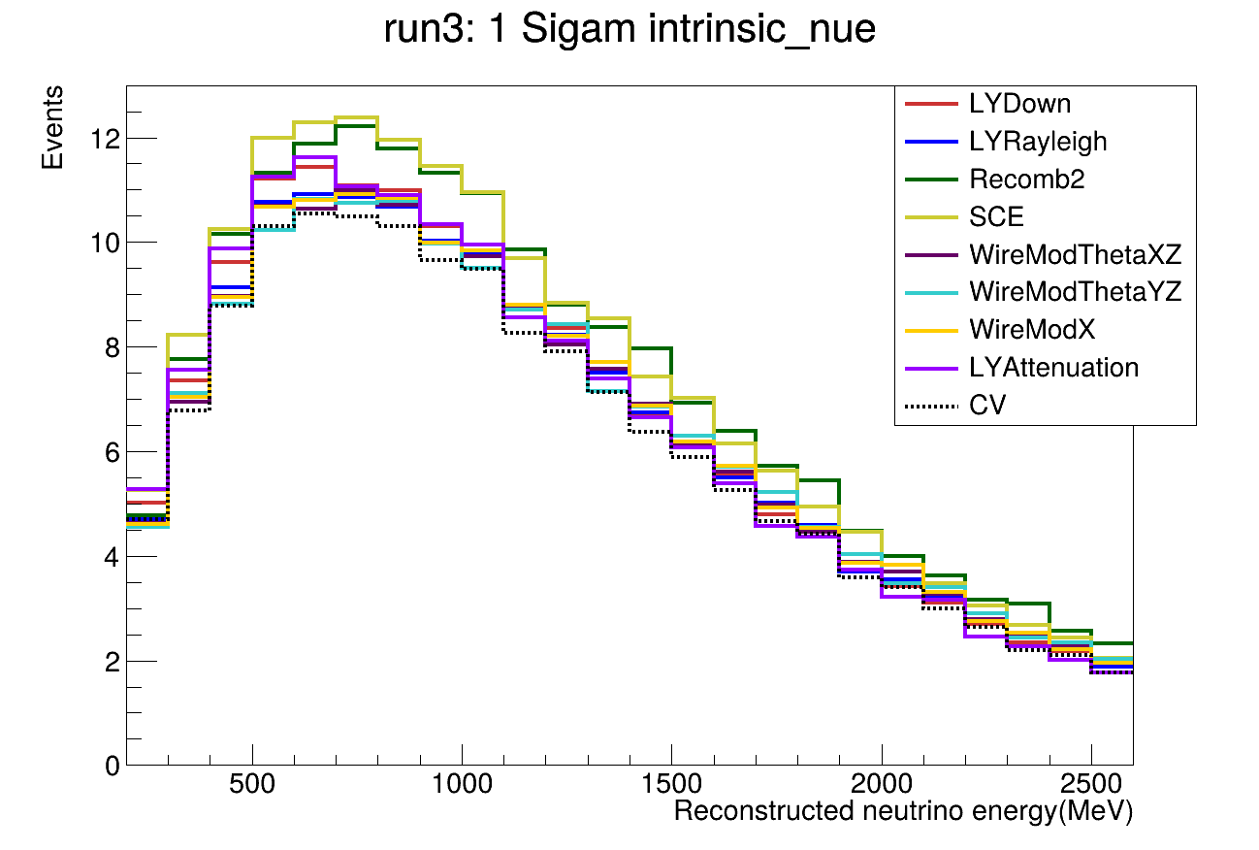
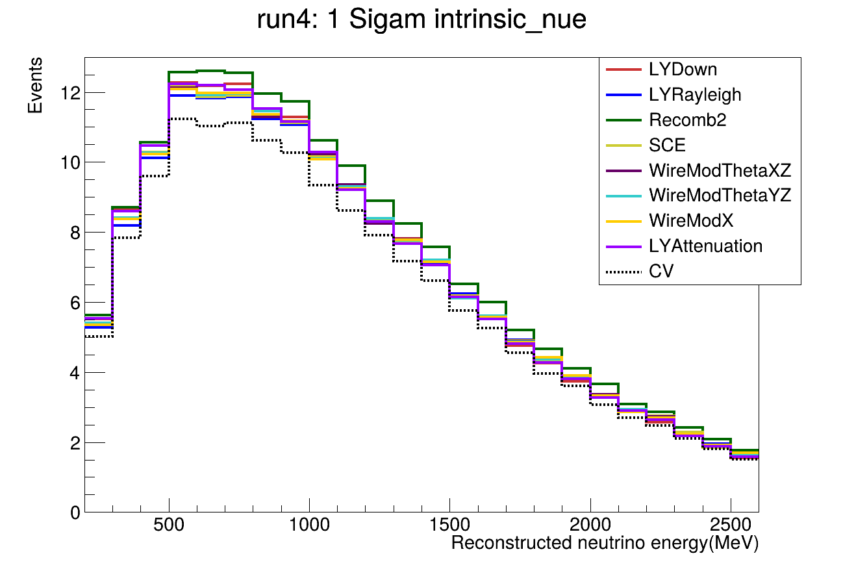
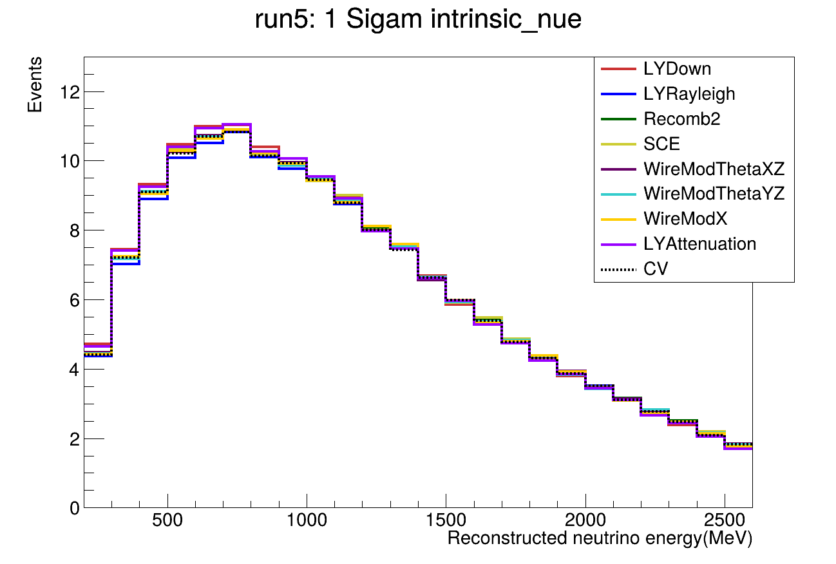
Distribution of each detector $ν_{e}$ sample
Run3: intrinsic $ν_{e}$
POT=1e+20
Run4:
intrinsic $ν_{e}$
POT=1e+20
Run5:
intrinsic $ν_{e}$
POT=1e+20
Distribution in Run4/5 are similar between each samples.
Distribution in Run3 have difference(SCE,Recomb2) between each samples.
CV’s distribution in Run4 is less than others.

Slide 6
Back Up

Slide 7
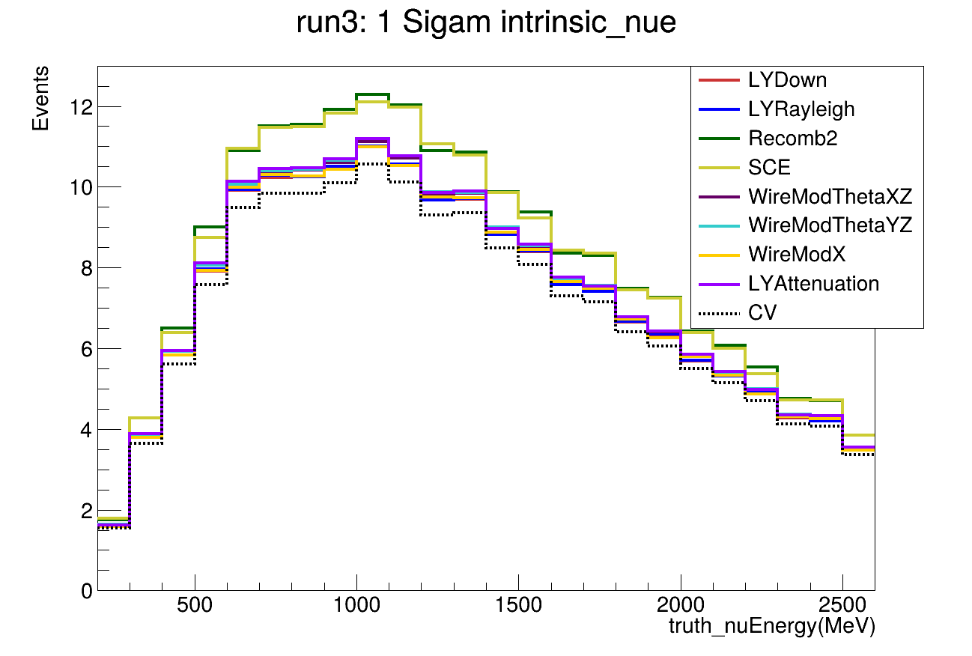
Comparison of different variable (Run3 $ν_{e}$ sample)
Run3: intrinsic $ν_{e}$
POT=1e+20
Run3: intrinsic $ν_{e}$
POT=1e+20
Reconstructed neutrino energy
truth_nuEnergy

Slide 8
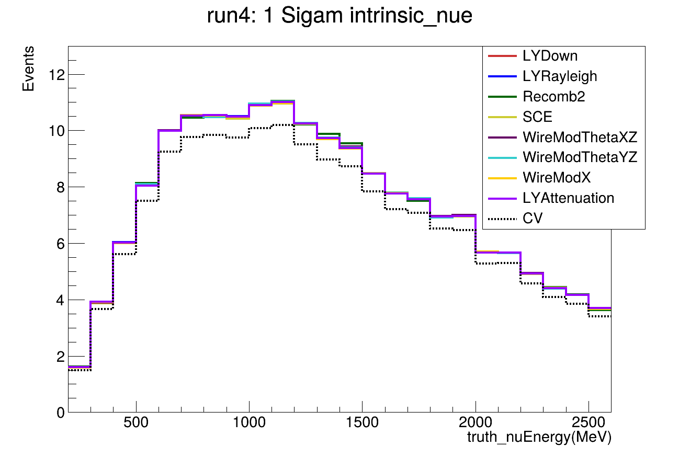
Comparison of different variable (Run4 $ν_{e}$ sample)
Run3: intrinsic $ν_{e}$
POT=1e+20
Run3: intrinsic $ν_{e}$
POT=1e+20
Reconstructed neutrino energy
truth_nuEnergy

Slide 9
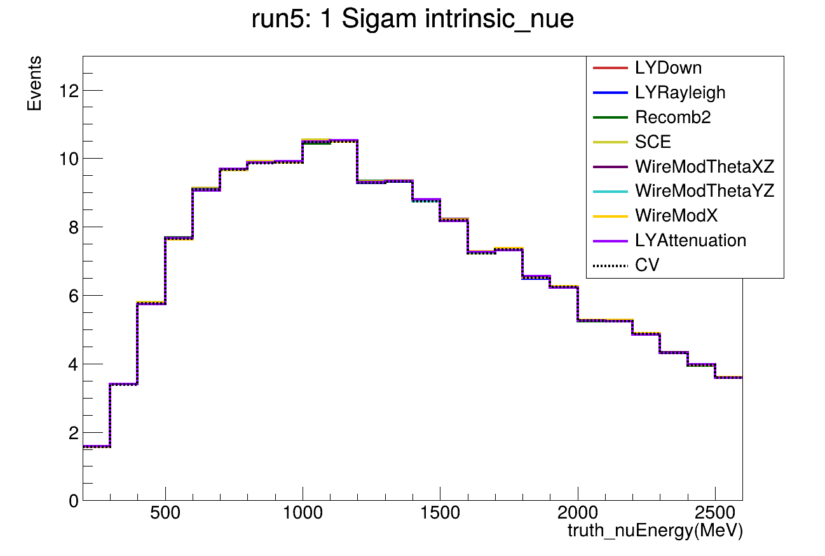
Comparison of different variable (Run5 $ν_{e}$ sample)
Run5: intrinsic $ν_{e}$
POT=1e+20
Run3: intrinsic $ν_{e}$
POT=1e+20
Reconstructed neutrino energy
truth_nuEnergy

Slide 10
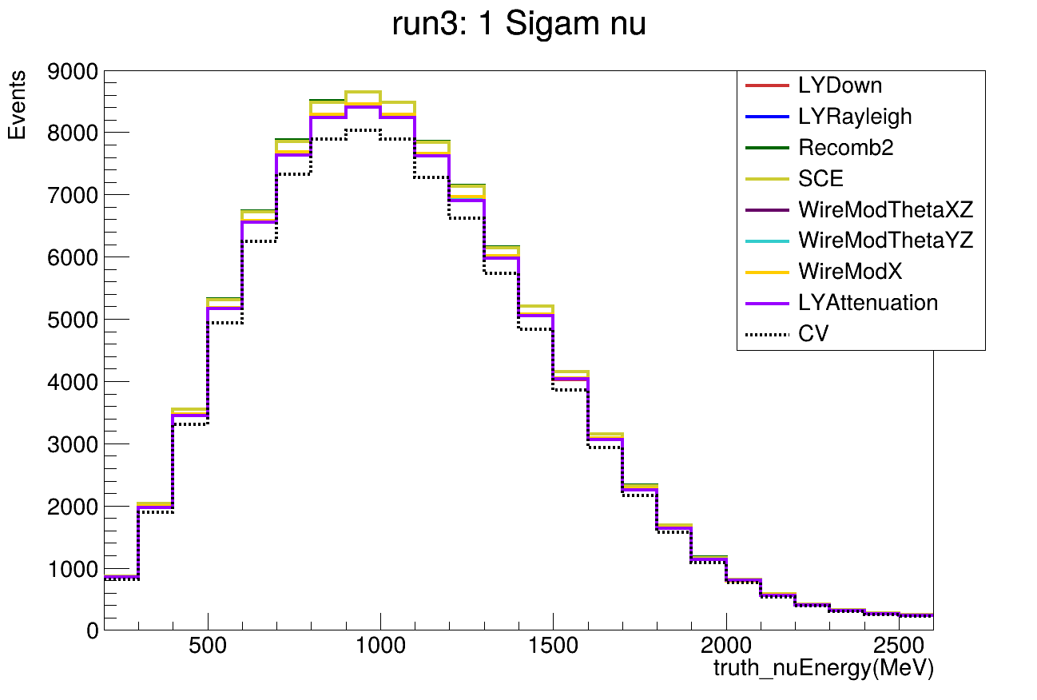
Comparison of different variable (Run3 $ν_{μ}$ sample)
Run3: $ν_{μ}$
POT=1e+20
Run3: $ν_{μ}$
POT=1e+20
Reconstructed neutrino energy
truth_nuEnergy

Slide 11
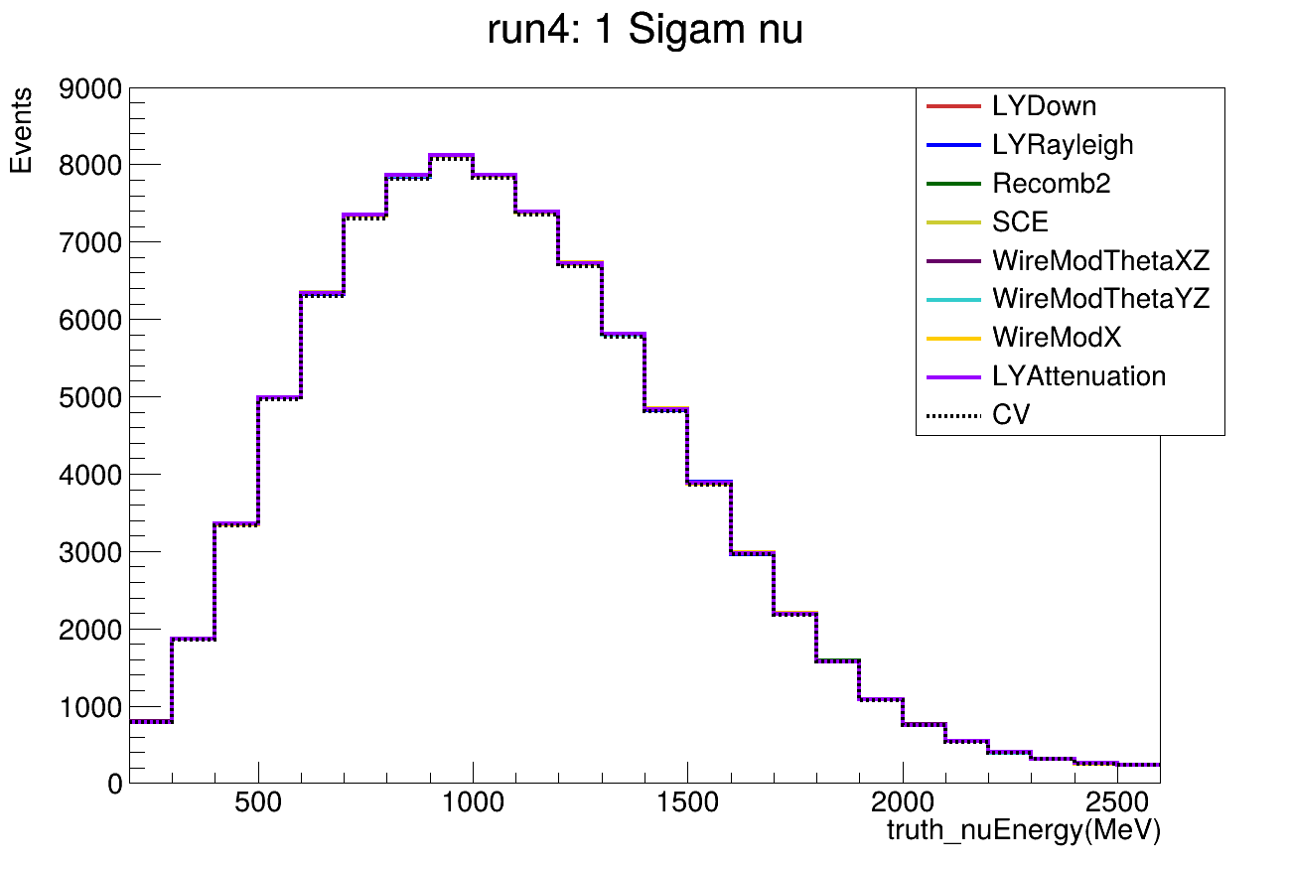
Comparison of different variable (Run4 $ν_{μ}$ sample)
Run4: $ν_{μ}$
POT=1e+20
Run3: $ν_{μ}$
POT=1e+20
Reconstructed neutrino energy
truth_nuEnergy

Slide 12
Comparison of different variable (Run5 $ν_{μ}$ sample)
Run5: $ν_{μ}$
POT=1e+20
Run3: $ν_{μ}$
POT=1e+20
Reconstructed neutrino energy
truth_nuEnergy

