Slide 1
Study of $ψ\left(3686\right)→pK^{−}\overline{Λ}η+c.c.$
Zhuang Xinyu
Nankai University
2025.03.11

Slide 2
Outline
Motivation
Decay chain
Data sets and MC simulation
Initial event selection criteria
Other event selection criteria
Topology analysis
2-body combinations
Next to do

Slide 3
Motivation
The study of charmonium decay plays a crucial role in our understanding of the low-energy regime of QCD. Among the charmonium decays, the processes of 𝜓(3686) and 𝐽/𝜓 decaying into baryon pairs have been understood in terms of $c\overline{c}$ annihilations into three gluons or into a virtual photon.
Currently, there is a significant amount of experimental and theoretical research on the decay of 𝜓(3686) into a pair of octet-baryons. However, there is a lack of research on decay modes with excited state as the final state. The 𝜓(3686) has higher energy, which allows for the search of heavier excited-state hyperons.

Slide 4
Decay Chain
$ψ\left(3686\right)→pK^{−}\overline{Λ}η/\overline{p}K^{+}Λη$
$\overline{Λ}/Λ→\overline{p}π^{+}/pπ^{−}$
$η→γγ$
Final state: $p\overline{p}K^{±}π^{∓}γγ$

Slide 5
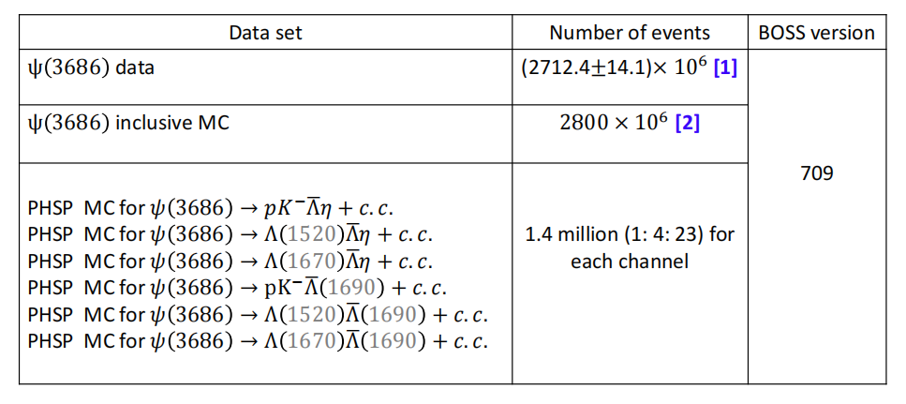
Data Sample and MC Simulation

Slide 6
Initial Event Selection Criteria
Charged tracks:
No vertex constraint (from $\overline{Λ}/Λ$ decay)
$\left|V_{xy}\right|<1 cm, \left|V_{z}\right|<10 cm$ (not from $\overline{Λ}/Λ$ decay)
$\left|cosθ\right|<0.93$
$N_{tot}≥4$
PID:
$N_{p}≥1, N_{K}≥1$
The tracks are assigned to the particle type with the highest confidence level
Good photons:
$0≤TDC≤14$
Barrel: $E>25 MeV, \left|cosθ\right|<0.8$
End cap: $E>50 MeV, 0.86<\left|cosθ\right|<0.92$
$N_{γ}≥2$
$\overline{Λ}/Λ$ reconstruction:
Combining pairs of oppositely charged tracks with $π^{−}/π^{+}$and $p/\overline{p}$ mass hypotheses satisfying a secondary vertex constraint
Vertex fit:
The $pK^{−}/\overline{p}K^{+}$ pair is fitted to a common vertex
Kinematic fit:
4-momentum conservation constrsint (4C) kinematic fit under hypothesis of $ψ\left(3686\right)→pK^{−}\overline{Λ}η/\overline{p}K^{+}Λη$

Slide 7
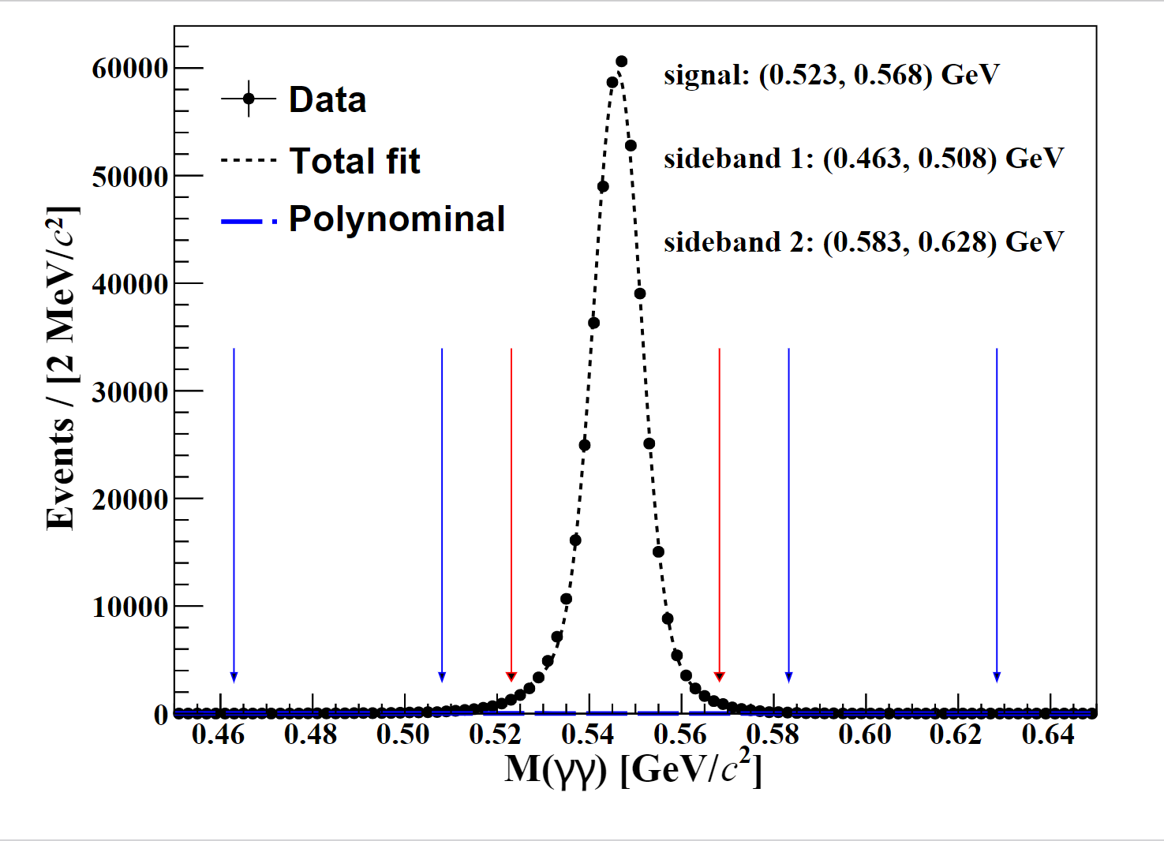
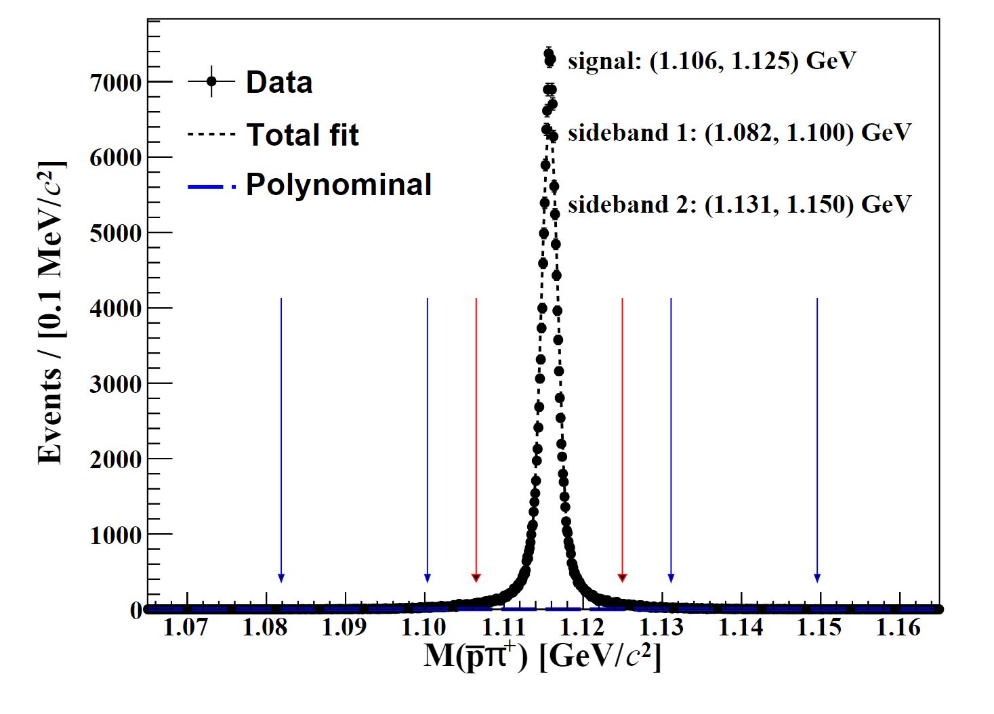
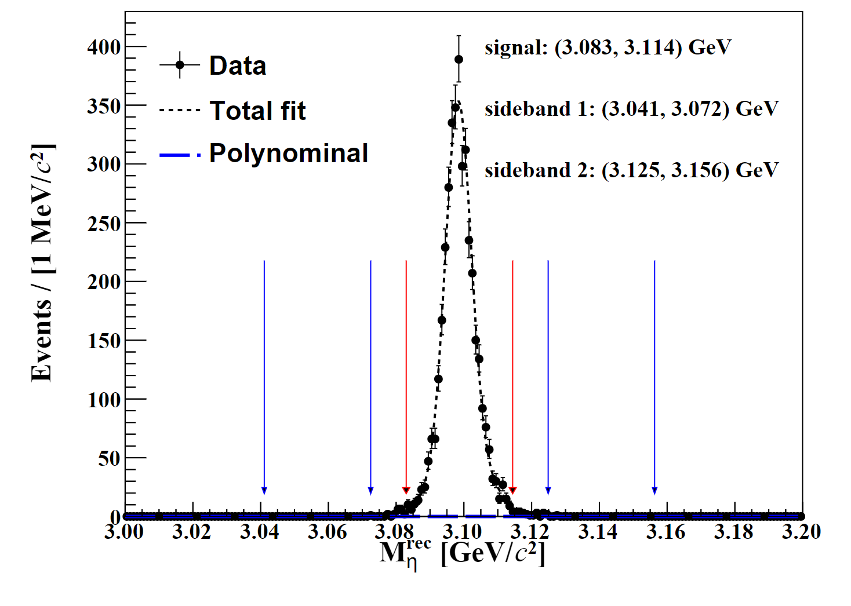
Other Event Selection Criteria
$$0.523< m_{η}<0.568 GeV$$
$$1.106<m_{Λ/\overline{Λ}}<1.125 GeV$$
$$m_{η}^{rec}<3.083 or$$
$$m_{η}^{rec}>3.114$$

Slide 8
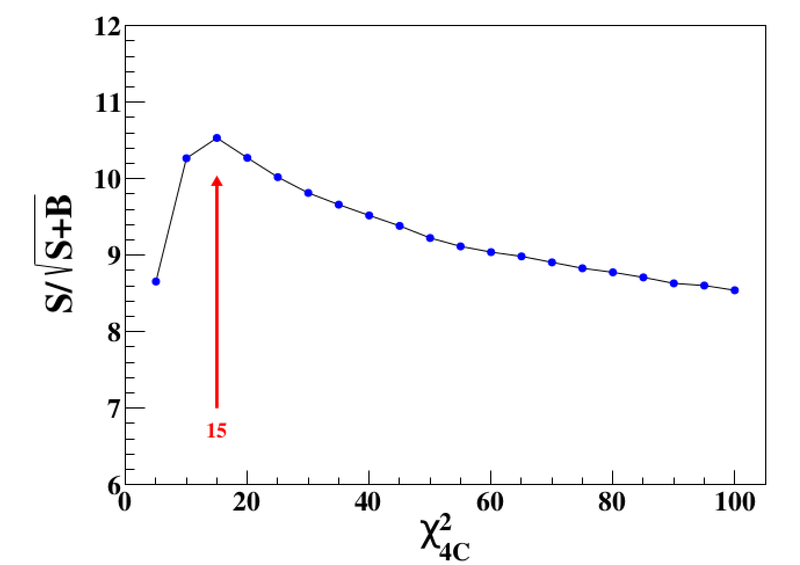
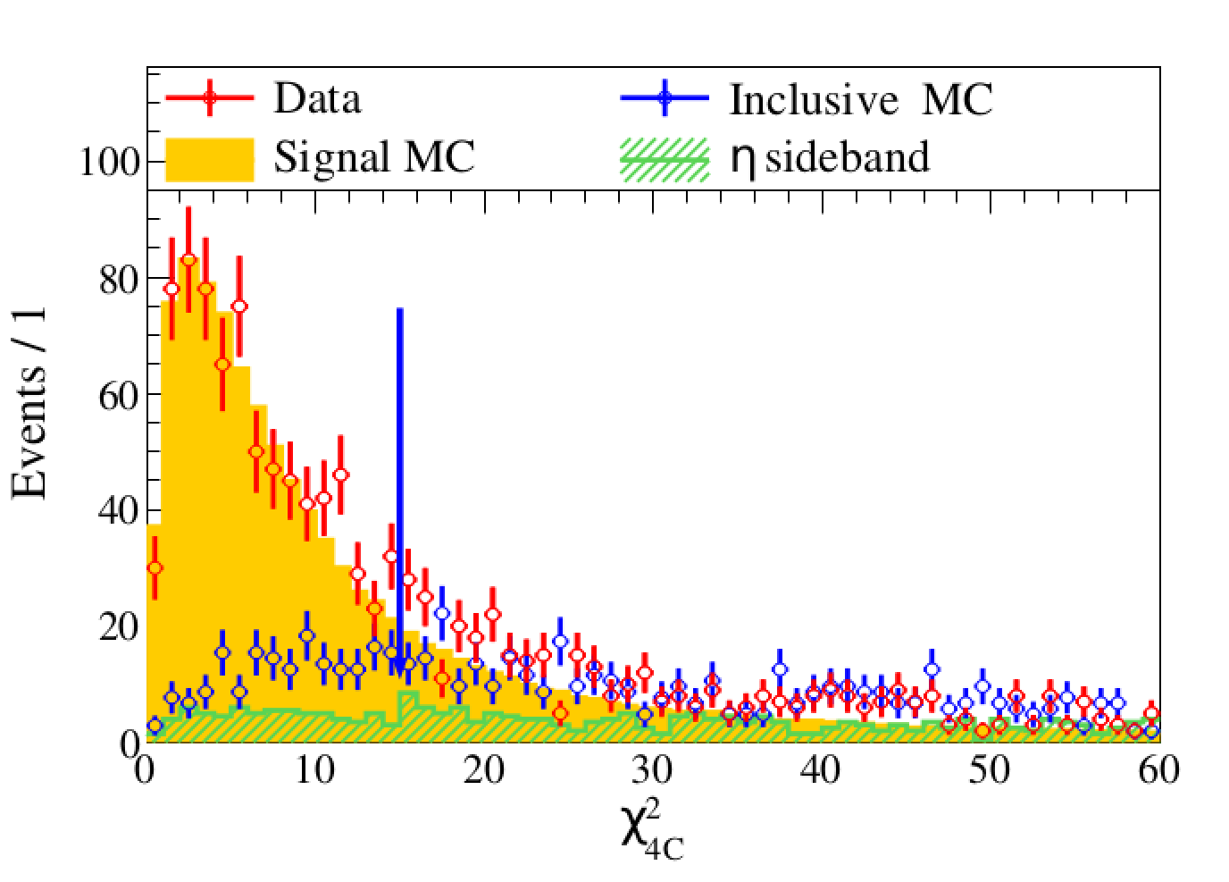
Other Event Selection Criteria
$$FOM=\frac{S}{\sqrt{S+B}}$$
$$χ^{2}<15$$

Slide 9
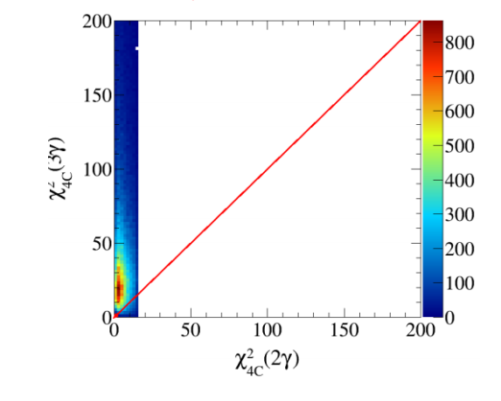
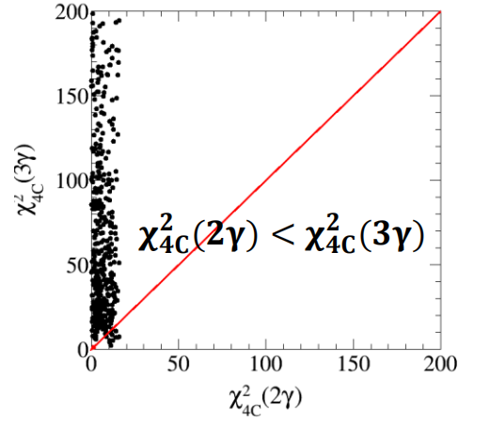
Other Event Selection Criteria
To supress the background with unexpected numbers of photons, we make $χ^{2}\left(2γ\right)<$ $χ^{2}\left(3γ\right)$.

Slide 10
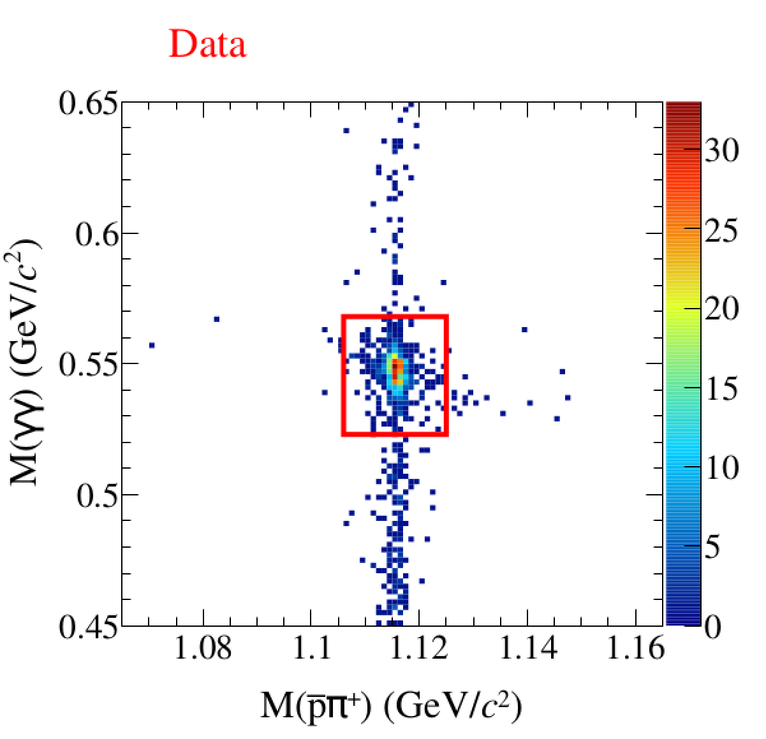
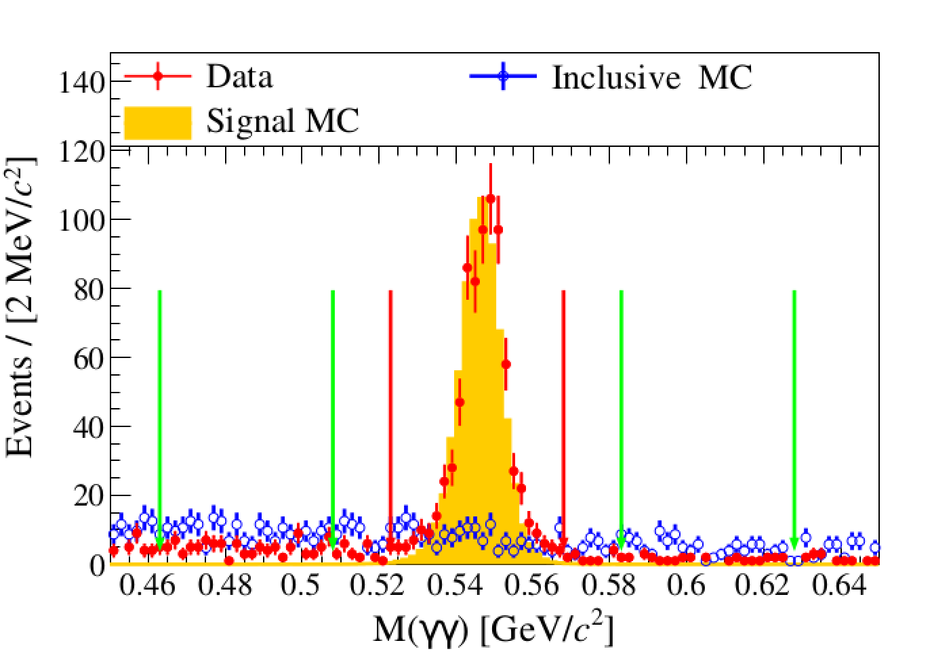
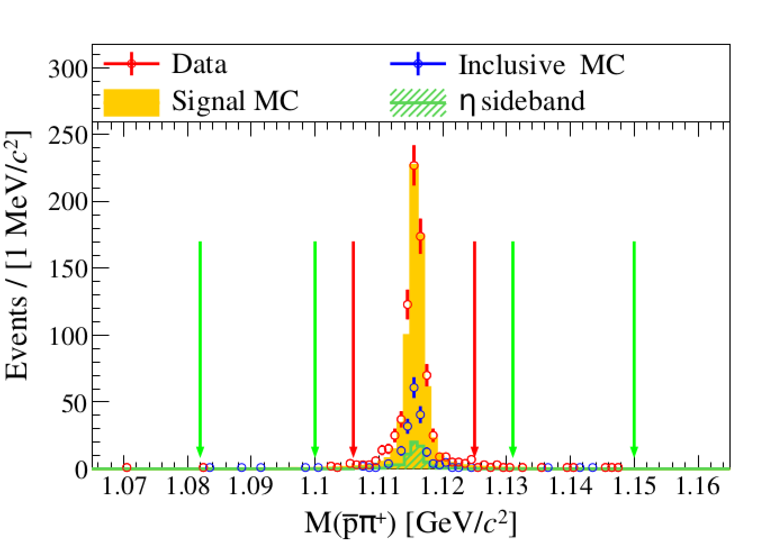
Other Event Selection Criteria
The peaking contribution from the $\overline{Λ}$ sideband can be neglected.

Slide 11
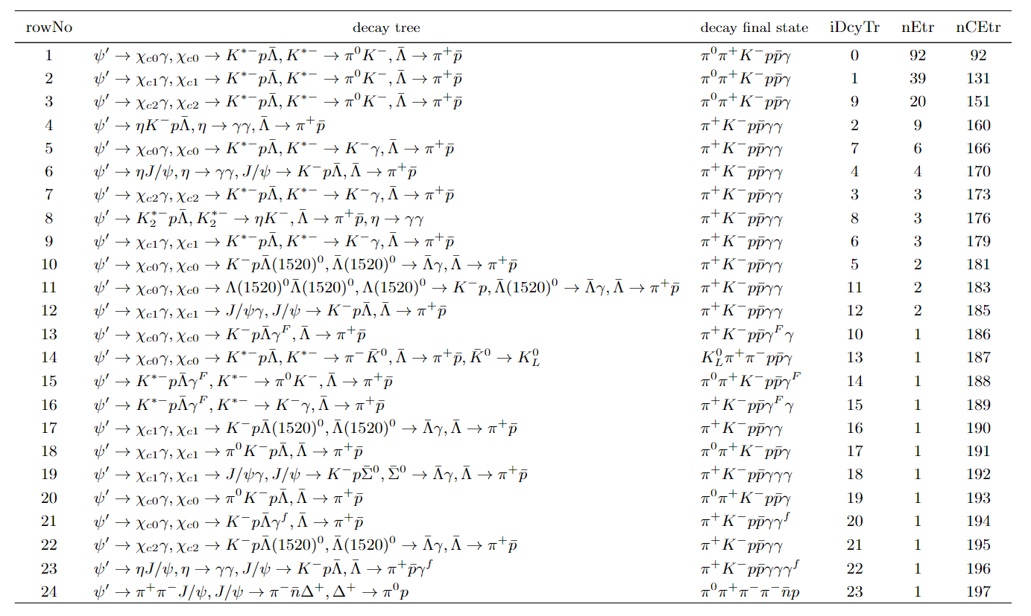
Topology Analysis

Slide 12
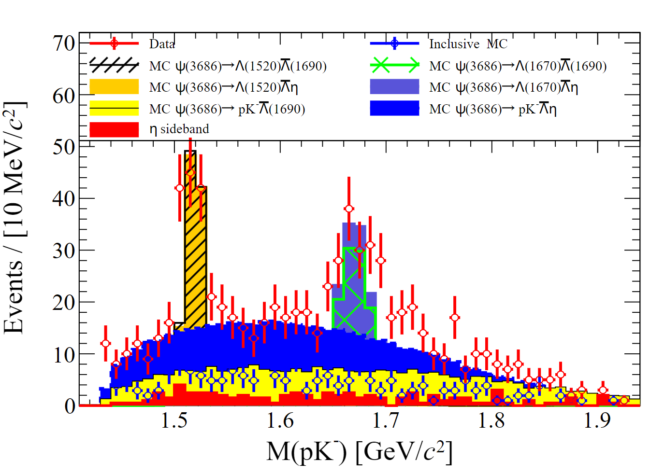
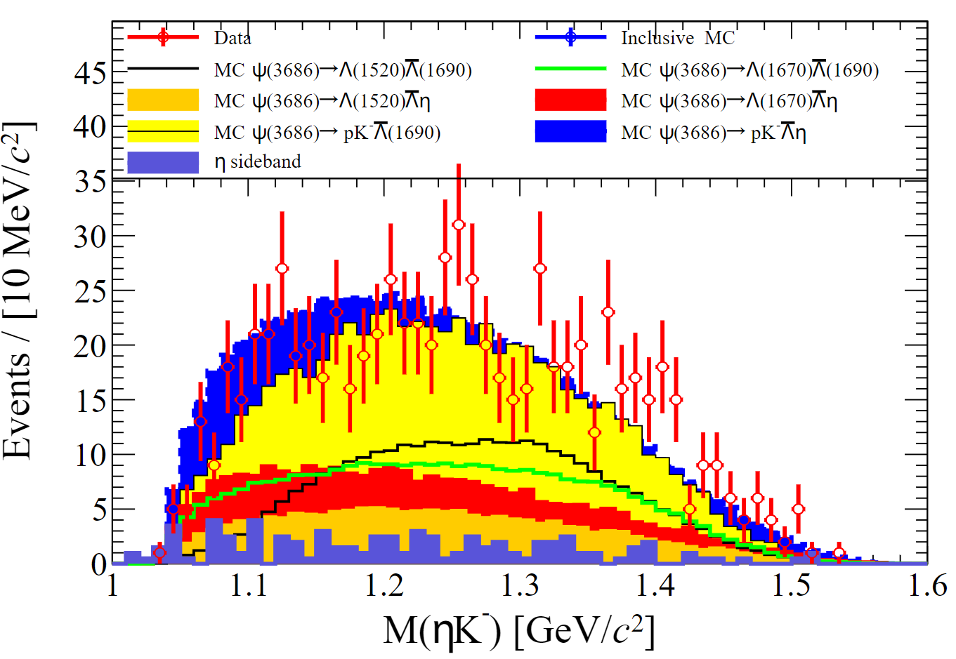
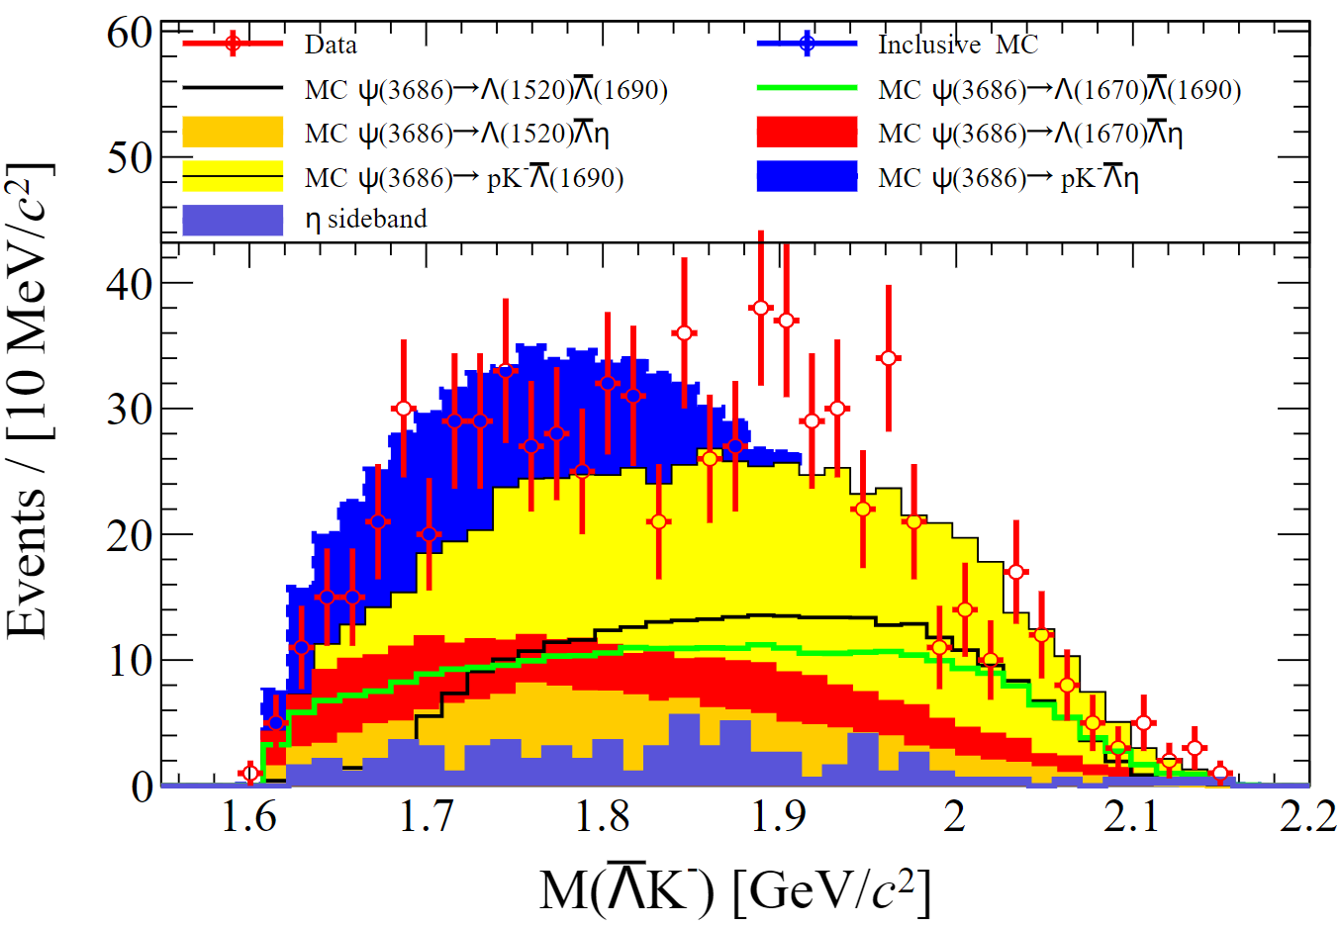
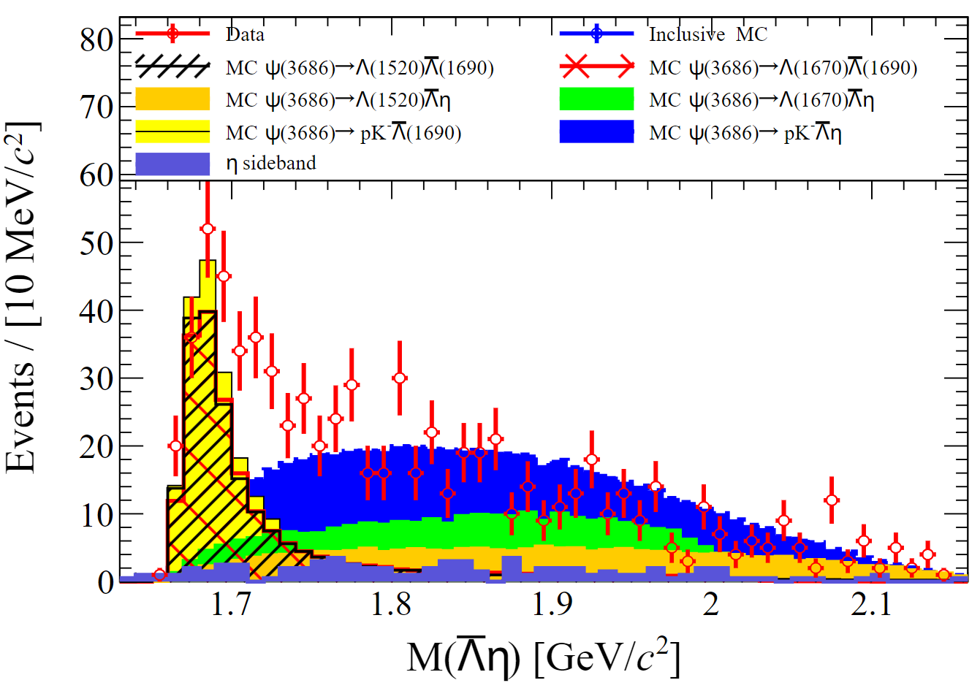
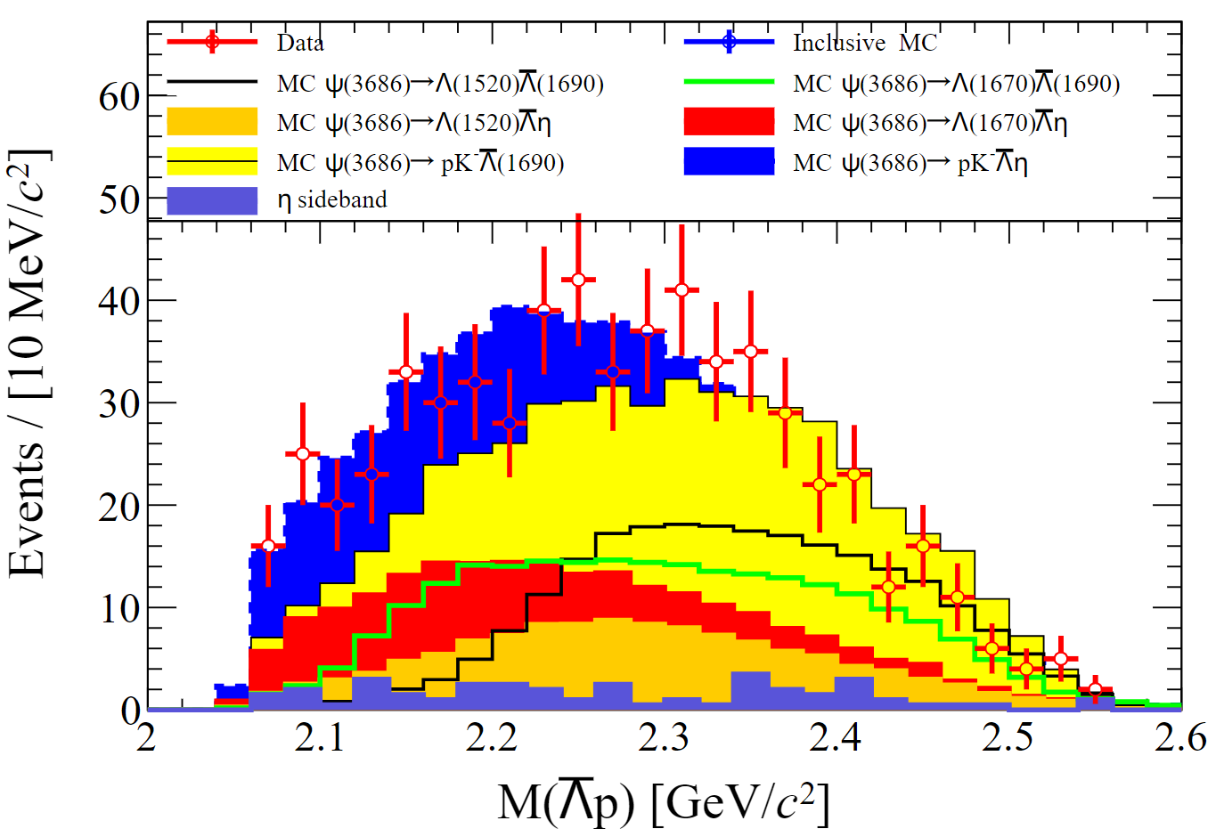
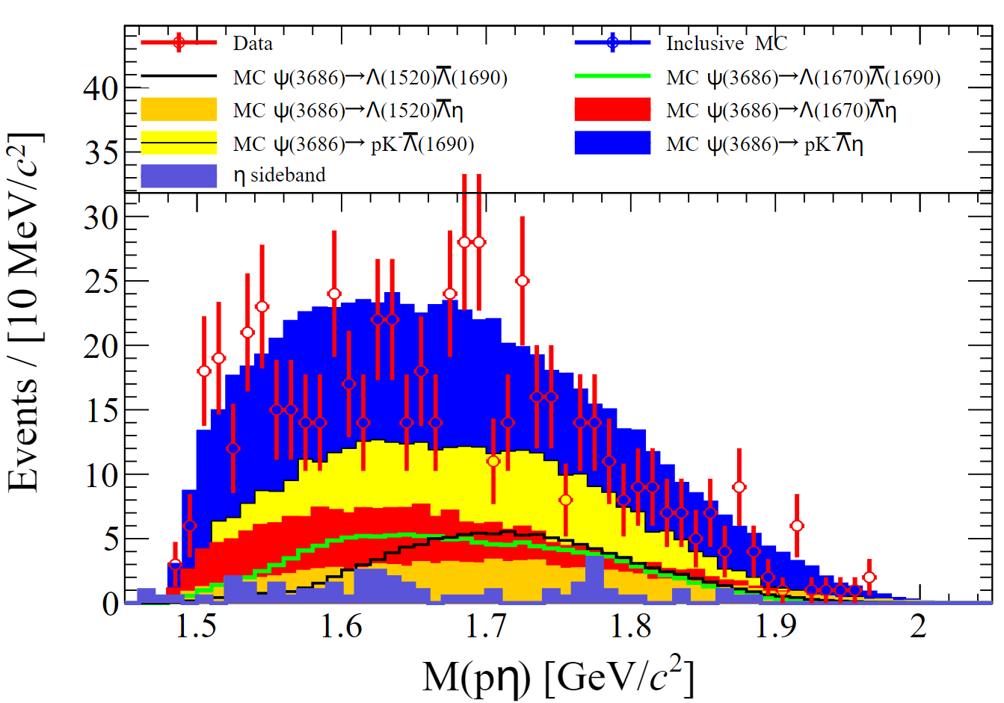
2-body Combinations

Slide 13
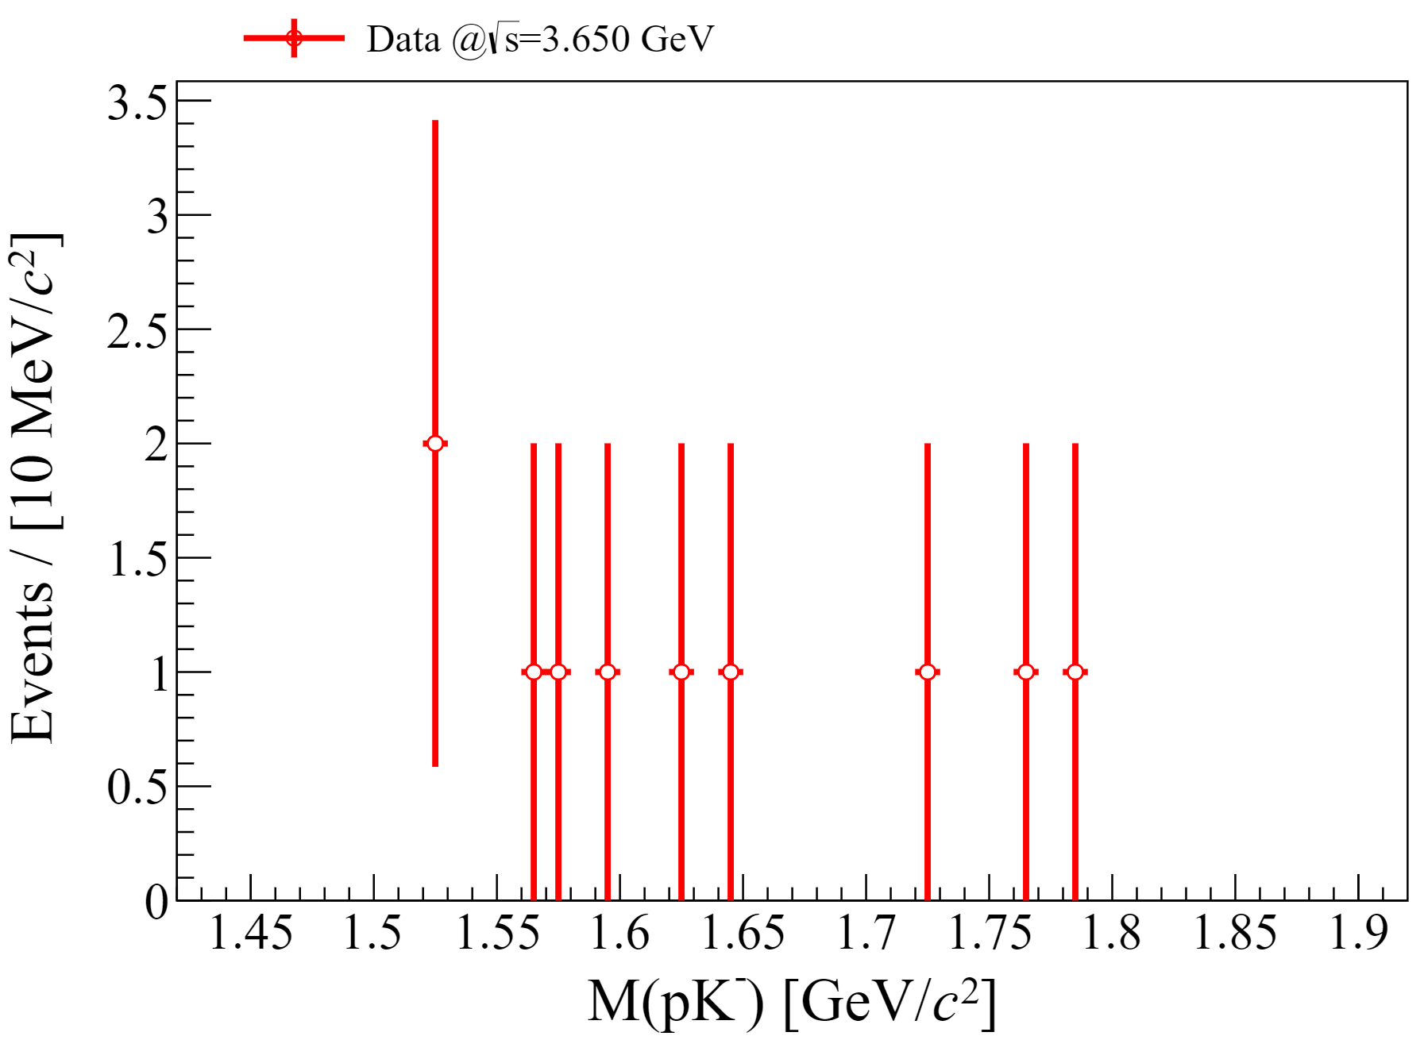
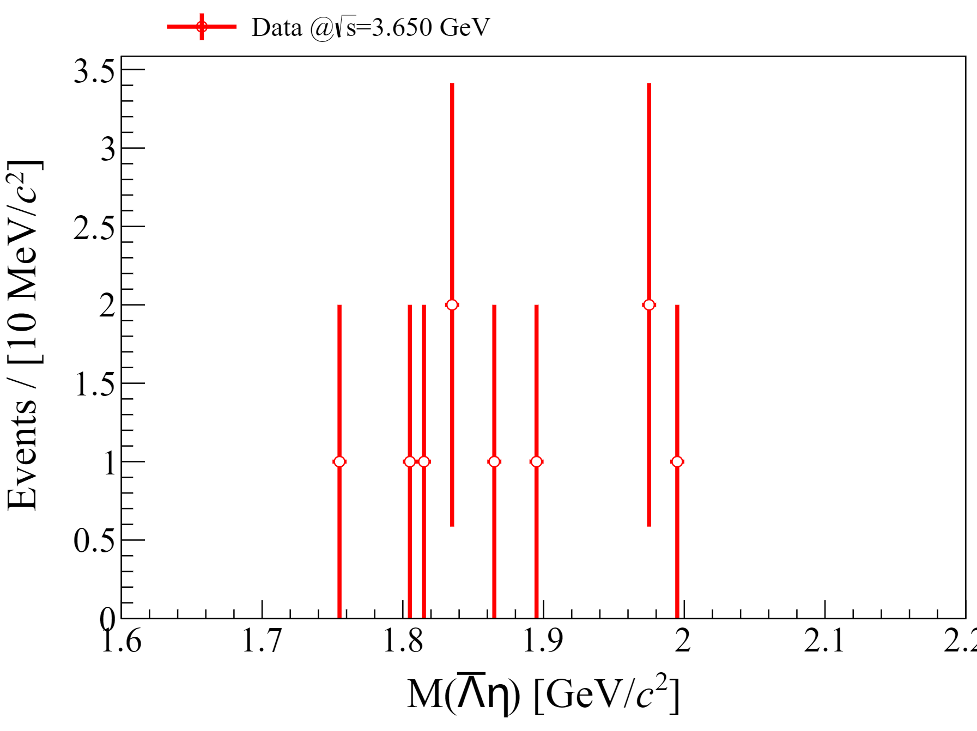
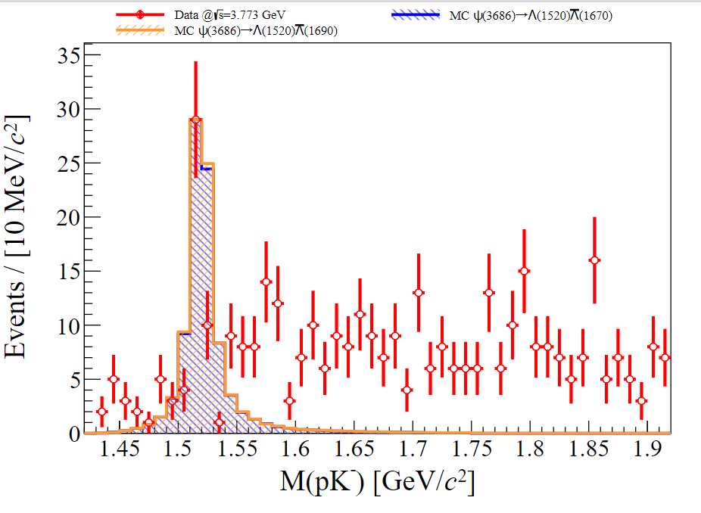
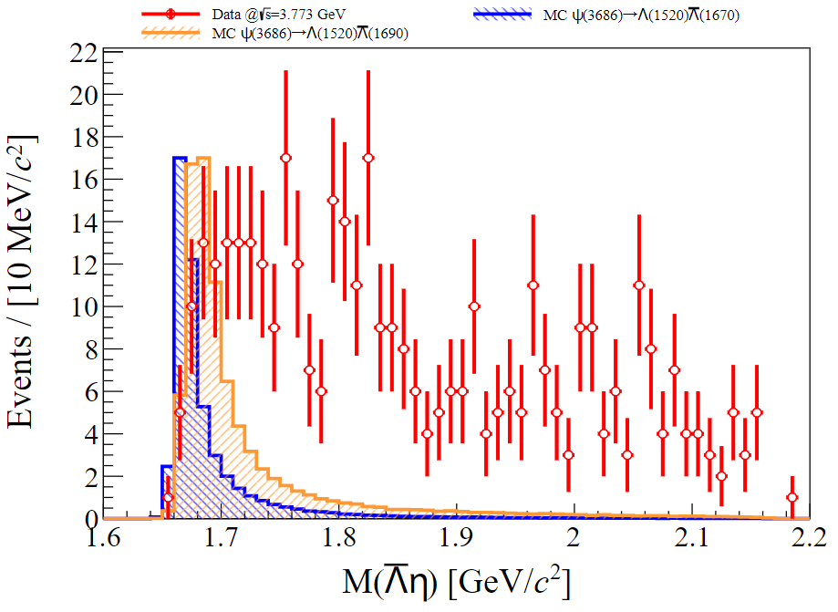
Continuum Background
The background contribution from the CM energy at 3.65 GeV is neglected.
Further consideration will be given to the background
contribution from the data at CM energy of 3.773 GeV.

Slide 14
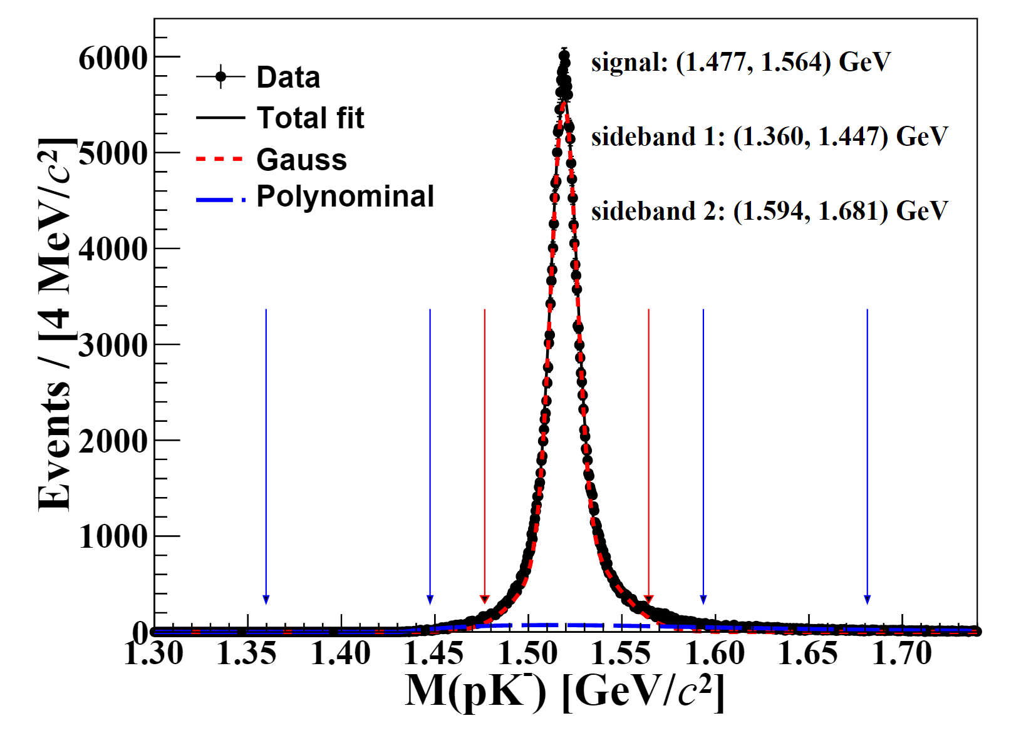
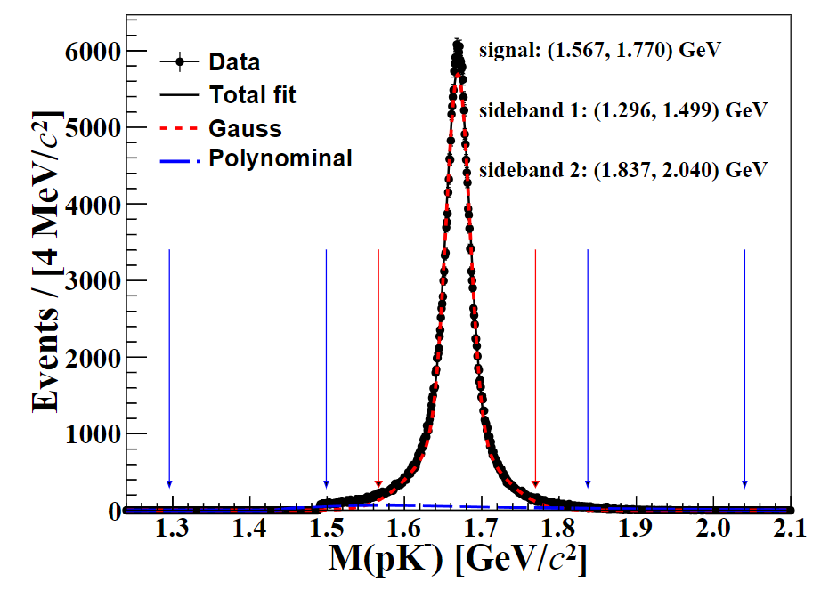
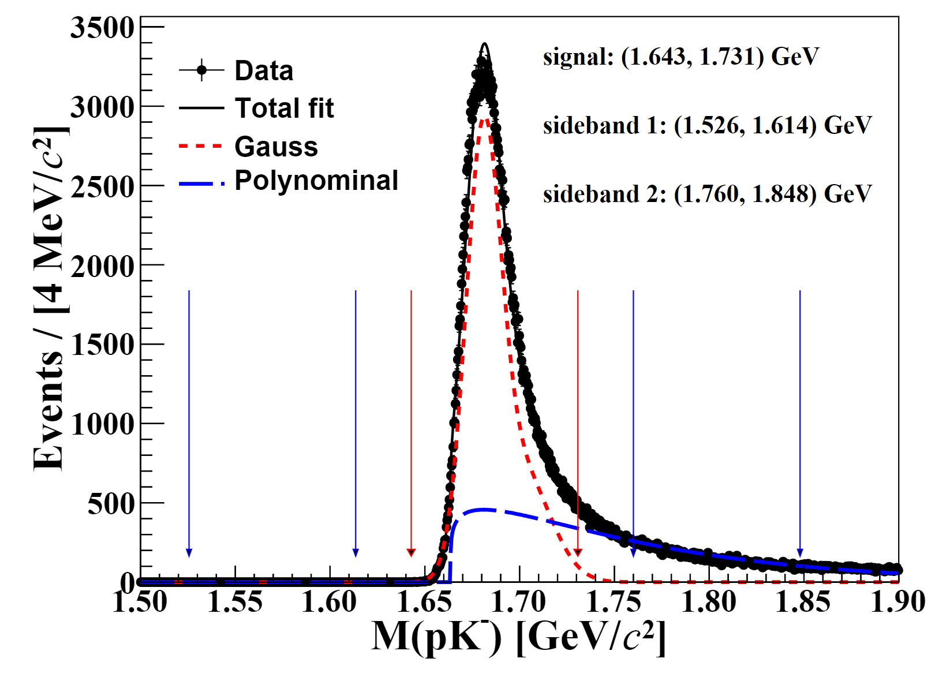
Potential excited states
$$M(ηΛ)$$
$$Λ\left(1520\right)$$
Mass window:(1.477, 1.564)
$$Λ\left(1670\right)$$
Mass window:(1.575, 1.764)
$$Λ\left(1690\right)$$
Mass window:(1.643, 1.731)

Slide 15
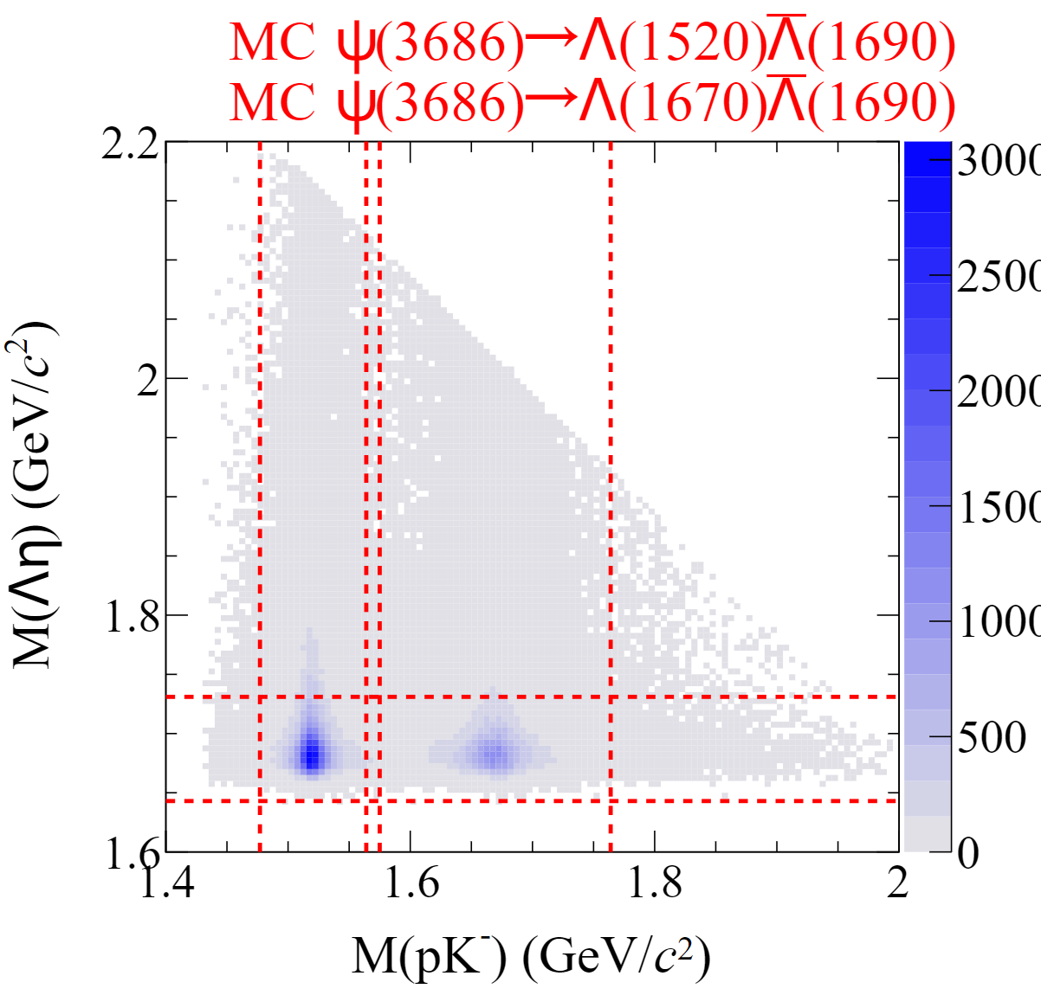
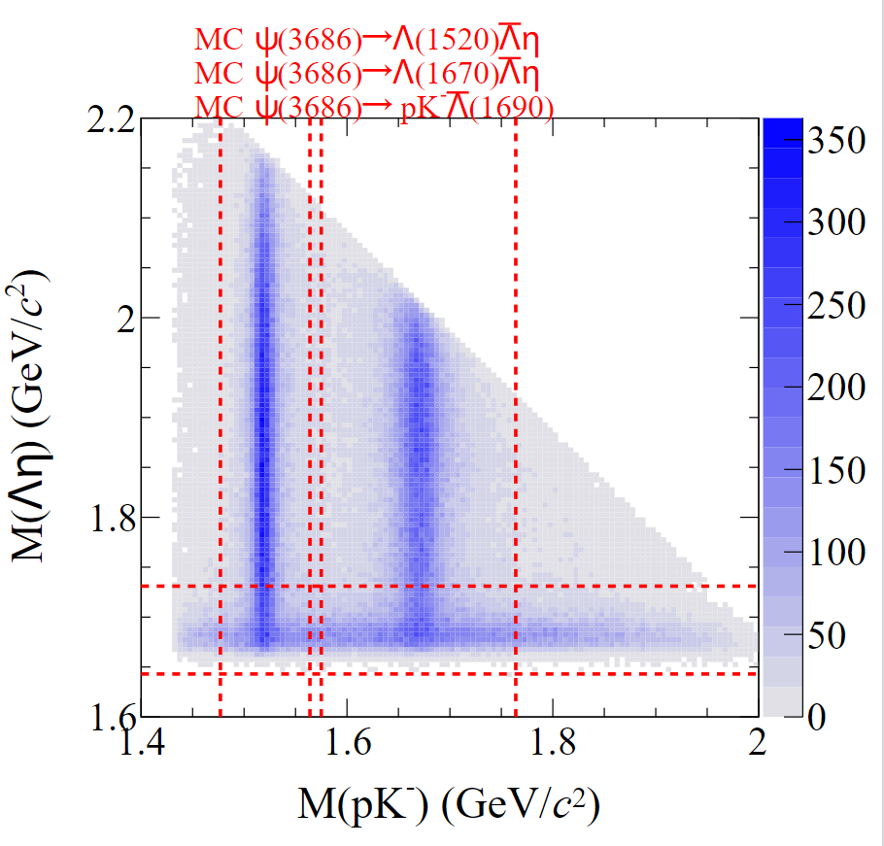
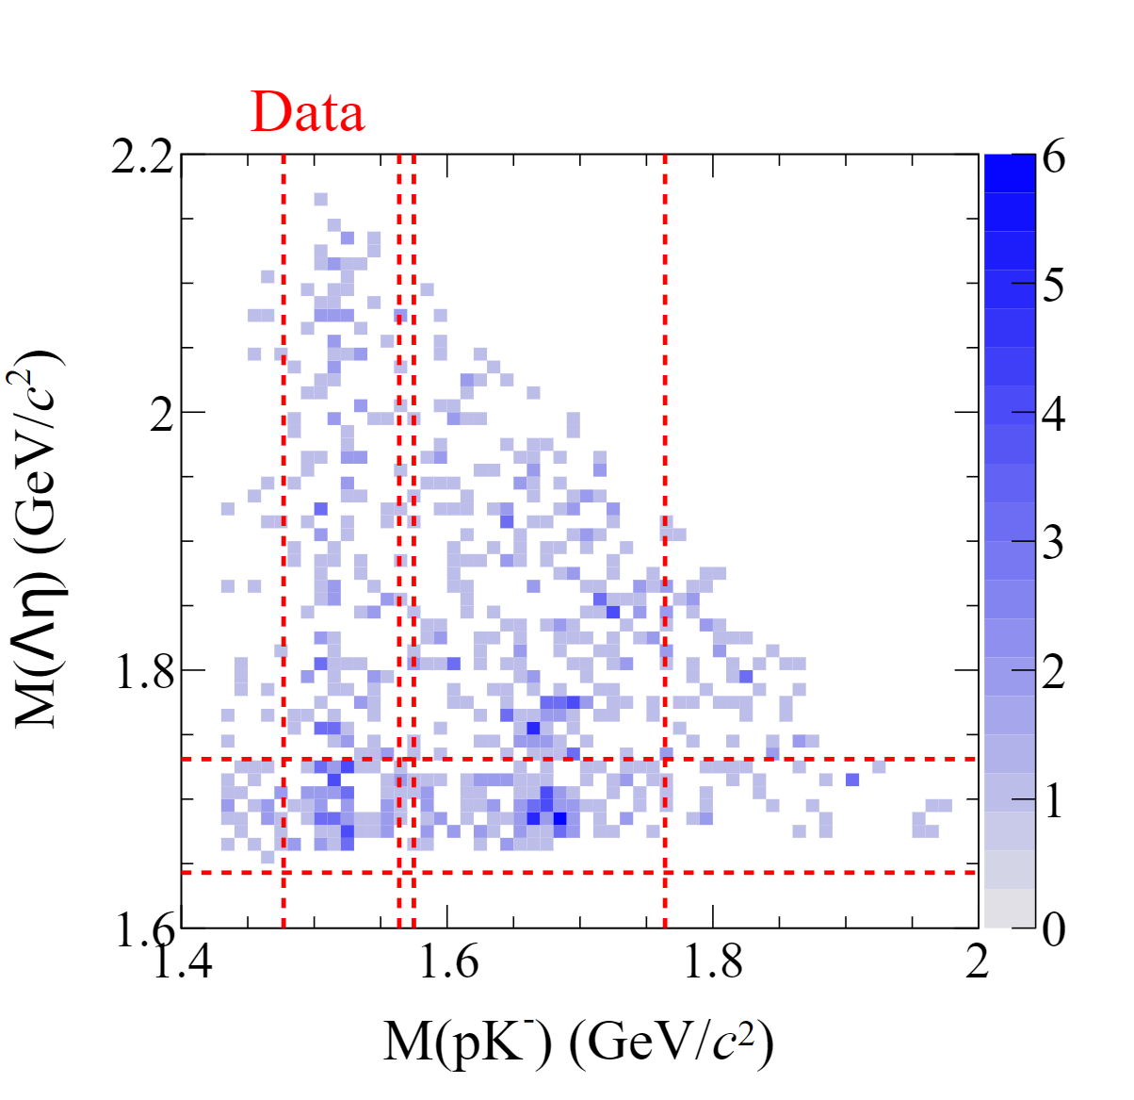
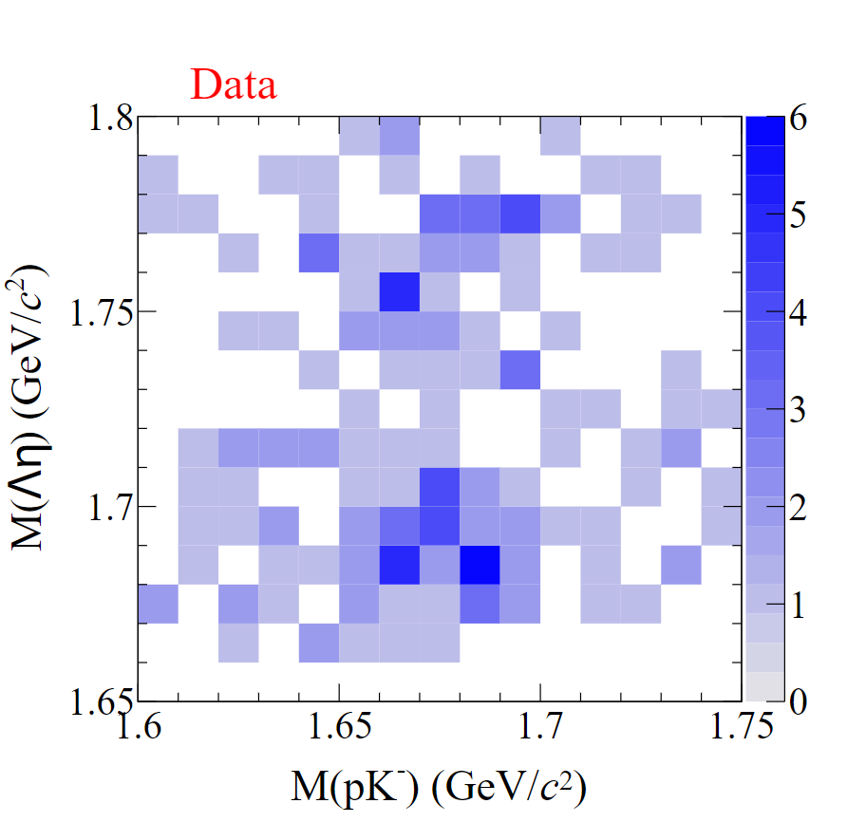
Potential excited states
?
$$Λ(1670)\overline{Λ}(1690)$$

Slide 16
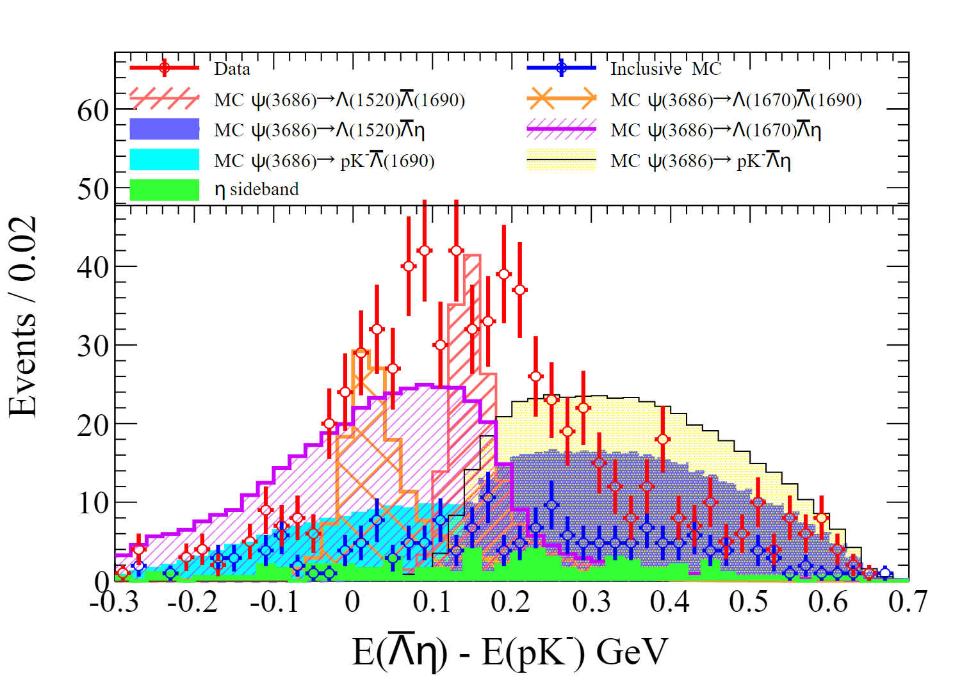
Potential excited states

Slide 17
Signal yields extraction
$$M_{pK}−{ΔE}_{\overline{Λ}η−pK}$$
$$M_{pK}−M_{\overline{Λ}η}$$

Slide 18
Signal yields extraction
Decay mode | $$N_{sig}^{obs}$$
 | $$3D$$ $$(M_{pK}−M_{\overline{Λ}η}−{ΔE}_{\overline{Λ}η−pK})$$ | $$2D$$ $$(M_{pK}−M_{\overline{Λ}η})$$ | $$2D$$ $$(M_{pK}−{ΔE}_{\overline{Λ}η−pK})$$ | $$2D$$ $$(M_{\overline{Λ}η}−{ΔE}_{\overline{Λ}η−pK})$$
$$Λ\left(1520\right)\overline{Λ}\left(1690\right)$$ | 46±11 | 46±11 | 46±11 | 52±13
$$Λ\left(1670\right)\overline{Λ}\left(1690\right)$$ | 79±16 | 79±16 | 76±16 | 77±17
$$Λ\left(1520\right)\overline{Λ}η$$ | 62±14 | 57±14 | 57±14 | 54±15
$$Λ\left(1670\right)\overline{Λ}η$$ | 46±19 | 44±19 | 46±20 | 48±20
$$pK^{−}\overline{Λ}\left(1690\right)$$ | 115±23 | 114±23 | 113±24 | 108±26

Slide 19
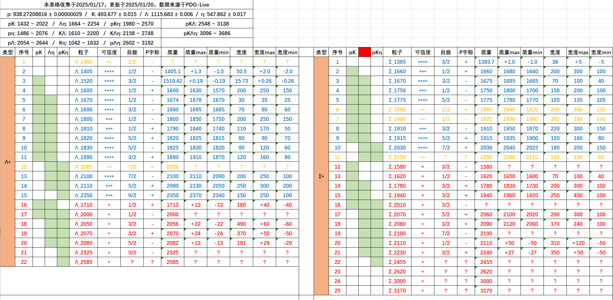
Partial Wave Analysis

Slide 20
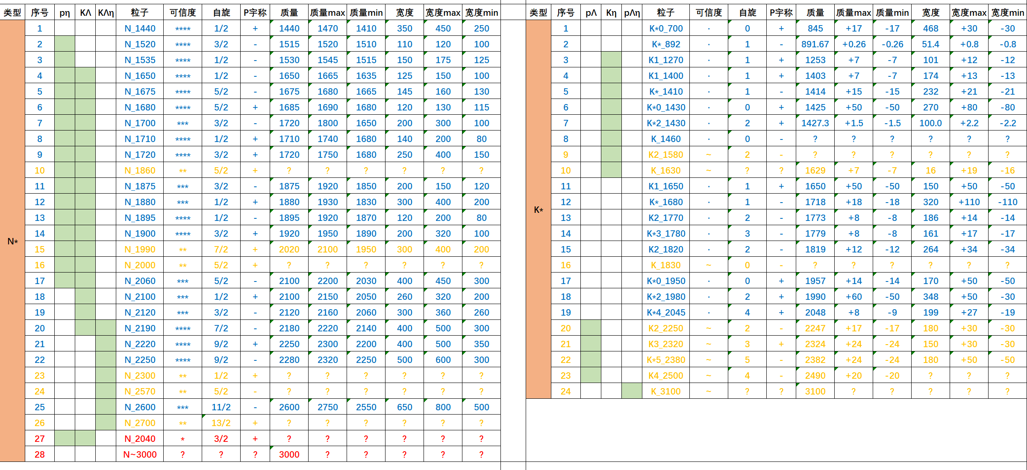
Partial Wave Analysis

Slide 21
Partial Wave Analysis ( i )
pK : Λ_1520 , Λ_1670
Data: 1450 events
Λη : Λ_1670 , Λ_1690, Λ_1800
Background:
inclusive MC (321 events, weight: 0.9874)
+ QED3773 (804 events, weight: 0.200)
≈ 478 events
pΛ : no states > 5σ
pη : no states > 5σ
KΛ : N_1880
Kη : no states > 5σ

Slide 22
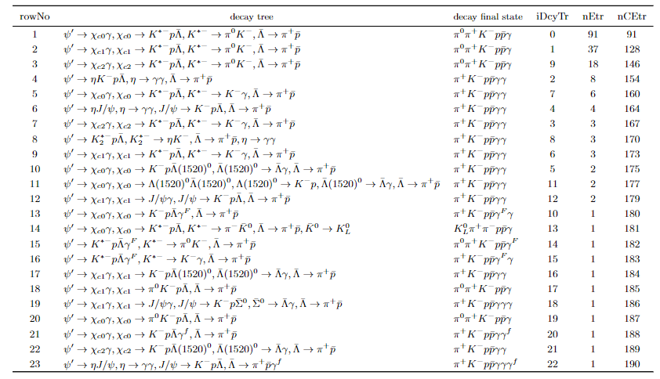
Background from inclusive MC ( i )

Slide 23
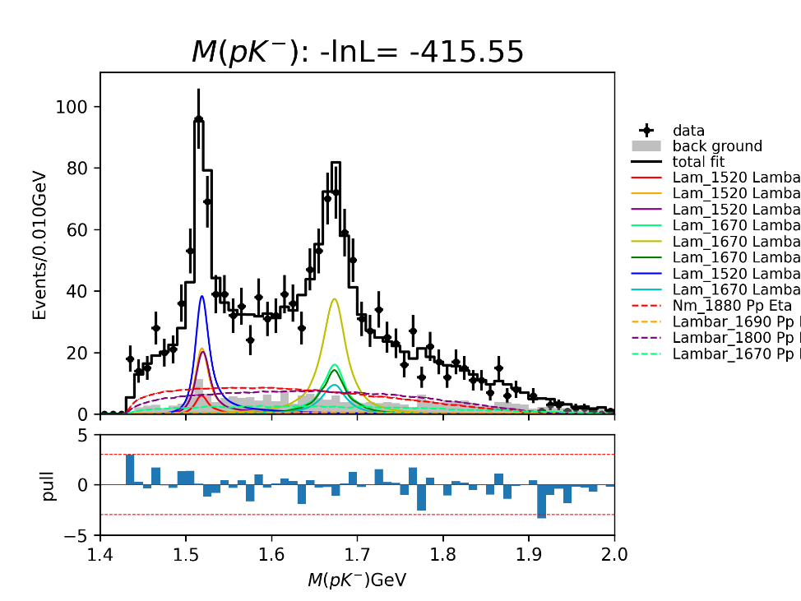
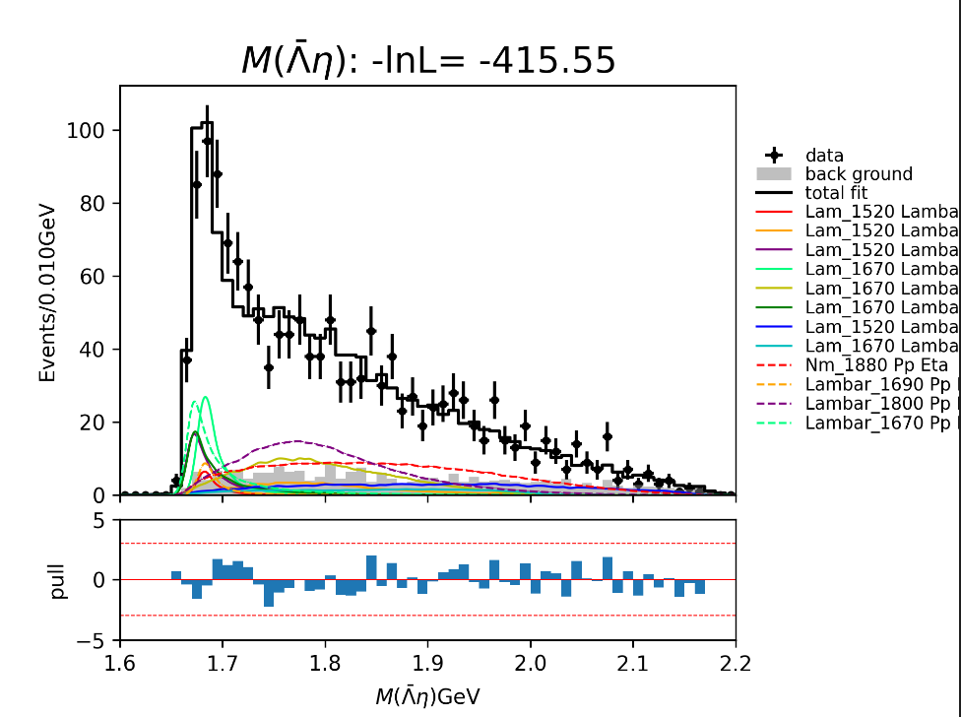
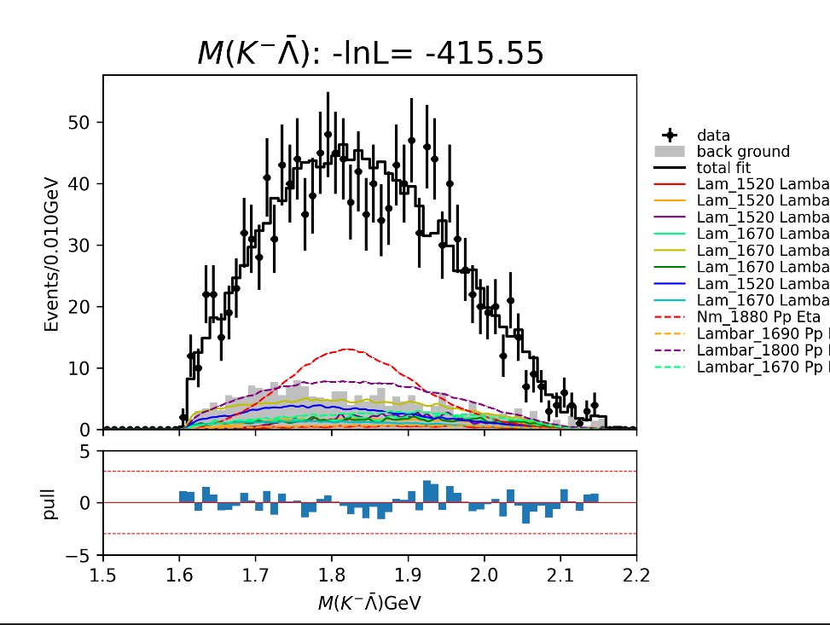
Partial Wave Analysis ( i )
Λ_1520
Λ_1670
Λ_1670 : 8.61 σ
Λ_1690
Λ_1800 : 22.34 σ
N_1880 : 6.41 σ

Slide 24
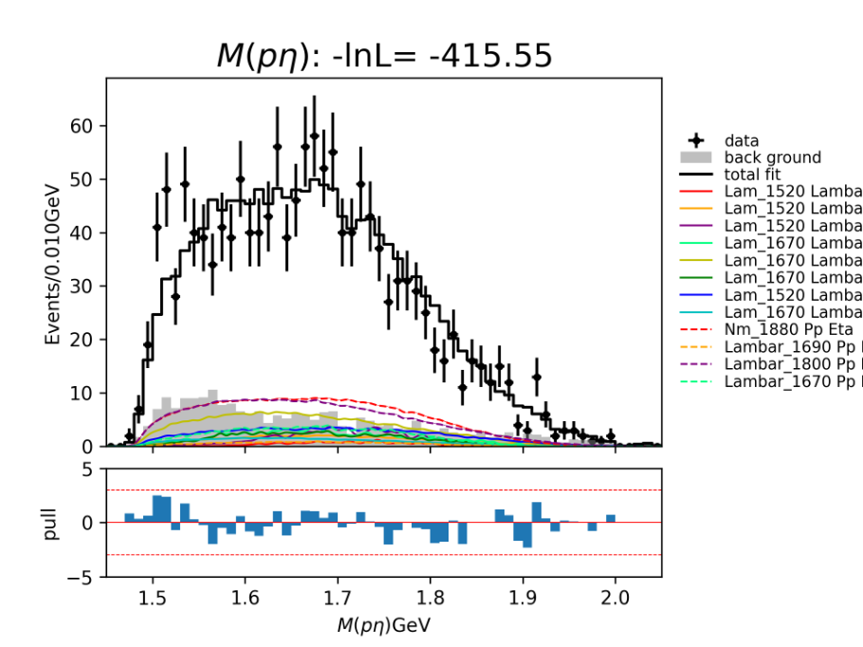
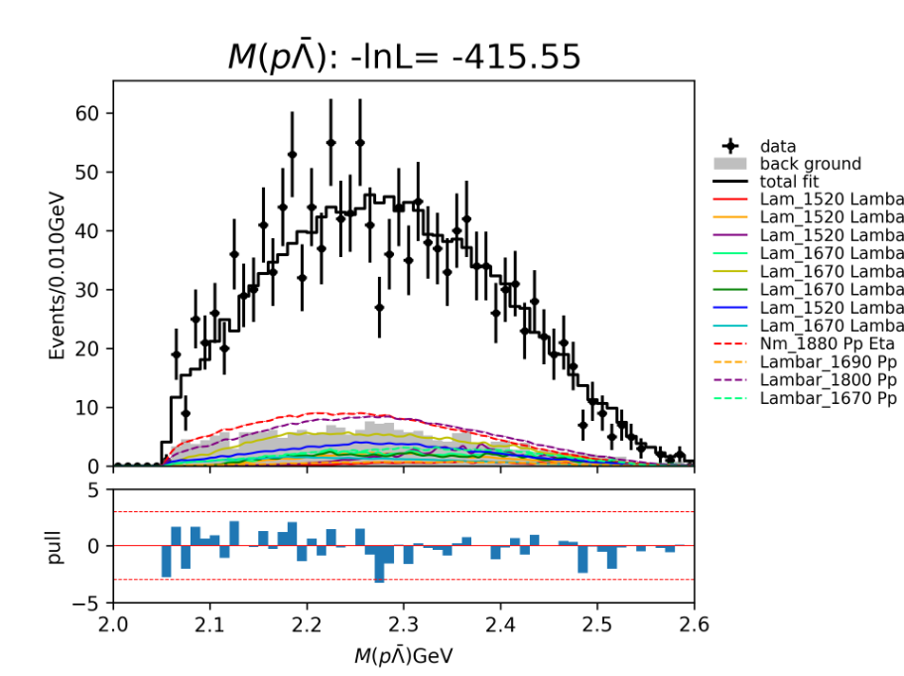
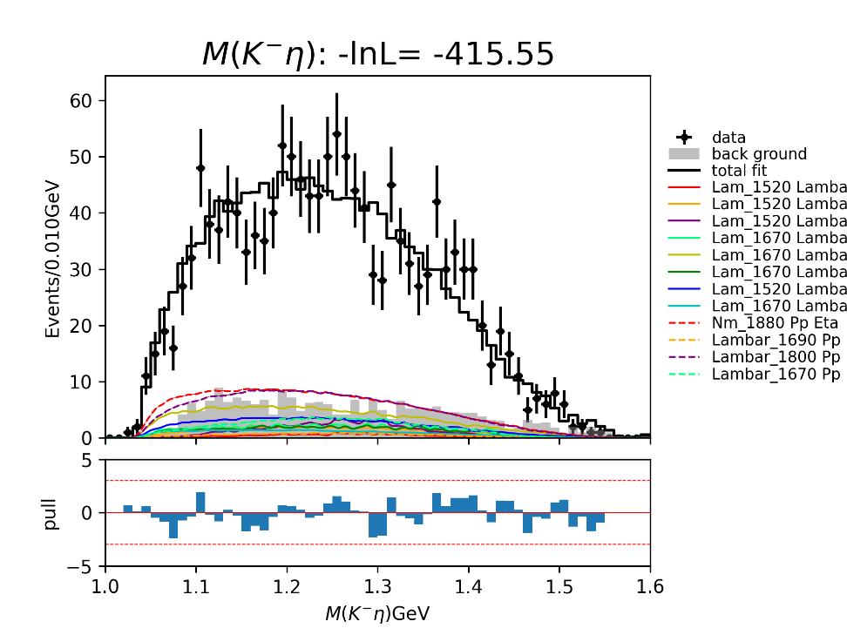
Partial Wave Analysis ( i )
no states > 5σ

Slide 25
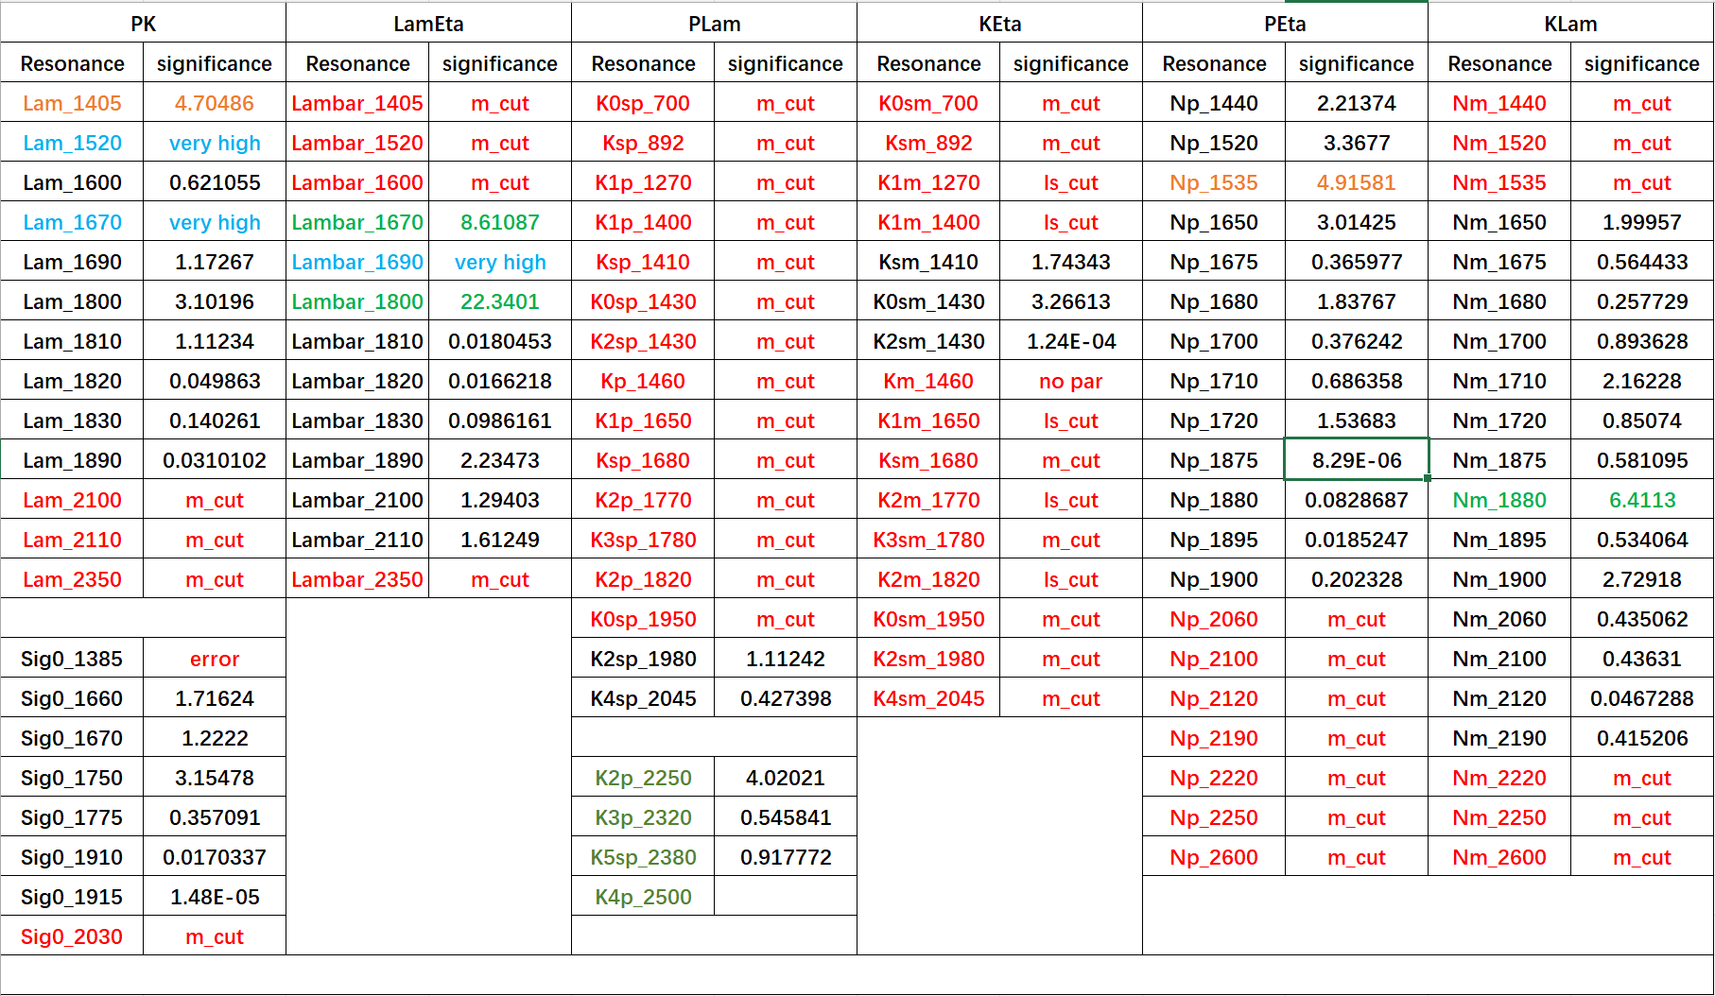
Partial Wave Analysis ( i )

Slide 26
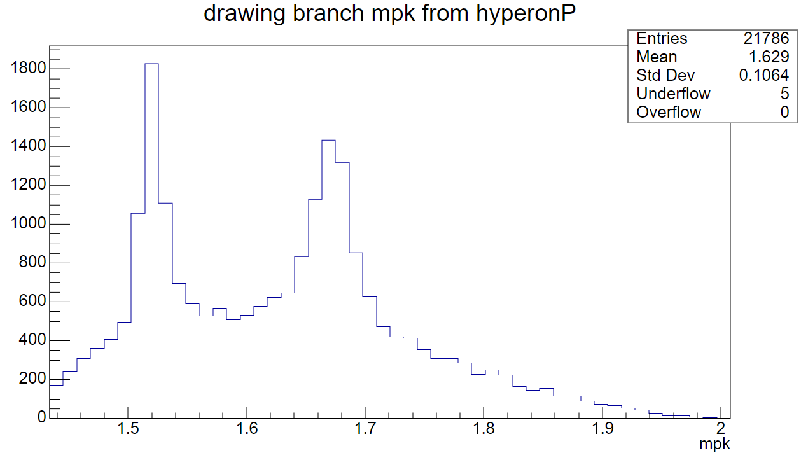
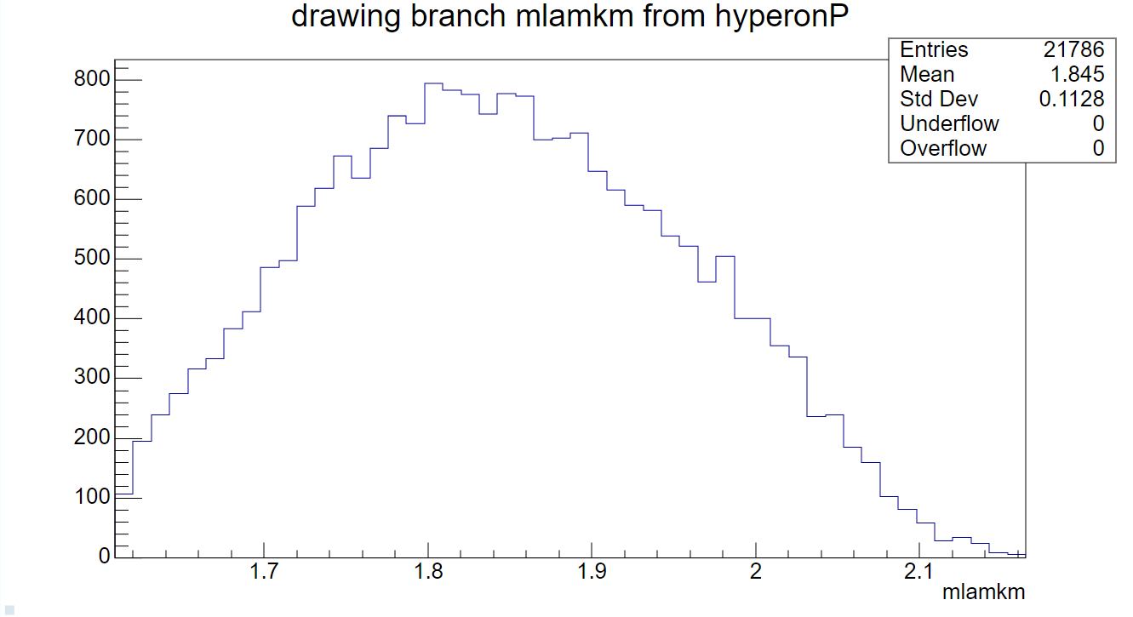
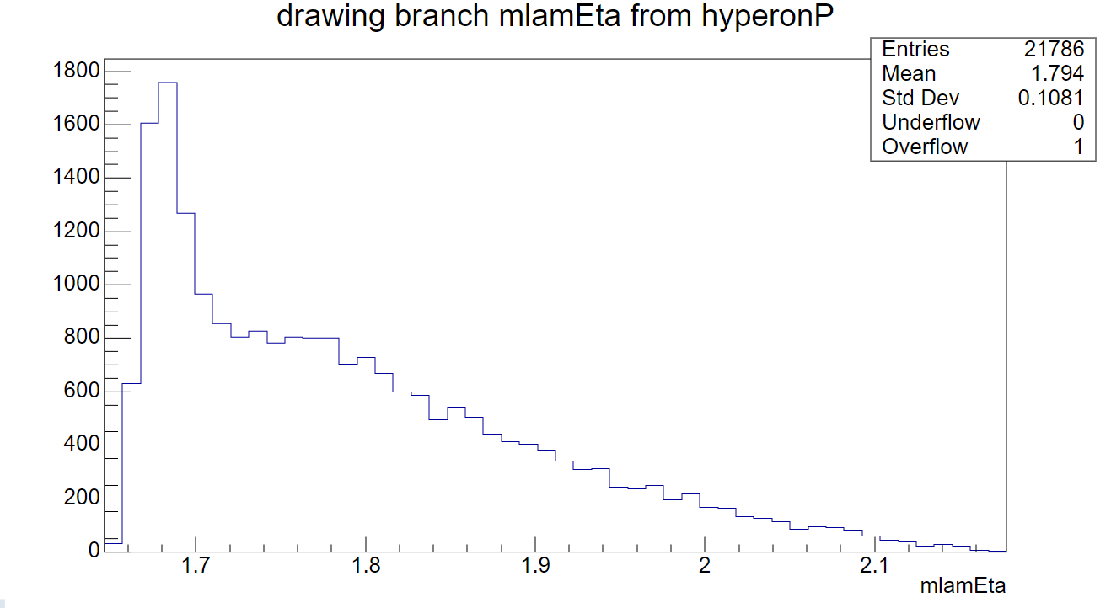
Toy MC from PWA ( i )

Slide 27
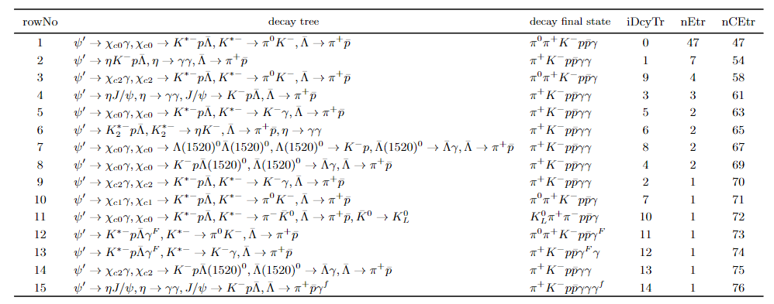
Background from inclusive MC ( ii )

Slide 28
Partial Wave Analysis ( ii )
pK : Λ_1520 , Λ_1670
Data: 1062 events
Λη : Λ_1670 , Λ_1690, Λ_1800
Background:
inclusive MC (107 events, weight: 0.9687)
+ QED3773 (624 events, weight: 0.200)
≈ 228 events
pΛ : no states > 5σ
pη : no states > 5σ → N_1535
KΛ : N_1880 → no states > 5σ
Kη : no states > 5σ

Slide 29
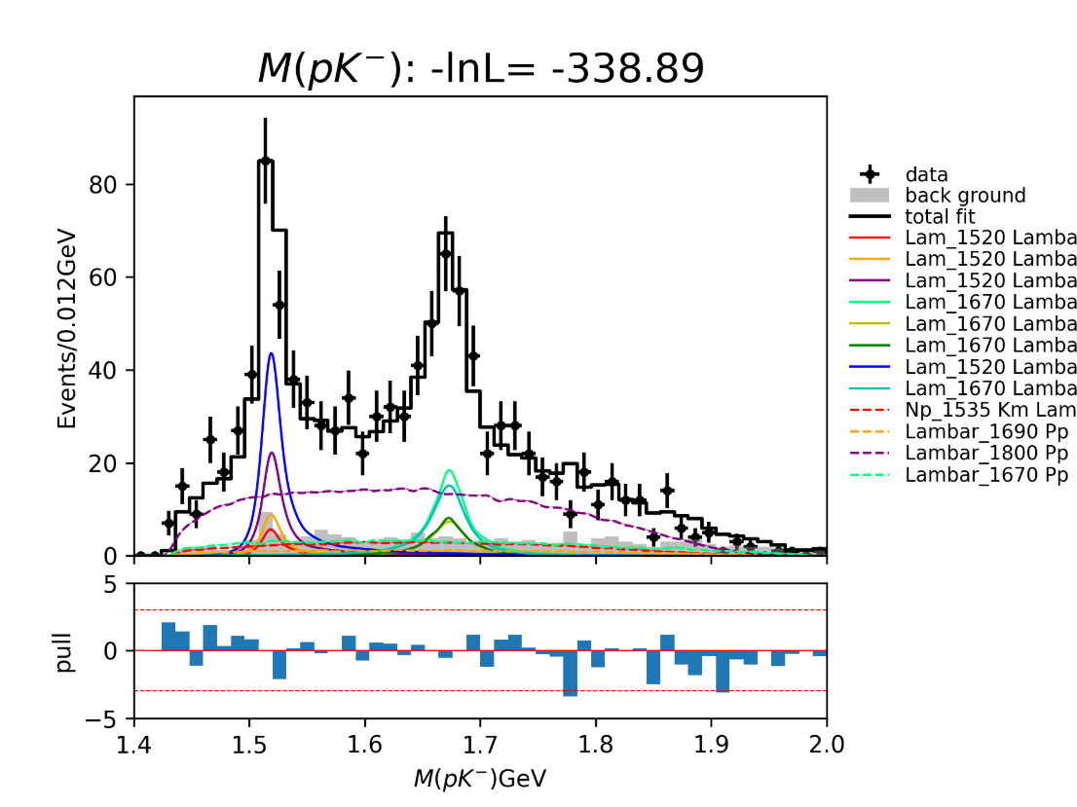
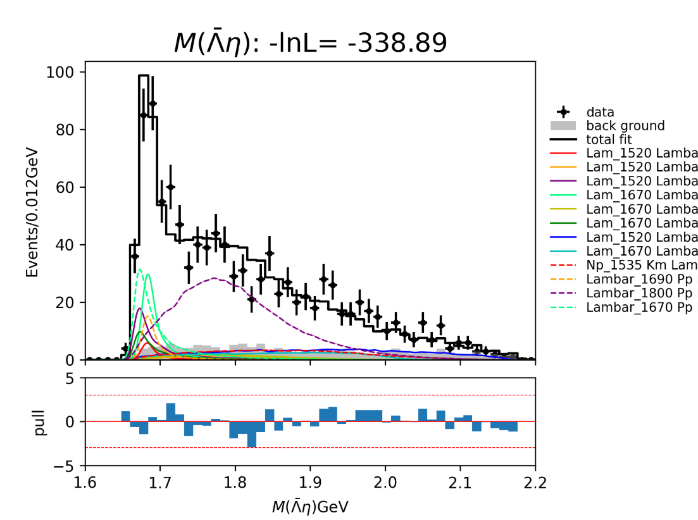
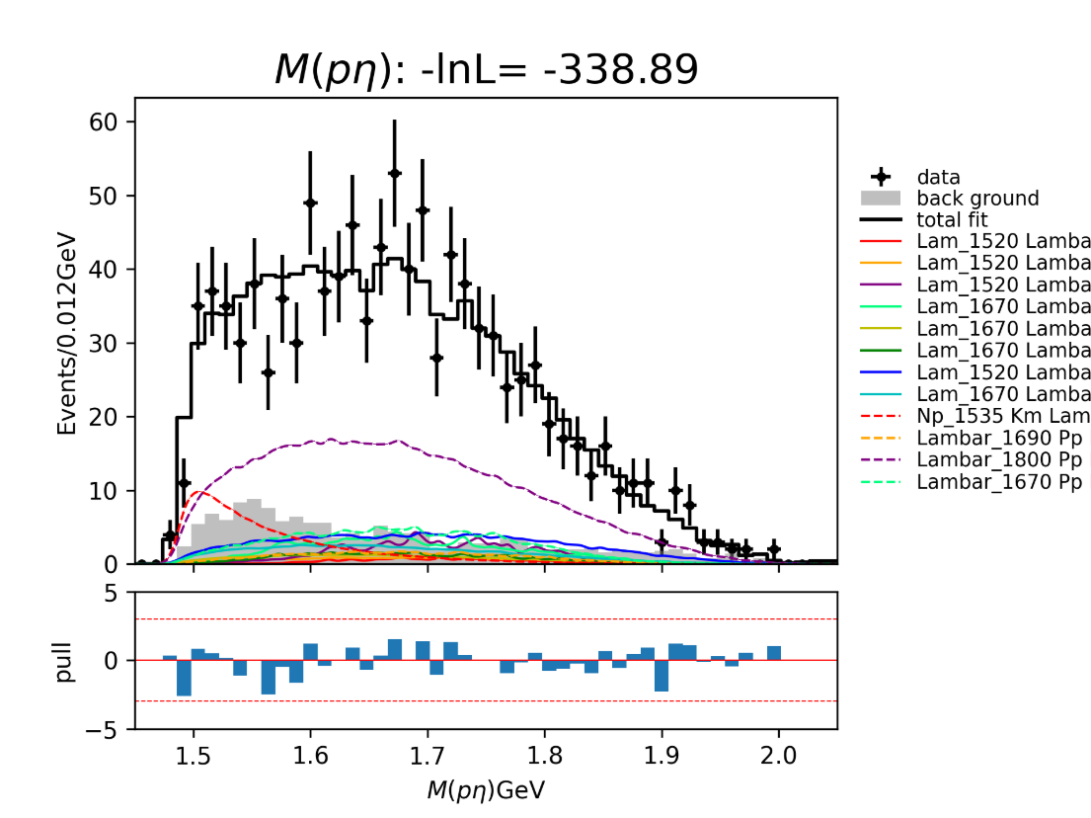
Partial Wave Analysis ( ii )
Λ_1520
Λ_1670
Λ_1670 : 6.87 σ
Λ_1690
Λ_1800 : 19.72 σ
N_1535 : 5.15 σ

Slide 30
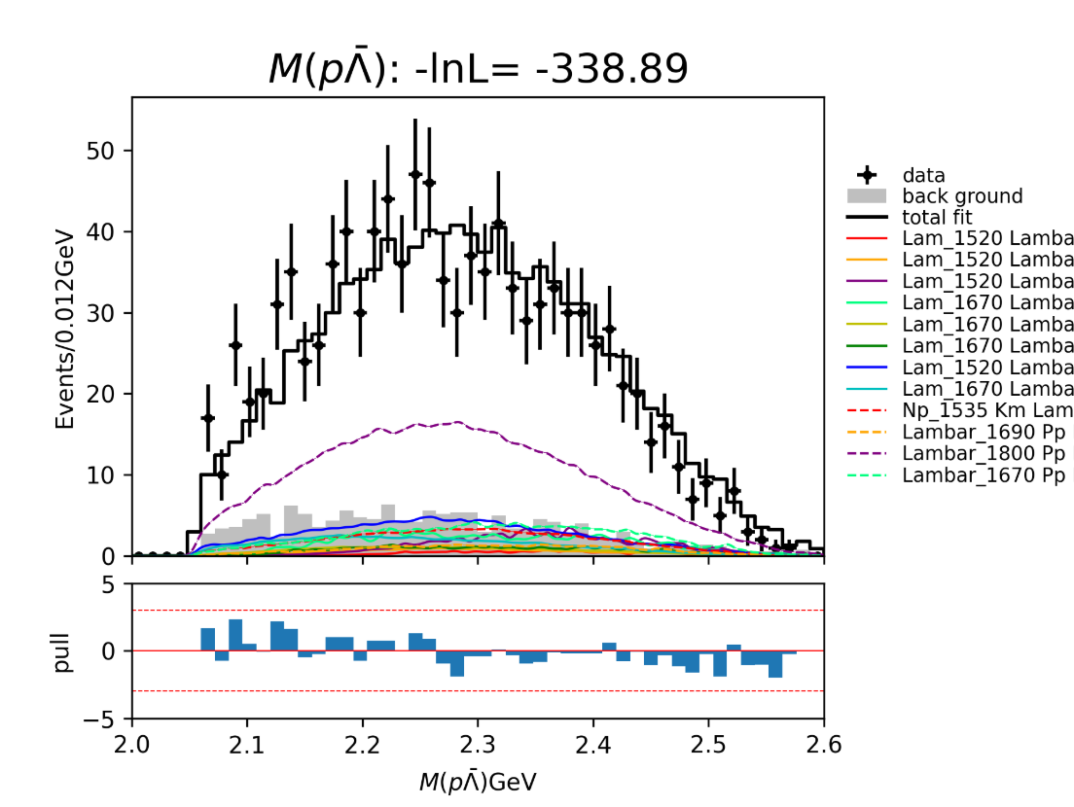
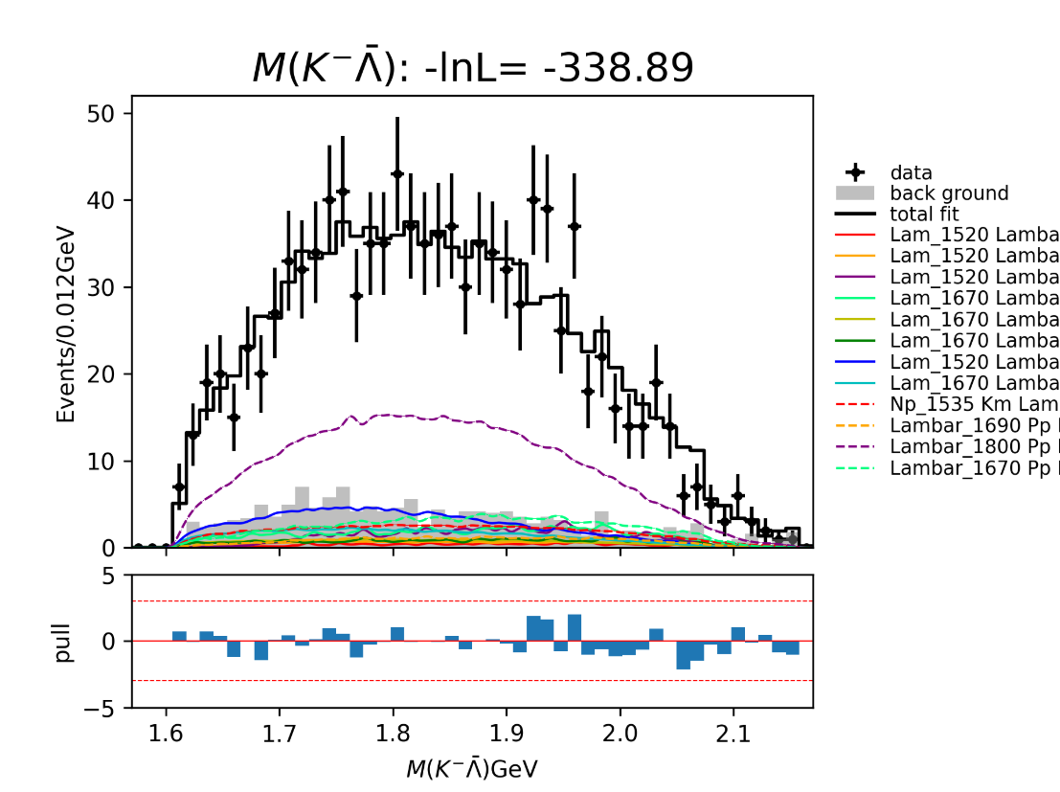
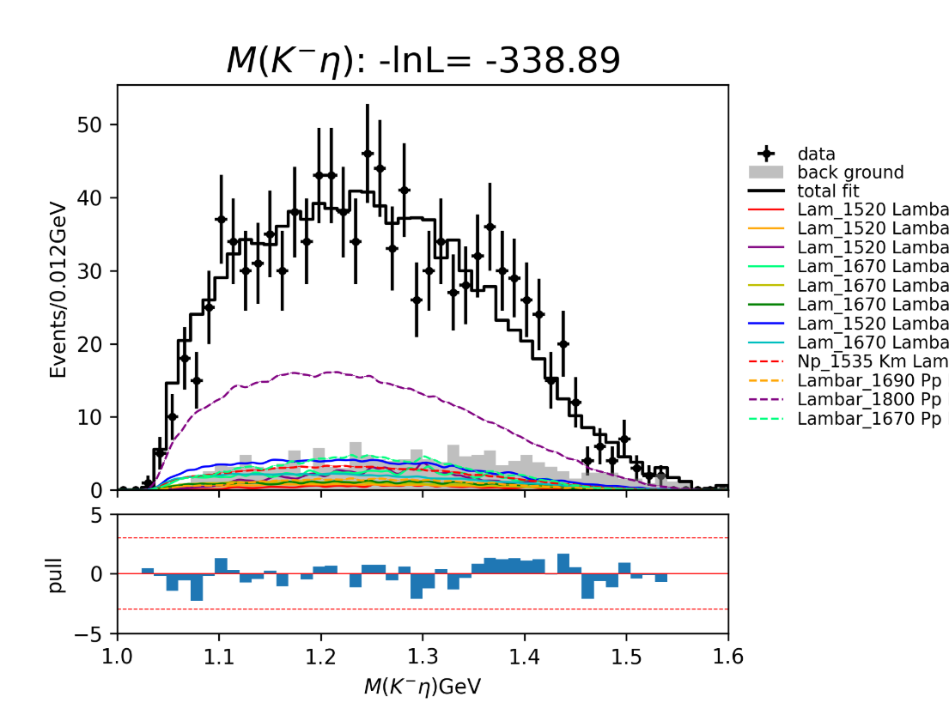
Partial Wave Analysis ( ii )
no states > 5σ

Slide 31
Next to do
Fit mass spectrum of $η$
Partial Wave Analysis

