Slide 1
Study of $ψ(3686)→p\overline{p}ηη$

Slide 2
行业PPT模板http://www.1ppt.com/hangye/
1
Motivation
2
Data sets and MC samples
CONTENTS
3
General event selection
4
Background study
5
Preliminary result

Slide 3
Motivation

Slide 4
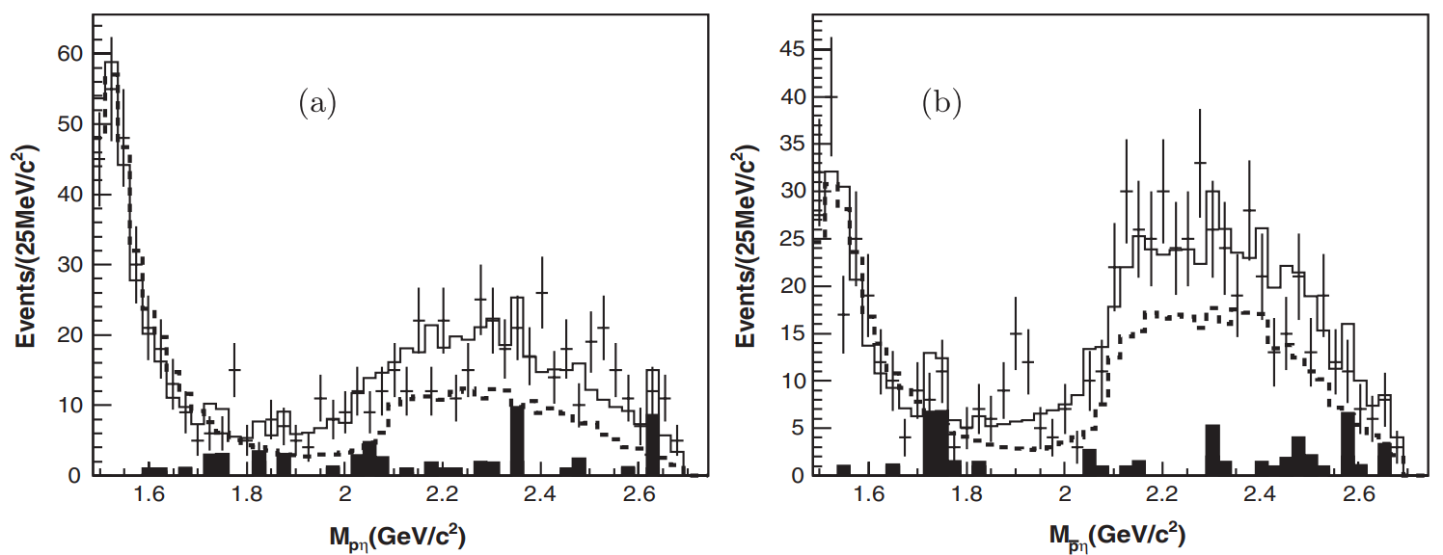
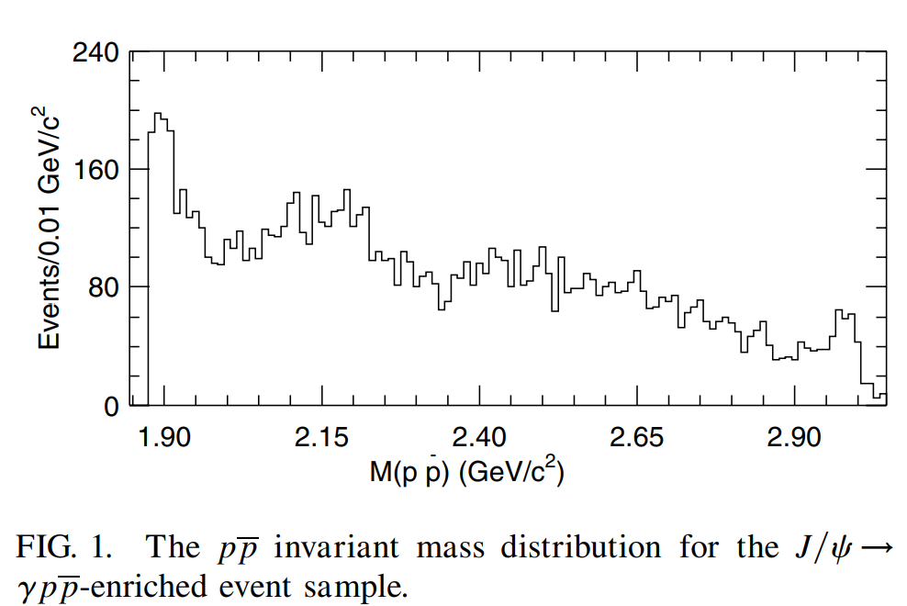
Search for possible excited baryon states consisting of $Nη.$
Serach for the potential excited baryons $N^{∗}$.
$N(1535),$ as $J^{P}={\frac{1}{2}}^{−}$ state, is observed as a state with mass expected in quark model, but its large decay branching fraction to $Nη$ is unexpected.
Search for possible $p\overline{p}$ threshold enhancement of $p\overline{p}$ like $X(1835)$.
Measure the braching fraction $Br(ψ(3686)⟶p\overline{p}ηη )$.
M. Ablikim et al. [BESIII Collaboration], Phys. Rev. D 88, 032010 (2013)
J. Z. Bai et al. [BES Collaboration], Phys. Rev. Lett. 91, 022001 (2003).

Slide 5
Data sets and MC samples

Slide 6
Dataset |  | Number of events | BOSS Version
$ψ(3686)$ Data |  | $$2.708×{10}^{9}$$ | 709
$ψ(3686)$ Inclusive MC |  | $$2.806×{10}^{9}$$
PHSP | $$ψ(3686)⟶p\overline{p}ηη$$ | 3.0 million of each channel
 | $$ψ(3686)⟶\overline{N}(1535)pη, \overline{N}(1535)⟶\overline{p}η$$
 | $$ψ(3686)⟶N(1535)\overline{p}η, N(1535)⟶pη$$
 | $$ψ(3686)⟶\overline{N}(1650)pη, \overline{N}(1650)⟶\overline{p}η$$
 | $$ψ(3686)⟶N(1650)\overline{p}η, N(1650)⟶pη$$
 | $$ψ(3686)⟶\overline{N}(1535)N(1535),$$ $$\overline{N}(1535)⟶\overline{p}η, N(1535)⟶pη$$
 | $$ψ(3686)⟶\overline{N}(1650)N(1650),$$ $$\overline{N}(1650)⟶\overline{p}η, N(1650)⟶pη$$

Slide 7
General event selection

Slide 8
Particle identification
- Prob($p$)> Prob($π$), Prob($p$)> Prob($K$)
- $N_{p}=1,N_{\overline{p}}=1$, vertex fit for $p$, $\overline{p}$
Charged tracks
- $\left|V_{r}\right|<1cm, \left|V_{z}\right|<10cm$
- $\left|cosθ\right|<0.93$
- $N_{m}=1, N_{P}=1$
4C kinematic fit with $ψ(3686)→4γp\overline{p}$
- Constraints on four momentum.
Good photon
- $0≤TDC≤14$
- Barrel :$E>25 MeV, \left|cosθ\right|<0.8$
- End cap :$E>50 MeV, 0.86<\left|cosθ\right|<0.92$
- $N_{γ}$ $≥$ 4
How to distinguish 4$γ$
- Minimum $∆M:$
$∆M=\sqrt{{(M_{γ_{1}γ_{2}}−m_{η})}^{2}+{(M_{γ_{3}γ_{4}}−m_{η})}^{2}}$

Slide 9
Background
study

Slide 10
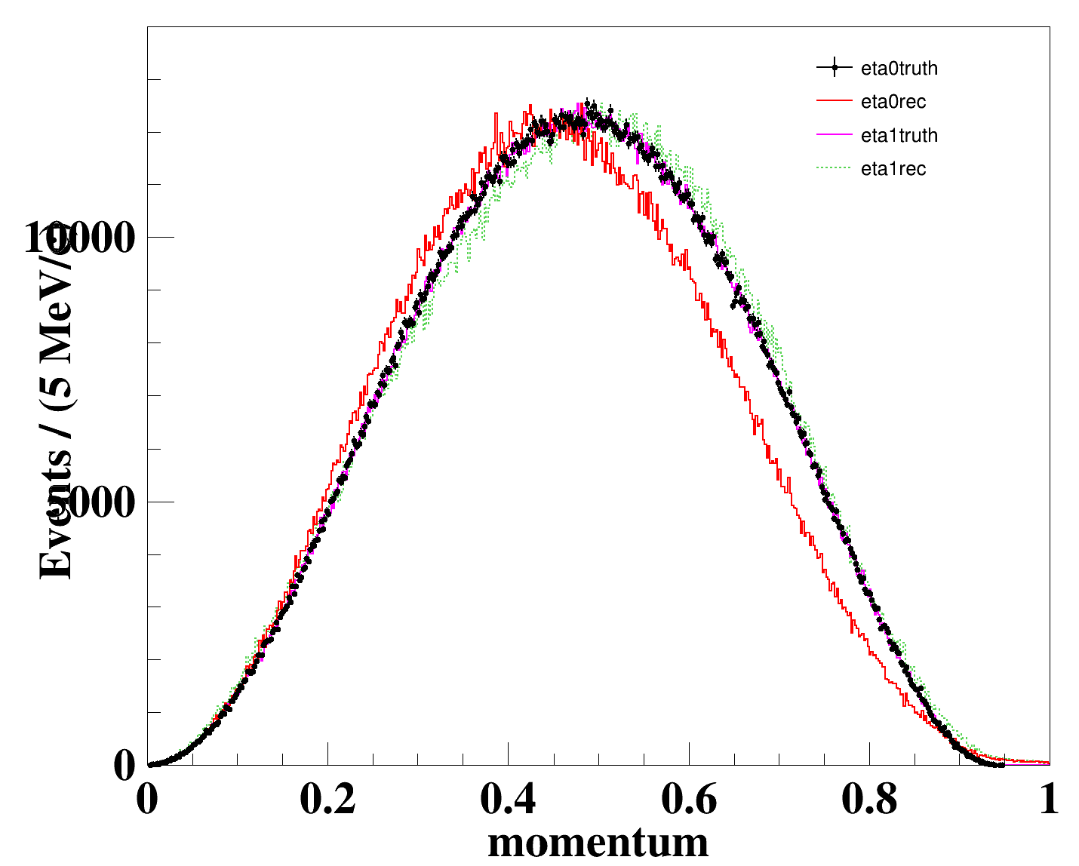
The momentum distribution between the "truth level" and the reconstructed of $η_{1}$and $η_{2}$

Slide 11
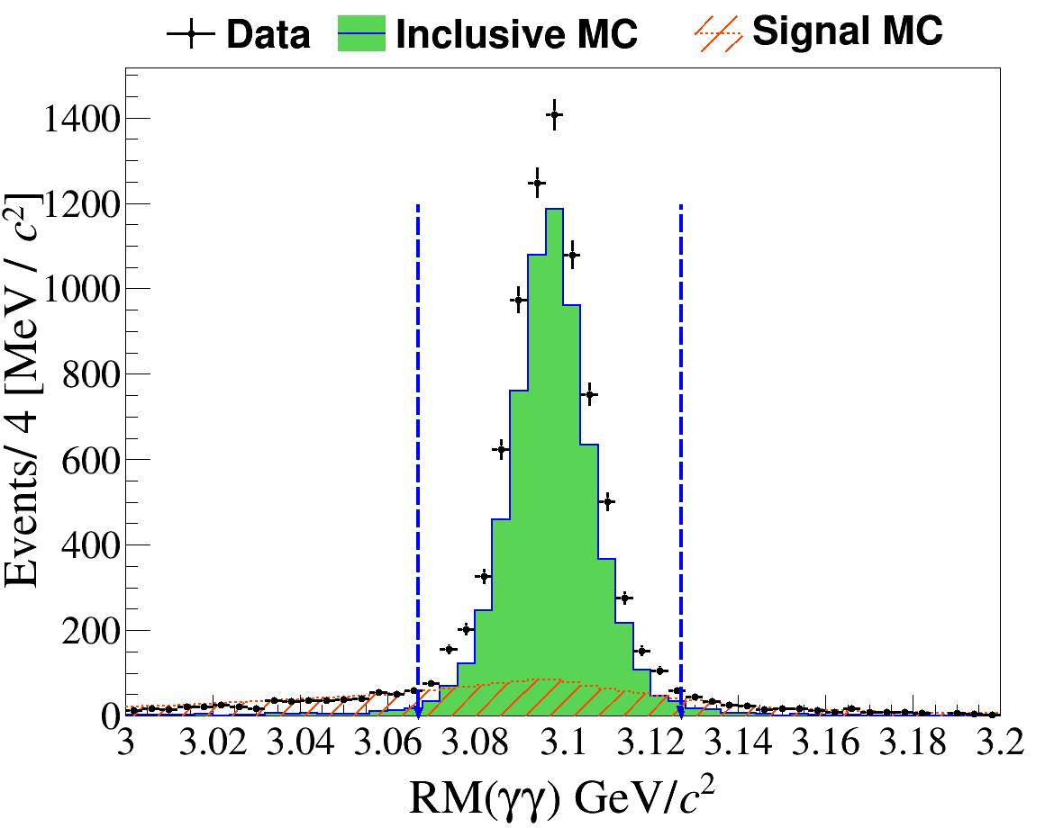
J/Psi
Mode | Decay Chain
$$ψ (3686) → γγJ/ψ$$ | $$ψ (3686) → γγJ/ψ$$
 | $$ψ (3686) → γχcJ,$$ $$χcJ → γJ/ψ$$
 | $$ψ (3686) → π^{0}J/ψ,$$ $$π^{0}→ γγ$$
 | $$ψ 3686 → ηJ/ψ,$$ $$η → γγ$$
• In the six combinations of $RM(γγ)$, we select the one by minimizing
$$Δ = \sqrt{{({RM}_{γγ}−m_{J/ψ})}^{2}}$$
• $|({RM}_{γγ}−m_{J/ψ})|>30MeV/c^{2}$

Slide 12
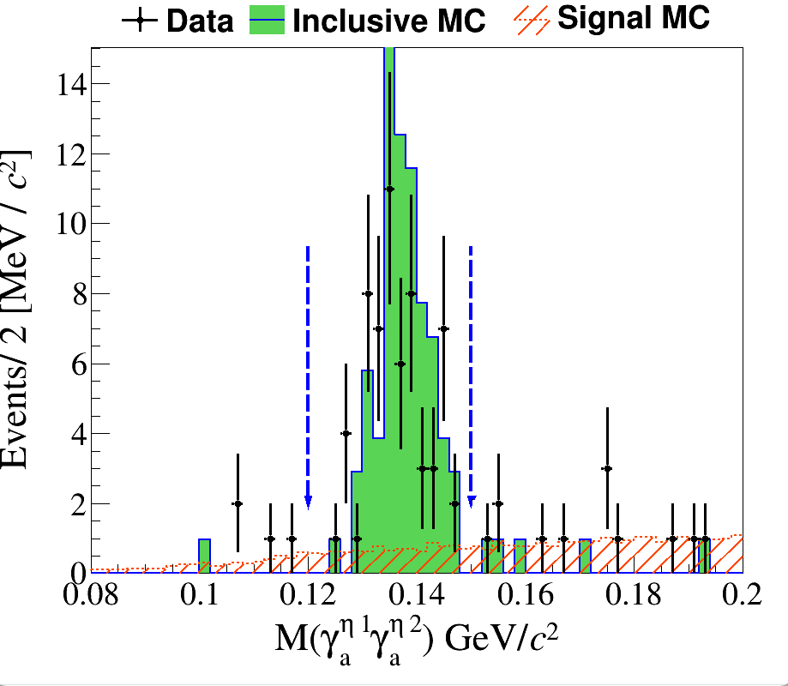
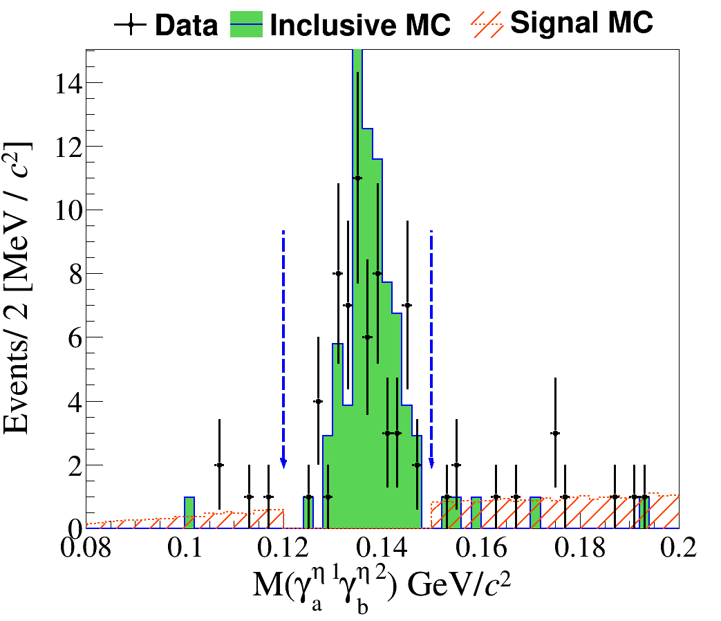
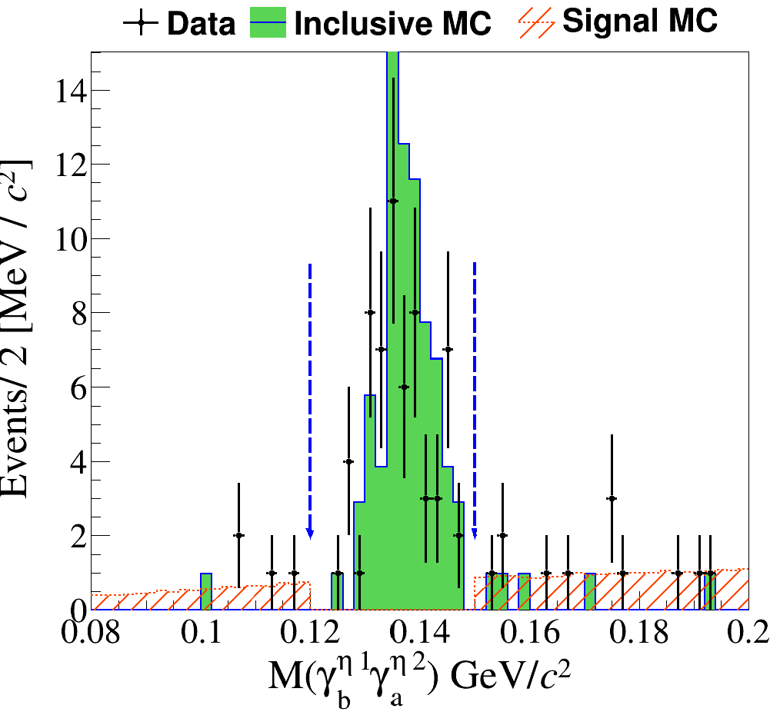
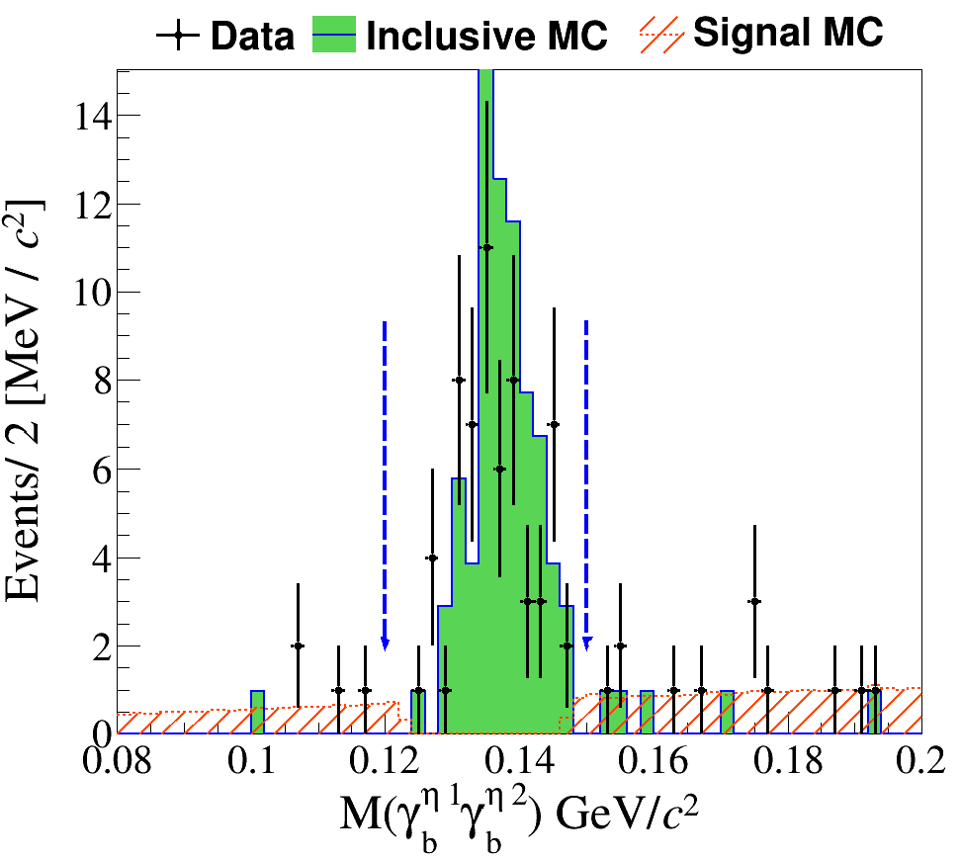
$2γ$ wrong combination

Slide 13
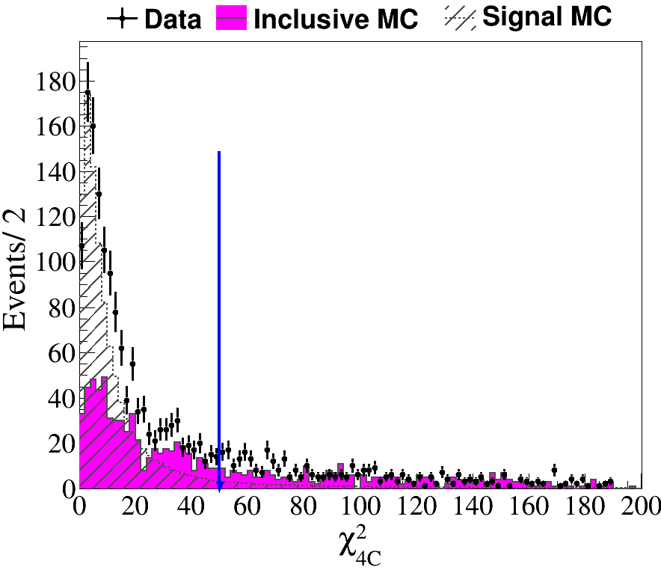
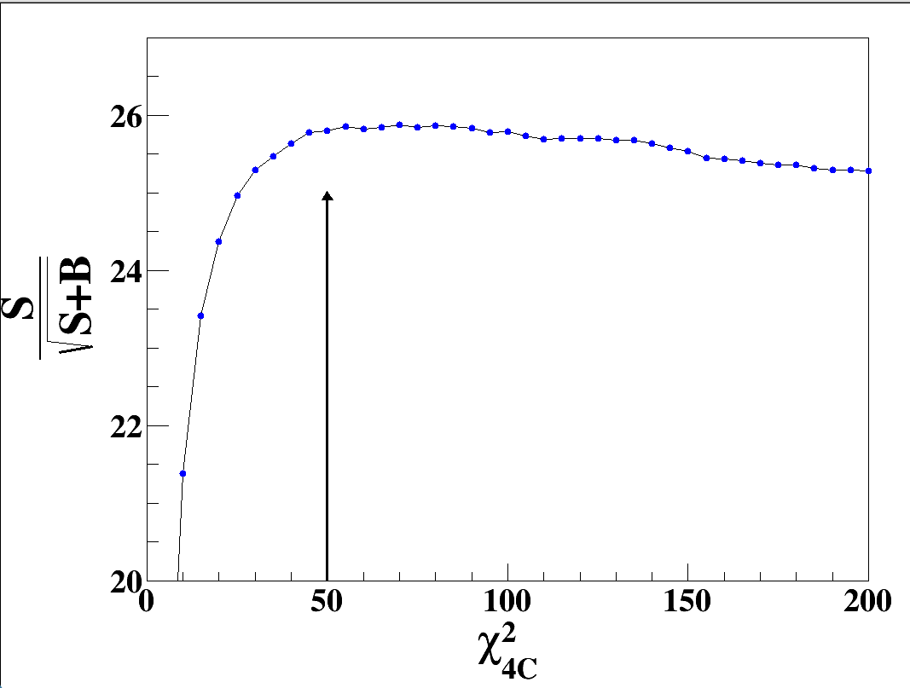
${ χ}_{4C}^{2}(4γp\overline{p})<{ χ}_{4C}^{2}(5γp\overline{p})$，
${ χ}_{6C}^{2}(ηηp\overline{p})<{ χ}_{6C}^{2}(π^{0}π^{0}p\overline{p})$，
${ χ}_{4c}^{2}<50$

Slide 14
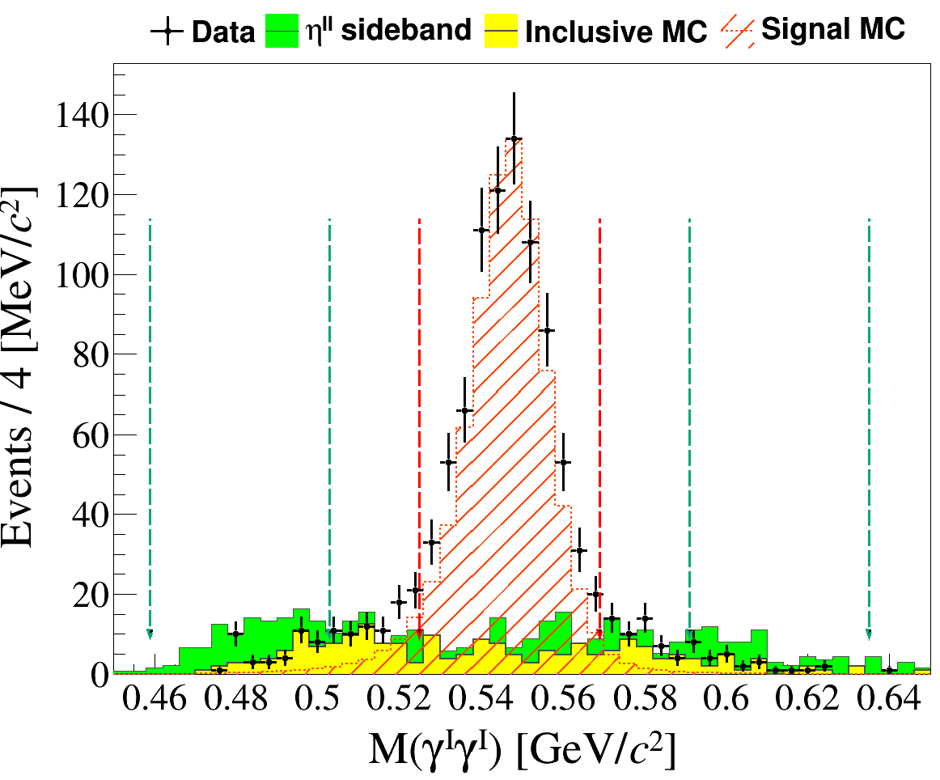
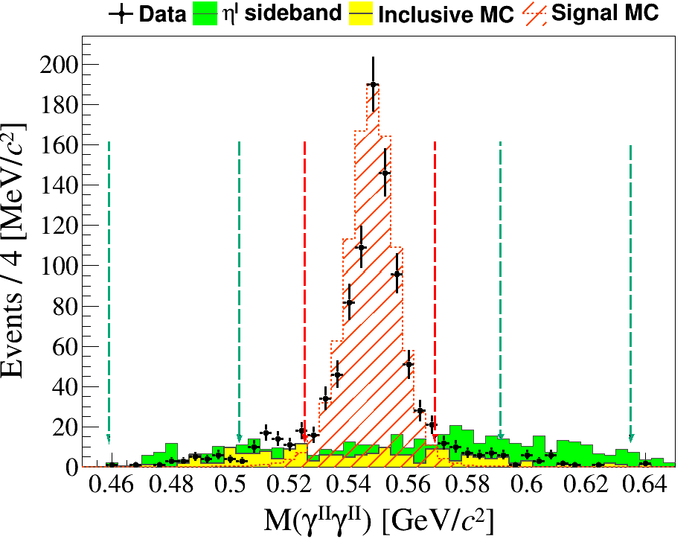
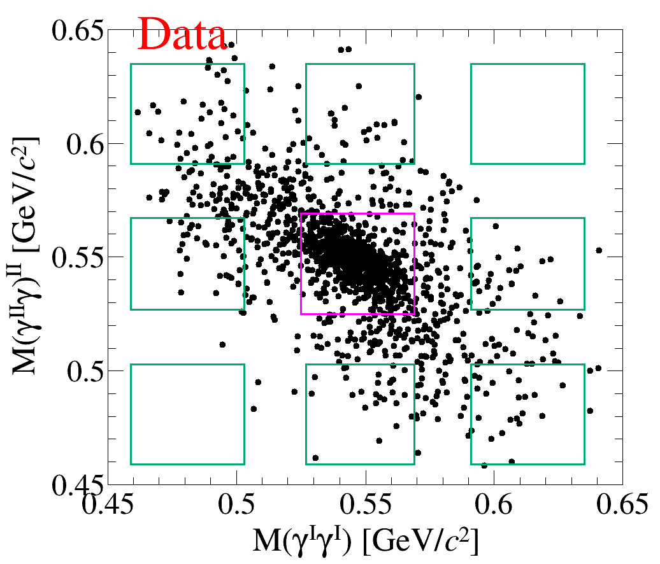
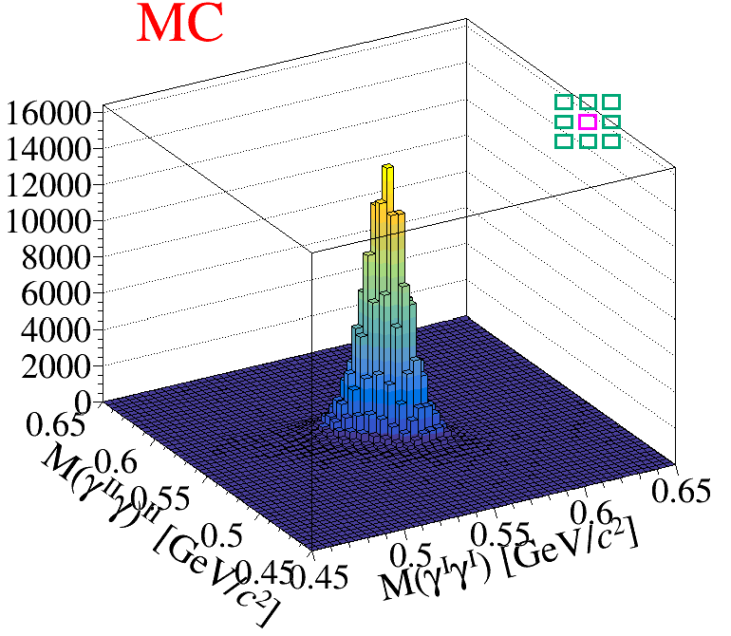
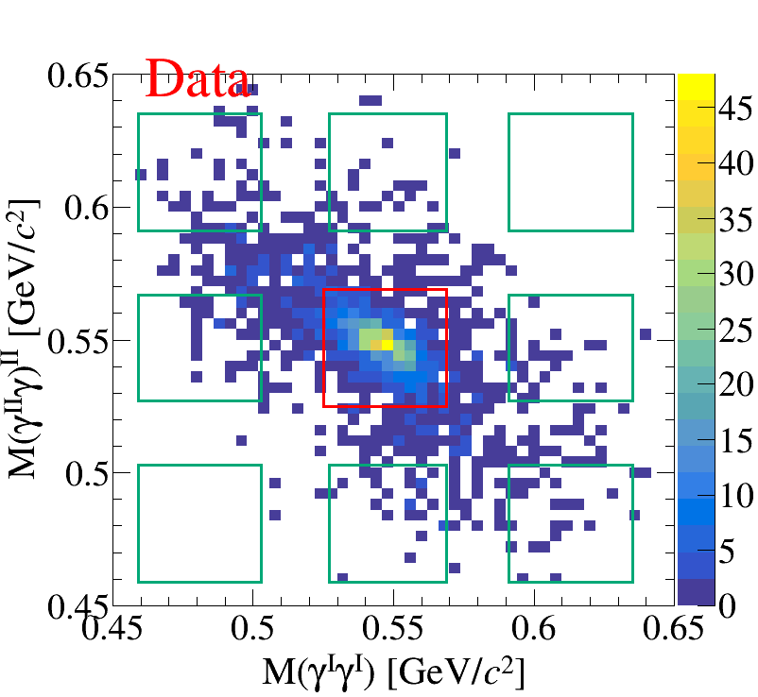
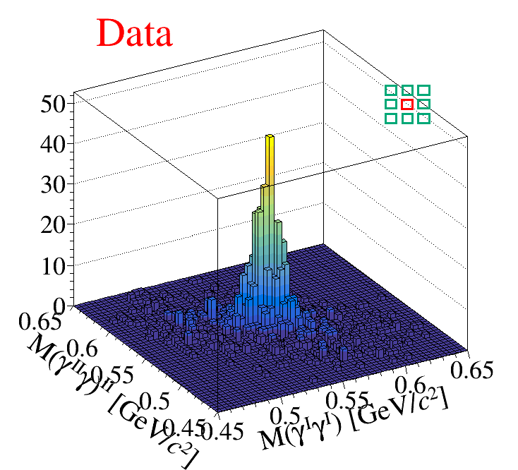
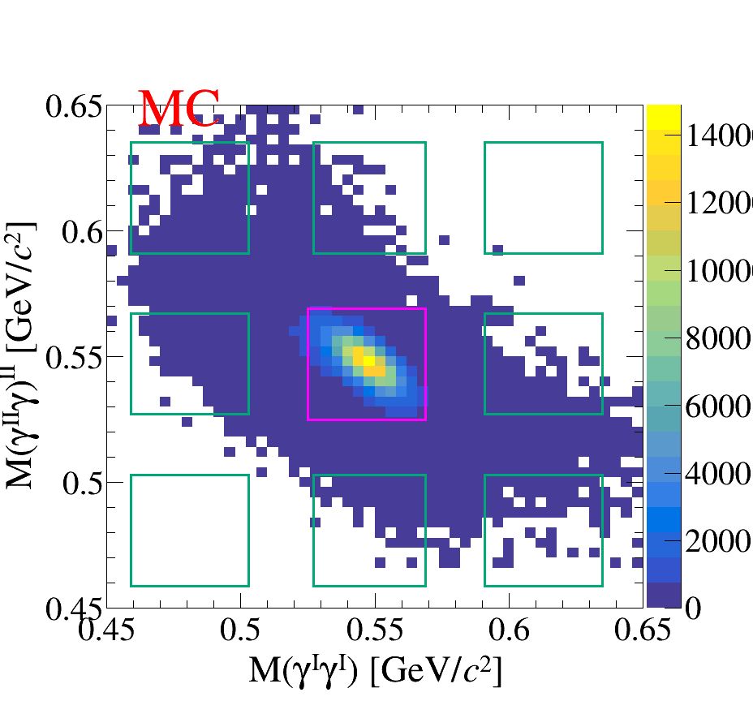
Signal region: $|M\left(γγ\right)−m\left(η\right)|<22MeV/c^{2}$
Sideband region: $44MeV/c^{2}<|M(γγ) −m(η)|<88MeV/c^{2}$

Slide 15
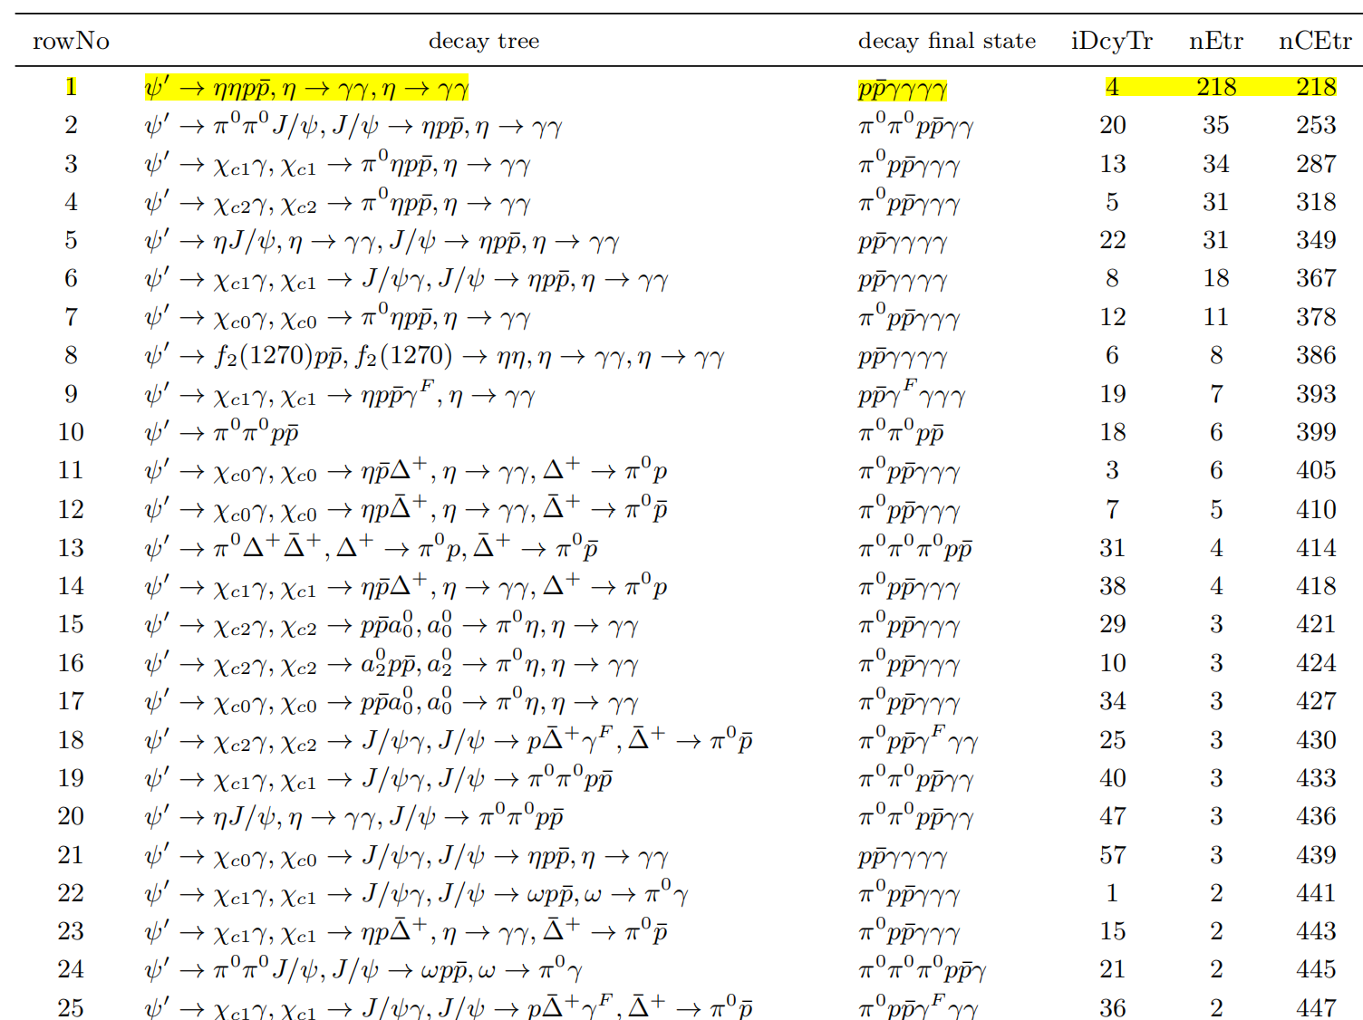
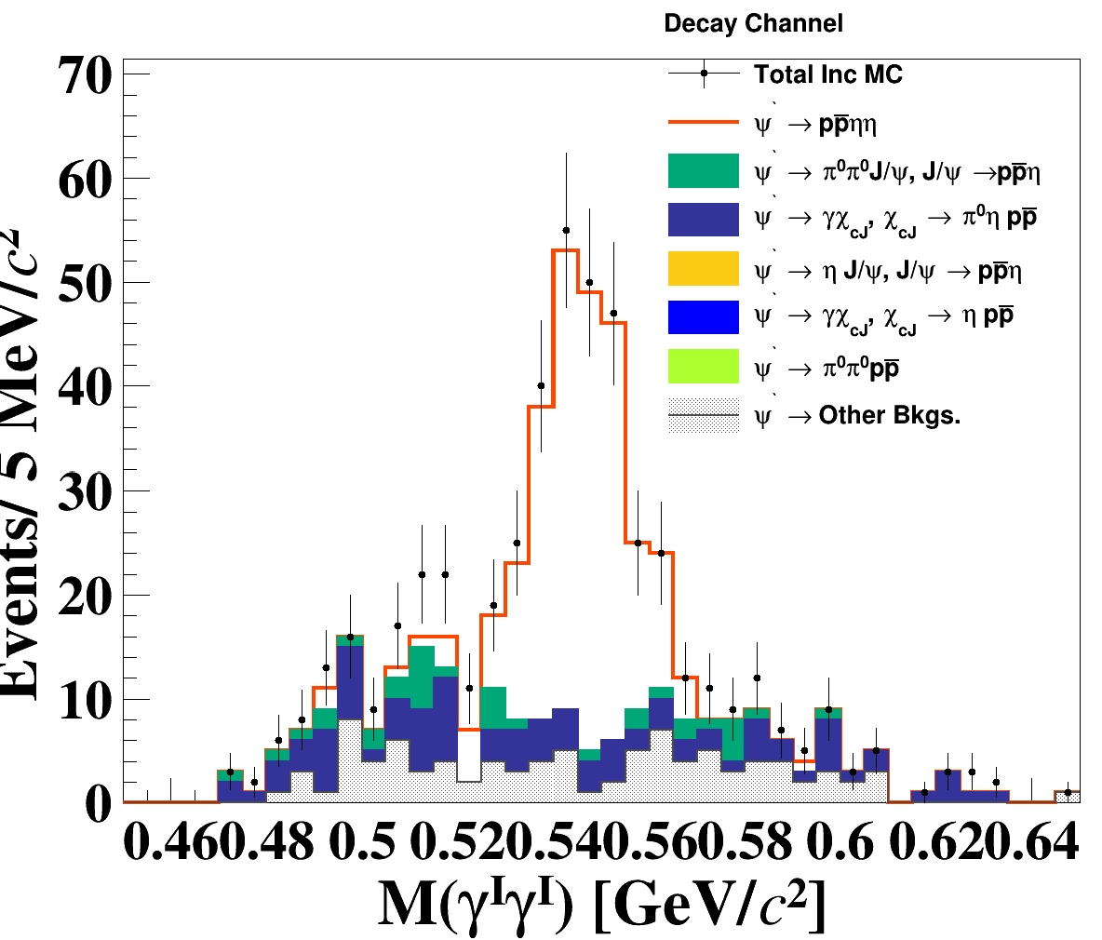

Slide 16
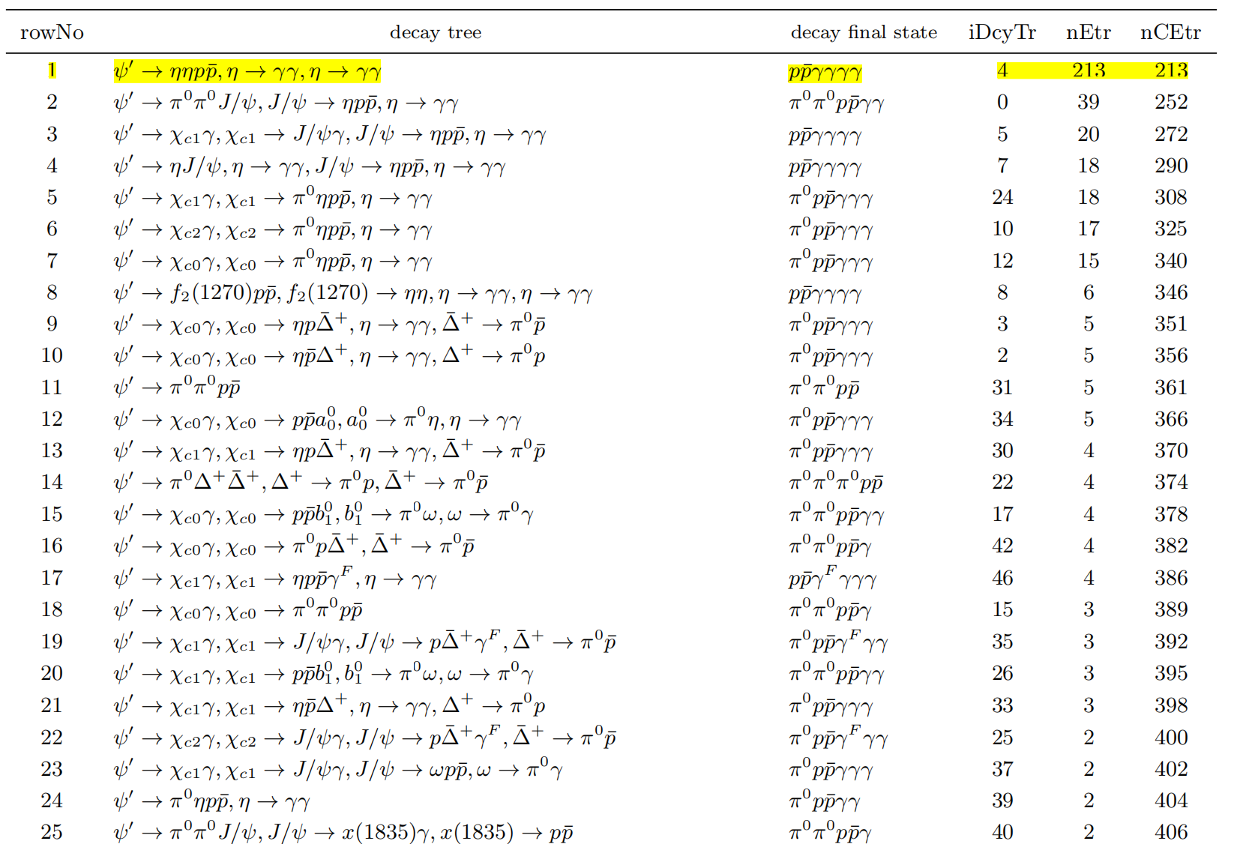
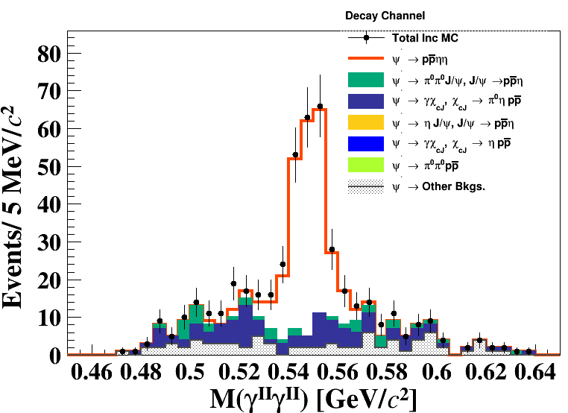

Slide 17
Preliminary
result

Slide 18
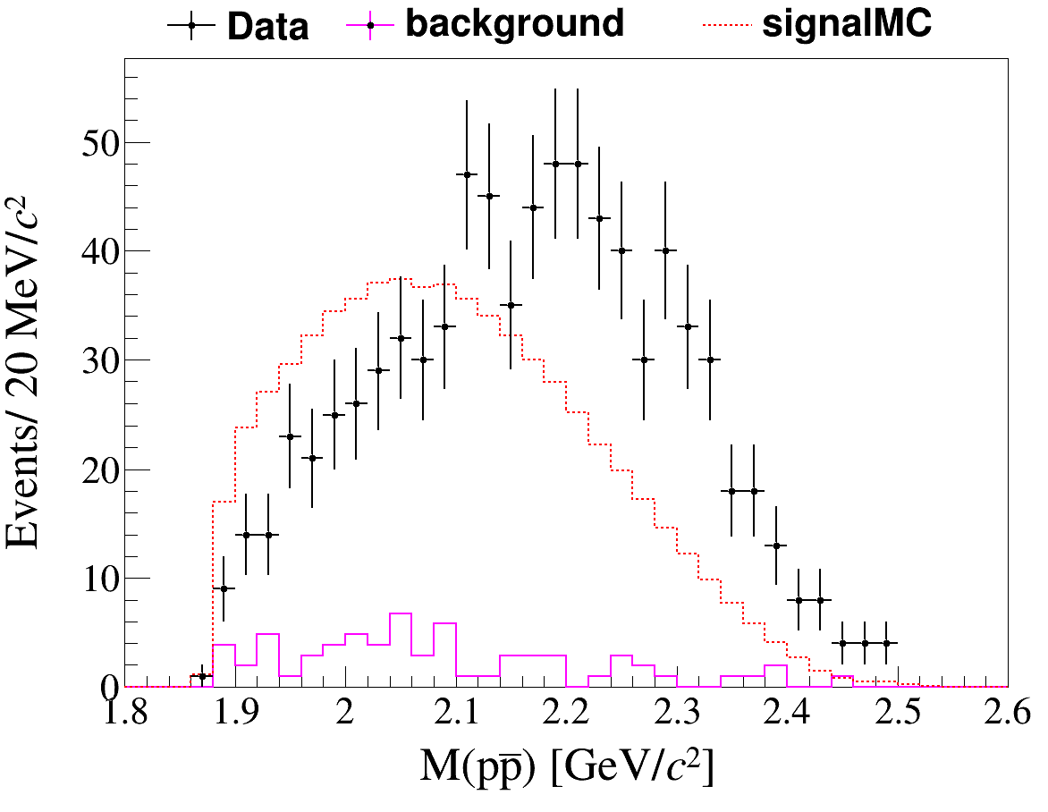
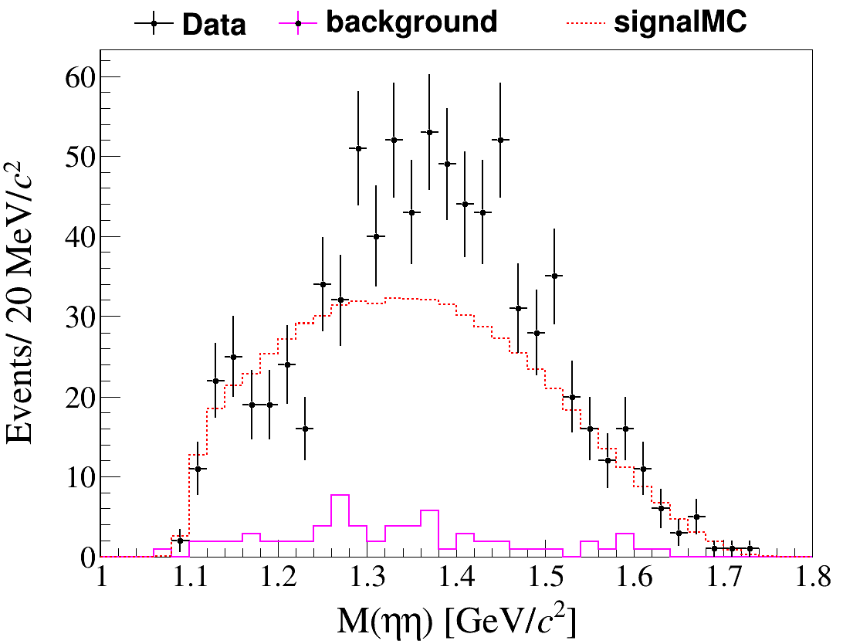
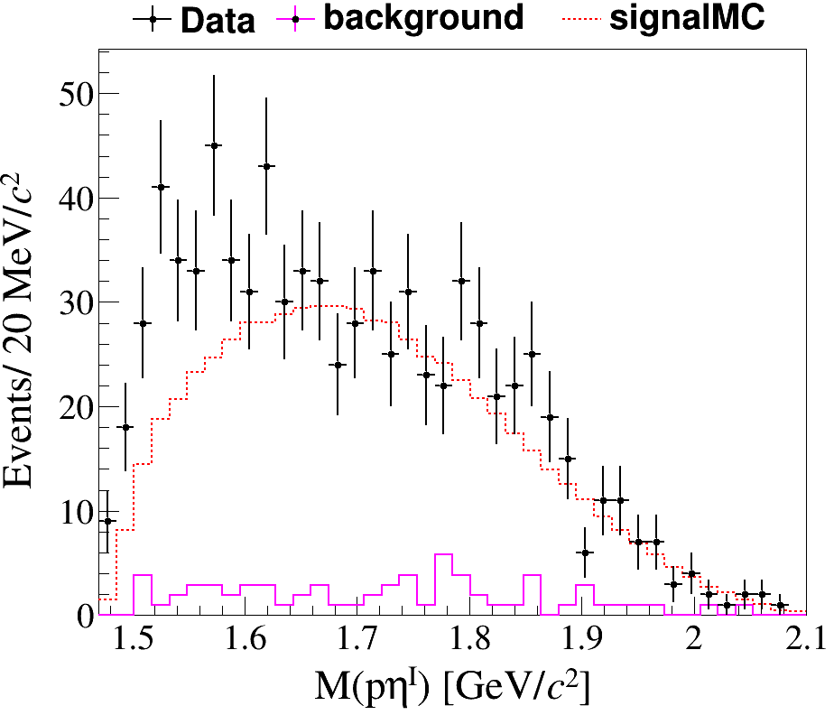
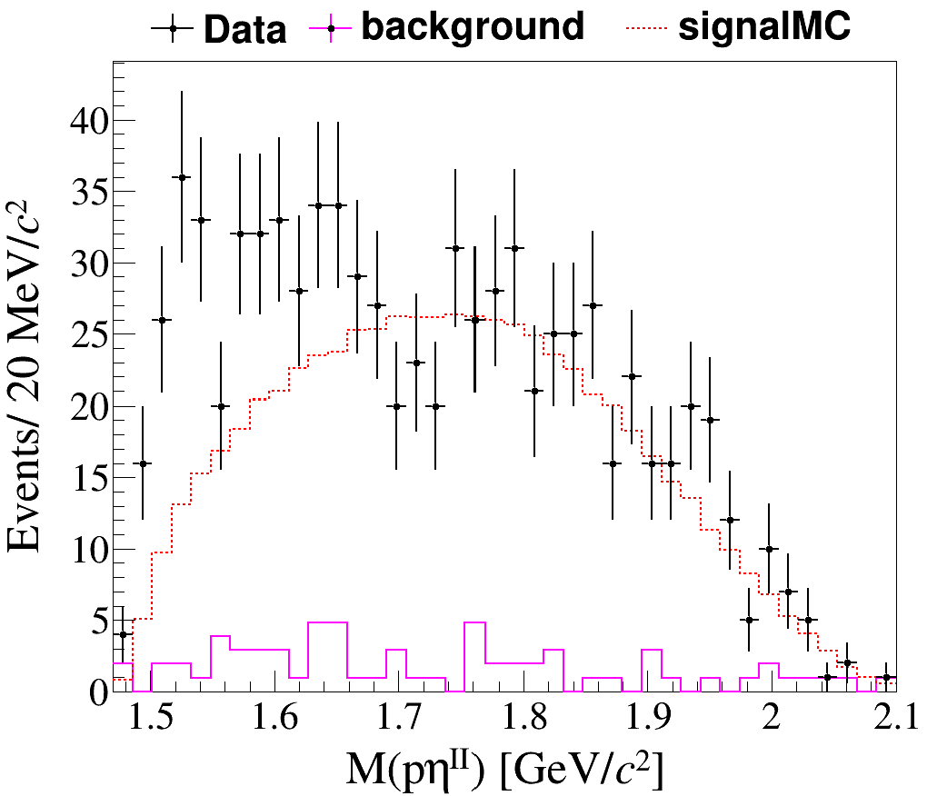
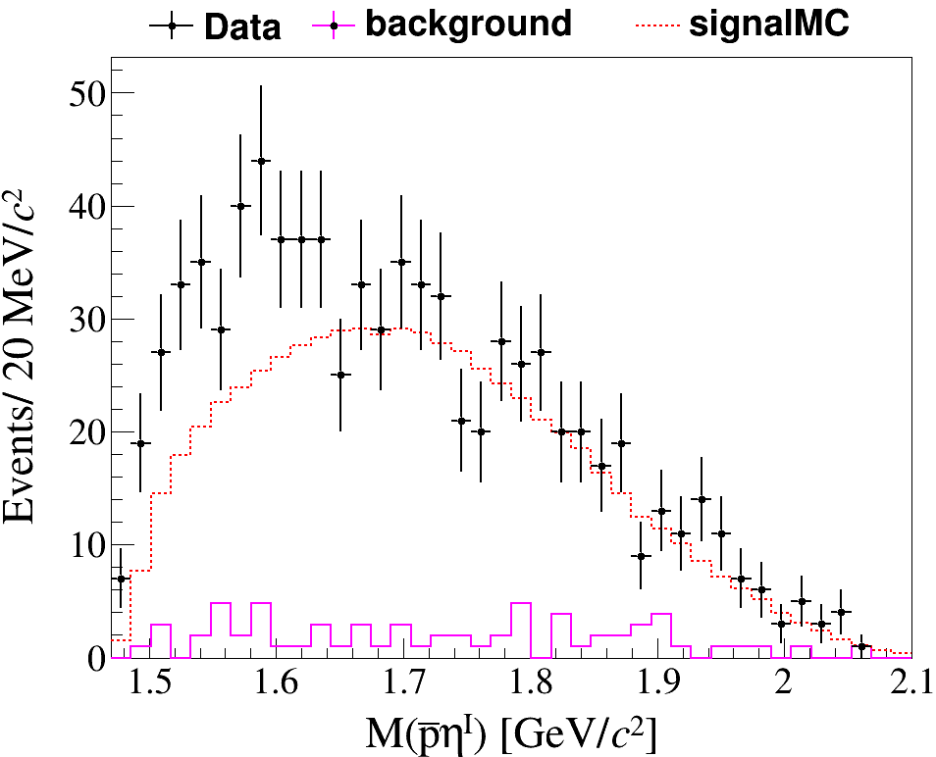
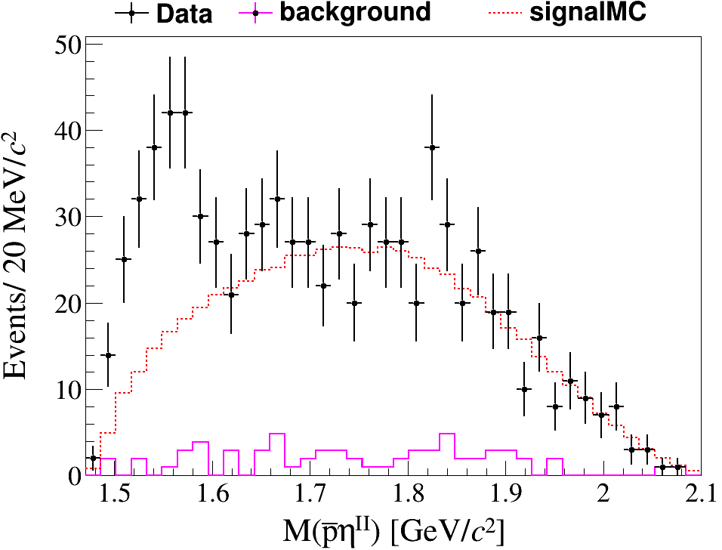

Slide 19
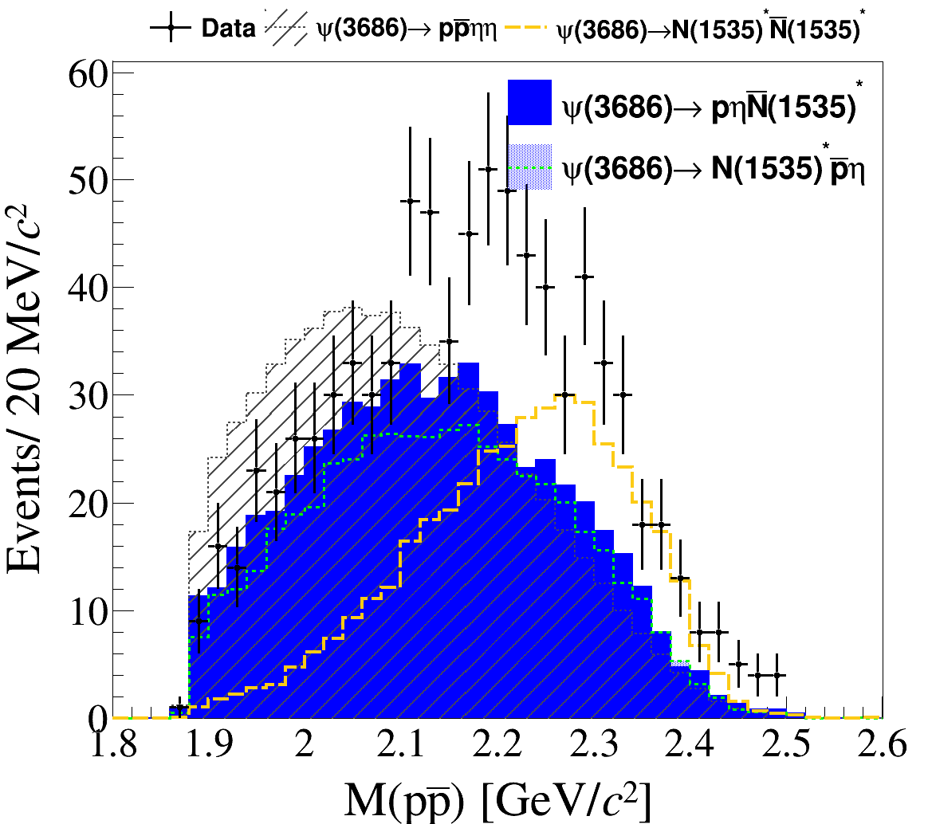
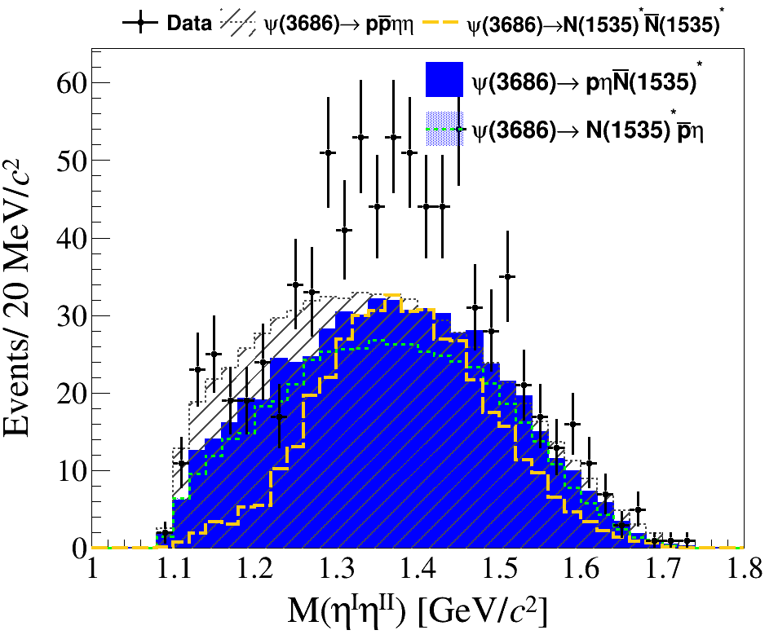
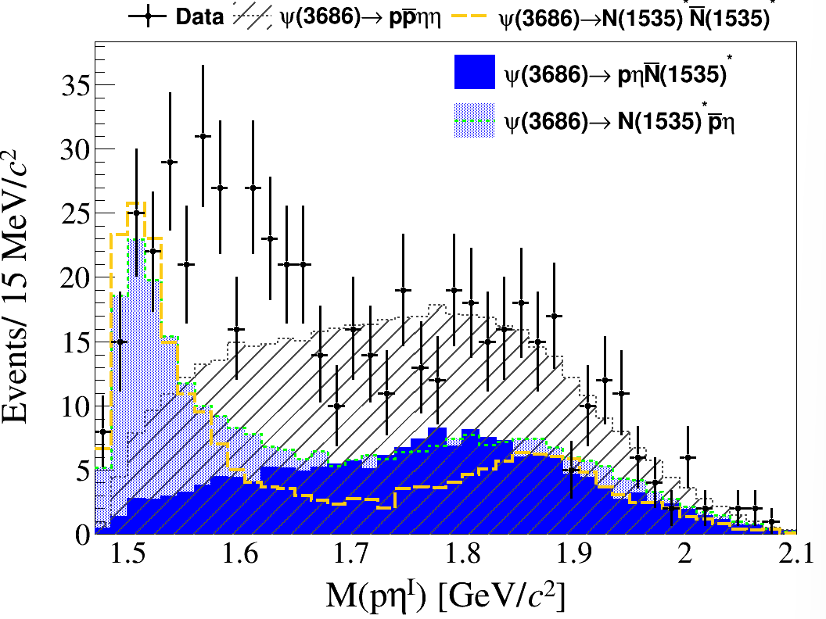
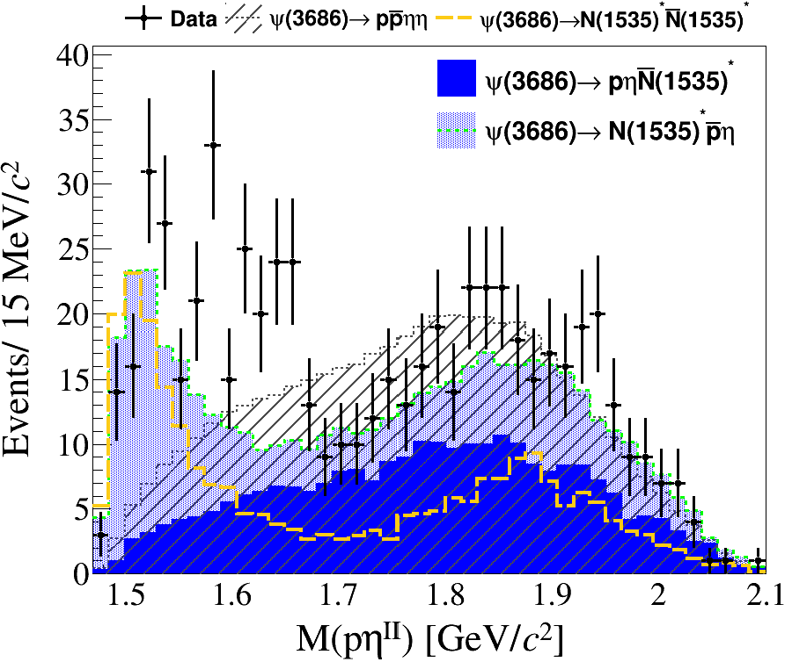
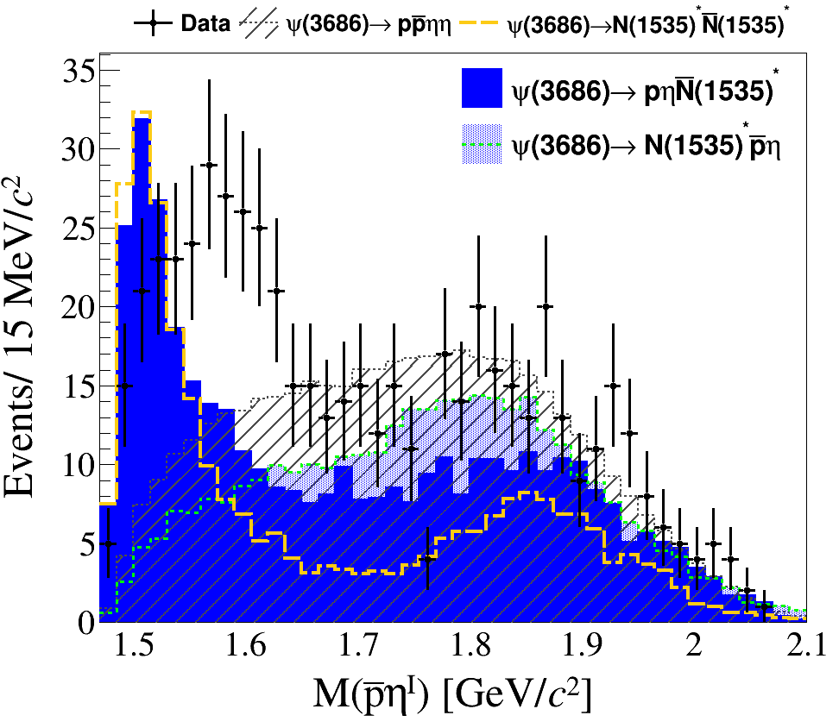
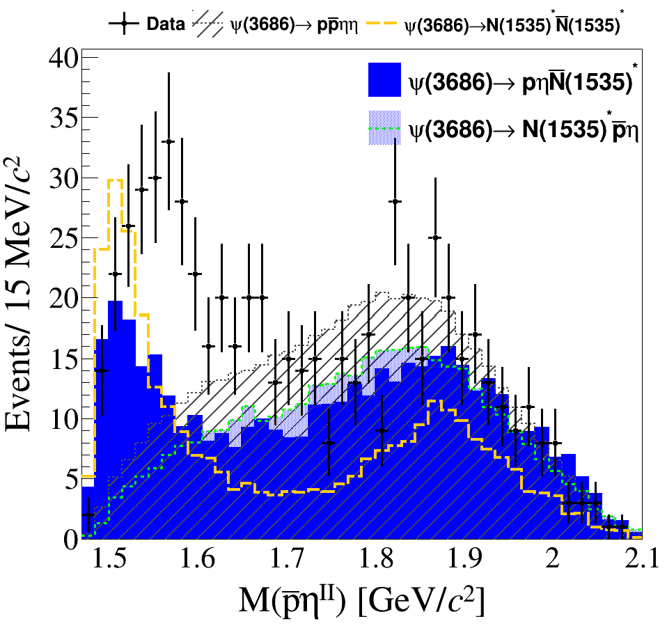

Slide 20
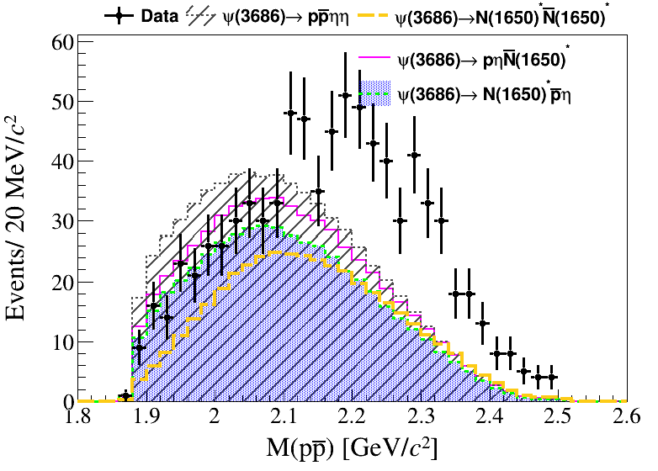
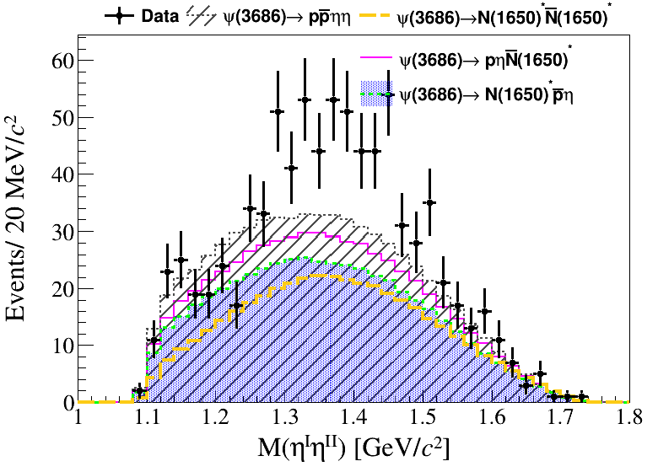
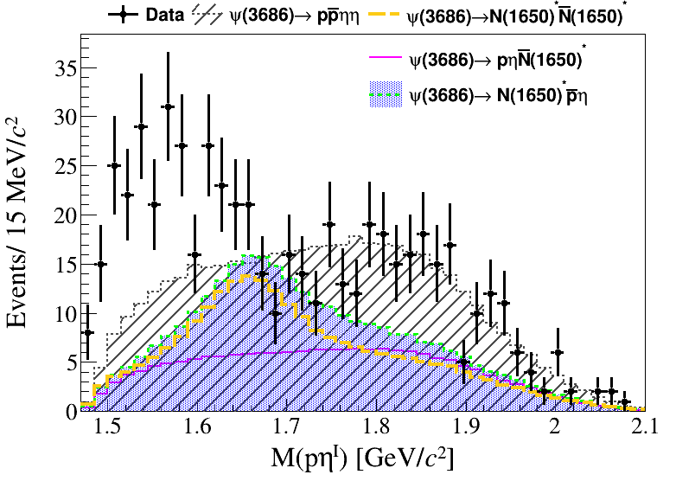
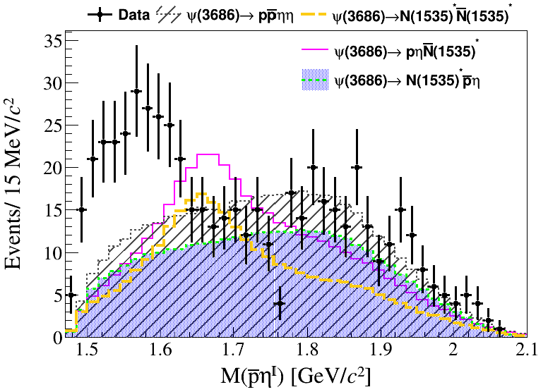
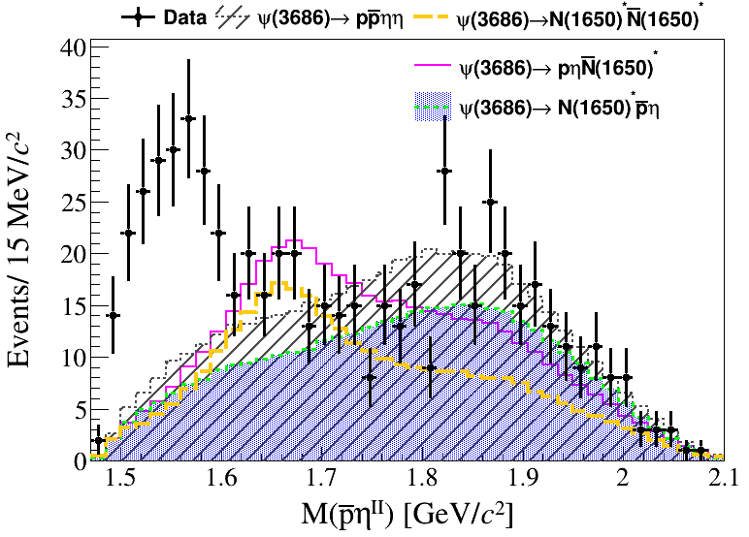
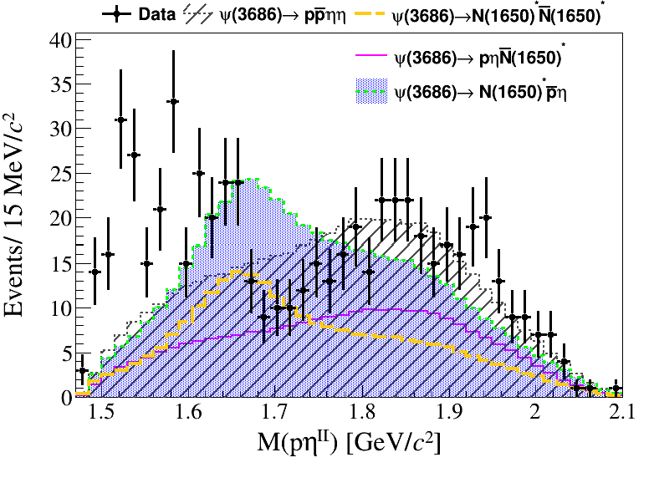

Slide 21
Decay Mode |  | Effciency（%） | error（%）
1 | $$ψ(3686)⟶p\overline{p}ηη$$ | 9.852 | 0.0172
2 | $$ψ(3686)⟶\overline{N}(1535)pη, \overline{N}(1535)⟶\overline{p}η$$ | 6.961 | 0.0146
3 | $$ψ(3686)⟶N(1535)\overline{p}η, N(1535)⟶pη$$ | 7.119 | 0.0148
4 | $$ψ(3686)⟶\overline{N}(1650)pη, \overline{N}(1650)⟶\overline{p}η$$ | 9.712 | 0.0170
5 | $$ψ(3686)⟶N(1650)\overline{p}η, N(1650)⟶pη$$ | 9.873 | 0.0172
6 | $$ψ(3686)⟶\overline{N}(1535)N(1535), \overline{N}(1535)⟶\overline{p}η, N(1535)⟶pη$$ | 10.351 | 0.0175
7 | $$ψ(3686)⟶\overline{N}(1650)N(1650), \overline{N}(1650)⟶\overline{p}η, N(1535)⟶pη$$ | 9.718 | 0.0171

Slide 22
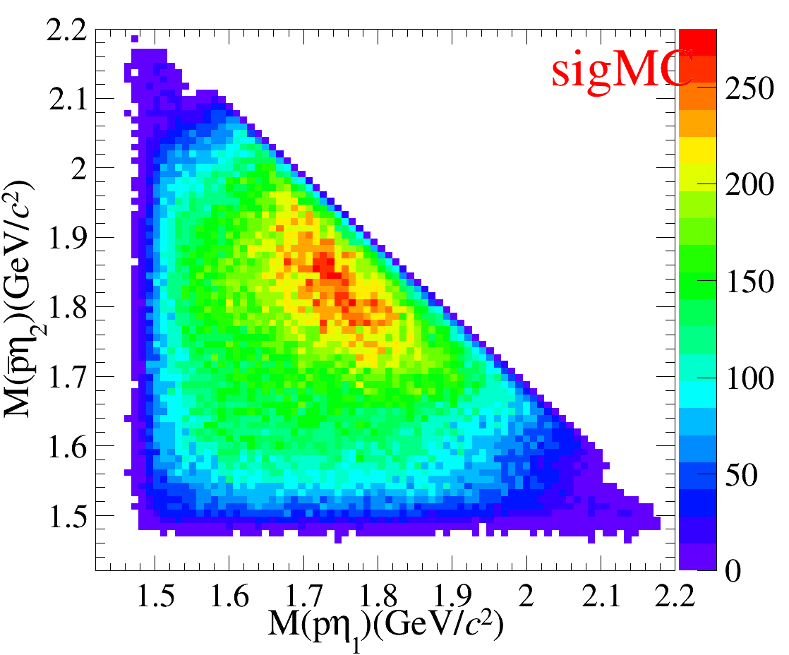
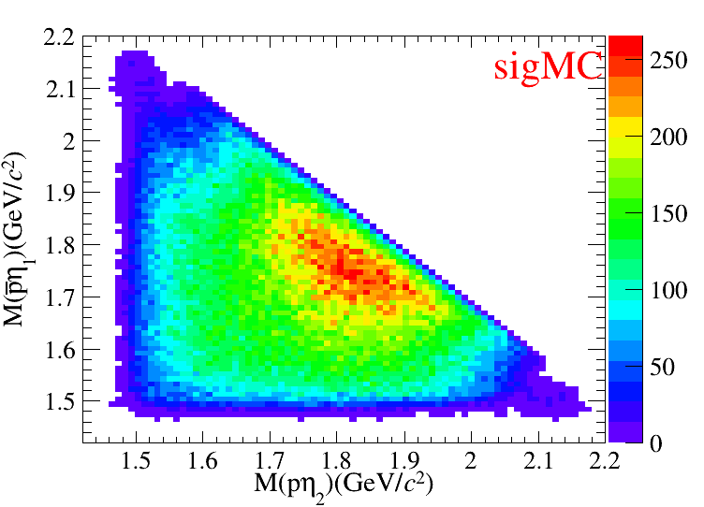
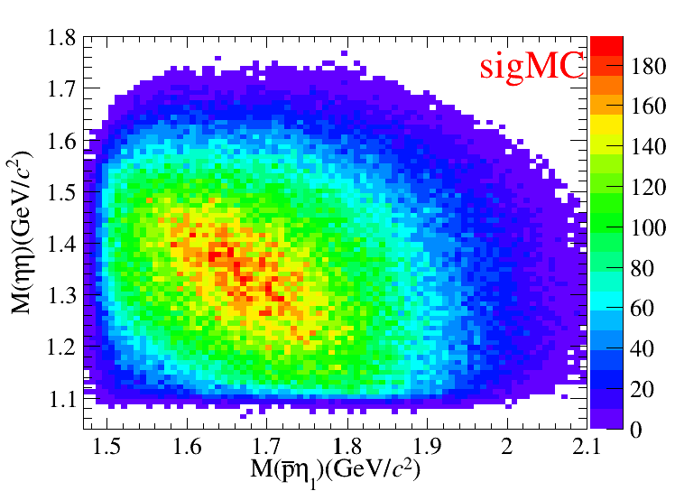
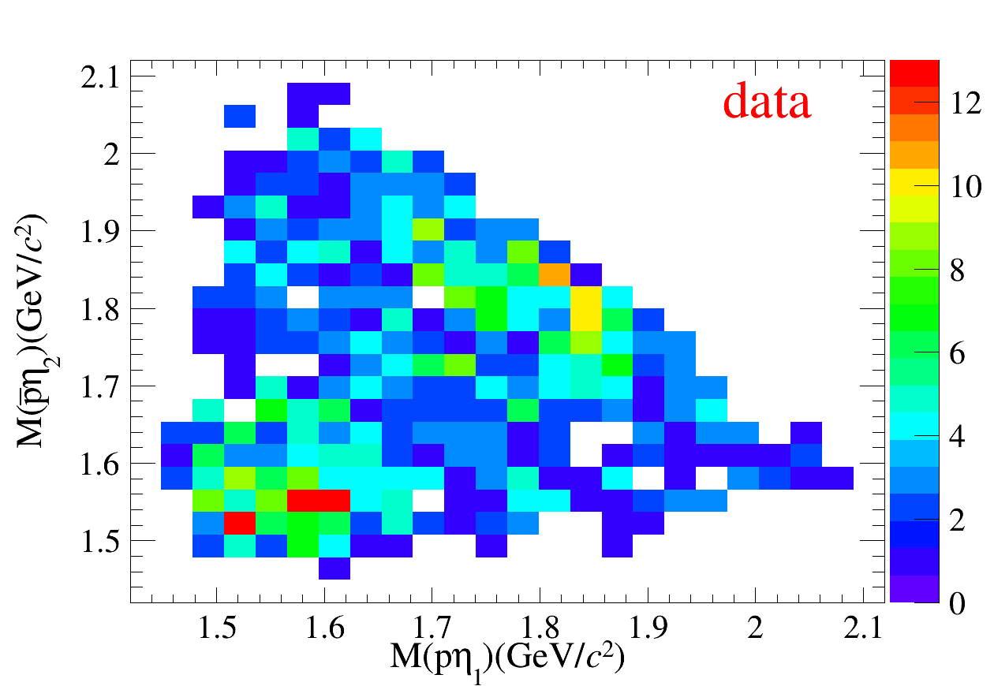
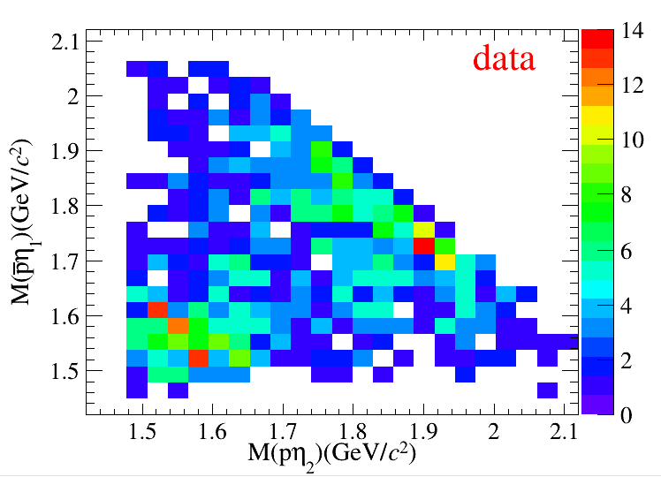
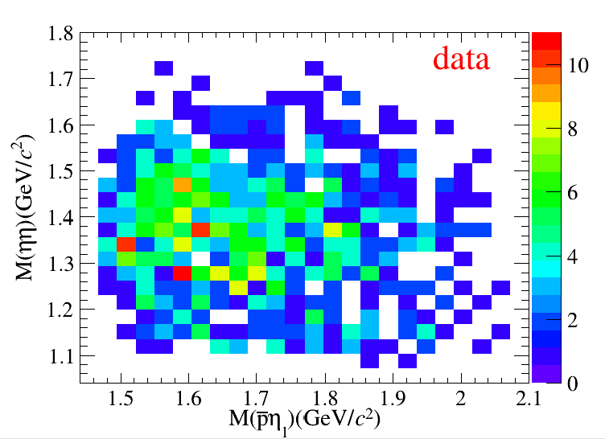

Slide 23
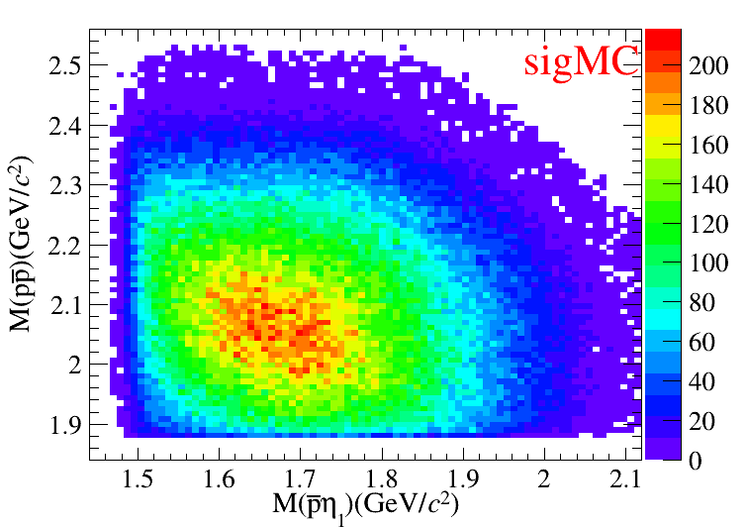
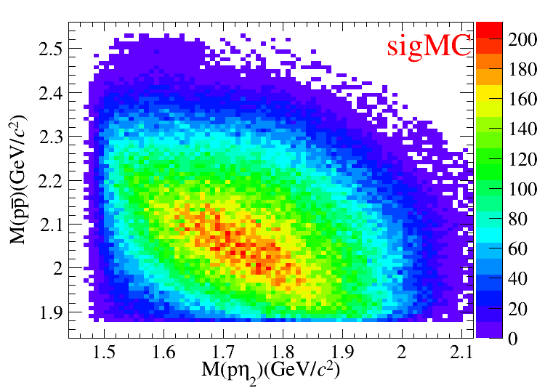
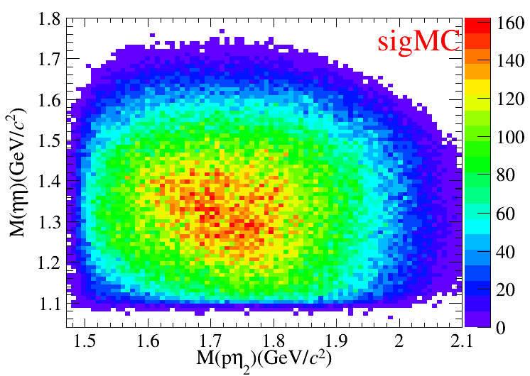
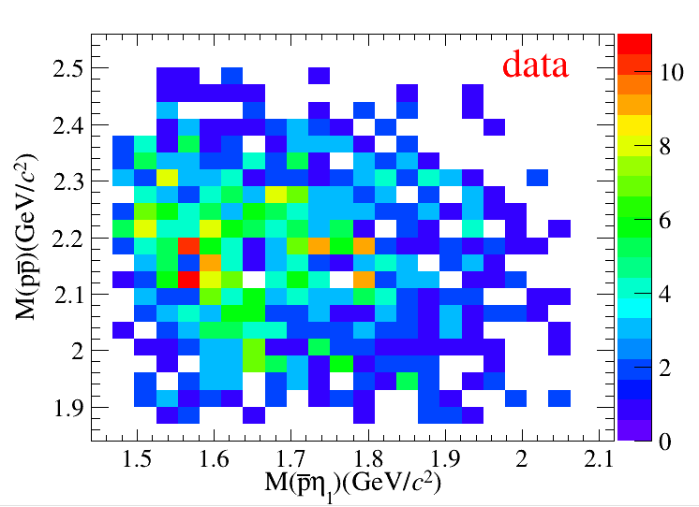
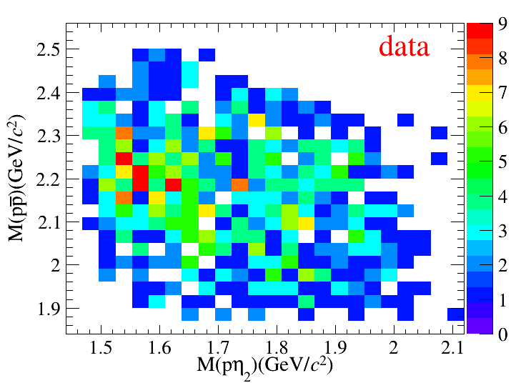

Slide 38
$N^{Sig}=821.8±33.1$
Br ($ψ（3686）→$ $p\overline{p}ηη$)$≈1.8×$ ${10}^{−5}$

Slide 45
Decay Mode |  | Effciency（%） | error（%）
1 | $$ψ(3686)⟶p\overline{p}ηη$$ | 11.06 | 0.018
2 | $$ψ(3686)⟶\overline{N}(1535)pη, \overline{N}(1535)⟶\overline{p}η$$ | 7.81 | 0.015
3 | $$ψ(3686)⟶N(1535)\overline{p}η, N(1535)⟶pη$$ | 7.98 | 0.015
4 | $$ψ(3686)⟶\overline{N}(1650)pη, \overline{N}(1650)⟶\overline{p}η$$ | 10.90 | 0.017
5 | $$ψ(3686)⟶N(1650)\overline{p}η, N(1650)⟶pη$$ | 11.07 | 0.018
6 | $$ψ(3686)⟶\overline{N}(1535)N(1535), \overline{N}(1535)⟶\overline{p}η, N(1535)⟶pη$$ | 11.45 | 0.018
7 | $$ψ(3686)⟶\overline{N}(1650)N(1650), \overline{N}(1650)⟶\overline{p}η, N(1535)⟶pη$$ | 10.88 | 0.017

Slide 47
eta1
sigMC
data
mEta1_4C>>hh","chi2<50&&((mEta0_4C>0.45&&mEta0_4C<0.65)&&(mEta1_4C>0.45&&mEta1_4C<0.65))&&abs(mEta1_4C-0.547)<0.022&&(chi2_6C<chi2_2pi0_6C )&&(chi2<chi25g )&& abs(mg13_wc-0.135 )>0.015 && abs(mg13_wc-0.135)>0.015 && abs(mg23_wc-0.135 )>0.015 && abs(mg24_wc-0.135 )>0.012 &&abs(m2gamrec_bkg-3.097)>0.03
mEta1_4C>>hh","chi2<50&&chi2<chi23g&&chi2<chi25g&&chi2_6C<chi2_2pi0_6C&&chi2_6C<chi2_pi0Eta_6C&&(mEta0_4C>0.45&&mEta0_4C<0.65) &&abs(m2gamrec_bkg-3.097)>0.03

Slide 48
eta2
chi2<50&&((mEta0_4C>0.45&&mEta0_4C<0.65)&&(mEta1_4C>0.45&&mEta1_4C<0.65))&&abs(mEta1_4C-0.547)<0.022&&(chi2_6C<chi2_2pi0_6C )&&(chi2<chi25g )&& abs(mg13_wc-0.135 )>0.015 && abs(mg14_wc-0.135)>0.015 && abs(mg23_wc-0.135 )>0.015 && abs(mg24_wc-0.135 )>0.012 &&abs(m2gamrec_bkg-3.097)>0.03
mEta1_4C>>hh","chi2<50&&chi2<chi23g&&chi2<chi25g&&chi2_6C<chi2_2pi0_6C&&chi2_6C<chi2_pi0Eta_6C&&(mEta0_4C>0.45&&mEta0_4C<0.65) &&abs(m2gamrec_bkg-3.097)>0.03

Slide 49
sigMC cut
data cut

Slide 50
$|({RM}_{γγ}−m_{J/ψ})|>30MeV/c^{2}$
$m_{η_{1}}/m_{η_{2}}∈[ 0.45, 0.65 ]GeV/c^{2}$
$m_{{γγ}_{wrong combination}}−m_{π^{0}}>15MeV/c^{2}$
$|({（RM}_{η_{1}}/{RM}_{η_{2}}）−m_{J/ψ})|>33MeV/c^{2}$
${ χ}_{4C}^{2}(4γp\overline{p})<{ χ}_{4C}^{2}(5γp\overline{p})$，${ χ}_{4C}^{2}(4γp\overline{p})<{ χ}_{4C}^{2}(3γp\overline{p})$
${ χ}_{6C}^{2}(ηηp\overline{p})<{ χ}_{6C}^{2}(π^{0}π^{0}p\overline{p})$， ${ χ}_{6C}^{2}(ηηp\overline{p})<{ χ}_{6C}^{2}(ηπ^{0}p\overline{p})$
${ χ}_{4c}^{2}<50$

Slide 51
- Boss Version 7.0.9
- Data sample
- $2.708×{10}^{9} ψ(2S)$ (2009+2012+2021)
- Inclusive MC
- $2.806×{10}^{9}$ $ψ(2S)$ (2009+2012+2021)
- Signal MC
- 3 $×{10}^{6}$ $ψ(2S)→p\overline{p}ηη$ (2009+2012+2021)
$ψ(2S)→p\overline{p}ηη$ PHSP
$η→γγ$ PHSP

