Slide 1
CGEM DAQ Status and Plan
Tingxuan Zeng
2025-03-11

Slide 2
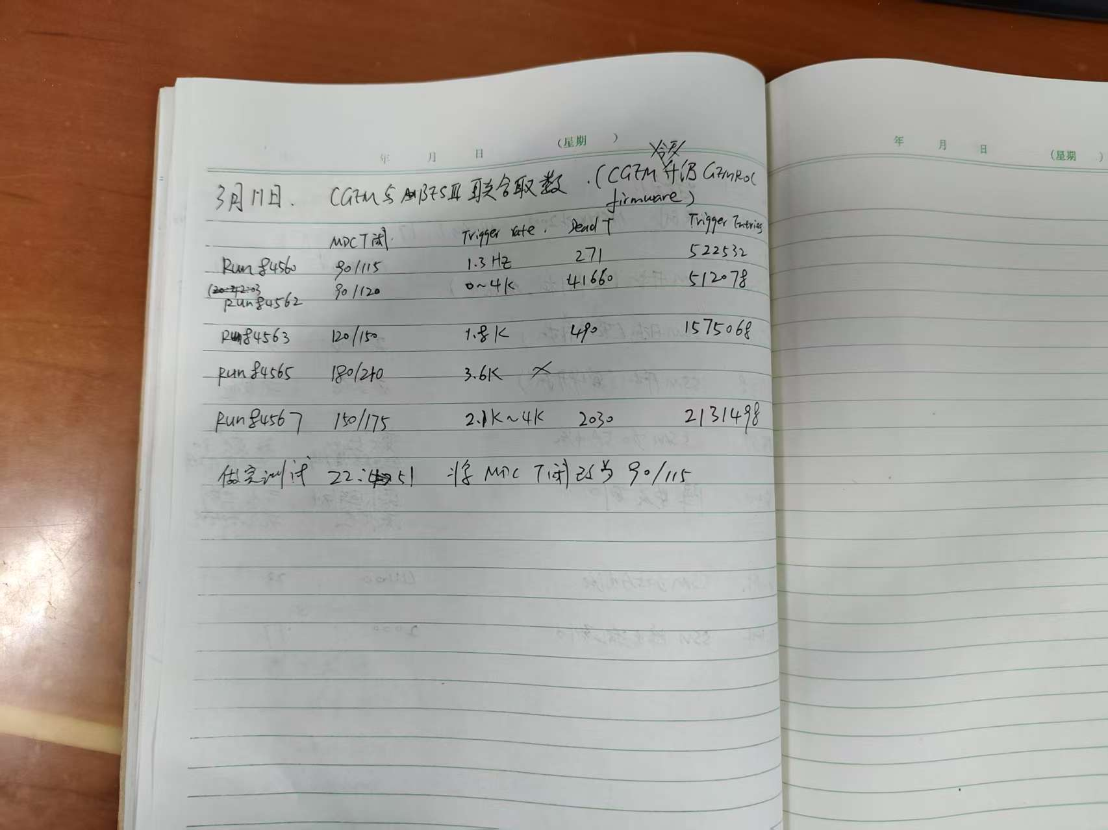

Slide 3
More Event number check results
Run number | Event rate | Dead Time | BES3 histogram Trigger Entries | BES3 event number in data file | CGEM Trigger number | Is CGEM trigger number consistent with BES3 ? | Is trigger number of each GEMROC the same? | Is last trigger number of all GEMROCs the same? | Is this run have check bit error? | remarks
84560 | 1.3Hz | 271 | 522532 | 522532 | 522531 | yes | yes | Yes (522531) | No | Mdc thre 90/115
84562 | 0~4 KHz | 41660 | 512078 | 512078 | 437538-452891 | No | No | Yes (512334) | No | Mdc thre 90/120
84563 | 1.8 KHz | 490 | 1575068 (has a overfow) | 1578977 | 1578971-1578977 | No | No | Yes (1578977) | No | Mdc thre 120/150
84565 | 3.6 KHz | - | - | 1111 | - | - | - | - | - | CGEM NO data
84567 | 2.1~4KHz | 2030 | 2131498 | 2131498 | 2131400-2131498 | No | No | Yes (2131498) | No | Mdc thre 150/175
Note: Full cable connected， noise trigger. Alberto updated firmware yesterday night.
Last Trigger number is same with all GEMROCs, also same with BES3 in 3 runs.

Slide 4
Run 84563 BES3 histogram has a overflow, event number is actually 1578977 in data file.

Slide 5
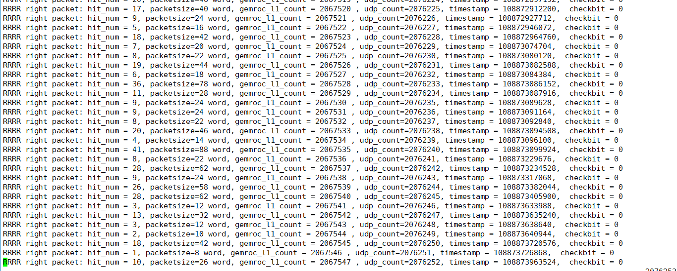
Udp sequence count recovers increasing sequentially.

Slide 6
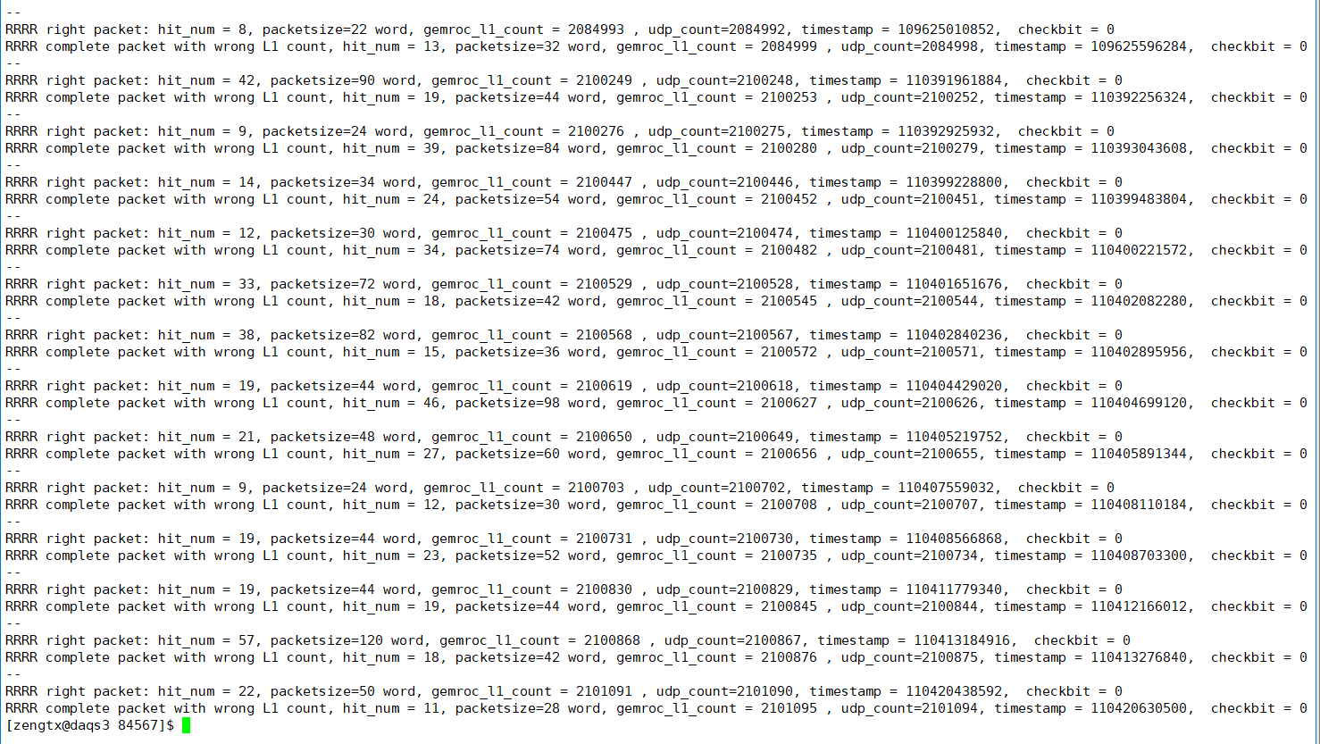
When GEMROC L1 count jumps, the udp sequence count jumps with same number.

