Slide 1
Hybrid status
Zhijun Liang (IHEP)
Notes:
1

Slide 2
Update in hybrid process flow
PI layer deposition for ALTIROC-A wafer is now after ASIC wafer probing
9 ALTIROC-A wafers in IHEP/NCAP
1 wafer UBMed and Diced for hybrids
ASIC probing will be performed for remaining 8 wafers
9 ALTIROC-A wafers in IJClab
1 wafer diced for ASIC study (distributed a few chips to other sites)
1 wafer under ASIC probing (died, take too long )
1 new wafer for ASIC probing ( )
6 wafer from recent batch
2 ALTIROC-A wafer on-hold in TSMC

Slide 3
Thick Sensor wafers UBM
IHEP-IME sensor UBM is managed by sensor group
Contract with IME is to provide UBMed diced LGAD
Status: pre-production Thick wafers (more detailed in sensor report tomorrow)
2 LGAD wafer picking is done (~60 LGAD)
10 LGAD wafers UBMed and diced, picking dies (200~300 LGAD, this week)
USTC-IME sensor UBM managed by module group
6 wafers received in middle of Dec 2024. (150~200 LGAD, this week)
One wafer reserved for USTC sensor probing
UBM ready by the end of this week
Dicing starting from next week, ready in ~10 days
80+ ASIC (unprobed )

Slide 4
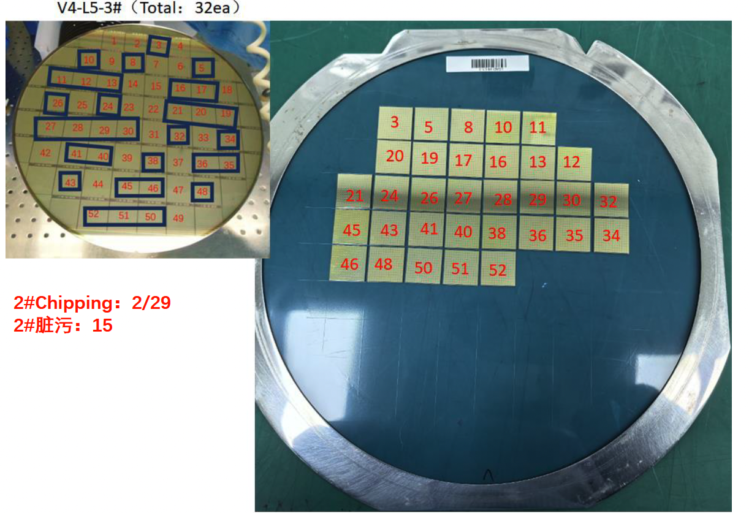
Thick Sensor wafers UBM
2 LGAD thick sensor picking is done

