Slide 1

CEPC meeting
H_recoil Status Report
Yuji Li(Fudan university)

Slide 2


Status
In this formula, the width of Z/H should be measured as a constant with H invisible events.
We use a chi square method to find the best lepton pair.
Clear relation between Z boson momenta and H recoil.
BKG Inputs: /cefs/higgs/liugeliang/CEPC/202501/Production/4fermions/
/cefs/higgs/liugeliang/CEPC/202501/Production/2fermions/
SIG Inputs: ZH, (Z->mumu, H->inclusive)

Slide 3
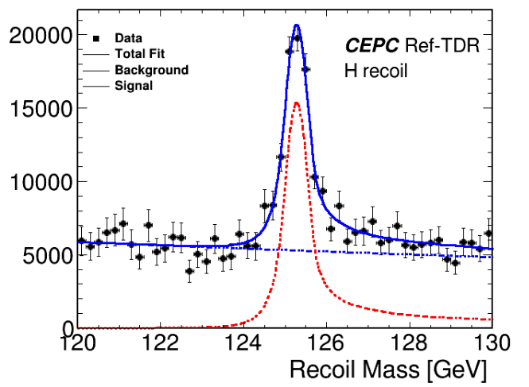
S+B Combination
Lumi: 20000(fb-1)
xs zz_l0mumu=19.38;
xs sznu_l0mumu=43.42
xs 4mu=15.56;
xs sl0mu_down=136.14;
xs sl0mu_up=87.39;
xs zzorww_l0=221.10;
(xs ll=5332.71);
Fitted by exponential & TwosidedCB
Mass=125.279 GeV Error = 6.88148e-05
Sigma = 0.296GeV Error = 7.36378e-05

Slide 4
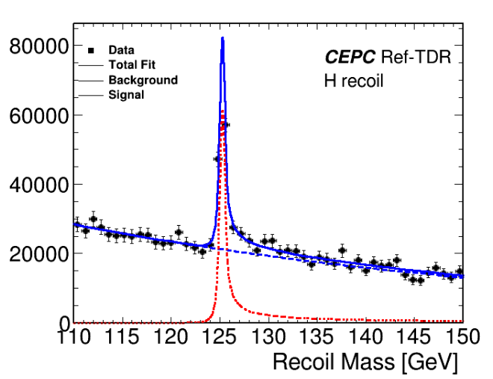
S+B Combination
Lumi: 20000(fb-1)
xs zz_l0mumu=19.38;
xs sznu_l0mumu=43.42
xs 4mu=15.56;
xs sl0mu_down=136.14;
xs sl0mu_up=87.39;
xs zzorww_l0=221.10;
(xs ll=5332.71);
Fitted by exponential & TwosidedCB
Mass=125.277 GeV Error = 2.08331e-03
Sigma = 0.294 GeV Error = 2.16136e-03

Slide 5
Summary and plans
MuonID has been implemented in CEPCSW, will update the muon selection in this study.
Lepton Pair selection：
Sys. uncertainty will be added in several aspects.
Event selection will be optimized by Zhilang.

