Slide 1
CGEM DAQ Status and Plan
Tingxuan Zeng
2025-03-13

Slide 2
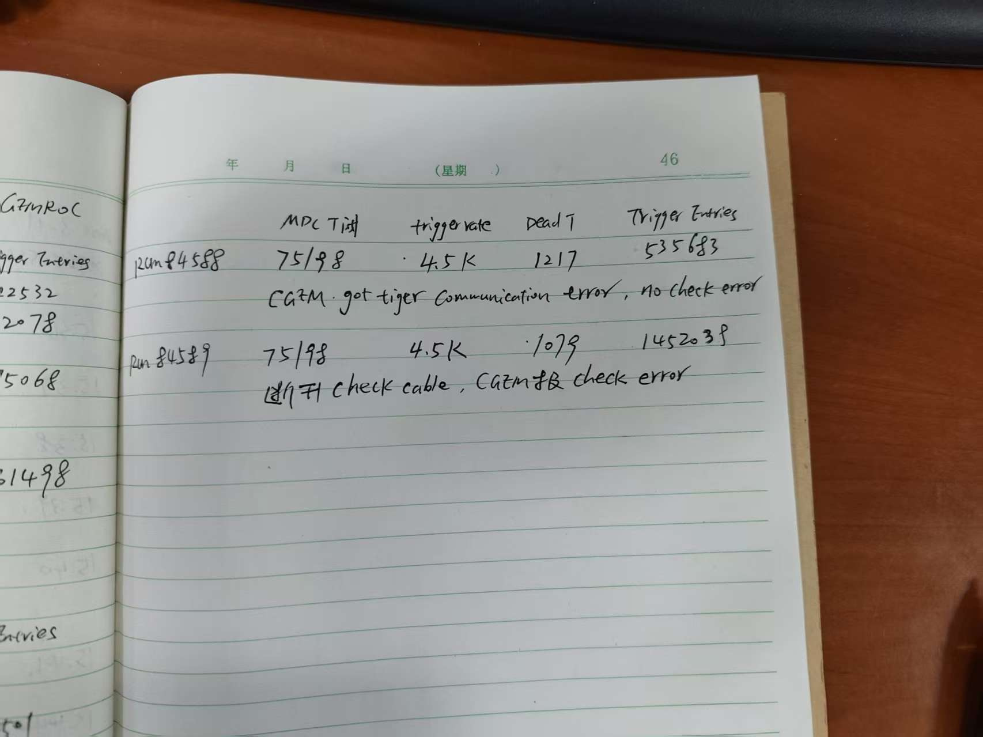
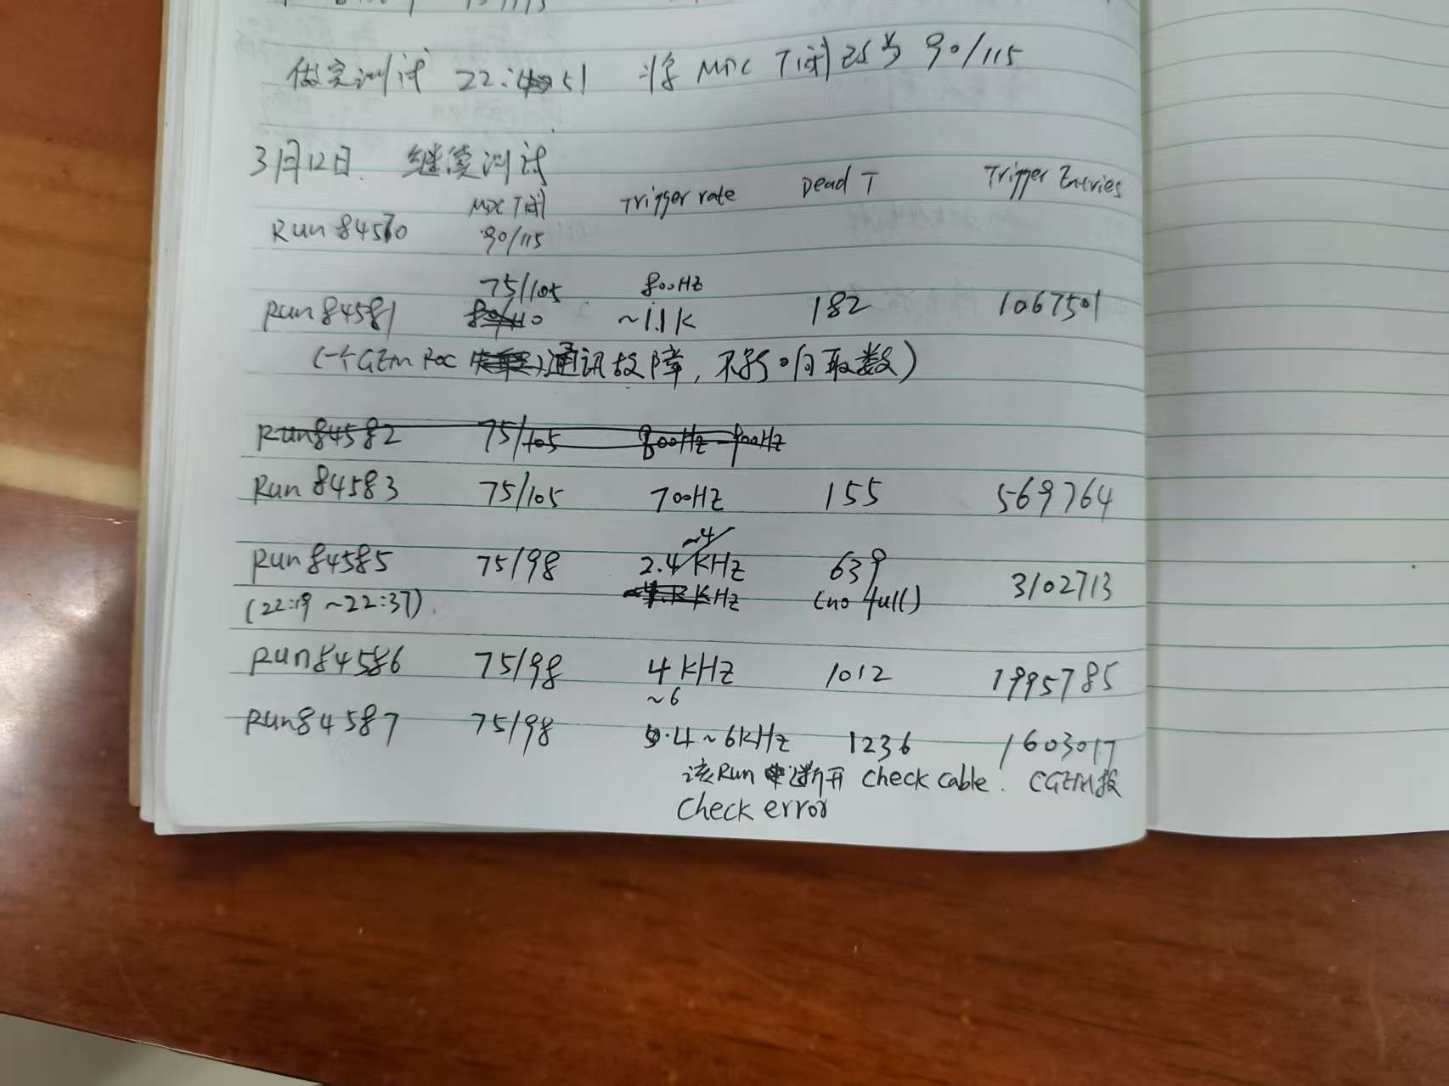

Slide 3
 | BES3 event number in data file | CGEM uniq trigger number(all gemrocs same ) | CGEM Last Trigger number(all gemrocs same) | Consistent ? | CGEM Checkbit error?(2 bits)
RUN 84576 | 2541251 | 2541251 | 2541251 | Yes | No
RUN 84577 | 2341672 | 2341672 | 2341672 | Yes | No
RUN 84578 | 711382 | 711463 | 711463 | Yes | No
Note: after adjusting the NIC and kernel settings by Alberto 3.12 afternoon.
The event number is consistent with BES 3 during these 10 runs.
No check bit error occurs during these 10 runs.
RUN 84576~84578 had been crossed checked with Alberto.

Slide 4
 | BES3 event number in data file | CGEM uniq trigger number(all gemrocs same ) | CGEM Last Trigger number(all gemrocs same) | Consistent ? | CGEM Checkbit error?(2 bits) | Remarks
RUN 84581 | 1067501 | 1067501 | 1067501 | Yes | No | 1.1KHz one gemroc has communication error
RUN 84583 | 569764 | 569764 | 569764 | Yes | No | 700Hz
RUN 84585 | 3102713 | 3102713 | 3102713 | Yes | No | 2.4~4KHz
RUN 84586 | 1995785 | 1995785 | 1995785 | Yes | No | 4KHz~6KHz
RUN 84587 | 1603817 | 1603817 | 1603817 | Yes | No | 4KHz~6KHz Disconnect check cable
RUN 84588 | 535683 | 535683 | 535683 | Yes | No | 4.5KHz cgem tiger has communication error
RUN 84589 | 1455347 | 1455347 | 1455347 | Yes | No | 4.5KHz Disconnect check cable

