Slide 1
CGEM DAQ Status and Plan
Tingxuan Zeng
2025-03-14

Slide 2
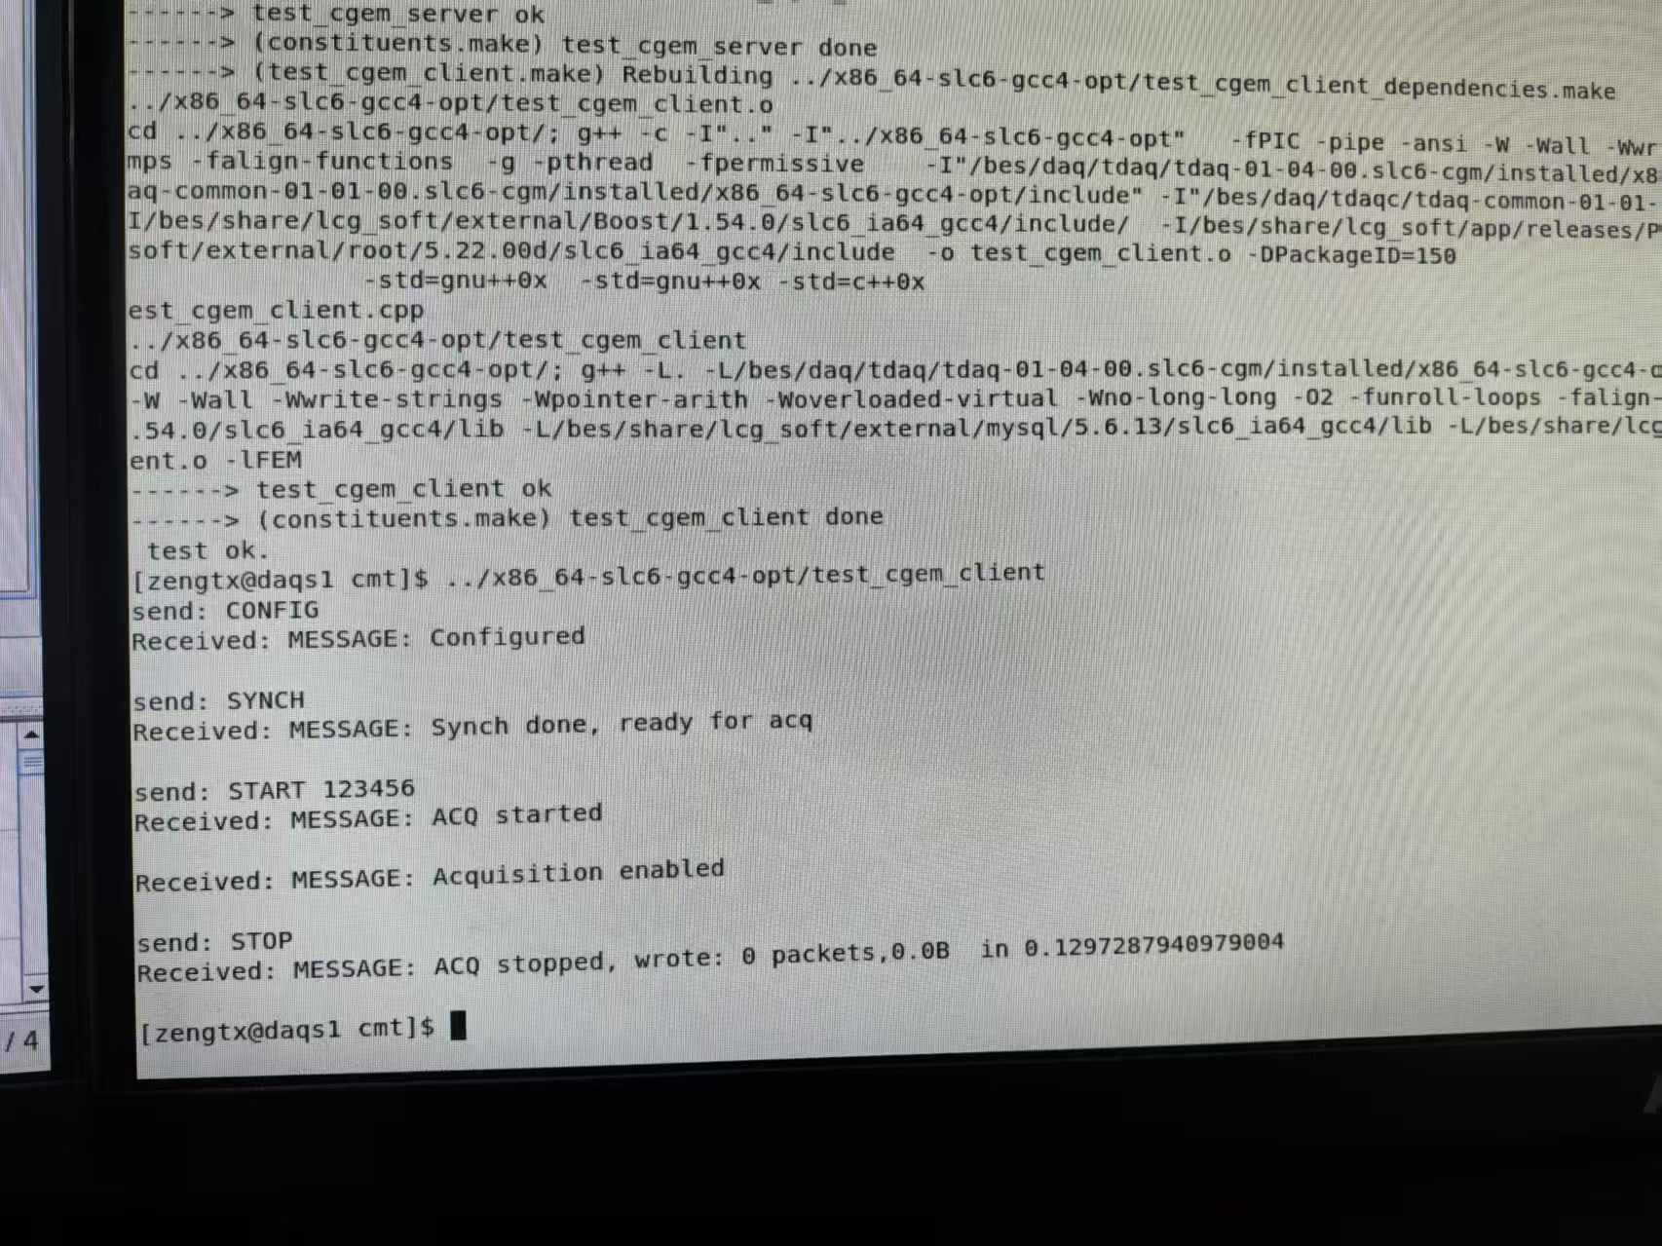
Cgem GUFI communication with BES 3 DAQ
Code development almost finished, 70%.
Has test interface with Antonial and confirmed the exactly response message today.
Try to run BES 3 DAQ with the modified code. (doing)
adjusting some of the xml file configuration

Slide 3
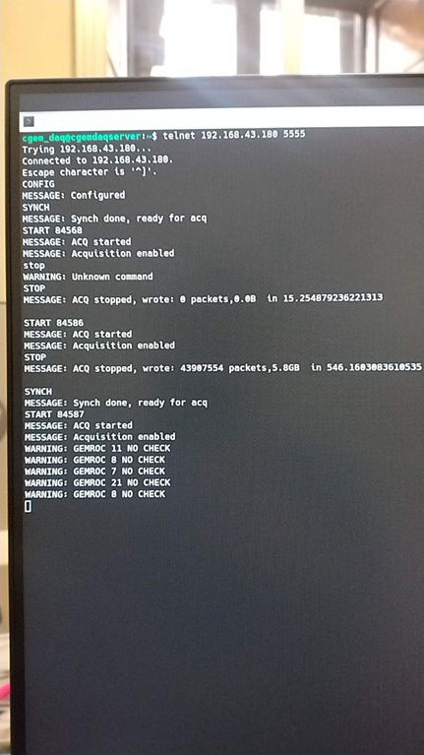
1. Send config
config
config
2. Recv config ok or config error
SYNC1
……
3. Send SYNC
For step 2, 4, 6, 8 :
If received error, report “ERROR” to the GUI and return
If received OK, continue jump to the next state machine.
SYNC4
SYNC
4. Recv SYNC ok or ERROR
5. Send START runnumber
PrepareForRun
START
6. Recv START ok or ERROR
After stopped, the state machine should jump to the configed state so that can start without reconfiguration.
StartTrigger
7. Send STOP
STOP
STOP
8. Recv STOP ok or ERROR
BES3 DAQ
CGEM GUFI DAQ
A daemon is now running, listening for TCP connections on port 192.168.43.180:5555.

Slide 4
Recheck the checkbit of the 10 runs
 | BES3 event number in data file | CGEM uniq trigger number(all gemrocs same ) | CGEM Last Trigger number(all gemrocs same) | Consistent ? | CGEM Checkbit error?(2 bits) | Remarks
RUN 84576 | 2541251 | 2541251 | 2541251 | Yes | No
RUN 84577 | 2341672 | 2341672 | 2341672 | Yes | No
RUN 84578 | 711382 | 711463 | 711463 | Yes | No
RUN 84581 | 1067501 | 1067501 | 1067501 | Yes | No | 1.1KHz 16min one gemroc has communication error
RUN 84583 | 569764 | 569764 | 569764 | Yes | No | 700Hz
RUN 84585 | 3102713 | 3102713 | 3102713 | Yes | No | 2.4~4KHz
RUN 84586 | 1995785 | 1995785 | 1995785 | Yes | No | 4KHz~6KHz
RUN 84587 | 1603817 | 1603817 | 1603817 | Yes | Yes 14740 error (~34sec) | 4KHz~6KHz Disconnect check cable
RUN 84588 | 535683 | 535683 | 535683 | Yes | No | 4.5KHz cgem tiger has communication error
RUN 84589 | 1455347 | 1455347 | 1455347 | Yes | Yes 10538 error ( ~27sec ) | 4.5KHz 5min Disconnect check cable

Slide 5
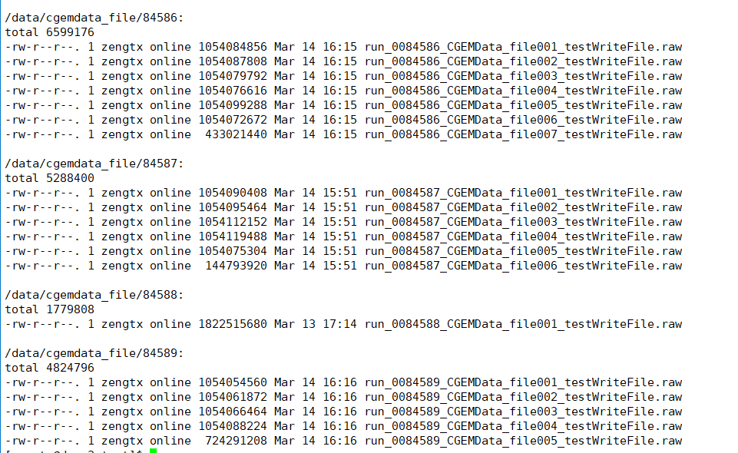
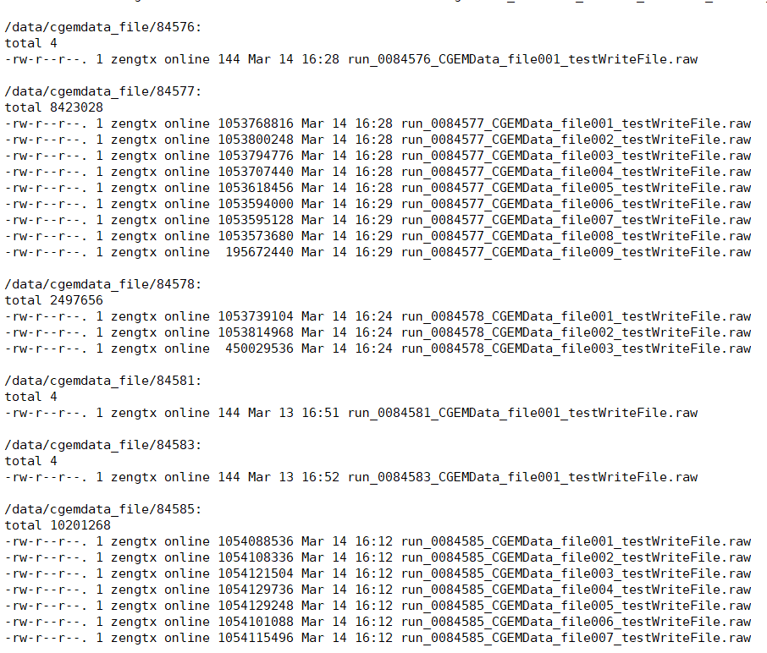
Data File merge interface
Merged the data files of the 10 runs.
preparing the merge and upload scripts and instructions.

Slide 6
Before: Don’t take checkbit==0 as error.
After: Take checkbit==0 while gemroc L1 count %256==0 as error.

Slide 7
