Slide 1
Flavor-tagging using BDT
2025 0317

Slide 2
Content
Motivation
Features
BDT results
Truth match
Lepton ID
from yifan
from changhua

Slide 3
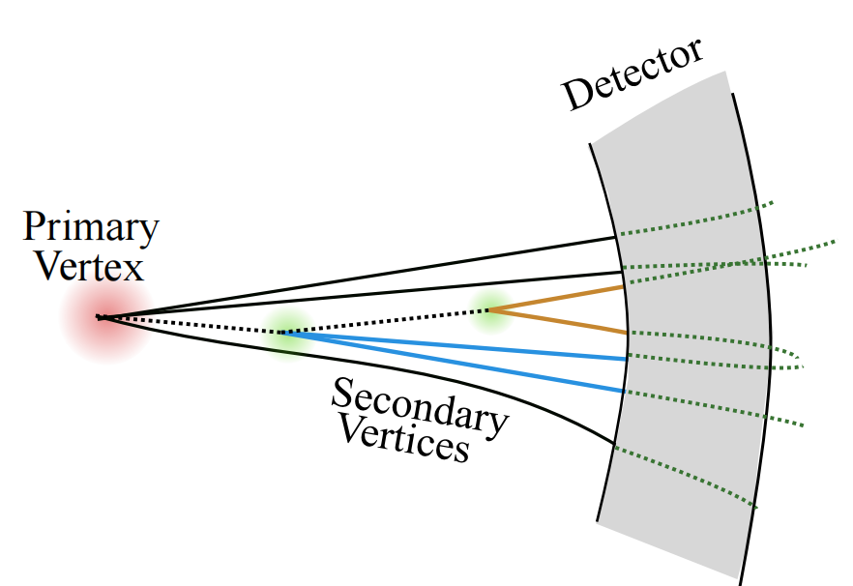
Motivation
>90% of ZH events contains jets
Jet Flavor Tagging is critical for revealing fundamental physical processes

Slide 4
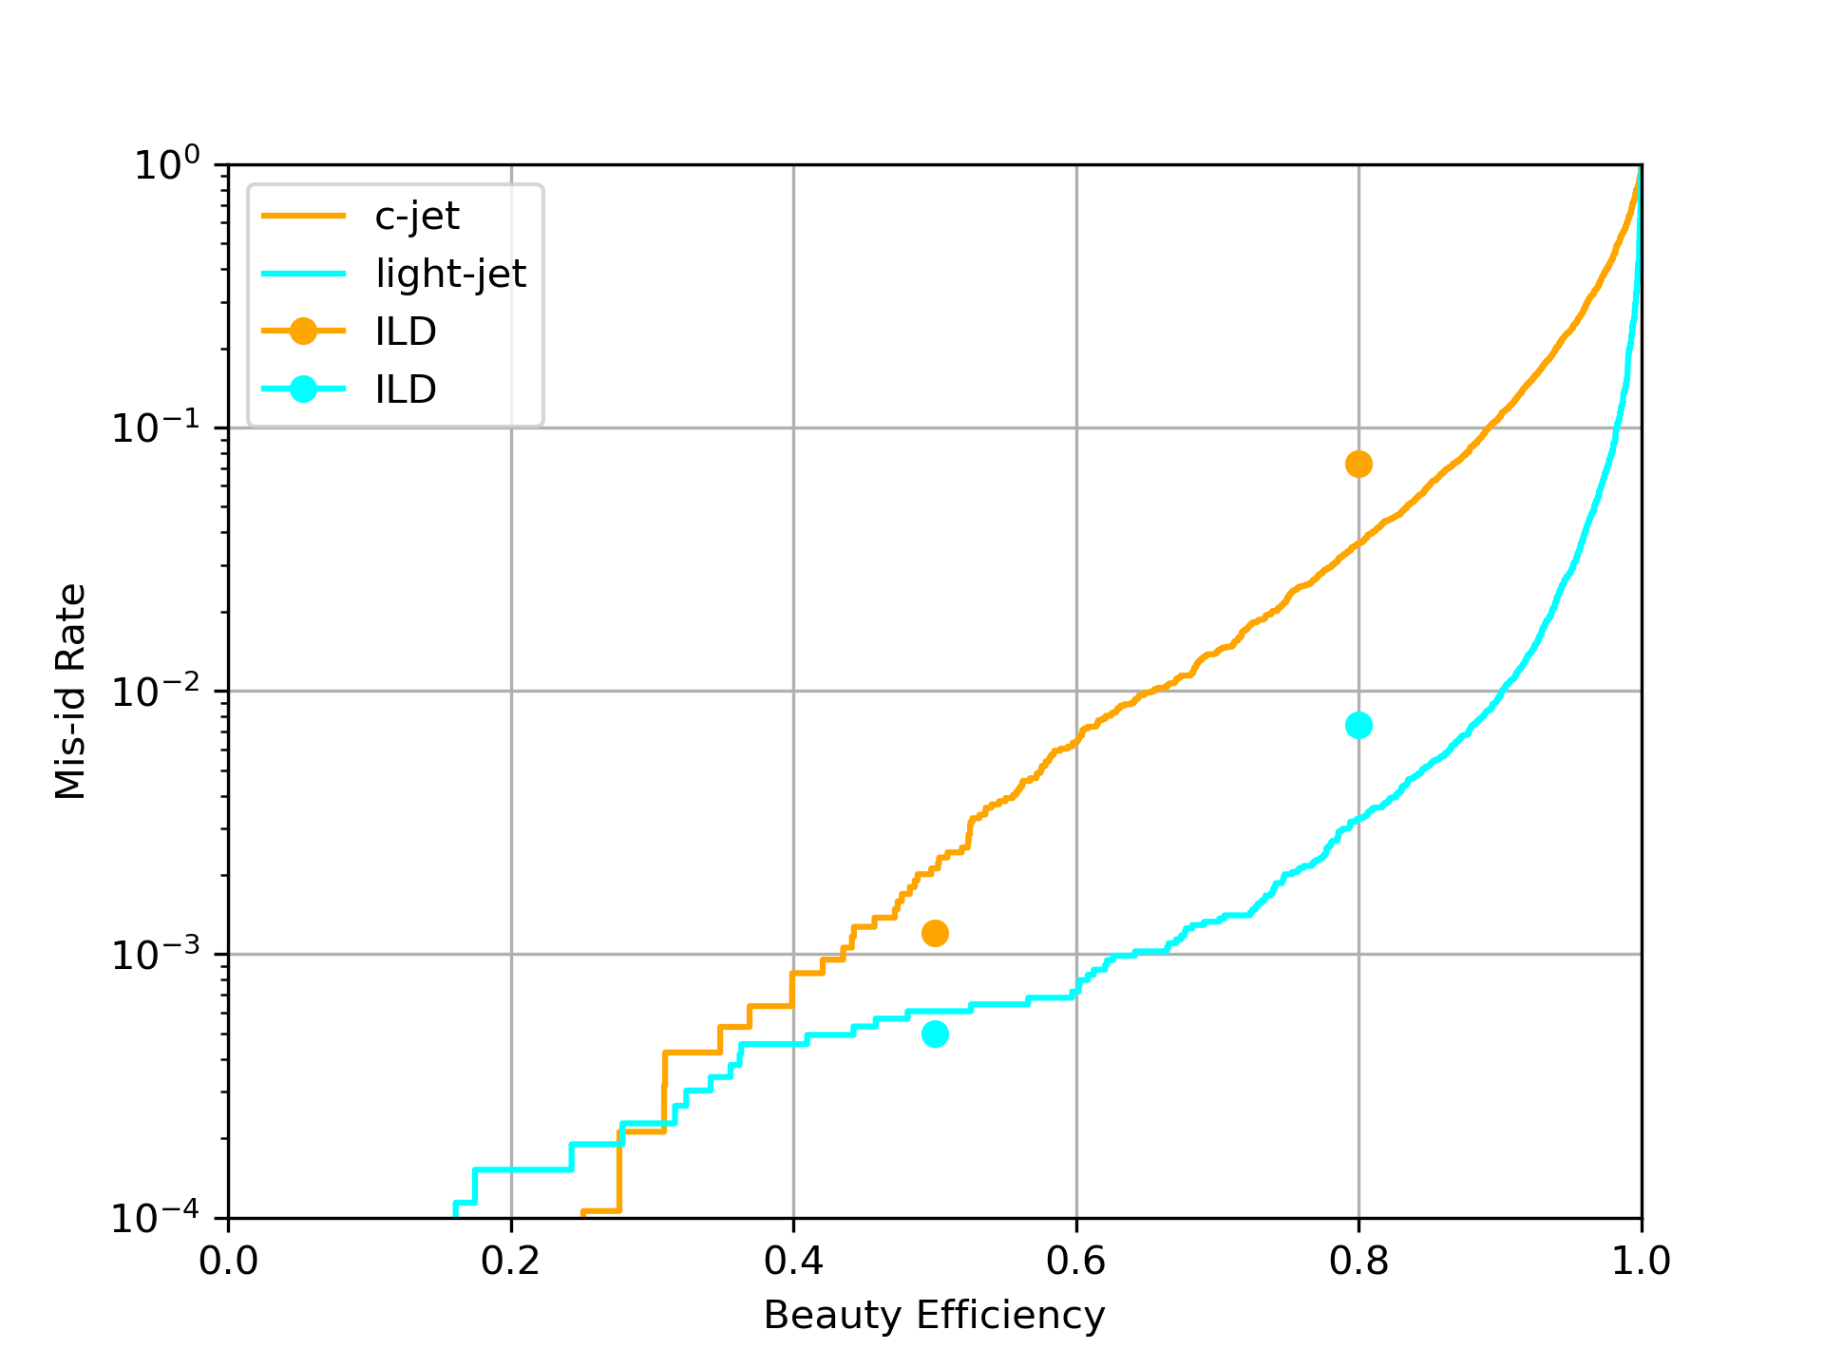
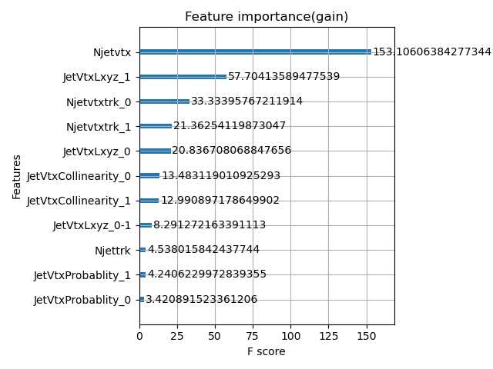
Motivation
from previous job
the performance not as good as those in ILD
Need to add more variables refer to ILD
ILD paper
https://arxiv.org/abs/1506.08371

Slide 5
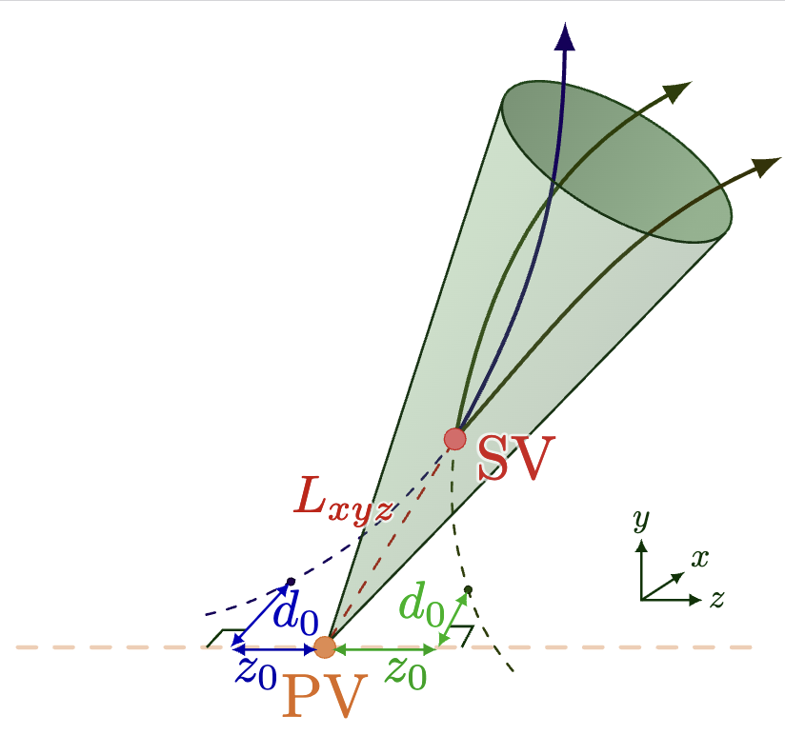
Features
track level features
Number of tracks in a jet
Number of tracks associated to a vertex
track parameters(d0/z0) ...
vertex level features
Number of vertices in a jet
Flight of distance of a vertex ...
number of features:
33 used from ILD
add 7 from ours
*Only the first two vertices information used when using vector-liked features

Slide 6
Feature categorize
ild_features: choose the features same as those in ILD paper
features_ild = ["SingleVtxProb", "JetVtxLxyz_0", "JetVtxLxyz_1", "vtxlen12","JetVtxAngle_0", "JetVtxAngle_1", "vtxsig_0", "vtxsig_1","vtxsig12", "vtxmult", "Njetvtxtrk_0", "Njetvtxtrk_1", "JetVtxMomenta_0", "JetVtxMomenta_1" ,"JetVtxMass_0", "JetVtxMass_1", "trk1d0sig", "trk2d0sig", "trk1z0sig", "trk2z0sig", "trk1pt", "trk2pt", "nelectron", "nmuon", "JetTotalVtxMass","allTrackD0bprob", "allTrackD0cprob", "allTrackD0qprob", "allTrackZ0bprob", "allTrackZ0cprob", "allTrackZ0qprob","allTrackMass", "JetVtxProbablity_0" ,"JetVtxProbablity_1"]
all_features: choose both of ILD_features and features added
features_ild +
Njettrk, Njetvtx, Njetvtxfrac, JetVtxCollinearity, JetVtxChi2, JetVtxEnergy, JetVtxKin

Slide 7
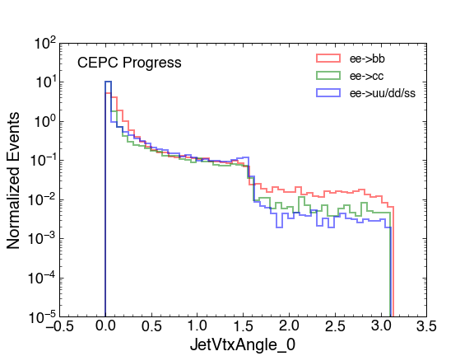
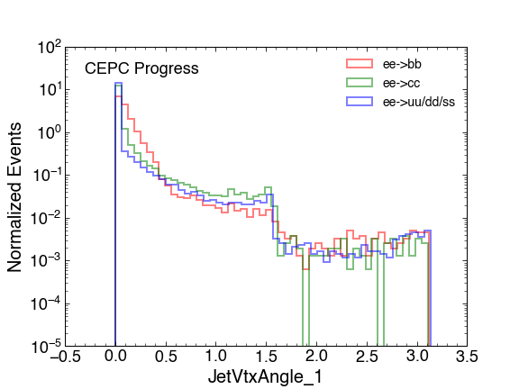
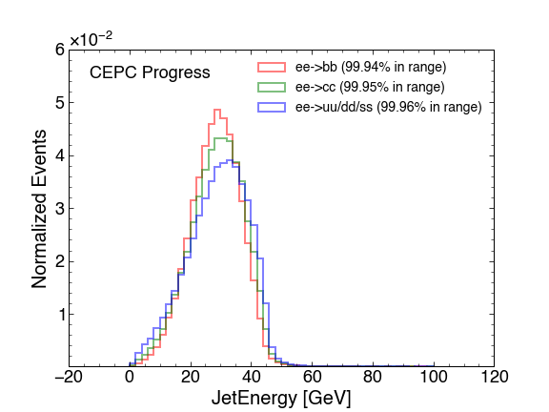
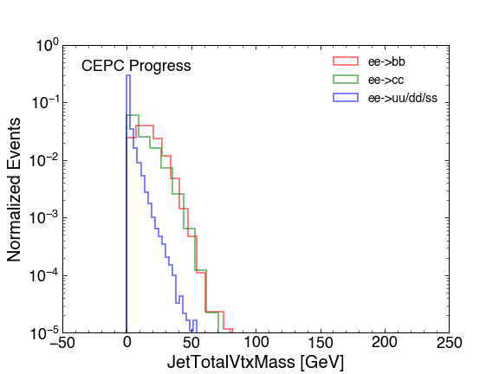
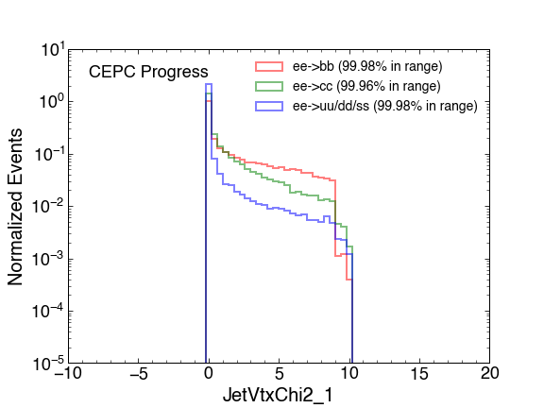
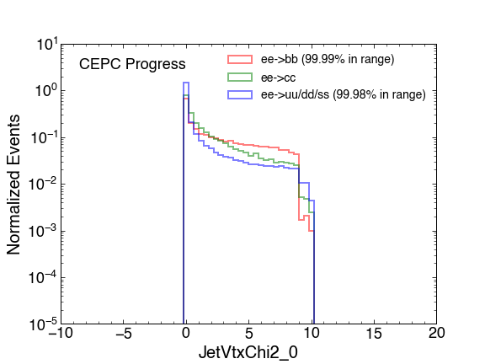
Jet Tagging Vars Distribution
The distribution and definition of all variables can be found in the backup

Slide 8
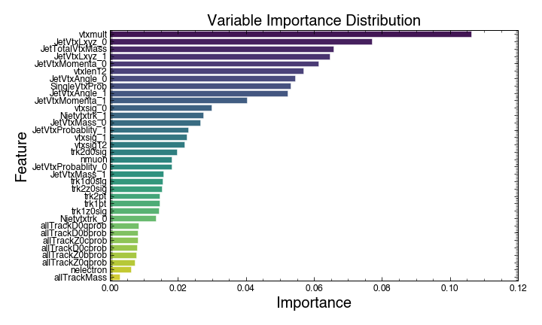
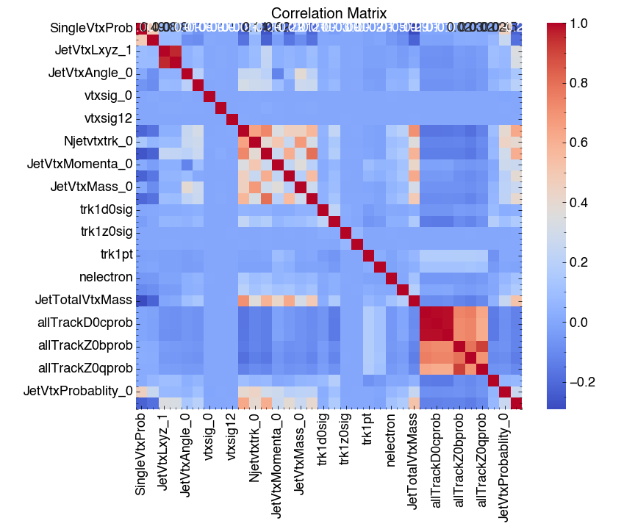
Vars importance and correlation
ild_features

Slide 9
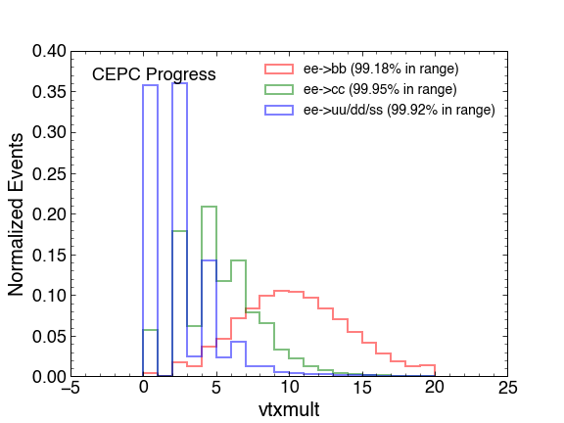
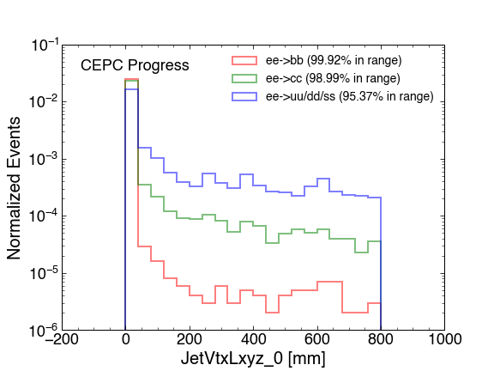
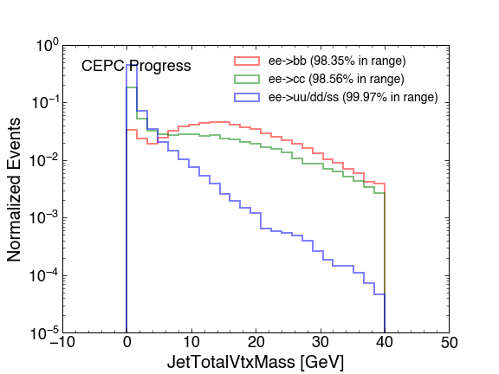
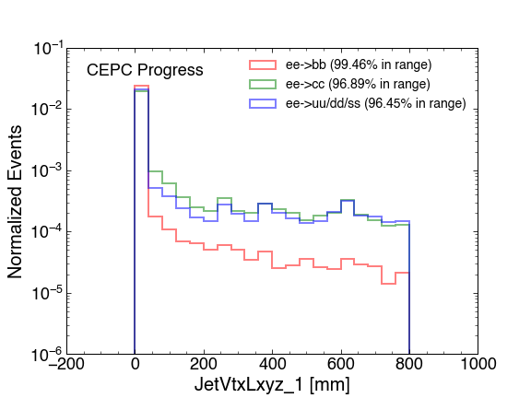
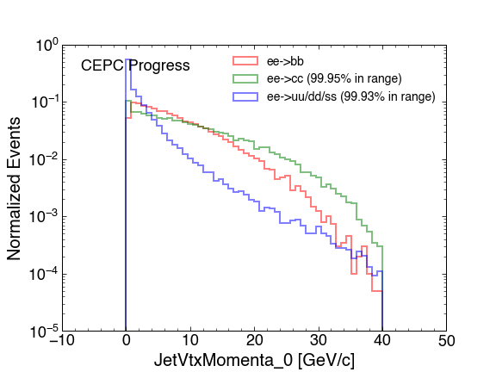
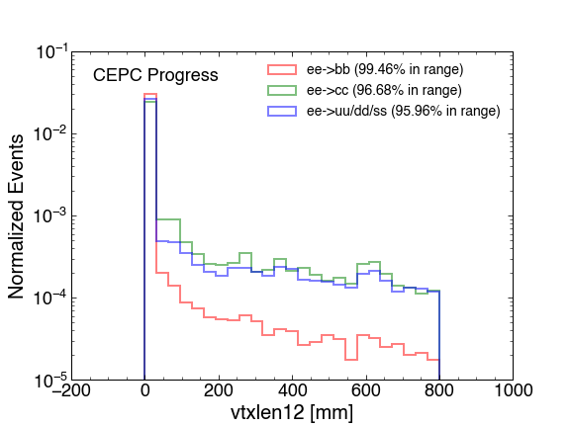
Discriminating vars

Slide 10
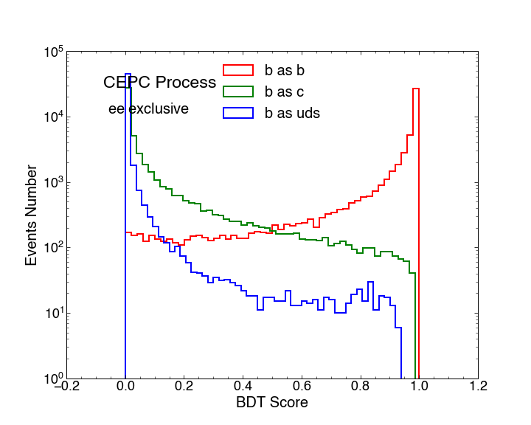
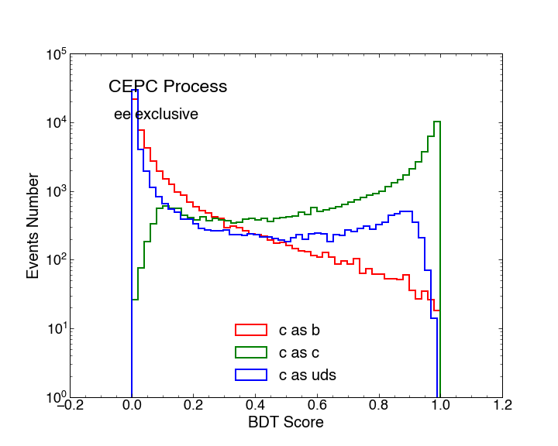
BDT results
ee->bb
ee->cc
ild_features
Score | b_eff | c_rej_eff | uds_rej_eff
0.30 | 0.95 | 0.89 | 0.98
0.60 | 0.90 | 0.96 | 0.99
0.90 | 0.75 | 0.99 | 0.99
Score | c_eff | b_rej_eff | uds_rej_eff
0.30 | 0.88 | 0.91 | 0.81
0.60 | 0.75 | 0.97 | 0.88
0.90 | 0.5 | 0.99 | 0.98

Slide 11
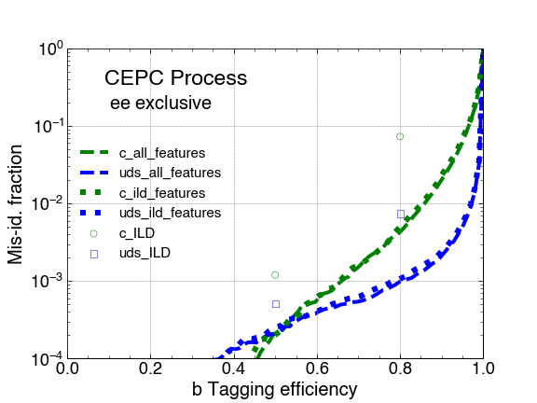
BDT results
the c-jet rejection improves by a factor of 17 (5) at a b-tagging efficiency of 0.8 (0.5).
the uds-jet rejection improves by a factor of 7 (2) at a b-tagging efficiency of 0.8 (0.5).

Slide 12
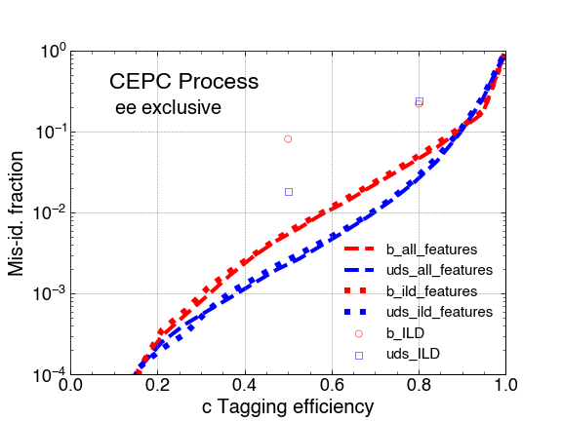
BDT results
the b-jet rejection improves by a factor of 4 (15) at a b-tagging efficiency of 0.8 (0.5).
the uds-jet rejection improves by a factor of 8 (7) at a b-tagging efficiency of 0.8 (0.5).

Slide 13
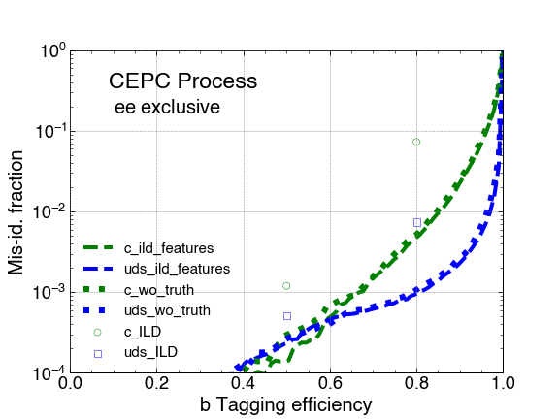
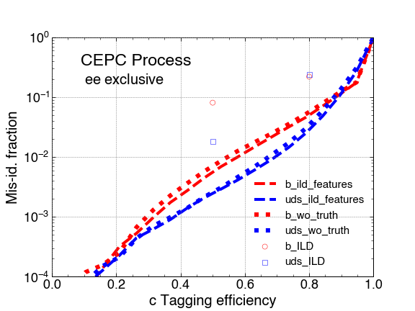
Remove the truth lepton PID

Slide 14
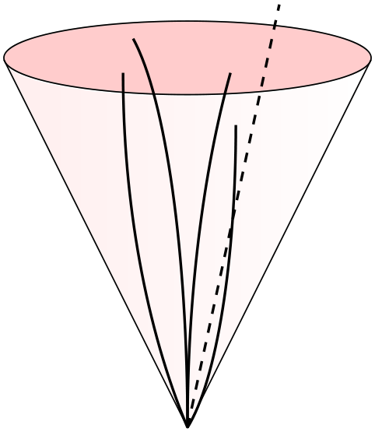
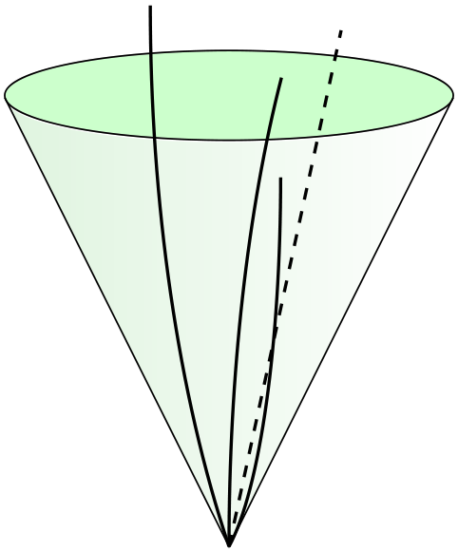
Truth matching idea
Reconstructed jet: clustered tracks
Truth jet: clustered MCP (charged & stable)
Match truth jet to reconstructed jet
Truth vertex: vertex of MCP in matched truth jet
from yifan
MCP collection
clustering
match
match
constituent
truth
reconstructed
truth vertex

Slide 15
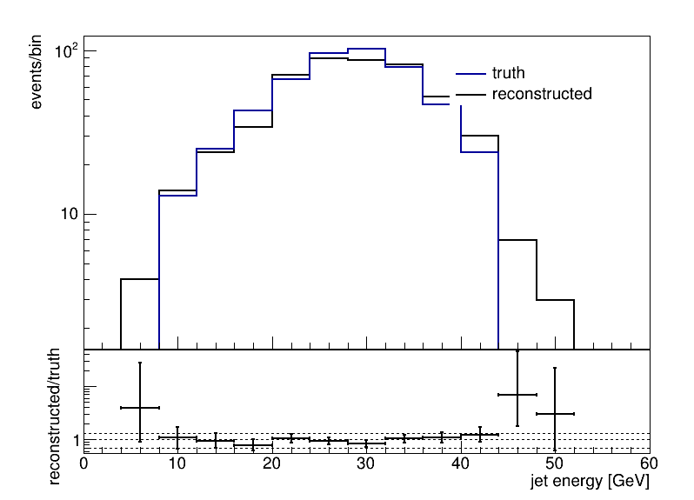
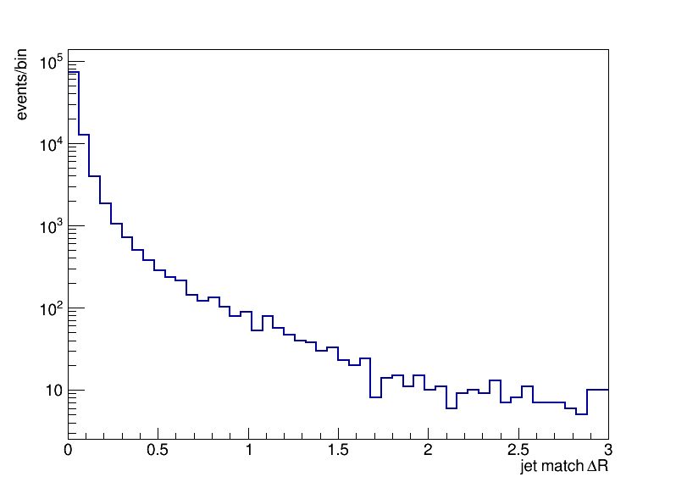
Jet matching performance
ee->bb @ 240GeV
Match jet by ΔR
ΔR and energy match well

Slide 16
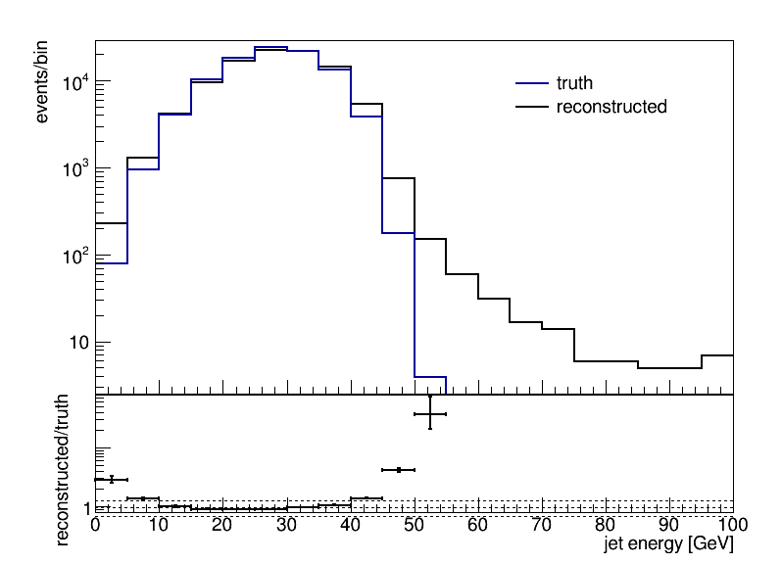
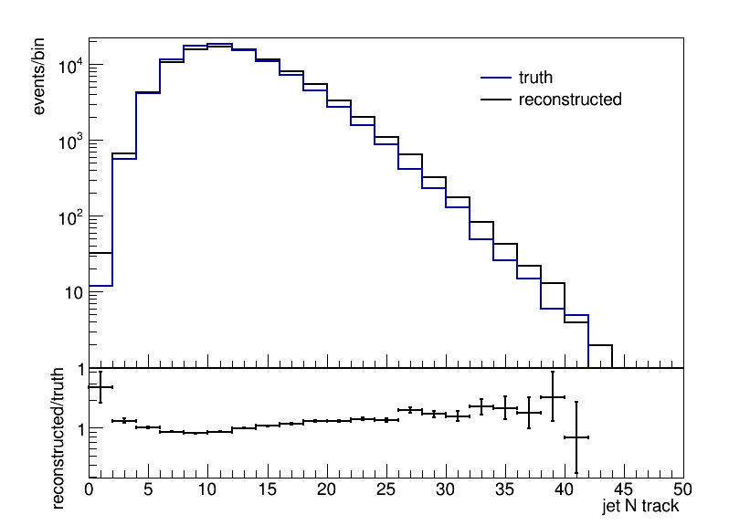
Jet vars
ΔR < 0.4
N tracks in jet matches well

Slide 17
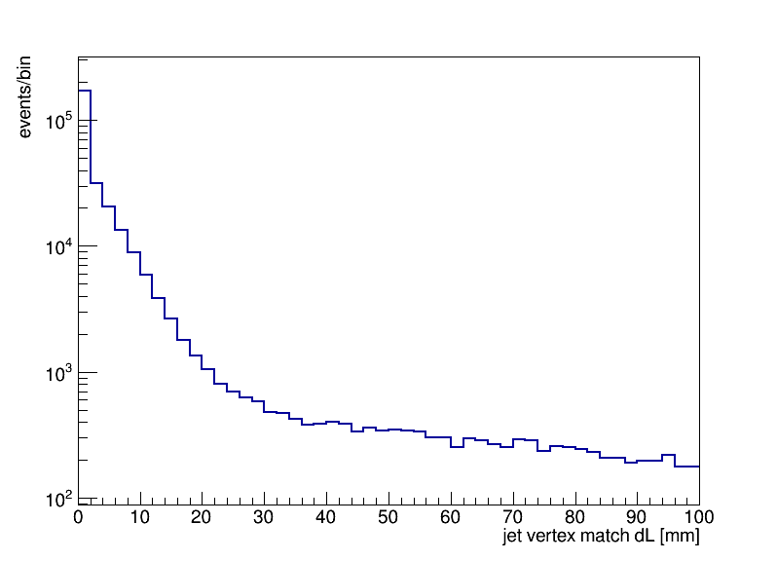
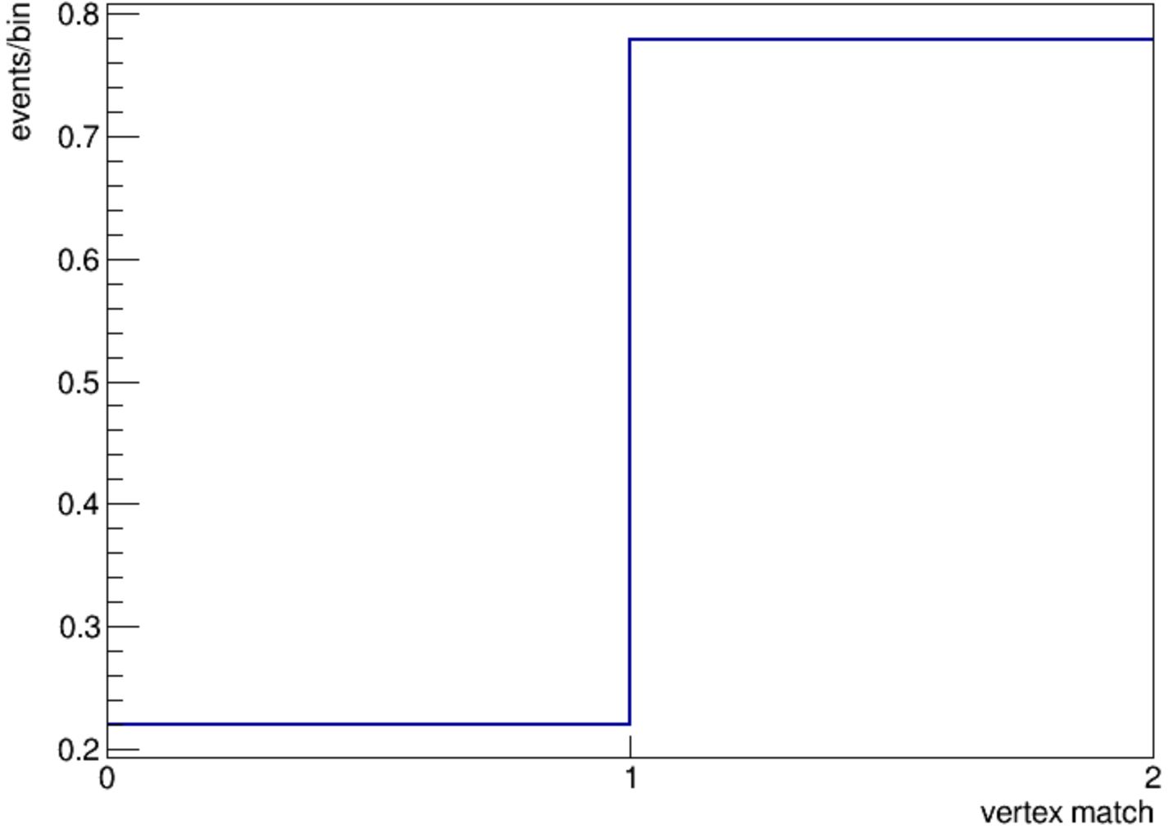
Vertex matching performance
Criteria: Match vertex by distance (jet ΔR < 0.4)
Resolution: ~cm
unmatched
matched

Slide 18
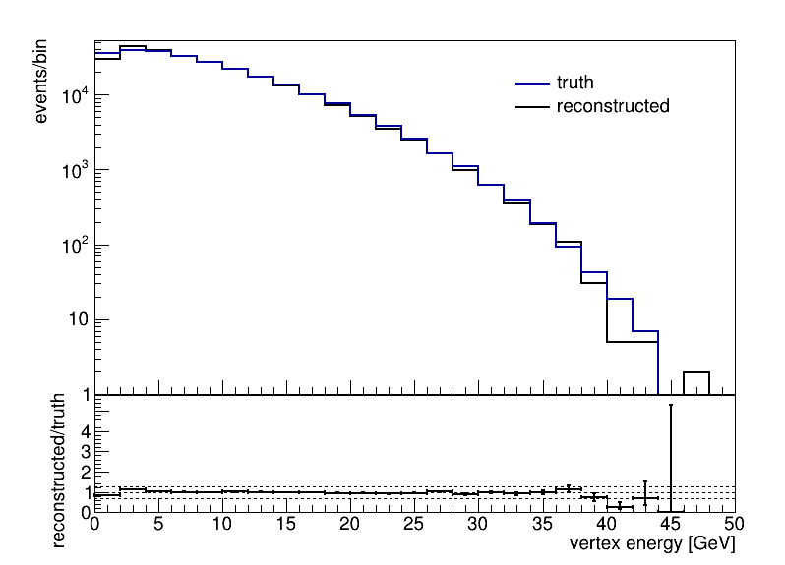
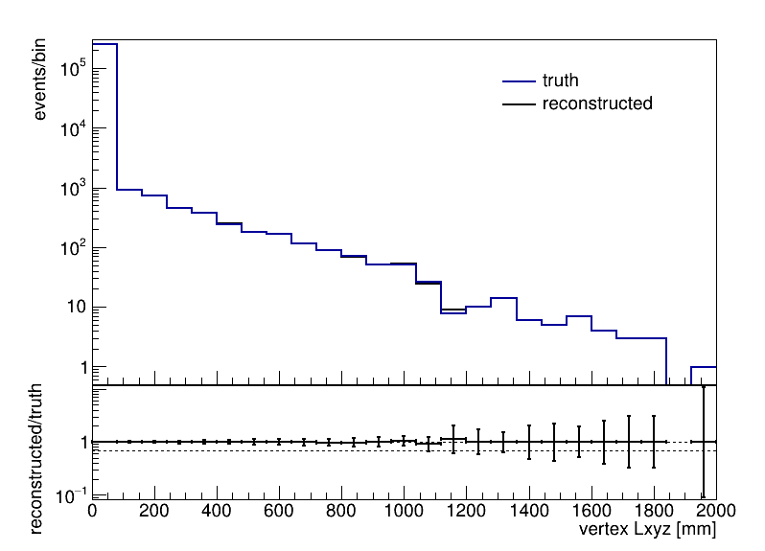
Vertex vars
dL(reco, truth) < 20mm
Good agreement

Slide 19
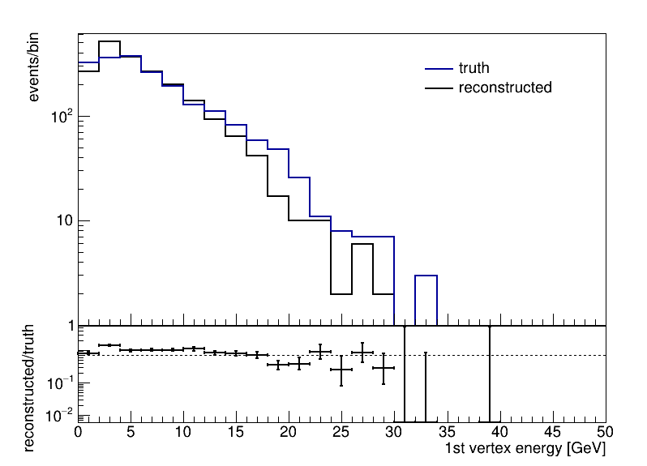
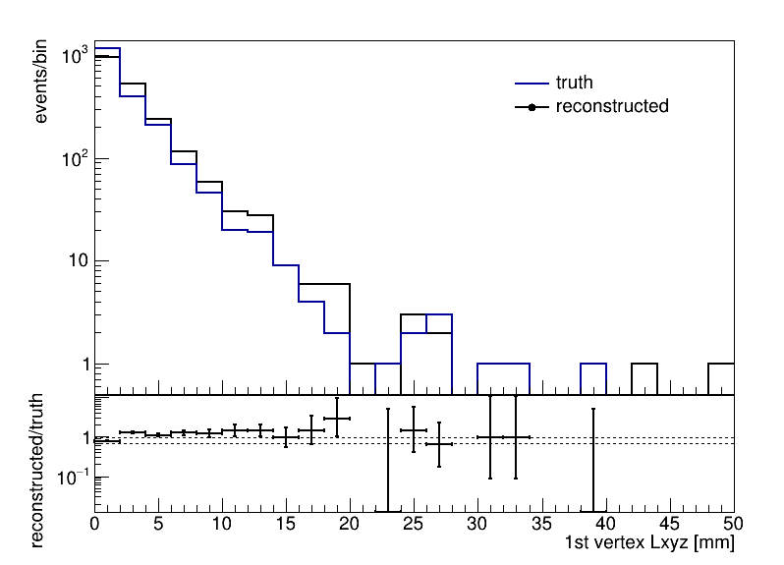
First secondary vertex vars
dL(reco, truth) < 20mm
Secondary vertex closest to IP/primary vertex
Good agreement

Slide 20
Lepton ID
Basic Idea
from changhua
chi2_dndx
chi2_tof
Eecal
Ehcal
Rhad
p
theta
output
chi2
track
chi2_dnd’
chi2_tof’
Eecal’
Ehcal’
Rhad’
“e/mu library”
the smaller the chi2, the higher the similarity between the reco particle and the records in the library
edm4hep::RecDqdxCollection, RecTofCollection, ReconstructedParticleCollection
still in process

Slide 21
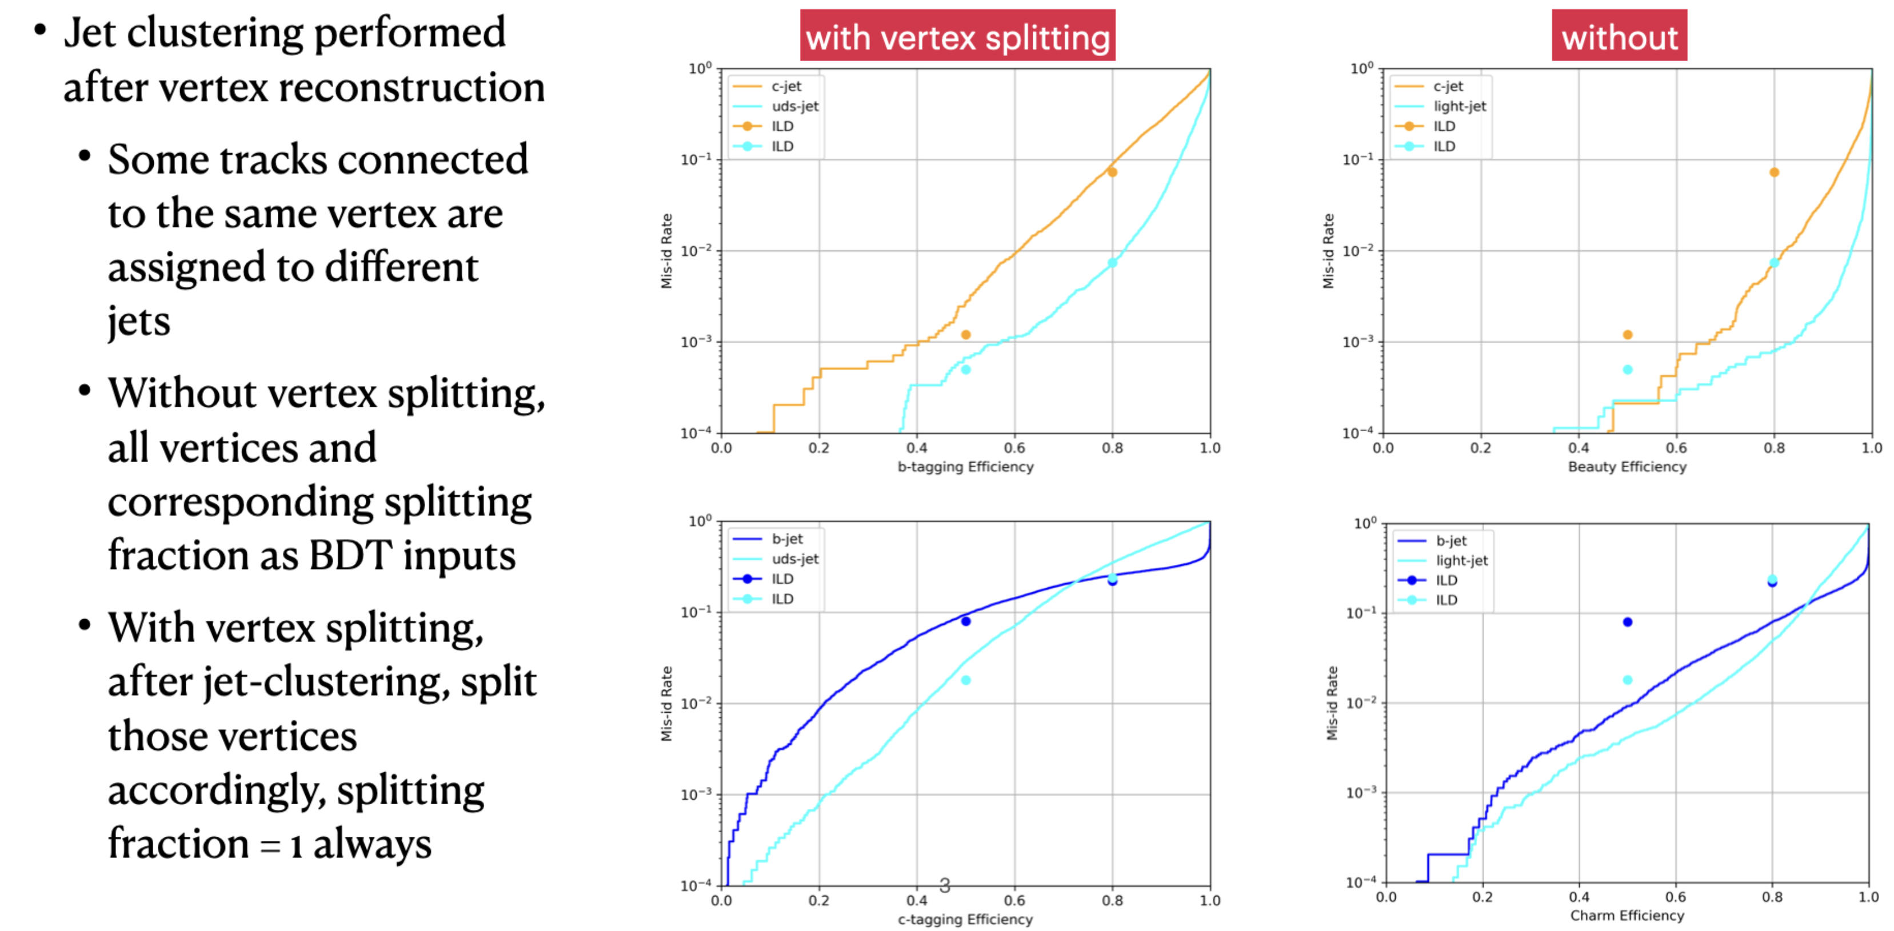
Njetvtxfrac

Slide 22
Thank You !

Slide 23
Backup

Slide 24
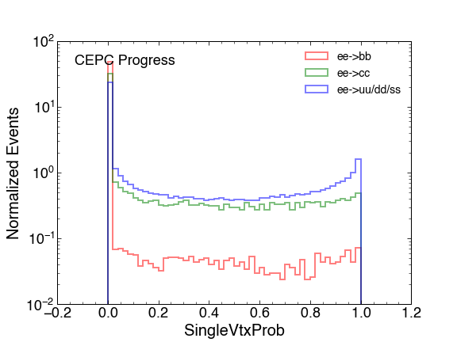
Features in ILD

Slide 25
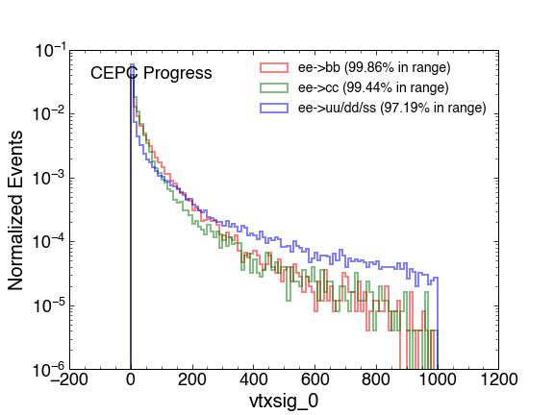
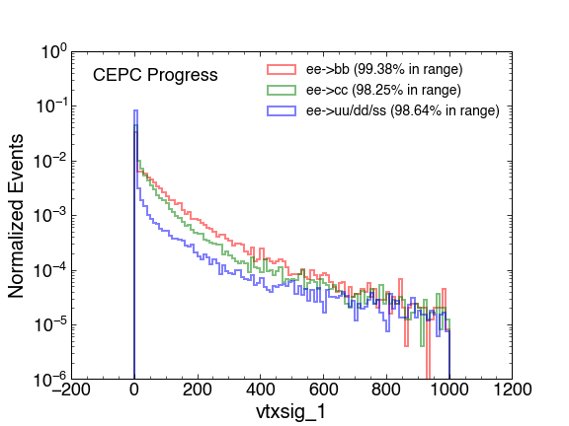
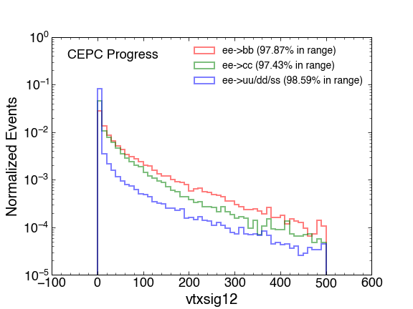
Features in ILD

Slide 26
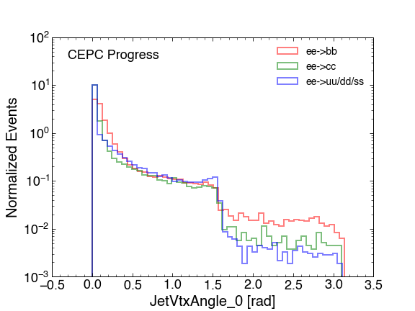
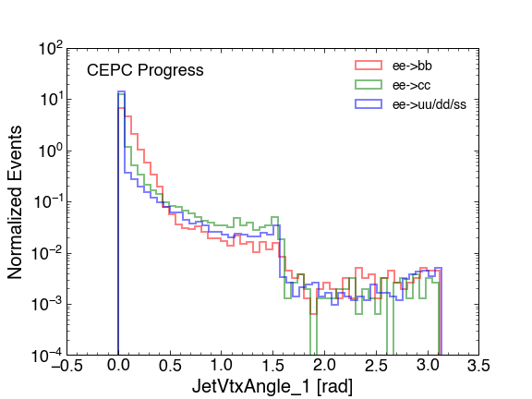
Features in ILD

Slide 27
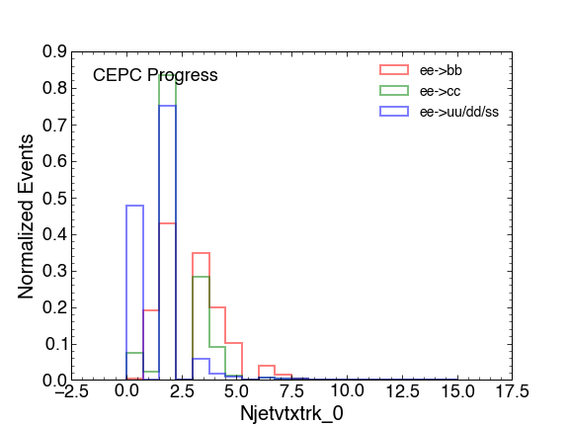
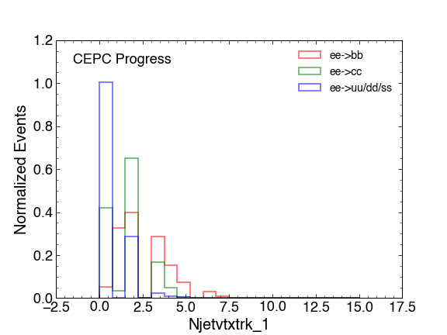
Features in ILD

Slide 28
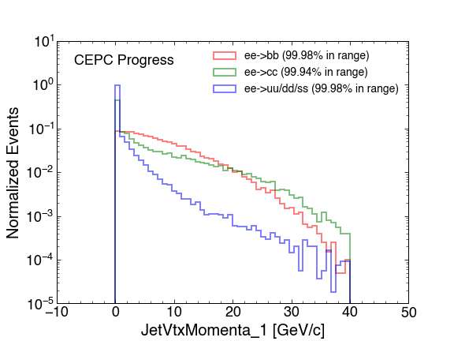
Features in ILD

Slide 29
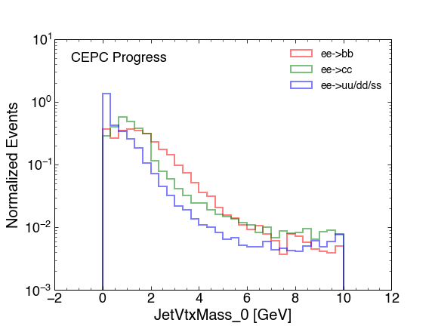
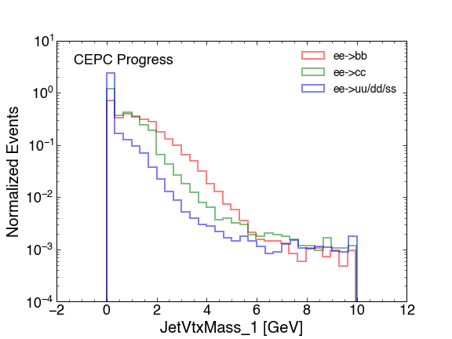
Features in ILD

Slide 30
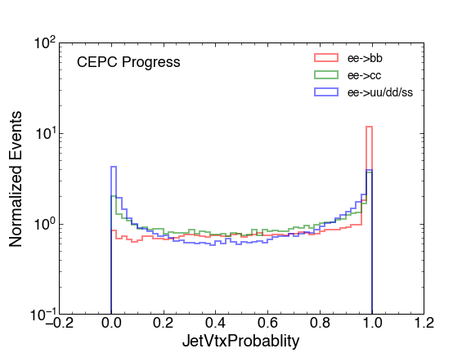
Features in ILD

Slide 31
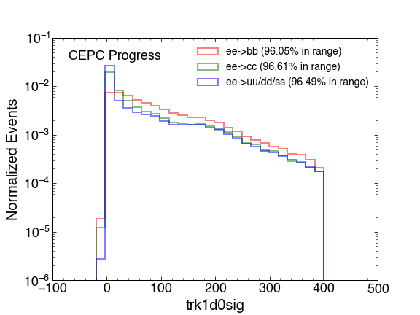
Features in ILD

Slide 32
Features in ILD

Slide 33
Features in ILD

Slide 34
Features in ILD

Slide 35
Features in ILD

Slide 36
Features added
Njettrk: the number of tracks in the jet
Njetvtx: the number of secondary vertexes in the jet
Njetvtxfrac: the fraction of a given secondary vertex’s tracks that fall within that jet’s region.

Slide 37
Features added
JetVtxCollinearity: Collinearity between the secondary vertex position and
the sum of momenta of associated tracks
JetVtxChi2: the χ2 of the secondary vertices

Slide 38
Features added
JetVtxEnergy: the sum of the tracks’ energy from the secondary vertex
JetVtxKin: the dot product of the tracks’ momentum with the secondary vertex displacement vector.

Slide 40
Content

