Slide 1

CEPC meeting
H_recoil Status Report
Yuji Li(Fudan university)

Slide 2

Status
In this formula, the width of Z/H should be measured as a constant with H invisible events.
Muon Selection:
pt>5GeV cos(theta)<0.85 (depends on v24.10)
Clear relation between Z boson momenta and H recoil.
BKG Inputs: /cefs/higgs/liugeliang/CEPC/202501/Production/4fermions/
/cefs/higgs/liugeliang/CEPC/202501/Production/2fermions/
SIG Inputs: ZH, (Z->mumu, H->inclusive, v24.10)

Slide 3
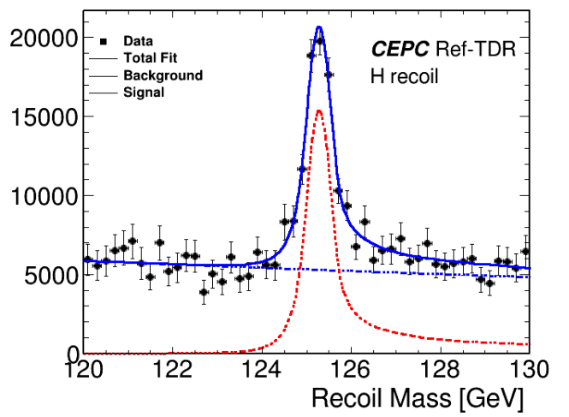
S+B Combination
Lumi: 20000(fb-1)
xs zz_l0mumu=19.38;
xs sznu_l0mumu=43.42
xs 4mu=15.56;
xs sl0mu_down=136.14;
xs sl0mu_up=87.39;
xs zzorww_l0=221.10;
(xs ll=5332.71);
Fitted by exponential & TwosidedCB

Slide 4
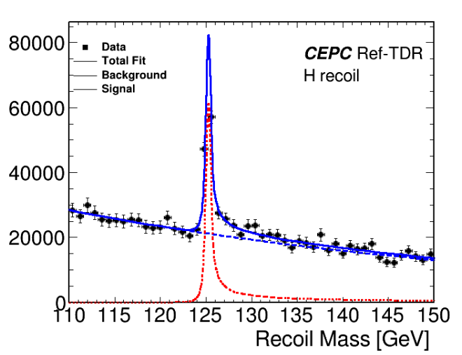
S+B Combination
Lumi: 20000(fb-1)
xs zz_l0mumu=19.38;
xs sznu_l0mumu=43.42
xs 4mu=15.56;
xs sl0mu_down=136.14;
xs sl0mu_up=87.39;
xs zzorww_l0=221.10;
(xs ll=5332.71);
Fitted by exponential & TwosidedCB
Mass=125.277 GeV Error = 2.08331e-03
Sigma = 0.294 GeV Error = 2.16136e-03

Slide 5
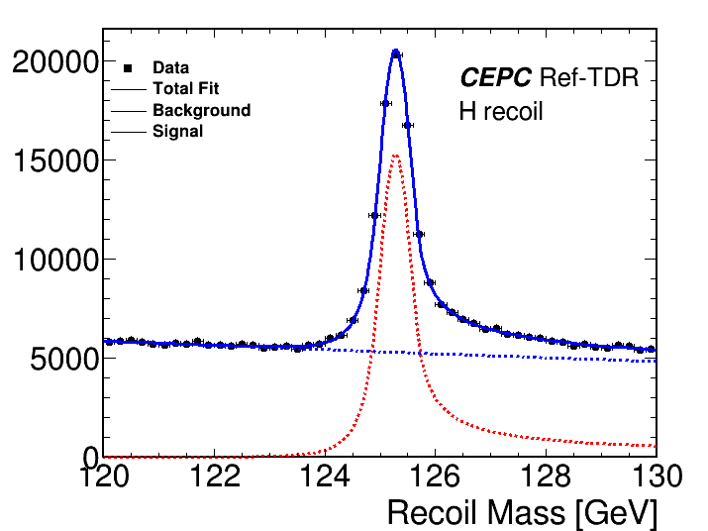
ReFit with ToyMC
Lumi: 20000(fb-1)
xs zz_l0mumu=19.38;
xs sznu_l0mumu=43.42
xs 4mu=15.56;
xs sl0mu_down=136.14;
xs sl0mu_up=87.39;
xs zzorww_l0=221.10;
(xs ll=5332.71);
Fitted by exponential & TwosidedCB
Mass=125.281 GeV Error = 2.4 MeV

Slide 6
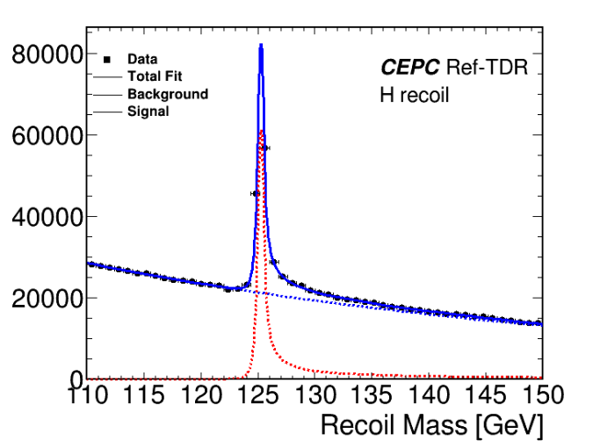
ReFit with ToyMC
Lumi: 20000(fb-1)
xs zz_l0mumu=19.38;
xs sznu_l0mumu=43.42
xs 4mu=15.56;
xs sl0mu_down=136.14;
xs sl0mu_up=87.39;
xs zzorww_l0=221.10;
(xs ll=5332.71);
Fitted by exponential & TwosidedCB
Mass=125.273 GeV Error = 2.12 MeV

Slide 7

Summary and plans
MuonID has been implemented in CEPCSW, where new samples has been produced by Kaili, will update the muon selection in this study.
Lepton Pair selection：
Sys. uncertainty will be added in several aspects.
Event selection will be optimized by Zhilang.

