Slide 1

Hyperon-Nucleon Spectrometer at HIAF
QPT2025 Guilin
Aiqiang Guo (guoaq@impcas.ac.cn)
Institute of Modern Physics, Chinese Academy of Sciences

Slide 2
Outline
Introduction of physics
H-NS at HIAF
Summary and Outlook

Slide 3
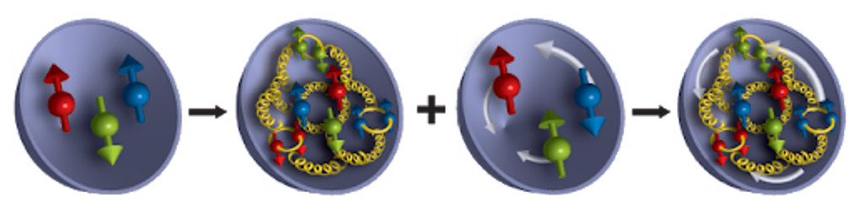
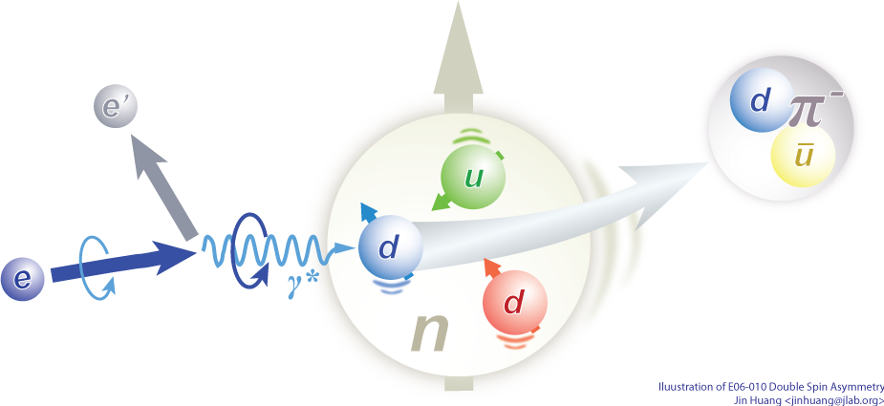

About nucleon spin structure
1988 EMC experiment → “Spin crisis”
Electron-ion scatering process
Pion/Kaon
1970s
1980s/2000s
Now
Spin decomposition:
$S_{tot}=\frac{1}{2}= \frac{1}{2}∆Σ+∆G+$ $𝓛_{q}+𝓛_{g}$
Detailed in Yuxiang’s talk!
Quark spin
Gluon Spin
Quark OAM
Gluon OAM
We have a framework for the understanding of the spin structure of the nucleon

Slide 4

Spin and its polarization
Polarization: spin of particles in a system is aligned in a preferred direction.
$${\hat{S}}_{z}$$
Reference plane

Slide 5
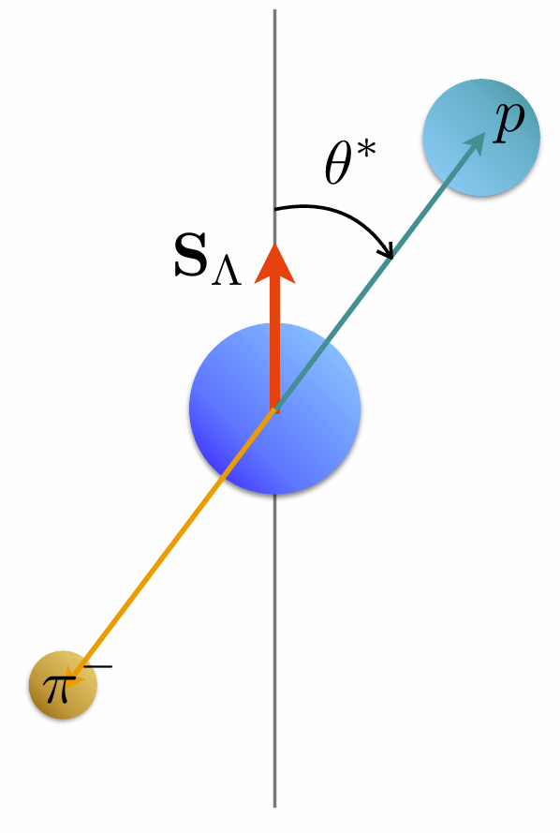
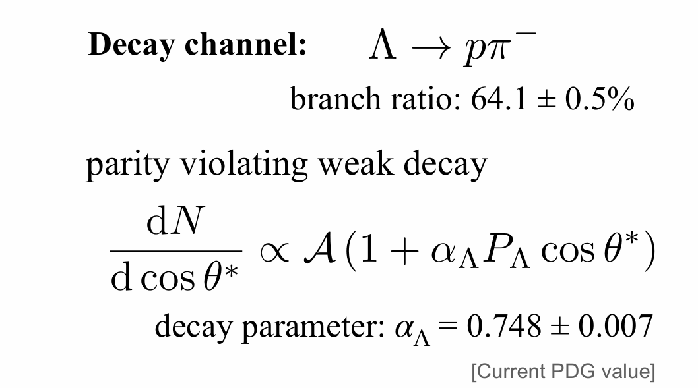
Spin and its polarization
$Λ^{0}$ serves as its own spin analyzer through the decay $Λ^{0}→p+π^{−}$

Slide 6
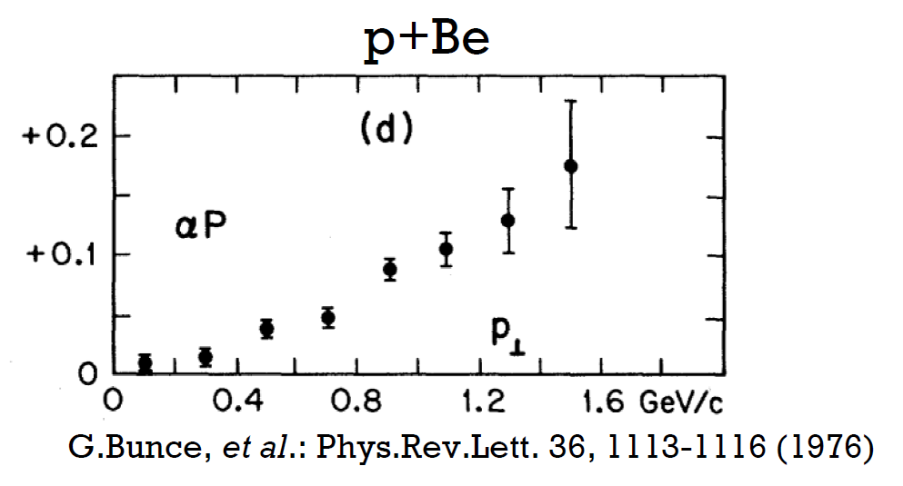

First observation of $Λ^{0}$ polarization in the 1970’s
Hyperons can be produced polarized in collisions of unpolarized particles
Discovered at Fermilab in the 1970’s in p + Be collisions: 300 GeV protons on Beryllium

Slide 7
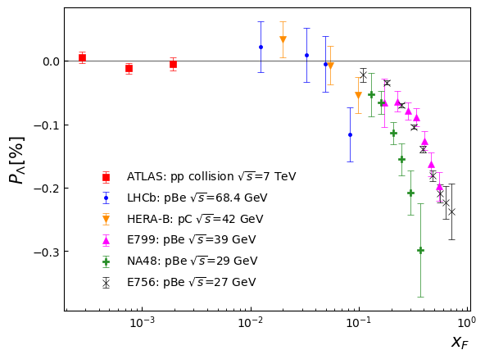
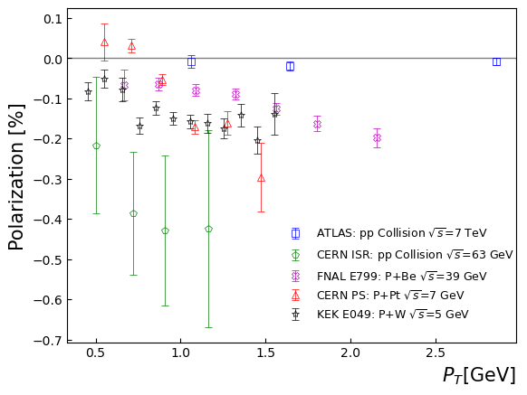
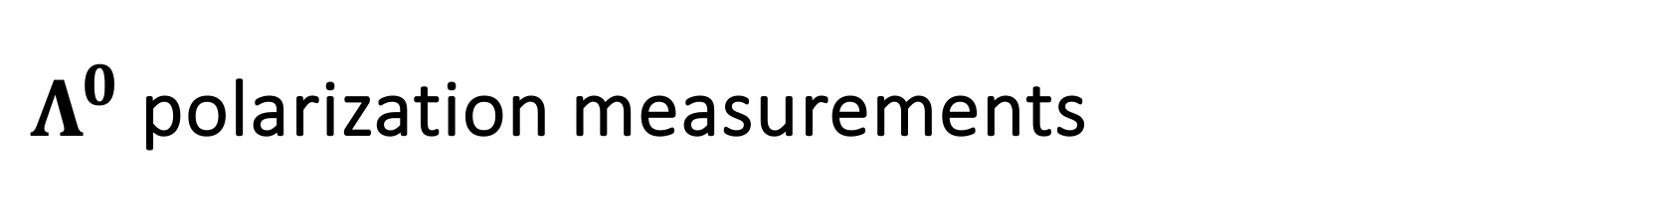
$Λ^{0}$ polarization measurements

Slide 8
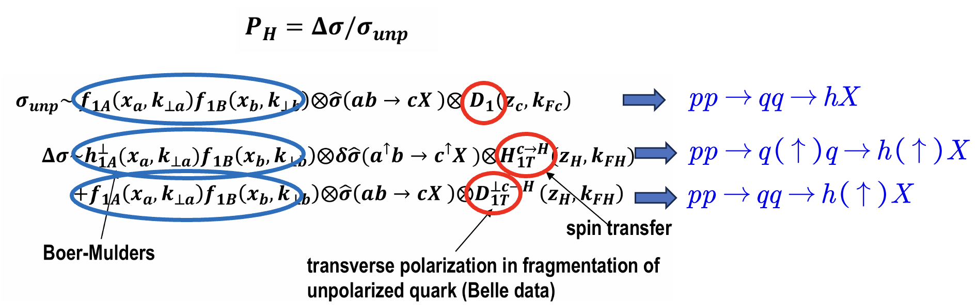
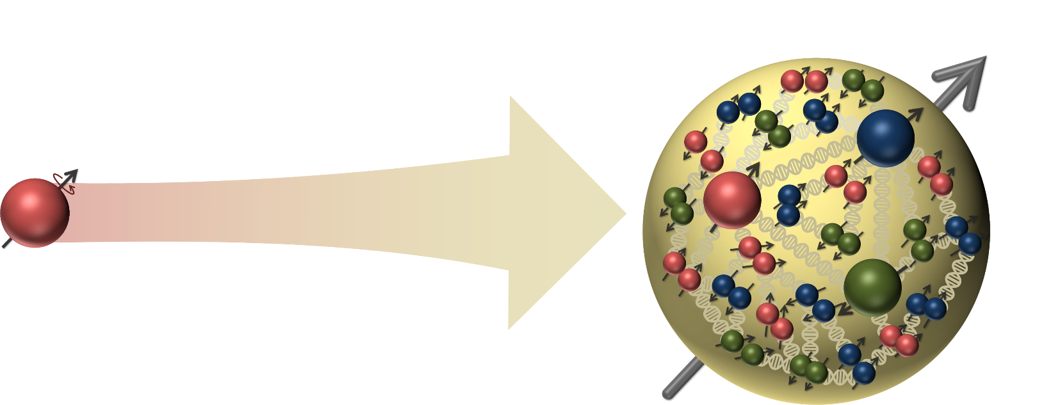
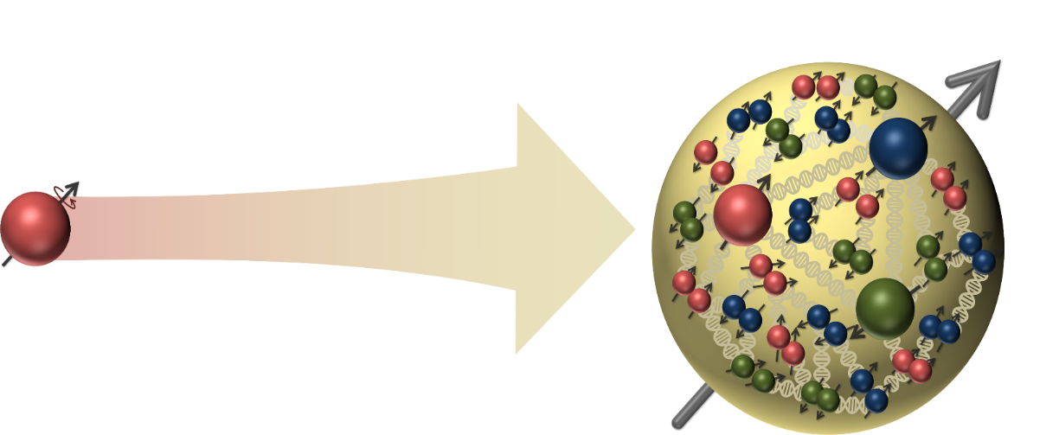



Origin of $Λ^{0}$ polarization?
The origin of polarization cannot be explained under perturbative QCD
Possible explanation:
Fragmentation?
Spin transfer?
$$p$$
$$Λ$$

Slide 9
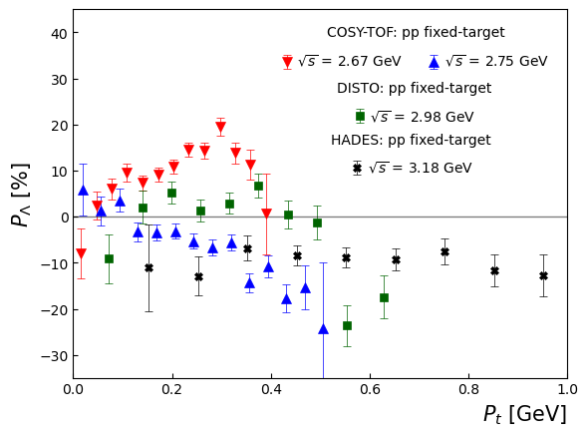
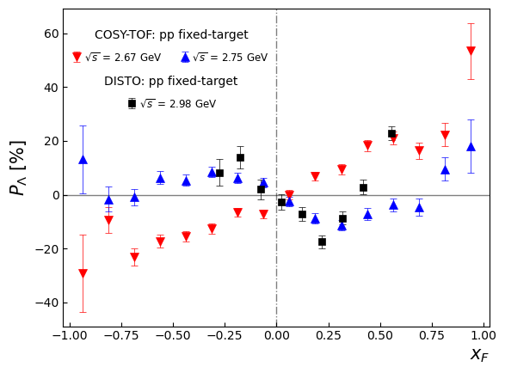
Puzzle in low energy collisions

Slide 10
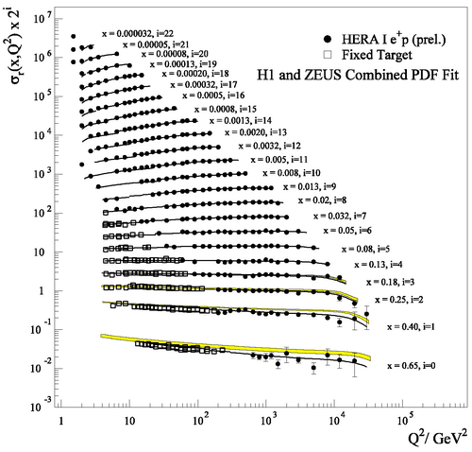
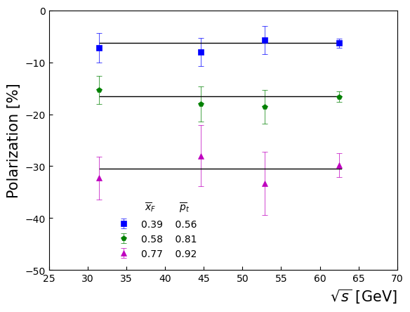
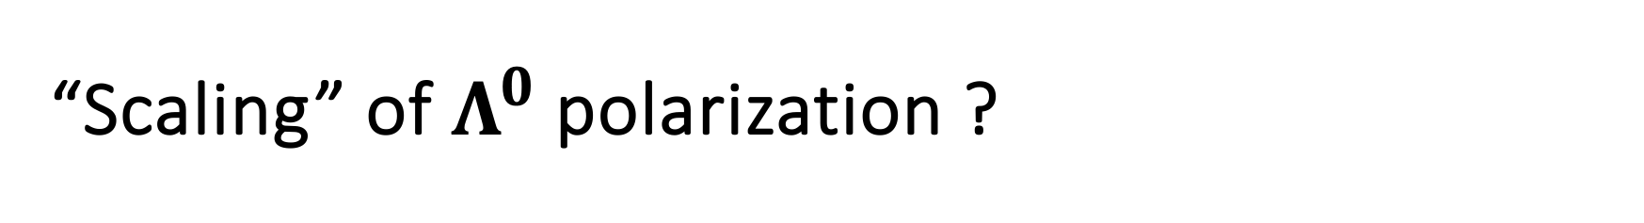
“Scaling” of $Λ^{0}$ polarization ?
R608: 10.1016/0370-2693(87)91556-5

Slide 11
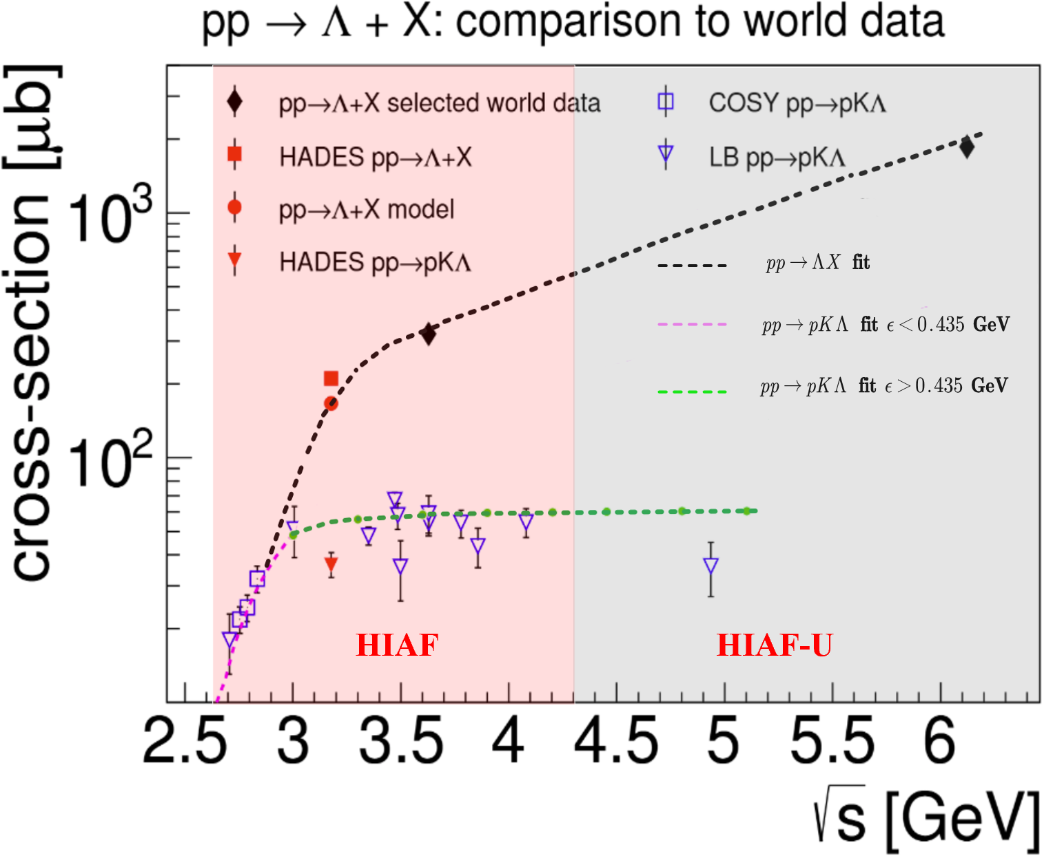
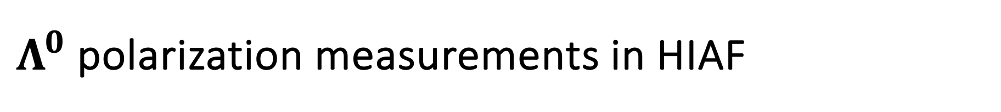



$Λ^{0}$ polarization measurements in HIAF
Hyperon-Nucleon Spectrometer (H-NS)
𝚲 polarization measurements cross energy region and collision system
$$pp(A)→ΛX$$
polarization through hadronization
Zuo-tang Liang, and C. Boros, Phys. Rev. Lett. 79, 3608 (1997); PRD 61, 117503 (2000).
H. Dong and Zuo-tang Liang, PRD 70, 014019 (2004); PRD 72, 033006 (2005).
$$pp→ΛKp$$
$Λ$ polarization in exclusive processes
R. Machleidt, K. Holinde and C. Elster, Phys. Rept. 149, 1 (1987).
B. C. Liu, B. S. Zou, PRL 96, 042002 (2006).

Slide 12
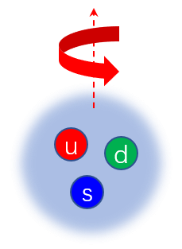
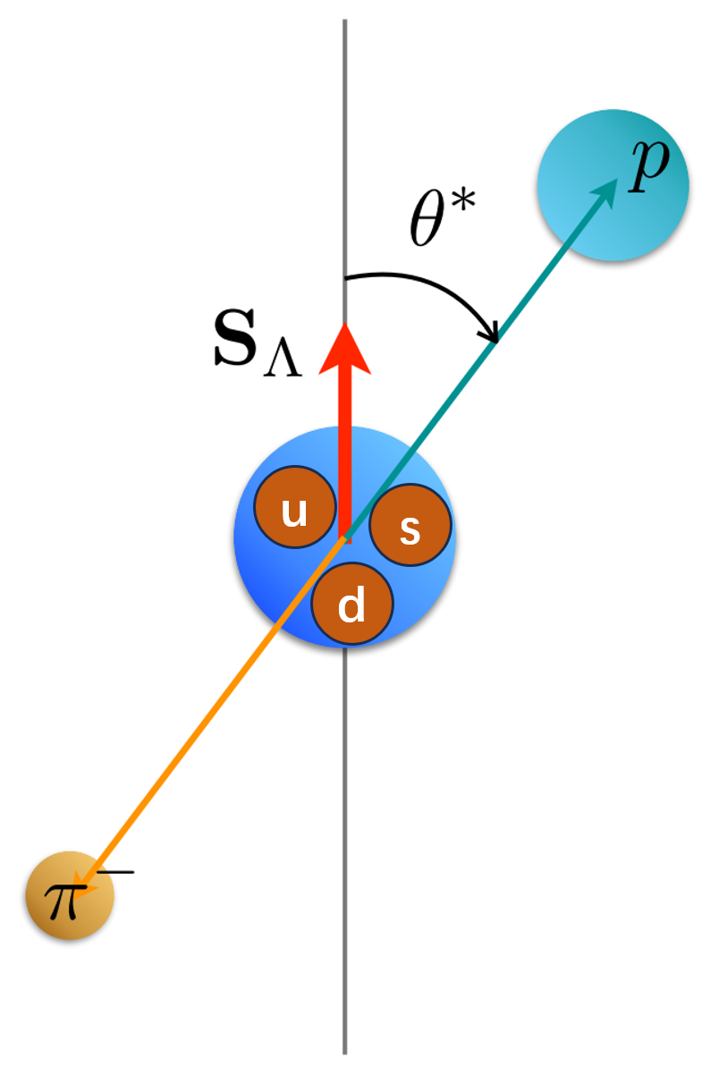
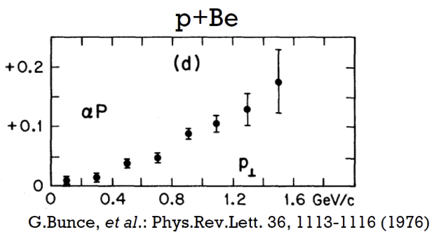
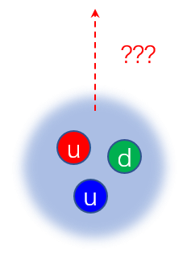
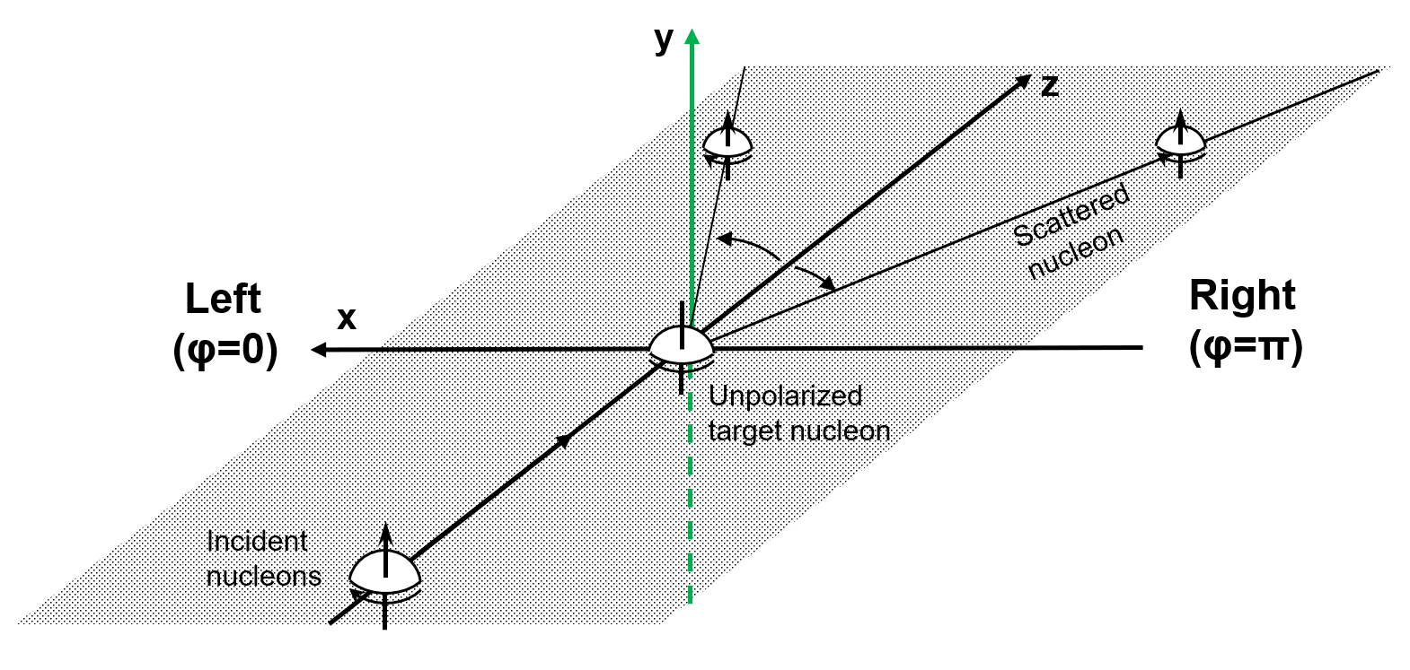
An interesting question: Is proton polarized as well?
pp → p K Λ
超子弱衰变角分布测量超子极化
pp → p + X
???
核核弹性散射测量核子极化
12

Slide 13
High Intensity heavy-ion Accelerator Facility (HIAF)
Booster Ring:
Circumference: 569 m
Rigidity: 34 Tm
Accumulation
Cooling & acceleration
HIAF for atomic physics, nuclear physics, applied research in biology and material science etc.
HFRS
SRing
High energy experimental hall
iLinac
Superconducting Ion Linac:
Length: 180 m
Energy: 17 MeV/u (U³⁴⁺)
CW and pulse modes
BRing
Two-plane painting injection scheme
Fast ramping rate operation

Slide 14
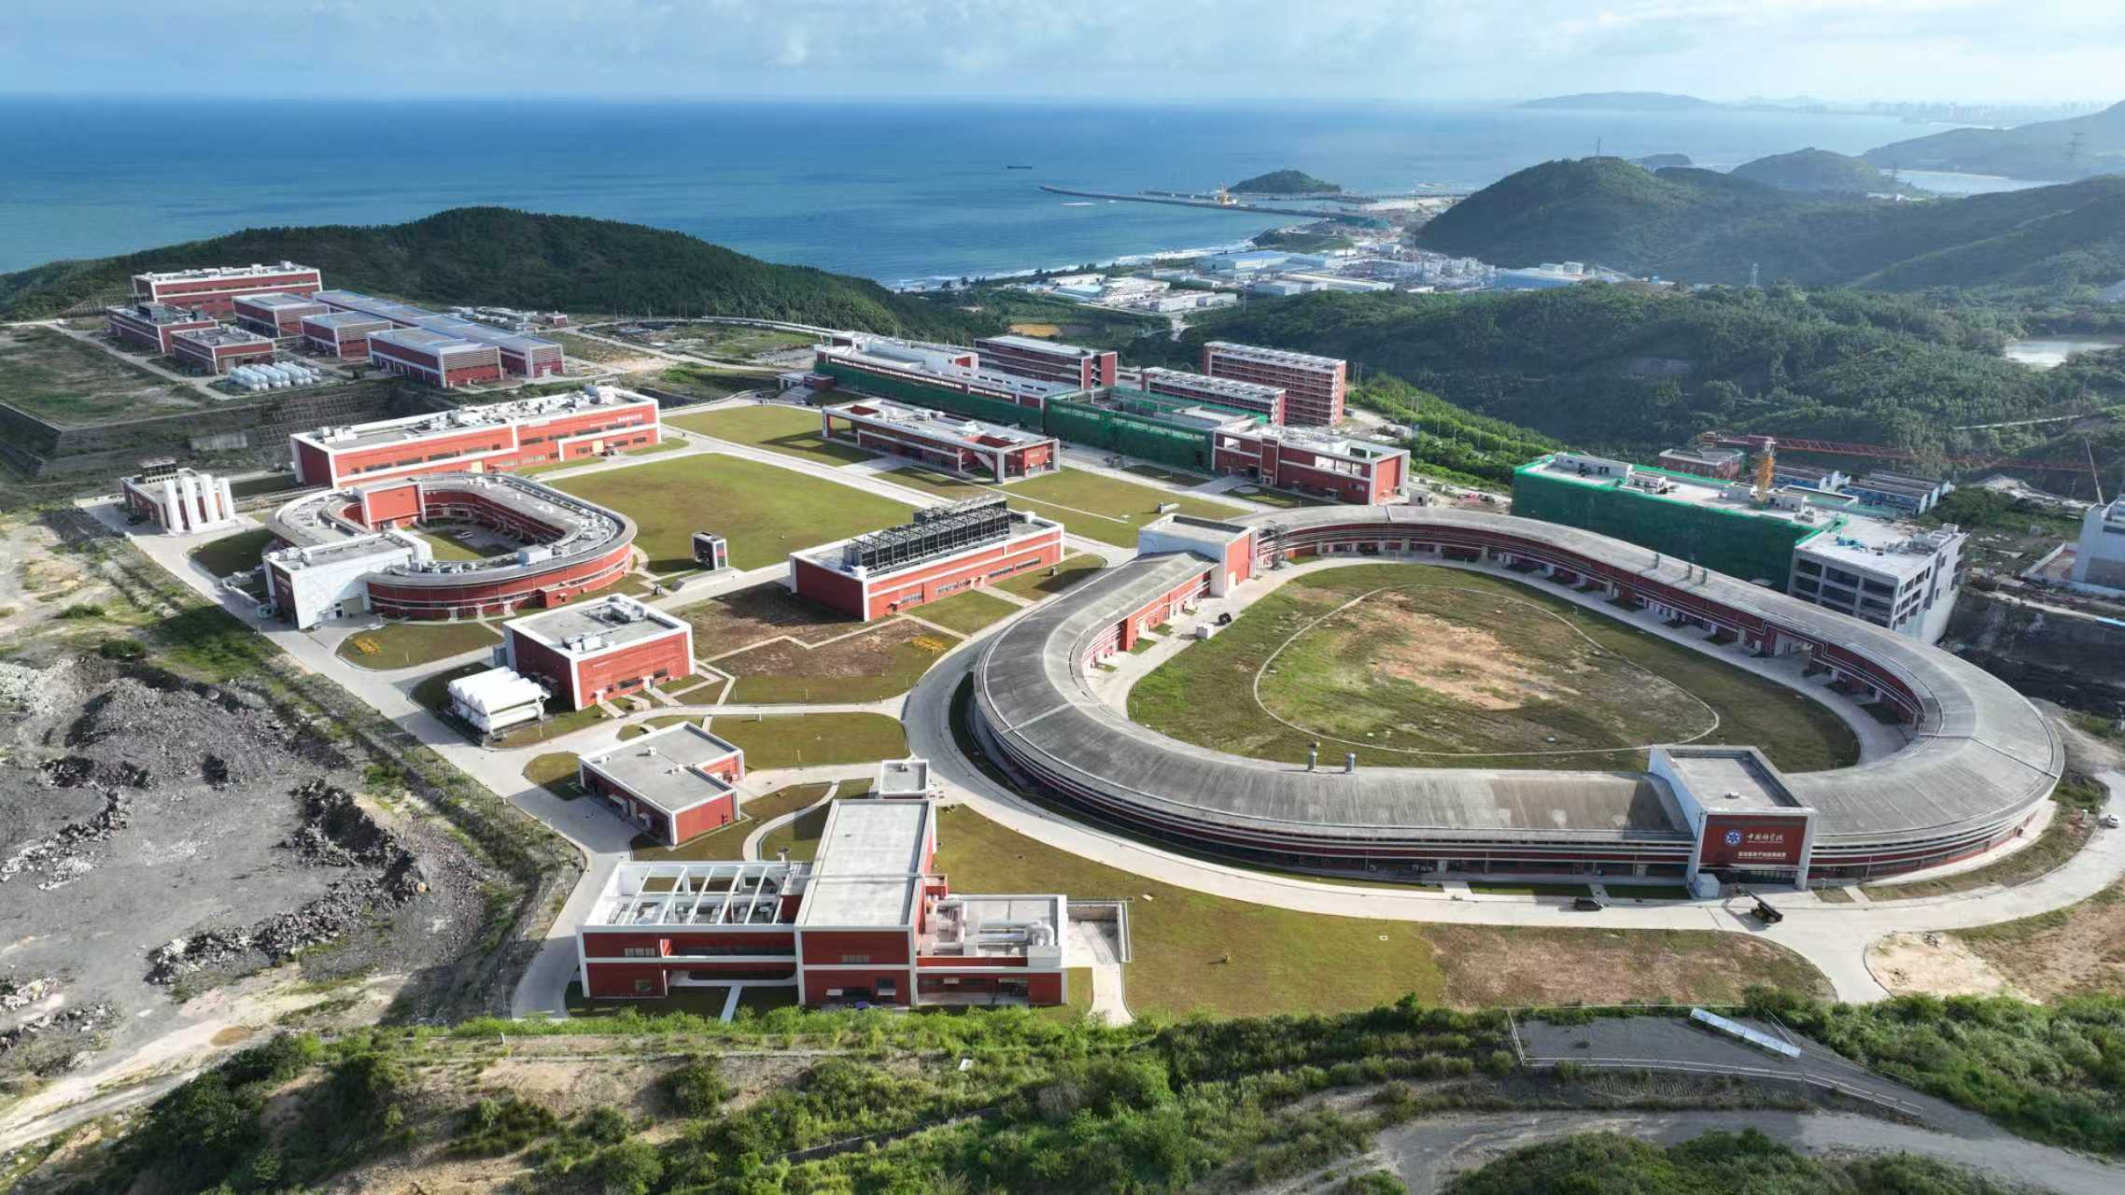

Slide 15
HIAF beam parameters
Ion | Intensity (ppp) | Kine_Energy (GeV/u)
²³⁸U³⁵⁺ | 2.0×10¹¹ | 0.84
²³⁸U⁷⁶⁺ | 5.0×10¹⁰ | 2.5
¹²⁹Xe²⁷⁺ | 3.6×10¹¹ | 1.4
⁷⁸Kr¹⁹⁺ | 5.0×10¹¹ | 1.7
⁴⁰Ar¹²⁺ | 7.0×10¹¹ | 2.3
¹⁸O⁶⁺ | 8.0×10¹¹ | 2.6
p | 5.0×10¹² | 9.3

Slide 16
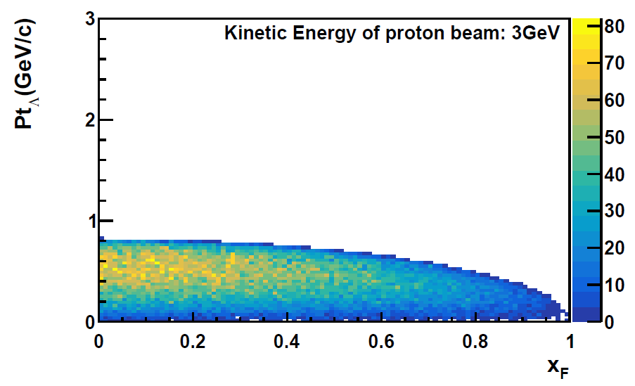
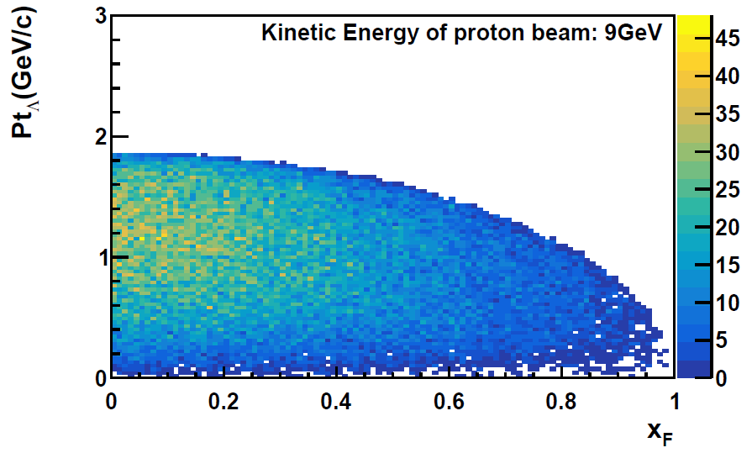
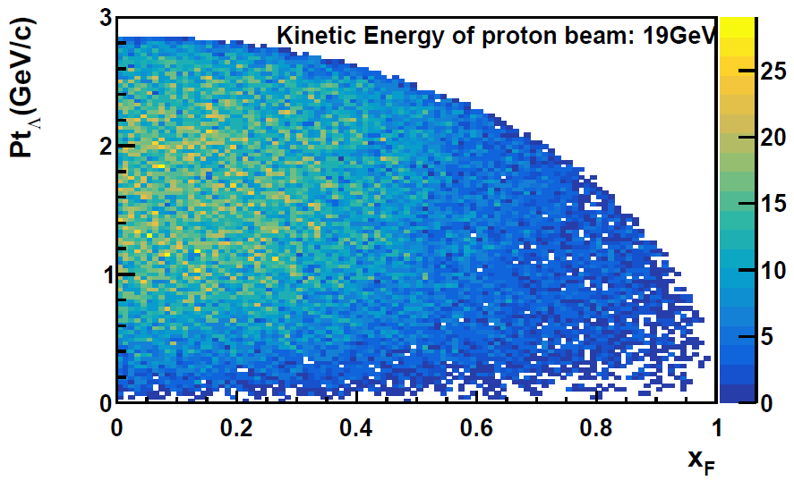

HIAF kinematics coverage
3 GeV → 9 GeV → 20 GeV
Allow for a multi-dimensional mapping of the $Λ^{0}$ polarization and production
Beam energy scan
p→p, p→A, A→A data taking

Slide 17
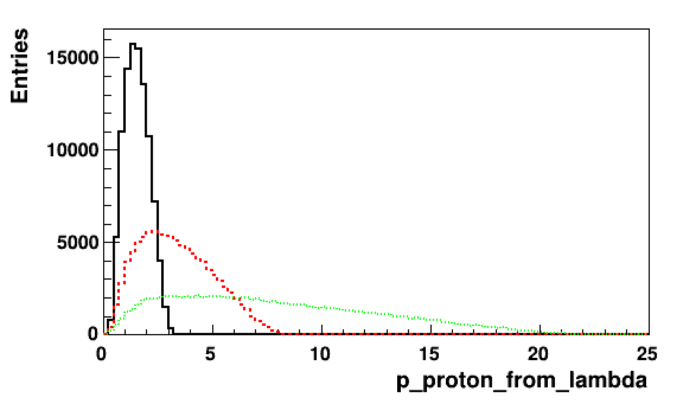
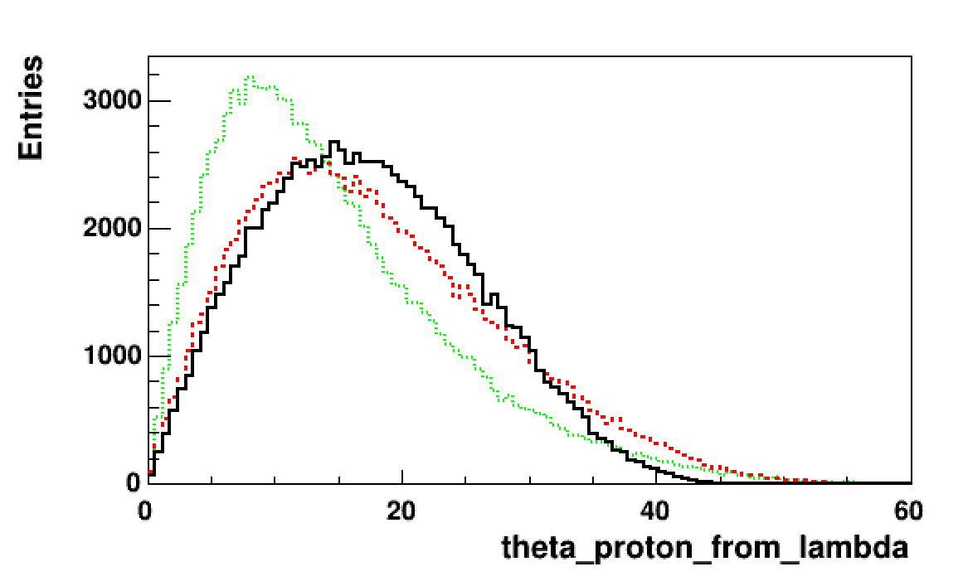
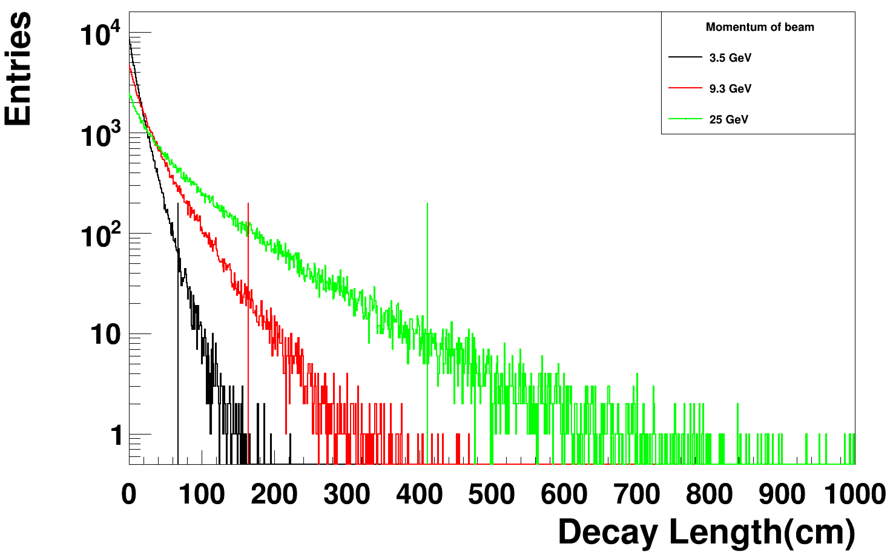



The challenge
All the momentum, angular distributions and the $Λ$ decay length are beam energy-dependent
M$omentum of p from Λ$
$$θ of p from Λ$$
Decay length of$Λ$

Slide 18
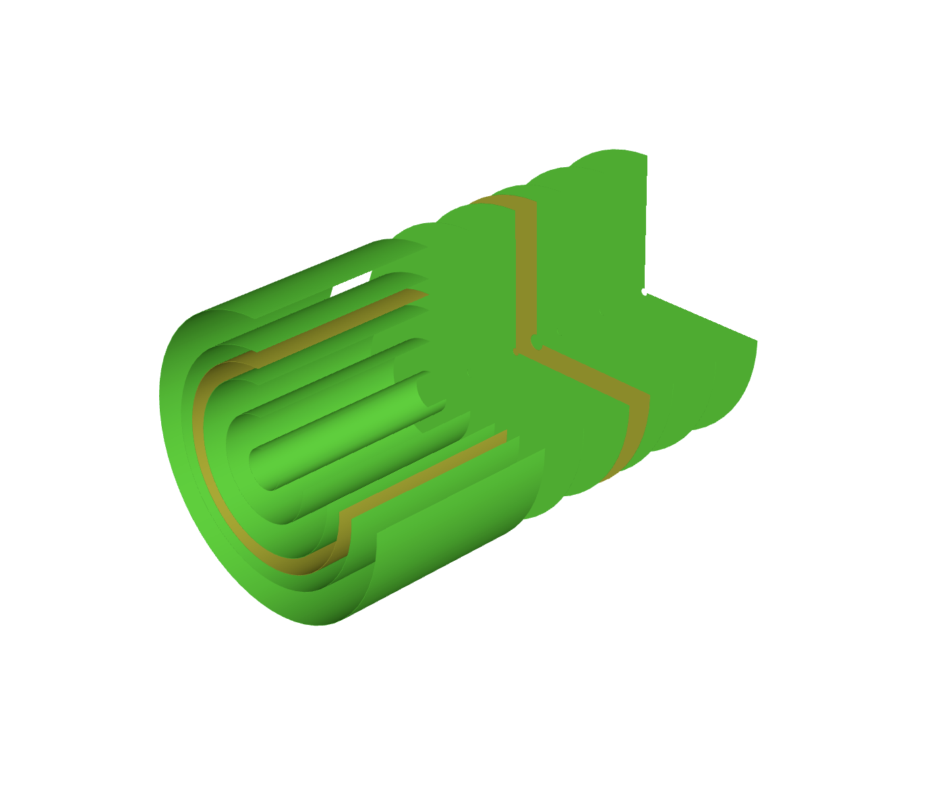
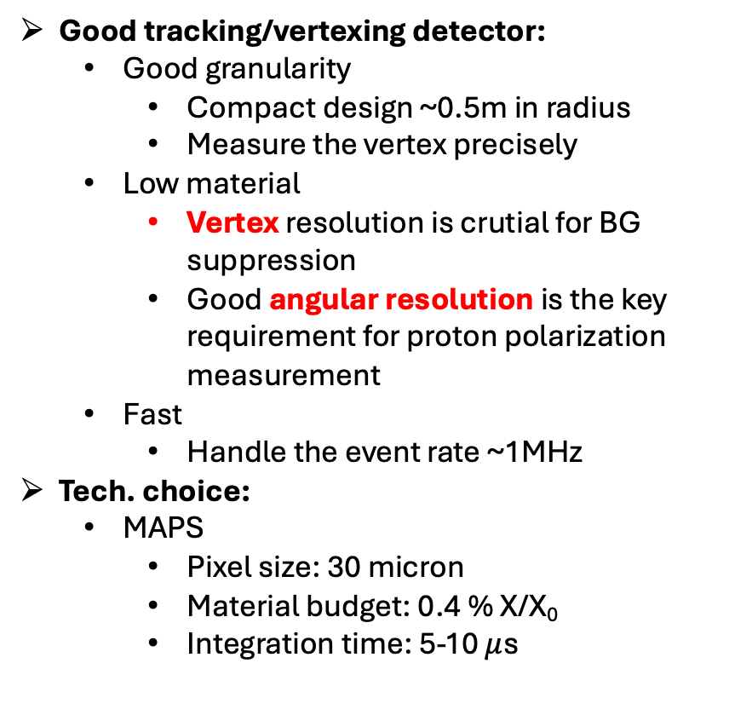
The conceptual design of H-NS detector
Good tracking/vertexing detector:
Good granularity
Compact design ~0.5m in radius
Measure the vertex precisely
Low material
Vertex resolution is crutial for BG suppression
Good angular resolution is the key requirement for proton polarization measurement
Fast
Handle the event rate ~1MHz
Tech. choice:
MAPS
Pixel size: 30 micron
Material budget: 0.4 % X/X₀
Integration time: 5-10 $μ$s
Target
Proton beam

Slide 19
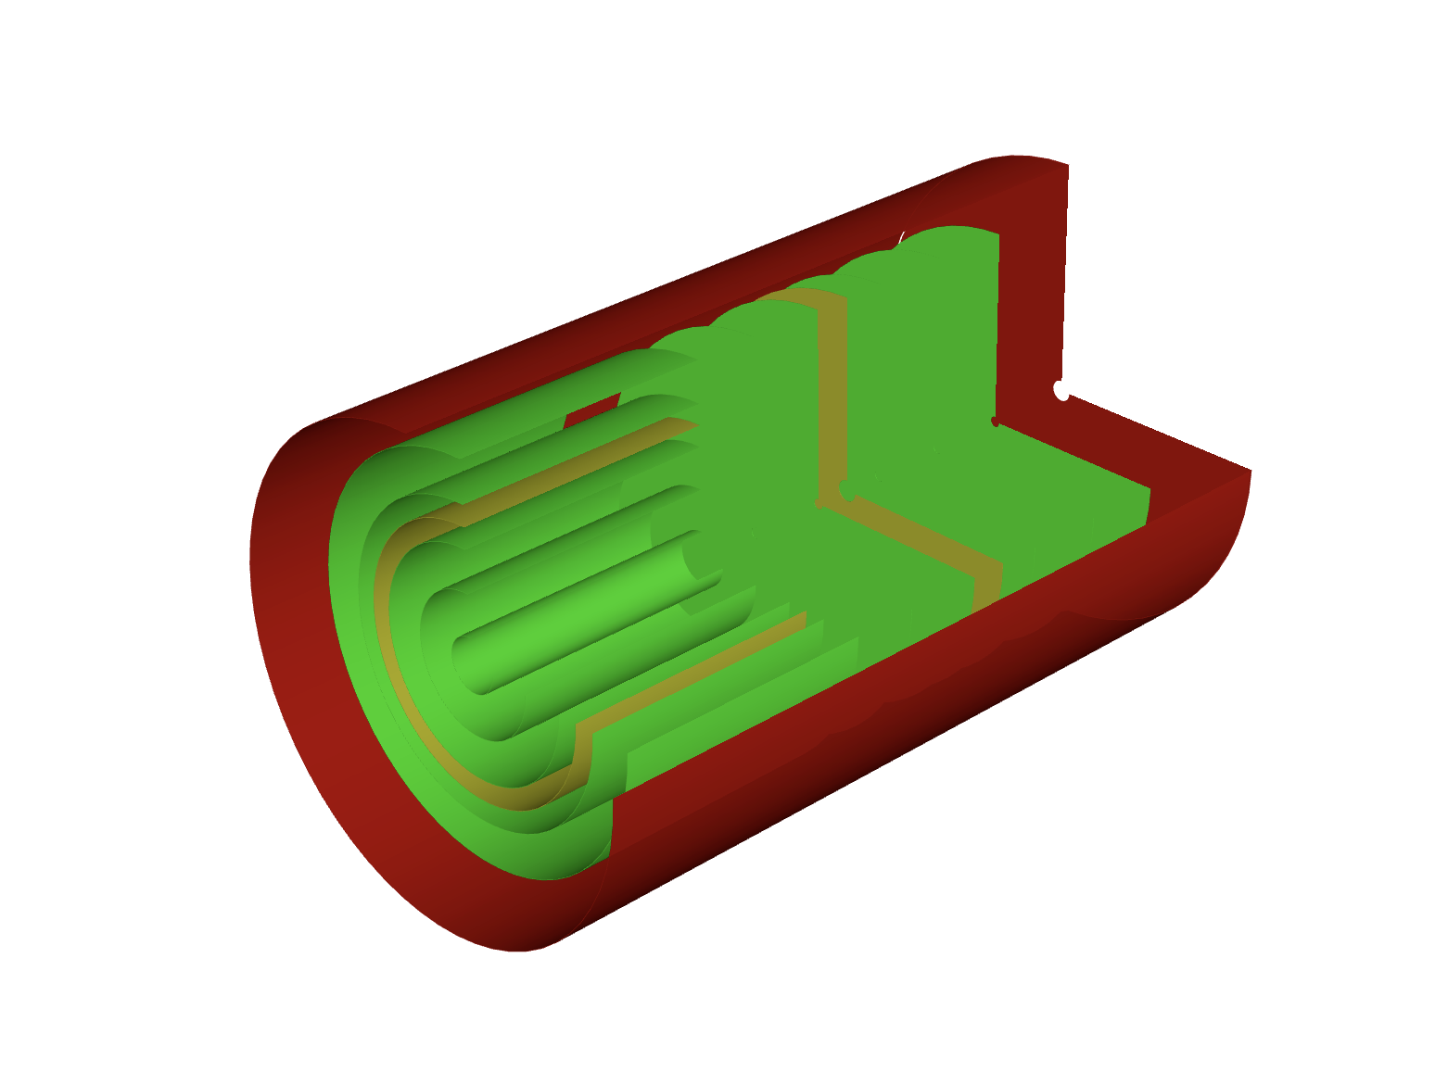

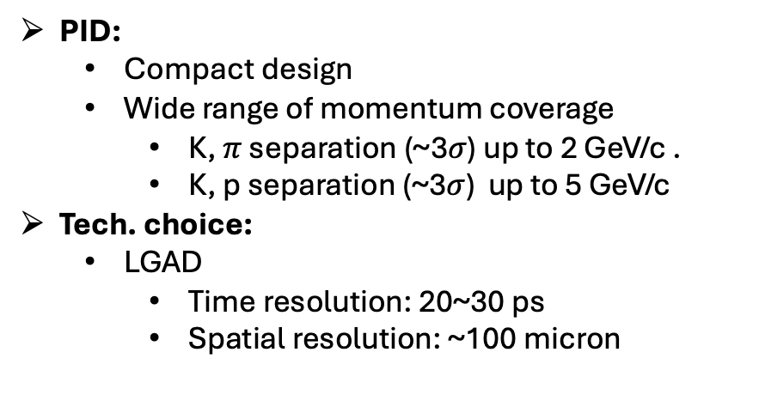




The conceptual design of H-NS detector
PID:
Compact design
Wide range of momentum coverage
K, $π$ separation (~3$σ$) up to 2 GeV/c .
K, p separation (~3$σ$) up to 5 GeV/c
Tech. choice:
LGAD
Time resolution: 20~30 ps
Spatial resolution: ~100 micron
$$p$$
$$p$$
$$Λ$$
Target
$$π$$
$$K$$
Proton beam

Slide 20
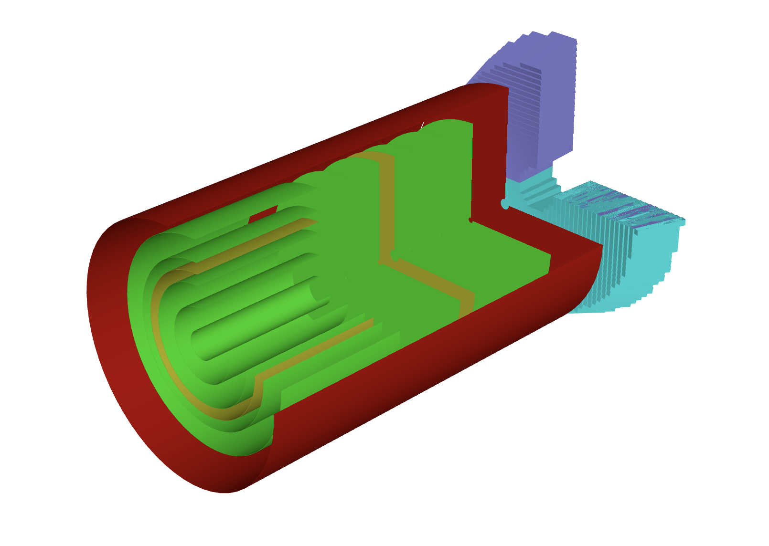
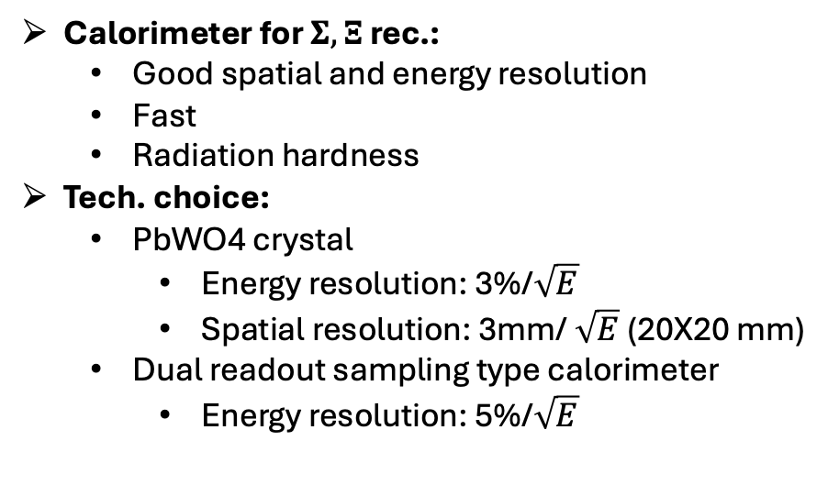
The conceptual design of H-NS detector
Calorimeter for $Σ,Ξ$ rec.:
Good spatial and energy resolution
Fast
Radiation hardness
Tech. choice:
PbWO4 crystal
Energy resolution: 3%/$\sqrt{E}$
Spatial resolution: 3mm/ $\sqrt{E}$ (20X20 mm)
Dual readout sampling type calorimeter
Energy resolution: 5%/$\sqrt{E}$

Slide 21
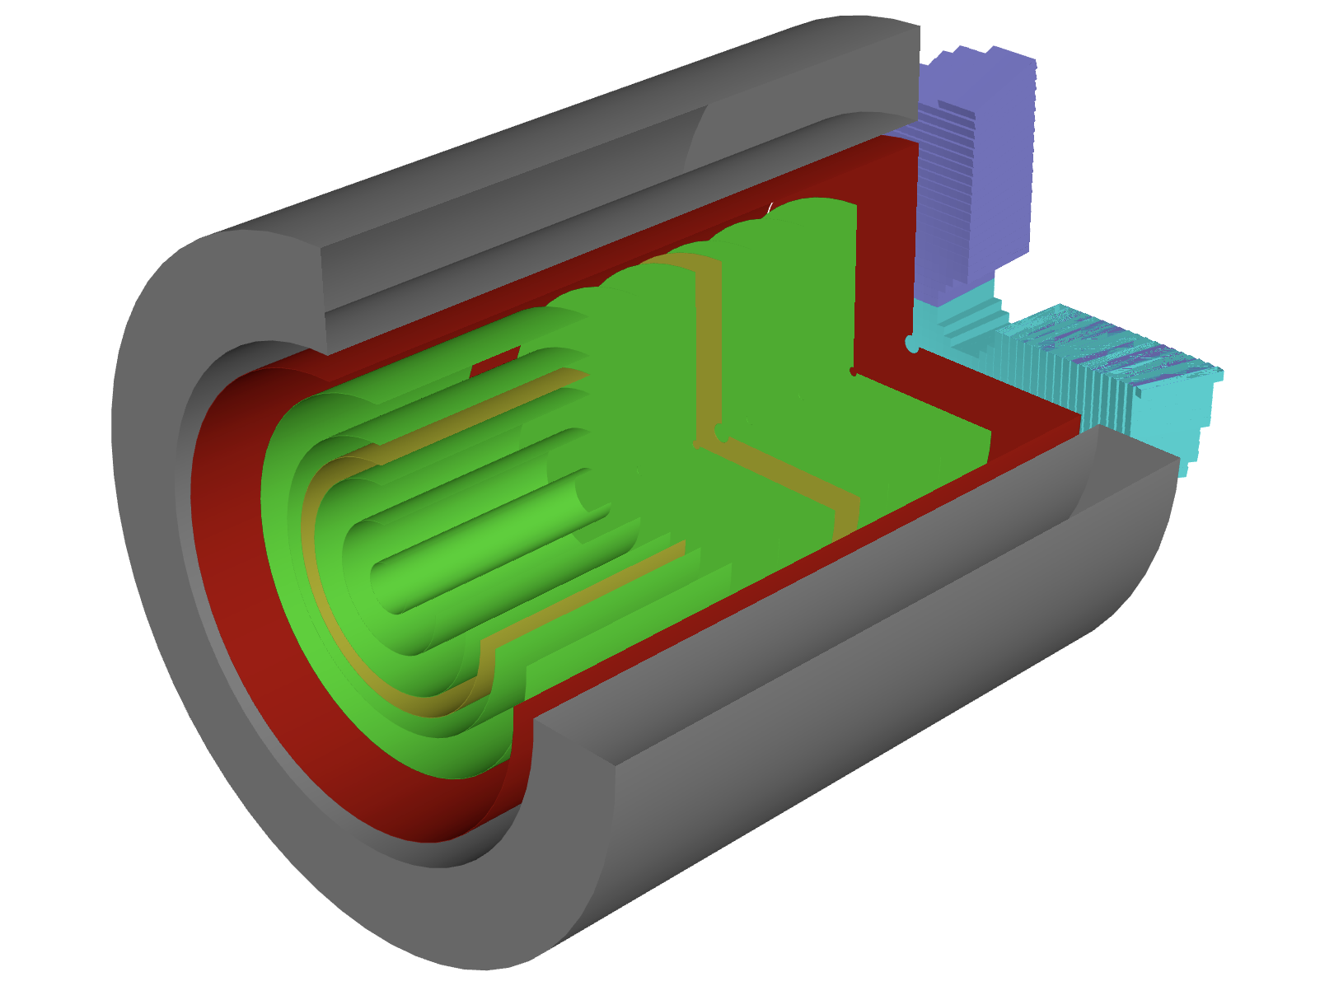
The conceptual design of H-NS detector
Magnet:
Be able to measure the track with high Pz and low Pt
Tech. choice:
Superconducting Solenoid @ Bz = 1.5T
Or dipole @ By = 1.5 T

Slide 22
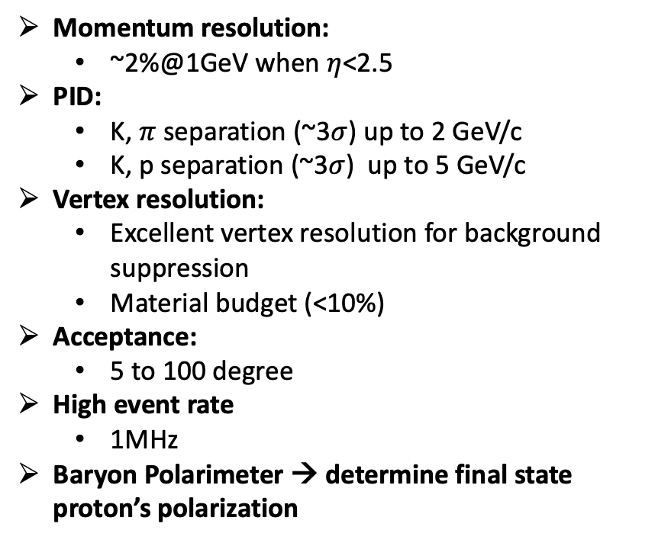
The conceptual design of H-NS detector
Momentum resolution:
~2%@1GeV when $η$<2.5
PID:
K, $π$ separation (~3$σ$) up to 2 GeV/c
K, p separation (~3$σ$) up to 5 GeV/c
Vertex resolution:
Excellent vertex resolution for background suppression
Material budget (<10%)
Acceptance:
5 to 100 degree
High event rate
1MHz
Baryon Polarimeter → determine final state proton’s polarization
L = 150cm
Ro = 50cm
Lb = 50cm

Slide 23
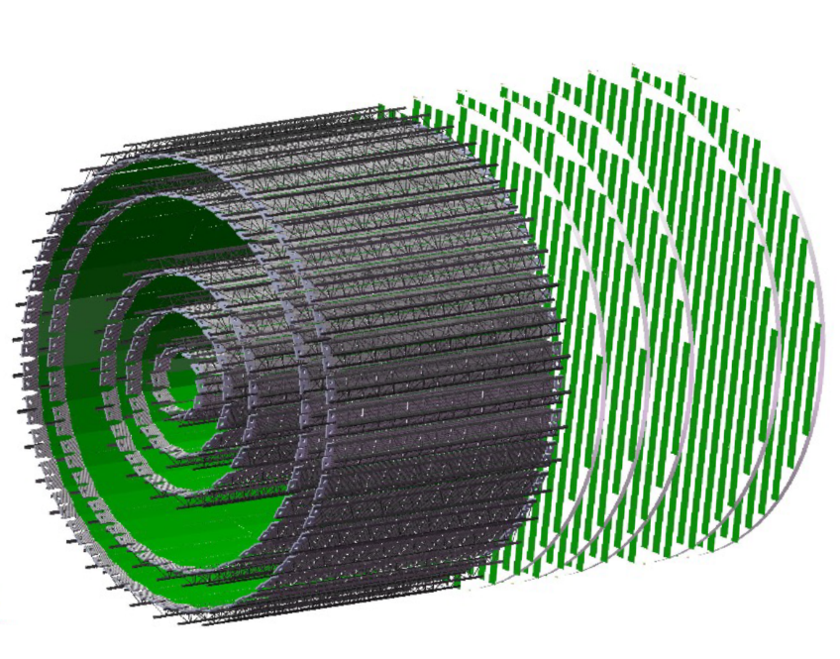
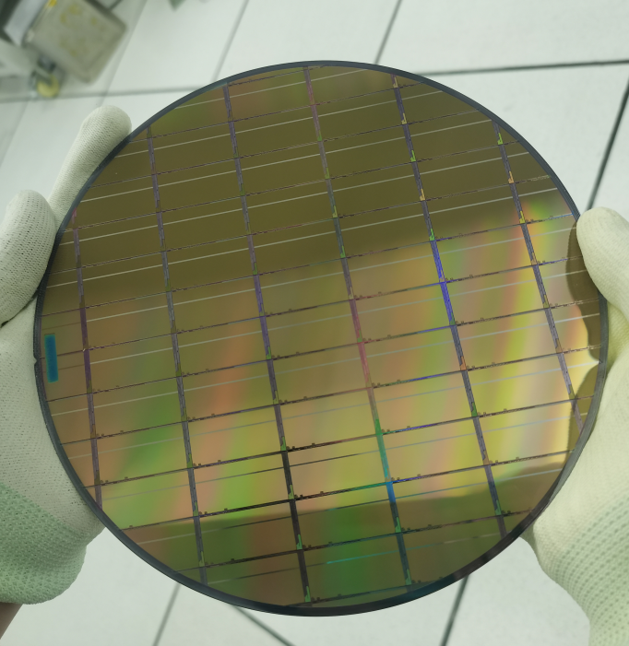
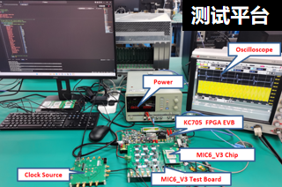
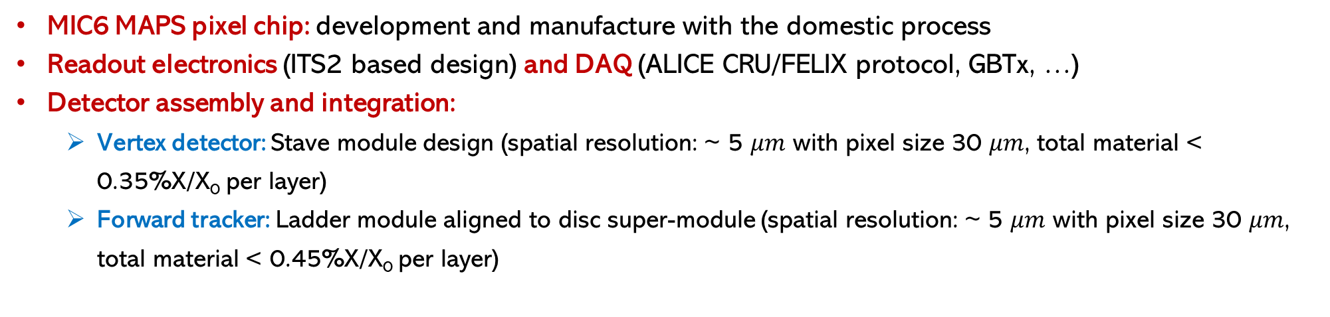
Silicon tracker at H-NS
MIC6 development at CCNU
MIC6 MAPS pixel chip: development and manufacture with the domestic process
Readout electronics (ITS2 based design) and DAQ (ALICE CRU/FELIX protocol, GBTx, …)
Detector assembly and integration:
Vertex detector: Stave module design (spatial resolution: ~ 5 $μm$ with pixel size 30 $μm$, total material < 0.35%X/X₀ per layer)
Forward tracker: Ladder module aligned to disc super-module (spatial resolution: ~ 5 $μm$ with pixel size 30 $μm$, total material < 0.45%X/X₀ per layer)

Slide 24
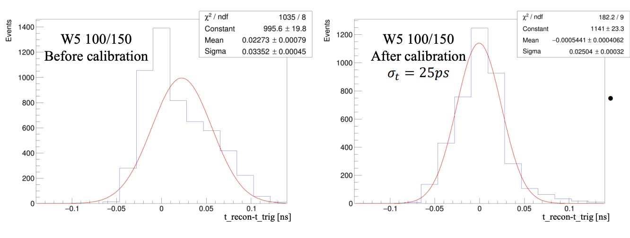
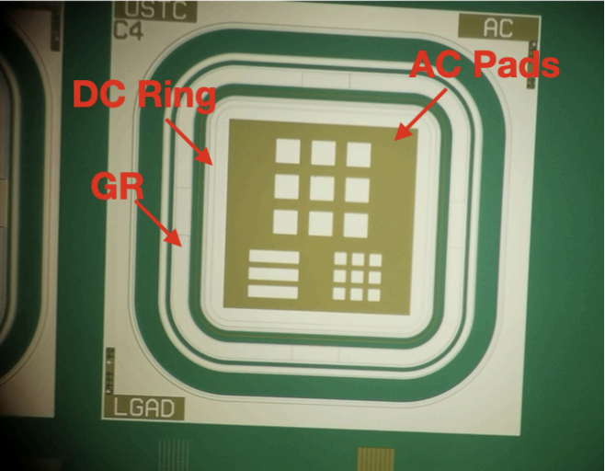
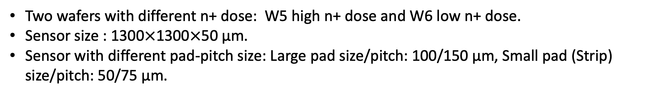
AC-LGAD at H-NS
Recent development at USTC:
Two wafers with different n+ dose: W5 high n+ dose and W6 low n+ dose.
Sensor size : 1300$×$1300$×$50 μm.
Sensor with different pad-pitch size: Large pad size/pitch: 100/150 μm, Small pad (Strip) size/pitch: 50/75 μm.

Slide 25
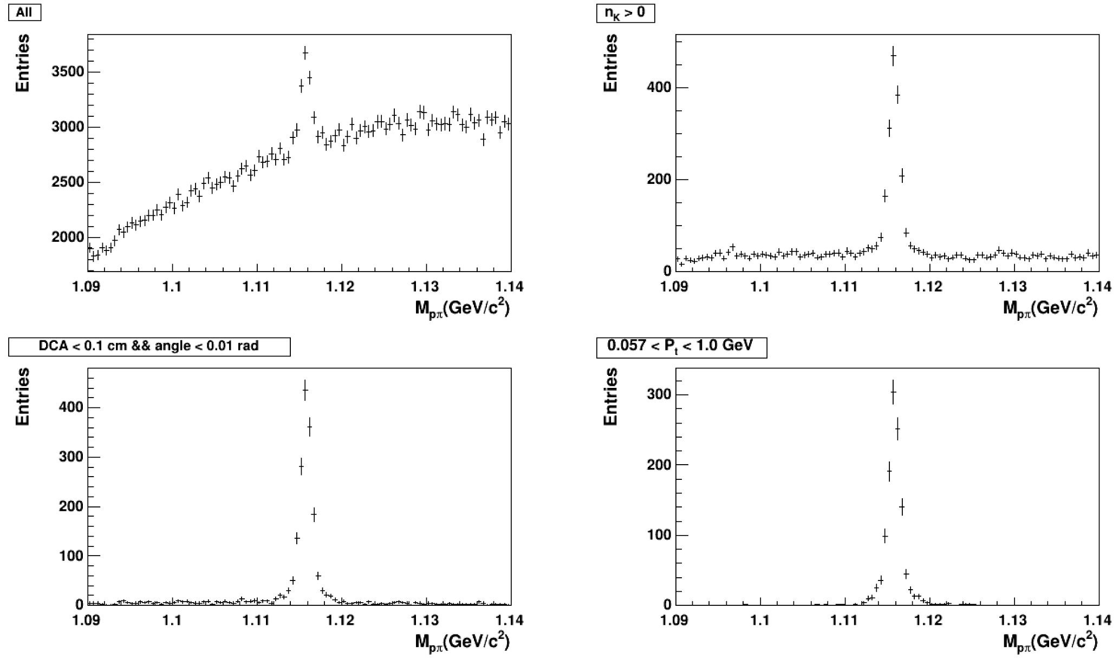
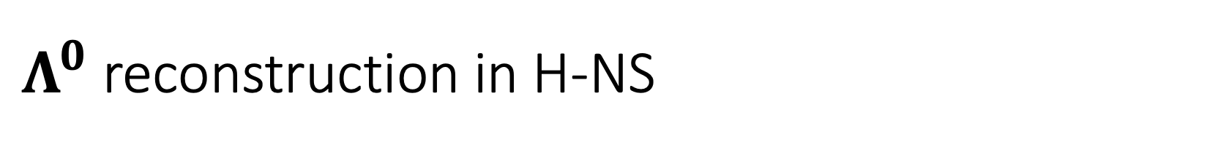
$Λ^{0}$ reconstruction in H-NS
PID
PID+Topo.

Slide 26
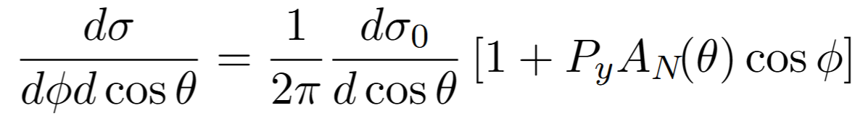
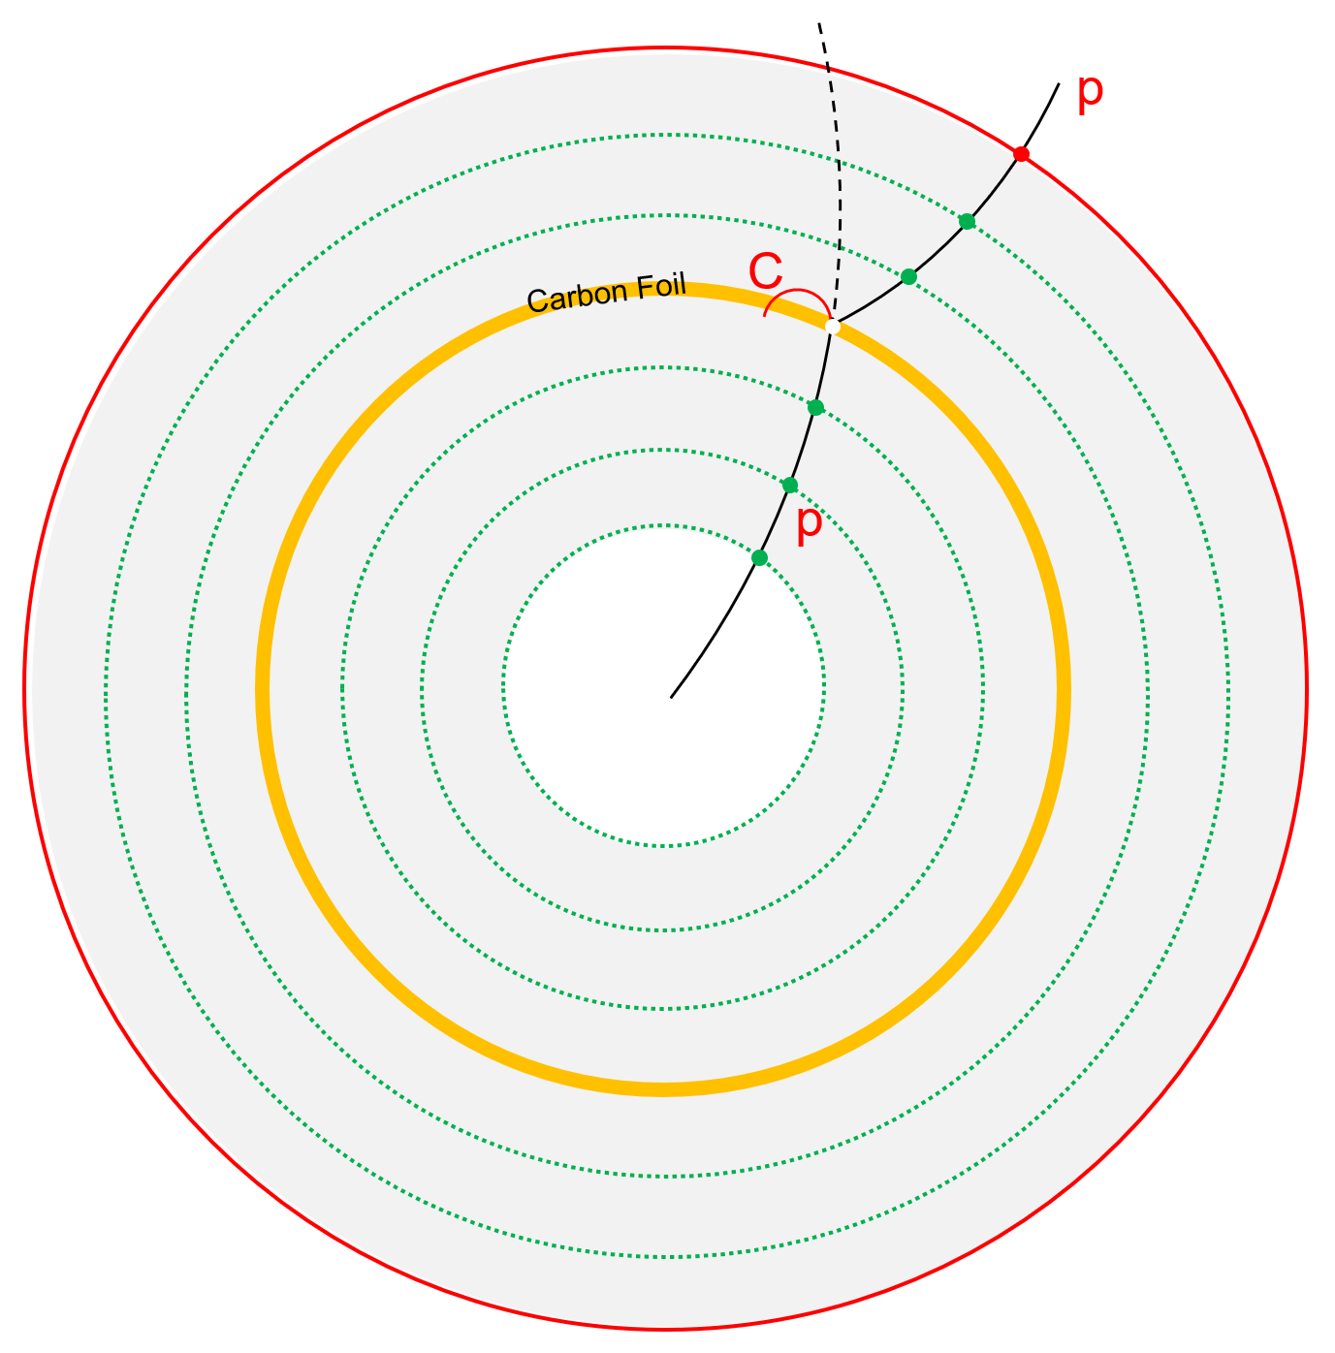
Baryon polarimeter
Determining proton polarization via elastic scattering
Transversely polarized protons
Carbon foil
x
Ф
θ
C
Carbon Foil layer
~1 mm thickness
Material budget: <1% X/X₀
Probability: pC (1E-3)
Position : in-between the tracking devices
Detailed in YuTie’s talk on 26th!
Y. T. Liang et. al. Phys. Rev. D 112, L031502 (2025)

Slide 27
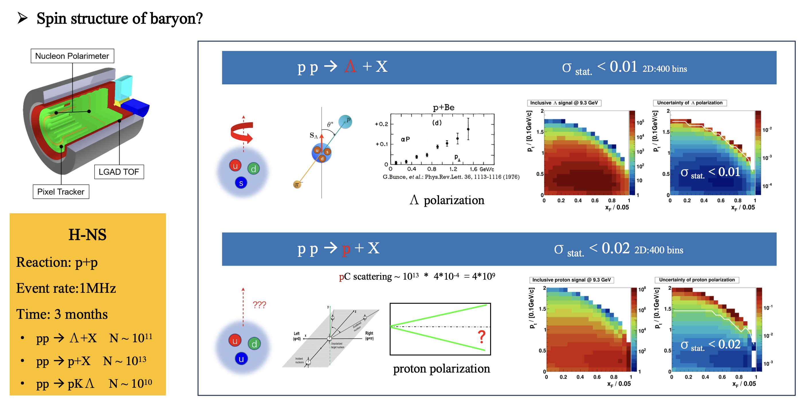
Projection of Λ and proton polarization

Slide 28
Timeline
18 | 19 | 20 | 21 | 22 | 23 | 24 | 25 | 26 | 27 | 28 | 29 | 30 | 31 | 32 | 33 | 34 | 35 | 36 | 37 | 38 | 39 | 40
十三五 |  |  | 十四五 |  |  |  |  | 十五五 |  |  |  |  | 十六五 |  |  |  |  | 十七五
HIAF
Accelerator
HIAF-U
EicC
CEE@CSR
Detector
H-NS DEMO
H-NS construction
H-NS run
EicC
H-NS DEMO running at HIAF
A smooth transition from H-NS to EicC, in terms of both physics and hardware

Slide 29


Summary
I. Physics：
$Λ$ production and polarization ( p+p )
Medium effect ( p+A )
Global polarization of $Λ$ hyperon ( A+A )
Hadron physics via p+p
II. Community：
Supports both communities of hadron structure and heavy-ion physics
International interests are expected: Japan
III. Detector R&D
Many parts are similar for CEPC, EicC, H-NS and STCF. Save resources.
HNS: a detector R&D platform for EicC, ½ EicC
Institutes in China：北京航空航天大学、复旦大学、国科大、华中师范大学、华南师范大学、近代物理研究所、清华大学、山东大学、香港中文大学（深圳）、中科大
Subsystems：Silicon tracker, AC-LGAD, Target, Baryon polarimeter, Calorimeter, Electronics, DAQ, Magnet, Beamline, Mechanics + Engineering

Slide 30

Thank you !

Slide 31
backups

Slide 32




Efficiency due to tracking
$$ε=\frac{N_{hits≥4}}{N_{all}}$$
E beam | $ε$($p$) | $ε$(K) | $ε$($π$) ($Λ$) | $ε$($p$) ($Λ$) | $ε$($Event)$
3.5GeV | 98% | 89% | 88% | 96% | 76%
9.3GeV | 98% | 95% | 82% | 86% | 74%
25GeV | 98% | 96% | 65% | 66% | 60%

Slide 33



PID performance: pion/kaon
Assume a resolution of 30 ps:
LGAD barrel (R=45cm), can cover a Pt up to 1.35 GeV/c
LGAD endcap (Z=150) can up to 2.5 GeV/c

Slide 34



PID performance: proton/kaon
Assume a resolution of 30 ps:
LGAD barrel, (R=45cm), can cover a Pt up to 2.25 GeV/c
LGAD endcap, (Z=150) can up to 4.2 GeV/c

Slide 35


Efficiency due to PID+tracking
E beam | $ε$($p$) | $ε$(K) | $ε$($π$) ($Λ$) | $ε$($p$) ($Λ$) | $ε$($Event)$
3.5GeV | 98%→98% | 89%→89% | 88%→88% | 96%→96% | 76%→76%
9.3GeV | 98%→76% | 95%→40% | 82%→82% | 86%→77% | 74%→20%
25GeV | 98%→32% | 96%→13% | 65%→65% | 66%→31% | 60%→1.5%

Slide 36




H-NS demo: H-NS0
H-NS0 will be ready and tested at HIAF next year

Slide 37




Efficiency due to tracking
E beam=3.5GeV
E beam=9.3GeV
E beam=25GeV
$Λ$decay vertex distribution
90% of all event
Normalized to total event

Slide 38



HNS
Silicon tracker
AC-LGAD (PID)
Ecal.
Super-conducting Solenoid
Silicon tracker
Ecal.
Super-conducting Solenoid
STCF
EicC
Silicon tracker
MPGD tracker
DIRC (PID)
RICH (PID)
Ecal
Super-conducting Solenoid

