Slide 1
Baryon polarimeter in high energy nuclear physics
Yutie Liang
Institute of Modern Physics, Chinese Academy of Sciences
2025-10-26
QPT2025

Slide 2
Outline
Introduction
New concept of general-purpose spectrometer
Performance of baryon polarimeter at H-NS
Physics potentials with baryon polarimeter
Summary

Slide 3
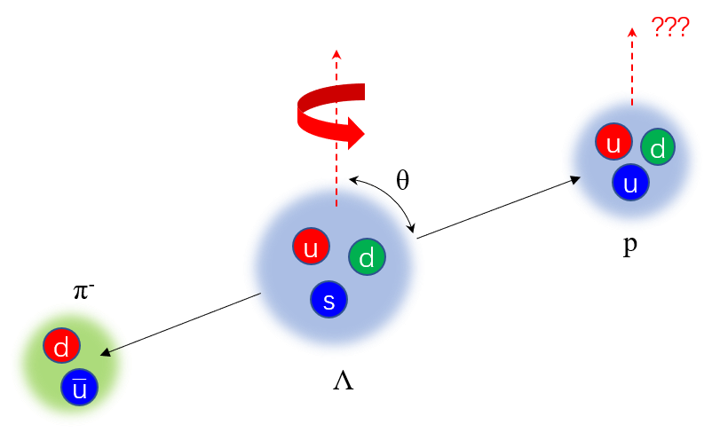
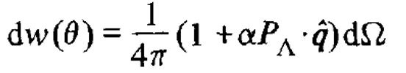
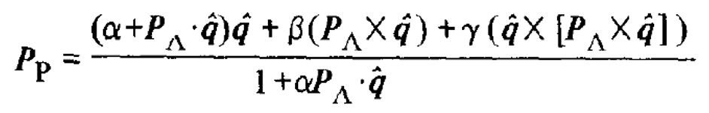
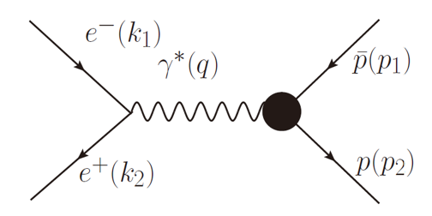
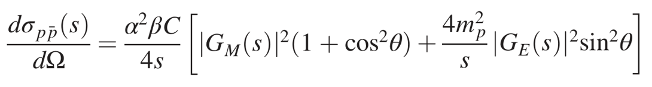
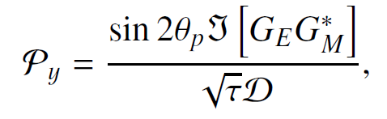
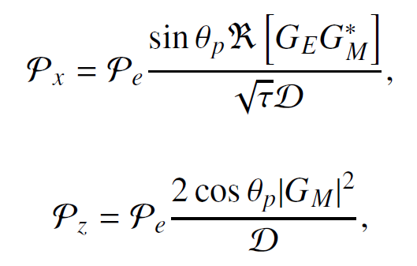
Spin and cross section
A reaction is described by the cross section and the polarization.
Λ → p + π
Cross section
Polarization
e⁺e⁻ → $p \overline{p}$
Cross section
Polarization
The polarization contains valuable information.

Slide 4
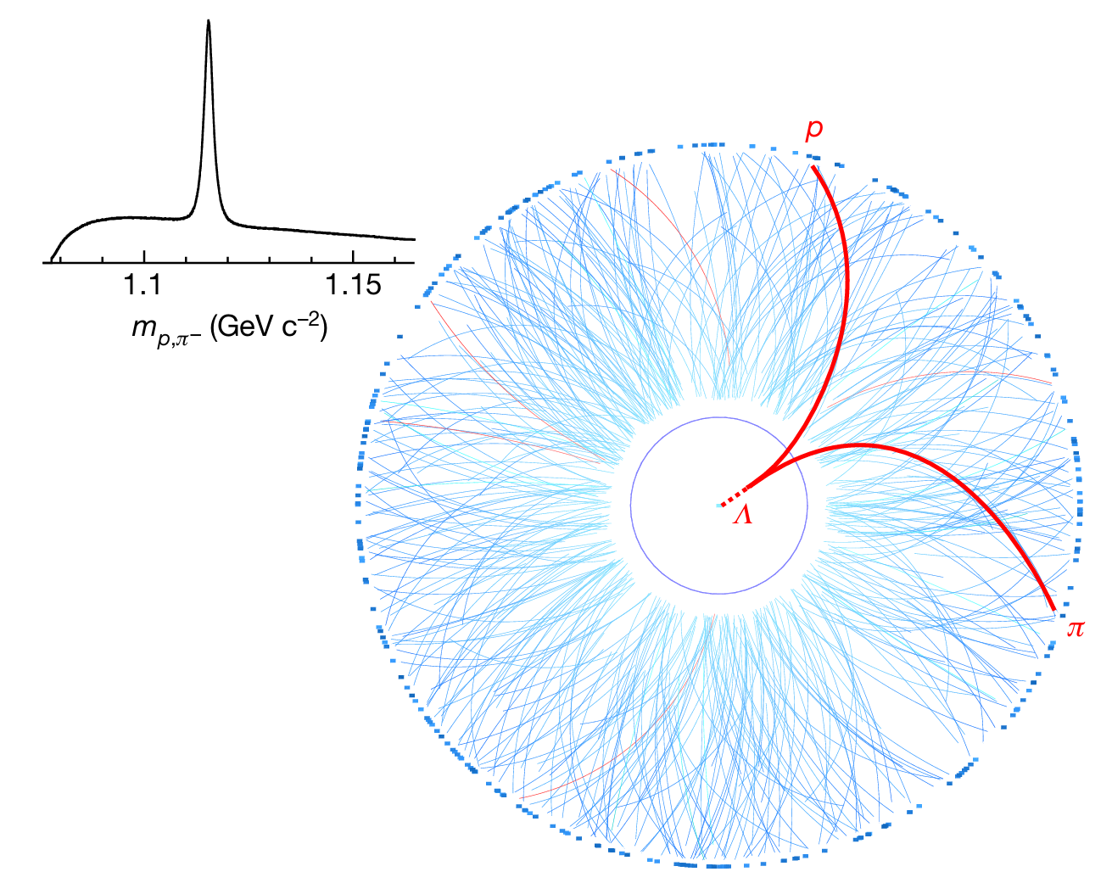
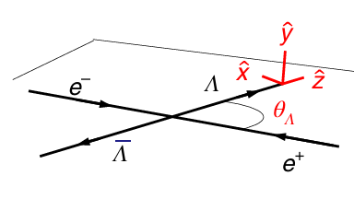
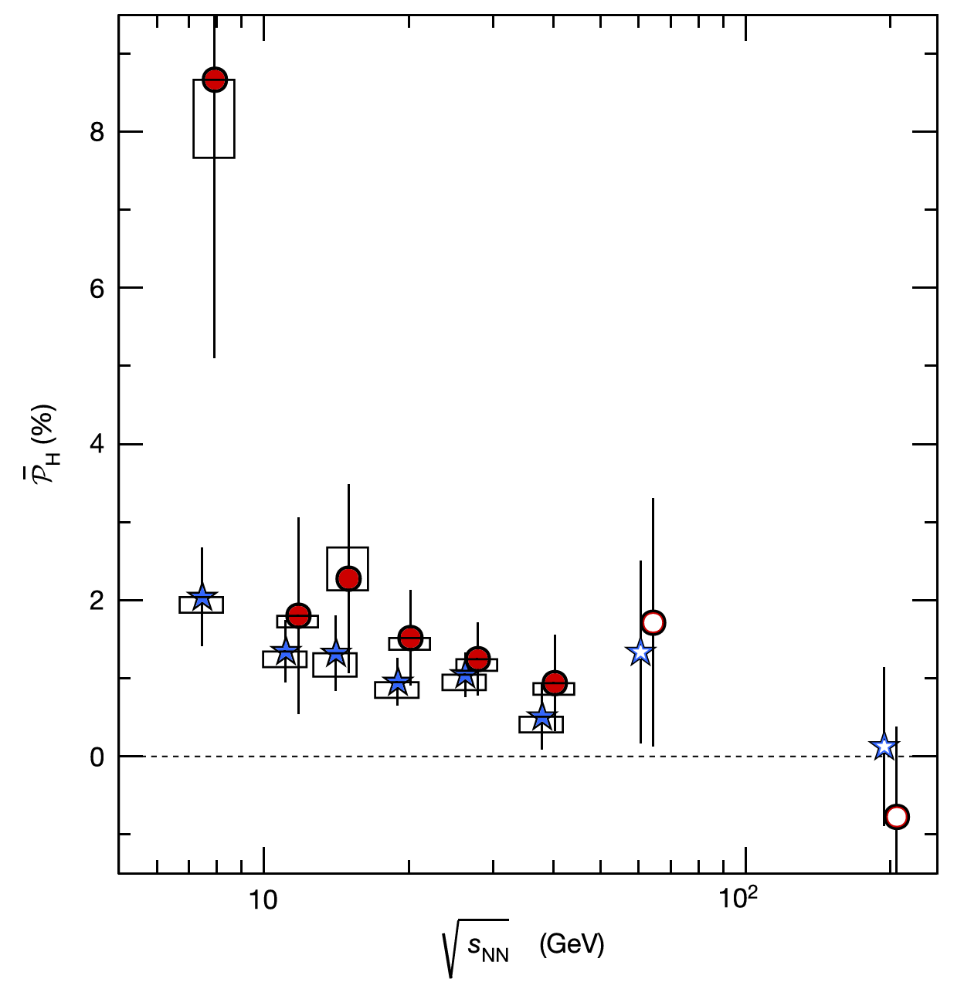
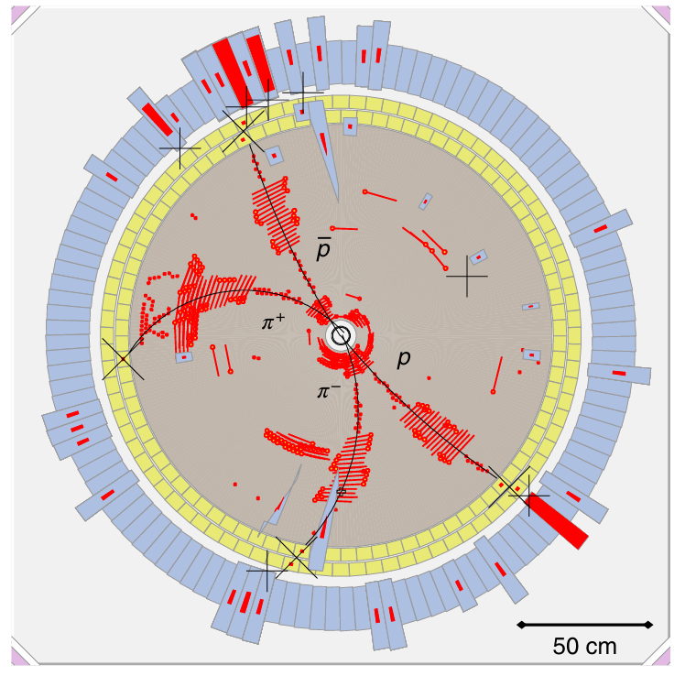
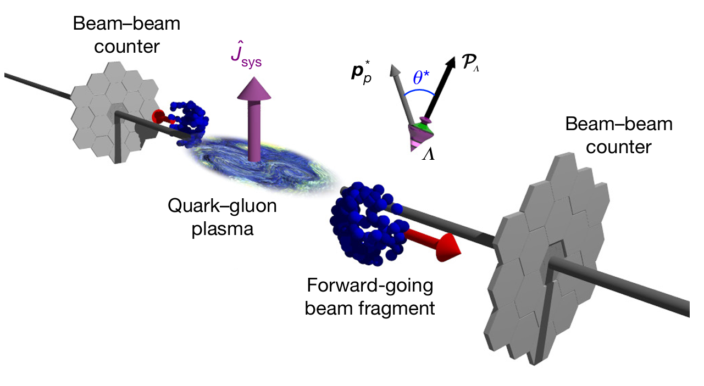
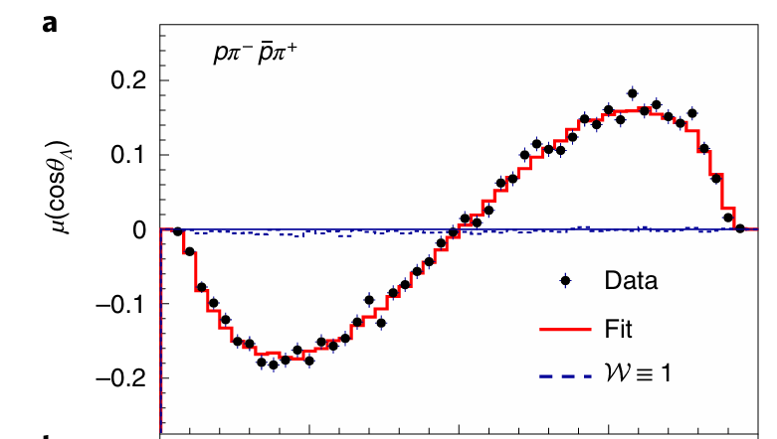
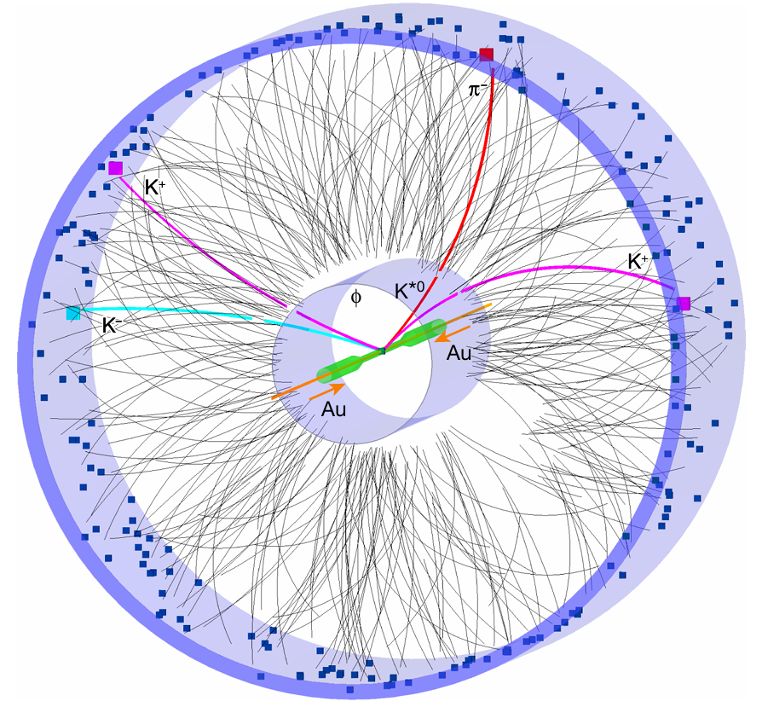
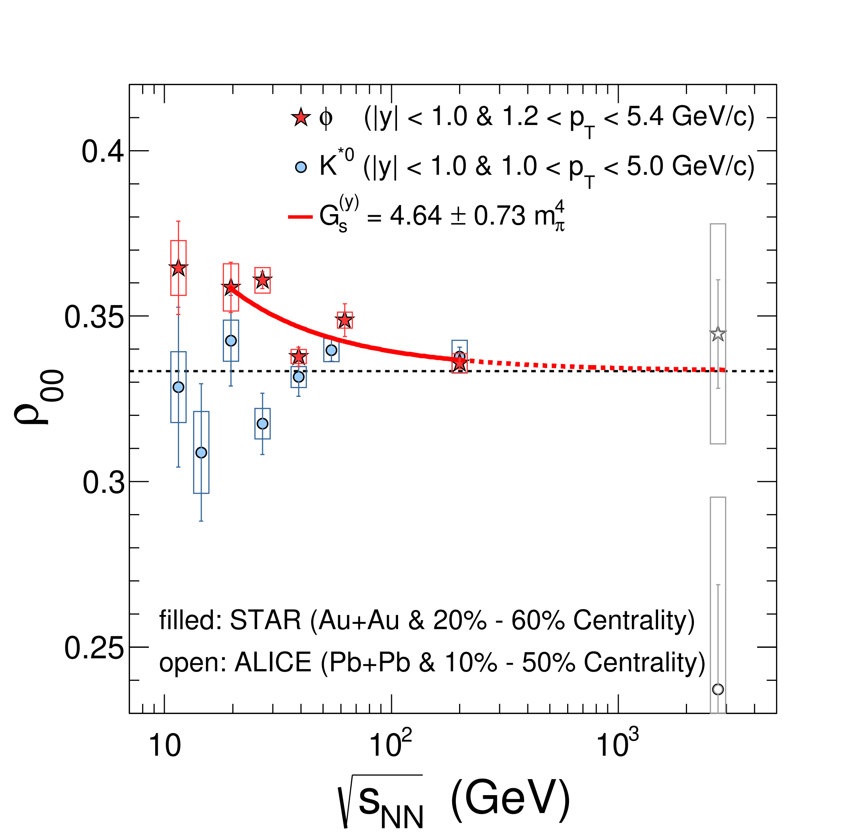
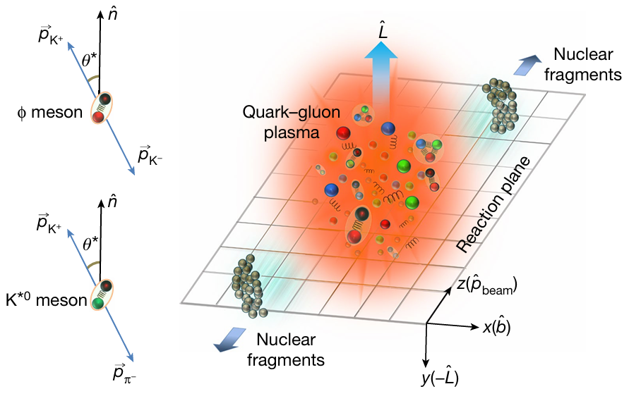
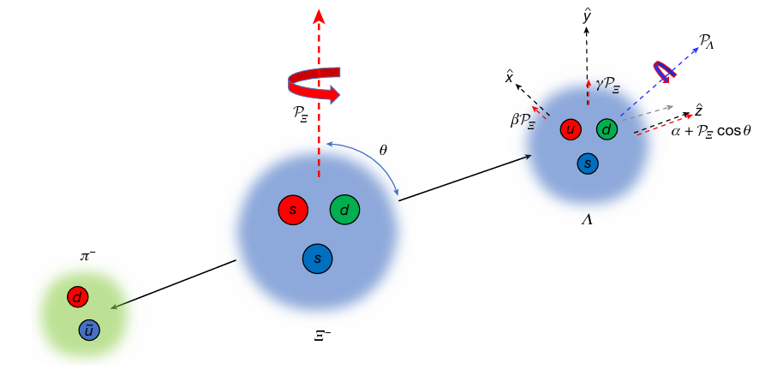
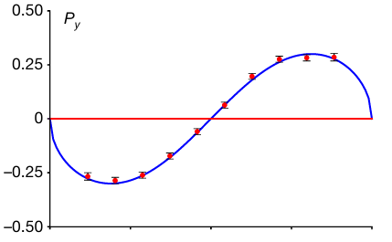
Spin with valuable information
STAR, Nature 548, 62 (2017)
BESIII, Nature Physics, 15, 631 (2019)
STAR, Nature 614, 244 (2023)
BESIII, Nature, 606, 64 (2022)

Slide 5
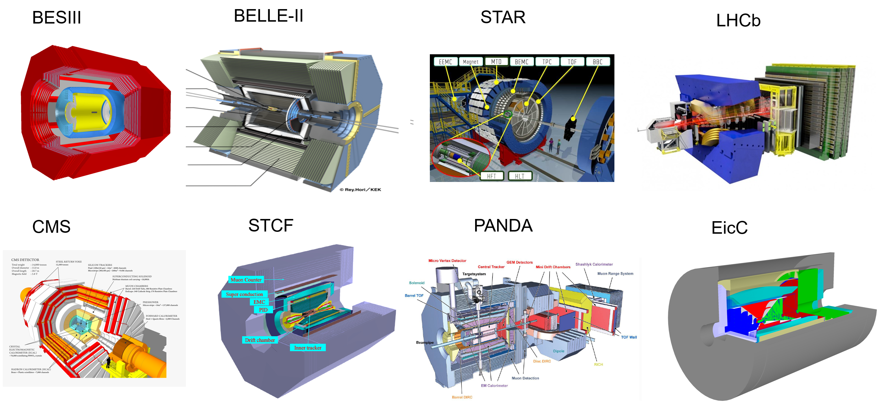
General-purpose spectrometer
Complete initial state VS Incomplete final state
E_{H}
E_{EM}
e⁻
ToF
p, dE/dx
μ
e⁺ / p/ A
J/ψ
π
η
Φ
K
ρ
n
π
γ
p
n
N*
Δ
p
K
e
γ
Λ
Σ
Ω
μ
e
μ
γ
π K
e⁻ /p / A
p
Complete initial state information: 4-momentum, polarization.
4-momentum measured!
Spin polarization of final state contains valuable information

Slide 6
New concept of general-purpose spectrometer
--with polarimeter function

Slide 7
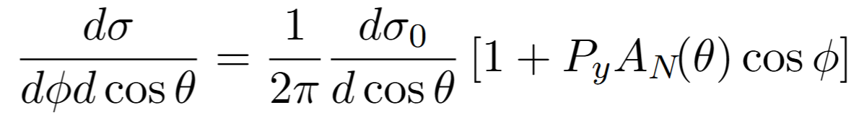
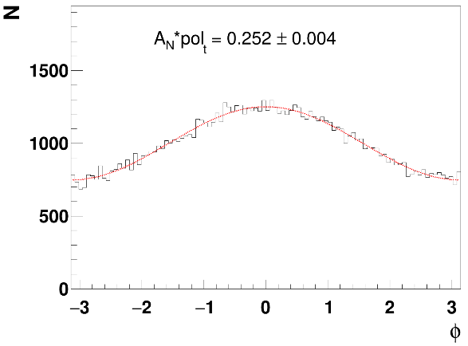
Principle of proton polarimeter
Relation between the spin-dependent cross-section of p + p/C scattering and the asymmetries
y
Transversely polarized protons
Carbon foil
x
Ф
θ
C
More protons to the left:
Left-right asymmetry
Widely used as polarimetric reaction to measure proton beam polarization (PSI, TRIMUF, LAMPF, COSY, SATURNE, ZGS, KEK-PS, AGS, RHIC …)

Slide 8
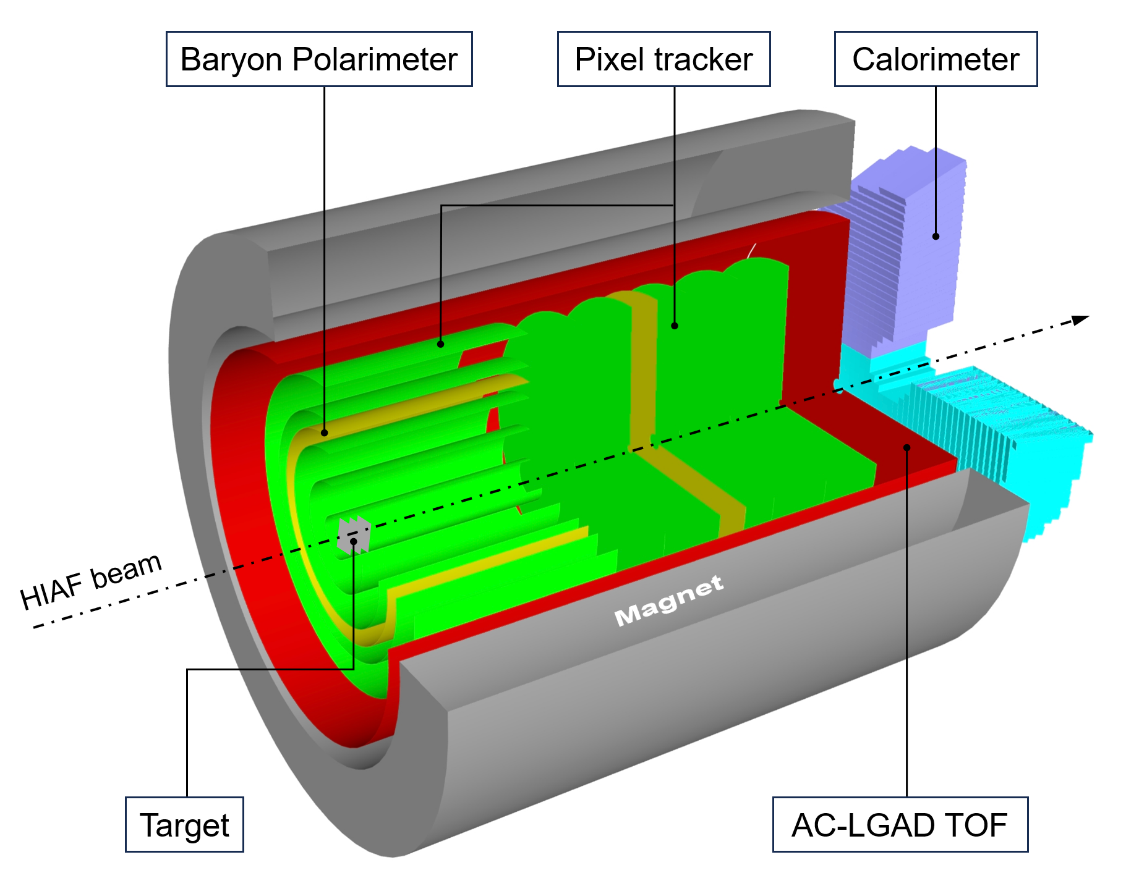
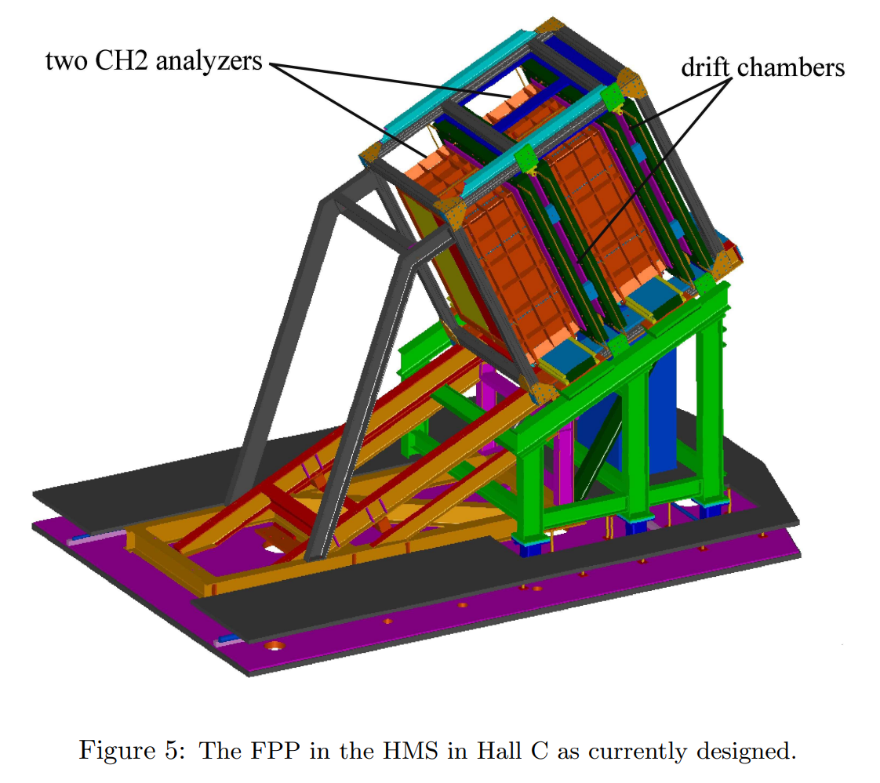
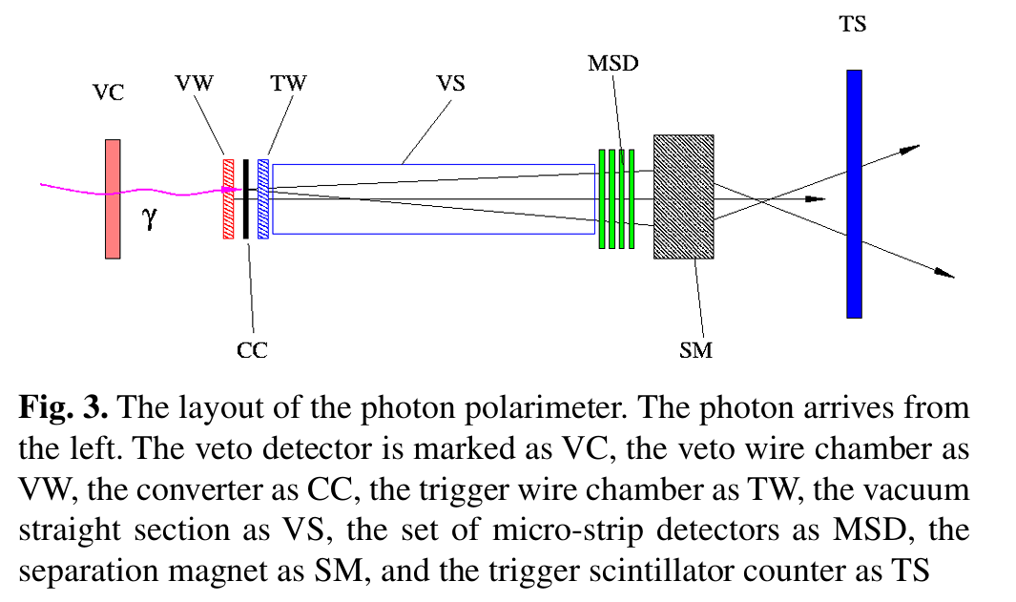
Proton polarimeter in general-purpose detector ?
General-use detector requirements:
e± μ± π± K± p± γ
Good tracking efficiency
Good momentum resolution
Good energy resolution
Secondary interaction
tracking || target || tracking
target || tracking
High luminosity machine?

Slide 9
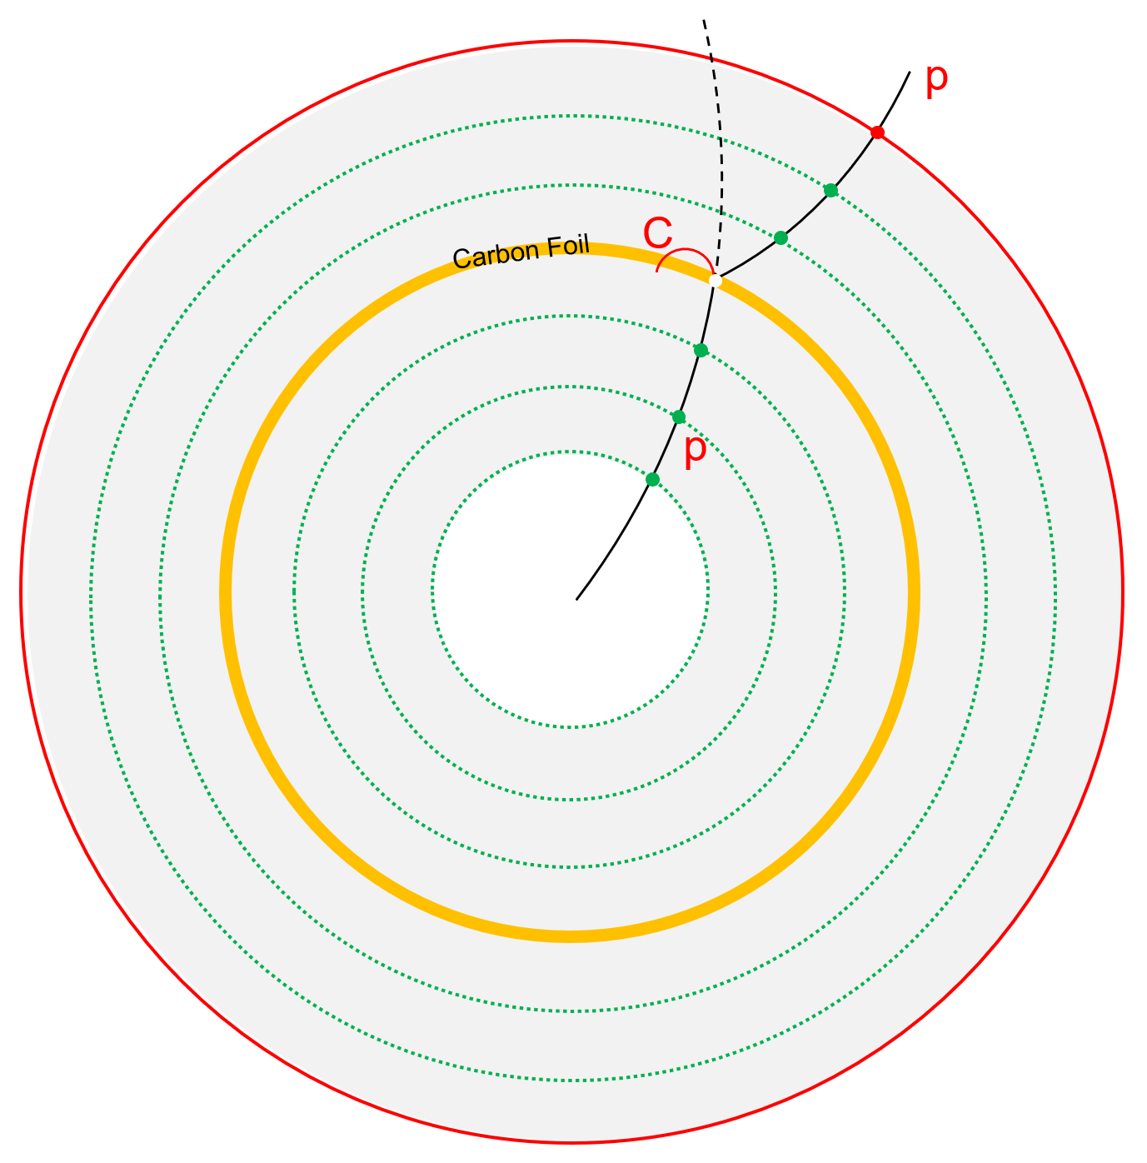
An extra scattering layer serve as baryon polarimeter
Carbon foil / Polyethylene foil
~1 mm thickness
Material budget: <1% X/X₀
Probability: pC / pp (1E-3)
Tiny influence to the conventional performance
Position : in-between the tracking devices
Appliable in all reactions: ee/ep/pp/pA/AA
Appliable in high energy machines
Yutie Liang, et. al., Phys. Rev. D 112, L031502

Slide 10
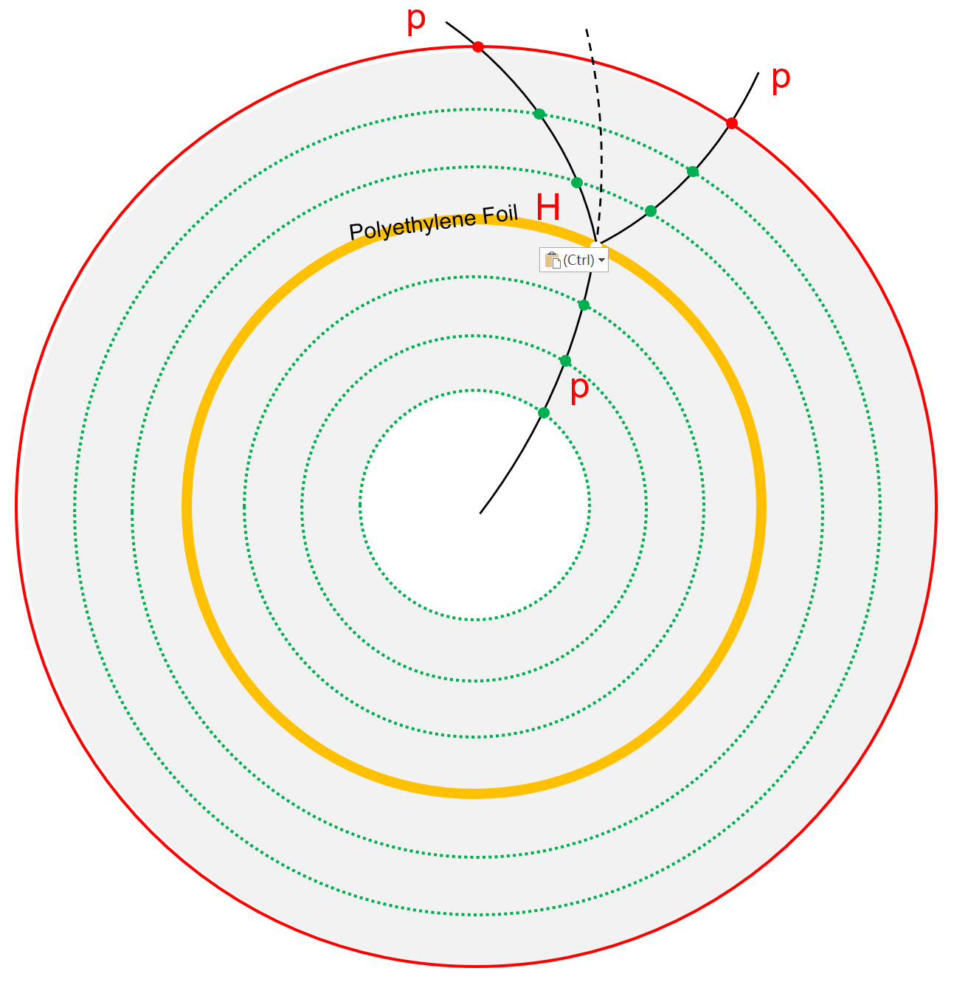
An extra scattering layer serve as baryon polarimeter
Carbon foil / Polyethylene foil
~1 mm thickness
Material budget: <1% X/X₀
Probability: pC / pp (1E-3)
Tiny influence to the conventional performance
Position : in-between the tracking devices
Appliable in all reactions: ee/ep/pp/pA/AA
Appliable in high energy machines
Yutie Liang, et. al., Phys. Rev. D 112, L031502

Slide 11
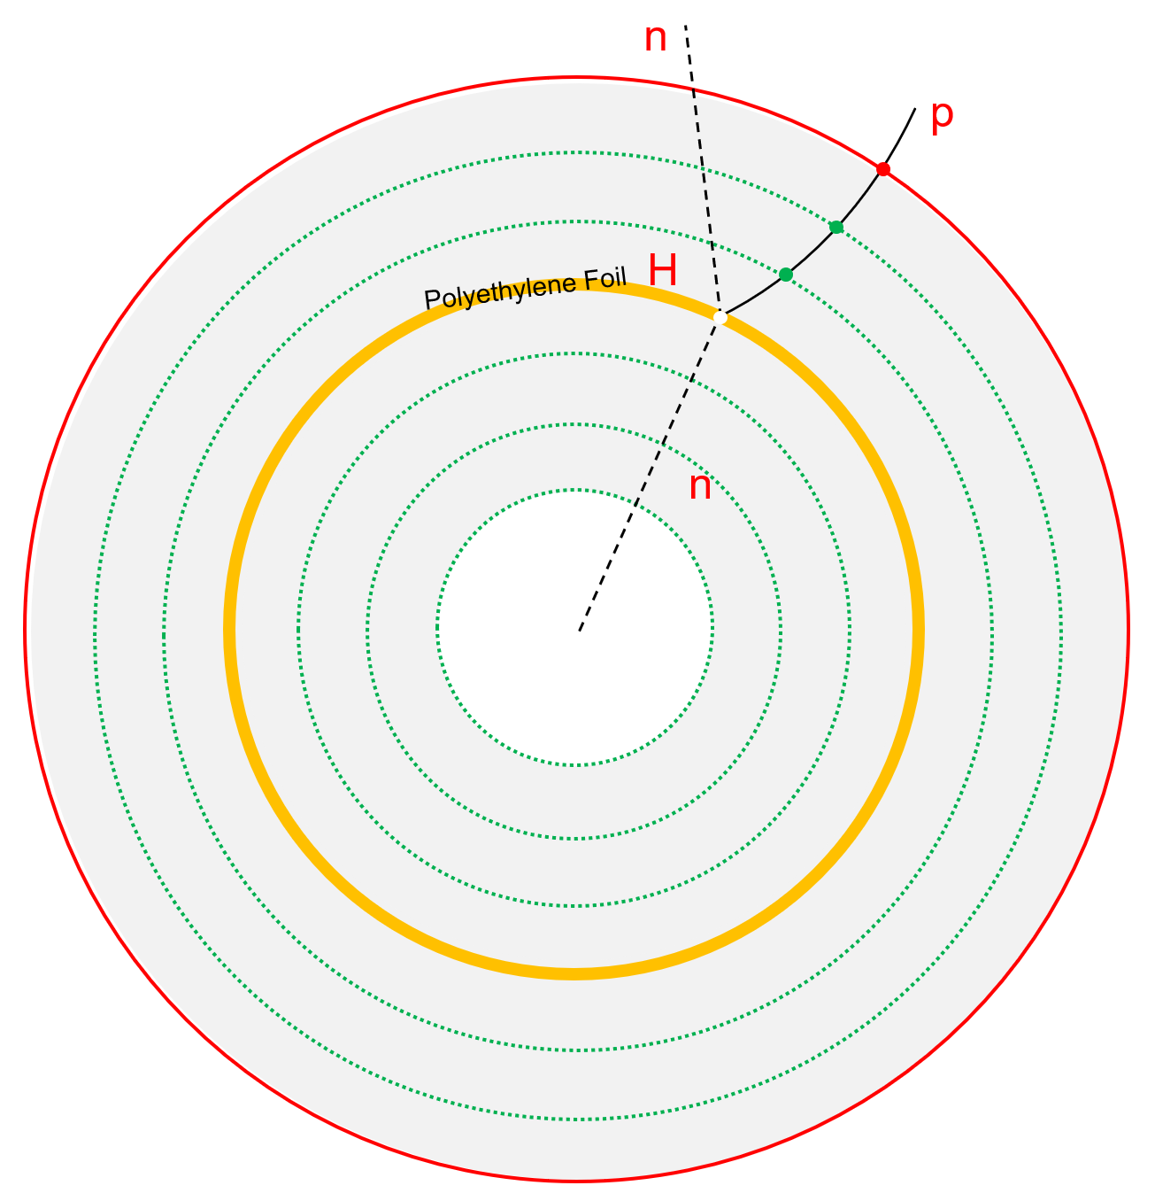
An extra scattering layer serve as baryon polarimeter
Carbon foil / Polyethylene foil
~1 mm thickness
Material budget: <1% X/X₀
Probability: pC / pp (1E-3)
Tiny influence to the conventional performance
Position : in-between the tracking devices
Appliable in all reactions: ee/ep/pp/pA/AA
Appliable in high energy machines
Yutie Liang, et. al., Phys. Rev. D 112, L031502

Slide 12
Polarimeter performance at H-NS

Slide 13
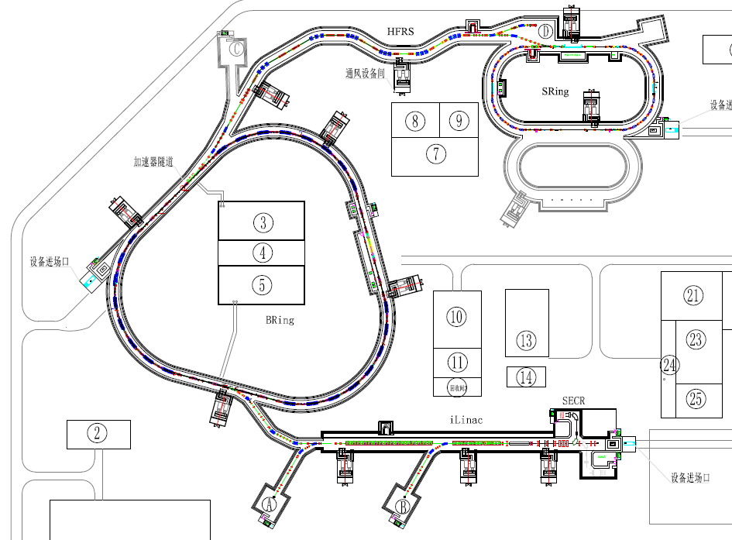
Hyperon Nucleon Spectrometer (H-NS)
proton beam up to 9.3 GeV
ion beam up to 4.25 GeV/u
p + p
p + A
A + A
High Energy Nuclear Physics Terminal
MIC6 MAPS
10:45 Oct. 28 Aiqiang Guo’s talk

Slide 14
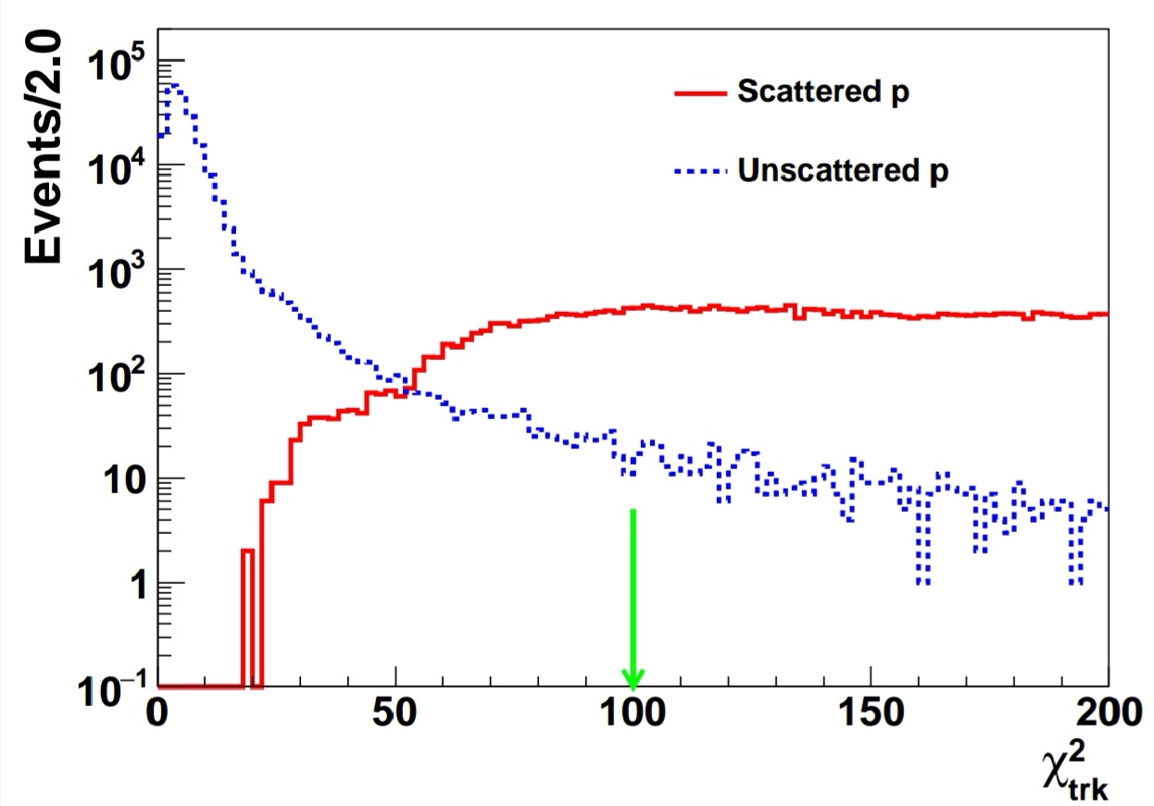

Non-scattering tracks suppression
$$σ=0.29 cm$$
Reconstruction effi: > 70%
Bkg. contimation: <1%

Slide 15
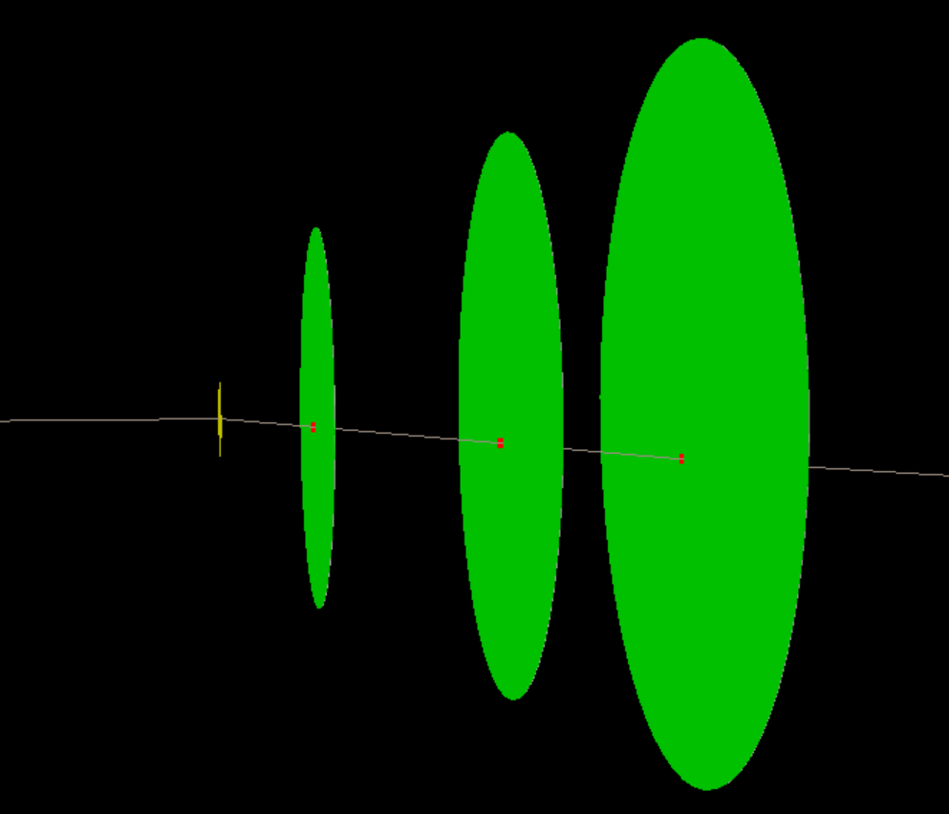
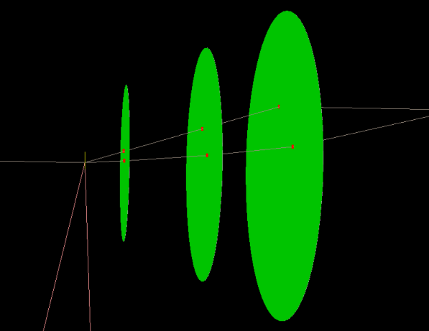
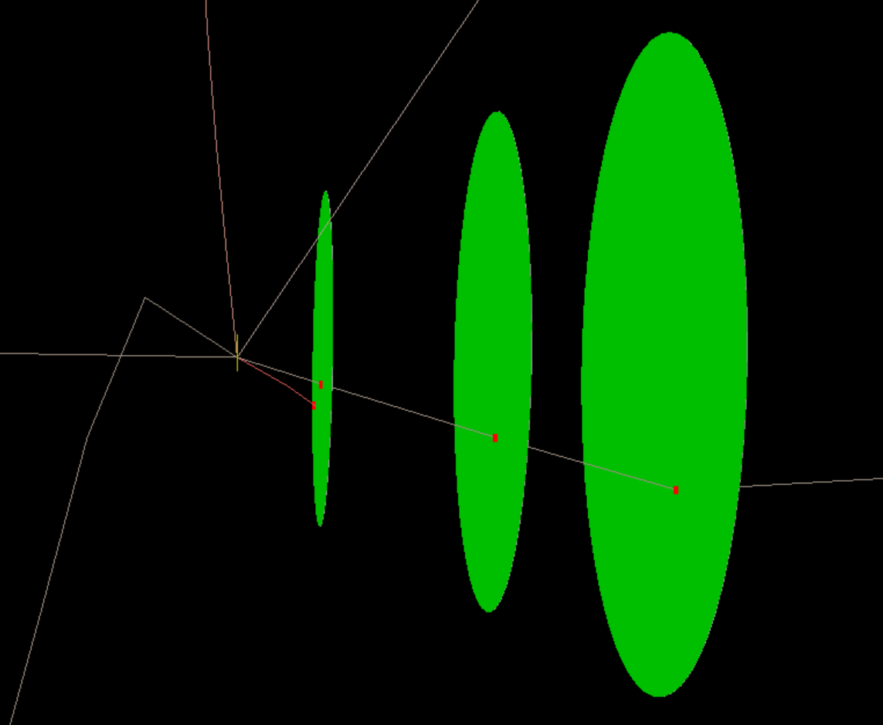
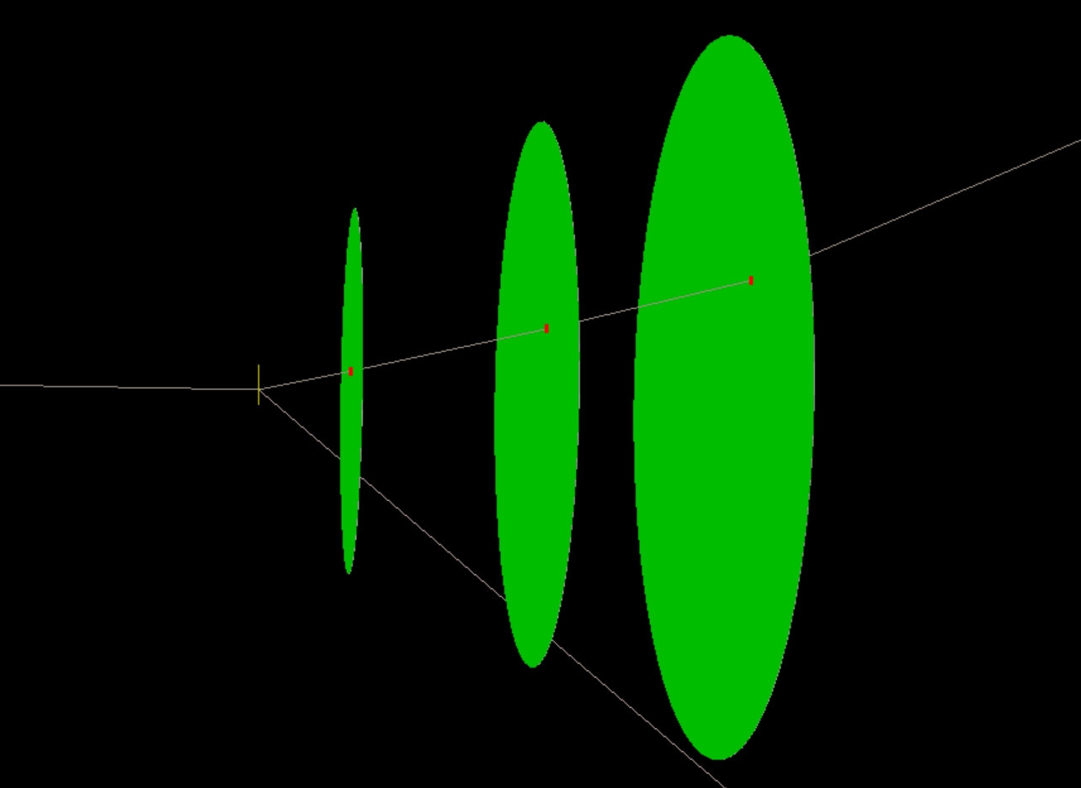
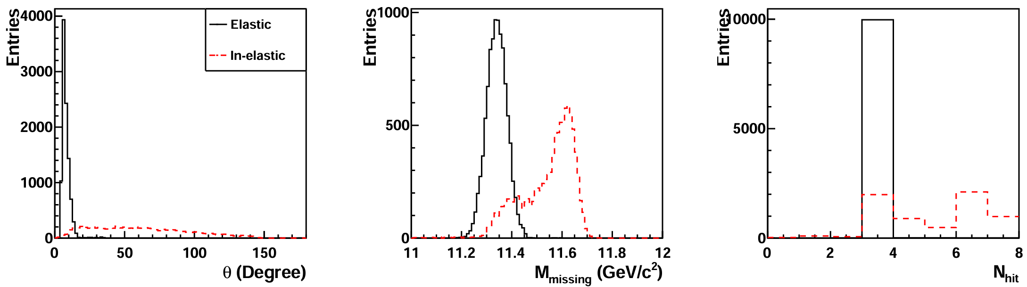
Background from inelastic scattering
Signal: p + C → p+C
Bkg: p + C → p + p + ...
p + C → p + d + α + He³
p + C → p + n + C¹¹
p + C → p + d + α + He³
p + C → p + n + C¹¹
p + C → p + p + B¹¹
…
Background level: 2-5%

Slide 16
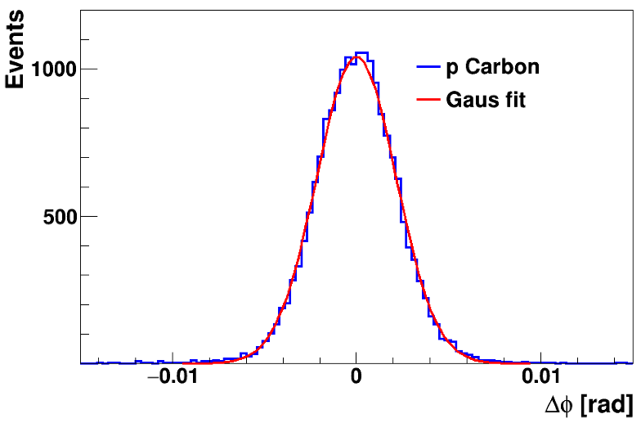
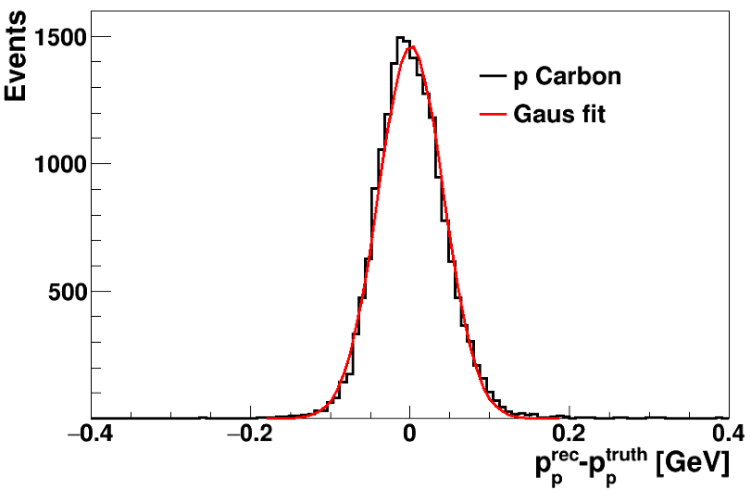
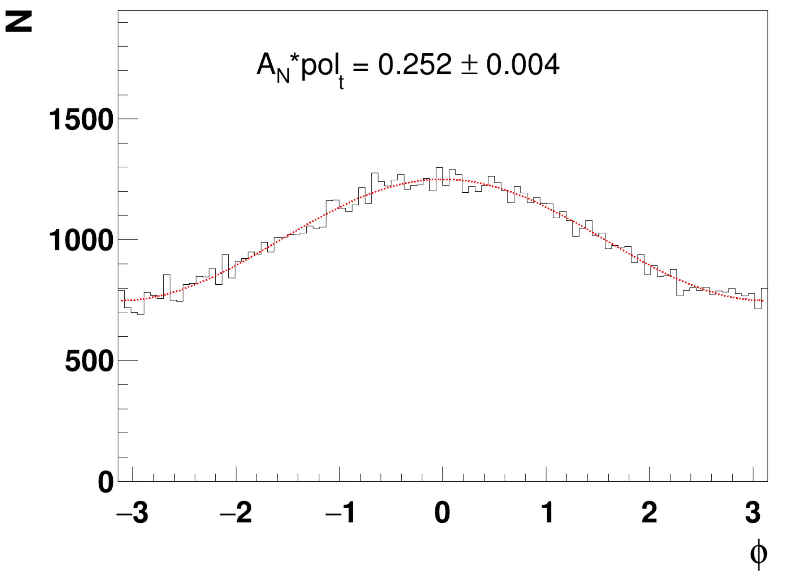


Precision measurement of proton polarization
$$σ=2.16 mrad$$
$$σ=0.041 GeV$$
Input: 0.250
Reconstruction effi: > 70%
Low background contamination!
High precision measurement!

Slide 17
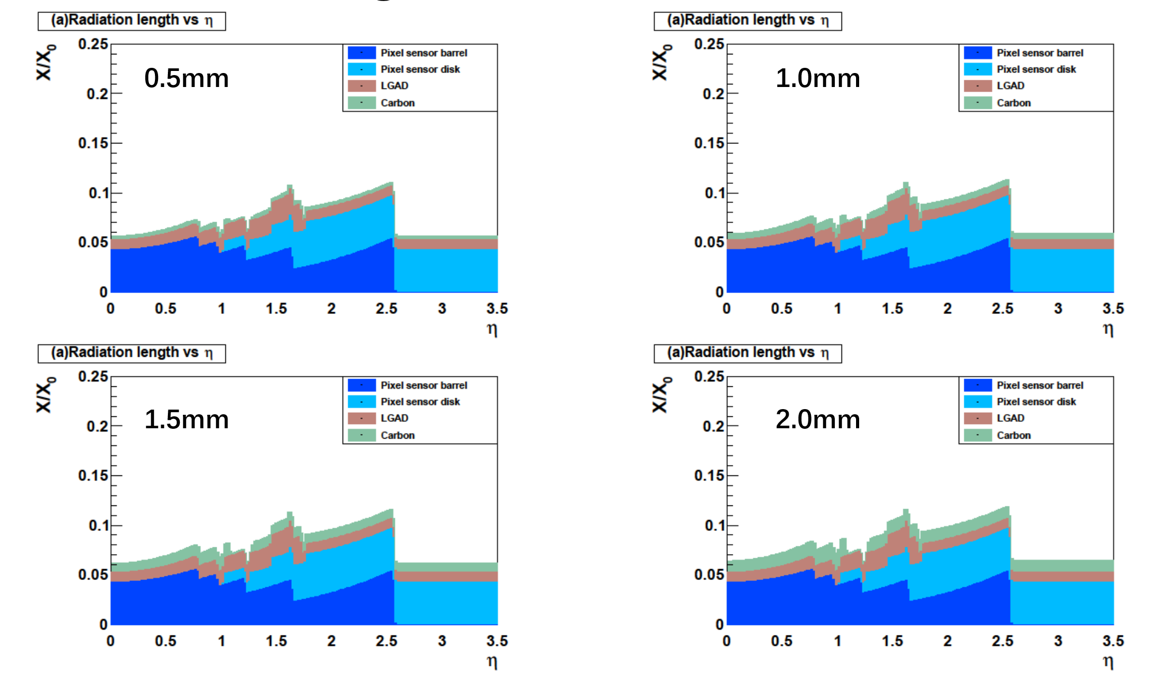
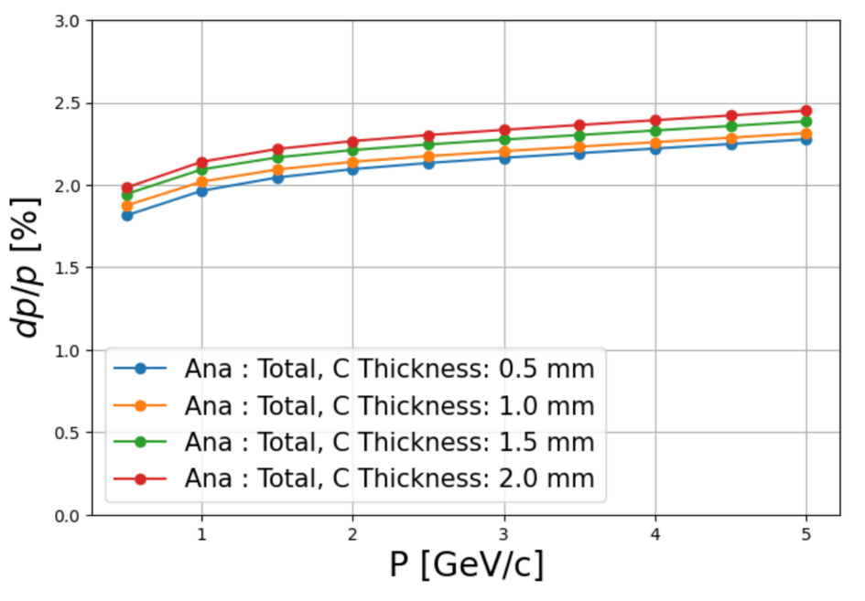
Material budget of carbon layer
Tiny influence on the conventional performance

Slide 18
Physics potentials at H-NS

Slide 19
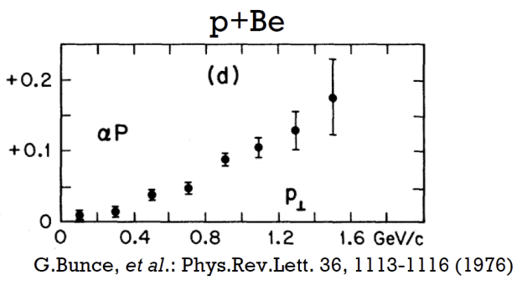
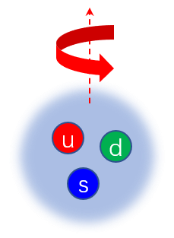
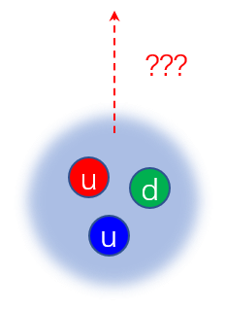
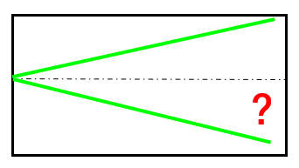
Baryon spin structure -- inclusive production of p/Λ
p+Be → Λ + X
pp → p/Λ + X
Λ polarization
p polarization

Slide 20
Uncertainty projection of the polarization measurement
pp → p/Λ + X
σ_{stat.} < 0.01 for Λ 400 bins σ_{stat.} < 0.02 for p 400 bins
H-NS
Reaction: p+p
Event rate:1MHz
Time: 3 months
pp →Λ+X N ~ 10¹¹
pp → p+X N ~ 10¹³
pp → pKΛ N ~ 10¹⁰
pC scattering ~ 10¹³ * 4*10⁻⁴ = 4*10⁹
σ_{stat.} < 0.01
σ_{stat.} < 0.02

Slide 21
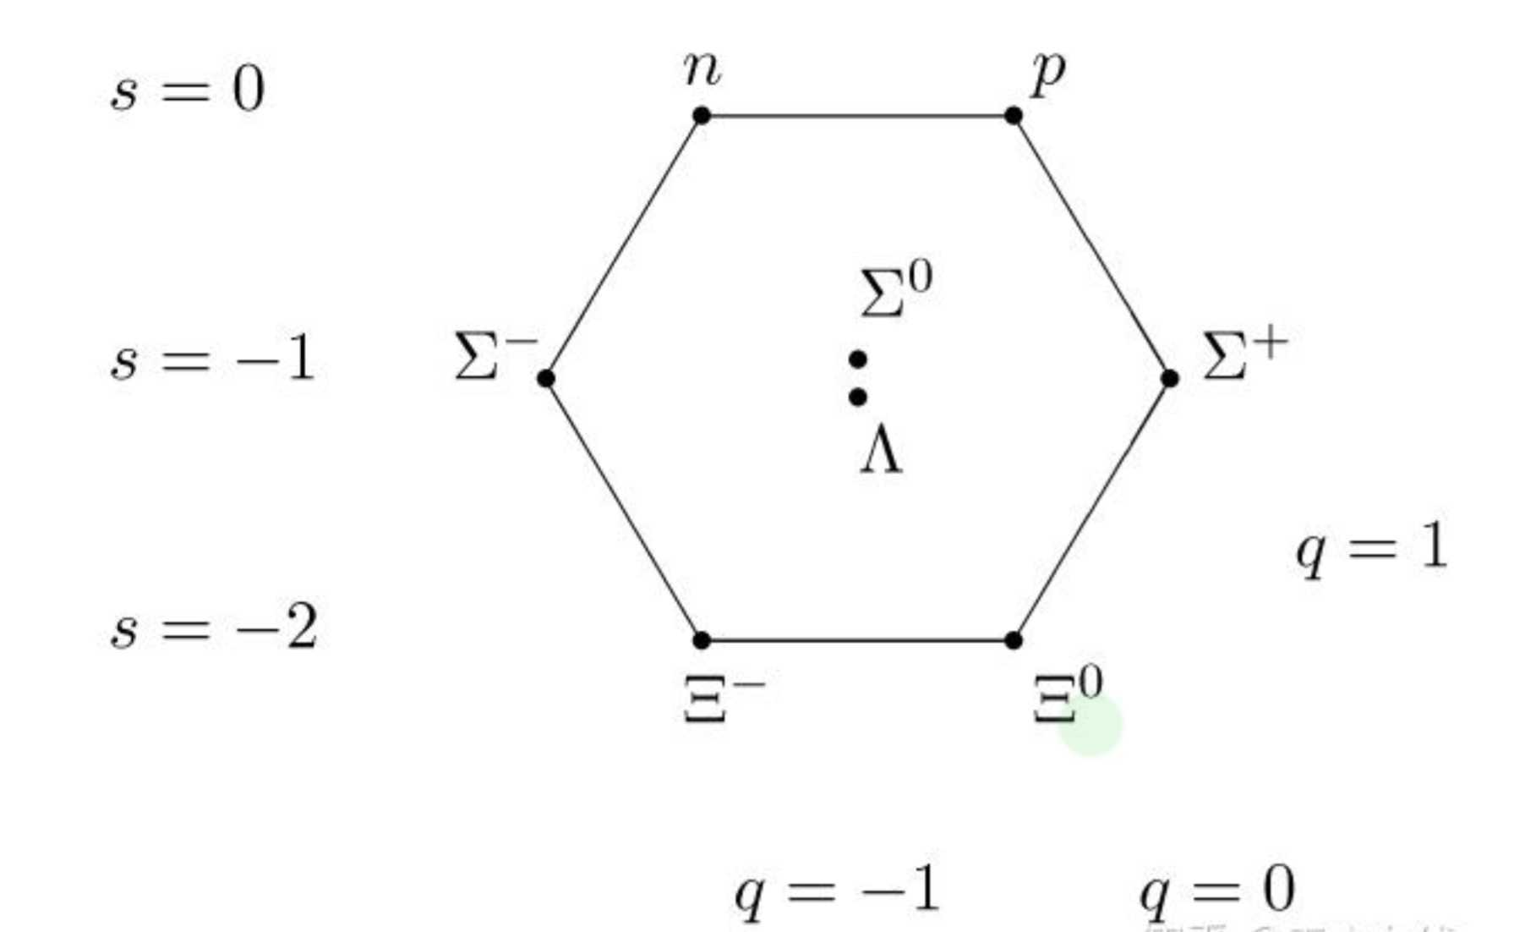
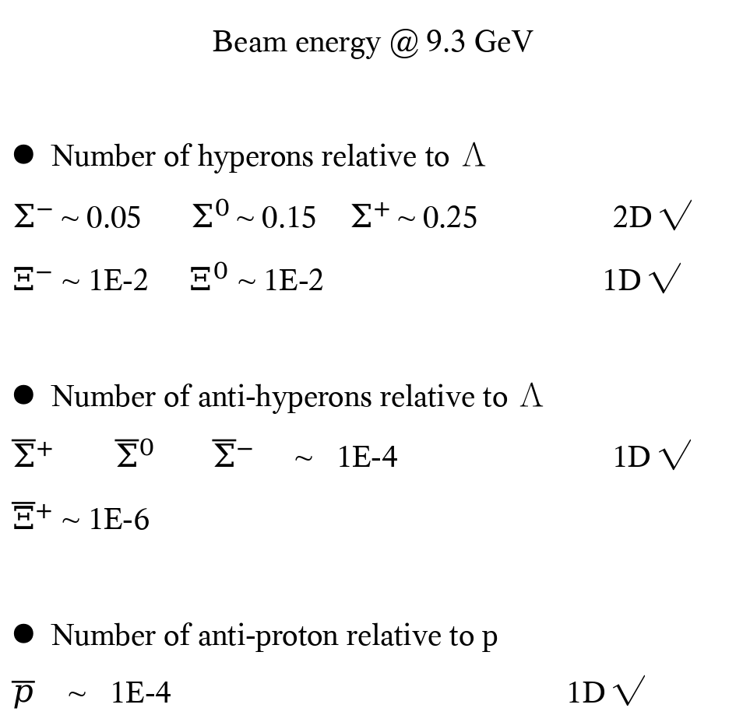
Various baryons at H-NS
Beam energy @ 9.3 GeV
Number of hyperons relative to Λ
$Σ^{−}$~ 0.05 $Σ^{0}$ ~ 0.15 $Σ^{+}$ ~ 0.25 2D √
$Ξ^{−}$ ~ 1E-2 $Ξ^{0}$ ~ 1E-2 1D √
Number of anti-hyperons relative to Λ
${\overline{Σ}}^{+}$ ${\overline{Σ}}^{0}$ ${\overline{Σ}}^{−}$ ~ 1E-4 1D √
${\overline{Ξ}}^{+}$ ~ 1E-6
Number of anti-proton relative to p
$\overline{p}$ ~ 1E-4 1D √
(udd)
(uud)
(uds)
(dds)
(uus)
(uds)
(dss)
(uss)

Slide 22
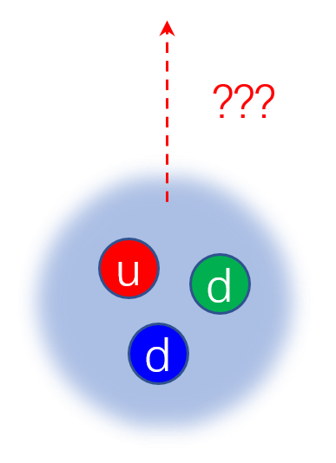
Neutron polarization measurement at H-NS
hyperons
proton
neutron
Baryons | Exclusive | Inclusive
Hyperons | √ | √
Proton | √ | √
Neutron | √ (H target) | χ

Slide 23
Physics potentials at H-NS
pp → pKΛ
p p → p K Λ→ p K p π σ_{stat.} < 0.005
Slides from Haibo Li
H-NS
Reaction: p+p
Event rate:1MHz
Time: 3 months
pp →Λ+X N ~ 10¹¹
pp → p+X N ~ 10¹³
pp → pKΛ N ~ 10¹⁰

Slide 24
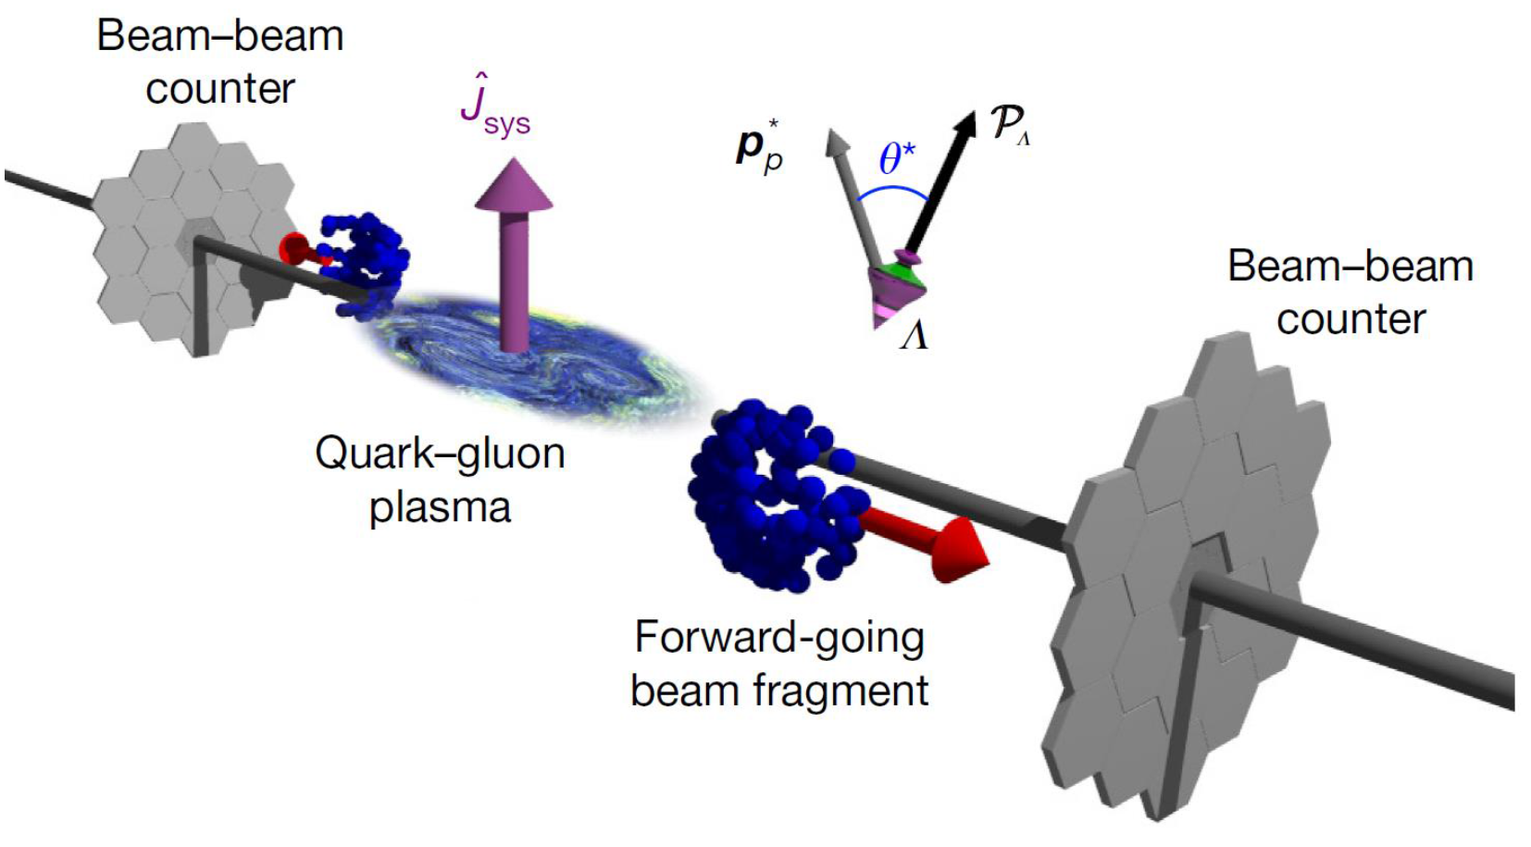
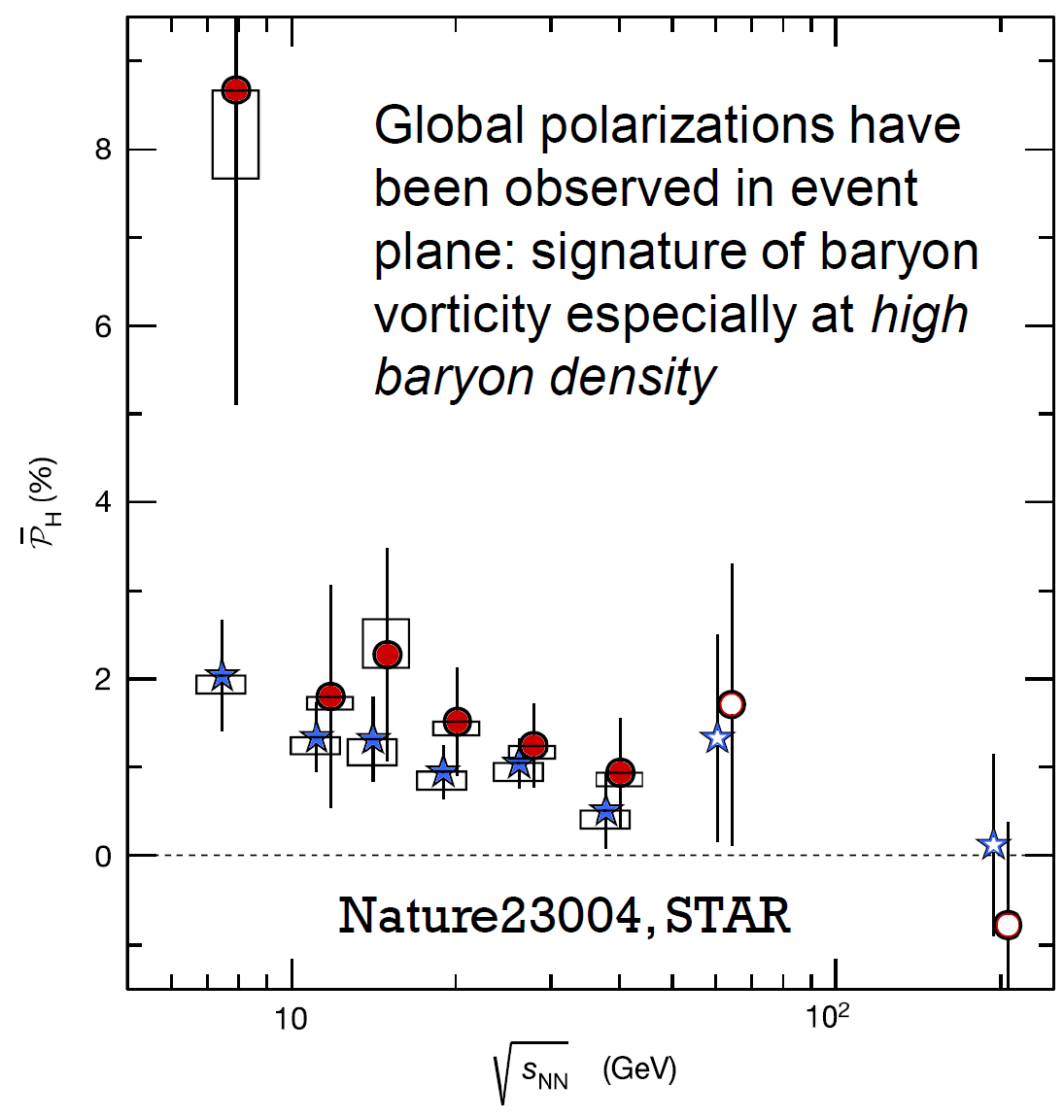
Physics potentials at H-NS
Heavy ion physics?
H-NS
Reaction: A+A
Event rate:?
Time:
AA →Λ+X
AA → p+X
A new probe with proton polarization?
Difficult at STAR, but possible at H-NS
Global polarization of proton?

Slide 25
Physics potential at EicC

Slide 26
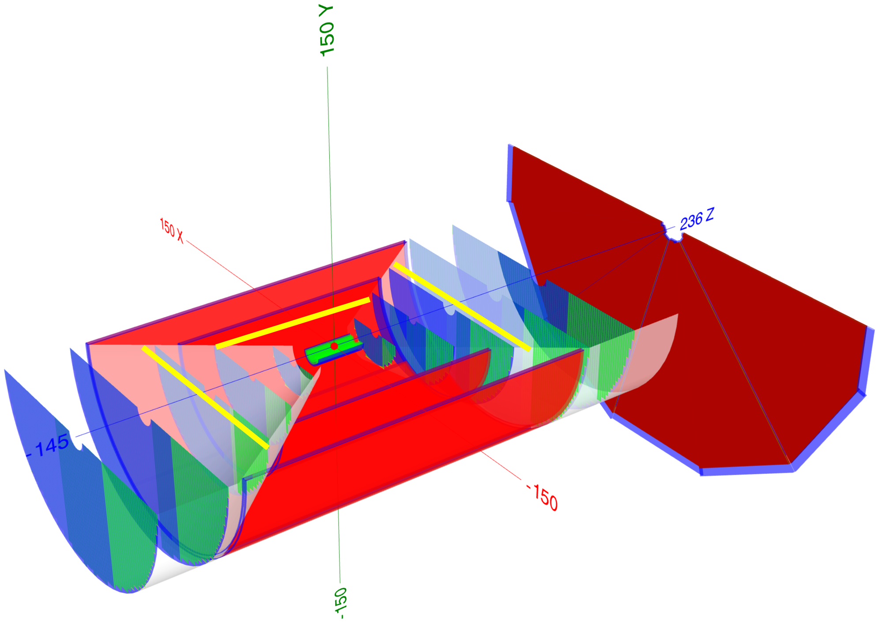
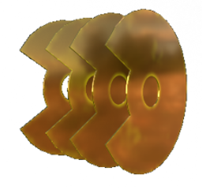


EicC Tracking system
MIC7/ITS3: 3 + Carbon + 4 layers
20X20 μm², 0.05%X/X₀ per layer
MIC7/ITS3: 4 → 3 + Carbon + 3 layers
20X20 μm², 0.05%X/X₀ per layer
10:15 Oct. 28 Yuxiang Zhao’s talk

Slide 27




Generalized Parton Distributions (GPDs)
Eight GPDs for quarks or gluons
DVCS gets access to GPDs
$H$ and $\tilde{H}$ are better constrained with data of unpolarized or longitudinally polarized target.
$E$ and $\tilde{E}$ are poorly known, since they require data with a transversely polarized target.
In the future EicC/EIC, a transversely polarized proton beam is feasible. $E$ is expected to be constrained.
But $\tilde{E}$ is still challenging.

Slide 28




New observable with recoil proton polarization
Polarization as a function of E_{k}, Q², x, t
Px depends mostly on $\tilde{H}$ and $\tilde{E}$
Py depends mostly on $H$, $E$and $\tilde{E}$
Pz no much sensitivity to any CFF
$$\tilde{H}$$
$$\tilde{E}$$
O. B. Bylund, et. al., Phys. Rev. D 107, 014020 (2023)

Slide 29



TMDs
Final state polarization measurement, sensitive to:
the spin dependent parton distribution functions
the spin dependent fragmentation functions
p
e + p → e + Λ→ + X
Z Ji. … J.L. Zhang, NST 34, 155 (2023)
e + p → e + p→ + X

Slide 30
Summary
New concept of general-purpose spectrometer with polarimeter funtion proposed
Gain the nucleon polarimeter function, with tiny impact on conventional performance
Feasibility study and optimization performed at H-NS/EicC
Tunable in thickness and material of scattering layer
Physics potentials extended in the high energy nuclear physics
Applicable in all reactions (ee, ep, pp, pA, AA) and in wide energy region
Thank You

Slide 32





A new domain: take full advantage of spin polarization
What is the origin of Λ/p polarization
What is the link between Λ/p spin structure and polarization
Electron ion collider in China (EicC)
Hyperon-Nucleon Spectrometer (H-NS)
EIC: Initial state is polarized
-How do partons form up a polarized nucleon?
$Λ$ polarization: Final state is polarized
-How do partons form up a polarized $Λ$ and p?
Final state
Initial state
Polarized by device
$Λ$ polarization: self-analyzing; p polarization: new concept detector
Baryon spin structure: origin of nucleon spin VS origin of $Λ$/p polarization

Slide 33

Probability of pC scattering with 1mm carbon
σ ~ 54.5 mb
Number of C nucleus per unit area (cm⁻²), in CarbonFiber layer
= d * ρ * N_{C}/Molar_mass * A
= 0.1 cm * 1.57 g/cm³ * 1/12 mol/g * 6.022*10²³ /mol
= 7.9 * 10²¹ /cm²
Cross section of p scattering off Carbon with scattering angle > 5º:
54.5 mb = 54.5* 10⁻²⁷ cm²
The probability of pC elastic scattering in Carbon layer of 1 mm:
Prob = 7.9 * 10²¹ /cm² * 54.5 * 10⁻²⁷ cm²
= 4.3 *10⁻⁴
One measurement for every 2000 proton.
PRC.41 1651

Slide 34



Background from non-scattering tracks
Signal: 200 K pCarbon elastic scattering
Background: 10 M non-scattering events
p: 1 3 5 GeV
θ: 10 20
61 73 85 Deg

Slide 35


A possible probe to baryon spin structure
pp → pKΛ
Λ
K⁺
Λ polarization
p polarization
p
Senario 1:
s quark causes the Λ polarization, assuming a Pt_{Λ} dependence.

Slide 36
Uncertainty projection of the polarization measurement
pp → pKΛ
σ_{stat.} < 0.01 for Λ 100 bins σ_{stat.} < 0.05 for p 100 bins
H-NS
Reaction: p+p
Event rate:1MHz
Time: 3 months
pp →Λ+X N ~ 10¹¹
pp → p+X N ~ 10¹³
pp → pKΛ N ~ 10¹⁰
σ_{stat.} < 0.01
σ_{stat.} < 0.05

Slide 37
Dexu Lin
p 2212 127427666 65.00% nucleon
n 2112 55047809 28.08% nucleon
Λ⁰ 3122 8175349 4.17% hyperon
Σ⁺ 3222 1891557 9.65e-03 hyperon
Σ⁰ 3212 1246247 6.36e-03 hyperon
p̄ -2212 665526 3.39e-03 anti-nucleon
n̄ -2112 638214 3.26e-03 anti-nucleon
Σ⁻ 3112 485700 2.48e-03 hyperon
Ξ⁰ 3322 162285 8.28e-04 hyperon
Λ̄⁰ -3122 107932 5.51e-04 anti-hyperon
Ξ⁻ 3312 86839 4.43e-04 hyperon
Σ̄⁰ -3212 36721 1.87e-04 anti-hyperon
Σ̄⁻ -3222 32800 1.67e-04 anti-hyperon
Σ̄⁺ -3112 30332 1.55e-04 anti-hyperon
Ξ̄⁰ -3322 6070 3.10e-05 anti-hyperon
Ξ̄⁺ -3312 5845 2.98e-05 anti-hyperon
Ω̄⁺ -3334 23 1.17e-07 anti-hyperon
Ω⁻ 3334 7 3.57e-08 hyperon
p 2212 141006963 70.44% nucleon
n 2112 52266785 26.11% nucleon
Λ⁰ 3122 4660670 2.33% hyperon
Σ⁺ 3222 1173672 5.86e-03 hyperon
Σ⁰ 3212 716643 3.58e-03 hyperon
Σ⁻ 3112 216593 1.08e-03 hyperon
n̄ -2112 45912 2.29e-04 anti-nucleon
p̄ -2212 44461 2.22e-04 anti-nucleon
Ξ⁰ 3322 36048 1.80e-04 hyperon
Ξ⁻ 3312 16314 8.15e-05 hyperon
Λ̄⁰ -3122 2189 1.09e-05 anti-hyperon
Σ̄⁰ -3212 431 2.15e-06 anti-hyperon
Σ̄⁺ -3112 377 1.88e-06 anti-hyperon
Σ̄⁻ -3222 315 1.57e-06 anti-hyperon
Ξ̄⁺ -3312 3 1.50e-08 anti-hyperon

Slide 38

A simple channel to start
pp → pKΛ
Λ polarization
Λ
p
K⁺
p
p polarization
?

Slide 39

A simple channel to start
pp → pKΛ
Λ
K⁺
p

Slide 40


Probe GPD via DVCS
Detect the scattered electron, real photon and nucleon.
Absolute Cross Section:
Asymmetries with polarized target and/or polarized beam:
σ^{+/-} : Beam or/and Target Polarization.

Slide 41



Sensitivity of CFFs to proton DVCS

Slide 42


Status of GPDs
$H$ and $\tilde{H}$ are better constrained with data of unpolarized or longitudinally polarized target.
$E$ and $\tilde{E}$ are poorly known, since they require data with a transversely polarized target.
In the future EicC/EIC, a transversely polarized proton beam is feasible. $E$ is expected to be constrained.
But $\tilde{E}$ is still challenging, due to the small factor

