Slide 1



第十六届“QCD相变与相对论重离子物理”研讨会
Moat regimes within a 2 + 1 flavor Polyakov-quark-meson model
Gaoqing Cao
School of Physics and Astronomy Sun Yat-sen University
2025.10.26 @ Guangxi Normal University

Slide 2
Outline
QCD phase diagram and moat regimes
The three-flavor PQM model with new parameters
The features of moat regimes
Summary

Slide 3
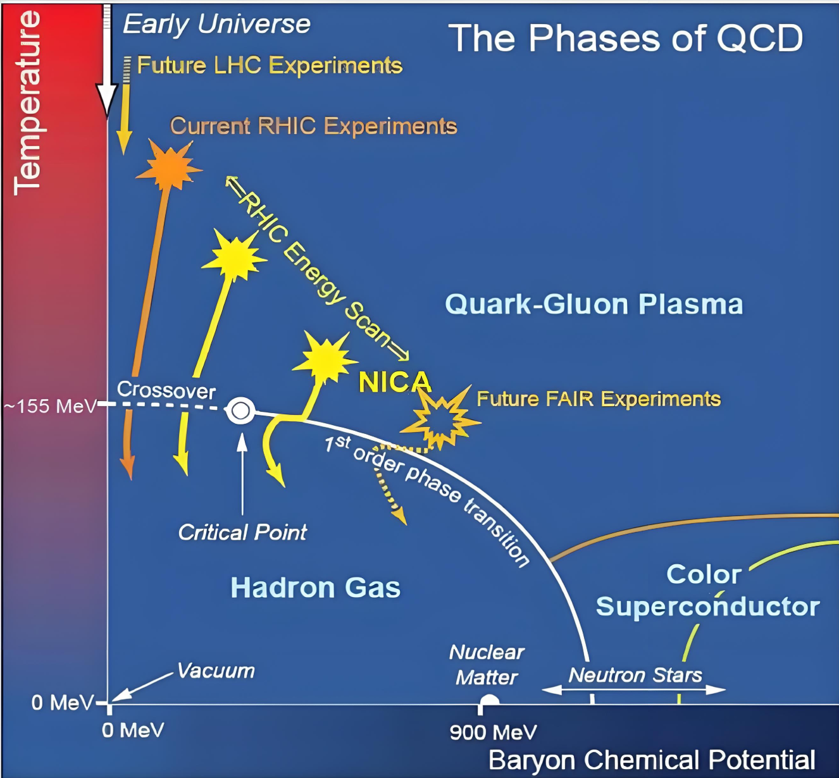
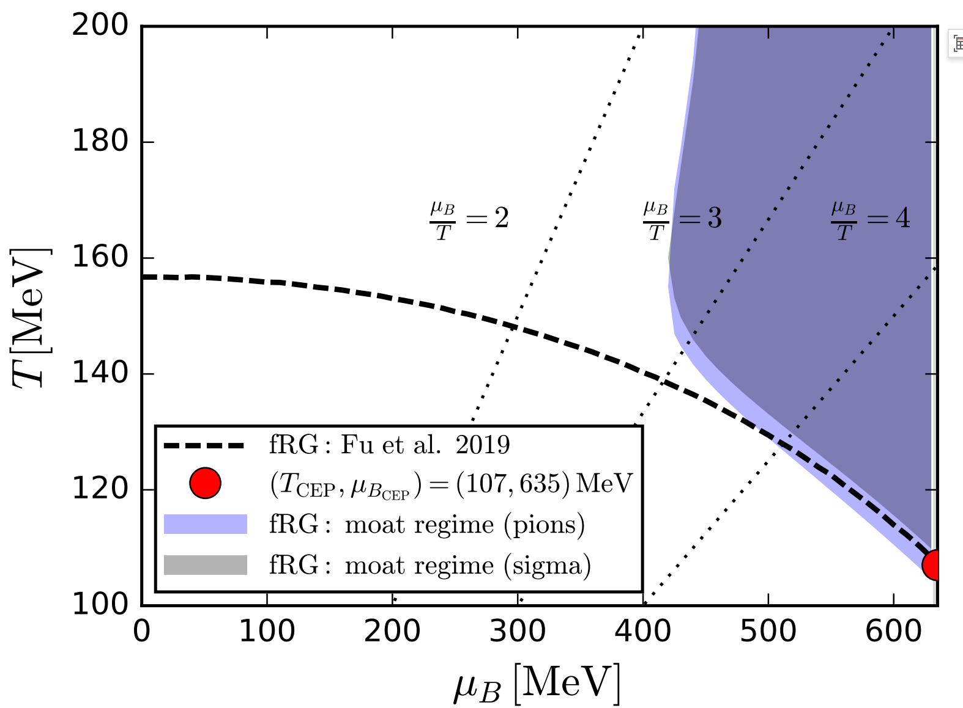
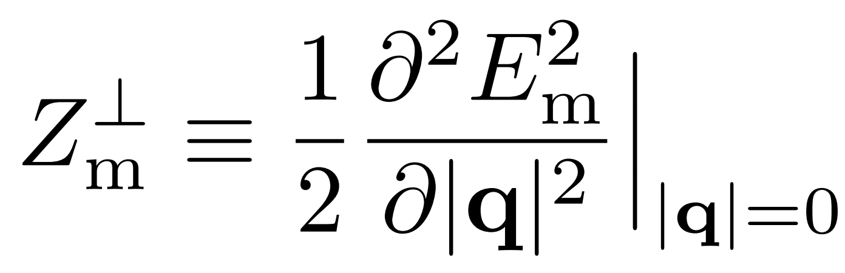
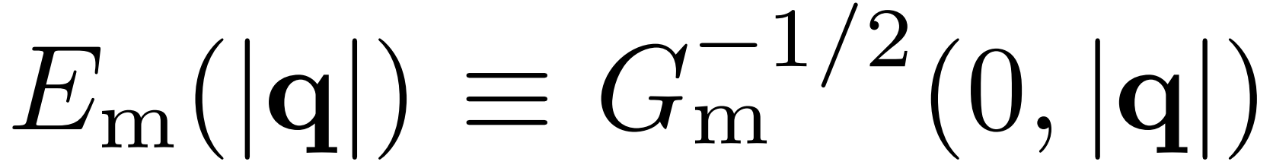


QCD phase diagram and moat regime
W. Fu et. al., PRD (2025)
$$，$$
$$<0$$

Slide 4

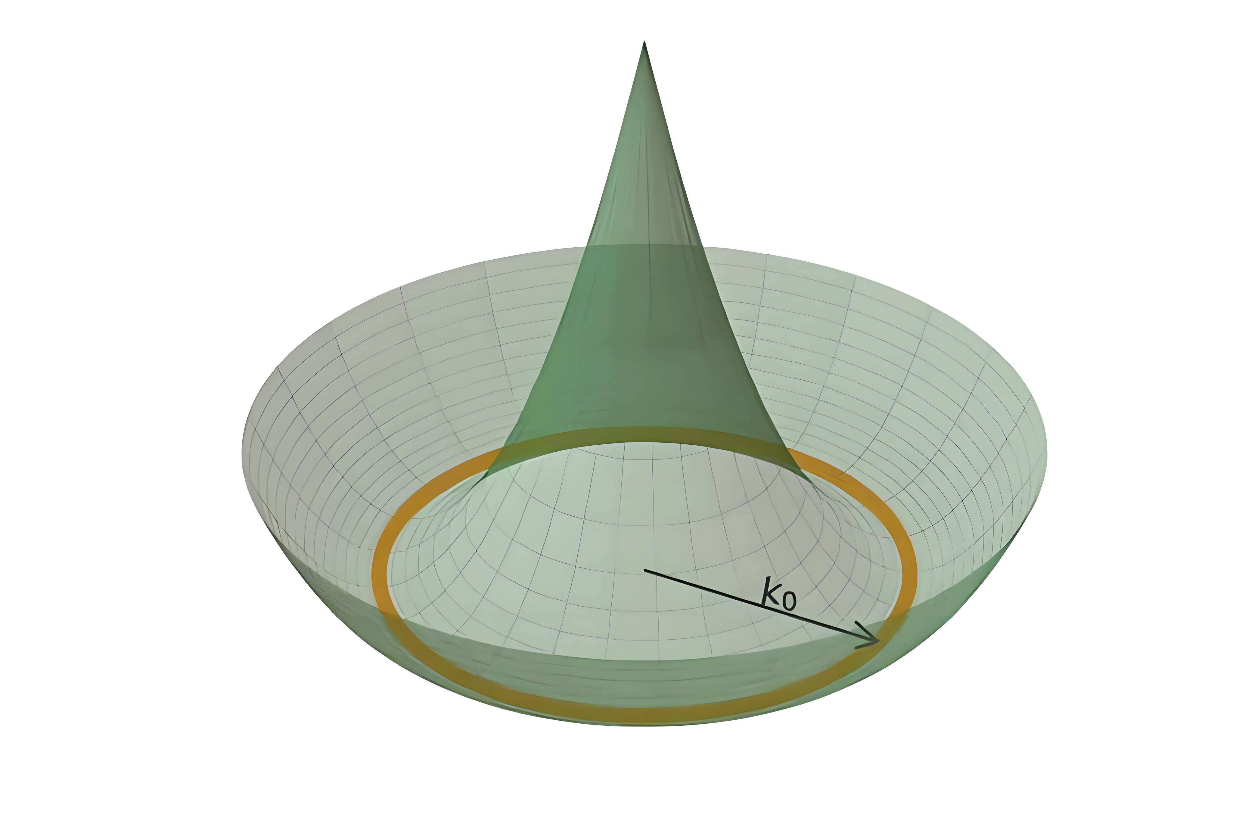
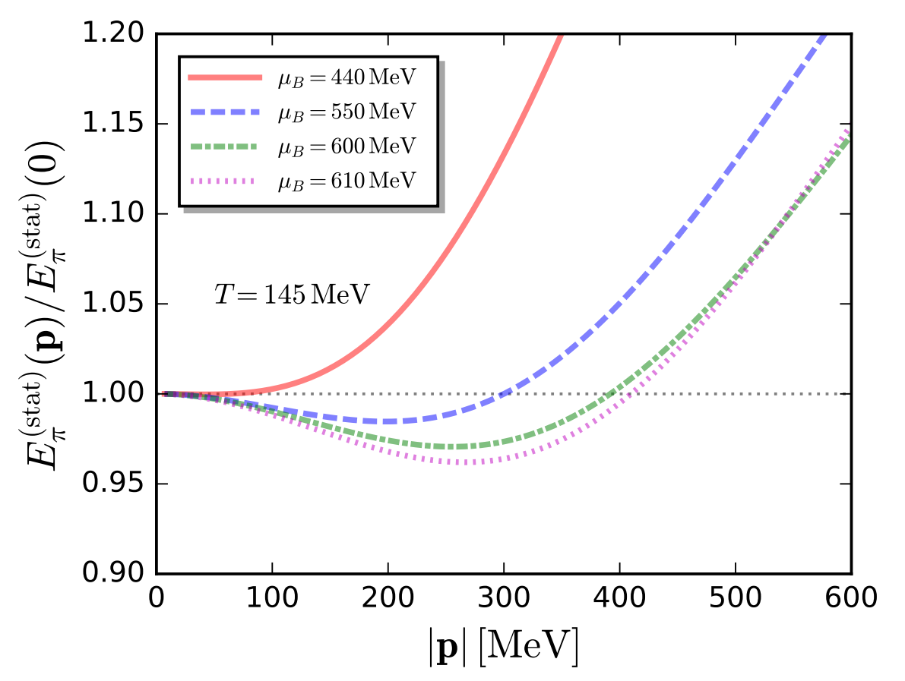
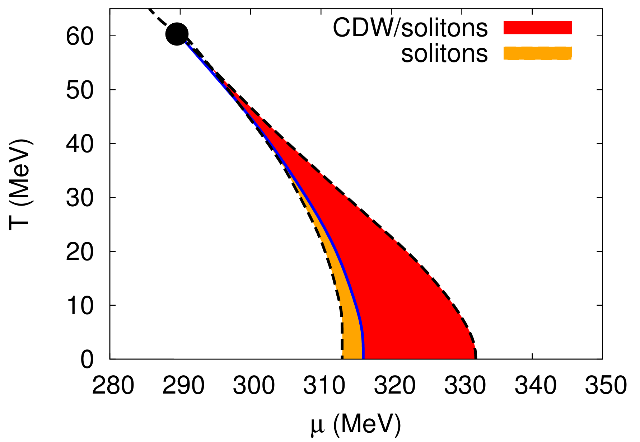
Moat regime is the precursor of inhomogeneous phase
W. Fu et. al., PRD (2025)
S. Carignano et. al., PRD (2014)

Slide 5
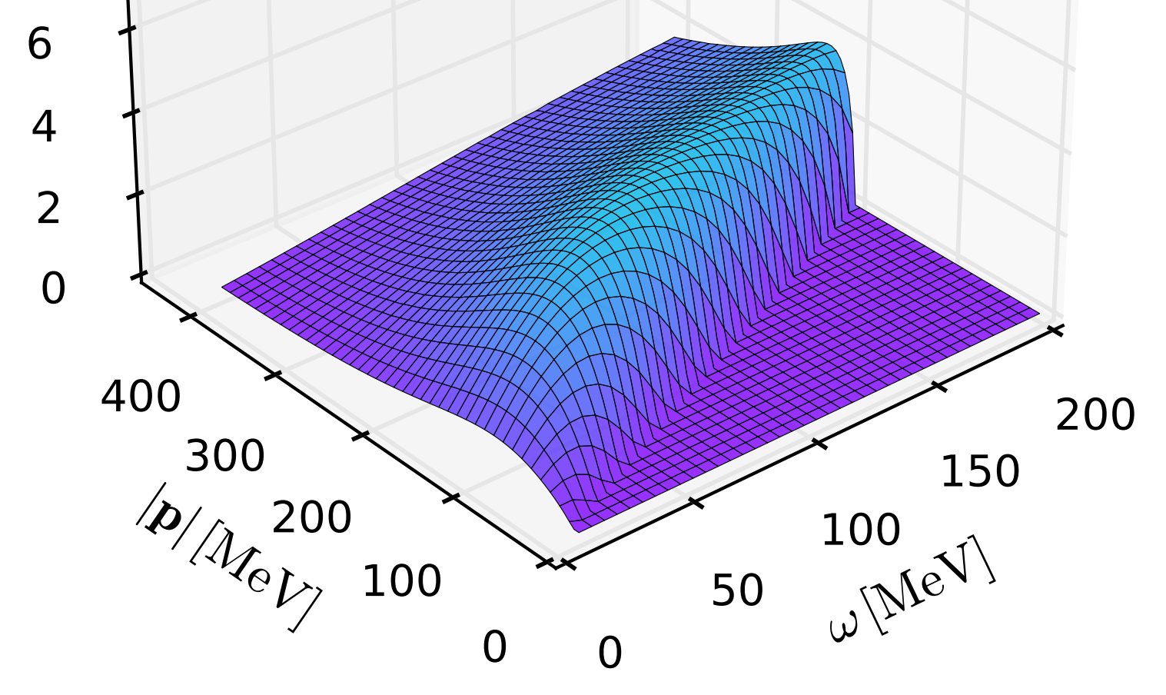
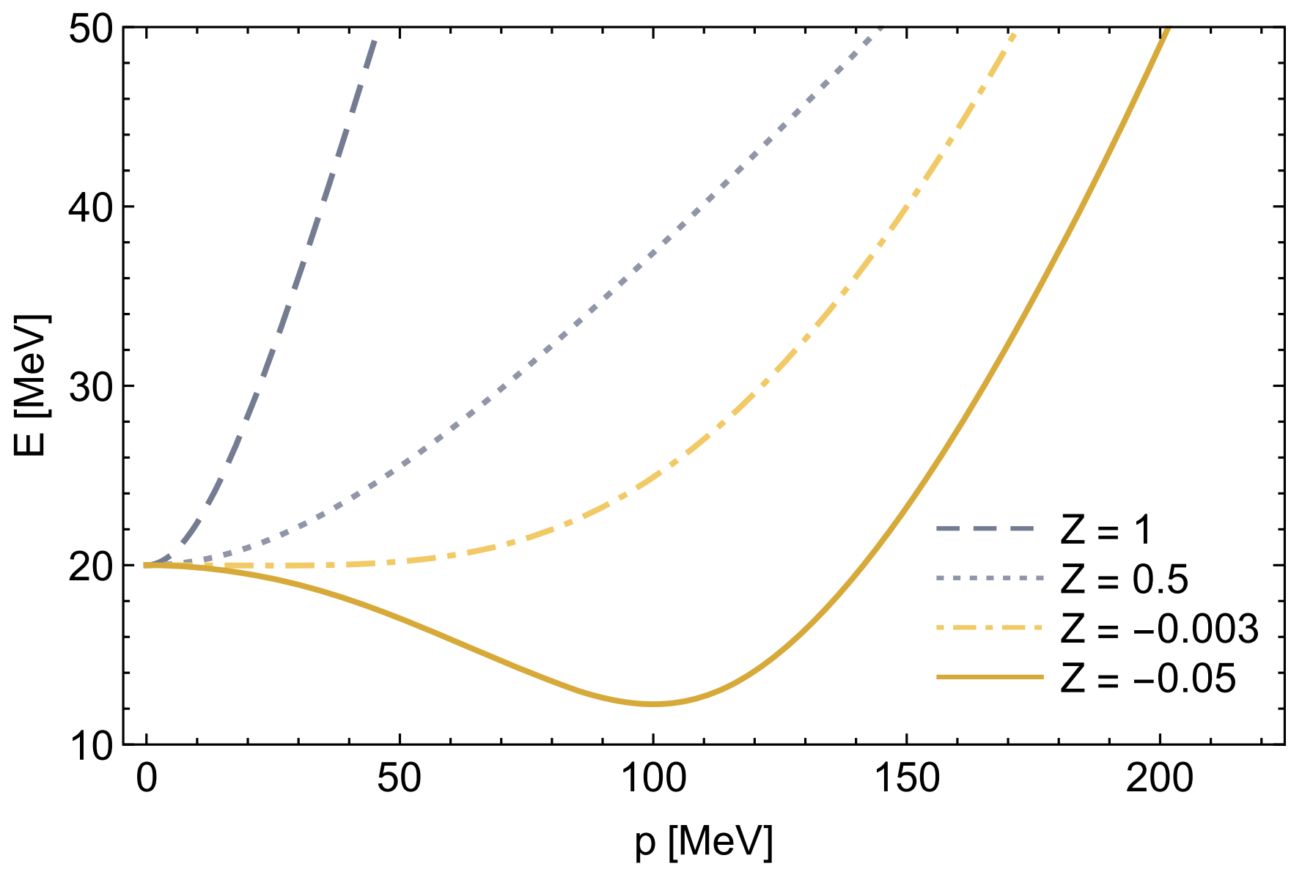
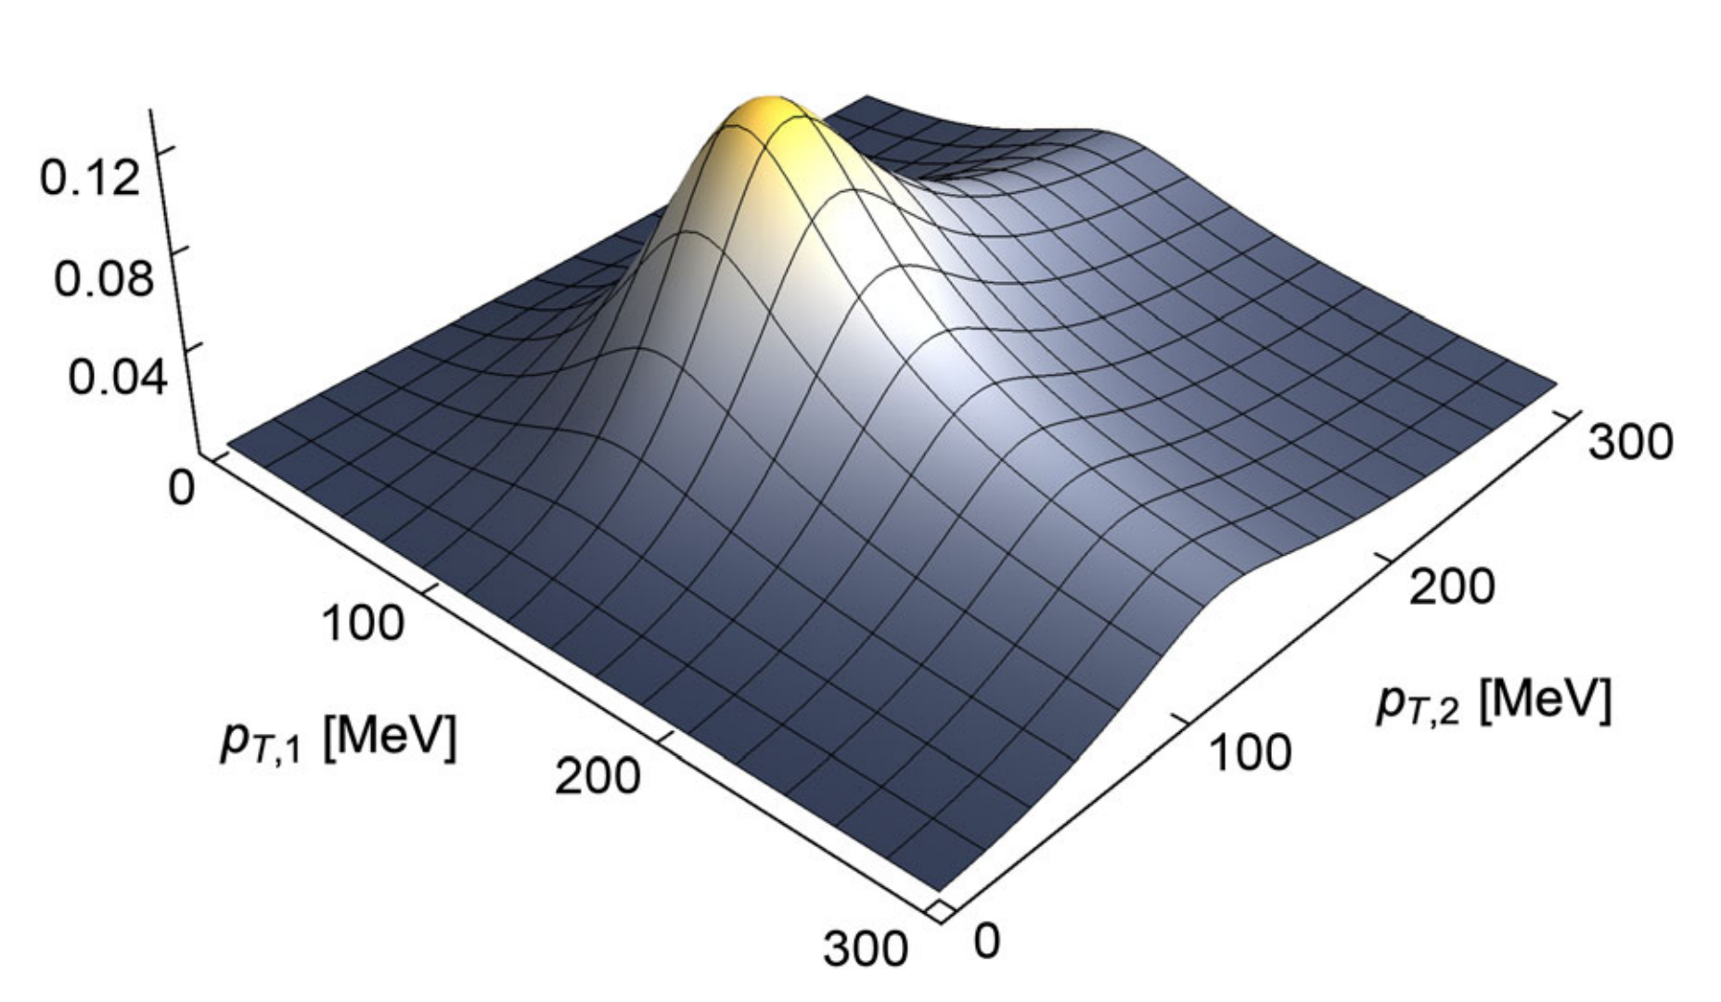
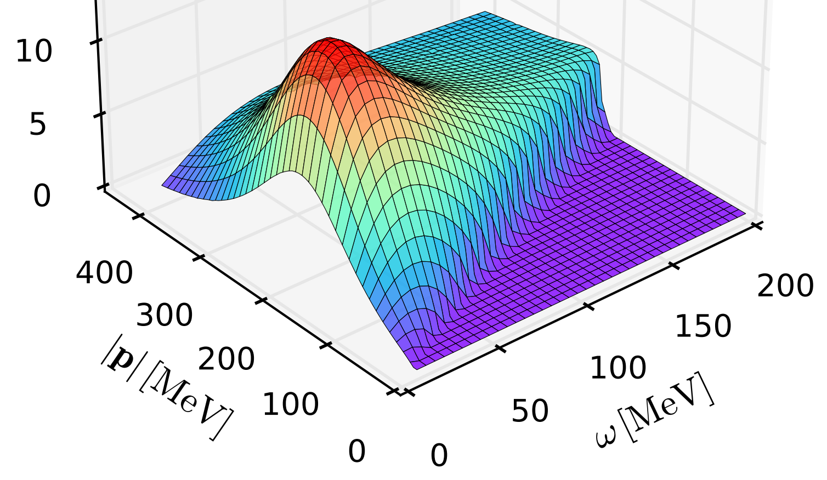
Signatures?
Pole energy
Spectral functions
Not the same
R. D. Pisarski and F. Rennecke, PRL (2021)

Slide 6
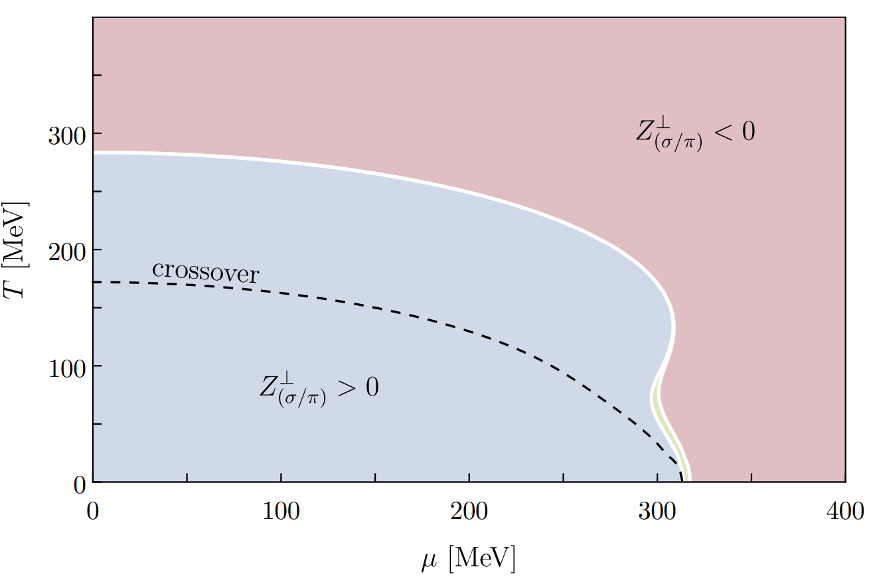
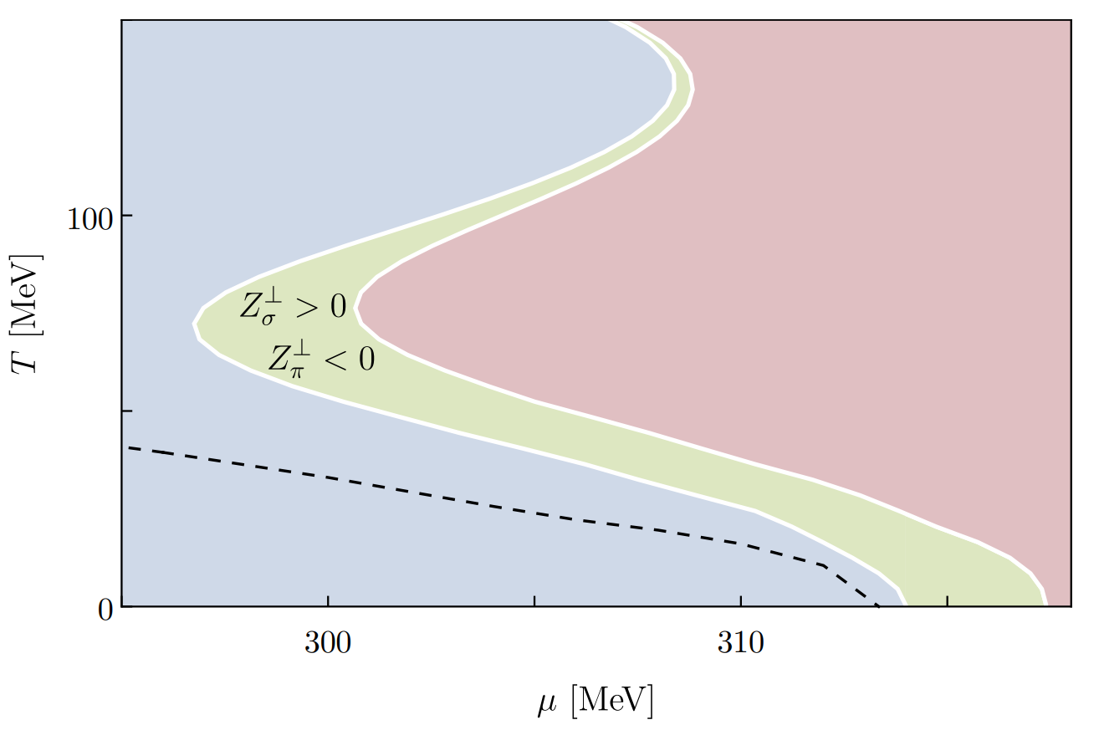
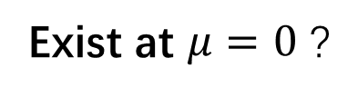
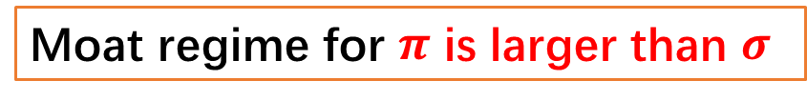
The two-flavor quark-meson model
S. Topfel, et. al., arXiv:2412.16059.
Moat regime for $π$ is larger than $σ$
Exist at $μ=0$ ?
vector coupling
F. Rennecke and S. Yin, arXiv:2510.06712
W/O critical point, Polyakov loop and strange quark

Slide 7
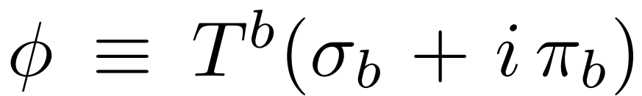
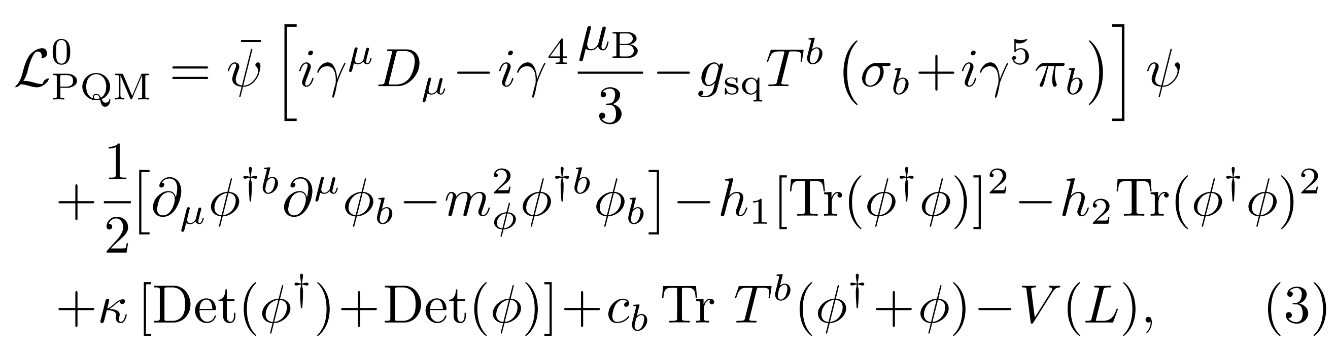
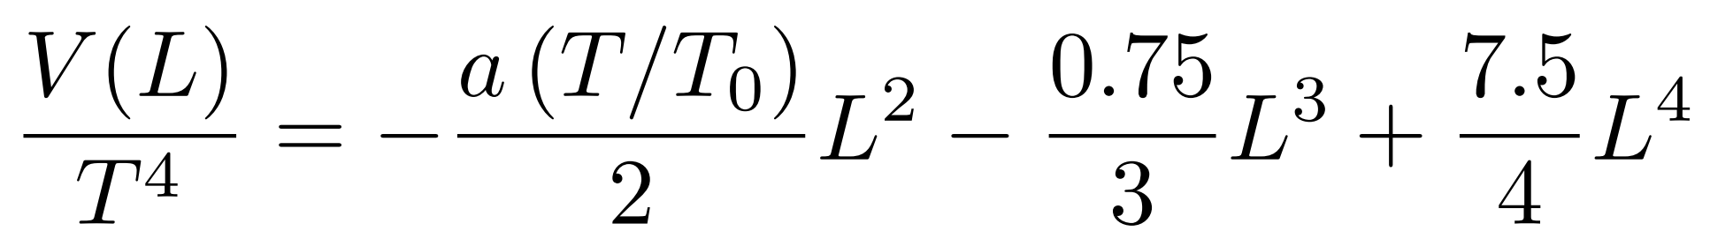
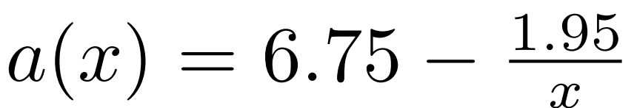
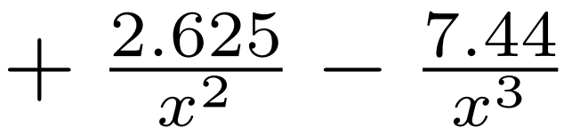
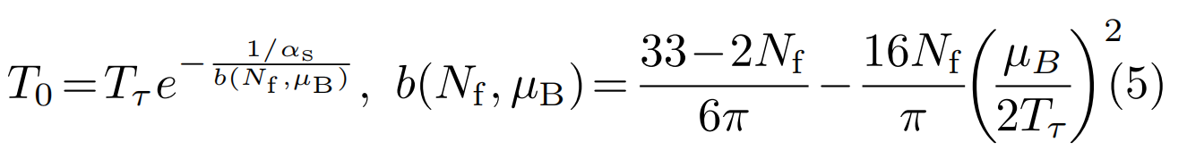

The three-flavor PQM model
Original Lagrangian
B. J. Schaefer et. al., (2010).
Gluon potential
Polyakov loop
C. Ratti et. al., PRD (2006).
T. K. Herbst et. al., PLB (2011).

Slide 8
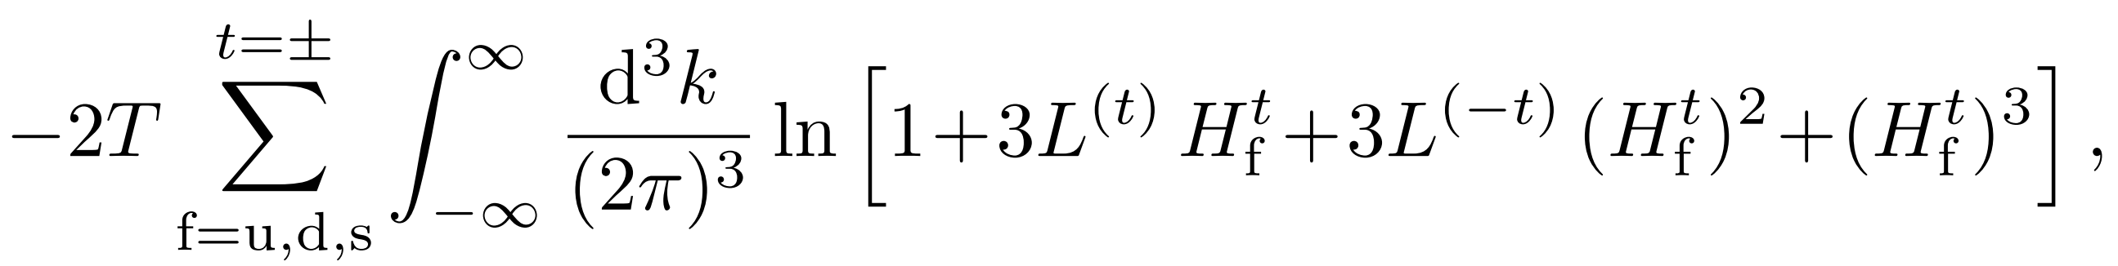
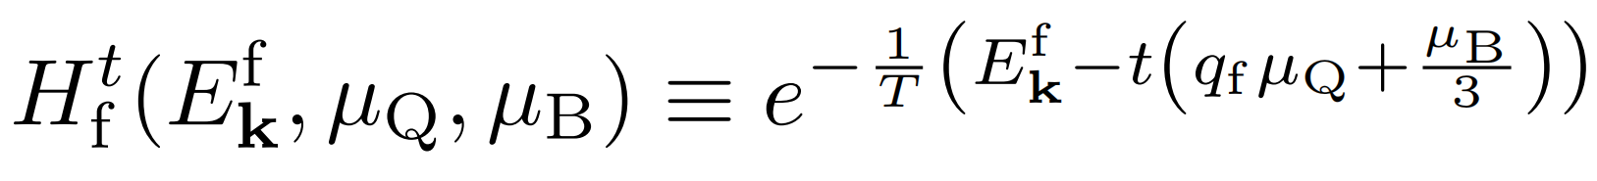
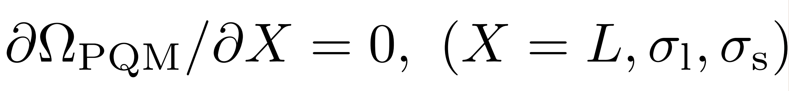
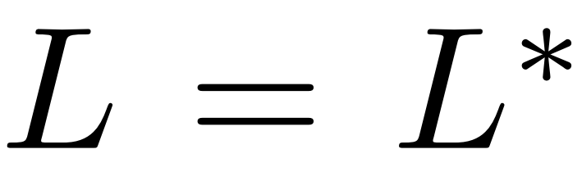
Mean field approximation
Thermodynamic potential
thermal
Gap equation

Slide 9
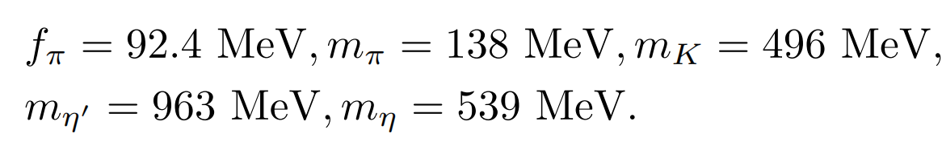
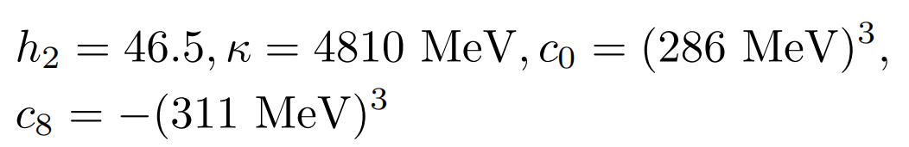
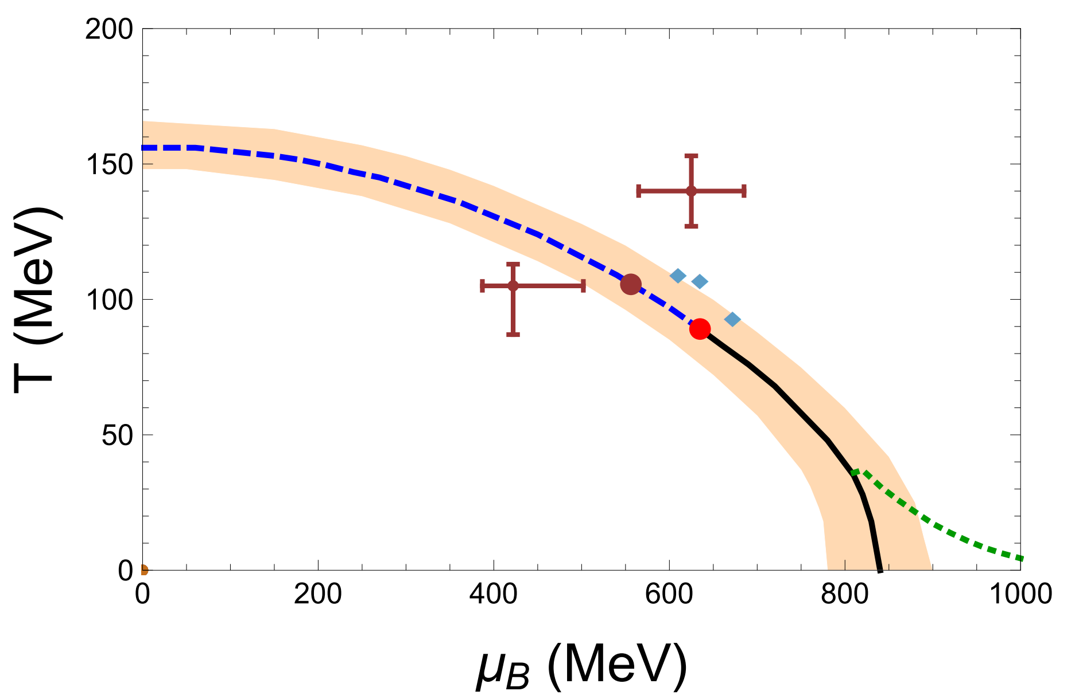
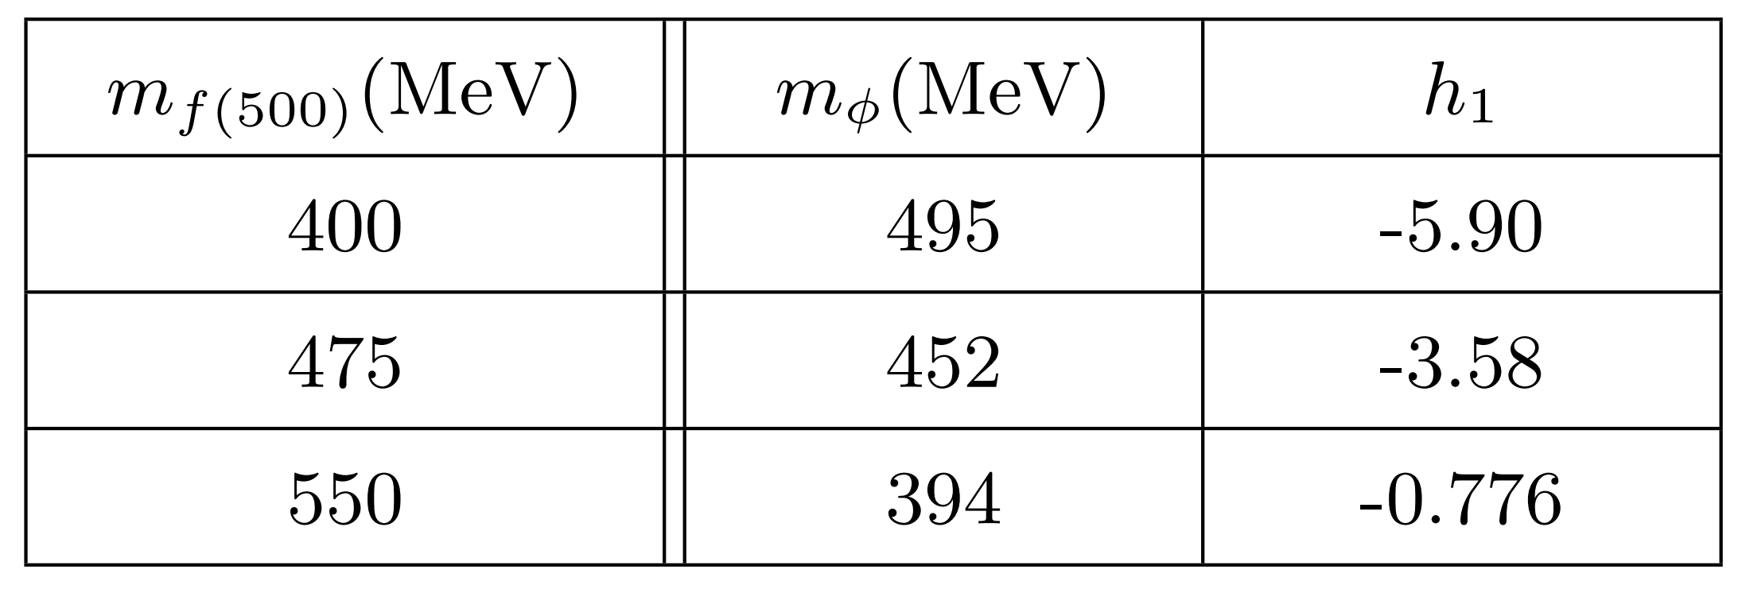
Fixing parameters

Slide 10
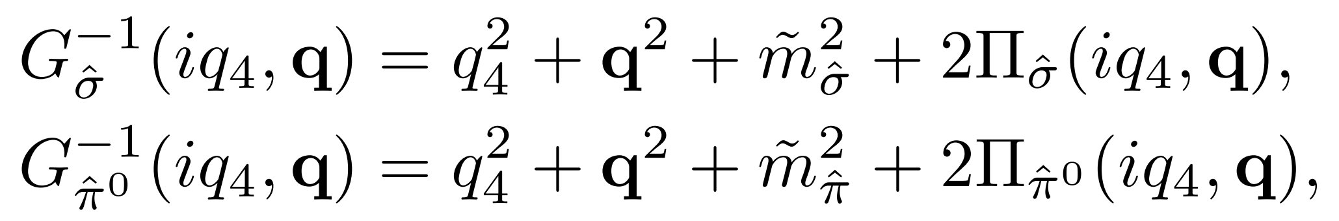
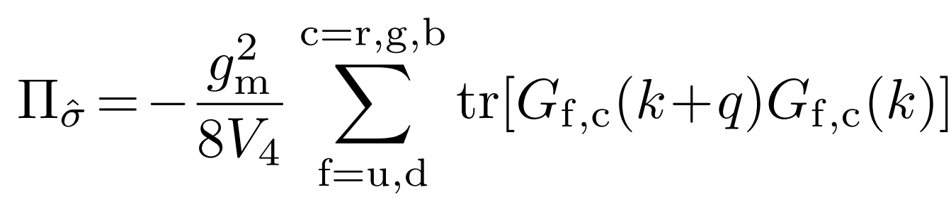



Meson propagators
$$=$$
Renormalization following gap equation

Slide 11
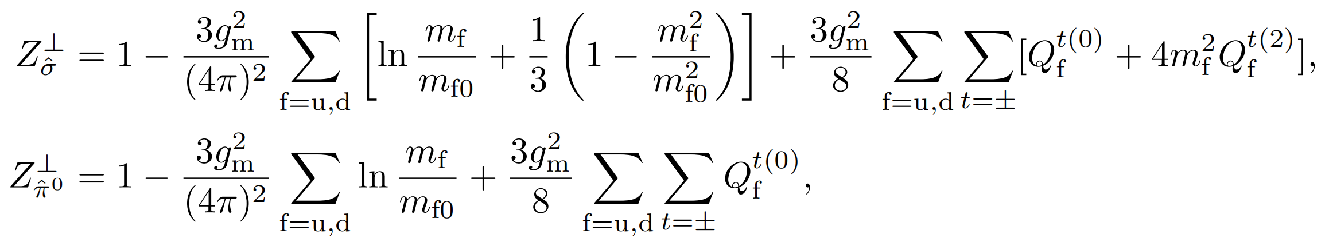
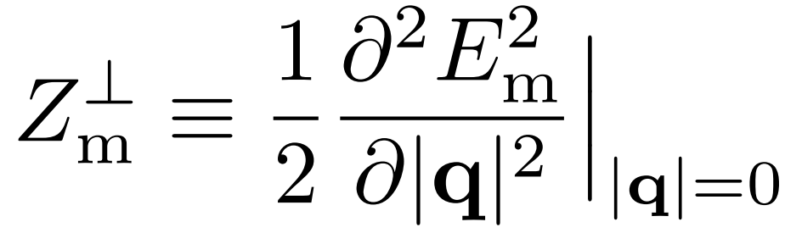
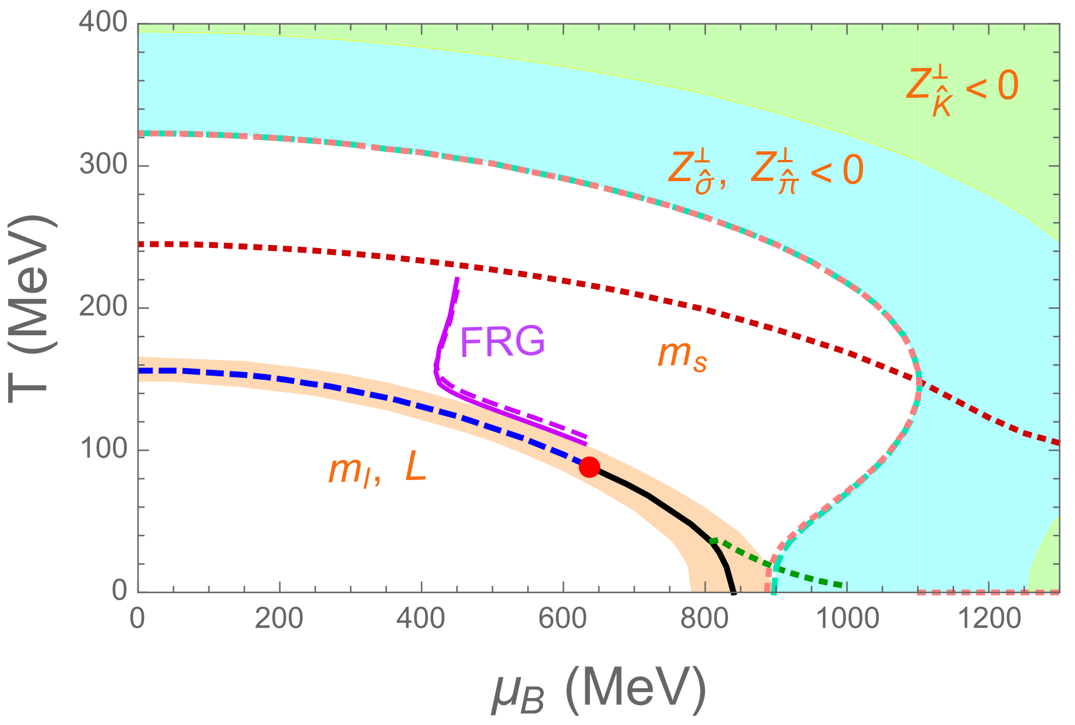
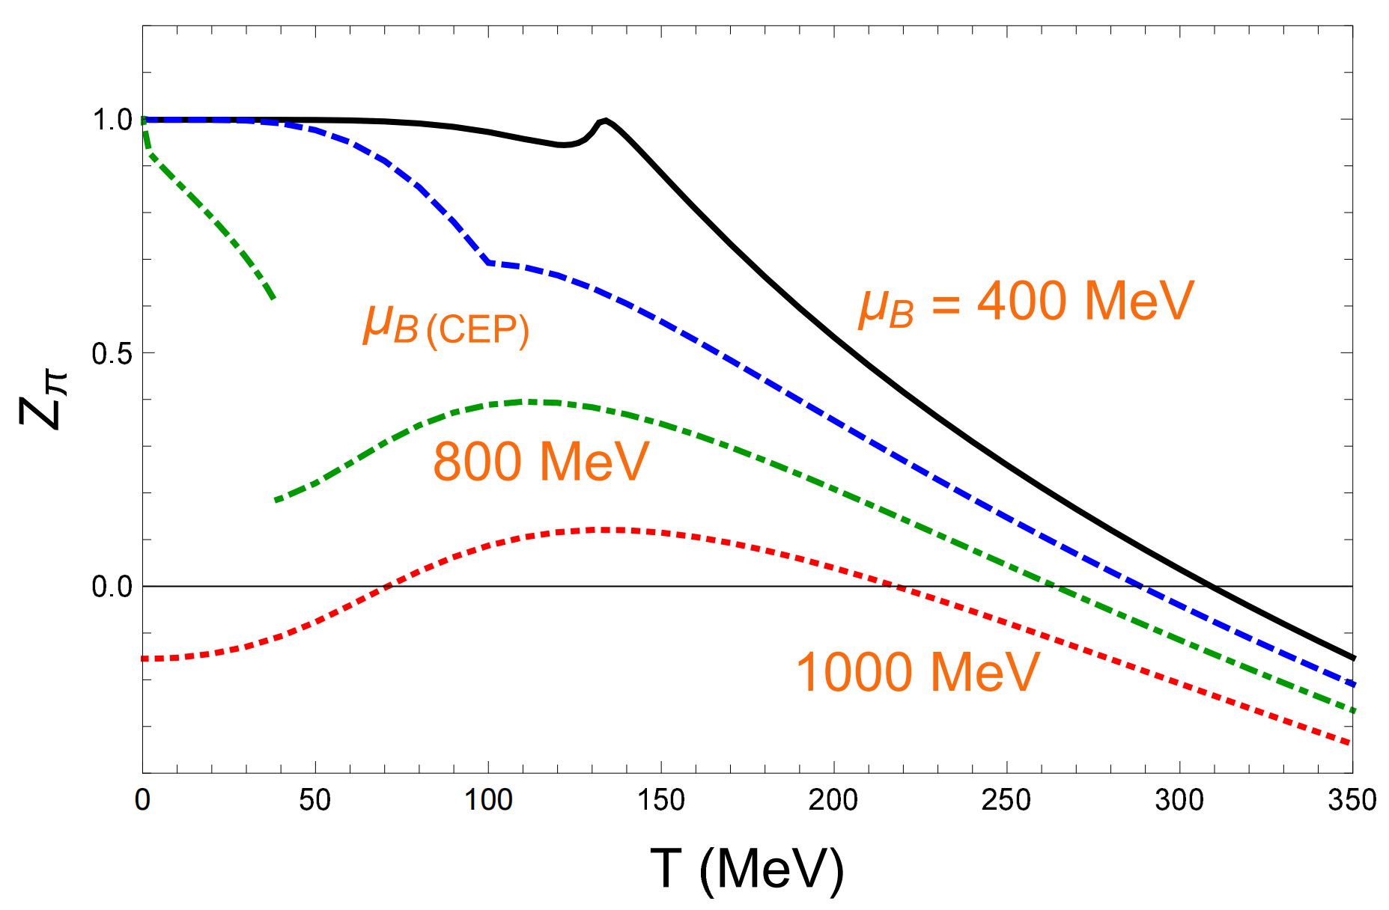
The moat regime

Slide 12
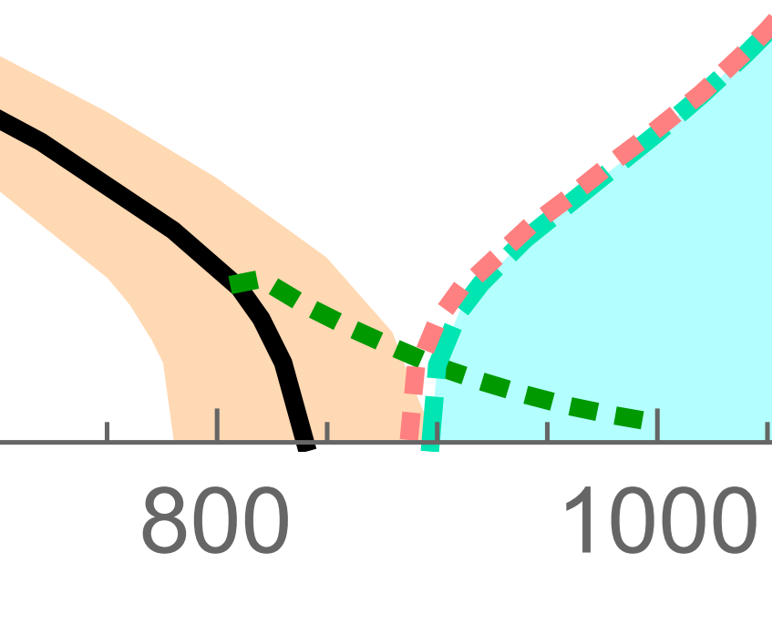
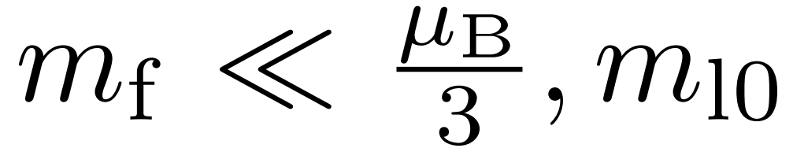
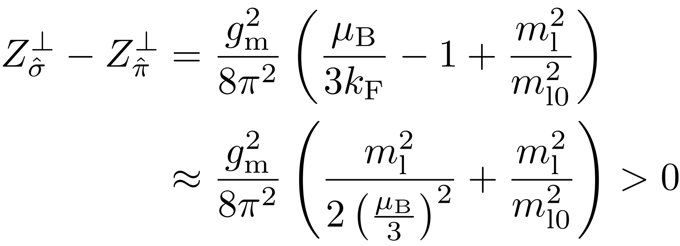

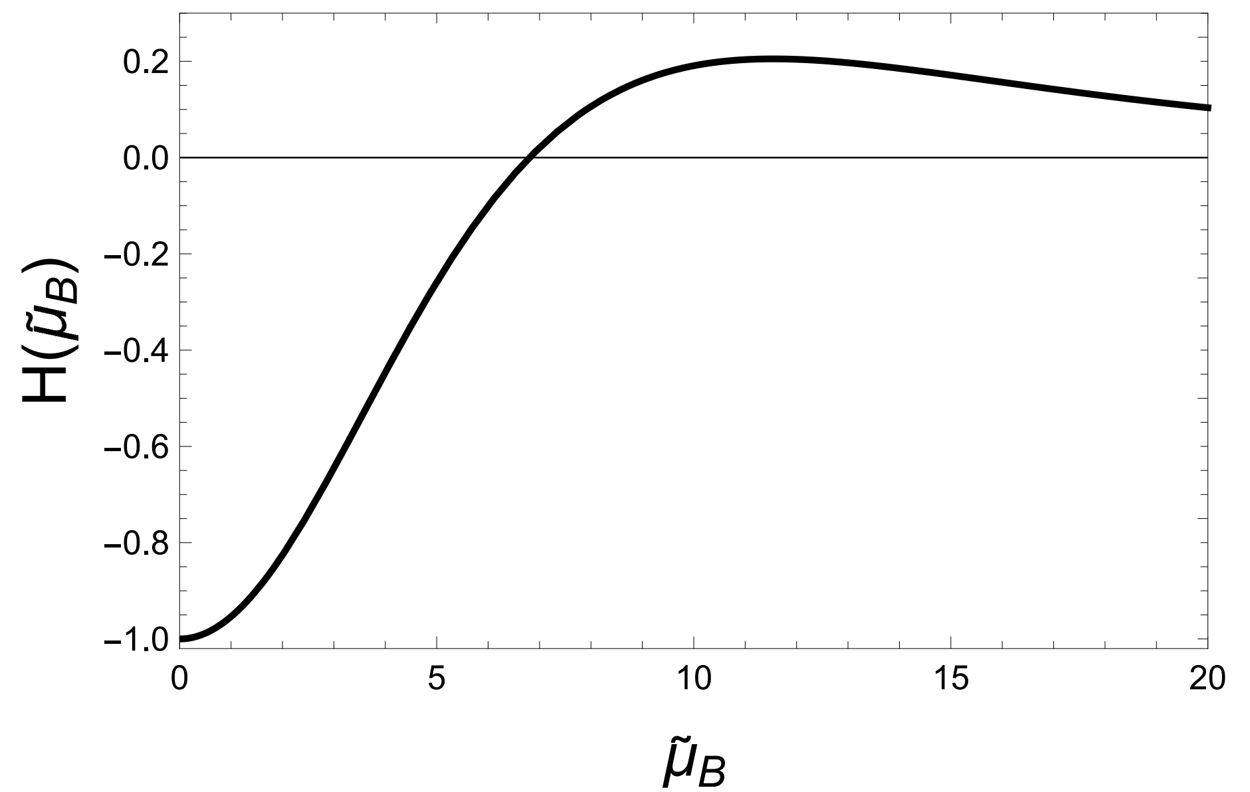
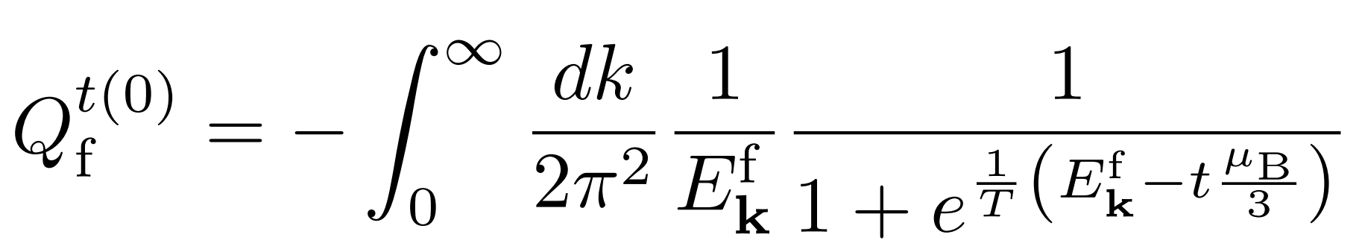
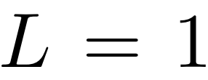
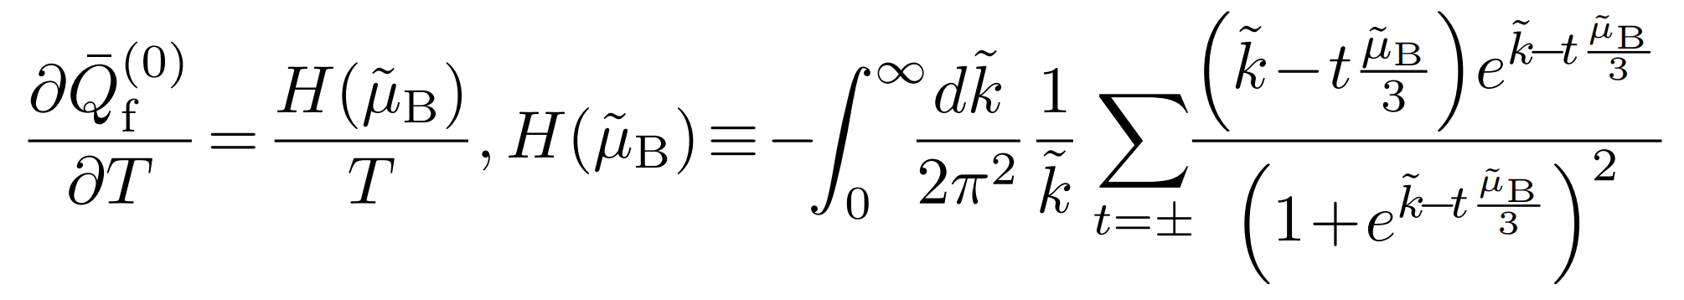

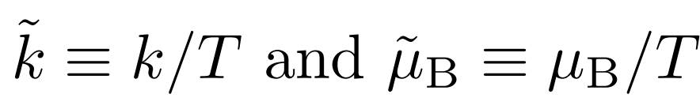





Some features
$$μ_{B}>μ_{B}^{C}$$
(1)
$$π$$
$$σ$$
$$μ_{B}^{C}$$
(2) reentrance
$$T↑$$

Slide 13
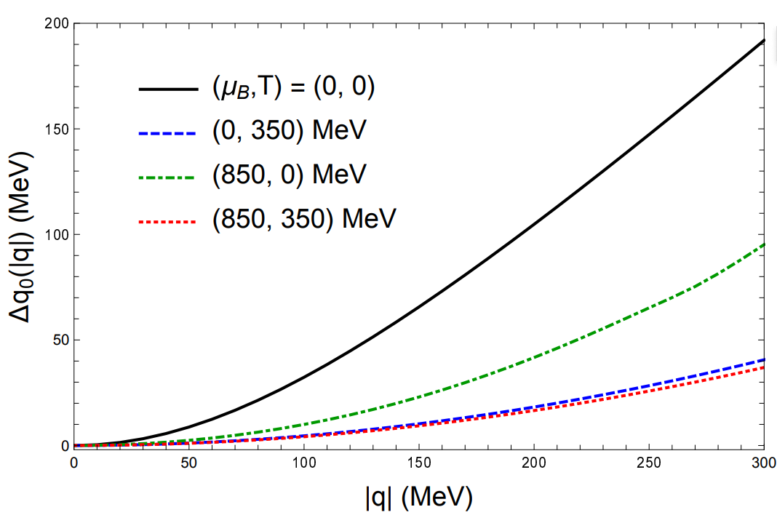
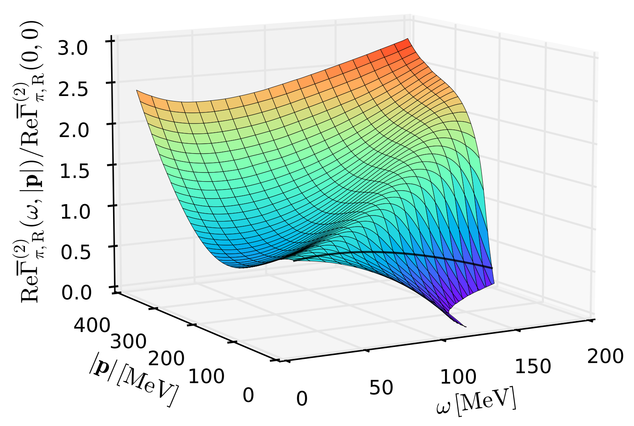
Pole energy
Black line
W. Fu et. al., PRD (2025)
No decreasing feature and extending to deep moat regime

Slide 14
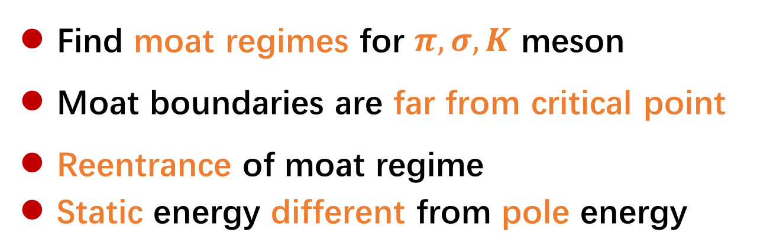
Summary
Find moat regimes for $π, σ, K$ meson
Moat boundaries are far from critical point
Reentrance of moat regime
Static energy different from pole energy
Thanks!

