Slide 1

QPT2025
The CEP of QCD Matter Acts as a Thermalization Point
报告人：黄安平
合作者：Shuzhe shi,Mei Huang,Pengfei zhuang
中国矿业大学 材料与物理学院
2025年10月26日
Notes:
My topic is thermal production of charms and charmonia in quark-gluon plasma. This work is collaborated with Kai Zhou, Carsten Greiner and Pengfei Zhuang.

Slide 2
Outline
Introduction
Framework
Results
Conclusion and Future
Notes:
This is the outline of my talk. Firstly, I will give a introduction. Then I will describe thermal production of charms in QGP. Subsequently, the mechanism of thermal charmonium production in QGP will be also indicated. I will present our numerical results on thermal production of charms and charmonia at LHC energy 2.76TeV and 5.5TeV and FCC energy 39TeV. At the end I will give summary for our work.

Slide 3
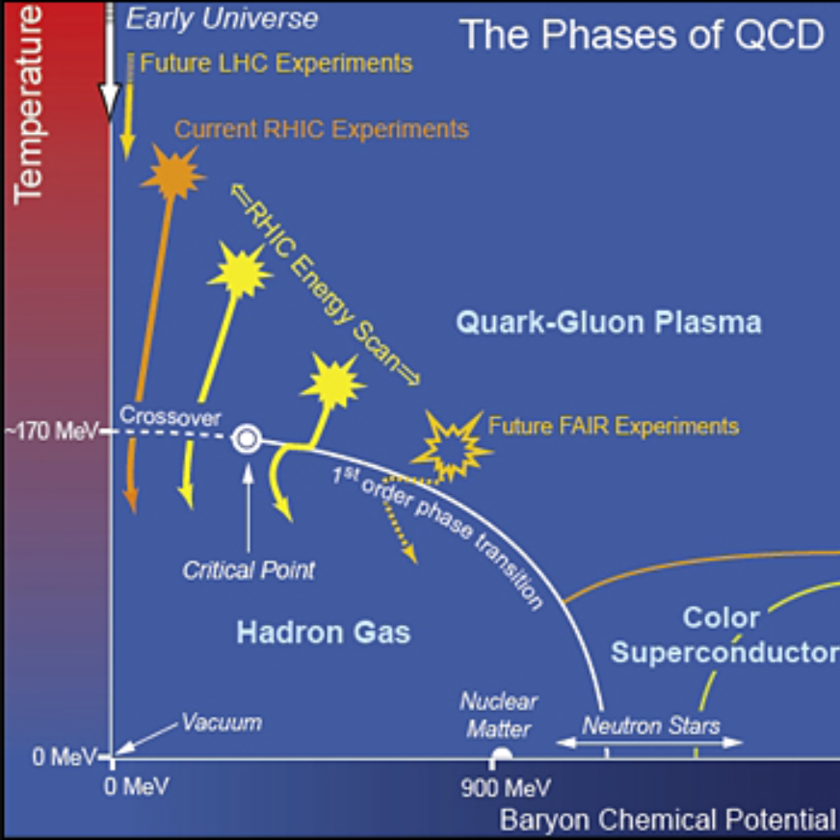
Introduction-background
USA-NSAC 2007 Long-range Plan

Slide 4
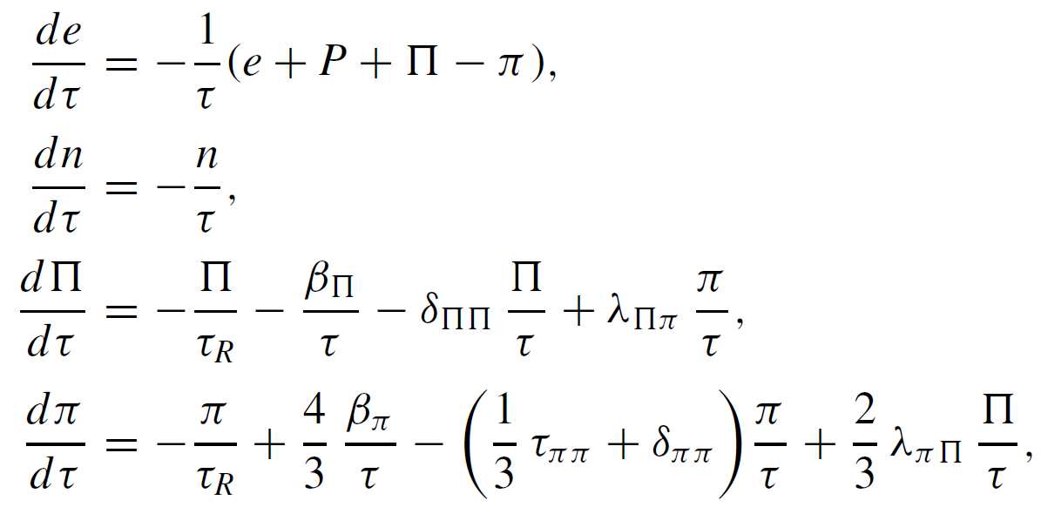


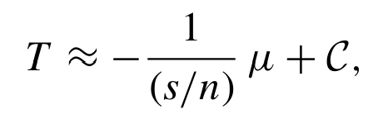

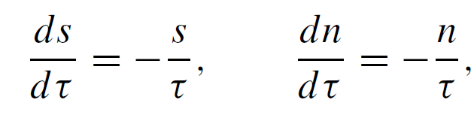
Introduction-isentropic trajectory
In the Bjorken expansion case, the hydrodynamics can written as
In ideal fluids
isentropic trajectories
C Chattopadhyay, U Heinz, T Schäfer, PhysRevC.107.044905

Slide 5
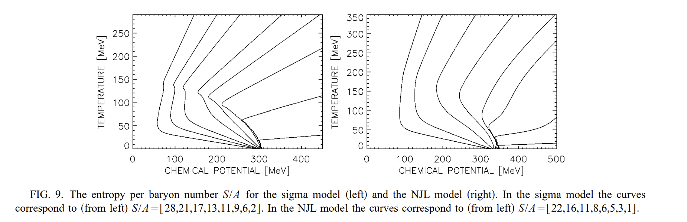
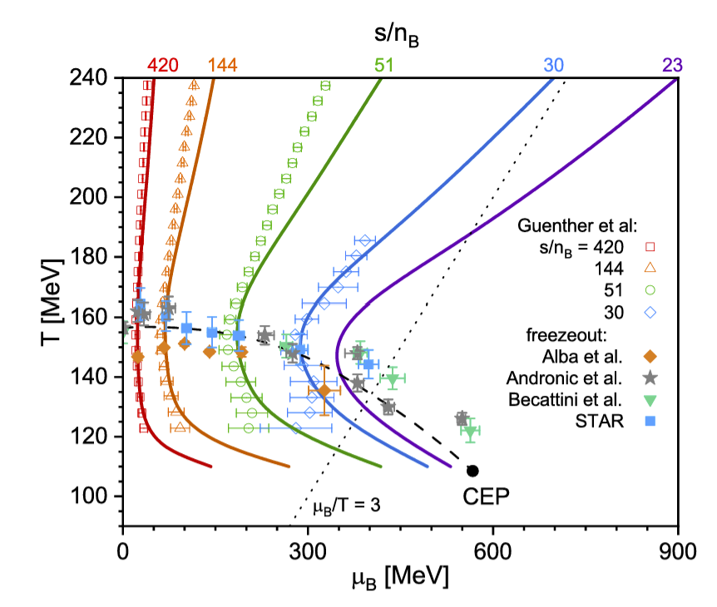
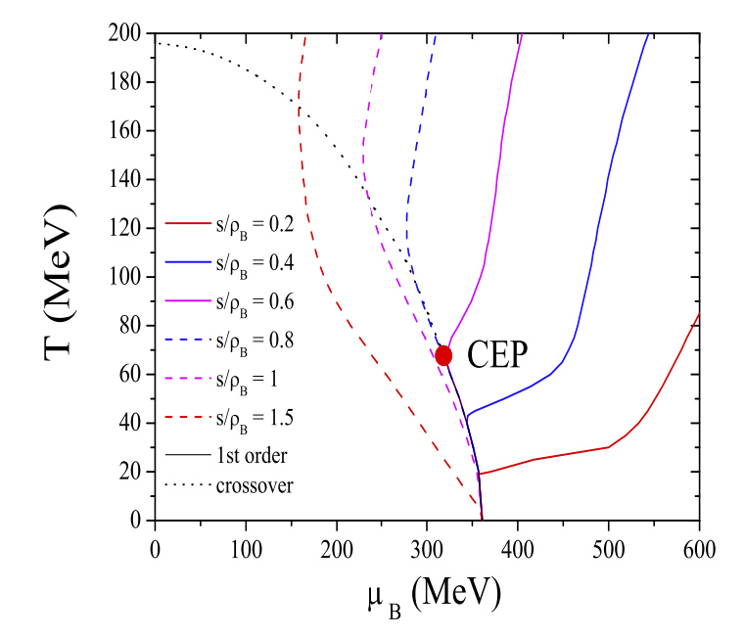
Introduction-isentropic trajectory
PRD 97, 014014 (2018)
SU(3) NJL
Yi Lu, Fei Gao, etc, 2310.18383
Phys.Rev.D 77 (2008) 096001

Slide 6
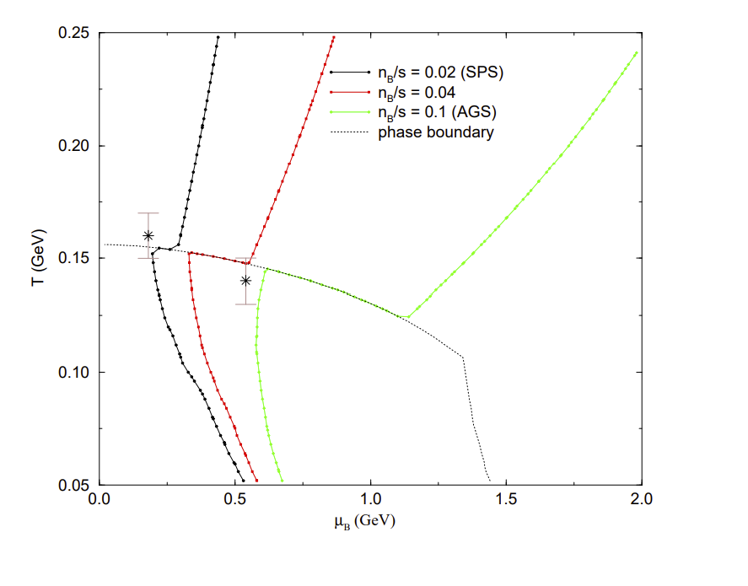
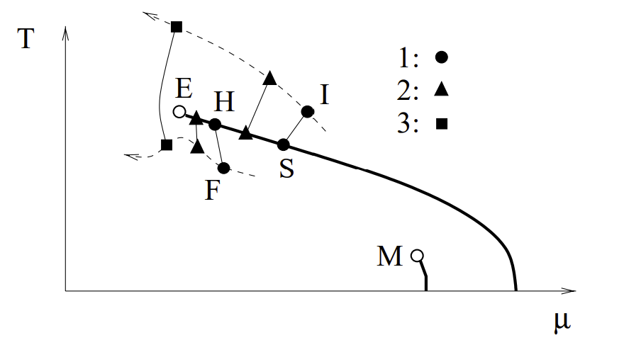
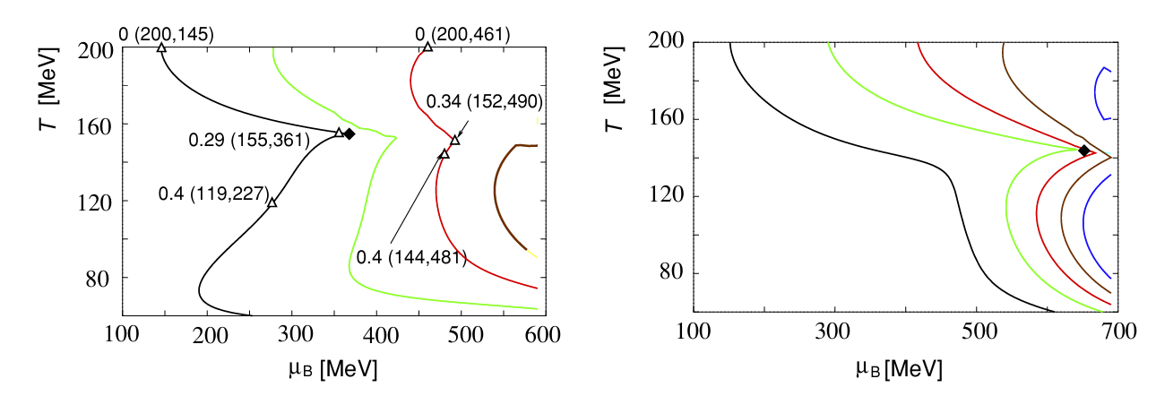
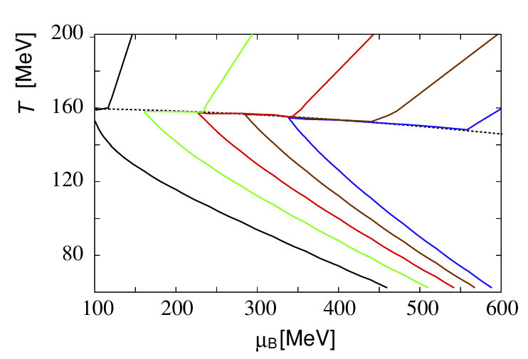
Introduction-isentropic trajectory
M Stephanov，Phys.Rev.Lett. 81 (1998) 4816-4819
C. M. Hung, E. Shuryak, Phys. Rev. C 57, 1891 (1998).
Chiho Nonaka，Masayuki Asakawa，PHYSICAL REVIEWC71,044904 (2005)

Slide 7
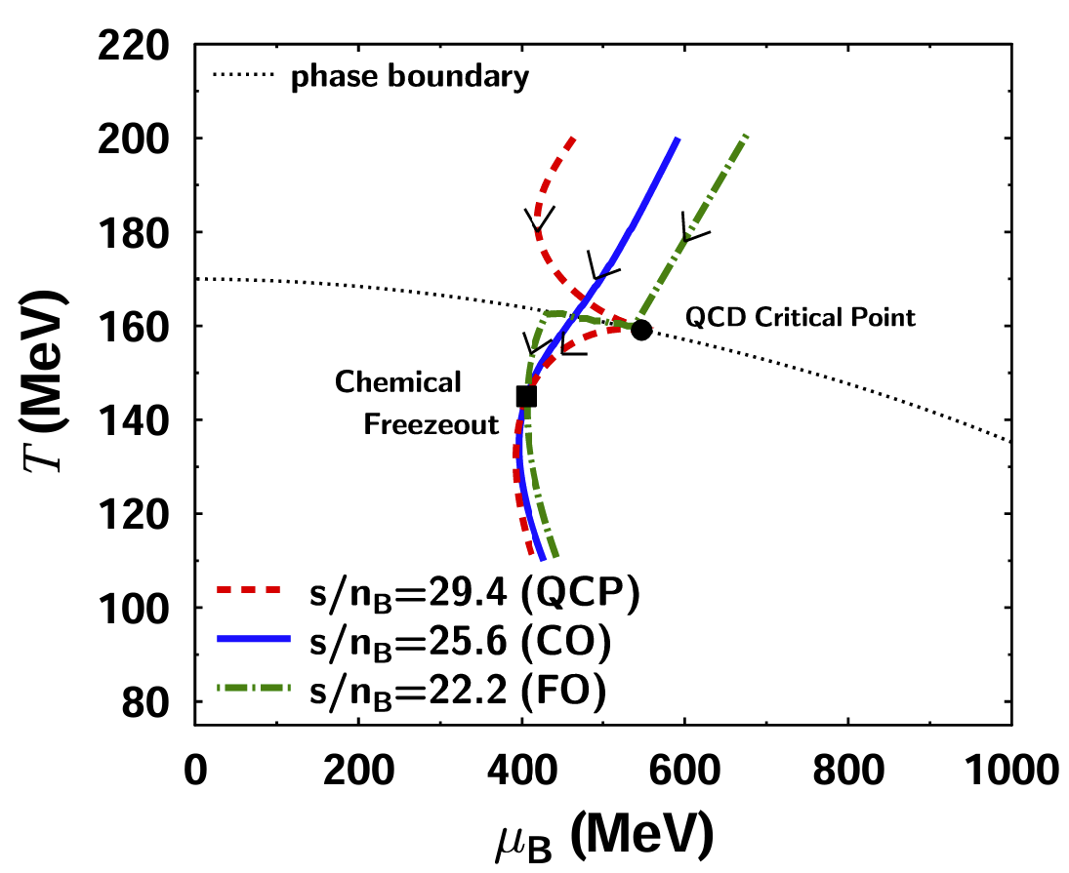
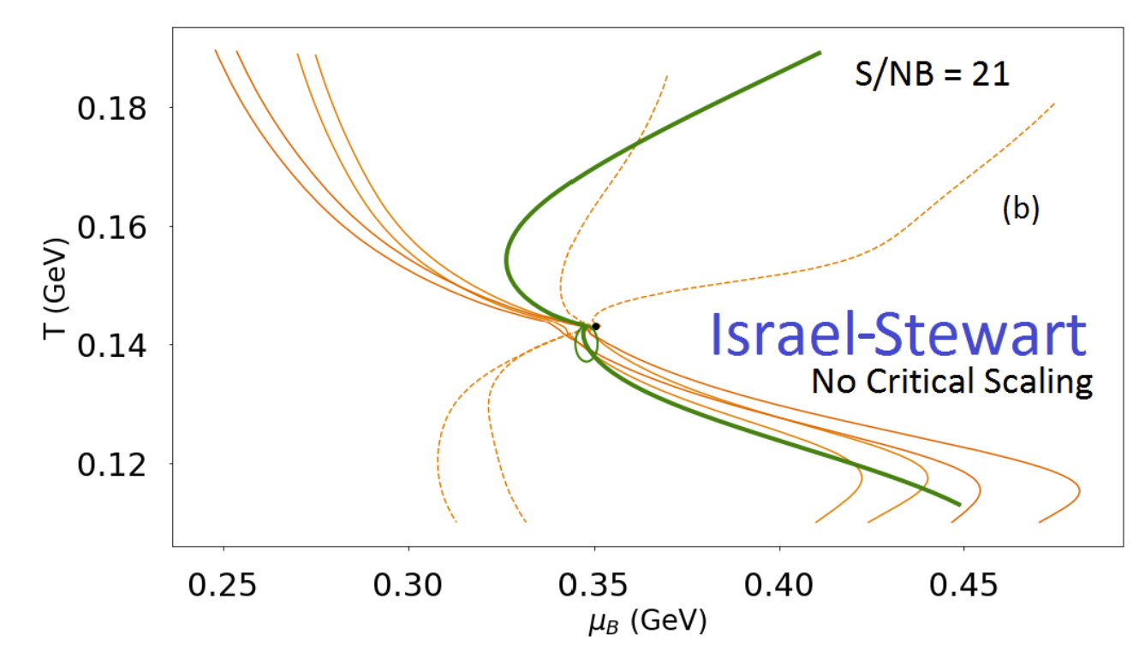
Introduction-isentropic trajectory
3+1D hydro--EOS+CEP
1+1D Hydro+
J. N.Hostler:2007.15083
Chiho Nonaka，Nuclear Physics A 830.1-4 (2009): 291c-294c.

Slide 8
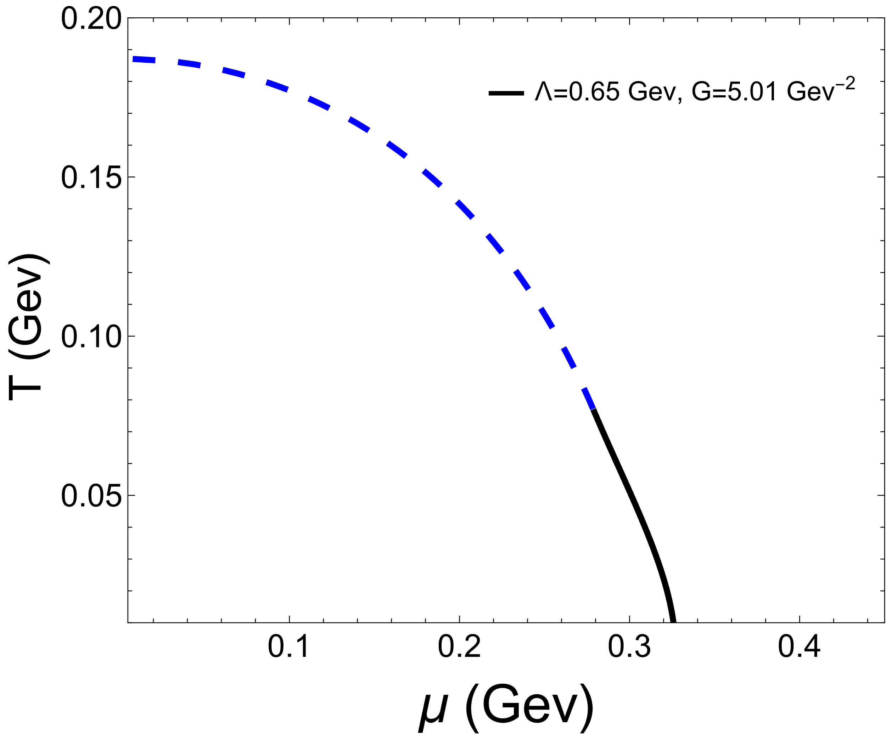
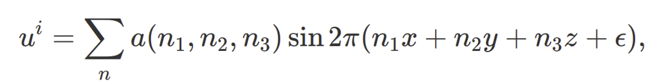
Introduction-motivation
A
Fluctuations induced by turbulence
B
E
D
C
Let’s explore how the critical end point (CEP) influences the evolution of the QCD system when fluctuations induced by turbulence arise around the phase transition line, as follows.

Slide 9
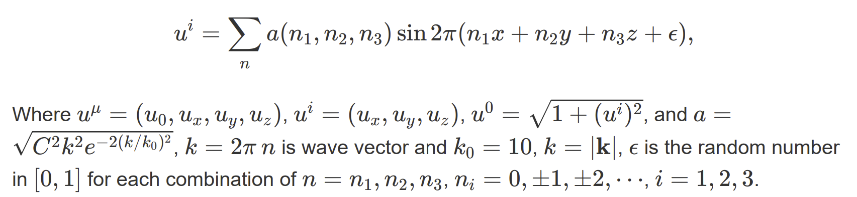
Introduction-turbulence
The turbulence can be given by the following
1. A. Sakurai and F. Takayama. Molecular kinetic approach to the problem of compressible turbulence.
2. V.V. Aristov and O.I. Rovenskaya. Application of the Boltzmann kinetic equation to the eddy problems.

Slide 10
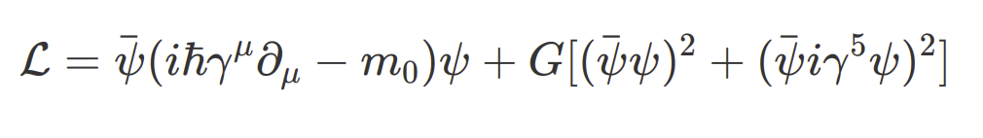

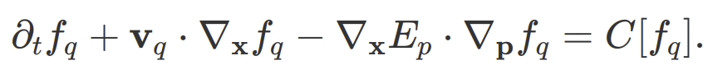
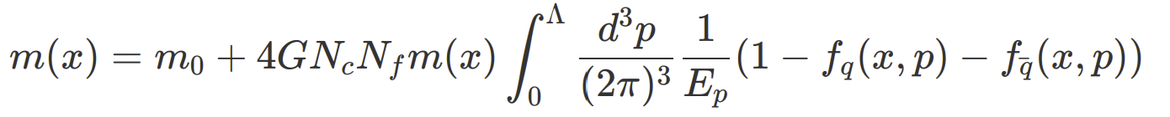
Framework
Our theoretical framework relies on the integration of the transport equation with the gap equation.
transport equation:
Gap equation:
Che Ming Ko, et al, Nucl.Phys.A 928 (2014) 234-246.
P. Rehberg, et al, Nucl.Phys.A 653 (1999) 415-435.
WeiMin Zhang, et al, Phys.Rev.C 45 (1992) 1900-1917.
Pengfei Zhuang, et al, Quantum transport theory and nonequilibrium chiral condensates.
Abdellatif Abada, Chiral Phase Transition in an Expanding Quark-Antiquark Plasma.

Slide 11
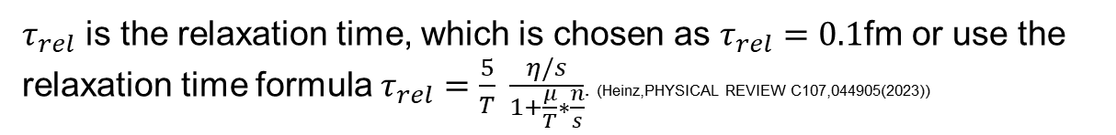
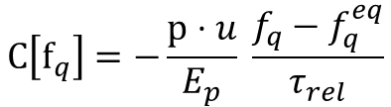

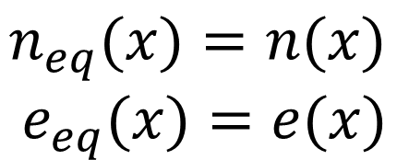

Framework
For simplicity, we chose the collision term with the relaxation time model.
$$C\left[f_{q}\right]=−\frac{p⋅u}{E_{p}} \frac{f_{q}−f_{q}^{eq}}{τ_{rel}}$$
$τ_{rel}$ is the relaxation time, which is chosen as $τ_{rel}=0.1$fm or use the relaxation time formula $τ_{rel}=\frac{5}{T} \frac{η/s}{1+\frac{μ}{T}∗\frac{n}{s}}$. (Heinz,PHYSICAL REVIEW C107,044905(2023))
$$f_{q/\overline{q}}^{eq}=\frac{1}{e^{(p⋅u∓μ(x))/T(x)}+1}$$
herein, the temperature and chemical potential are fixed by the matching conditions for number density and energy at every space-time point, i.e
$$n_{eq}(x)=n(x)$$
$$e_{eq}(x)=e(x)$$
$$μ\left(x\right), T(x)$$

Slide 12
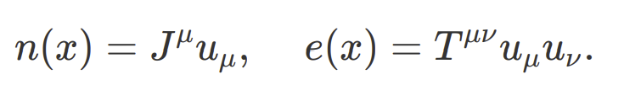
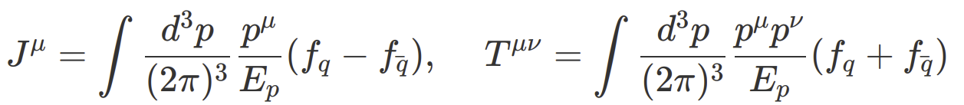
Framework
While the local number density n(x) and energy density e(x) are defined by the following
The current density $J^{μ}(x)$and stress tensor density $T^{μν}(x)$are defined by the following,
The fluid velocity can be calculated in either the Eckart or Landau frames. We will use the Eckart frame, which is $u^{μ}=J^{μ}/\sqrt{J^{μ}J_{μ}}$.

Slide 13
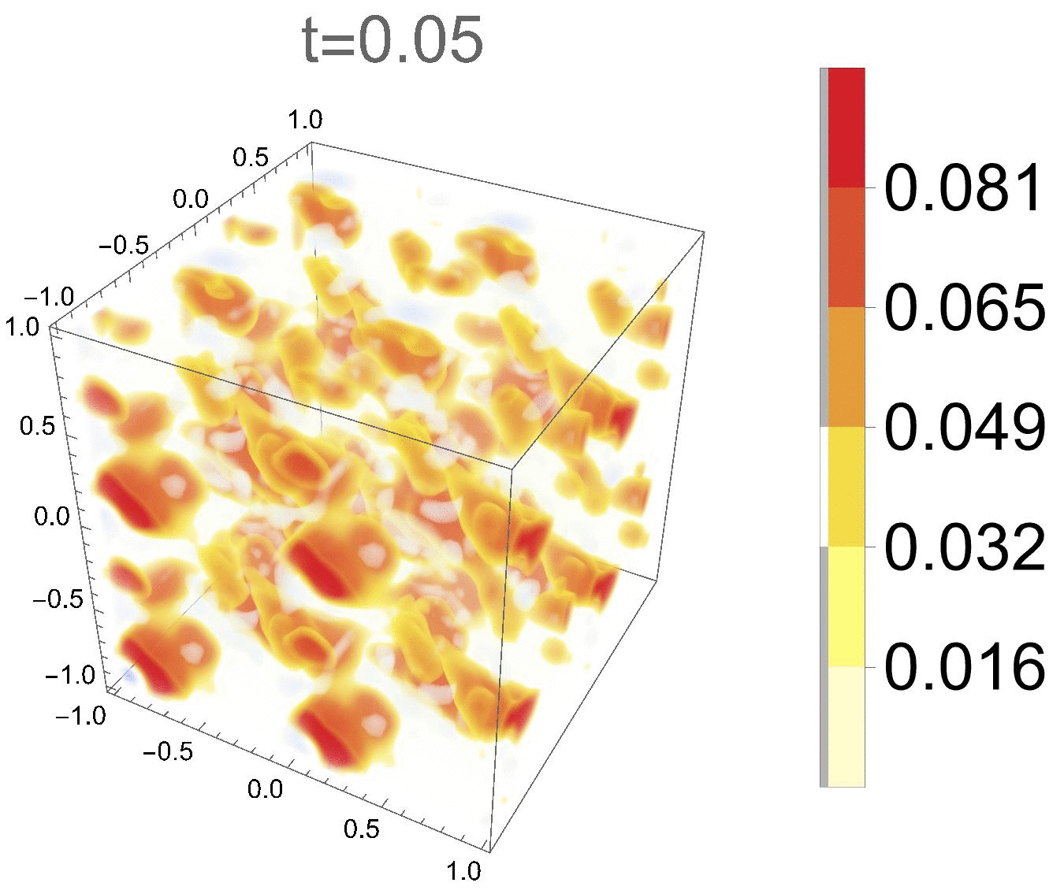
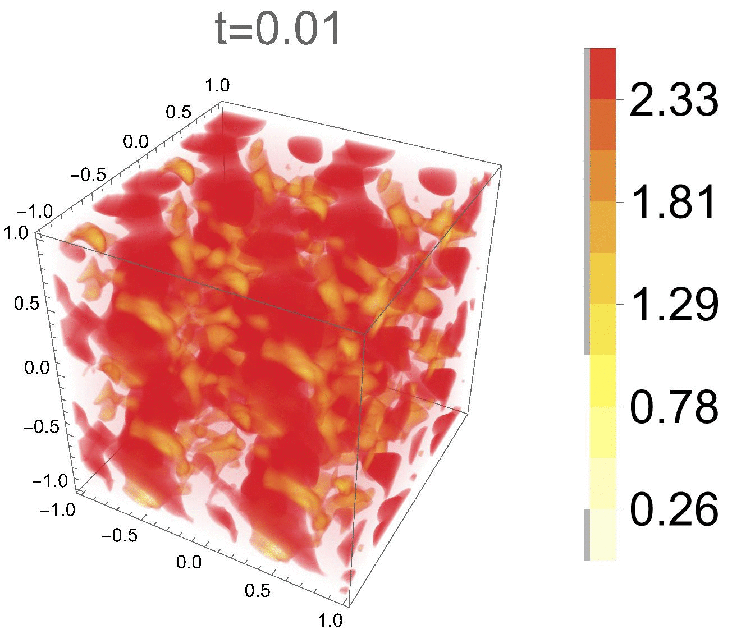




Results
1.The evolution of number density and vorticity
$$n(x,y,z)$$
$$ω(x,y,z)$$
The evolution of the system tends to a stable state.
$$ω={\left(ω_{x}^{2}+ω_{y}^{2}+ω_{y}^{2}\right)}^{1/2}$$

Slide 14
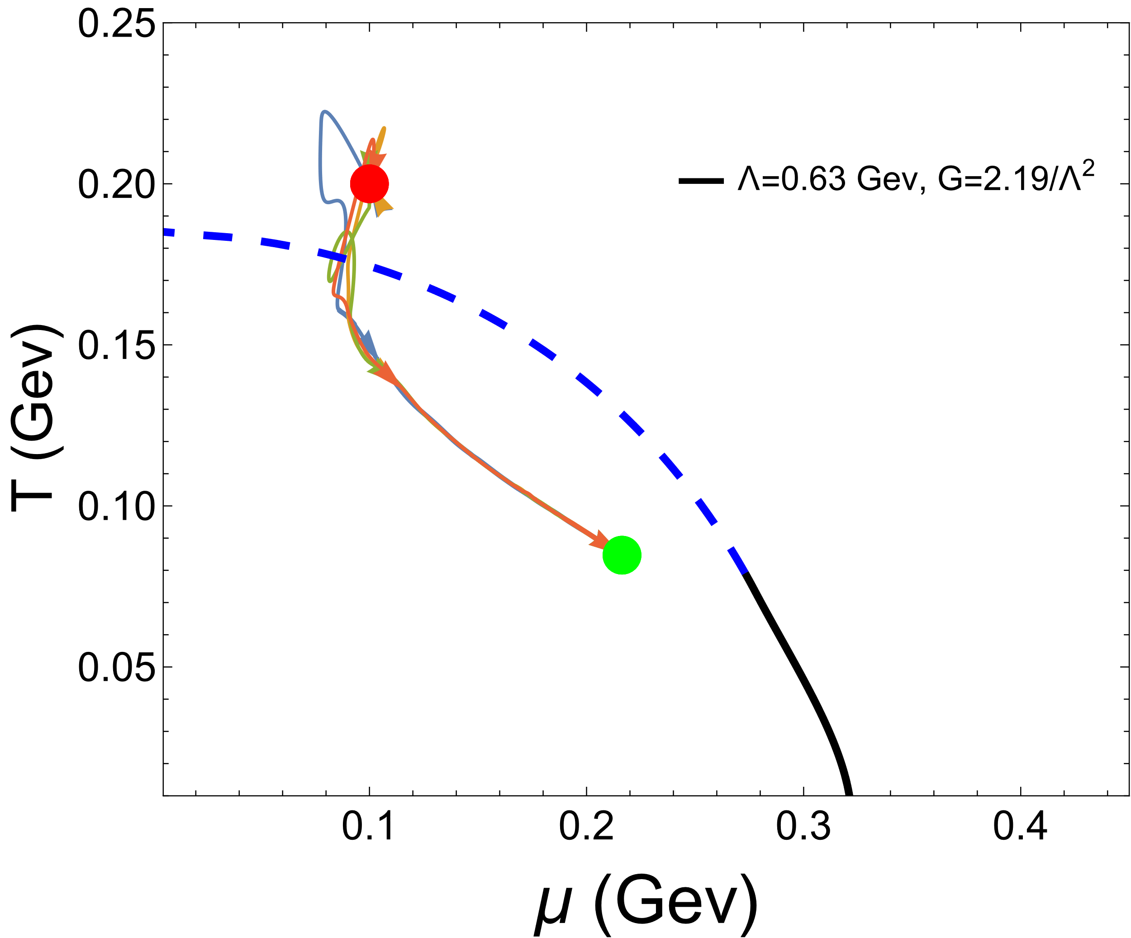
Results
2. The evolution of the system on the plane of (T-$μ$)
A
Red point is starting point, green point is end point.
Each trajectory represents the evolutionary path of a point within a system.

Slide 15
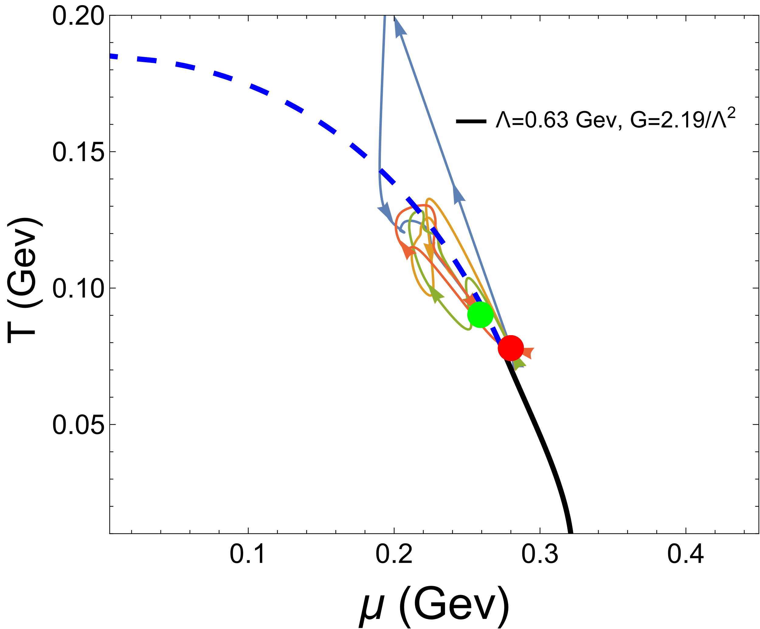
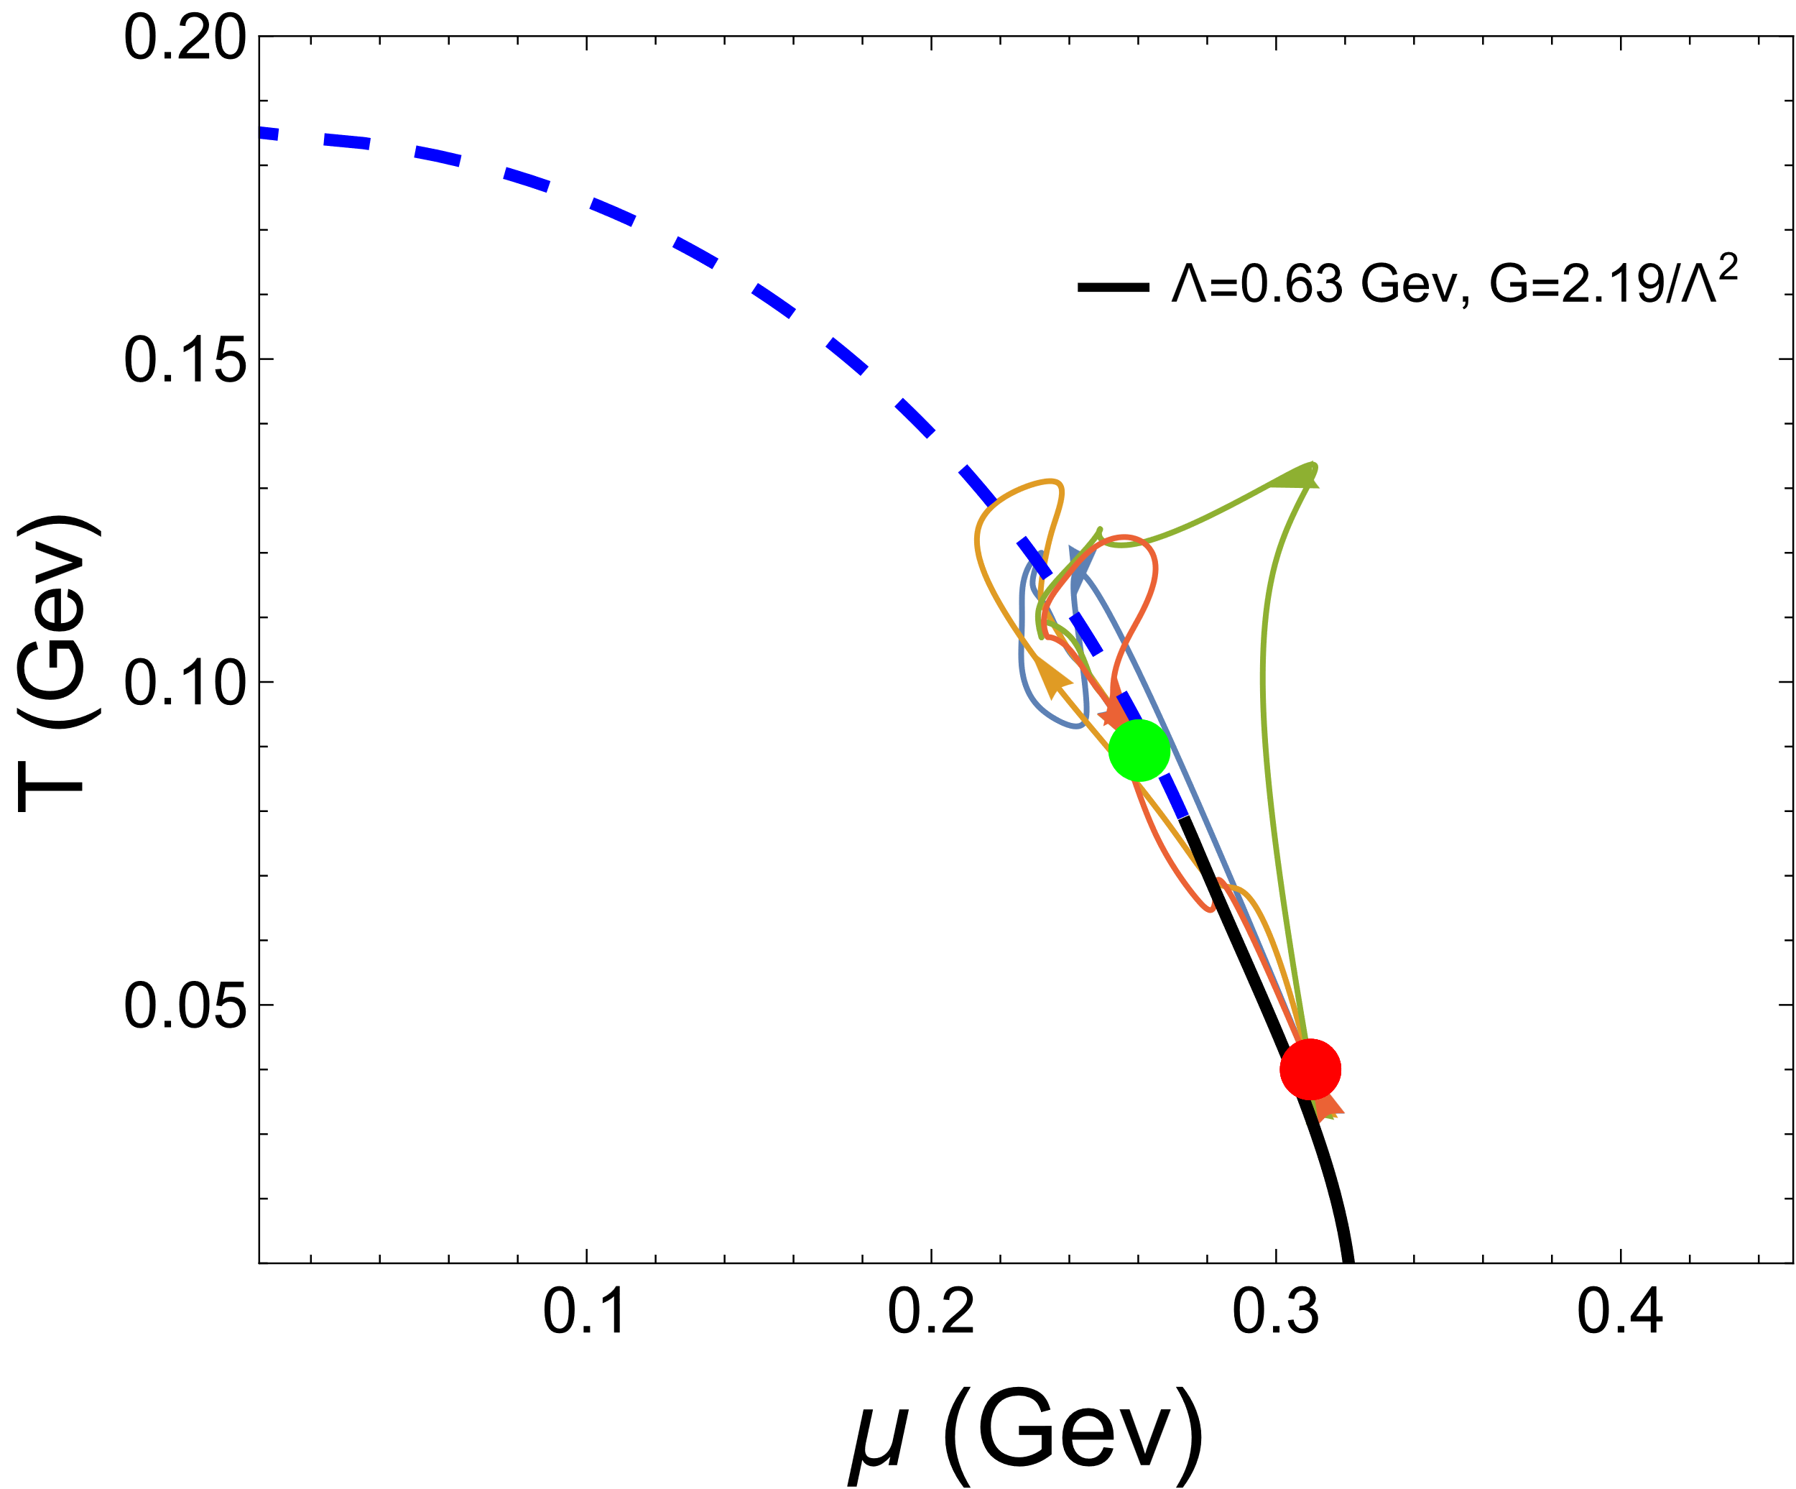
Results
3. The evolution of the system on the plane of (T-$μ$)
The CEP acts as an attractor.
near the CEP at right-hand side
far from the CEP at right-hand side
B
C
Each trajectory represents the evolutionary path of a point within a system.

Slide 16
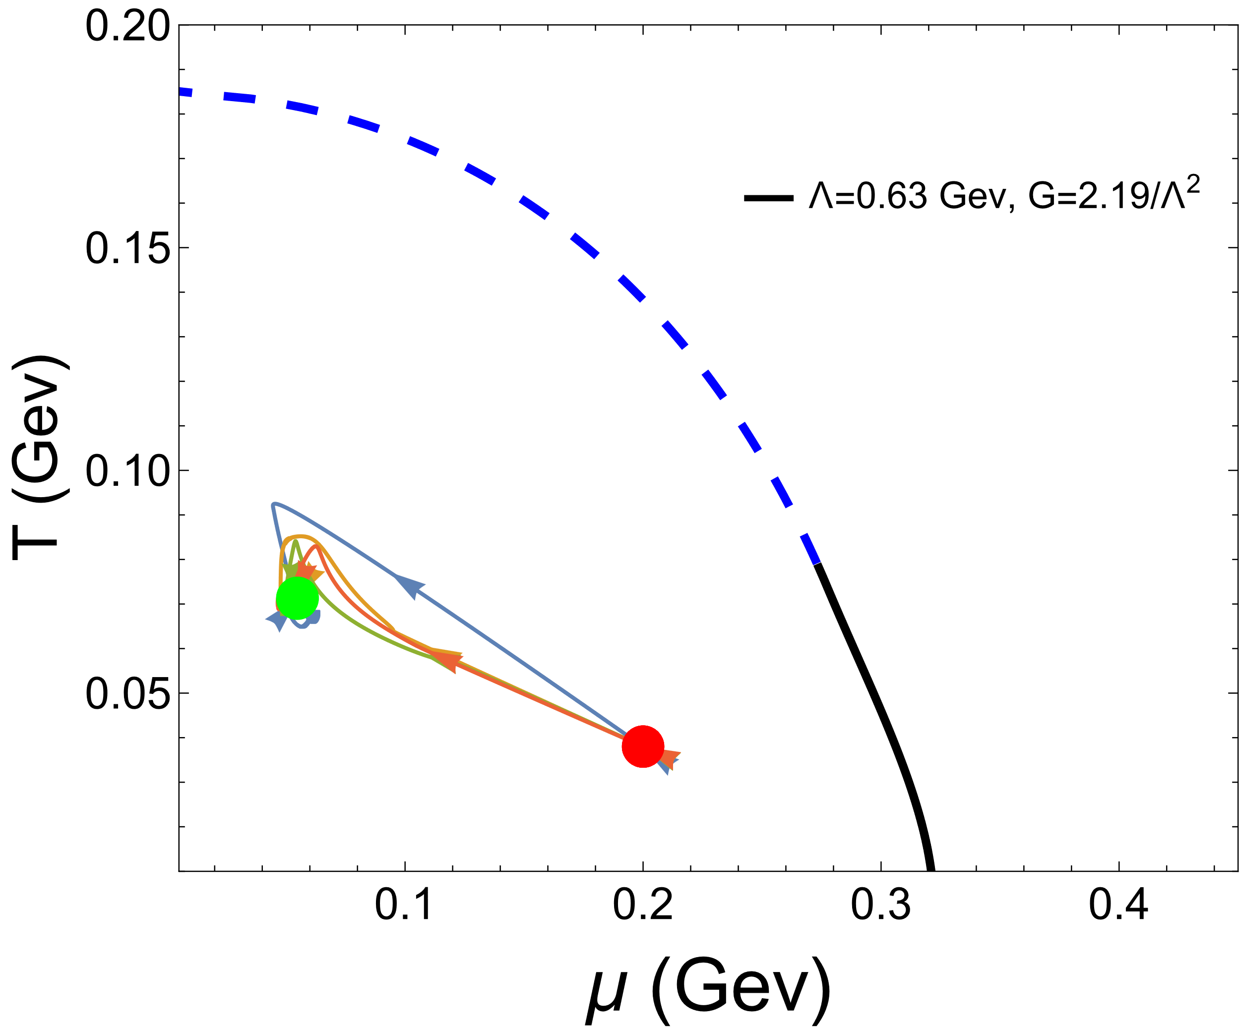
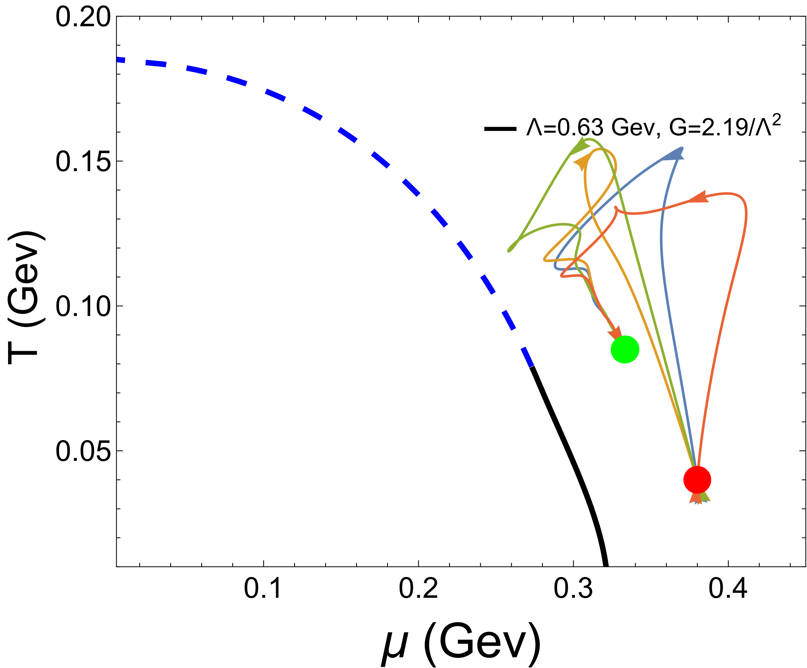
Results
4. The evolution of the system on the plane of (T-$μ$)
far from PT line at hadron phase
far from PT line at QGP phase
D
E
Each trajectory represents the evolutionary path of a point within a system.

Slide 17
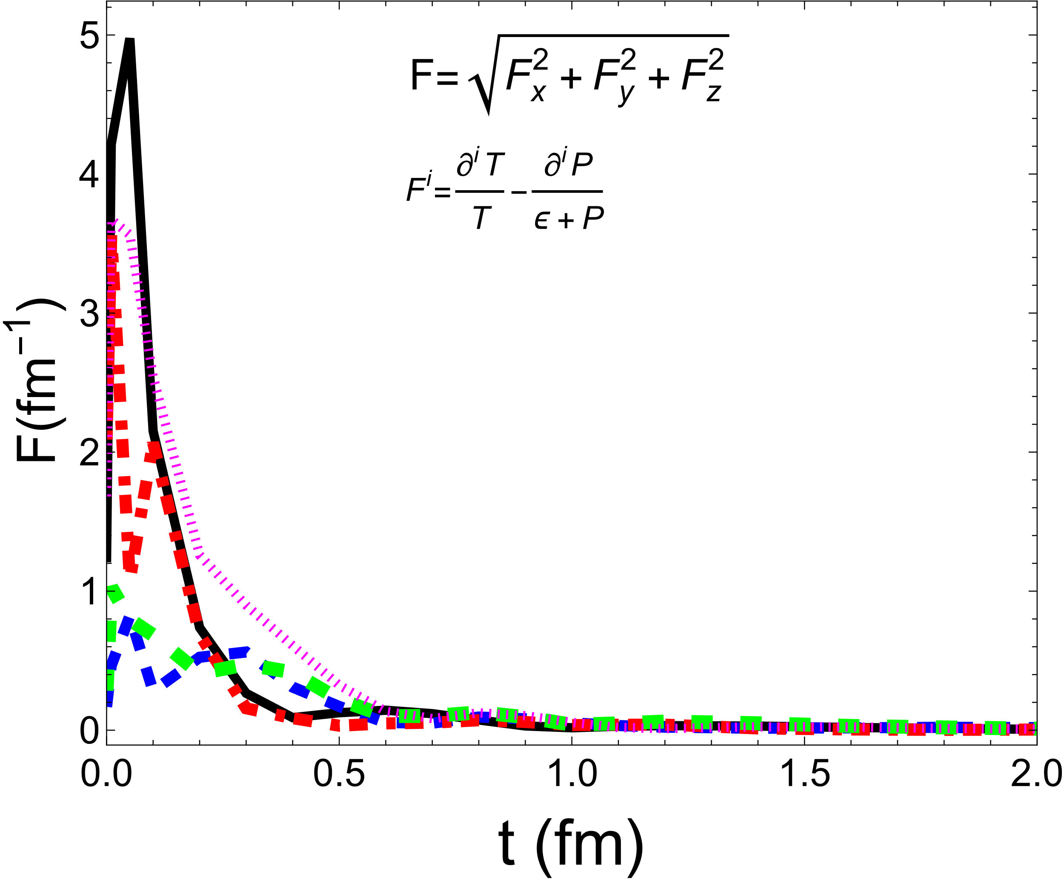
Results
5. The evolution of the local driving force
The evolution of heat flow in the system is driven by the local thermodynamic driving force.
The case of the initiated in B point
Each (solid or dashed) line depicts the temporal evolution of the driving force at a specific point in the system.

Slide 18
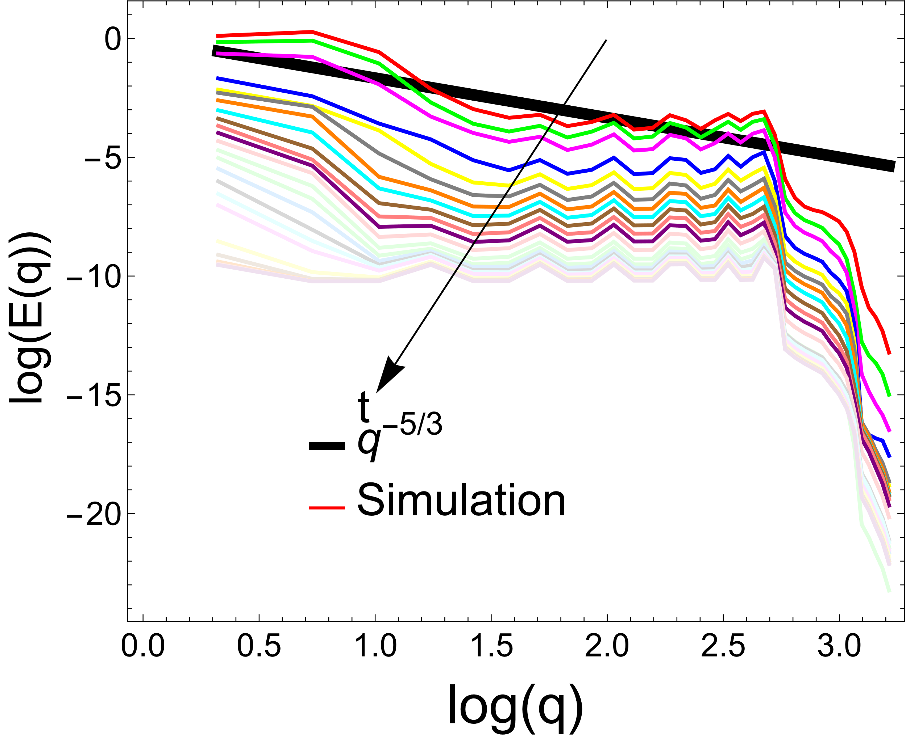
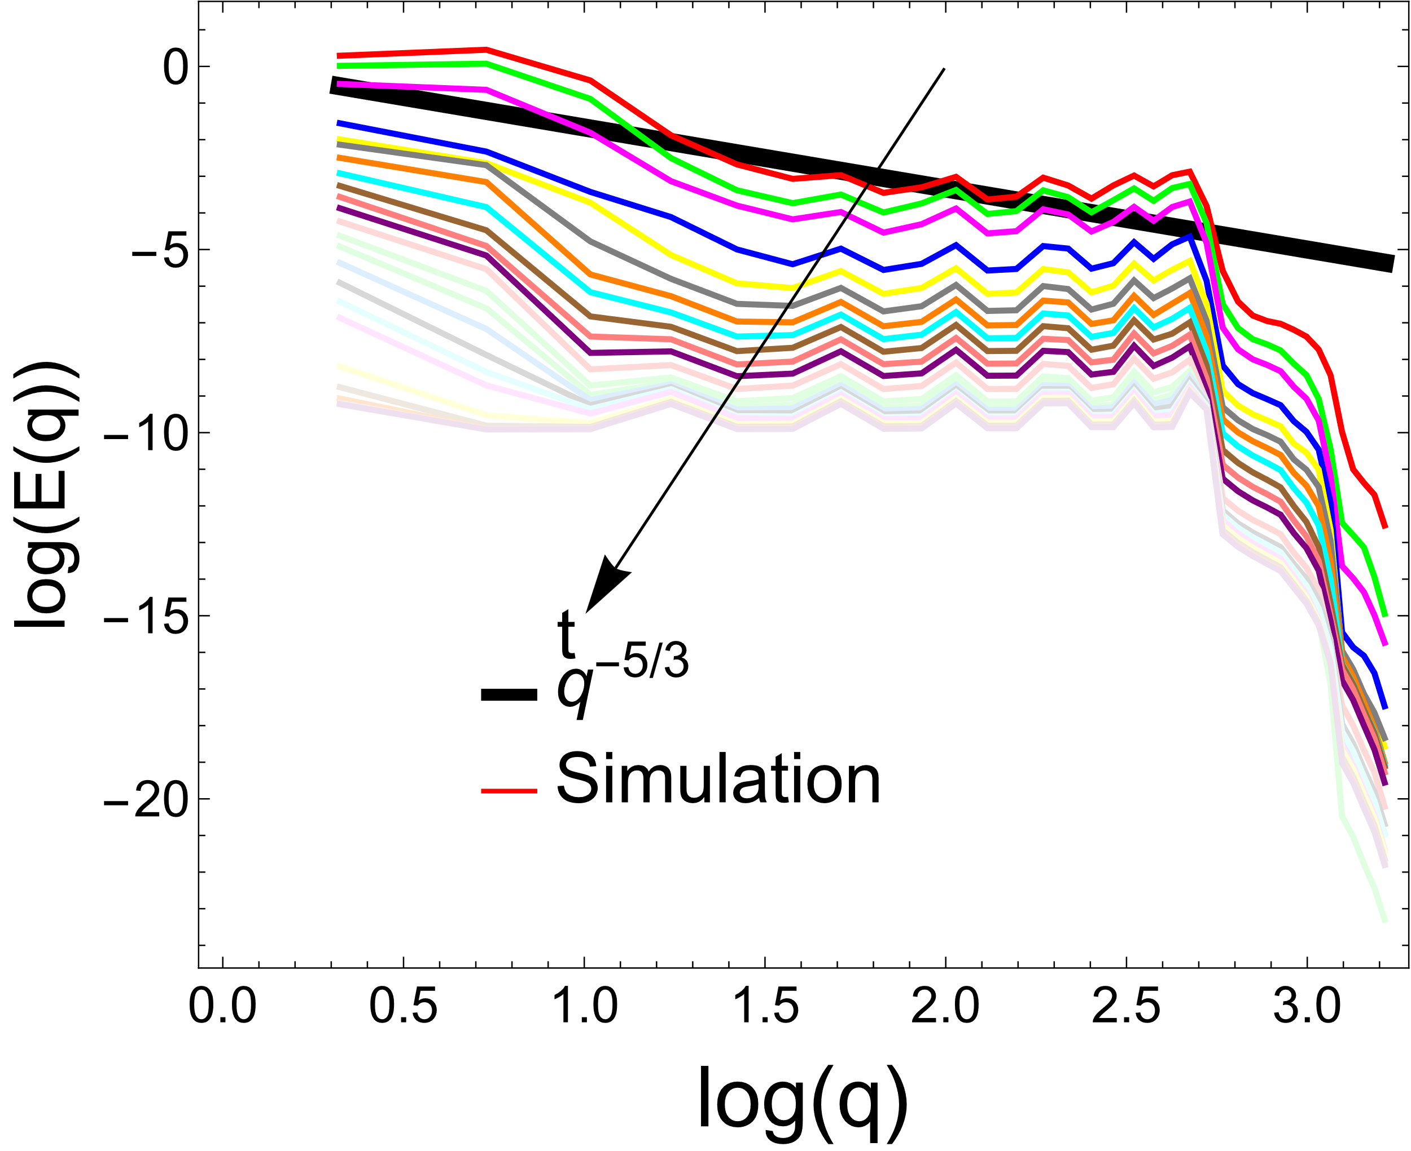
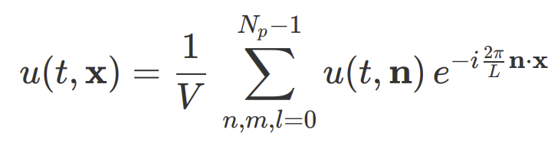
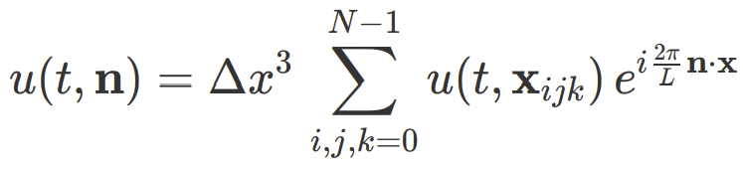

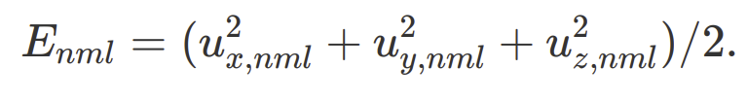
Results
6.The turbulence properties
Initialized at CEP
Initialized near the PT line
Kolmogorov value

Slide 19
Conclusion and Future
1. The CEP has an attractor effect or focusing effect, and acts as an thermalization point.
B
C

Slide 20
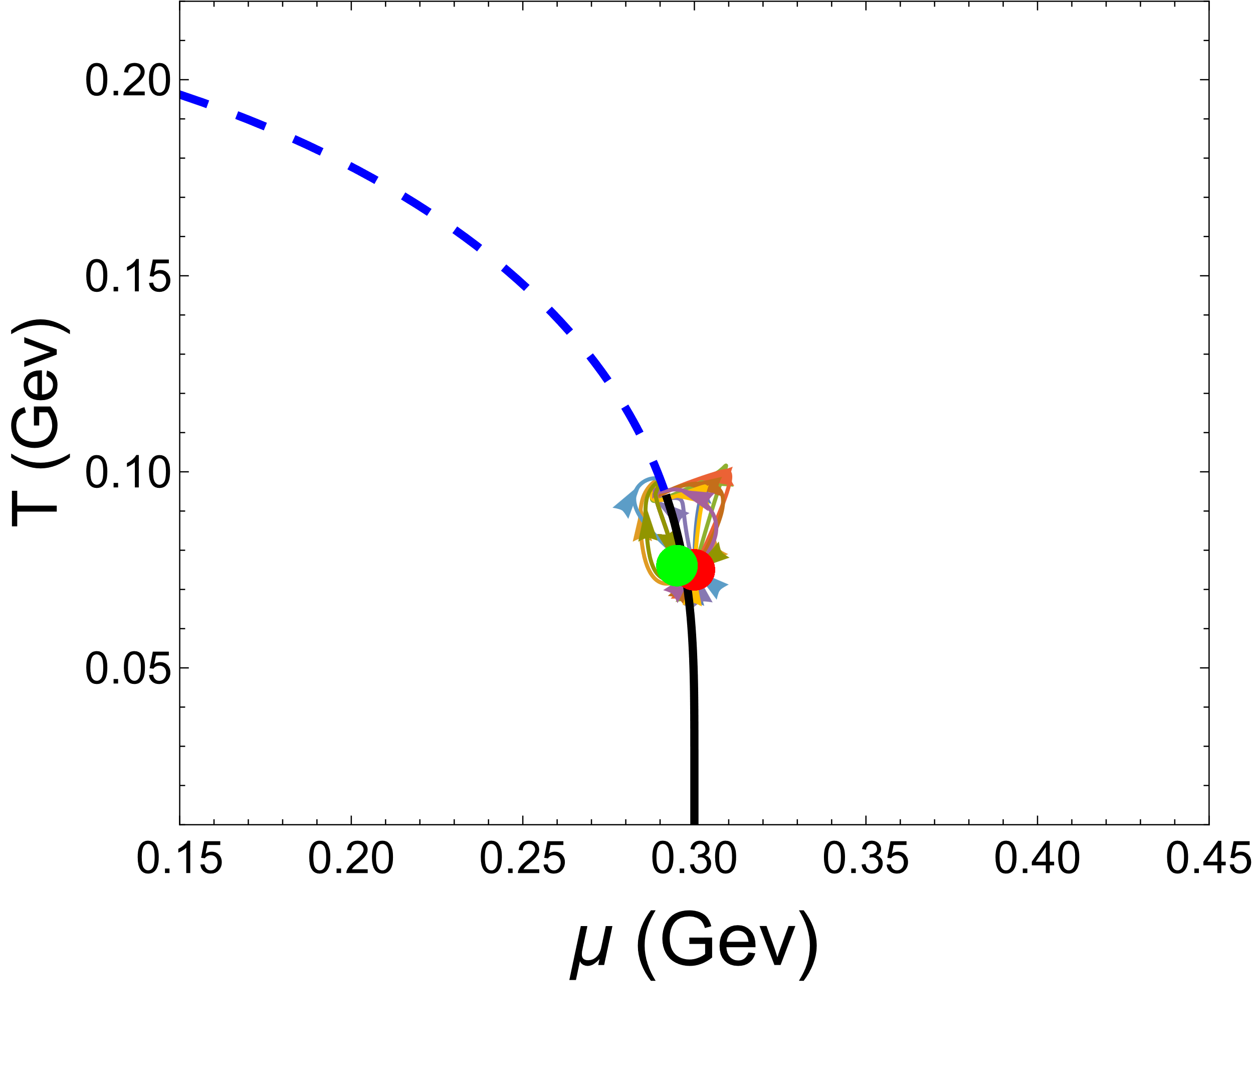
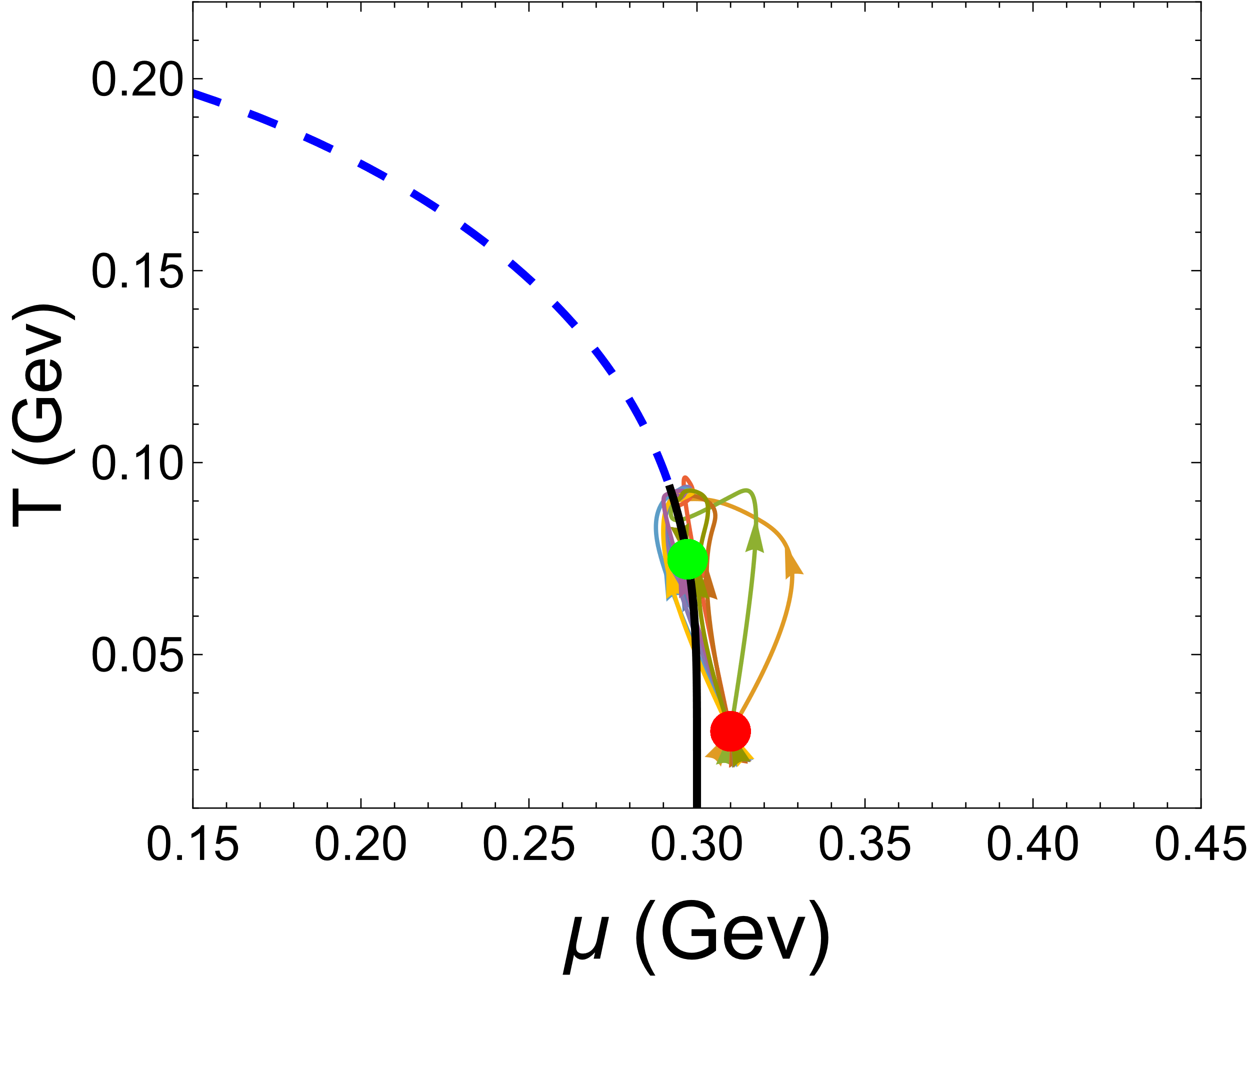
Conclusion and Future
2. The above effect may be a universal feature; we also observe the same behavior in the 2+1 dimensions.

Slide 21
Thank You!

Slide 22
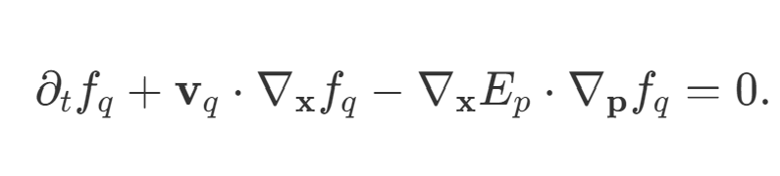
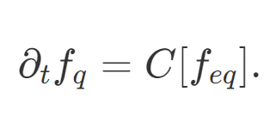
Appendix: Algorithm
The transport equation will be split into two steps.
1. The first step is to describe the free-streaming of particles.
To solve this part, we can use the QUICK algorithm or WENO method.
2. The second step is collision term

Slide 23

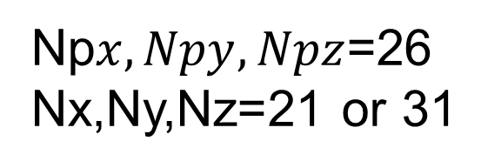
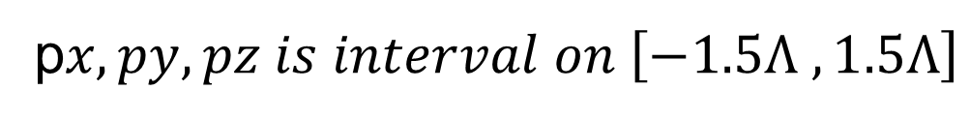
Appendix: Algorithm
We use the boundary conditions as follows
f$\left(x+1,y+1,z+1, \vec{p}\right)=f(x,y,z, \vec{p})$
The grid of phase space
$$x,y, z is interval on \left[−1,1\right]fm$$
p$x,py, pz is interval on \left[−1.5Λ ,1.5Λ\right]$
Np$x,Npy, Npz$=26
Nx,Ny,Nz=21 or 31

Slide 24
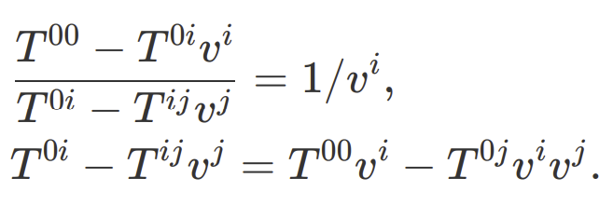




Appendix: velocity
Let use the perturbation method to solve velocity, first let the velocity expanded order by order like as

Slide 25

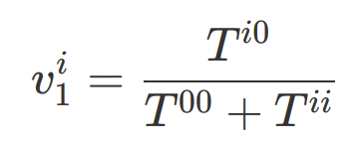
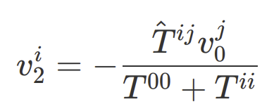
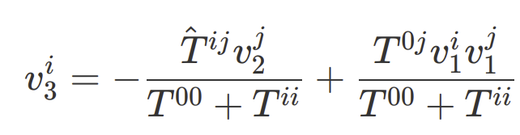
Appendix: velocity
Let assume
Where ${\hat{T}}^{ij}=T^{ij}−T^{ii}$, Then we can now solve the velocity order by order.
the first order
the second order
the third order

Slide 26
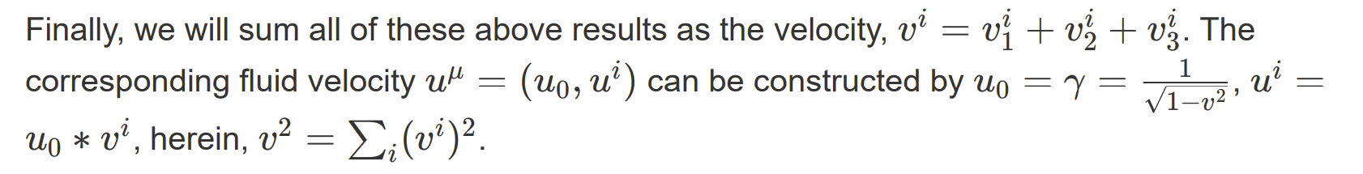
Appendix: velocity

Slide 27
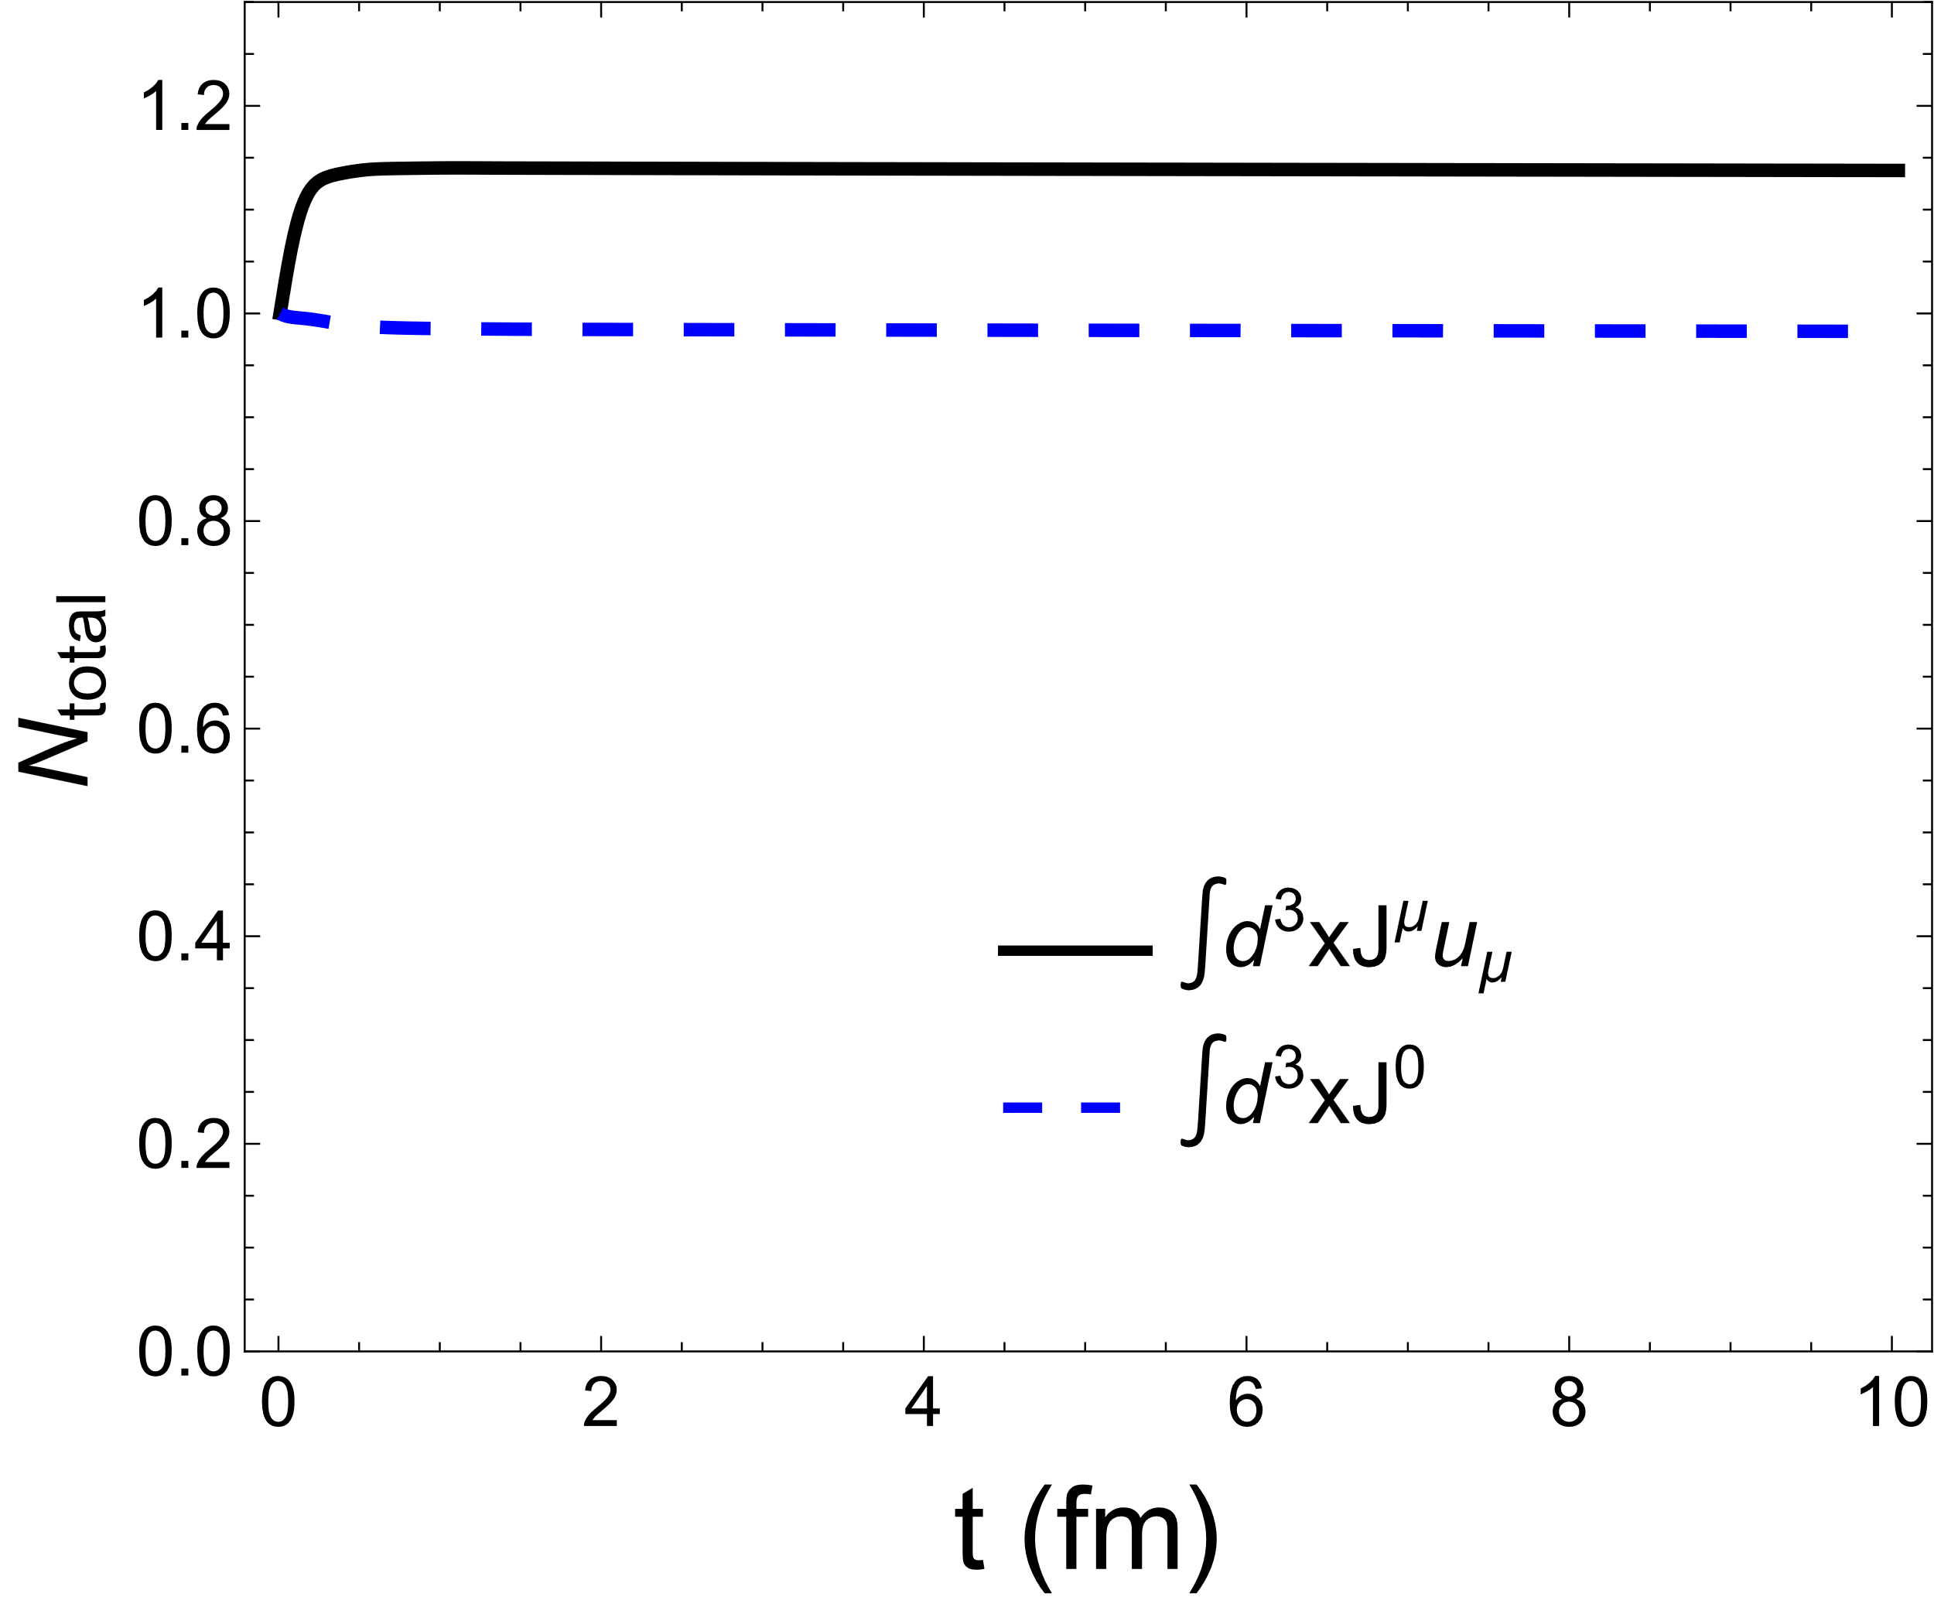
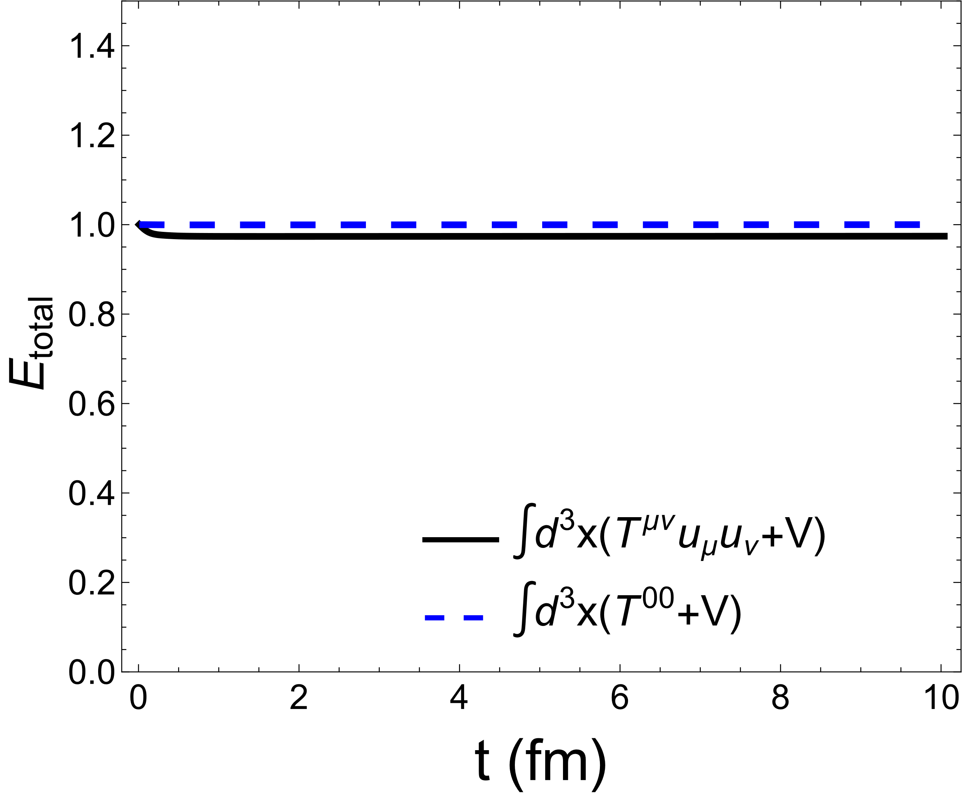

Appendix: N and E
$N_{total}$ is the net total quark number
These plots depict the temporal evolution of the net quark number and total energy in the system.

