Slide 1
CGEM DAQ Status and Plan
Tingxuan Zeng
2025-03-17

Slide 2
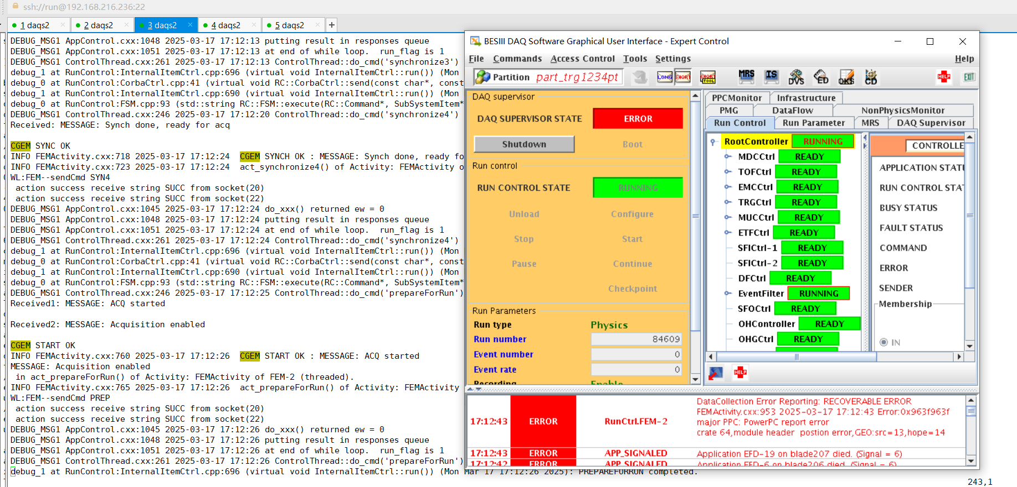
Communication between BES3 and GUFI
The communication interface is ready to test. (will test tomorrow with Alberto)
The Error reporting interface still need more development.
When stop BES3 DAQ abnormally without clicking stop → should use the test program to send a stop command now.
Not allowed to send two start commands to GUFI continuously.

Slide 3
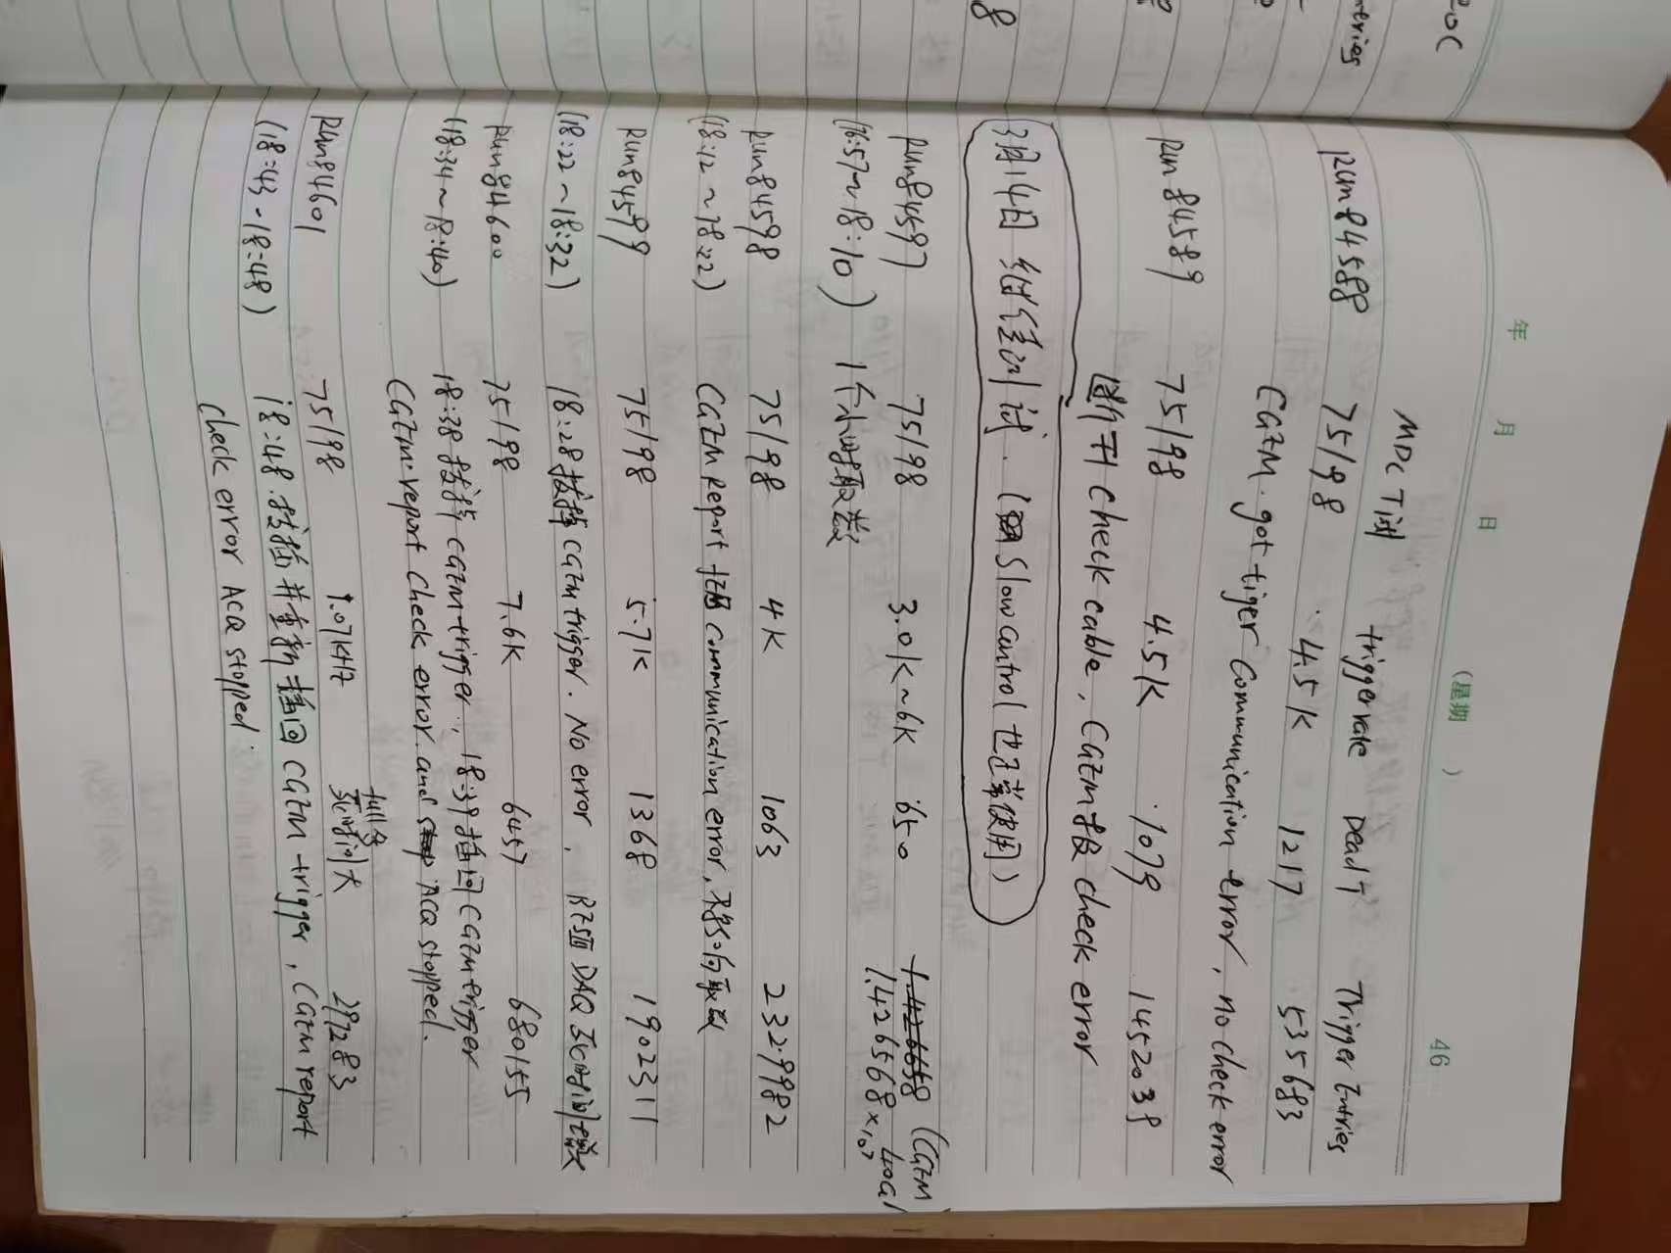

Slide 4
More data check results
 | BES3 event number in data file | CGEM uniq trigger number | CGEM Last Trigger number(all gemrocs same) | Consistent ? | CGEM Checkbit error?(2 bits) | Remarks
RUN 84598 | 2329982 | 2329982 | 2329982 | Yes | No
RUN 84599 | 1902311 | 1327327 | 1327327 | - | No | Disconnect cgem trigger cable
RUN 84600 | 680155 | 588007~588102 | 588007~588102 | - | Yes 52352error 6.9sec | 18:38 Disconnect cgem trigger cable 18:39 reconnect 7.6KHz
RUN 84601 | 297283 | 290671 | 290671 | - | Yes 29456 27sec | Disconnect and reconnect cgem trigger cable
RUN 84604 | 9255447 | 9452038~9452042 | 9452042 | yes? | No | BES3 stop abnormally?

Slide 5
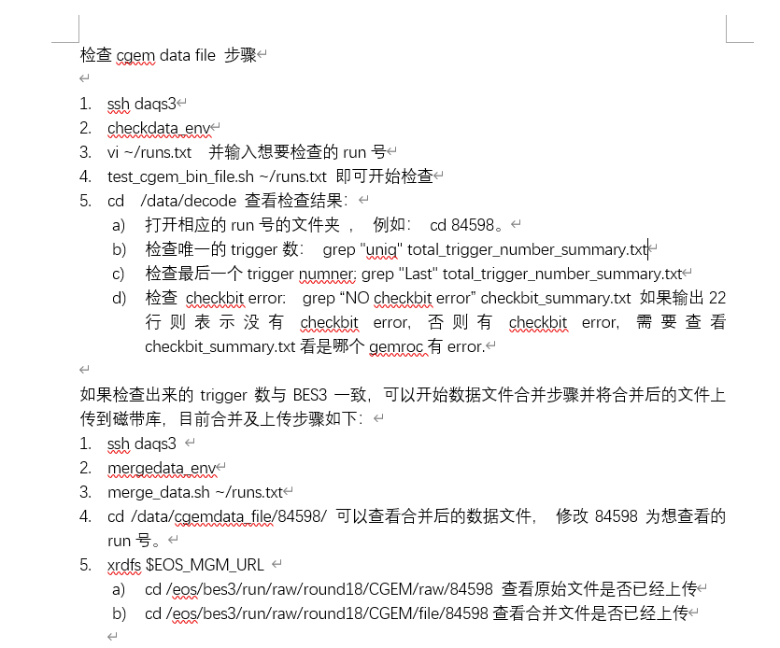
Release a data file test and merge instructions
Can we release the interface to the shifters?

