Slide 1
CGEM DAQ Status and Plan
Tingxuan Zeng
2025-03-18

Slide 2
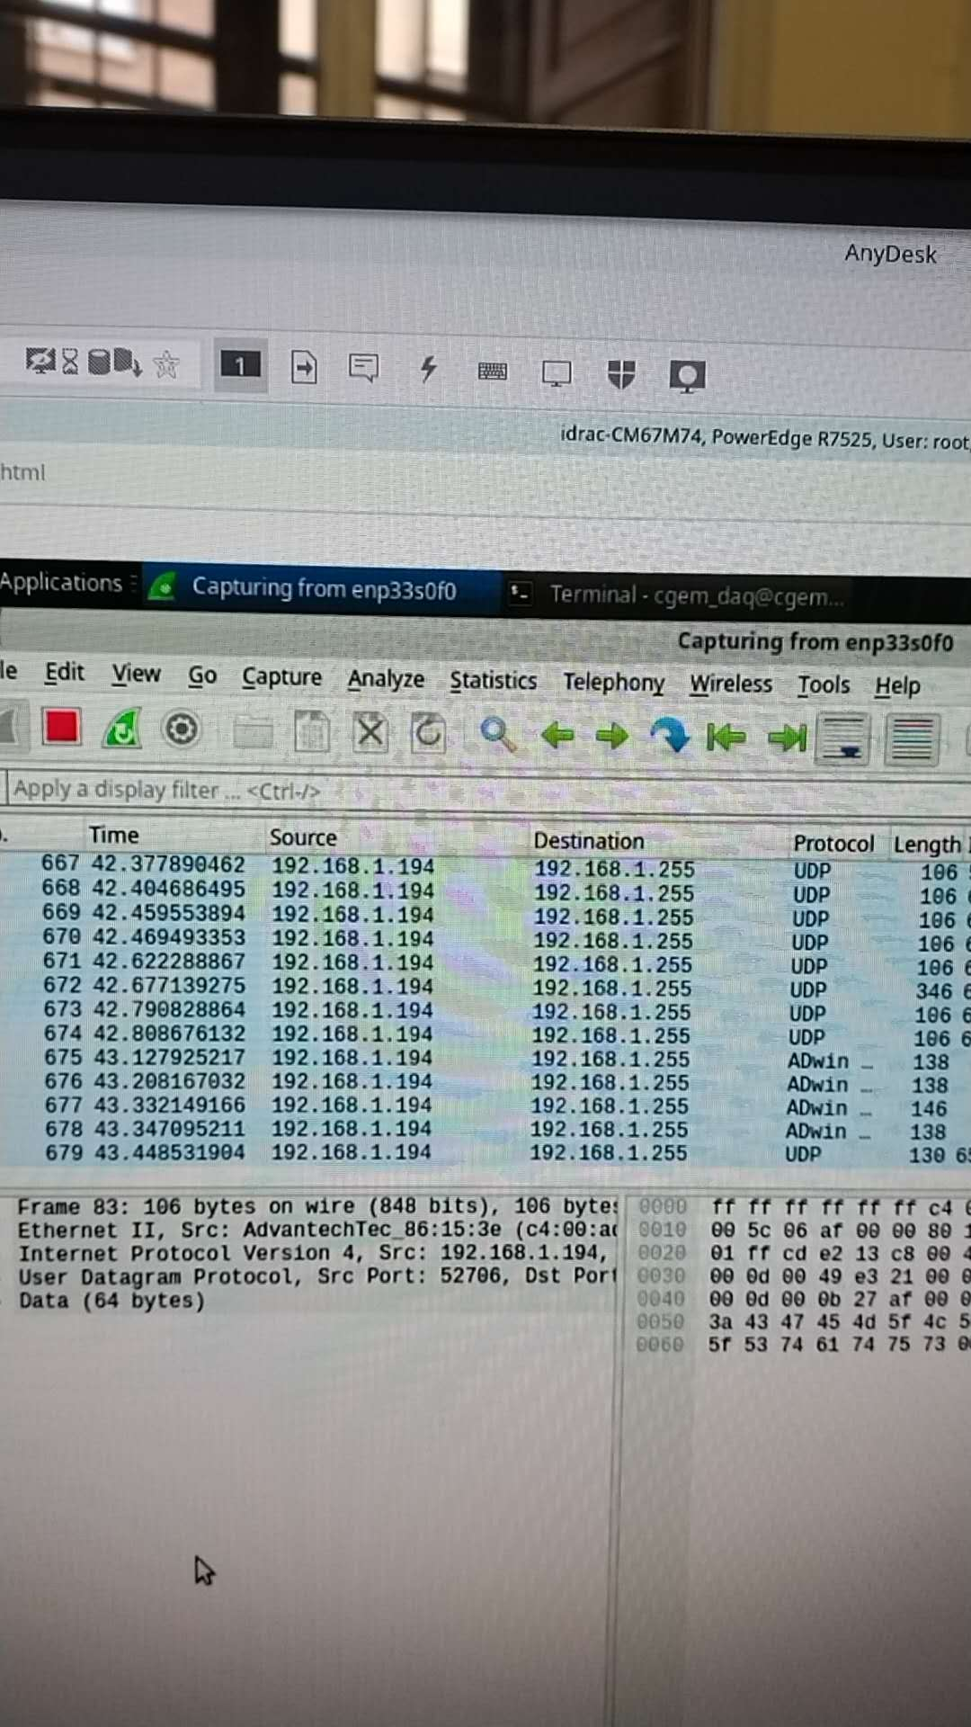
Communication test between BES3 and GUFI
Meet a problem: Send command and get no response
4 of the GEMROCs are down (first time since installed). They are sending a lot of data, in a strange status.
try to understand the situation → Alberto find tons of broadcast calls on the router from 192.168.1.194 from slow control
First talk to Si Ma to solve this problem(has been solved now) and then continue our tests at night.

