Slide 1
“Do you need a distance?”
Optimal Transport for Jet Physics
Speaker: Tianji Cai 蔡恬吉
Date: Apr 10, 2025
Workshop: Opportunities and Ideas at the QCD Frontier
Venue: 中国高等科学技术中心

Slide 2
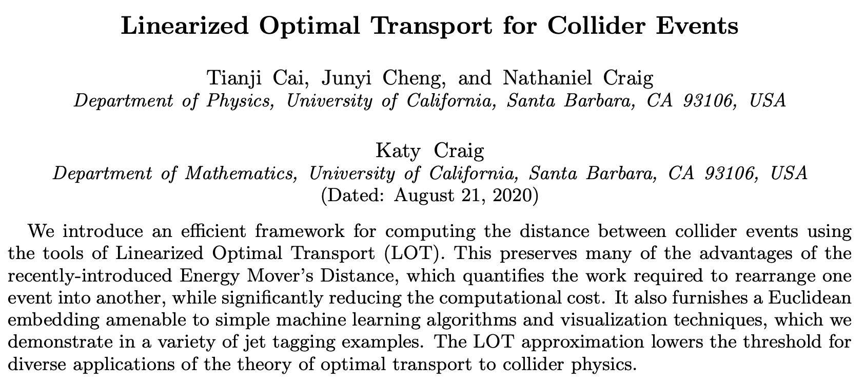
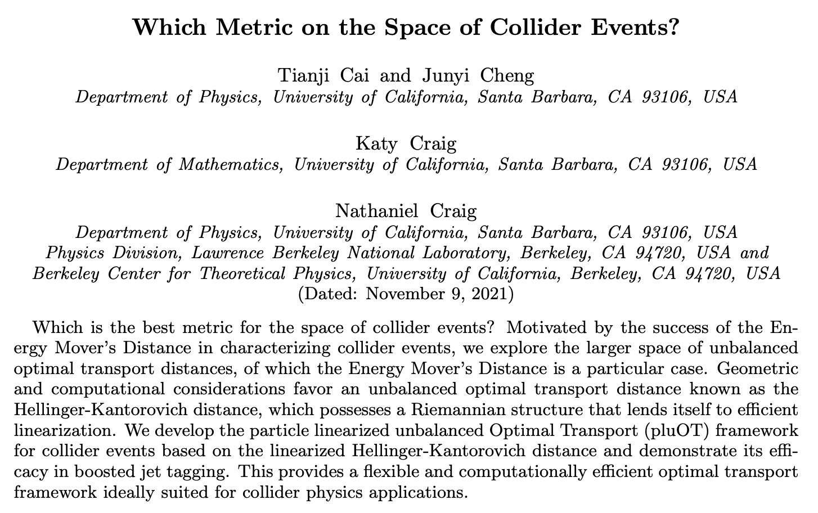
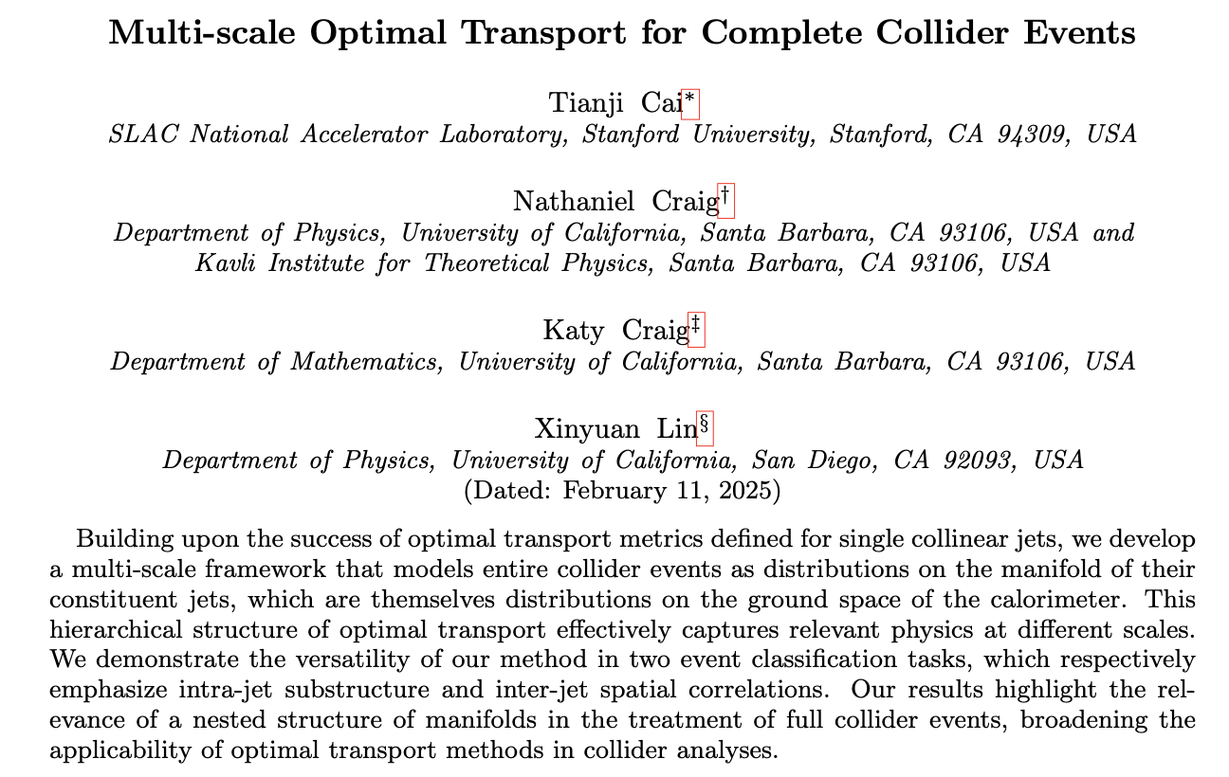
Our works: The Star Wars Optimal Transport Series
2021
2020
2021
Tianji Cai, Nathaniel Craig, Katy Craig, Junyi Cheng, Xinyuan Lin, Jessica Howard, Hancheng Li, Bernhard Schmitzer, Matthew Thorpe
2025

Slide 3
1. Why care about OT?
… because OT defines a metric on the space of collider events with many practical benefits and deep theoretical insights. 😎

Slide 4
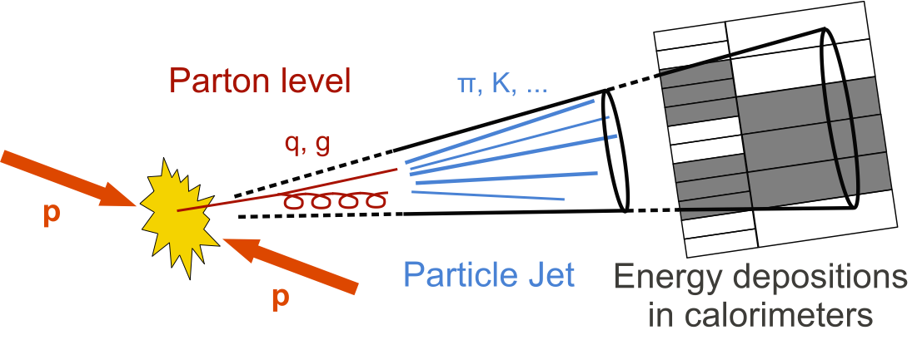
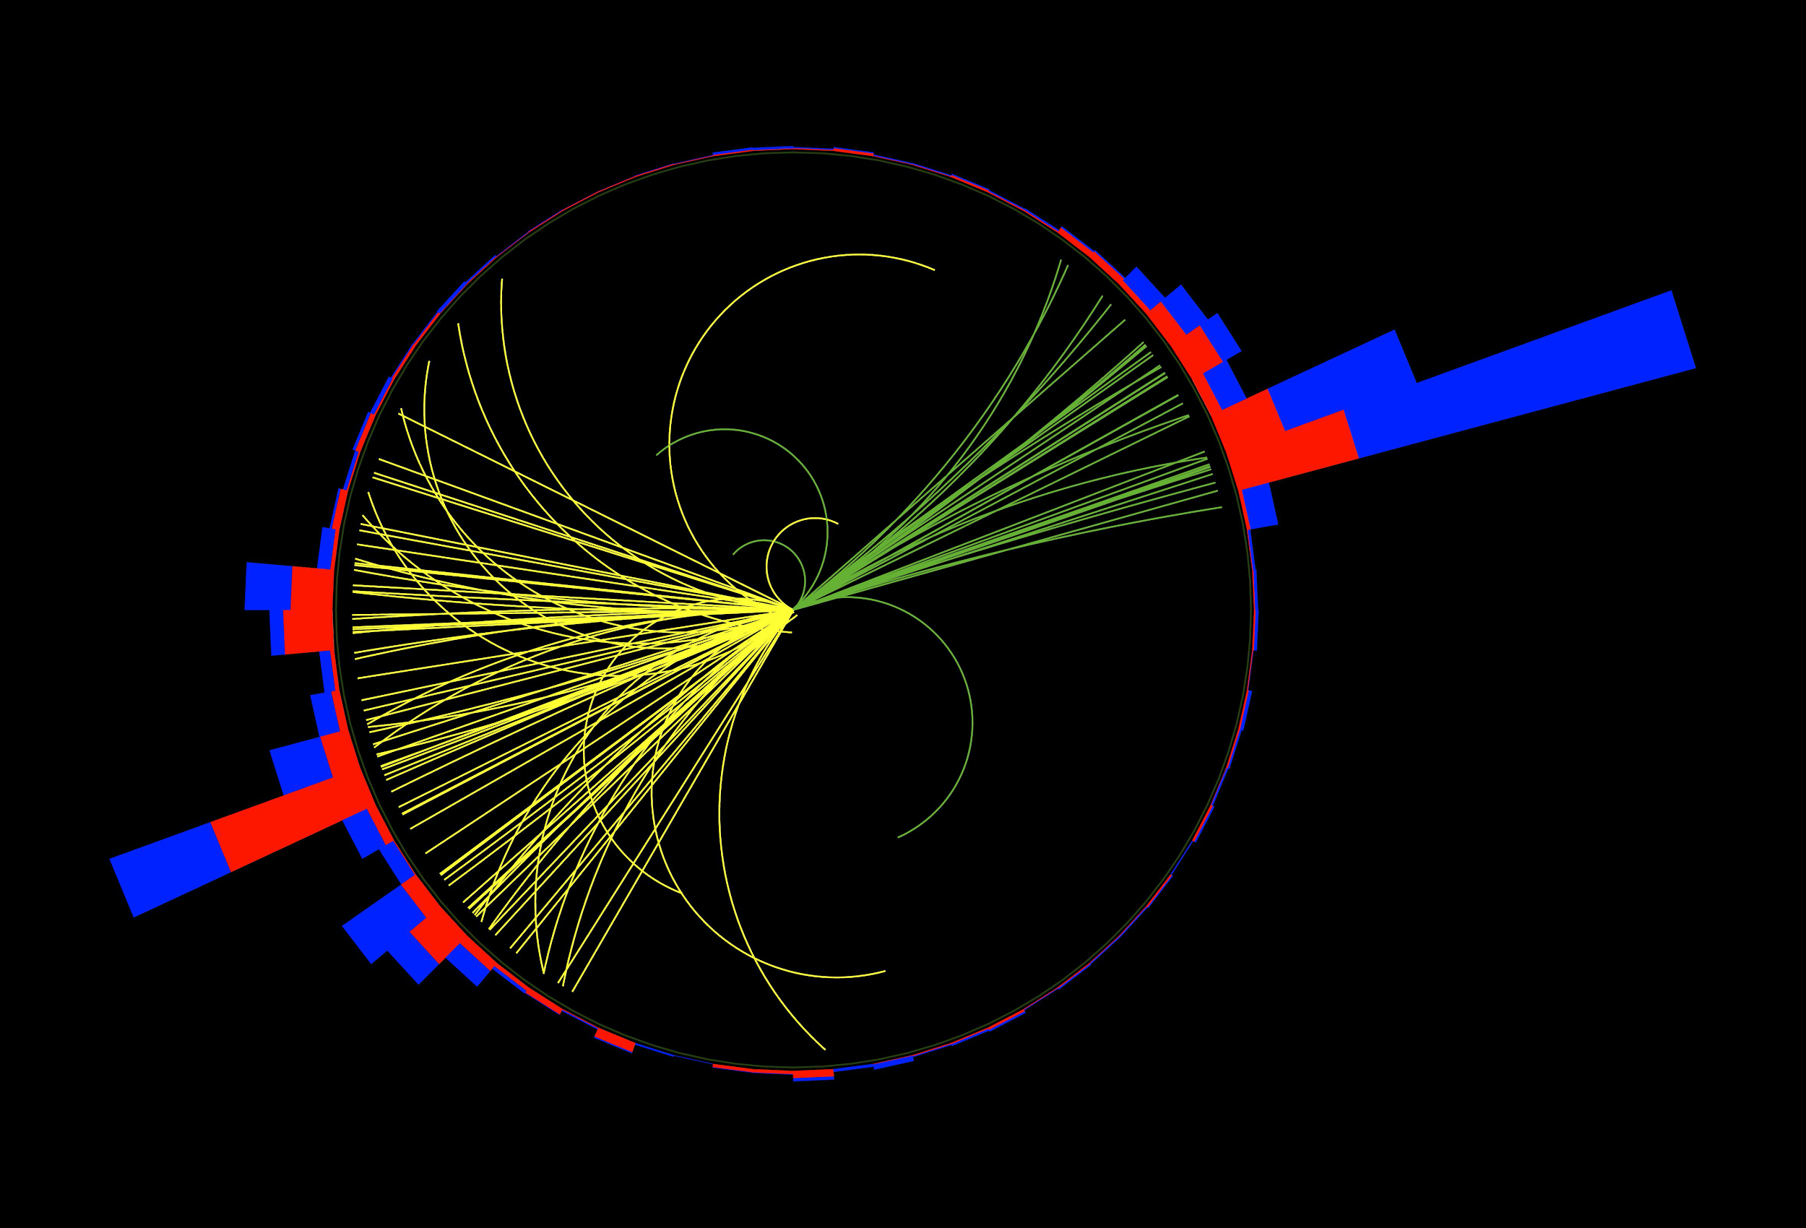
A New Era for Jet Study
Handmade Observables
DL Models
Foundation Models
Representation Space
→ A physically meaningful metric!
Event display: 2 top quarks
t → 3-pronged jet
Here is a jet!
Another jet!
Image from
Philip Harris’s talk.

Slide 5
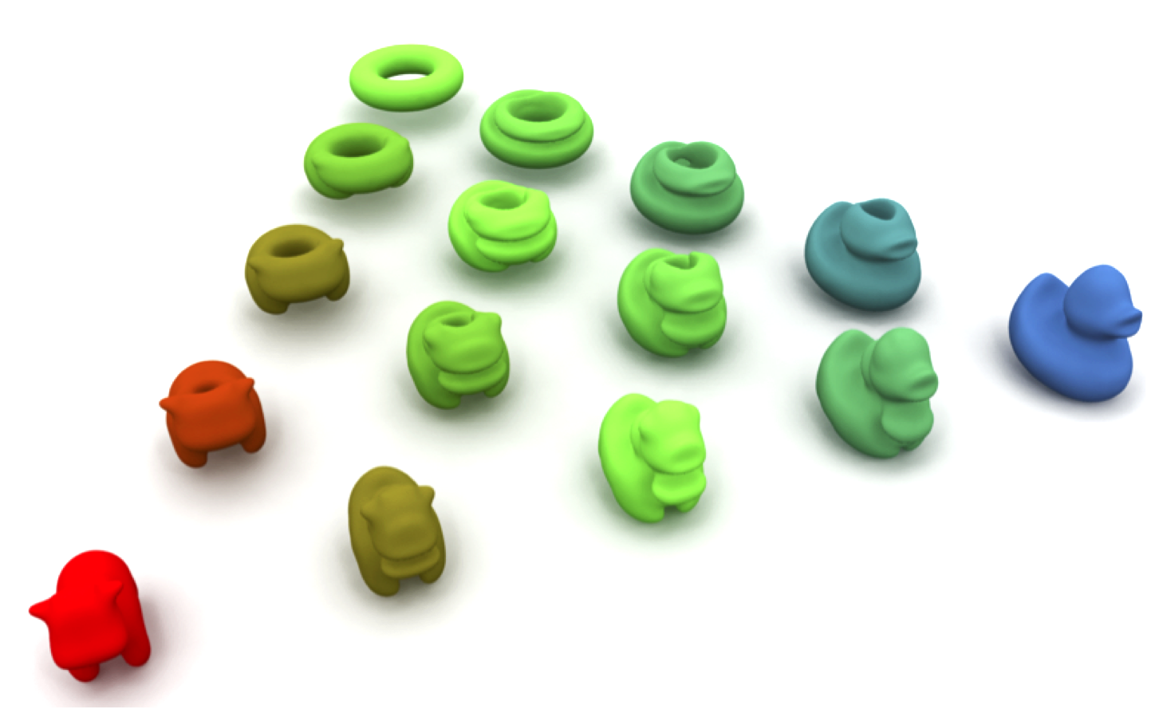
What is our data type?
Example jet image, Fig 2.2 in Hadronic Jets.
Fig 4 in paper.
Large distance
Small distance
Discrete distributions
Optimal Transport
Energy flow of a jet on the y-phi plane can be seen as a discrete distribution.
Define distances between distributions & Morph one distribution into another.

Slide 6
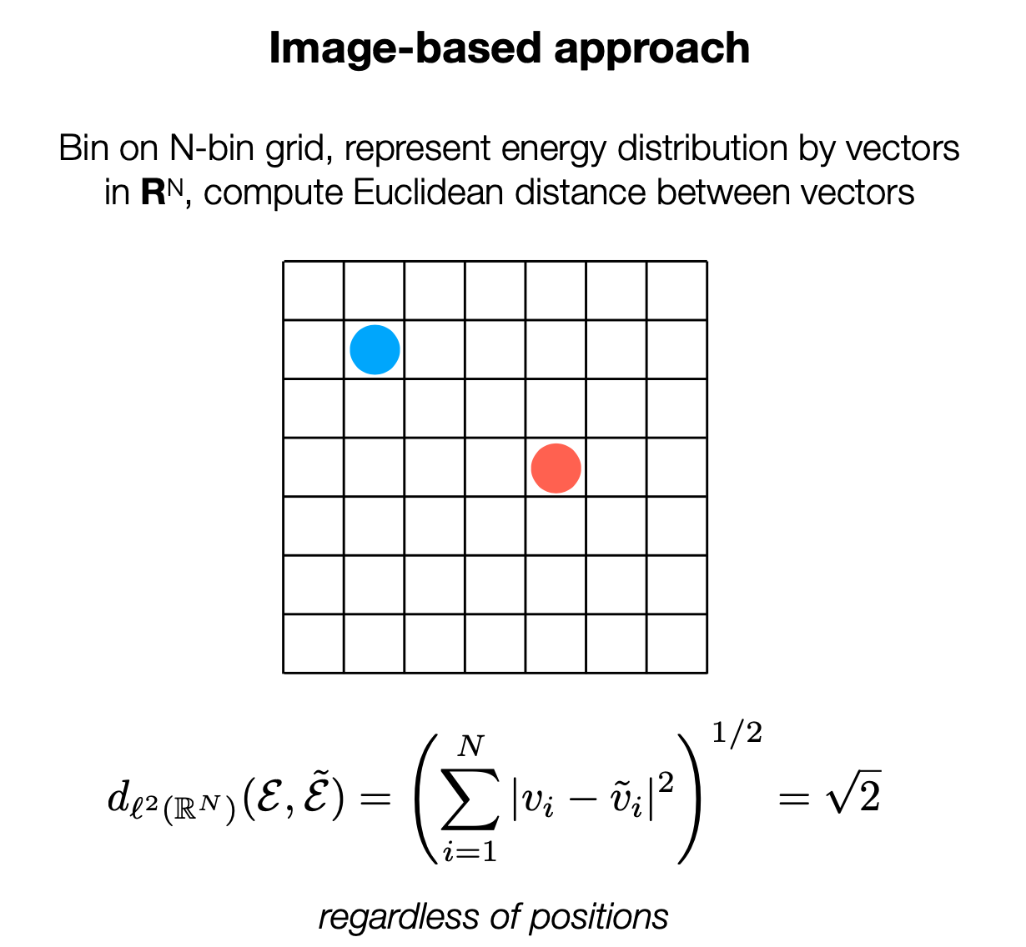
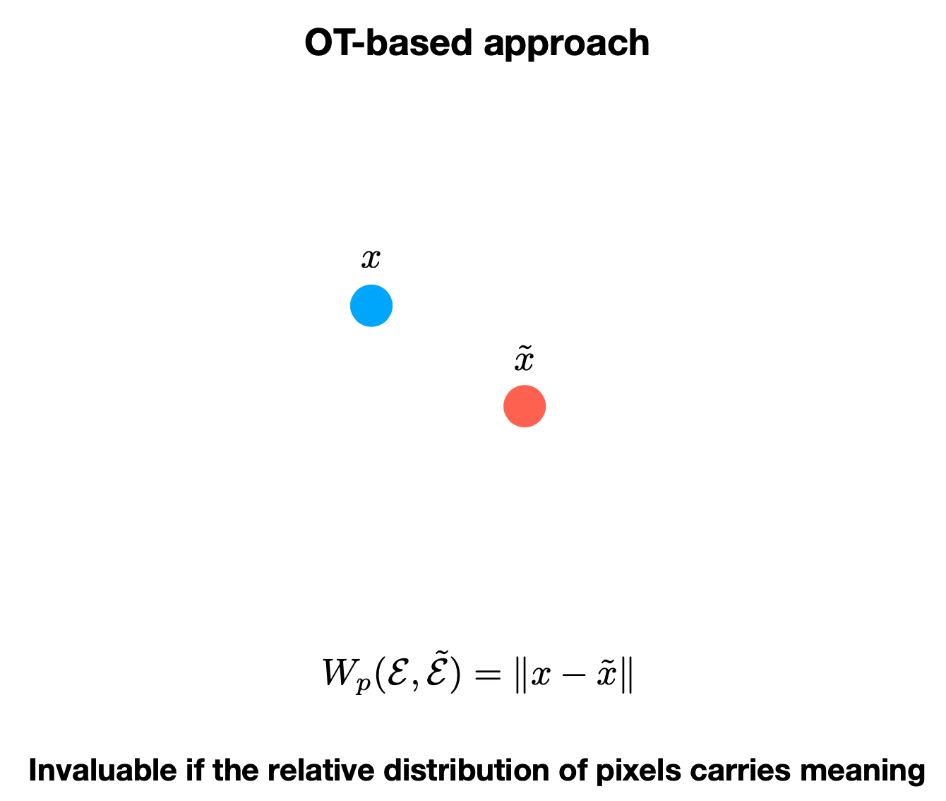
Why is normal Euclidean distance not good enough?
Consider two particles with unit energy.
Ground metric~
0
0
0
0
0
0
0
0
1
0
…
Ground space~
0
1
…
v = [0, …, 1, 0, …, 0, 0, …, 0]
v’= [0, …, 0, 0, …, 1, 0, …, 0]
0
0
OT preserves the underlying geometry of the ground space!

Slide 7
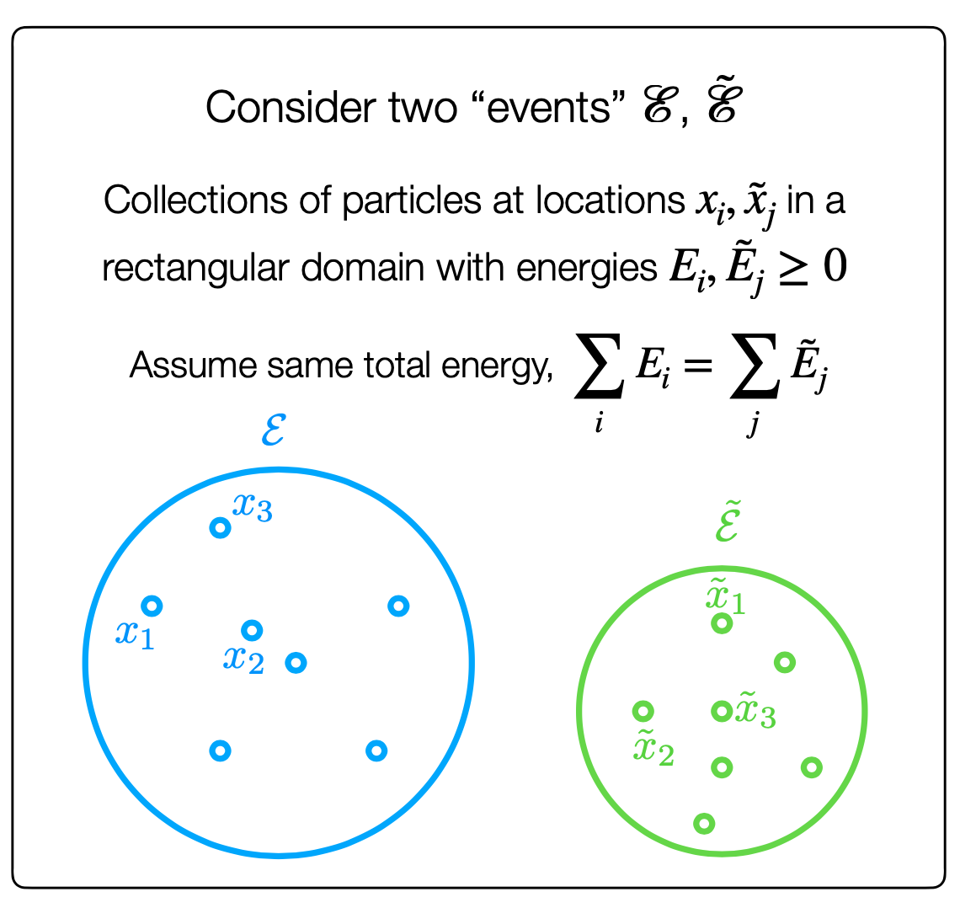
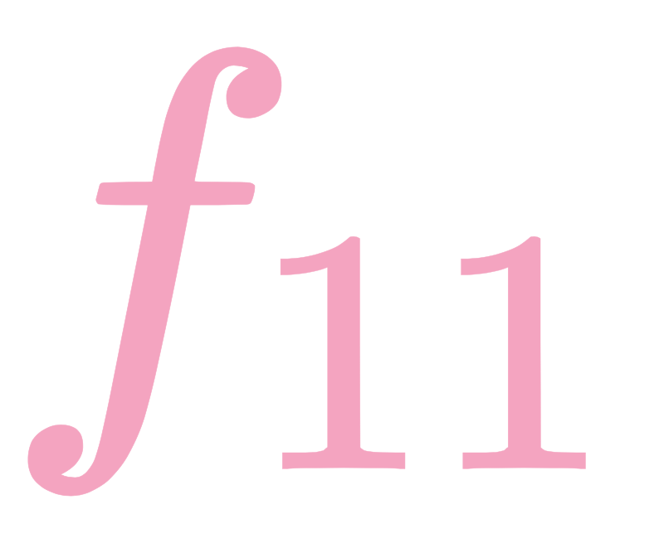
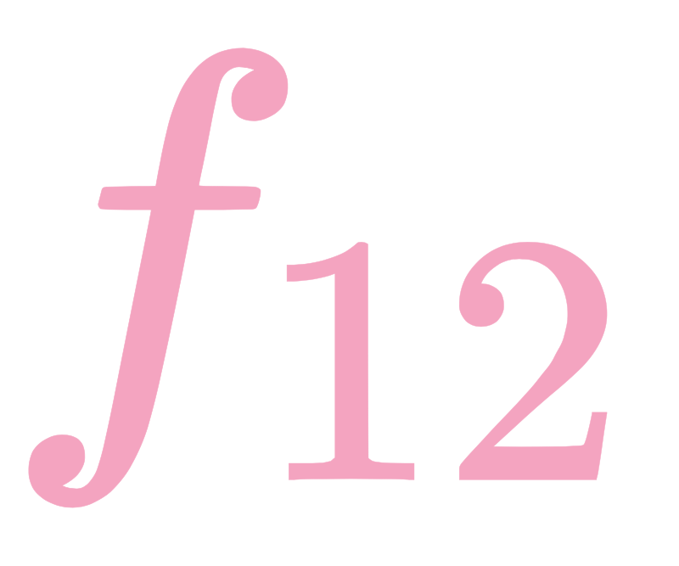
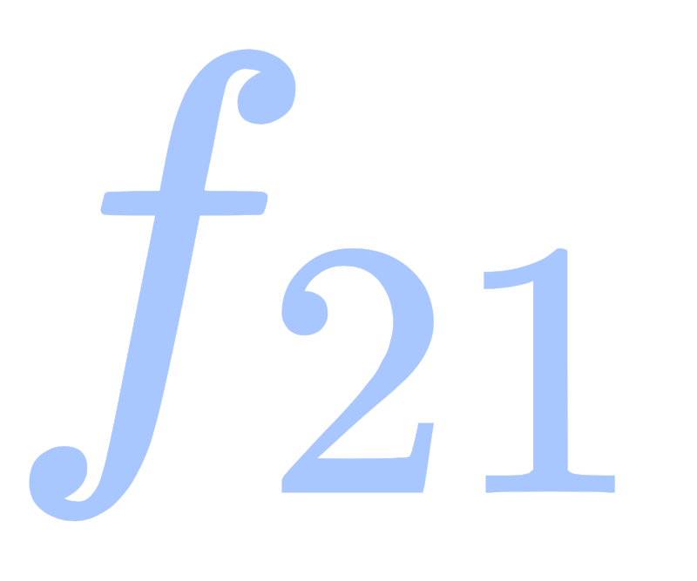
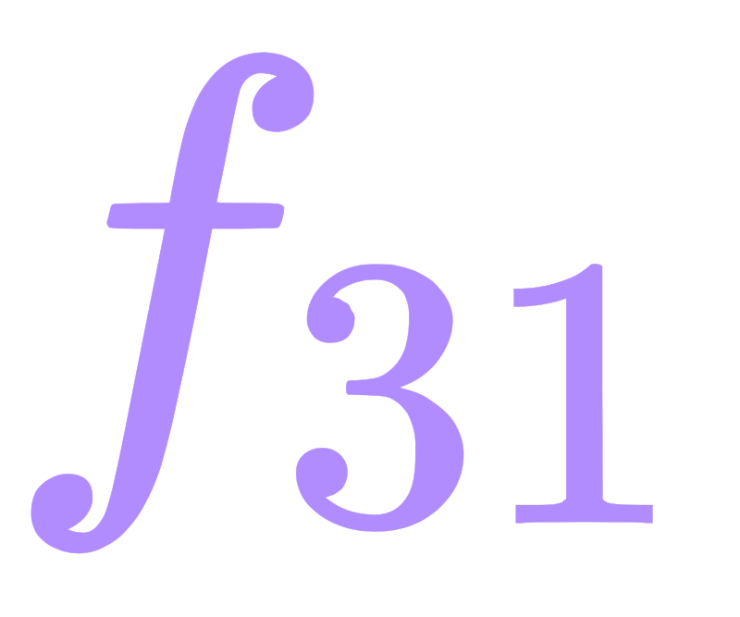
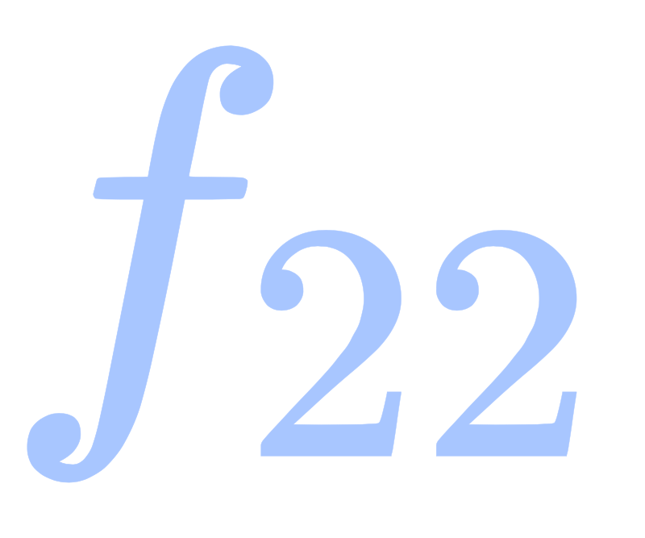
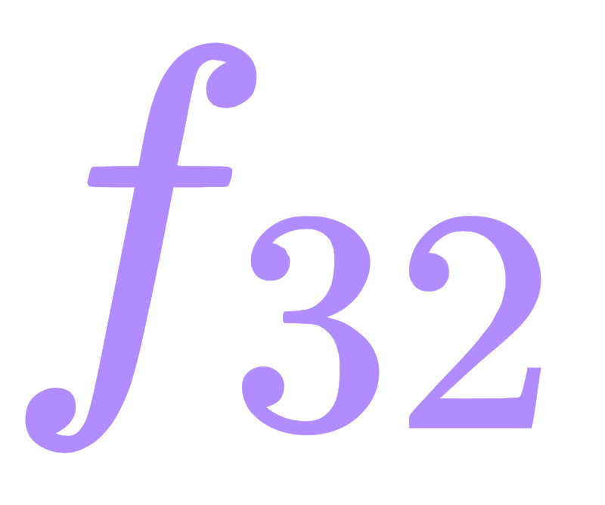
Earth Mover’s Distance (EMD): A first example of OT
𝝷_{ij}: ground metric between particles i and j
f_{ij}: the amount of mass moved from particle i in E to particle j in E’.
Example:
E₁
E’₁
E₂
E’₂
E₃

Slide 8
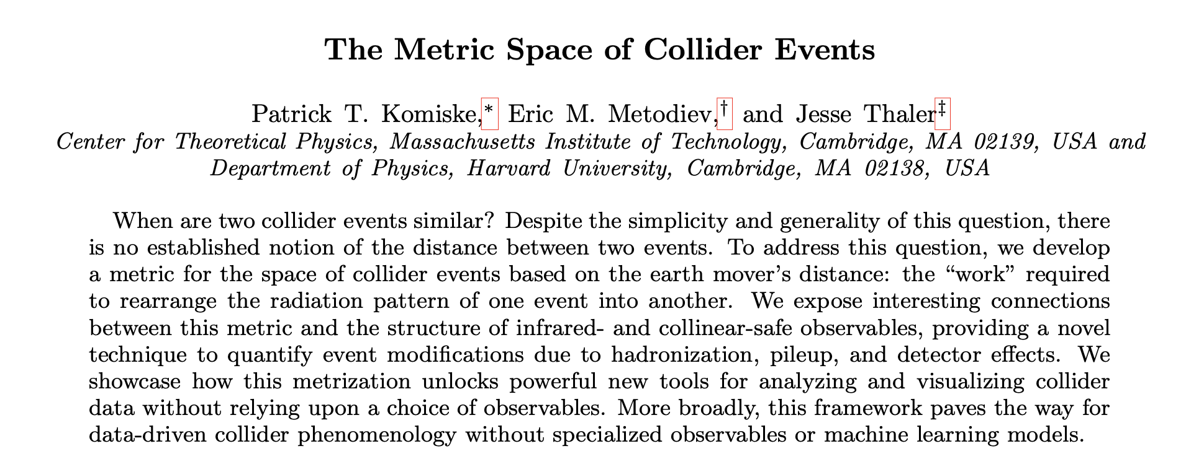
OT in Jet Physics: The Beginning
2019

Slide 9
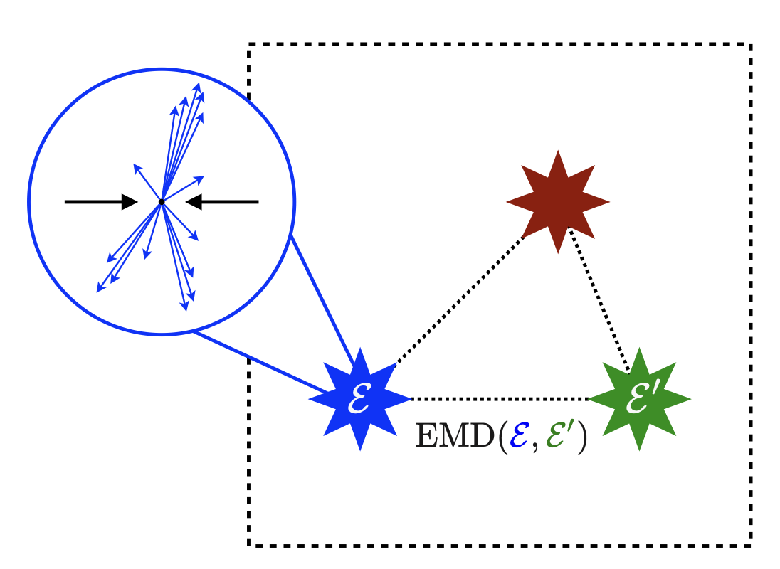
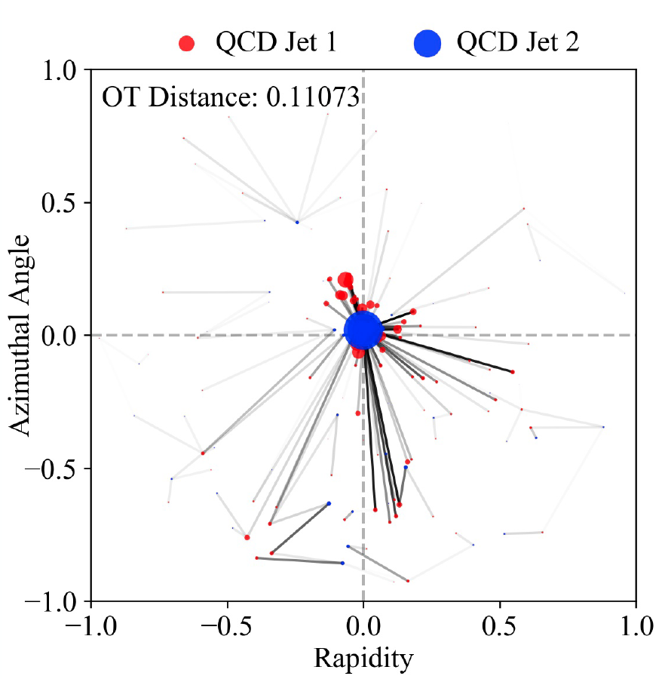
Metric for the Space of Collider Events:
Left: Fig 1 in 2004.04159; Right: Home-made.

Slide 10
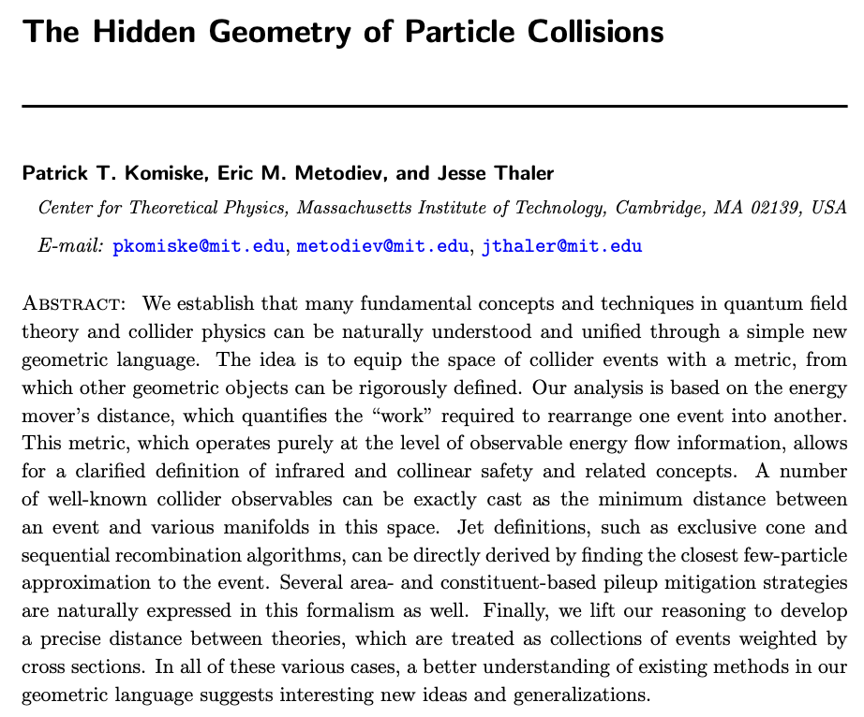
A unified Geometric Framework
By metricizing the space of collider events, OT offers a new geometric language to unify many fundamental concepts in jet physics.
2020

Slide 11
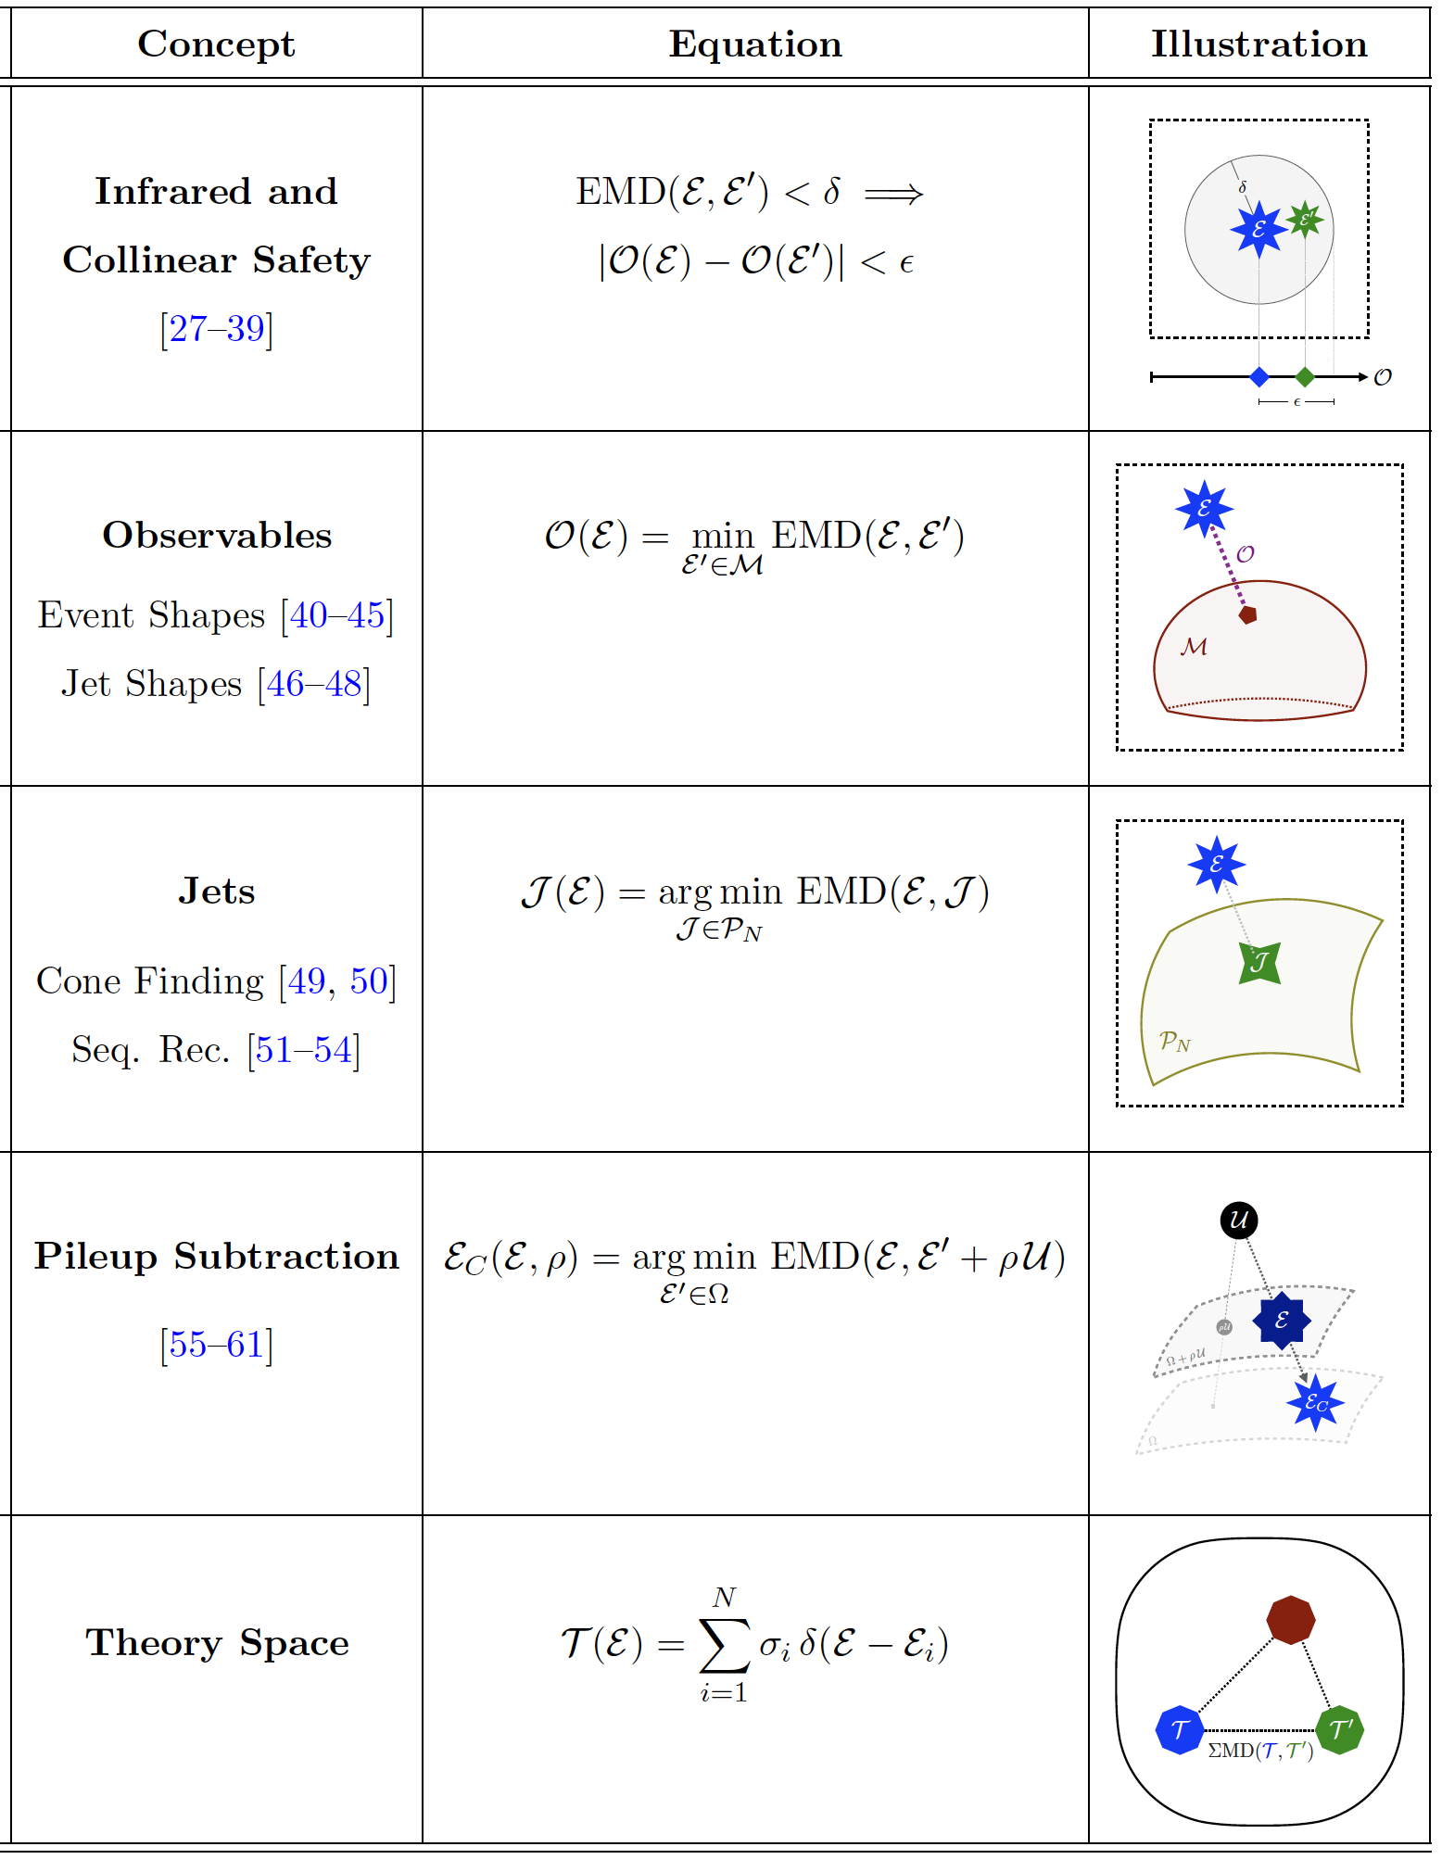
Source: Table 1, 2004.04159.
IRC safety: EMD continuity everywhere except a negligible set of events.
Collider observables: Distance of closest approach between an event and a manifold of events.
Jet algorithm: Approximates an M-particle event with N < M objects called jet.
Pileup mitigation: Finds the event that, when combined with an amount rho of uniform radiation U, is closest to the given event.
A distance between theories: EMD as the ground metric and cross sections as weights.

Slide 12
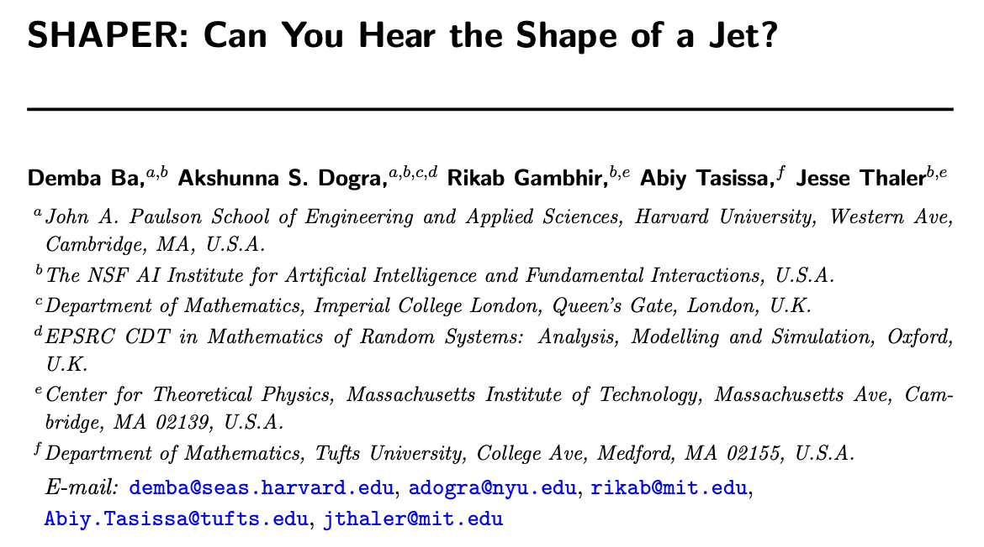
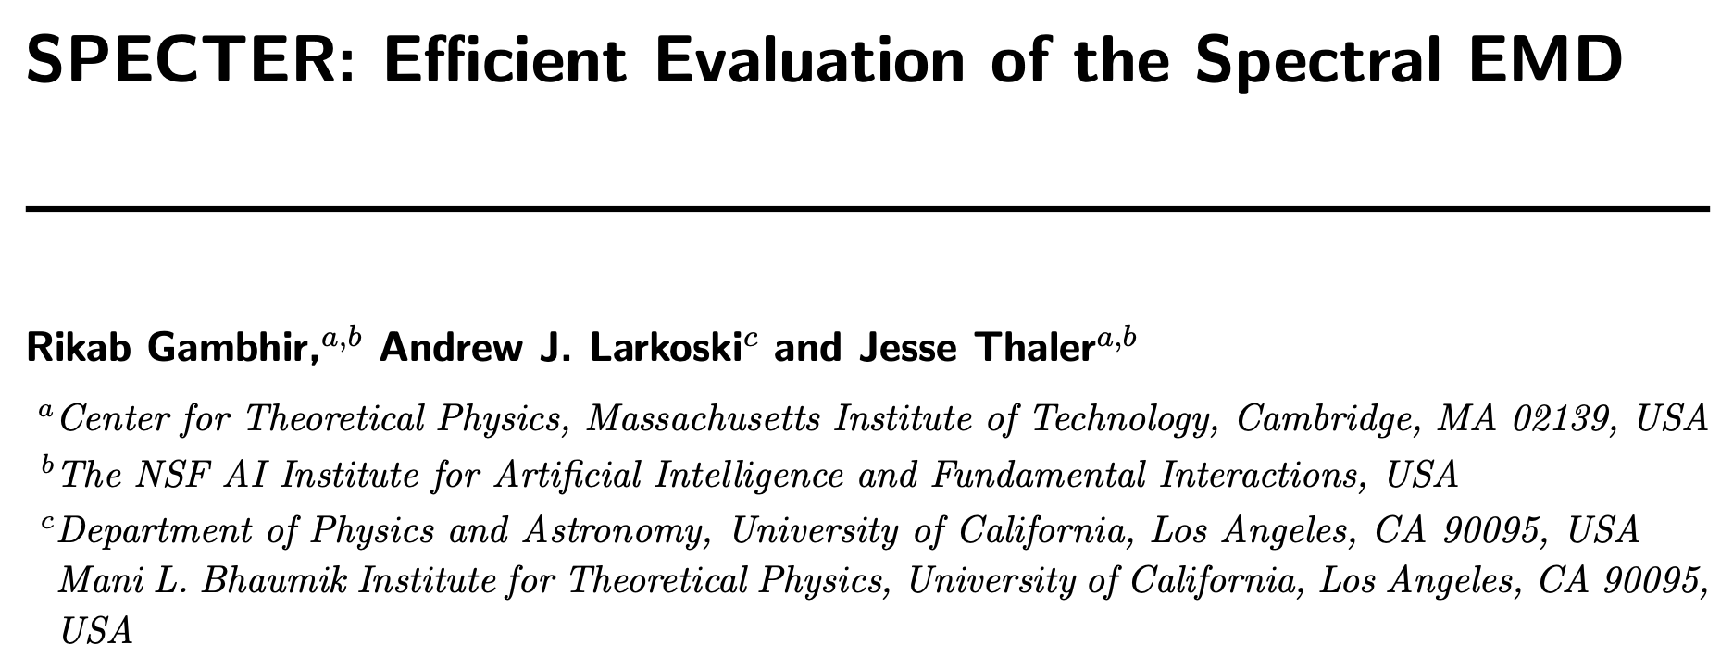
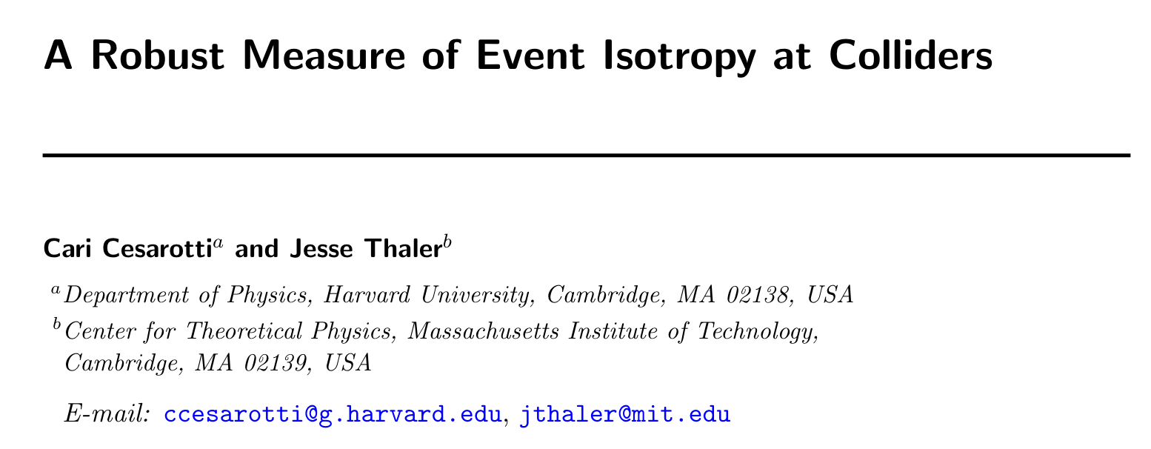
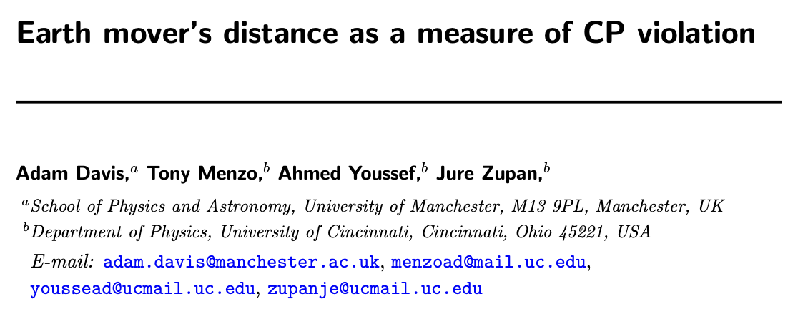
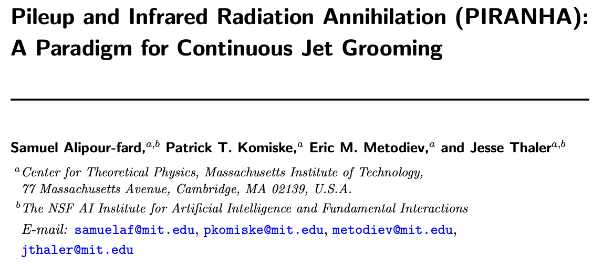
Fast-growing Applications of OT in Jet Physics
Jet tagging, New Observables, Anomaly Detection, Pileup Mitigation, Detector Unfolding, Calibration…

Slide 13
2. Our Growing OT Shop…
We have in stock balanced OT, unbalanced OT, linearized OT, multi-scaled OT, multi-species OT… What do you want? 💁

Slide 14
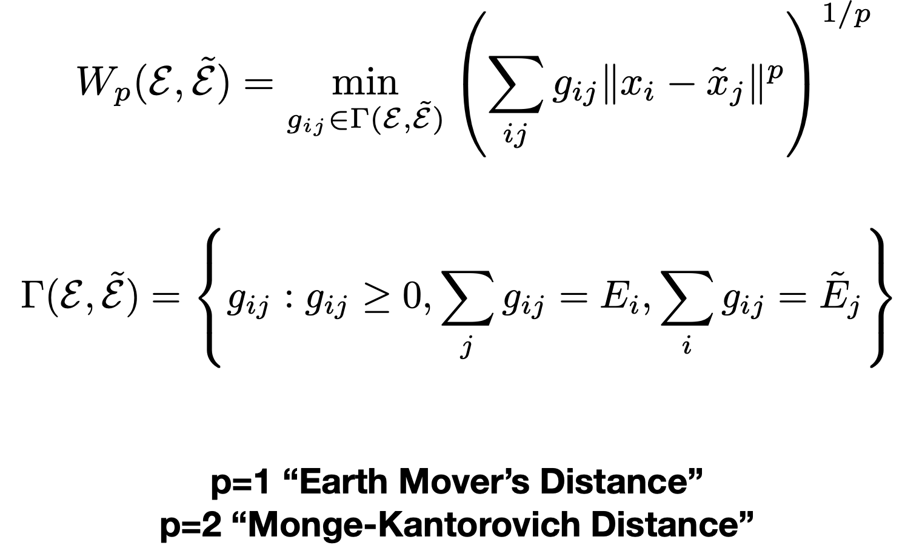
p-Wasserstein Distance: Generalizing EMD
W₂ has a (weak) Riemannian structure → Can linearize!
p=1: Earth Mover’s Distance (EMD)
p=2: Monge-Kantorovich Distance / 2-Wasserstein (W₂) Distance

Slide 15
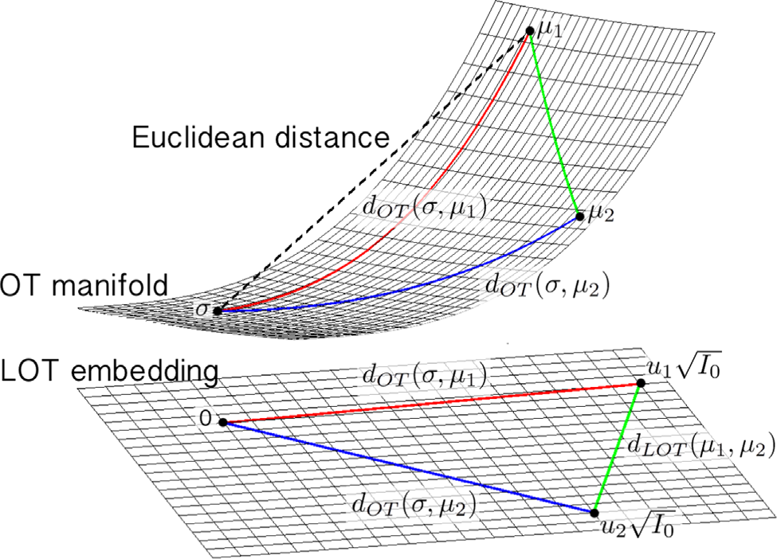
OT too computationally expensive? Linearize W₂!
LOT: Project onto the tangent plane of a chosen reference.
Benefit 1 (practical): Reduce computation to N × T_{OT} (~0.1 secs) + N(N-1)/2 × T₂ (~ 10⁻³ secs), where N is the # of samples.
Benefit 2 (practical): Give a theoretically guaranteed approximation to the W₂ distance.
Benefit 3 (theoretical): Facilitate a Euclidean Embedding for each jet.

Slide 16
But how to account for total mass (p_{T}) difference?
Same as Standard EMD
Extra piece to account for the unequal total mass
Different conditions for the unbalanced case
Ad-hoc!
Are there more natural ways to incorporate the total mass difference?

Slide 17
From Balanced OT to Unbalanced OT
Balanced: Mass can only be transported, not created or destroyed. So the total mass of the two distributions must be exactly equal.
Unbalanced: Mass can be transported, created and destroyed. The total mass of the two distributions can be different, or they can be the same.
Credit: L. Chizat, G. Peyré, B. Schmitzer, F-X. Vialard on G. Peyré’s Github.

Slide 18
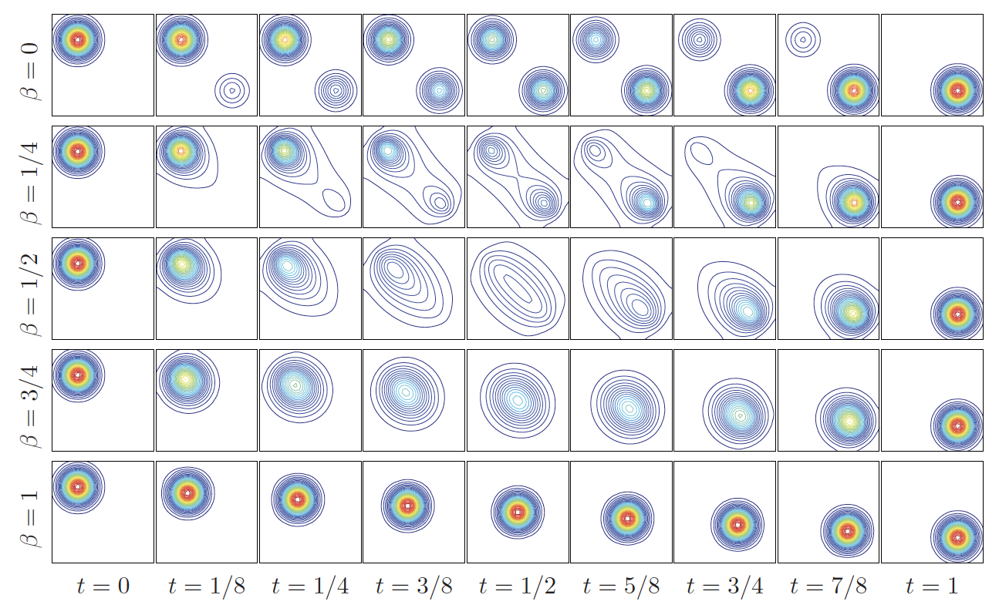
Source and target distributions have the same mass. Still can do mass creation and destruction (C/D).
Credit: N. Papadakis, G. Peyré, E. Oudet [10.1137/130920058]
Only C/D
No transport
Only transport No C/D

Slide 19
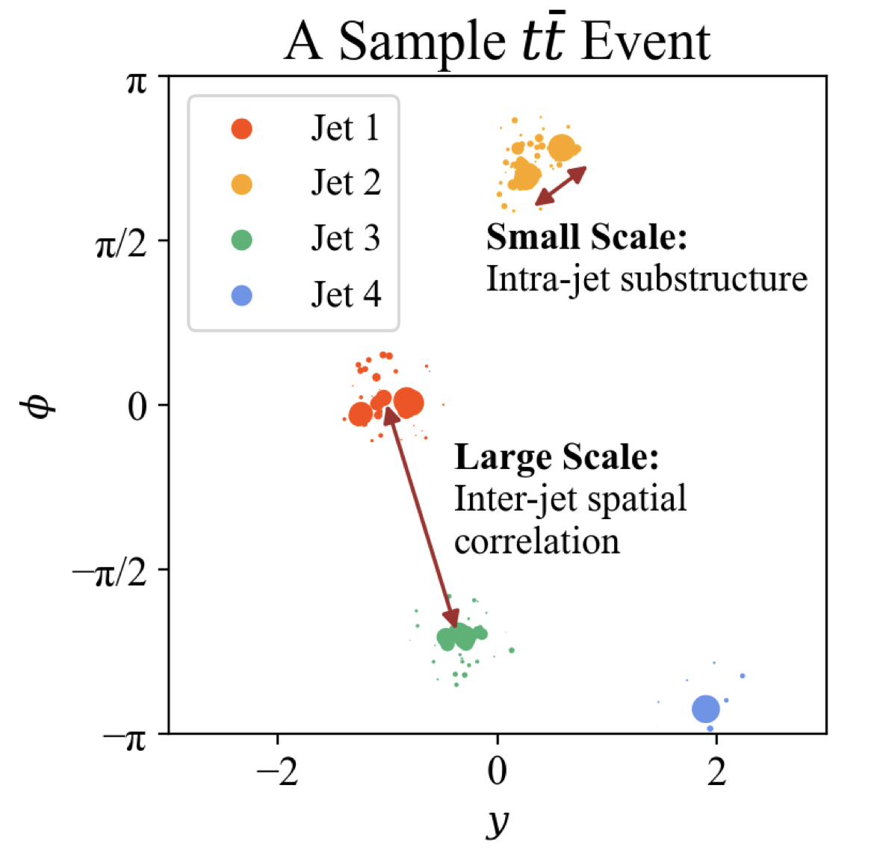
Distributions have different scales? Multi-scaled OT!
For single-scale OT, large scale separation may wash away fine structures of the small scale. How to avoid that?
Define a new “ground” metric to include both the large and small scale information.
Another OT with the new ground metric.
This method can define a novel, meaningful distance between entire collider events.
Multi scale OT:
Single scale OT:
2501.10681

Slide 20
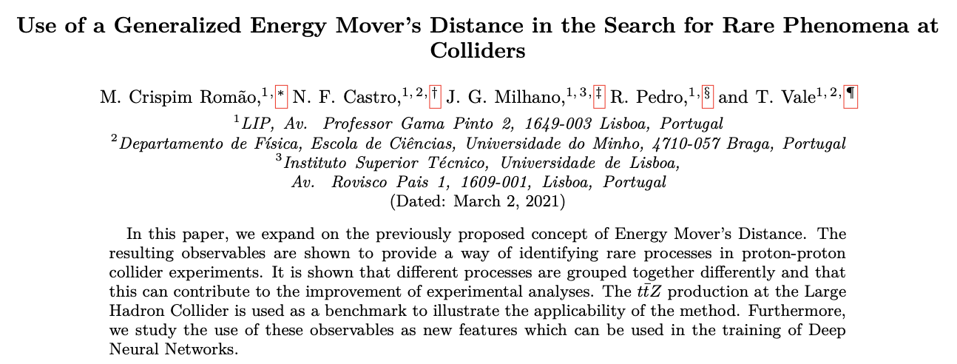
Having different types of masses? Multi-species OT!
In development
How to incorporate information beyond energy flow?
E.g., charge, flavor, PID…
Ways to include various species:
Combine OT for individual species: No species change.
Modify the ground space: User-defined cost of species change.
First Try:
Charge + Energy Flow

Slide 21
3. Welcome to the OT Showroom!
... and brainstorm about the next creative usage of the tools. 👀

Slide 22
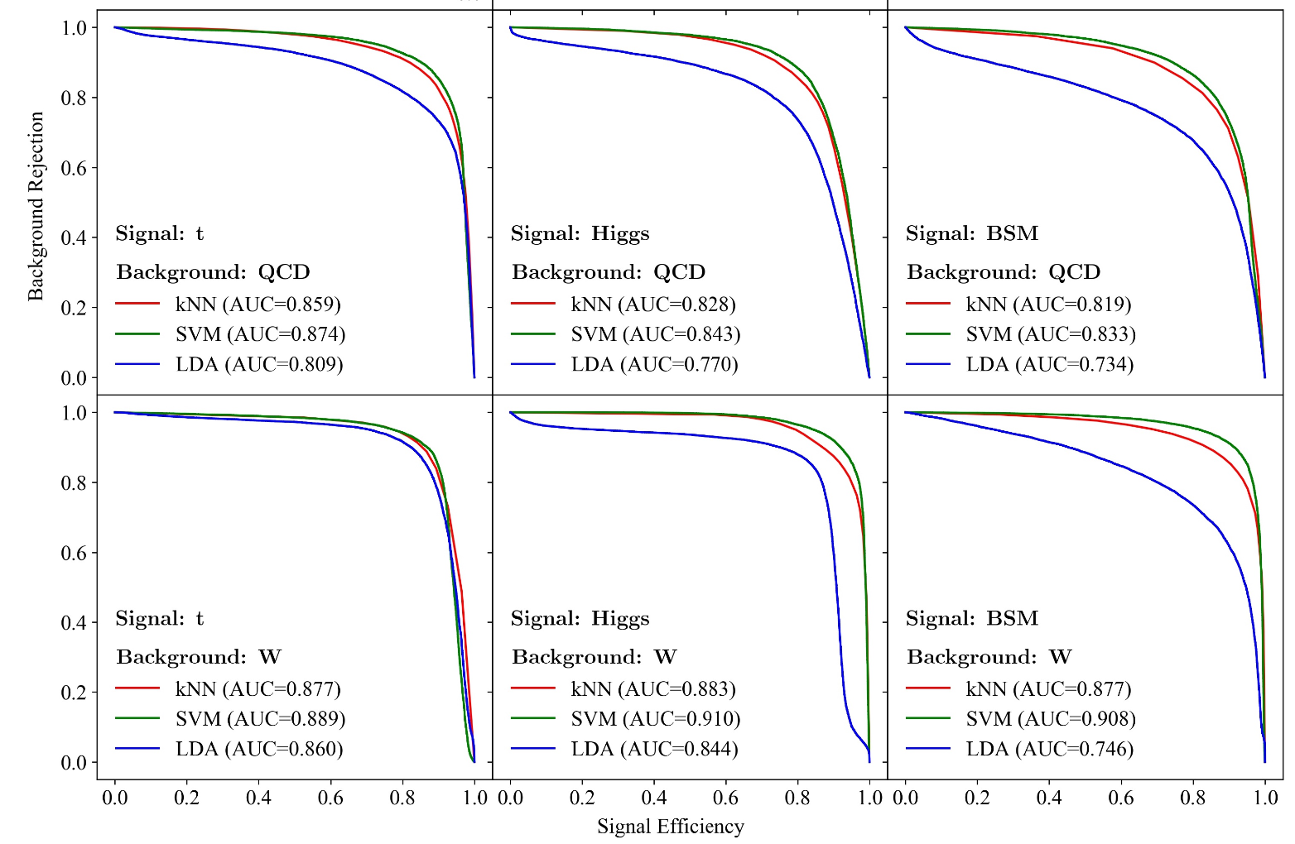
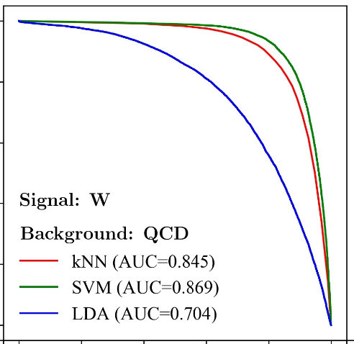
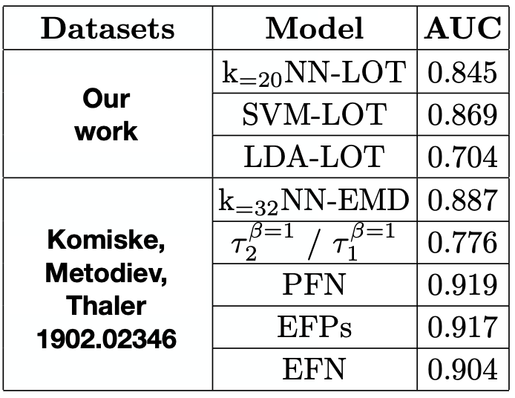
Jet Tagging with LinW₂ + Simple ML Models
Performance is not the only goal here. Still, what are better models for the OT representation? 🧐
Another jet!

Slide 23
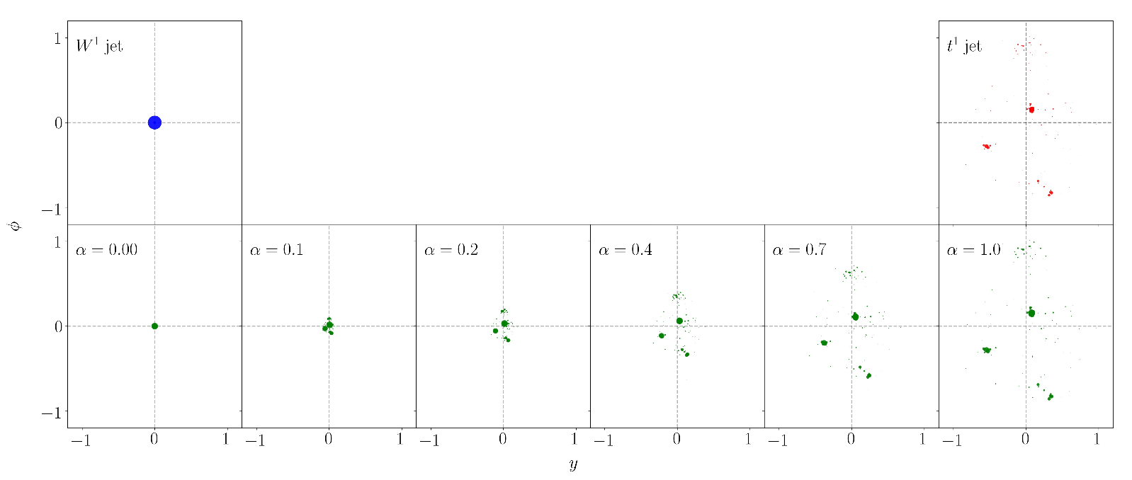
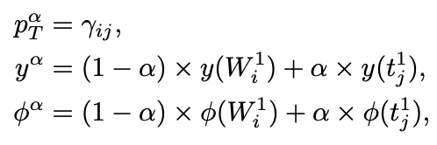
Jet Generation with W₂
A new jet^{ɑ} with i*j particles:
Jet^{ɑ} is the W₂ geodesic between the two jets.
What are some good usages for these geodesics in experiments? Not fully utilized for now… 🧐

Slide 24
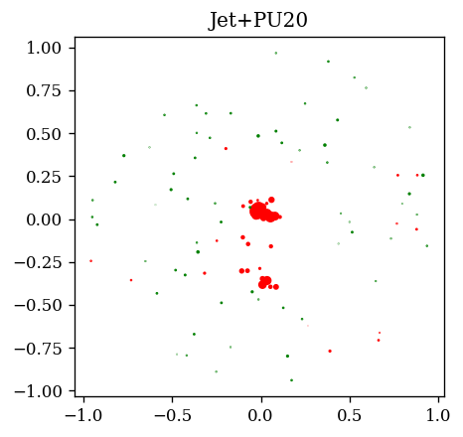
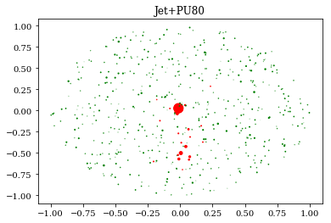
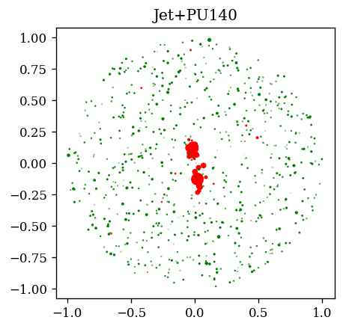
Pileup Robustness of OT
10k W & QCD jets with different amounts of pileup.
Some in-depth analysis of its pileup robustness is needed if we want to incorporate OT into the exp analysis pipeline. 🧐

Slide 25
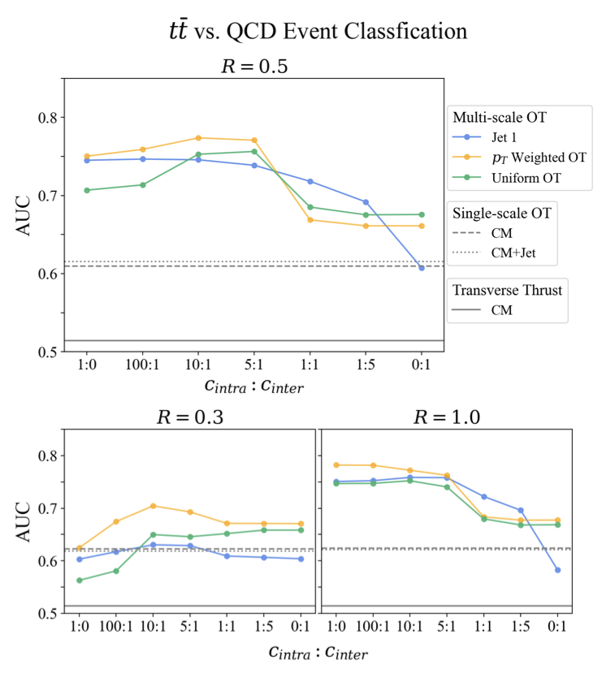
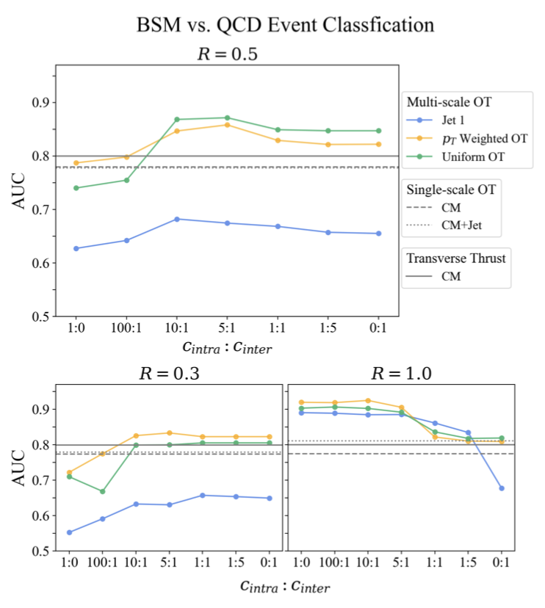
Event-level Classification with Multi-scale OT
Intra-jet substructure more informative
Inter-jet separation more informative
Any real experimental analysis that may benefit from using multi-scale OT? 🧐

Slide 26
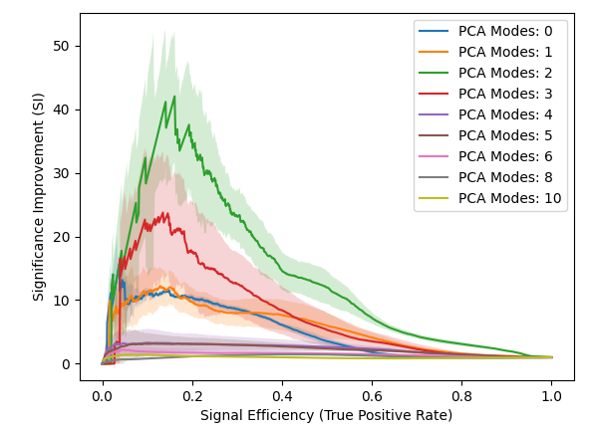
Anomaly Detection with OT Features
Preliminary results
LHCO R&D
Signal injection level: 0.19%.
10 runs, each stopping at 200 epochs, with a fixed-size MLP of [64, 64, 64].
Baseline high-level features: m^{J1}, m^{J2}, tau₂₁^{J1}, tau₂₁^{J2}, tau₃₂^{J1}, tau₃₂^{J2}.

Slide 27
Let’s first be as thorough as possible to accomplish the first two goals.
Already lots of work to do! 💦
Exp focused: OT used as a tool to address a specific collider analysis task.
Theory & Pheno driven: OT used as a new representation for collider events, a new perspective to look into the physics encoded in the events.
Goal: To incorporate OT into the experimental analysis pipeline.
More broadly, infuse OT with AI…

Slide 28
4. Next Sequel in the OT Series
The full power of OT (and other metrics) is yet to be realized. 🦾

Slide 29
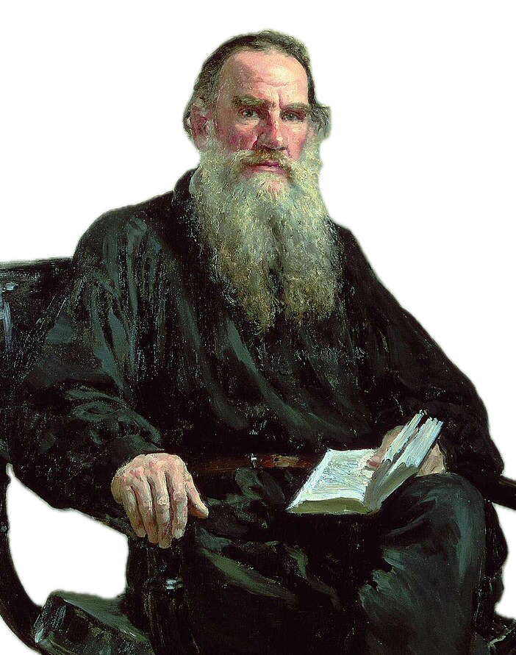
Metric and AI Models for Collider Physics
🤩 The Standard Model (& Beyond) Hypothesis 🤩
If some AI model is so general and powerful in solving a variety of tasks in collider physics, then it must have learnt something about the underlying physical laws, i.e., SM (and maybe BSM).
OT
Anna Karenina Principle:
All good models are alike; each failed model fails in its own way.
Handmade space
Compare metrics
Phase Space
Automatically learnt embedding space by AI, such as big foundation models.
Extract physics from the space!
Compare spaces
Is it possible? If yes, then how?

Slide 30
Doing particle pheno in ~2050?
Experimental Data
- Curated by human experts.
- All datasets combined.
- Analyzed by AI.
“Garbage in, garbage out.”
AI Model
- Implicitly encode the underlying laws.
- Uncovered by human experts.
“Intelligence remains with humans.”
Physical Laws

Slide 31
Great Thanks!
Q&A?
For more discussions, please contact me at tianjiresearch@gmail.com.
Actively looking for collaborations and motivated students (undergrads, masters, phds).
We are organizing a regional group “AI+HEP in East Asia” for annual workshops, occasional bootcamps, monthly seminars, etc. For those who are interested, please email me directly.

Slide 32
Backup Slides

Slide 33
References: OT in Jet Physics
The Metric Space of Collider Events: 1902.02346.
The Hidden Geometry of Particle Collisions: 2004.04159.
Linearized optimal transport for collider events: 2008.08604.
The Linearized Hellinger-Kantorovich Distance: 2102.08807.
Which metric on the space of collider events?: 2111.03670.
Optimal transport for a global event description at high-intensity hadron colliders: 2211.02029.
SHAPER: Can You Hear the Shape of a Jet?: 2302.12266.
A Spectral Metric for Collider Geometry: 2305.03751.
Pileup and Infrared Radiation Annihilation (PIRANHA): A Paradigm for Continuous Jet Grooming: 2305.00989.
…
For more references, please refer to my dissertation.

Slide 34
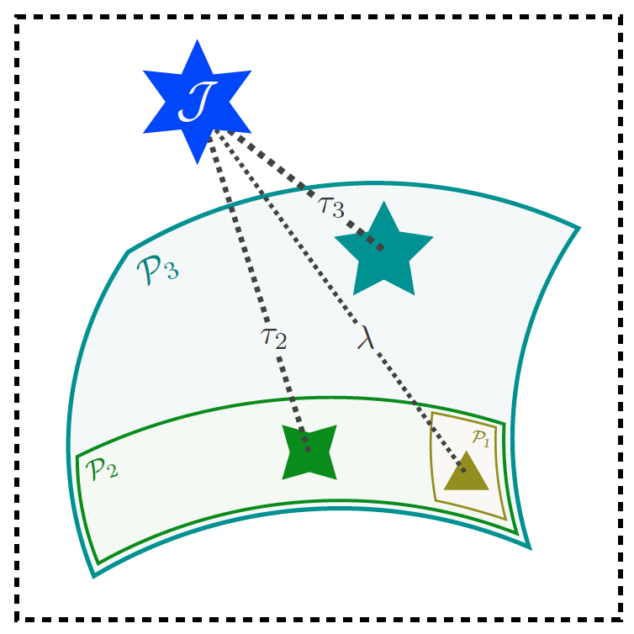
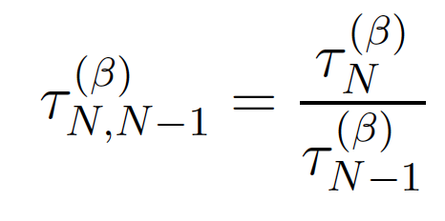
For example, N-subjettiness can be defined using the EMD distance.
Source: Figure 6, 2004.04159.

Slide 35
Two equivalent formulations of W₂ distance
Kantorovich formulation (static):
Benamou-Brenier formulation (dynamic):
⇔ Charge conservation
⍴: charge density; ω: current density
No source/sink
Continuity Equation
Cost Functional
Minimizer

Slide 36
Example: Two dirac masses at position x₀ and x₁.
x₀
⍴_{t}
x_{t}
𝞈_{t}
x₁
Let
A Dirac-to-Dirac geodesic in W₂ consists of a single Dirac traveling along the straight line between them at constant speed.

Slide 37
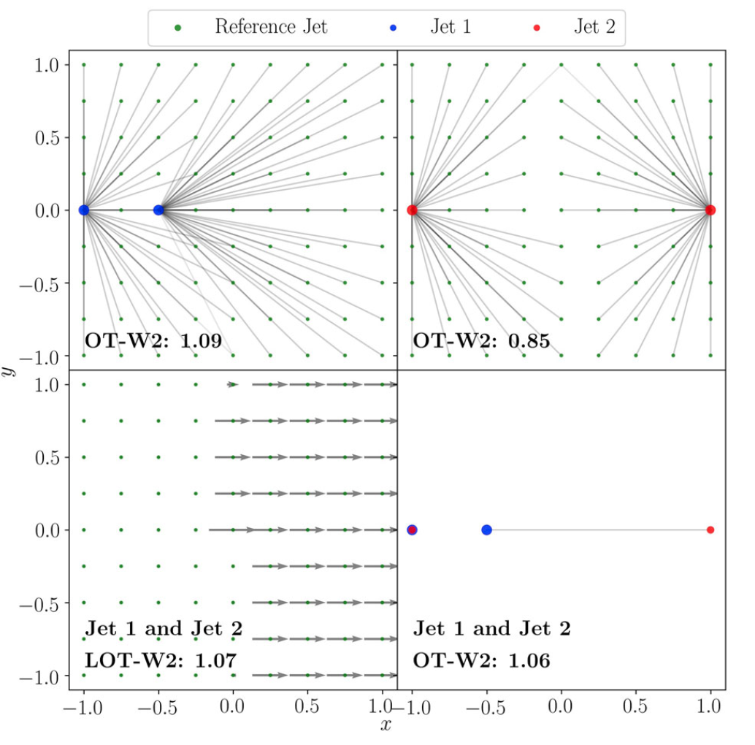
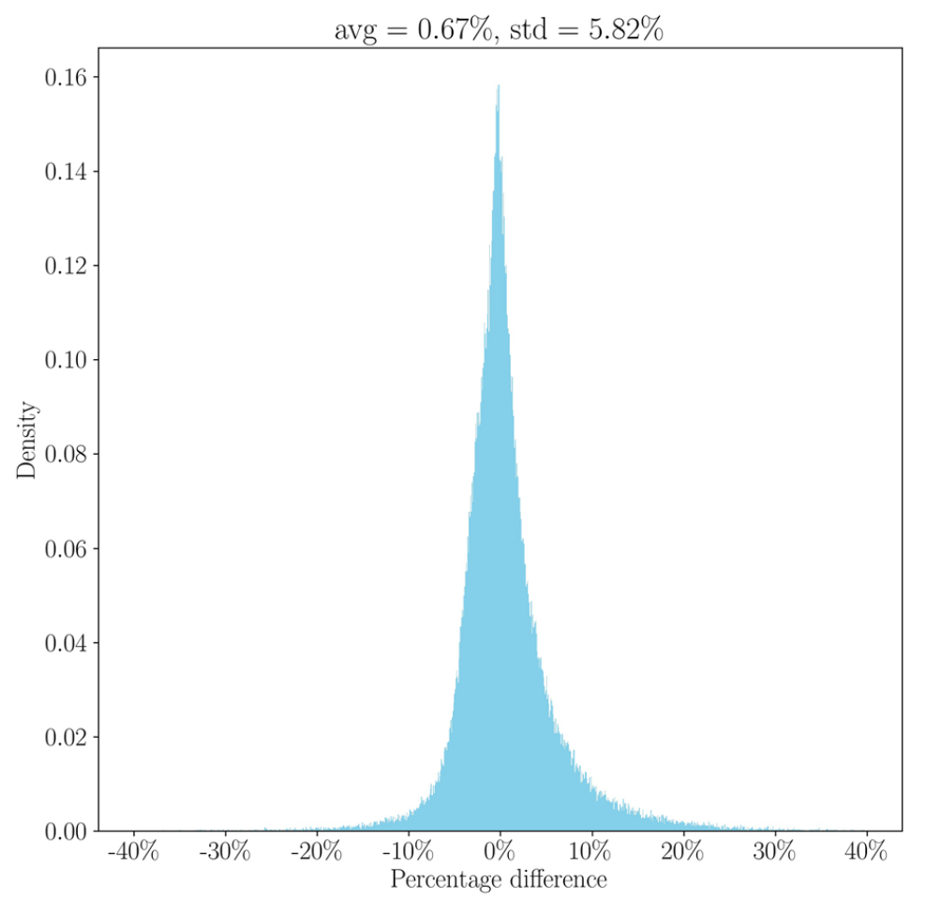
LinW₂ metric: A simple example
Percent diff between linearized and exact W₂ distances for 500 W/QCD jets.
The linear approx. is pretty good! 👻

Slide 38
Unbalanced Twin of W₂: Hellinger-Kantorovich (HK)
38
Kantorovich type formulation (static):
Bonus: HK also enjoys a (weak) Riemannian structure → can linearize!
Benamou-Brenier-type formulation (dynamic):
Continuity Equation with Source
Additional term takes care of mass creation/destruction

Slide 39
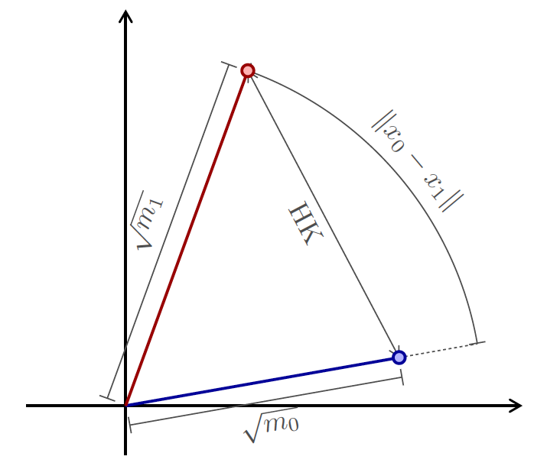
Example: Again two dirac masses at position x₀ and x₁ with mass m₀ and m₁.
m₀ x₀
x_{t}
M(t): Evolution of mass
𝞈_{t}
m₁ x₁
Mass at x₀ is destroyed, mass at x₁ created. No transport!

Slide 40
HK Distance: The Unbalanced Twin of W₂
Hellinger distance (~ Euclidean)
𝛋
∞
0
Can also be linearized!
𝛋 : a tunable parameter to control the relative importance between mass transportation and mass creation/destruction.

Slide 41
Linearizing the HK distances is similar, but more complicated.
Two Distributions have different total mass.
Source Distribution:
Target Distribution:
𝜇₁⟂: Mass of particles that are created from nothing.
Spatial movement of mass particles:
Change of mass of moving particles and of those that disappear entirely at t=1:
The tangent space now consists of a velocity field and a mass growth field.
For detailed descriptions, please refer to our math paper.

Slide 42
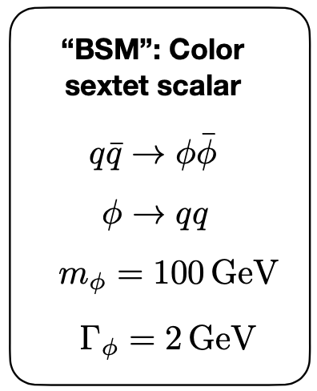
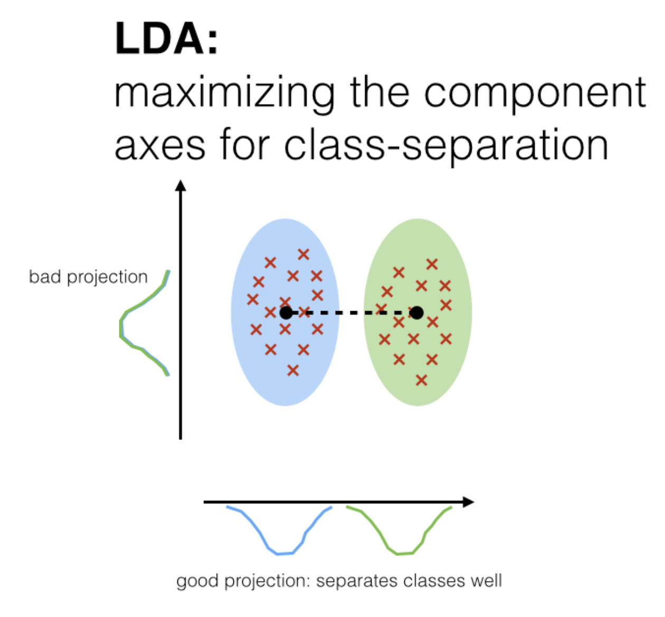
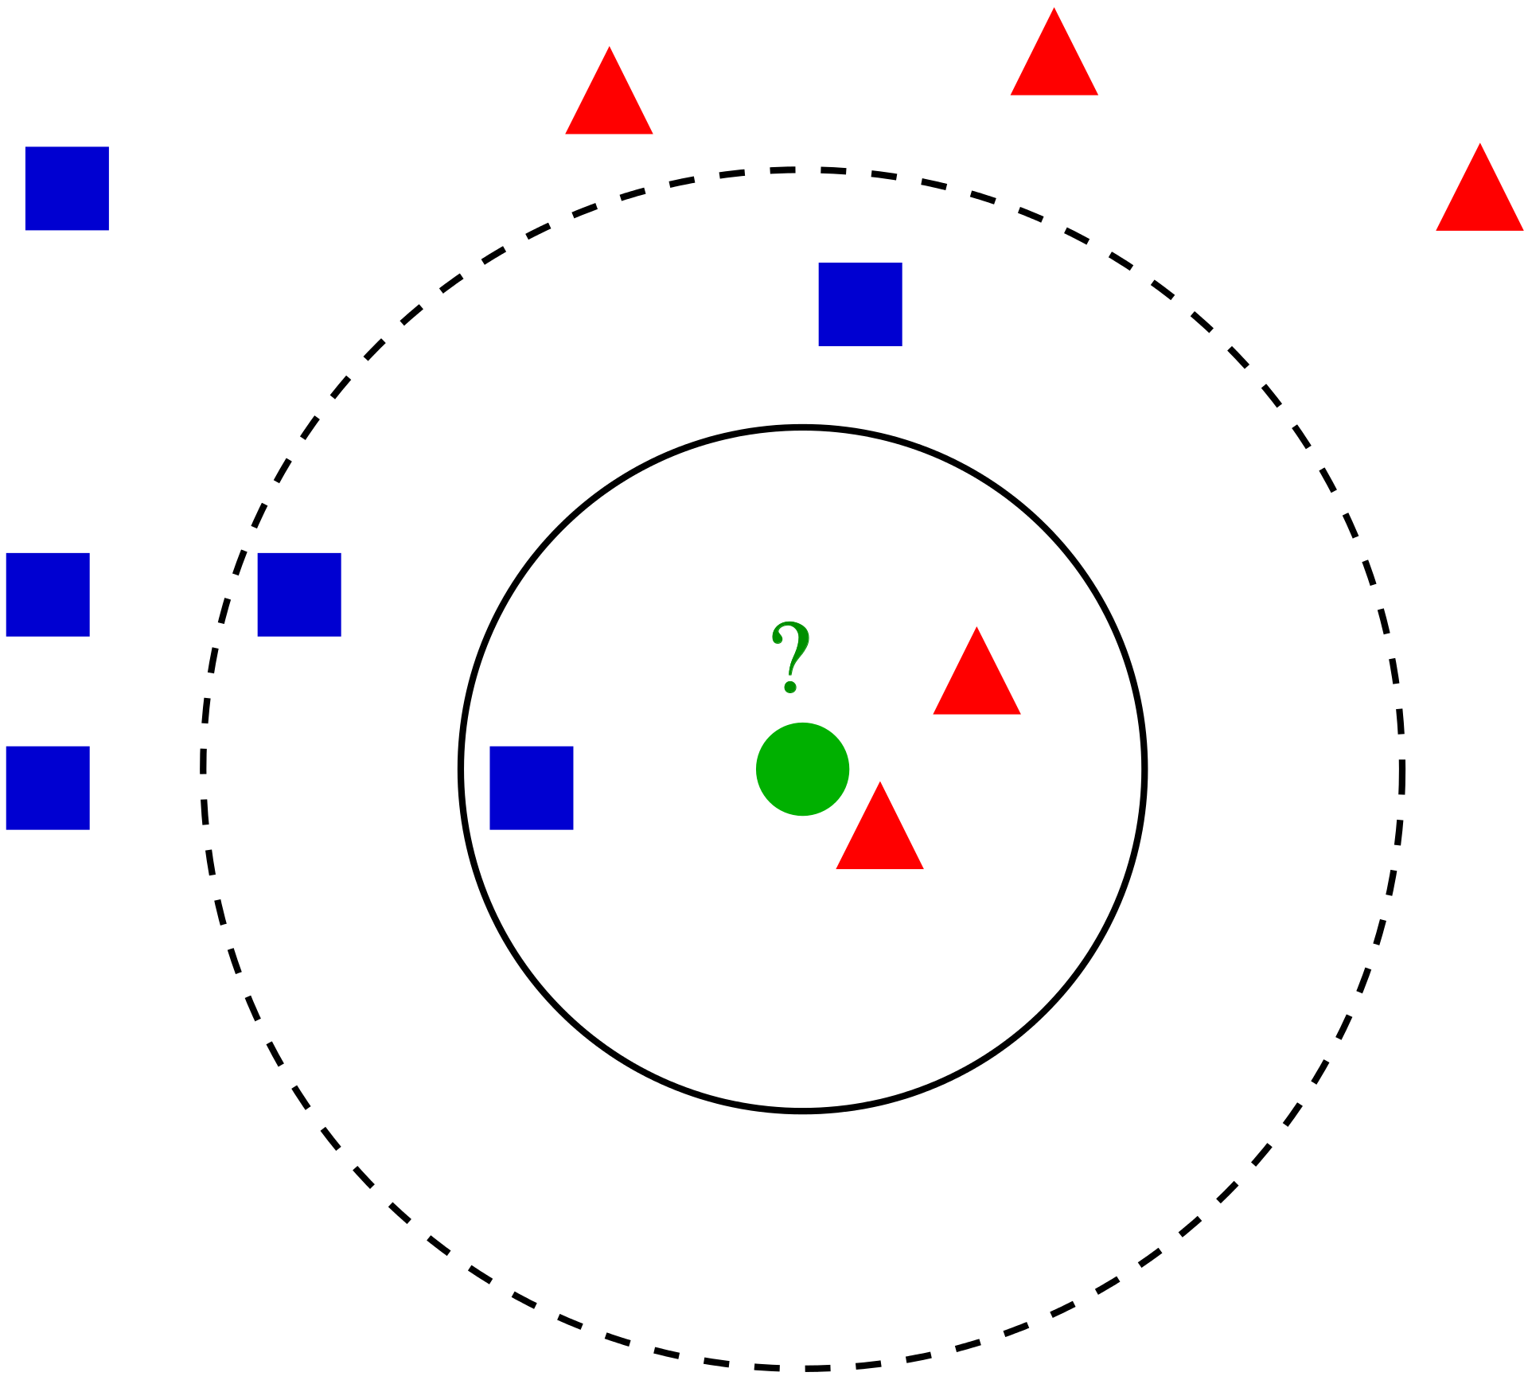
Jet Tagging Procedure using OT
Tagging Tasks:
W v.s. QCD jets (primary)
t v.s. QCD, t v.s. W
Higgs v.s. QCD, Higgs v.s. W
BSM v.s. QCD, BSM v.s. W
→ All datasets balanced.
Data Generation:
MadGraph: matrix elements of pp collisions @ √s = 14 TeV
Pythia: Hadronization, multi-parton interactions on; no detector simulation.
FastJet: anti-kt with R=1.0. At most two jets with p_{T} in 500-550 GeV and |y|<1.7 are kept.
Jet Preprocessing:
Center the jet axis.
Vertically align the principal component of the constituent p_{T} in the y-phi plane.
LOT Computation: Uniform ref jet of 15*15 particles (|y|<1.7, |phi|<π/2) with a total p_{T} of 525 GeV.
ML Models: PCA, LDA, kNN, SVM (anything simple, NN not necessary)…
kNN:
Another jet!

Slide 43
Visualizing an OT manifold with PCA
10k simulated QCD (green) vs. W (red) jets with p_{T} in [500, 550] GeV.
Manifold for the linearized HK distances with 𝛋=1.
Projection onto the first two PCA modes.
Six markers in the PCA projection space with the closest jets (1-6) shown on the y-𝝓 plane.

Slide 44
W vs. QCD tagging with various OT distances: p_{T} range

Slide 45
W vs. QCD tagging with various OT distances: reference jet
The optimal value κ_{best} lies between 0.2 and 0.5, regardless of the inter-particle spacing l. No obvious relationship between l and κ_{best}.

