Slide 1
QCD Vacuum
Ying Chen
Institute of High Energy Physics, CAS

Slide 2
Contents
Strong interaction vacuum prior to QCD——SSB of chiral symmetry
Arguments on non-trivial QCD vacuum
OPE to condensates
Models for QCD vacuum
Savvidy vacuum, instabilities and structure
Dual superconducting model
String model
Bag model
Instanton ensemble
Abelian projection, center vortex picture
QCD vacuum from lattice QCD

Slide 3
SSB of chiral symmetry
Chiral symmetry
$$q=\left(u,d,s\right)→SU_{L}\left(3\right)⊗SU_{R}\left(3\right)⊗U_{V}\left(1\right)⊗U_{A}(1)$$
Why SSB of Chiral symmetry
Noether theorem: $J_{L}^{a, μ}={\overline{q}}_{L}γ^{μ}t^{a}q_{L}, J_{R}^{a,μ}={\overline{q}}_{R}γ^{μ}t^{a}q_{R}$
Vector charges and axial charges: $Q^{a}, Q_{5}^{a}, Q_{5}^{a}→𝒫Q_{5}^{a}𝒫^{−1}=−Q_{5}^{a}$
Taking the scalar meson $|S⟩$ for example
$$𝒫Q_{5}^{a}\left|S\right\rangle =𝒫Q_{5}^{a}𝒫^{−1}𝒫\left|S\right\rangle =−Q_{5}^{a}\left|S\right\rangle ∝|P⟩$$
Chiral symmetry requires $m_{S}=m_{P}$, a scalar meson has his pseudoscalar
mass partner, but this is not supported by experiments. So, chiral symmetry must
be SB. The order parameter of $χ_{SB}$: $\left\langle \overline{ψ}ψ\right\rangle ≠0$

Slide 4
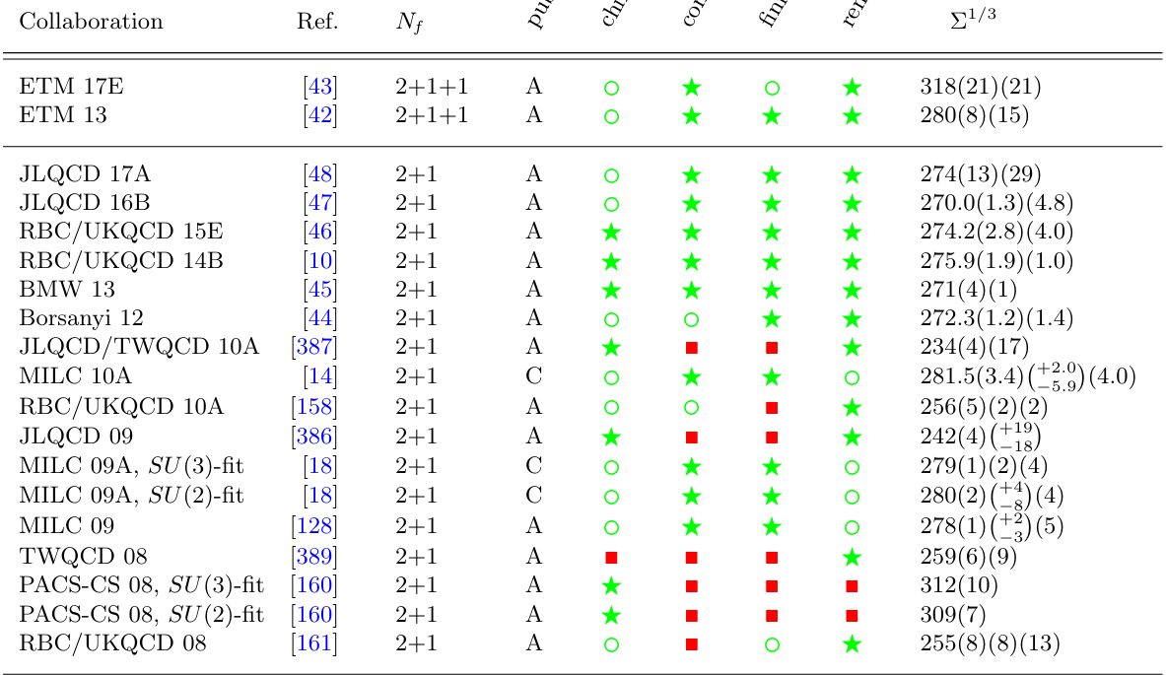
$$m_{π}^{2}f_{π}^{2}=−\frac{1}{2}\left(m_{u}+m_{d}\right)\left\langle Ω\left|\overline{u}u+\overline{d}d\right|Ω\right\rangle$$
GMOR relation:
$$\left\langle Ω\left|\overline{u}u\right|Ω\right\rangle =\left\langle Ω\left|\overline{d}d\right|Ω\right\rangle =\left\langle Ω\left|\overline{s}s\right|Ω\right\rangle =−μ^{3}≈−{\left(250MeV\right)}^{3}$$
FLAG 2019

Slide 5
Gluon condensate
Operator product expansion
$$J_{μ}\left(x\right)J_{ν}\left(x\right)∼C_{μν}^{\left(0\right)}\left(x\right)⋅1+C_{μν}^{\left(3\right)}\overline{q}q\left(0\right)+C_{μν}^{\left(4\right)}\left(x\right) G^{2}(0)$$
QCD sum rules
$$\left\langle Ω\left|TJ_{Γ}\left(x\right)J_{Γ}^{+}\left(0\right)\right|Ω\right\rangle →\left\langle \overline{q}q\right\rangle , \left\langle {g^{2}G}^{2}\right\rangle ,…$$
Especially, $\left\langle {g^{2}G}^{2}\right\rangle ≠0$
Nontrivial QCD vacuum
A full solution of QCD should give a full description of the vacuum, confinement and the hadron spectrum.

Slide 6
Models for QCD vacuum
Savvidy [PLB71(1977)133]: It cannot be the conventional Fock vacuum empty of particles and fields, which is unstable and decays into a state of non-vanishing field. The vacuum can contain non-zero homogeneous field.
Effective action:
$$Γ=\int{d^{4}x[\overline{ℒ}\left[G^{2}\right]+\tilde{ℒ}+…]}, G^{2}→\frac{1}{4}G_{μν}^{a}G^{a,μν}≡\frac{1}{2}\left(B_{YM}^{2}−E_{YM}^{2}\right)$$
The general solution to $D_{μ}G^{μν}=0$:
$$A_{μ}=−\frac{1}{2}G_{μν}x^{ν}−\frac{1}{g}V^{−1}∂_{μ}V$$
Choosing $V^{−1}∂_{μ}V=0$ gives (for SU(2))
$$A_{μ}^{a}=−\frac{1}{2}F_{μν}x^{ν}n^{a}, n^{a}n^{a}=1$$
Considering a constant vacuum “magnetic” field $B_{i}∼ε_{ijk}F_{jk}$, the energy density of the
vacuum
$$ε_{vac}=\frac{B^{2}}{2}+\frac{11{\left(gB\right)}^{2}}{48π^{2}}\left[\ln{\frac{gB}{μ^{2}}−\frac{1}{2}}\right]→B_{min}=μ^{2}e^{−\frac{24π^{2}}{11g^{2}}}, ε_{vac}^{min}=−\frac{11{\left(gB\right)}^{2}}{96π^{2}}$$

Slide 7
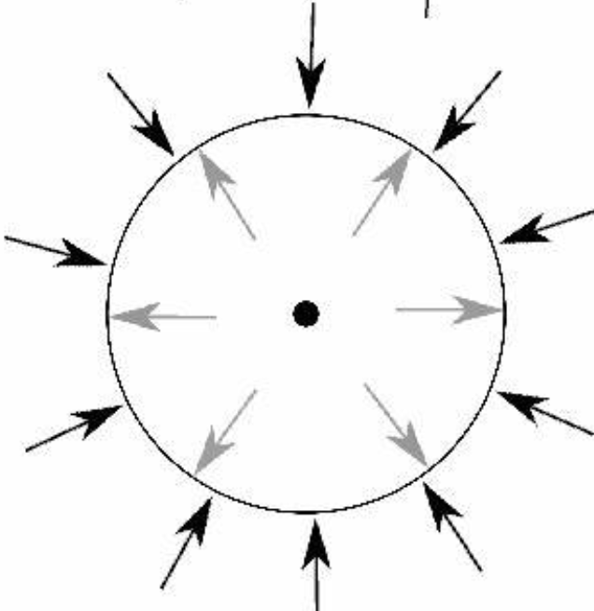
which means there is a mode making the vacuum energy density to be negative (a similar result
can be derived from the QCD trace anomaly $T_{μ}^{μ}=\frac{β\left(g\right)}{2g^{3}}G^{2}$ )
$$\left\langle Ω\left|T_{μν}\right|Ω\right\rangle ≡ε_{vac}g_{μν}→ε_{vac}≈−\frac{b}{128π^{2}}\left\langle {\left(gG\right)}^{2}\right\rangle$$
Nielsen, Olesen [NPB144(1978)376]: A homogeneous vacuum gluon field can be instable with
$$Im ε_{vac}=−\frac{1}{8π}g^{2}B^{2}$$
It is possible that the scalar condensates are an effective long-range description of the vacuum.
The vacuum may have structure at short distance below the QCD scale.
The instability problem may be solved [P. Olesen 1981 Physica. Scripta. 23 (1981) 1000]
MIT bag model:
Quarks are forced inside a given spatial region (a bag) by a fixed
external pressure.
Outside the bag is the real QCD vacuum
The bag pressure comes from the difference of the energy density
between the QCD vacuum and the perturbative vacuum.

Slide 8
The dual superconducting model
Type-II superconductor: E-charges condense into Cooper pairs, such that magnetic flux is squeezed into tubes.
QCD vacuum as the dual: CM monopoles condense into dual Cooper pairs, causing CE flux to be squeezed into tubes.
‘t Hooft and Mandelstam: Abelian projection of NA gauge theory contains magnetic monopoles.
Abrikosov-Nielsen-Olesen vortices may vibrate wildly or be knotted.

Slide 9
SU(2) Gauge link:
Maximal Abelian gauge fixing: one maximizes the functional
$$F\left[U\right]=\sum_{x}{\sum_{μ=1}^{4}{Tr }\left[σ_{3}U_{μ}\left(x\right)σ_{3}U_{μ}^{+}\left(x\right)\right]}$$
$$A→\left(\begin{matrix}e^{iθ} & 0 \\ 0 & e^{−iθ}\end{matrix}\right)$$
Center projection: one maximizes the functional
$$F\left[θ\right]=\sum_{x}{\sum_{μ}{\cos^{2}{θ_{μ}(x)}}}$$
$$A→\operatorname{sgn}{(\cos{θ})}∈Z_{2}$$

Slide 10
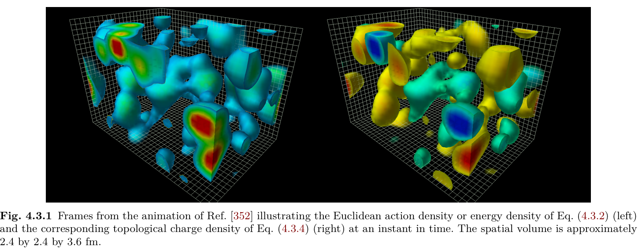
QCD vacuum from lattice QCD
1. Topological charge and instantons
Gauge action in Euclidean space
https://youtu.be/WZgZI5vymiM
$$S_{E}=\int{d^{4}x}\frac{1}{2g^{2}}tr F_{μν}F_{μν}$$
$$Q=\int{d^{4}x}\frac{1}{16π^{2}}{tr F}_{μν}{\tilde{F}}_{μν}=n$$
$${\left(F_{μν}±{\tilde{F}}_{μν}\right)}^{2}=2(F_{μν}F_{μν}±F_{μν}{\tilde{F}}_{μν})$$
$$S_{E}=\frac{1}{2g^{2}} tr\int{d^{4}x} F_{μν}F_{μν}≥\frac{1}{2g^{2}}\left|tr\int{d^{4}x} F_{μν}{\tilde{F}}_{μν}\right|=\frac{8π^{2}n}{g^{2}}$$
Minimum condition：
$$tr\int{d^{4}x}{\left(F_{μν}±{\tilde{F}}_{μν}\right)}^{2}≥0$$
$$F_{μν}=±{\tilde{F}}_{μν}$$
SU(2) instanton solution: $S^{3}→S^{3}$
$$A_{0}\left(x\right)=\frac{−\vec{x}⋅\vec{σ}}{x^{2}+ρ^{2}}, \vec{A}=−\frac{x_{0}\vec{σ}+\vec{σ}×\vec{x}}{x^{2}+ρ^{2}}$$

Slide 11
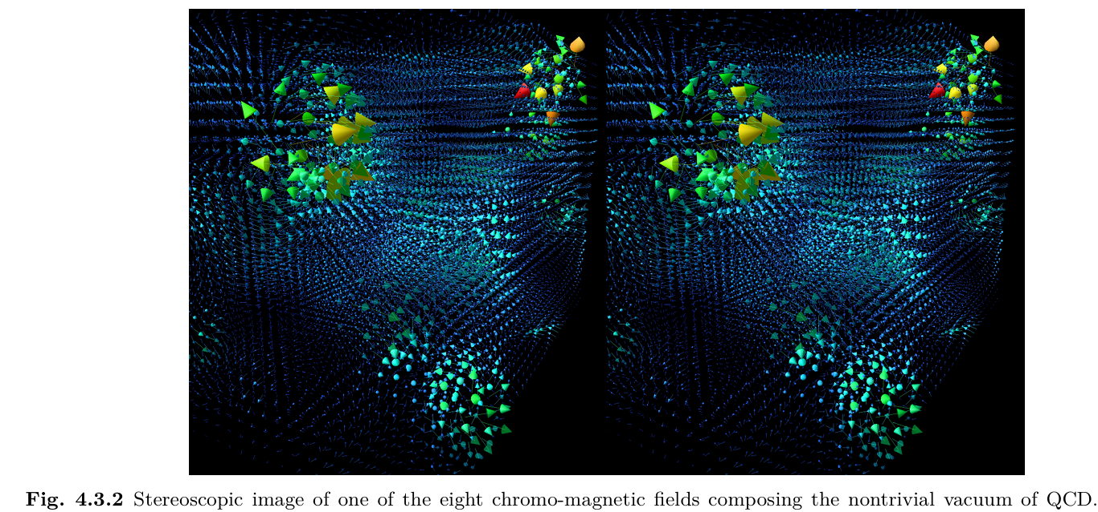

Slide 12
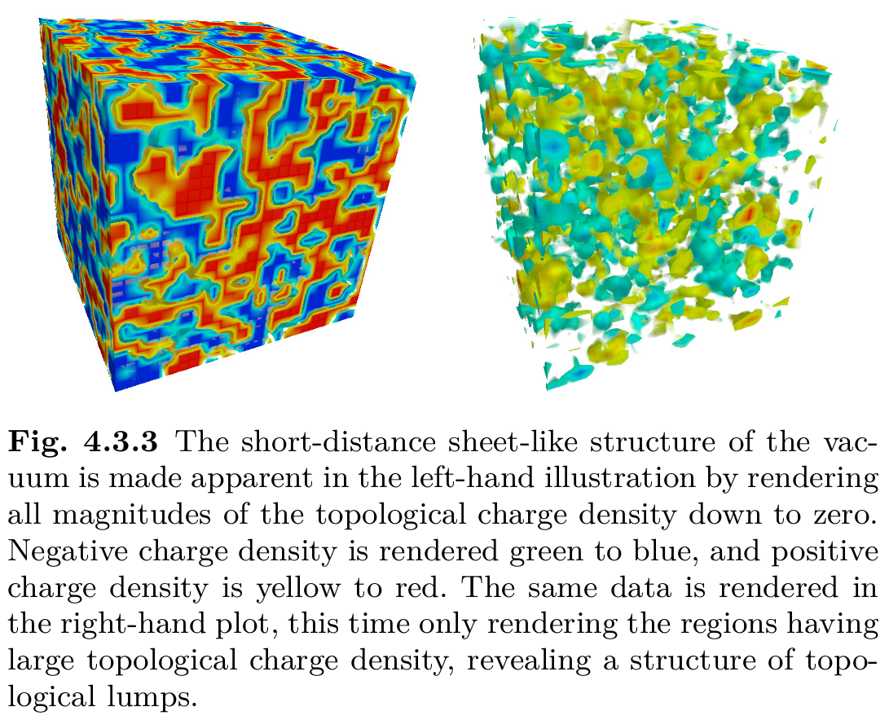
Do instantons account for the vacuum structure?
Atiyah-Singer theorem
$$Q=n_{+}−n_{−}$$
$$\int{d^{4}xq\left(x\right)=}Tr γ_{5}=\sum_{λ}{\int{d^{4}x}ψ_{λ}^{+}γ_{5}ψ_{λ}}$$
$$\left\{γ_{5}, D\left(m=0\right)\right\}=0$$
$$D\left(0\right)γ_{5}ψ_{λ}=−λγ_{5}ψ_{λ}$$
$$\sum_{λ}{\int{d^{4}x}ψ_{λ}^{+}γ_{5}ψ_{λ}}=\sum_{λ=0}{\int{d^{4}x}\left(ψ_{L}^{+}γ_{5}ψ_{L}+ψ_{R}^{+}γ_{5}ψ_{R}\right)}$$
For chiral fermions on the lattice,
$$q\left(x\right)=−tr \left[γ_{5}\left(1−\frac{a}{2}D\left(0;x,x\right)\right)\right]$$
Low-dimensional long range correlation (two connected sheets) vs. topological lumps

Slide 13
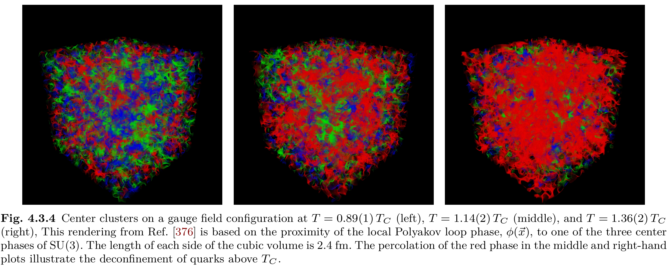
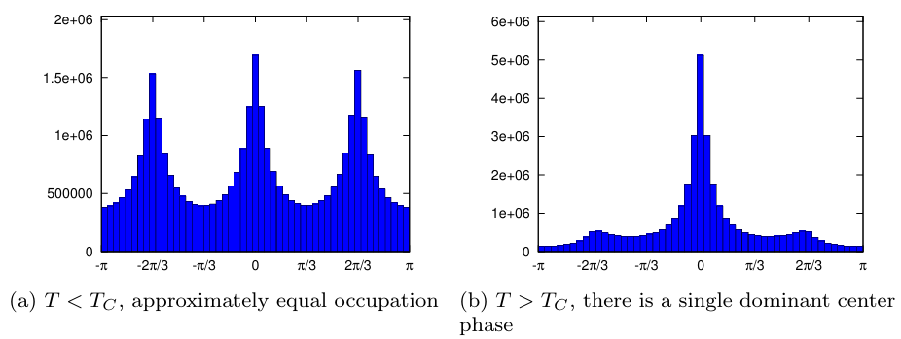
2. Center clusters
SU(3) has a center
$$Z_{3}=\left(1, ω,ω^{2}\right)=\left\{e^{i\frac{λ2π}{3}}, λ=0,1,2\right\}$$
Polyakov loops
$$L\left(\vec{x}\right)=Tr\prod_{t=1}^{N_{t}}{U_{4}\left(t,\vec{x}\right)}=ρ\left(\vec{x}\right)e^{iφ\left(\vec{x}\right)}$$
$$\left\langle L\left(\vec{x}\right)\right\rangle =\left\langle L\right\rangle ∝\exp\left(−\frac{F_{q}}{T}\right)$$
Nontrivial transformation
$$L\left(\vec{x}\right)→zL\left(\vec{x}\right), z∈Z_{3}$$
$⟨L⟩$ as an order parameter for confinement-deconfinement phase transition
$T<T_{c}$ (confinement): $\left\langle L\right\rangle =0→F_{q}=∞$
$T>T_{c}$ (deconfinement): $\left\langle L\right\rangle ≠0$

Slide 14
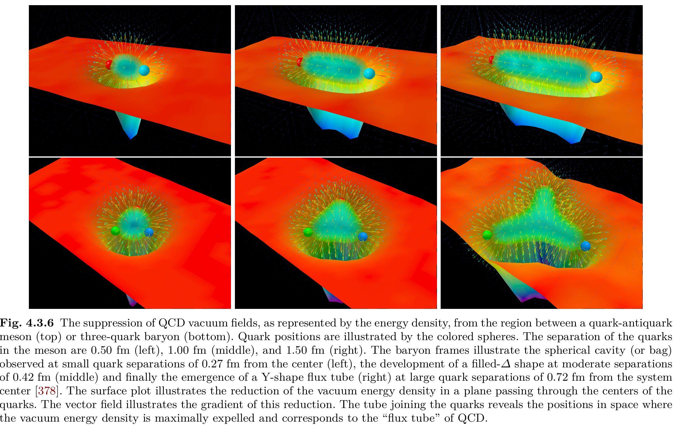
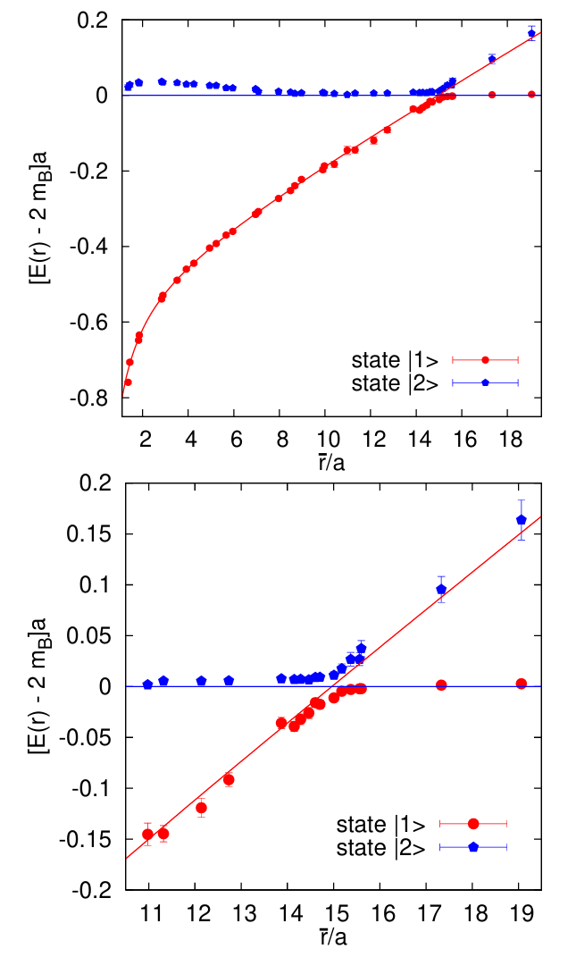
3. Flux tubes and static potential
$Q\overline{Q}$ flux tubes at different separation: $V_{Q\overline{Q}}\left(r\right)∼σ_{Q\overline{Q}}r$
Baryonic flux tubes: $Δ$-type $V_{3Q}∼σ_{3Q}\left(l_{1}+l_{2}+l_{3}\right)$
$Y$-type $V_{3Q}∼σ_{Q\overline{Q}}\min\left(r_{1}+r_{2}+r_{3}\right)$
$Q\overline{Q}$ potential: $V_{Q\overline{Q}}\left(r\right)=V_{0}−\frac{α_{s}}{r}+σr$
String breaking in the presence of light dynamical quarks

Slide 15
4. $η′$ puzzle——instantons vs. large $N_{c}$
$U_{A}(1)$ anomaly (chiral limit): $∂^{μ}j_{μ}^{5}\left(x\right)=\frac{N_{f}g^{2}}{32π^{2}}ε^{αβρσ}G_{αβ}^{a}G_{ρσ}^{a}={2N}_{f}q\left(x\right)=2N_{f}∂_{μ}K^{μ}→∂^{μ}{\tilde{j}}_{μ}^{5}\left(x\right)=0$
Current algebra expected (PRD 12 (1975) 3583) $m_{η^{′}}≤\sqrt{3}m_{π}$
$θ$-vacuum: $ℒ_{QCD}→ℒ_{QCD}+θ\frac{1}{16π^{2}}tr G\tilde{G}$
Witten-Veneziano (NPB 149 (1979) 285, NPB 156 (1979) 269, NPB 159 (1979) 213 ):
$$m_{η^{′}}^{2}→m_{0}^{2}=\frac{4N_{f}}{f_{π}^{2}}χ_{YM}, χ_{YM}=\int{d^{4}x} {\left\langle q\left(x\right)q\left(0\right)\right\rangle }_{YM}$$
In the physical case,
$$χ_{YM}=\frac{f_{π}^{2}}{4N_{f}}\left(m_{η}^{2}+m_{η^{′}}^{2}−2m_{K}^{2}\right)≈{\left(180 MeV\right)}^{4}$$
Witten’s argument:
The largest tunneling amplitude $∼e^{−\frac{8π}{g^{2}}}$ owing to instantons
With the large $N_{c}$ expansion (for a fixed $g^{2}N_{c}$), the amplitude scales as $e^{−cN_{c}}$, which is less important
than any finite power of $1/N_{c}$.
$χ_{YM}∼O(1)$ in the large $N_{c}$ expansion
In the presence of massless quarks, $χ$ is exactly zero
So the cancellation of $χ$ demands $η′$ has a mass of $m_{η^{′}}^{2}∝O\left(\frac{1}{N_{c}}\right)$

Slide 16
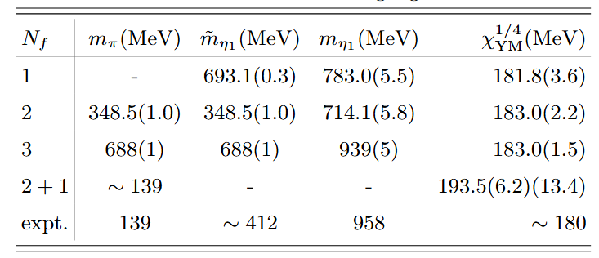
Lattice QCD calculations gives $χ_{YM}={\left(193.5\left(6.2\right)\left(13.4\right) MeV\right)}^{4}$.
For different $N_{f}$, the flavor singlet pseudoscalar mass satisfies
$$m_{η_{1}}^{2}={\tilde{m}}_{η_{1}}^{2}+\frac{4N_{f}}{f_{π}^{2}}χ_{YM}$$
It seems Witten-Veneziano formalism based on large $N_{c}$ expansion valid
Then there may be problems with the concept of instantons.

Slide 17
Summary
QCD vacuum is very complicated.
No definite solutions till now!
Thank you for your attention!

Slide 19
Resolution to the $η′$ mass puzzle
E. Witten, Nucl. Phys. B 156 (1979) 269-283

Slide 20
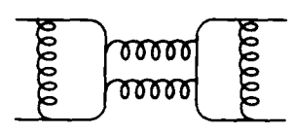
Despite being superficially a total divergence, the anomaly term has non-zero matrix elements at zero momentum. This leads to a physical non-conservation of the U(1) charge.
Isgur and De Rujula, Georgi and Glashow suggested the quark annihilation results in a non-zero mass of the flavor singlet pseudoscalar $η′$. But in PT, this kind of diagrams, do not reflect the anomaly and therefore cannot avoid a massless U(1) Goldstone.
One can resort to instantons for this problem to be resolved: a NP contribution of instanton does reflect anomaly.
However, as shown in previous pages, : PT can resolve the U(1) problem.
Large $N_{c}$ expansion works. It is for large $N_{c}$ that the anomaly turns off, and
it is in the sense of the $1/N_{c}$ expansion that one can say that the anomaly gives a
mass to a U(1) particle that would have been massless. And it is in the large $N_{c}$ limit that $η′$ and $π$ are
degenerate. The degeneracy is lifted by quark-antiquark annihilation diagrams that are suppressed by one
power of $1/N_{c}$.
$θ$ dependence of the physics can be present in the $1/N_{c}$ expansion. This can arise through an interchange of limits.
Actually, for any $N_{c}$, there is no $θ$ dependence if the Lagrangian contains massless fermions.

Slide 21
Actually, for any $N_{c}$, there is no $θ$ dependence if the Lagrangian contains massless fermions.
Assumption: the physics depends on $θ$ to leading order in $1/N_{c}$ in the absence of massless fermions.
A seemingly paradox: How does the massless fermion contribution of non-leading order cancels the leading order $θ$ dependence.
Consider the second derivative of the vacuum energy with respect to $θ$ at $θ=0$:
$$S_{YM}=\int{d^{4}x} \left(−\frac{1}{4}F^{2}+θ\frac{g^{2}}{32π^{2}N}F\tilde{F}\right) \left(g→\frac{g}{\sqrt{N}}\right)$$
$${\left(\frac{d^{2}E}{dθ^{2}}\right)}_{θ=0}=\frac{1}{N^{2}}{\left(\frac{g^{2}}{32π^{2}}\right)}^{2}\int{d^{4}x} \left\langle TF\tilde{F}\left(x\right)F\tilde{F}\left(0\right)\right\rangle +Schwinger terms$$
By introducing
$$U\left(k\right)=\int{d^{4}x} e^{ik⋅x}\left\langle TF\tilde{F}\left(x\right)F\tilde{F}\left(0\right)\right\rangle$$
and a proper infrared cutoff, one has
$$\frac{d^{2}E}{dθ^{2}}=\frac{1}{N^{2}}{\left(\frac{g^{2}}{32π^{2}}\right)}^{2}\lim_{k→0} U(k)$$
Since $F\tilde{F}=∂_{μ}K^{μ},$ it is easy to see that $U\left(k=0\right)=0$ in PT.
$$𝒪(N^{2})$$

Slide 22
This is also a paradox since we expect $U\left(k=0\right)$ controls the $θ$ dependence.
Solution: To the leading order in $1/N$, $U\left(k\right)≠0$ after summing over planar diagrams first,
$$U\left(k\right)=ak^{2}+bg^{2}\ln{k^{2}}+cg^{4}k^{2}{\left(\ln{k^{2}}\right)}^{2}+…,$$
with higher terms approaching 0 more slowly due to the higher order of $\ln{k^{2}}$.
Let us assume that $U\left(k\right)$ is non-vanishing at $k=0$ in the quenched approximation, in which $θ$ dependence is expected. When massless quarks are included, $U\left(k\right)$ must vanish at $k=0.$
In the large $N$ expansion,
$$U\left(k\right)=U_{0}\left(k\right)+U_{1}\left(k\right)+U_{2}\left(k\right)+…$$
with each successive term is suppressed by an extra $1/N$ (A quark loop is suppressed by a factor of $1/N$ and
the subscript here labels the number of quark loops).
How comes $U\left(k=0\right)=0$ then, since $U_{0}(k)$ is non-zero and $U_{i}(k)$ are subleading terms?
$U(k)$ is the two point function of gauge-invariant operators, and are given, to the lowest order in $1/N$，by
sums over one-hadron poles, namely, one-hadron intermediate states,
$$U\left(k\right)=\sum_{g}{\frac{N^{2}a_{g}^{2}}{k^{2}−m_{g}^{2}}}+\sum_{η}{\frac{Nc_{η}^{2}}{k^{2}−m_{η}^{2}}}$$
where $Na_{g}=\left\langle 0\left|F\tilde{F}\right|g\right\rangle , \sqrt{N}c_{η}=⟨0|F\tilde{F}|η⟩$. To the lowest order in $1/N$, the value of $a_{g}$ does not depend on
whether massless quarks are present in the Lagrangian or not. The first term determines the $θ$ dependence
in the world without massless quarks and is denoted by $U_{0}\left(k\right)$. In order for the second term to cancel the
first term at $k=0$，one demands $m_{η}^{2}∝1/N$. Actually, $η′$ is the only one that bring about the concellation.

Slide 23
The glueball sum must be canceled at $k=0$ by the $η′$ term alone. This gives directly,
$$\frac{Nc_{η^{′}}}{m_{η^{′}}^{2}}=U_{0}(0)$$
On the other hand,
$$\sqrt{N}c_{η^{′}}=\left\langle 0\left|F\tilde{F}\right|η^{′}\right\rangle =\frac{32π^{2}}{g^{2}}\frac{N}{2N_{f}}\left\langle 0\left|∂_{μ}j_{5}^{μ}\right|η^{′}\right\rangle =\frac{32π^{2}}{g^{2}}\frac{N}{2N_{f}}\sqrt{N_{f}}f_{η^{′}}m_{η^{′}}^{2}$$
to the lowest order in $1/N$，$f_{η^{′}}=f_{π}$,
$$\frac{N^{2}}{4N_{f}}m_{η^{′}}^{2}f_{π}^{2} {\left(\frac{32π^{2}}{g^{2}}\right)}^{2}=U_{0}\left(0\right)$$
$$m_{η^{′}}^{2}=\frac{4N_{f}}{f_{π}^{2}}χ_{top}≡\frac{4N_{f}}{f_{π}^{2}}\int{d^{4}x} {\left\langle TQ\left(x\right)Q\left(0\right)\right\rangle }_{YM}$$
Why the $𝒪(1/N)$ correction to $m_{η^{′}}^{2}$ is so large? It is still a question.

