Slide 1
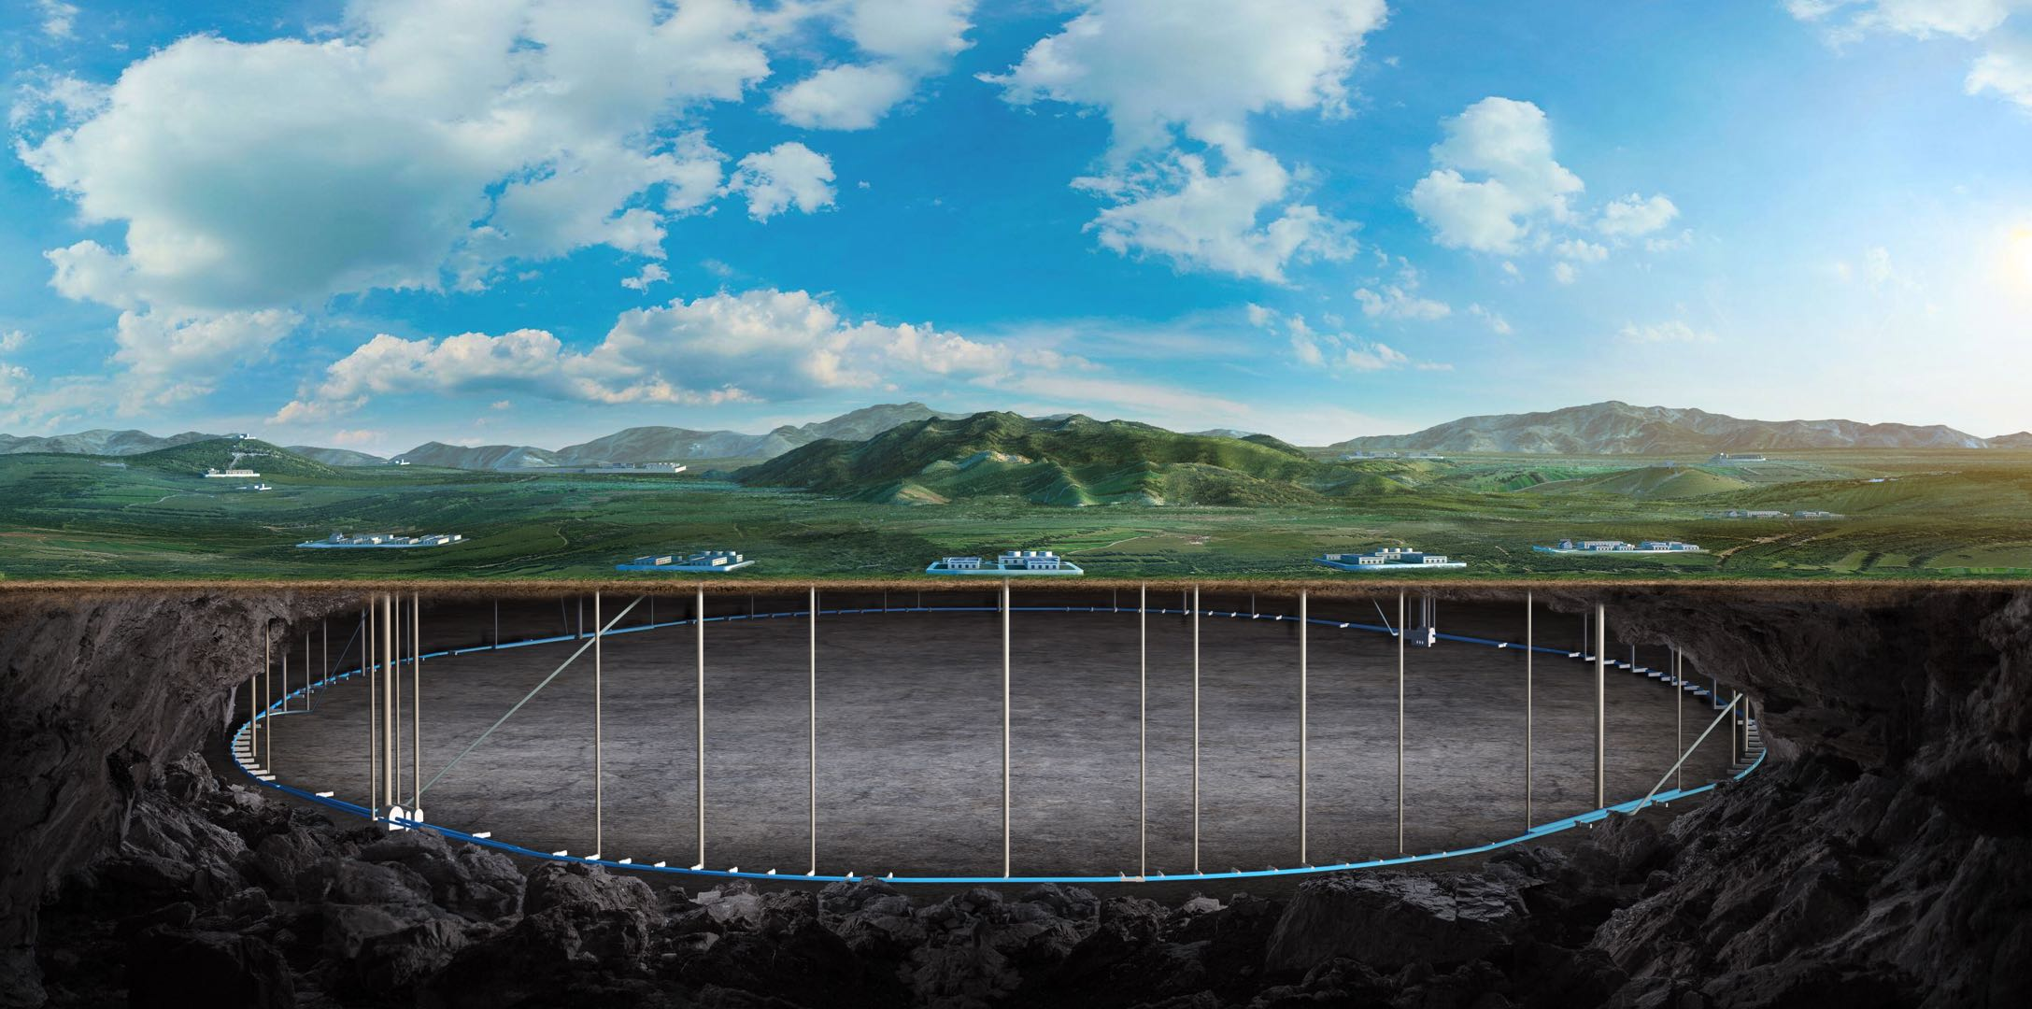
CEPC vertex Detector
Zhijun Liang

Slide 2
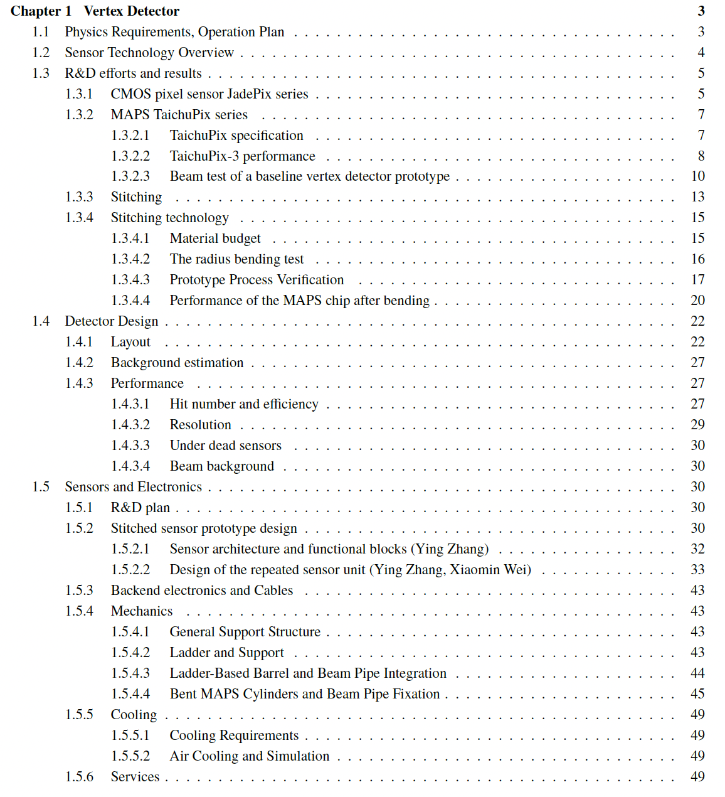
COST review
More than 50 pages ready (85%)
Introduction part (ready)
R & D part
Jadepix/Taichu (1st draft ready)
Stitching (just upload)
Detector design
Physics Layout (1st draft ready)
Stitching design (1st draft ready)
Mechanics (1st draft ready)
https://latex.ihep.ac.cn/project/6745179fef5108a66841008a

Slide 3
Feedback from Yifang
Introduction: missing why we choose 65nm ? Power issue ? --》 ZL
R & D: missing general overview, roadmap, missing ref to ALICE … → ZL
R & D: vertex prototype description was scattered in many sections
Should put them together around 4.3.3
Design : Taichu3 → Taichu or Taichu Serial → Ying,Xiaomin
Add roadmap for future development → Weiwei
Design section, There are too many details → xiaomin
should remove some of the content
Performance should move to after Mechanics

Slide 4
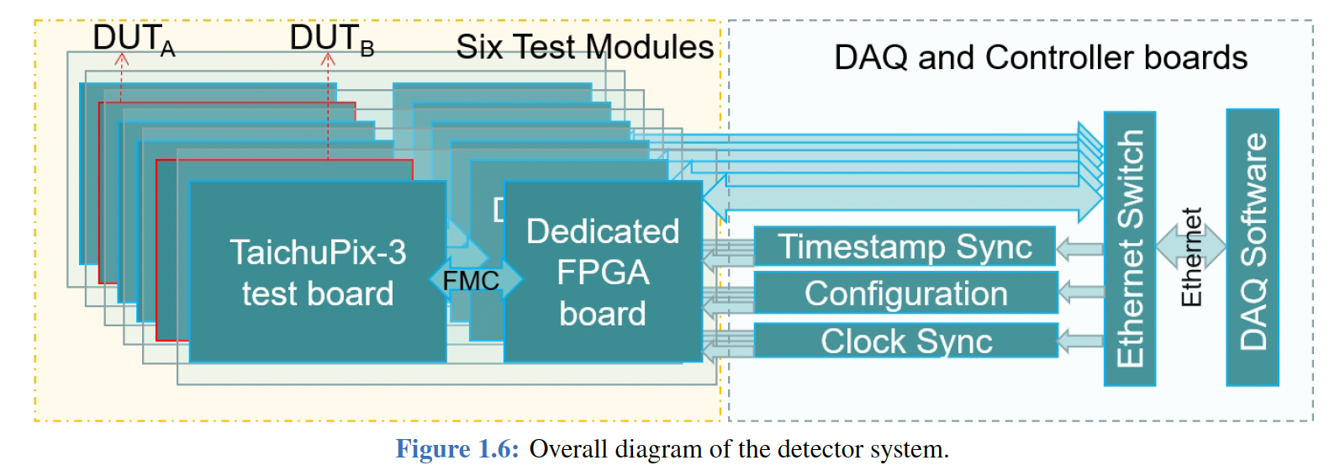
Figure issue
TaichuPix-3 → TaichuPix or other name for future chip

Slide 5
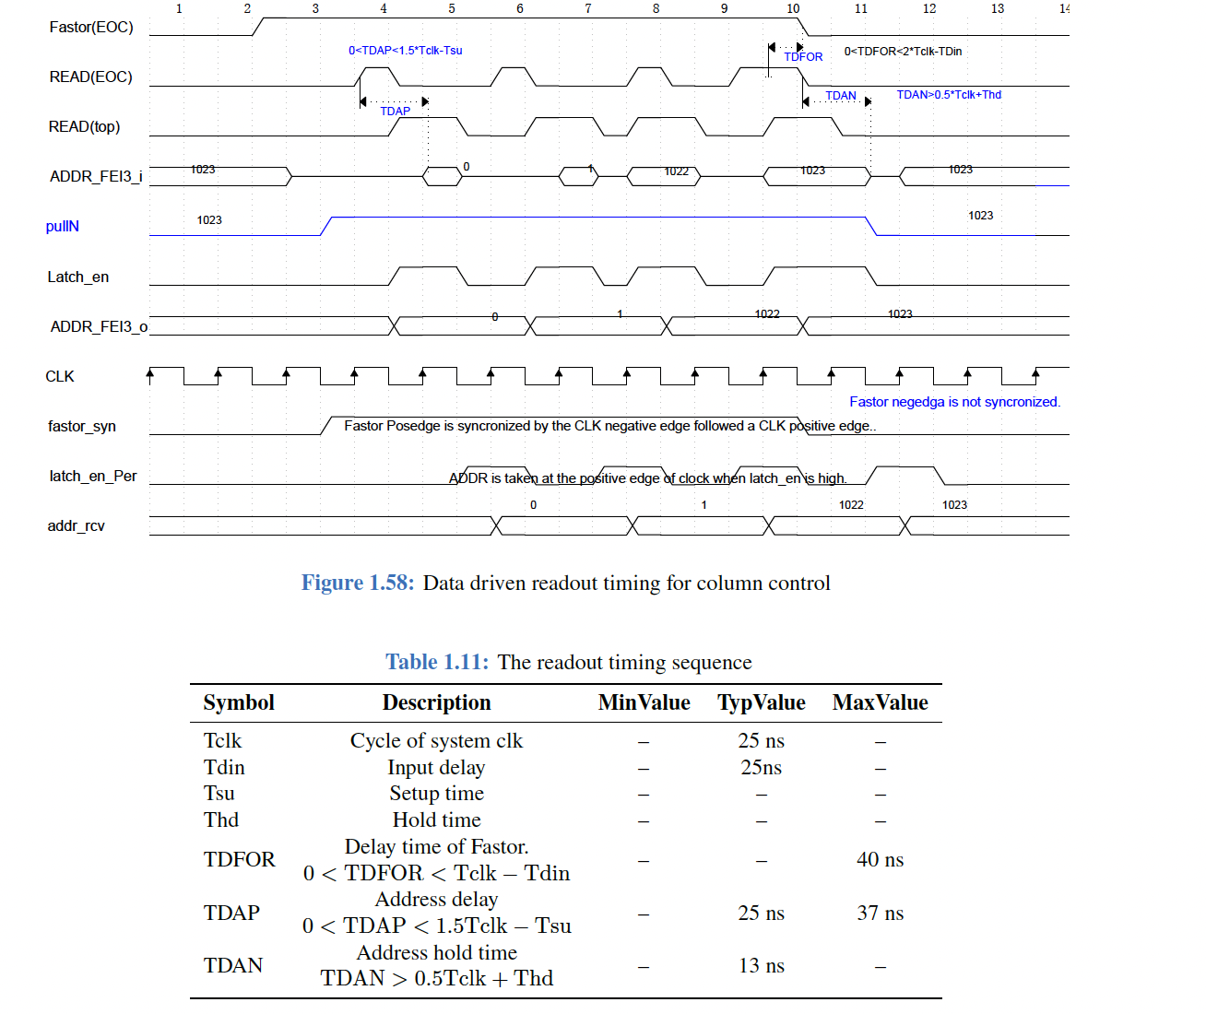
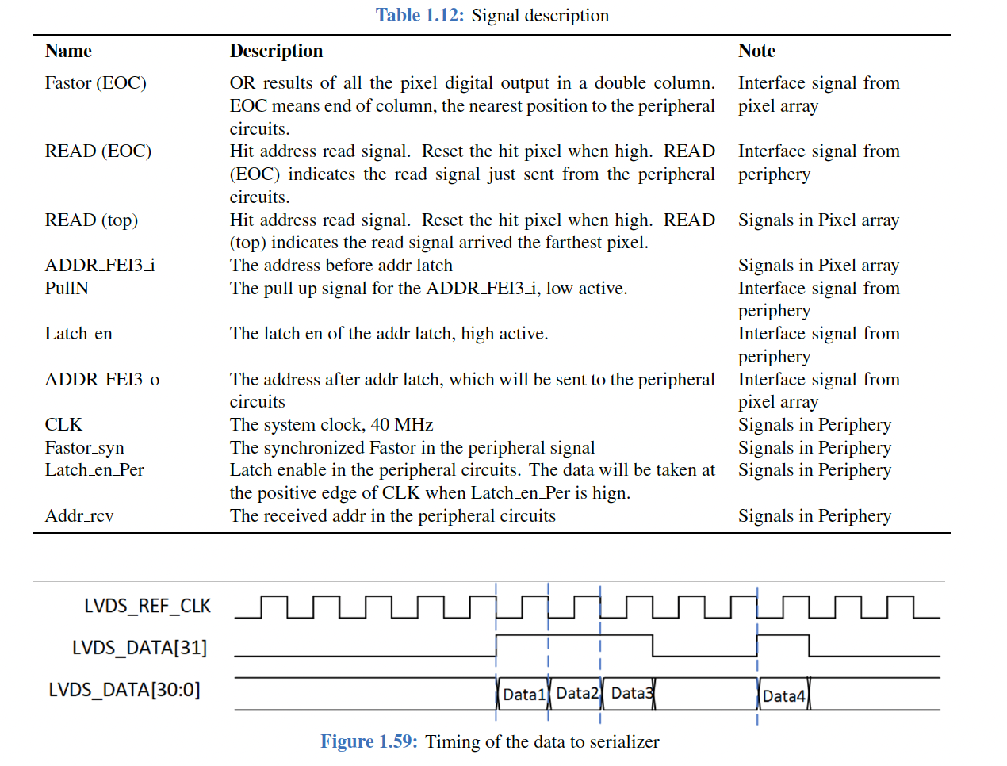
Figure
Too details, Suggest to remove
Appendpix

Slide 6
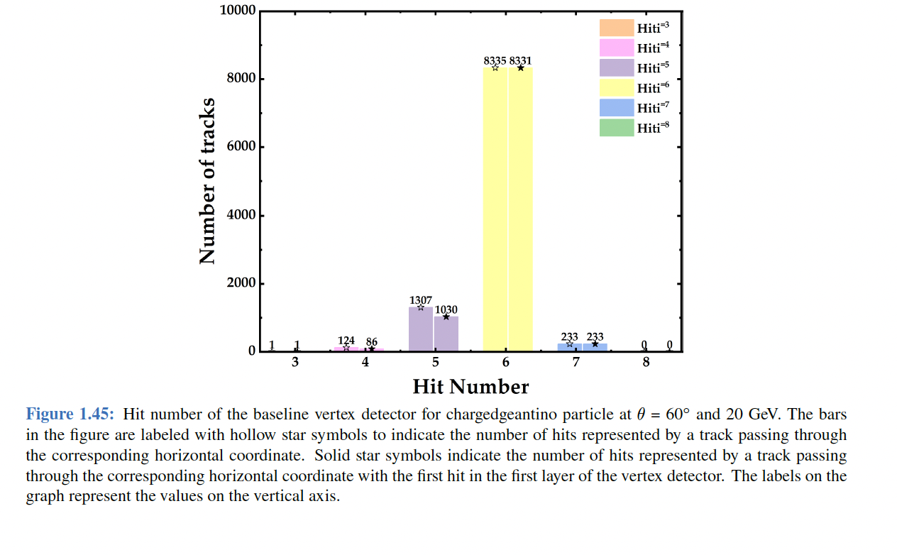
Figure
Absolute number has no meaning, fraction
Hit efficiency, track efficiency, alignment

Slide 7
Cost estimation
ITS3 TDR，
2490 kCHF R&D (2 engineering)
3592 kCHF CI (all items , 2 engineering, most from TJ )
CEPC vertex
Two masks
Two engineerings

