Slide 1

CEPC meeting
H_recoil Status Report
Yuji Li(Fudan university)

Slide 2

Motivation
Independent of Higgs decay mode for Higgs properties measurement.
For ZH events, Z decay to muon pair events are considered, which helps us to understand the performance of muon reconstruction.
The main target for this measurement is performing Higgs mass measurement with H_recoil method, and extracting the uncertainties.

Slide 3

Event Selections
Muon Selection:
Matched with GENMuon(dR<0.1)
pt>20 GeV cos(theta)<0.85 (Barrel only for now)
Best Muon Pair Selection:
The nearest inv. mass to Z pdg mass.
Signal Samples: ZH, H->inclusive
Bkg Samples: ZZ->2l2q, ZZ->2l2v, WW->2l2v, ZZ->4l(4 fermion)
Z->mumu(2 fermion)
Lumi = 20000fb-1

Slide 4
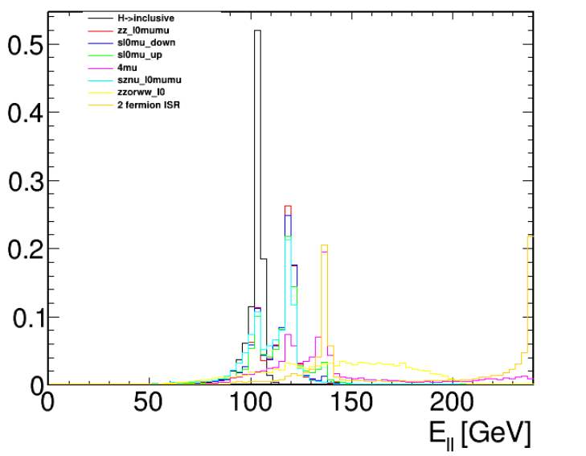
Event Selections: Dilepton kinematics

Slide 5
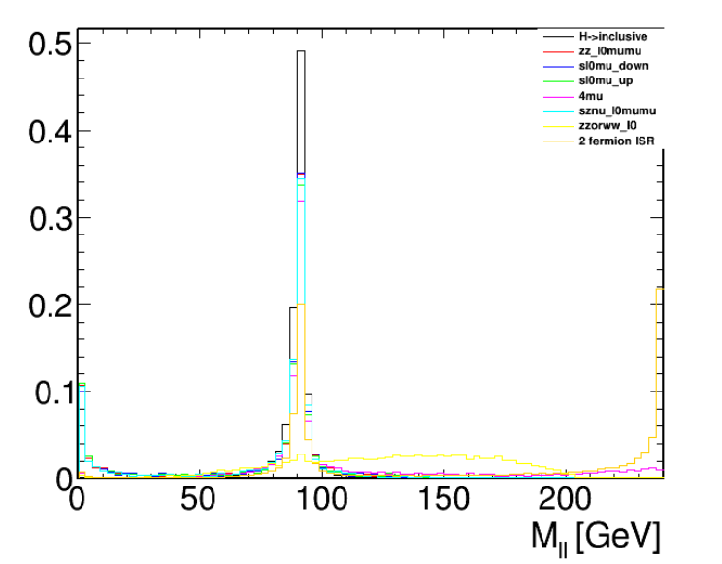
Event Selections: Dilepton kinematics

Slide 6
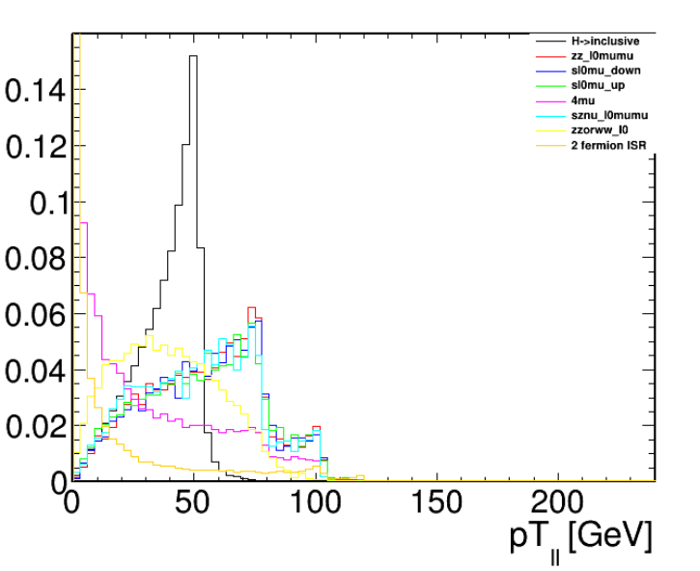
Event Selections: Dilepton kinematics

Slide 7
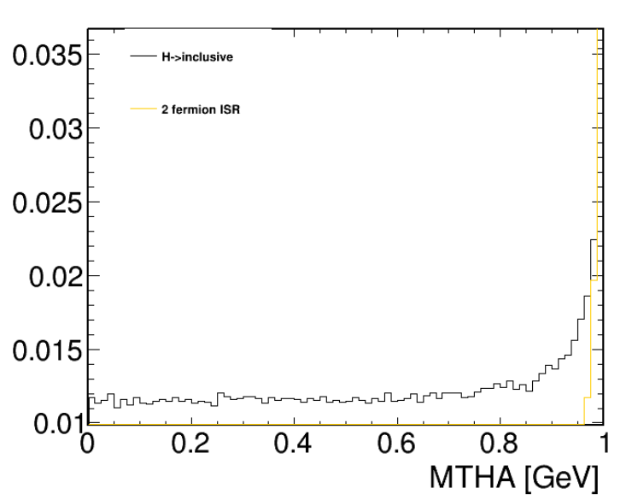
Event Selections: Missing Theta

Slide 8
Event Selections: Summary and cutflow
Cos(Missing_theta) < 0.95
20<P_ll < 60
50<M_ll < 120
E_ll< 110
Process | zz_l0mumu | 4mu | sznu_l0mumu | sl0mu_down | sl0mu_up | zzorww_ll | 2fermion | H->incl.
xs | 19.38 | 15.56 | 43.32 | 136.14 | 87.39 | 221.1 | 5332.71 | 6.77
input | 20000 | 20000 | 19800 | 18400 | 18600 | 20000 | 98000 | 891390
selected | 434 | 421 | 449 | 296 | 302 | 791 | 141 | 492225
eff | 0.0217 | 0.021 | 0.0227 | 0.016 | 0.0162 | 0.0395 | 0.0014 | 0.56

Slide 9
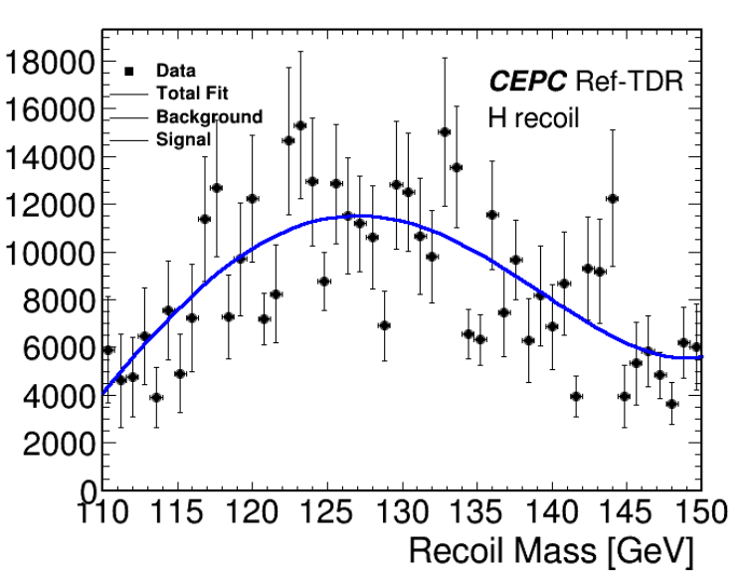
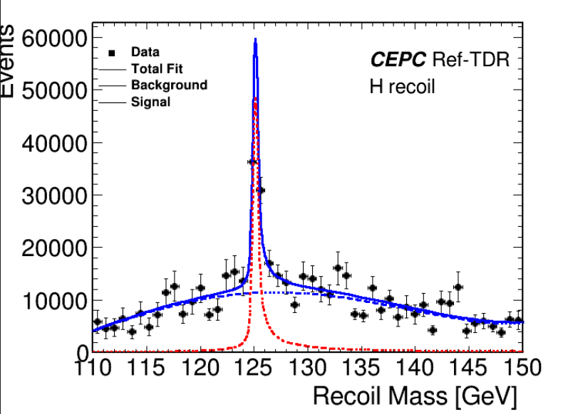
Fitting details
Step1: Get bkg pdfs, fitting with chebychev polynomial
Step2: S+B fitting, get the pdf and mean value from DCB.

Slide 10
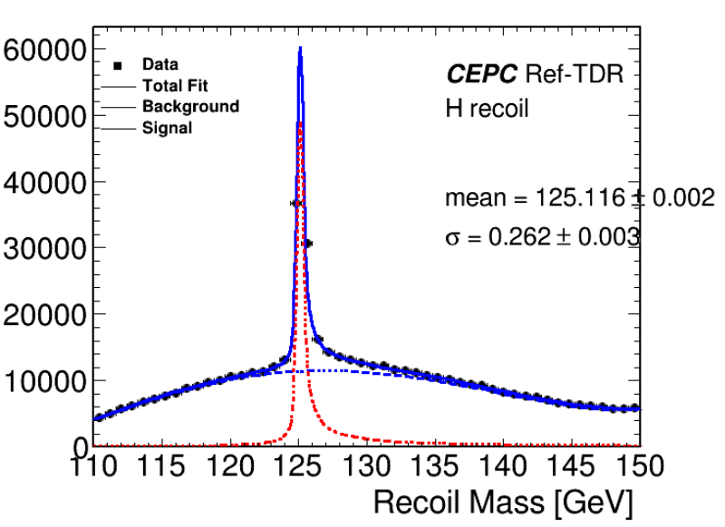
Fitting details
Step3: Get ToyMC with the pdf obtainted from step2. 20000fb-1 events need to be generated for extracting the statistic uncertainties.

Slide 11
Summary and plans
MuonID has been implemented in CEPCSW, for now the BKG samples are under production.
Fitting strategy needs to be updated, as the fitting POI should be parameterized with H_mass.
Sys. uncertainty will be added in several aspects in Higgs Combine.

