Slide 1
Digitization and Reconstruction of Muon Detector in CEPCSW
Weiqi Meng
2025.3.21

Slide 2
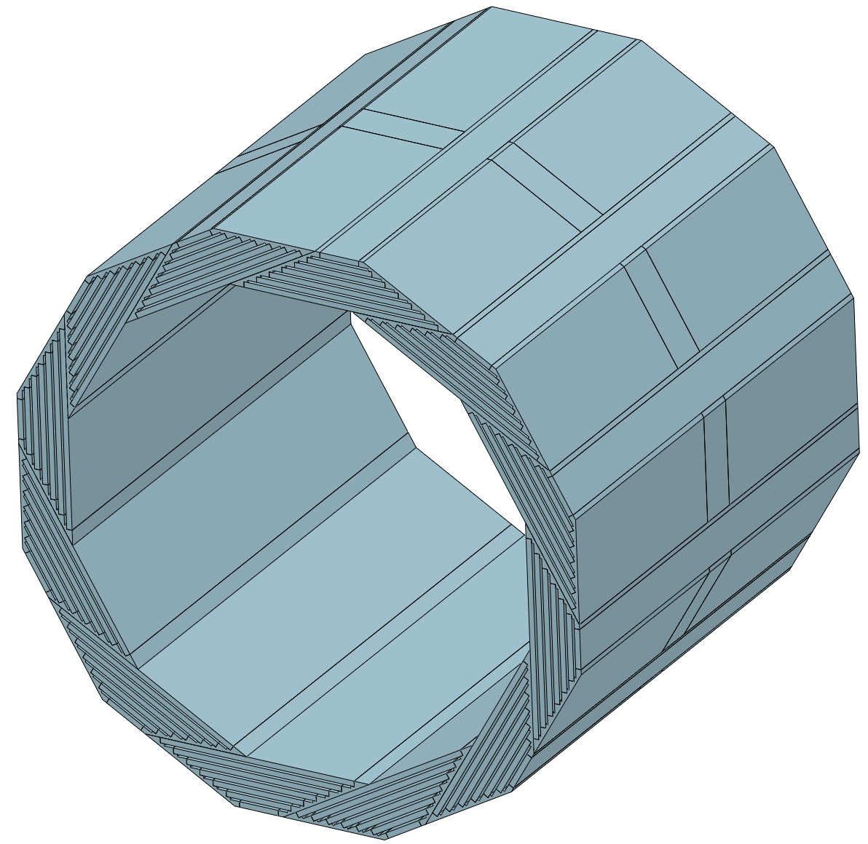
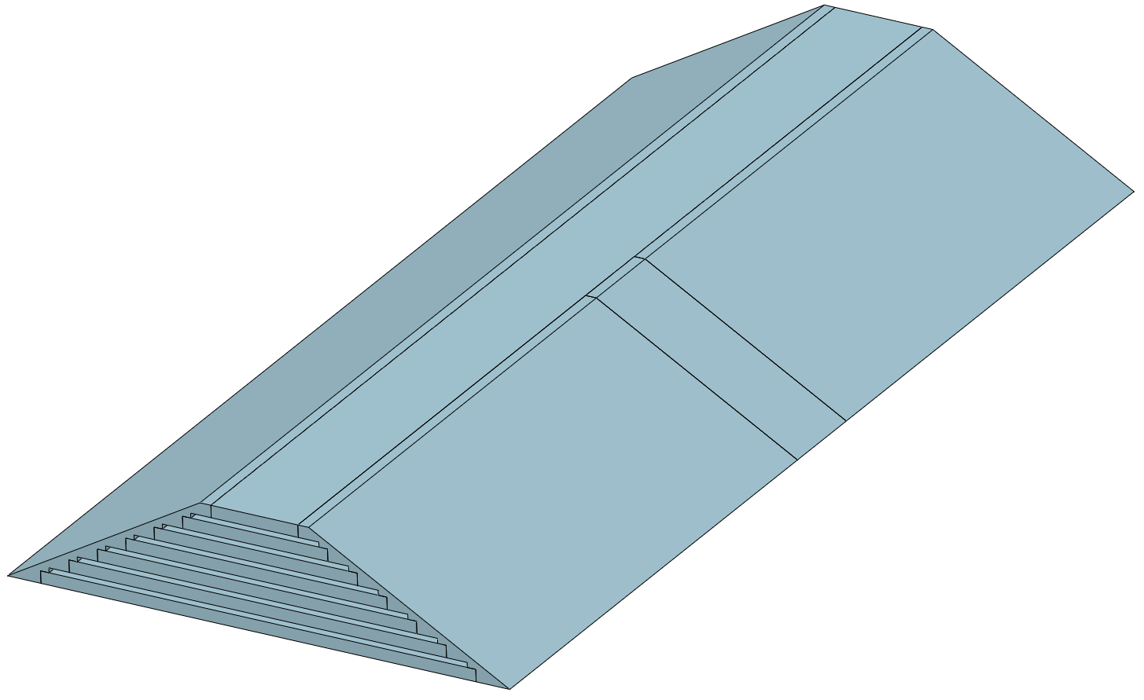
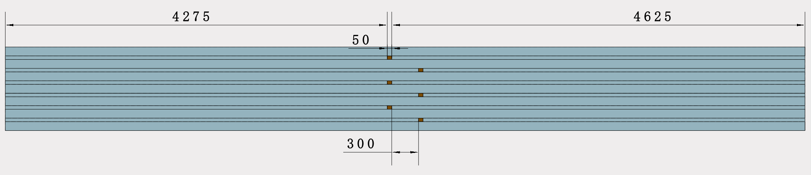
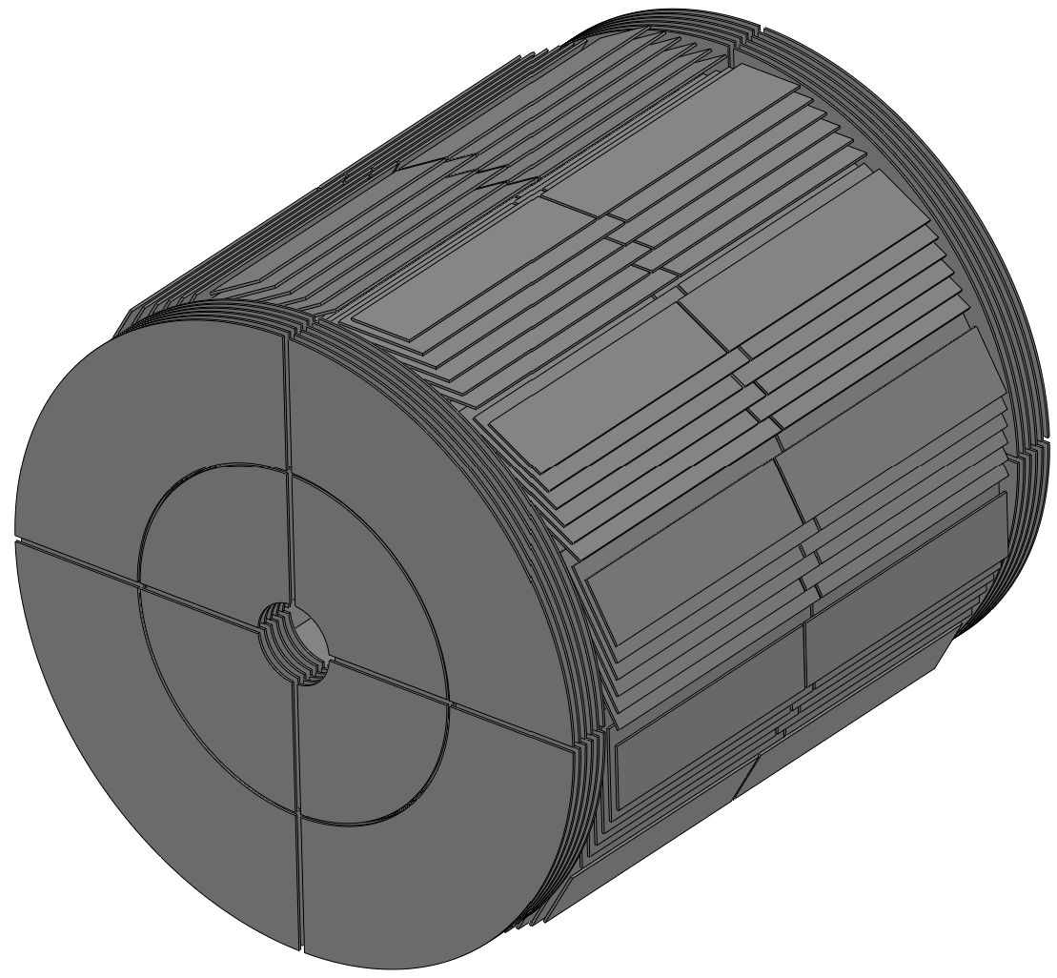
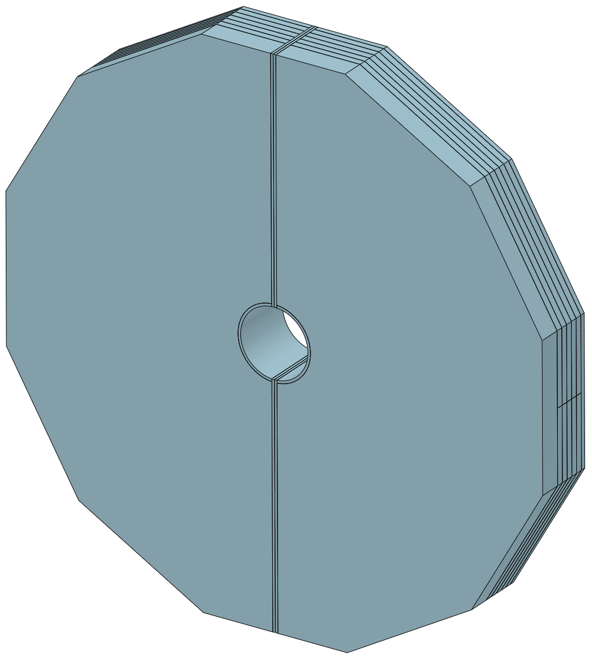
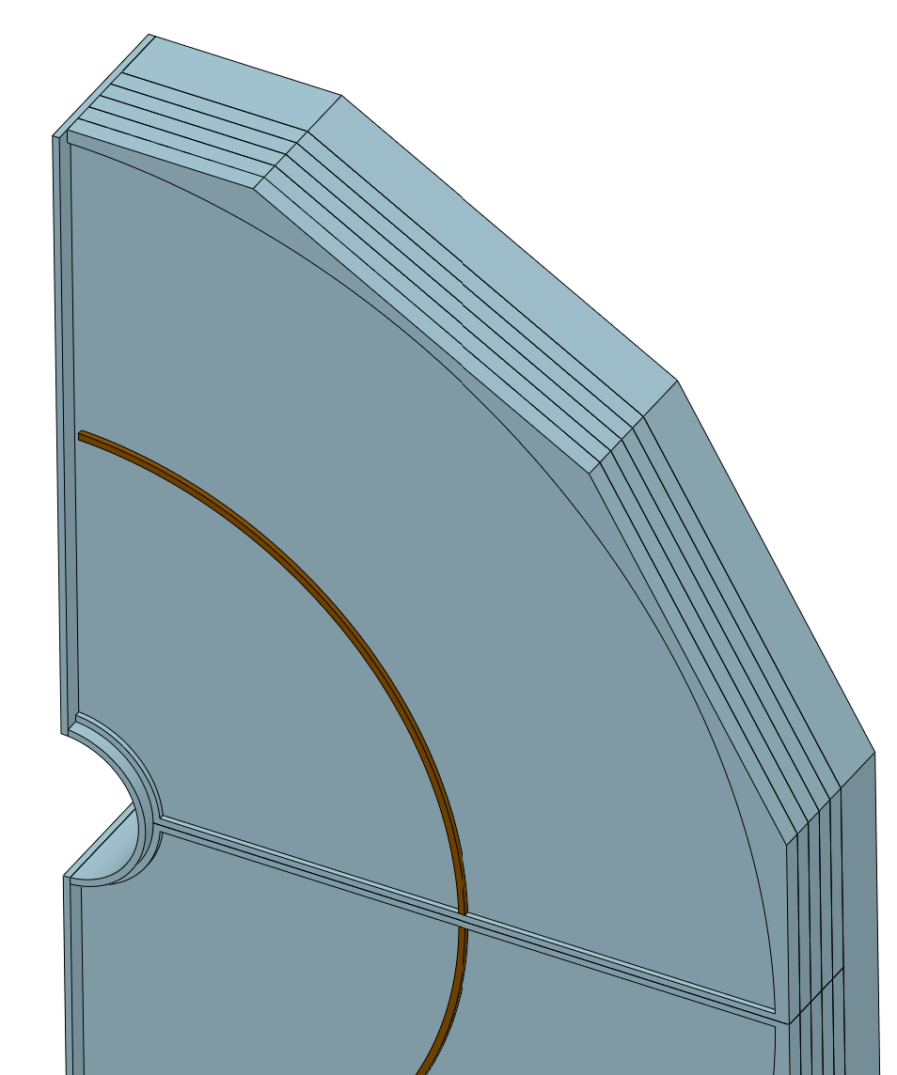
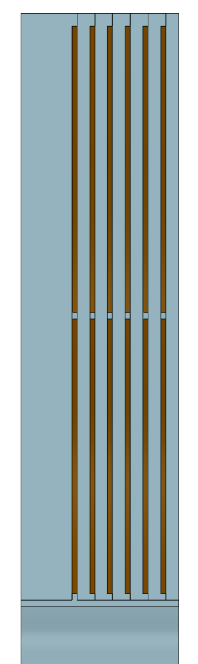
Muon Detector

Slide 3
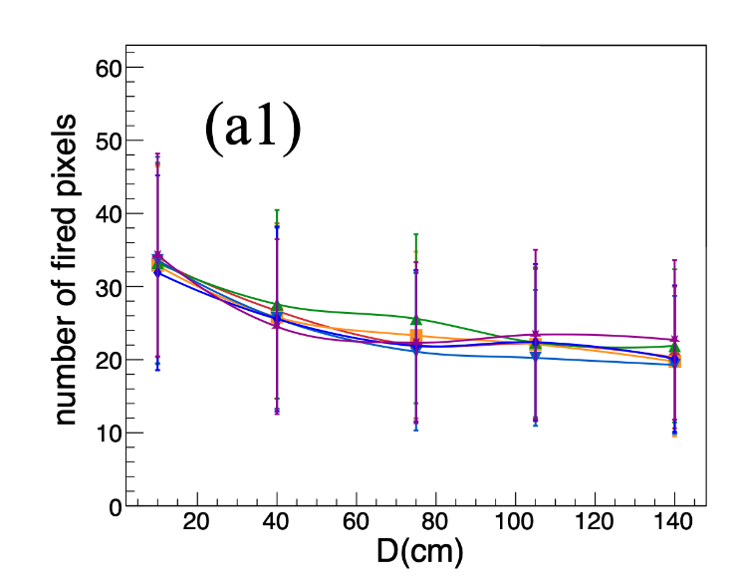
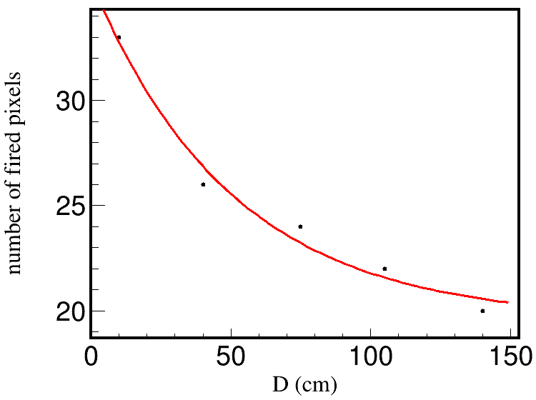
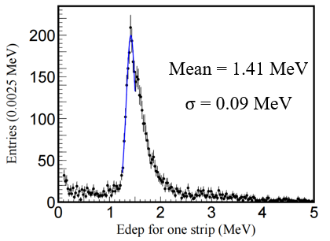
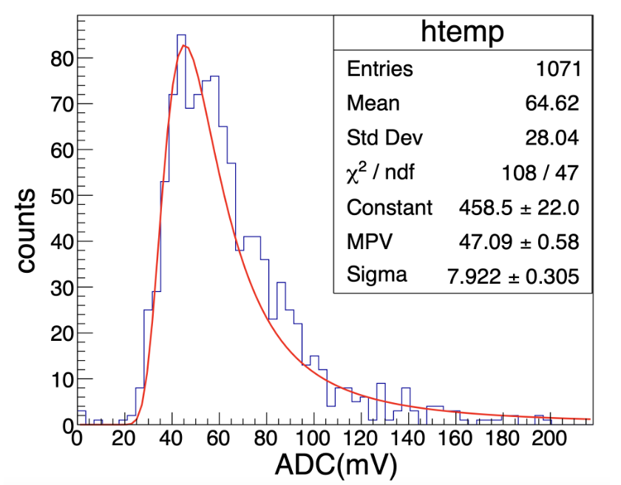
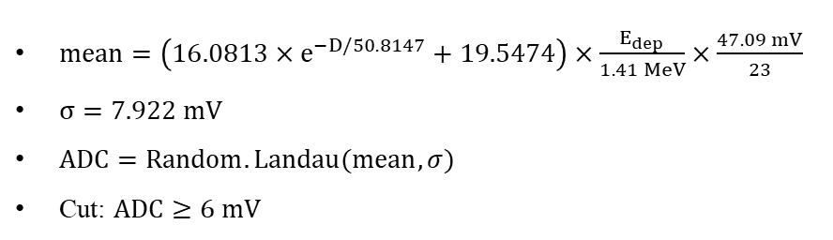


Digitization
Zhang H, Wang X, Ma W, et al. Journal of Instrumentation, 2024, 19(06): P06020.
The relationship between the number of photons received by the SiPM at the scintillator endpoint and the distance from the hit point to the SiPM under 1 mip energy deposition.
$$N=16.0813×e^{−D/50.8147}+19.5474$$
The fitting results of the distribution shown in the left figure.
$mean=\left(16.0813×e^{−D/50.8147}+19.5474\right)×\frac{E_{dep}}{1.41 MeV}×\frac{47.09 mV}{23}$
$σ=7.922 mV$
$ADC=Random.Landau(mean,σ)$
Cut: $ADC≥6 mV$
$$1 mip=1.41 MeV$$
$$1 mip→ADC=47.09$$
$$p. e.=23 σ=7.922$$
The ADC distribution corresponding to the SiPM output for a 1 MIP energy deposition.

Slide 4
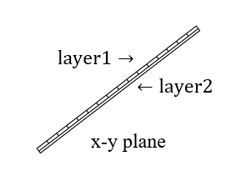
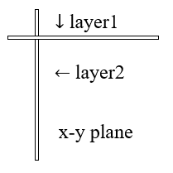
Digitization
In a superlayer of Barrel, layer1 gives pos.x and pos.y, layer2 gives pos.z.
In a superlayer of Endcap, layer1 gives pos.y, layer2 gives pos.x, both can give pos.z.

Slide 5
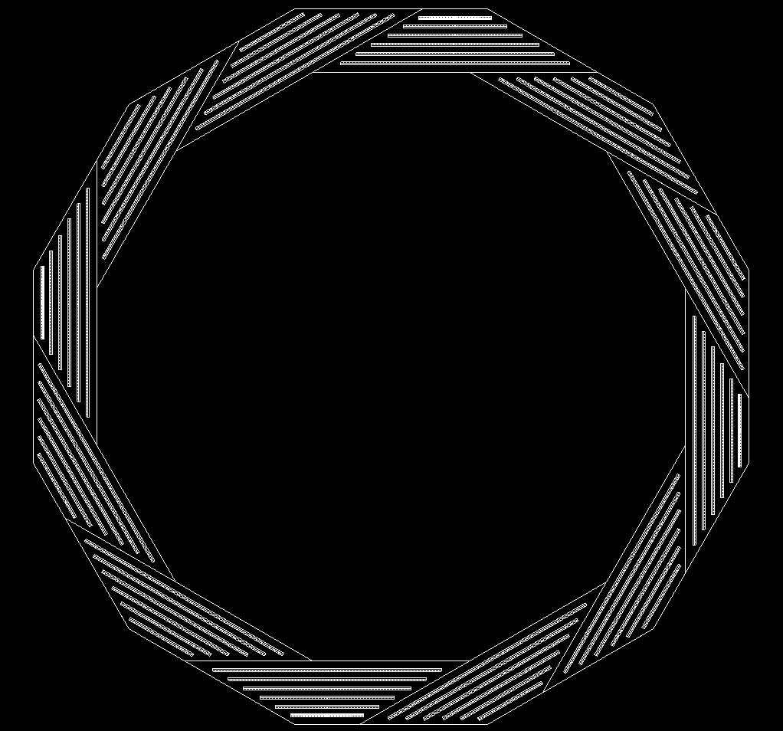

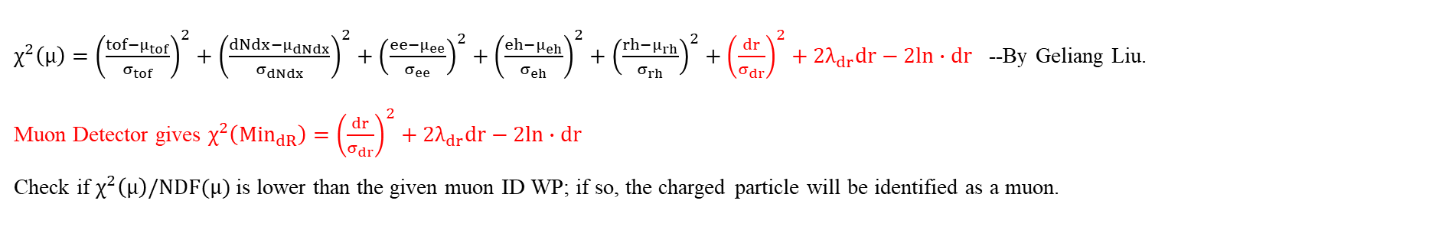
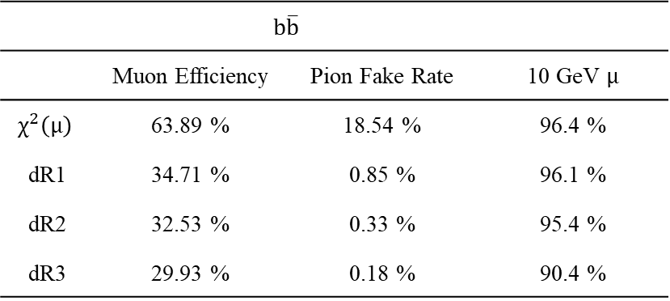
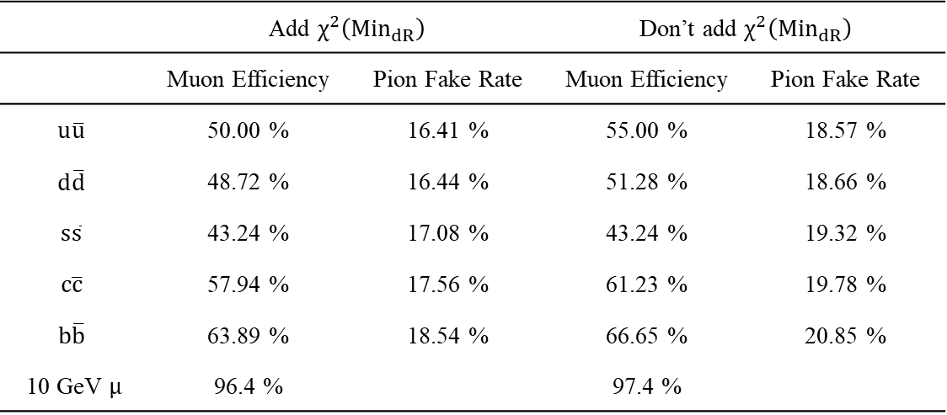
Muonid
$χ^{2}\left(μ\right)={\left(\frac{tof−μ_{tof}}{σ_{tof}}\right)}^{2}+{\left(\frac{dNdx−μ_{dNdx}}{σ_{dNdx}}\right)}^{2}+{\left(\frac{ee−μ_{ee}}{σ_{ee}}\right)}^{2}+{\left(\frac{eh−μ_{eh}}{σ_{eh}}\right)}^{2}+{\left(\frac{rh−μ_{rh}}{σ_{rh}}\right)}^{2}+{\left(\frac{dr}{σ_{dr}}\right)}^{2}+2λ_{dr}dr−2ln∙dr$ --By Geliang Liu.
Muon Detector gives $χ^{2}\left({Min}_{dR}\right)={\left(\frac{dr}{σ_{dr}}\right)}^{2}+2λ_{dr}dr−2ln∙dr$
Check if $χ^{2}\left(μ\right)/NDF(μ)$ is lower than the given muon ID WP; if so, the charged particle will be identified as a muon.
 | Add $χ^{2}\left({Min}_{dR}\right)$ |  | Don’t add $χ^{2}\left({Min}_{dR}\right)$
 | Muon Efficiency | Pion Fake Rate | Muon Efficiency | Pion Fake Rate
$$u\overline{u}$$ | 50.00 % | 16.41 % | 55.00 % | 18.57 %
$$d\overline{d}$$ | 48.72 % | 16.44 % | 51.28 % | 18.66 %
$$s\overline{s}$$ | 43.24 % | 17.08 % | 43.24 % | 19.32 %
$$c\overline{c}$$ | 57.94 % | 17.56 % | 61.23 % | 19.78 %
$$b\overline{b}$$ | 63.89 % | 18.54 % | 66.65 % | 20.85 %
10 GeV $μ$ | 96.4 % |  | 97.4 %
 | $b\overline{b}$
 | Muon Efficiency | Pion Fake Rate | 10 GeV $μ$
$$χ^{2}\left(μ\right)$$ | 63.89 % | 18.54 % | 96.4 %
dR1 | 34.71 % | 0.85 % | 96.1 %
dR2 | 32.53 % | 0.33 % | 95.4 %
dR3 | 29.93 % | 0.18 % | 90.4 %
Samples from Kaili Zhang.

