Slide 1
SiPM PreAMP for ASHIPH（updata）
Xiyang Wang Shiming Zou
2024.3.20

Slide 2
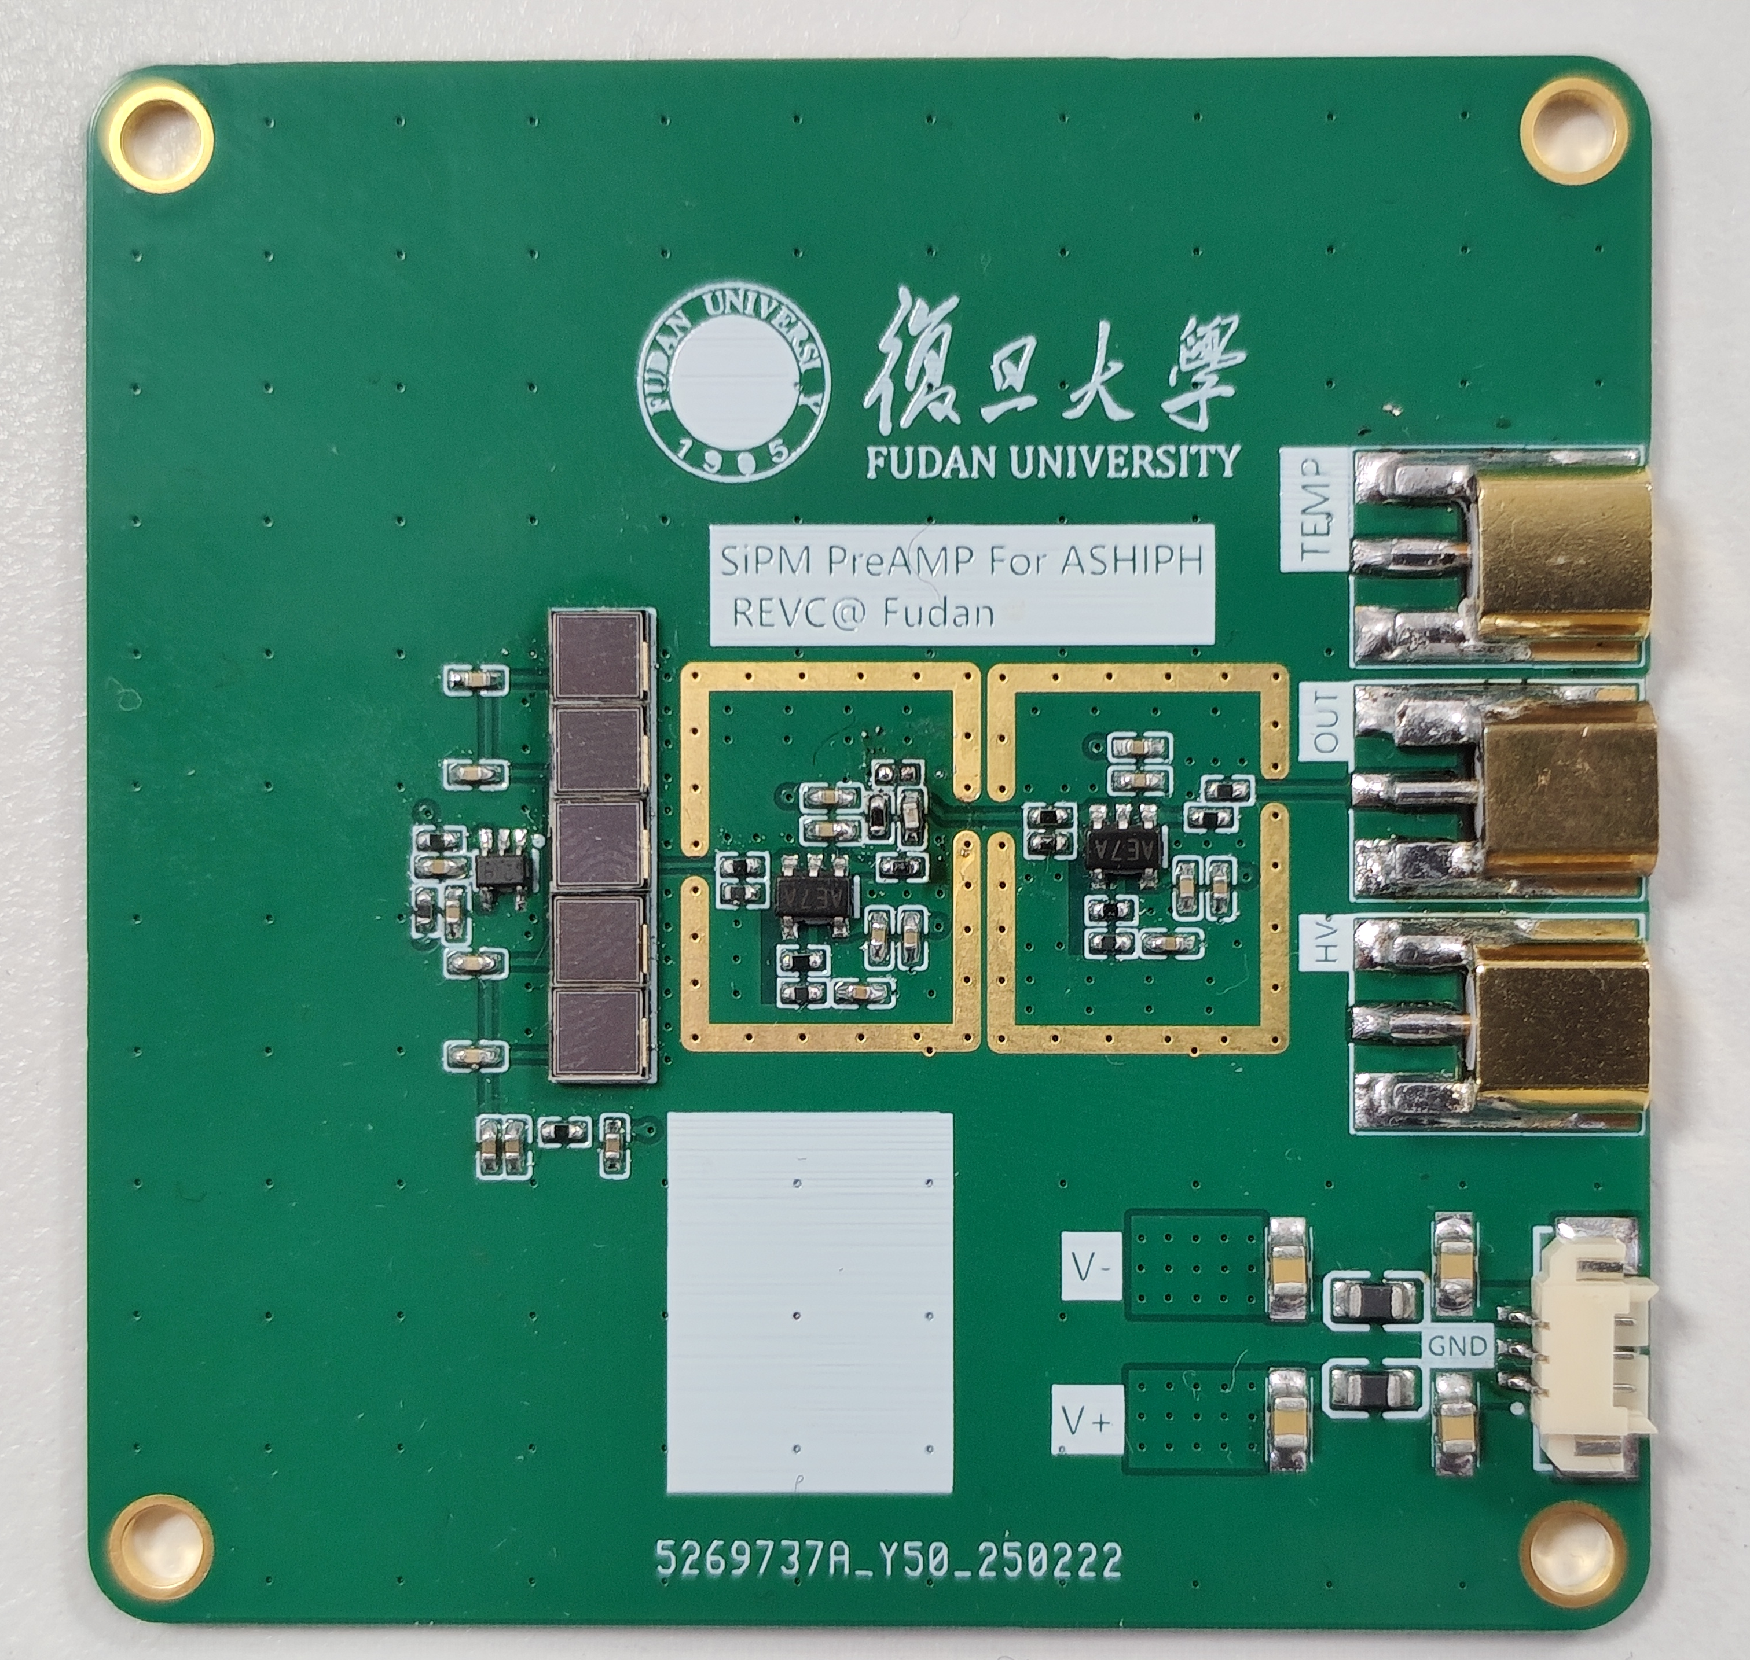
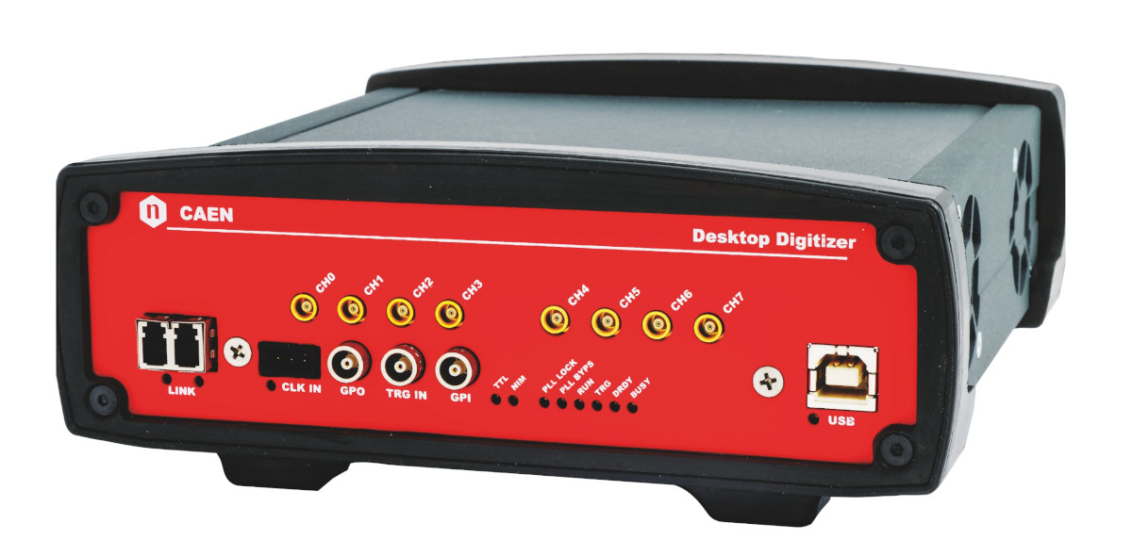
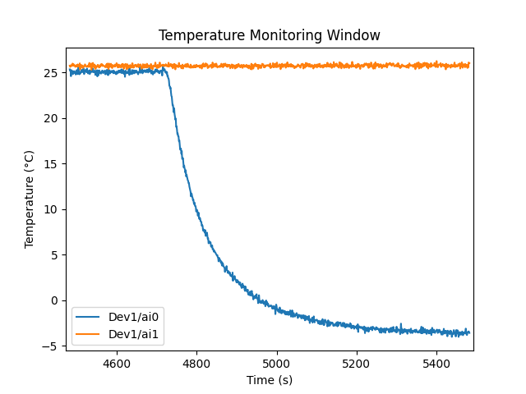
Low Temperature System
Room Temperature
Temp Sensor
MON CH1
16CH ADC
Temperature monitoring
MON CH0
USB
Temp Sensor
SiPM
AMP
MCX
8CH Digitalizer
DT5725
PCB
USB
semiconductor chilling plate
Cold Water
Flow

Slide 3
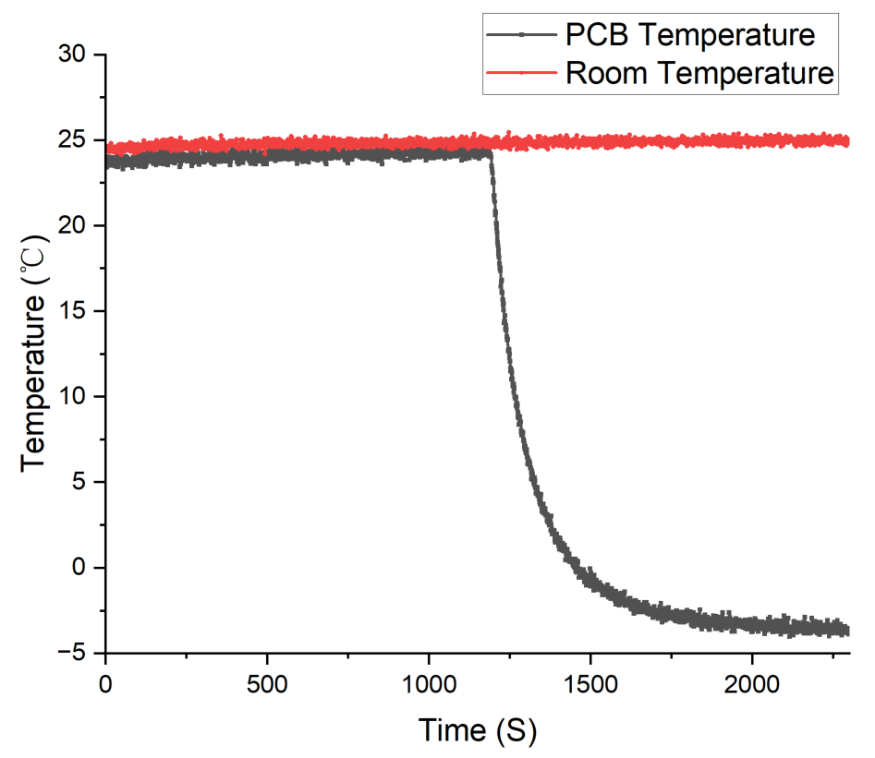
Low Temperature System
Start cooling
Temperature begins to stabilize：- 3 ℃

Slide 4
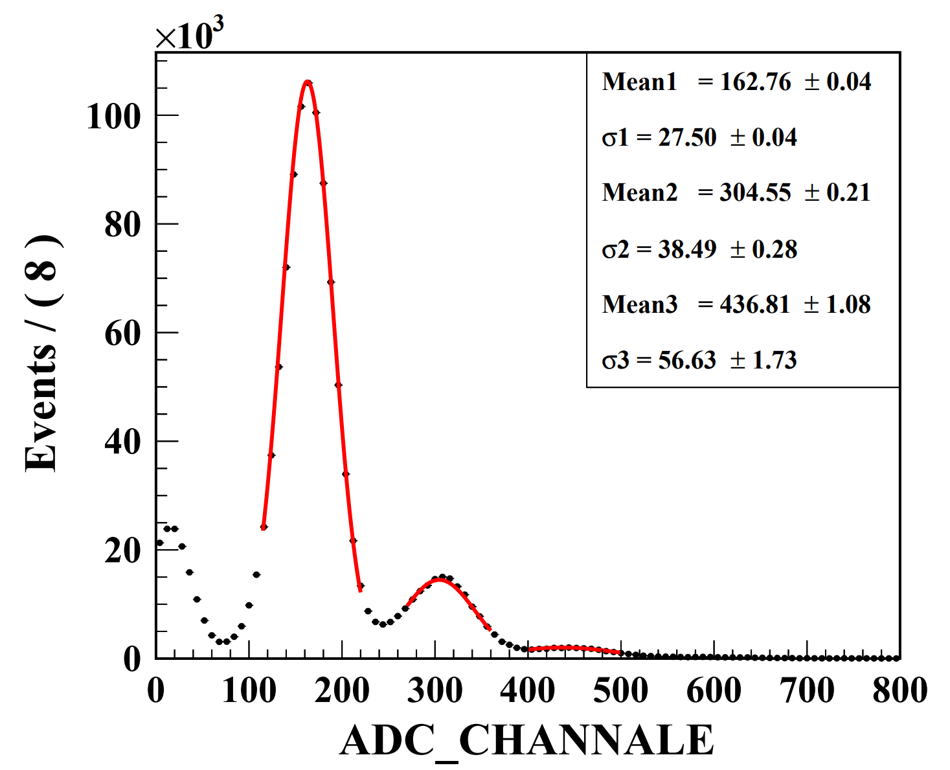
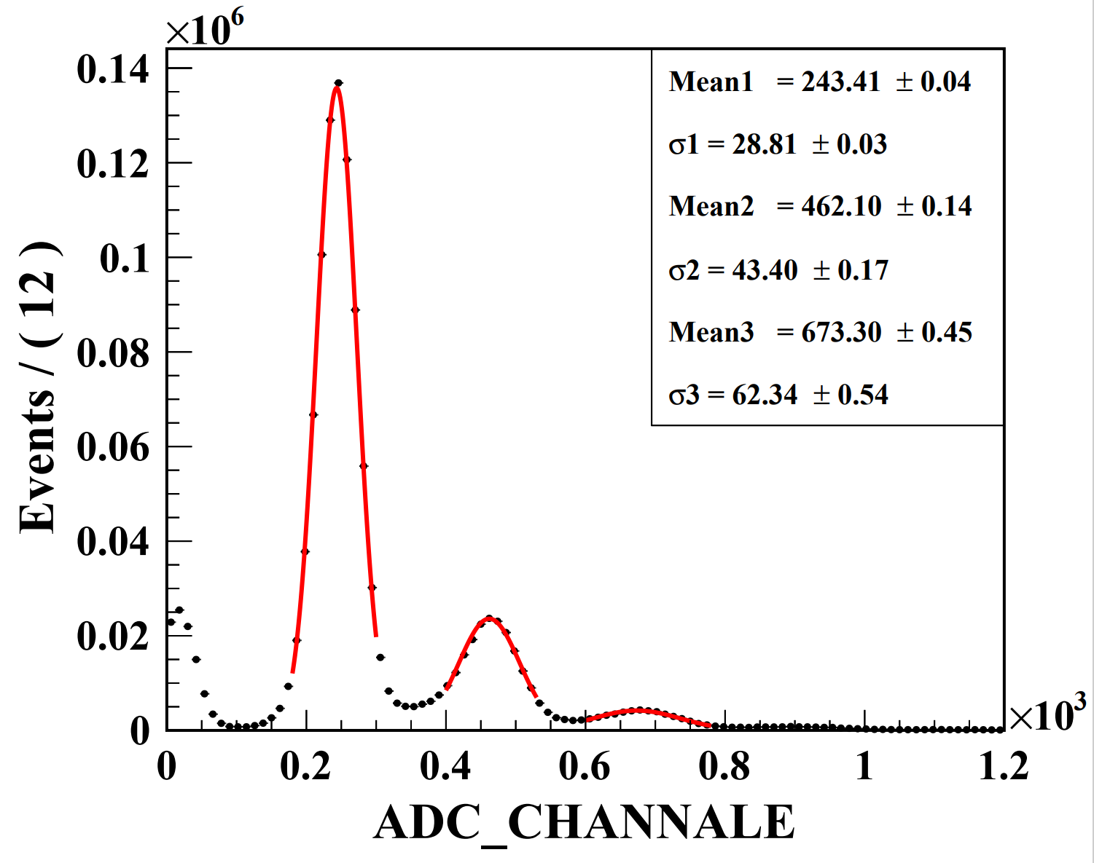
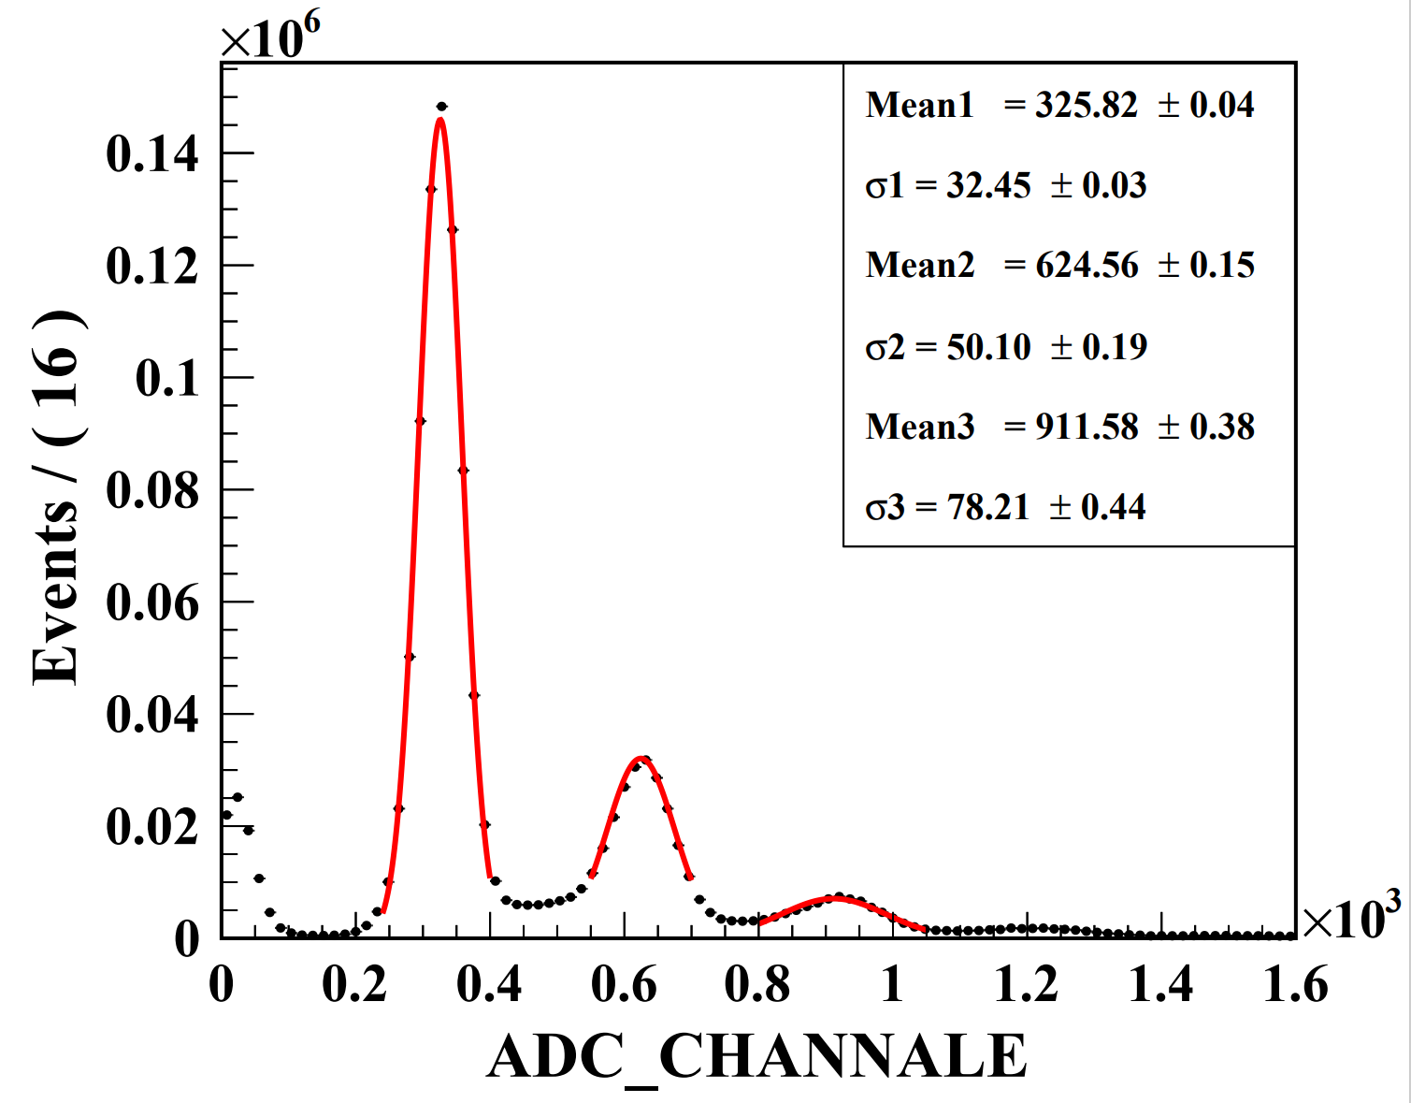
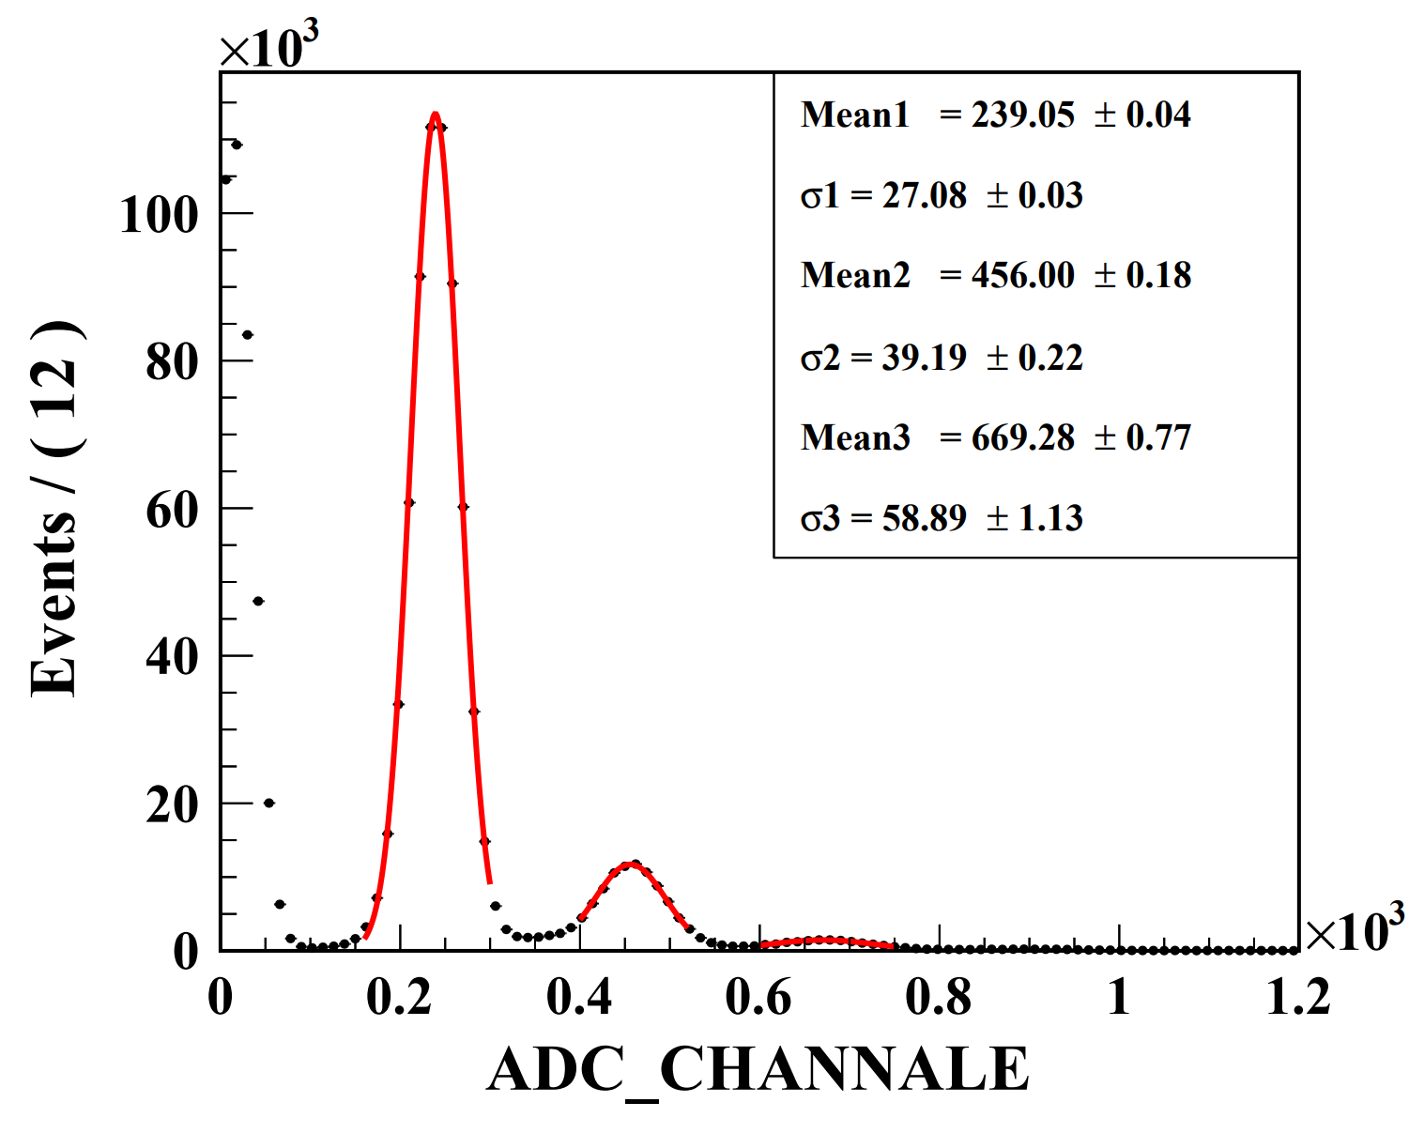
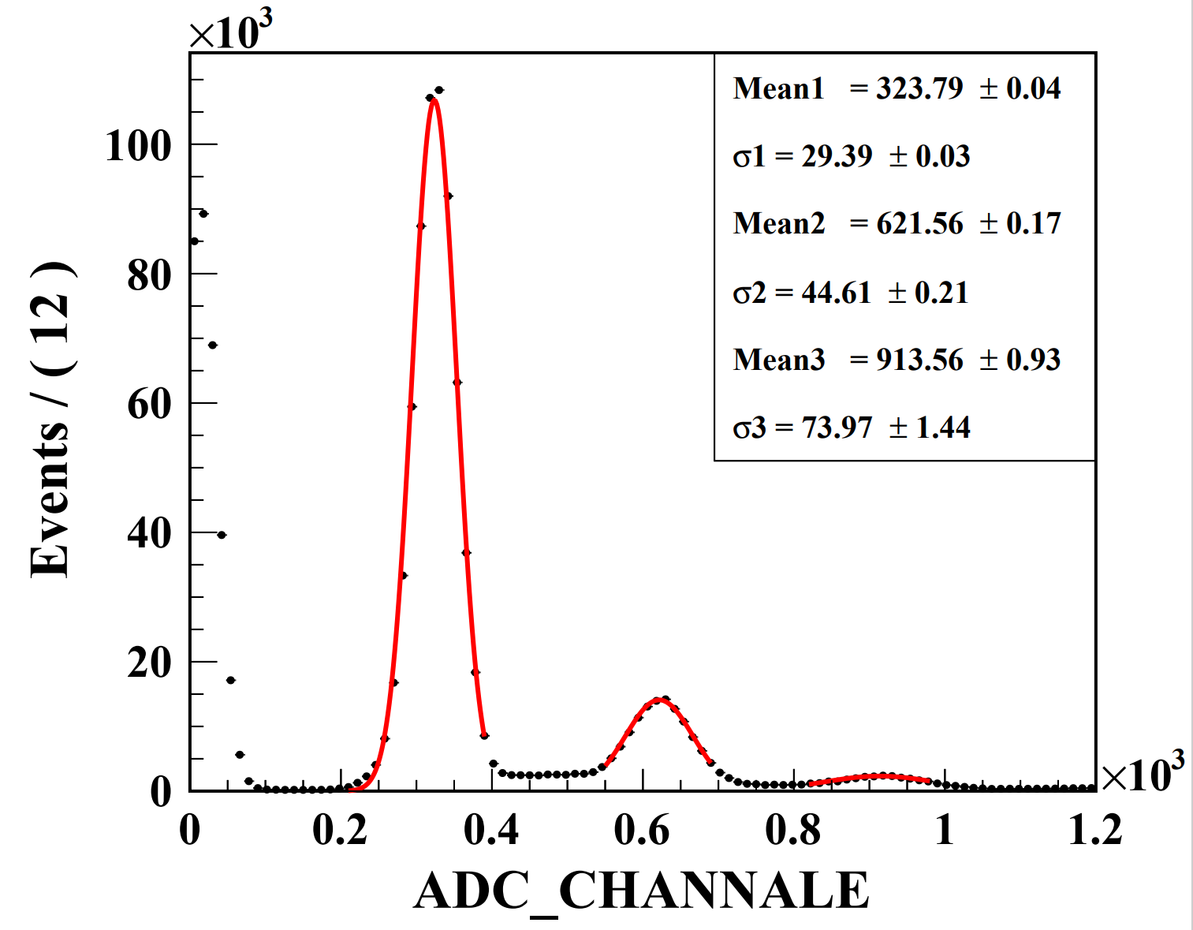
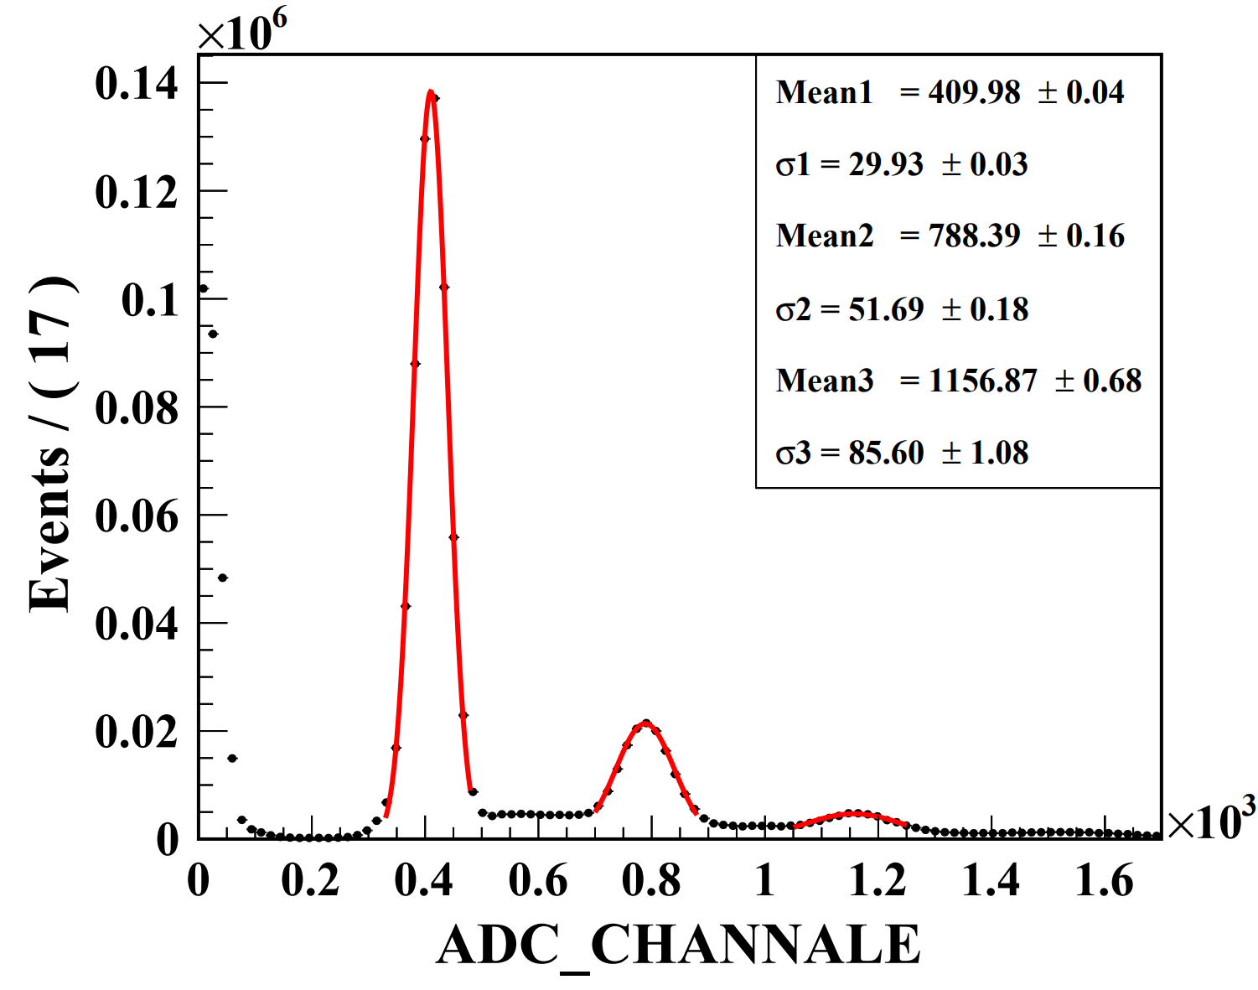
Dark counts test (For 5SiPM Array )
Vbias = 31V
Vbias = 32V
Vbias = 33V
Room
Temperature
~25℃
Vbias = 31V
Vbias = 32V
Vbias = 33V
LOW
Temperature
~-3℃

Slide 5
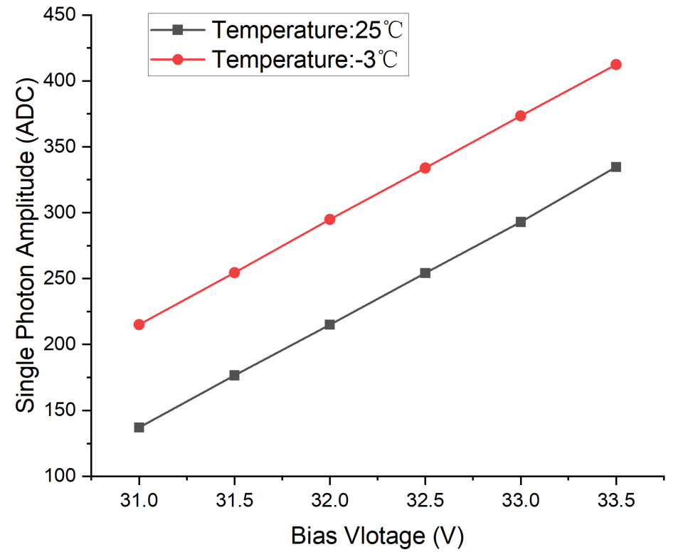
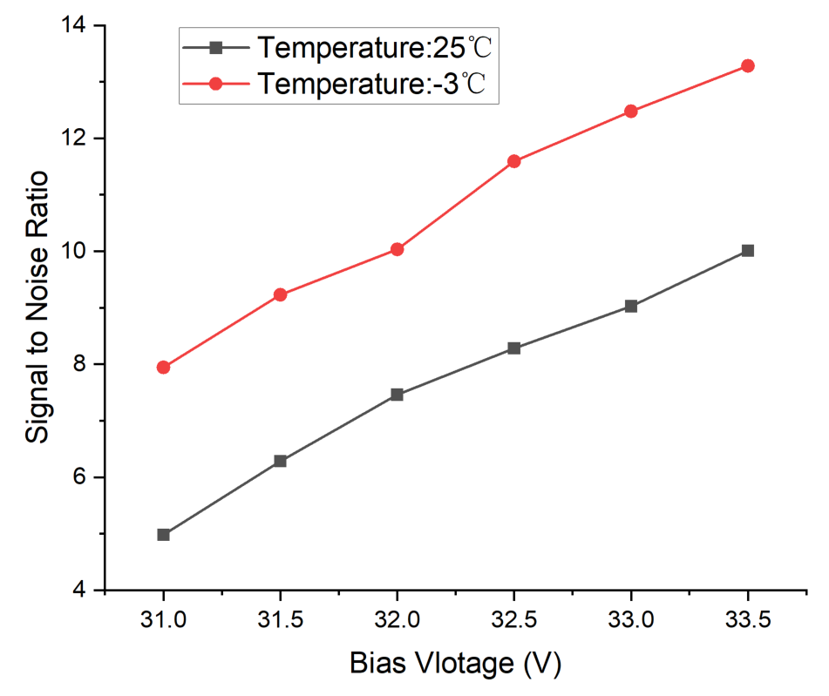
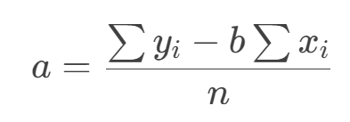
Dark counts test (For 5SiPM Array)
Peak 1
Peak 2
Peak 3
SPA VS Bias
SNR VS Bias
Least Squares
SPA(Single photon amplitude) = b
SNR(Signal to Noise Ratio) = b/σ1

Slide 6
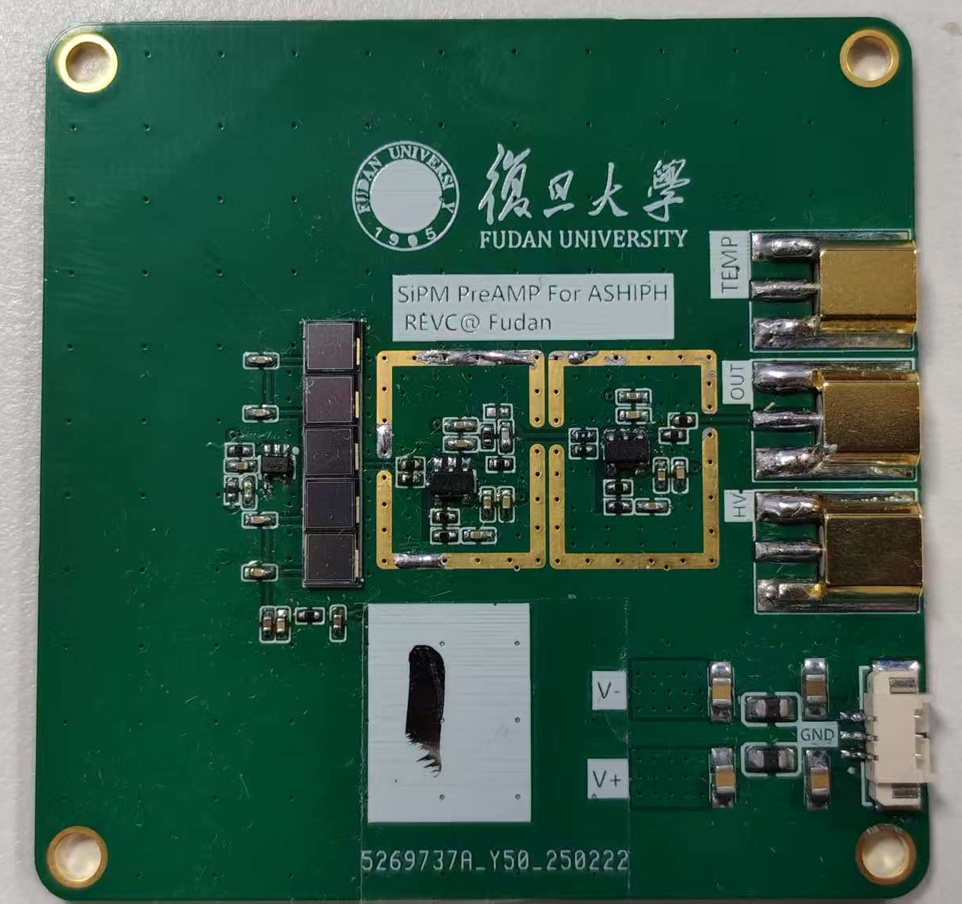
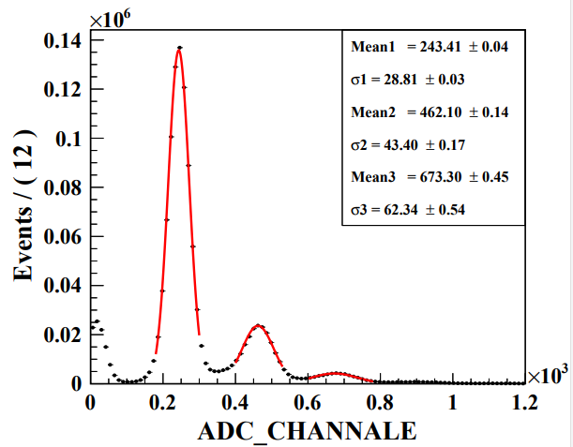
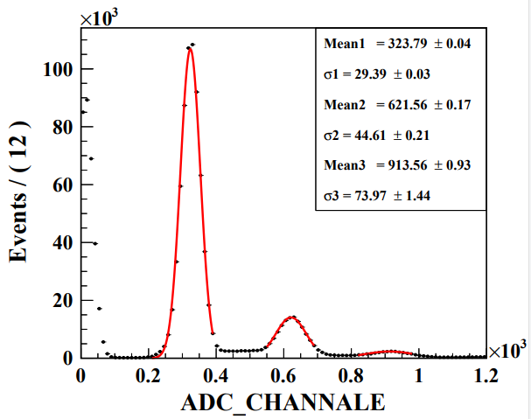
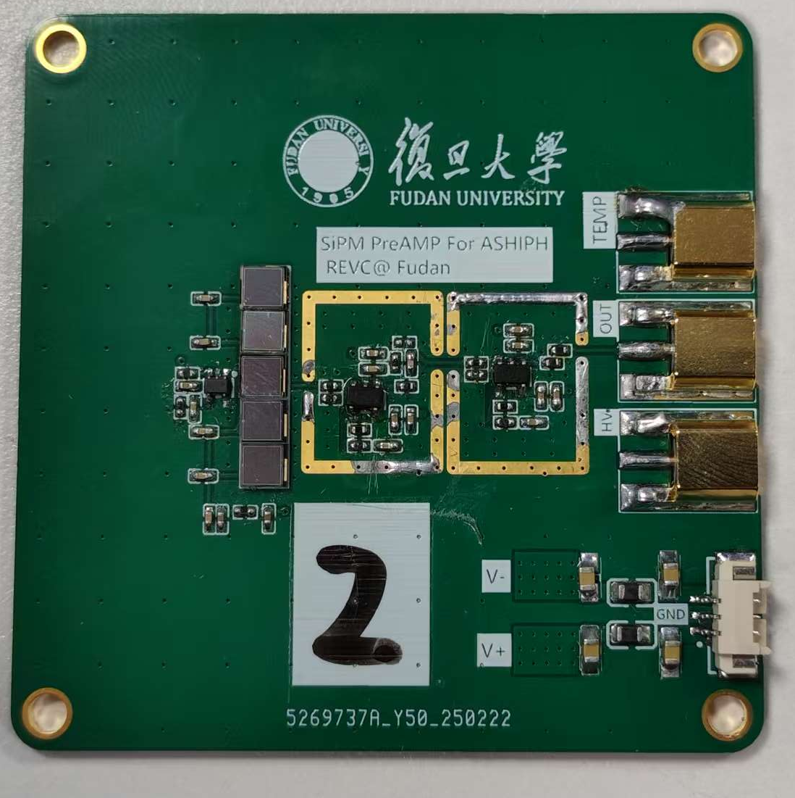
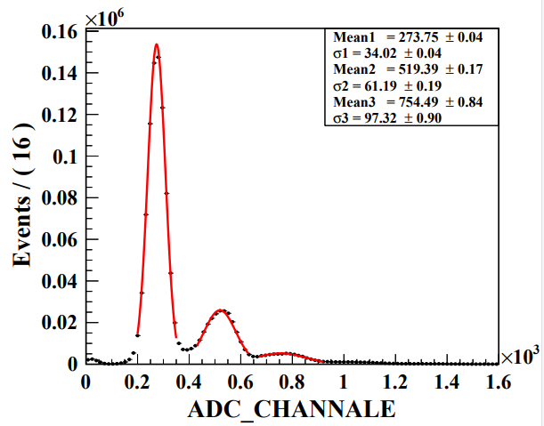
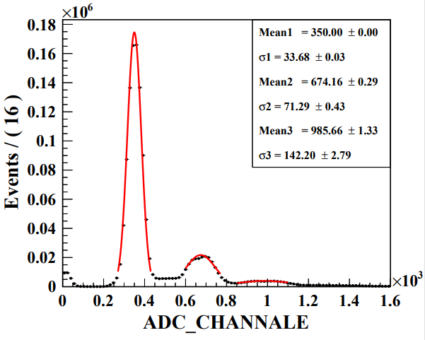
Performance of different PCB

Slide 7
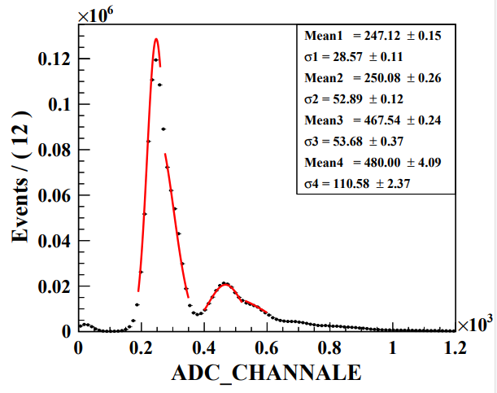
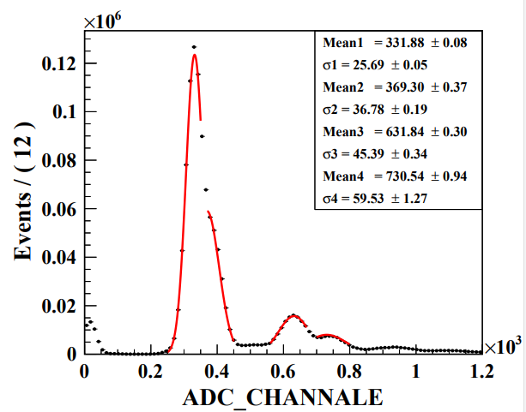
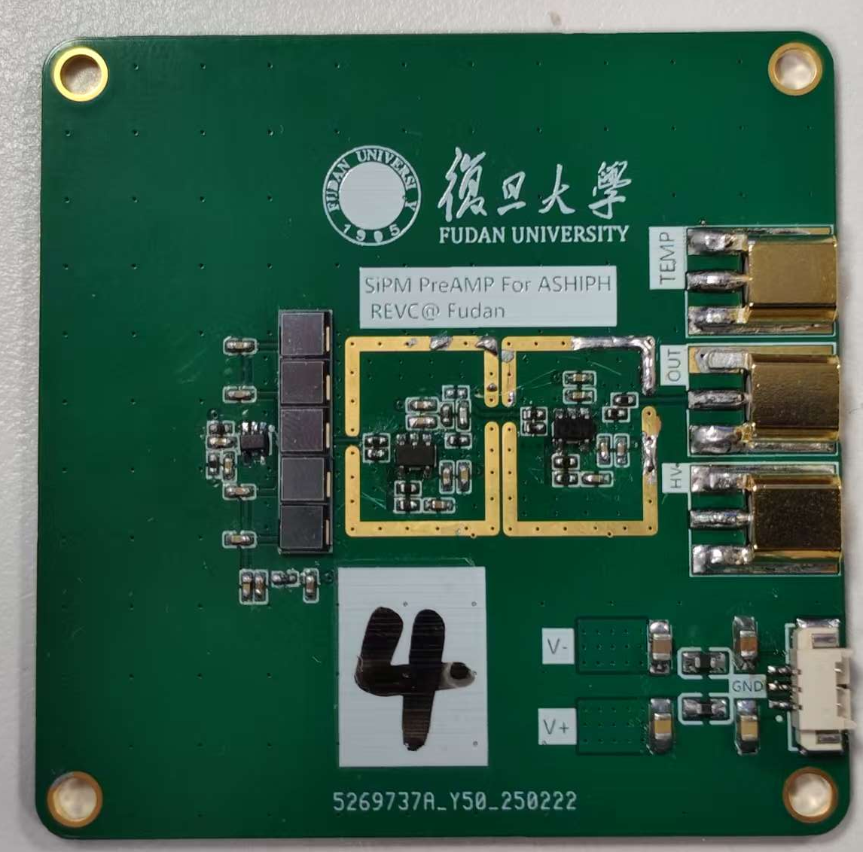
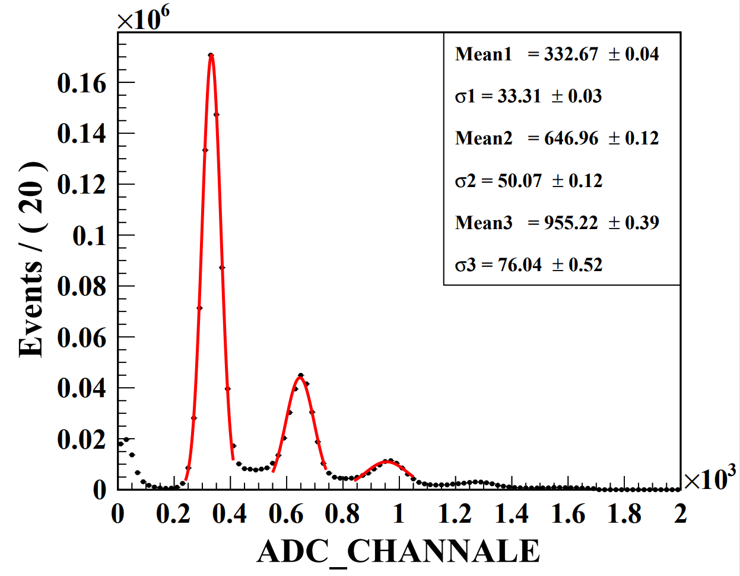
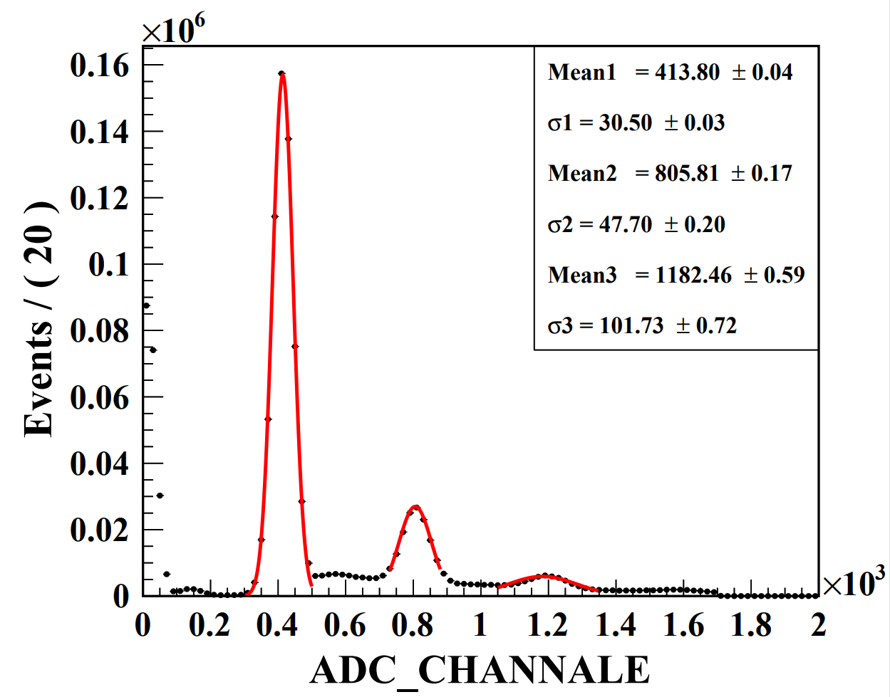
Performance of different PCB
Multiple peaks due to inconsistent SiPM performance

Slide 8
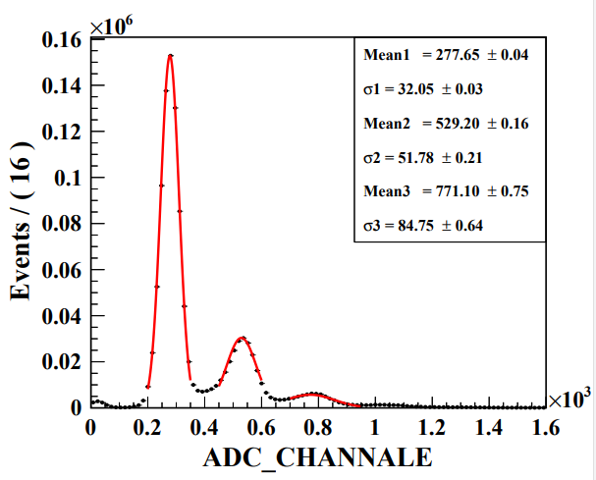
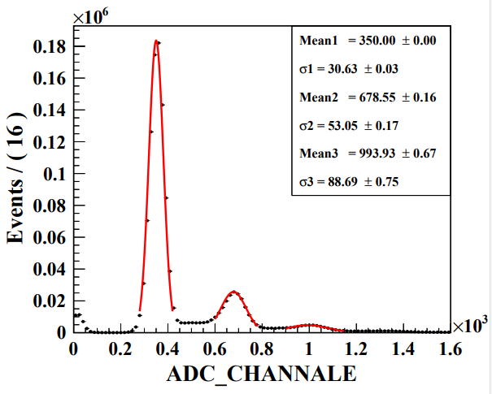
Performance of different PCB
Board NO. | 1 |  | 2 |  | 3 |  | 4 |  | 5
Temperature | 25℃ | -3℃ | 25℃ | -3℃ | 25℃ | -3℃ | 25℃ | -3℃ | 25℃ | -3℃
SPA（ADC） | 214.9 | 294.8 | 240.4 | 317.8 | 222.9 | 304.4 | 311.3 | 384.3 | 246.7 | 321.9
SNR | 7.4 | 10.5 | 7.1 | 9.4 | / | / | 9.4 | 12.6 | 7.7 | 10.5
Dark Current(uA) | 2.52 | 0.73 | 1.47 | 0.52 | 1.47 | 0.52 | 2.06 | 0.71 | 9.55 | 8.55

Slide 9
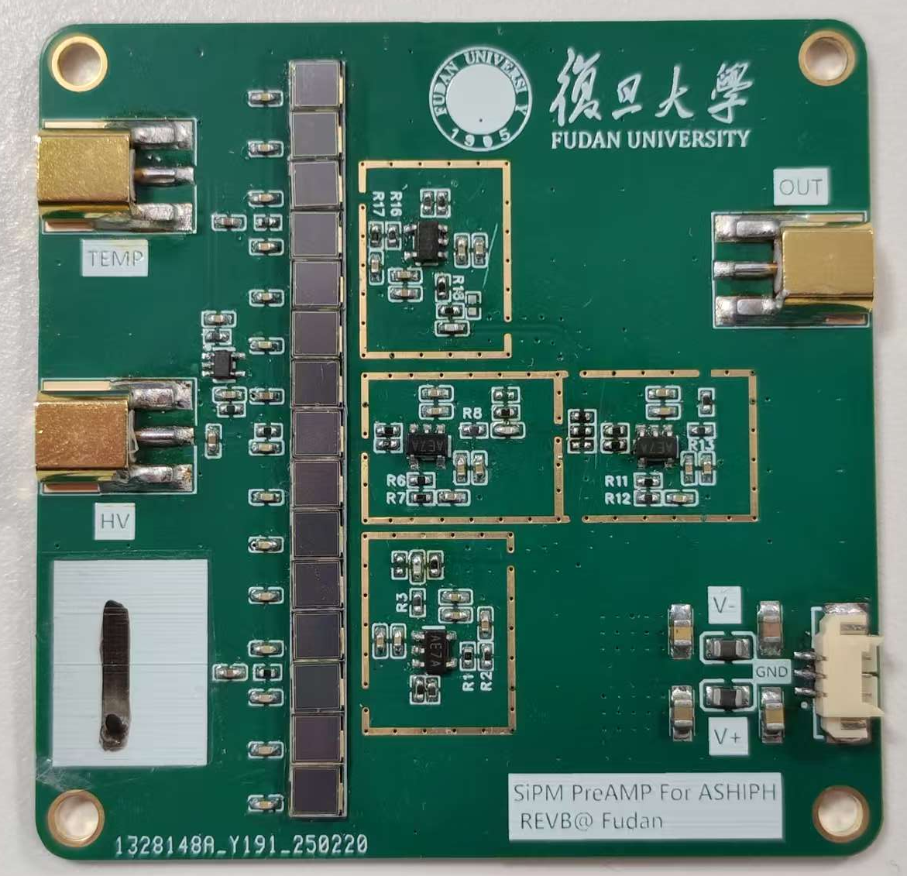
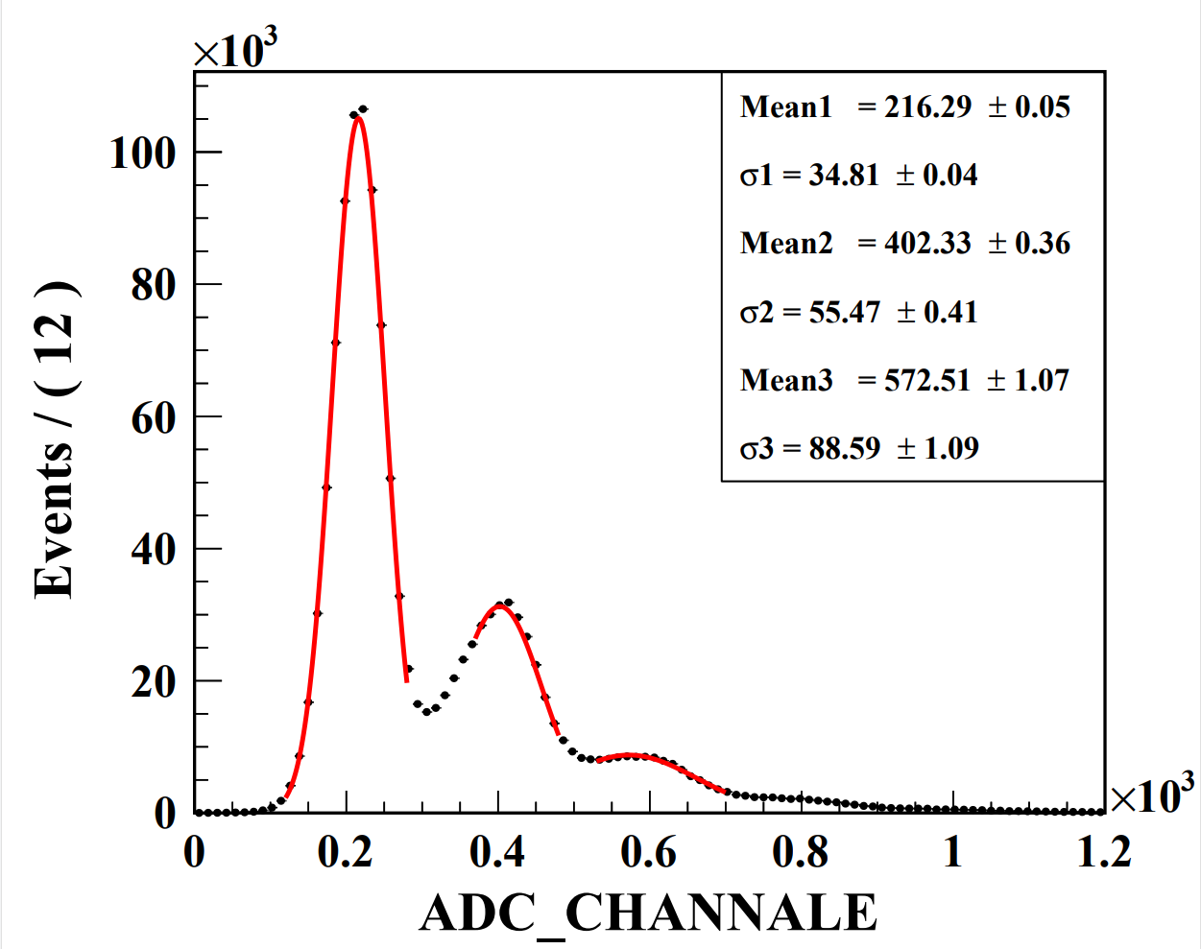
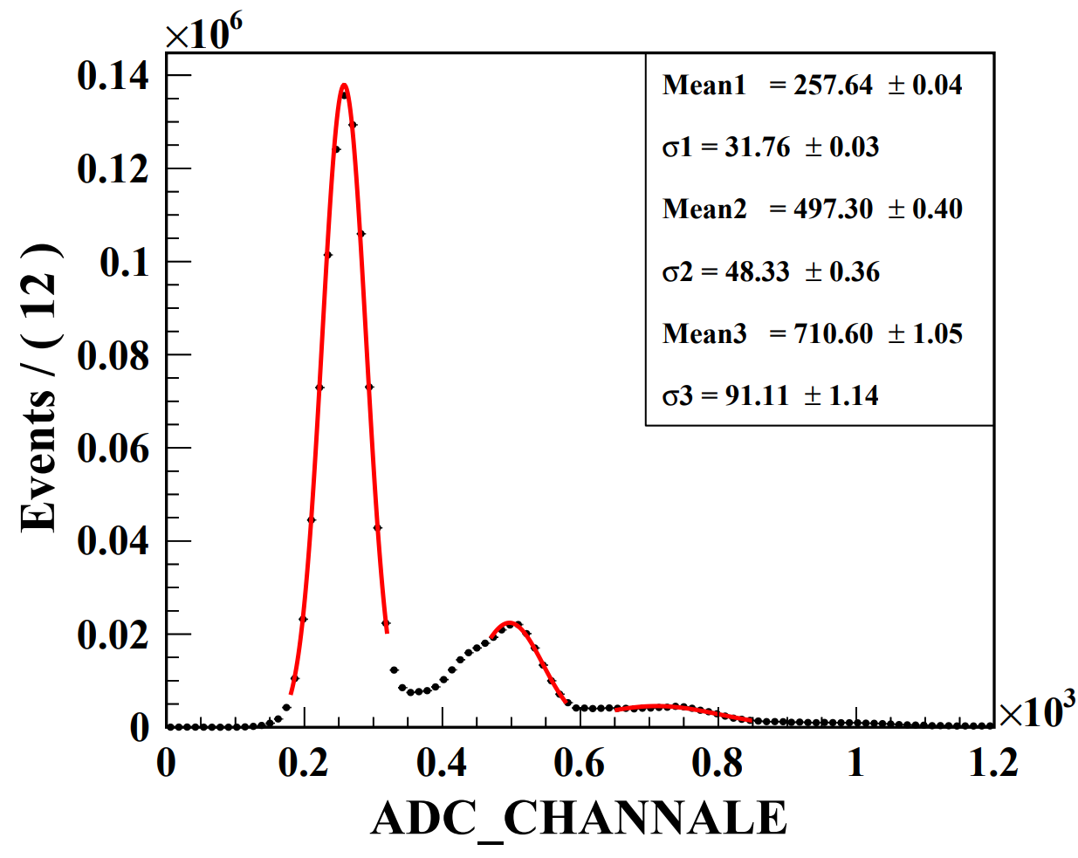
Dark counts test (For 15SiPM Array )
Room Temperature
~25℃
LOW Temperature
~-3℃
SPA(Single photon amplitude) = 178.1
SNR(Signal to Noise Ratio) = SPA/σ1=5.2
SPA(Single photon amplitude) = 226.5
SNR(Signal to Noise Ratio) = 7.1

Slide 10
Back Up

Slide 11
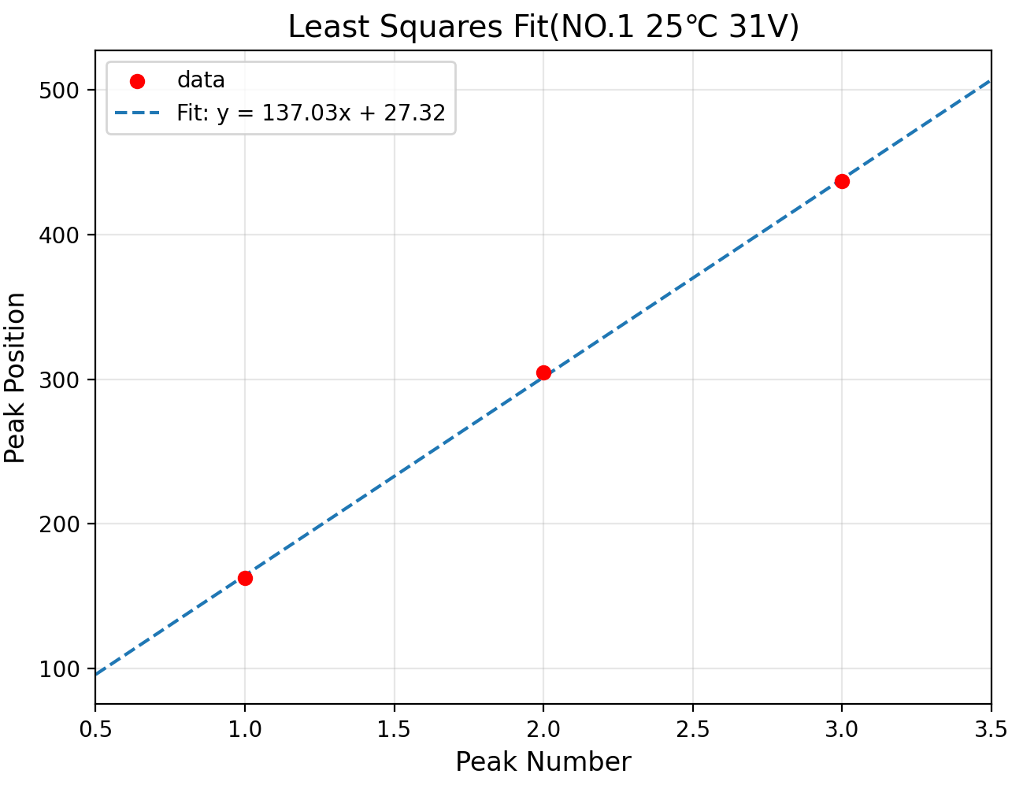
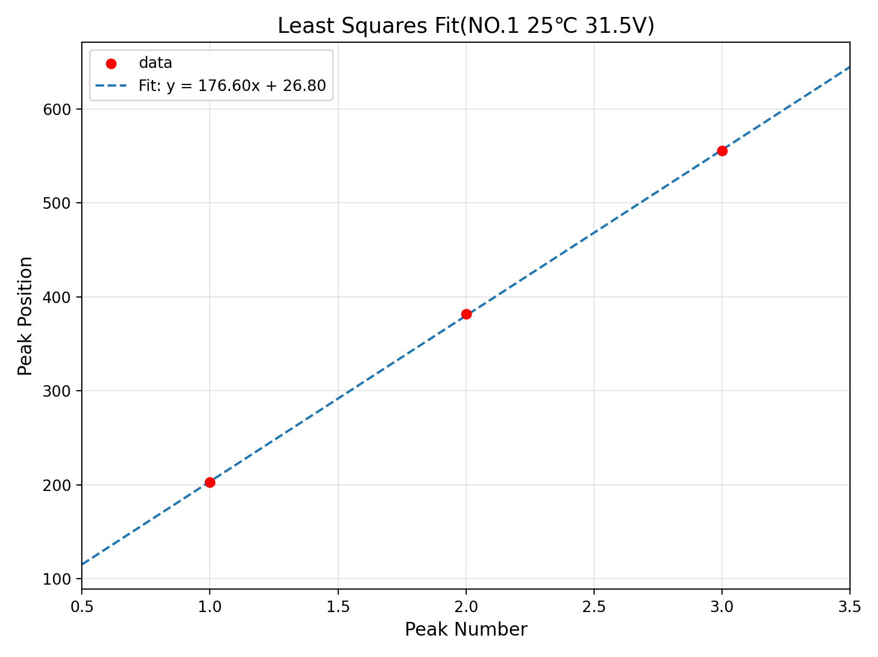
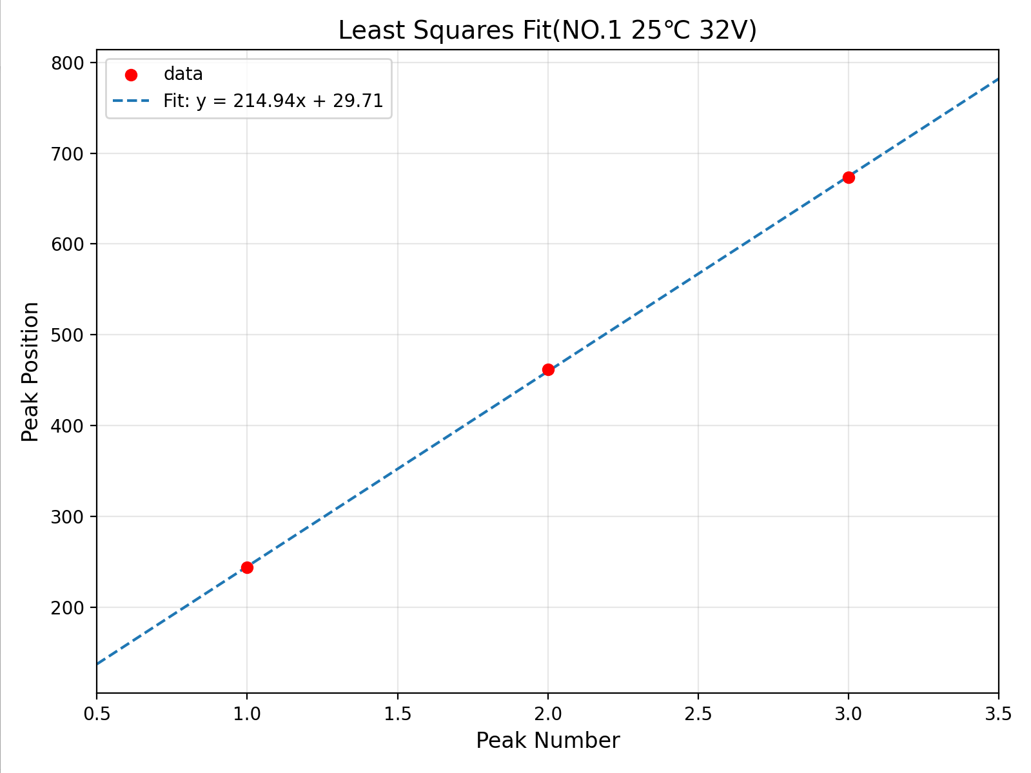
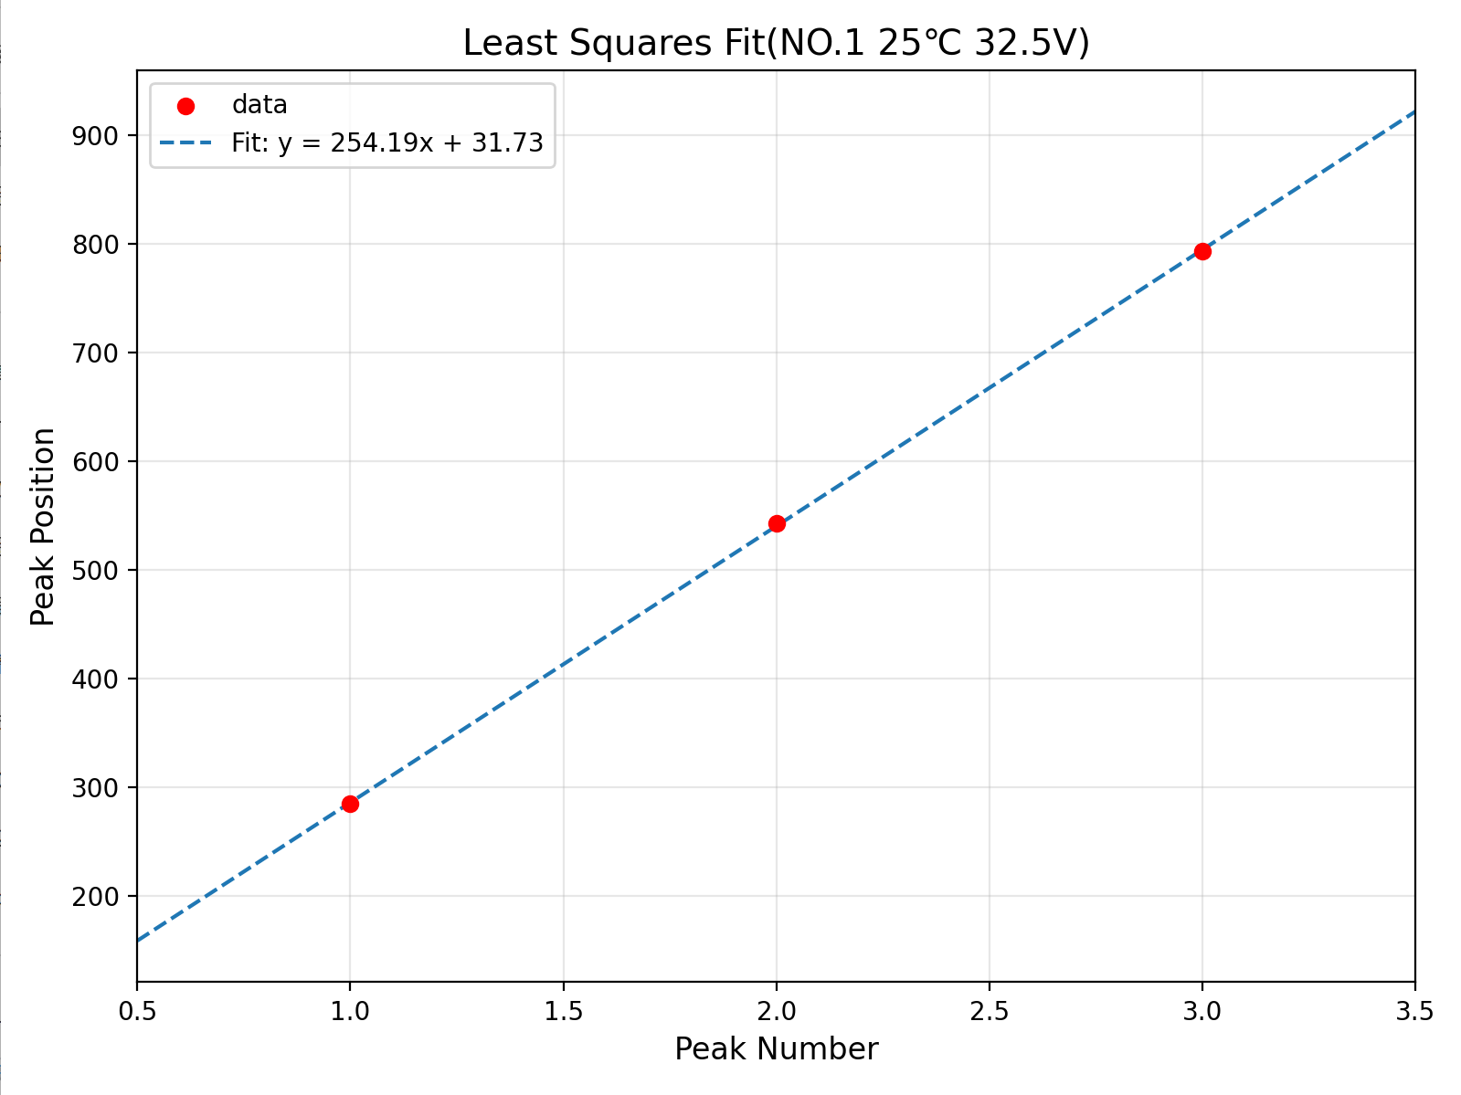
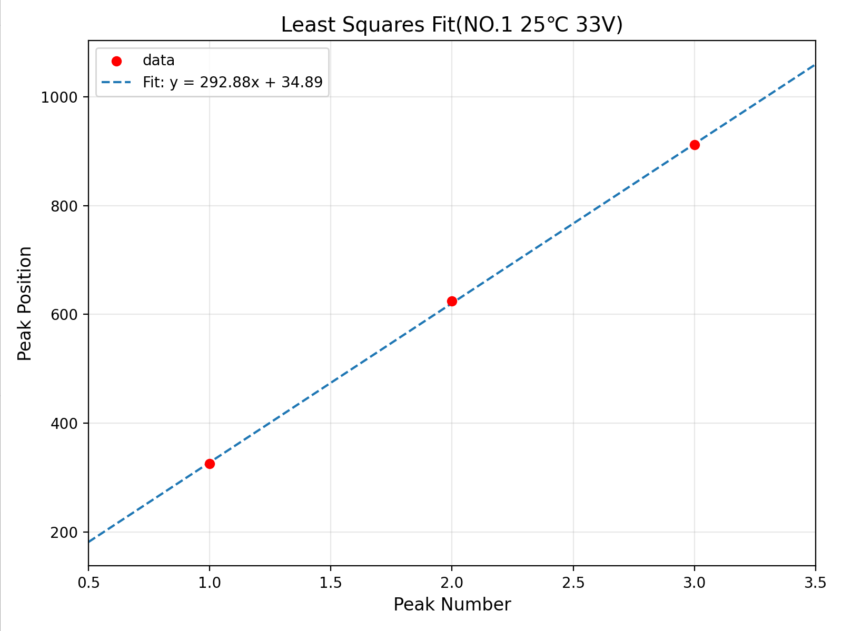
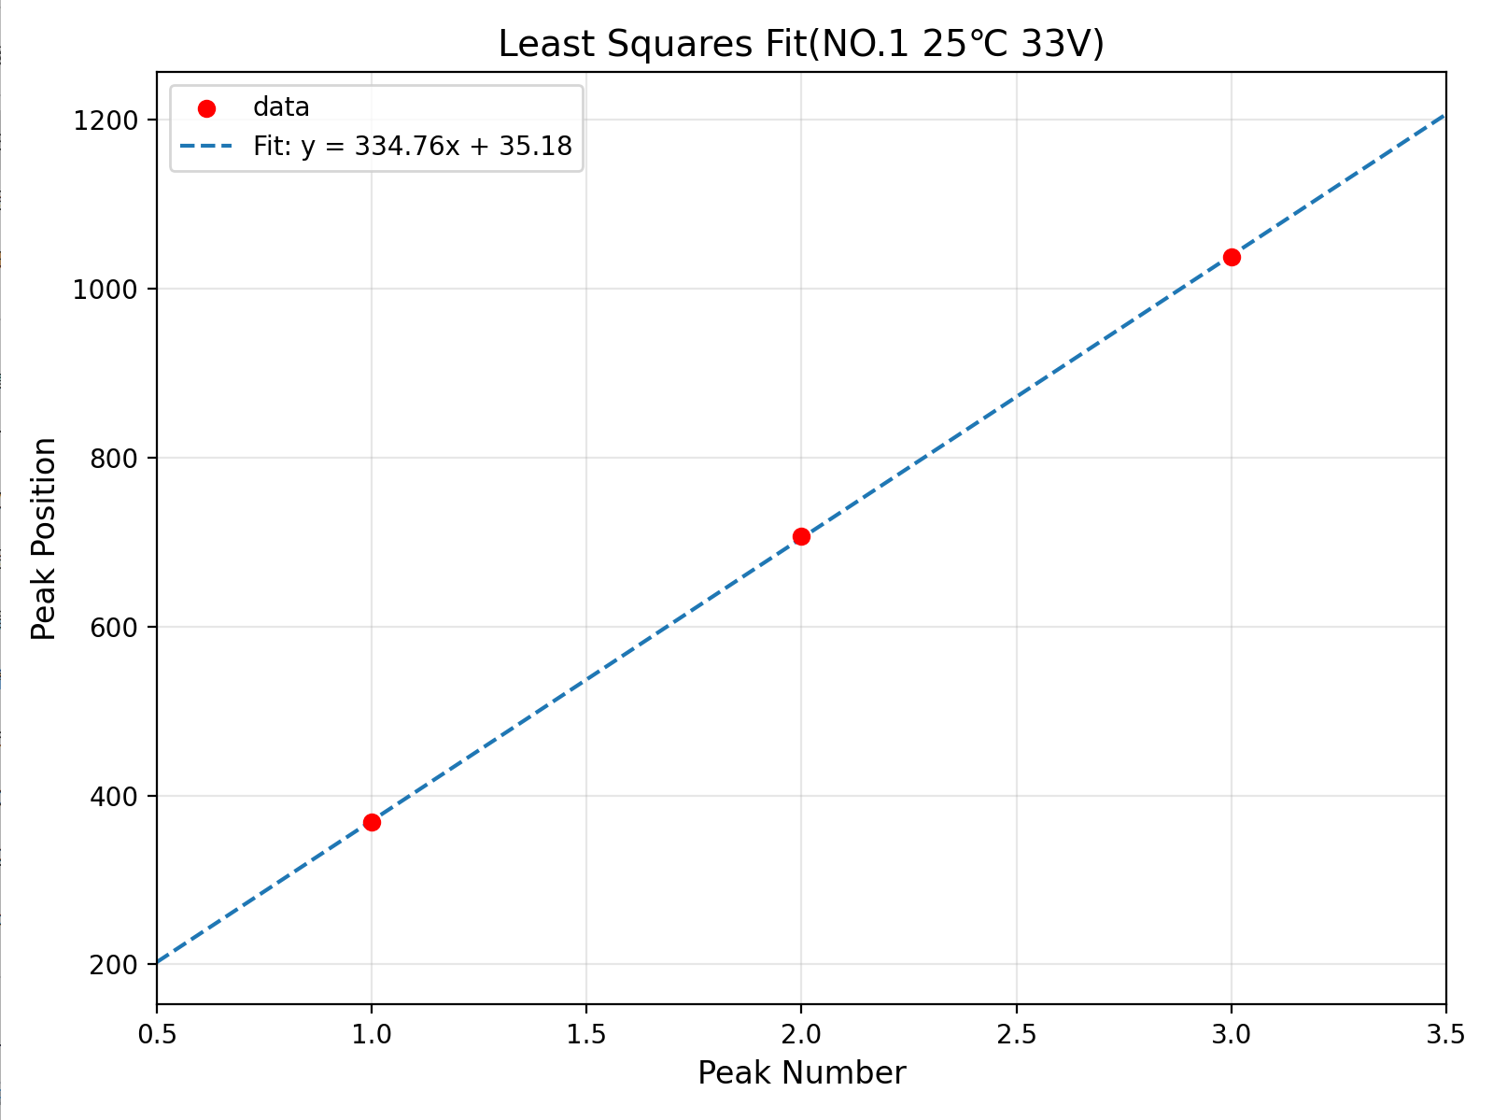
Back UP data

Slide 12
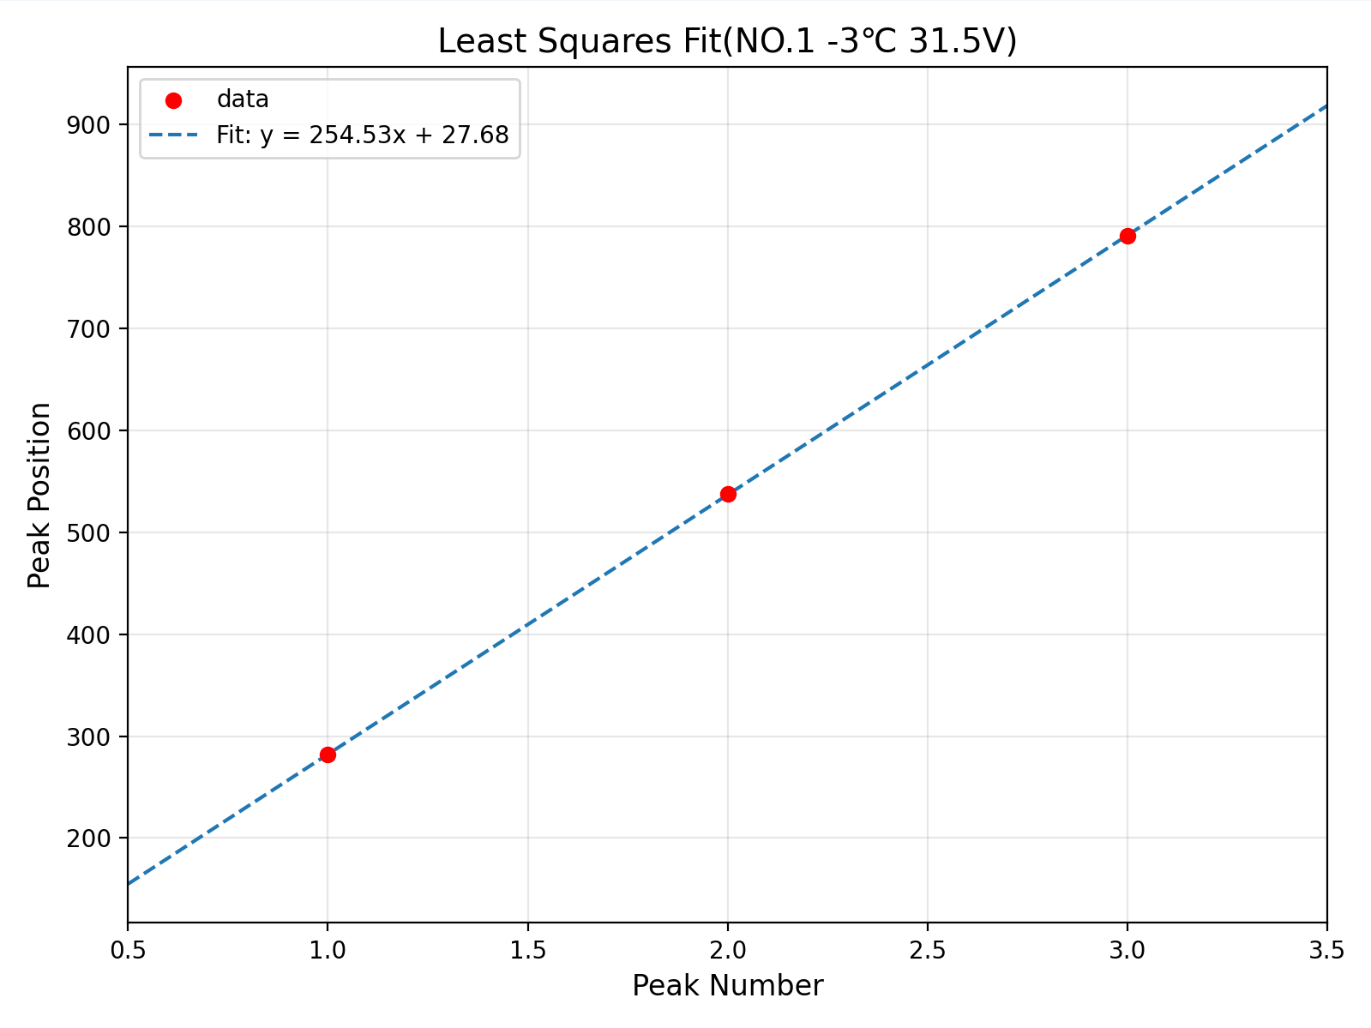
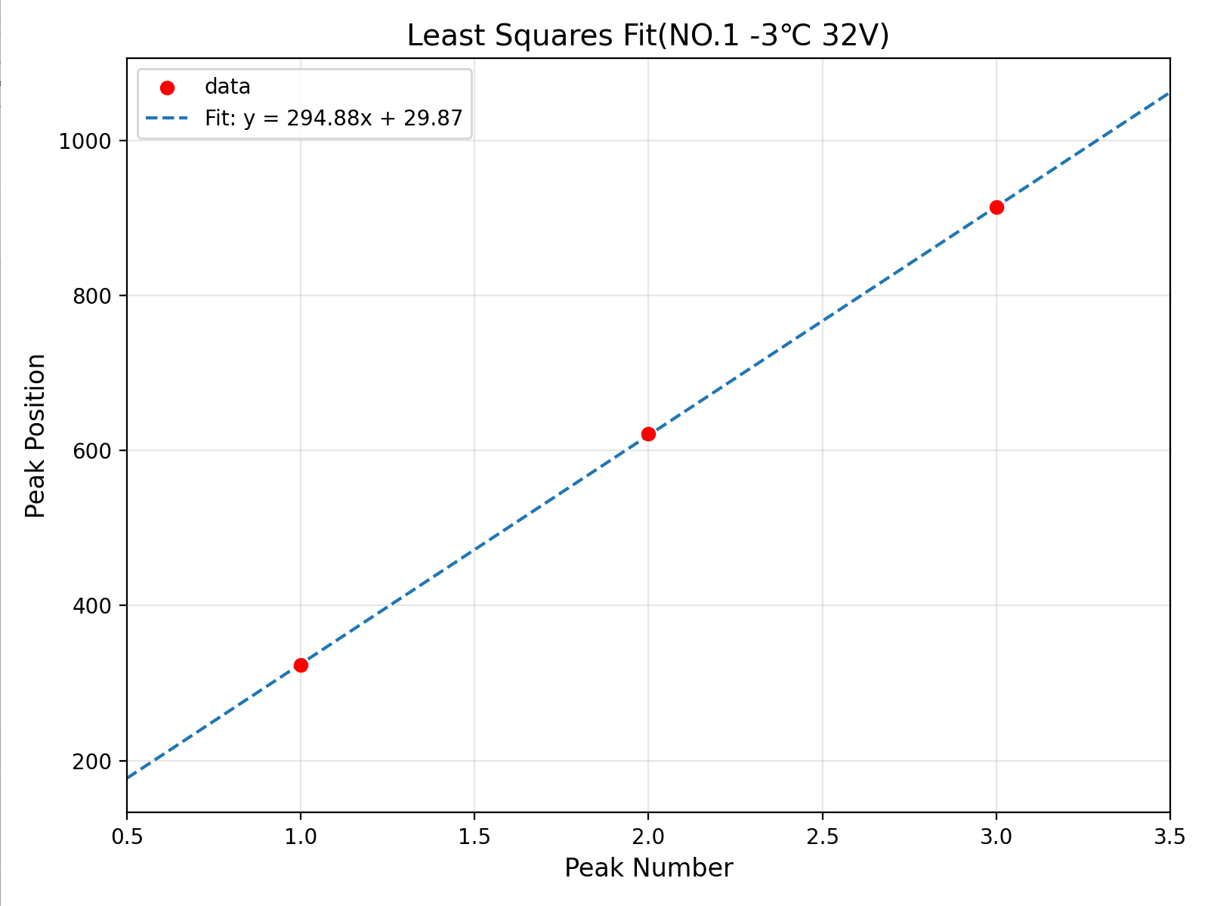
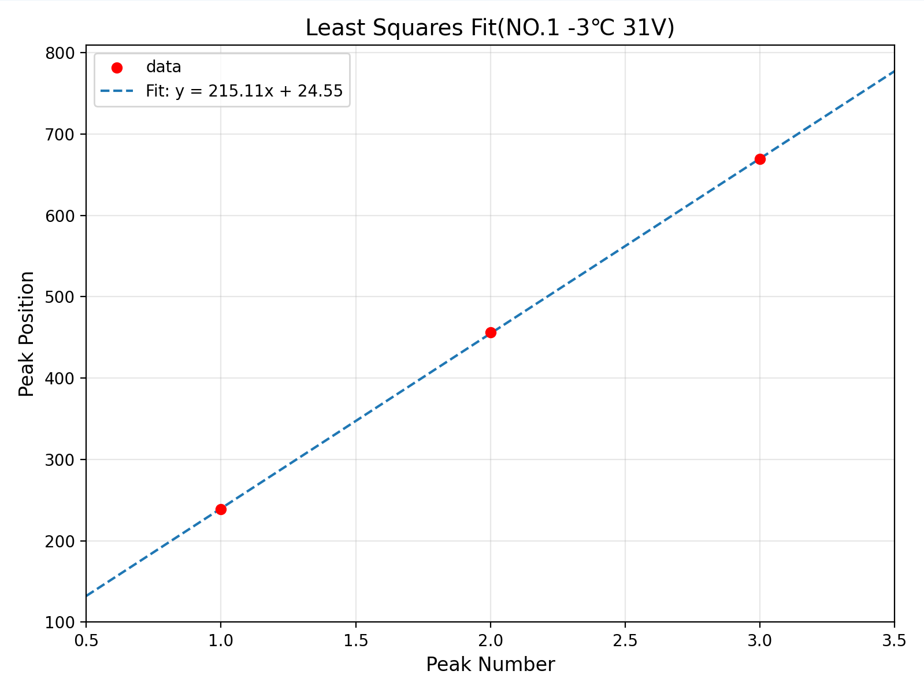
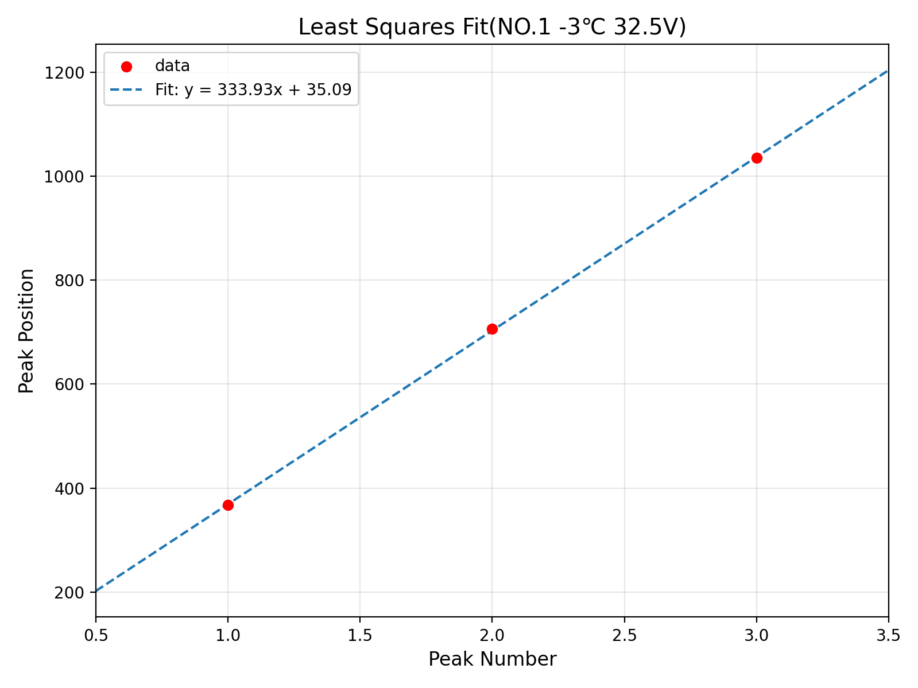
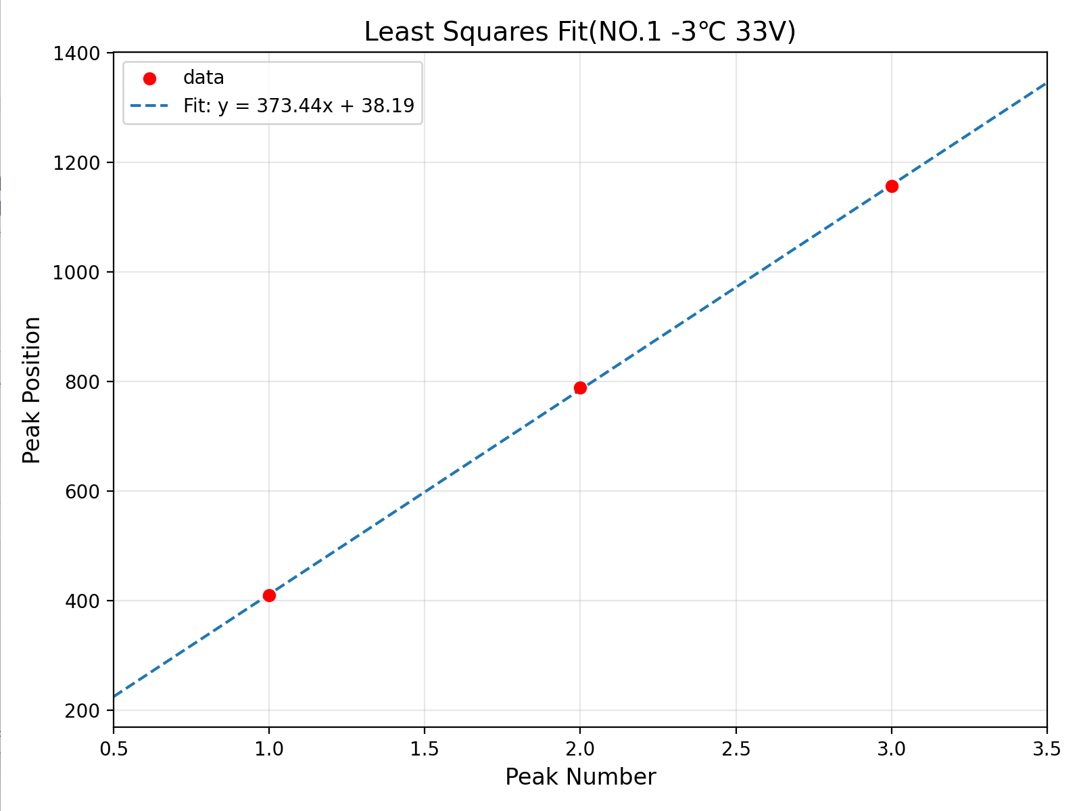
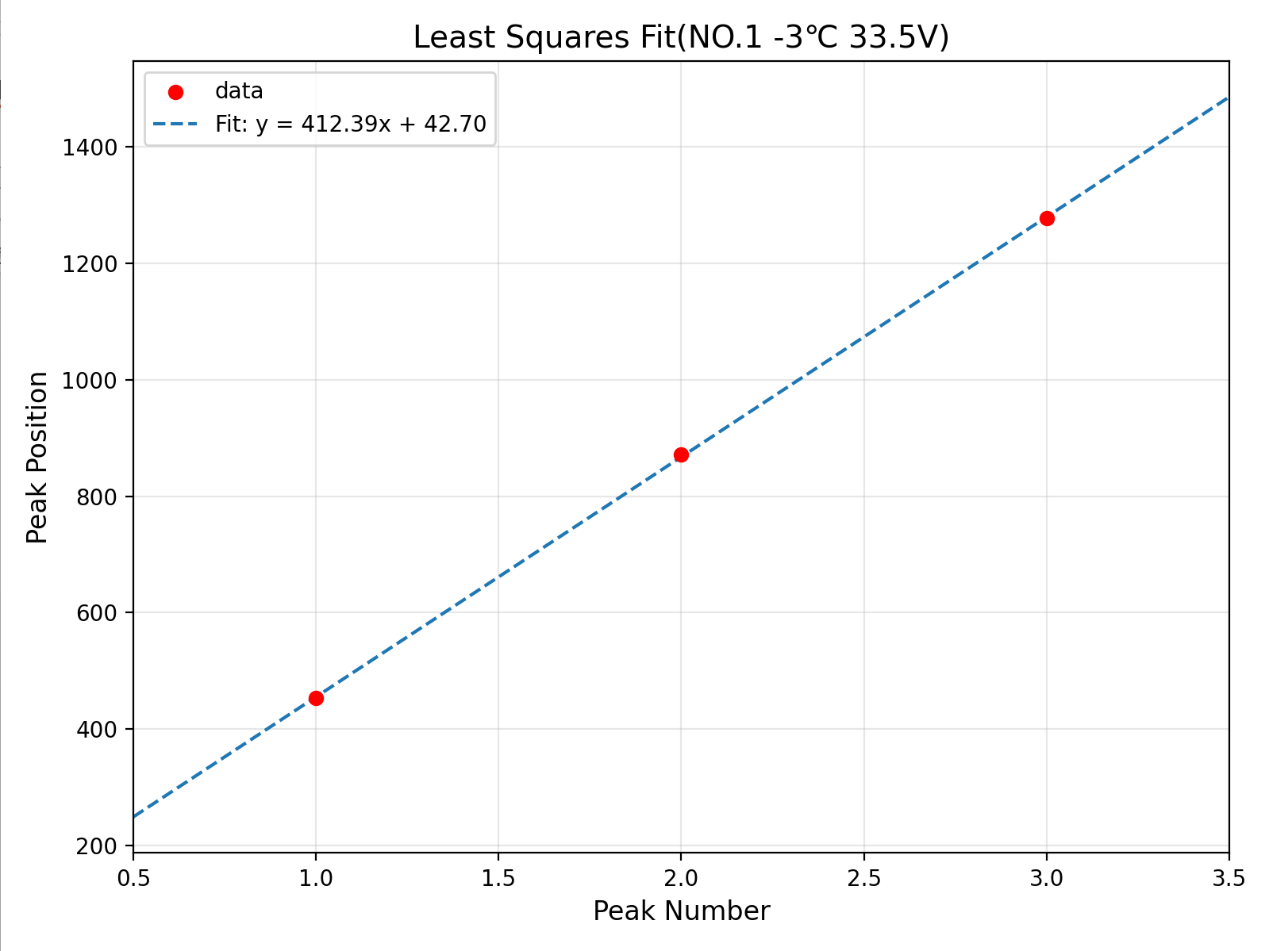
Back UP data

Slide 13
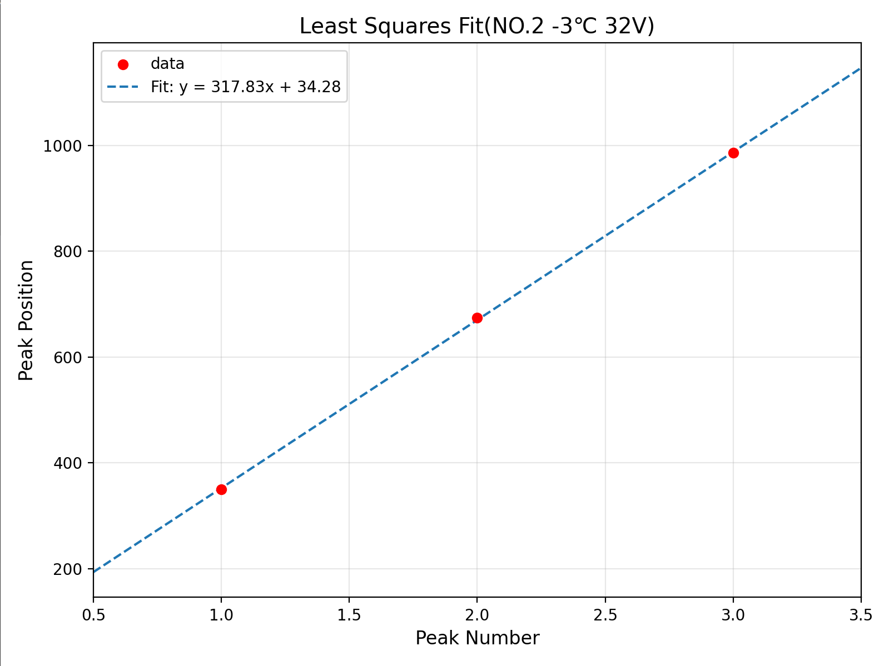
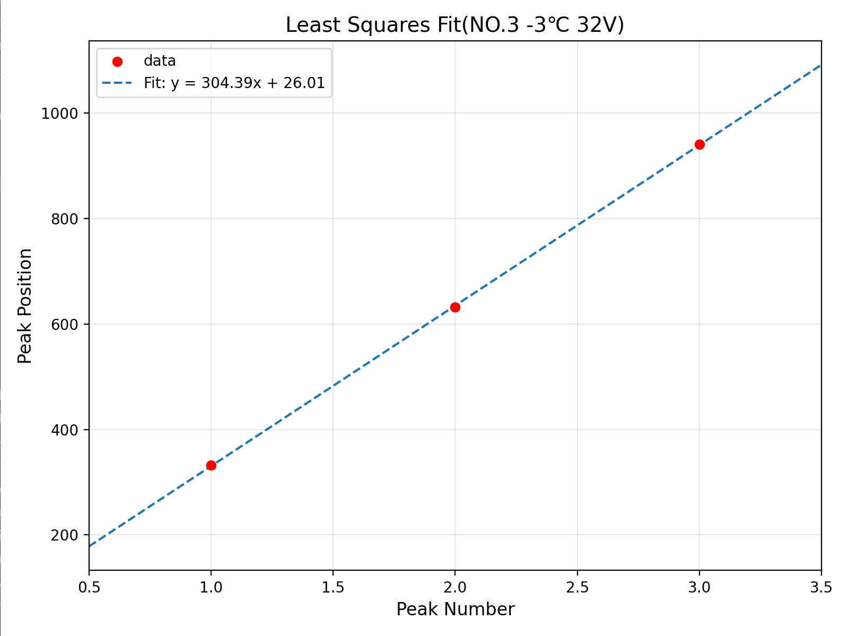
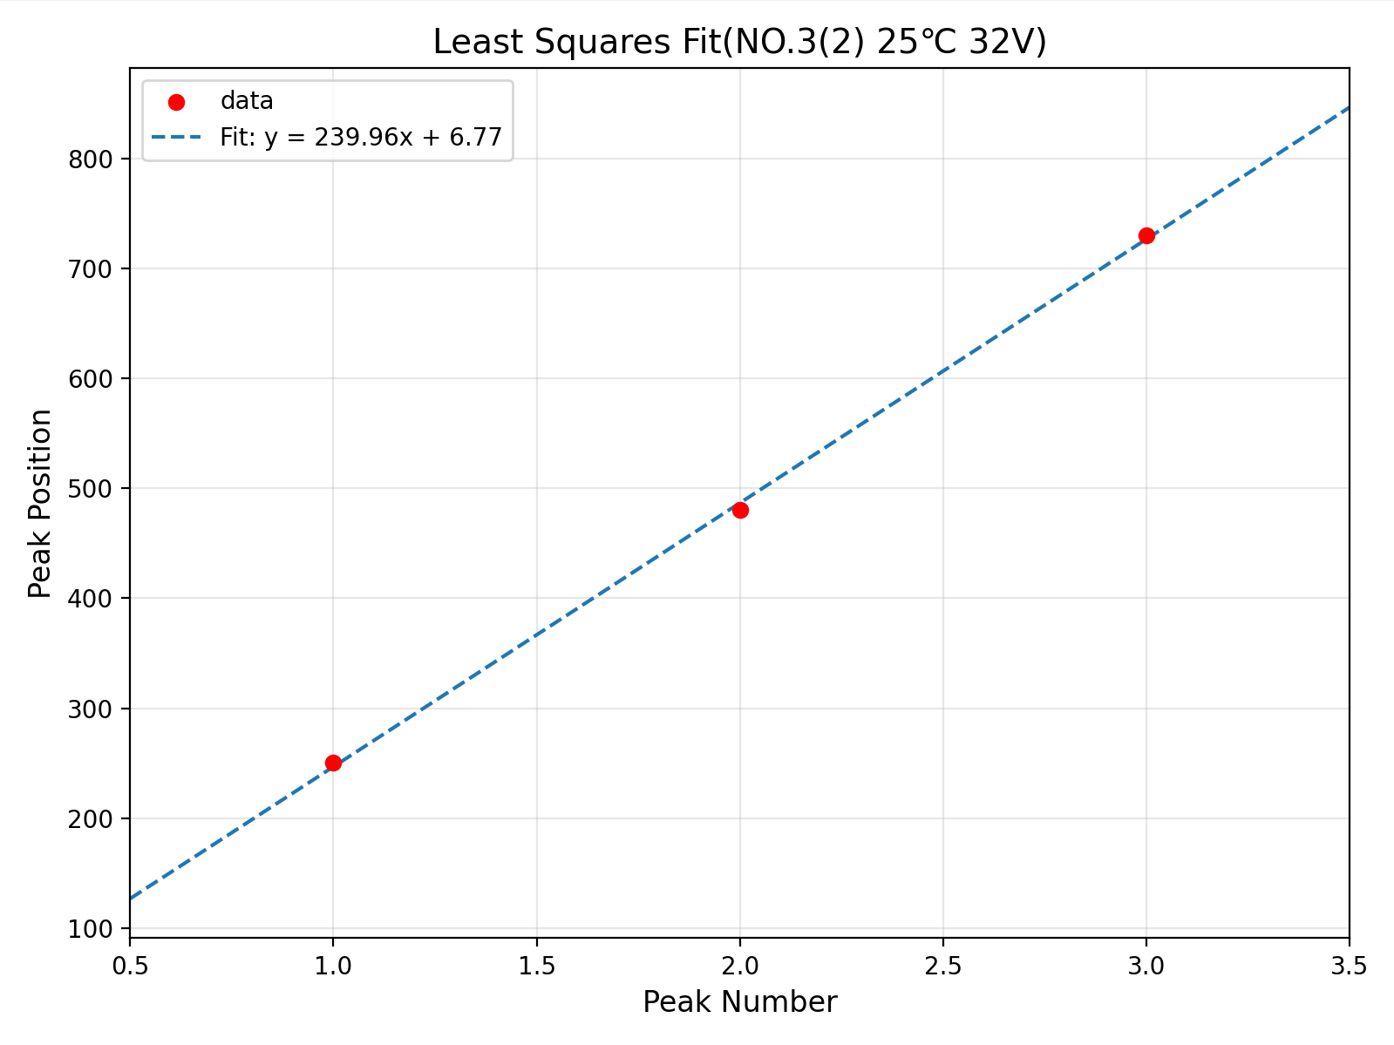
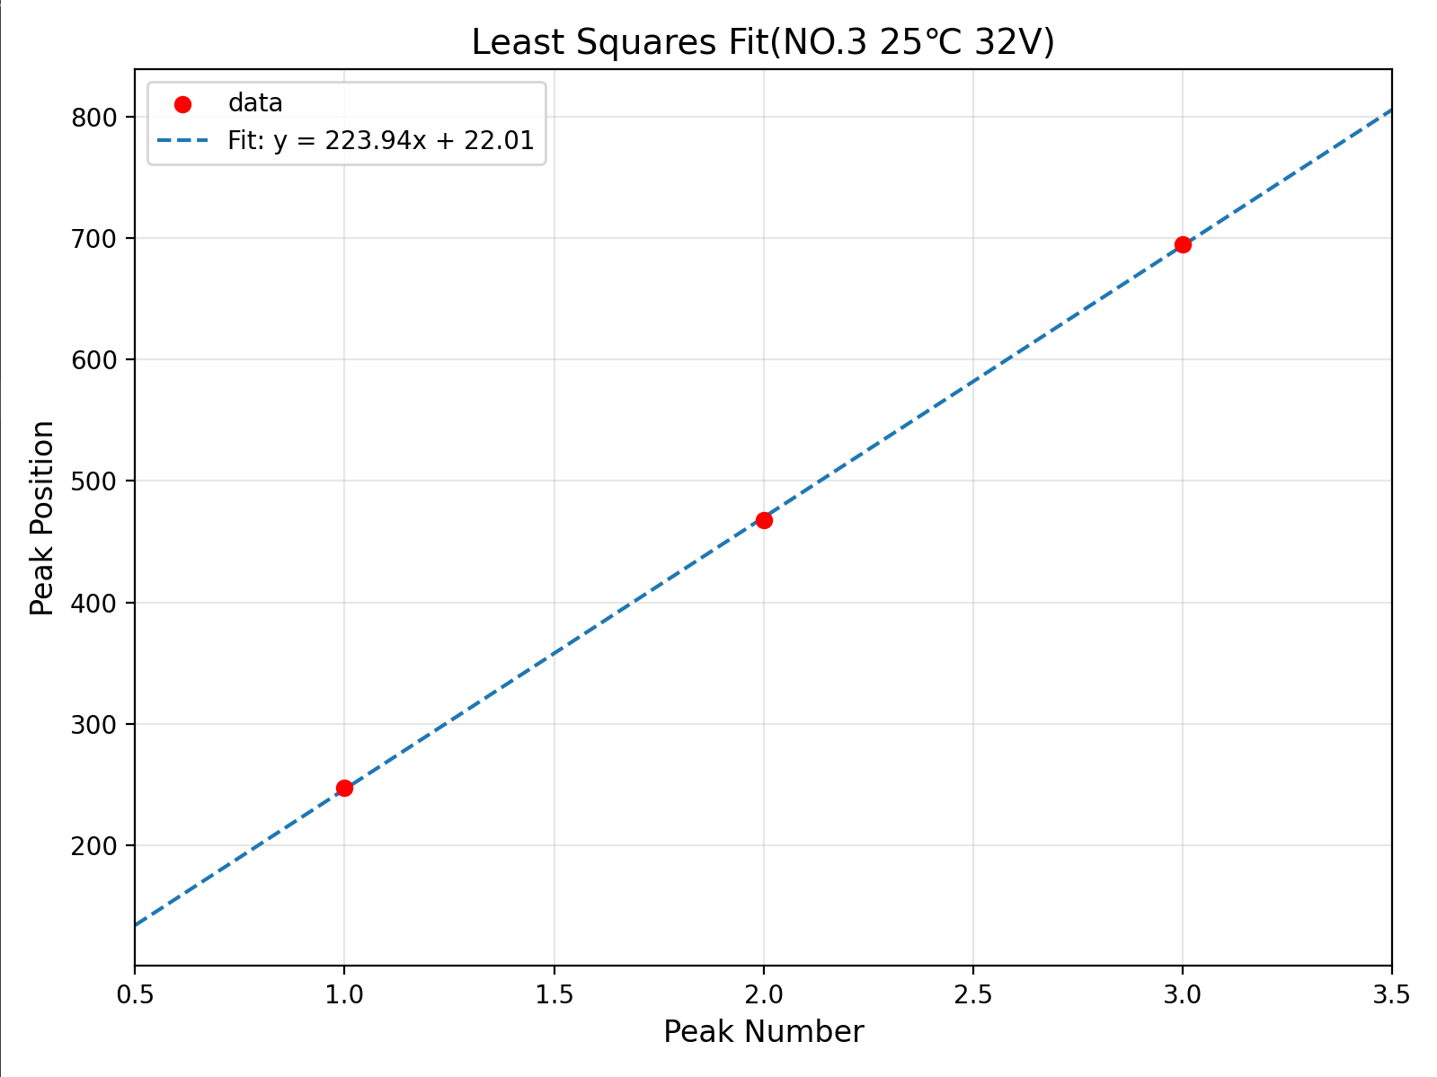
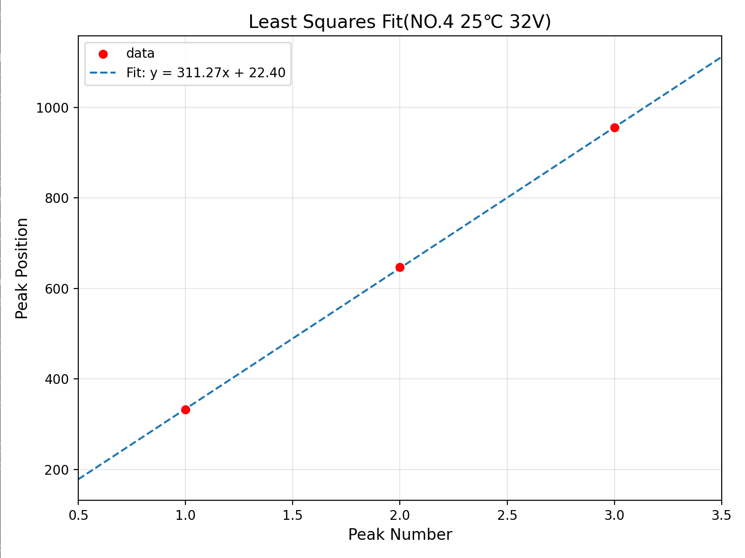
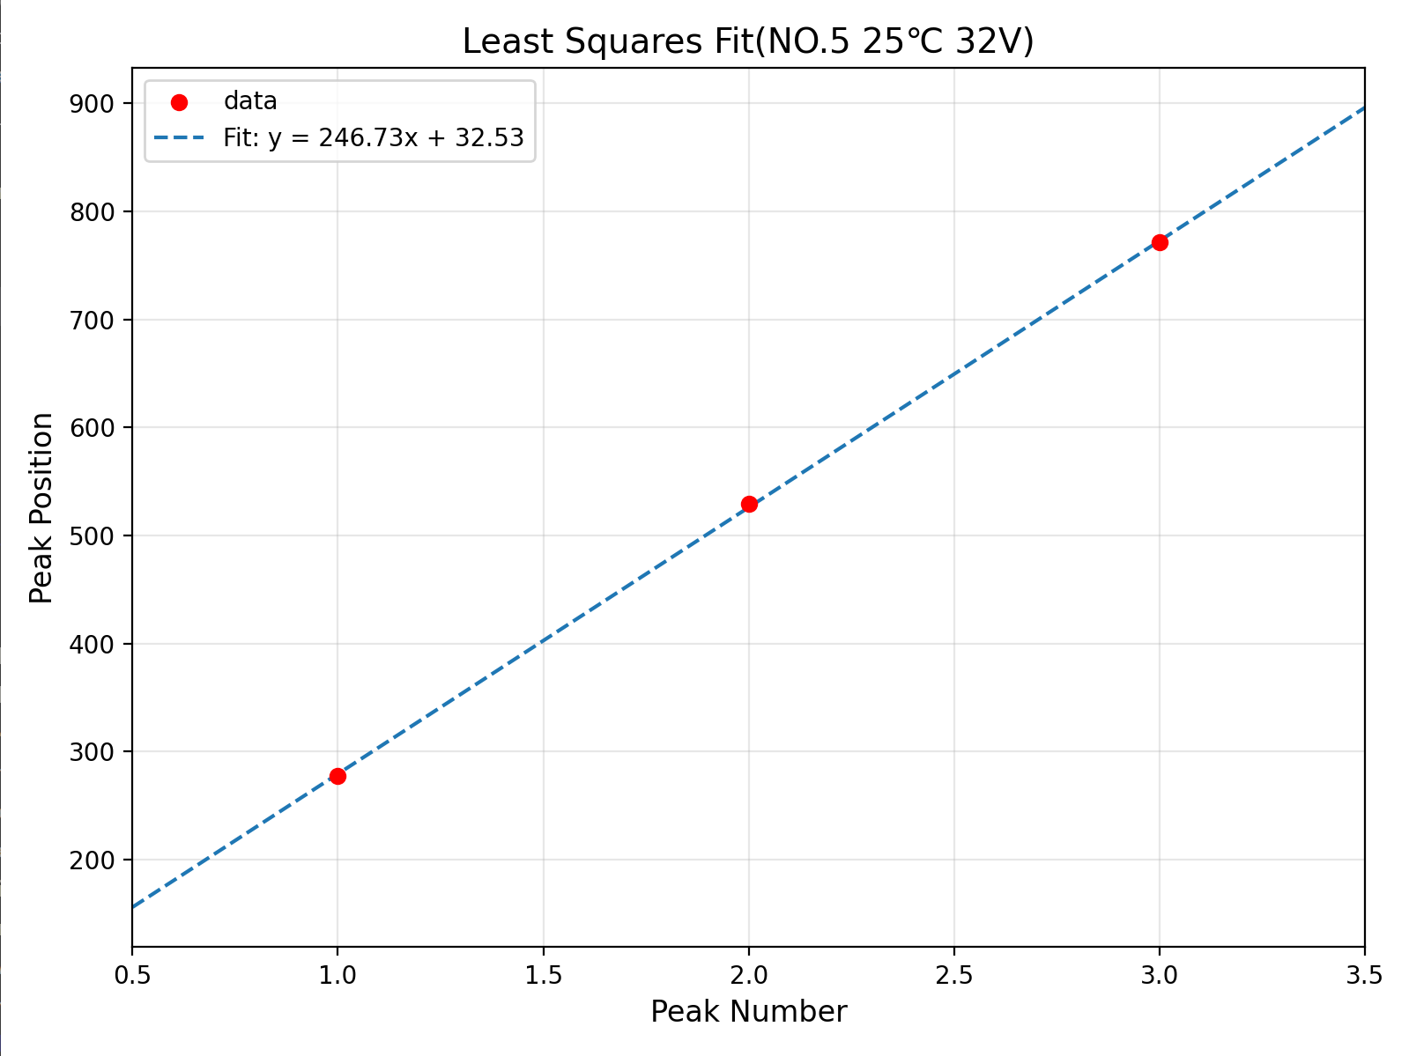
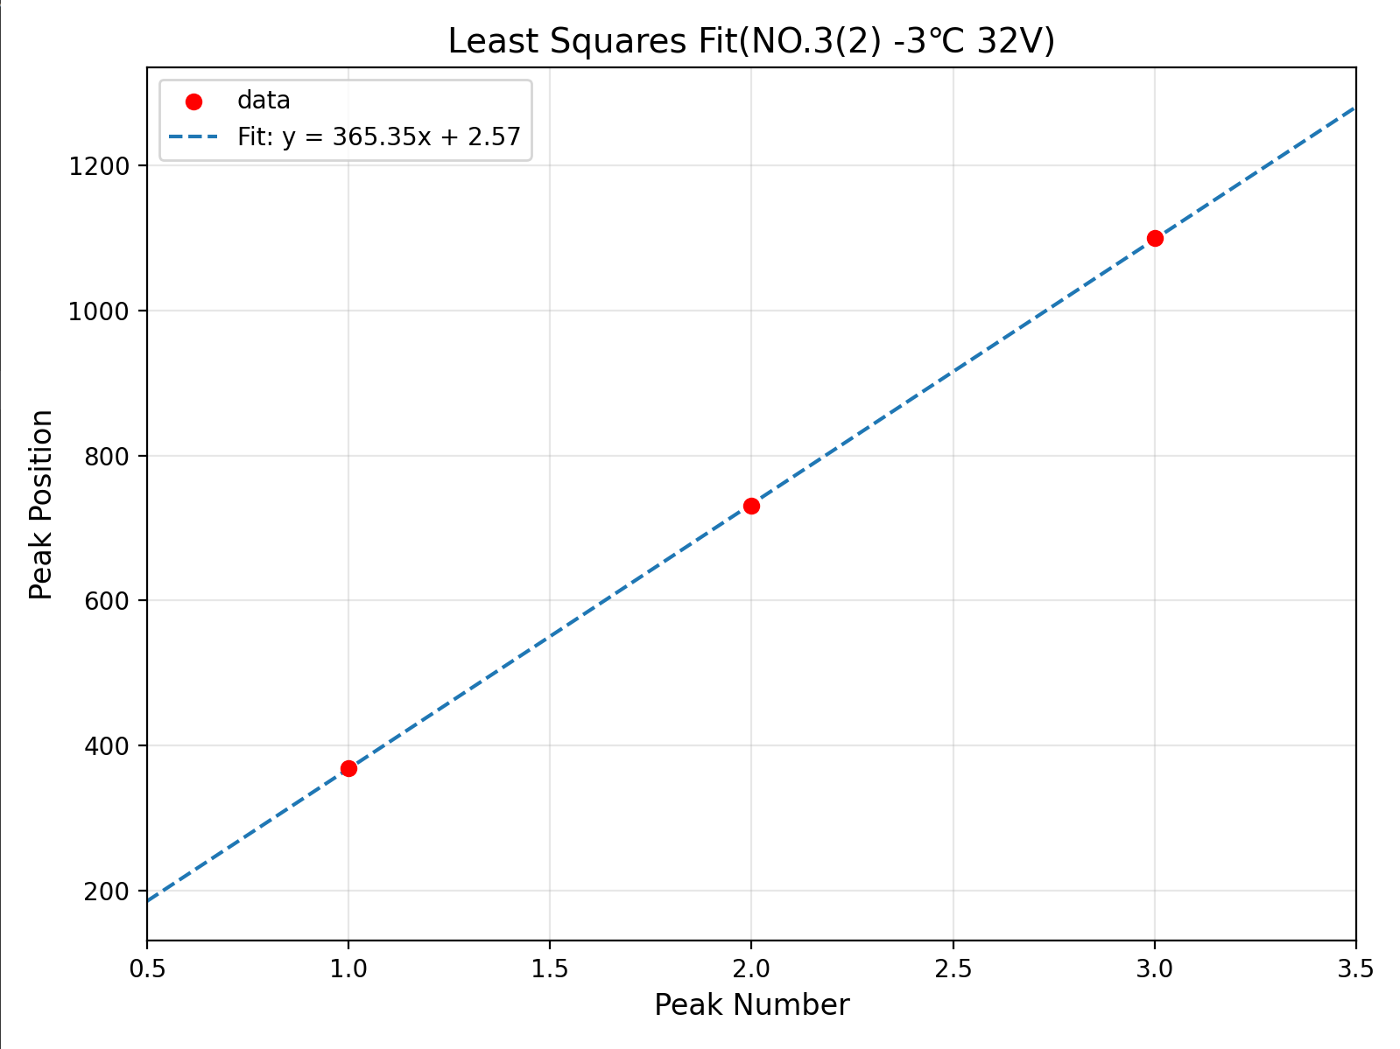
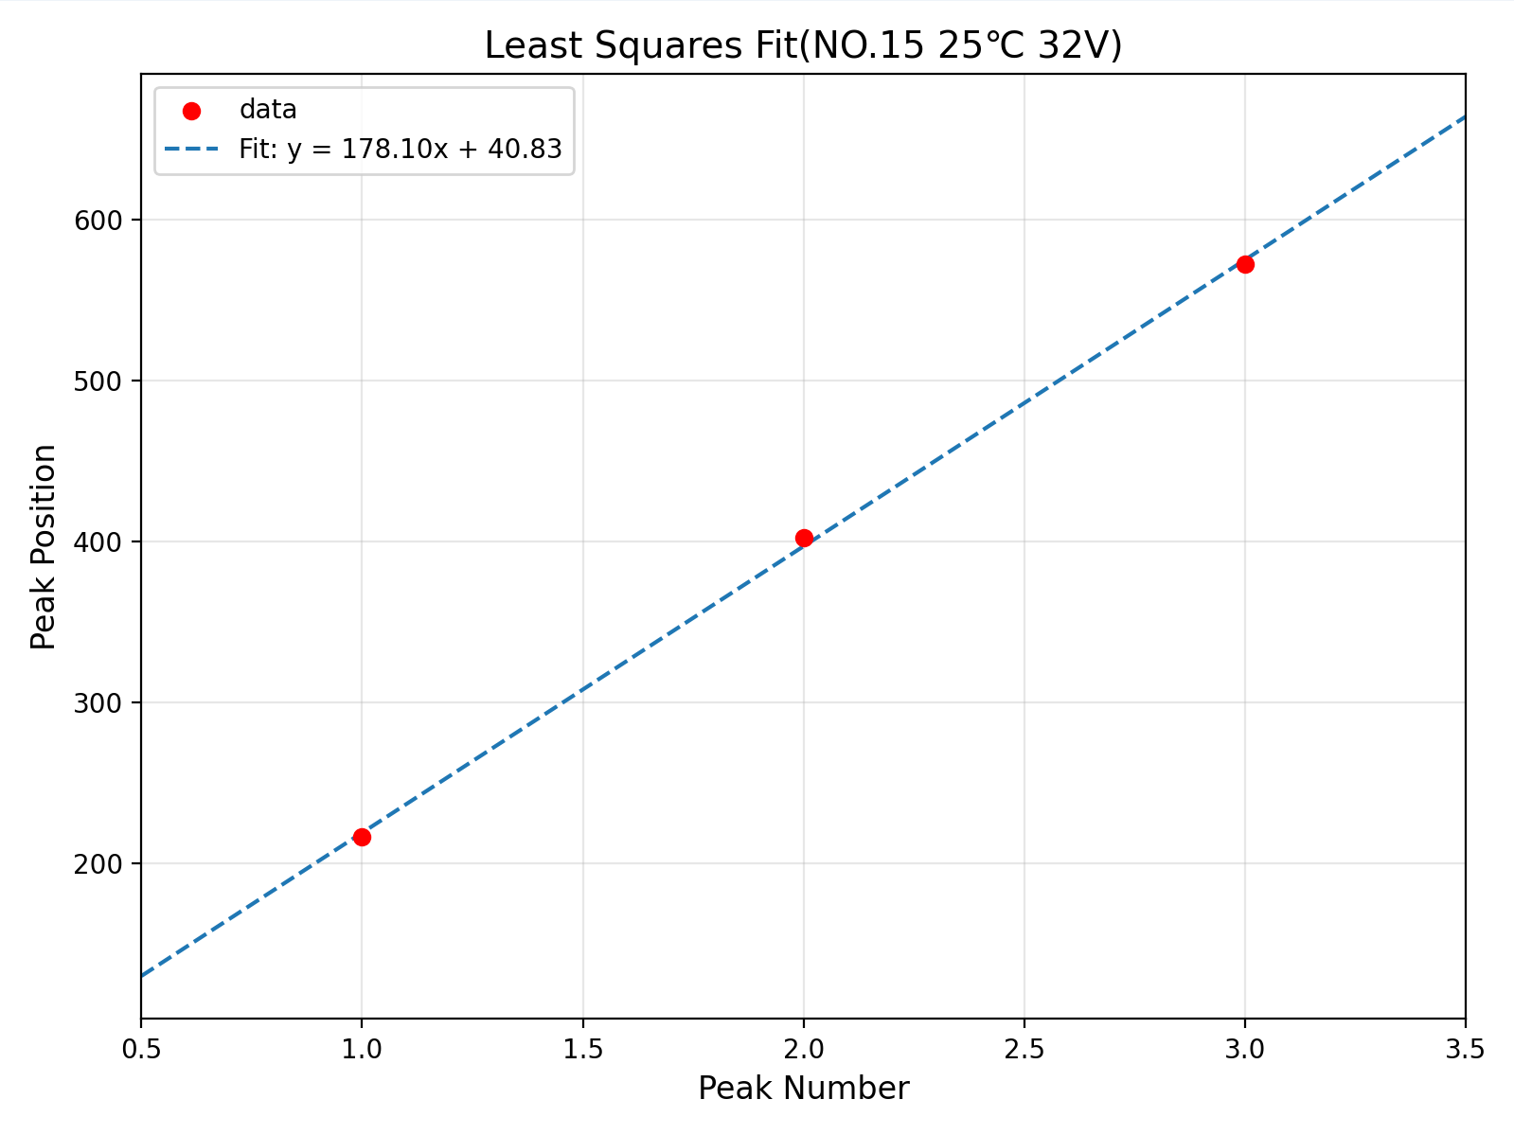
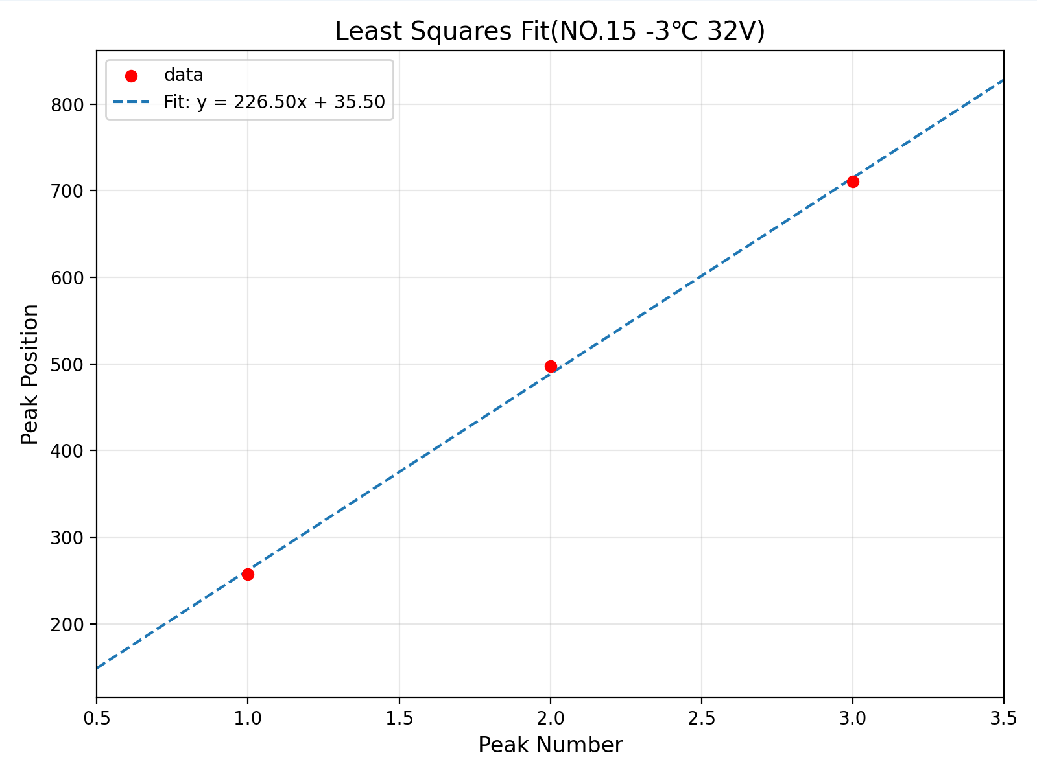
Back UP data

