Slide 1
CGEM DAQ Status and Plan
Tingxuan Zeng
2025-03-20

Slide 2
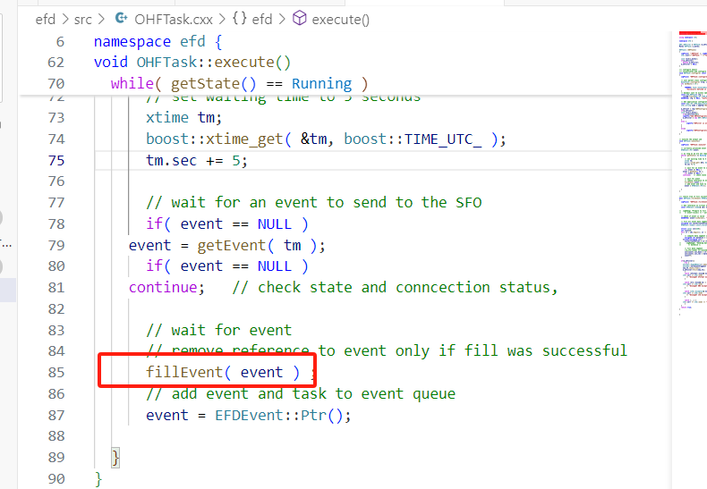
Continue to debug the EventFilter/DQMServer errors
Compared the xml files with stable version. It’s consistent.
Copy another base source code and run → it also had those errors. → errors comes from fillEvent() of the OHFTask.cxx

Slide 3
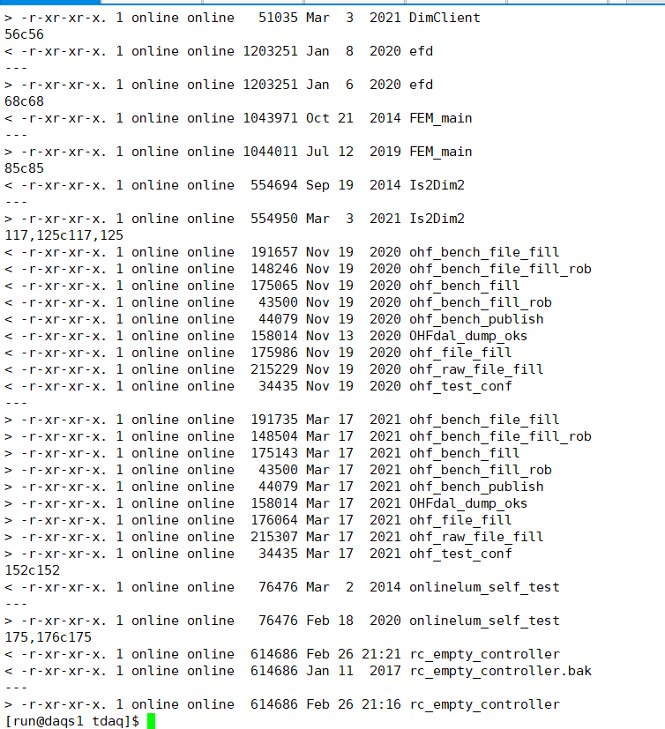
Compare the libraries and executables within base source code and the stale version
The ohf libs and executables in stable version are older than the base source code.

Slide 4
conclusion
The errors maybe because the stable version is older than the base source code.
The errors are not come from the new added CGEM communication code.
Next plan: copy the libraries and executables in the stable version to the current version and try to run the code again.

