Slide 1
Sensor News
Mei Zhao
2025-3-24

Slide 2
QT for Tianyuan Zhang
Approved: 2025-3-17
Tianyuan Zhang will work on sensor quality check （SQC）for the IHEP-IME production, data analysis and uploading.
1.) SQC: I-V testing will be done on large amounts of full-size sensors from each batch of IHEP-IME sensor production within one year by using per pad methods.
2.) Detailed analysis and the verification of production sensors compliance with required HGTD sensor specifications. Cross-check the SQC results with PQC and IT results during production, and regularly investigate the data to identify issues and check the quality of the production.
3.) C-V testing will be conducted on some pads of full-size sensors from the production batches and on certain QC-TS structures to evaluate sensor performance. 4.) I-V testing, CC/timing tests using 90Sr will be performed on some QC-TS structure before irradiation and on irradiated QC-TS in addition to main irradiation test site studies for verification of results if needed.

Slide 3
Thick sensor information
IHEP-IME | Good sensor number | status
B5-W2 | 37 | delivered, under hybridization
B5-W3 | 32
B5-W4 | 30 | Under picking
B5-W5 | 34
B5-W6 | 38
B5-W7 | 27
B5-W9 | 22
B5-W14 | 38
B5-W15 | 35
B5-W18 | 41
B5-W22 | 36
B5-W24 | 32
Total: 402
USTC-IME: 6 wafers, at picking company, ~ good sensors.

Slide 4
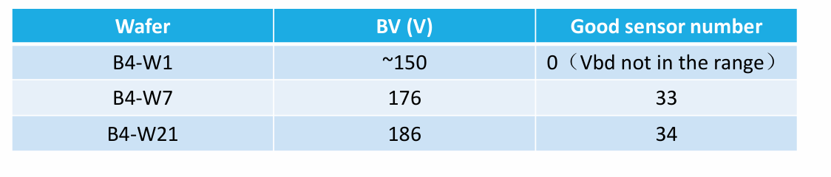
Pilot batch
~25 wafers from pilot batch be fabricated. Now under testing.
Results from 3 wafers (probe card testing)

Slide 5
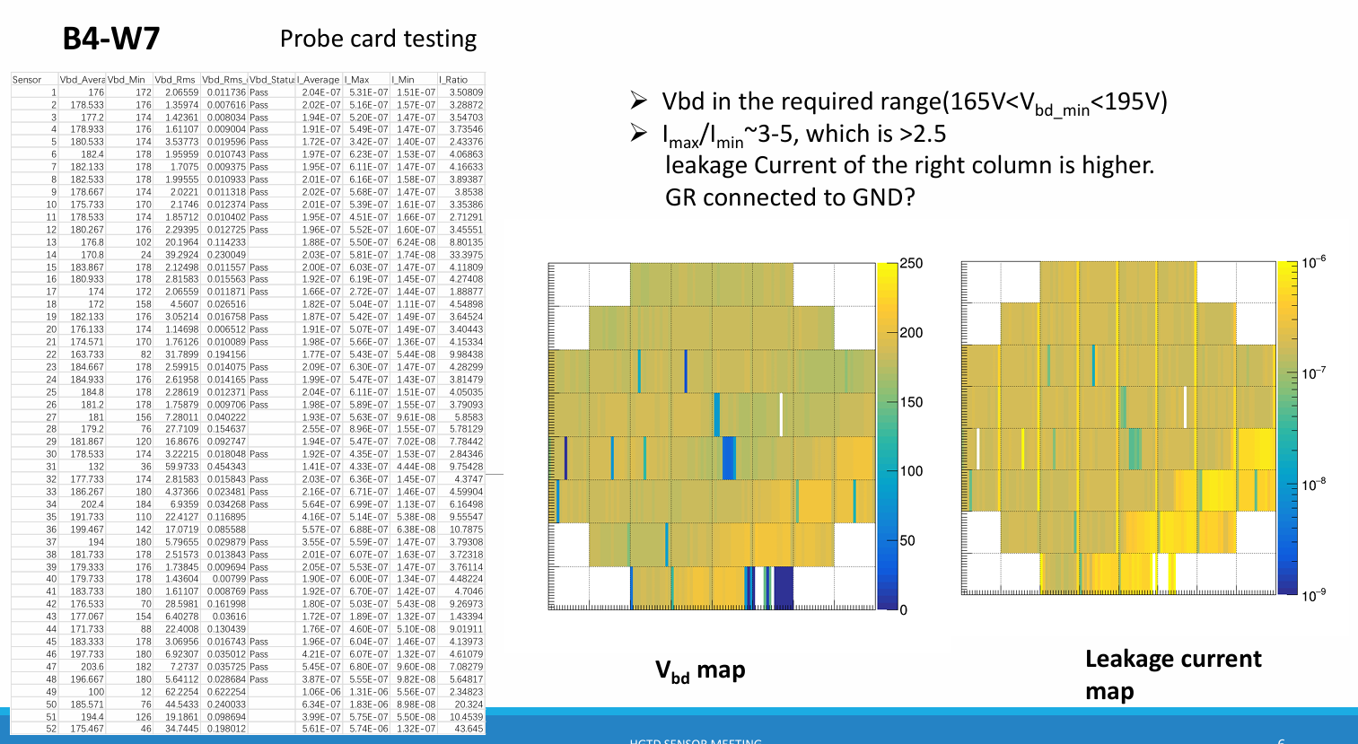
Pilot batch

Slide 6
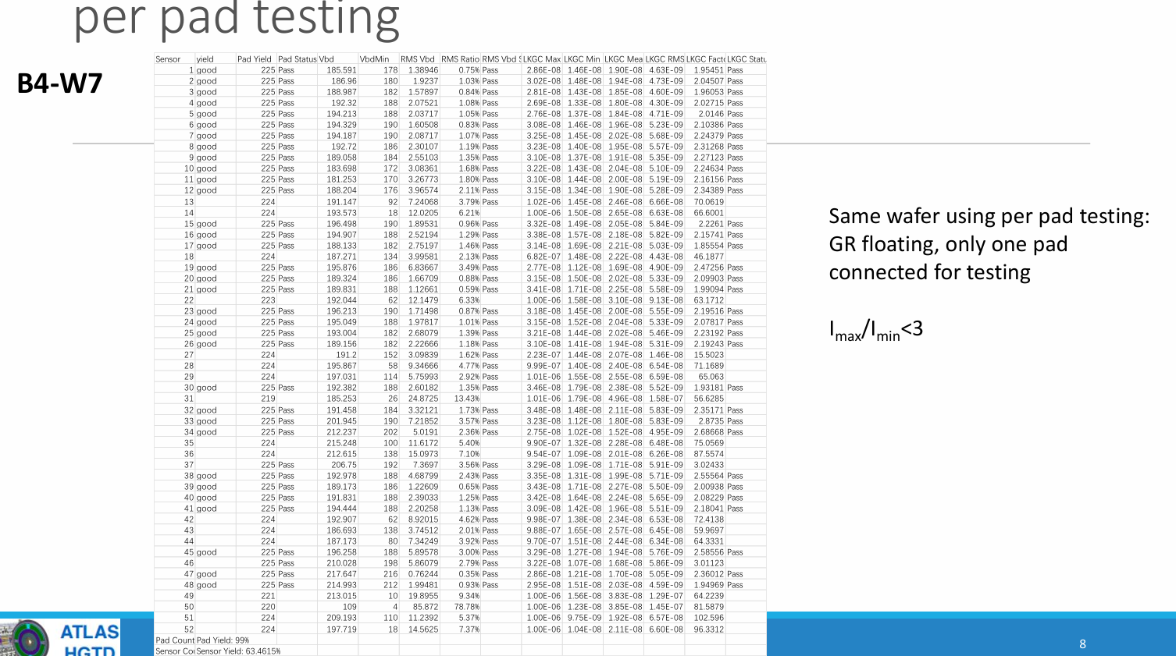
Pilot batch

Slide 8
Database
225 IV .csv file for one sensor. One wafer has 52 sensors. All the 52 sensors’ data be stored in one .zip file with name as wafer name(HGTD ID)
Register wafers and sensors firstly, then upload the .zip file
[scripts be used to rename each IV files, generate register document before uploading.]
More information(calculated by IME, using the script written by Weiyi) including Vbd, Vbd spread, Leakage current ratio will also be uploaded to the database. One excel for one wafer.

