Slide 1
Detector Unit
Yunyun Fan
2025.3.21

Slide 2
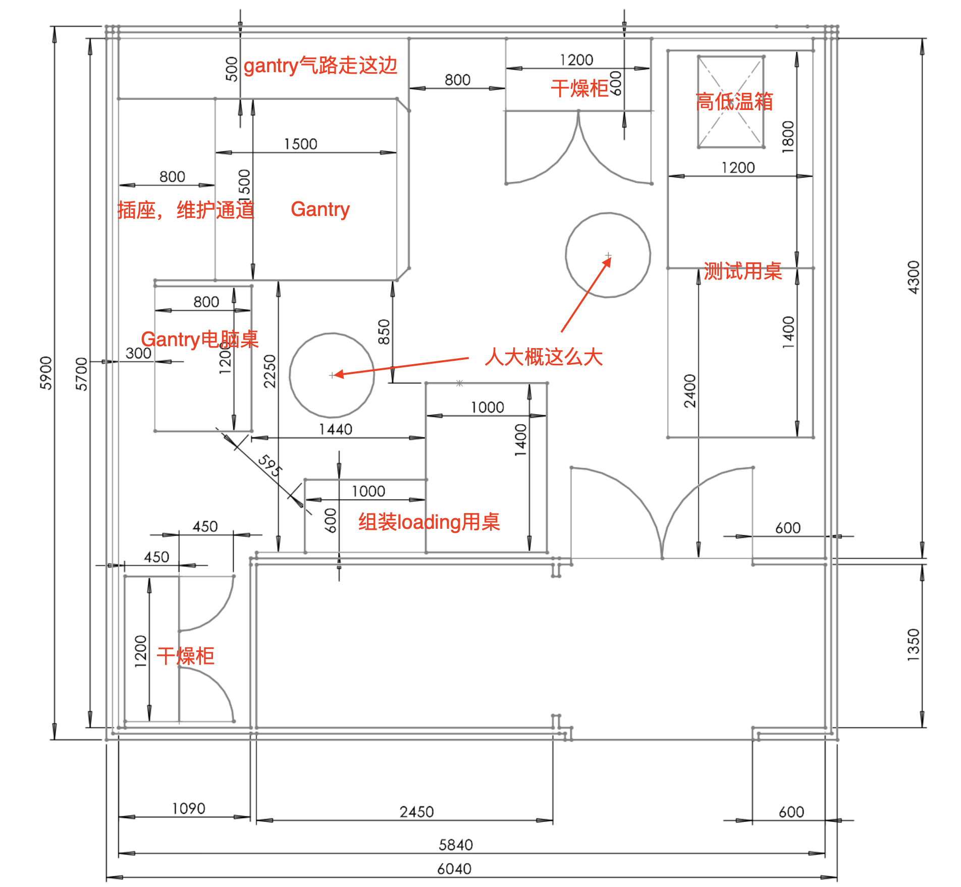
Move Gantry from 107 to 108
Things to buy：
Climate chamber
Desk： 2
Chairs：4
Clothes and
Gantry move plan

Slide 3
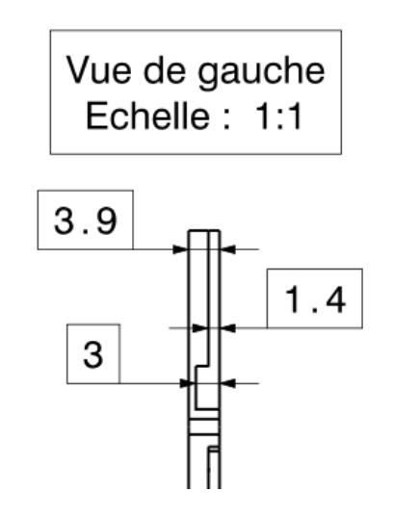
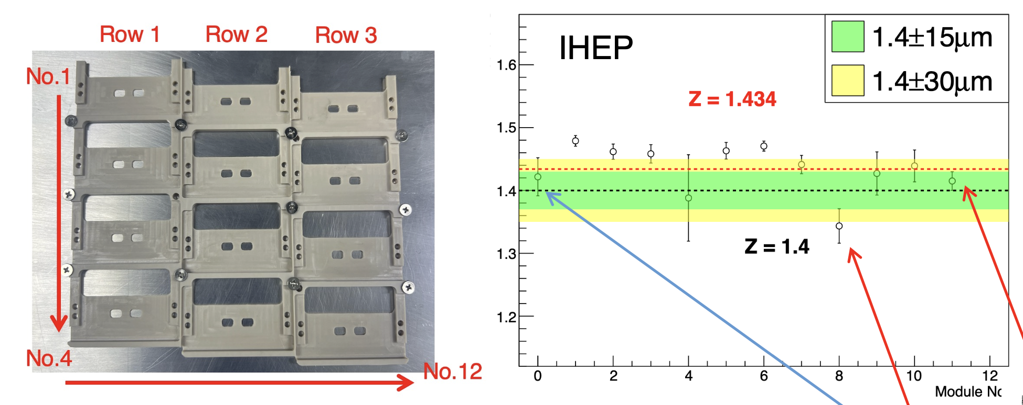
Measurement of the DU
Decide how to measure the planarity of the DU
Ensure the modules fits the DU and safely installed on the cooling plate

Slide 4
Results from the company
1.4126 – 1.5170 mm

