Slide 1
Flavor-tagging using BDT
2025 0324

Slide 2
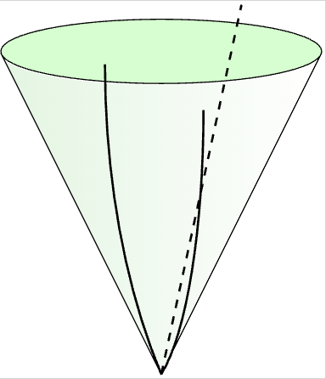
Vertex spliting
event level VS jet level
problem: mismatch in granularity
When performing jet-level classification, we are using partially event-level features
solve: vertex spliting
before:
jet2
jet1
jet1: [a,b,c,d]
jet2: [a,b,c,d]
c
a
d
b
after:
jet1: [a,b]
jet2: [c,d]
jet level
event level

Slide 3
Features for BDT
class1= ["SingleVtxProb", "JetVtxLxyz_0", "JetVtxLxyz_1", "vtxlen12","JetVtxAngle_0", "JetVtxAngle_1", "vtxsig_0", "vtxsig_1","vtxsig12", "vtxmult", "Njetvtxtrk_0", "Njetvtxtrk_1", "JetVtxMomenta_0", "JetVtxMomenta_1" ,"JetVtxMass_0", "JetVtxMass_1", "trk1d0sig", "trk2d0sig", "trk1z0sig", "trk2z0sig", "trk1pt", "trk2pt", "JetTotalVtxMass","allTrackD0bprob", "allTrackD0cprob", "allTrackD0qprob", "allTrackZ0bprob", "allTrackZ0cprob", "allTrackZ0qprob",'JetVtxProbablity_0','JetVtxProbablity_1', 'allTrackMass'] # 32
class2 = [
'Njettrk', 'Njetvtx', "JetVtxCollinearity_0", "JetVtxCollinearity_1", "JetVtxChi2_0", "JetVtxChi2_1", "JetVtxEnergy_0", "JetVtxEnergy_1", "JetVtxKin_0", "JetVtxKin_1","JetEnergy","allTrackD0_0", "allTrackD0_1", "allTrackZ0_0", "allTrackZ0_1" + class1] # 47

Slide 4
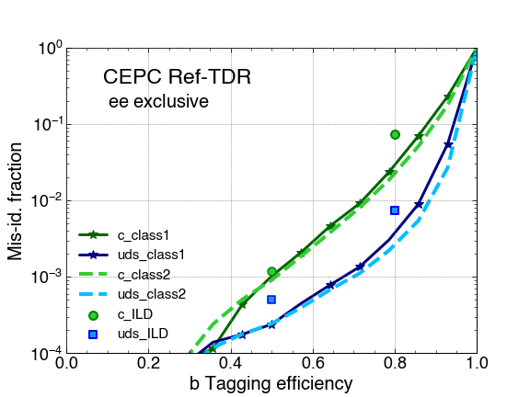
Performance
class1
the c-jet rejection improves by a factor of 2.5 (1.2) at a b-tagging efficiency of 0.8 (0.5).
the uds-jet rejection improves by a factor of 2 (2) at a b-tagging efficiency of 0.8 (0.5).

Slide 5
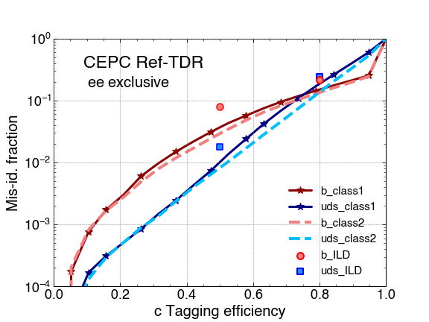
Performance
class1
the b-jet rejection improves by a factor of 1.4 (2.1) at a b-tagging efficiency of 0.8 (0.5).
the uds-jet rejection improves by a factor of 1.3 (1.7) at a b-tagging efficiency of 0.8 (0.5).

Slide 6
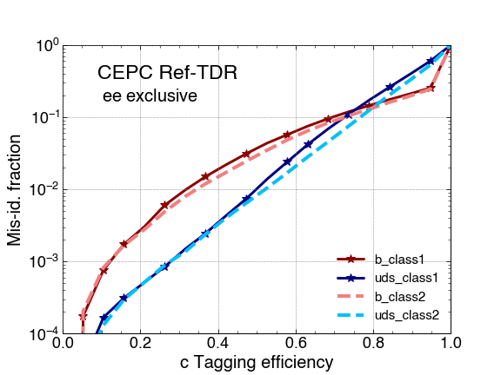
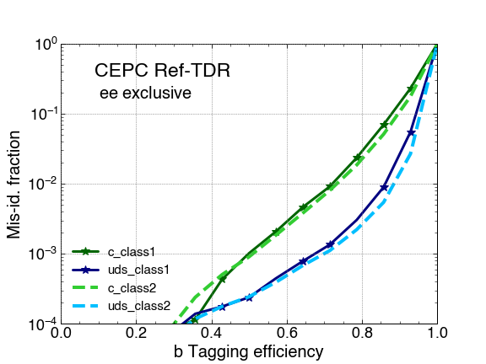
Performance

