Slide 1
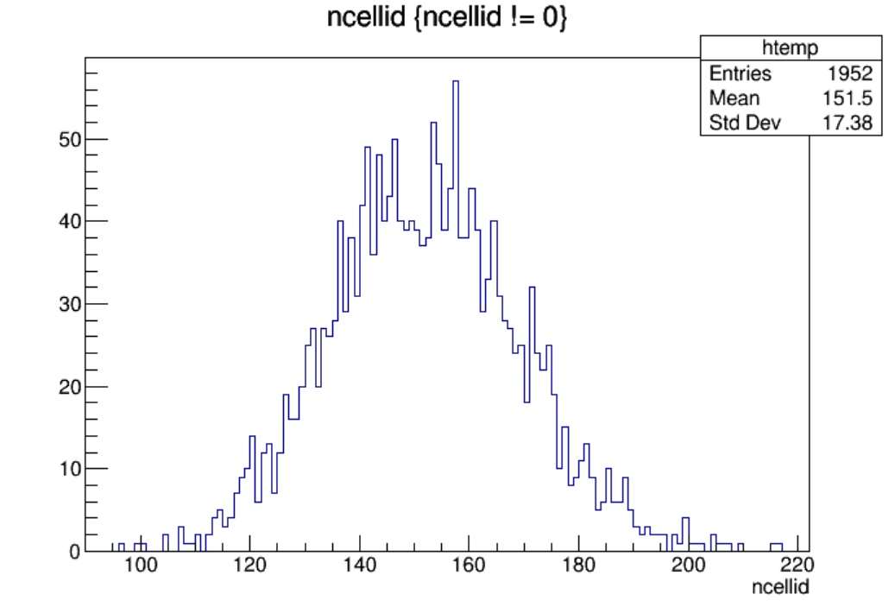
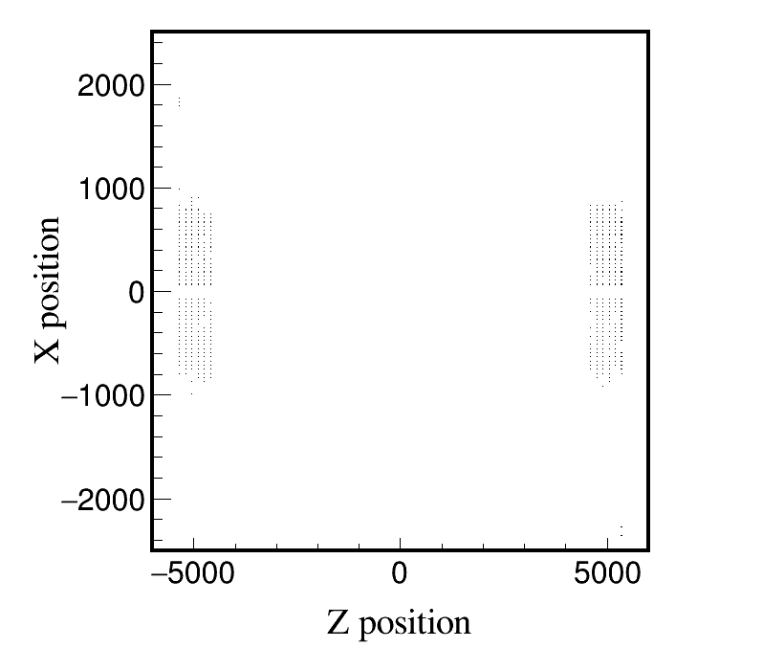
Higgs, Whole_250306, endcap, 2000 files, 10BX:
Higgs, Whole_250306, endcap, 10 files, 10BX:
Distribution of ncellid
Max ncellid: 216

Slide 2
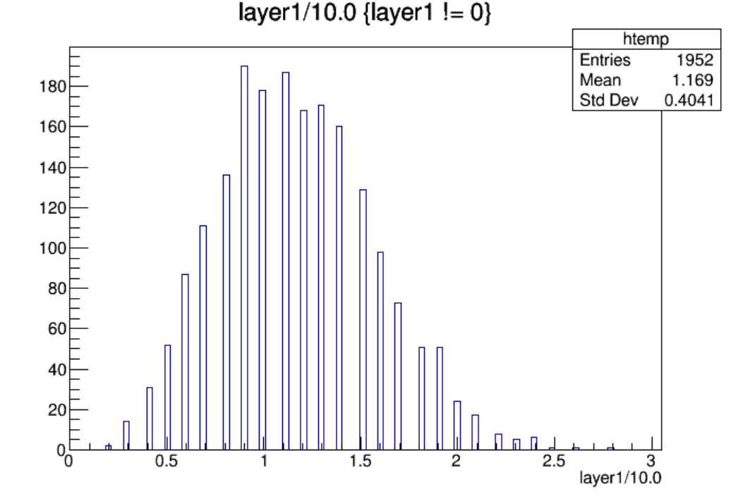
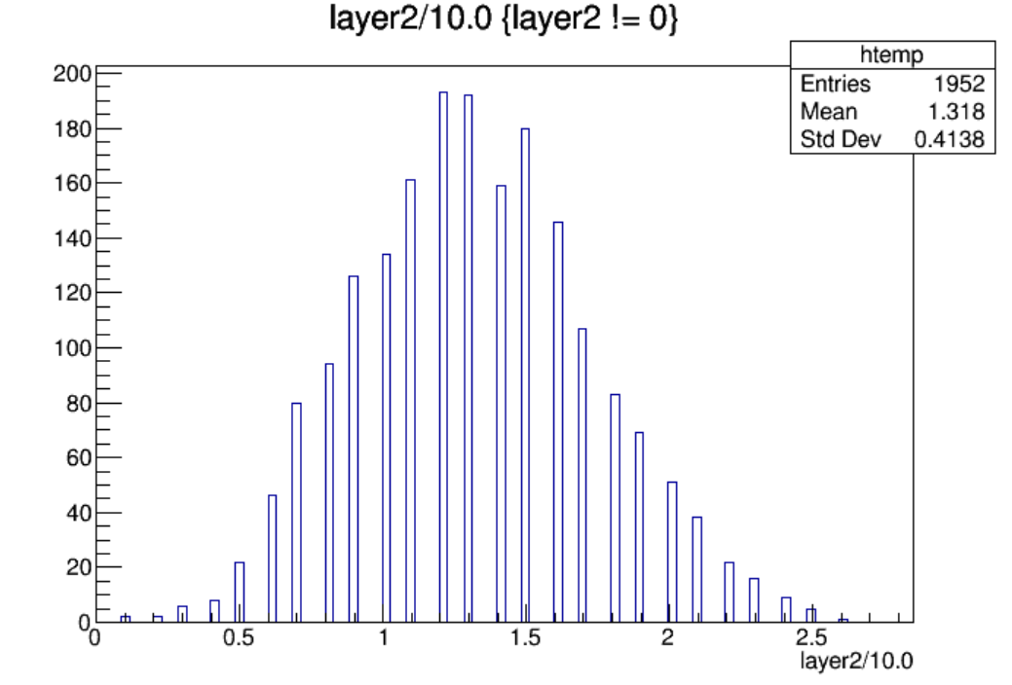
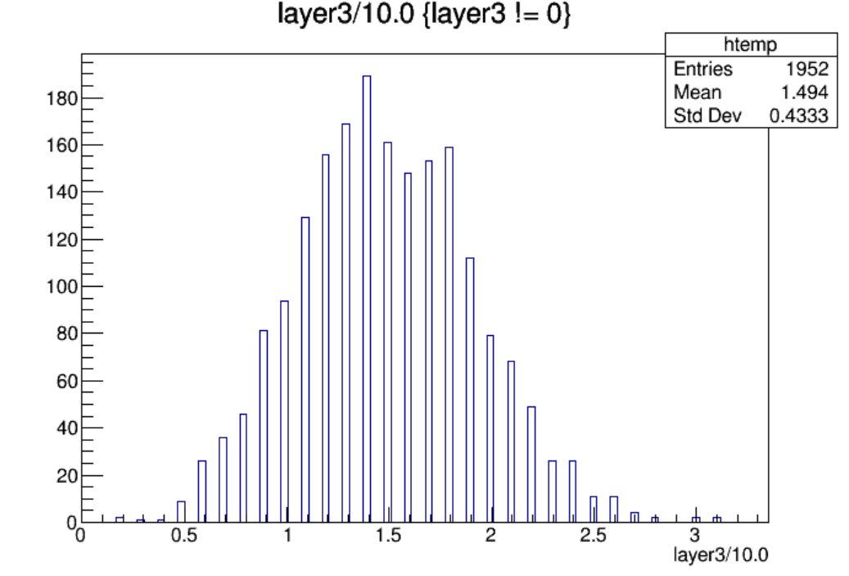
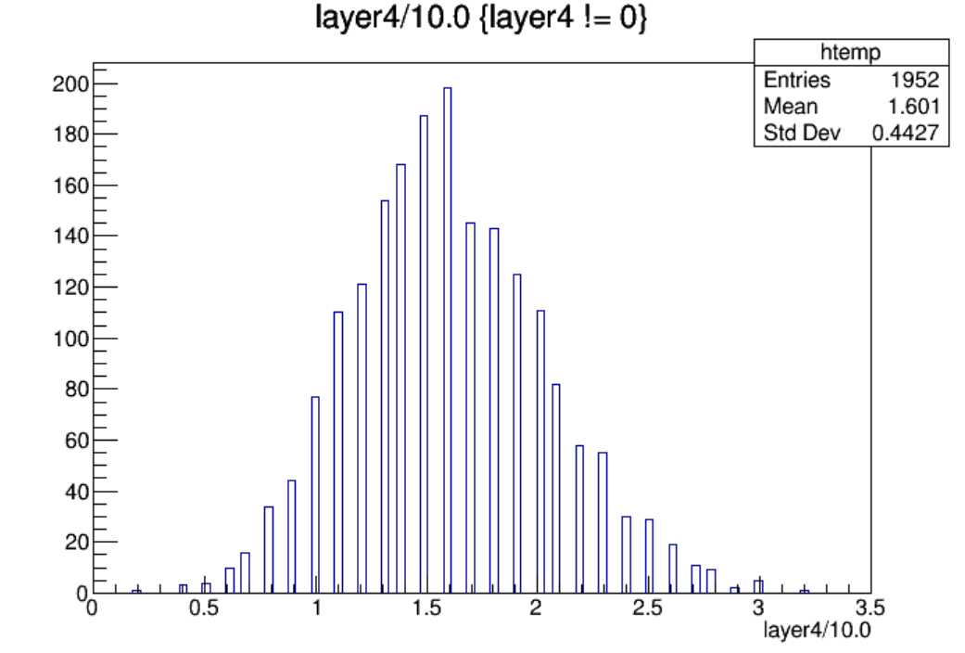

Slide 3
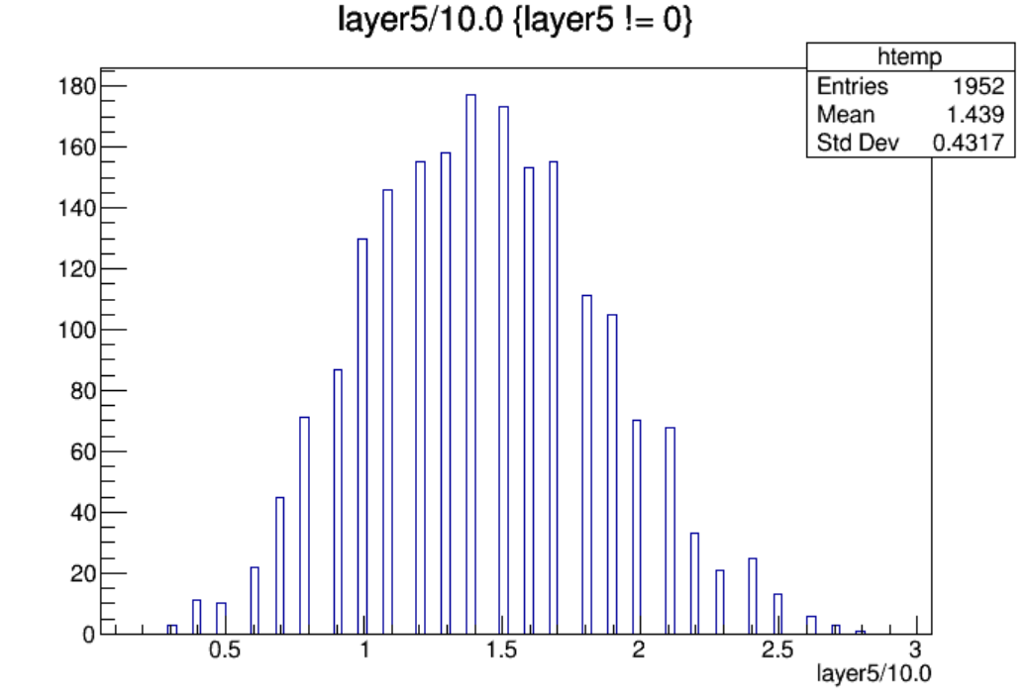
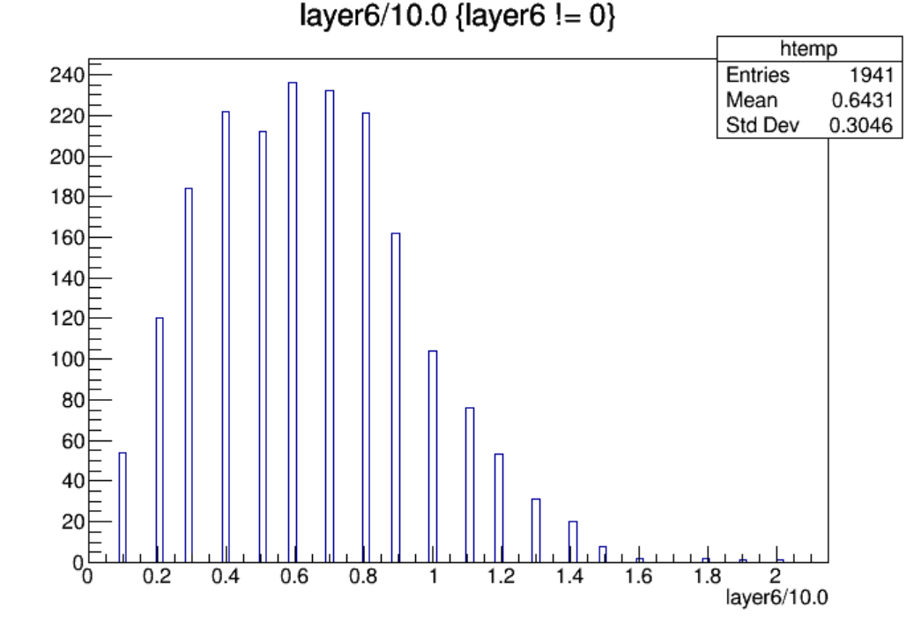
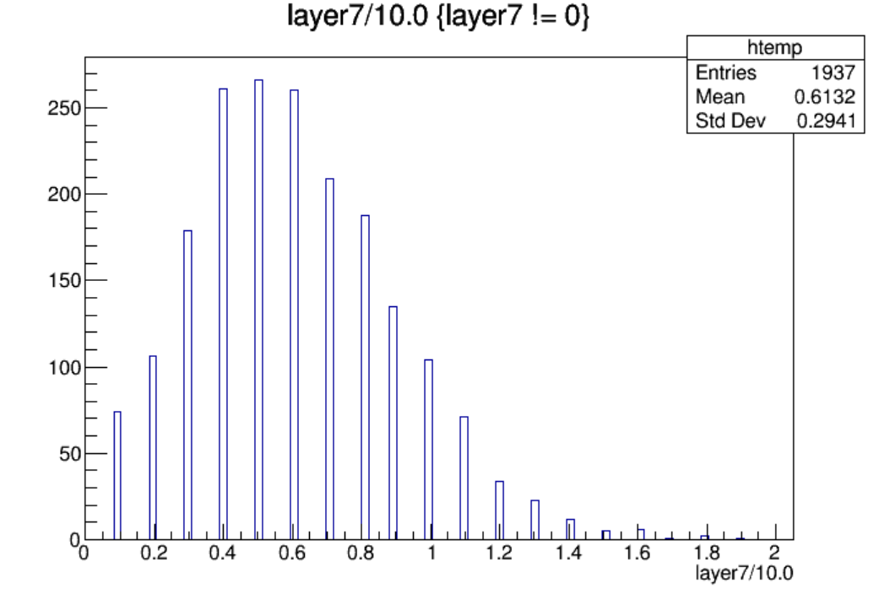

Slide 4
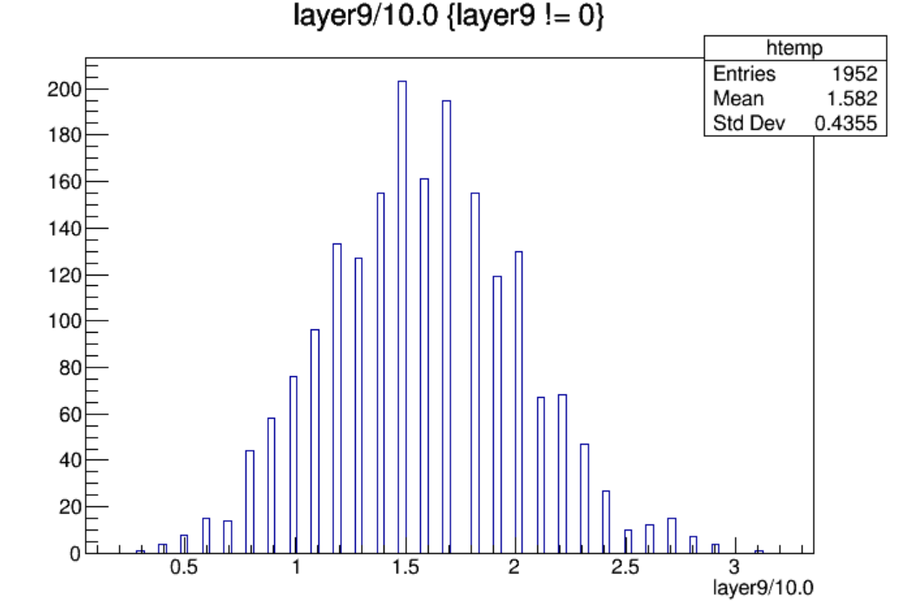
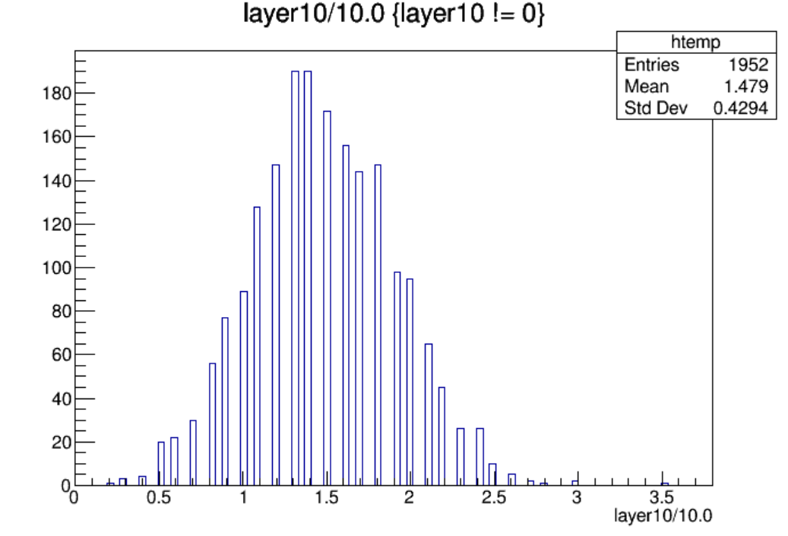
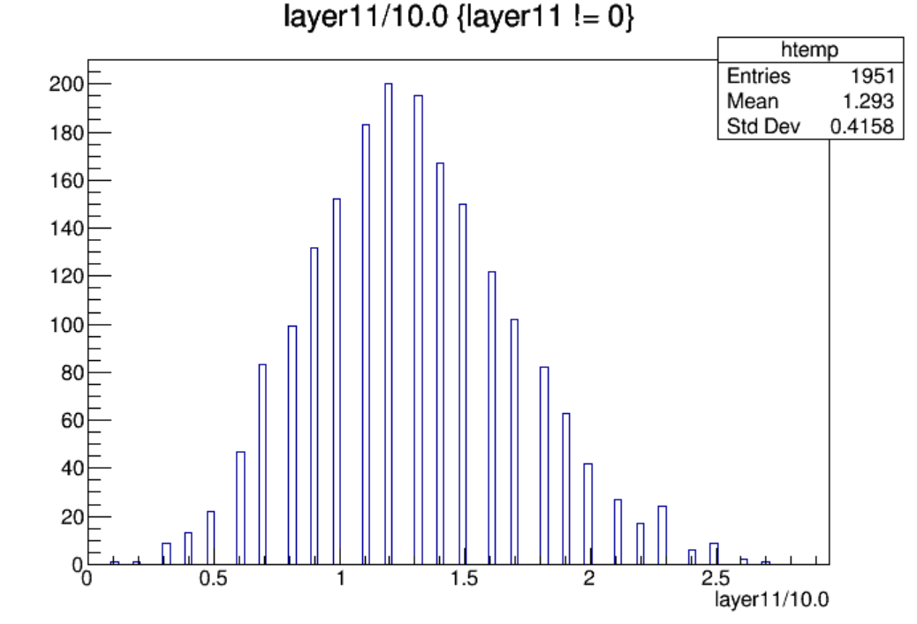
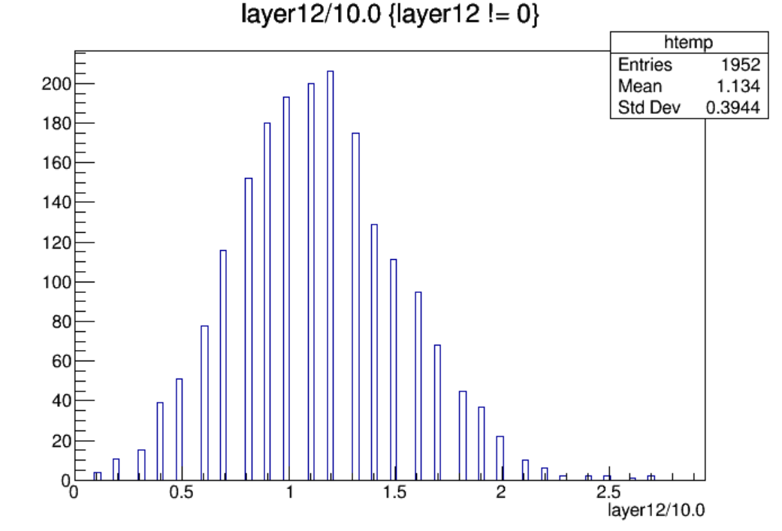

Slide 5
$Nstrip\left(endcap\right)=19200$, $Nstrip\left(endcap, per layer\right)={19200}/{12}=1600$
Layer | Max Hit Density(/${cm}^{2}$/BX) | Max Hit Rate(Hz/${cm}^{2}$) | Average Hit Rate(Hz/${cm}^{2}$) | Occupancy(%)
Layer1-L | 1.83e-6 | 2.49 | 1.01 | 0.18
Layer2-L | 1.70e-6 | 2.31 | 1.15 | 0.16
Layer3-L | 2.03e-6 | 2.76 | 1.30 | 0.19
Layer4-L | 2.10e-6 | 2.85 | 1.40 | 0.20
Layer5-L | 1.83e-6 | 2.49 | 1.25 | 0.18
Layer6-L | 1.31e-6 | 1.78 | 0.56 | 0.13
Layer6-R | 1.24e-6 | 1.69 | 0.53 | 0.12
Layer5-R | 1.77e-6 | 2.40 | 1.21 | 0.17
Layer4-R | 2.03e-6 | 2.76 | 1.38 | 0.19
Layer3-R | 2.29e-6 | 3.11 | 1.29 | 0.22
Layer2-R | 1.77e-6 | 2.40 | 1.13 | 0.17
Layer1-R | 1.77e-6 | 2.40 | 0.99 | 0.17
Hit Rate定义为：对应超层每秒钟着火的strip数/一层的表面积

Slide 6
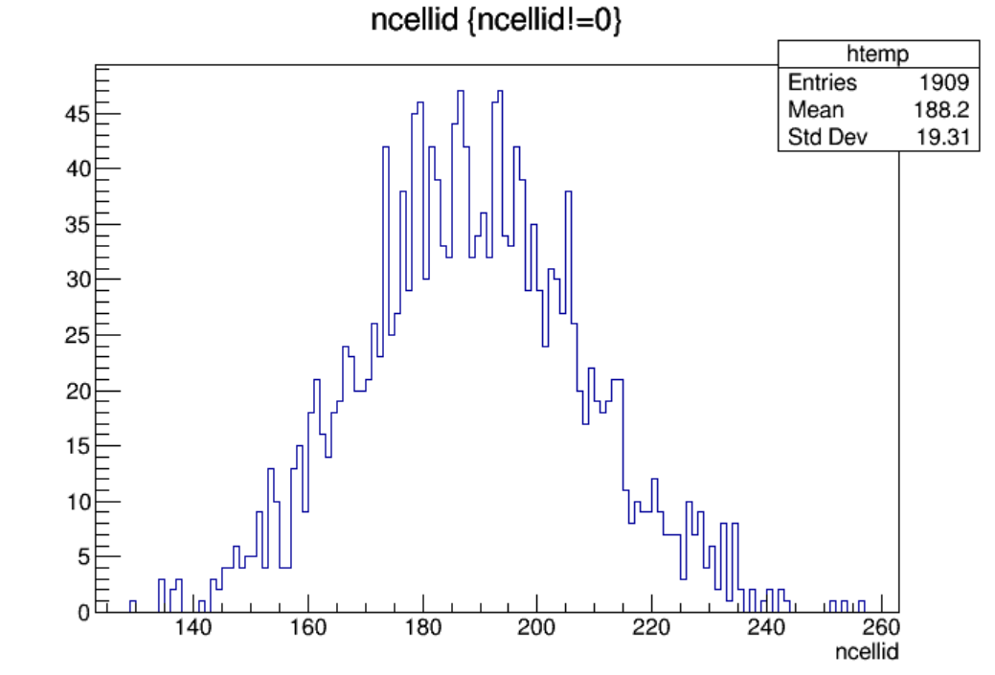
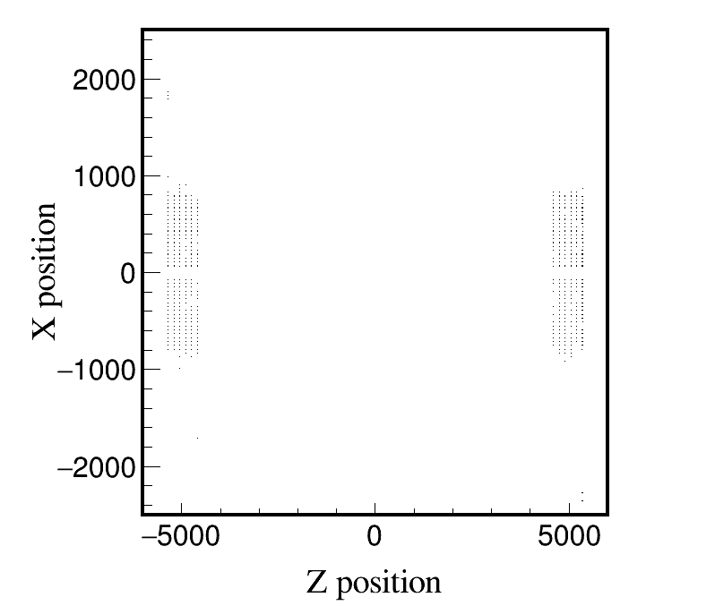
Higgs, Whole_250310, endcap, 2000 files, 10BX:
Higgs, Whole_250310, endcap, 10 files, 10BX:
Distribution of ncellid
Max ncellid: 256

Slide 7
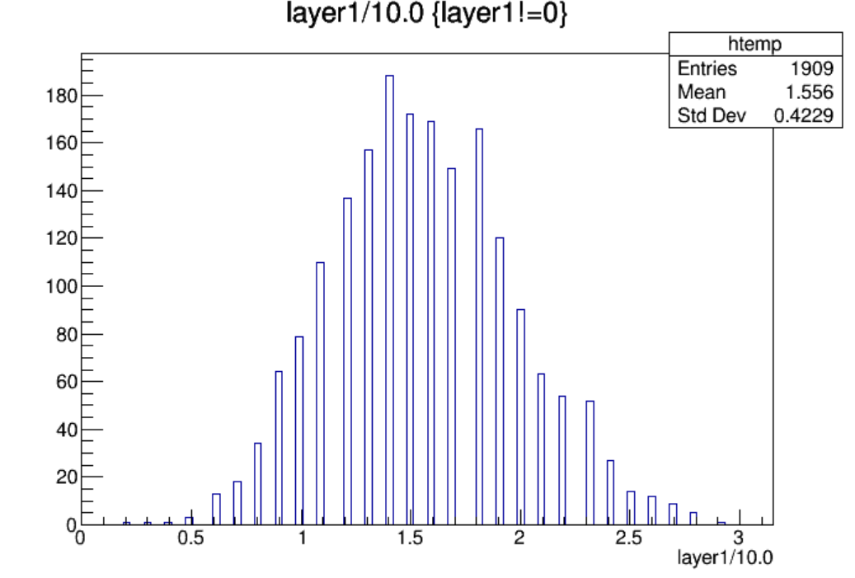
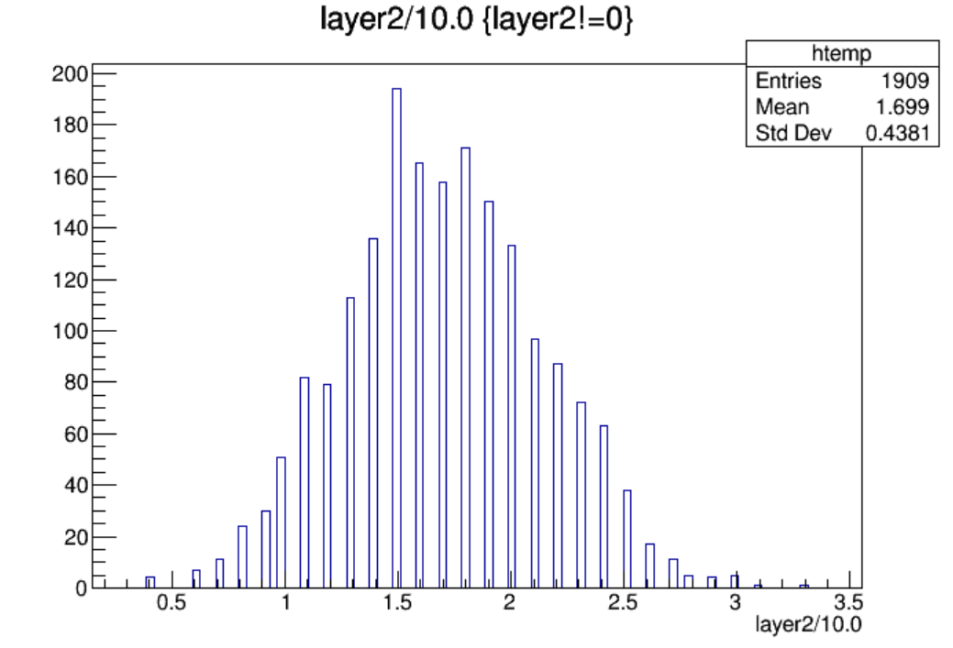
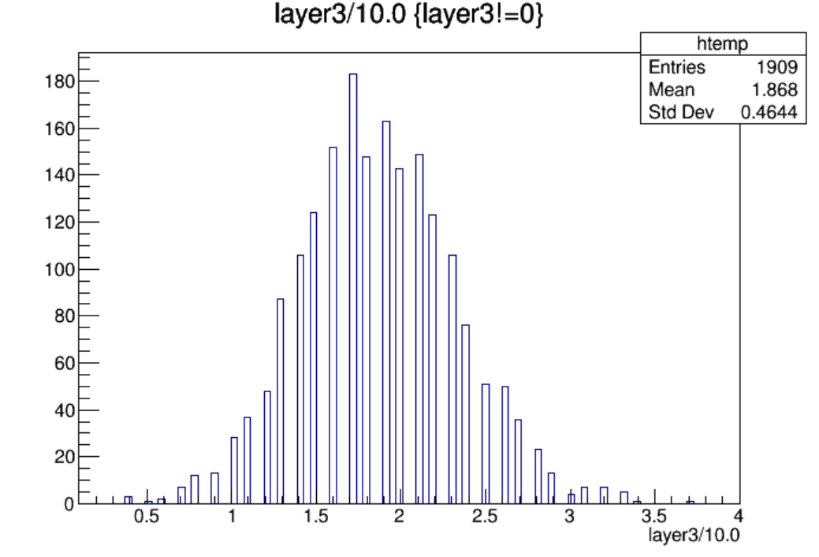
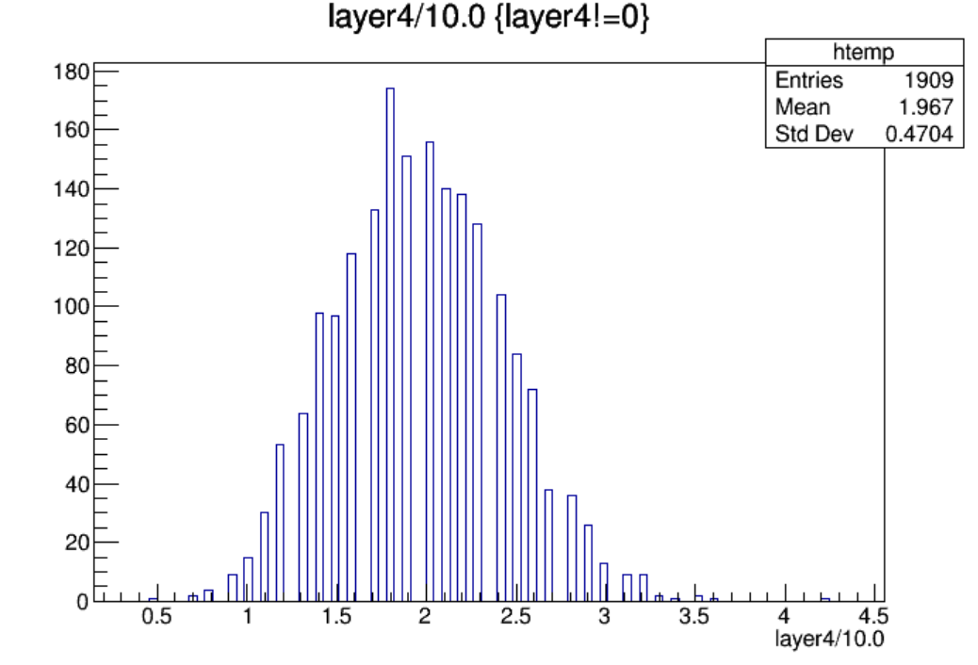

Slide 8
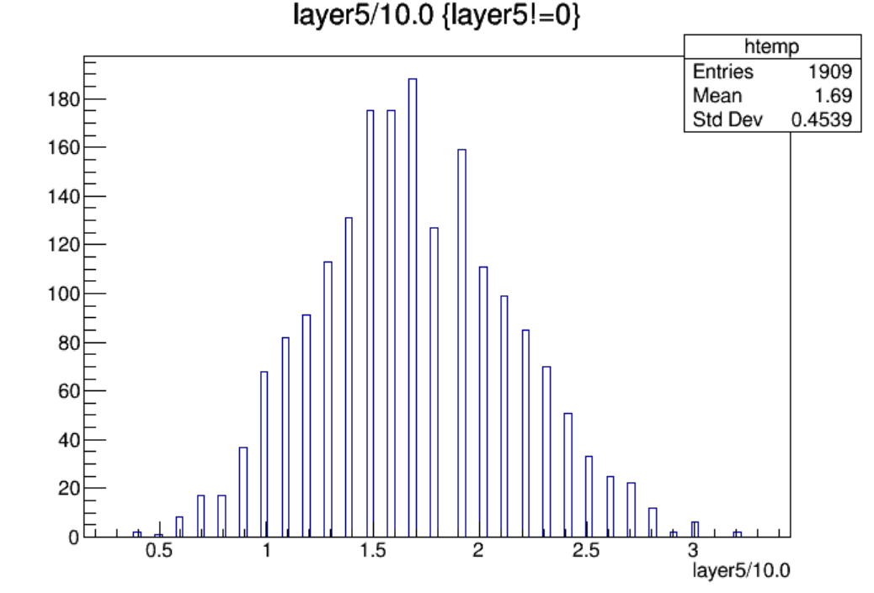
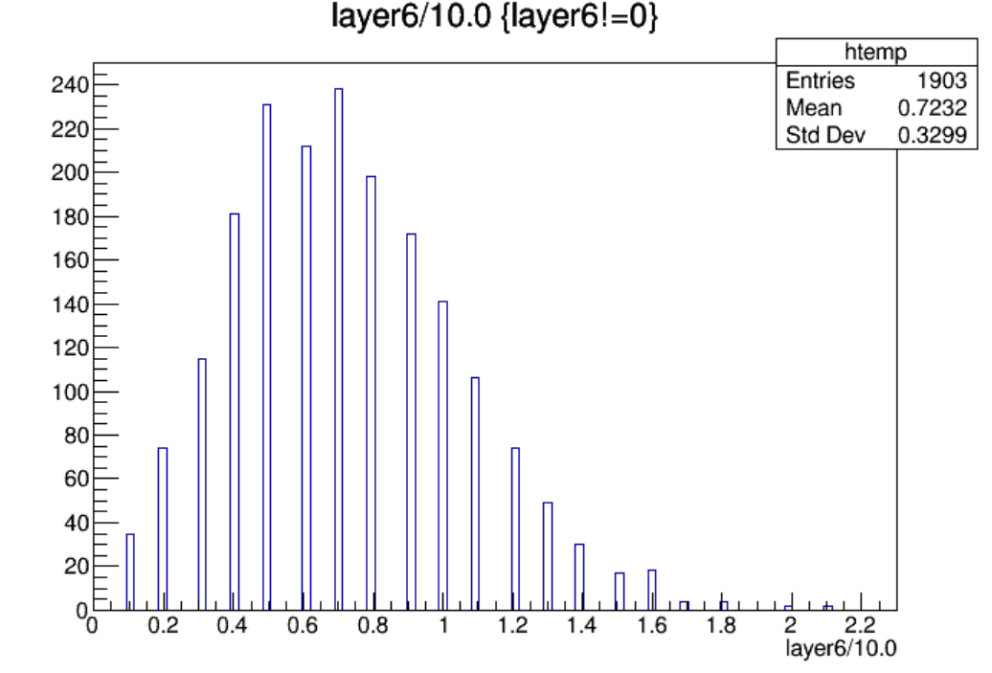
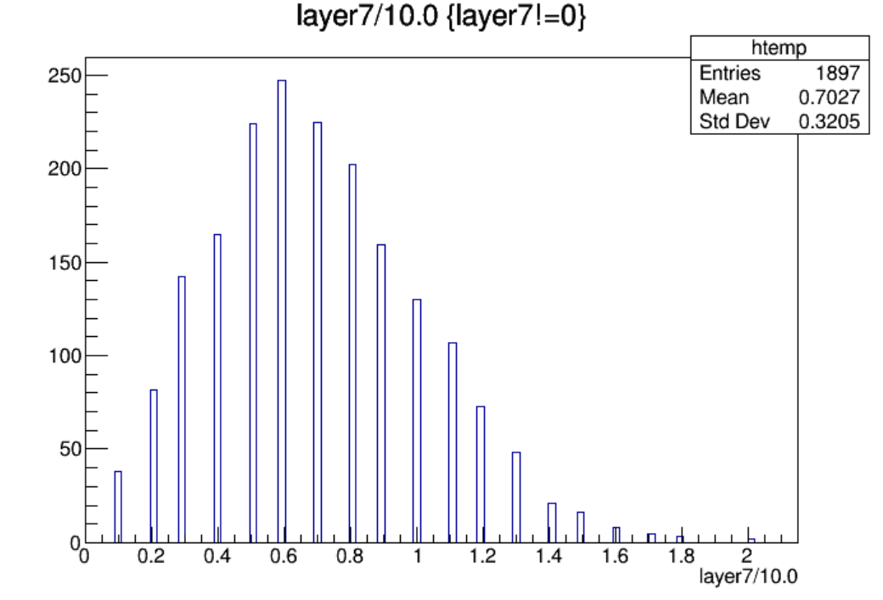
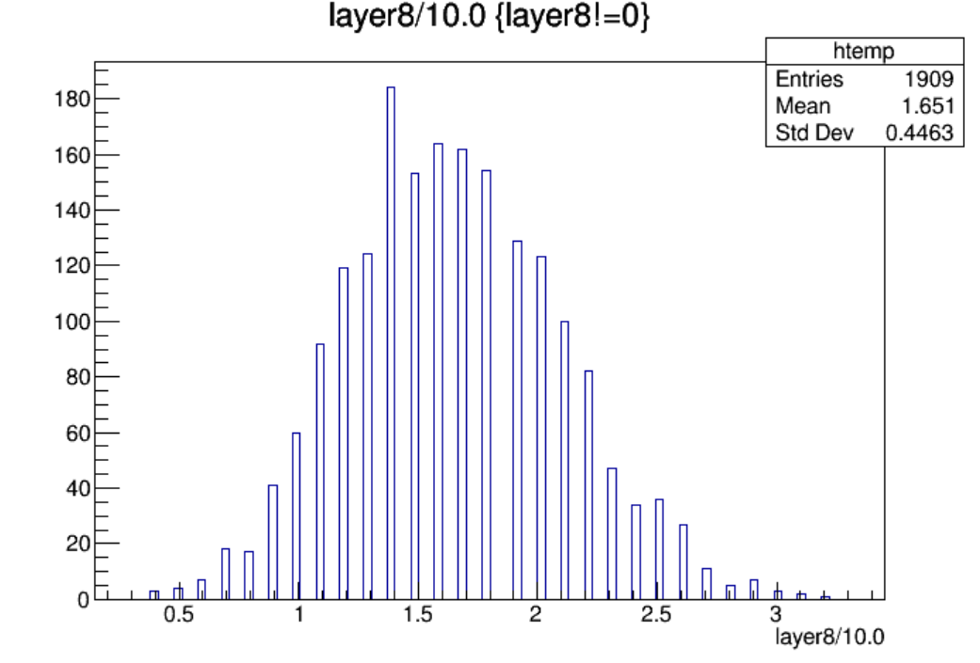

Slide 9
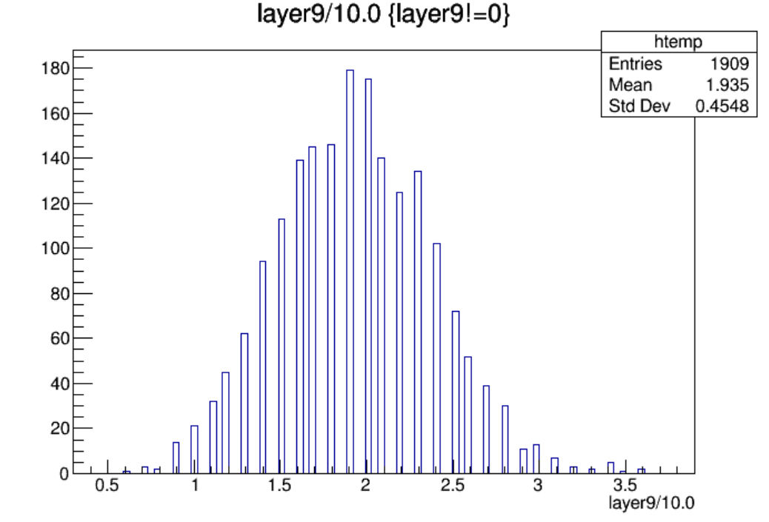
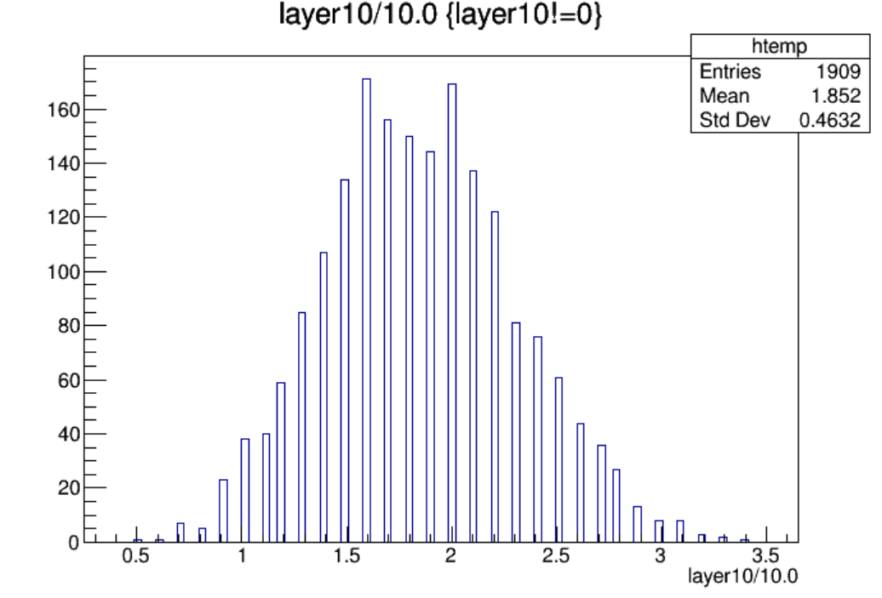
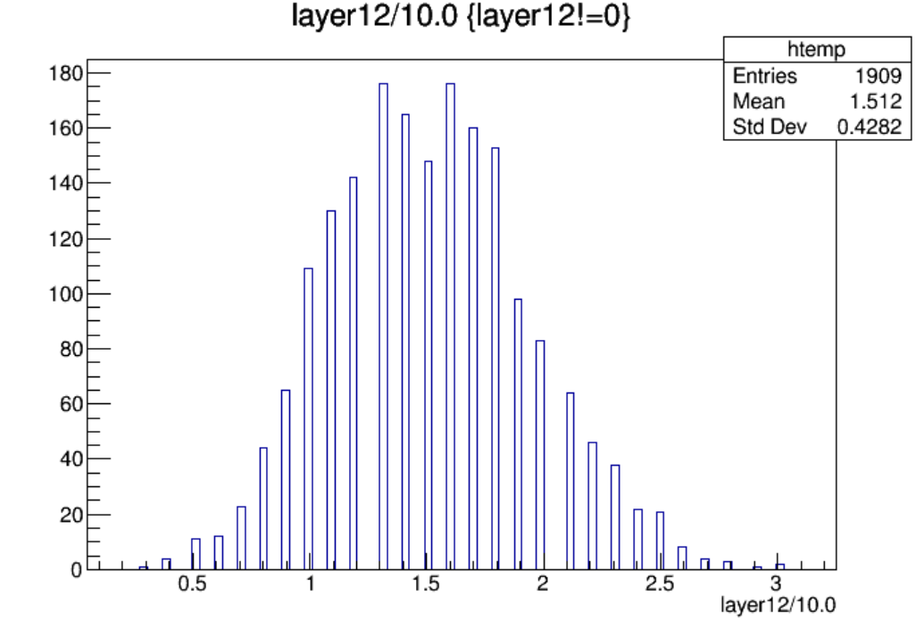

Slide 10
$Nstrip\left(endcap\right)=19200$, $Nstrip\left(endcap, per layer\right)={19200}/{12}=1600$
Layer | Max Hit Density(/${cm}^{2}$/BX) | Max Hit Rate(Hz/${cm}^{2}$) | Average Hit Rate(Hz/${cm}^{2}$) | Occupancy(%)
Layer1-L | 1.90e-6 | 2.58 | 1.34 | 0.18
Layer2-L | 2.16e-6 | 2.94 | 1.46 | 0.21
Layer3-L | 2.42e-6 | 3.29 | 1.60 | 0.23
Layer4-L | 2.75e-6 | 3.74 | 1.69 | 0.26
Layer5-L | 2.10e-6 | 2.85 | 1.45 | 0.20
Layer6-L | 1.38e-6 | 1.87 | 0.62 | 0.13
Layer6-R | 1.31e-6 | 1.78 | 0.60 | 0.13
Layer5-R | 2.10e-6 | 2.85 | 1.42 | 0.20
Layer4-R | 2.36e-6 | 3.20 | 1.66 | 0.23
Layer3-R | 2.23e-6 | 3.02 | 1.59 | 0.21
Layer2-R | 2.23e-6 | 3.02 | 1.43 | 0.21
Layer1-R | 1.96e-6 | 2.67 | 1.30 | 0.19
Hit Rate定义为：对应超层每秒钟着火的strip数/一层的表面积

Slide 11
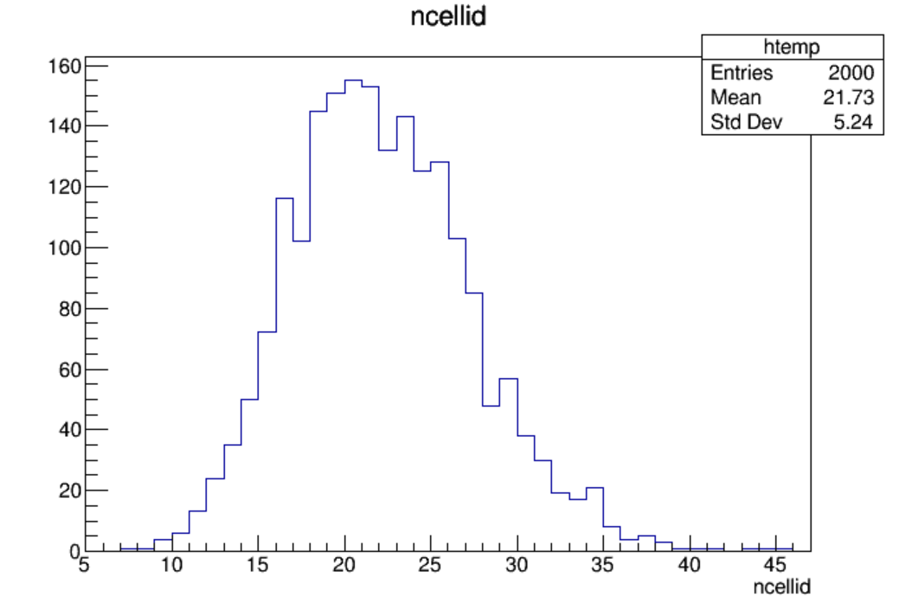
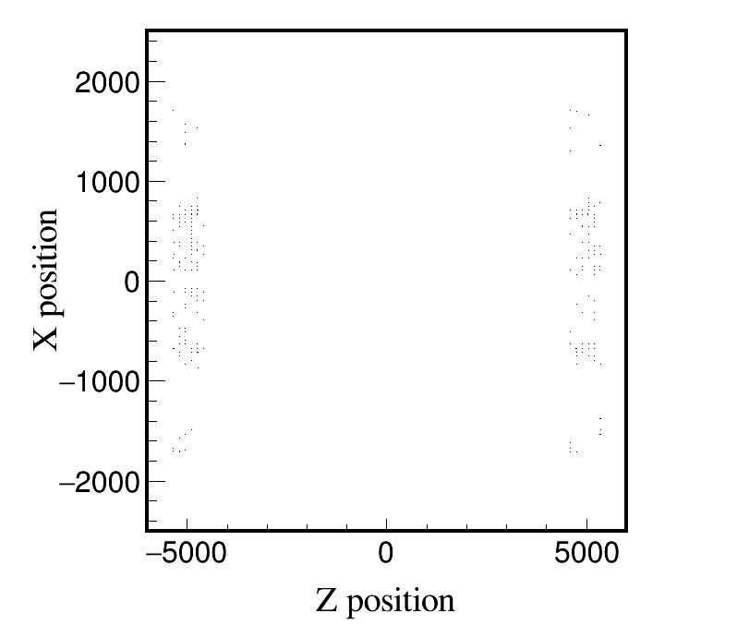
Low_Z, Whole_250306, endcap, 2000 files, 10BX:
Low_Z, Whole_250306, endcap, 10 files, 10BX:
Distribution of ncellid
Max ncellid: 45

Slide 12
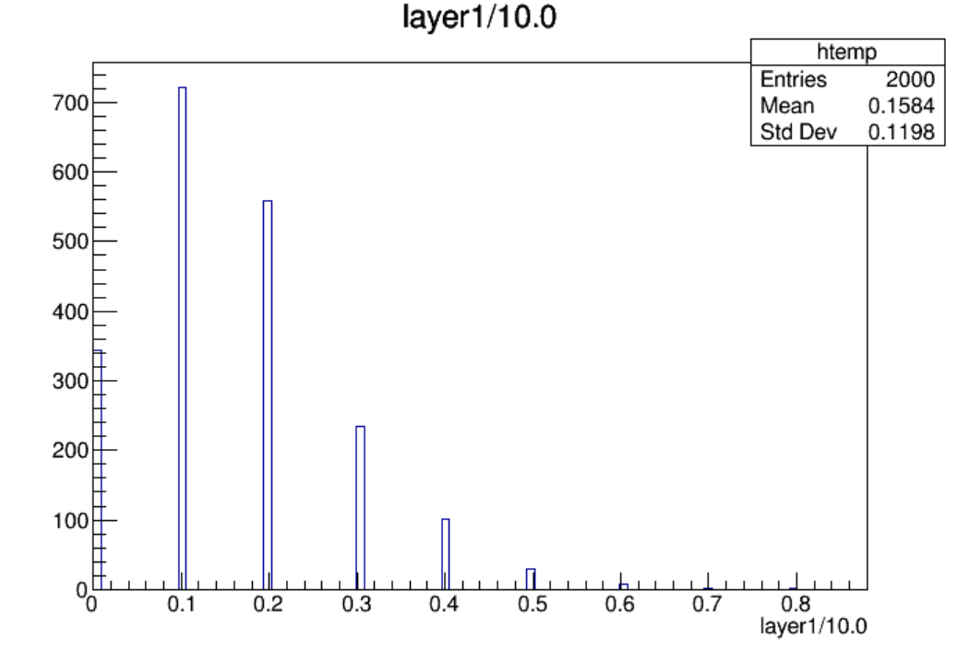
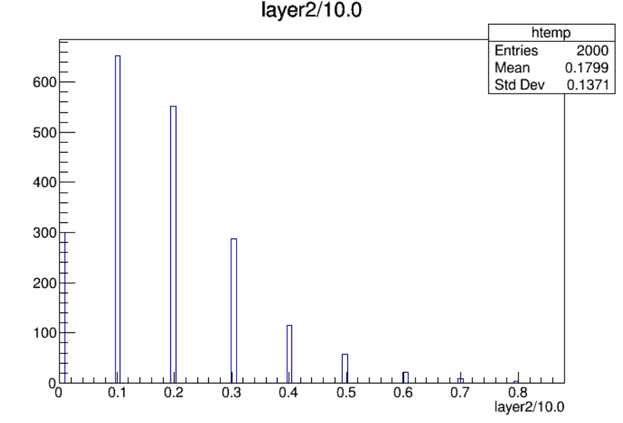
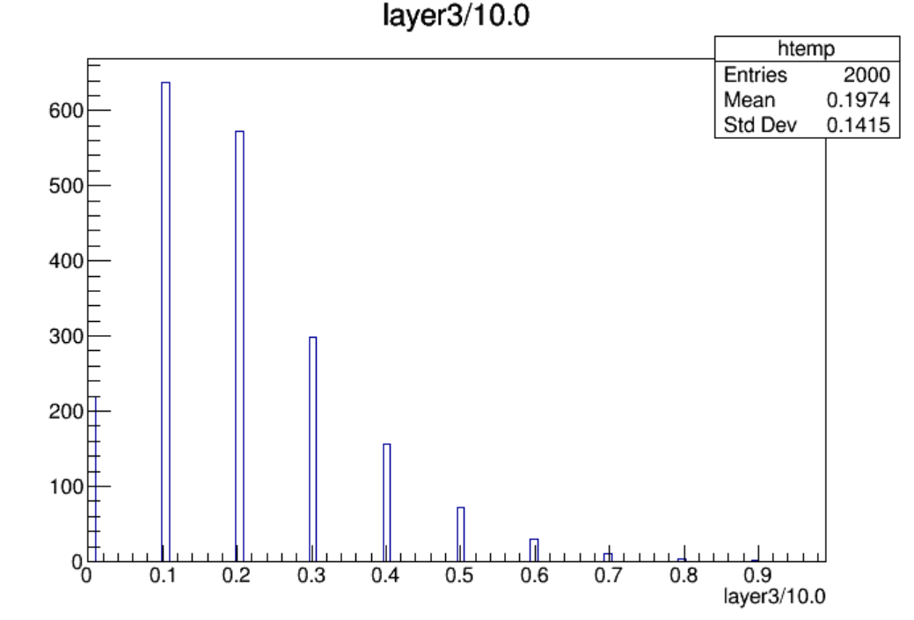
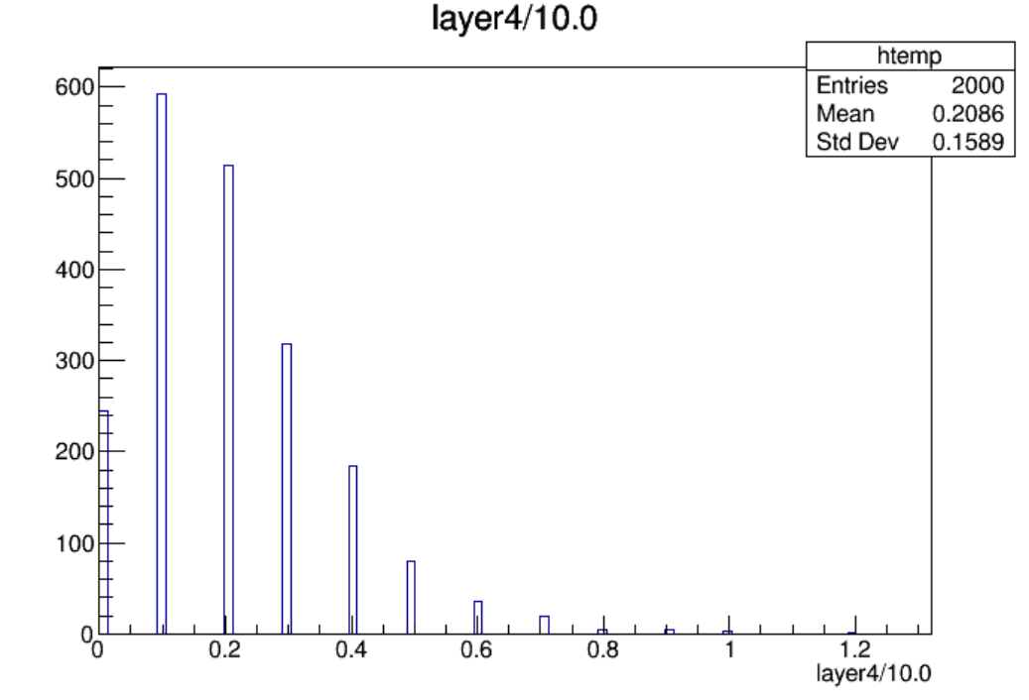

Slide 13
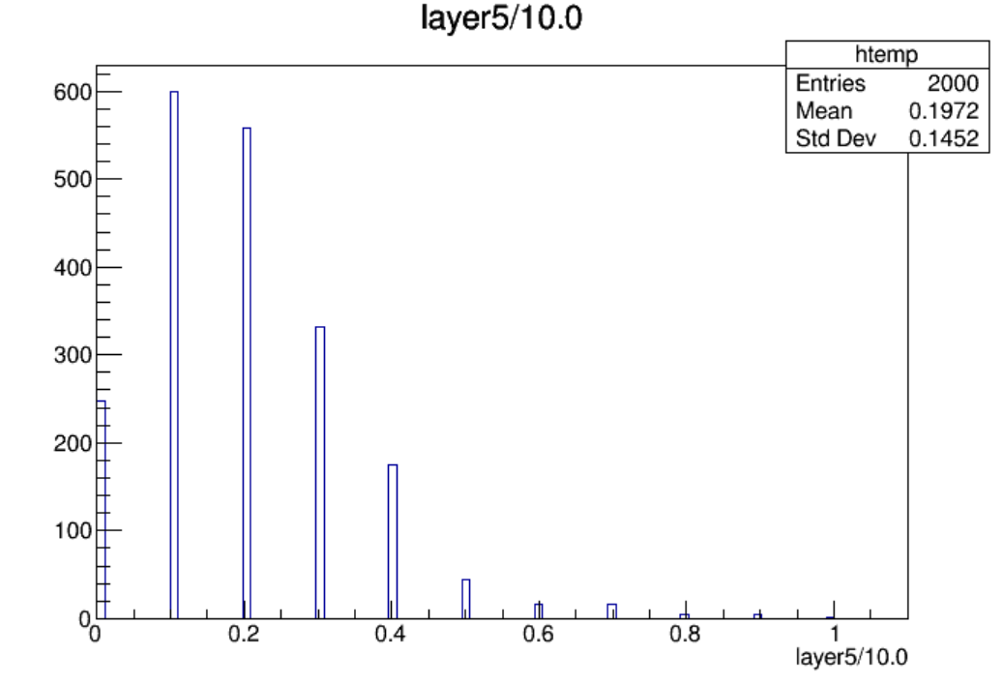
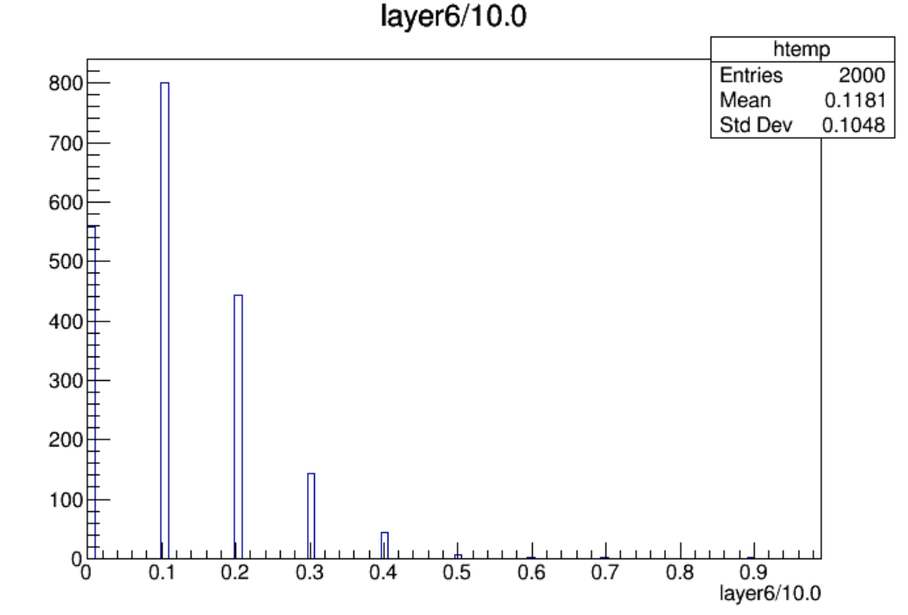
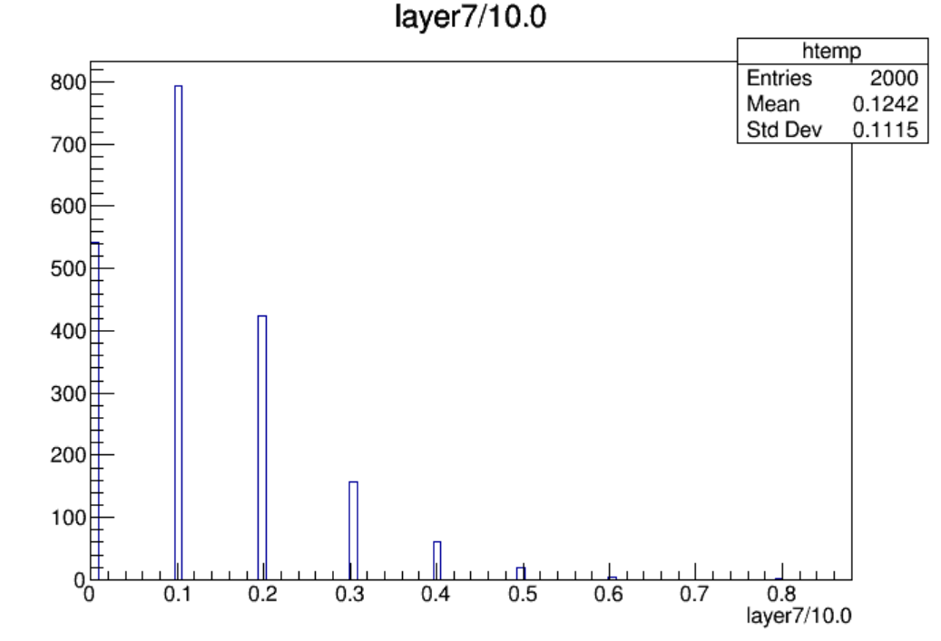
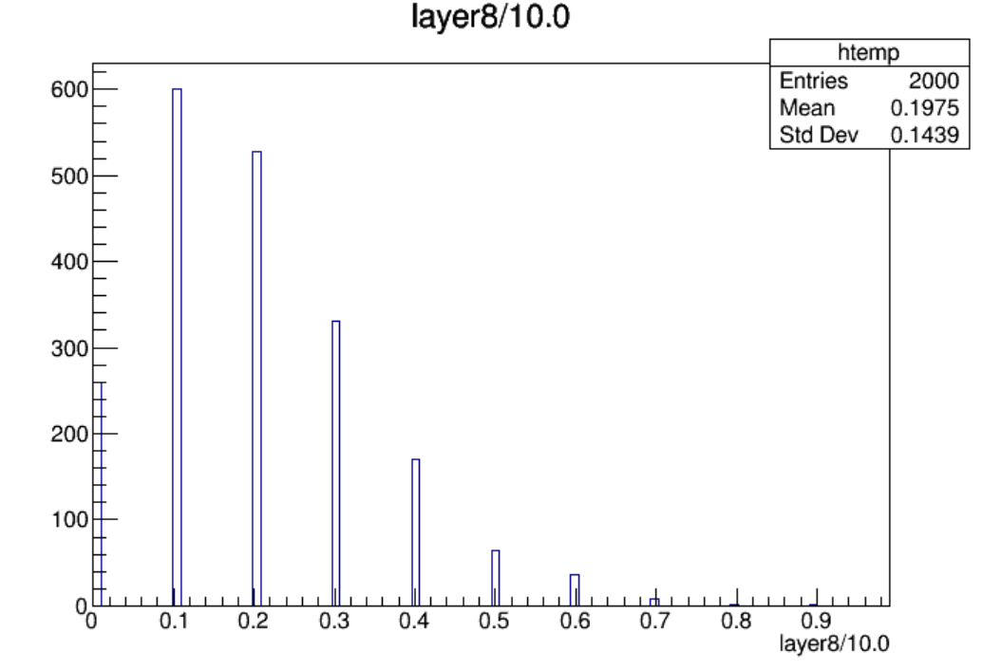

Slide 14
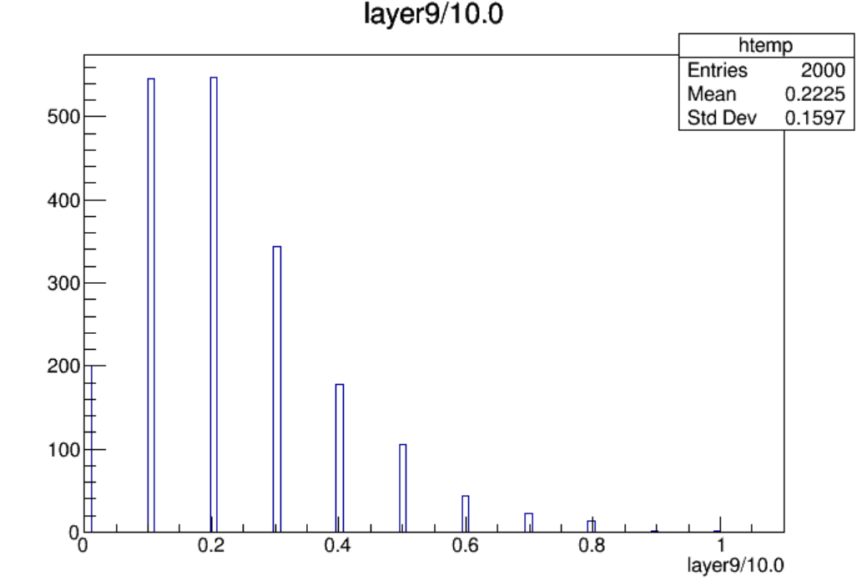
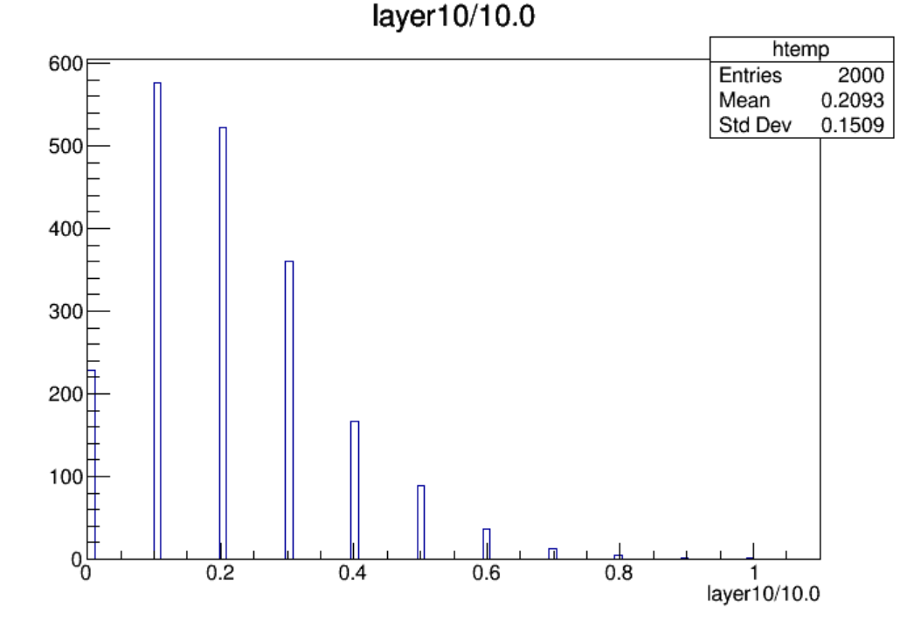
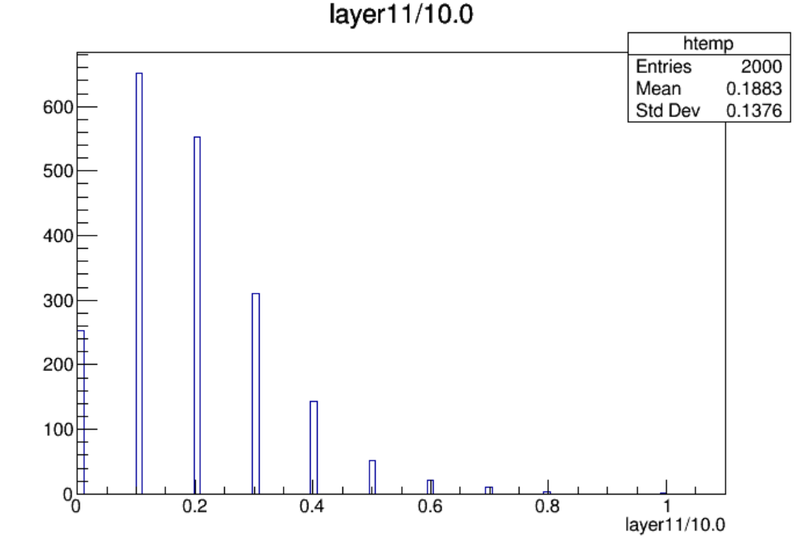
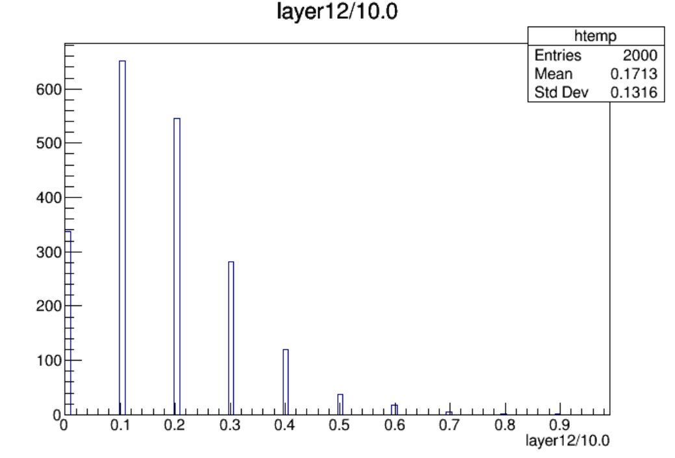

Slide 15
$Nstrip\left(endcap\right)=19200$, $Nstrip\left(endcap, per layer\right)={19200}/{12}=1600$
Layer | Max Hit Density(/${cm}^{2}$/BX) | Max Hit Rate(Hz/${cm}^{2}$) | Average Hit Rate(Hz/${cm}^{2}$) | Occupancy(%)
Layer1-L | 5.24e-7 | 6.83 | 1.35 | 0.05
Layer2-L | 5.24e-7 | 6.83 | 1.54 | 0.05
Layer3-L | 5.89e-7 | 7.69 | 1.69 | 0.06
Layer4-L | 7.86e-7 | 10.25 | 1.78 | 0.08
Layer5-L | 6.55e-7 | 8.54 | 1.68 | 0.06
Layer6-L | 5.89e-7 | 7.69 | 1.01 | 0.06
Layer6-R | 5.24e-7 | 6.83 | 1.06 | 0.05
Layer5-R | 5.89e-7 | 7.69 | 1.69 | 0.06
Layer4-R | 6.55e-7 | 8.54 | 1.90 | 0.06
Layer3-R | 6.55e-7 | 8.54 | 1.79 | 0.06
Layer2-R | 6.55e-7 | 8.54 | 1.61 | 0.06
Layer1-R | 5.89e-7 | 7.69 | 1.46 | 0.06
Hit Rate定义为：对应超层每秒钟着火的strip数/一层的表面积

Slide 16
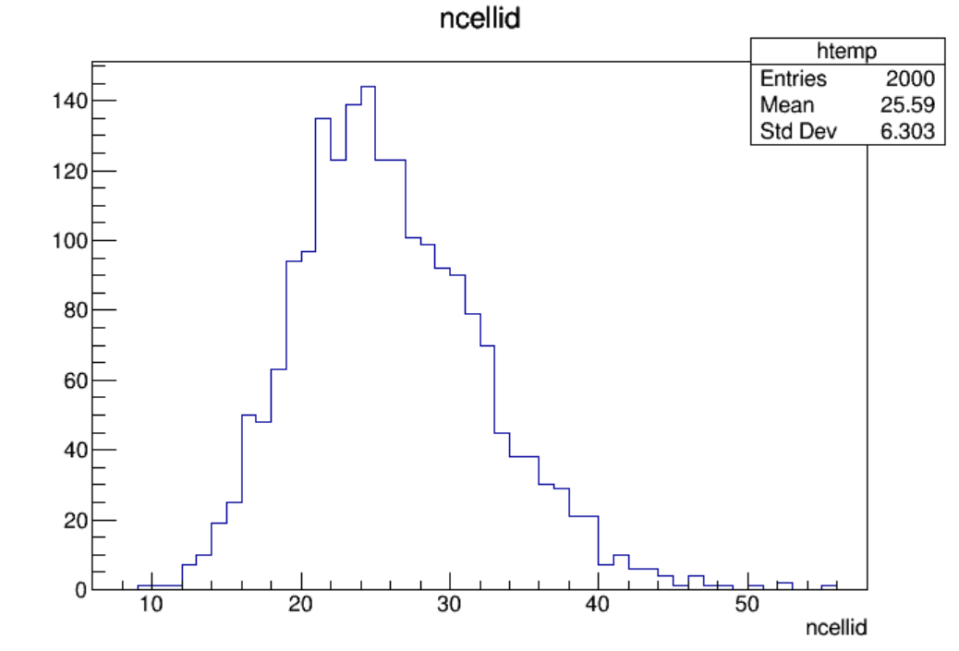
Low_Z, Whole_250310, endcap, 2000 files, 10BX:
Low_Z, Whole_250310, endcap, 10 files, 10BX:
Distribution of ncellid
Max ncellid: 55

Slide 17
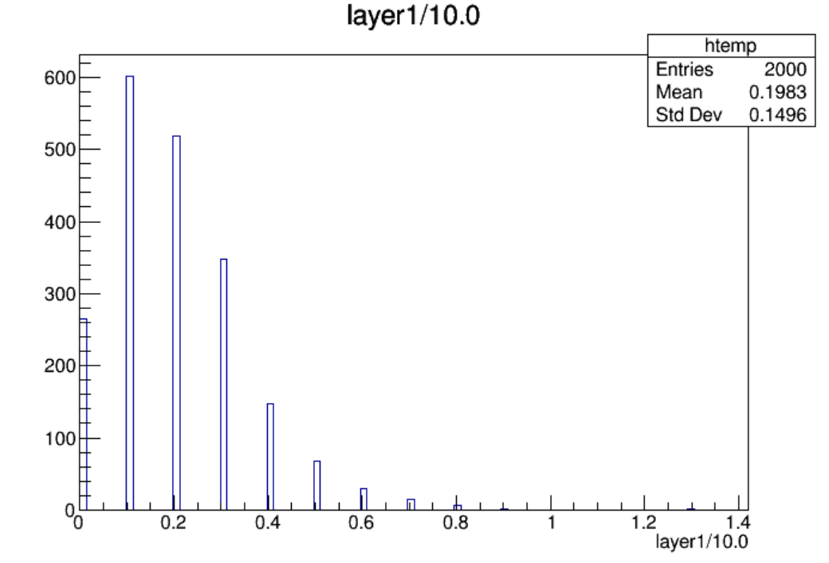
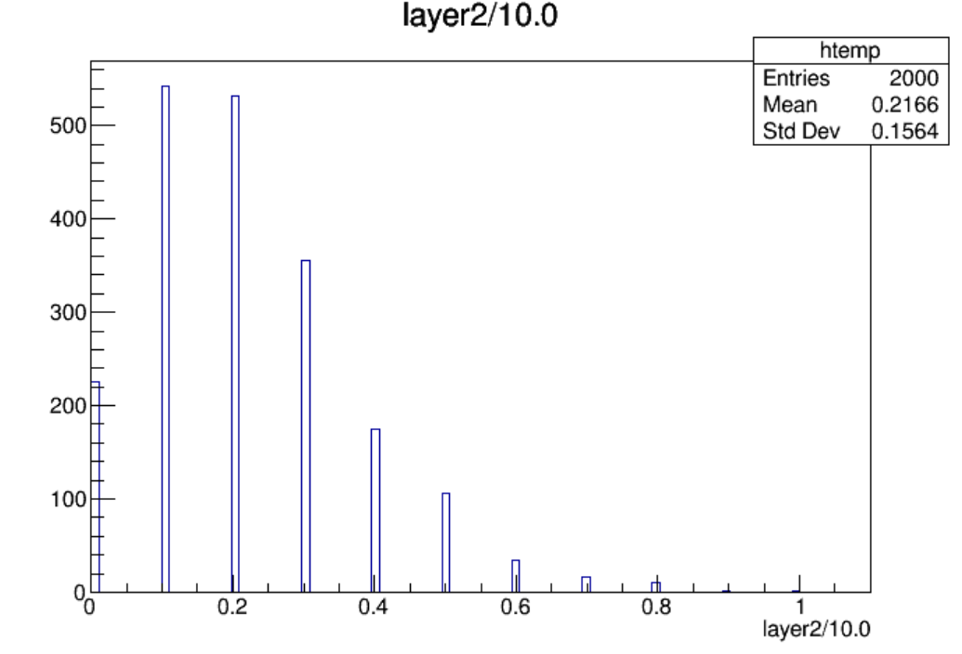
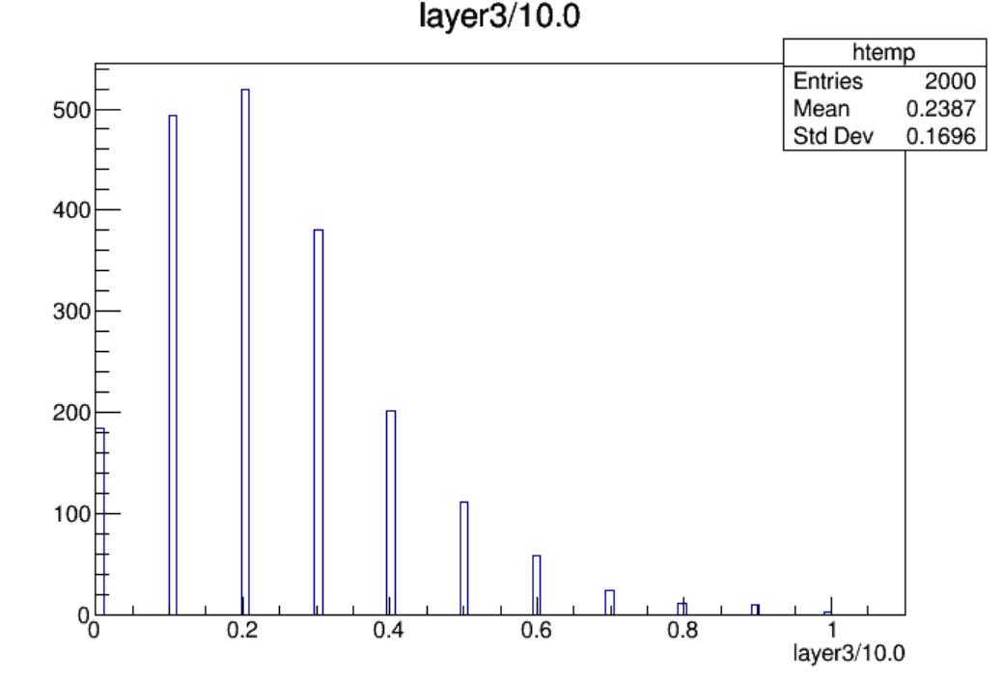
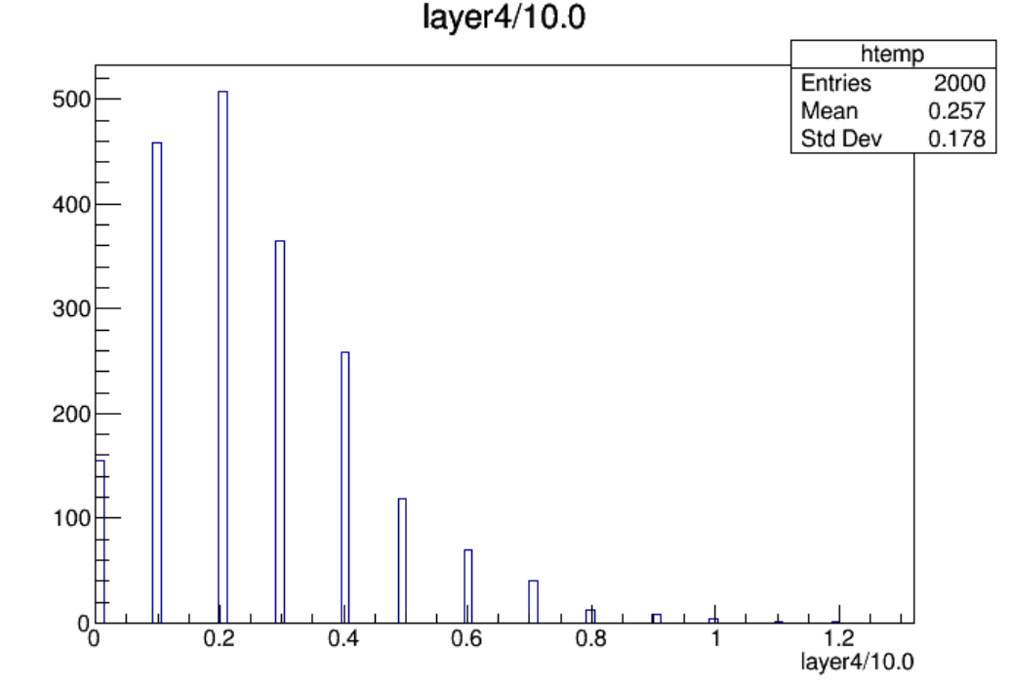

Slide 18
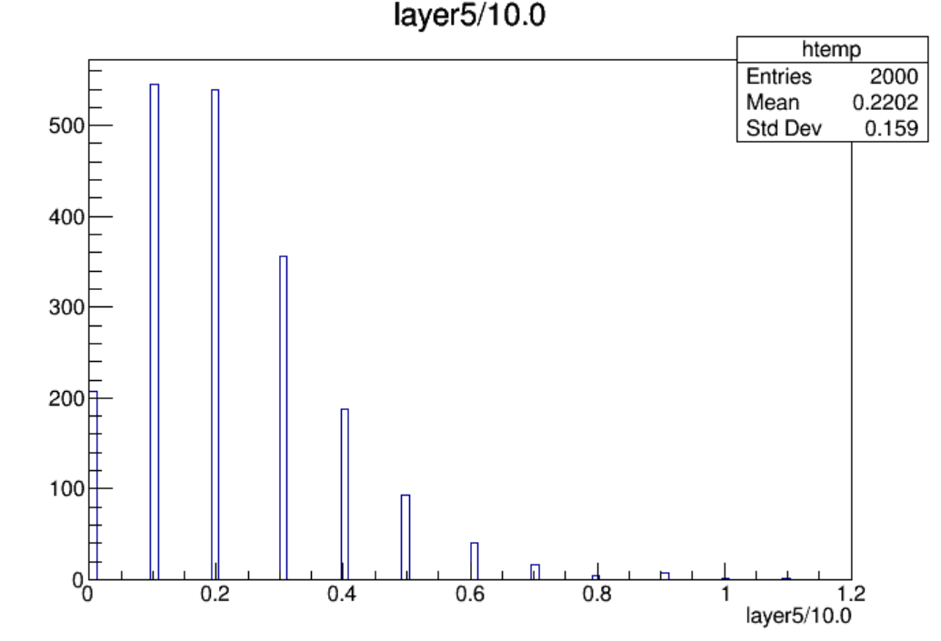
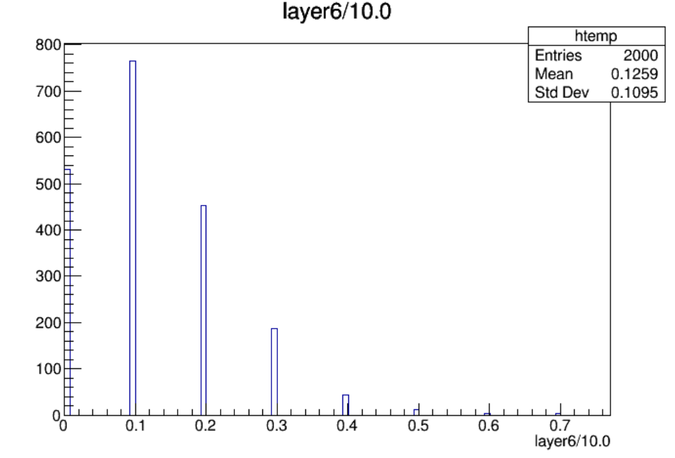
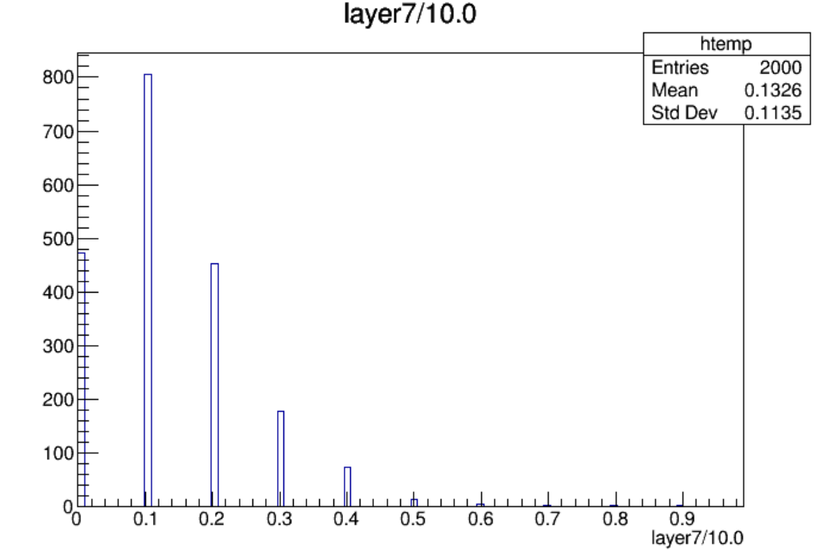
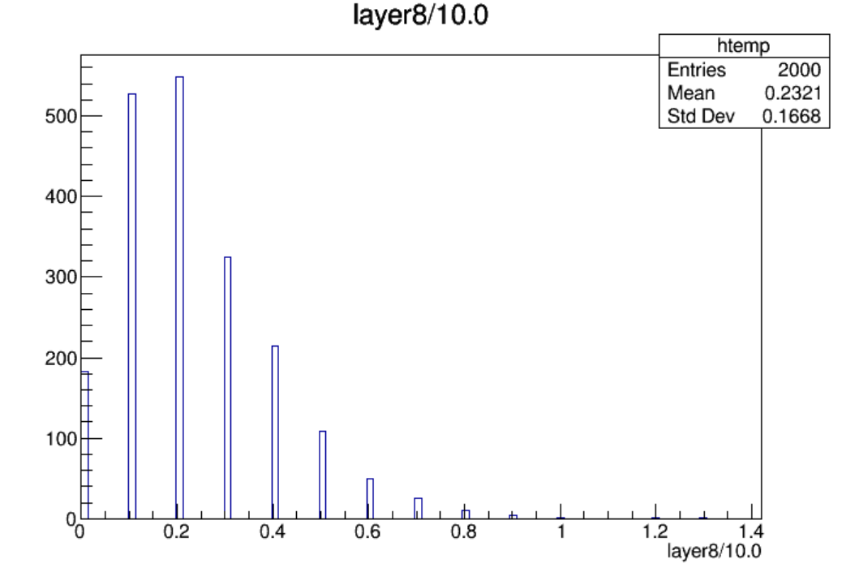

Slide 19
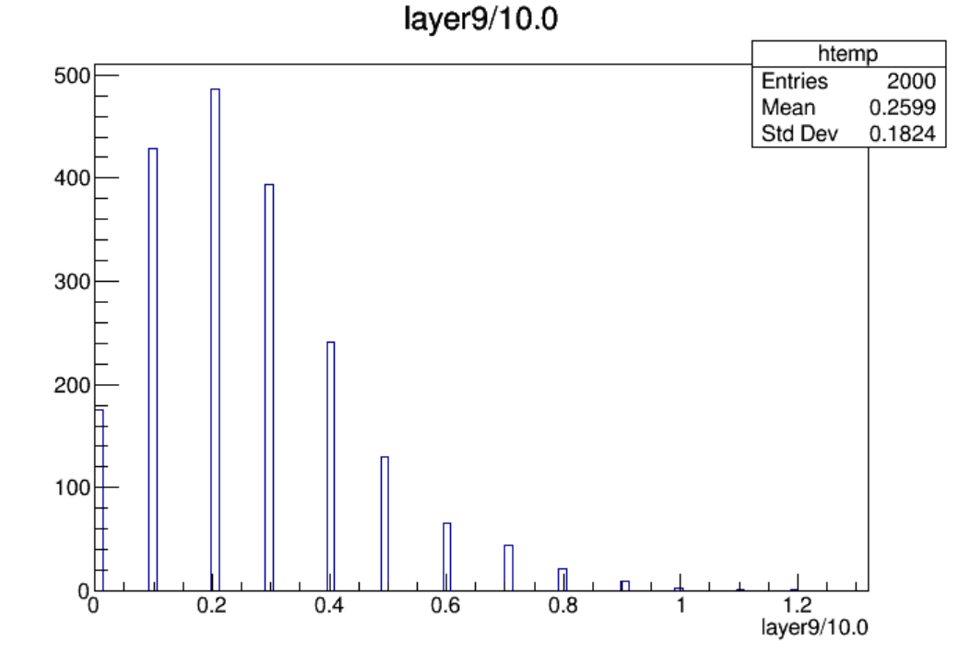

Slide 20
$Nstrip\left(endcap\right)=19200$, $Nstrip\left(endcap, per layer\right)={19200}/{12}=1600$
Layer | Max Hit Density(/${cm}^{2}$/BX) | Max Hit Rate(Hz/${cm}^{2}$) | Average Hit Rate(Hz/${cm}^{2}$) | Occupancy(%)
Layer1-L | 8.51e-7 | 11.10 | 1.69 | 0.08
Layer2-L | 6.55e-7 | 8.54 | 1.85 | 0.06
Layer3-L | 6.55e-7 | 8.54 | 2.04 | 0.06
Layer4-L | 7.86e-7 | 10.25 | 2.19 | 0.08
Layer5-L | 7.20e-7 | 9.40 | 1.88 | 0.07
Layer6-L | 4.58e-7 | 5.98 | 1.08 | 0.04
Layer6-R | 5.89e-7 | 7.69 | 1.13 | 0.06
Layer5-R | 8.51e-7 | 11.10 | 1.98 | 0.08
Layer4-R | 7.86e-7 | 10.25 | 2.22 | 0.08
Layer3-R | 8.51e-7 | 11.10 | 2.15 | 0.08
Layer2-R | 6.55e-7 | 8.54 | 1.95 | 0.06
Layer1-R | 5.89e-7 | 7.69 | 1.69 | 0.06
Hit Rate定义为：对应超层每秒钟着火的strip数/一层的表面积

Slide 21
High_Z, Whole_250306, endcap, 2000 files, 10BX:
High_Z, Whole_250306, endcap, 10 files, 10BX:
Distribution of ncellid
Max ncellid: 44

Slide 25
$Nstrip\left(endcap\right)=19200$, $Nstrip\left(endcap, per layer\right)={19200}/{12}=1600$
Layer | Max Hit Density(/${cm}^{2}$/BX) | Max Hit Rate(Hz/${cm}^{2}$) | Average Hit Rate(Hz/${cm}^{2}$) | Occupancy(%)
Layer1-L | 4.58e-7 | 17.94 | 4.20 | 0.04
Layer2-L | 5.89e-7 | 23.06 | 4.87 | 0.06
Layer3-L | 6.55e-7 | 25.62 | 5.20 | 0.06
Layer4-L | 8.51e-7 | 33.31 | 5.55 | 0.08
Layer5-L | 7.20e-7 | 28.19 | 5.13 | 0.07
Layer6-L | 4.58e-7 | 17.94 | 3.16 | 0.04
Layer6-R | 4.58e-7 | 17.94 | 3.28 | 0.04
Layer5-R | 7.20e-7 | 28.19 | 5.37 | 0.07
Layer4-R | 7.86e-7 | 30.75 | 5.91 | 0.08
Layer3-R | 9.17e-7 | 35.87 | 5.63 | 0.09
Layer2-R | 7.20e-7 | 28.19 | 4.98 | 0.07
Layer1-R | 5.24e-7 | 20.50 | 4.55 | 0.05
Hit Rate定义为：对应超层每秒钟着火的strip数/一层的表面积

Slide 26
High_Z, Whole_250310, endcap, 2000 files, 10BX:
High_Z, Whole_250310, endcap, 10 files, 10BX:
Distribution of ncellid
Max ncellid: 53

Slide 30
$Nstrip\left(endcap\right)=19200$, $Nstrip\left(endcap, per layer\right)={19200}/{12}=1600$
Layer | Max Hit Density(/${cm}^{2}$/BX) | Max Hit Rate(Hz/${cm}^{2}$) | Average Hit Rate(Hz/${cm}^{2}$) | Occupancy(%)
Layer1-L | 6.55e-7 | 25.62 | 5.12 | 0.06
Layer2-L | 6.55e-7 | 25.62 | 5.81 | 0.06
Layer3-L | 8.51e-7 | 33.31 | 6.27 | 0.08
Layer4-L | 8.51e-7 | 33.31 | 6.72 | 0.08
Layer5-L | 5.89e-7 | 23.06 | 5.98 | 0.06
Layer6-L | 5.48e-7 | 17.94 | 3.31 | 0.04
Layer6-R | 4.58e-7 | 17.94 | 3.39 | 0.04
Layer5-R | 9.17e-7 | 35.87 | 6.18 | 0.09
Layer4-R | 7.86e-7 | 30.75 | 7.00 | 0.08
Layer3-R | 7.20e-7 | 28.19 | 6.78 | 0.07
Layer2-R | 8.51e-7 | 33.31 | 6.00 | 0.08
Layer1-R | 7.20e-7 | 28.19 | 5.40 | 0.07
Hit Rate定义为：对应超层每秒钟着火的strip数/一层的表面积

