Slide 1
CGEM DAQ Status and Plan
Tingxuan Zeng
2025-03-22

Slide 2
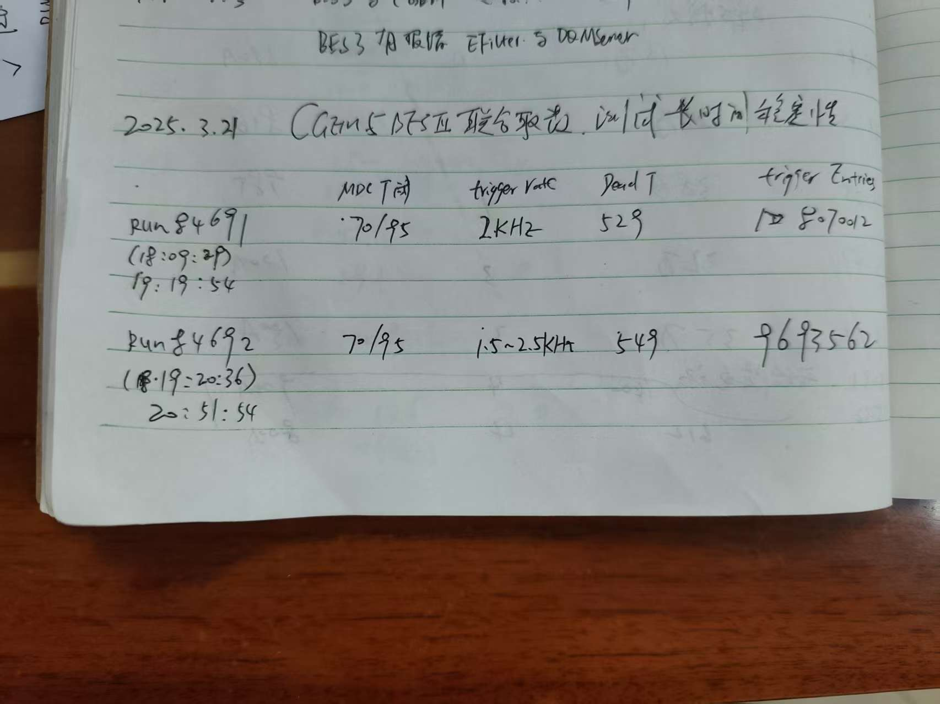
More data check results
 | BES3 event number in data file | CGEM uniq trigger number(all gemrocs same ) | CGEM Last Trigger number(all gemrocs same) | Consistent ? | CGEM Checkbit error?(2 bits) | Remarks
RUN 84691 | 8070012 | 8070000~8070012 | 8070012 | East side consistent | No | 2KHz
RUN 84692 | 9693776 | 9693746~9693776 | 9693776 | East side consistent | No | 1.5~2KHz
Note: 1 hour run, DAQ stop normally. Noise trigger.
The GEMROCs of east side trigger number are consistent with BES3.
The GEMROCs of West side has less trigger counts.

Slide 3
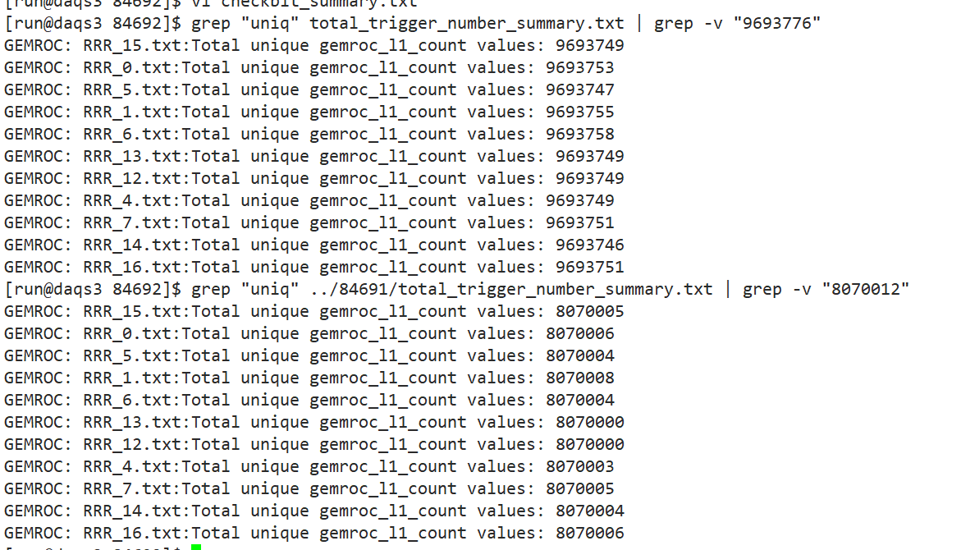
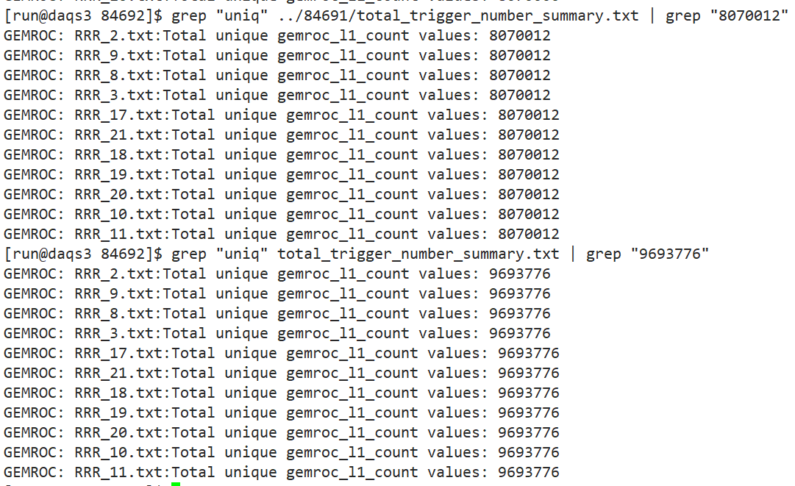
The GEMROCs of West side has less trigger counts.
The GEMROCs of east side trigger number are consistent with BES3.
East side
West side

Slide 4
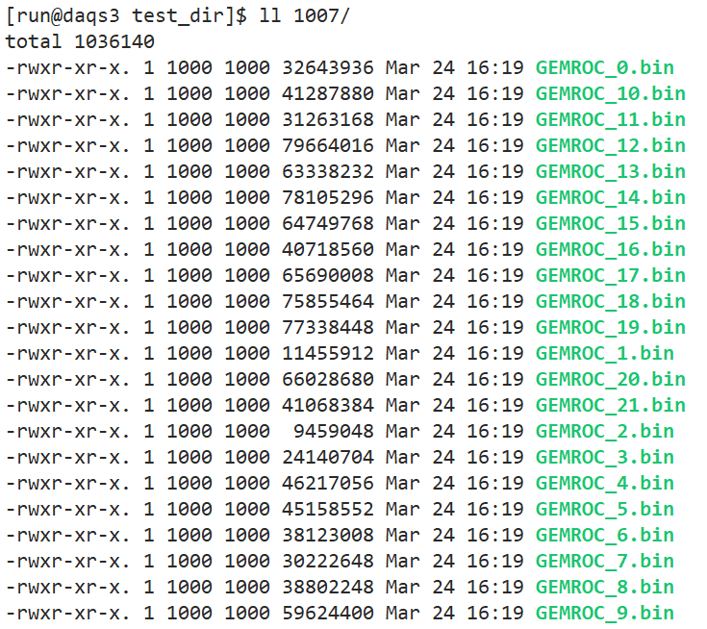
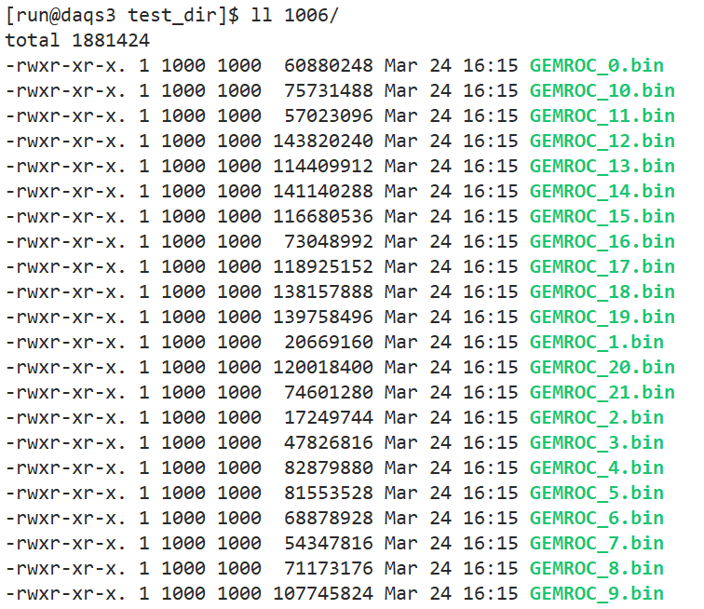
BES3 communication test with CGEM GUFI
Communication with CGEM GUFI is fine now.
adjust the release version link path and copy the modified executable and library file to the path and it can run successfully now.
Has taken a few runs this afternoon.
Run number : 1006 1007

