Slide 1
HighZ 250310
LYSO | Average Hit Rate (MHz/cm2) | Max Hit Rate(MHz/cm2) | Max Occupancy(%)
Si I@560mm | 129.27649 | 7970.35217 | /
Si II@640mm | 118.14467 | 7794.87878 | /
LYSO I@658mm | 28.53041 | 97.95959 | 6.51810
LYSO II@875mm | 4.32056 | 11.656665 | 10.96759

Slide 2
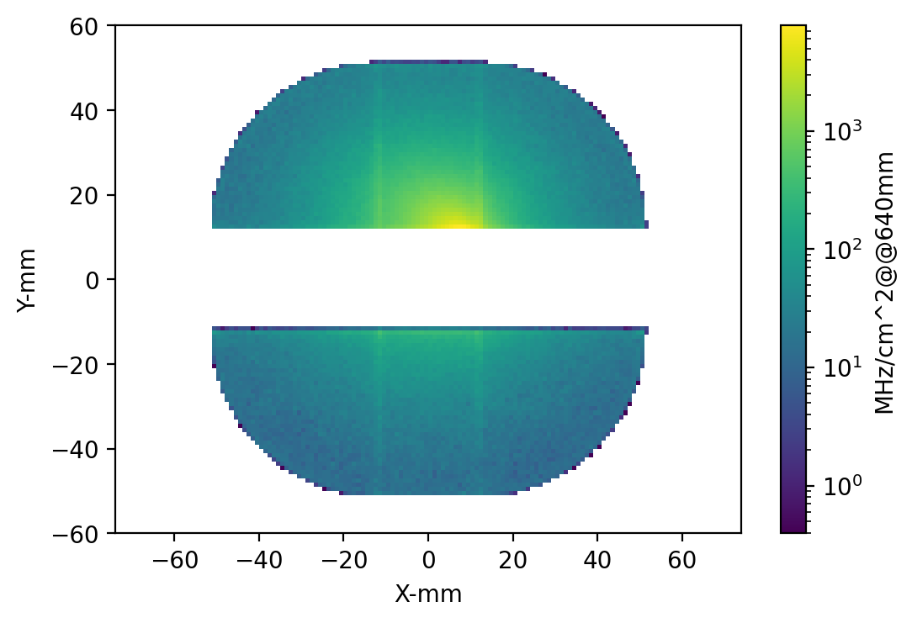
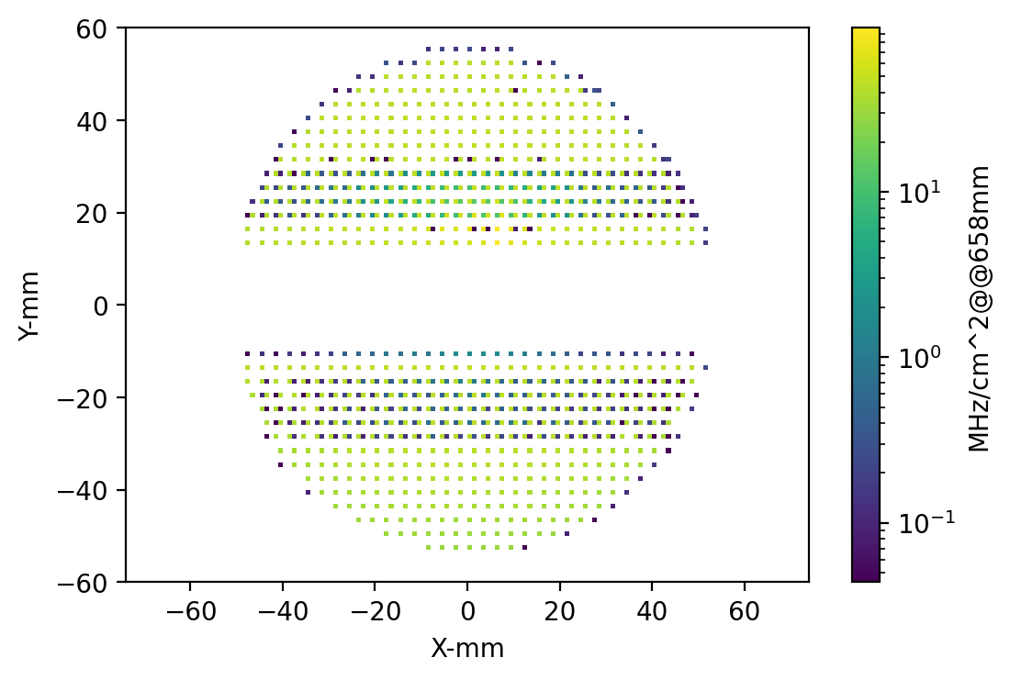
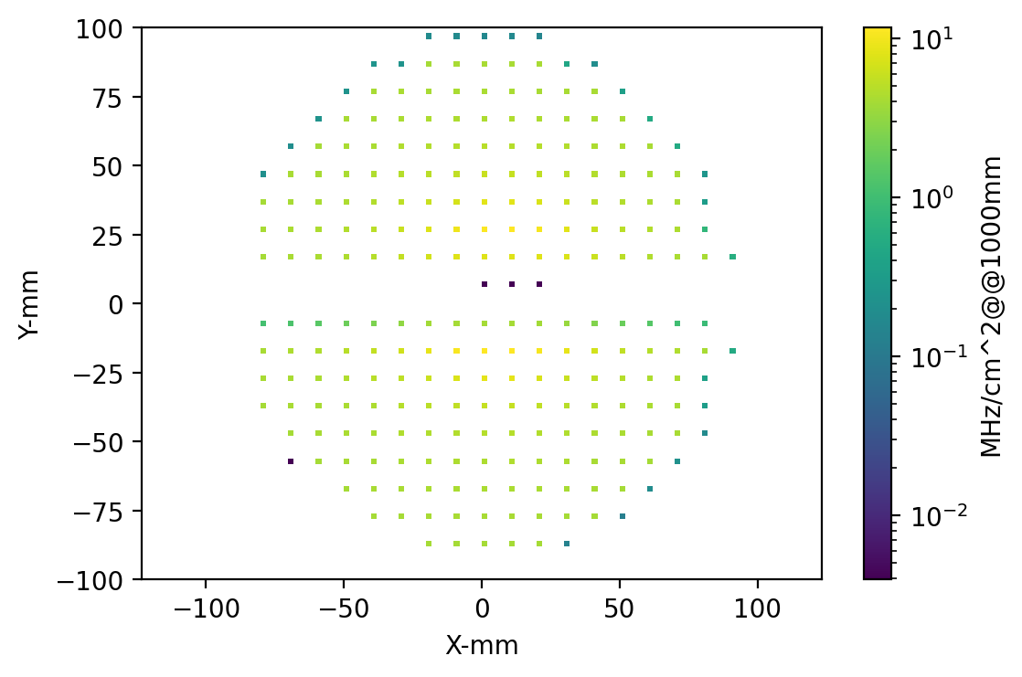

Slide 3
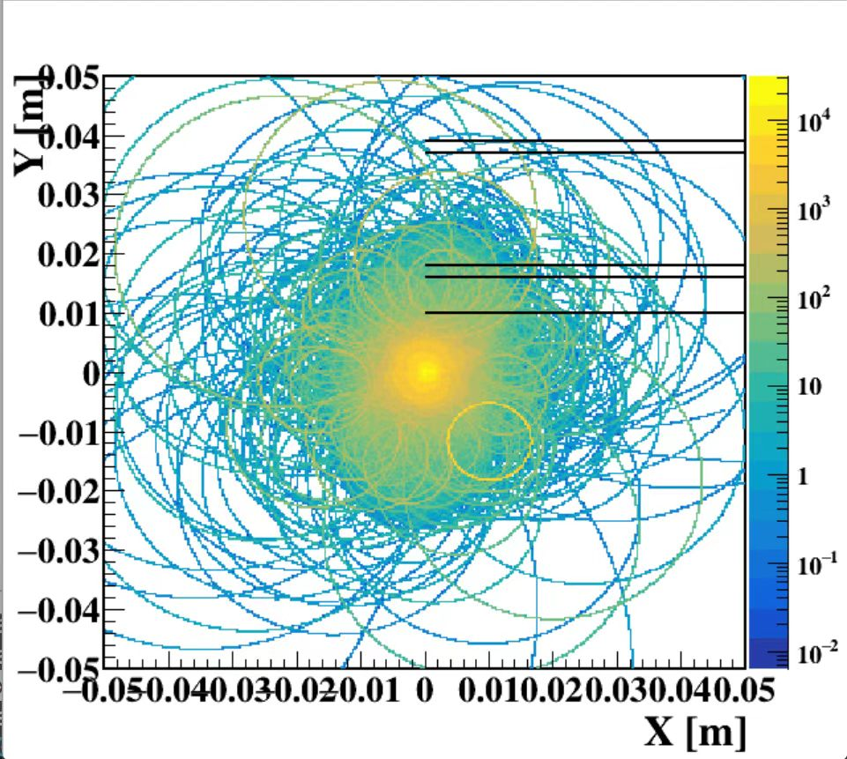
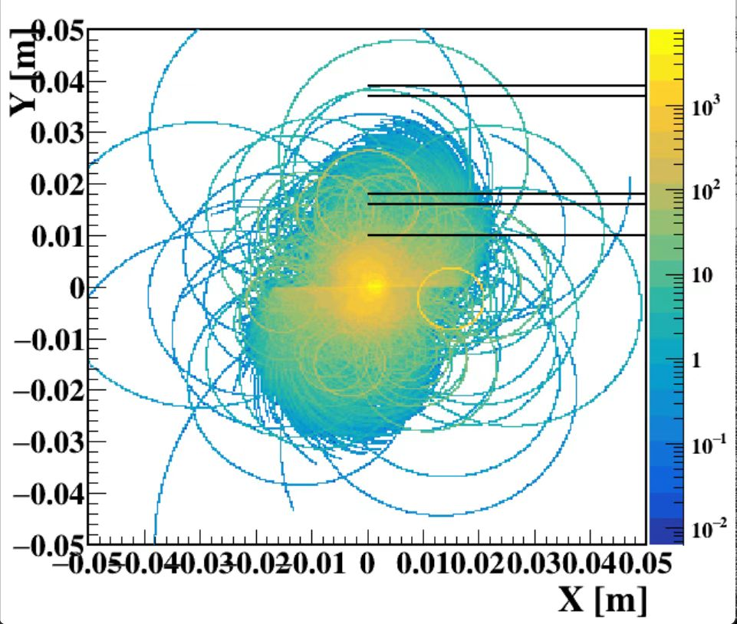
粒子在磁场中运动轨迹 from 唐彦邦 左为未Boost 右为 Boost

Slide 4
LowZ 250310
LYSO | Average Hit Rate (MHz/cm2) | Max Hit Rate(MHz/cm2) | Max Occupancy(%)
Si I@560mm | 46.45611 | 2567.95926 | /
Si II@640mm | 42.49460 | 2845.21739 | /
LYSO I@658mm | 10.42919 | 37.34299 | 6.47652
LYSO II@875mm | 1.58400 | 4.29710 | 10.92964

Slide 5
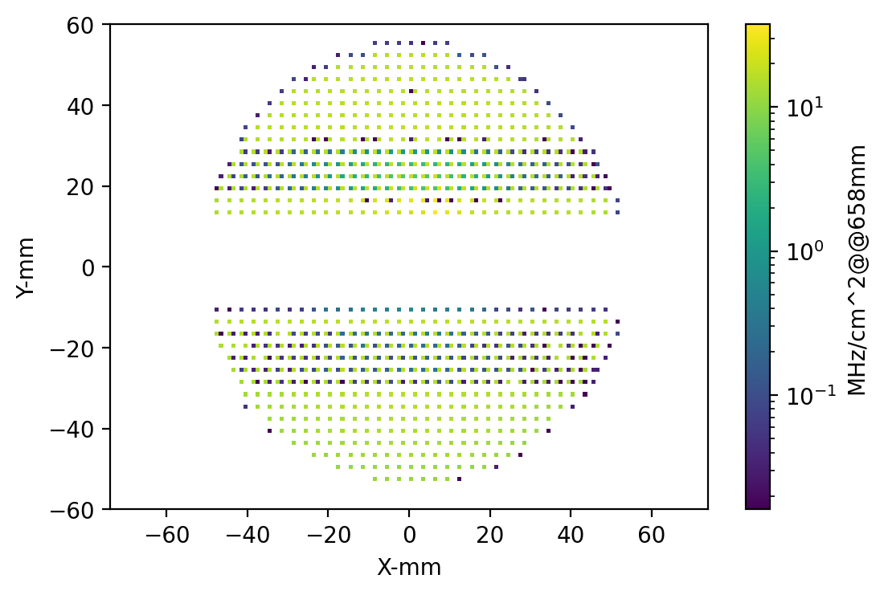
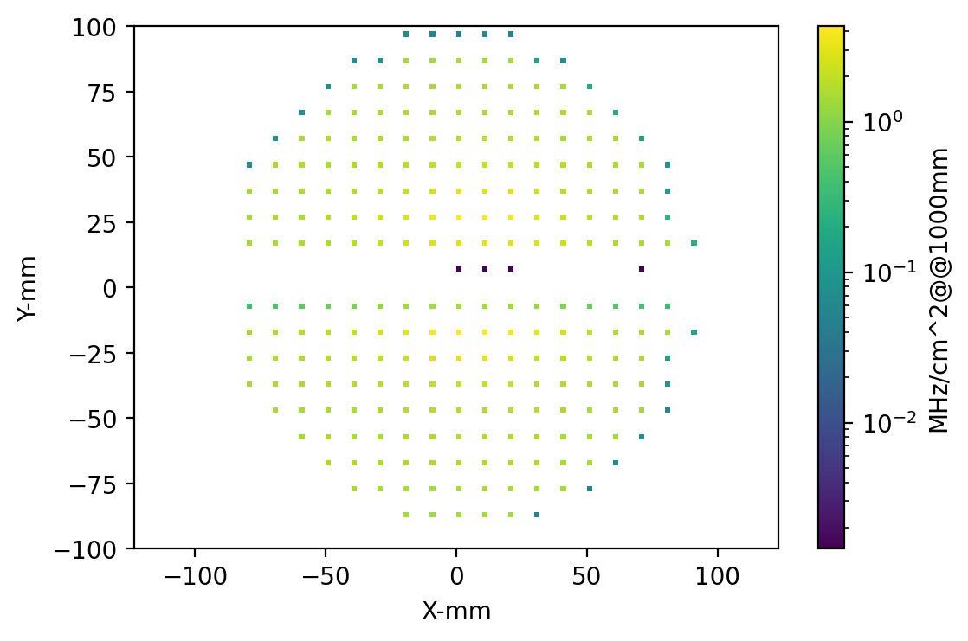

Slide 6
Higgs 250310
LYSO | Average Hit Rate (MHz/cm2) | Max Hit Rate(MHz/cm2) | Max Occupancy(%)
Si I@560mm | 12.32158 | 203.53048 | /
Si II@640mm | 9.79078 | 253.25195 | /
LYSO I@658mm | 1.10164 | 3.36492 | 7.29897
LYSO II@875mm | 0.15882 | 0.40765 | 11.69234

Slide 7
