Slide 1
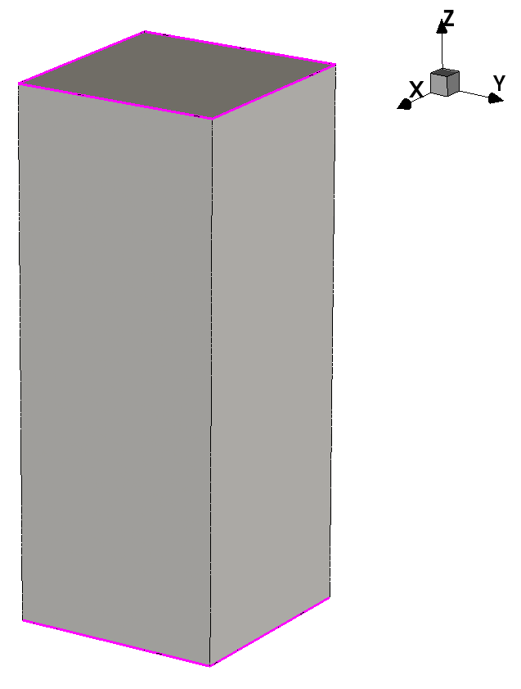
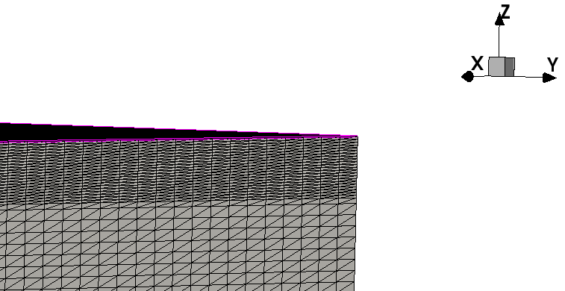
Geometry
Contact
A small one is used for testing meshing and doping
$100×100×500 μm (x−y−z)$
Removed materials between diamond and contact, directly contact to the diamond
The properties of contact can be modified for additional studies (Ohmic, Schottky, Resistive...)
Meshing refined at regions close to contacts
$$500 μm$$
$$100 μm$$
$$100 μm$$
Contact
Notes:
由于使用整个探测器的模型模拟耗时会很长，另准备了两个较小的模型，其中一个尺寸为100*100*500微米，并去掉了金属材料，而直接把contact放在金刚石上，这样之后可以研究contact的特性，比如修改接触特性、改变电阻等。在接近contact的位置，使用了更大的网格密度。

Slide 2
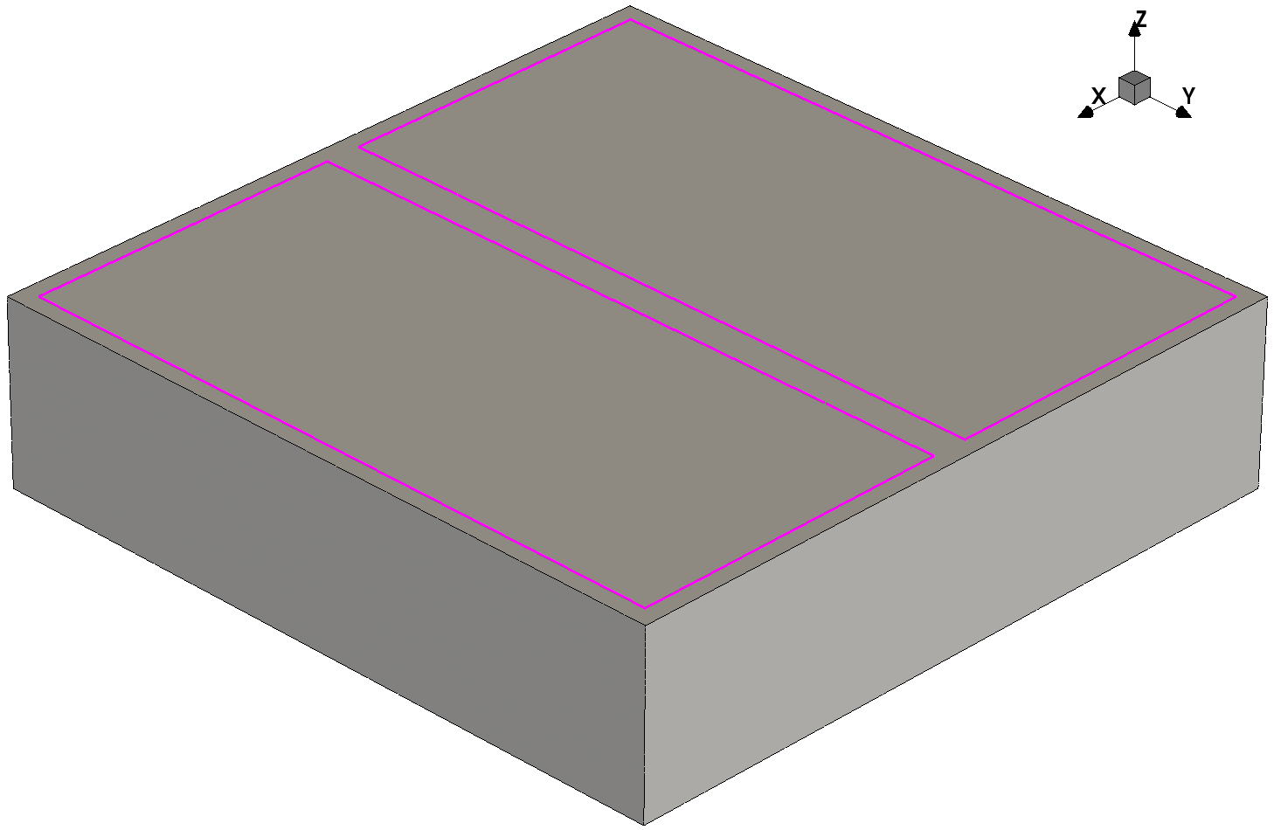
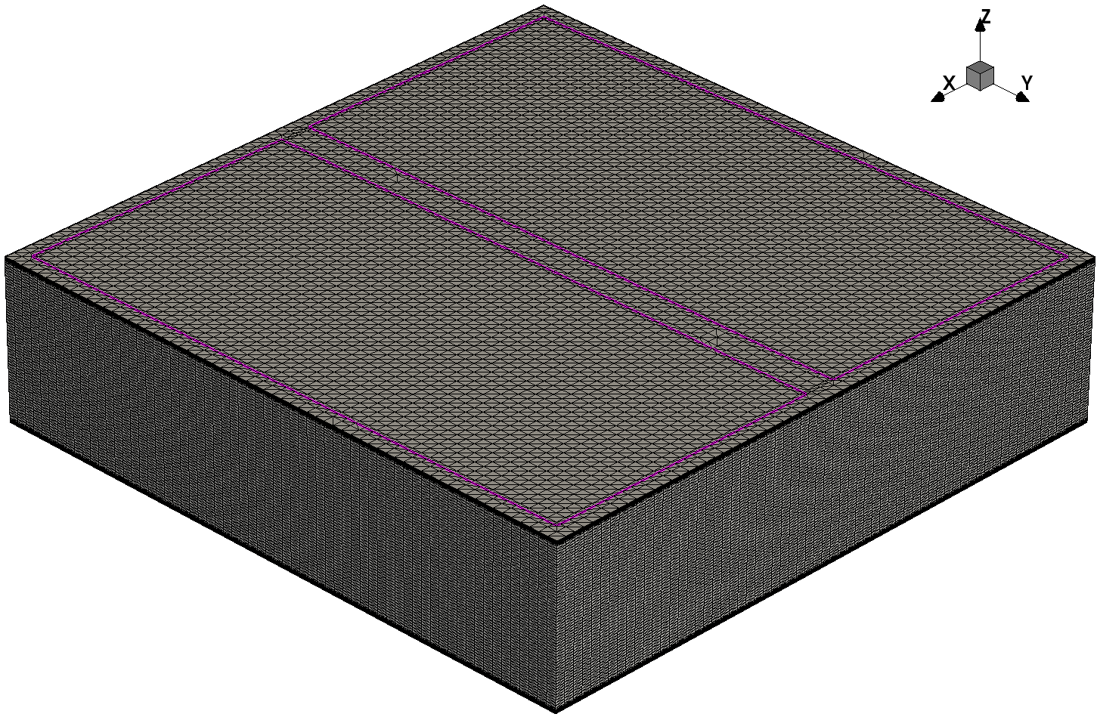
Geometry
Another design for transient simulation testing later
$2000×2000×500 μm (x−y−z)$
Two electrodes on front side, each $900×1900 μm (x−y)$
One on back side, $1900×1900 μm (x−y)$
Notes:
另外一个的尺寸是2000*2000*500微米，正面两个电极，每个是900*1900微米，背面一个电极，1900*1900微米，用于验证前一模型的IV曲线，并在之后可用于模拟粒子击中

Slide 3
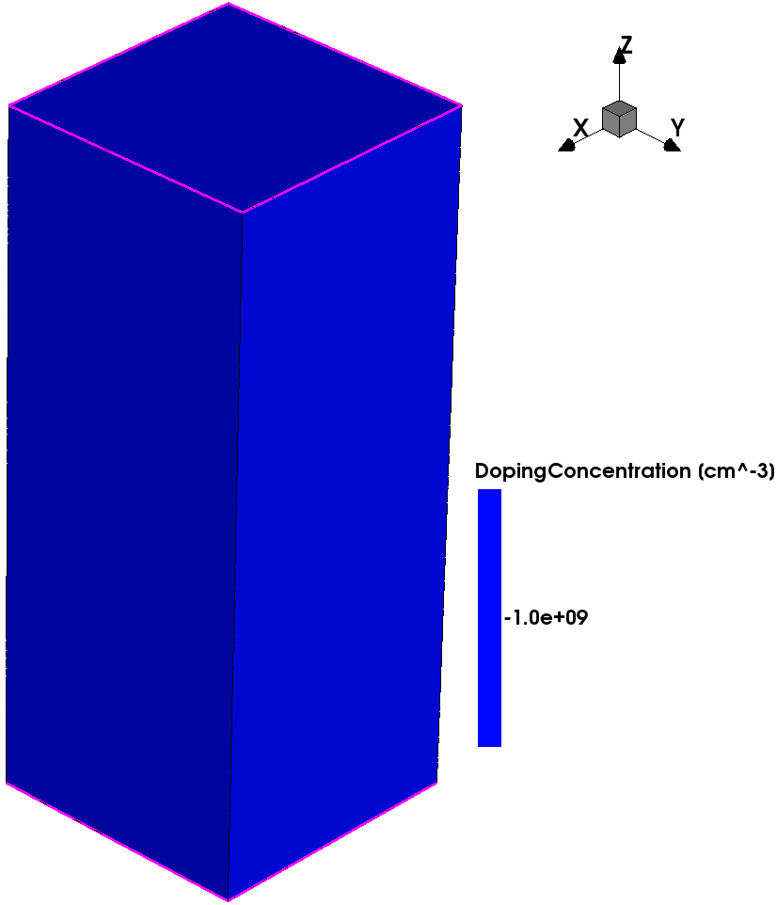
Doping
During CVD process, Boron and Nitrogen are common impurities
Doping helps to avoid convergence issues
Boron acts as positive-type doping
Activation energy $0.37 eV$
Add ${10}^{9}, {10}^{10}, or {10}^{11} {cm}^{−3}$ to Diamond Material
Notes:
接下来是掺杂，在气相沉积的过程中，会有硼和氮杂质进入金刚石。同时，掺杂还可以防止模拟过程中的计算不收敛问题。因此，在金刚石中使用硼作为P型掺杂，其激活能为0.37eV。分别使用10的9，10，11次方每立方厘米浓度掺杂进行IV曲线模拟。

Slide 4
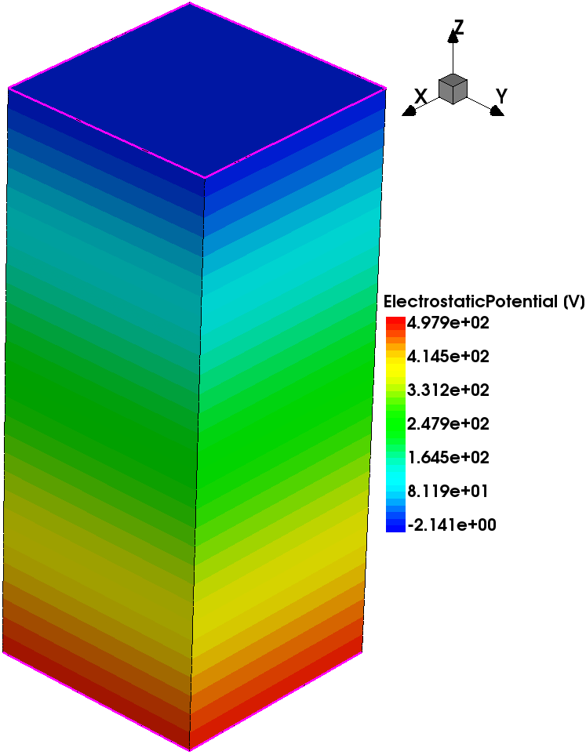
I-V Characteristic Curve
Quasistationary Simulation
Voltage of back electrode : from 0 V to 500 V
Physics Models :
EffectiveIntrinsicDensity( OldSlotboom ) # doping bandgap narrowing effect
Mobility(
-ConstantMobility # Do not use ConstantMobility model
DopingDep
HighFieldsaturation( Eparallel )
Enormal # mobility degradation at interfaces
)
Recombination(
SRH( DopingDep ) # Shorkley-Read-Hall recombination
Avalanche
)
Notes:
IV曲线使用稳态模拟，将背面电极的电压从0V逐渐增加到500V。使用的物理模型如下。首先是掺杂禁带变窄模型，接着是迁移率设置，其中关闭了默认的固定迁移率模型，使用掺杂浓度相关的迁移率模型，再加上高场饱和模型和界面散射模型。然后是SRH复合模型和雪崩击穿模型。雪崩击穿只有在很高的电场下才会发生，金刚石探测器的电压远低于击穿电压，所以基本不用考虑击穿问题。

Slide 5
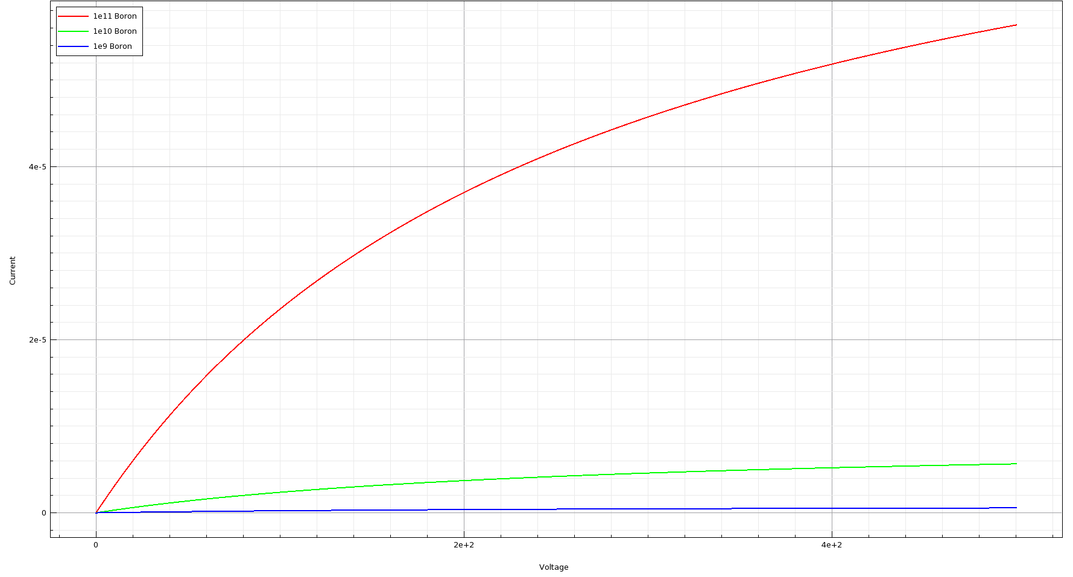
I-V Characteristic Curve
Notes:
这是IV曲线的绘制结果，掺杂浓度越高，载流子浓度越高，电流就越大

Slide 6
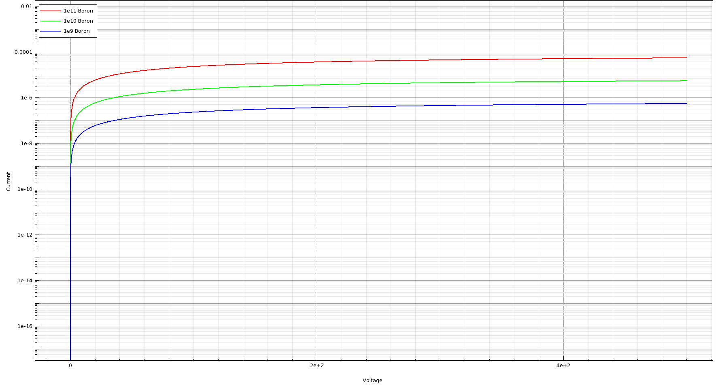
I-V Characteristic Curve
(Log Y)
Notes:
将Y轴改为对数坐标，可以看出在10的10次方左右的掺杂浓度下，掺杂浓度高一个数量级，电流也增加约一个数量级

Slide 7
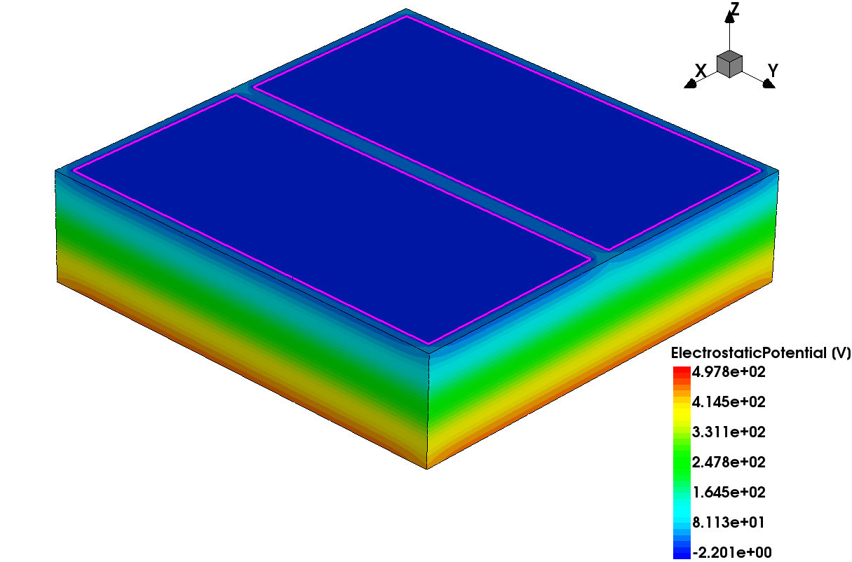
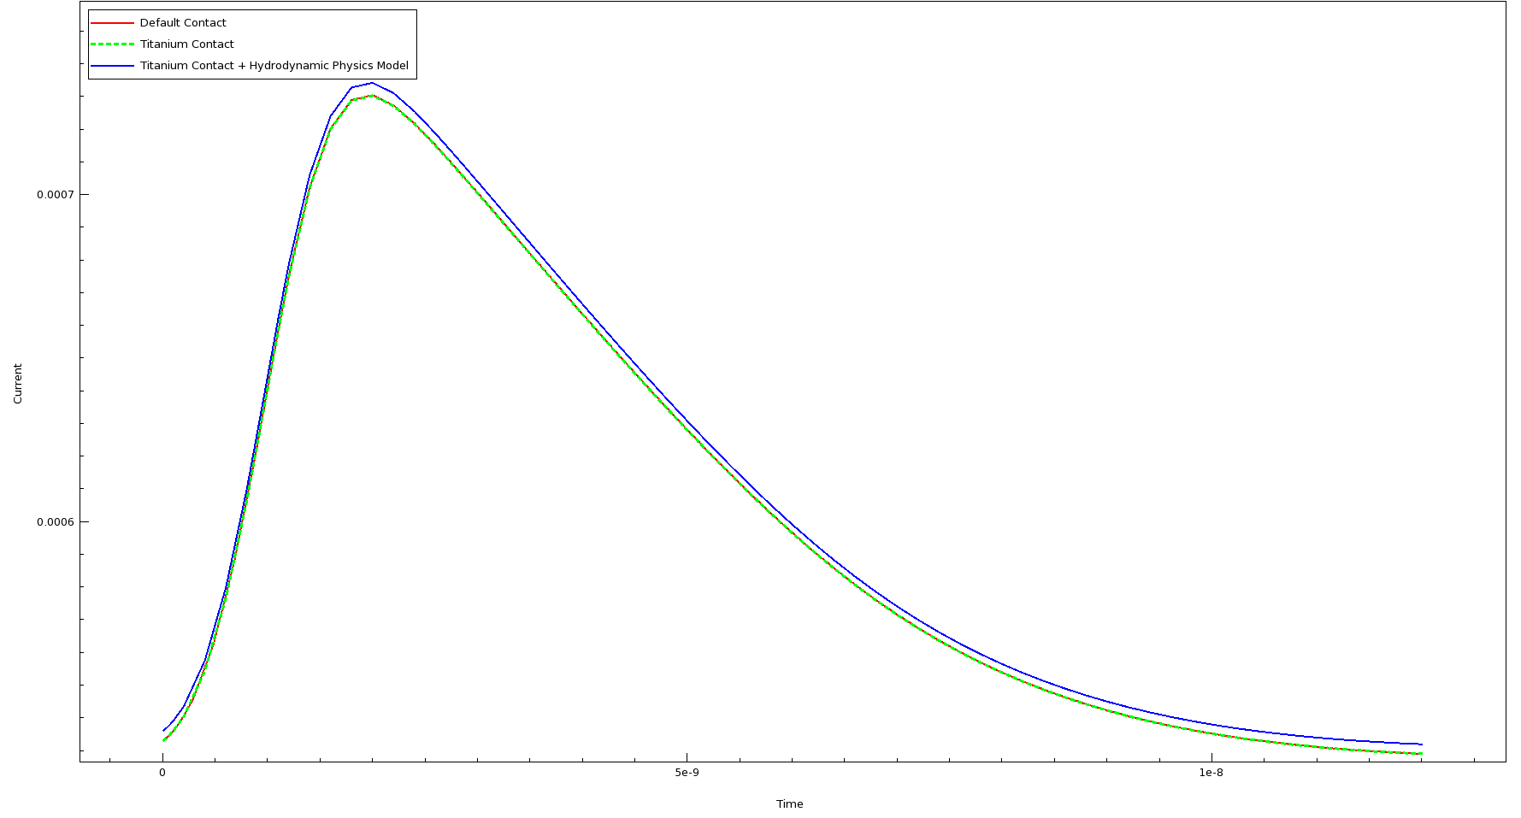
Transient Simulation
中心正入射
HeavyIon(
Direction = (0,0,1)
Location = (0,0,-260)
Time = 1e-9
Length = 520
Wt_hi = 1
LET_f = 5.767e-6
Gaussian
PicoCoulomb
)

Slide 8
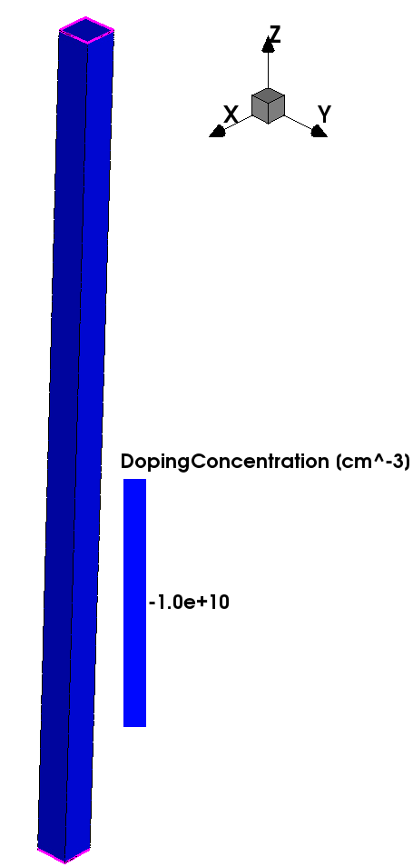
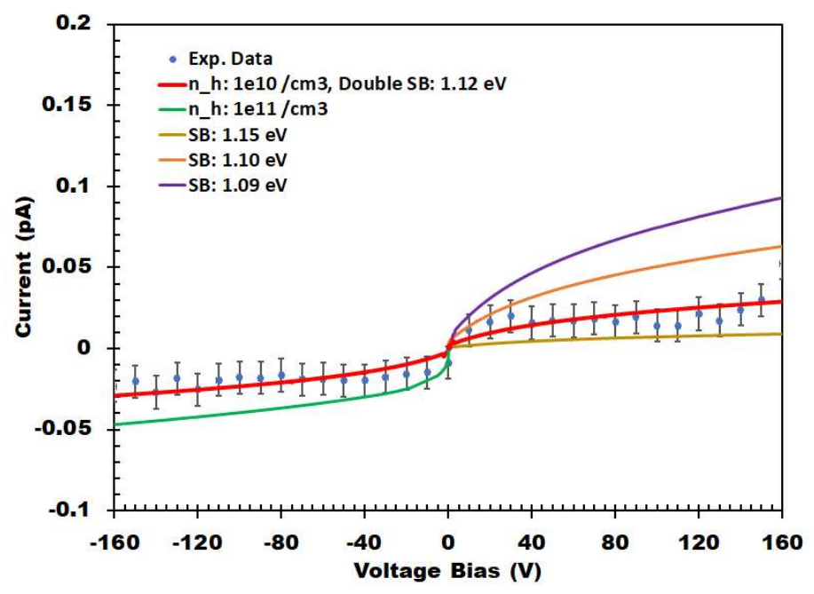
Schottky Contact
Geometry
$$20×20×500 um$$
Electrode {
{ Name = "front" Voltage = 0 Schottky Barrier = 1.12}
{ Name = "back" Voltage = 0 Schottky Barrier = 1.12}
}
“Direct connection between the SMU and diamond case generates significant leakage current that overwhelm the extremely low dark current of diamond detector. However, both of the sample shows small leakage current for both voltage bias polarity. It indicates both metal contacts for those samples have significant Schottky Barrier.”
改为肖特基接触后，IV曲线模拟计算不收敛
尝试更密网格，不收敛
尝试增加 BarrierTunneling，不收敛
尝试改 Physics，在关闭各种模型后收敛，但不符合实际

Slide 9
