Slide 1
Analysis code checking

Slide 2
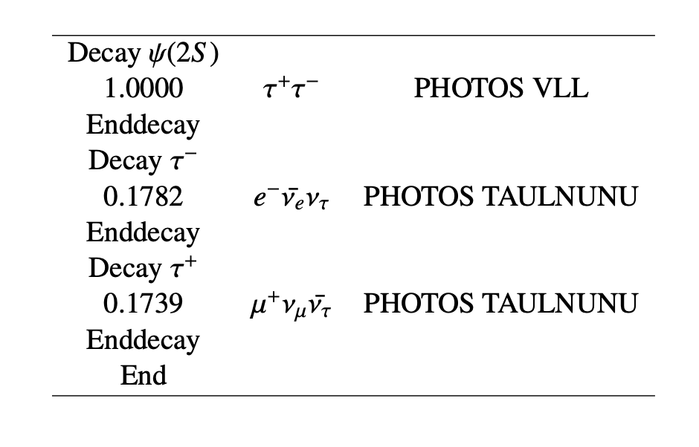
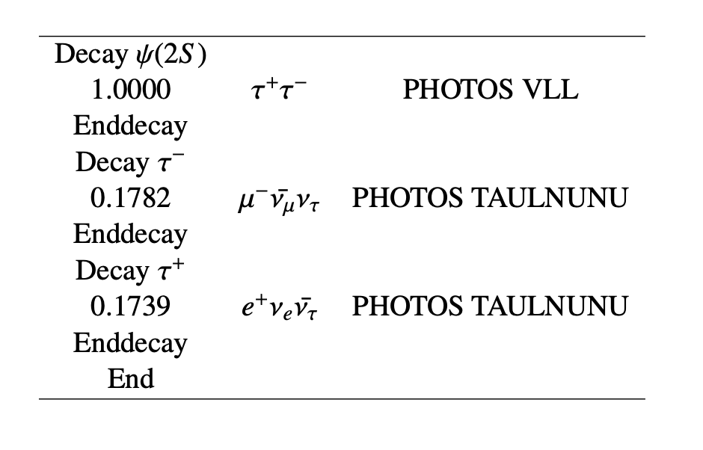
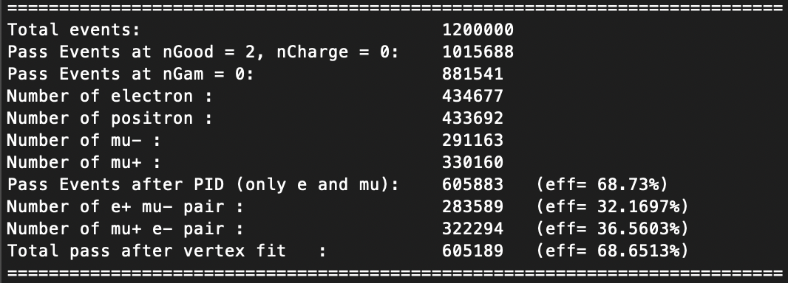
Signal MC test

Slide 3
 | My code | Yunhe’s code
After pass the vertex fit | 605,189 | 605,189
Exclusion criteria | Deleted events for each conditions
P_{e,µ} ≥1.2 GeV/c | 93 | 93
Deposited energy (Electron) ≥1.2 | 34 | 34
Deposited energy (Muon) ≥ 0.3 | 1,474 | 4,086
E/P ratio (Muon) ≥ 0.6 | 49,066 | 52,196
Muc_depth ≤ 0 | 214,285 | 202,641
Muc_depth ≤ 83*(P_{µ} - 0.65) | 75,178 | 75,493

Slide 4
Deposited energy of muon
Deposited energy of electron
Check amount of zero value
Yunhe’s code: 14230 events
My code : 20506 events
Check amount of zero value
Yunhe’s code: 6256 events
My code : 8850 events

Slide 5
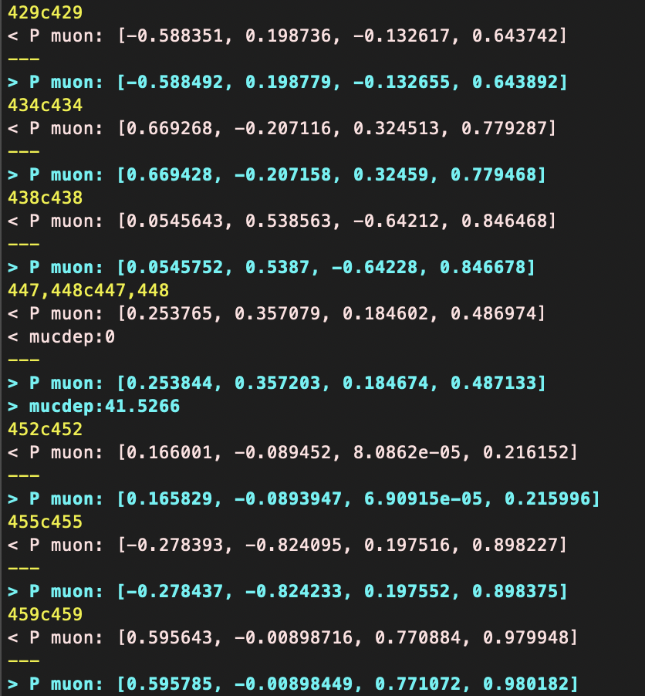
The muon momenta are slightly different (electron momenta are the same )
The MUC depth is missing in some events
Me
Yunhe
MUC depth

