Slide 1

24/3/2025
Status Report: H Recoil Mass
Yuji Li

Slide 2

Status
Validation for MuID in signal Samples
Muon momentum leveling
CutFlow checking for backgrounds
Muon Selection: 20<p<80, cos(theta)<0.85
Best Z candidate: mimimize the chisquare

Slide 3
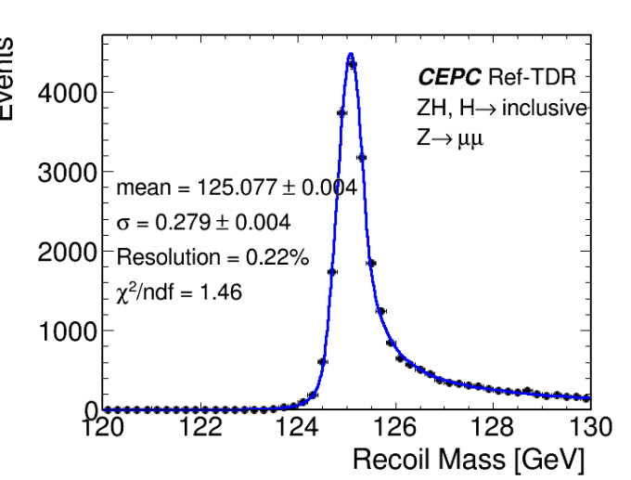
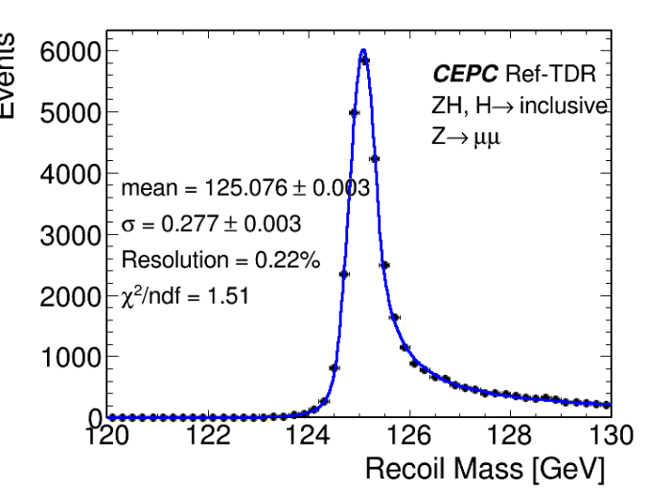
General performance in MuID
MuID
GenMatch

Slide 4
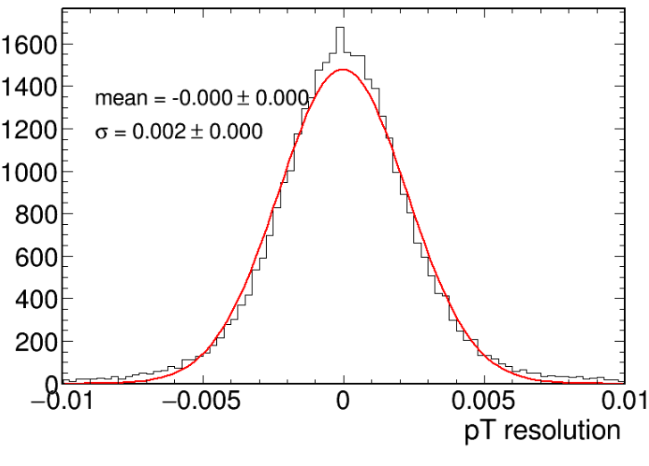
Muon momentum resolution
Resolution= (Reco.P – Gen.P)/Gen.P
We can take pT*0.002 for sys. Uncertainty study.

Slide 5
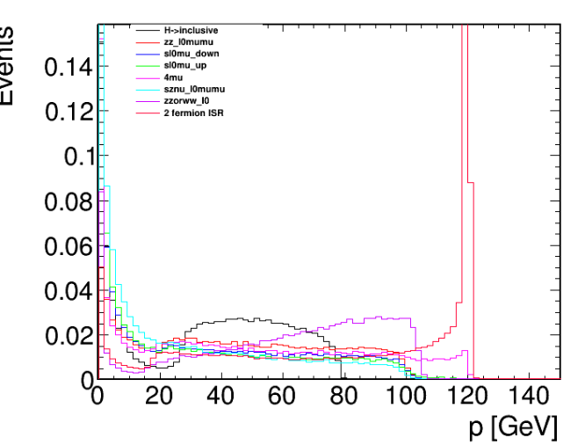
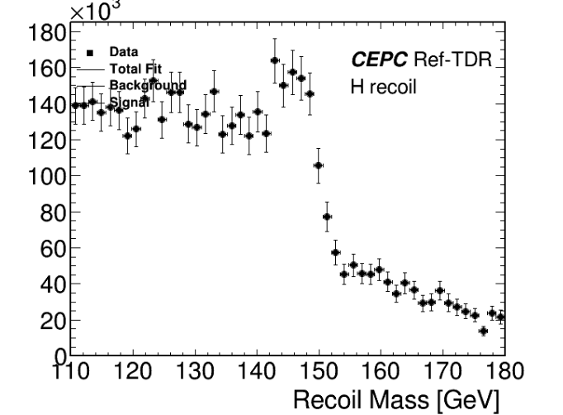
Muon Selections: Momentum(20<p<80)

Slide 6
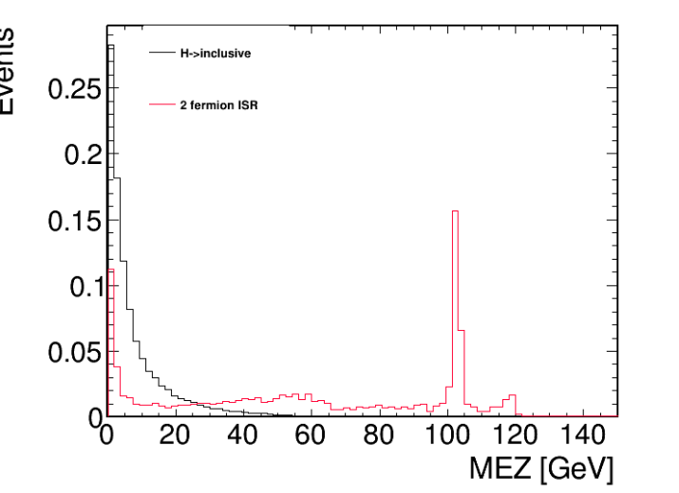
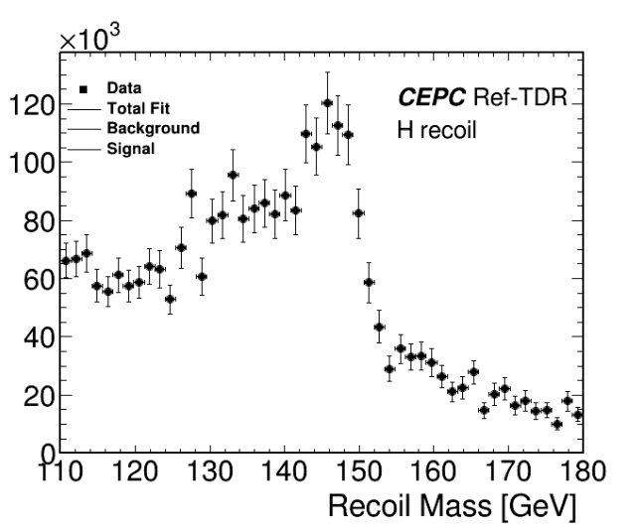
Muon Selections: MissingEZ<50

Slide 7
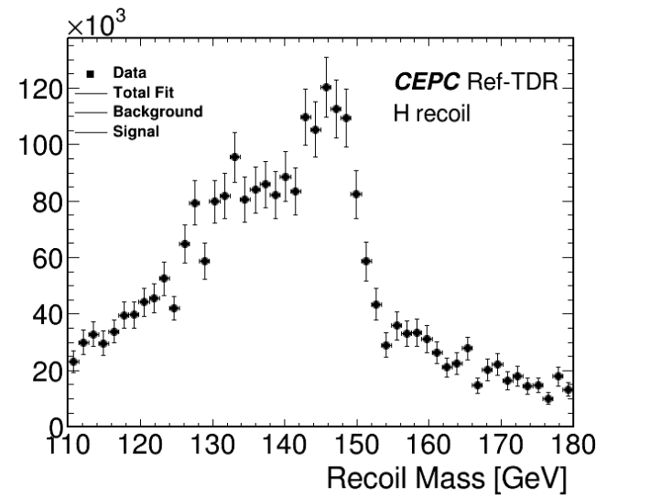
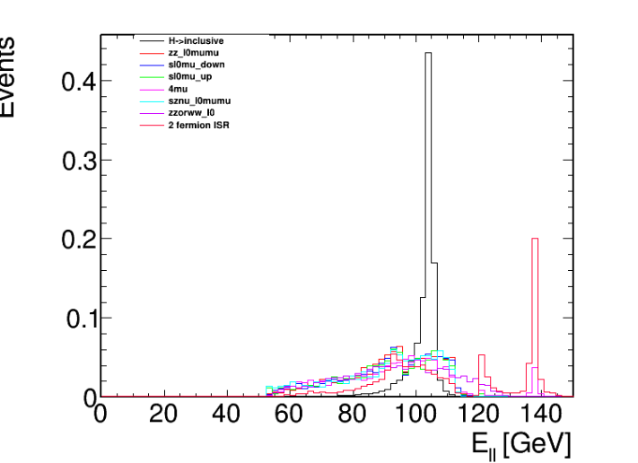
Muon Selections: E_ll<110

Slide 8
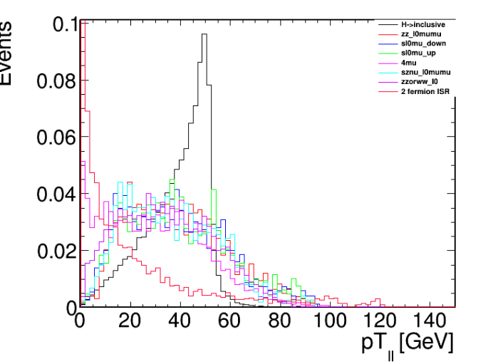
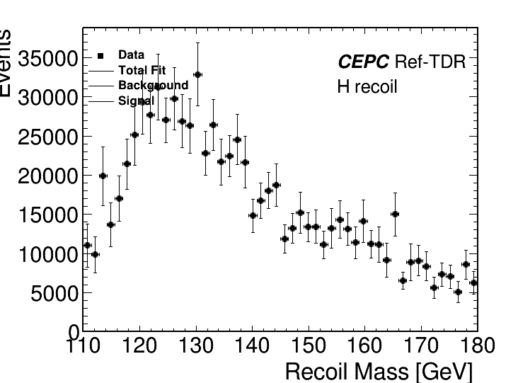
Muon Selections:20< P_ll<60

Slide 9
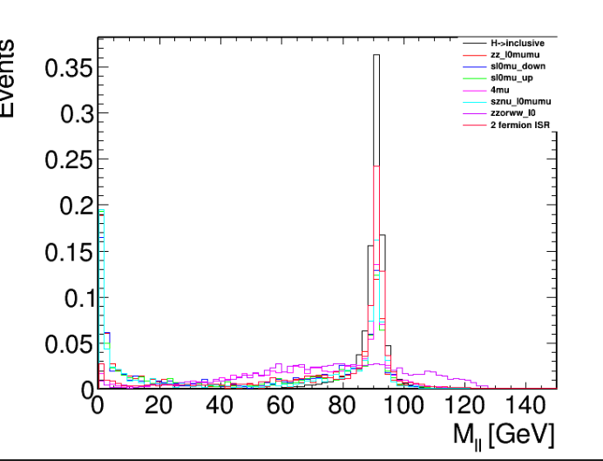
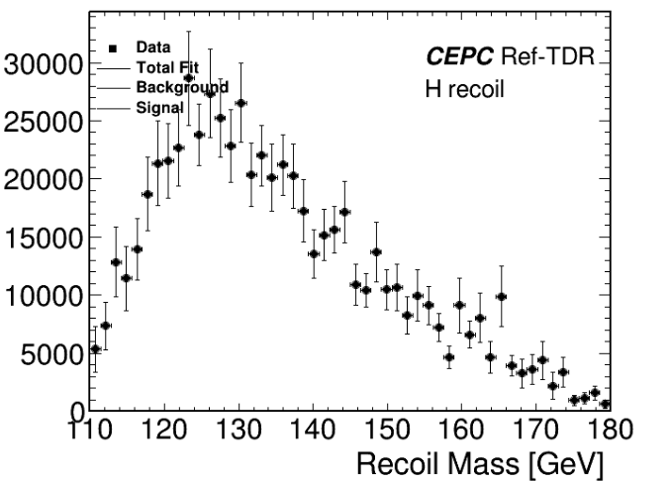
Muon Selections: 50<M_ll<120

Slide 10
Event Selections: Summary and cutflow
Process | zz_l0mumu | 4mu | sznu_l0mumu | sl0mu_down | sl0mu_up | zzorww_ll | 2fermion | H->incl.
xs | 19.38 | 15.56 | 43.32 | 136.14 | 87.39 | 221.1 | 5332.71 | 6.77
input | 20000 | 20000 | 19800 | 18400 | 18600 | 20000 | 98000 | 44000
2 muons | 4842 | 6923 | 2953 | 4386 | 4053 | 5584 | 10391 | 34690
110<recoil mass<150 | 1063 | 2383 | 1001 | 976 | 957 | 2209 | 3802 | 33636
MEZ<50 | 676 | 1768 | 681 | 929 | 904 | 1834 | 1506 | 33267
E_ll<110 | 607 | 1514 | 630 | 830 | 818 | 1291 | 933 | 33052
20<P_ll<60 | 402 | 933 | 434 | 514 | 518 | 812 | 133 | 29780
50<m_ll<120 | 390 | 831 | 425 | 414 | 405 | 783 | 109 | 29752
selected | 390 | 831 | 425 | 414 | 405 | 783 | 109 | 29752
eff | 0.0195 | 0.0415 | 0.0215 | 0.0225 | 0.0221 | 0.0391 | 0.0011 | 0.676

