Slide 1
CEPC LLP Study:
2-lepton channel full simulation analysis
Ziyang Sun, Xiang Chen
Zhengzhou University, Shanghai Jiao Tong University
2025-03-27

Slide 2
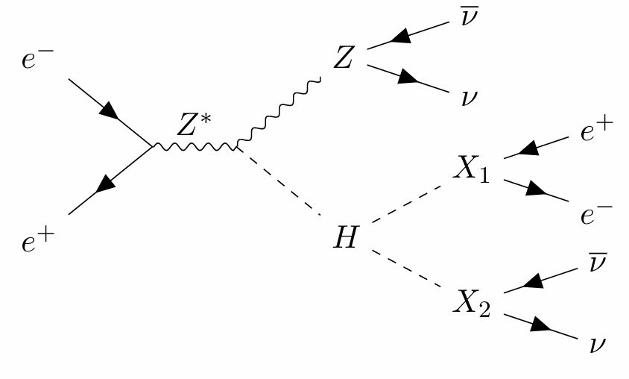
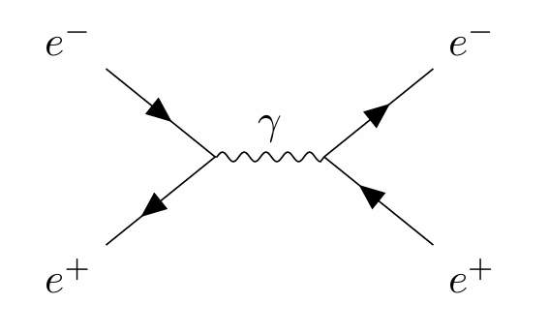
2-electron channel full simulation analysis
The version of CEPCSW is tdr25.3.6, and it doesn’t have Final PID, only CyberPFO information.
Signal: ee -> HZ, Z->νν, H->X1,X2, X1->ee, X2 -> νν
Background: ee -> ee
Signal events: 80,000, M_{X1,2}: 10 GeV
Background events: 20,000

Slide 3
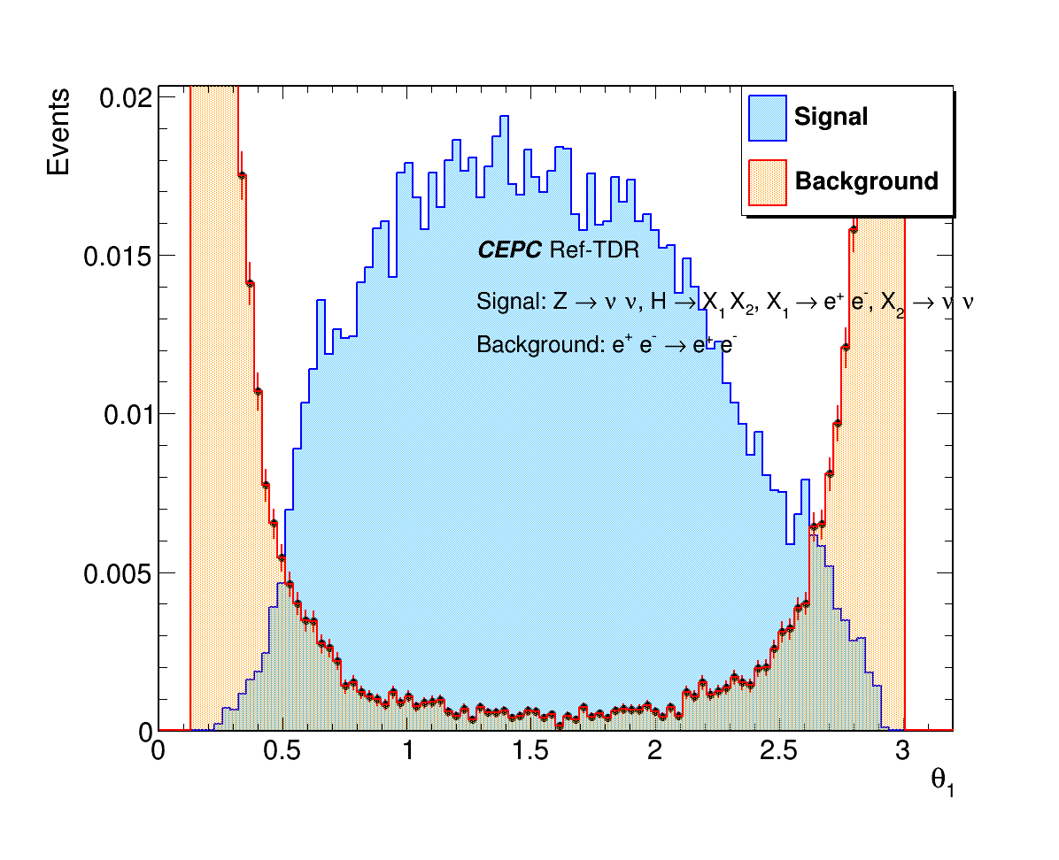
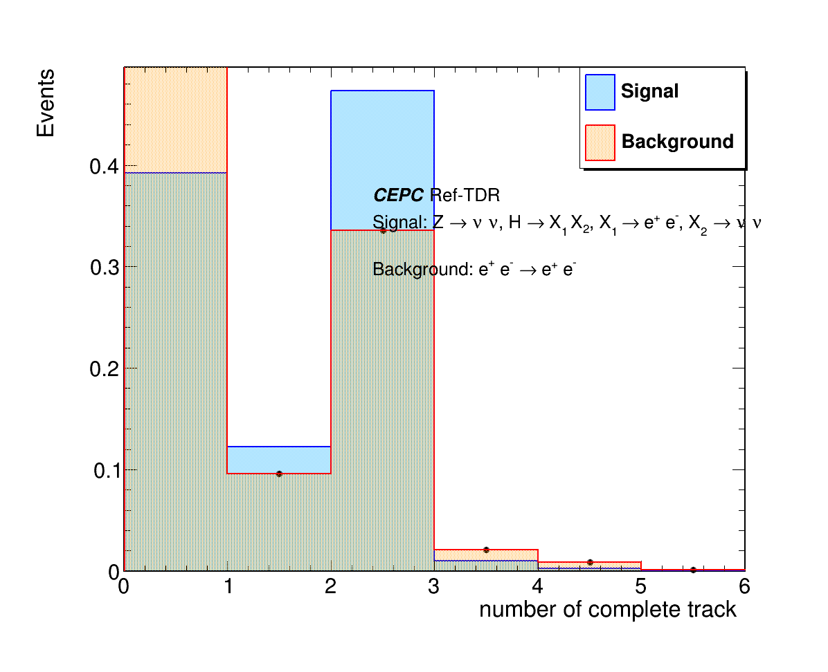
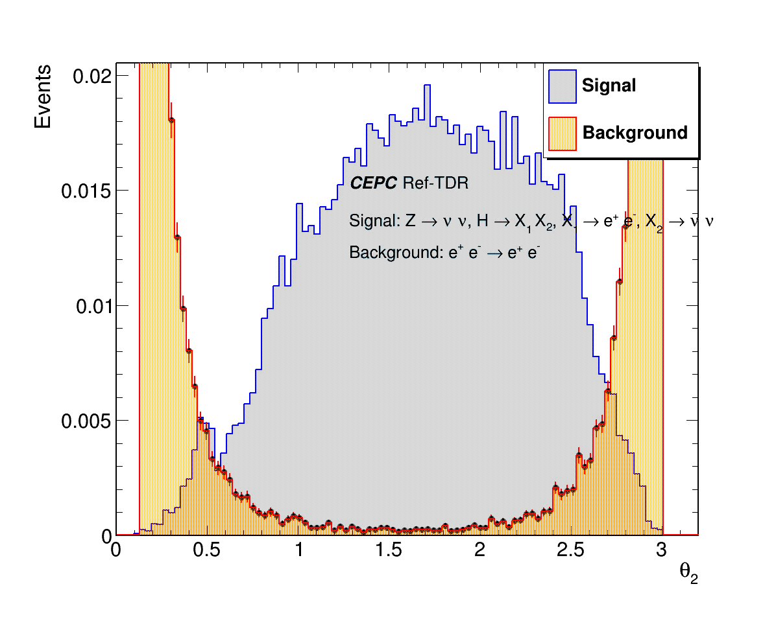
Number of complete tracks:
Signal vs Background
θ₁
θ₂
Number of complete tracks
Background events have a small theta

Slide 4
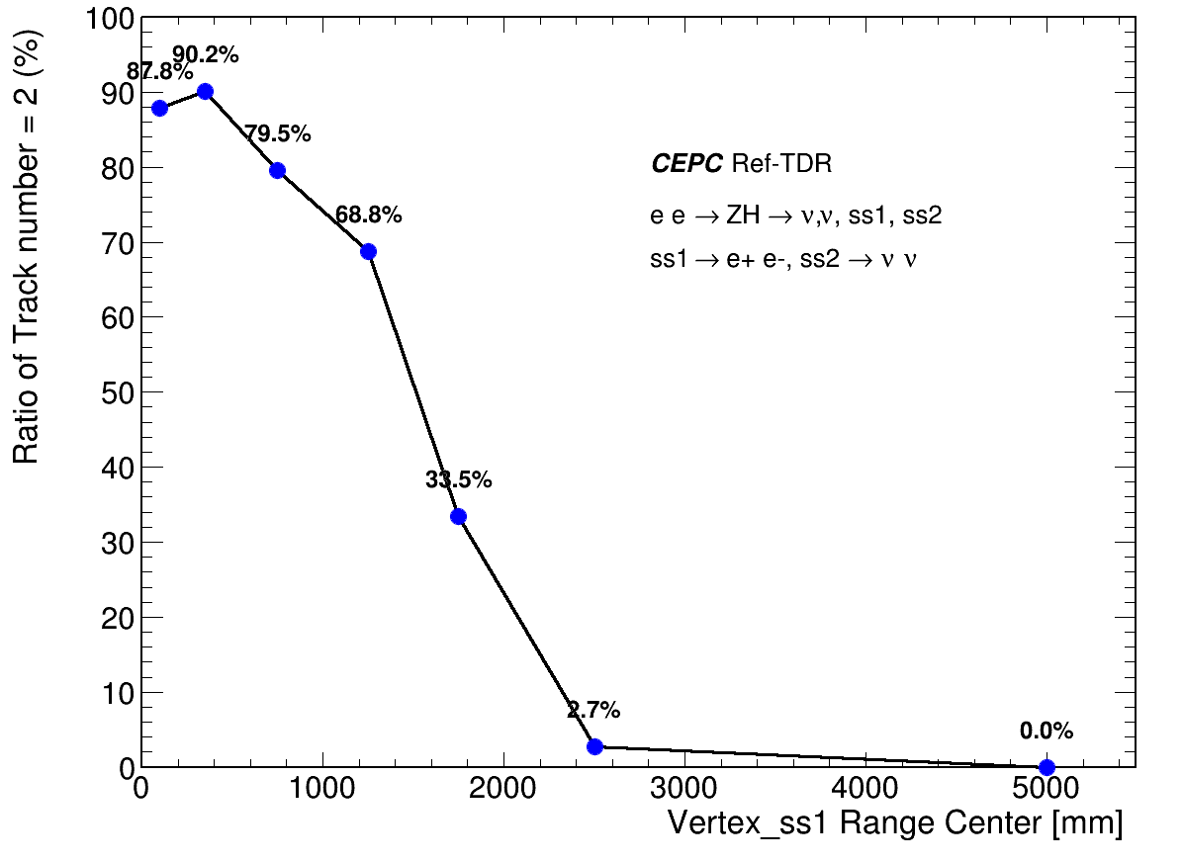
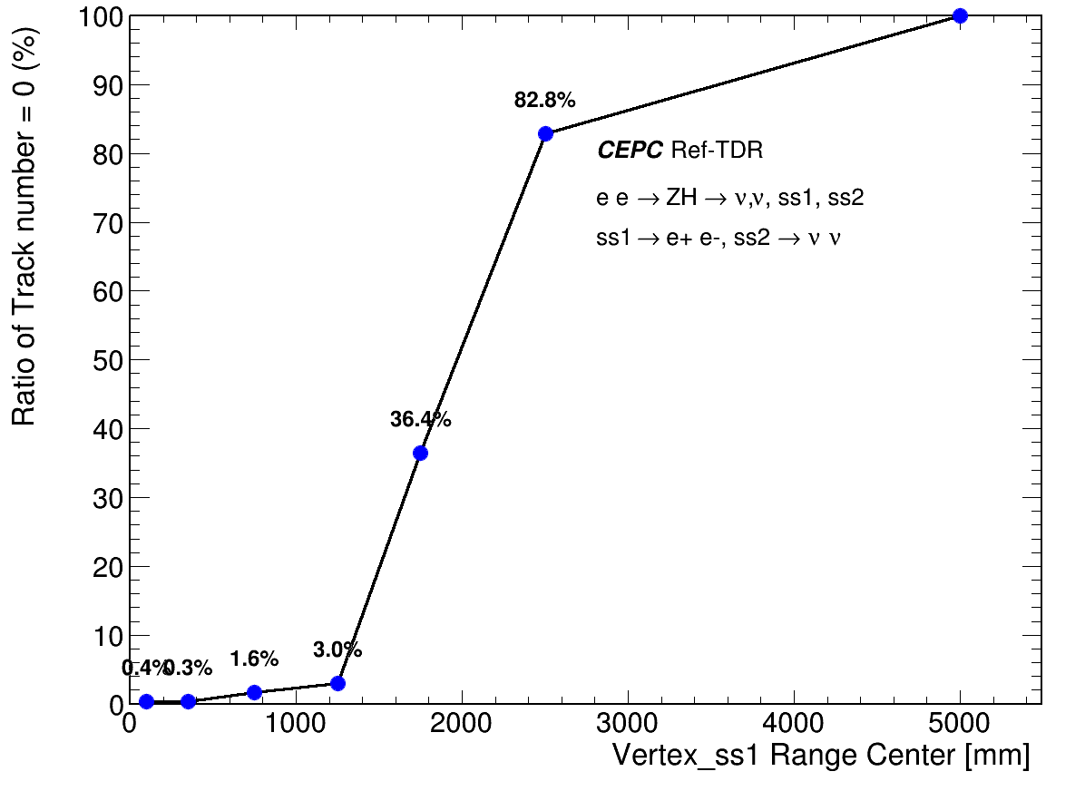
Efficiency of Complete Tracks with vertices range
Inefficiency in complete tracks for large range vertices,
Need to investigate tracks from standalone detectors
proportion of track number =2
proportion of track number =0

Slide 5
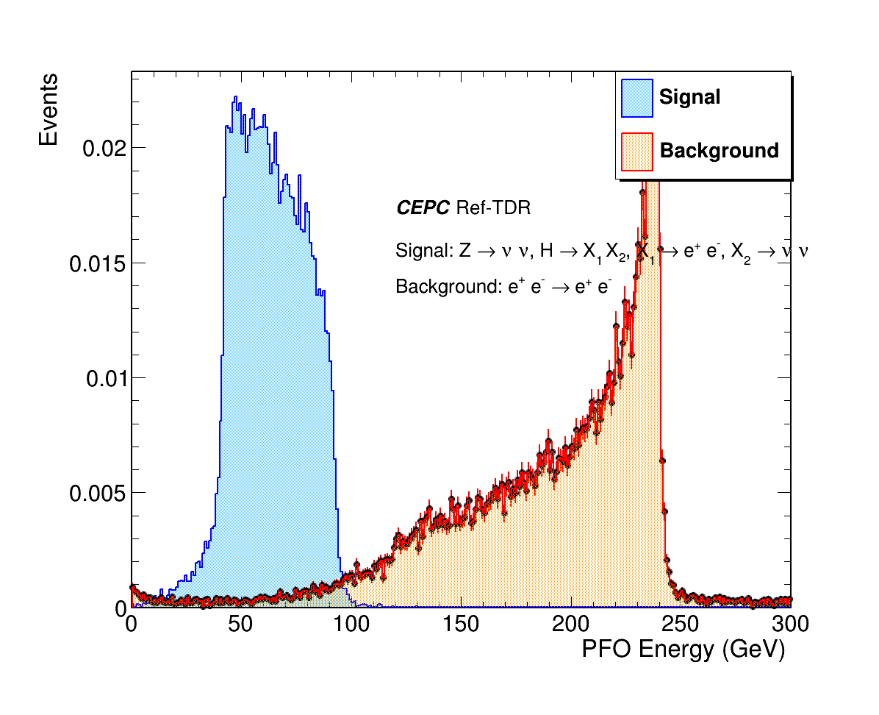
PFO Energy: Signal vs background
PFO energy: signal vs background

Slide 6
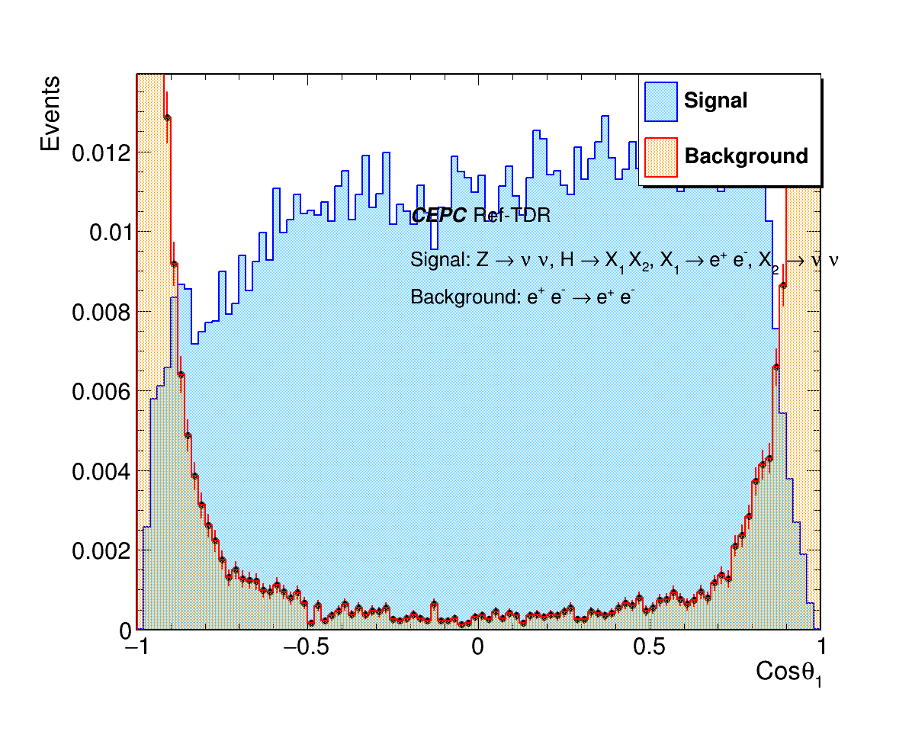
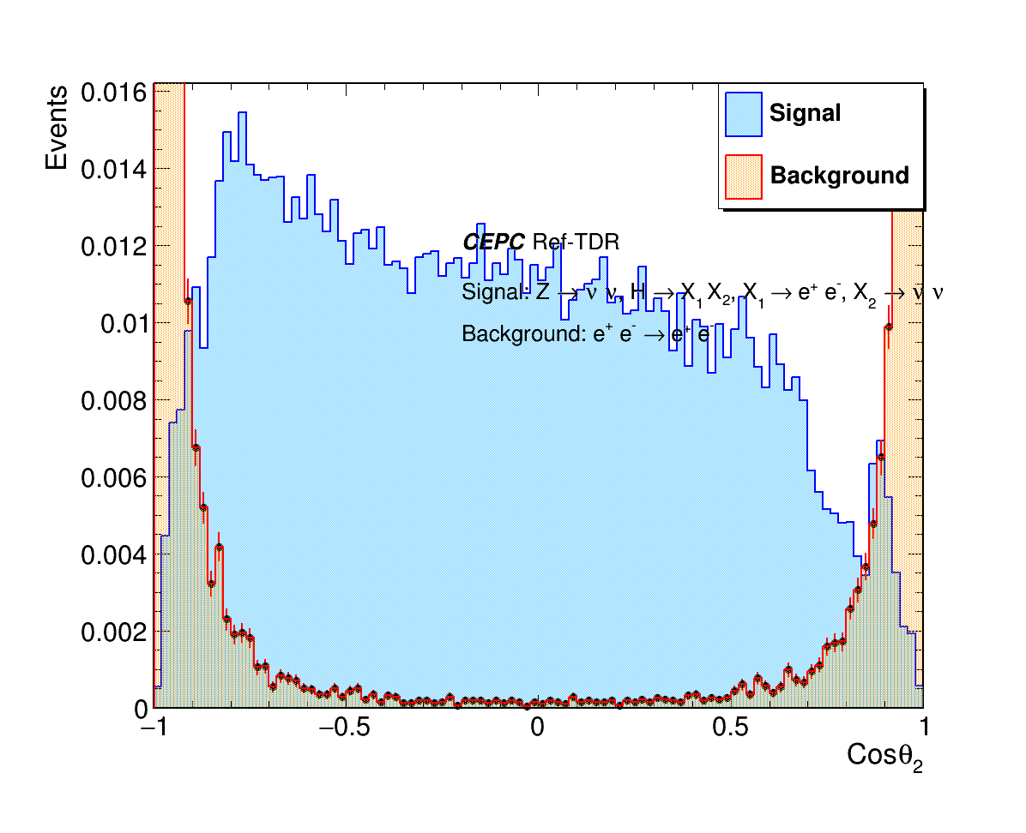
Cosθ: Signal vs background
Cosθ₁ & Cosθ₂ : signal vs background

Slide 7
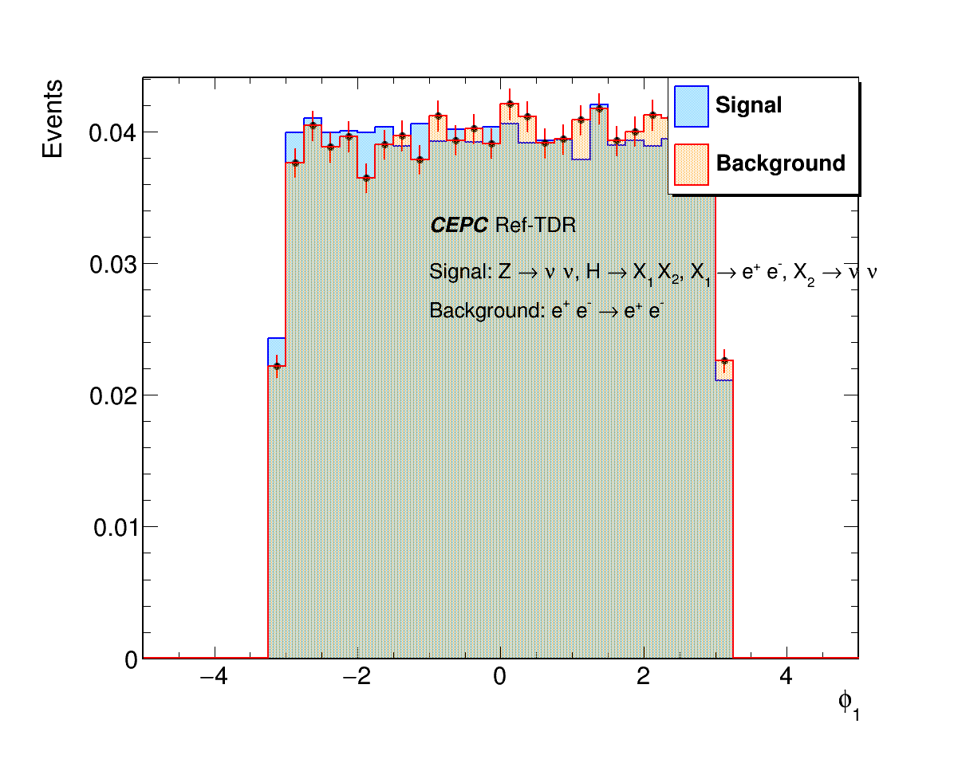
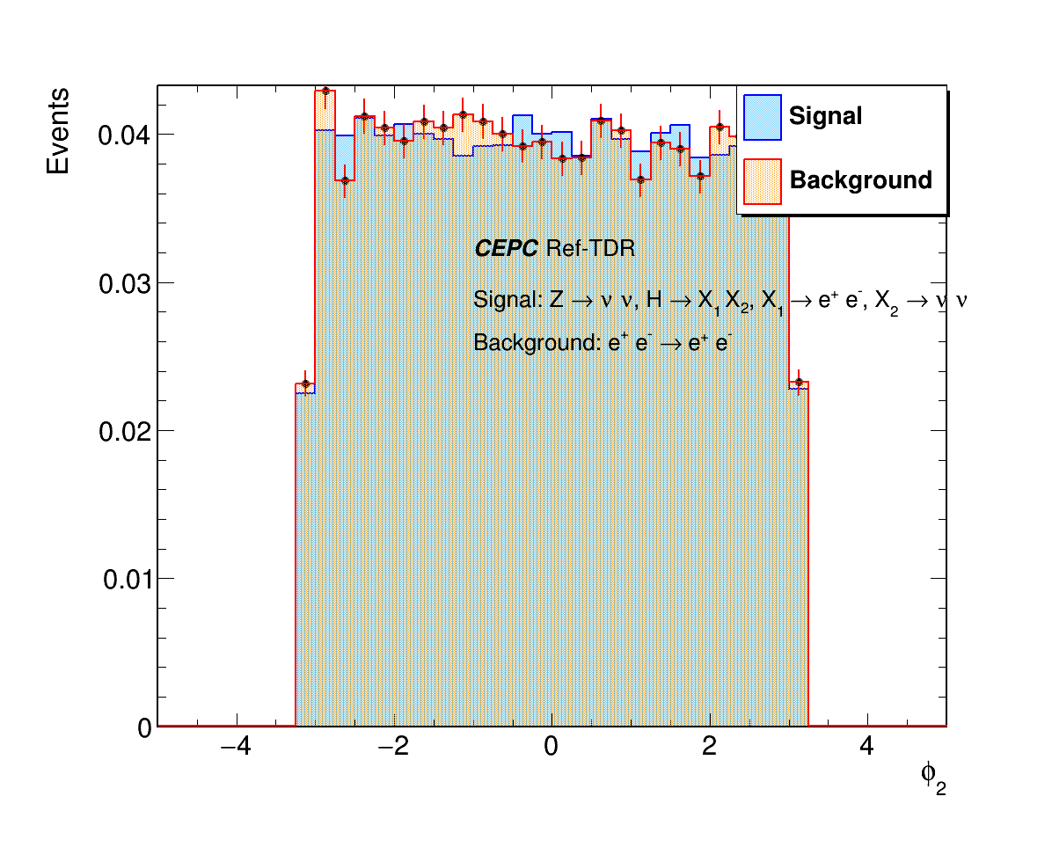
φ: Signal vs background
φ1 & φ2 : signal vs background

Slide 8
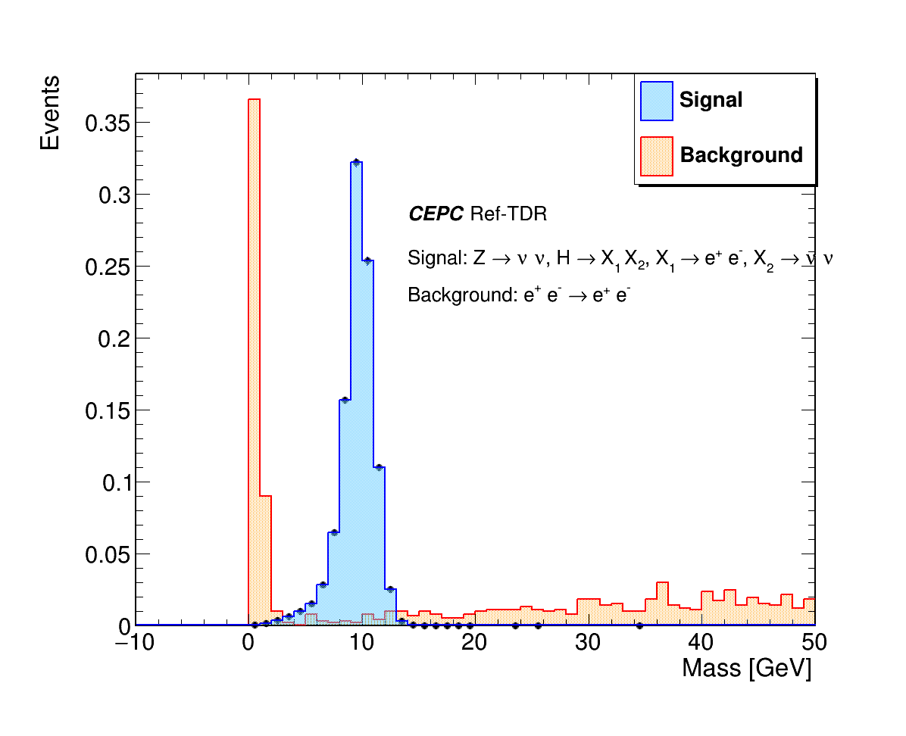
m_{e1e2}: Signal vs background
m_{e1e2} : signal vs background

Slide 9
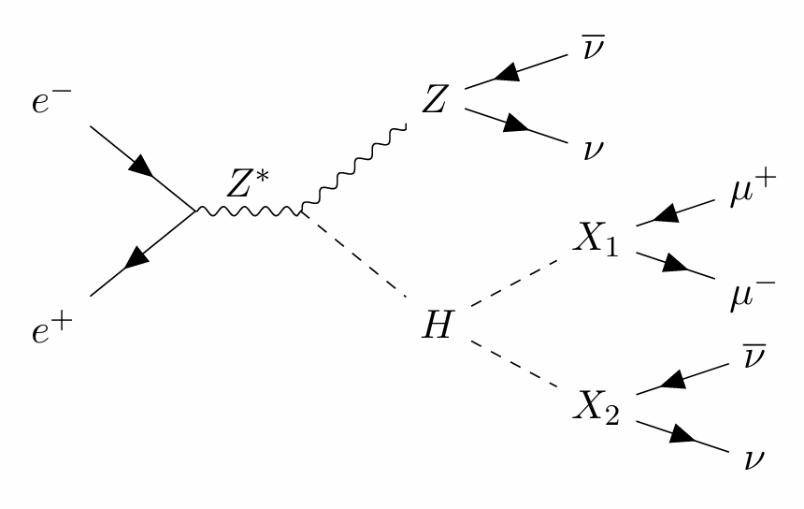
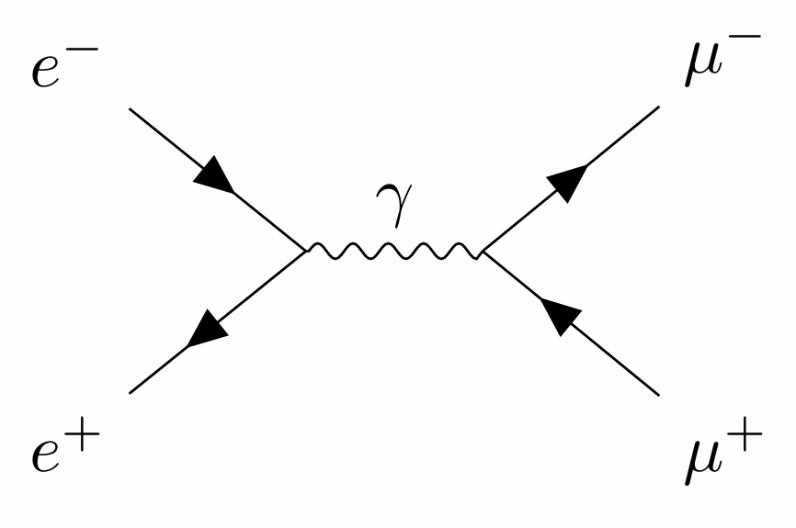
2-muon channel full simulation analysis
Signal: ee -> HZ, Z-> νν, H->X1,X2, X1->μμ, X2 -> νν
Background: ee -> μμ
Signal events: 80,000, M_{X1,2}: 10 GeV
Background events: 20,000

Slide 10
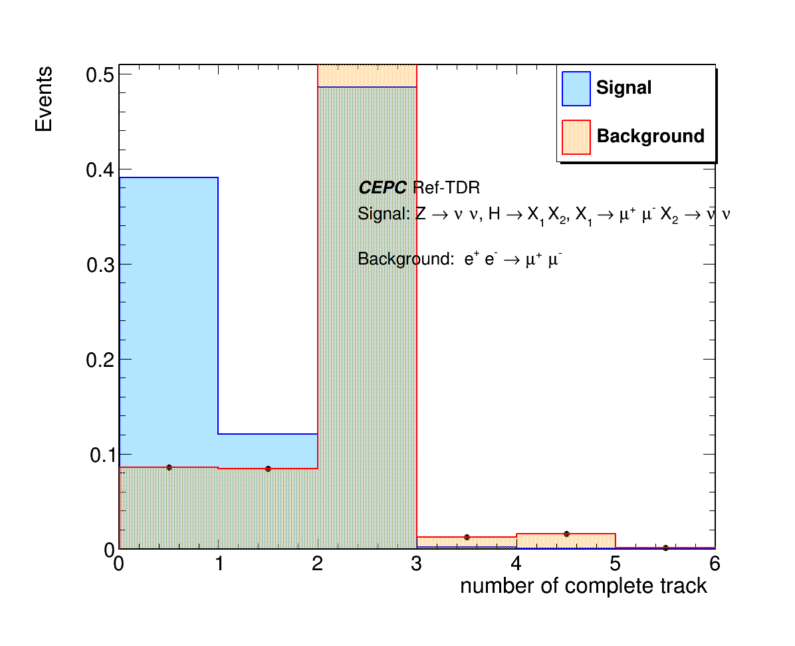
Number of complete tracks: Signal vs Background
Number of complete tracks

Slide 11
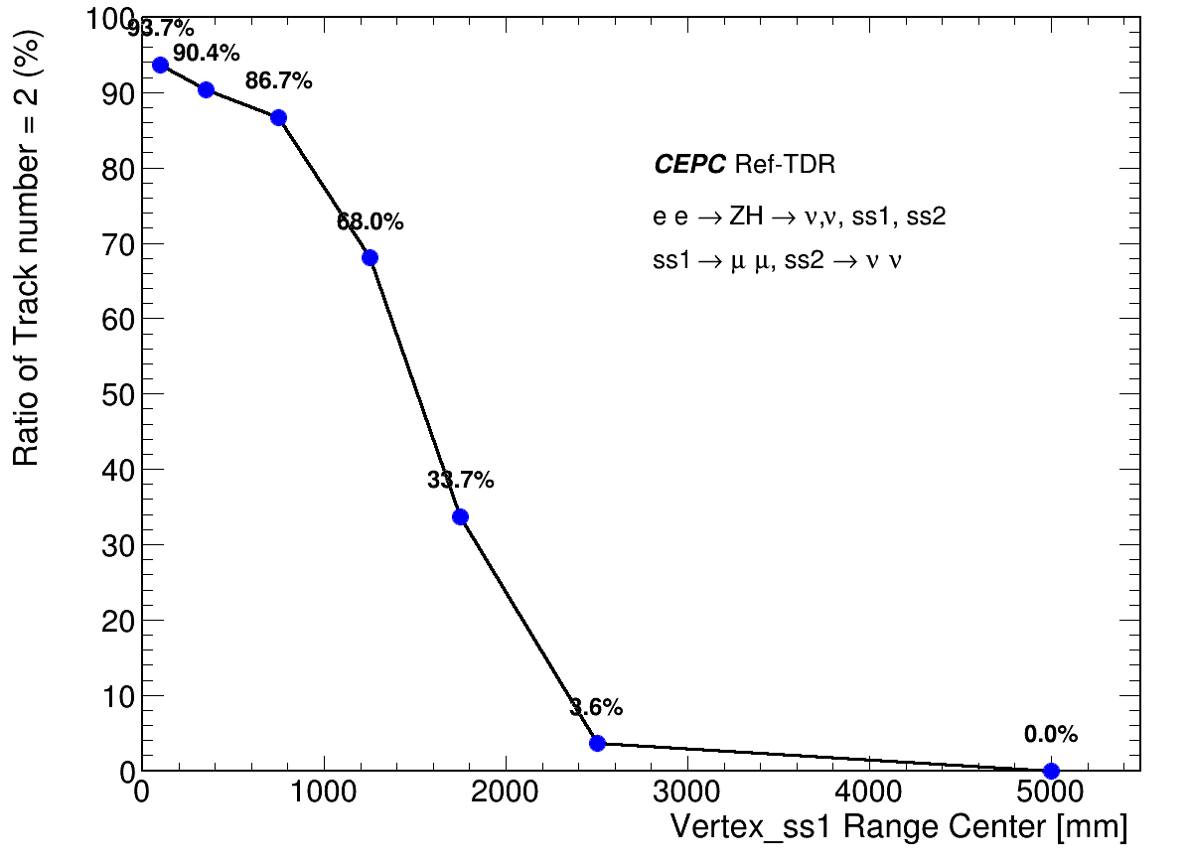
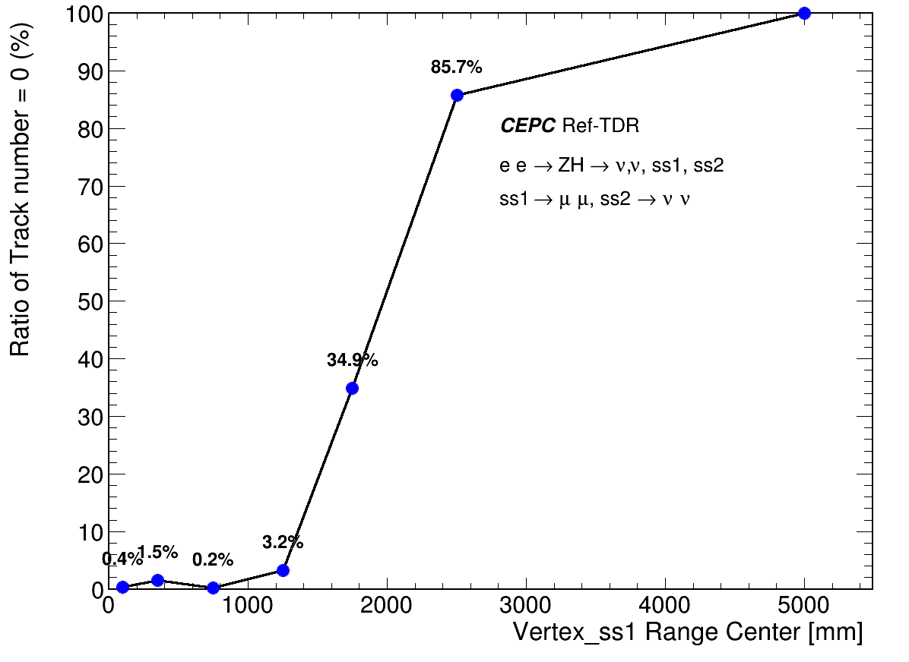
Efficiency of Complete Tracks with vertices range
proportion of track number =2
proportion of track number =0

Slide 12
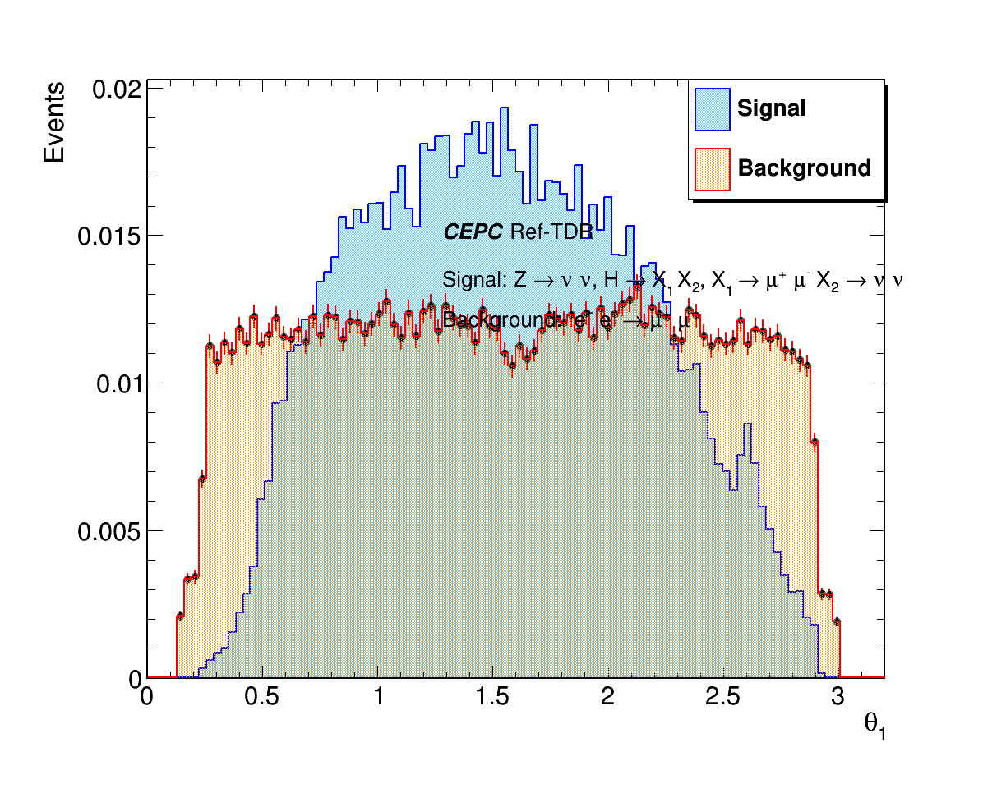
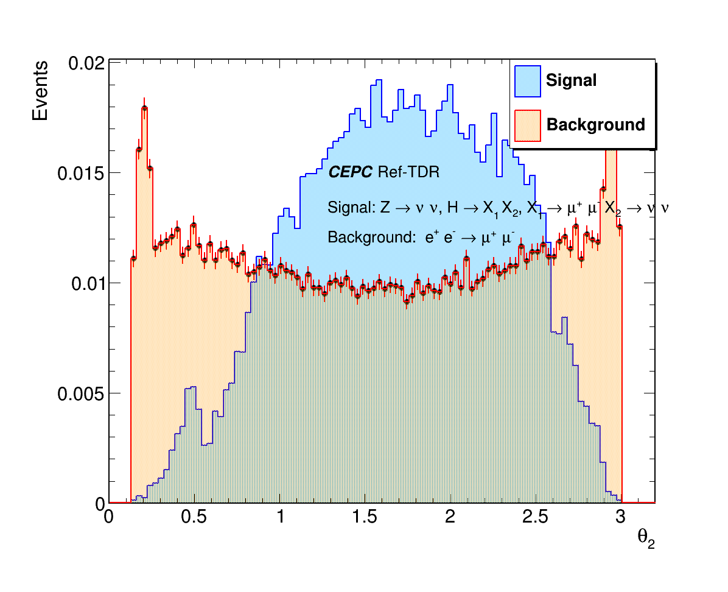
θ: Signal vs background
θ₁ & θ₂ : signal vs background

Slide 13
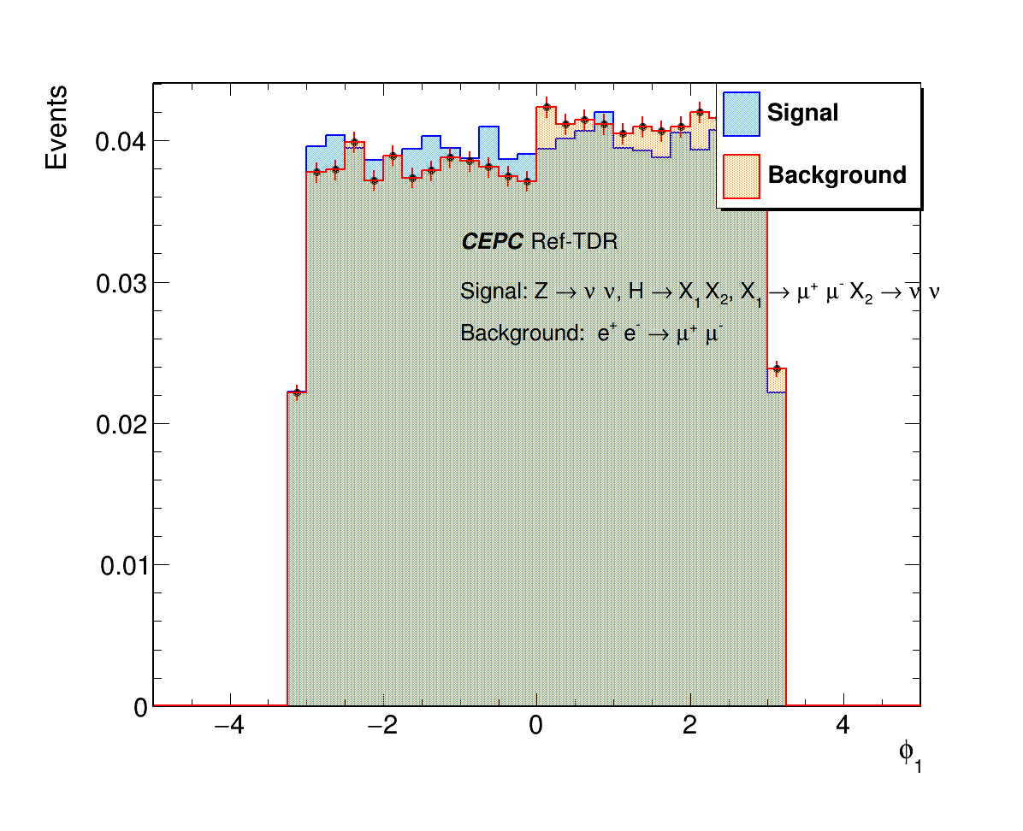
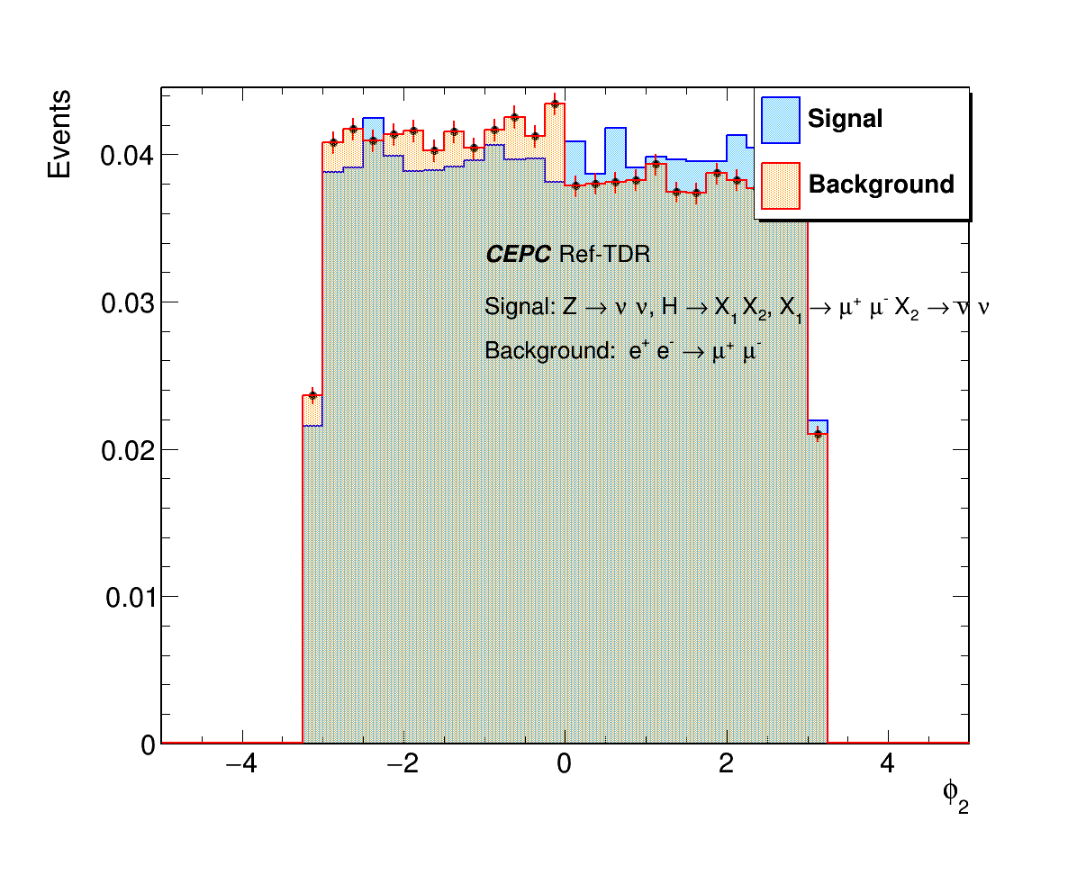
φ: Signal vs background
φ1 & φ2 : signal vs background

Slide 14
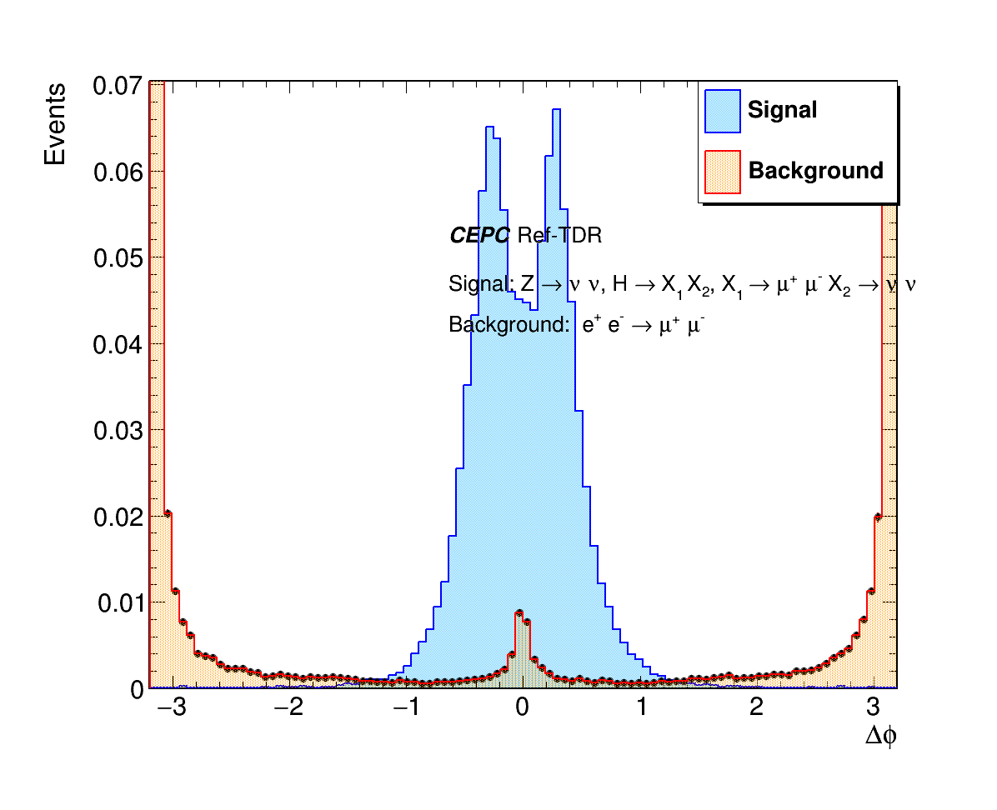
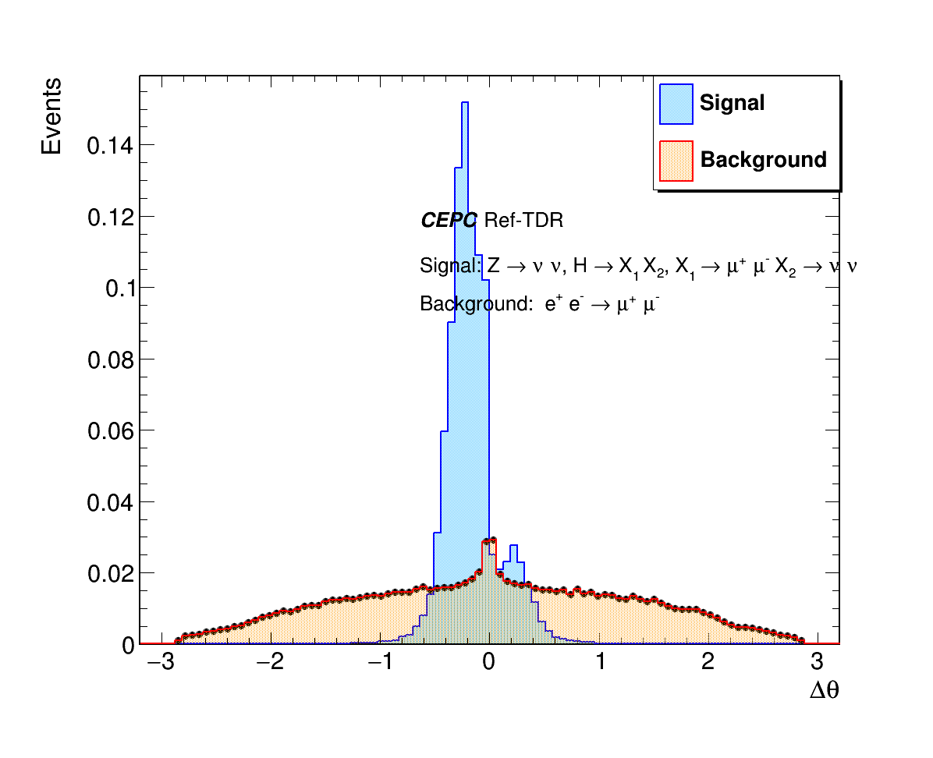
Δθ, Δφ : Signal vs background
Δφ : signal vs background
Δθ : signal vs background
Backgrounds: two electrons back to back;

Slide 15
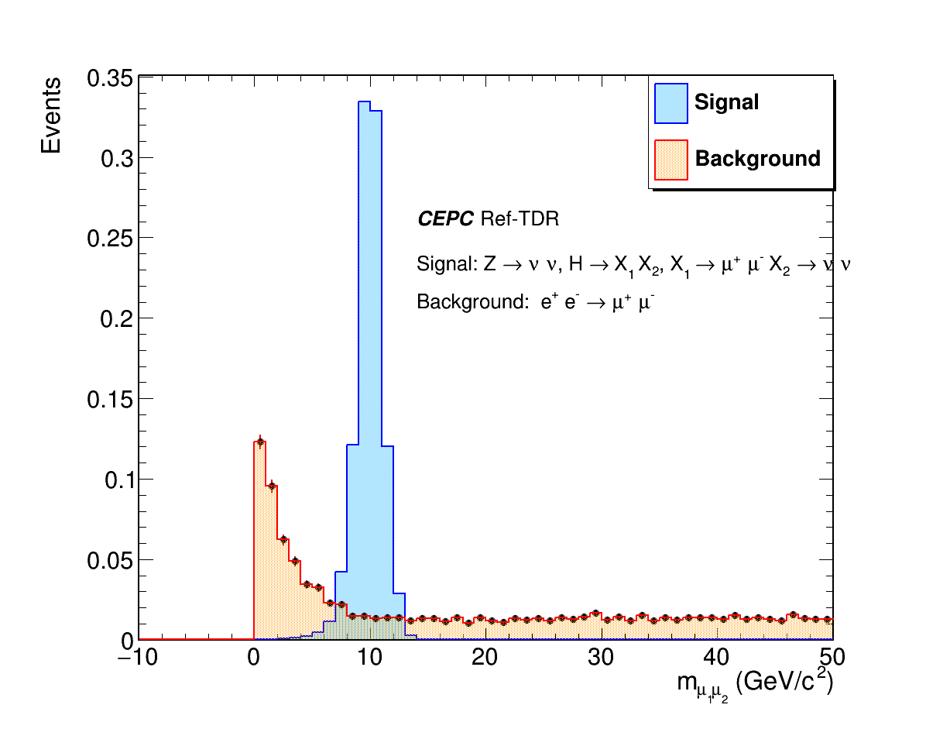
m_{μ1μ2}: Signal vs background
m_{μ1μ2} : signal vs background

Slide 16
Summary
The number of reconstructed tracks depends on vertex range
Compared θ, φ, Δθ, Δφ, PFO energy, m_{e1e2} distributions between LLP signal and background
Discriminating variables: Δθ, Δφ, PFO energy, m_{e1e2}
To do
Apply Final PID with CEPCSW
Re-vertexing in small vertex range to improve tracking efficiency
Check more distributions: Δt_{e1e2}, Pt_{e1}, Pt_{e2}, Δt_{μ1μ2}, Pt_{μ1}, Pt_{μ2}
4-lepton channel analysis

Slide 17
Backup

Slide 18
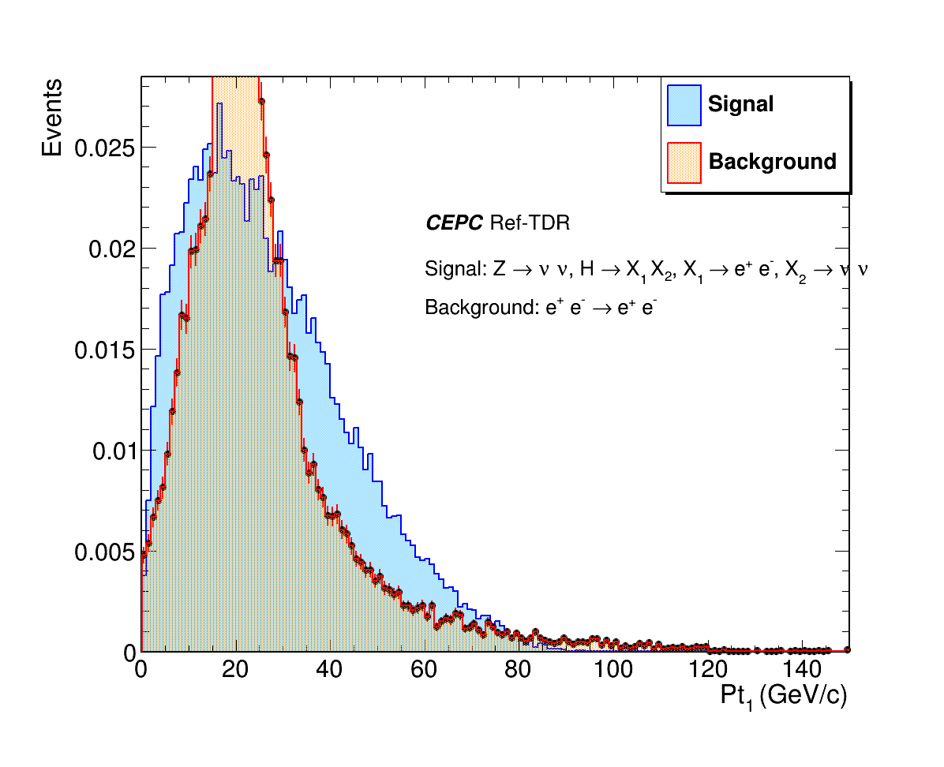
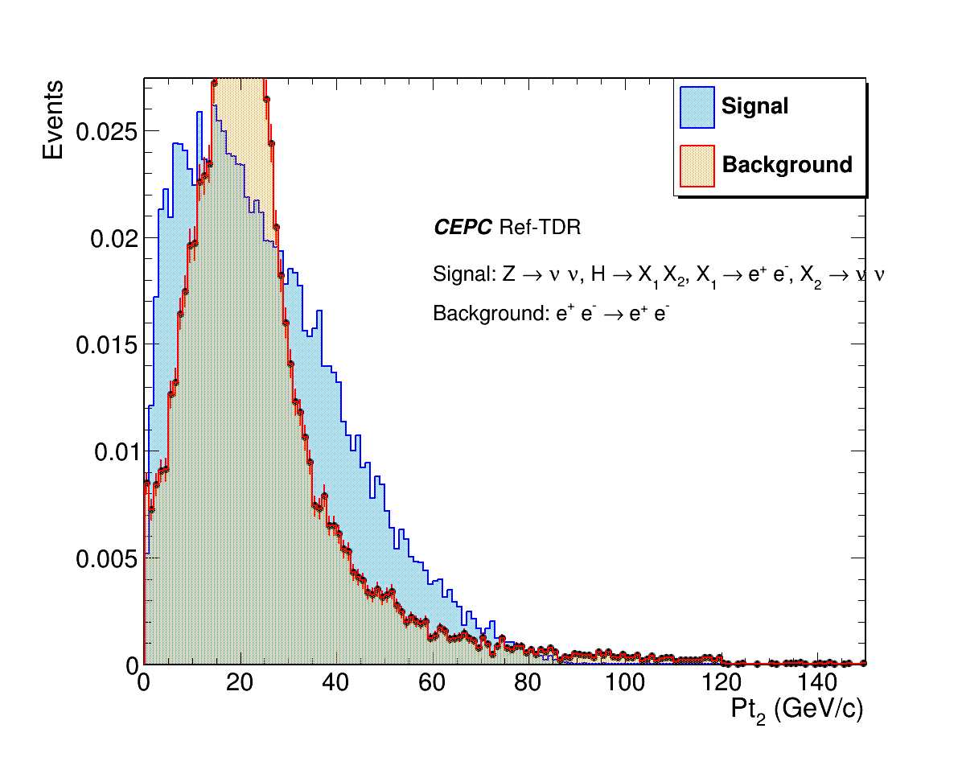
2-electron: Pt_{1，}Pt₂ Signal vs background
Pt₁ : signal vs background
Pt₂: signal vs background

Slide 19
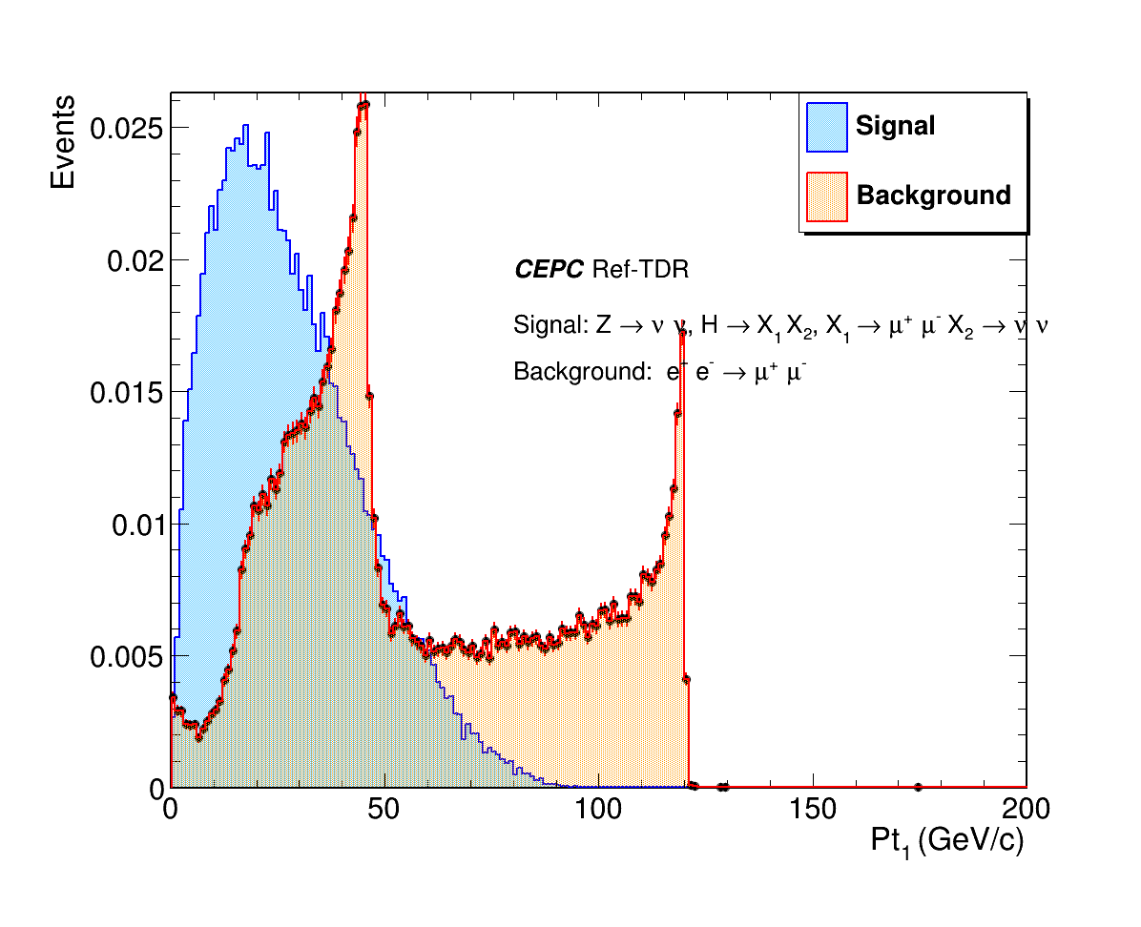
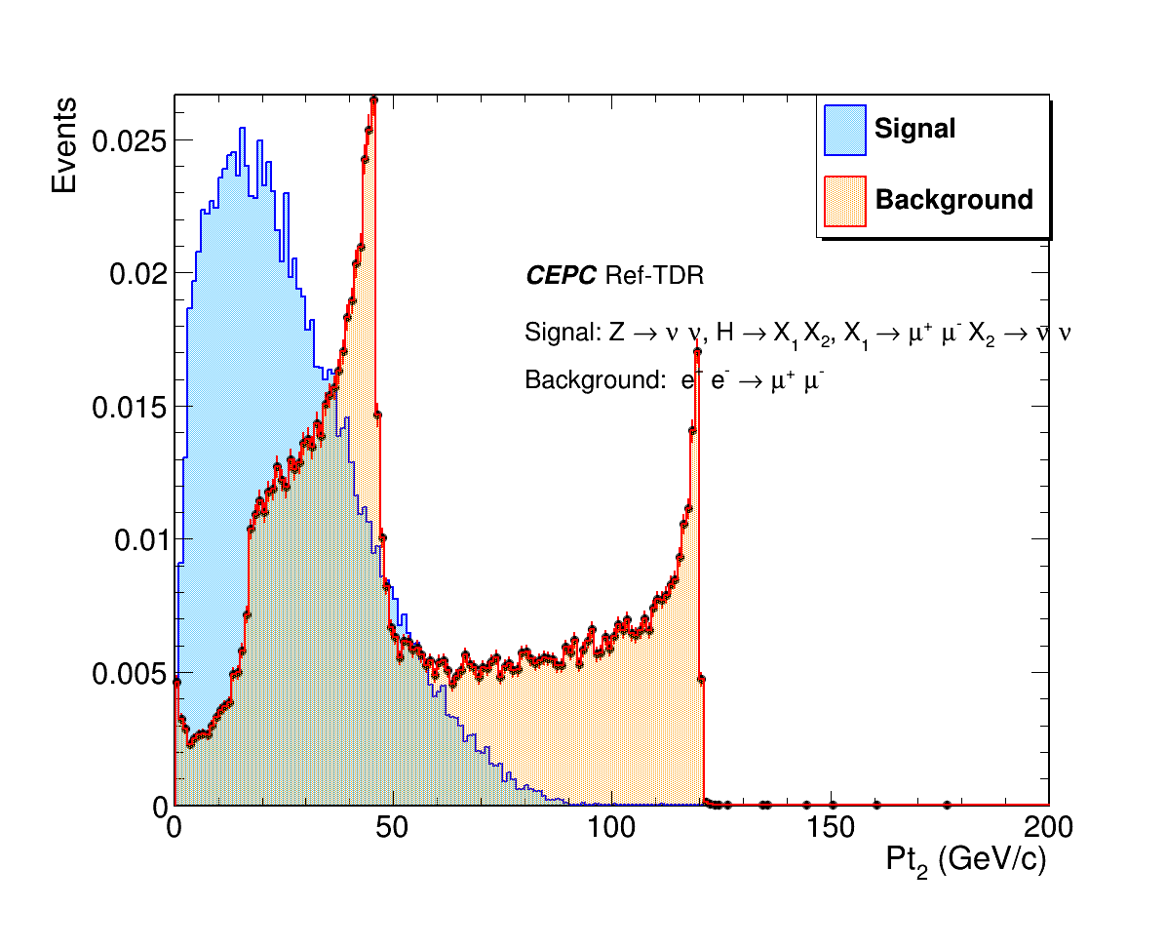
2-muon: Pt_{1，}Pt₂ Signal vs background
Pt₁ : signal vs background
Pt₂: signal vs background

Slide 20
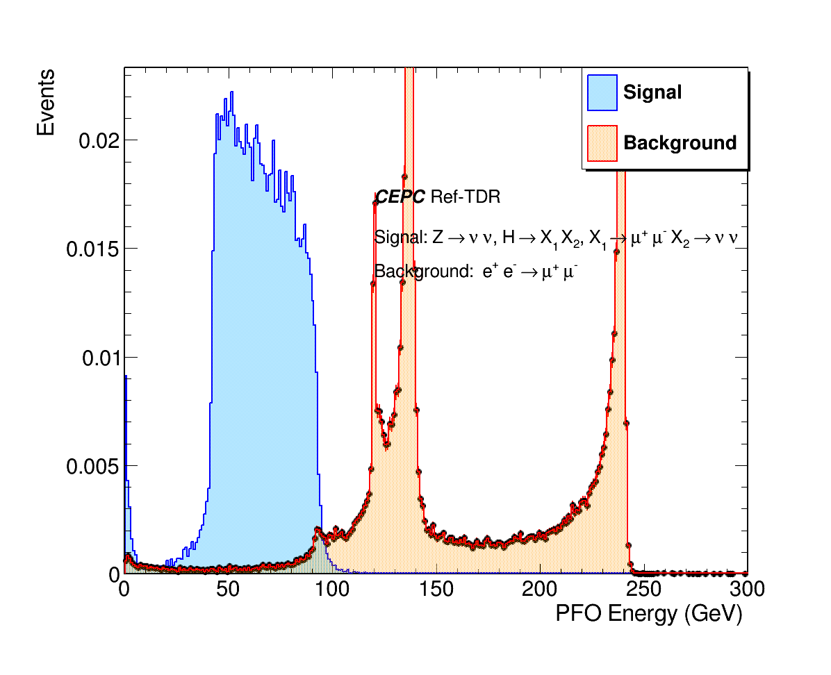
2-muon PFO Energy: Signal vs background
PFO energy: signal vs background

Slide 21
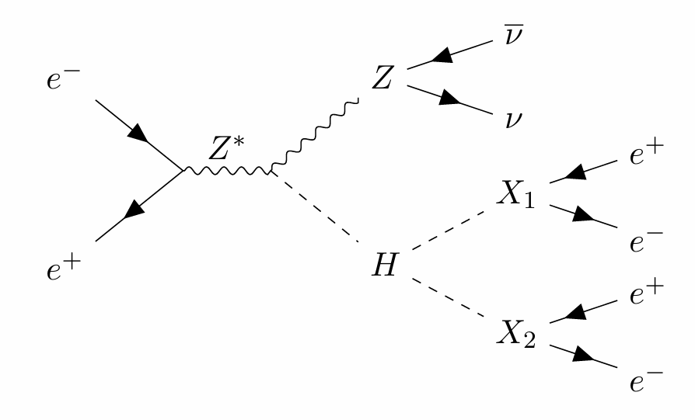
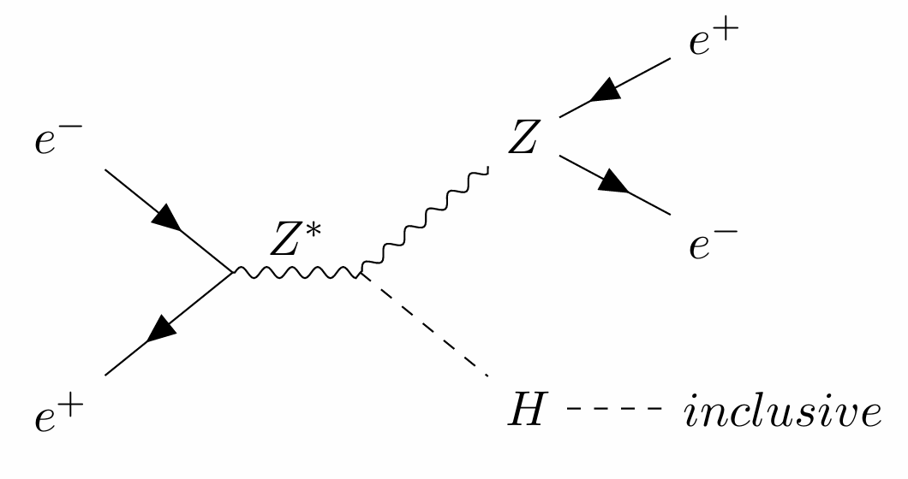
4-electron channel full simulation analysis
Signal: ee -> HZ, Z->nunu, H->X1,X2, X1->ee, X2 ->ee
Background: ee -> HZ, Z->ee, H->inclusive
Signal events: 80,000, M_{X1,2}: 10 GeV
Background events: 200,000

Slide 22
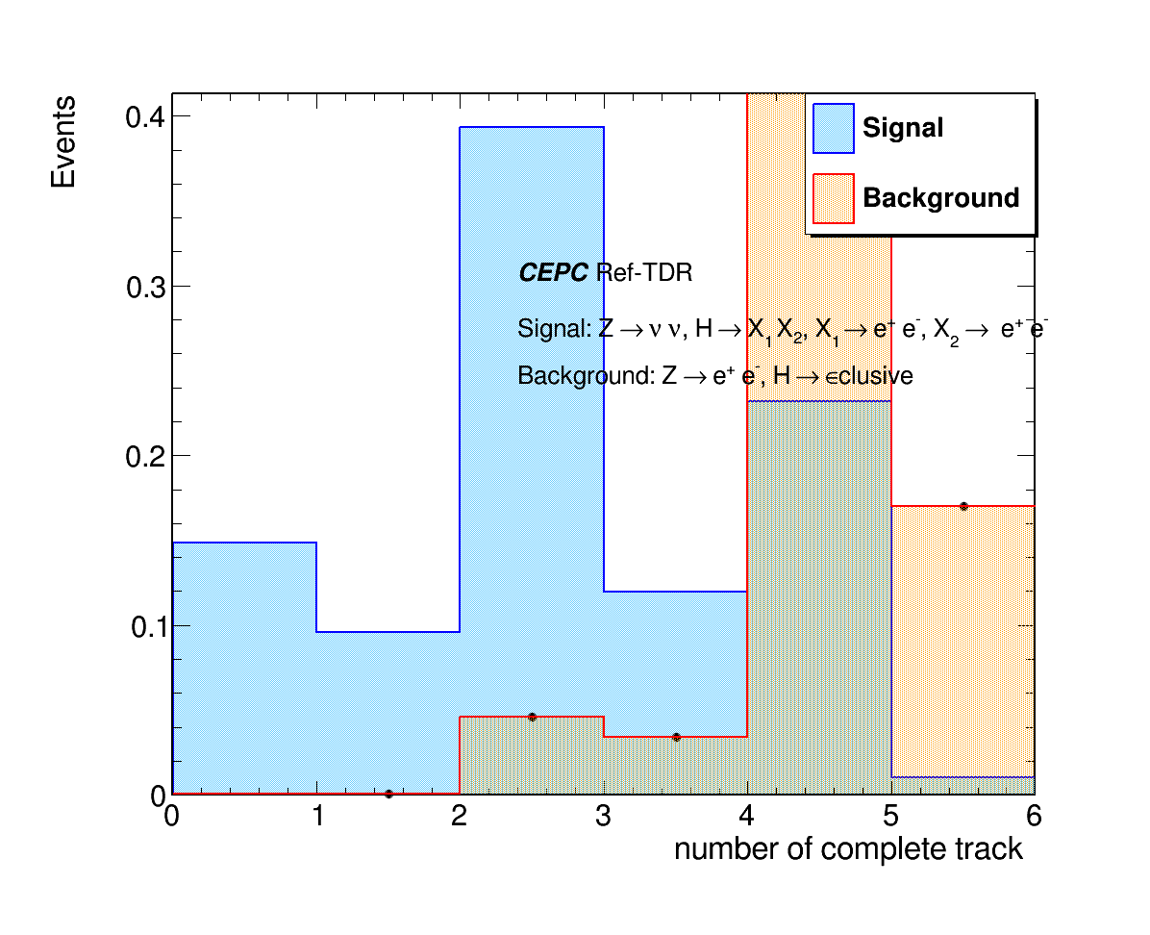
Number of complete tracks: Signal vs Background
Number of complete tracks

Slide 23
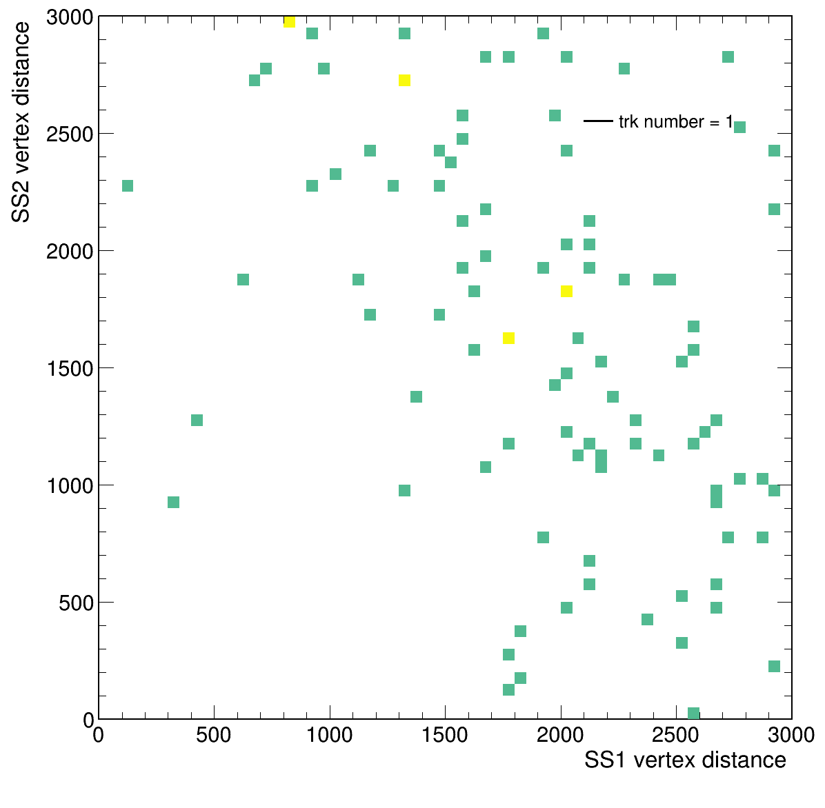
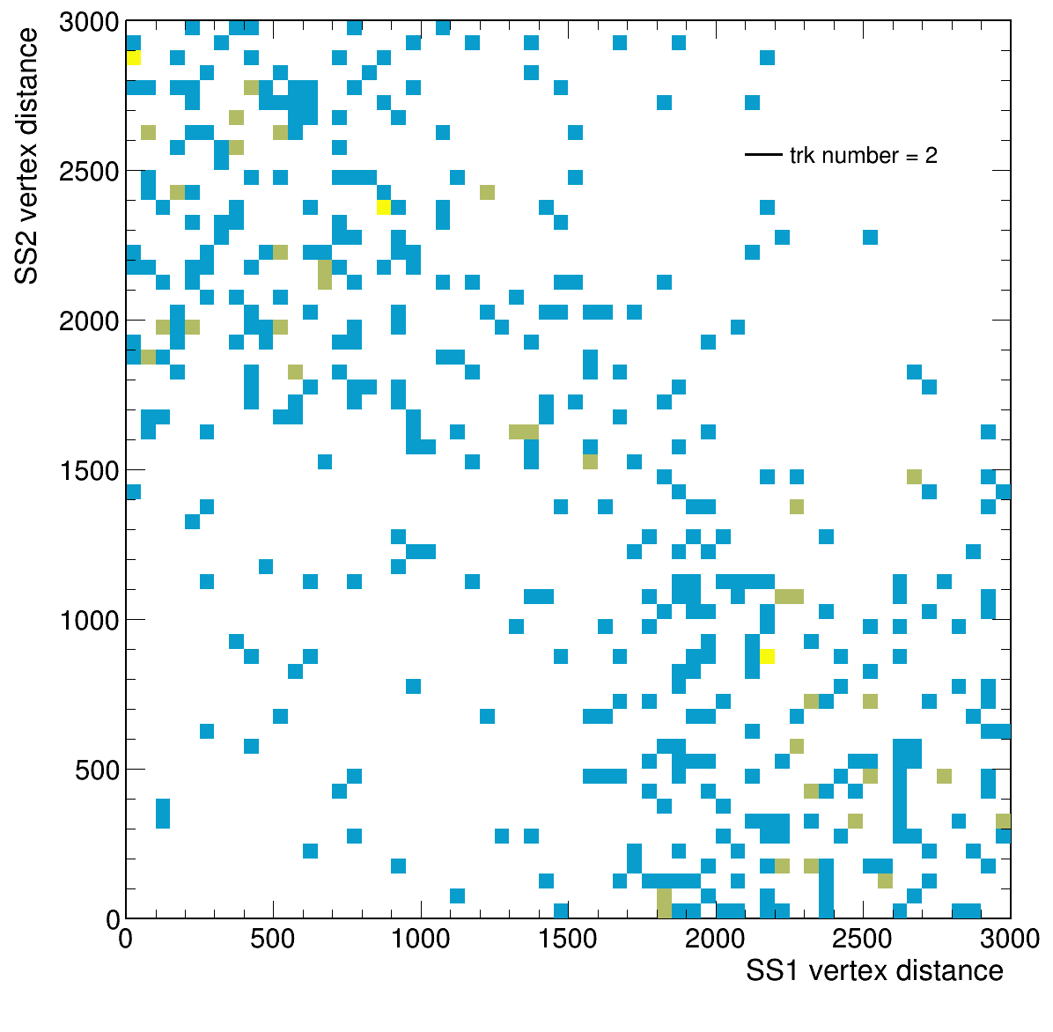
SS1 vertex vs SS2 vertex : complete tracker number
track number =1
track number =2

Slide 24
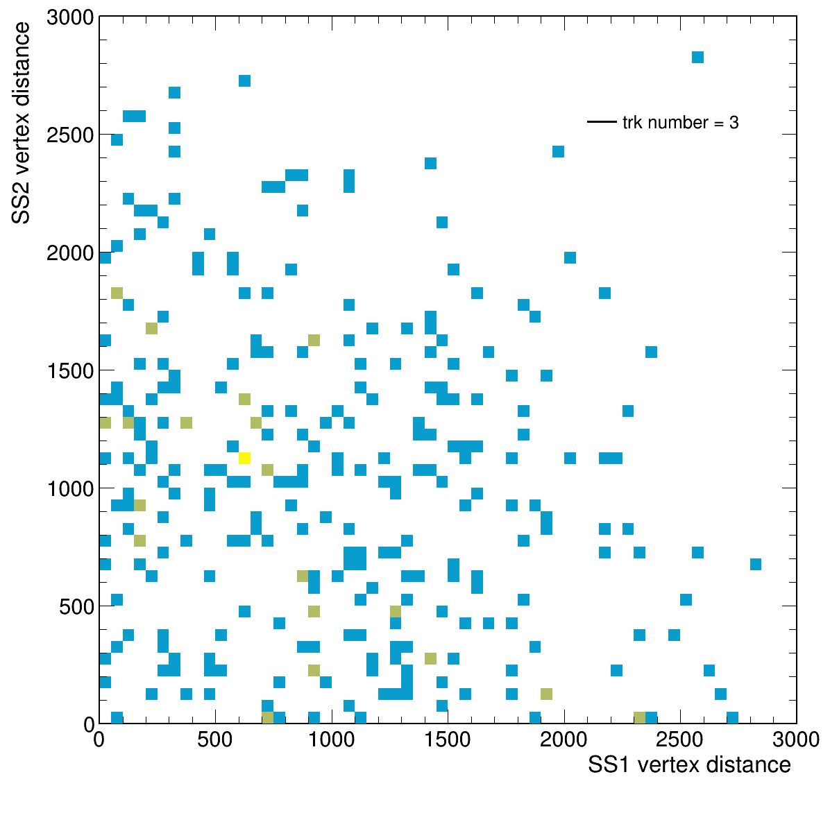
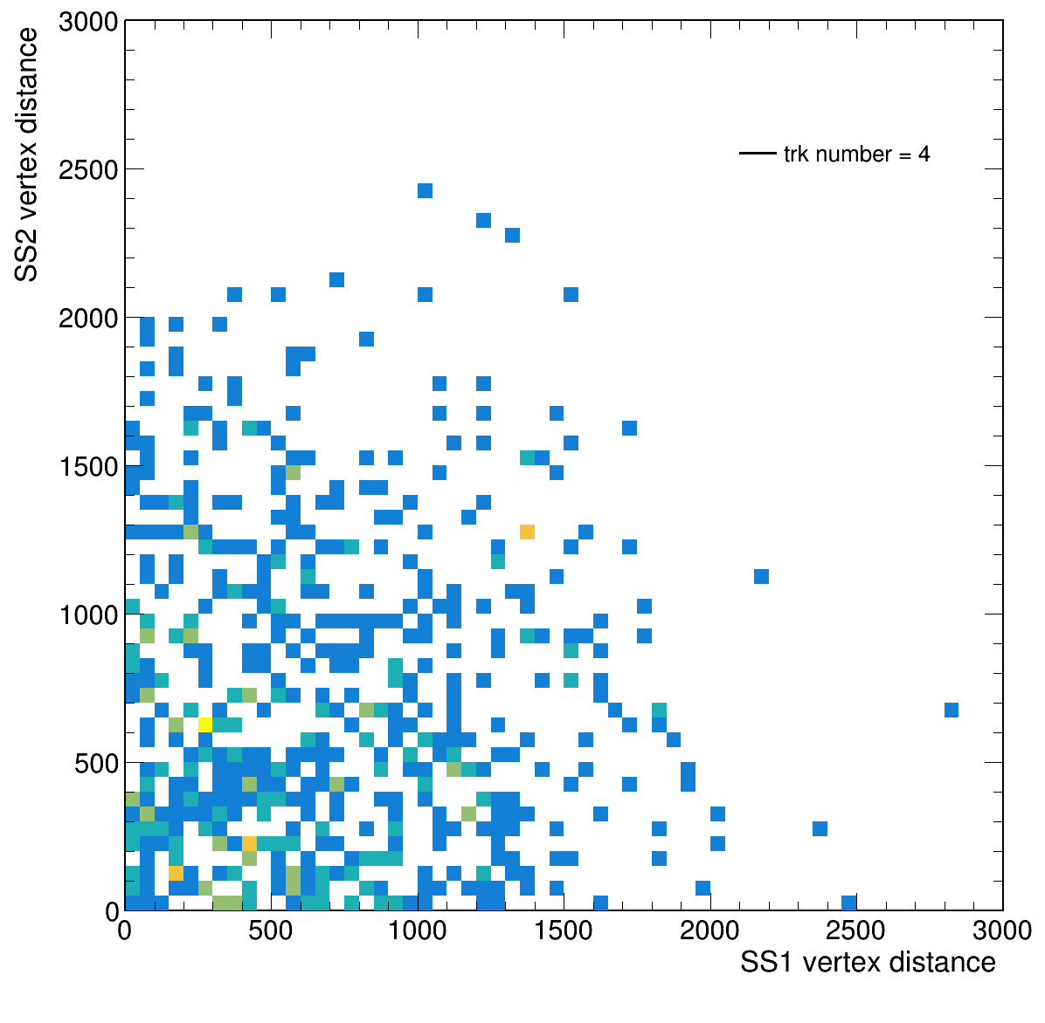
SS1 vertex vs SS2 vertex : complete tracker number
track number =3
track number =4

Slide 25
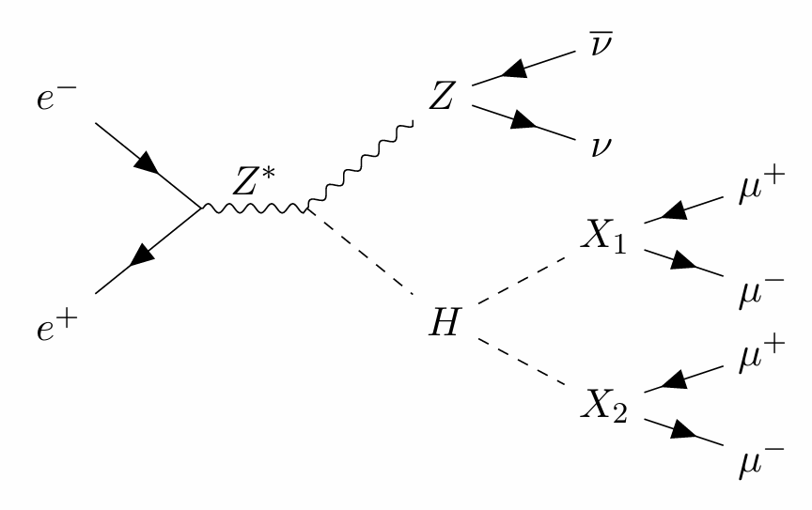
4-muon channel full simulation analysis
Signal: ee -> HZ, Z->nunu, H->X1, X2, X1->mumu, X2 ->mumu
Background: ee -> HZ, Z->mumu, H->inclusive
Signal events: 80,000, M_{X1,2}: 10 GeV
Background events: 200,000

Slide 26
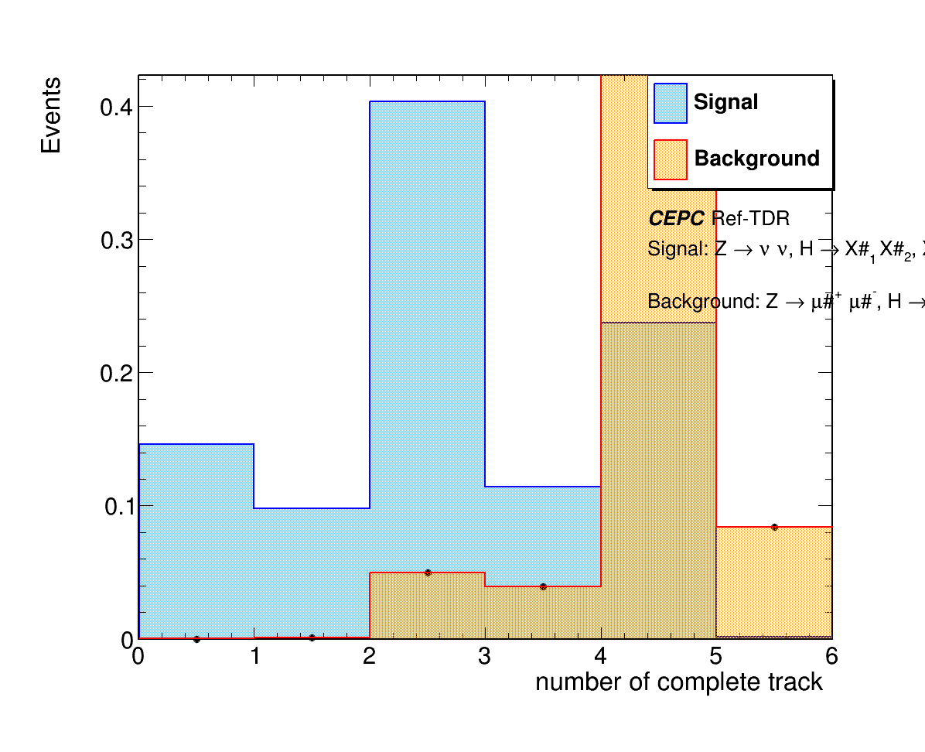
Number of complete tracks: Signal vs Background
Number of complete tracks

Slide 27
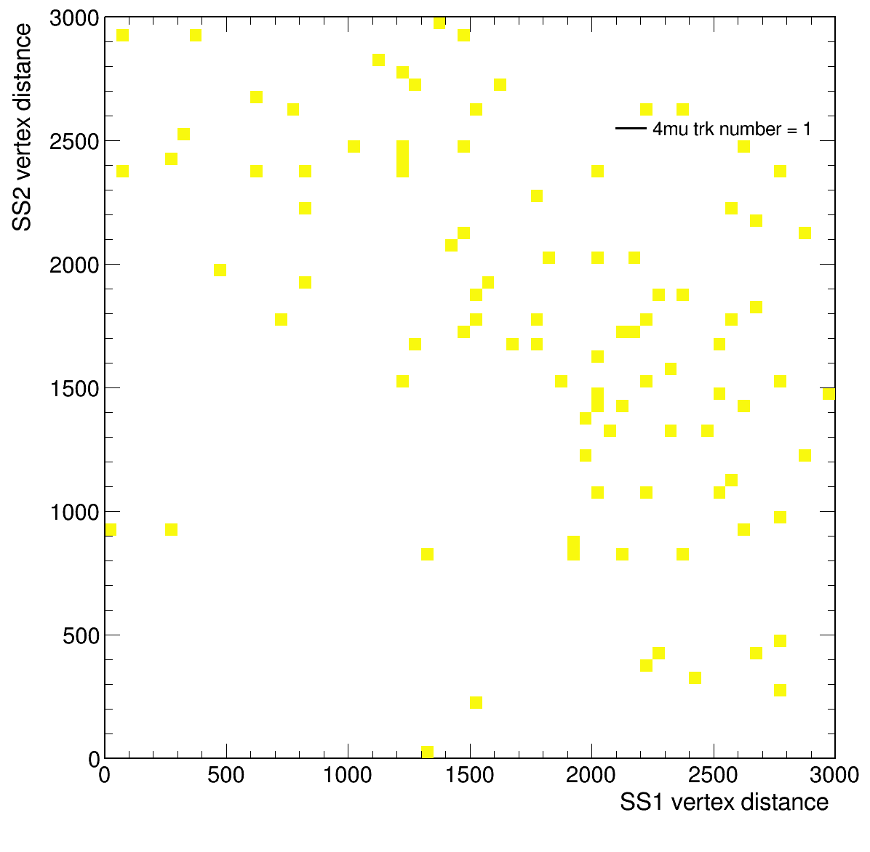
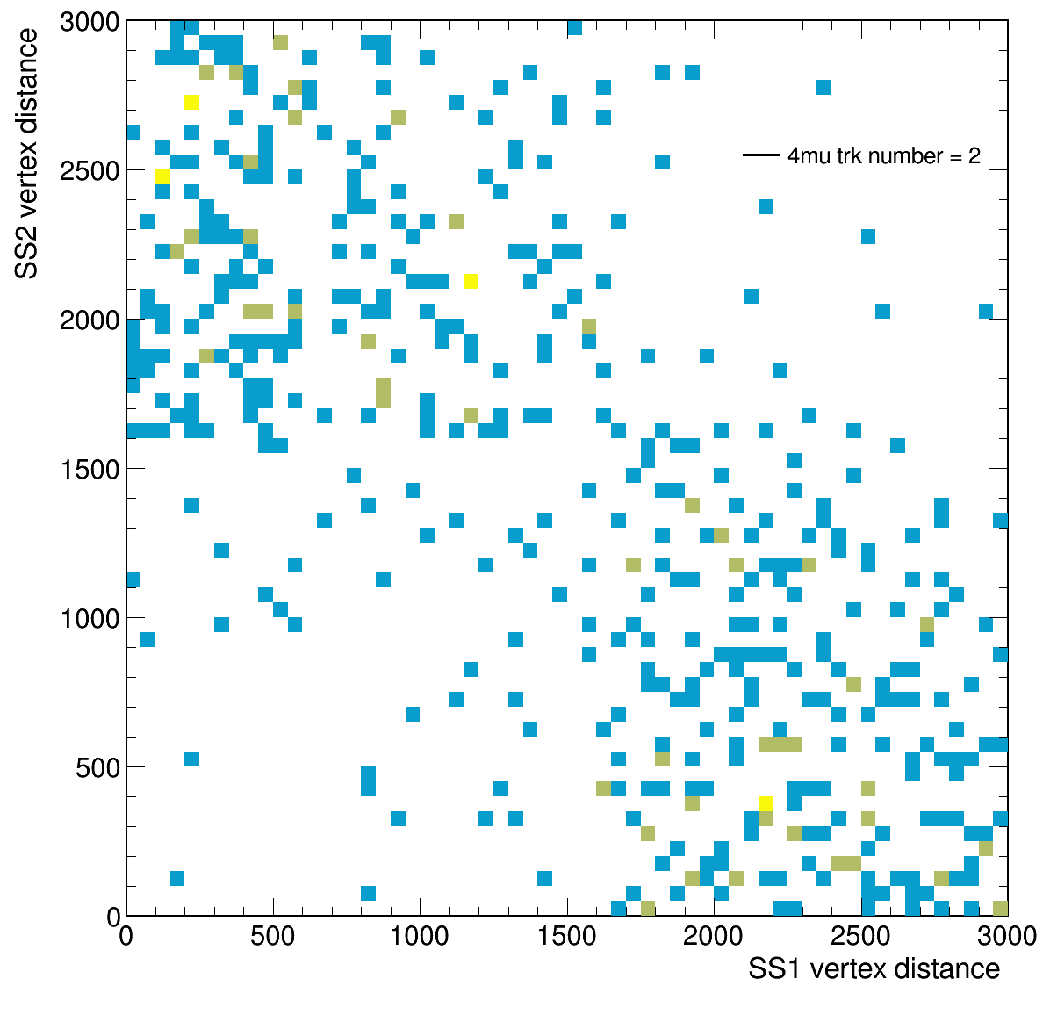
SS1 vertex vs SS2 vertex : complete tracker number
proportion of track number =1
proportion of track number =2

Slide 28
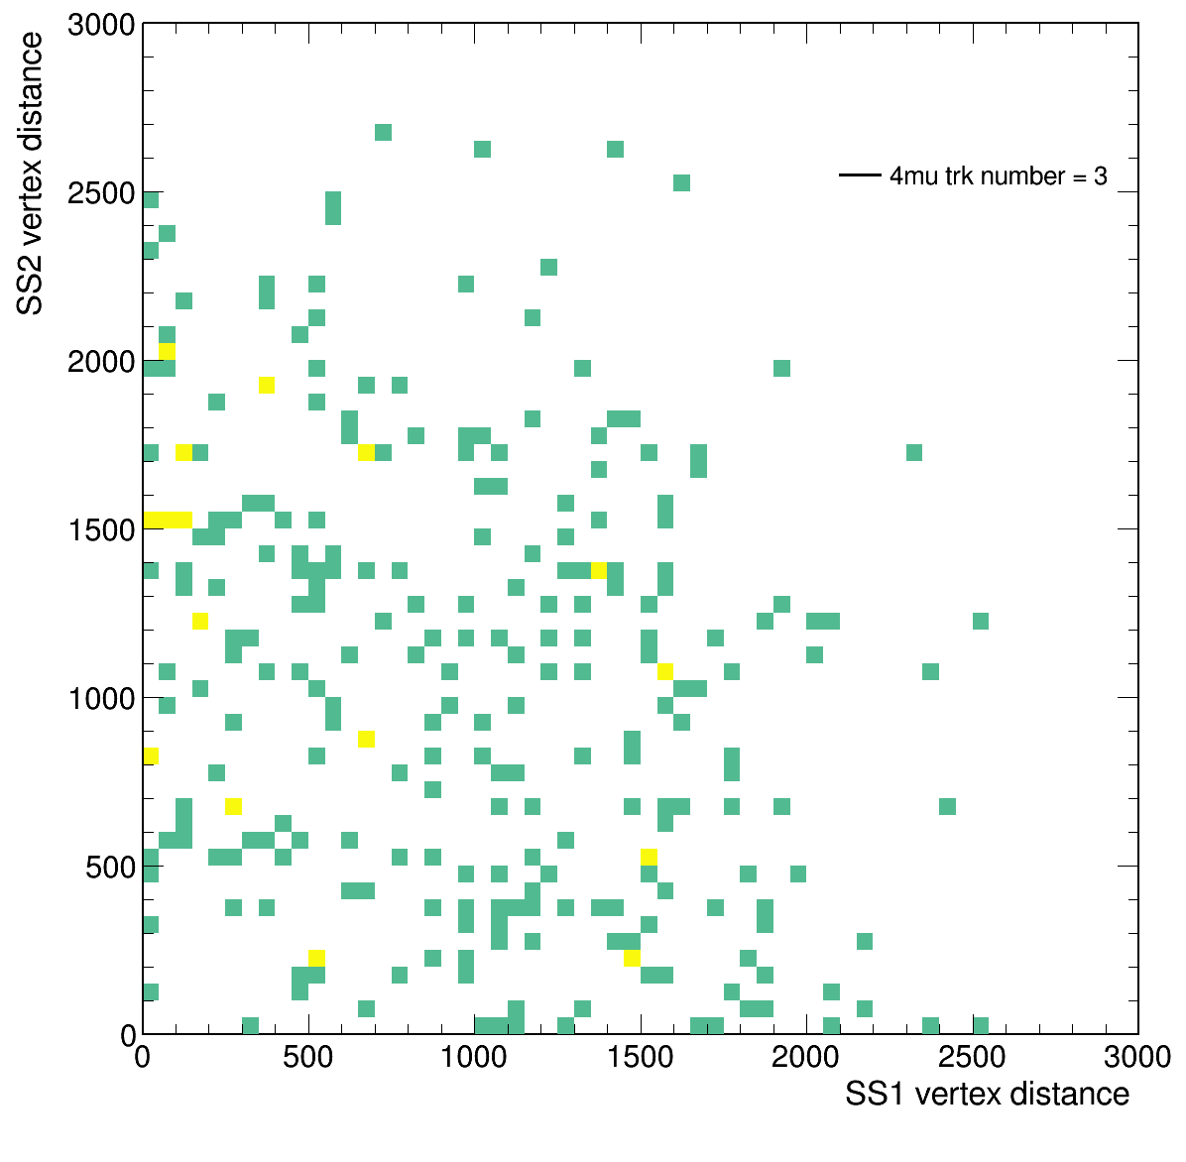
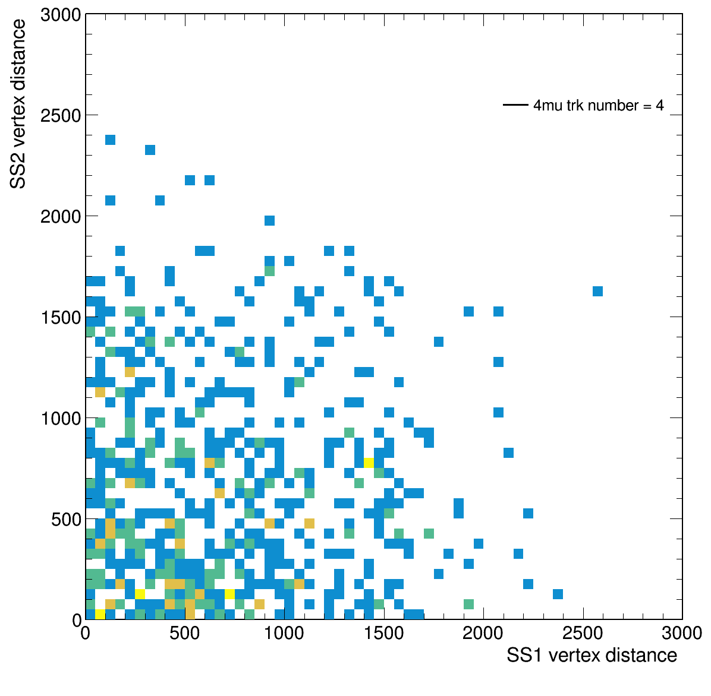
SS1 vertex vs SS2 vertex : complete tracker number
track number =3
track number =4

