Slide 1
CGEM DAQ Status and Plan
Tingxuan Zeng
2025-03-27

Slide 2
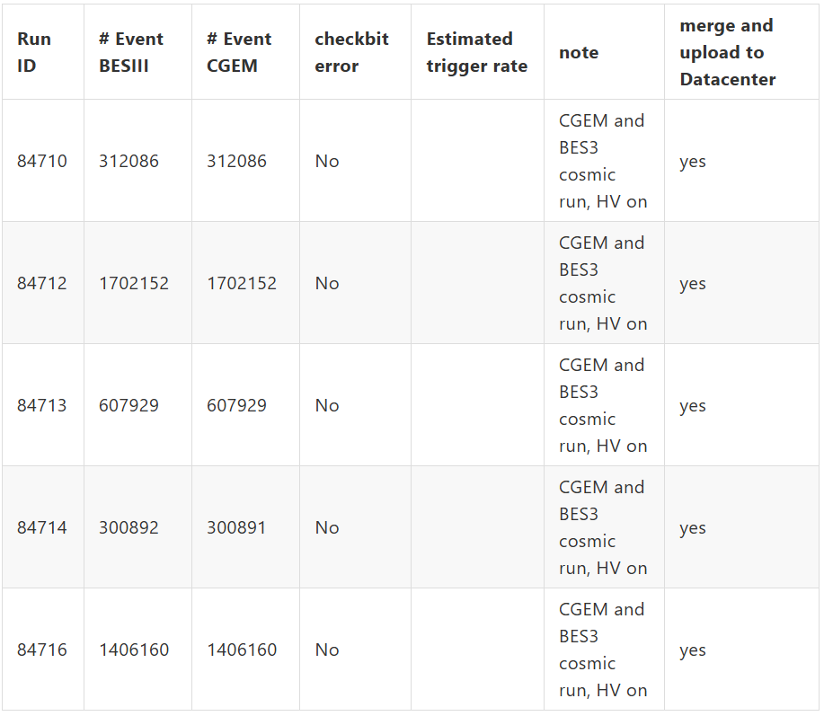
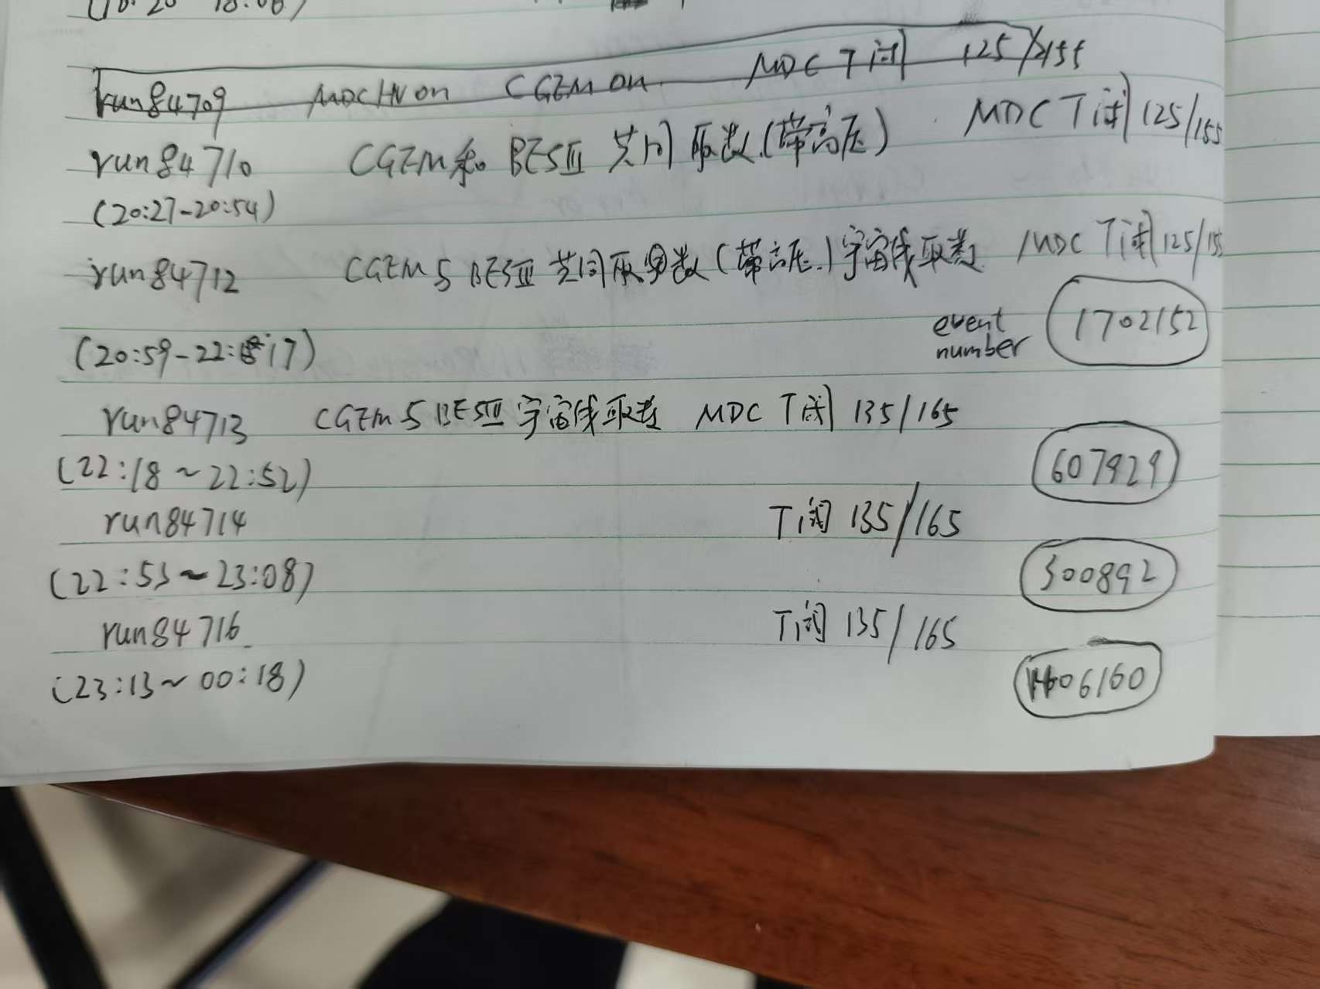
More data check results with HV on
5 cosmic runs with HV on yesterday night
CGEM Trigger number consistent with BES3
Data files had merged and uploaded to data
center.

