Slide 1
Group meeting
2025.3.28

Slide 2
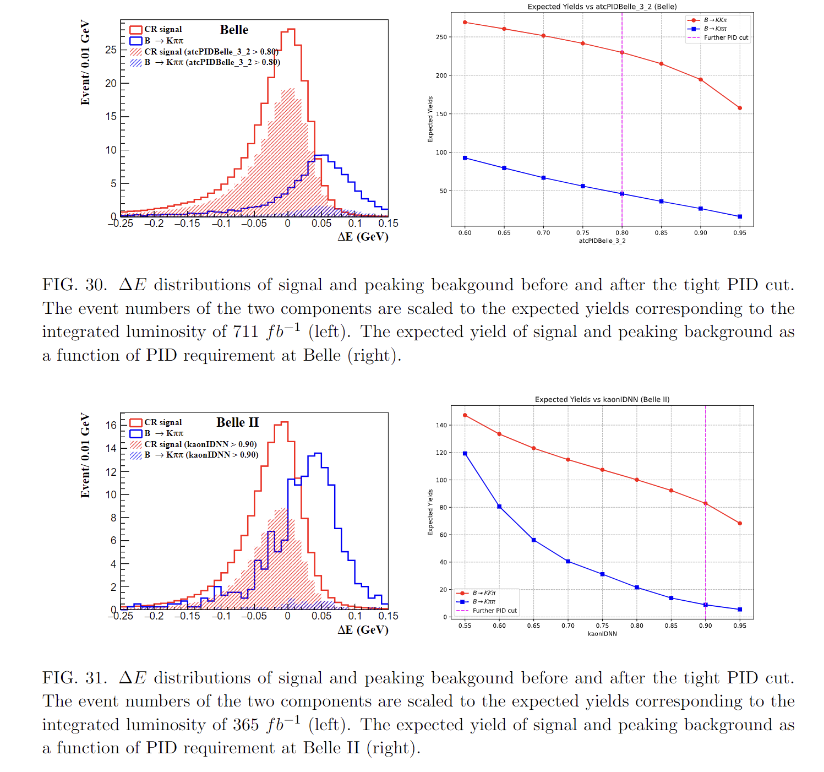
Reply to Xiaodong
Traverse PID from 0.6 to 0.95 ?

Slide 3
KLM upgrade
Recover part of the scripts and data from Bolun’s account
Need to be completed …
KLM Time calibration
Chunhui’s reply

