Slide 1
Group Meeting
邹世明
2025/03/28

Slide 2
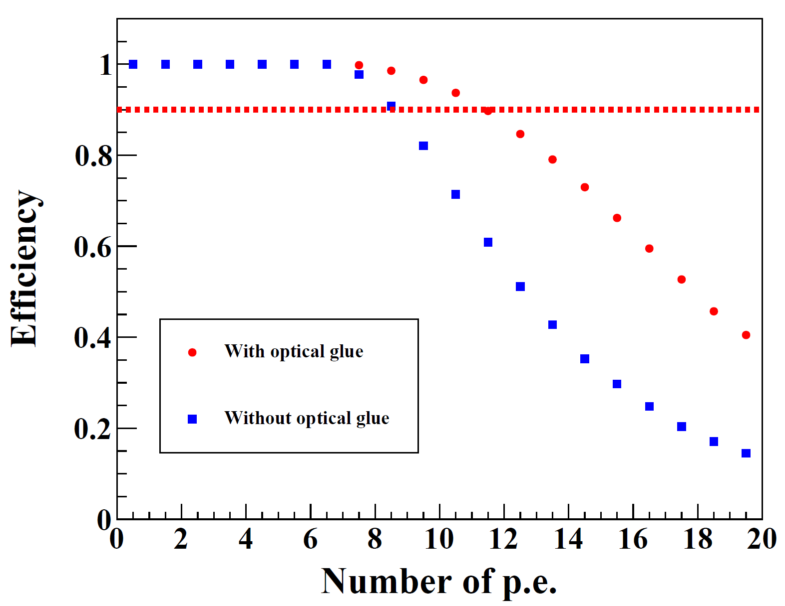
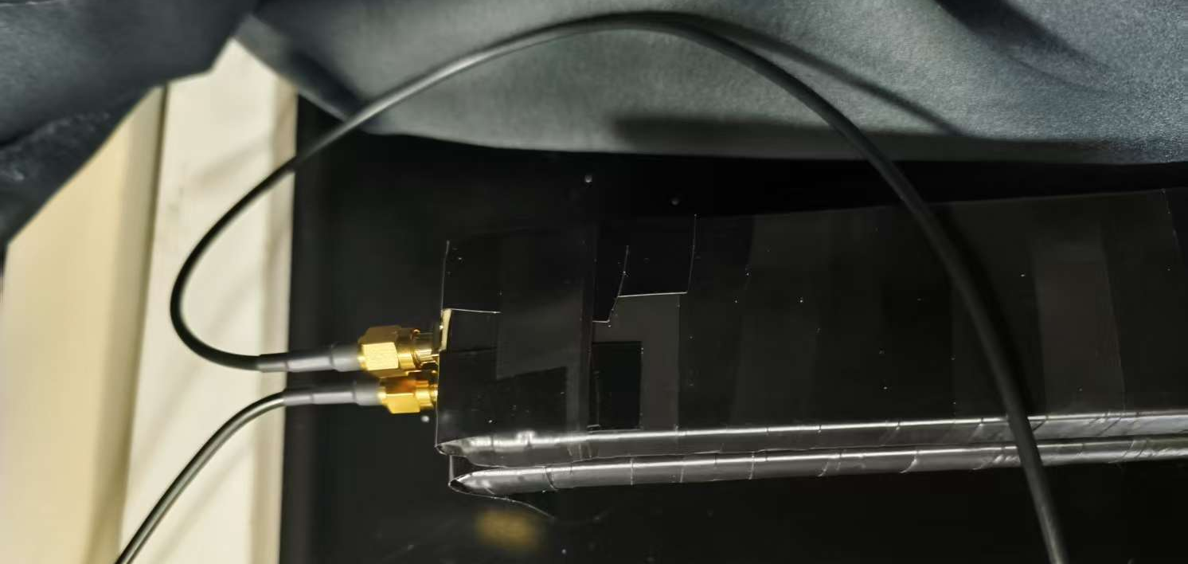
160 cm Scintillators (efficiency)
TRG
EQR 20-3030
单光子幅度约为3.2 mV

Slide 3
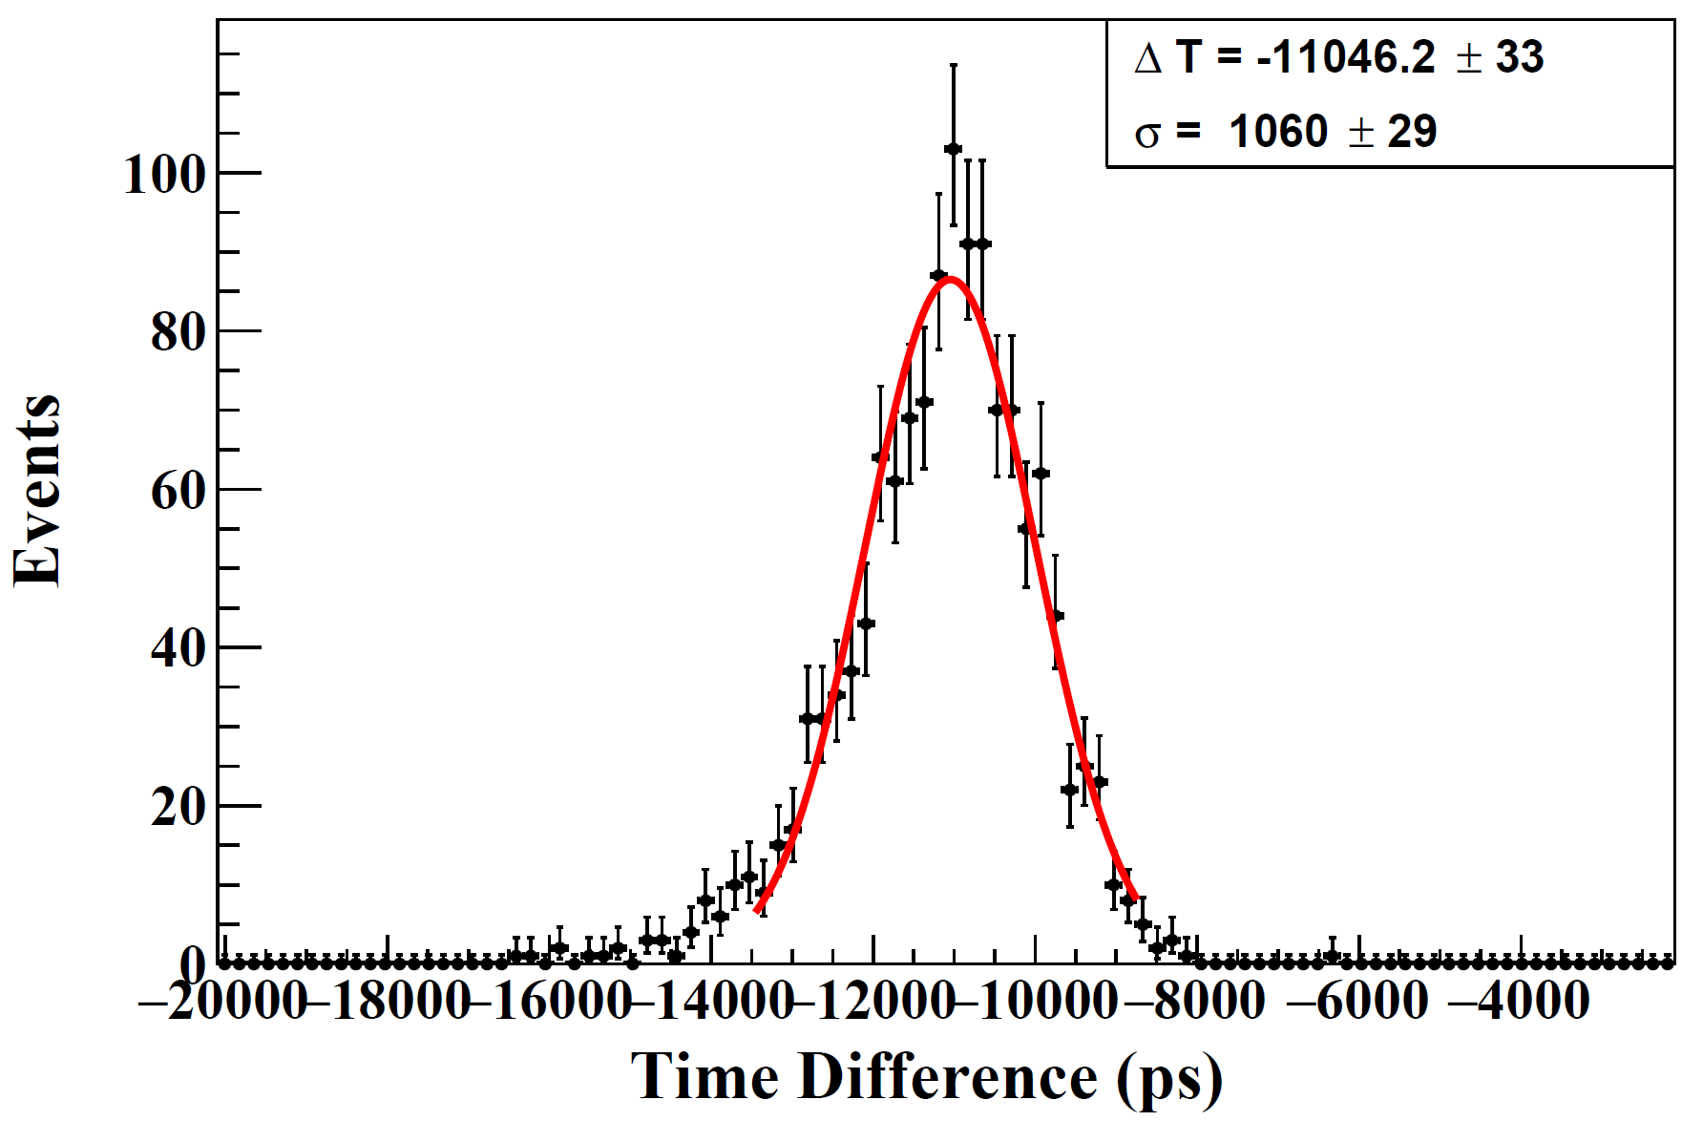
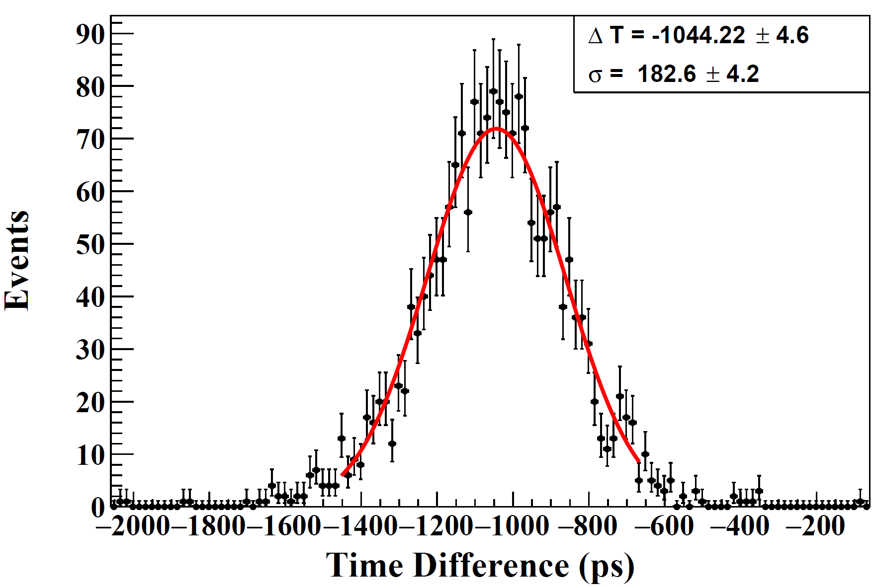
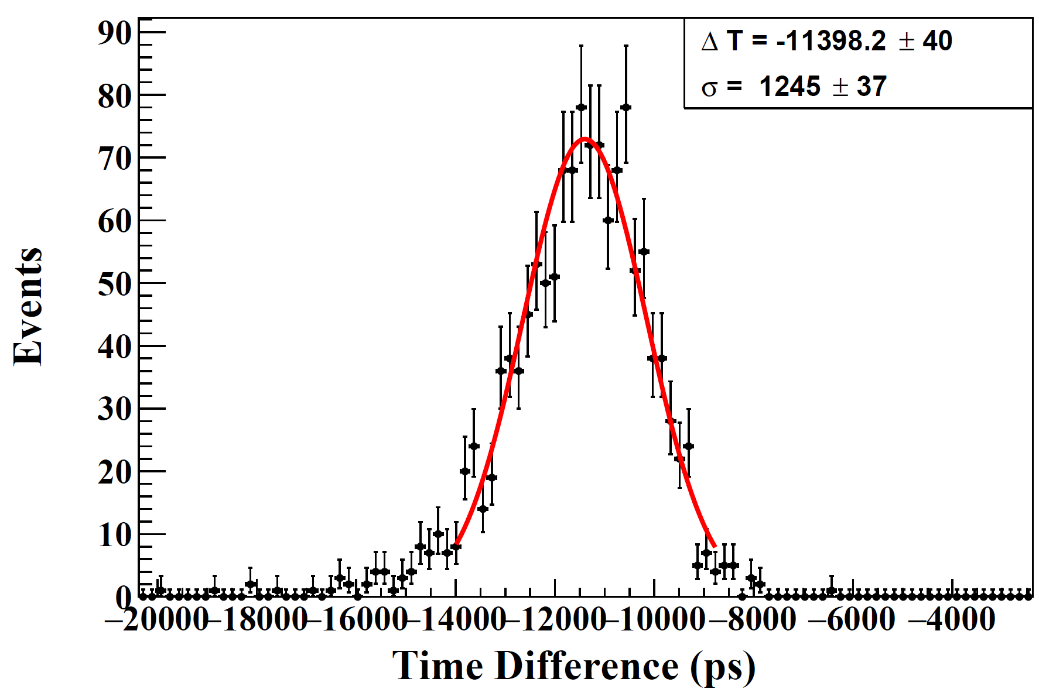
160 cm Scintillators (time resolution)
$$T_{scn.1}−T_{0}$$
TRG
$$T_{scn.2}−T_{0}$$
$$σ_{T_{scn.1}}=\sqrt{{1060.0}^{2}−{\left(\frac{182.6}{2}\right)}^{2}}=1056.1 ps$$
$$σ_{T_{scn.2}}=\sqrt{{1245.0}^{2}−{\left(\frac{182.6}{2}\right)}^{2}}=1241.6 ps$$

Slide 4
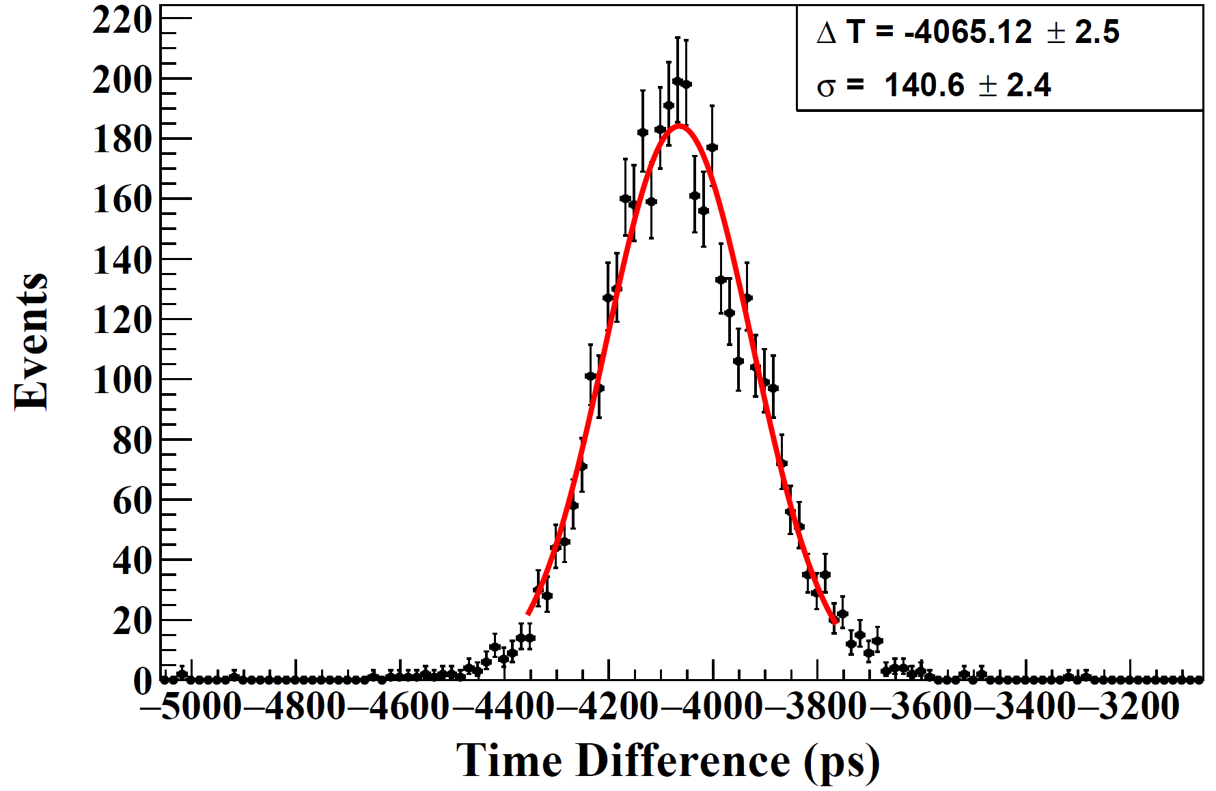
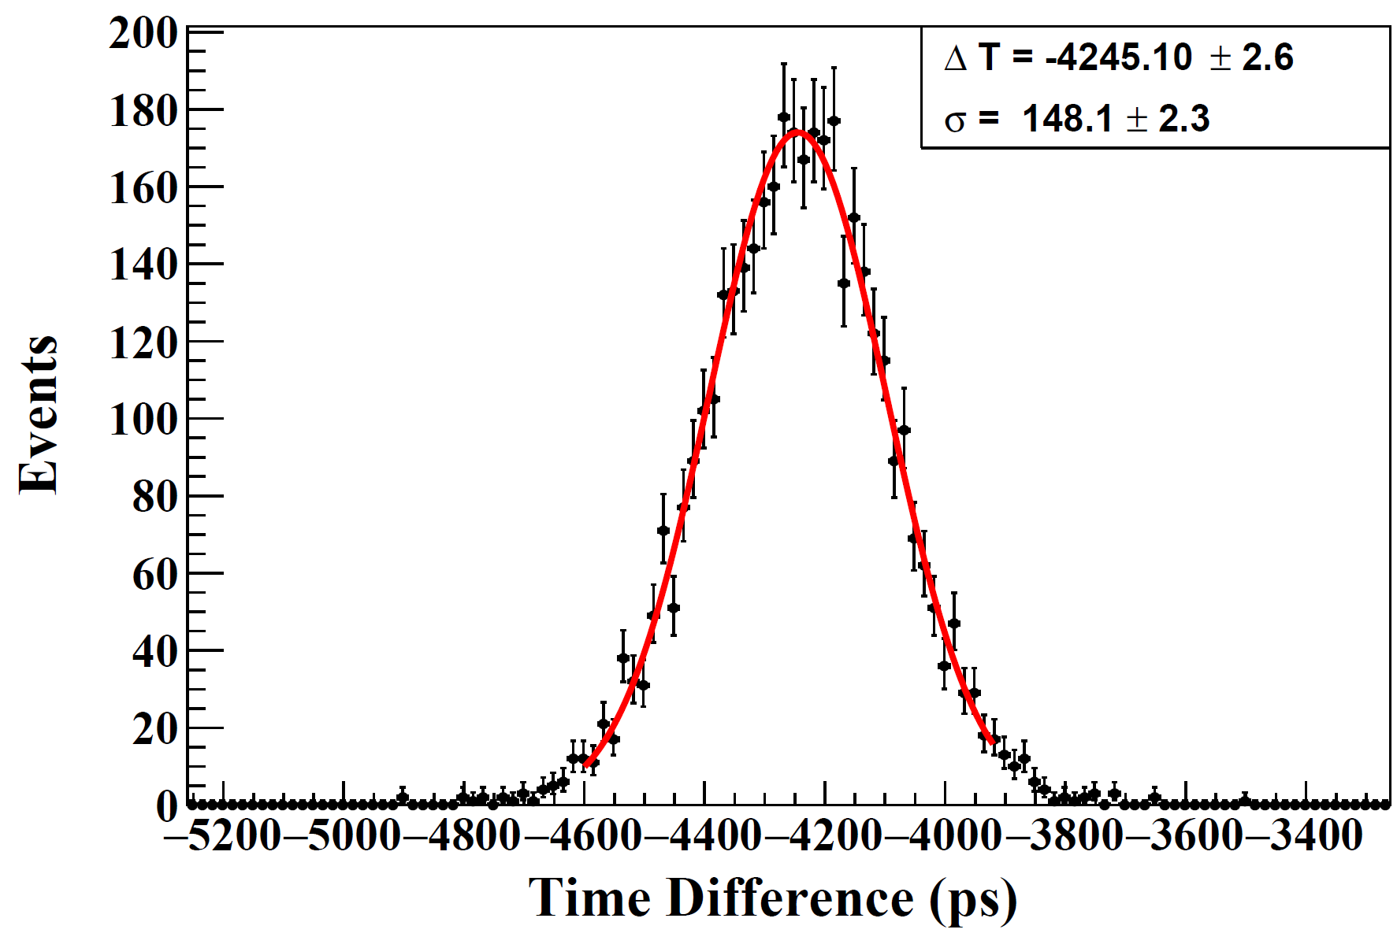
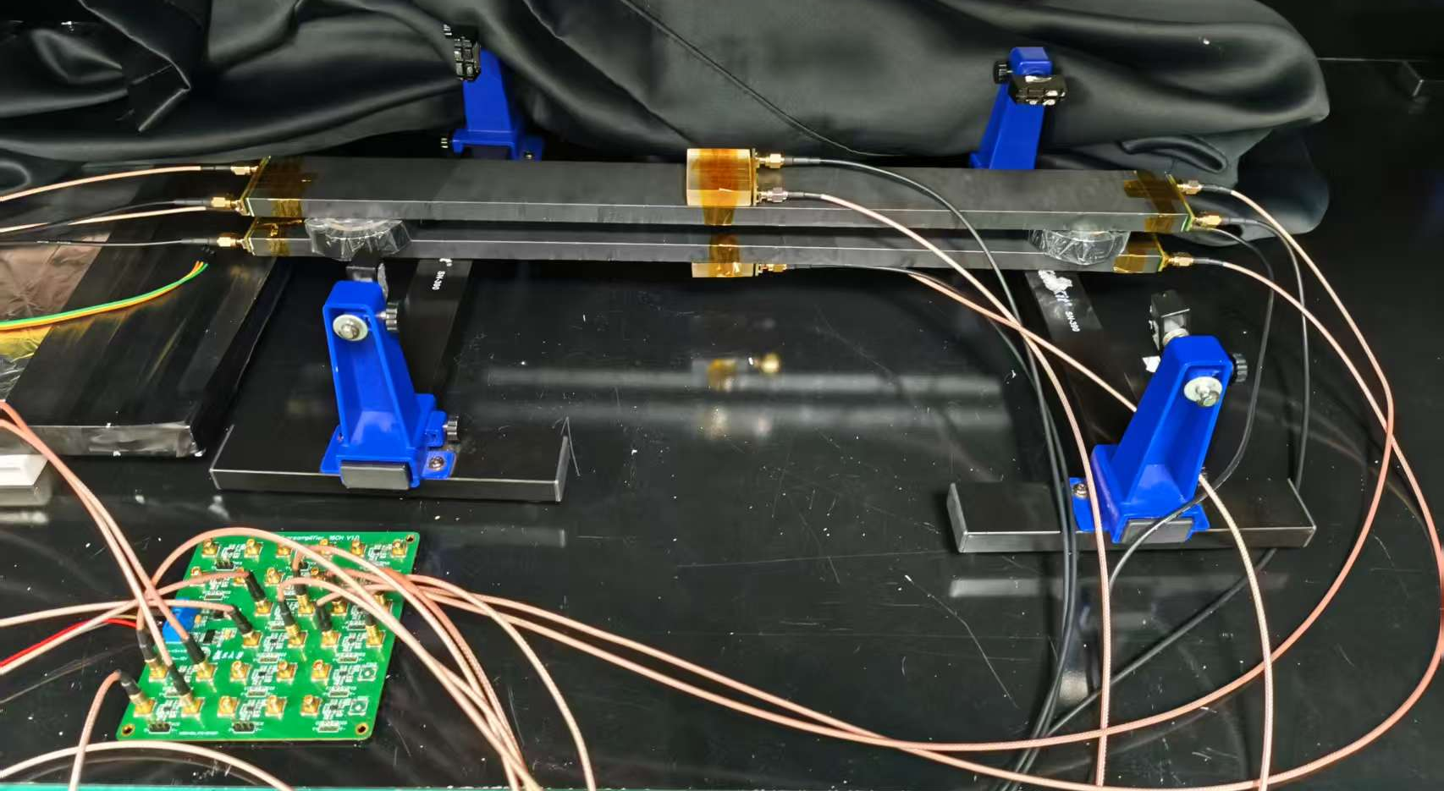
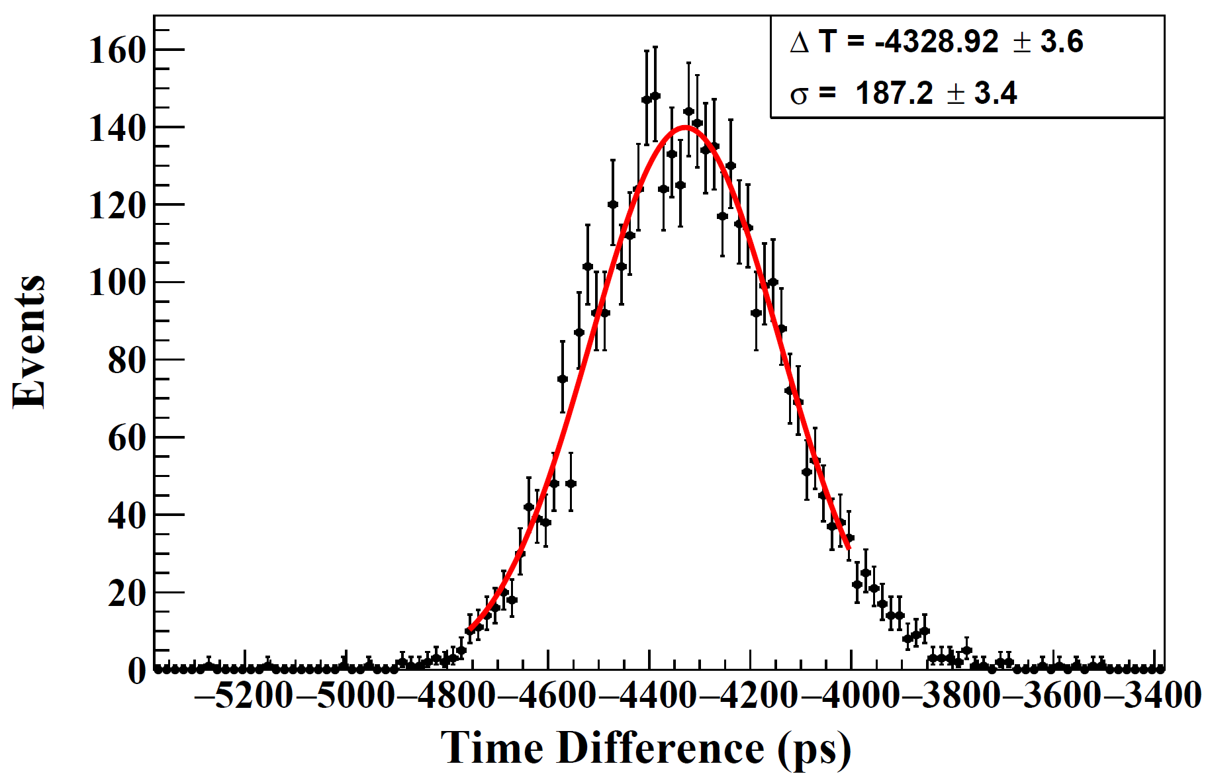
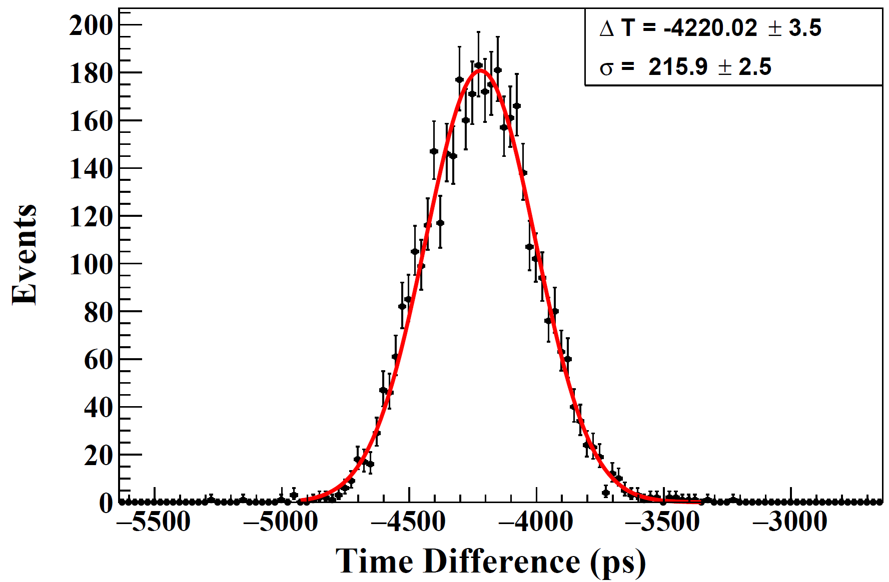
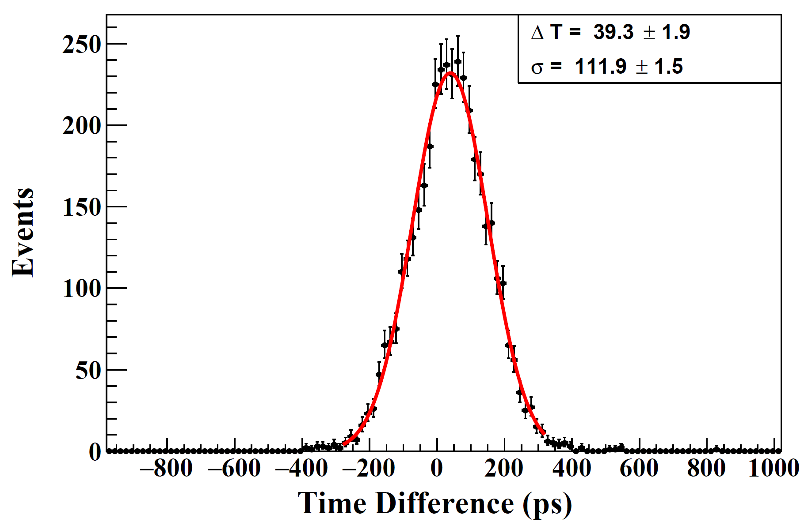
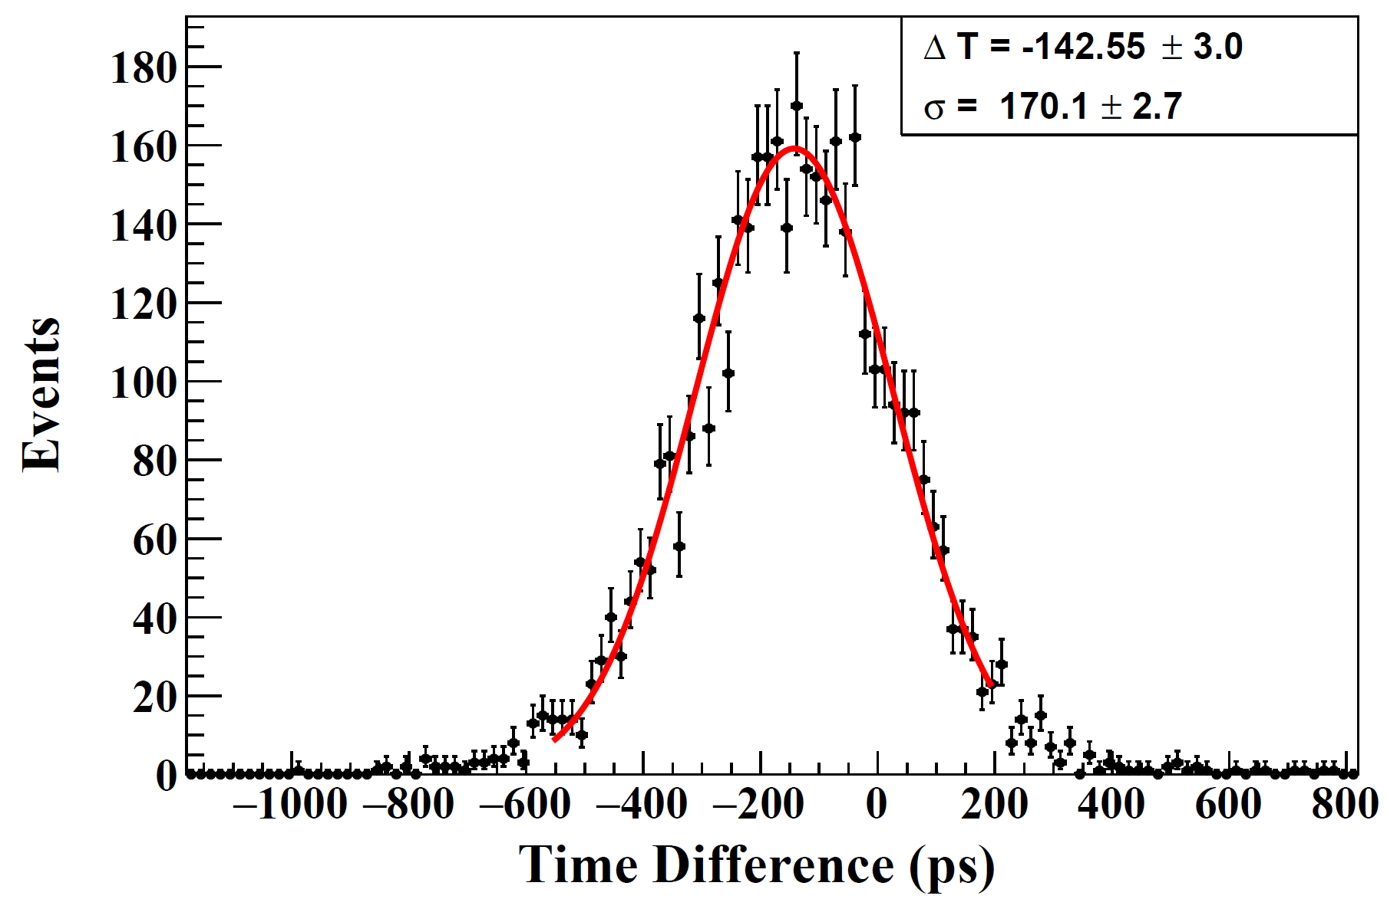
50 cm Scintillators (efficiency)
$$T_{1}−T_{0}$$
$$T_{3}−T_{0}$$
$$T_{1}$$
$$T_{2}$$
$$σ_{1}=112.0 ps$$
$$σ_{3}=121.2 ps$$
$$T_{3}$$
$$T_{4}$$
$$T_{2}−T_{0}$$
$$T_{4}−T_{0}$$
$$σ_{2}=166.8 ps$$
$$σ_{4}=197.5 ps$$
$$T_{scn.1}−T_{scn.2}$$
$$σ_{scn.1}=\sqrt{1/{\left(\frac{1}{σ_{1}^{2}}+\frac{1}{σ_{2}^{2}}\right)}}=93.0 ps$$
TRG
$$σ_{scn.2}=\sqrt{1/{\left(\frac{1}{σ_{3}^{2}}+\frac{1}{σ_{4}^{2}}\right)}}=103.3 ps$$
$σ=111.9/\sqrt{2}$ =79.1 ps

Slide 5
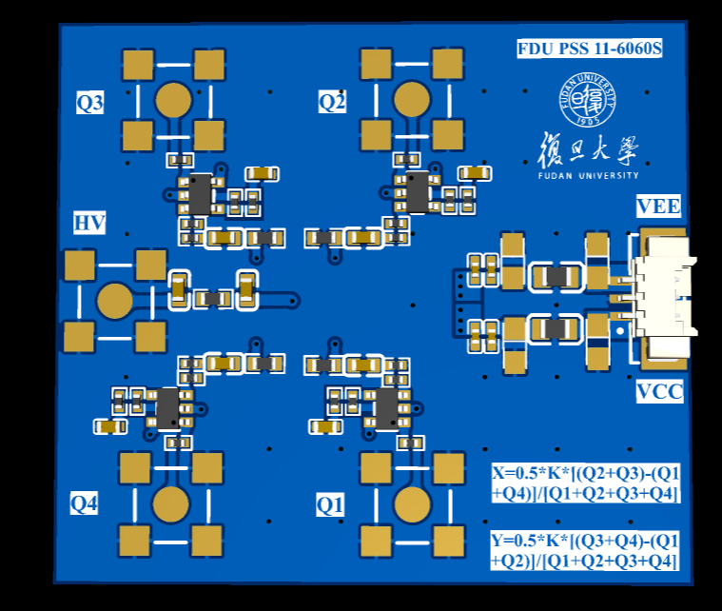
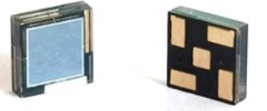
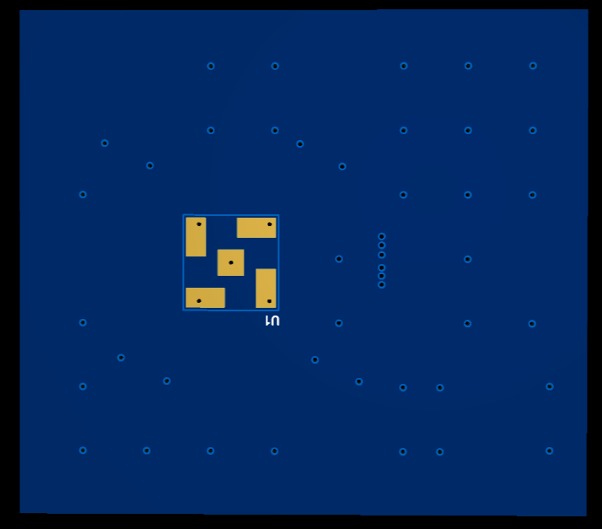
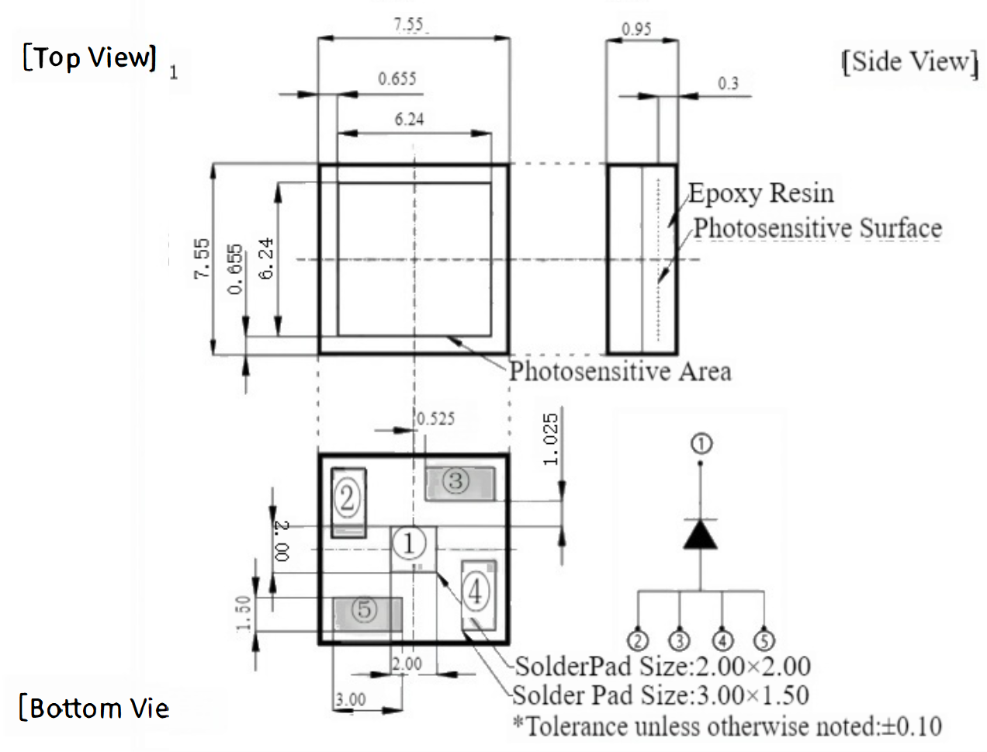
PCB design
PSS 11-6060S

