Slide 1
CGEM DAQ Status and Plan
Tingxuan Zeng
2025-03-28

Slide 2
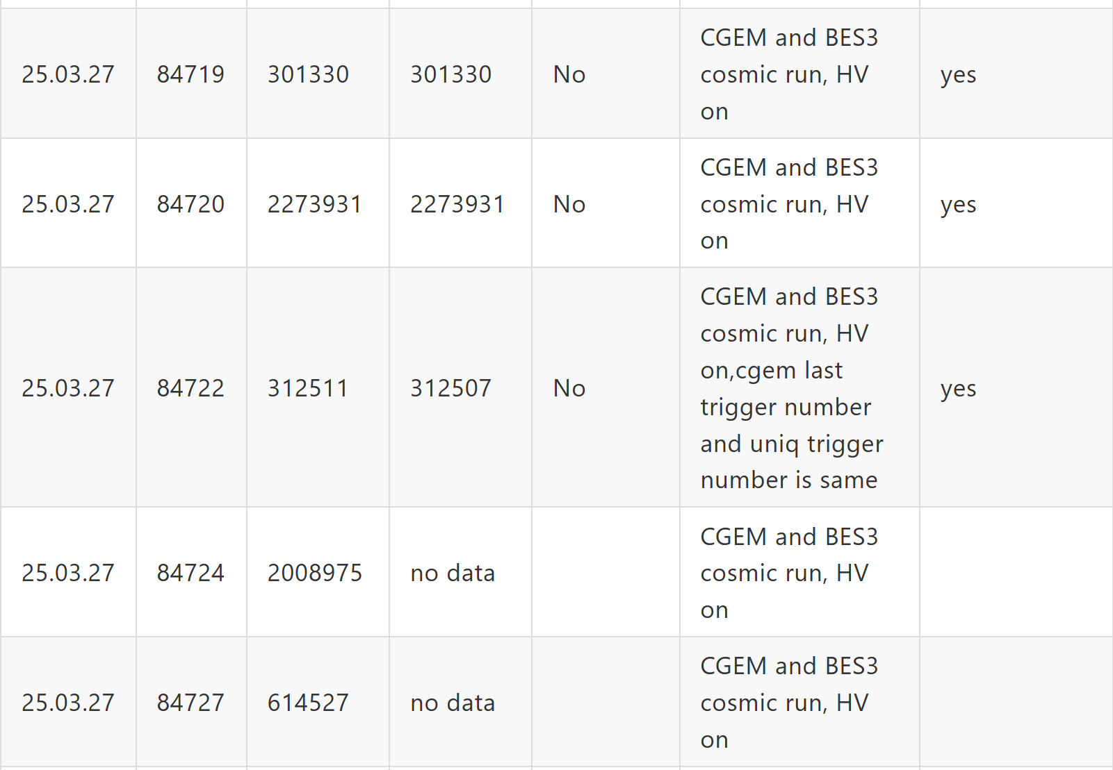
More data check results with HV on
13 more cosmic runs with HV on yesterday and today
7 runs consistent
2 runs cgem no data
4 runs not consistent
84722, 84728
84742 , 84744 BESs stop abnormally
CGEM Data files had merged and uploaded to data
center.
Details:
BES3 and CGEM data taking logbook - HedgeDoc

Slide 3
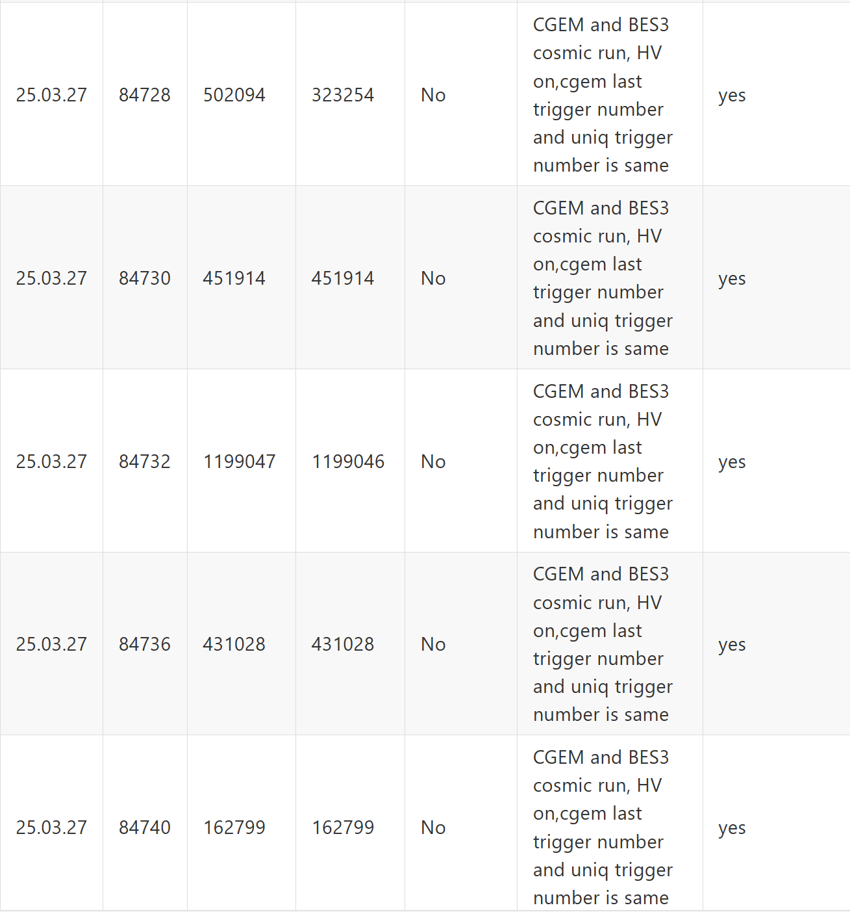
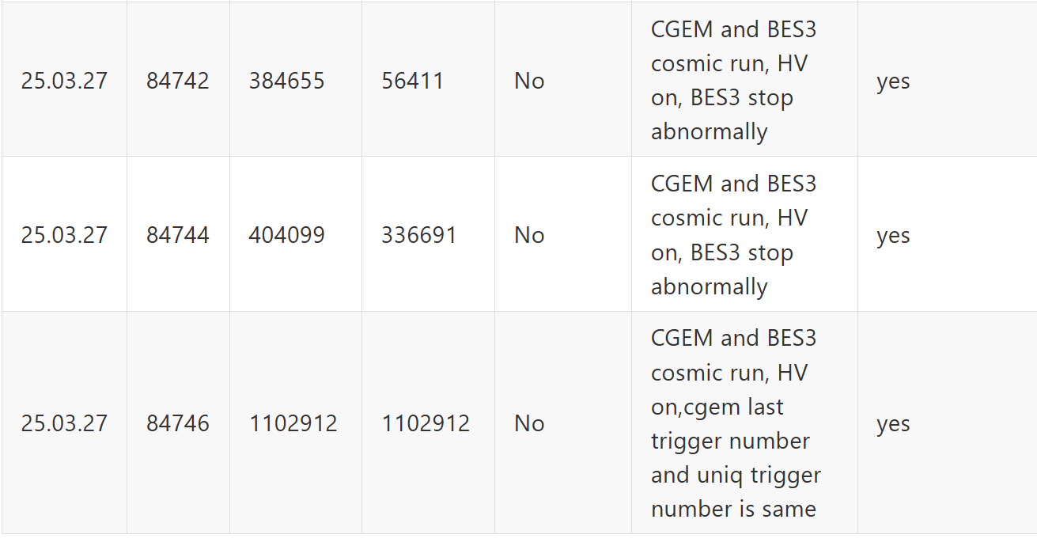

Slide 4
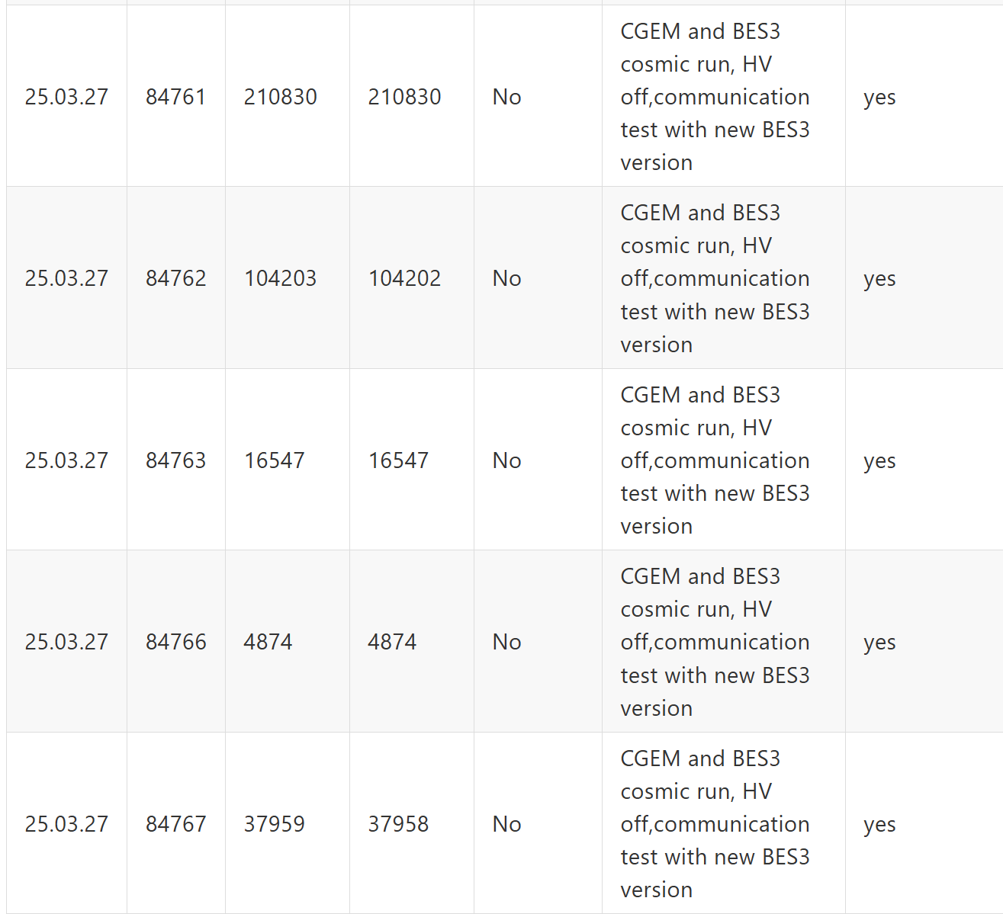
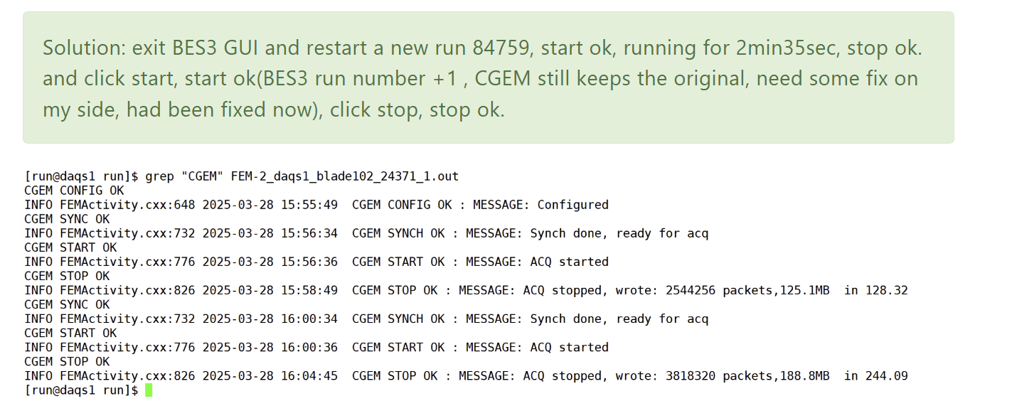
Communication tests
Test more runs and fixed a bug
take 5 more runs with new BES3 version which communicates with CGEM, HV off.
This 5 runs CGEM Trigger number is consistent with BES3

