Slide 1
Truth Vertexing at CEPC
Wang Xinzhu, Wu Jingfei, Zhang Chenguang, Zhu Yifan
Wang Tao, Huan Yanping

Slide 2
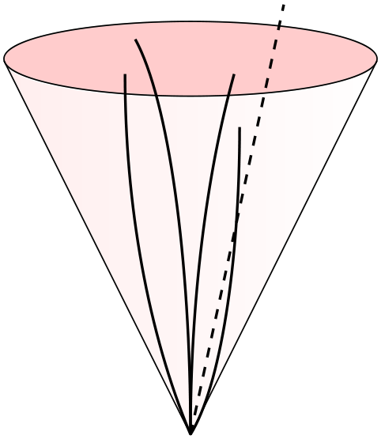
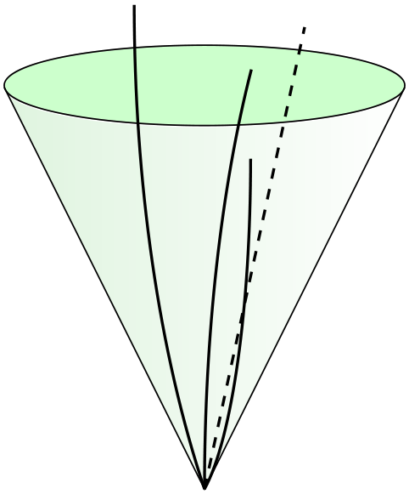
Truth matching idea
Jet
Reconstructed: clustered PFOs
Truth: clustered MCP (charged + neutral & stable)
Vertex
Reconstructed: tracks (charged PFO)
Truth: vertex of charged stable MCP
MCP collection
clustering
match
constituent
truth
reconstructed
truth vertex

Slide 3
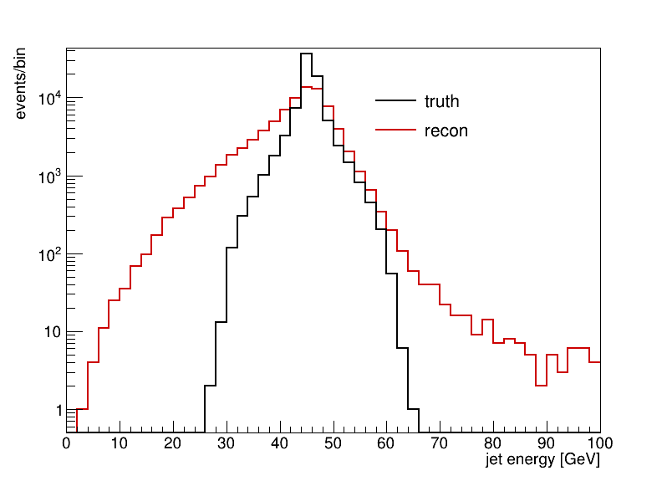
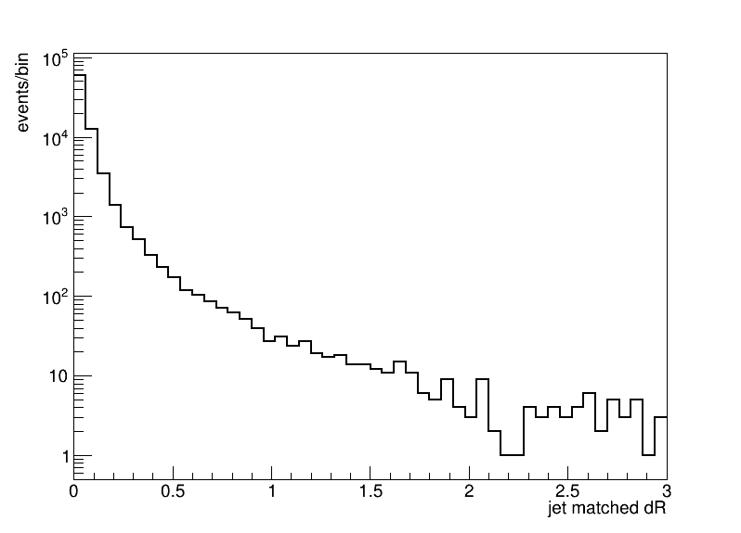
Jet matching performance
ee->bb @ 91.2GeV
Match jet by ΔR
Performance cut @ 0.4
eff: 98%

Slide 4
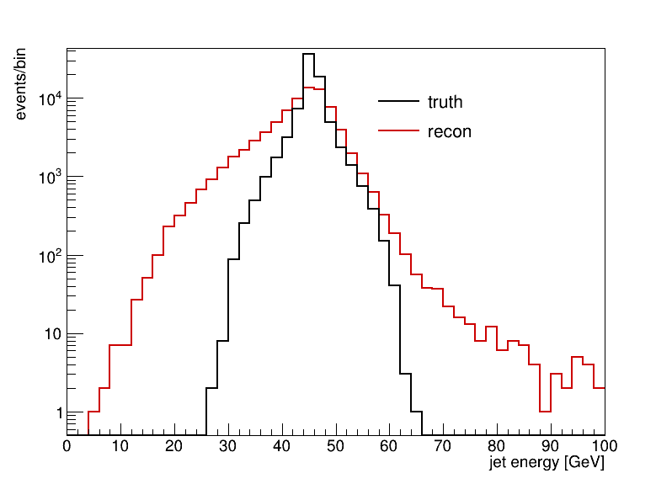
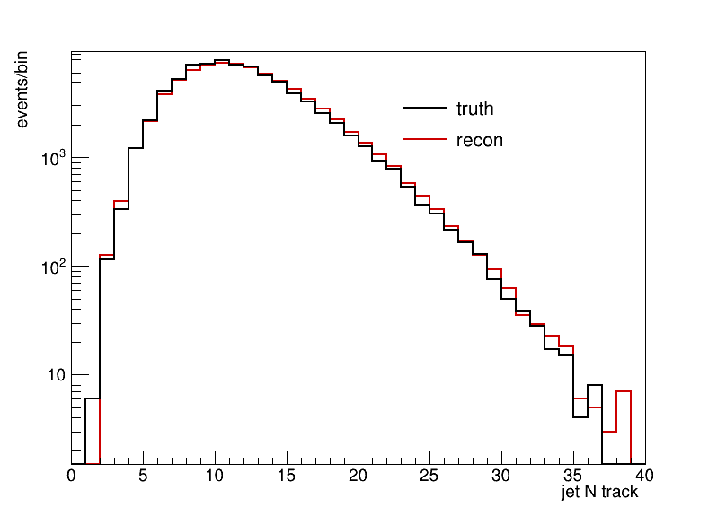
Jet vars
ΔR < 0.4
Energy resolution: ~9%
Charged track counts match well

Slide 5
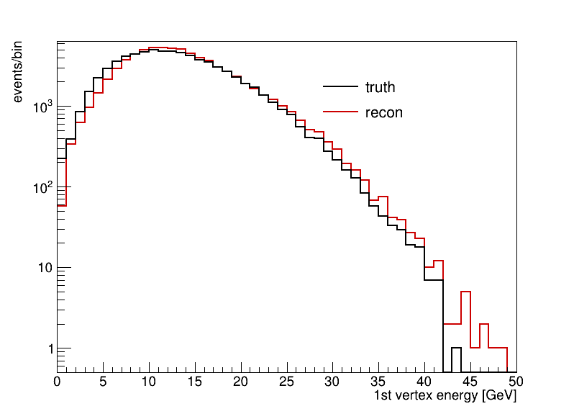
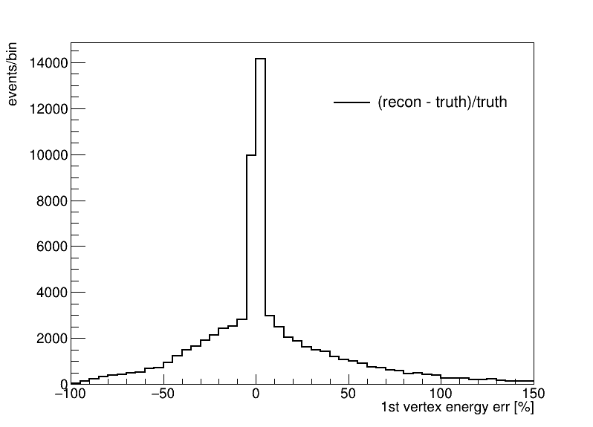
First secondary vertex vars
Match reco/truth vertex with highest energy
Select matched vertices with distance(rec, truth) < 20mm
~3% shift from reconstructed vertices

Slide 6
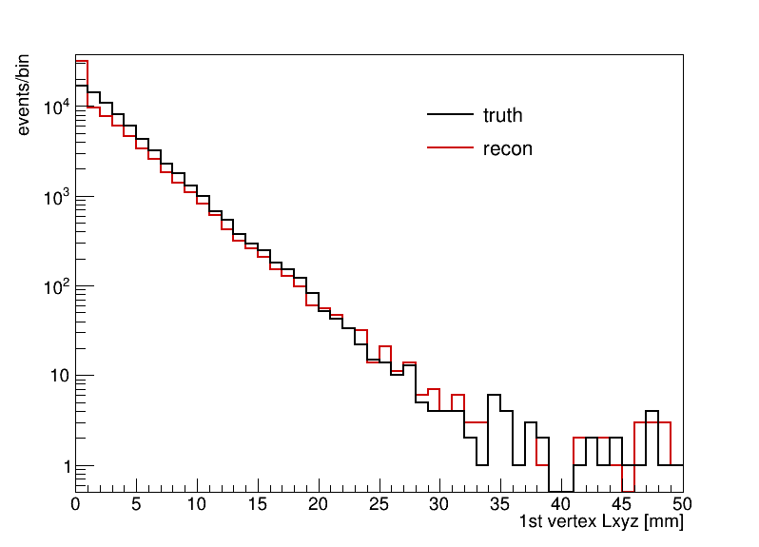
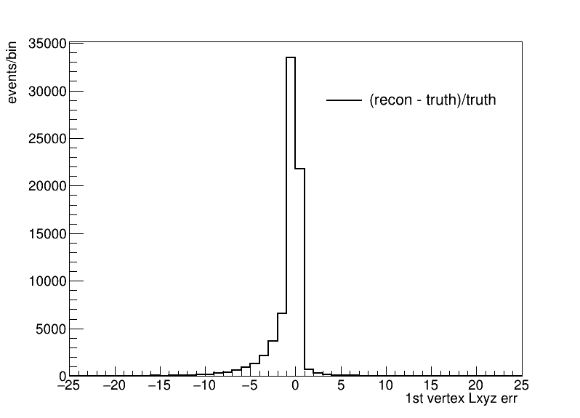
First secondary vertex vars
Vertex distance to IP
More reco vertices close to IP

Slide 7
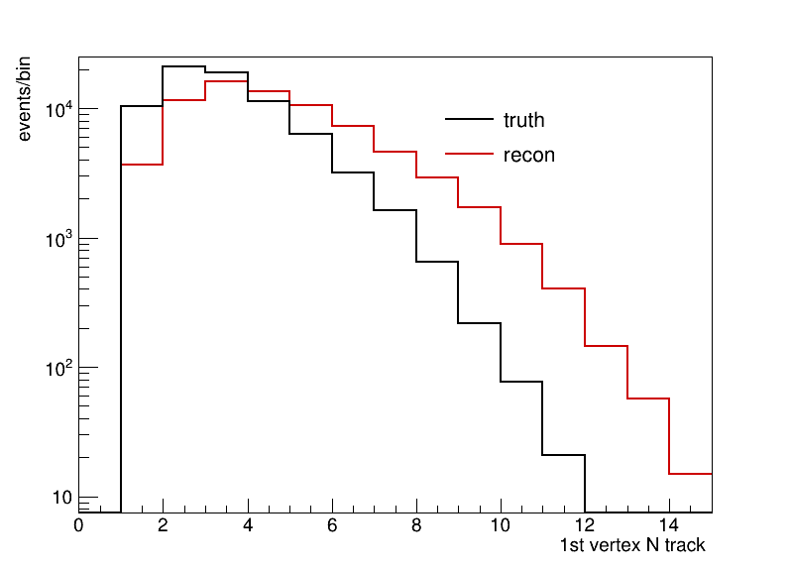
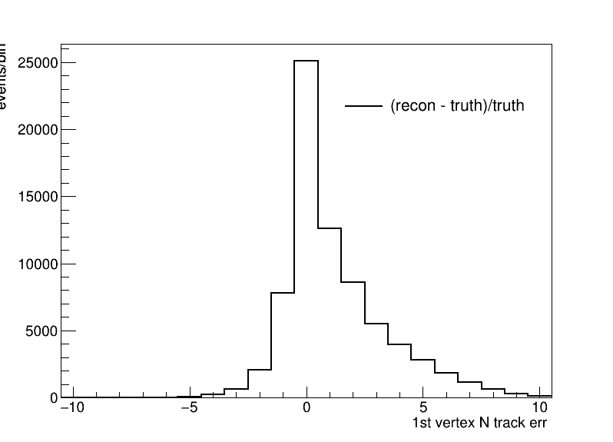
First secondary vertex vars
Vertex N tracks
Reco vertex tend to have ~1 more track

Slide 8
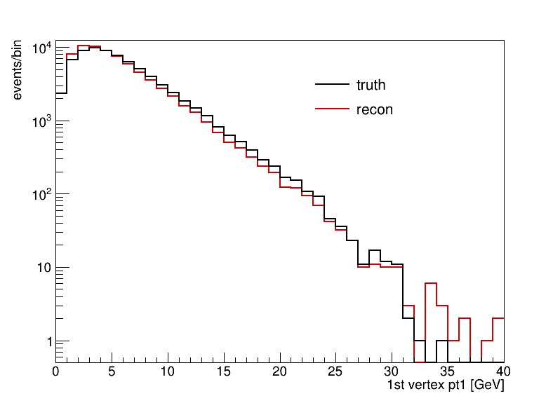
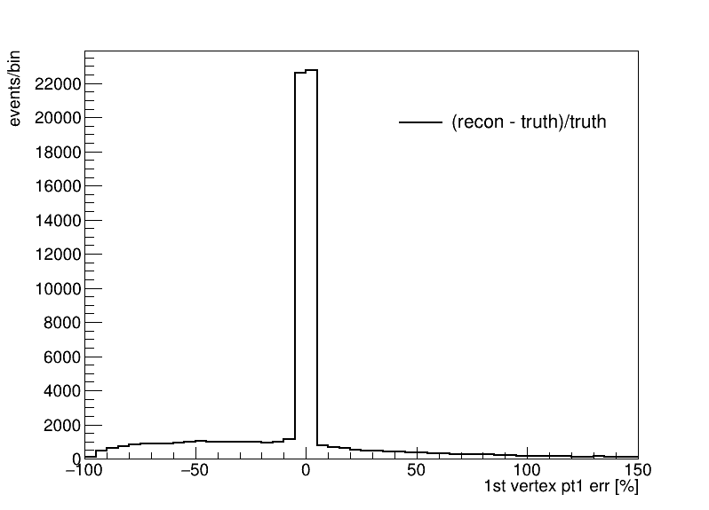
First secondary vertex vars
Leading pT of the hardest vertex
Select vertices with distance(rec, truth) < 20mm
Good agreement

Slide 9
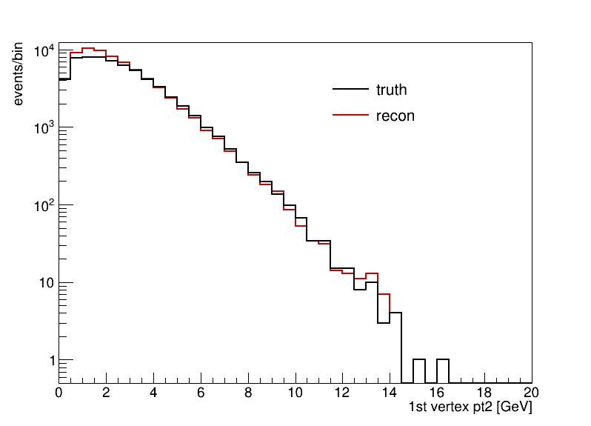
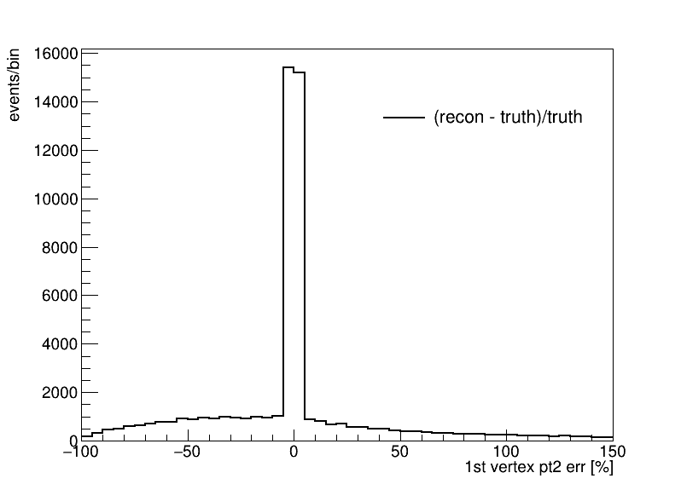
First secondary vertex vars
Sub-leading pT of the hardest vertex
Select vertices with distance(rec, truth) < 20mm
Good agreement

Slide 10
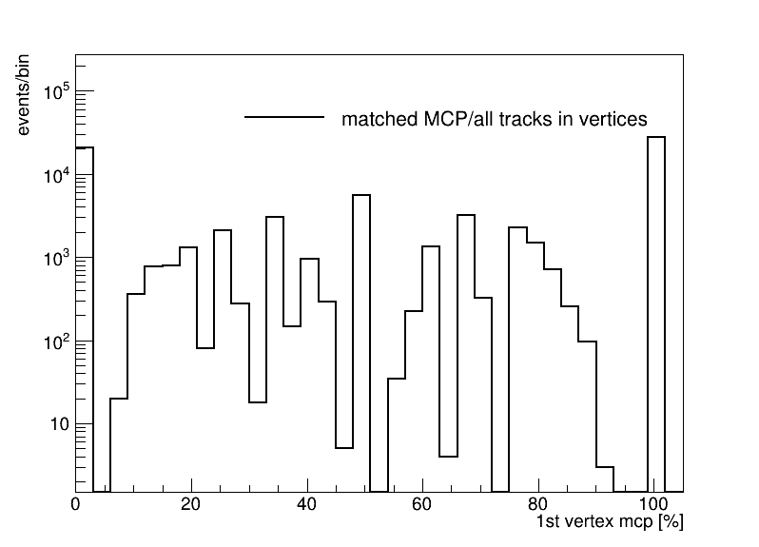
First secondary vertex vars
Ratio of tracks from reco vertex matched to correct MCP in the truth vertex
Ratio = (tracks matched to correct MCP)/all tracks
No tracks in hardest reco vertices matched to MCPs from truth: ~28%

Slide 11
Thank You

