Slide 1
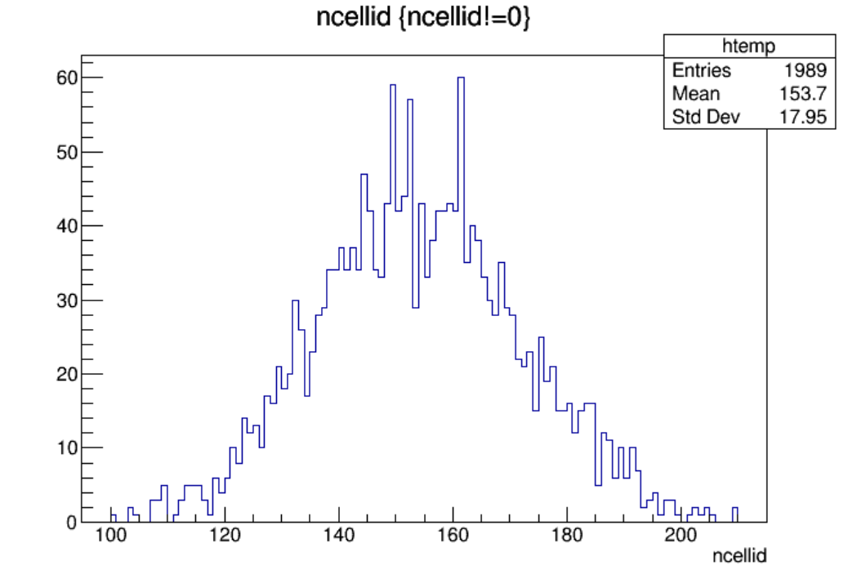
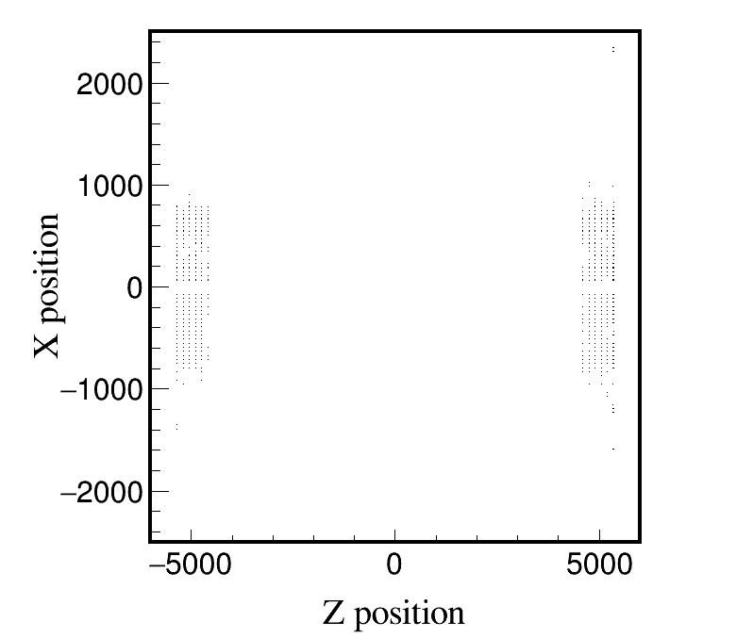
Higgs, Whole_250317, endcap, 2000 files, 10BX:
Higgs, Whole_250317, endcap, 10 files, 10BX:
Distribution of ncellid
Max ncellid: 209

Slide 2
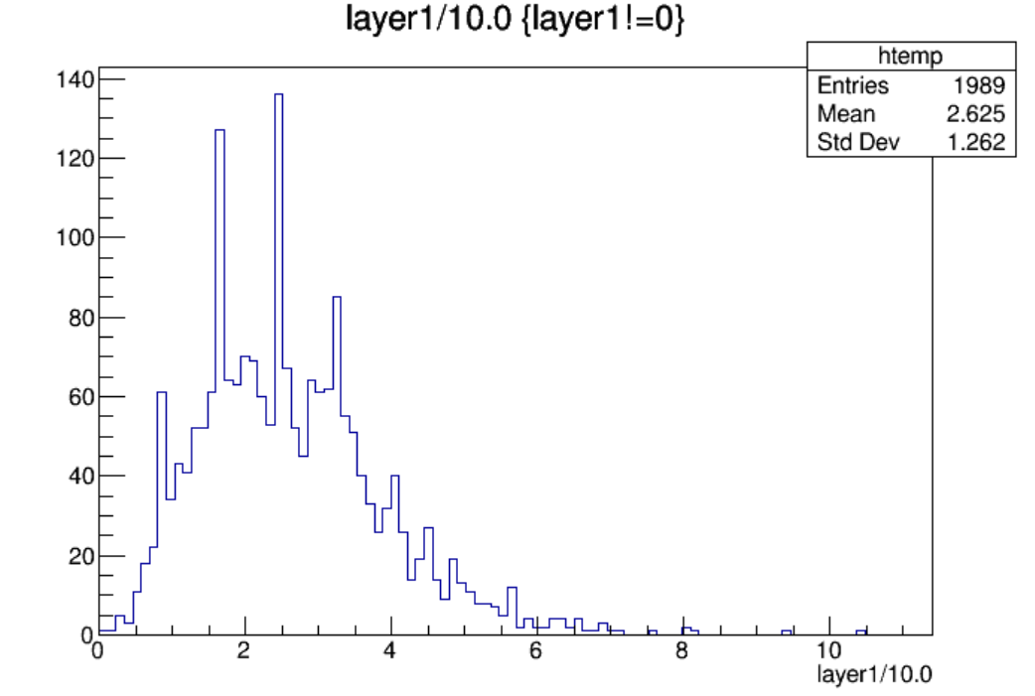
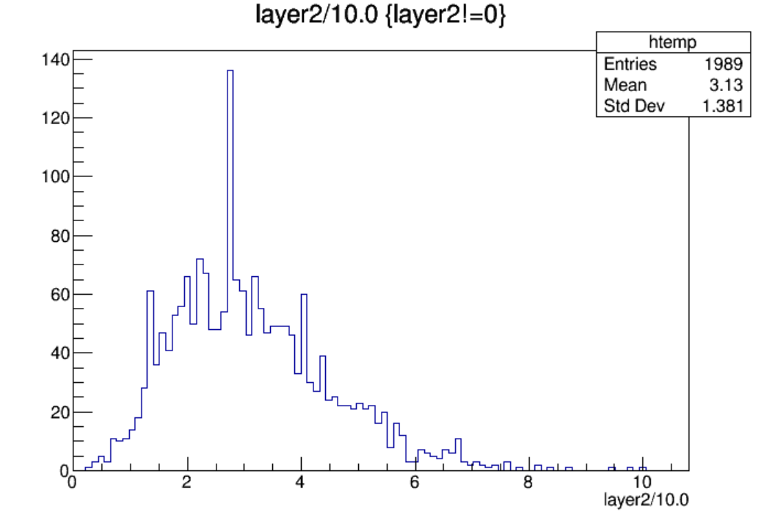
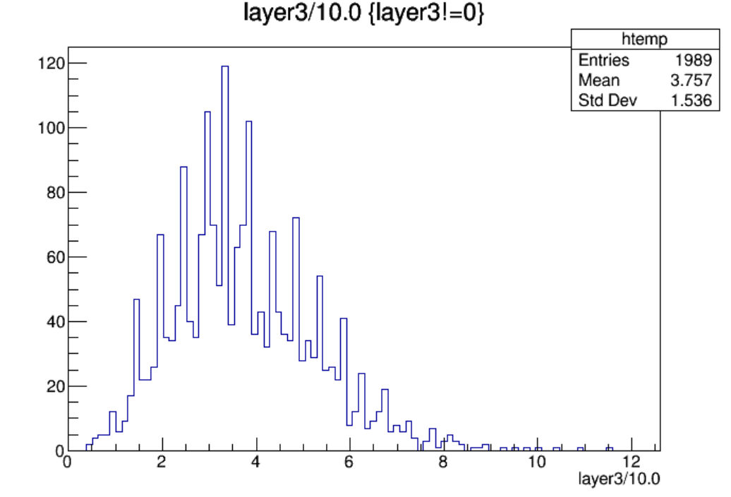
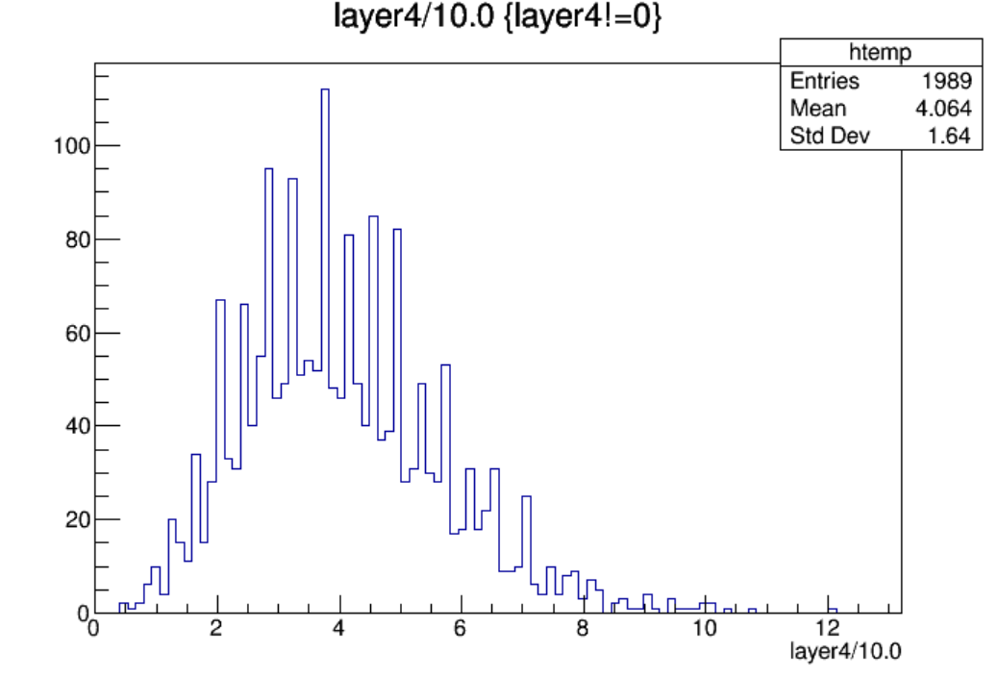

Slide 3
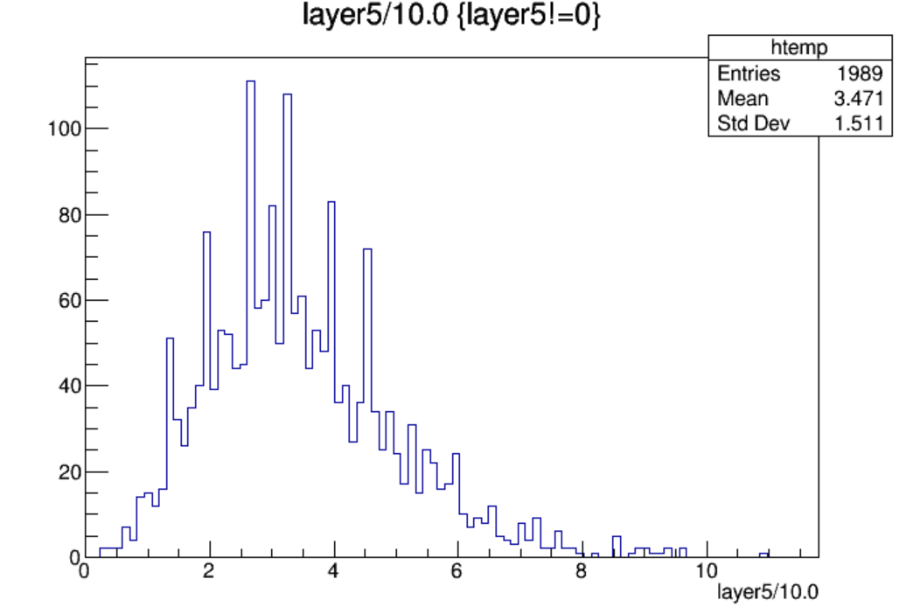
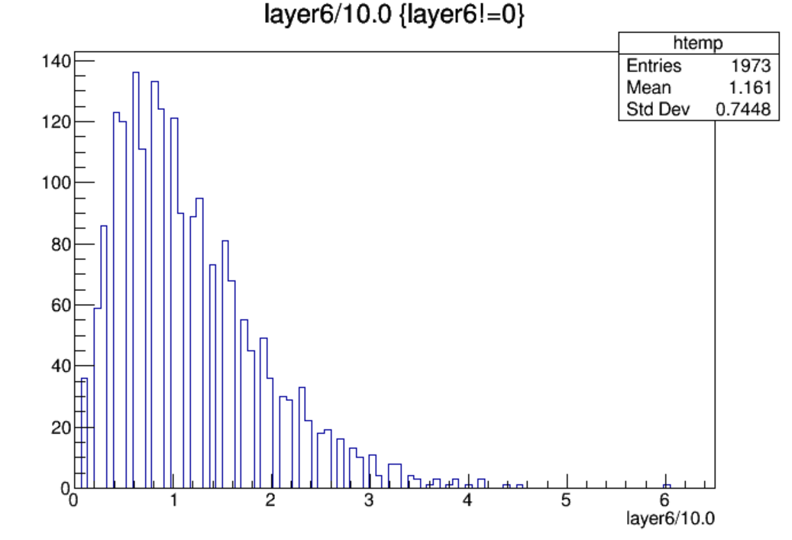
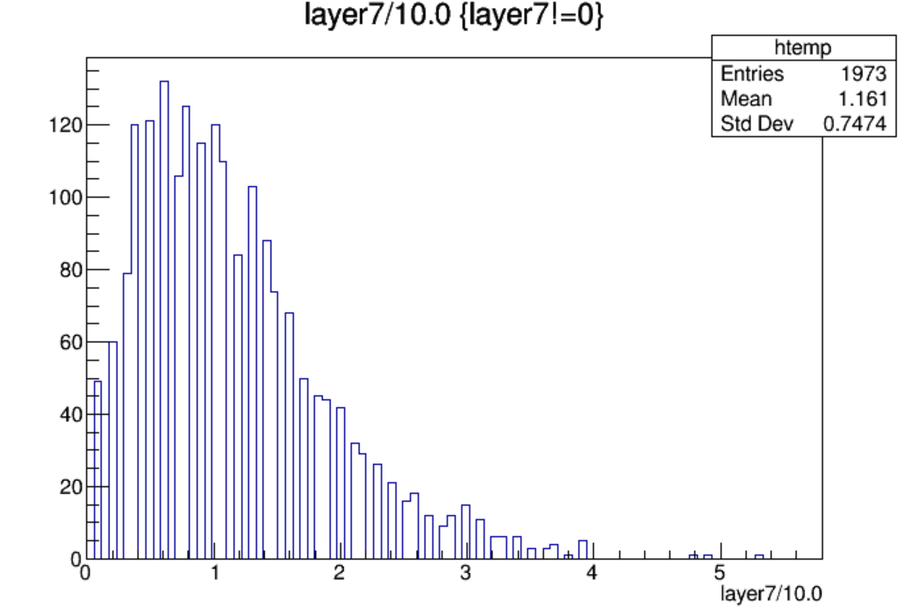
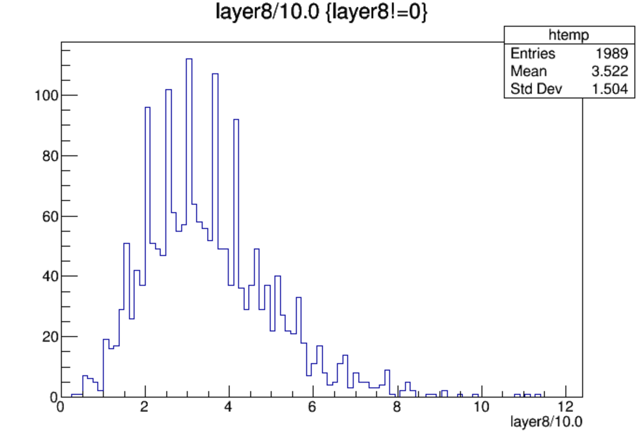

Slide 4
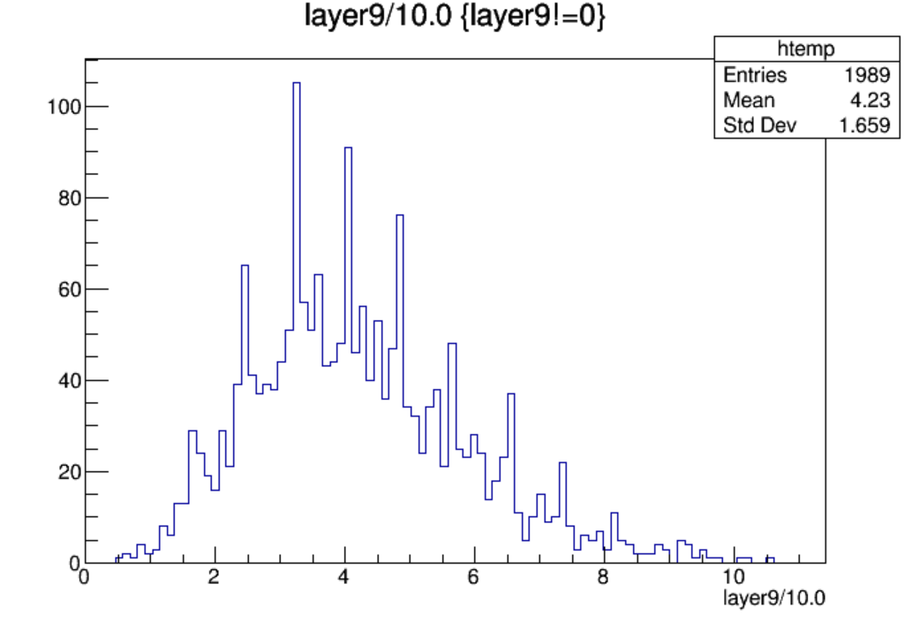
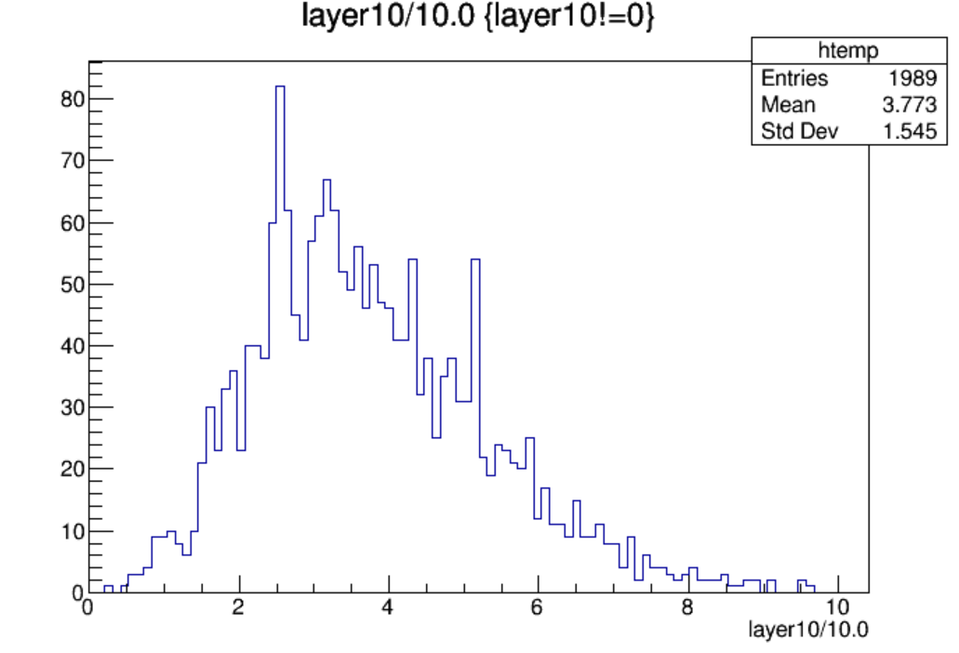
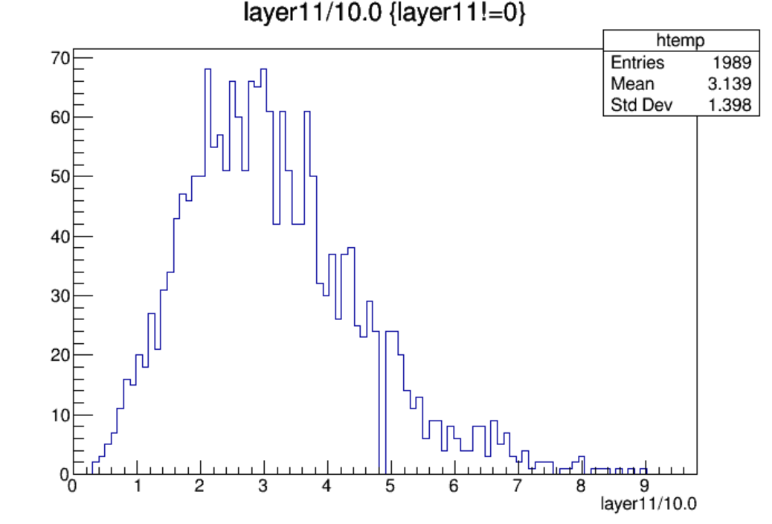
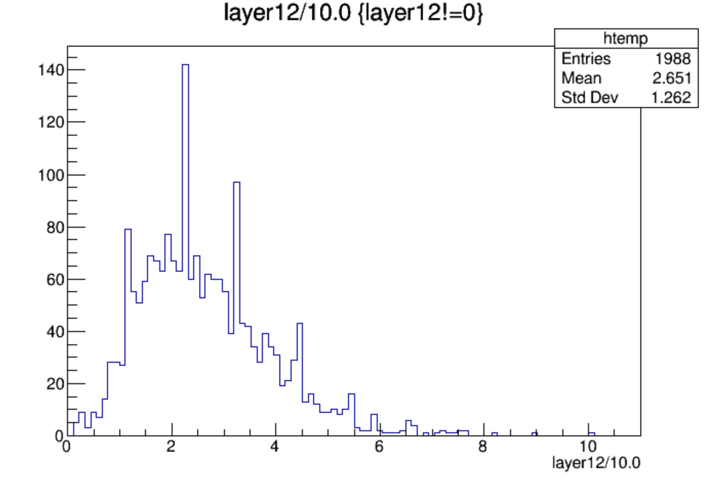

Slide 5
$Nstrip\left(endcap\right)=19200$, $Nstrip\left(endcap, per layer\right)={19200}/{12}=1600$
Layer | Max Hit Density(/${cm}^{2}$/BX) | Max Hit Rate(Hz/${cm}^{2}$) | Average Hit Rate(Hz/${cm}^{2}$) | Occupancy(%)
Layer1-L | 6.81e-06 | 9.25 | 2.33 | 0.65
Layer2-L | 6.55e-06 | 8.90 | 2.78 | 0.63
Layer3-L | 7.53e-06 | 10.23 | 3.33 | 0.72
Layer4-L | 7.92e-06 | 10.76 | 3.60 | 0.76
Layer5-L | 7.14e-06 | 9.70 | 3.08 | 0.68
Layer6-L | 3.93e-06 | 5.34 | 1.02 | 0.38
Layer6-R | 3.47e-06 | 4.71 | 1.02 | 0.33
Layer5-R | 7.40e-06 | 10.05 | 3.12 | 0.71
Layer4-R | 6.88e-06 | 9.34 | 3.75 | 0.66
Layer3-R | 6.29e-06 | 8.54 | 3.35 | 0.60
Layer2-R | 5.89e-06 | 8.01 | 2.78 | 0.56
Layer1-R | 6.61e-06 | 8.98 | 2.35 | 0.63
Hit Rate定义为：对应超层每秒钟着火的strip数/一层的表面积

Slide 6
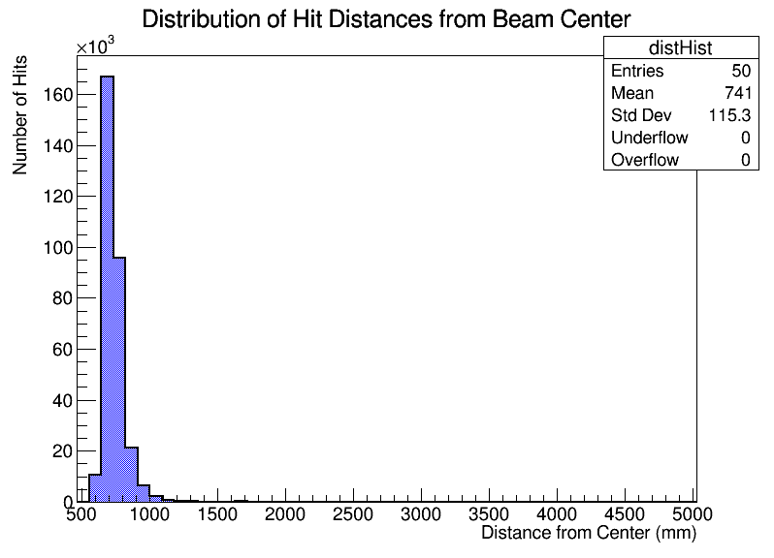
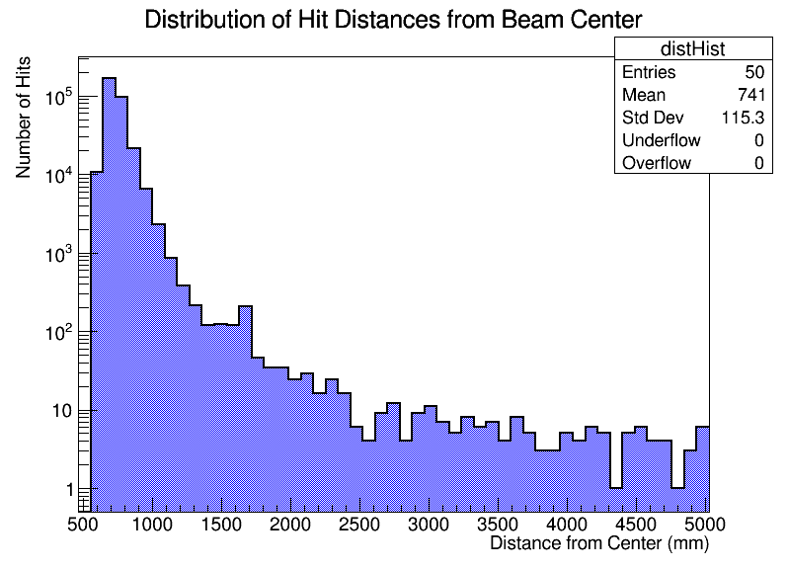
Total hits: 305819
Average distance: 741.78
Minimum distance: 554.44
Maximum distance: 5030.01

Slide 7
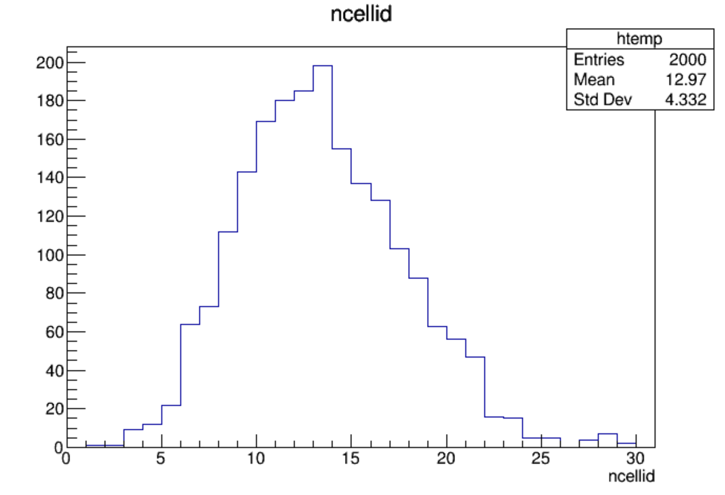
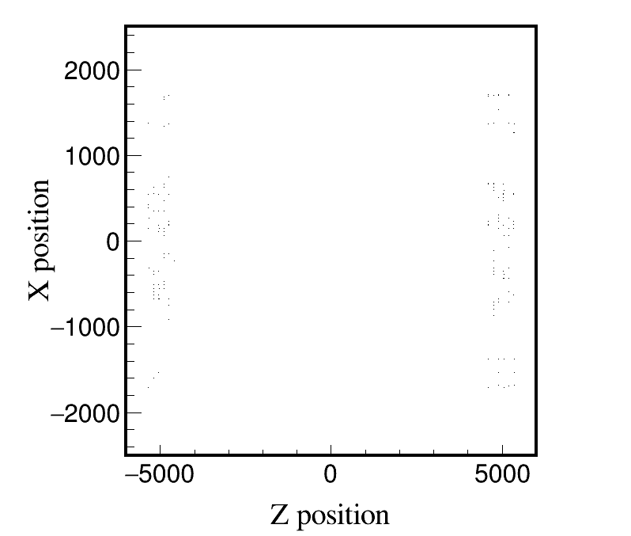
Low_Z, Whole_250317, endcap, 2000 files, 10BX:
Low_Z, Whole_250317, endcap, 10 files, 10BX:
Distribution of ncellid
Max ncellid: 29

Slide 8
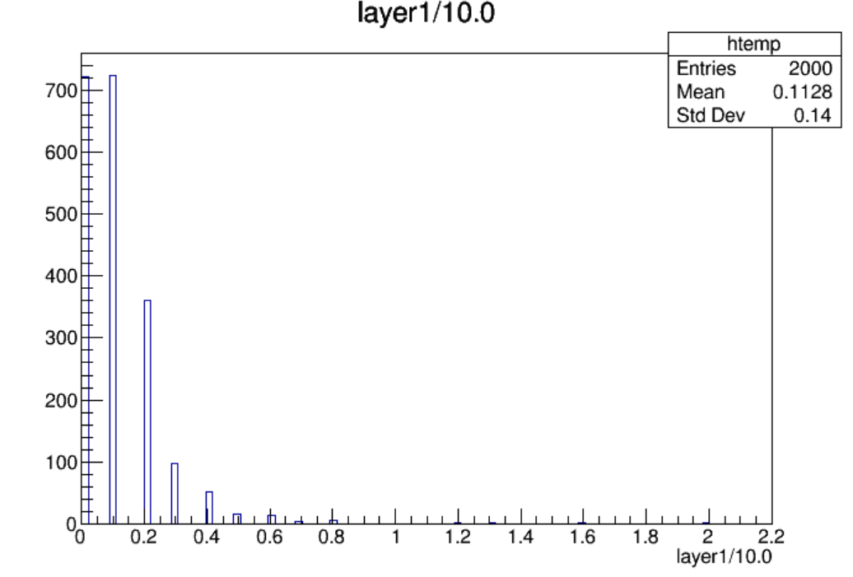
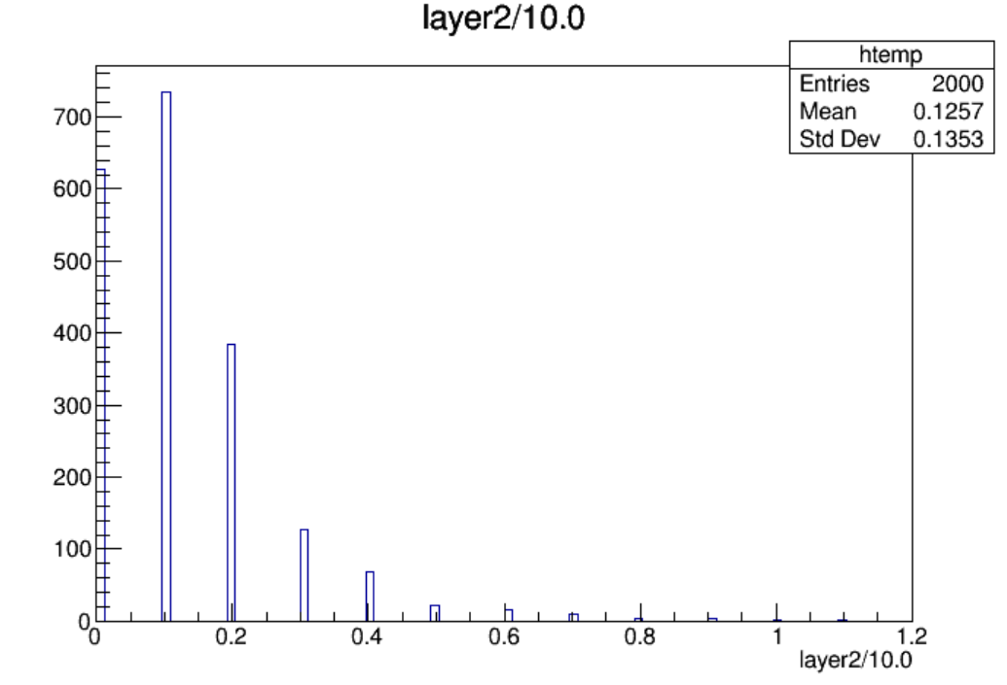
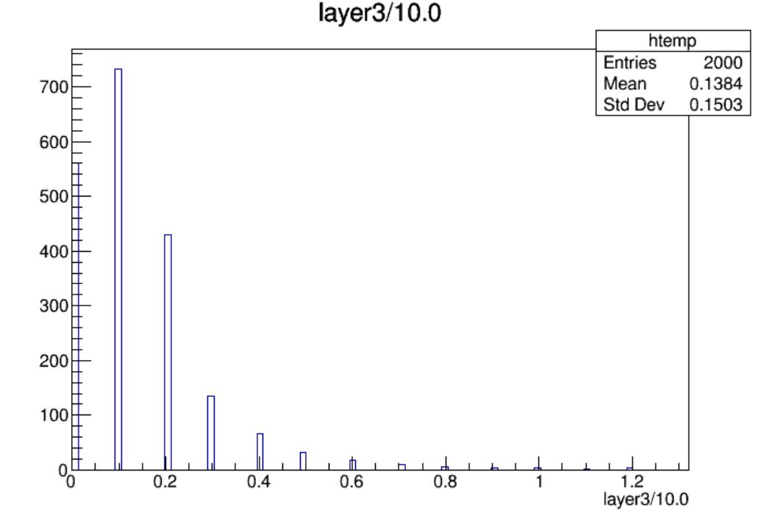
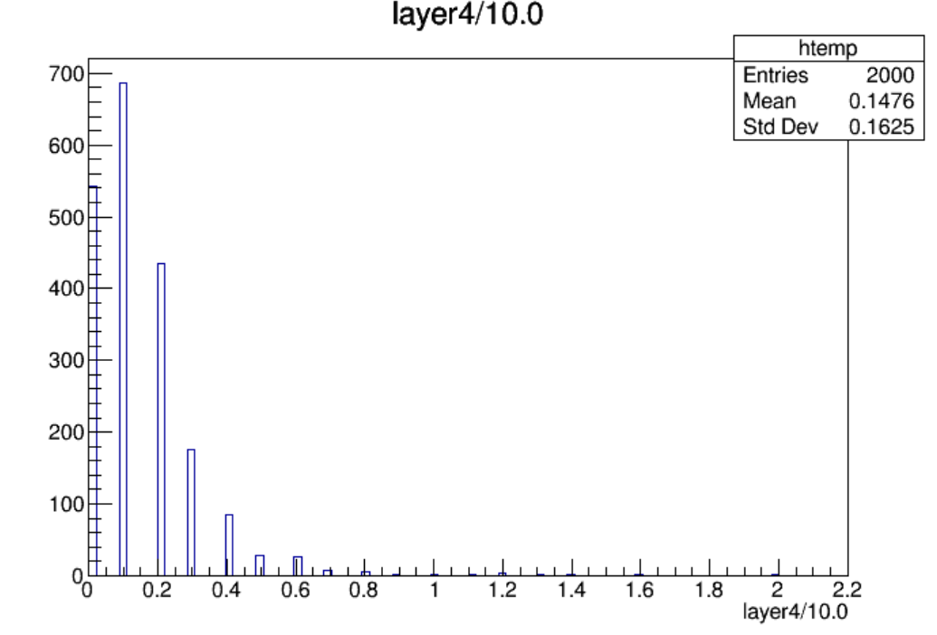

Slide 9
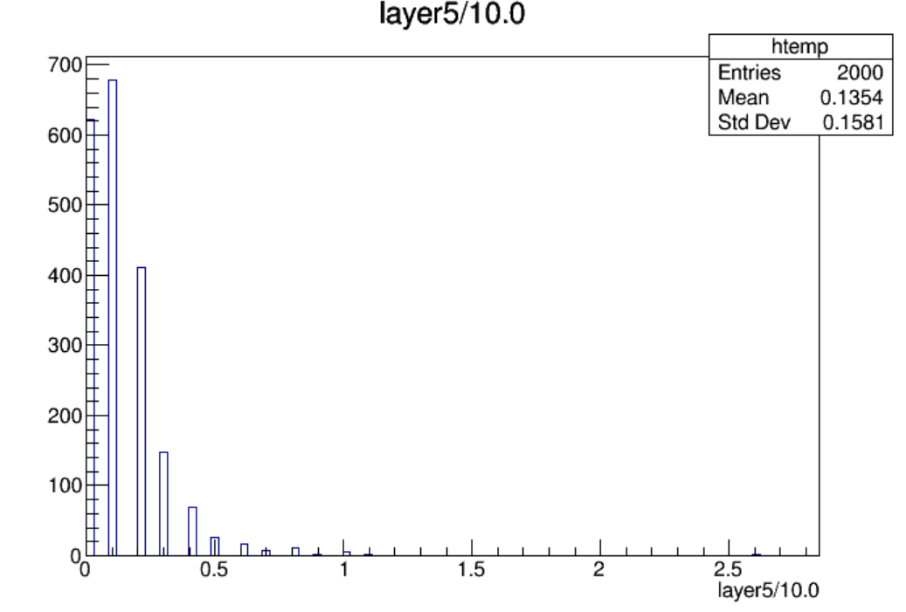
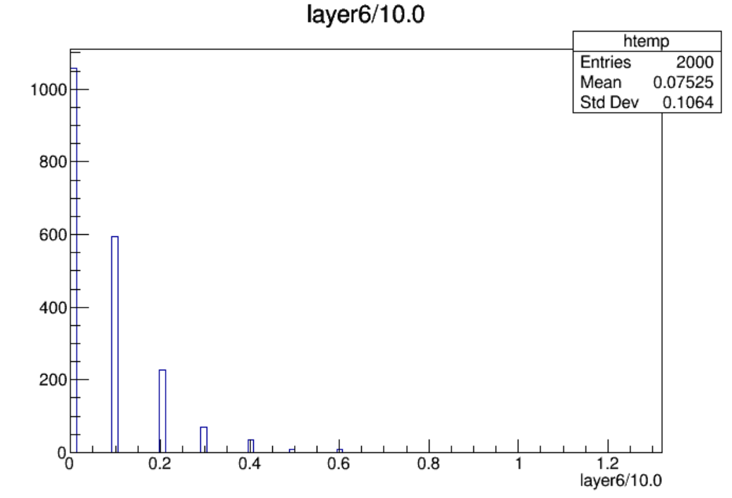
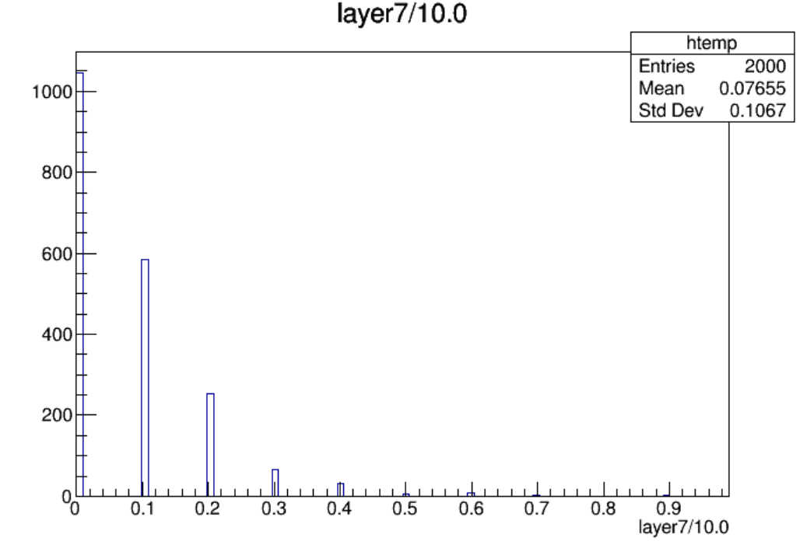
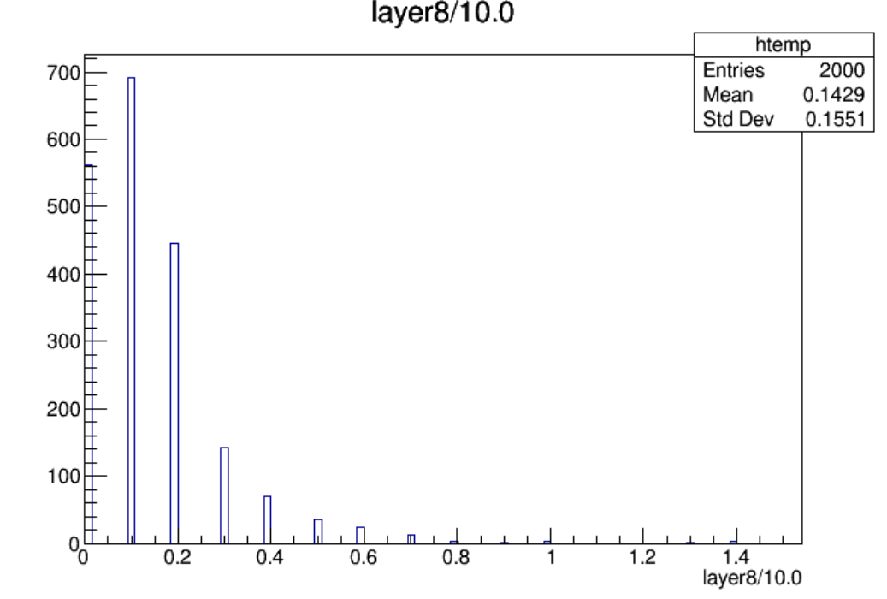

Slide 10
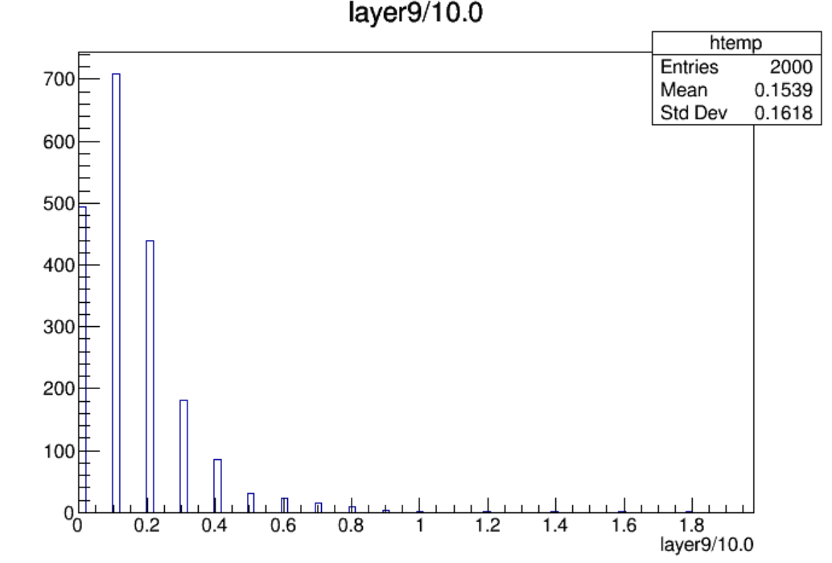
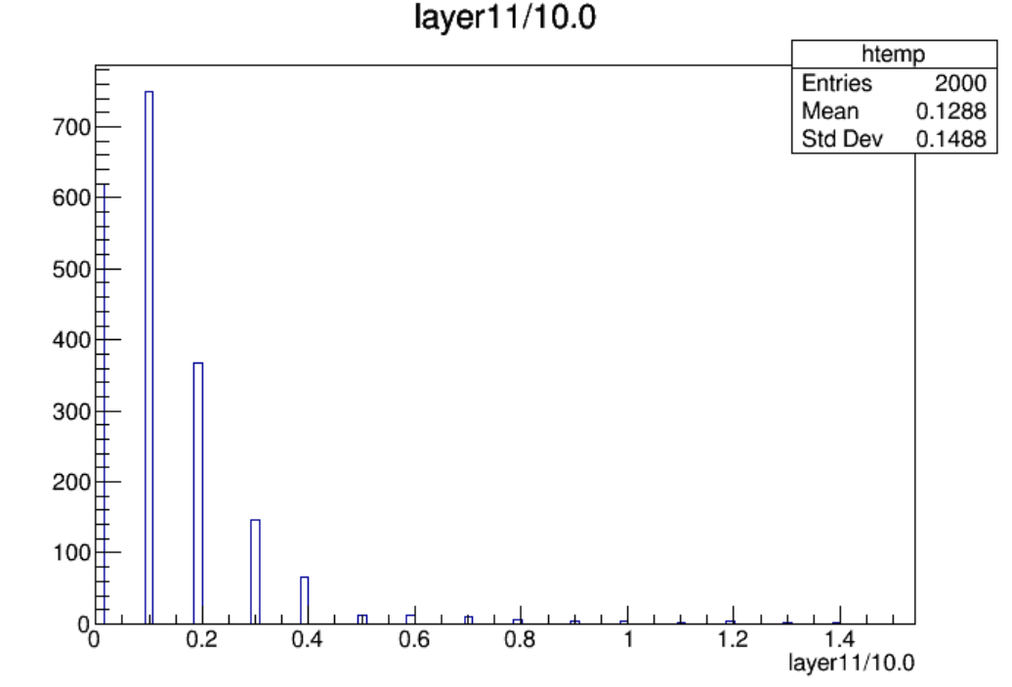

Slide 11
$Nstrip\left(endcap\right)=19200$, $Nstrip\left(endcap, per layer\right)={19200}/{12}=1600$
Layer | Max Hit Density(/${cm}^{2}$/BX) | Max Hit Rate(Hz/${cm}^{2}$) | Average Hit Rate(Hz/${cm}^{2}$) | Occupancy(%)
Layer1-L | 1.31e-06 | 17.08 | 0.96 | 0.13
Layer2-L | 7.20e-07 | 9.40 | 1.07 | 0.07
Layer3-L | 7.86e-07 | 10.25 | 1.18 | 0.08
Layer4-L | 1.31e-06 | 17.08 | 1.26 | 0.13
Layer5-L | 1.70e-06 | 22.21 | 1.16 | 0.16
Layer6-L | 7.86e-07 | 10.25 | 0.64 | 0.08
Layer6-R | 5.89e-07 | 7.69 | 0.65 | 0.06
Layer5-R | 9.17e-07 | 11.96 | 1.22 | 0.09
Layer4-R | 1.19e-06 | 15.37 | 1.31 | 0.11
Layer3-R | 1.18e-06 | 15.37 | 1.25 | 0.11
Layer2-R | 9.17e-07 | 11.96 | 1.10 | 0.09
Layer1-R | 6.55e-07 | 8.54 | 0.97 | 0.06
Hit Rate定义为：对应超层每秒钟着火的strip数/一层的表面积

Slide 12
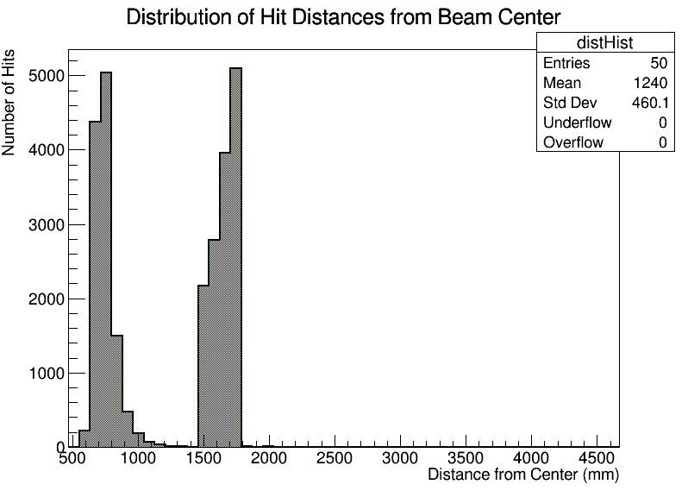
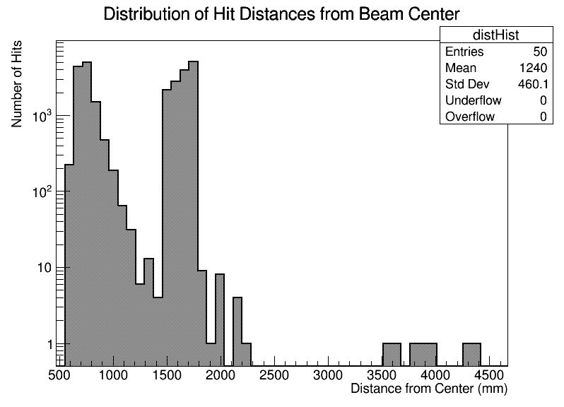
Total hits: 25946
Average distance: 1237.75
Minimum distance: 554.44
Maximum distance: 4666.82

