Slide 1
Manifestation of scale symmetry in dense nuclear meduim ---peak of sound velocity and pseudoconformal structure
Yong-Liang Ma
Nanjing University
The QCD phase diagram: From theory to experimental signatures, Dalian, Liaoning, Oct. 8-11, 2025

Slide 2
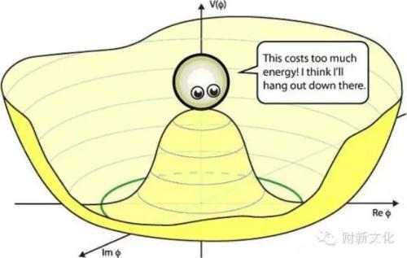
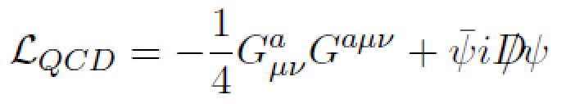


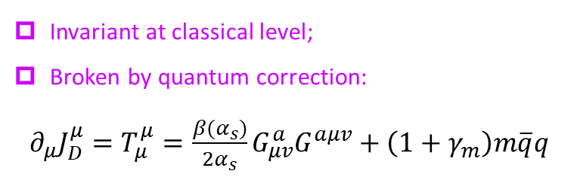
Symmetry and symmetry breaking play dominant roles in particle and nuclear physics.
Scale symmetry in medium is drawing more and more attentions.
Scale symmetry and scale symmetry breaking:
Scale transformation: $x_{μ}→λ^{−1}x_{μ}$
$$A_{μ}^{a}→λA_{μ}^{a}, ψ→λ^{3/2}ψ$$
Invariant at classical level;
Broken by quantum correction:
$∂_{μ}J_{D}^{μ}=T_{μ}^{μ}=\frac{β(α_{s})}{2α_{s}}G_{μv}^{a}G^{aμv}+\left(1+γ_{m}\right)m\overline{q}q$

Slide 3

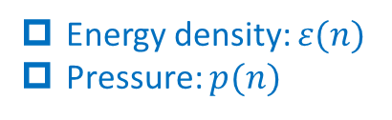
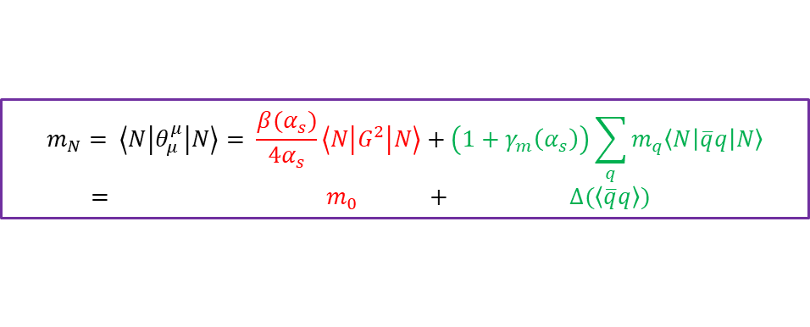
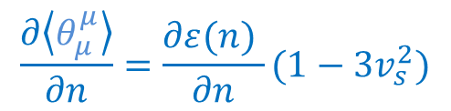
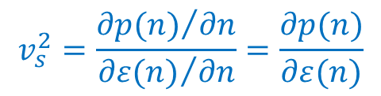
Scale symmetry in dense matter:
Energy density: $ε(n)$
Pressure: $p(n)$
Trace of energy momentum tensor
$θ_{μ}^{μ}(n)=ε\left(n\right)−3p(n)$
$$\frac{∂\left\langle θ_{μ}^{μ}\right\rangle }{∂n}=\frac{∂ε(n) }{∂n}(1−3v_{s}^{2})$$
$$v_{s}^{2}=\frac{{∂p(n)}/{∂n}}{{∂ε(n)}/{∂n}}=\frac{∂p(n)}{∂ε(n)}$$
Stiffness of EOS, behaviour of SV, interaction among quasiparticles！
$$m_{N}= \left\langle N\left|θ_{μ}^{μ}\right|N\right\rangle = \frac{β(α_{s})}{4α_{s}}\left\langle N\left|G^{2}\right|N\right\rangle +\left(1+γ_{m}\left(α_{s}\right)\right)\sum_{q}{m_{q}\left\langle N\left|\overline{q}q\right|N\right\rangle }$$
$= m_{0} + ∆(\left\langle \overline{q}q\right\rangle )$
Origin of nucleon mass:

Slide 4
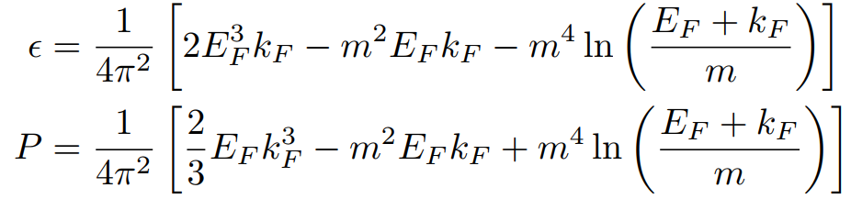
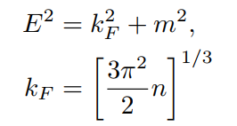
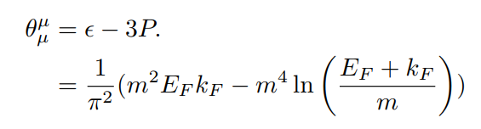
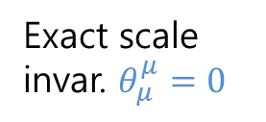
An example: Cold non-interaction fermion matter:
Exact scale invar. $θ_{μ}^{μ}=0$
Scale symmetry is breaking by fermion mass

Slide 5






An example: Cold non-interaction fermion matter:
Extreme high density regime, $k_{F}≫m$
Energy density and pressure → massless fermion
TEMT → non-zero (even divergent !)
Conformal window?
Notes:
Check 一下此式

Slide 6
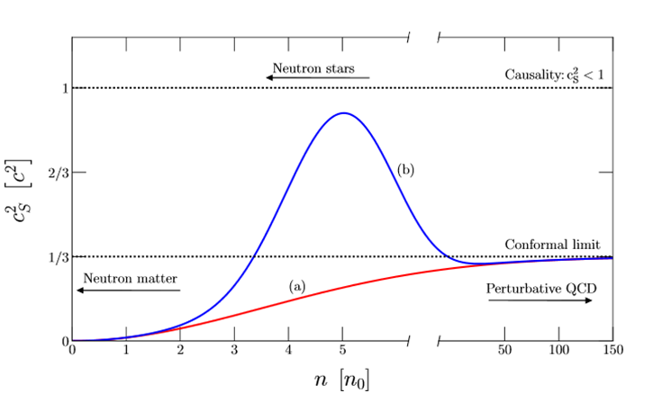
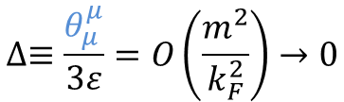
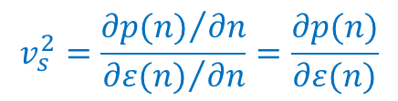
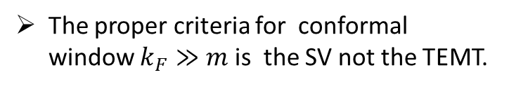
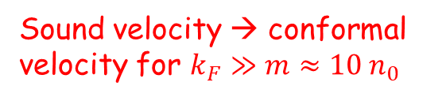
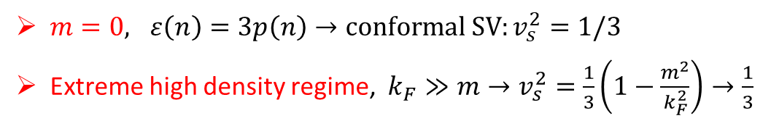
An example: Cold non-interaction fermion matter:
Sound velocity:
$$v_{s}^{2}=\frac{{∂p(n)}/{∂n}}{{∂ε(n)}/{∂n}}=\frac{∂p(n)}{∂ε(n)}$$
$m=0, ε\left(n\right)=3p\left(n\right)→conformal SV:v_{s}^{2}=1/3$
Extreme high density regime, $k_{F}≫m→v_{s}^{2}=\frac{1}{3}\left(1−\frac{m^{2}}{k_{F}^{2}}\right)→\frac{1}{3}$
Sound velocity → conformal velocity for $k_{F}≫m≈10 n_{0}$
S. Reddy et al, 2018
$$∆≡\frac{θ_{μ}^{μ}}{3ε}=O\left(\frac{m^{2}}{k_{F}^{2}}\right)→0$$
The proper criteria for conformal window $k_{F}≫m$is the SV not the TEMT.
Notes:
Check 一下此式

Slide 7
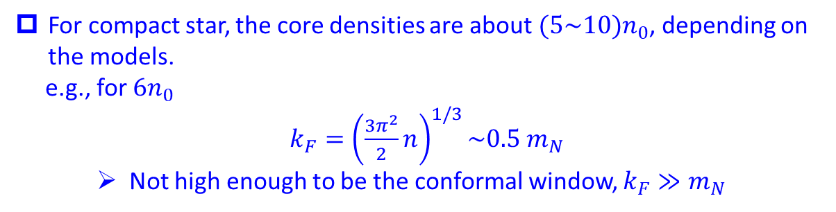
Compact star matter (strongly correlated matter):
For compact star, the core densities are about $(5\sim 10)n_{0}$, depending on the models.
e.g., for $6n_{0}$
$k_{F}={\left(\frac{3π^{2}}{2}n\right)}^{1/3}\sim 0.5 m_{N}$
Not high enough to be the conformal window, $k_{F}≫m_{N}$
Since it is a criterion relevant to the non-interacting massive fermions, the same criterion cannot be simply imposed on the strongly interacting fermionic matter at the core of compact star. A conformal window may appear in a different context.
H. K. Lee, symmetry 16 (2024), 1598
Notes:
Check 一下此式

Slide 8



Effective Lagrangian for interacting nucleon $N$
Symmetries implemented
Chiral symmetry: pseudo scalar mesons, pion $π$
Chiral symmetry: pseudo scalar mesons, pion 𝜋
Hidden local symmetry: vector mesons, $ρ, ω$
Hidden local symmetry: vector mesons, 𝜌, 𝜔
Scale symmetry: dilaton, $χ$
Scale symmetry: dilaton, χ
Trace anomaly in effective models：
anomaly match
Trace anomaly in QCD
Trace anomaly EFT
$$θ_{μ}^{μ}=\frac{β(g)}{2g}G_{μv}G^{μv}∝χ^{4}$$
Dilaton compensator;
A source of scalar meson in EFT
$$δ_{D}V(χ) ∝χ^{4}$$

Slide 9
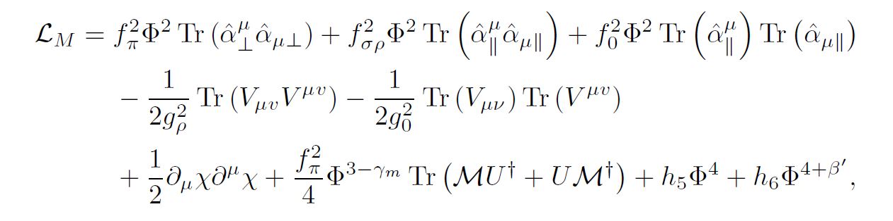
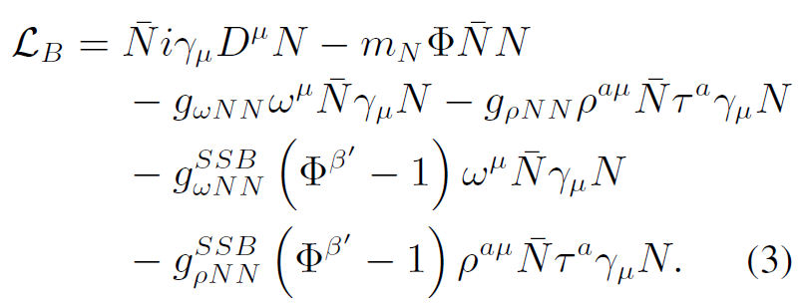
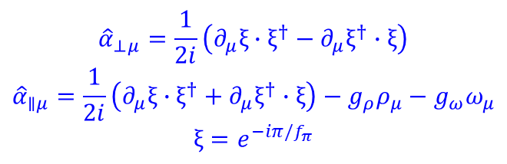
$${\hat{α}}_{⊥μ}=\frac{1}{2i}\left(∂_{μ}ξ∙ξ^{†}−∂_{μ}ξ^{†}∙ξ\right)$$
$${\hat{α}}_{∥μ}=\frac{1}{2i}\left(∂_{μ}ξ∙ξ^{†}+∂_{μ}ξ^{†}∙ξ\right)−g_{ρ}ρ_{μ}−g_{ω}ω_{μ}$$
$$ξ=e^{−iπ/f_{π}}$$
Y. L. Li, YLM, M. Rho, PRD95 (2017), 114011
L. Q. Zhang, Y. Ma and YLM, 2410.04142; 2412.19023.

Slide 10
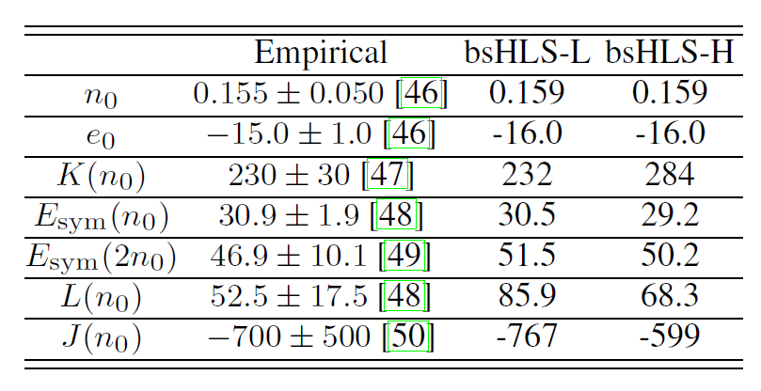
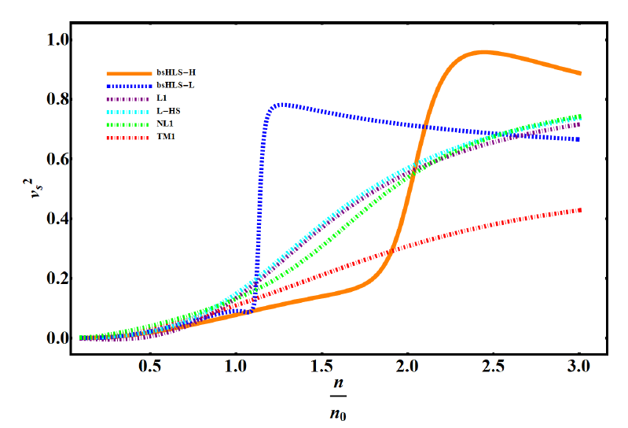
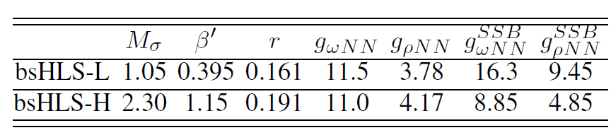

Self-consistent mean field calculation
Peak of SV, not far from $n_{0}$
Linear model
The peak in the SV is due to the nonlinear realization of scale symmetry, NOT observed in Walecka-typy models!

Slide 11
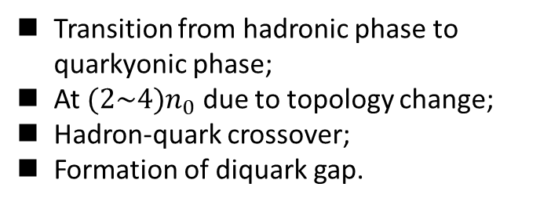
Hippert, et al. , 2105.04535
Emerges in the transition from a phase with broken chiral symmetry to one with gapped Fermi surface with the condensation of diquarks and dibaryons.
Transition from hadronic phase to quarkyonic phase;
At $(2\sim 4)n_{0}$ due to topology change;
Hadron-quark crossover;
Formation of diquark gap.
Hadronic phase
L. McLerran and S. Reddy, PRL122 (2019), 122701.
T. Zhao and J. M. Lattimer, PRD102 (2020), 023021.
YLM and M. Rho, PRD99 (2019), 014034; PPNP113 (2020), 103791;
G. Baym, S. Furusawa, et al., APJ 885 (2019), 42;
M. Leonhardt, M. Pospiech, et al., PRL125 (2020), 142502 (2020).
Chiral-scale EFT, NO phase transition/configuration change!

Slide 12
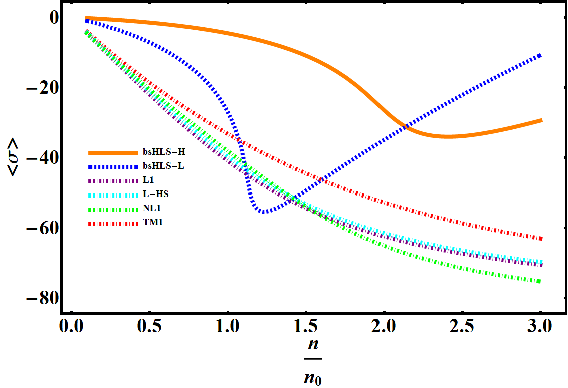
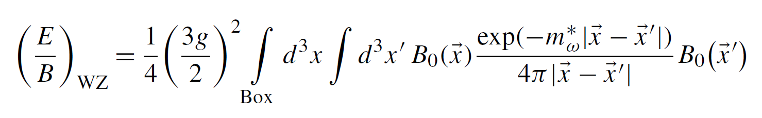
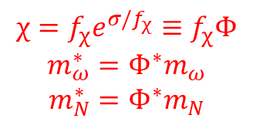
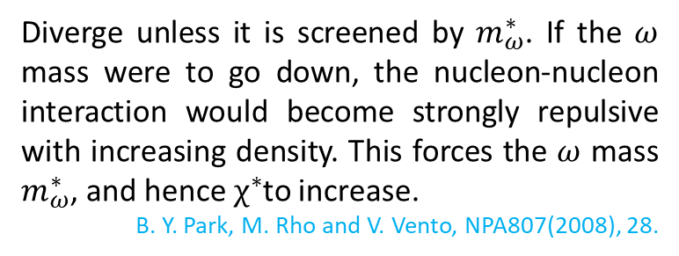
Why in Chiral-scale EFT?
Scale symmetry is first partially restored with density, but then stops after a critical denity.
Also found in skyrmion crystal approach.
Long-Qi Shao, YLM, arXiv:2202.09957
The nonlinear realization of scale symmetry gives a natural explanation of the peak in the SV, WITHOUT retrospect to phase transition/configuration change!
Diverge unless it is screened by $m_{ω}^{∗}$. If the $ω$ mass were to go down, the nucleon-nucleon interaction would become strongly repulsive with increasing density. This forces the $ω$ mass $m_{ω}^{∗}$, and hence $χ^{∗}$to increase.
B. Y. Park, M. Rho and V. Vento, NPA807(2008), 28.
$$χ=f_{χ}e^{σ/f_{χ}}≡f_{χ}Φ$$
$$m_{ω}^{∗}=Φ^{∗}m_{ω}$$
$$m_{N}^{∗}=Φ^{∗}m_{N}$$

Slide 13
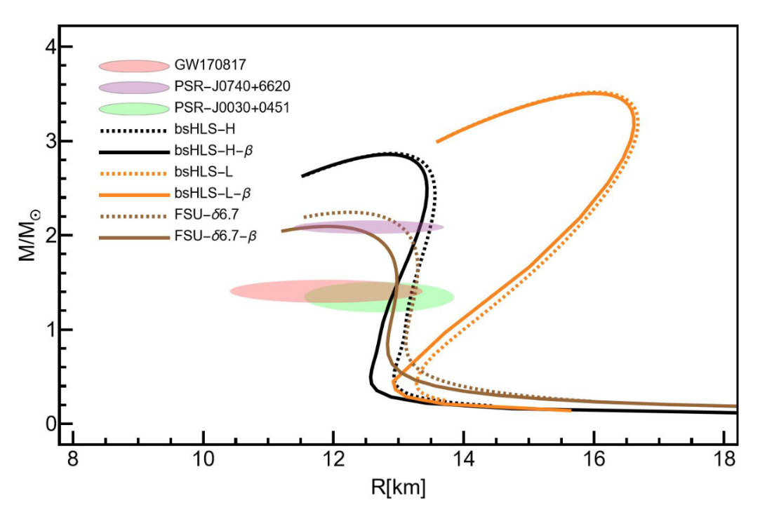
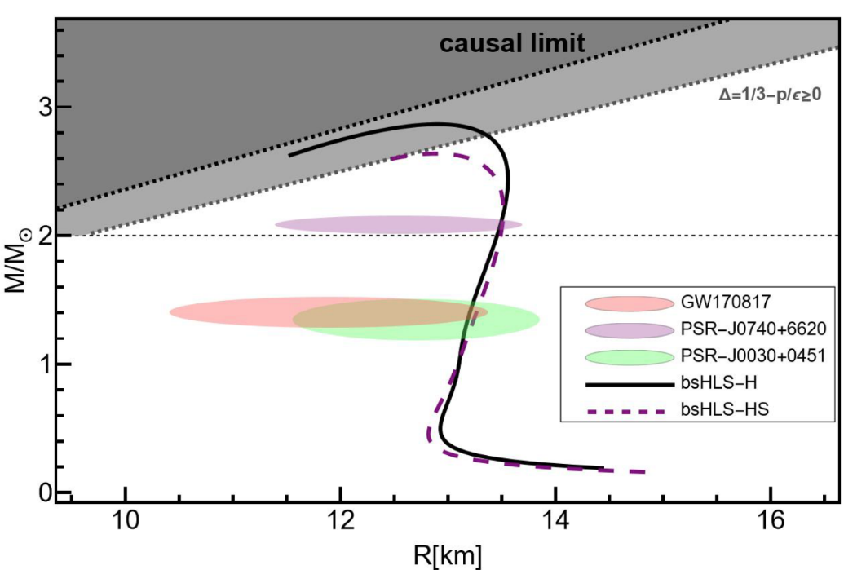
Confront with NS observations

Slide 14
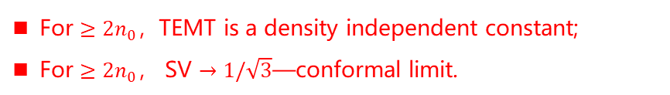
Pseudoconformal structure
Peak due to topology change
Relevant to the core of NS
For $≥2n_{0}$，TEMT is a density independent constant;
For $≥2n_{0}$， SV $→1/\sqrt{3}$—conformal limit.
W. G. Paeng, T. T. S. Kuo, H. K. Lee, YLM, M. Rho, arXiv: 1704.02775.
A feature not observed before.

Slide 15
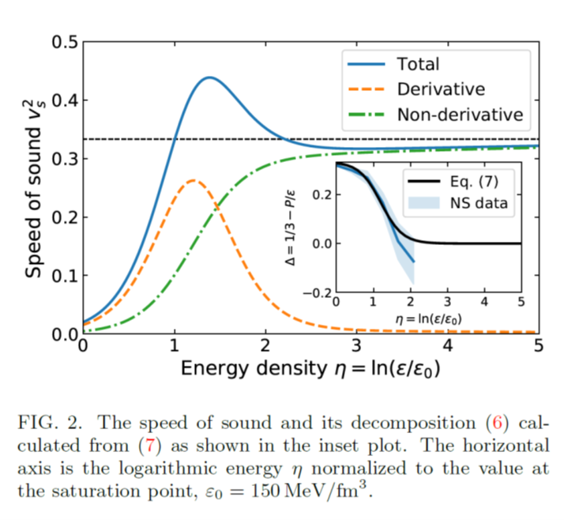
The PCM changed the previous understanding of the EoS：
The model where the sound velocity saturating the conformal limit at asymptotic density, cannot predicted the maximum value of the NS mass satisfying the observation of the massive NSs.
Predicted in more models
Quark-hadron crossover
Quarkyonic matter
Quarkyonic matter
Kapusta & Welle, 2103.16633
Zhao & Lattimer, 2004.08293
Margueron et al, 2103.10209
Fujimoto, et al, 2207.06753

Slide 16
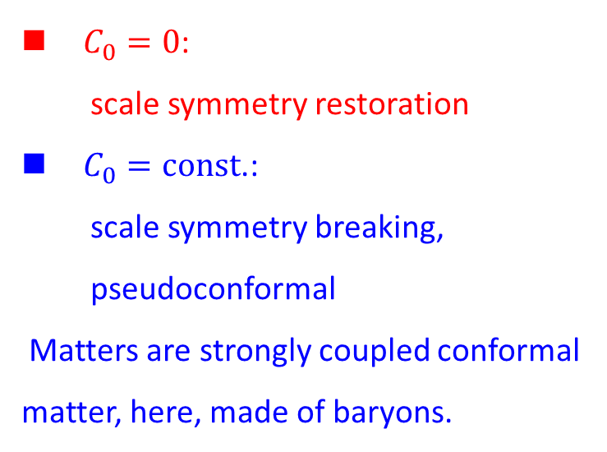
$C_{0}=0$:
scale symmetry restoration
$C_{0}=const$.:
scale symmetry breaking,
pseudoconformal
Matters are strongly coupled conformal matter, here, made of baryons.
YLM & M. Rho, 2006.14173
YLM & W. C. Yang, 2301.02105

Slide 17
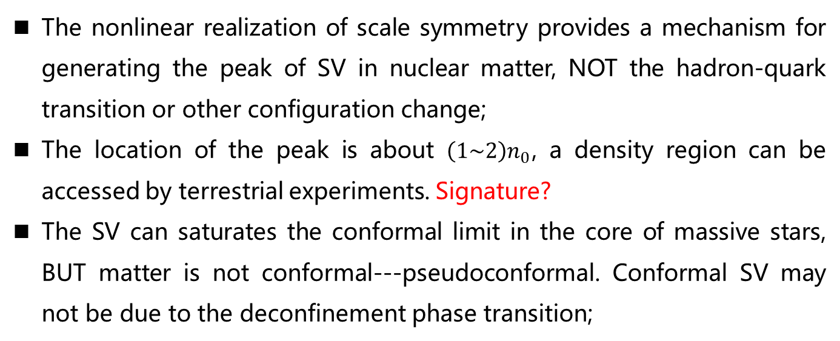
Summary and discussion
The nonlinear realization of scale symmetry provides a mechanism for generating the peak of SV in nuclear matter, NOT the hadron-quark transition or other configuration change;
The location of the peak is about $\left(1\sim 2\right)n_{0}$, a density region can be accessed by terrestrial experiments. Signature?
The SV can saturates the conformal limit in the core of massive stars, BUT matter is not conformal---pseudoconformal. Conformal SV may not be due to the deconfinement phase transition;

Slide 18
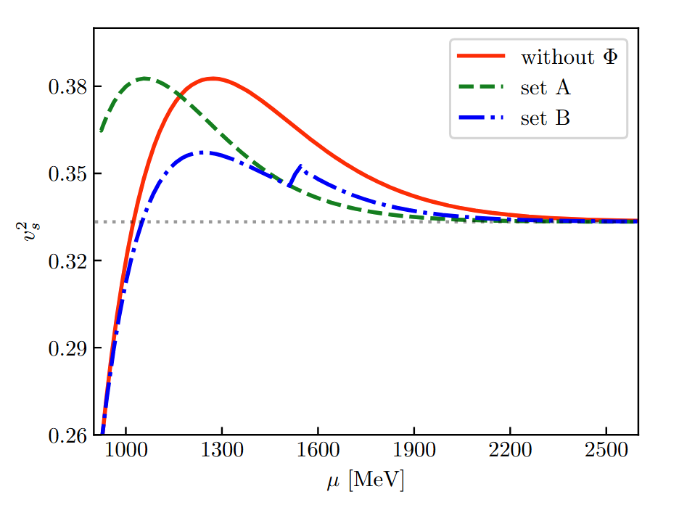
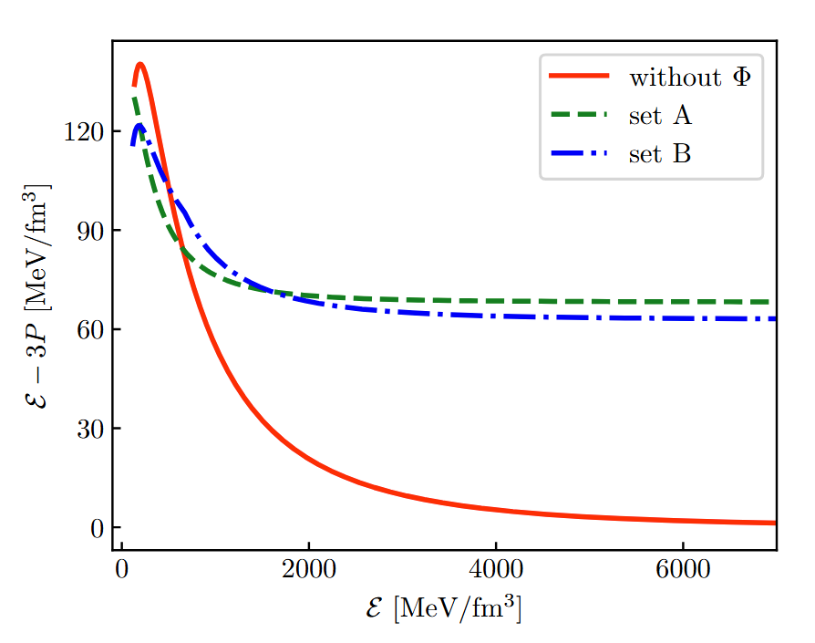
Summary and discussion
Pseudoconformal, also hQCD models (soliton matter);
The predictions of the theory agree with all the observations obtained so far. We cannot distinguish it from other models, but cannot be excluded; Maybe mixing of them?
J. S. Wang, L. K. Yang, et al., 2508.18659

Slide 19
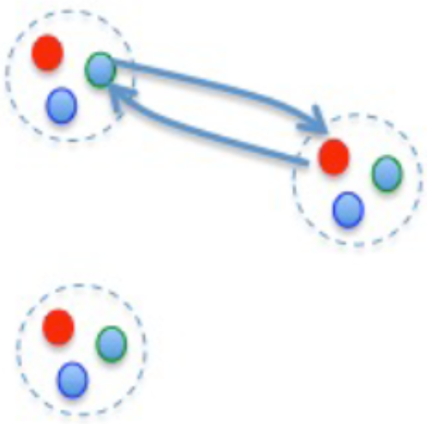
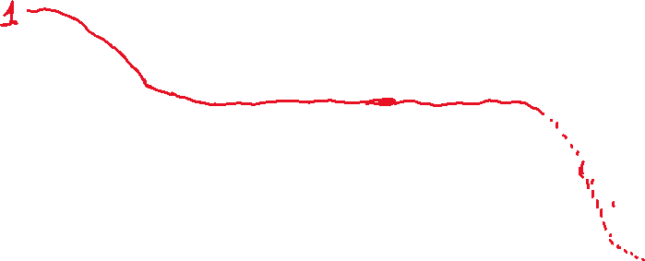


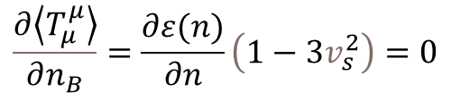

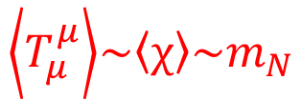

Summary and discussion
G-T transition of heavy nuclei
(YM & M. Rho, 2020)
$$\left\langle T_{μ}^{μ}\right\rangle \sim \left\langle χ\right\rangle \sim m_{N}$$
$${\left\langle T_{μ}^{μ}\right\rangle }^{∗}/\left\langle T_{μ}^{μ}\right\rangle$$
Chiral invariant mass of hadron
Quark matter
pQCD region
Peak of SV
$$\frac{∂\left\langle T_{μ}^{μ}\right\rangle }{∂n_{B}}=\frac{∂ε(n)}{∂n}\left(1−3v_{s}^{2}\right)=0$$
Scale symmetry is hidden. Pseudoconformal
YLM, M. Rho, et al, 15’~22’
$$\sim 2n_{0}$$
$$\sim 10 n_{0}$$
$$\sim 100n_{0}$$
Scale symmetry is broken
Scale invariant.

Slide 20
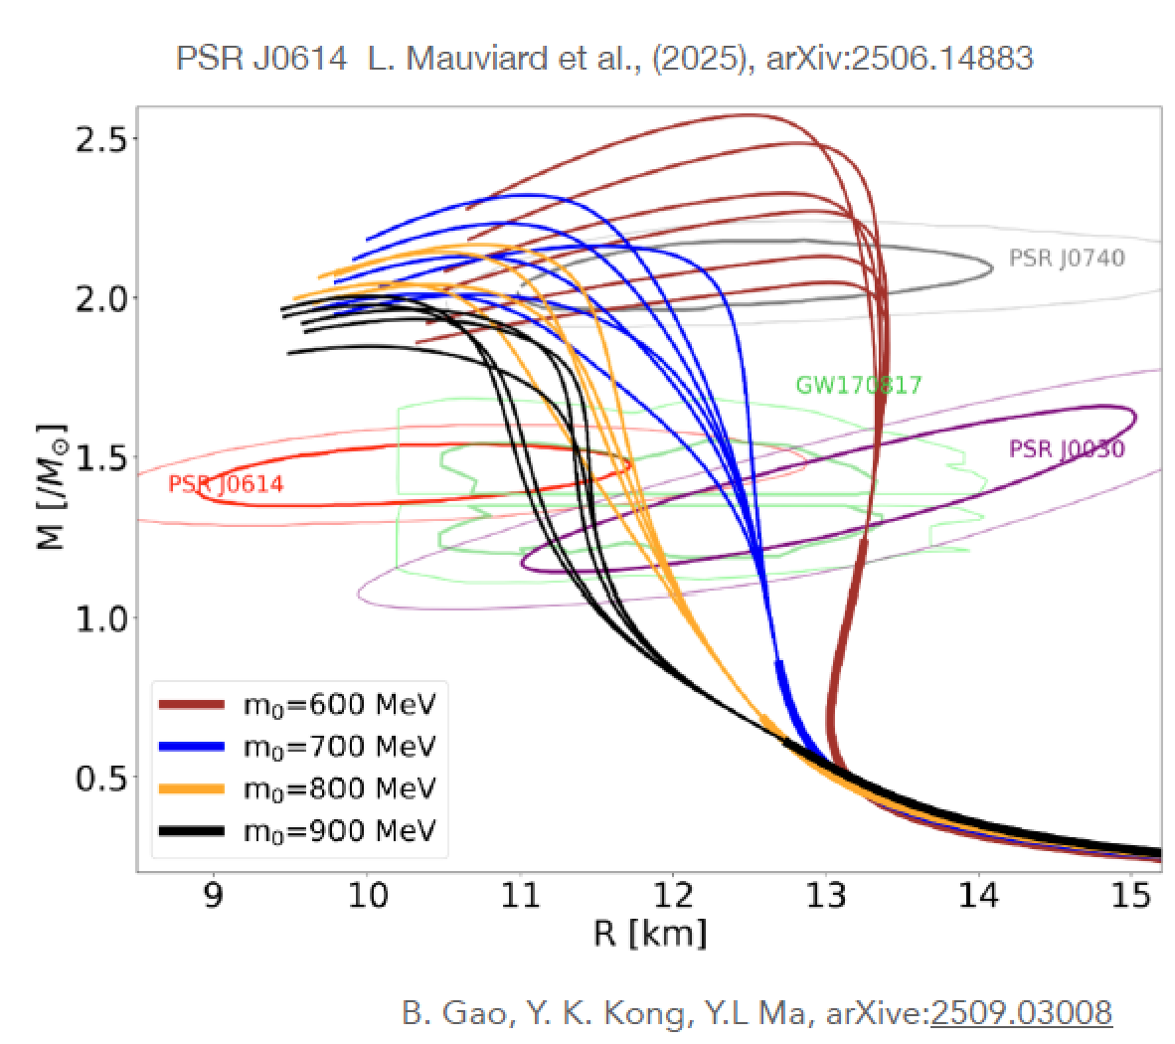
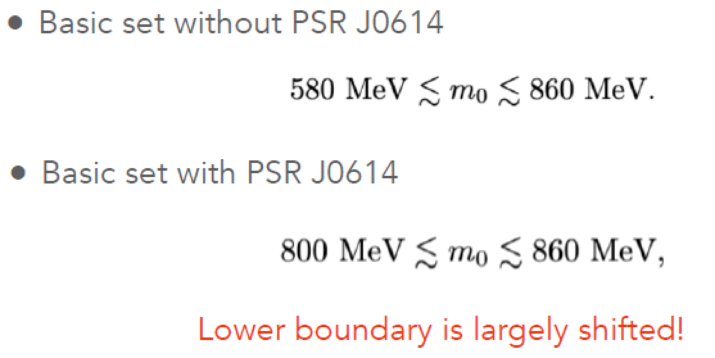

Summary and discussion
Nucleon mass includes a large of chiral invariant component. Gluon/Dilaton condensate.
$$m_{N}= \left\langle N\left|θ_{μ}^{μ}\right|N\right\rangle = \frac{β(α_{s})}{4α_{s}}\left\langle N\left|G^{2}\right|N\right\rangle +\left(1+γ_{m}\left(α_{s}\right)\right)\sum_{q}{m_{q}\left\langle N\left|\overline{q}q\right|N\right\rangle }$$
$= m_{0} + ∆(\left\langle \overline{q}q\right\rangle )$
Origin of nucleon mass:

Slide 21
Acknowledgement:
M. Harada (Nagoya), T. Kuo (Stony Brook), H. K. Lee (Hanyang), Y. L. Li (Jilin), Yao Ma (Nanjing), W. G. Paeng (Hanyang), B. Y. Park (Daejon), M. Rho (Saclay), L. Q. Zhang (Nanjing), ……

Slide 22
Thank you for your attention!

Slide 23
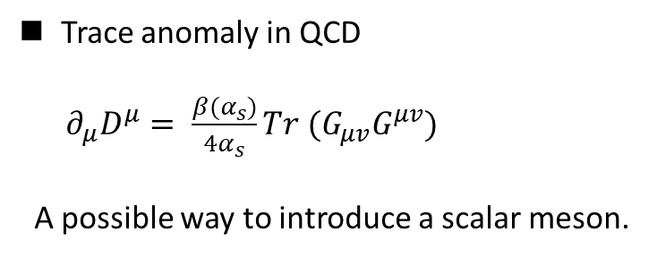
I. Introduction
Trace anomaly in QCD
$∂_{μ}D^{μ}= \frac{β(α_{s})}{4α_{s}}Tr (G_{μv}G^{μv})$
A possible way to introduce a scalar meson.

Slide 24
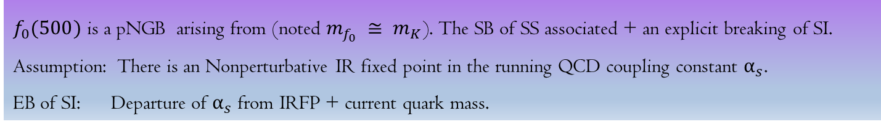
I. Introduction
$f_{0}(500)$ is a pNGB arising from (noted $m_{f_{0}} ≅ m_{K}$). The SB of SS associated + an explicit breaking of SI.
Assumption: There is an Nonperturbative IR fixed point in the running QCD coupling constant $α_{s}$.
EB of SI: Departure of $α_{s}$ from IRFP + current quark mass.
Crewther and Tunstall , PRD91(2015), 034016, e-Print: 1312.3319
Provides an approach to include scalar meson in ChPT.

Slide 25
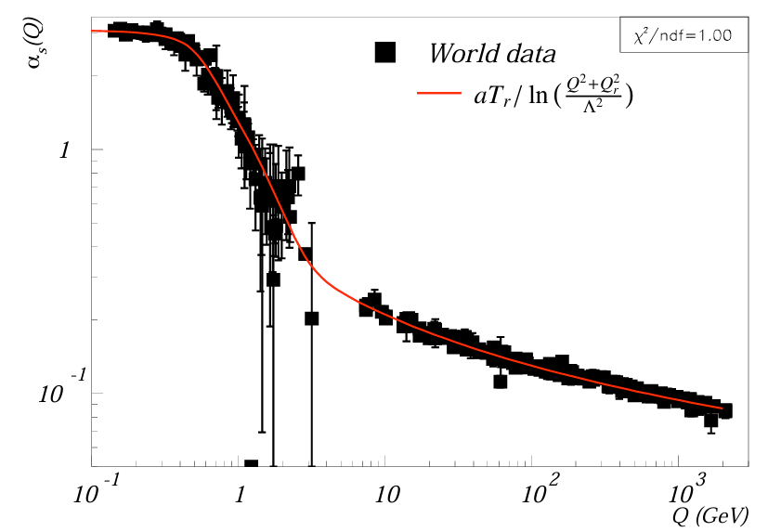
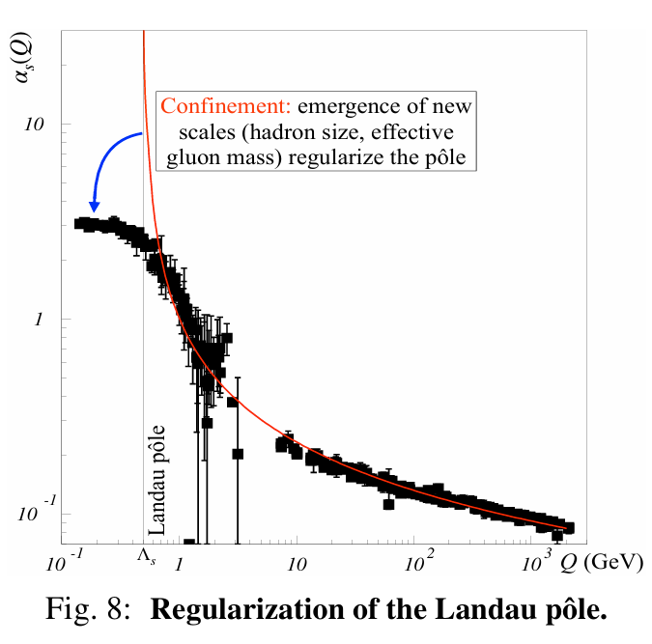
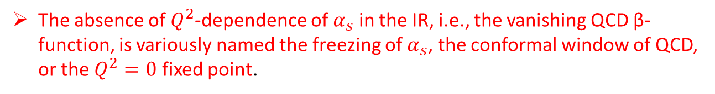
I. Introduction
The QCD Running Coupling, A. Deur, e-Print: 2502.06535 [hep-ph].
The absence of $Q^{2}$-dependence of $α_{s}$ in the IR, i.e., the vanishing QCD β-function, is variously named the freezing of $α_{s}$, the conformal window of QCD, or the $Q^{2}=0$ fixed point.

