Slide 1
Determination of High-Density Symmetry Energy in the Multi-Messenger Era
Zheng Cao(曹政) advisor: Lie-Wen Chen
preliminary result

Slide 2
目录 Contents
1
Nuclear Matter EOS and Symmetry Energy
Constraints in the Multi-Messenger Era
and Bayesian Inference
2
3
Construction of model-indenpent EOS
4
Results

Slide 3
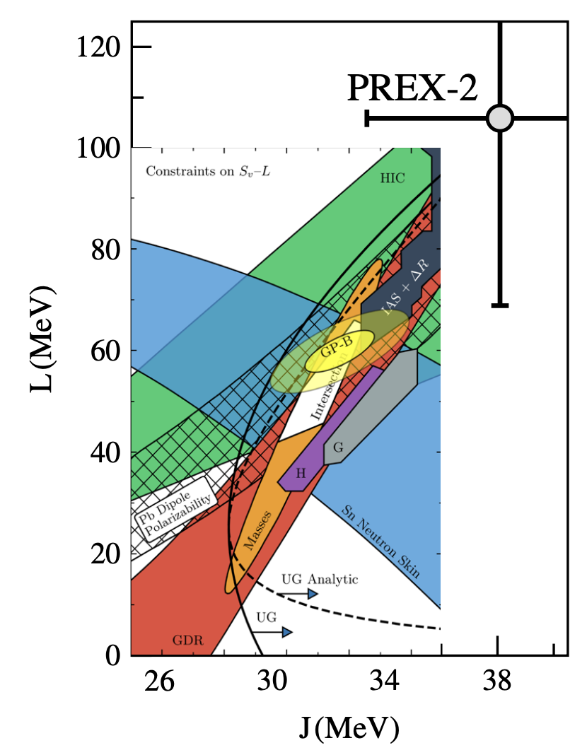
Nuclear Matter EOS and Symmetry Energy
(Parabolic law)
Symmetric Nuclear Matter
(relatively well-determined)
Isospin asymmetry
Symmetry energy term (largely uncertain)
Lead Radius Experiment
N2LO
N3LO
68% C.L.
Theoretical calculation
with different models
Tension between PREX-2 and previews results
S. Huth et al., Nature 606, 276 (2022)
LWC, EPJ Web of Conf. 88, 00017 (2015)
Reed, PRL, 126, 172503 (2021)
Notes:
characterized, isospin asymmetry; approximation;
Current research; vary in； tendency; as the density increases
Besides, Different Experiments； last exp on extracting Esym
nuclear matter parameter; far different from

Slide 4
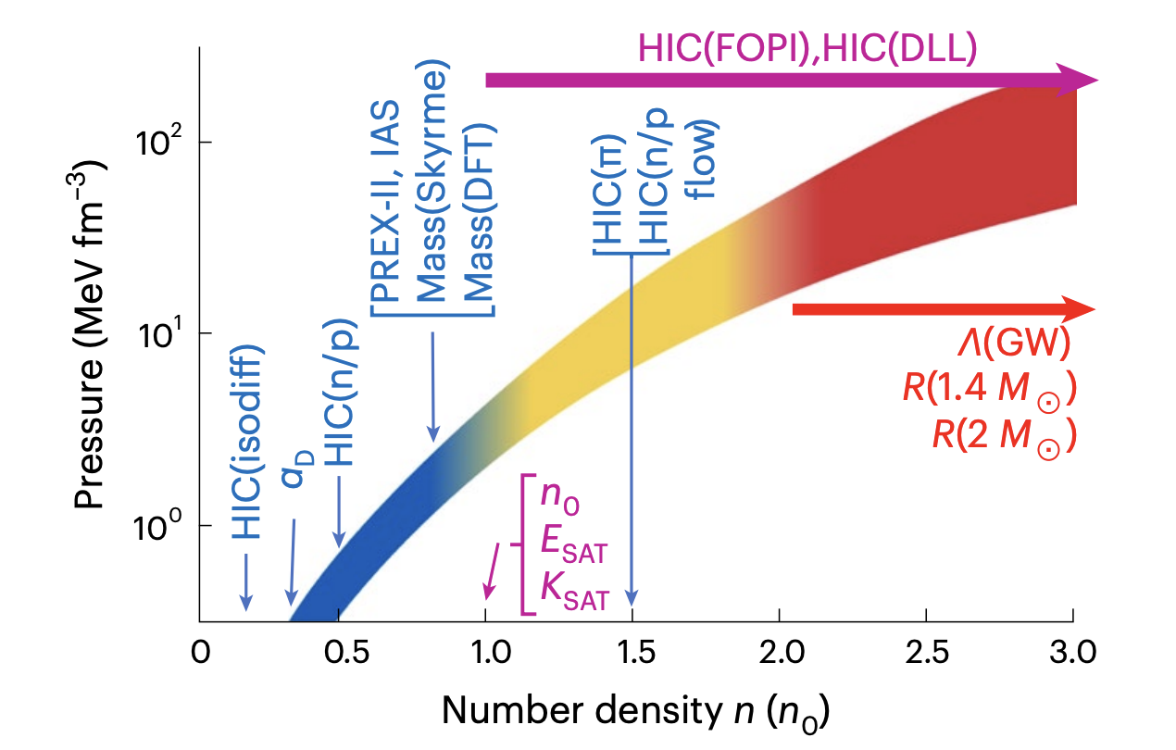
Nuclear Matter EOS and Symmetry Energy
Could we extract Symmetry Energy in a model-independent manner?
Constraints on EOS at different densities
Tsang et al. Nat Ast., 2023

Slide 5
Nuclear Matter EOS and Symmetry Energy
Could we extract Symmetry Energy in a model-independent manner?
Astro observation: neutron star, etc. >3n0, ☺
Constraints on EOS at different densities
Tsang et al. Nat Ast., 2023
Notes:
experimental data；
Look at expression of EOS more carefully；
the sensitive density is

Slide 6
Nuclear Matter EOS and Symmetry Energy
Could we extract Symmetry Energy in a model-independent manner?
Astro observation: neutron star, etc. >3n0, ☺
Symmetric matter constraints:
heavy-ion collisions, etc. >n0, ☺
E(n,0) is stiff based on morden analysis,
see, e.g., Cozma, PRC 110, 064911 (2024)
Constraints on EOS at different densities
Tsang et al. Nat Ast., 2023

Slide 7
Nuclear Matter EOS and Symmetry Energy
Could we extract Symmetry Energy in a model-independent manner?
Astro observation: neutron star, etc. >3n0, ☺
Symmetric matter constraints:
heavy-ion collisions, etc. >n0, ☺
E(n,0) is stiff based on morden analysis,
see, e.g., Cozma, PRC 110, 064911 (2024)
Symmetry energy:
nuclear mass, etc. <n0, ☺
heavy-ion collisions >n0, 😭
Constraints on EOS at different densities
Tsang et al. Nat Ast., 2023

Slide 8
目录 Contents
1
Nuclear Matter EOS and Symmetry Energy
Constraints in the Multi-Messenger Era
and Bayesian Inference
2
3
Construction of model-indenpent EOS
4
Results

Slide 9
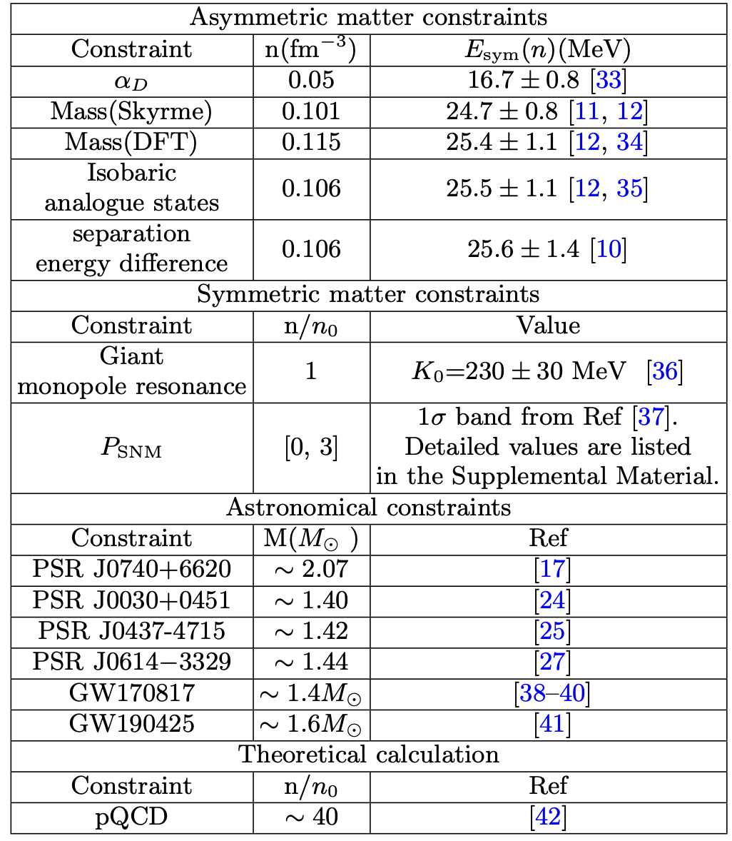

Constraints in the Multi-Messenger Era and Bayesian Inference
Likelihood for different observations
Asymmetric matter constraints
Notes:
After constructing the physics-agnostic EOS, we could combine the reliable data;
4 mass-radius measurements from NICER

Slide 10
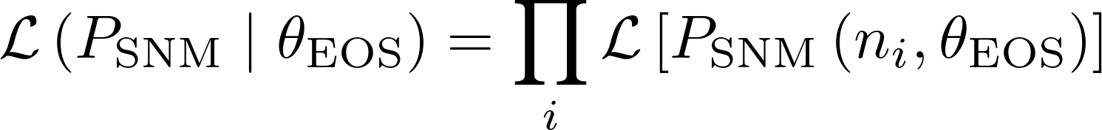
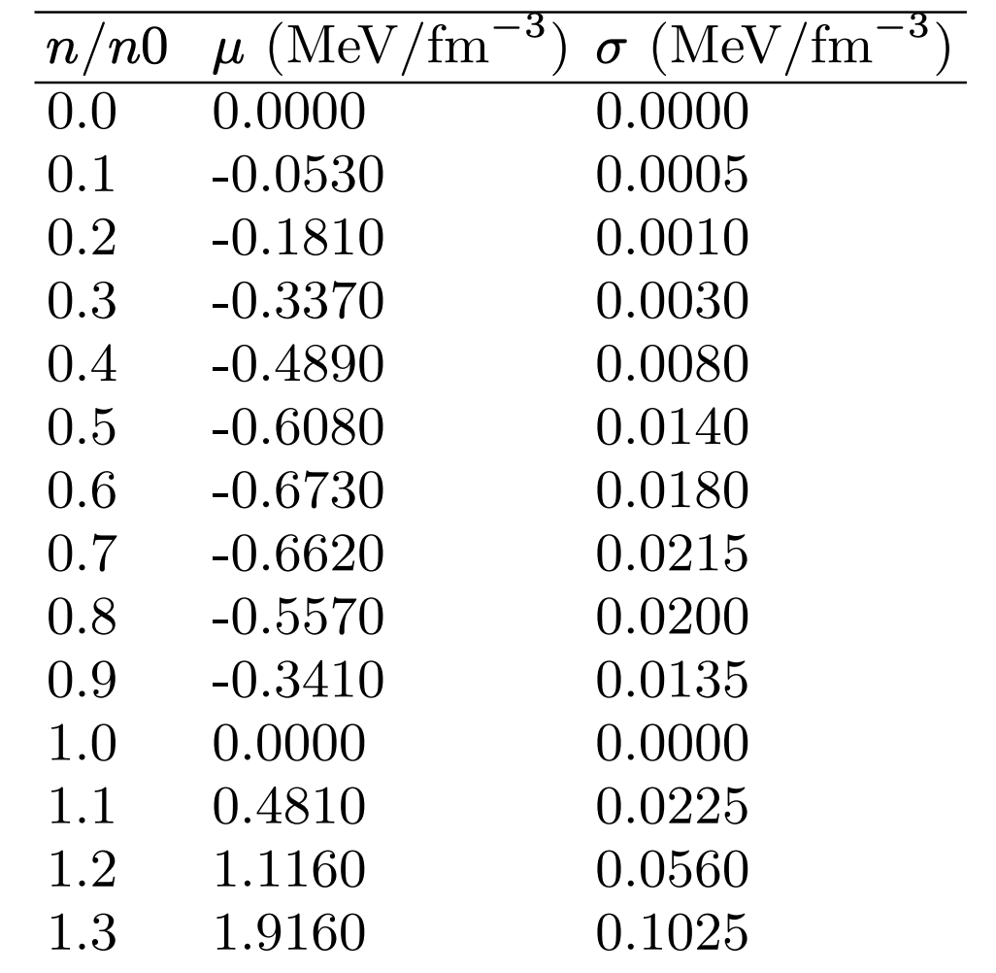
Constraints in the Multi-Messenger Era and Bayesian Inference
Likelihood for different observations
P_{SNM}
Cozma, PRC (2024)
...., up to 3n₀
Notes:
After constructing the physics-agnostic EOS, we could combine the reliable data;
4 mass-radius measurements from NICER

Slide 11
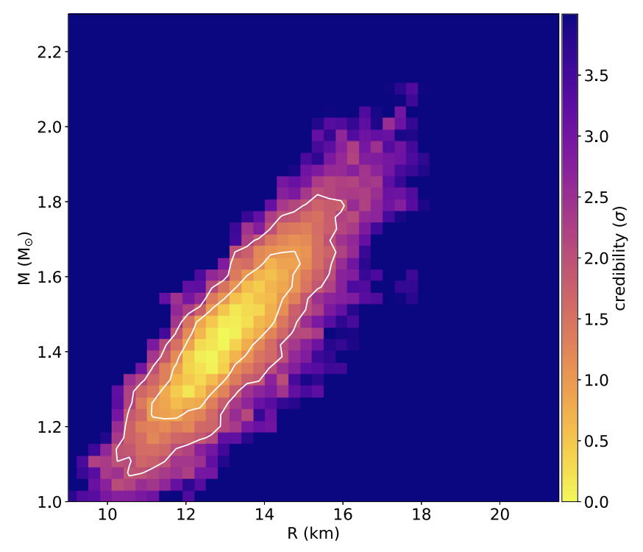
Constraints in the Multi-Messenger Era and Bayesian Inference
Likelihood for different observations
Astronomical constraints
Mass-radius relation
measured by NICER
Posterior samples
are publicly available!
Notes:
After constructing the physics-agnostic EOS, we could combine the reliable data;
4 mass-radius measurements from NICER

Slide 12
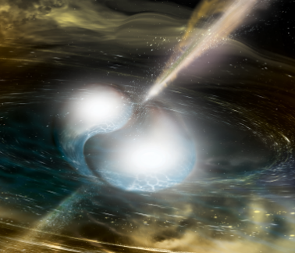
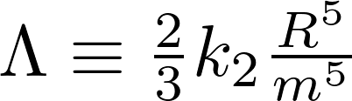
Constraints in the Multi-Messenger Era and Bayesian Inference
Likelihood for different observations
Astronomical constraints
gravitational wave event
Notes:
After constructing the physics-agnostic EOS, we could combine the reliable data;
4 mass-radius measurements from NICER

Slide 13
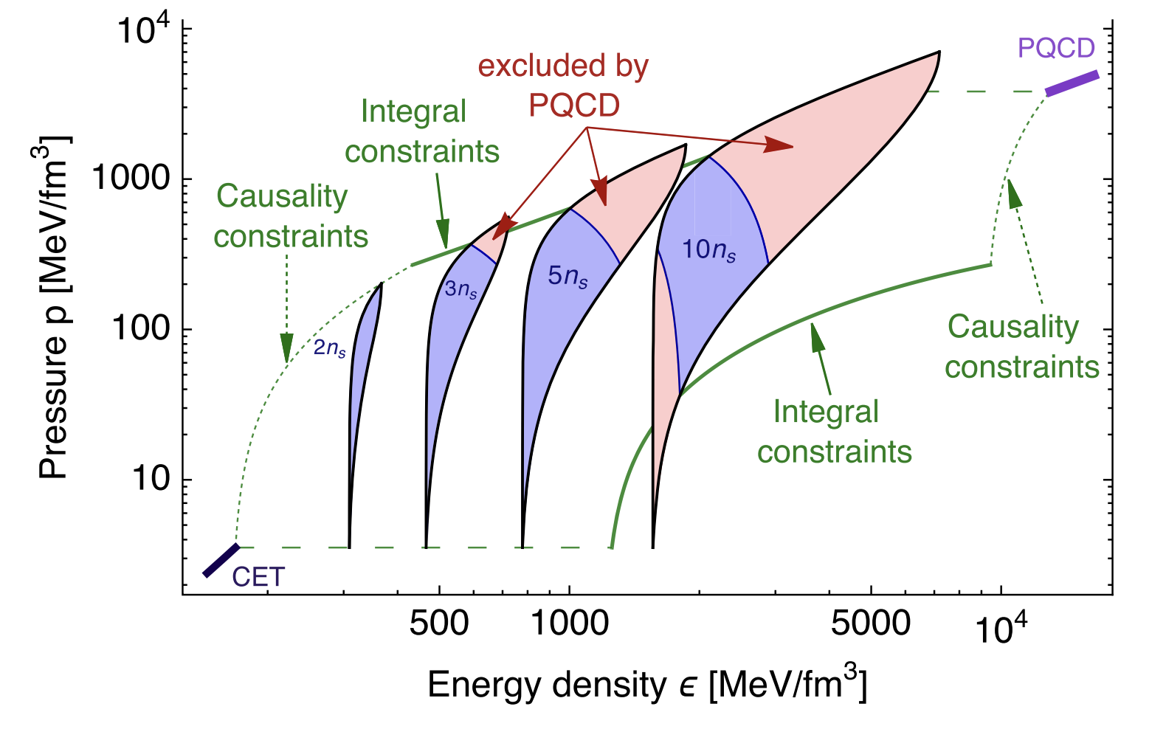
Constraints in the Multi-Messenger Era and Bayesian Inference
Likelihood for different observations
pQCD calculation
Komoltsev et al., 2022
EOS is constrained at intermediate density
once properties at two limits are fixed!
Notes:
After constructing the physics-agnostic EOS, we could combine the reliable data;
4 mass-radius measurements from NICER

Slide 14
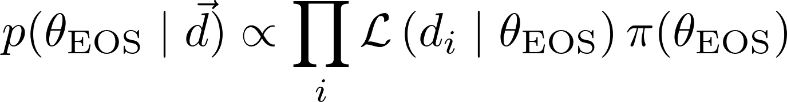
Constraints in the
Multi-Messenger Era
Different observations are indenpendent
Bayes' theorem
Notes:
After constructing the physics-agnostic EOS, we could combine the reliable data;
4 mass-radius measurements from NICER

Slide 15
目录 Contents
1
Nuclear Matter EOS and Symmetry Energy
Constraints in the Multi-Messenger Era
and Bayesian Inference
2
3
Construction of model-indenpent EOS
4
Results

Slide 16
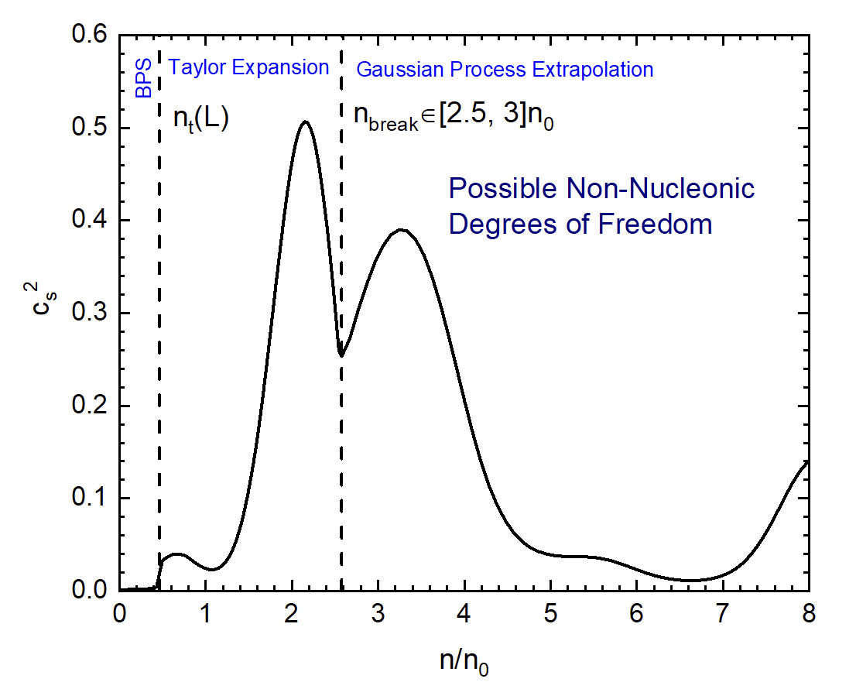
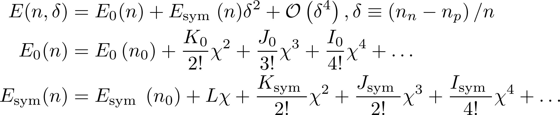
Construction of model-indenpent EOS
Demo of physics-agnostic EOS
Below n_{break}: Taylor Expansion + BPS crust
Notes:
Fristly, we should construct a physics-agnostic EOS

Slide 17
Construction of model-indenpent EOS
Demo of physics-agnostic EOS
Below n_{break}: Taylor Expansion + BPS crust
The EOS below n_{break} is uniquely determined
by the expansion parameter!
nuclear matter in beta-equilibrium:
Transition density

Slide 18


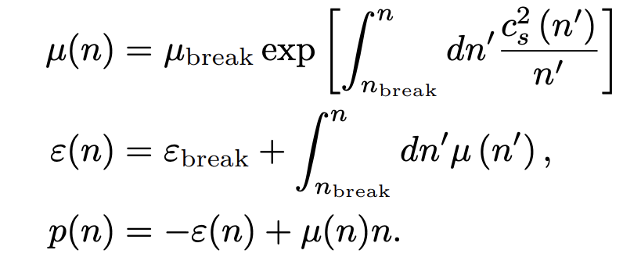
Construction of model-indenpent EOS
Demo of physics-agnostic EOS
Above n_{break}: Gaussian Process Extrapolation
Parameterizing the speed of sound in beta-equilibrium dense matter
Gorda et al. APJ (2023)
auxiliary variable
Notes:
Extrapolate;ɪkˈstræpəleɪ； ɔːɡˈzɪliəri

Slide 19
目录 Contents
1
Nuclear Matter EOS and Symmetry Energy
Constraints in the Multi-Messenger Era
and Bayesian Inference
2
3
Construction of model-indenpent EOS
4
Results

Slide 20
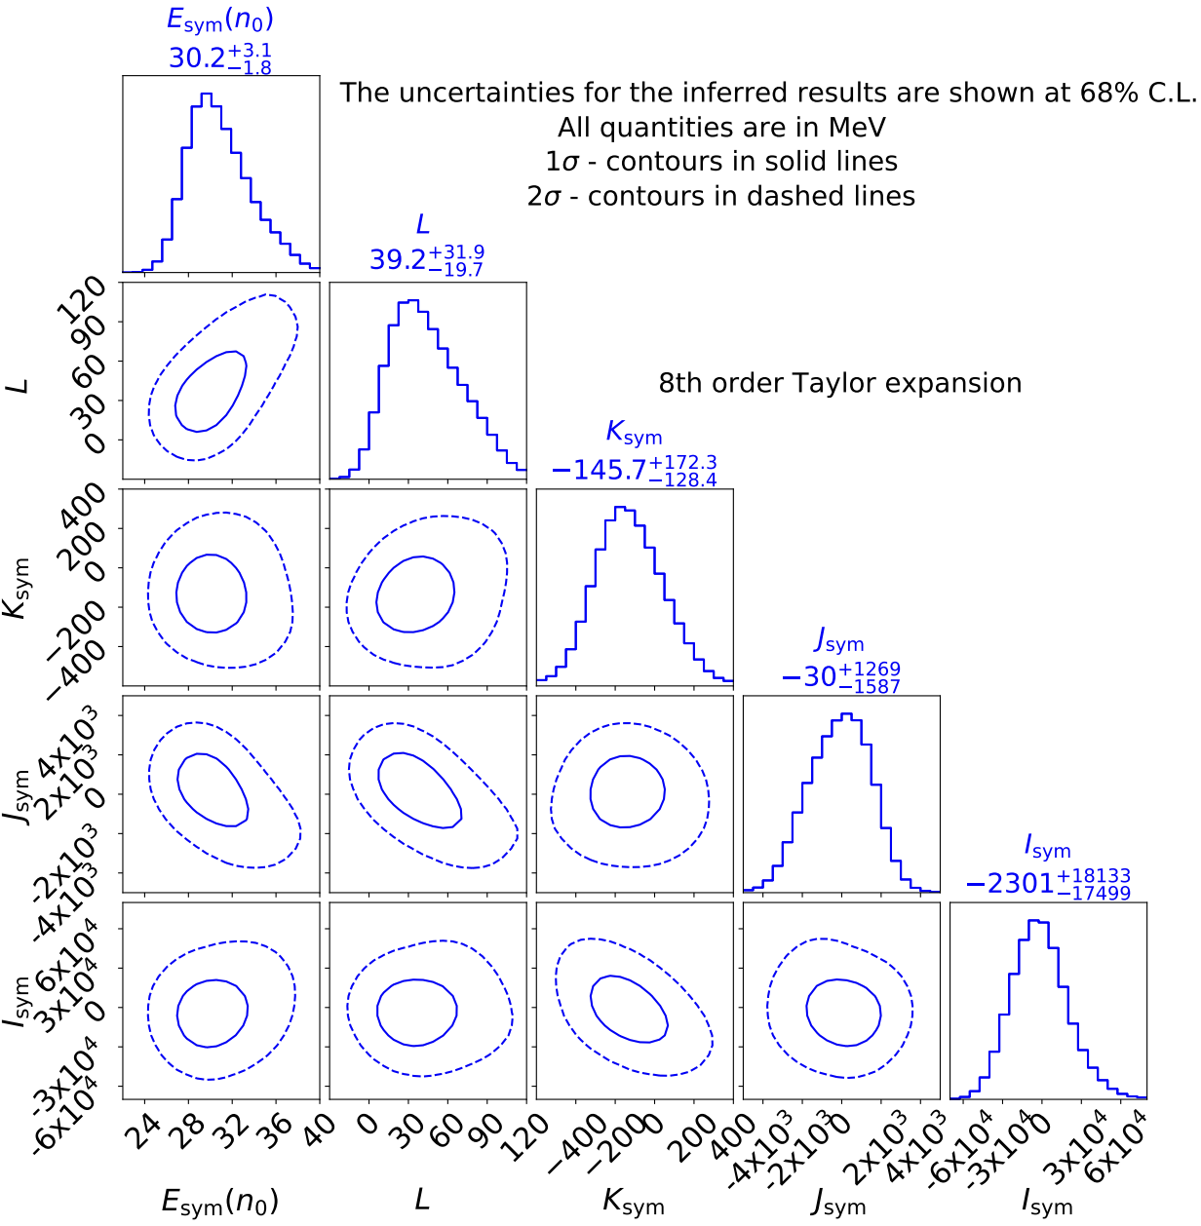
Results
High-Density Symmetry Energy
1. Slope parameter L~40MeV
Notes:
parameter of sym energy;
all of them have a peak; stiffen

Slide 21
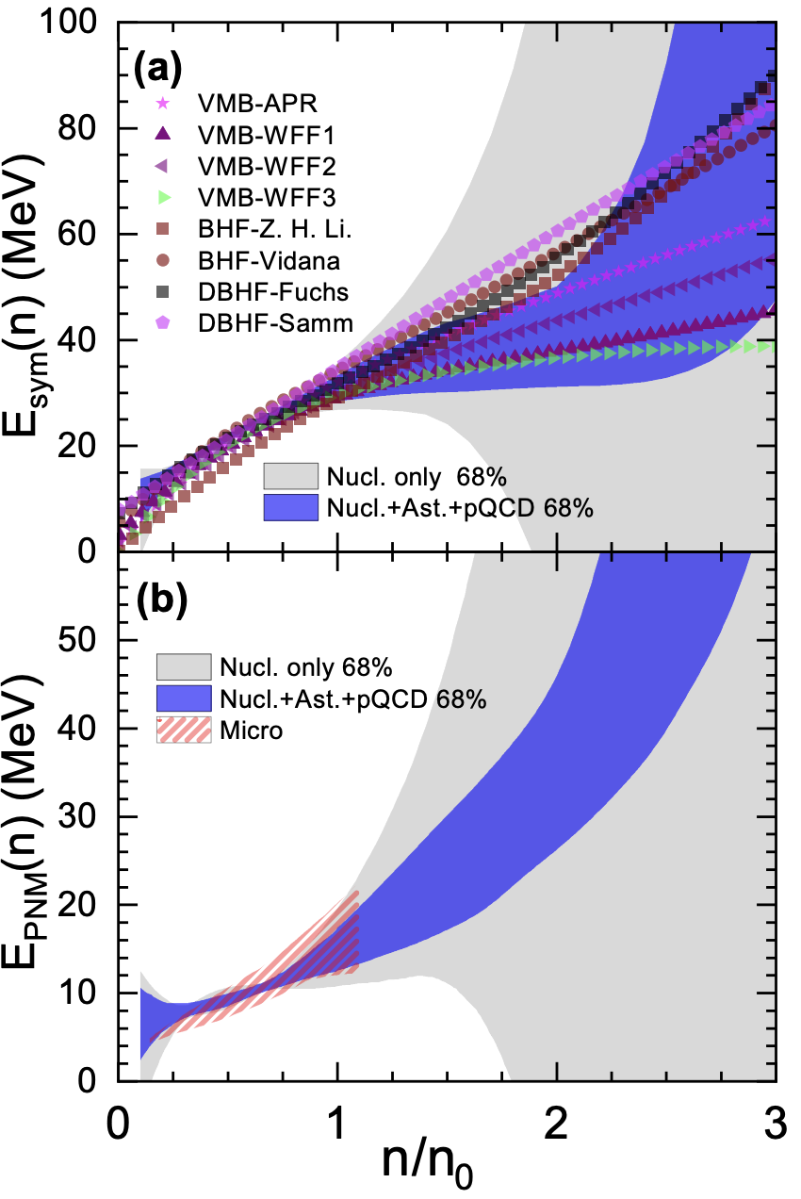
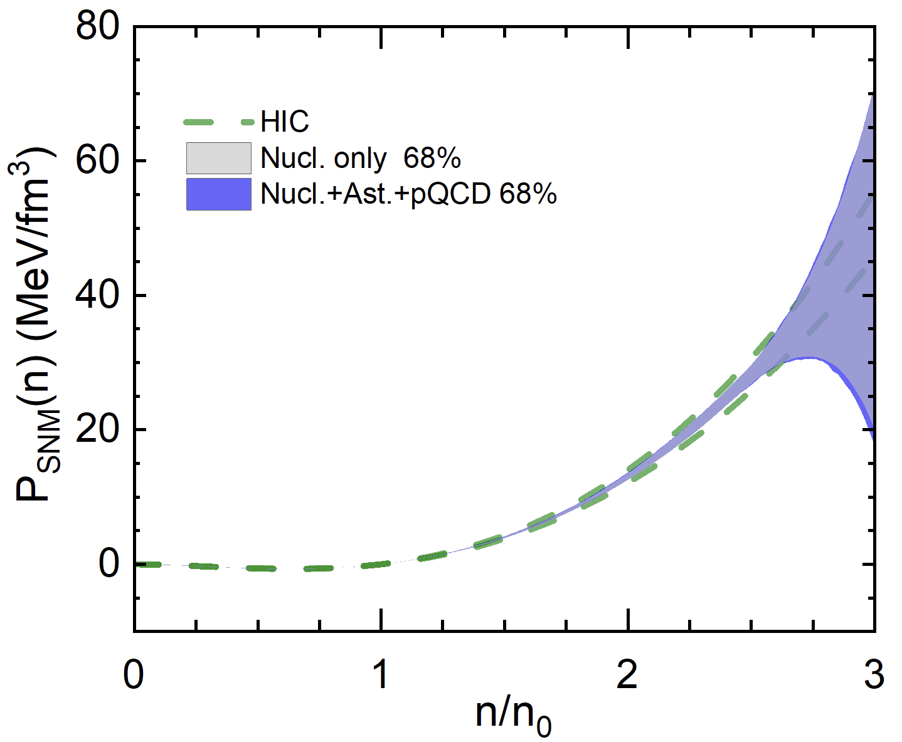
Results
High-Density Symmetry Energy
1. Slope parameter L~40MeV
2. Due to the EOS of symmetric nuclear matter is sitff,
Symmetry energy is soft at
intermediate densities (~ [1, 2]n₀)
3. Energy of pure neutron matter(PNM) is consistent with microscopic calculations.
Notes:
parameter of sym energy;
all of them have a peak; stiffen

Slide 22
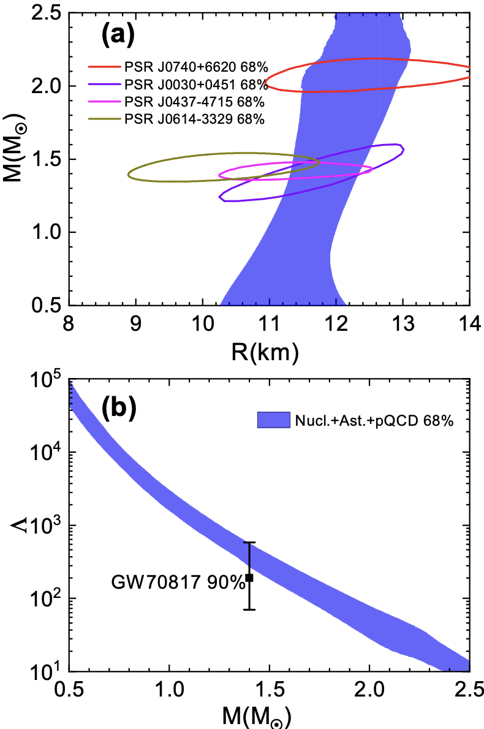
Results
Astronomical implications
1.
Notes:
1. extract the radius and Tidal information of NS
2. Besides, our results have an import implication on eka process
3. eka : role in NS coolling.
4. Our results show that this Threshold is larger 1.5 solar mass
5.We note that this value is first extracted in a model-indenpent manner.

Slide 23
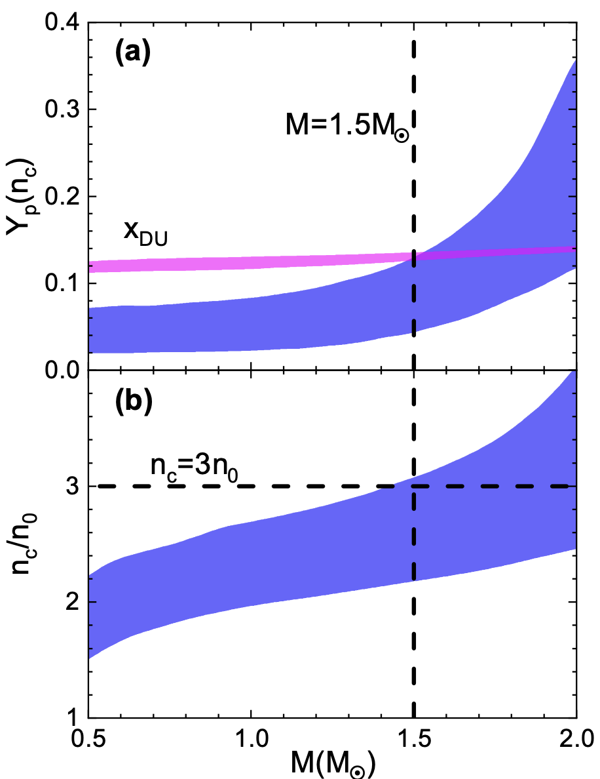

Results
Astronomical implications
1.
2. Direct Urca(DU) Process:
Neutron star Cooling
Yp: Proton Fraction
x_{DU}: Threshold of DU Process
Modern Astro Observations:
M_{DU}>1~1.5 M_{sun}
Our Results: M_{DU}>1.5M☉
Notes:
1. extract the radius and Tidal information of NS
2. Besides, our results have an import implication on eka process
3. eka : role in NS coolling.
4. Our results show that this Threshold is larger 1.5 solar mass
5.We note that this value is first extracted in a model-indenpent manner.

Slide 24
Summary
Based on:
(1) low-density nuclear structure data
(2) intermediate-density heavy-ion collision results on symmetric nuclear matter
(3) multi-messenger astrophysical observations
(4) pQCD calculations from ultra high-density
We find that:
(1) Symmetry energy is soft at intermediate densities (~ [1, 2]n₀)
(2) The threshold mass for the direct Urca process is larger than ~1.5 M☉.
Thanks！

