Slide 1

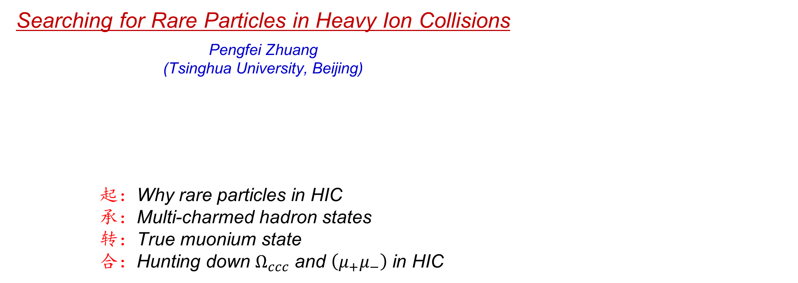
Searching for Rare Particles in Heavy Ion Collisions
Pengfei Zhuang (Tsinghua University, Beijing)
起：Why rare particles in HIC
承：Multi-charmed hadron states
转：True muonium state
合：Hunting down $Ω_{ccc}$ and $\left(μ_{+}μ_{−}\right)$ in HIC
Pengfei Zhuang, Workshop on QCD phases, Dalian, 20251008-11 1

Slide 2
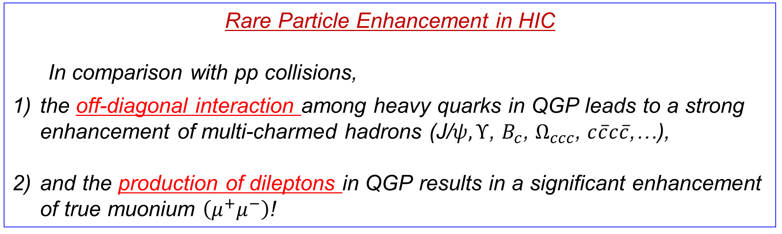
Rare Particle Enhancement in HIC
In comparison with pp collisions,
the off-diagonal interaction among heavy quarks in QGP leads to a strong enhancement of multi-charmed hadrons (J/$ψ, Υ$, $B_{c}$, $Ω_{ccc}$, $c\overline{c}c\overline{c}$,…),
and the production of dileptons in QGP results in a significant enhancement of true muonium $\left(μ^{+}μ^{−}\right)$!
Pengfei Zhuang, Workshop on QCD phases, Dalian, 20251008-11 2

Slide 3
1. $Ω_{CCC}, B_{C}, c\overline{c}c\overline{c}$ in HIC
Pengfei Zhuang, Workshop on QCD phases, Dalian, 20251008-11 3

Slide 4
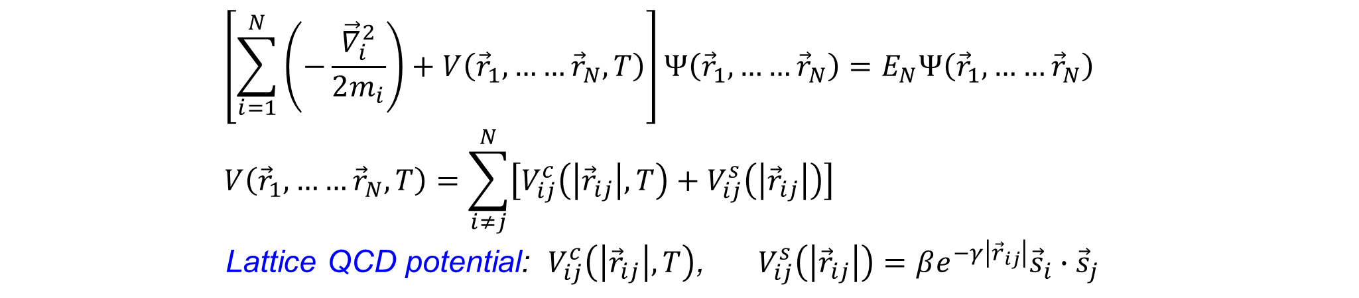

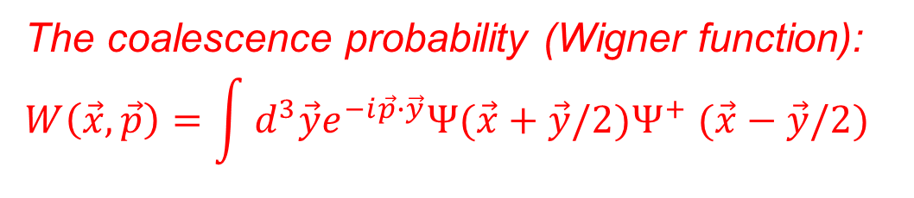
N-body Schroedinger + Coalescence
$$\frac{dn}{d^{3}\vec{p}}=C\int_{Σ}{\frac{p^{μ}dσ_{μ}}{{\left(2π\right)}^{3}}\int{\frac{d^{N−1}\vec{x}d^{N−1}\vec{y}}{{\left(2π\right)}^{3N}}W\left(\vec{x},\vec{p}\right)}f_{q}\left({\vec{x}}_{1},{\vec{p}}_{1}\right)……f_{q}\left({\vec{x}}_{N},{\vec{p}}_{N}\right)}$$
The coalescence region is determined The heavy quark distribution is controlled by
by hydrodynamics a transport equation or simply an equilibrium
distribution
H.He, Y.Liu and PZ, PLB746, 59(2015)
$$\left[\sum_{i=1}^{N}{\left(−\frac{{\vec{∇}}_{i}^{2}}{2m_{i}}\right)+V\left({\vec{r}}_{1},……{\vec{r}}_{N},T\right)}\right]Ψ\left({\vec{r}}_{1},……{\vec{r}}_{N}\right)=E_{N}Ψ\left({\vec{r}}_{1},……{\vec{r}}_{N}\right)$$
$$V\left({\vec{r}}_{1},……{\vec{r}}_{N},T\right)=\sum_{i≠j}^{N}{\left[V_{ij}^{c}\left(\left|{\vec{r}}_{ij}\right|,T\right)+V_{ij}^{s}\left(\left|{\vec{r}}_{ij}\right|\right)\right]}$$
Lattice QCD potential: $V_{ij}^{c}\left(\left|{\vec{r}}_{ij}\right|,T\right)$, $V_{ij}^{s}\left(\left|{\vec{r}}_{ij}\right|\right)=βe^{−γ\left|{\vec{r}}_{ij}\right|}{\vec{s}}_{i}∙{\vec{s}}_{j}$
The coalescence probability (Wigner function):
$$W\left(\vec{x},\vec{p}\right)=\int{d^{3}\vec{y}e^{−i\vec{p}∙\vec{y}}Ψ(\vec{x}+\vec{y}/2)Ψ^{+} (\vec{x}−\vec{y}/2) }$$
Pengfei Zhuang, Workshop on QCD phases, Dalian, 20251008-11 4

Slide 5

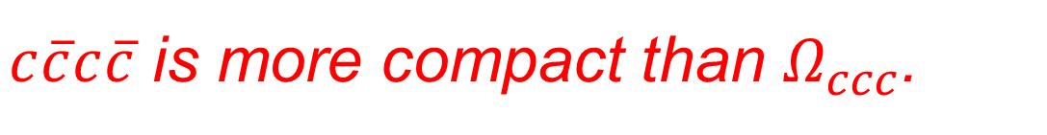

Wave Functions
$$Ω_{ccc}$$
$$cc\overline{c}\overline{c}$$
J.Zhao, H.He and PZ, PLB771, 349(2017)
$c\overline{c}c\overline{c}$ is more compact than $Ω_{ccc}$.
J.Zhao, S.Shi and PZ, PRD102, 114001 (2020)
Pengfei Zhuang, Workshop on QCD phases, Dalian, 20251008-11 5

Slide 6

$QQ\overline{Q}\overline{Q}$ in Vacuum
J.Zhao, S.Shi and PZ, PRD102, 114001 (2020)
LHCb Collaboration, Science Bulletin 65, 1983(2020)
Pengfei Zhuang, Workshop on QCD phases, Dalian, 20251008-11 6

Slide 7

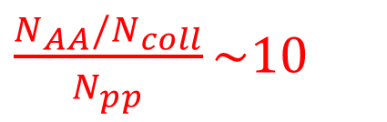
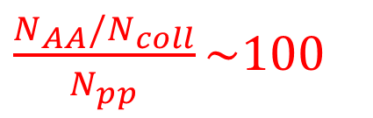



Wigner Functions
$$Ω_{ccc}$$
$$→$$
$\frac{N_{AA}/N_{coll}}{N_{pp}}\sim 100$
J.Zhao and PZ, PLB775, 84(2017)
$$cc\overline{c}\overline{c}$$
$$→$$
$\frac{N_{AA}/N_{coll}}{N_{pp}}\sim 10$
Off-diagonal interactions !
J.Zhao, S.Shi and PZ, PRD102, 114001 (2020)
Pengfei Zhuang, Workshop on QCD phases, Dalian, 20251008-11 7

Slide 8
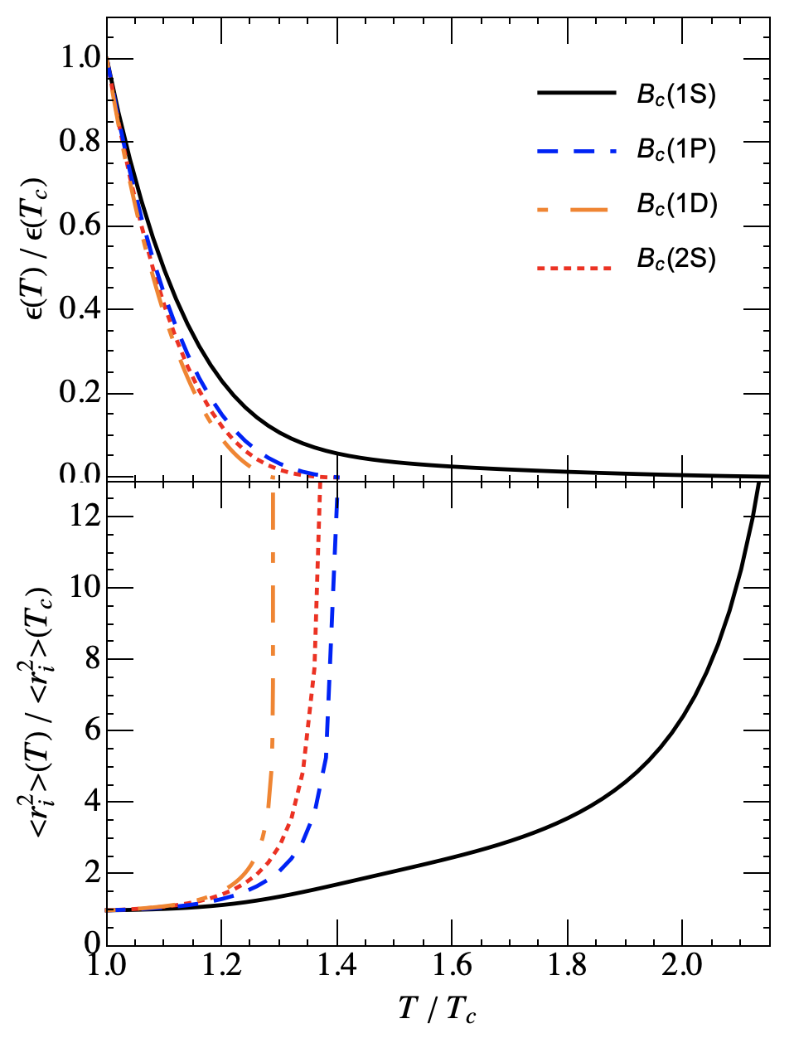
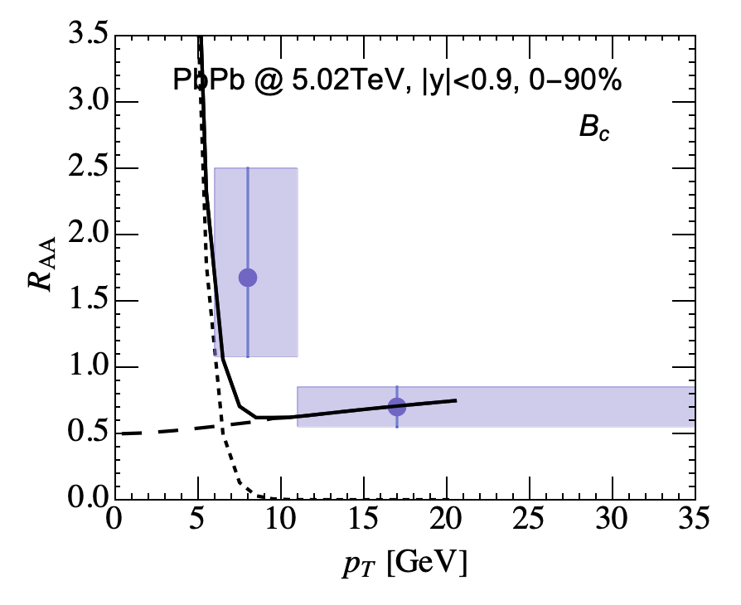
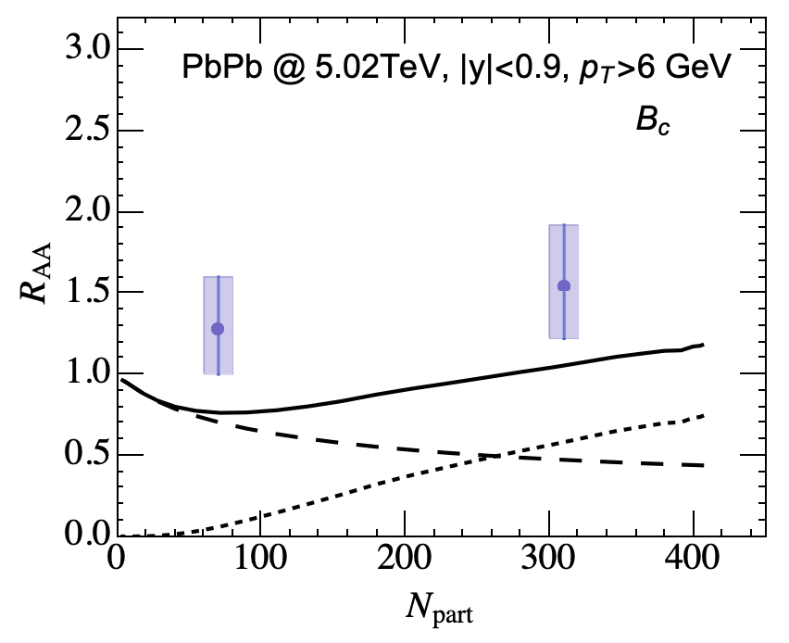
$$B_{c}$$
J.Zhao and PZ, Eur.Phys.J.A61, 41(2025)
see also L.Zhang, X.Li, W.Xing, S.Cao and G.Qin, Phys.Rev.C111, 5(2025)
Pengfei Zhuang, Workshop on QCD phases, Dalian, 20251008-11 8

Slide 9
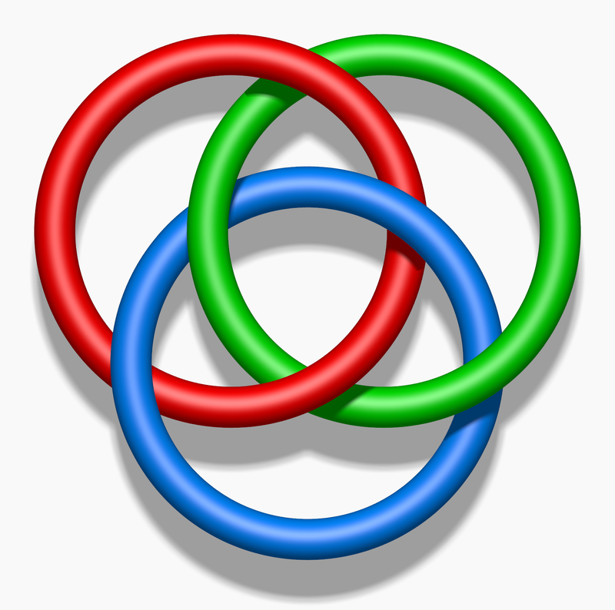
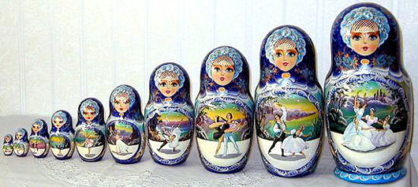
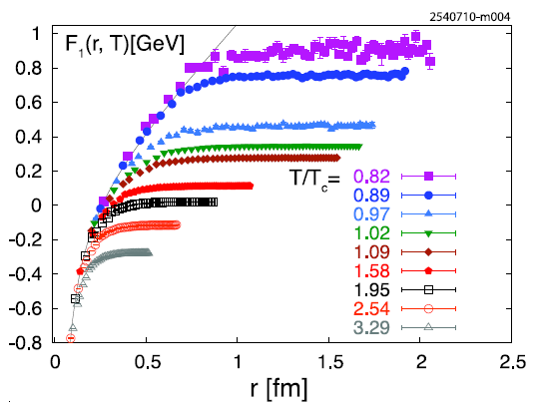
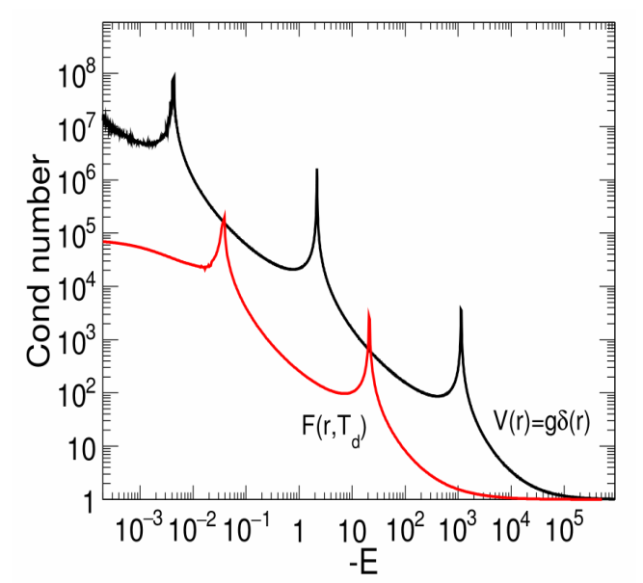

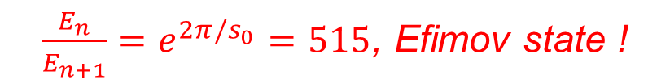
$Ω_{ccc}$ as a Borromean Ring and an Efimov State
J.Zhao and PZ, PLB775,84(2017)
Question: Is it possible to realize Efimov state at quark level?
Answer: In vacuum, no, because of the long range interaction.
At finite temperature, probably yes, due to the screened quark potential.
short range potential at high T !
$\frac{E_{n}}{E_{n+1}}=e^{2π/s_{0}}=515$, Efimov state !
Pengfei Zhuang, Workshop on QCD phases, Dalian, 20251008-11 9

Slide 10
2. True Muonium$(μ^{+}μ^{−})$ $\left[n^{3}S_{1}\right]$ in HIC
Y.Chen and PZ, 1204.4389 Z.Liang, Q.Yang, H.Zhang, J.Zhao and PZ, 2505.10070
Pengfei Zhuang, Workshop on QCD phases, Dalian, 20251008-11 10

Slide 11
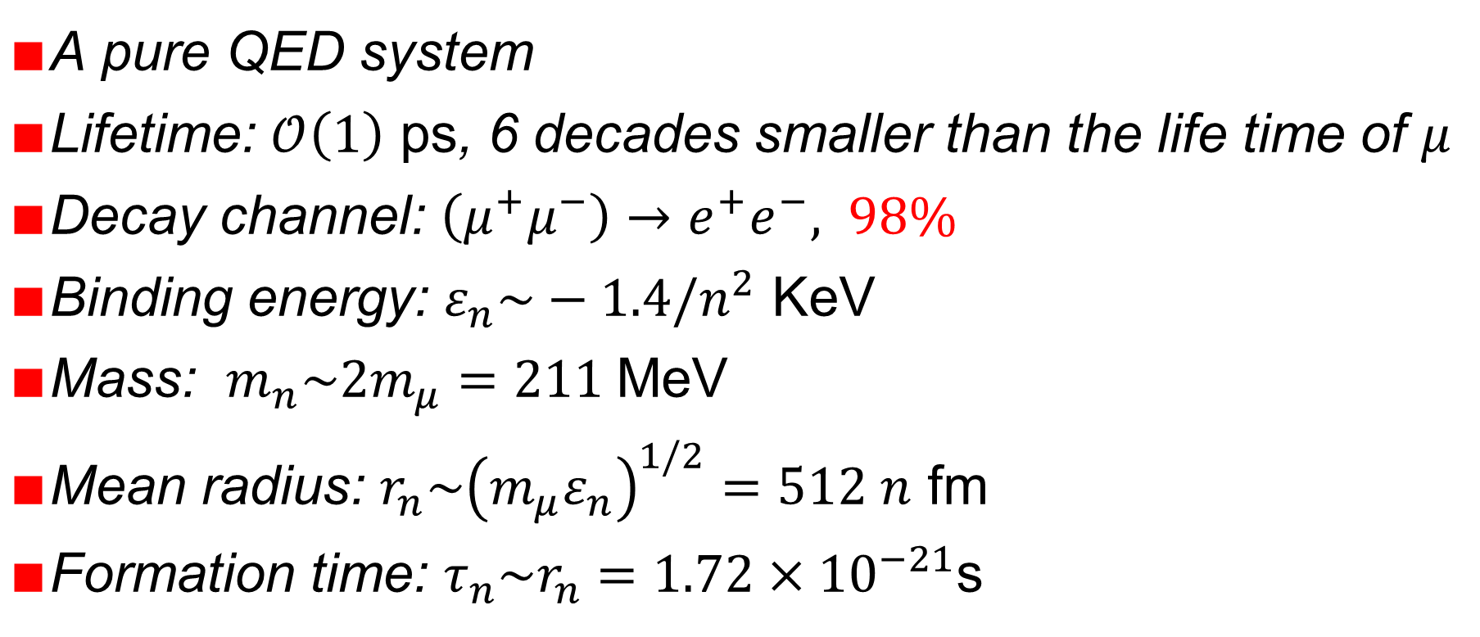
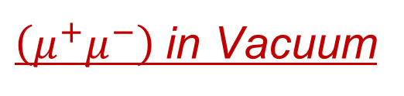
$\left(μ^{+}μ^{−}\right)$in Vacuum
$∎$A pure QED system
$∎$Lifetime: $𝒪\left(1\right)$ ps, 6 decades smaller than the life time of $μ$
$∎$Decay channel: $\left(μ^{+}μ^{−}\right)→e^{+}e^{−}, 98\%$
$∎$Binding energy: $ε_{n}\sim −1.4/n^{2}$ KeV
$∎$Mass: $m_{n}\sim 2m_{μ}=211$MeV
$∎$Mean radius: $r_{n}\sim {\left(m_{μ}ε_{n}\right)}^{1/2}=512 n$ fm
$∎$Formation time: $τ_{n}\sim r_{n}=1.72×{10}^{−21}$s
Pengfei Zhuang, Workshop on QCD phases, Dalian, 20251008-11 11

Slide 12
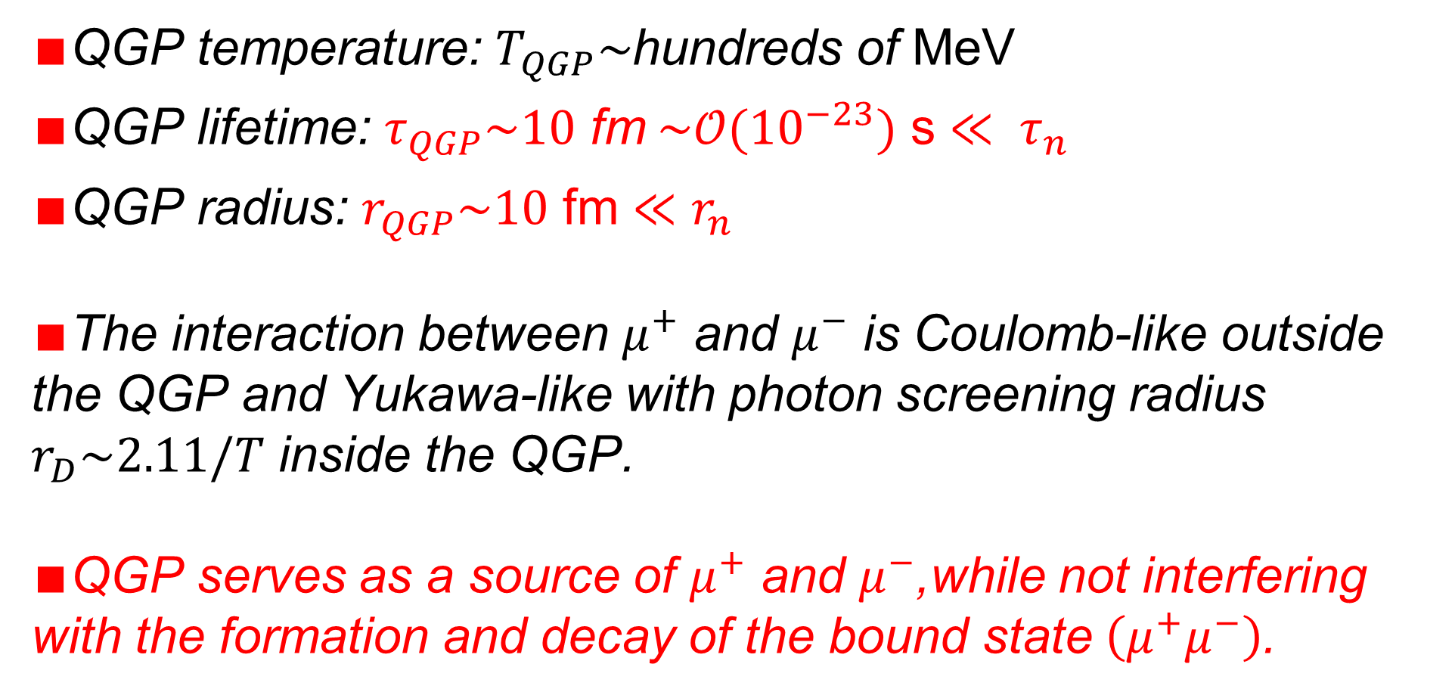
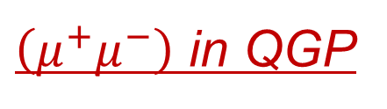
$\left(μ^{+}μ^{−}\right)$ in QGP
$∎$QGP temperature: $T_{QGP}\sim$hundreds of MeV
$∎$QGP lifetime: $τ_{QGP}\sim 10$ fm$\sim 𝒪({10}^{−23})$ s $≪ τ_{n}$
$∎$QGP radius: $r_{QGP}\sim 10$ fm $≪r_{n}$
$∎$The interaction between $μ^{+}$ and $μ^{−}$ is Coulomb-like outside the QGP and Yukawa-like with photon screening radius $r_{D}\sim 2.11/T$ inside the QGP.
$∎$QGP serves as a source of $μ^{+}$ and $μ^{−}$,while not interfering with the formation and decay of the bound state $\left(μ^{+}μ^{−}\right)$.
Pengfei Zhuang, Workshop on QCD phases, Dalian, 20251008-11 12

Slide 13
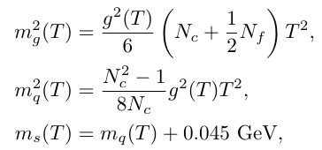
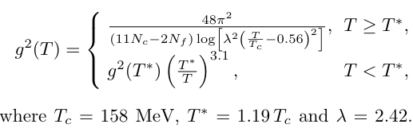
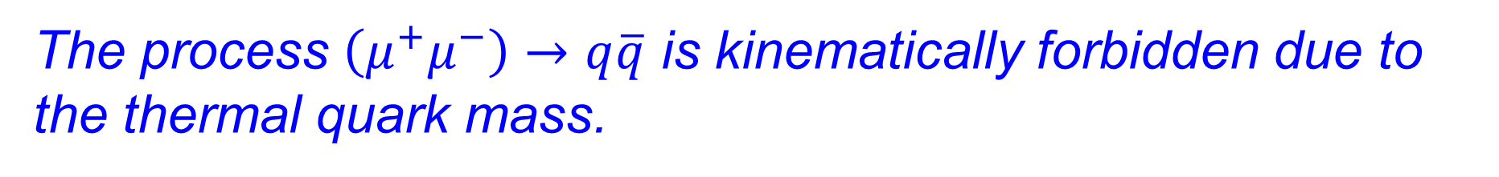
Parton Mass and Coupling in QGP
Extracted from Lattice QCD:
The process $\left(μ^{+}μ^{−}\right)→q\overline{q}$ is kinematically forbidden due to the thermal quark mass.
Pengfei Zhuang, Workshop on QCD phases, Dalian, 20251008-11 13

Slide 14
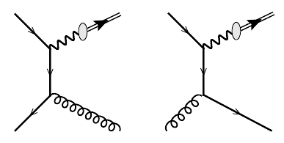
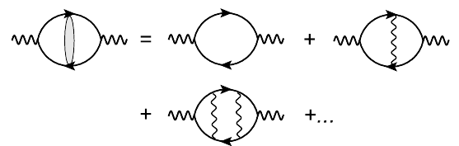


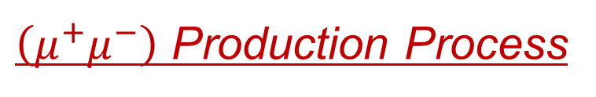
$\left(μ^{+}μ^{−}\right)$ Production Process
$∎$LO: $q\overline{q}→\left(μ^{+}μ^{−}\right)$ is kinematically forbidden.
$∎$NLO: $q\overline{q}→\left(μ^{+}μ^{−}\right)g$ and $qg→\left(μ^{+}μ^{−}\right)q$
$∎$Coulomb resummation
$∎$Photon-$\left(μ^{+}μ^{−}\right)$ vertex
Pengfei Zhuang, Workshop on QCD phases, Dalian, 20251008-11 14

Slide 15

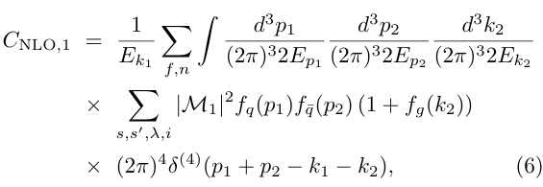
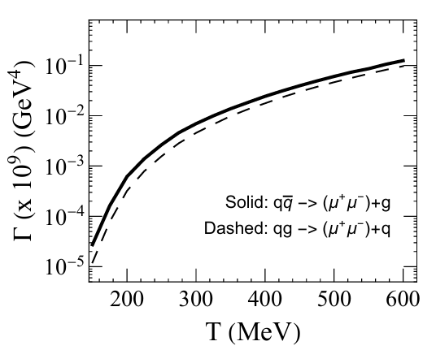
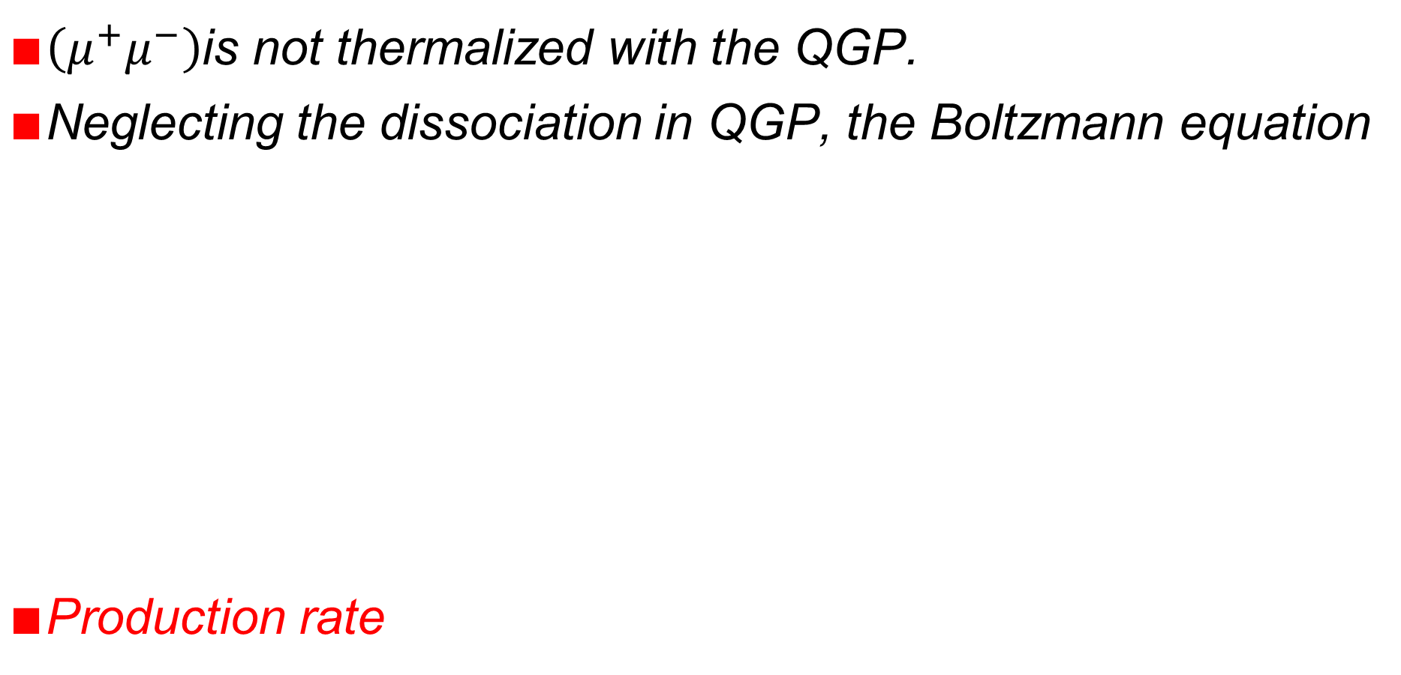
Transport in QGP
$∎\left(μ^{+}μ^{−}\right)$is not thermalized with the QGP.
$∎$Neglecting the dissociation in QGP, the Boltzmann equation
$∎$Production rate
Pengfei Zhuang, Workshop on QCD phases, Dalian, 20251008-11 15

Slide 16
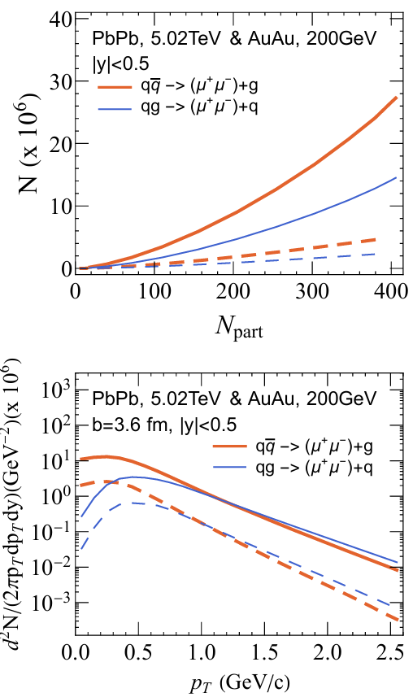
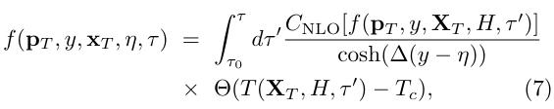
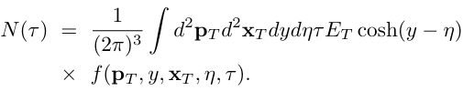
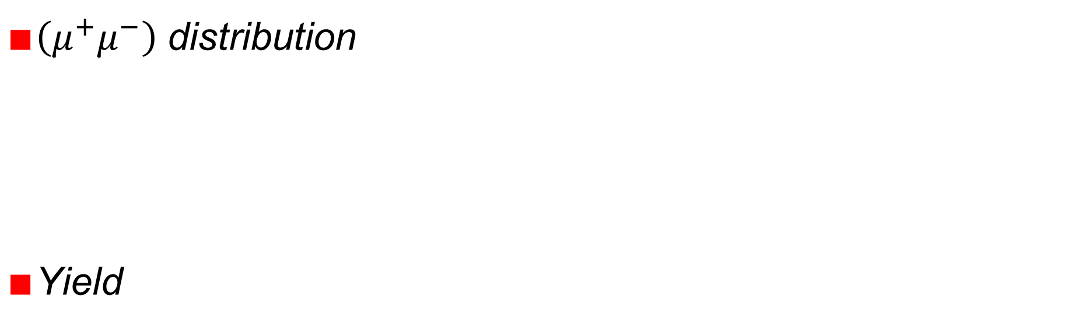
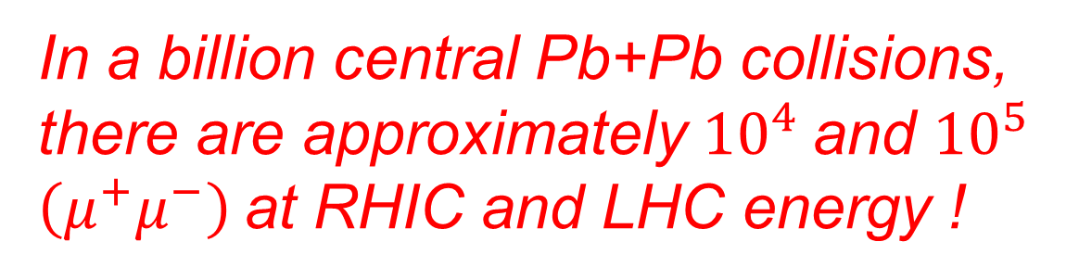
Yield
$∎\left(μ^{+}μ^{−}\right)$ distribution
$∎$Yield
In a billion central Pb+Pb collisions, there are approximately ${10}^{4}$and ${10}^{5}$ $\left(μ^{+}μ^{−}\right)$at RHIC and LHC energy !
Pengfei Zhuang, Workshop on QCD phases, Dalian, 20251008-11 16

Slide 17
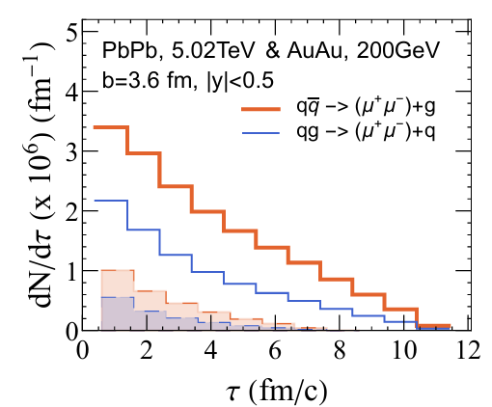
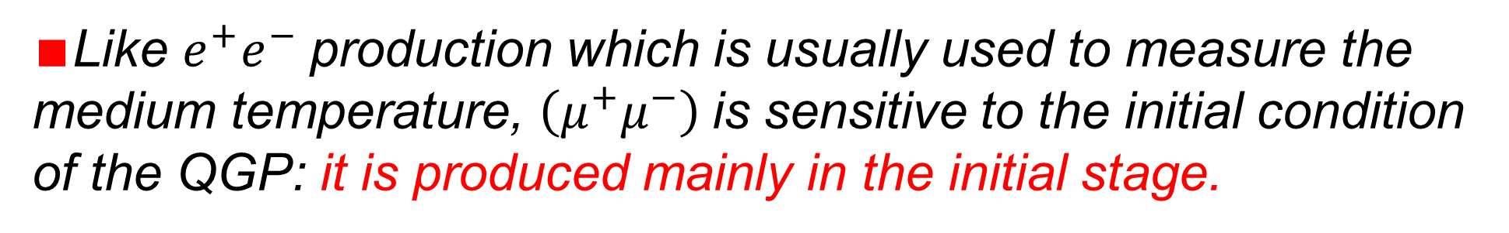
Time Dependence
$∎$Like $e^{+}e^{−}$production which is usually used to measure the medium temperature, $\left(μ^{+}μ^{−}\right)$is sensitive to the initial condition of the QGP: it is produced mainly in the initial stage.
Pengfei Zhuang, Workshop on QCD phases, Dalian, 20251008-11 17

Slide 18
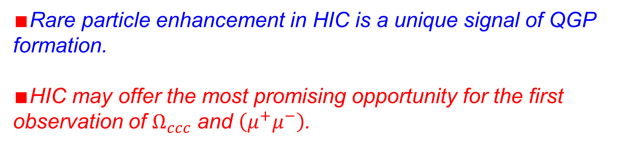
Conclusions
$∎$Rare particle enhancement in HIC is a unique signal of QGP formation.
$∎$HIC may offer the most promising opportunity for the first observation of $Ω_{ccc}$ and $\left(μ^{+}μ^{−}\right)$.
Happy Birthday, Professor Jan Pawlowski!
Pengfei Zhuang, Workshop on QCD phases, Dalian, 20251008-11 18

Slide 19

Difficulty for detecting $Ω_{ccc}$: Cascade decay
Nonleptonic cascade decay mode
Semi-leptonic decay mode
Pengfei Zhuang, Workshop on QCD phases, Dalian, 20251008-11 19

Slide 20
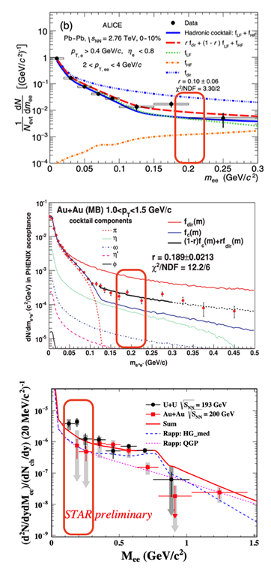

Difficulty for detecting $\left(μ^{+}μ^{−}\right)$: Background
Pengfei Zhuang, Workshop on QCD phases, Dalian, 20251008-11 20

