Slide 1

QCD Phase Diagram in View of General Principle
Yu-xin Liu
Department of Physics, Peking University
Outline
I. Introduction
Ⅱ. Order of QCD Phase Transition
Ⅲ. Possibility of Observation in RHIC
Ⅳ. Summary & Remarks
Intl. Workshop on the QCD Phase Diagram: From Theory to Experimental Signatures, Dalian，2025/10/10/

Slide 2
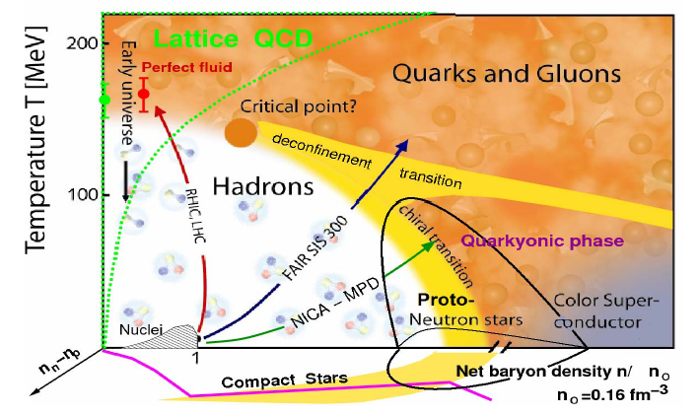
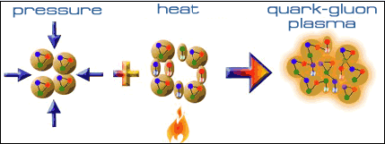
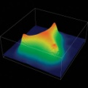
I. Introduction
Strong interaction matter evolution in early universe can be attributed to QCD Phase Transitions
Phase Transitions involved：
Flavor Sym. – F.S. Breaking
Deconfinement–confinement
DCS – DCSB
？
sQGP
Chiral Symmetric
Quark deconfined
？
？
Items Influencing the Phase Transitions:
Medium：Temperature T ,
Density ρ ( or μ )
Size
Intrinsic：Current mass,
Coupling Strength,
Color-flavor structure,
••• •••
？
χSB, Quark confined

Slide 3
I. Introduction
♠ QCD phase transitions reveal the process & mechanism
of the observable matter and its mass generation.
♣ Approaches should be the nonperturbative QCD
which involves simultaneously the charters of
the DCSB & its Restoration,
the Confinement & Deconfinement ,
since the aspects appear at NP QCD scale (10 ² MeV) .
♣ Critical end point (CEP) has been predicted with the
fQCD & effective field theory models.
(Jan’s talk, Nu’s talk, Xiaofeng’s talk, Fei’s talk, Yi’s talk, etc.)
♣ The existence of the CEP is still in challenging.
♣ Exploring the existence of the CEP & phase boundary
are highly imperative.
♣ We visit the issue via general principle & observations.

Slide 4
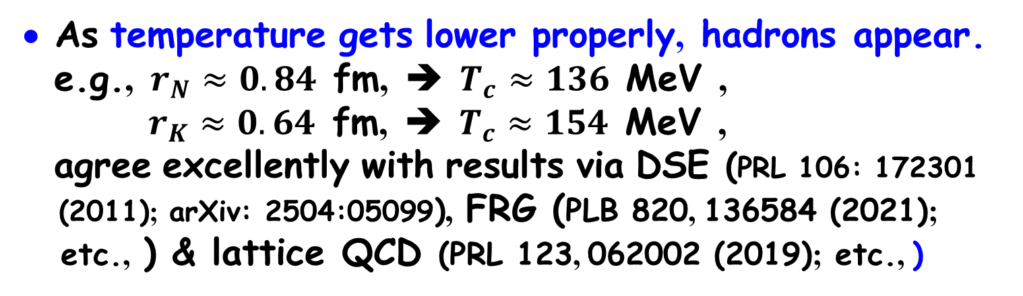
II . Order of the QCD Phase Transitions
1. Driven by temperature
• Asymptotic freedom means
that when the temperature
is very high, the momentum of the invisible quarks
are very close to each other,
which is consistent with the uncertainty principle!
• As temperature gets lower properly, hadrons appear.
e.g., $r_{N}≈0.84$ fm, ➔ $T_{c}≈136$ MeV ,
$r_{K}≈0.64$ fm, ➔ $T_{c}≈154$ MeV ,
agree excellently with results via DSE (PRL 106: 172301
(2011); arXiv: 2504:05099), FRG (PLB 820, 136584 (2021);
etc., ) & lattice QCD (PRL 123, 062002 (2019); etc., )
• As the distance gets smaller continuously with the
descent of temperature,
(in chiral limit) or crossover (beyond chiral limit).
the transition is 2nd order

Slide 5
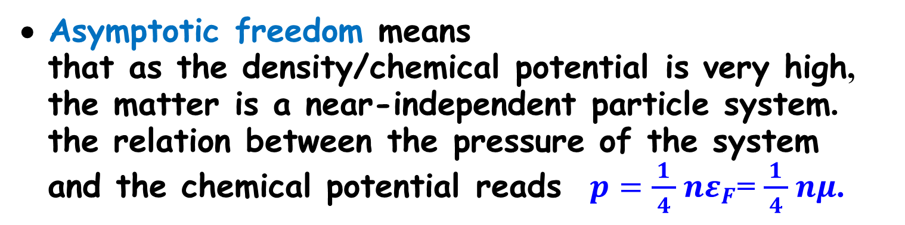


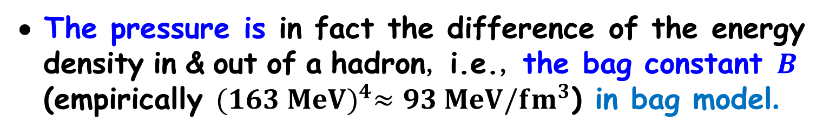
II . Order of the QCD phase transitions
2. Driven by density (or $μ_{B}$)
• Asymptotic freedom means
that as the density/chemical potential is very high,
the matter is a near-independent particle system.
the relation between the pressure of the system
and the chemical potential reads $p=\frac{1}{ 4 } nε_{F}$= $\frac{1}{ 4 } nμ$.
• The pressure is in fact the difference of the energy
density in & out of a hadron, i.e., the bag constant $B$
(empirically ${(163 MeV)}^{4}≈93 MeV/{fm}^{3}$) in bag model.
• As $p>B$, the bag is broken, ➔ $μ_{q,c}≅308$ MeV !
agrees excellently with the empirically value.
• Since the bag breaks abruptly as $μ_{q}>μ_{q,c}$,
the corresponding transition is in 1st order.
• The glitch of pulsars(Vela), the “flatted” cooling curve
of proto-neutron stars, etc, indicate so.

Slide 6
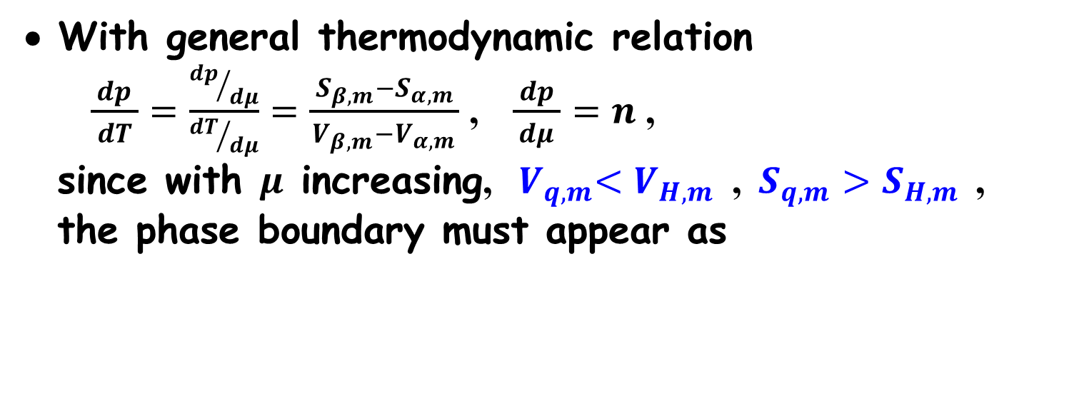
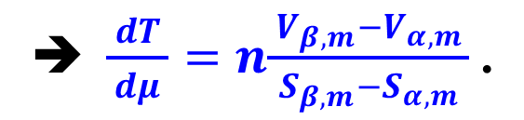
II . Order of the QCD Phase Transitions
3. At both non-zero $T$ & $μ$
• With general thermodynamic relation
$\frac{dp}{ dT }=\frac{{dp}/{dμ}}{{dT}/{dμ}}=\frac{{ S}_{β,m}−S_{α,m }}{V_{β,m}−V_{α,m}}$ , $\frac{ dp }{dμ}=n$ ,
since with $μ$ increasing, ${ V}_{q,m}<V_{H,m}$ , $S_{q,m}>S_{H,m}$ ,
the phase boundary must appear as
➔ $\frac{ dT }{dμ}=n\frac{{ V}_{β,m}−V_{α,m }}{S_{β,m}−S_{α,m}}$.
CEP
•
• There must then exist an intersection, the CEP !
• Work on smoothing the boundary lines to form the
usual continuous curve is under progress.

Slide 7
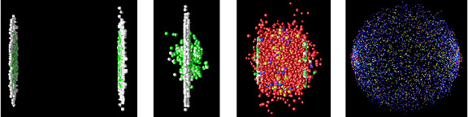
III. Possibility of Observation in RHIC
1. RHIC is the facility to realize the QCD phase
transitions in laboratory (u23u)
Thin Pancakes
Lorentz γ=100
Nuclei pass thru each other
< 1 fm/c
Huge Stretch
Transverse Expansion
High Temperature (?!)
The Last Epoch:
Final Freezeout--
Large Volume
We measure the “final” state,
we are most interested in the “intermediate” state,
we need to understand the “initial” state…
♠ Difficulty：What observed in experiment are those
after the freeze-out but not at the
phase transition

Slide 8
III. Possibility of Observation in RHIC
2. It is possible to get the information about the
QCD phase transitions in general principle
Phase transition correspond to the change of the
minima of thermodynamical potential
Isentropic
trajectory
In general
.

Slide 9
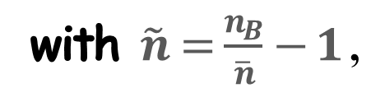
3. Combination of High order baryon number
fluctuations is an excellent signal
• Taking the thermodynamic potential in terms of the baryon
number fluctuations or the chemical potential fluctuations
• Legendre transformation
➔ ，
with $\tilde{n}=\frac{n_{B}}{\overline{n}}−1$ ,
The two-bottom nature of the thermodynamic potential
in case of FOPT ➔
.
Y. Lu, F. Gao, X.F. Luo, L. Chang, and Y.X. Liu, Sci. China-Phys. Mech. Atron. 68, 251012 (2025).
(a rViv: 2211.03401)

Slide 10

• Taking the thermodynamic potential in terms of the baryon
number fluctuations or the chemical potential fluctuations
experimental data & calculations ➔
$$ Along the freeze-out line in DSE
Extracted thermodynamic potential reads
Y. Lu, F. Gao, X.F. Luo, L. Chang, and Y.X. Liu, Sci. China-Phys. Mech. Atron. 68, 251012 (2025).
(a rViv: 2211.03401)

Slide 11
• Taking the thermodynamic potential in terms of the baryon
number fluctuations or the chemical potential fluctuations
Check via the NJL model
Y. Lu, F. Gao, X.F. Luo, L. Chang, and Y.X. Liu, Sci. China-Phys. Mech. Atron. 68, 251012 (2025).
(a rViv: 2211.03401)

Slide 12
• Including the dynamical evolution & other effects
With the Fokker-Planck equation & relation time approx.
τ_{rel} = 0.1 fm
τ_{rel} = 0.1 fm
τ_{rel} = 0.1 fm
τ_{rel} = 0.1 fm
τ_{rel} = 0.1 fm
L.J. Jiang, F. Gao, and Y.X. Liu, Eur. Phys. J. C 85, 807 (2025). (arViv: 2310.15770)

Slide 13
4. Possibility for the CEP to be detected at RHIC
• Generally $\left(T_{CEP},μ_{B,CEP}\right)=(105\sim 120,600\sim 700)$MeV.
• The experiments observed are the states after the freeze-out,
but not the those at the phase transition.
• Determining the freeze-out condition via the DSE including the $A_{0}$
to consider the Polyakov-loop effect
Δ Along the freeze-out line in DSE
➔
• It is possible for the CEP to be detected at RHIC if the beam
intensity is enhanced.
Yi Lu, et. al., in preparation.

Slide 14

IV. Summary & Remarks
With general principle and observations, we show
there must exist a CEP in QCD Phase diagram.
♠ Position of the CEP proposed via fQCD & eff. models
• fQCD (DSE & FRG) ➔ $\left(T_{CEP},μ_{B,CEP}\right)=(105\sim 120, 600\sim 700)$ MeV.
• Combining the DSE calculation & the Lee-Yang zero analysis
➔ $\left(T_{CEP},μ_{B,CEP}\right)=(122,652)$MeV.
• Sophisticated effective model ➔ ${μ_{B,CEP}}/{T_{CEP}}>3.0$ .
♠ A new criterion to identify the 1st PT is proposed.
♠ With analyzing the freeze-out condition obtained in
DSE calculation, we propose that the CEP could be
detected in RHIC with enhanced beam intensity.
Thanks !!

Slide 15

♠ DCSB is the origin for the mass of observable particles to be generated
♣ The conventional Higgs mechanism can not generate
the observable mass: The Nucleon Mass Crisis
How does the mass of nucleon
arise ??
What is
the other
99% ??

Slide 16
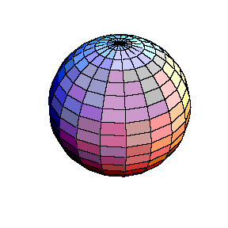
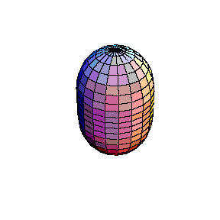
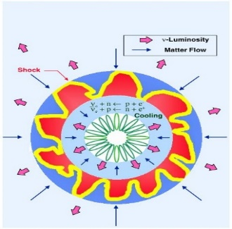
♠ The glitch of pulsars is still a puzzle in astronomical observations
• The first observation
• General feature
NATURE. VOL. 222. APRIL 19, 1969
NATURE. 222, 228 (1969)
NATURE. 222, 229 (1969)
• We’d say it arises from the radial instability corresponding to a first order hadron-quark PT
This G-mode oscillation
induces the GW radiation

Slide 17
• Comparison of G-mode Oscillation
Frequencies of the two kind nb Stars
Neutron Star: RMF, Quark Star: Bag Model
Frequency of the G-mode oscillation
W.J. Fu, H.Q. Wei, & Y.X. Liu, arXiv: 0810.1084;
Phys. Rev. Lett. 101，181102 (2008).

Slide 18
• Comparison with other modes
Neutron Star: RMF, Quark Star: Bag Model
Frequencies of the f- & p-mode oscillations
♣ G-mode oscillation in quark star has rel. low freq. !
Z. Bai, W.J. Fu, & Y.X. Liu, ApJ 922 (2021) 2: 266.

Slide 19
♣ The Cooling Curve of Proto-neutron Stars
• Observed much slower cooling process means that the Urca process is highly modified.
• The reason may be that the production
rate and their mean free path of
neutrinos are reduced by the medium effect.
W.J. Fu, G.H. Wang, & YXL, ApJ 678: 1715 (2008).
• One of the mechanism of the high T to be
maintained may be that a first order phase
transition takes place there.

Slide 20
♣ Systems with phase coexistence are much
more complicated
♦ Uniform Matter in case of fully nonperturbative
• ,
with
♦ NonUniform Matter (with phase coexistence) in case
of fully nonperturbative
• Multi-conservation charges,
transition region,
• Above described approach fails.
• Construction Methods:
Maxwell, Gibbs, 3-window,
• Homotopy
Method:

Slide 21
♦ Result via Gibbs construction &
3-window construction
• Hadron Matter: RMF;
Quark matter: DSE;
• TOV Eq. ➔ MR Relation.
• Distribution of the ingredients
in terms of the radius，
➔ Massive pulses may be
hybrid stars.
Z. Bai & YXL, Phy. Rev. D 97, 023018 (2018)

Slide 22
♦ Chemical potential (baryon density) region for the phase transition to occur
• Taking the sound speed as interpolation objective
(200000 groups of data, quadratic & cubic constructions)
• Taking the M-R relation, Maximum mass,
tidal deformability as the calibrations.
• We obtain
most probable
Z. Bai & YXL, Phy. Rev. D 108, 014018 (2023)

Slide 23
♦ Some results via the Homotopy method
• Effective potential of the QCD systems
• Phase diagram & that in compact star matter
H.W. Zheng, Y. Lu, F. Gao, S.X. Qin, & YXL, Phy. Rev. D 109, 114013 (2024);
H.W. Zheng, F. Gao, L.G. Bian, S.X. Qin, & YXL, PRD 111, L021303 (2025).

