Slide 1

International Workshop on The QCD Phase Diagram: From Theory to Experimental Signatures
Effects of Chiral Phase Transition on Light Nuclei and Dilepton Production
KaiJia Sun
kjsun@fudan.edu.cn
Fudan University
Oct. 10, 2025
In collaboration with Lie-Wen Chen, Che Ming Ko, Feng Li, Rui Wang, Jun Xu, Wen-Hao Zhou

Slide 2
Outline
Background
2. Probing the first-order chiral phase transition with light nuclei production
3. Probing chiral symmetry restoration with dilepton production
4. Summary and outlook
K. J. Sun, W. H. Zhou, L. W. Chen, C. M. Ko, and F. Li, R. Wang, and J. Xu, arXiv:2205.11010 (2022)
Wen-Hao Zhou, Che Ming Ko, and Kai-Jia Sun, arXiv:2412.18895 (2024)
W. H. Zhou, L. M. Liu, C. M. Ko, K. J. Sun, and J. Xu arXiv:2507.18189 (2025)

Slide 3
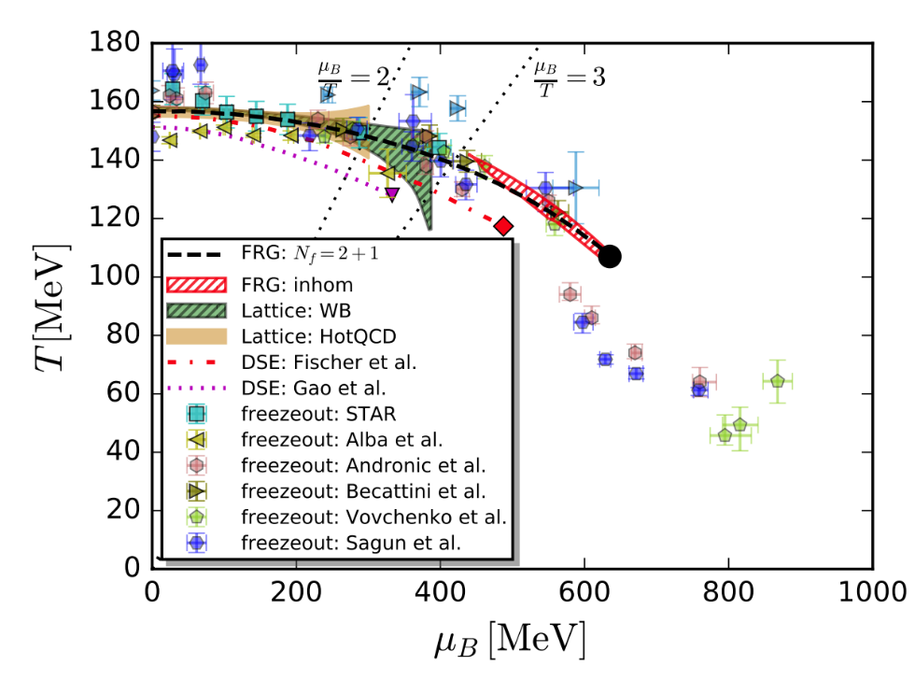
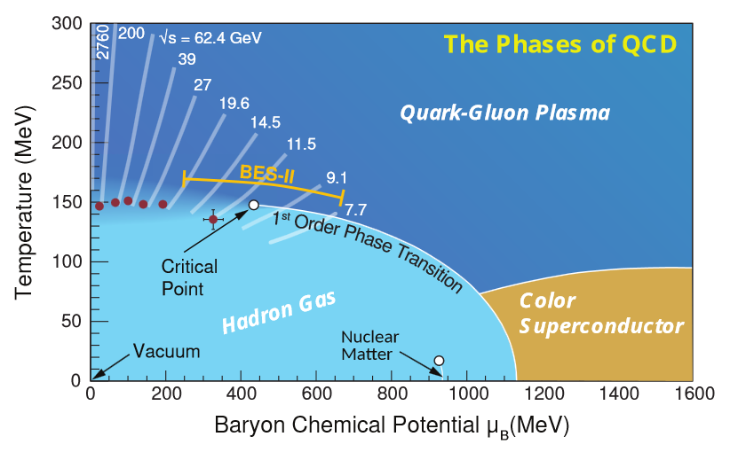
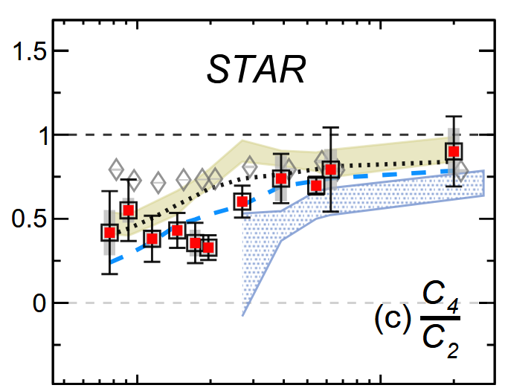
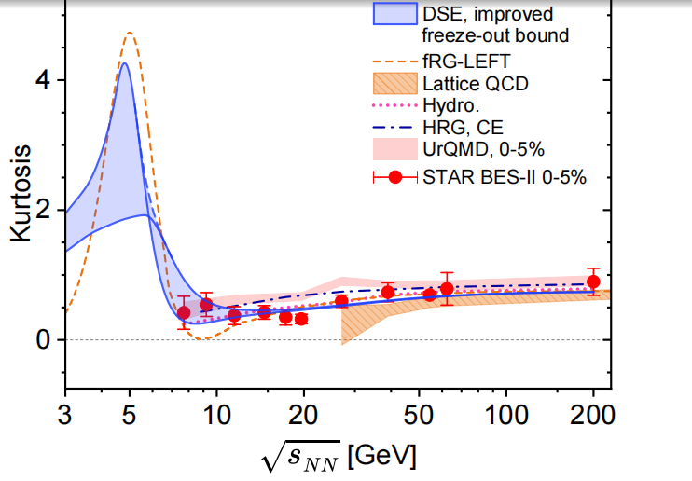

Hunting for the QCD critical point
(1)
See talk by Fei Gao
Critical Point: long-range correlation
Y. Aoki et al., Nature 443, 675 (2006)
X. Luo and N. Xu, Nucl. Sci. Tech. 28, 112 (2017)
A. Bzdak et al., Phys. Rept. 853, 1 (2020);
W. J. Fu, J. M. Pawlowski, F. Renneke, Phys. Rev. D101, 054032 (2020);
STAR, Phys. Rev. Lett. 135, 142301 (2025)
For non-equilibrium effects, see talk by Fei Gao

Slide 4
I will focus on effects of chiral symmetry restoration and the first-order chiral phase transition

Slide 5
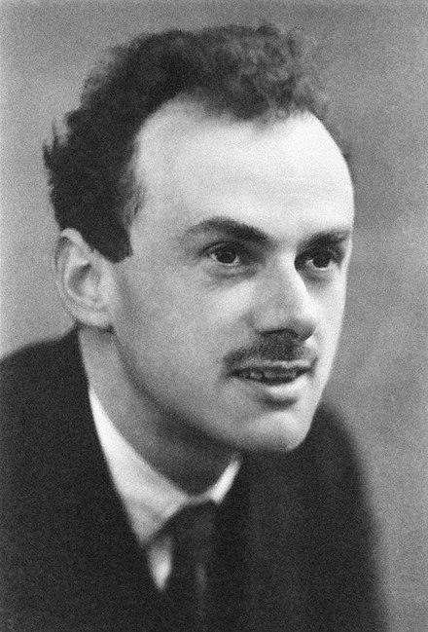
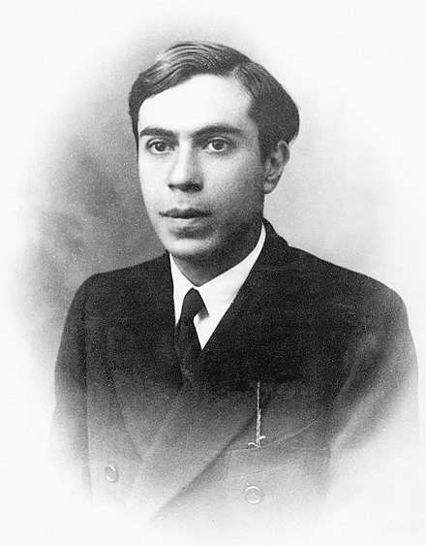
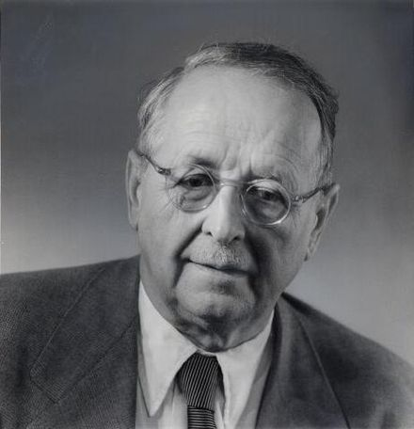
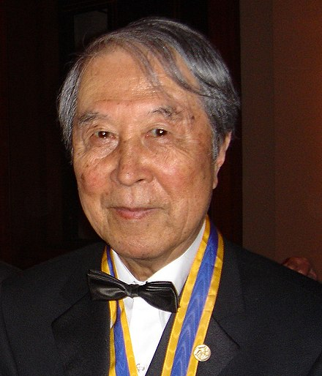
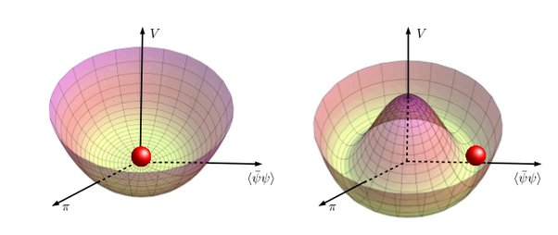


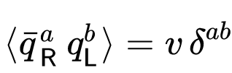





Spontaneous breaking of chiral symmetry & Mass generation
(2)
Spontaneous symmetry breaking
$${U(1)}_{V}×{SU(N_{f})}_{L}×{SU(N_{f})}_{R}$$
$$→{U(1)}_{V}×{SU(N_{f})}_{V}$$
Mass generation:
P. Dirac, 1928
H. Weyl, 1929
E. Majorana, 1937
Y. Nambu, 1961
In analogy with BCS theory for
superconductivity
$$M∝ −<\overline{q}q>$$

Slide 6
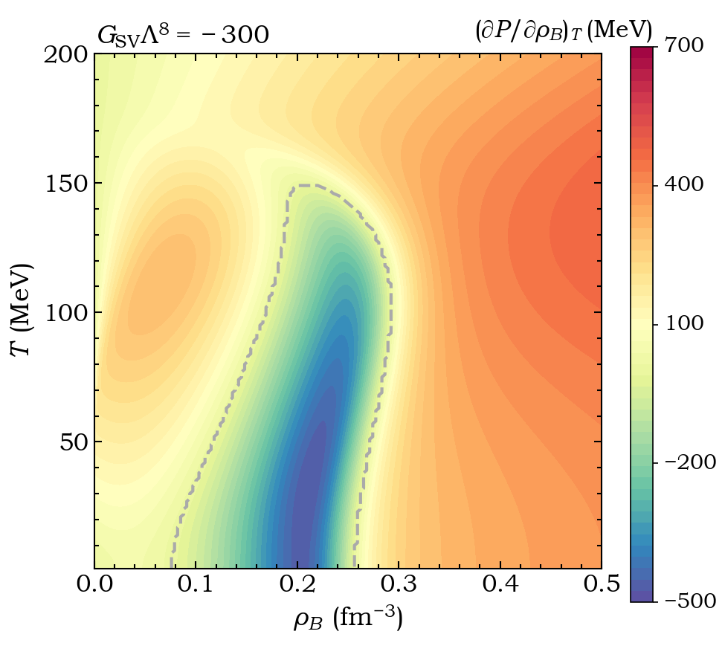
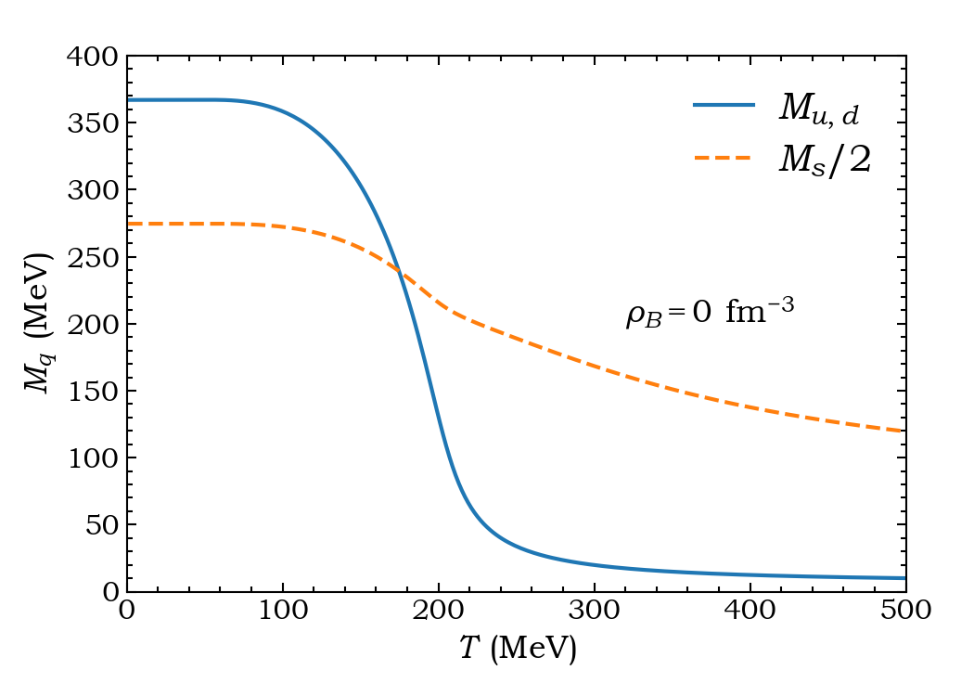
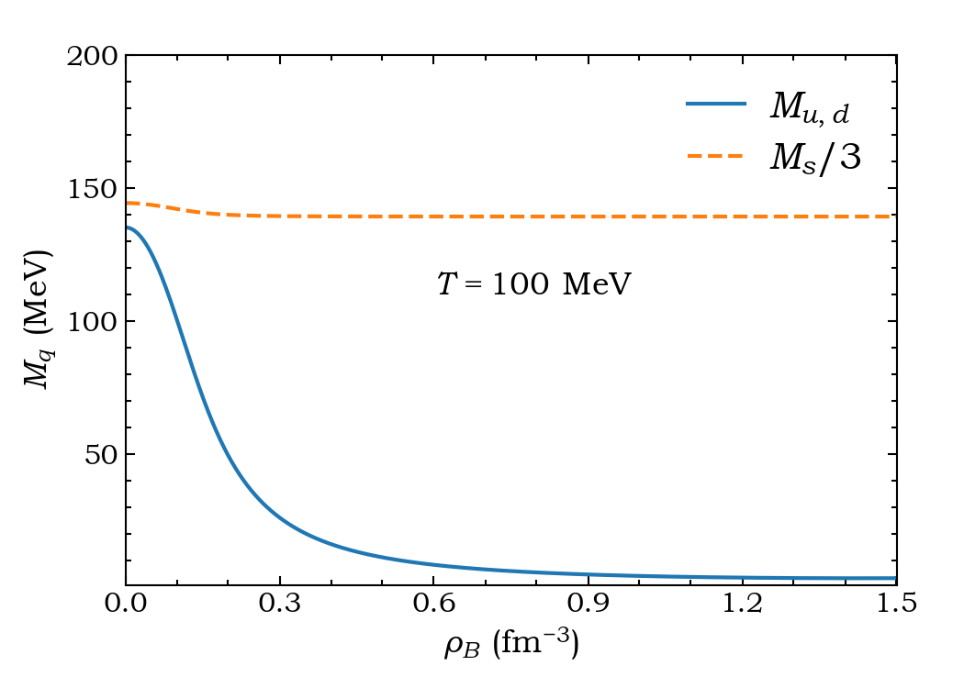
Chiral symmetry restoration
(3)

Slide 7
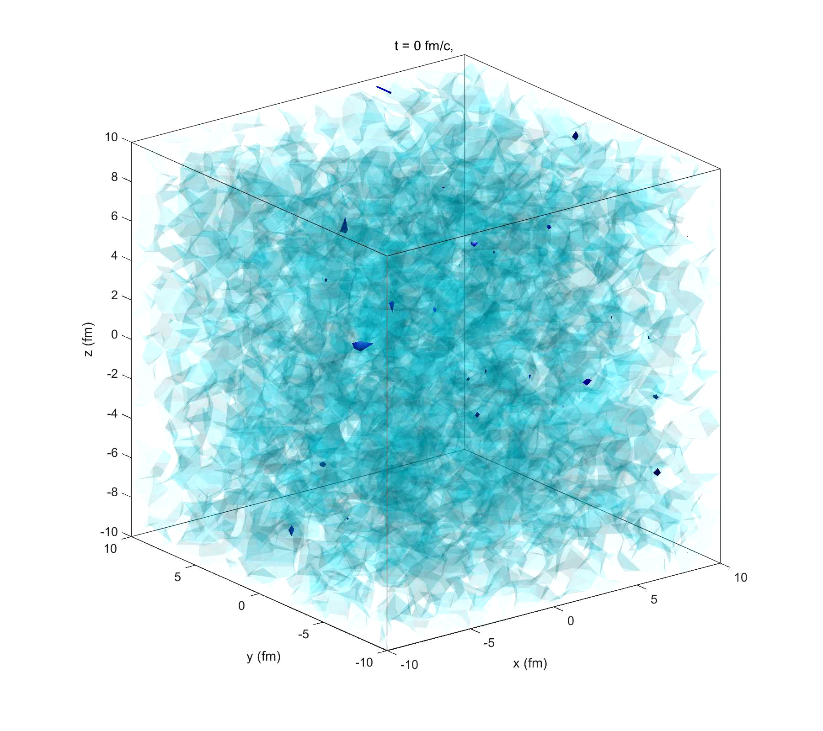
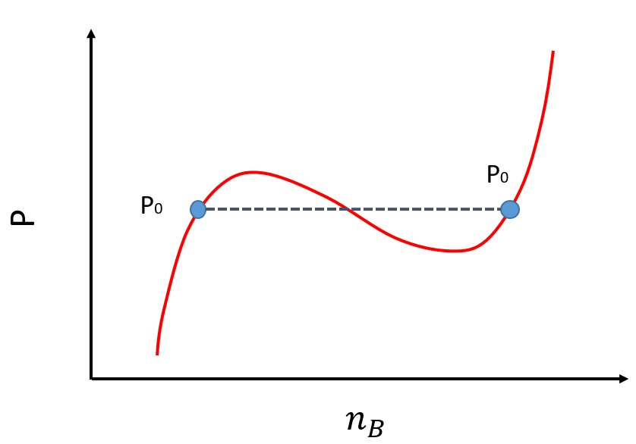
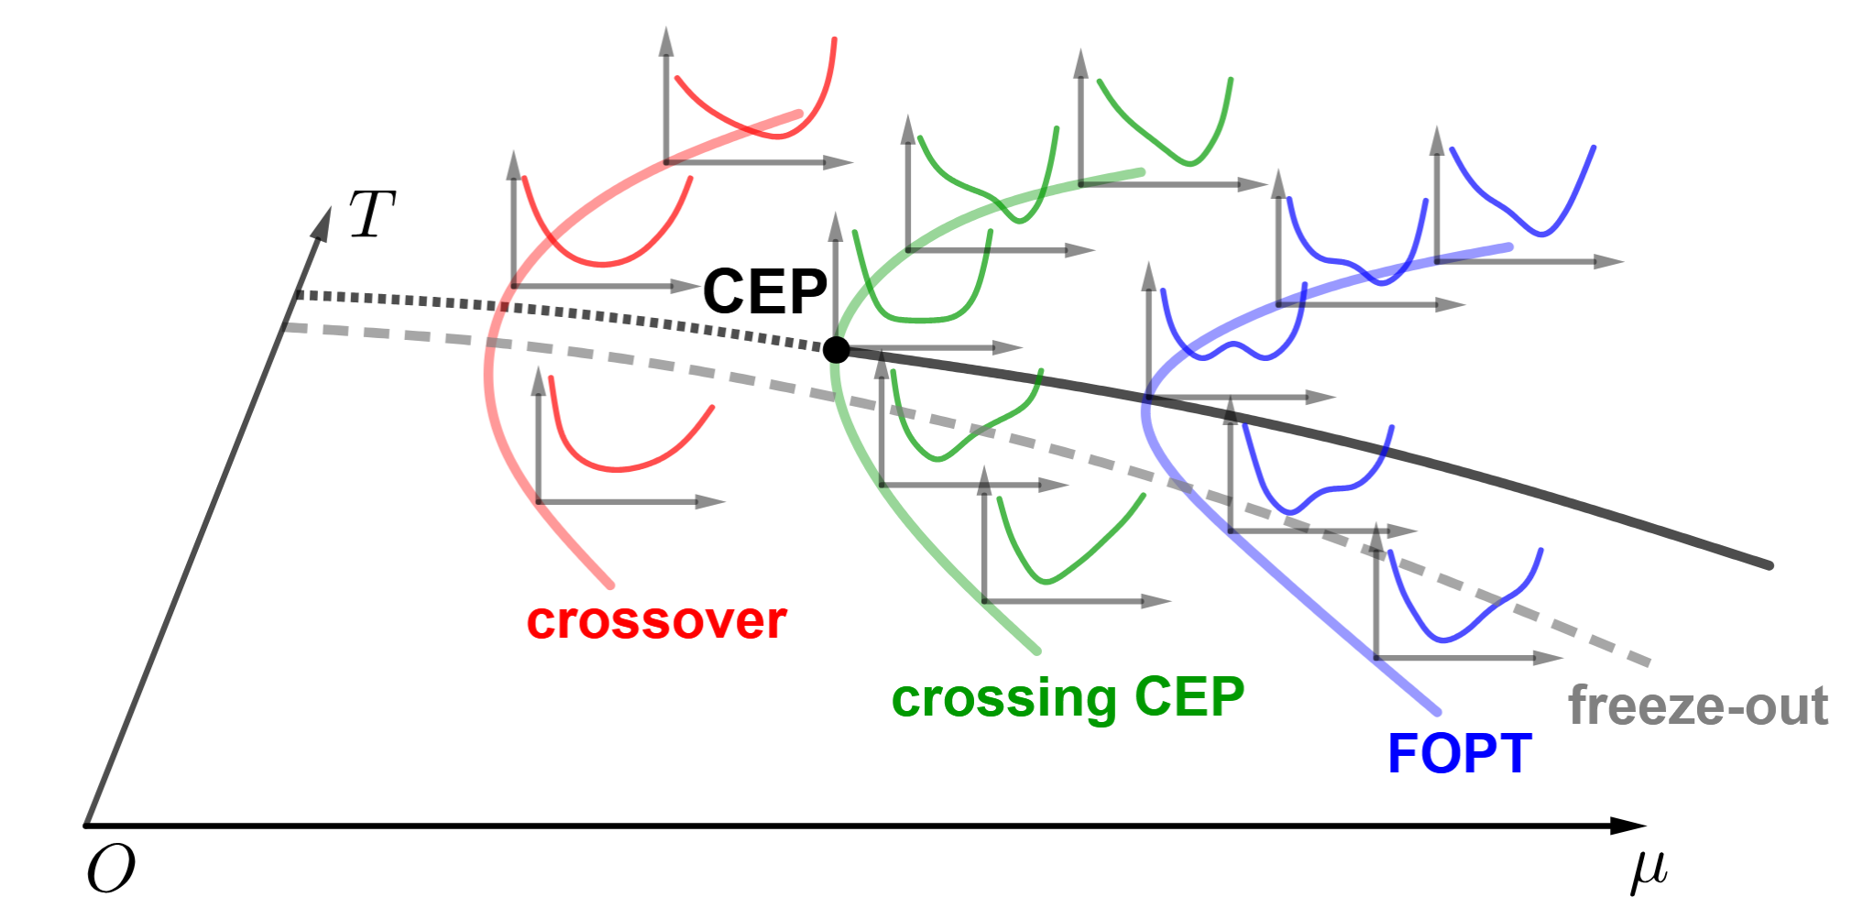
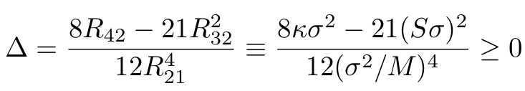


(4)
Spinodal instability
P. Chomaz, M. Clonna, and J. Randrup, Phys. Rep. 389, 263 (2004)
Y. Lu, F. Gao, and Y. X. Liu, arXiv:2509.02974 (2025)
See talk by Y. X. Liu
Spinodal decomposition(SD)
Large density fluctuations (inhomogeneities),
clusterings
Criteria in the form of
cumulant ratios:
Spinodal: $\frac{∂P}{∂ ρ_{B}}<0$
$$ρ_{B}$$
Metastable
Y. Lu, F. Gao, X. F. Luo, L. Chang, and Y. X. Liu, Sci. China Phys. Mech. Astron. 68 (2025) 5, 251012

Slide 8
Probing The First-Order Chiral Phase Transition with Light Nuclei Production

Slide 9
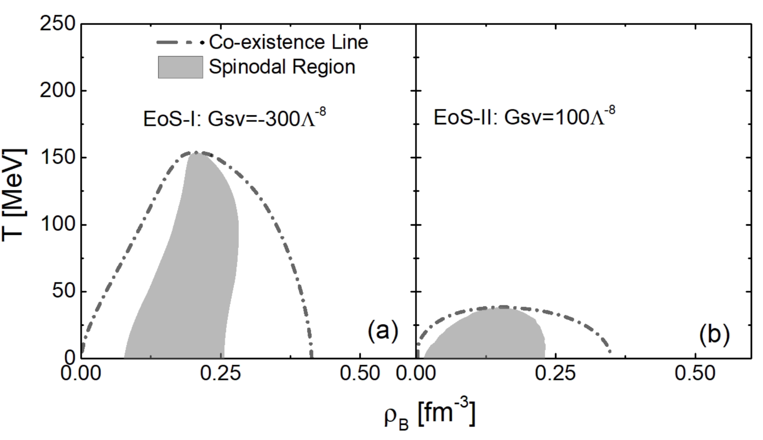
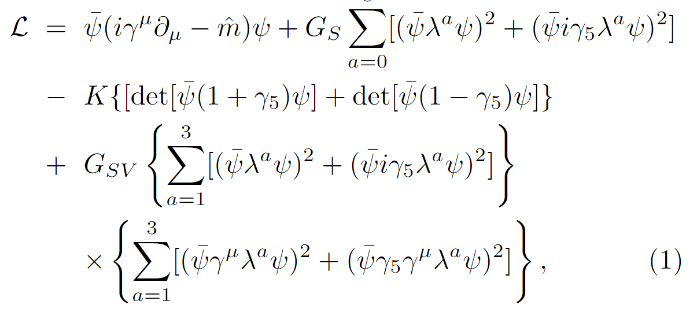
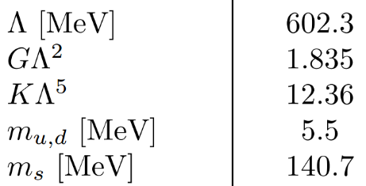
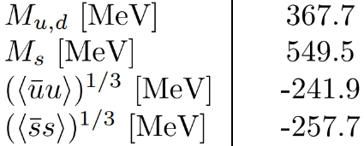
(5)
Equation of State (extended NJL model)
The eNJL provides a flexible equation of state (EoS) . The critical temperature can be easily changed by
varying the strength of the scalar-vector interaction without affecting the vacuum properties.
Lagrangian density for an extended Nambu-
Jona-Lasinio (eNJL) model
M. Buballa, Phys. Rept. 407, 205 (2005)
K. J. Sun, C. M. Ko, S. Cao, and F. Li., Phys. Rev. D 103, 014006 (2021)

Slide 10
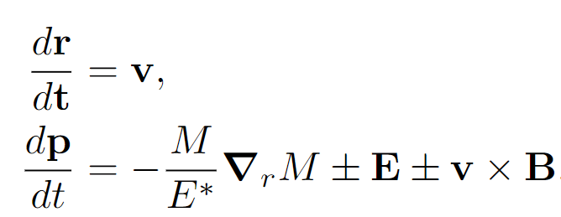
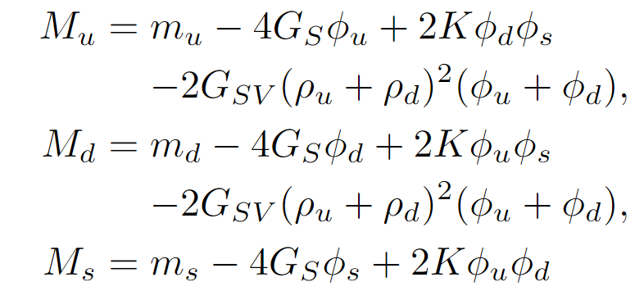
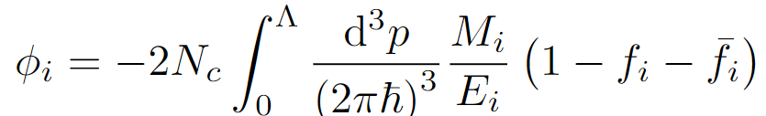
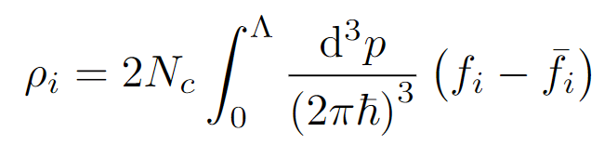
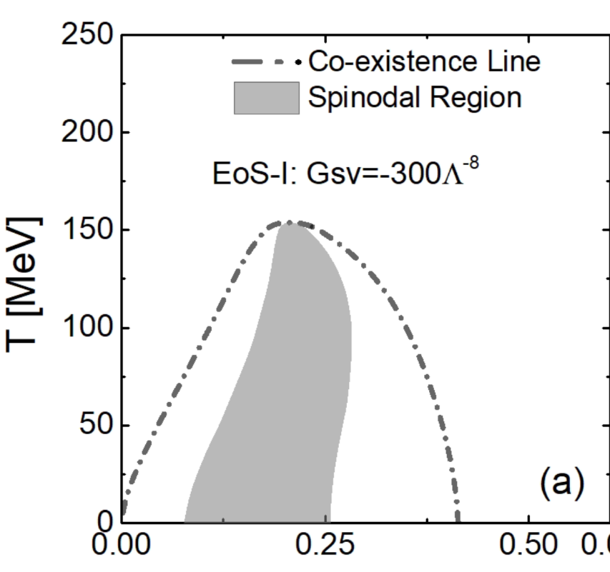
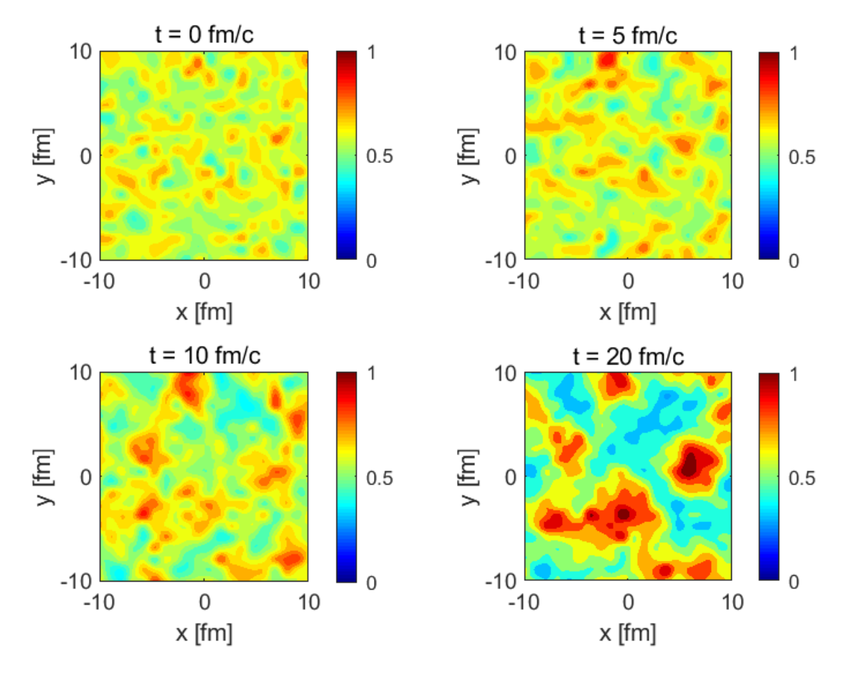
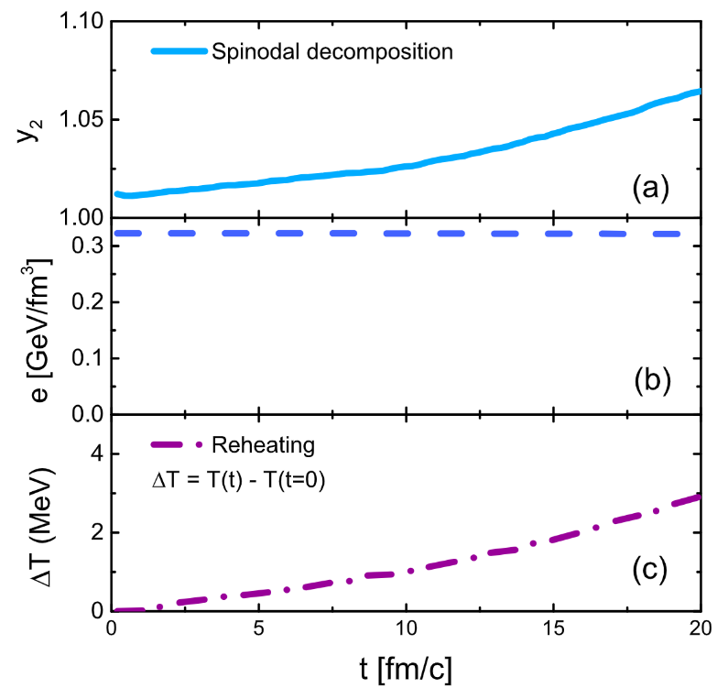
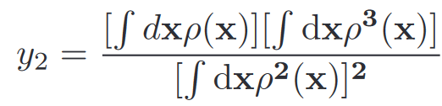

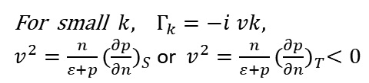
(6)
Box Simulation
Effective mass:
Test –particle method: J. Xu, arXiv:1904.00131 (2019)
Strong EM fields
Small irregularities will grow exponentially
and soon the evolution becomes ’chaotic’.
For small $k, Γ_{k}=−i vk,$
$v^{2}=\frac{n}{ε+p}{(\frac{∂p}{∂n})}_{S}$ or $v^{2}=\frac{n}{ε+p}{(\frac{∂p}{∂n})}_{T}<0$
M. Buballa, Phys. Rept. 407, 205 (2005)
K. J. Sun, C. M. Ko, S. Cao, and F. Li., Phys. Rev. D 103, 014006 (2021)

Slide 11
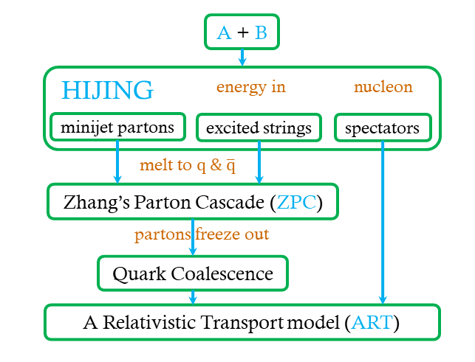
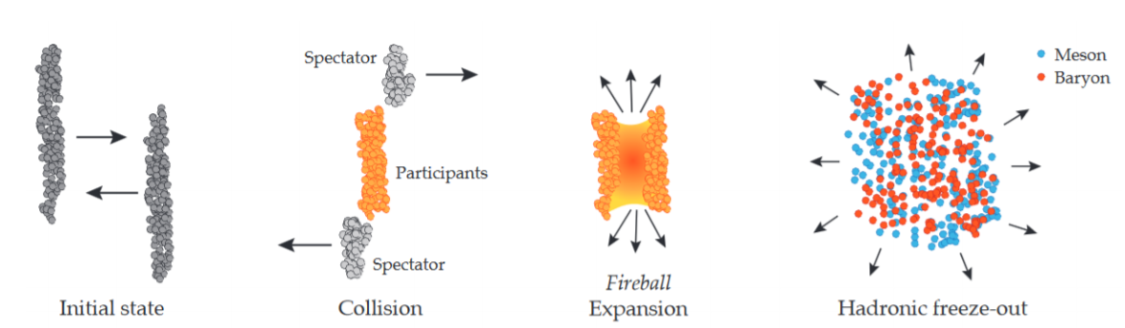
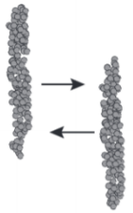
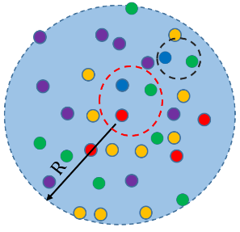

Relativistic Heavy-Ion Collisions
(7)
String Melting-AMPT
Parton Transport with Nambu-Jona-Lasinio (NJL) model
$$N_{A}=Tr\left({\hat{ρ}}_{s}{\hat{ρ}}_{A}\right)$$
${=g}_{c}∫dΓ ρ_{s}\left({\{x}_{i},p_{i}\} \right){×W}_{A}(\{x_{i},p_{i}\})$
Nucleon Coalescence
Z.-W. Lin, C. M. Ko, B.-A. Li, B. Zhang, S. Pal, Phys. Rev. C 72, 064901 (2005).
Replace ZPC model with an extended NJL model.

Slide 12
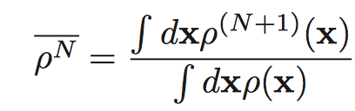
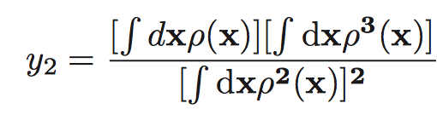
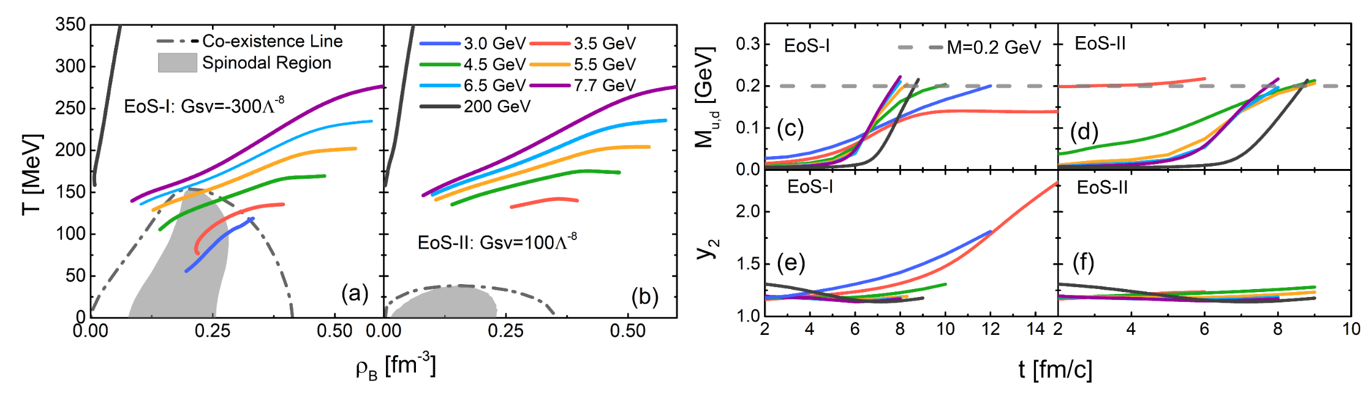
(8)
Trajectories in the phase diagram
Phase trajectories of central cells in the phase diagram

Slide 13
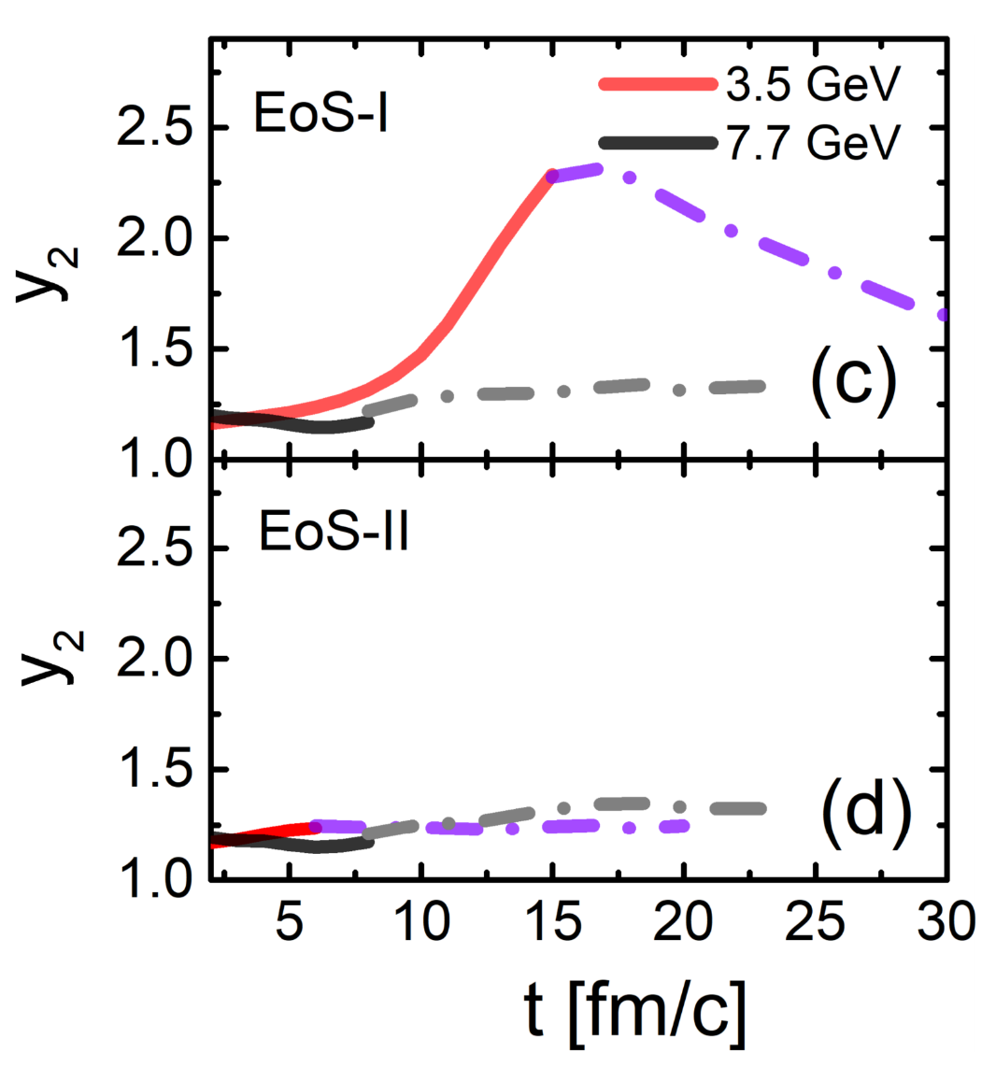


(9)
Density fluctuation in an expanding fireball
Off-equilibrium effects
Density moment:
partonic
hadronic
If the expansion is self-similar or scale invariant
then $y_{2}\left(t\right)=y_{2}\left(t_{h}\right)$, i.e., remains a constant
K.J.Sun et al., Eur.Phys.J.A 57 (2021) 11, 313
Non-equilibrium ‘memory effects’: Large density inhomogeneity survives to kinetic freezeout

Slide 14
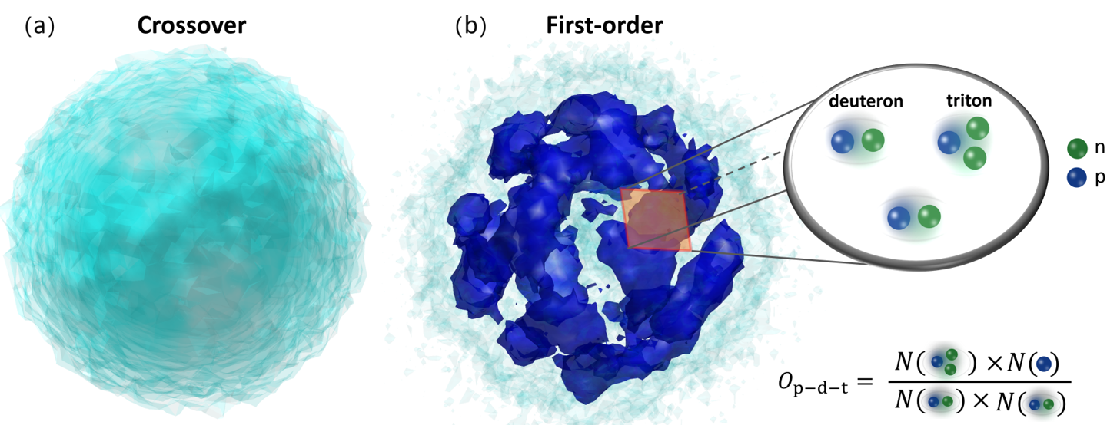

Observable: Light Nuclei Production
(10)
C. M. Ko, NST 34, 80 (2023).
$$\frac{N_{t}N_{p}}{N_{d}^{2}}≈\frac{1}{2\sqrt{3}}\left[1+∆ρ_{n}+\frac{λ}{σ}G\left(\frac{ξ}{σ}\right)\right]$$
Large density fluctuations could lead to enhancements of $N_{t}N_{p}/N_{d}^{2}$
K. J. Sun, L. W. Chen, C. M. Ko, and Z. Xu, Phys. Lett. B 774, 103 (2017); K. J. Sun, C. M. Ko, and F. Li, PLB 816, 136258 (2021);
E. Shuryak, J.M.Torres-Rincon et al., PRC 100, 024903(2019); S. Wu et al., PRC 106,034905(2022).

Slide 15
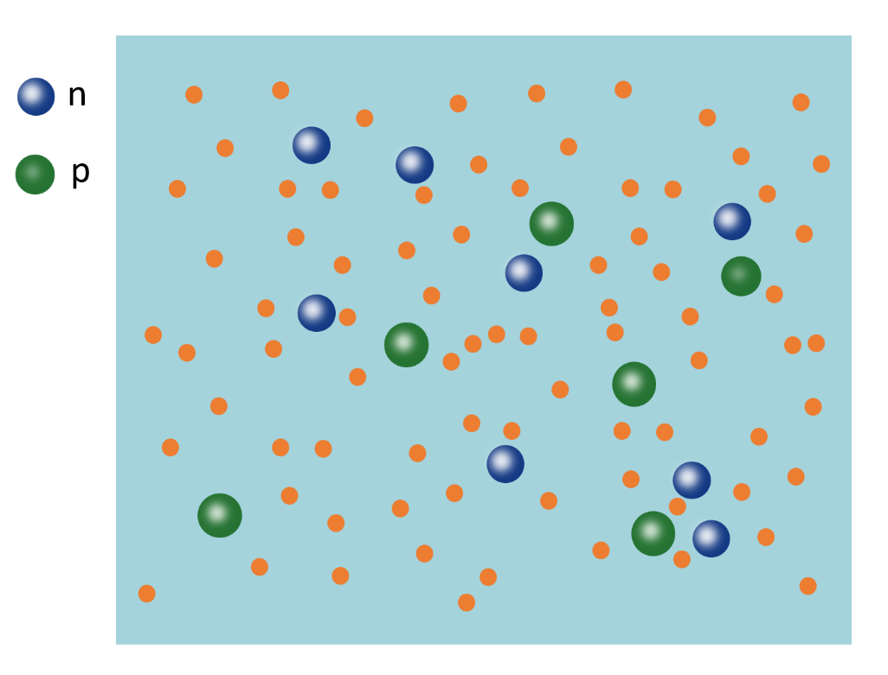
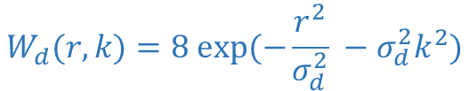





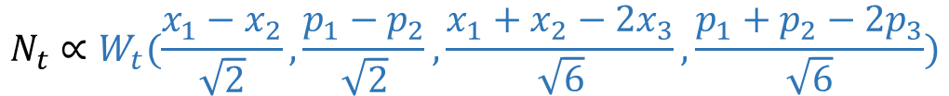
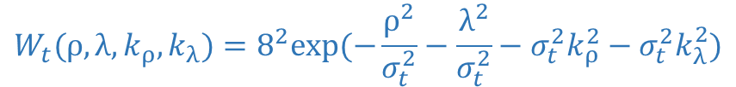
Light Nuclei Production
(11)
$$N_{d}∝W_{d}(\frac{x_{1}−x_{2}}{\sqrt{2}},\frac{p_{1}−p_{2}}{\sqrt{2}})$$
$$d$$
$$N_{t}∝W_{t}(\frac{x_{1}−x_{2}}{\sqrt{2}},\frac{p_{1}−p_{2}}{\sqrt{2}},\frac{x_{1}+x_{2}−2x_{3}}{\sqrt{6}},\frac{p_{1}+p_{2}−2p_{3}}{\sqrt{6}})$$
Wigner function:
$$W_{d}(r,k)=8 exp⁡(−\frac{r^{2}}{σ_{d}^{2}} −σ_{d}^{2}k^{2})$$
$${}_{}^{3}H$$
$σ_{d}≈2.26$fm
$$W_{t}(ρ,λ,k_{ρ},k_{λ})=8^{2}exp⁡(−\frac{ρ^{2}}{σ_{t}^{2}}−\frac{λ^{2}}{σ_{t}^{2}}−σ_{t}^{2}k_{ρ}^{2}−σ_{t}^{2}k_{λ}^{2})$$
$σ_{t}≈1.59$ fm
See K. J. Sun et al., arXiv:2207.12532(2022) for the more advanced treatment
R. Scheibl and U. W. Heinz, Phys. Rev. C59. 1585(1999)

Slide 16
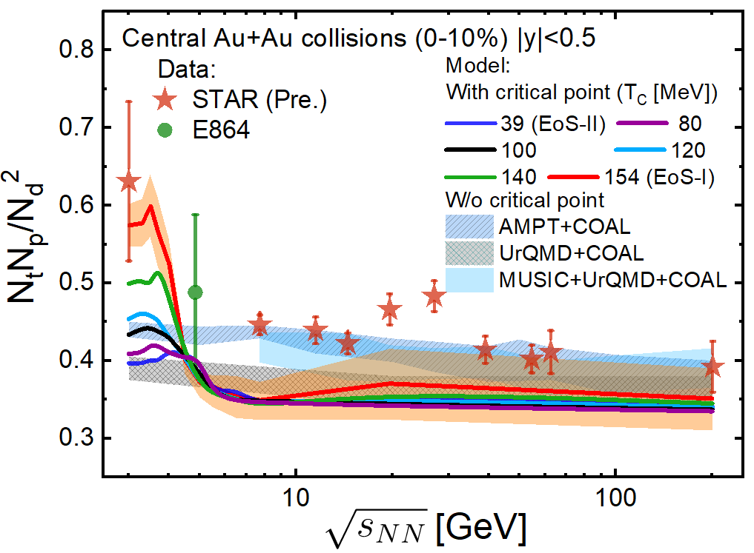
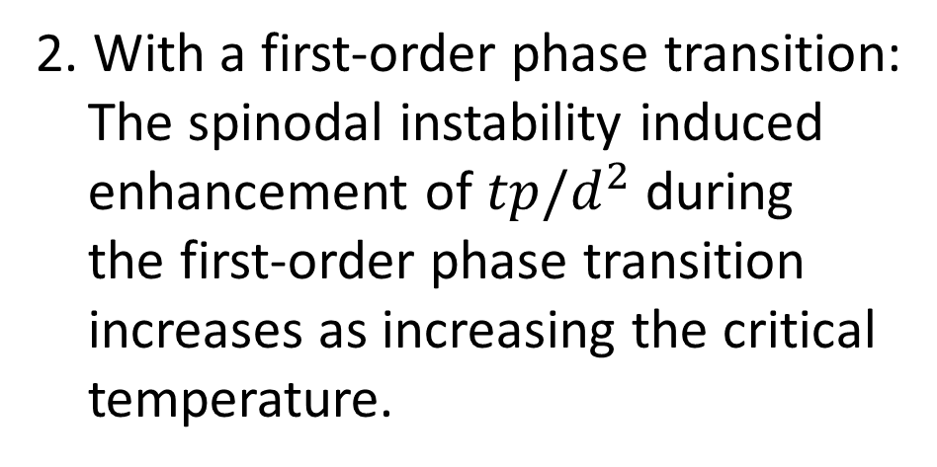
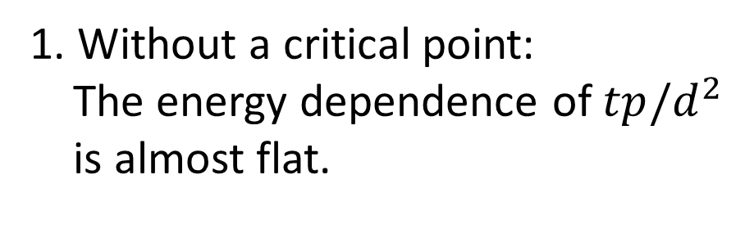
(12)
Collision energy dependence
1. Without a critical point:
The energy dependence of $tp/d^{2}$
is almost flat.
2. With a first-order phase transition:
The spinodal instability induced
enhancement of $tp/d^{2}$ during
the first-order phase transition
increases as increasing the critical
temperature.
STAR, Phys. Rev. Lett. 130, 202301 (2023)
STAR, Phys. Rev. C 110 (2024) 5, 054911
T. A. Armstrong et al. (E864), Phys. Rev. C 61, 064908 (2000).

Slide 17
(13)
Collision energy dependence
1. Without a critical point:
The energy dependence of $tp/d^{2}$
is almost flat.
2. With a first-order phase transition:
The spinodal instability induced
enhancement of $tp/d^{2}$ during
the first-order phase transition
increases as increasing the critical
temperature.
STAR, Phys. Rev. Lett. 130, 202301 (2023)
STAR, Phys. Rev. C 110 (2024) 5, 054911
T. A. Armstrong et al. (E864), Phys. Rev. C 61, 064908 (2000).

Slide 18
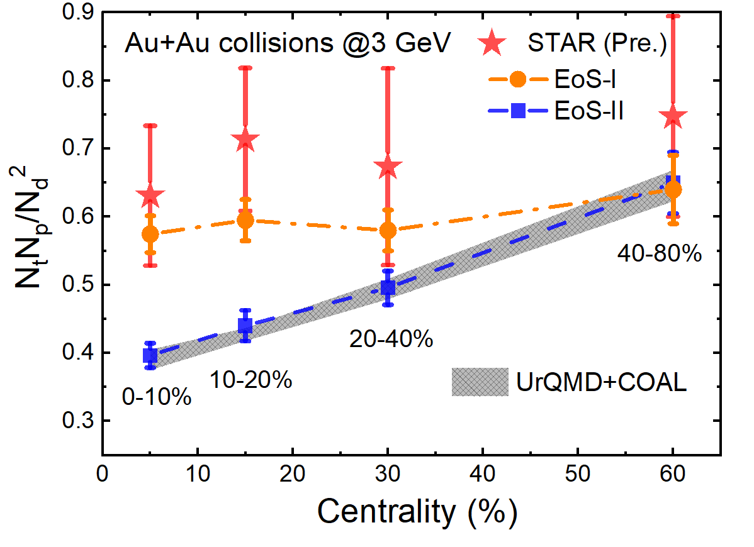
(14)
Centrality dependence

Slide 19
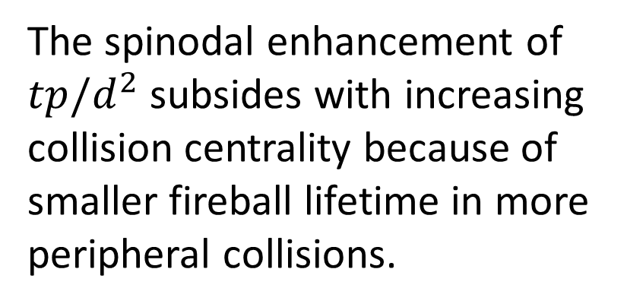
(14)
Centrality dependence
The spinodal enhancement of
$tp/d^{2}$ subsides with increasing
collision centrality because of
smaller fireball lifetime in more
peripheral collisions.
High Tc
Low Tc

Slide 20
(14)
Centrality dependence
The spinodal enhancement of
$tp/d^{2}$ subsides with increasing
collision centrality because of
smaller fireball lifetime in more
peripheral collisions.
The slope with EoS-I is 5 times smaller

Slide 21
Probing Chiral Symmetry Restoration with Dilepton Production

Slide 22
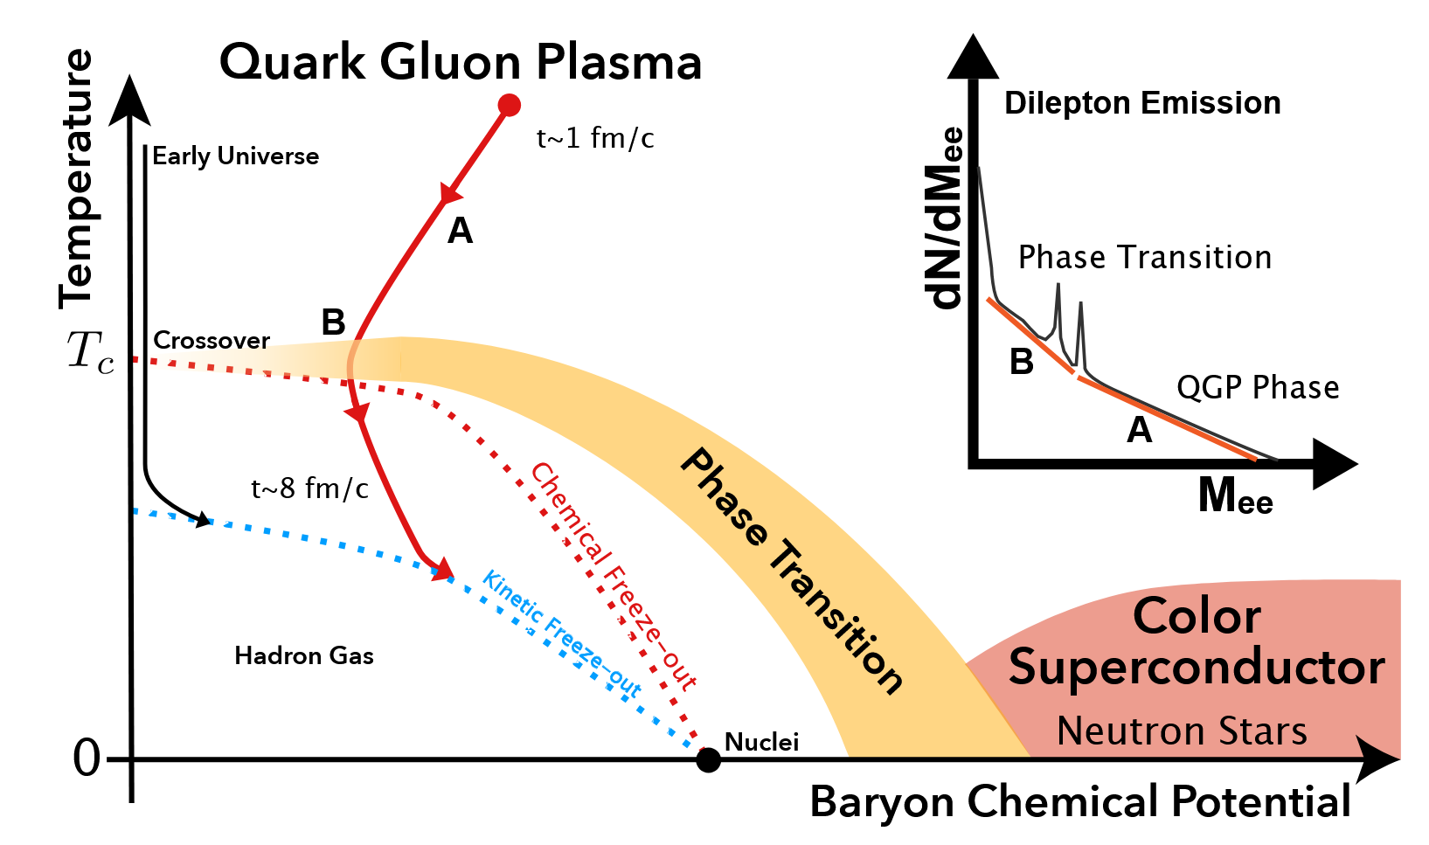
Dilepton production probing earlier dynamics
(15)
See talks by Chi Yang and Gaoqing Cao
STAR, ArXiv: 2402.01998 (2024).

Slide 23
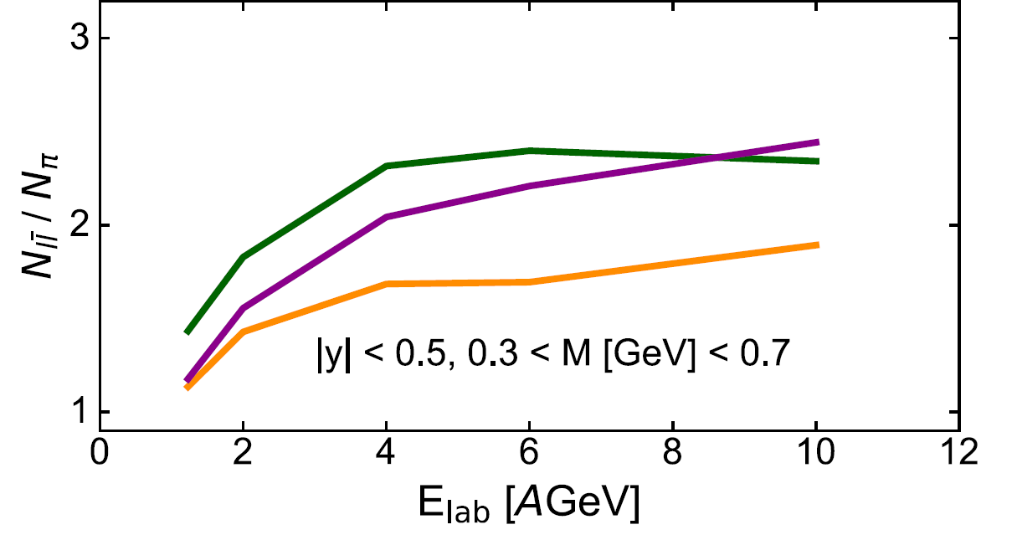



Dilepton production and QCD phase transitions
(16)
Dilepton and photon productions are not affected by strong force and emitted continuously at all stages of evolution.
Hadronic rescatterings tend to wash out the information from the EoS-driven expansion i.e. spinodal decomposition.
EM radiation may be sensitive to a local density clumping and a longer lifetime of the fireball when the medium undergoes a first-order phase transition.
The dilepton production rate is proportional to the square of parton density, more dileptons are produced when the density fluctuation is large.
The dilepton production serve as a thermometer.
first-order
crossover
F. Seck et. al., Phys. Rev. C 106, 014904 (2022).
O. Savchuk, et. al., J. Phys. G: Nucl. Part. Phys. 50, 125104 (2023).
R. Rapp and H. van Hees, Phys. Lett. B 753, 586 (2016).
crossover
first-order
F. Li and C. M. Ko, Phys. Rev. C 95, 055203 (2017).
J. Churchill, L. Du, et al., PRL 132, 172301 (2024).
F. Seck et. al., Phys. Rev. C 106, 014904 (2022).

Slide 24






Dilepton production rate
(17)
Cross section for quark, anti-quark pair to dilepton
Collision rate for quarks
Dilepton production rate
This approximation is more accurate when temperature is high.

Slide 25







Model validation: box calculation
(18)
$T_{n}$ are the local temperature of cells, $w_{n}$ are the weights, which are the product of density of quark and antiquark.
Temperature,
Density,
Energy density,
Effective mass
…
Invariant mass spectra of dileptons
is obtained by local cells.
is obtained by fitting the invariant mass spectrum of dilepton.
Assuming local thermal equilibrium.

Slide 26






Fireball calculation
(19)
Woods-Saxon type initial profiles
Contour plots of temperature and net-baryon density
$$Density ({fm}^{−1})$$
Fireball becomes bubble structure as time goes on.
Density gradient-driven expansion.
$t_{max}=10 fm/c.$
$$r (fm)$$

Slide 27




Result I: Medium temperature from dilepton production
(20)
Initial $T$
time
Dileptons are produced less and less when the system become more and more diluted.
Hydrodynamics and emission rates accurate at next-to-leading order in perturbation theory.
J. Churchill, L. Du, et al., PRL 132, 172301 (2024).

Slide 28


Dilepton production as a thermometer
(21)
See talks by Chi Yang and Gaoqing Cao
HADES, Nat. Phys. 15, 1040 (2019).
STAR, ArXiv: 2402.01998 (2024).
To appear on Nature Communications

Slide 29


Result II: In-medium quark mass from dilepton production
(22)
Chiral restoration
Chiral breaking
Effective quark mass as a function of evolution time
Temperature and in-medium quark mass extracted from the invariant mass spectra of dileptons
The effective quark mass gradually increases as the system expands due to the spontaneous breaking of chiral symmetry at lower densities and temperatures.
Results suggest that dilepton production is a sensitive probe to chiral symmetry restoration in heavy-ion collisions.

Slide 30

Summary and outlook
(23)
Large density inhomogeneities generated by the spinodal instability during the first-order QCD phase transition can survive the fast expansion of the subsequent hadronic matter and lead to an enhanced $tp/d^{2}$ in central Au+Au collisions at $\sqrt{s_{NN}}=$3 − 5 GeV for $T_{c}≥80$ MeV.
The dilepton production can serve as a thermometer for the produced partonic matter
The dilepton production provides a feasible tool to probe chiral symmetry restoration
Provide more realistic calculations including hadronic evolution on chiral symmetry restoration
Explore the spinodal enhancement effect on dilepton production

Slide 31
Backup

Slide 32





Dilepton production in heavy-ion collisions
Dileptons are perturbatively produced both in partonic and hadronic phases.
Cocktail includes dilepton production from variety of sources.
“Excess” = “Data” – “Cocktail”
Mainly from QGP and $ρ$in-medium.
STAR, Phys. Rev. C 92, 024912 (2015).
O. Linnyk, E.L. Bratkovskaya, W. Cassing, PPNP 87, 50 (2016).

Slide 33




Dilepton production in heavy-ion collisions
QGP:
$ρ^{0}$:
G.-Q. Li and C. M. Ko, NPA 582, 731 (1995).

Slide 34







Experimental results
S. Endres, et al., PRC 91, 054911 (2015).
STAR, PLB 750, 64 (2015).
STAR, PRC 107, L061901 (2023).
IMR is mainly contributed by partonic scattering.
R. Rapp and H. van Hees, PLB 753, 586 (2016).
STAR, ArXiv: 2402.01998 (2024).

Slide 35




Experimental results
PHENIX, PRC 107, 024914 (2023).
HADES, Nat. Phys. 15, 1040 (2019).
PHENIX, PRC 109, 044912 (2024).
STAR, ArXiv: 2402.01998 (2024).

Slide 36


Phase trajectory
$$Spinodal$$
$$Spinodal$$

Slide 37







Effects of collective flow
Introducing collective expansion
1. initial flow vector
2. vector coupling
The larger $R_{V}$, the more repulsive force the quark can be felt.
$2^{3} {fm}^{3}$
Stream plots of velocities at the $XOY$-plane within $|z| < 1$ fm at different times
Phase trajectories of fireball with same temperatures

Slide 38



Beam Energy Scan

Slide 39






Equation of state
K.-J. Sun, C. M. Ko, S. S. Cao, F. Li, Phys. Rev. D 103, 014006 (2021).
Finite negative $G_{SV}$ term can obtain higher critical point temperature and bigger area of spinodal region.

Slide 40


Transport approach
A Relativistic Transport model (ART)
nuclei
spectators
Parton Transport with Nambu-Jona-Lasinio (NJL)
A + B
HIJING
energy in
Quark Coalescence
excited strings
minijet partons
Deformed nuclei
quark-antiquark
$$q+\overline{q}→l^{+}+l^{−}$$
$ρ$-mesons decay
$ρ^{0}→$ $l^{+}+l^{−}$
fragment to
partons
partonic
evolution
quark
coalescence
hadronic
rescatterings

Slide 41




Dilepton production in Au+Au system
Integral invariant mass yields of dileptons
Invariant mass spectra of dileptons
LMR is dominated by $ρ^{0}$ decay;
IMR is dominated by quark and antiquark annihilations.
Dilepton yields are normalized by charge particles yields to reduce the volume effect and model dependence.

Slide 42








Equation of state of partonic matter
Nambu-Jona-Lasinio model
Thermodynamics
Quark densities
scalar
pseudo-scalar
Quark masses (gap equations)
vector
pseudo-vector
KMT interaction
Mean field approximation
Quark condensates
Y. Nambu and G. Jona-Lasinio, Rhys. Rep. 122, 235 (1961); 124, 246 (1961).
W.-H. Zhou, et al., PRC 104, 044901 (2021).

Slide 43









Dynamics of partonic matter
Transport approach
Single particle Hamiltonian
Equation of motions
Effective electromagnetic fields
Effective vector fields
Boltzmann equation
Stochastic collision criterion
Pauli blocking process is included
Z. Xu, C. Greiner, PRC 71, 064901 (2005).
W/o Pauli blocking
With Pauli blocking
C. M. Ko, et al., NST 24, 050525 (2013).

