Slide 1

The QCD Phase Diagram: From Theory to Experimental Signatures
Dilepton emission as a novel probe of QCD critical point
Gaoqing Cao
School of Physics and Astronomy Sun Yat-sen University
Collaborators: Xiaofeng Luo and Weijie Fu
Theoretical project
2025.10.10 @ Dalian University of Technology

Slide 2
Outline
QCD phase diagram and novel probes
Extended Polyakov-quark-meson model
Dilepton emission rate
Integrated dilepton emission rate and moments
Summary

Slide 3
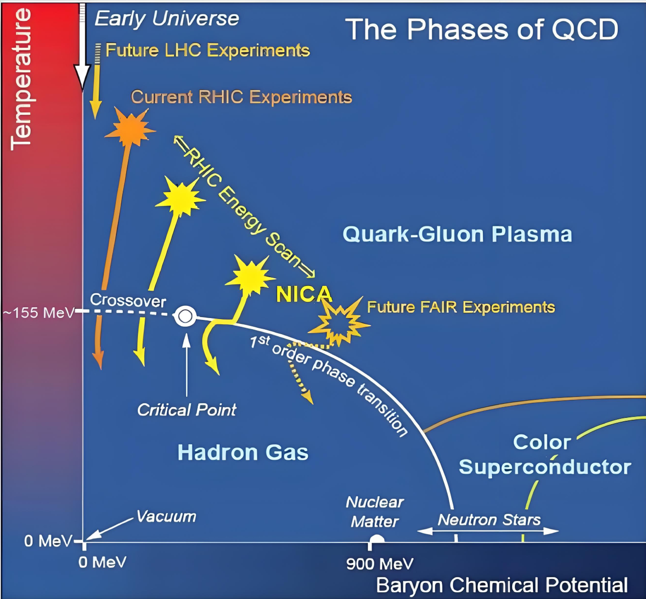
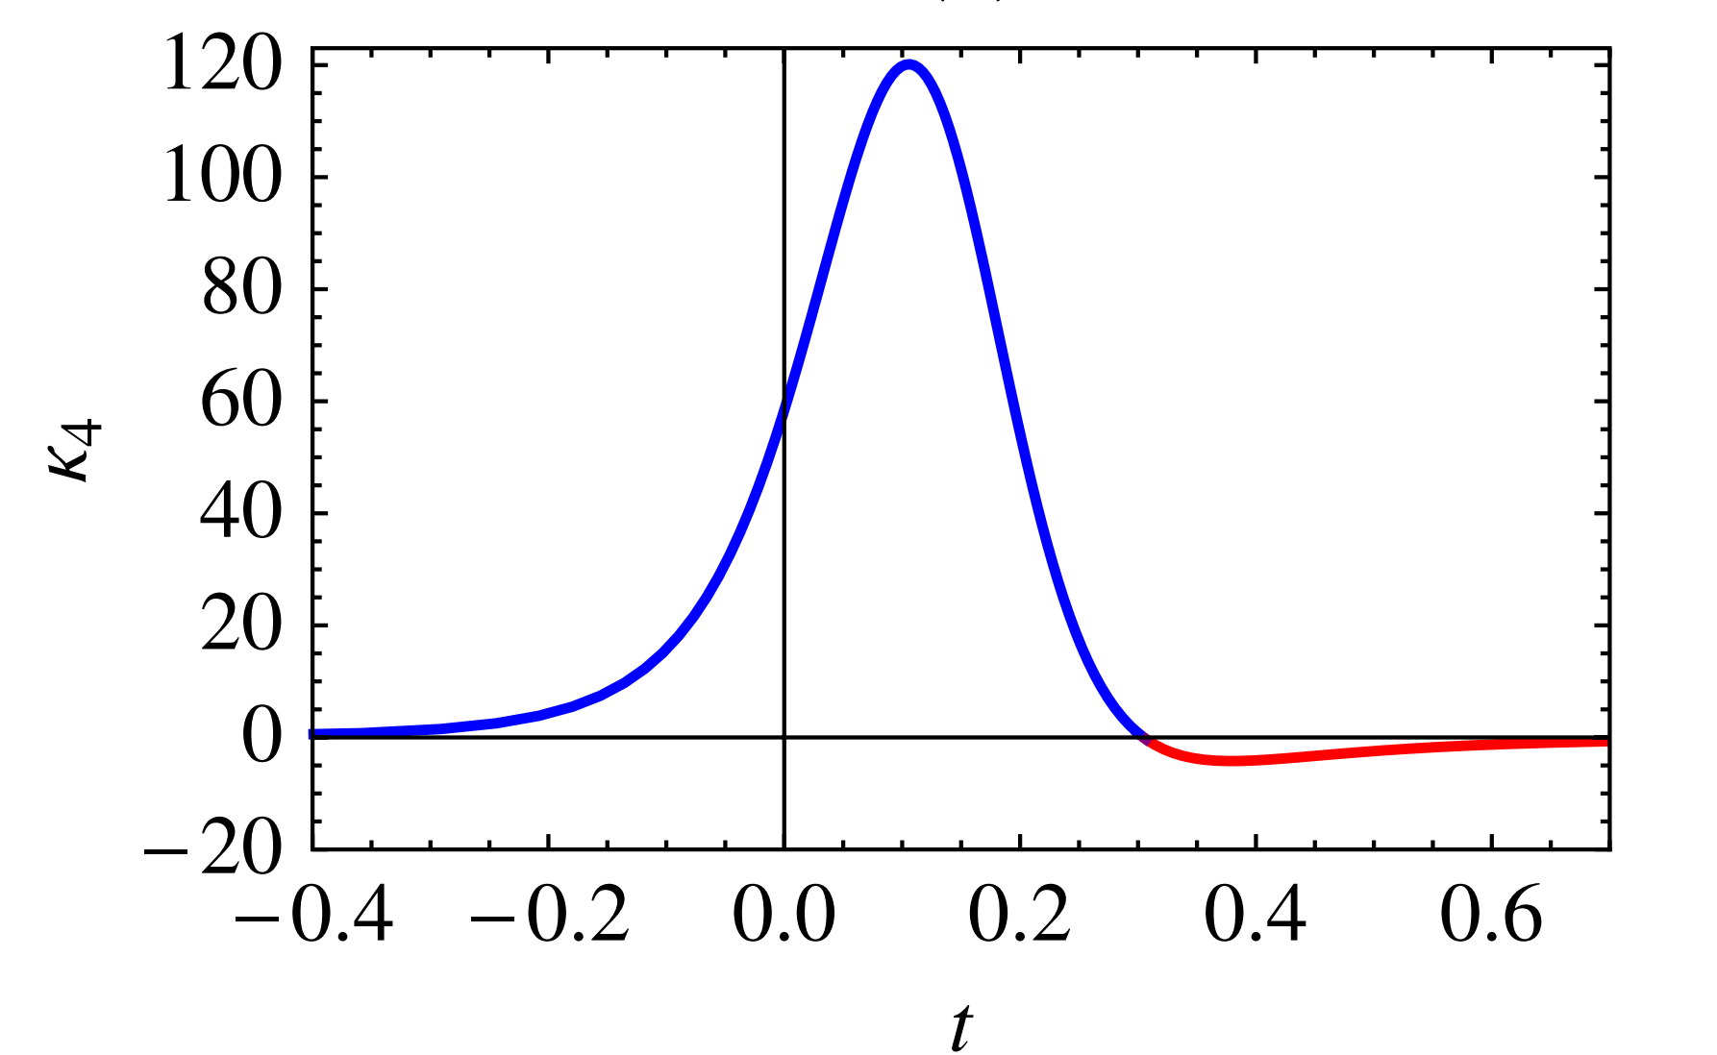
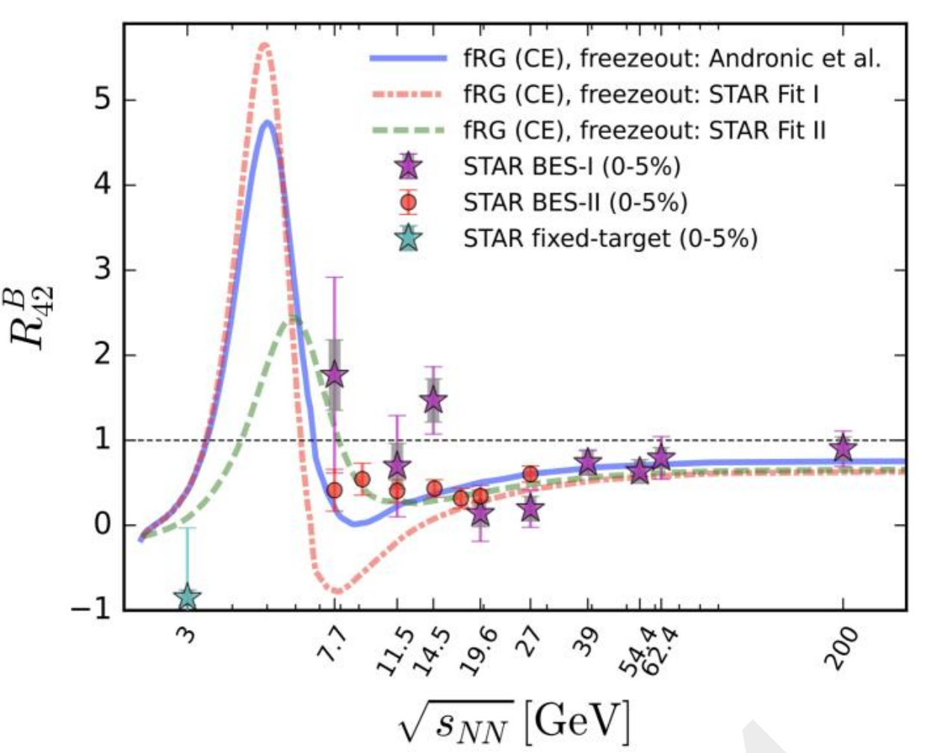
QCD phase diagram and baryon number fluctuations
M. A. Stephanov, PRL (2011)
W. Fu et. al., PRD (2025)

Slide 4

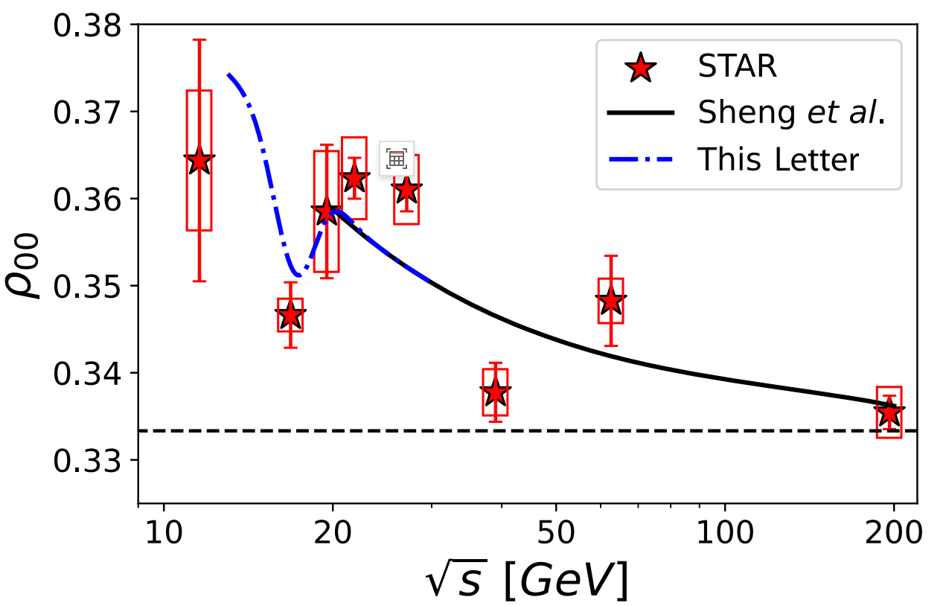
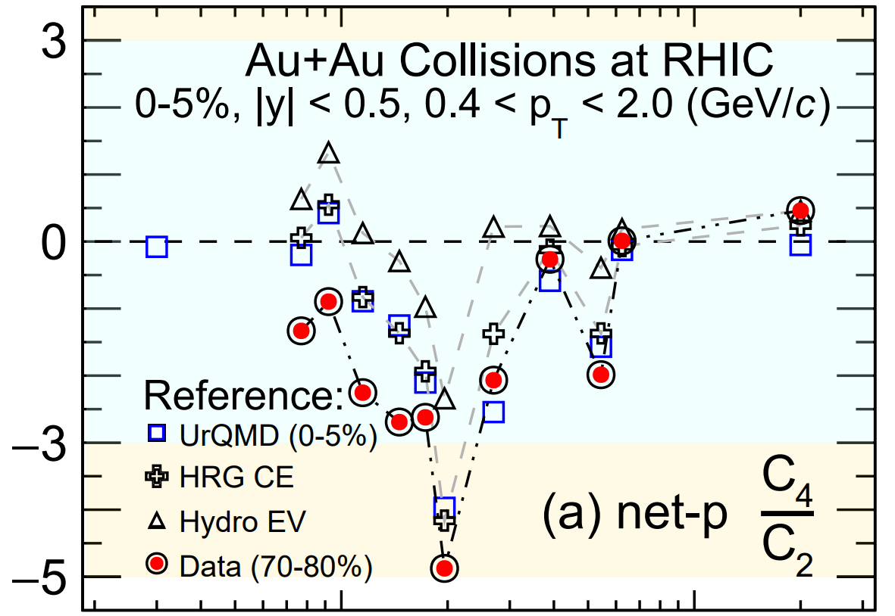
New supports
Spin fluctuations
STAR Collaboration, PRL (2025)
H.L. Chen et. al., PRL (2025)

Slide 5
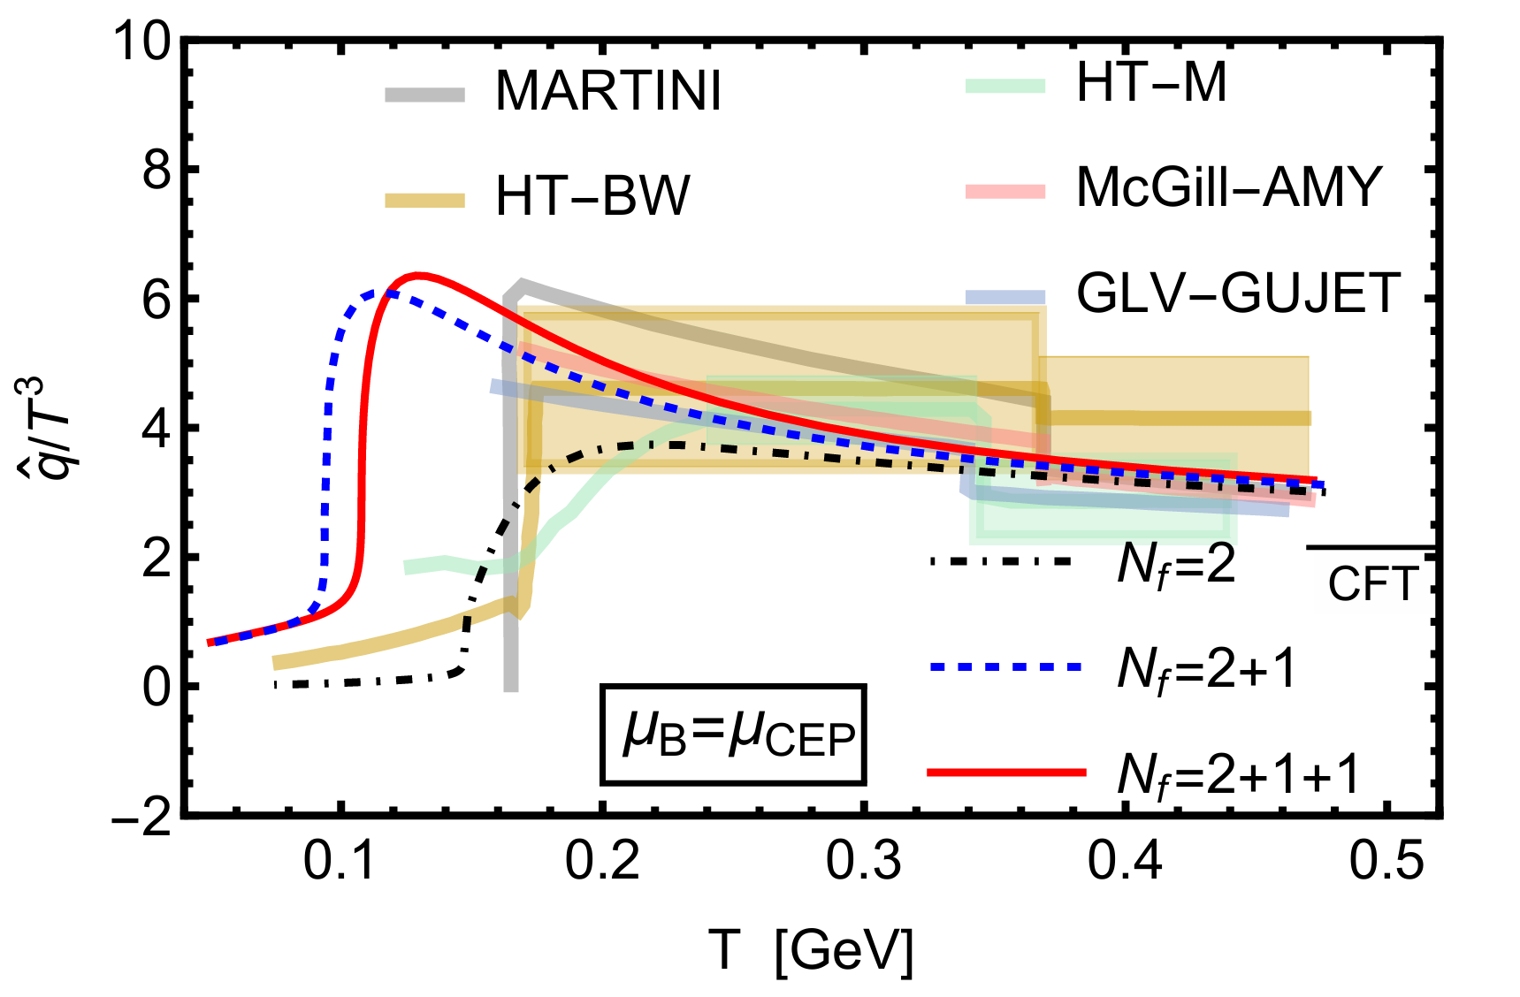
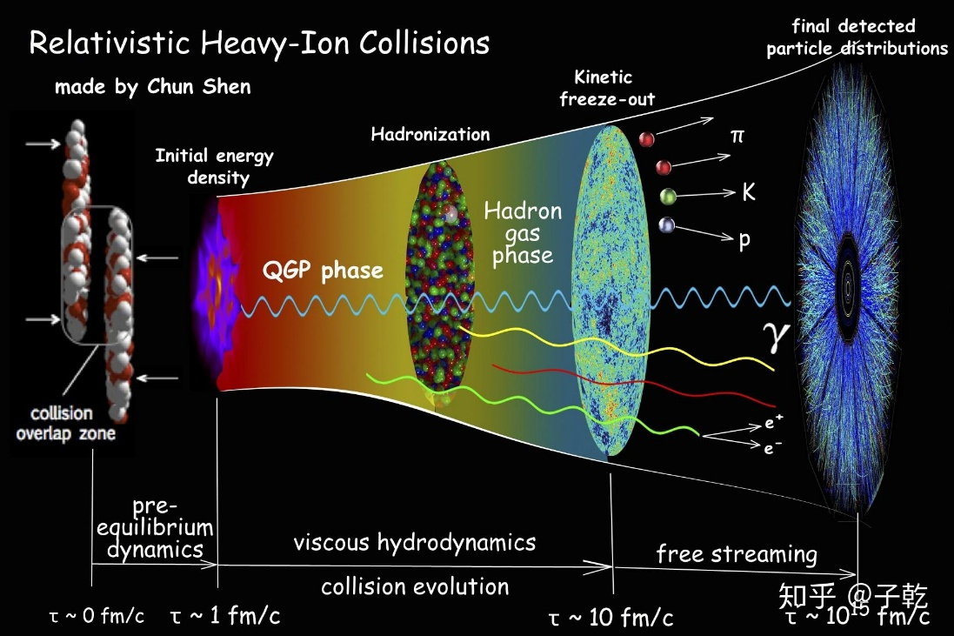
Novel probes --- cross check
Probes of quark-gluon plasma:
heavy quarkonia, jets, dileptons and photons
QCD critical opalescence?
Easy to detect、high illuminations in CBM
Z. Li, D. Li and M. Huang, PRD (2025)

Slide 6
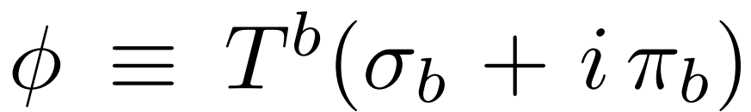
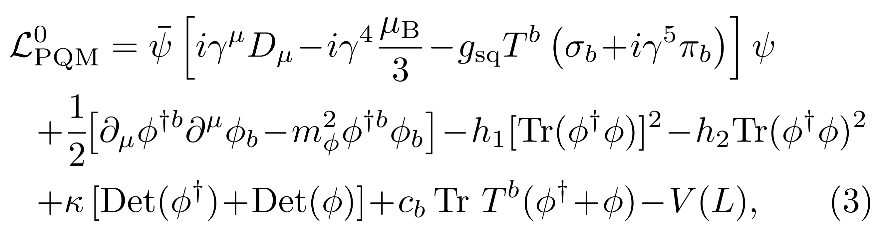
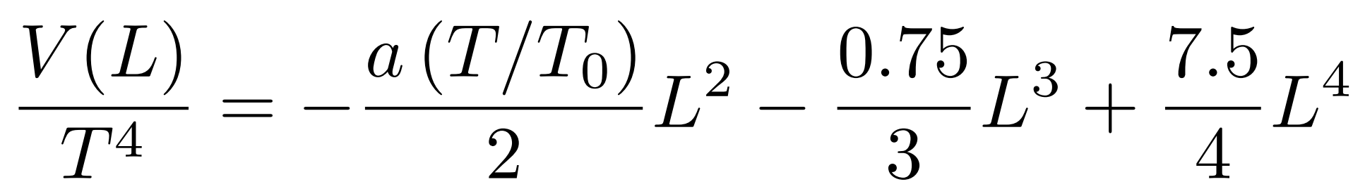
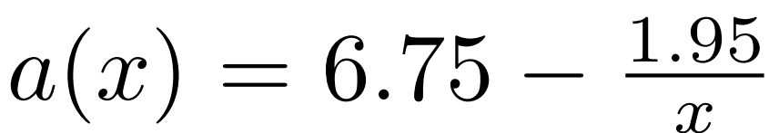
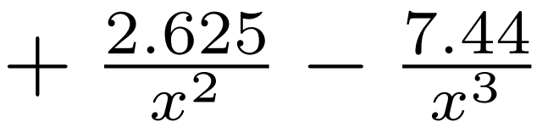
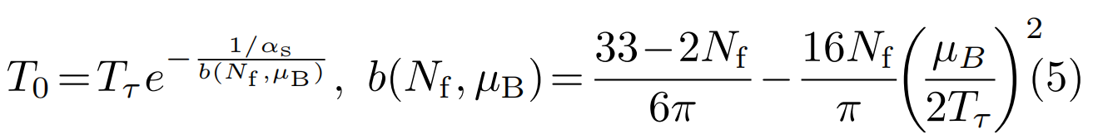

Extending the three-flavor PQM model
Original Lagrangian
B. J. Schaefer et. al., (2010).
Gluon potential
Polyakov loop
C. Ratti et. al., PRD (2006).
T. K. Herbst et. al., PLB (2011).

Slide 7
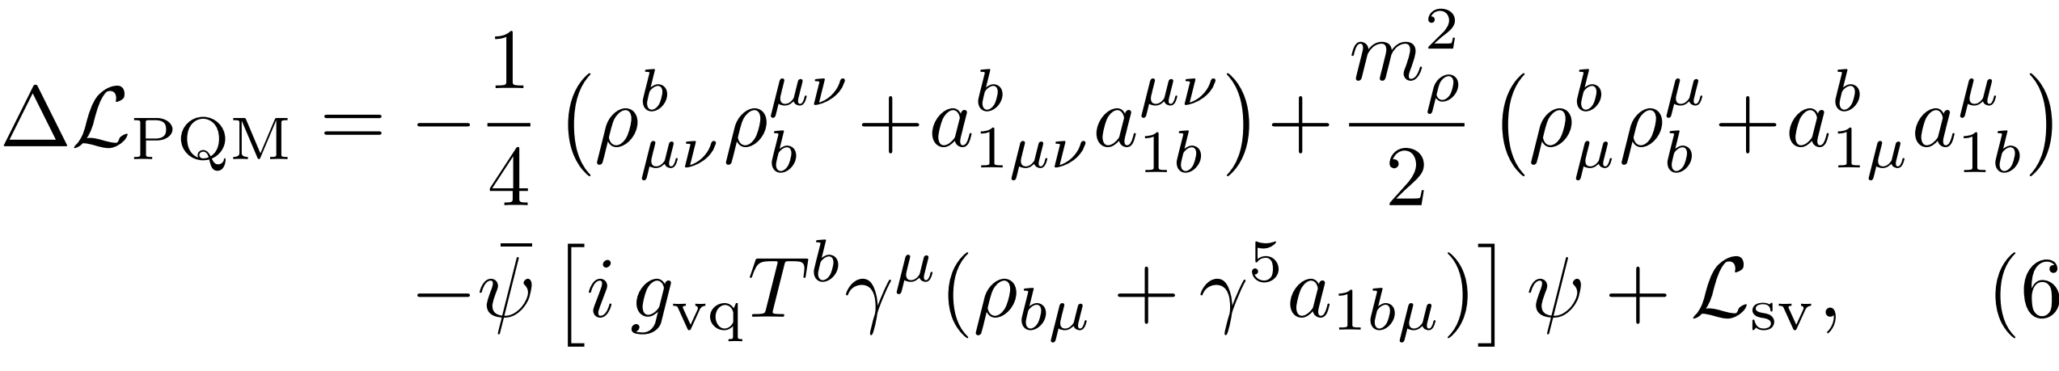
Vector dominance
R. D. Pisarski, PRD (1995).
Compared to ω and φ, ρ0 is supposed to be the most sensitive to study the SU(2) chiral symmetry breaking and restoration as it mostly decays through π +π− and is not chiral invariant.

Slide 8
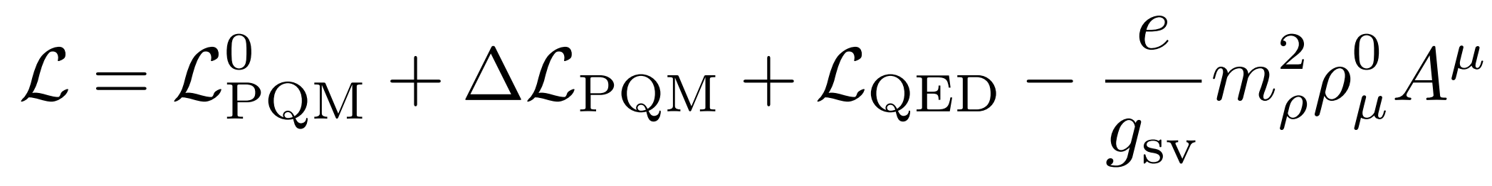
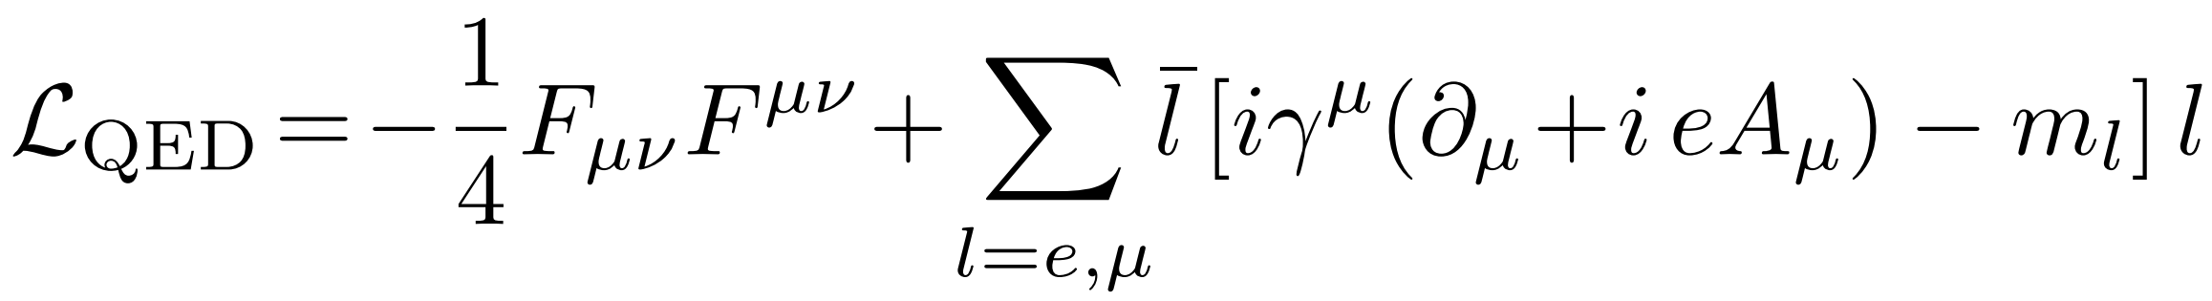
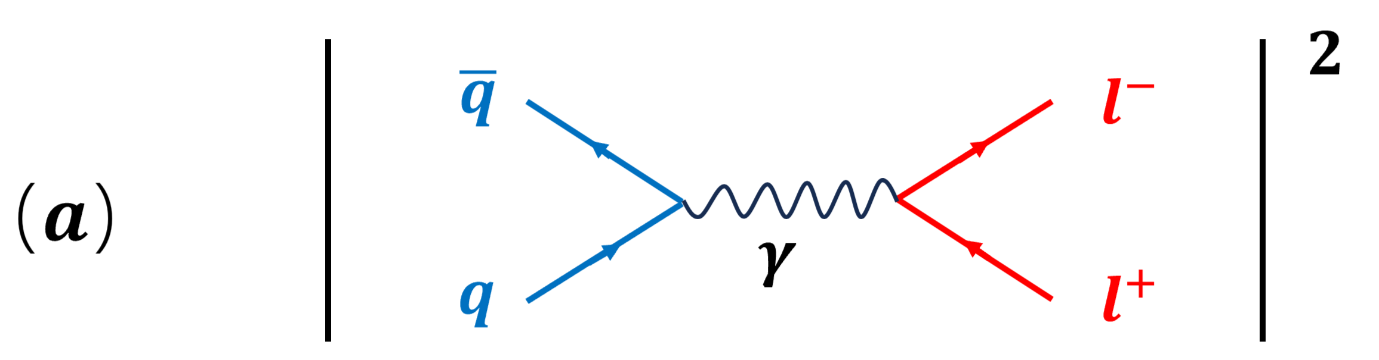
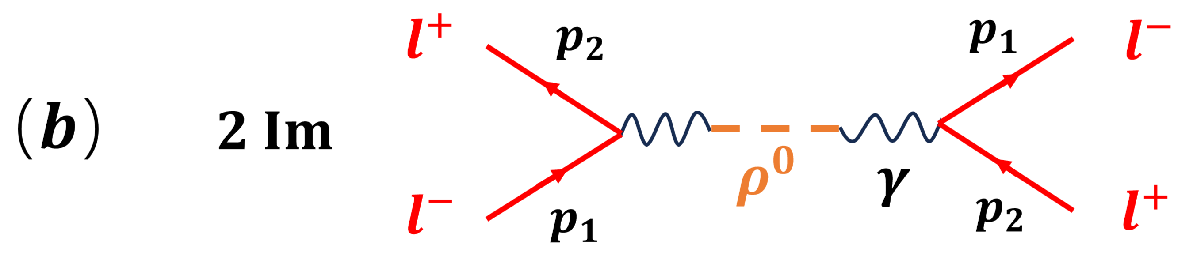
The mechanisms of dilepton production
Total Lagrangian
Quark-gluon plasma phase
Hadronic phase
K. Kajantie et. al., (1986)
C. Gale and J. I. Kapusta, NPB (1991).

Slide 9
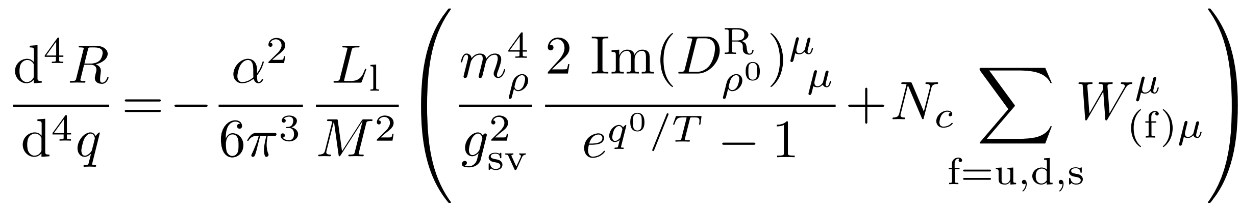
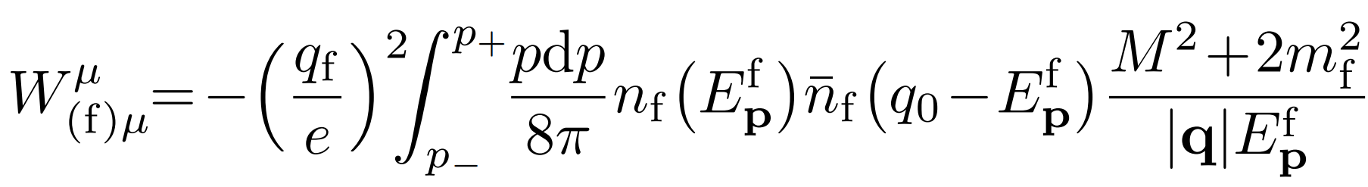
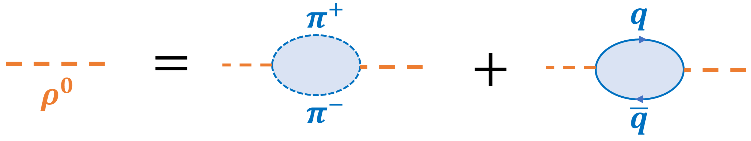
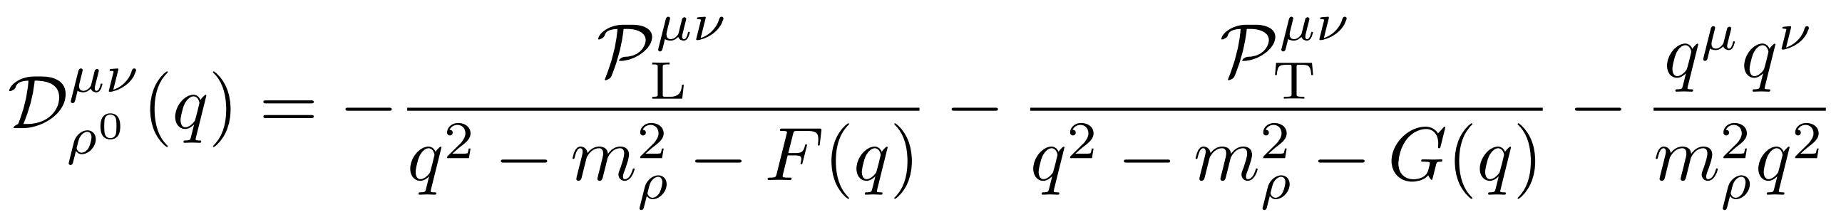



Dilepton emission rate
$$(b)$$
$$(a)$$
L. D. McLerran, PRD (1987).
(a) QED effect
(b) $π^{±}$ and quark loops

Slide 10
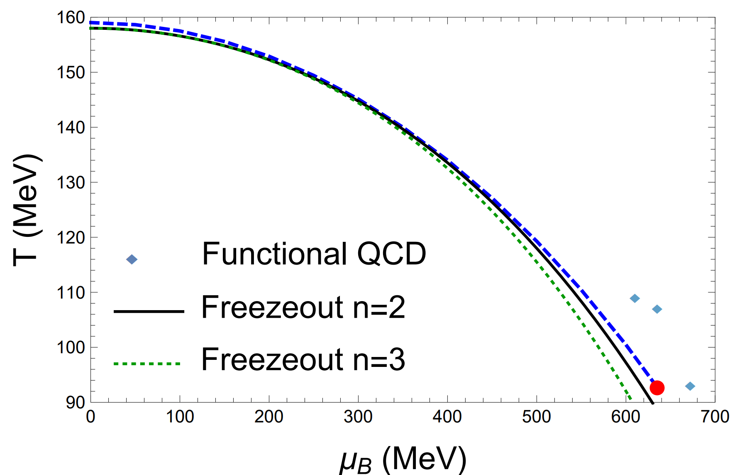

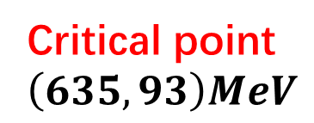
The phase diagram at mean field approximation
$$T_{ps}=159 MeV$$
Critical point
$$\left(635, 93\right)MeV$$
In good agreement with LQCD and functional QCD
The Freezeout lines
X. Luo and N. Xu, NST (2017)

Slide 11
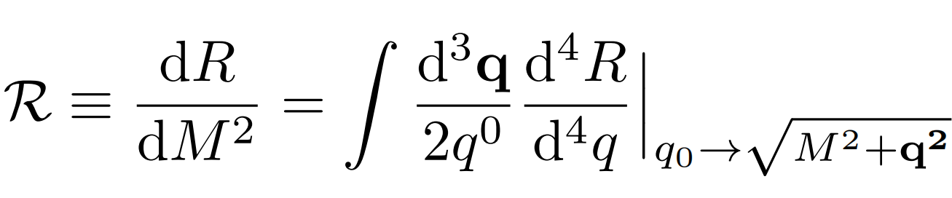
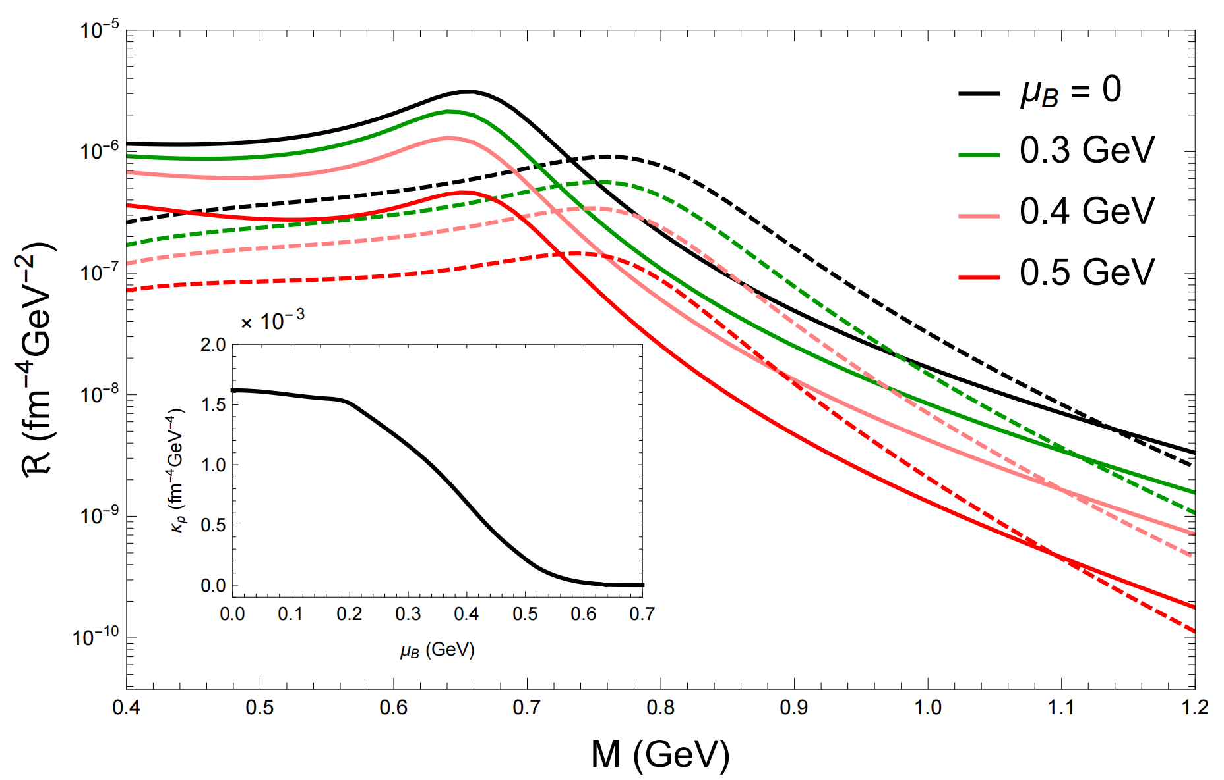
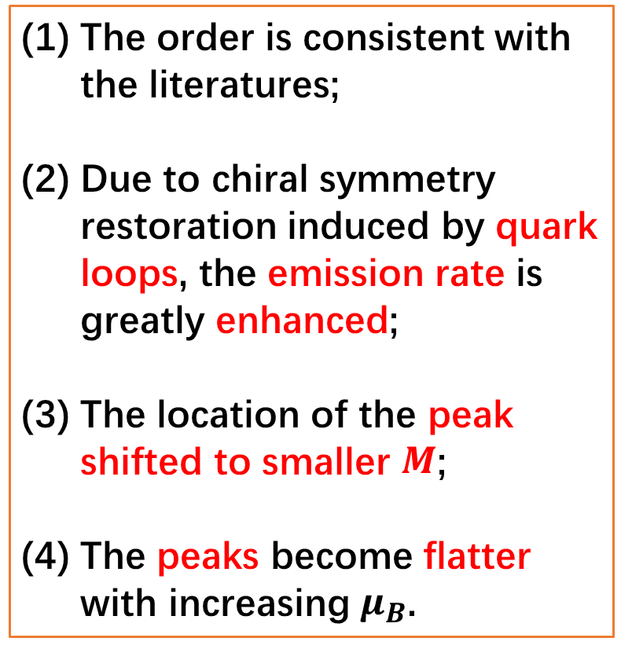
Integrated dilepton emission rate
The order is consistent with the literatures;
Due to chiral symmetry restoration induced by quark loops, the emission rate is greatly enhanced;
The location of the peak shifted to smaller $M$;
The peaks become flatter with increasing $μ_{B}$.
R. Rapp and J. Wambach, ANP (2000)
A. Bazavov et. al. , PRD (2019)

Slide 12
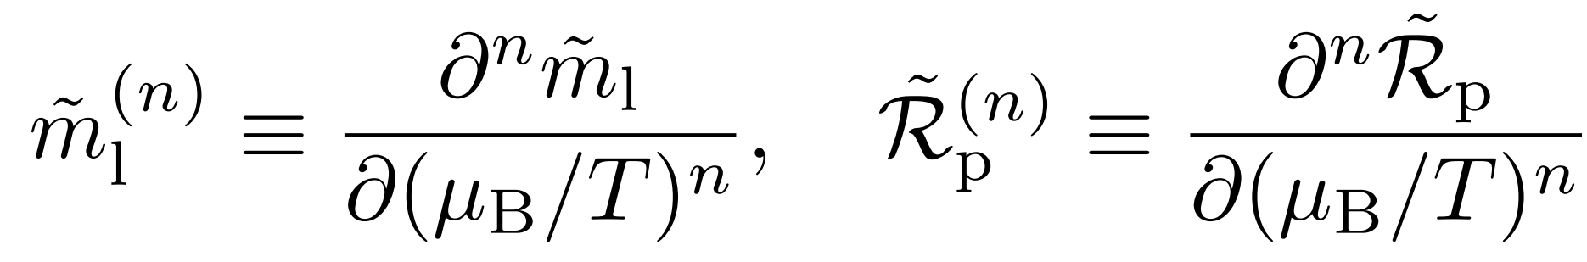
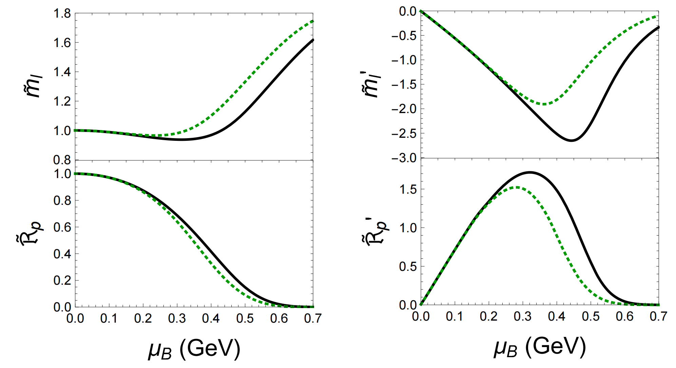
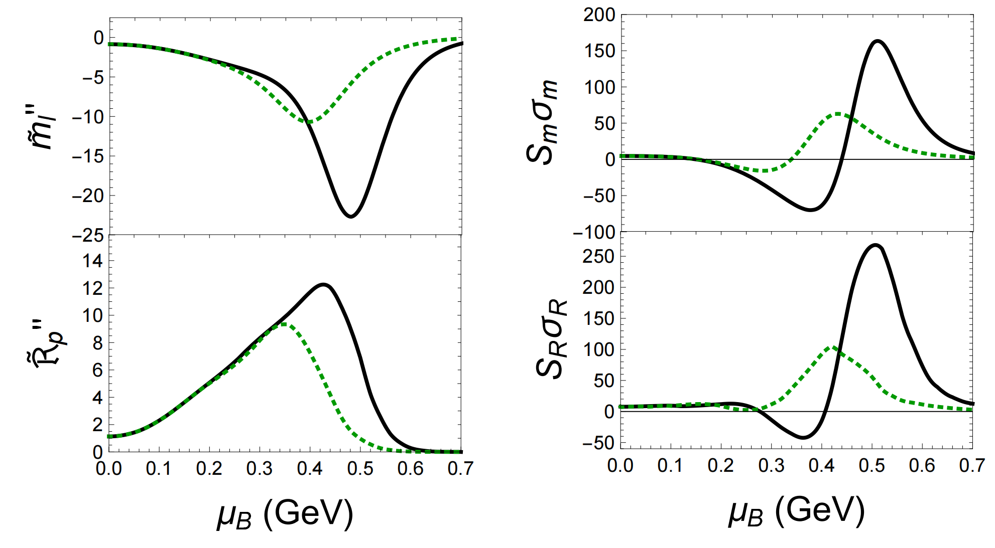
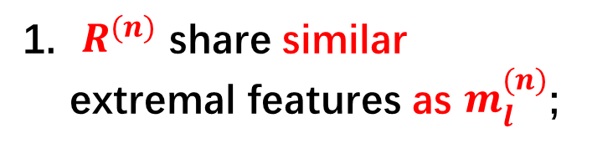

The moments of quark mass and DER
$R^{(n)}$ share similar extremal features as $m_{l}^{(n)}$;
Compare to baryon kurtosis $κ_{B}σ_{B}^{2}\sim 5$, $S_{R}σ_{R}$ and $S_{m}σ_{m}$ is more
sensitive to critical point and its location

Slide 13
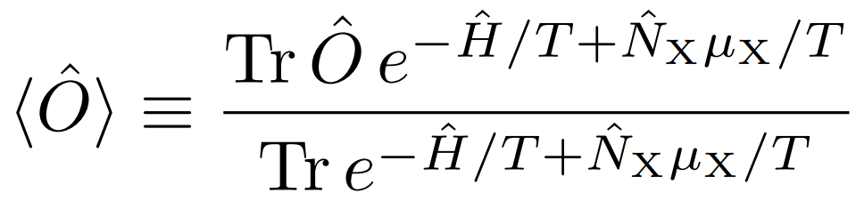
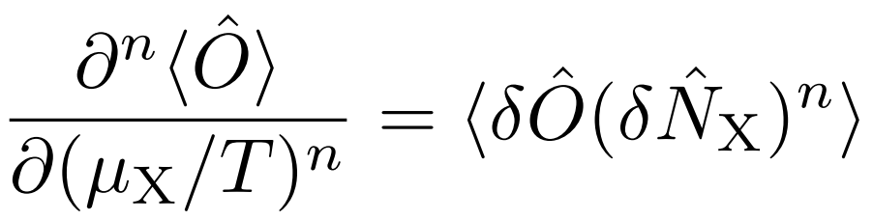
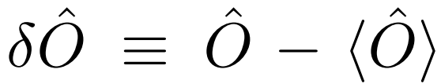
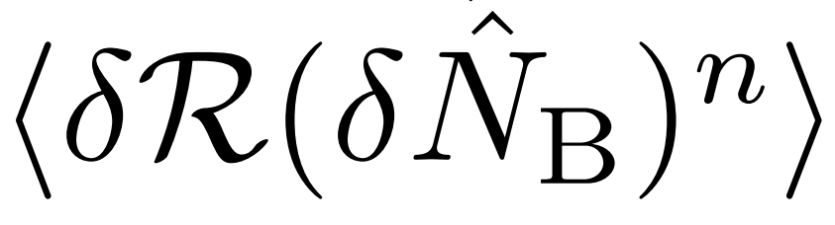

Summary and discussion
Dilepton emission rate is a nice and
sensitive probe of QCD critical point
$$n=1,2$$
Experimental observables for the DER moments

