Slide 1


Baryon-strangeness Correlation and QCD Phase diagram
The QCD Phase Diagram: From Theory to Experimental Signatures
Rui Wen
University of Chinese Academy of Sciences
2025.10.11
Based on: W.-j. Fu, C. Huang, J. M. Pawlowski, F. Rennecke, R. Wen, S. Yin. (2025) in preparation
collaboration: J. Braun, Y.-r. Chen, W.-j. Fu, F. Gao, F. Ihssen, A. Geissel, C. Huang, J. M. Pawlowski, F. Rennecke, F. R. Sattler, B. Schallmo, J. Stoll, Y.-y. Tan, S. T¨opfel, J. Turnwald, R. Wen, J. Wessely, N. Wink, S. Yin, H.-w. Zheng and N. Zorbach, (2025).

Slide 2
Outline
Introduction
The 2+1 flavor QCD Theory within FRG
Numerical results
Gluon propagator; quarks and mesons mass; chiral condensates
QCD phase structure
2nd order susceptibilities (B-S Correlation)
Summary

Slide 3
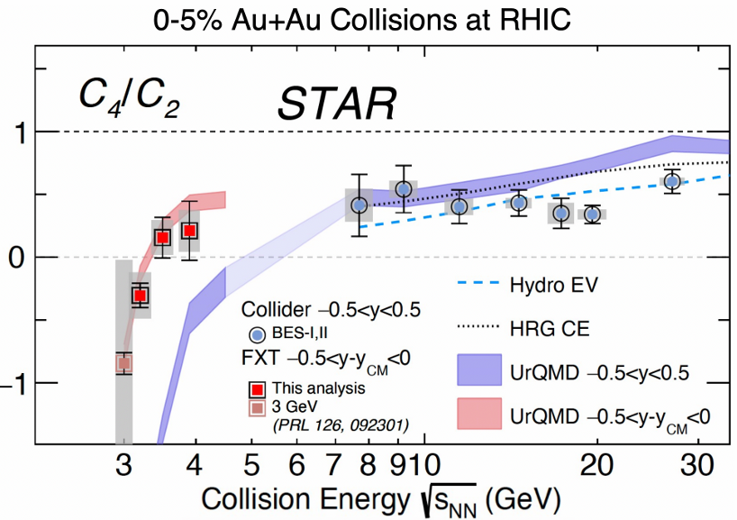
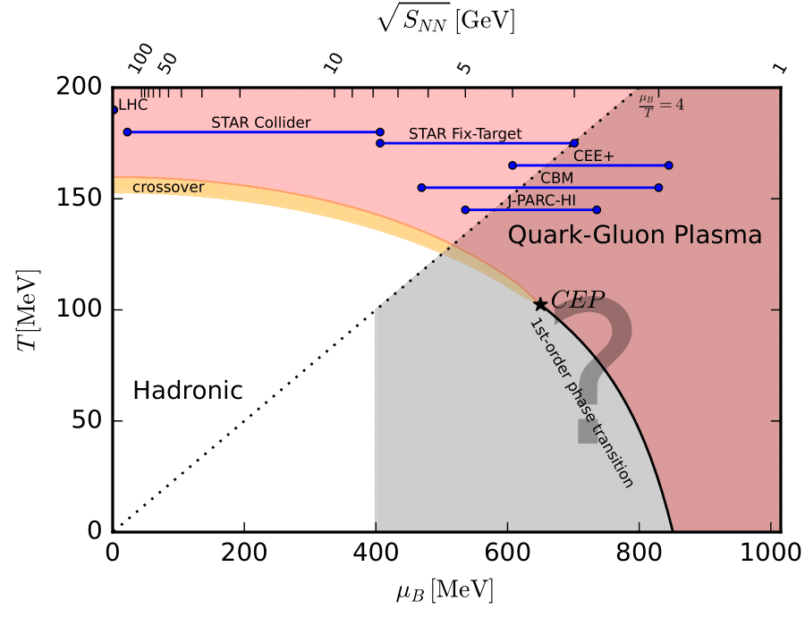
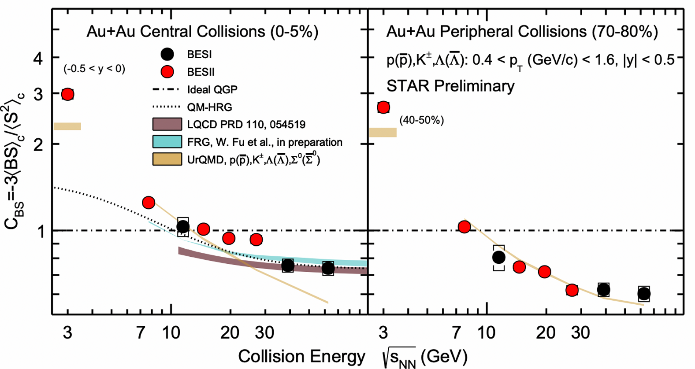
Introduction
STAR Collaboration, QM2025
STAR Collaboration, QM2025

Slide 4
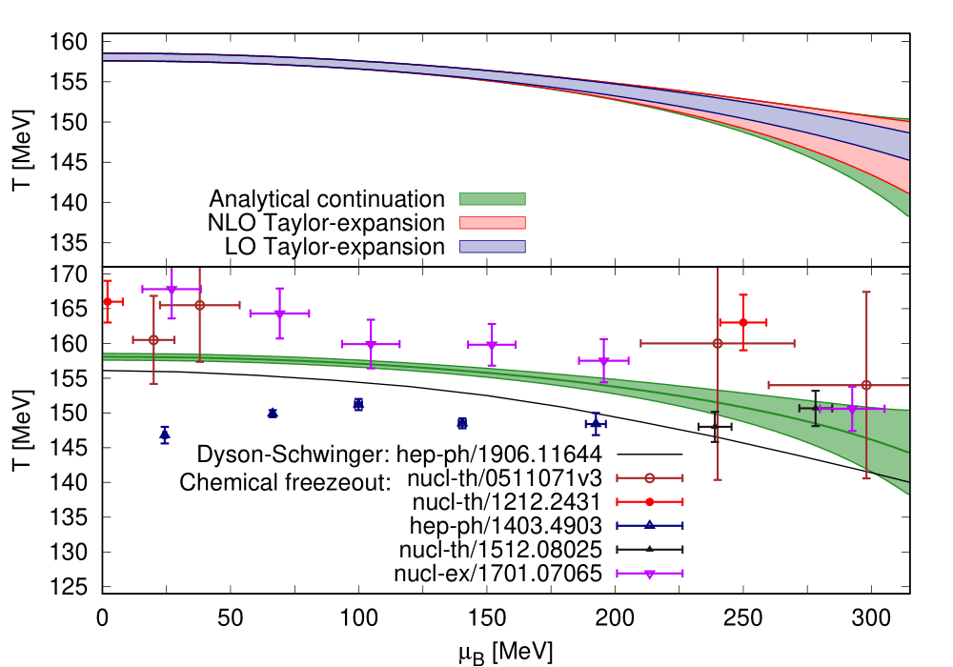
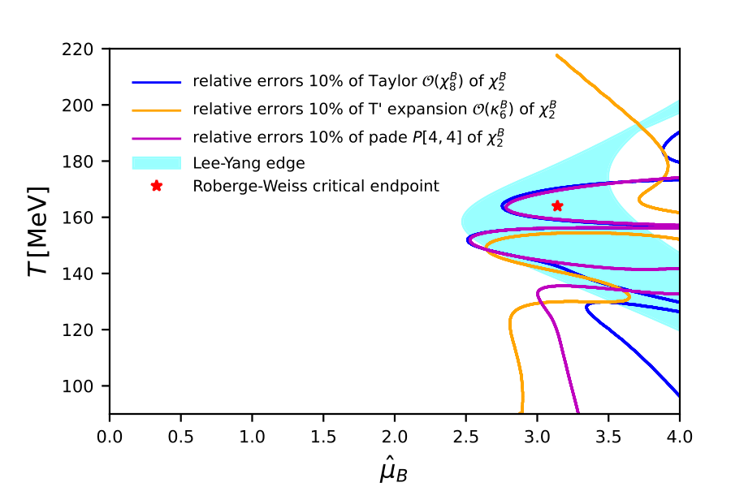
Introduction
PQM model
Rui Wen, Shi Yin, Wei-jie Fu. Phys.Rev.D 110 (2024), 016008
Szabolcs Borsanyi, et. al.
Phys. Rev. Lett. 125, 052001 (2020)

Slide 5
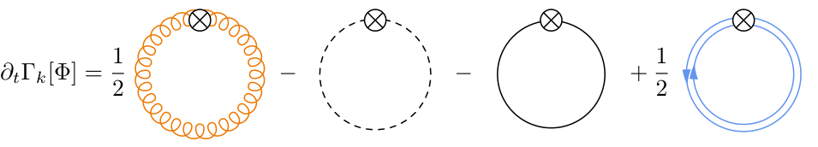
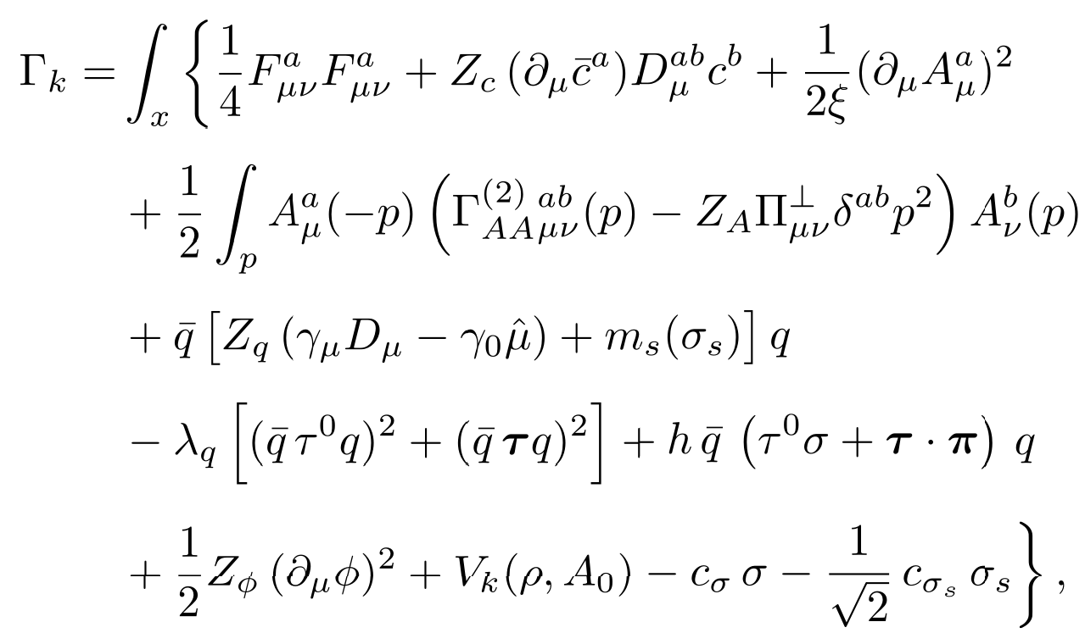
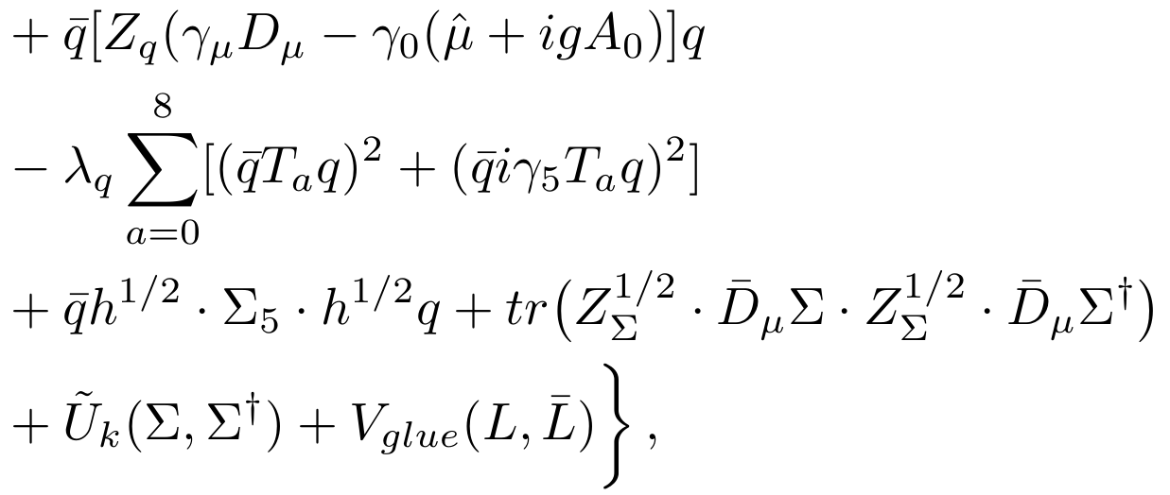

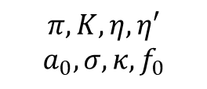


The 2+1 flavor QCD Theory within FRG
$$π,σ$$
$$π,K,η,η′$$
$$a_{0},σ,κ,f_{0}$$
Glue sector
Matter sector
$$q={\left(l,l,s\right)}^{T}$$
W-j Fu, J.M. Pawlowski, F. Rennecke, Phys.Rev.D 101 (2020) 5, 054032
Instantons information k≳700 [MeV]
J.M. Pawlowski Phys.Rev.D 58 (1998) 045011

Slide 6
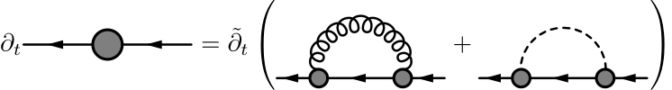
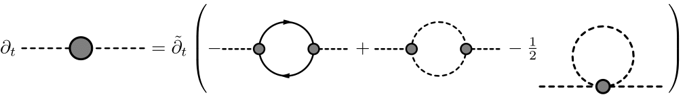
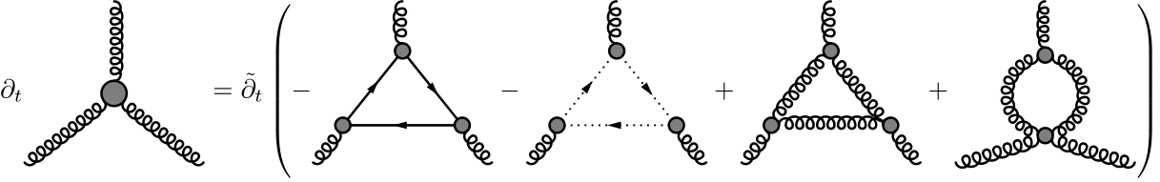
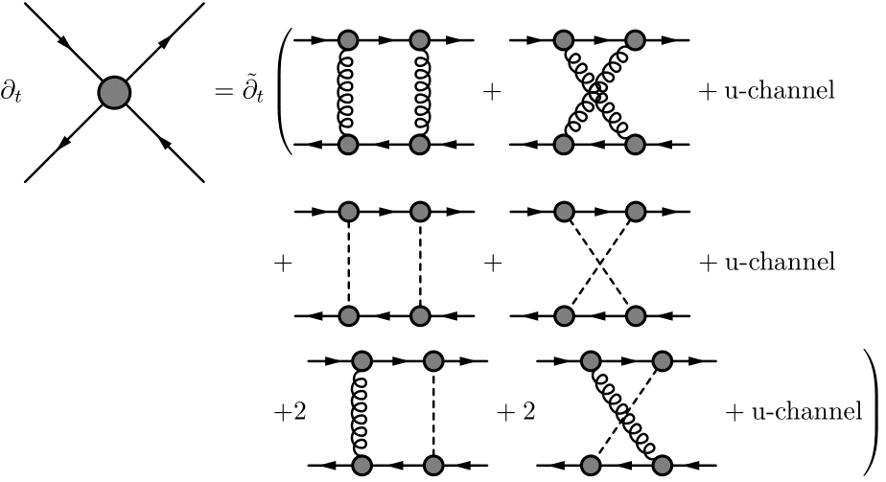
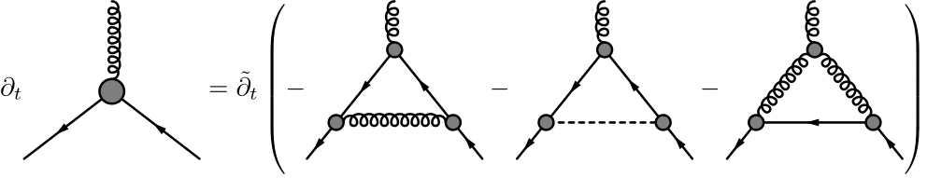
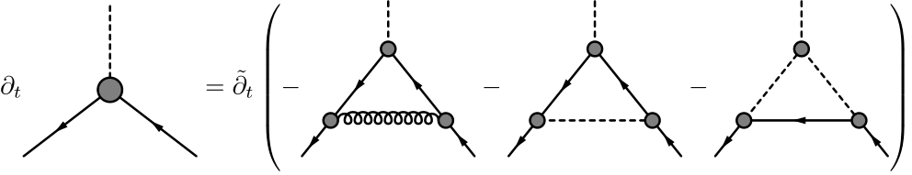
The flow equations

Slide 7
The flow equations
propagators :
vertices:

Slide 8
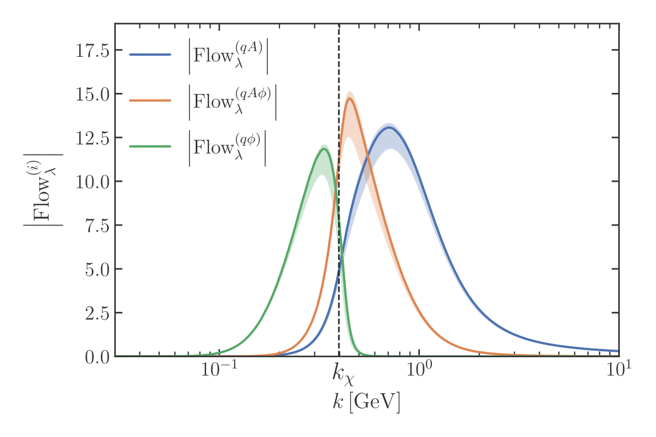
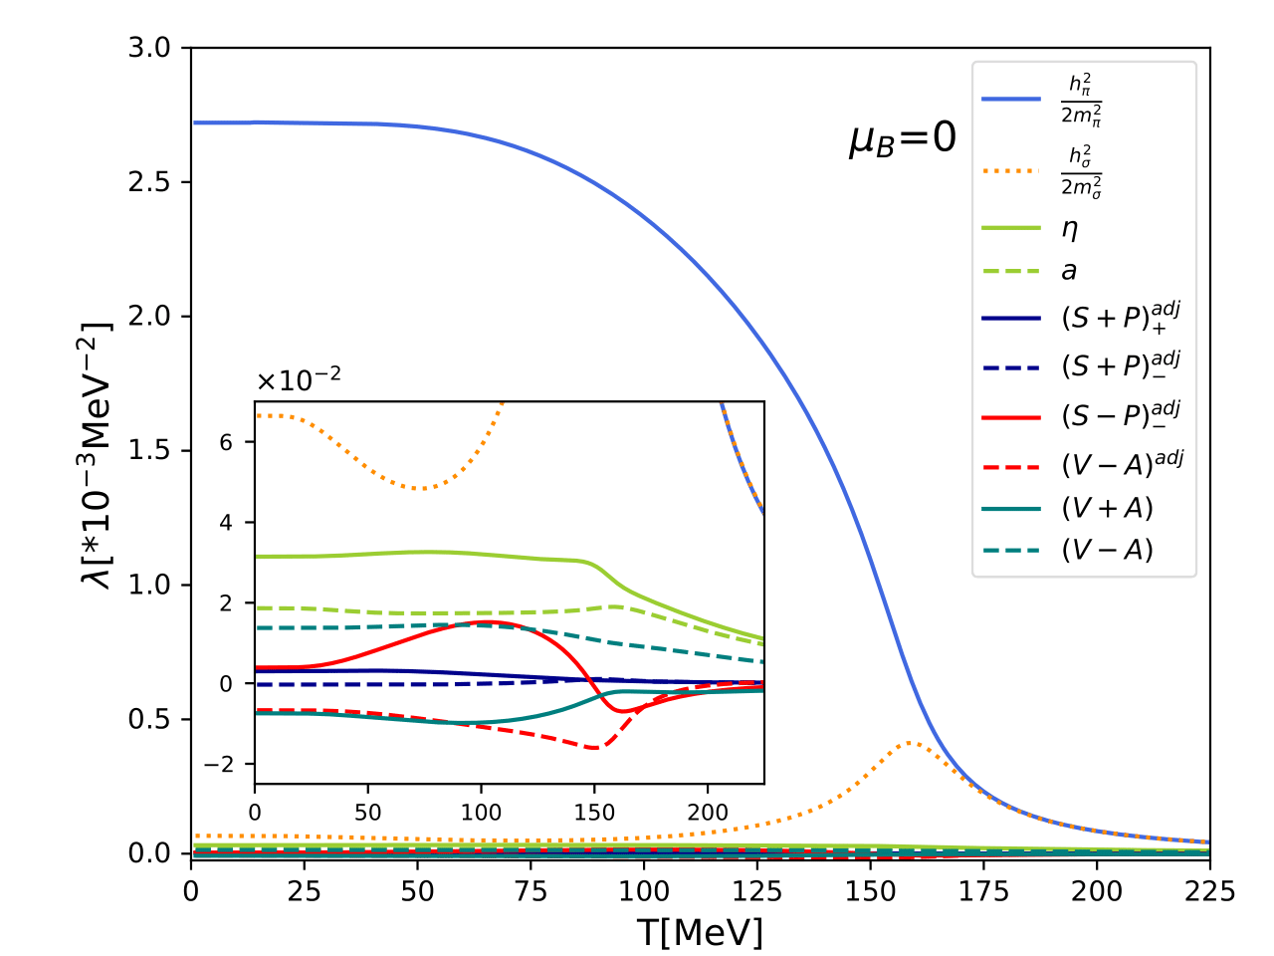
Four-quark vertex
F. Ihssen, J. M. Pawlowski, F. R. Sattler, N. Wink, arXiv:2408.08413
W.-j. Fu, C. Huang, J. M. Pawlowski, Y.-y Tan, L.-j. Zhou arXiv: 2502.14388
Ignore the mixed quark-gluon-meson box
The scalar and pseudoscalar channel
Preliminary
Fierz-complete
Z.-n. Wang, C. Huang, R. Wen, S. Yin, W.-j. Fu, (2025) in preparation

Slide 9
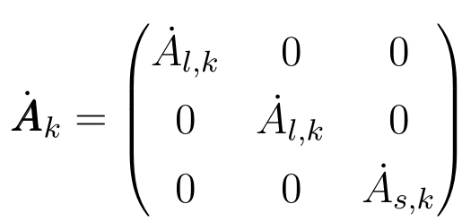
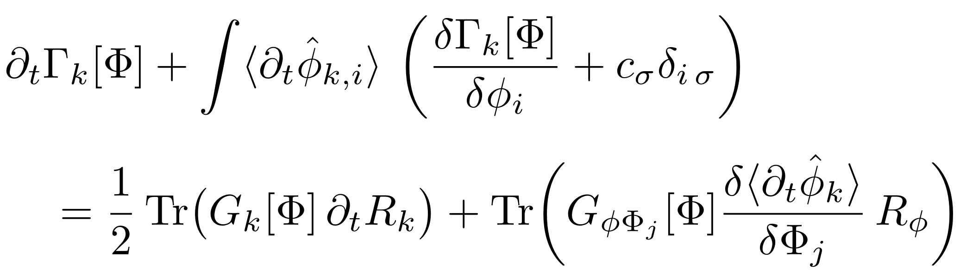
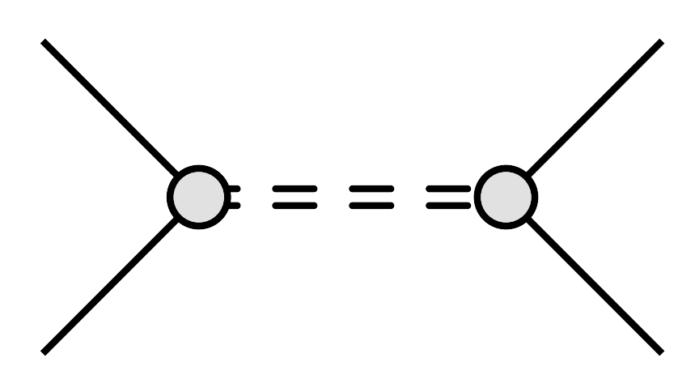

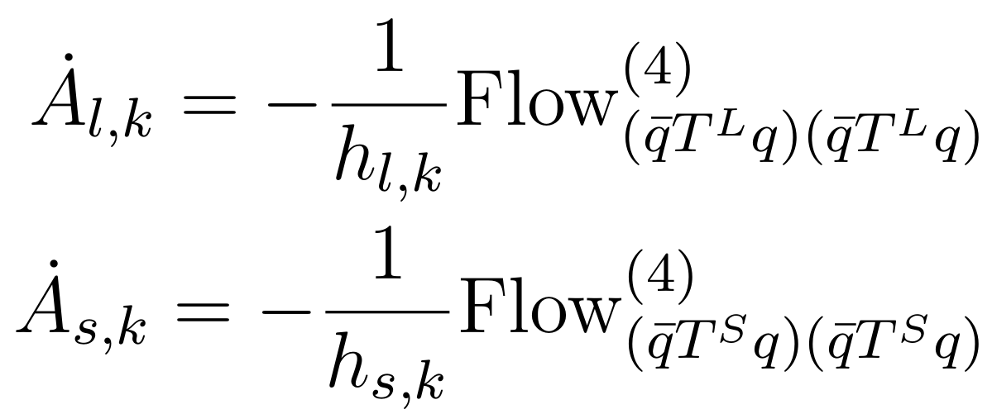
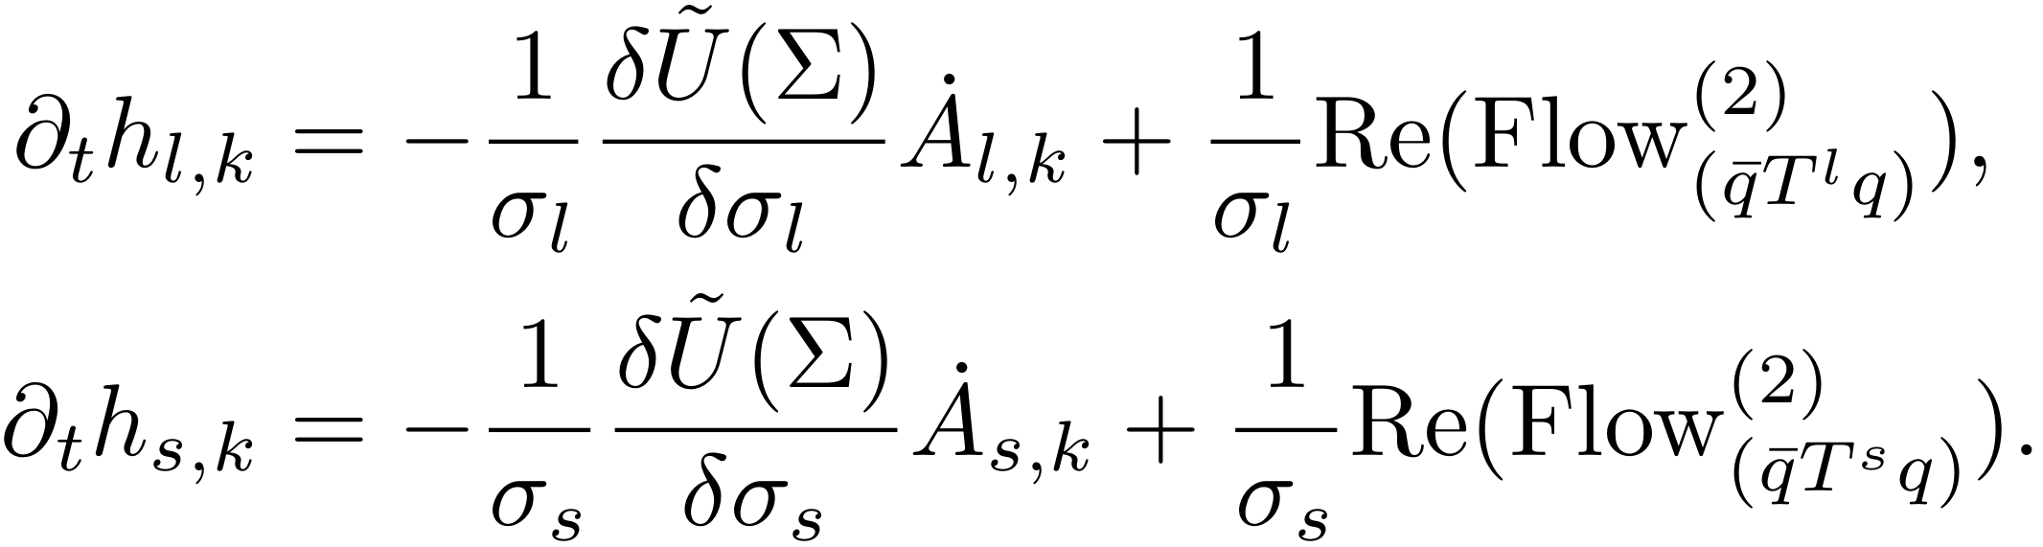
Dynamical hadronization
The scale dependent meson fields:
The Wetterich equation with dynamical hadronization:
With the fully hadronized condition:
Gies, Wetterich , PRD 65 (2002) 065001; 69 (2004) 025001
Pawlowski, AP 322 (2007) 2831
Flörchinger, Wetterich, PLB 680 (2009) 371
We get the hadronization functions :

Slide 10
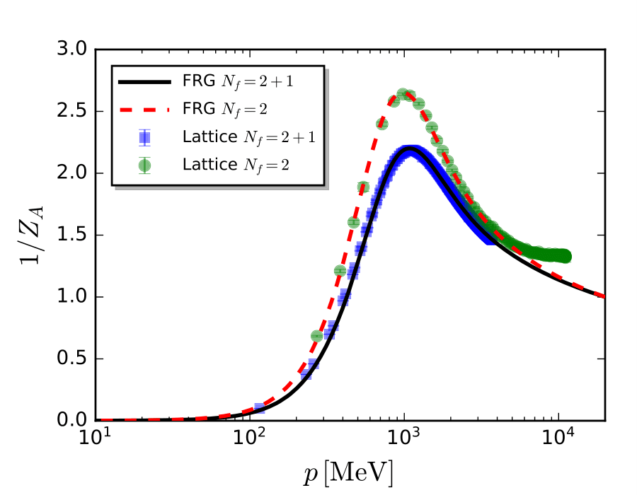
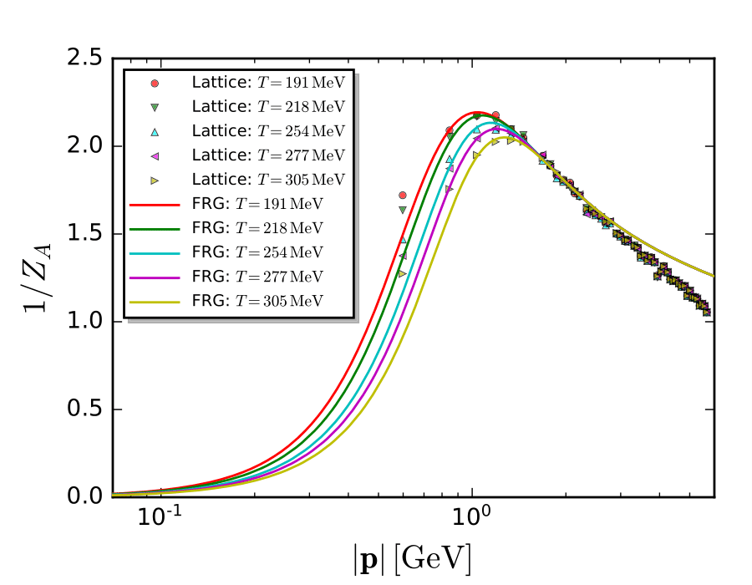
The Gluon Propagator at T=0 and Finite T
W-j Fu, J.M. Pawlowski, F. Rennecke, Phys.Rev.D 101 (2020) 5, 054032

Slide 11
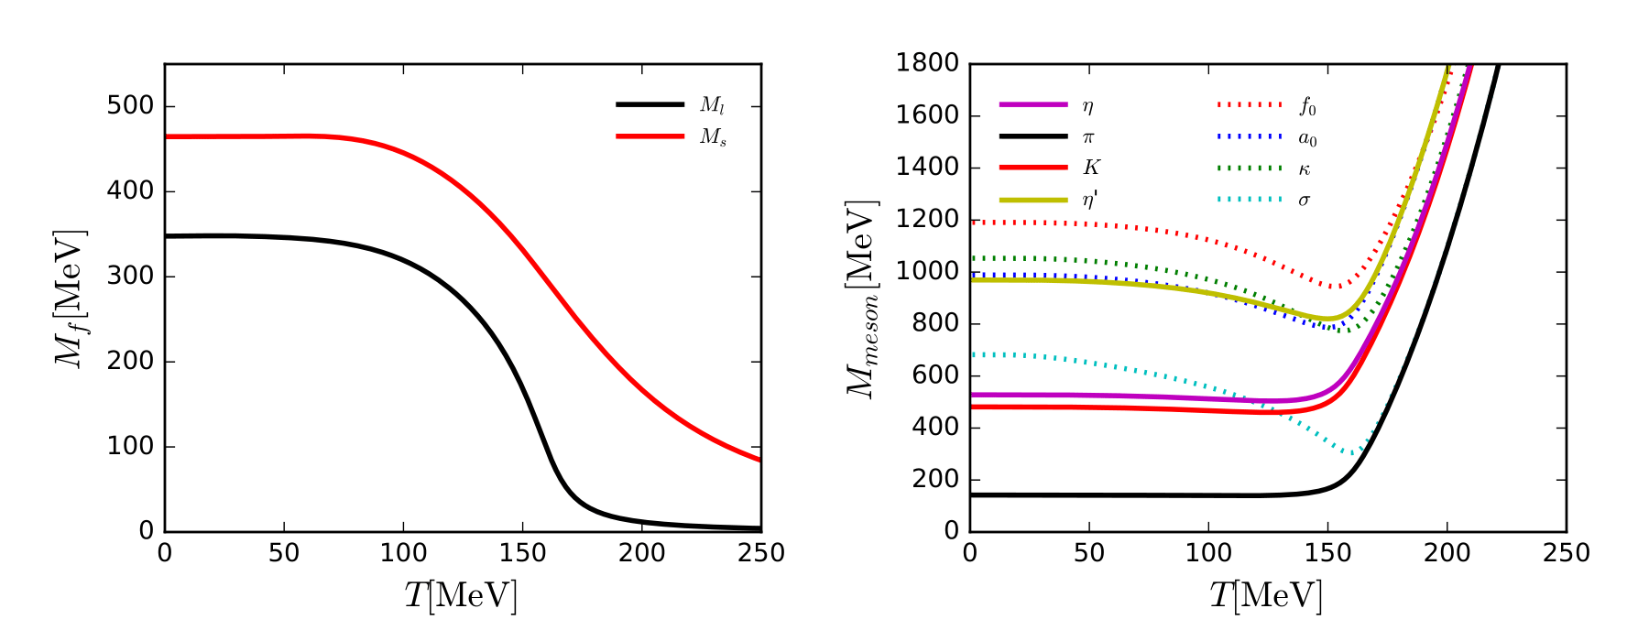

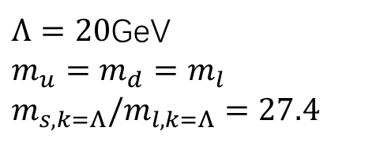
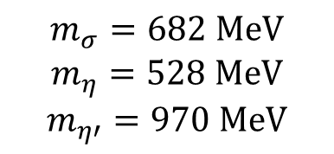
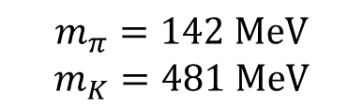
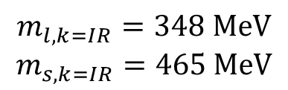
Quarks and Mesons Masses
Preliminary
$Λ=20$GeV
$$m_{u}=m_{d}=m_{l}$$
$$m_{s,k=Λ}/m_{l,k=Λ}=27.4$$
$$m_{l,k=IR}=348 MeV$$
$$m_{s,k=IR}=465 MeV$$
$$m_{π}=142 MeV$$
$$m_{K}=481 MeV$$
$$m_{σ}=682 MeV$$
$$m_{η}=528 MeV$$
$$m_{η′}=970 MeV$$

Slide 12
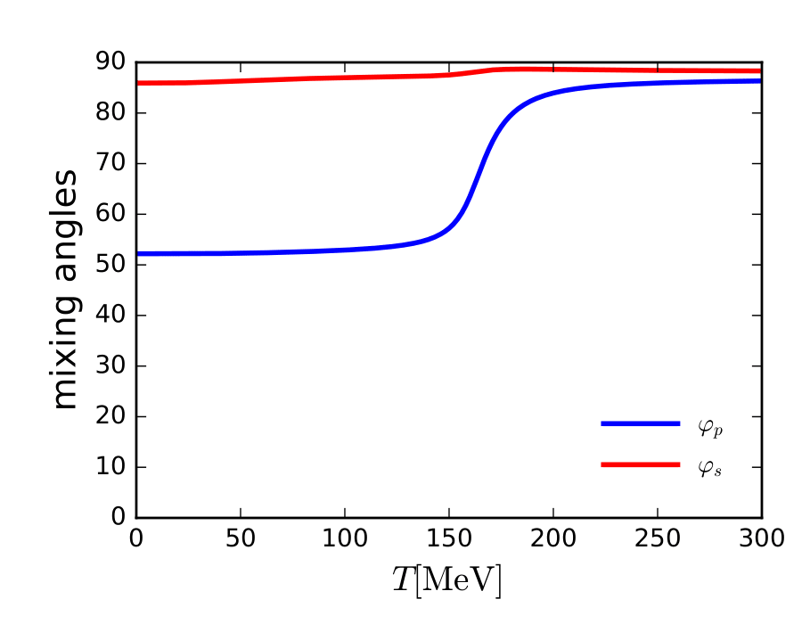
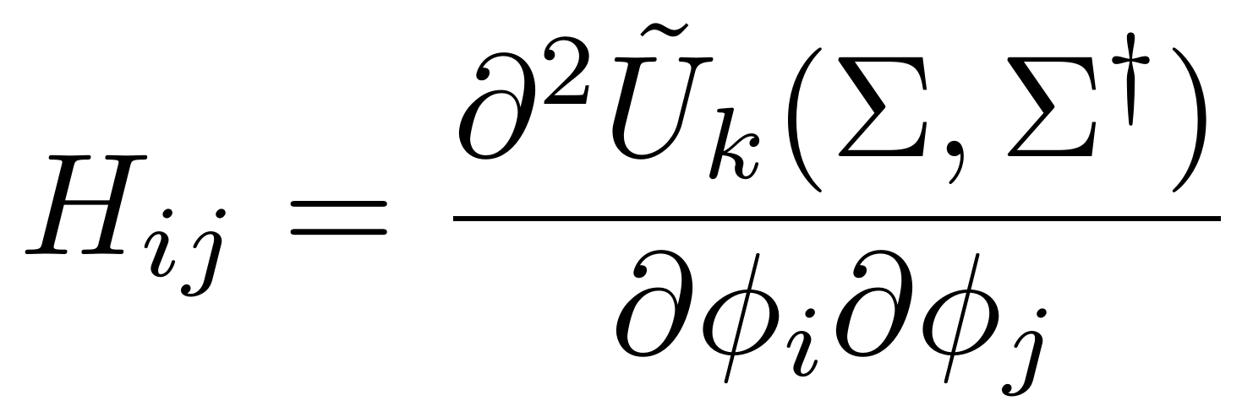

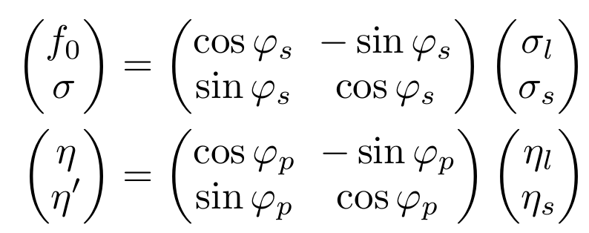
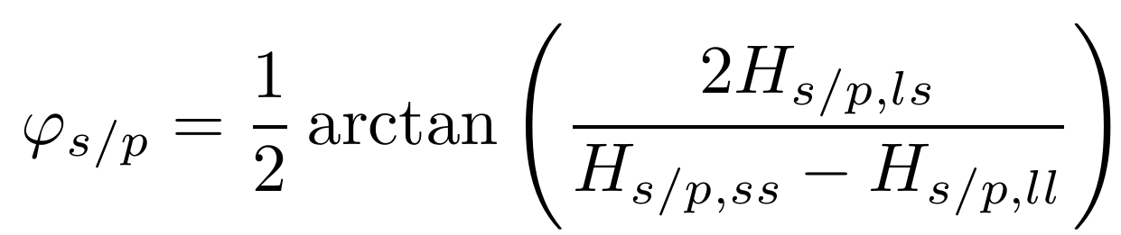
The mixing angles between light-strange (LS) basis and physical basis
Hessian matrix
Because the nonvanishing nondiagonal element
Preliminary
The mixing angles
η is almost octet state
η′ is singlet state
η′ becomes light state

Slide 13
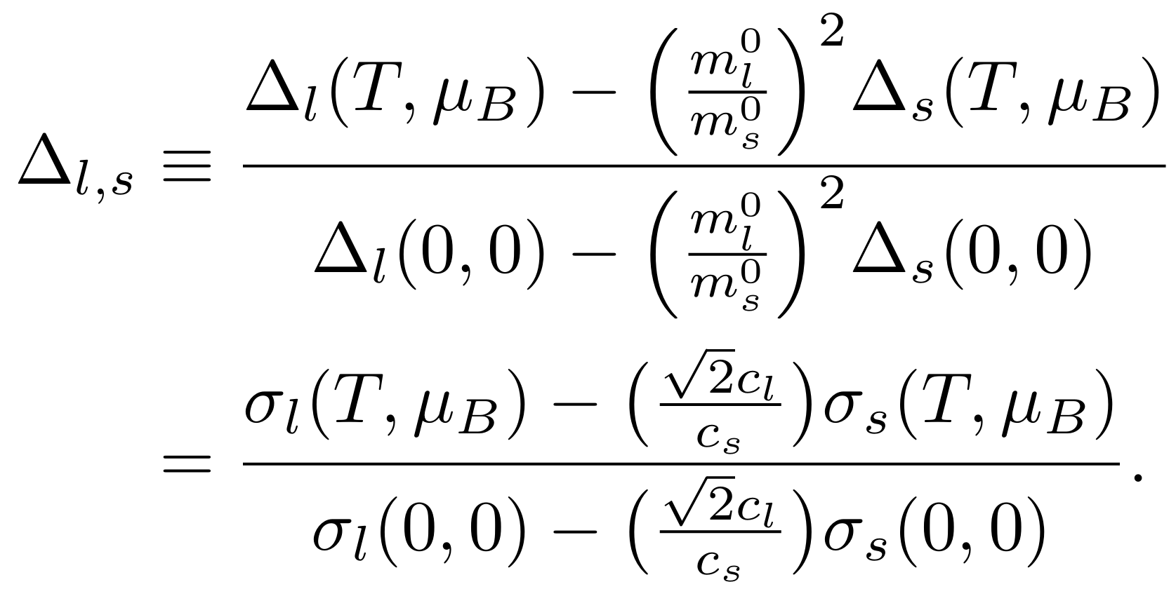
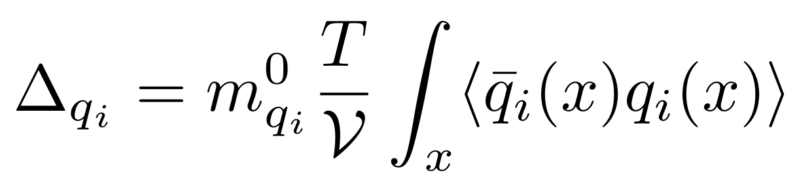
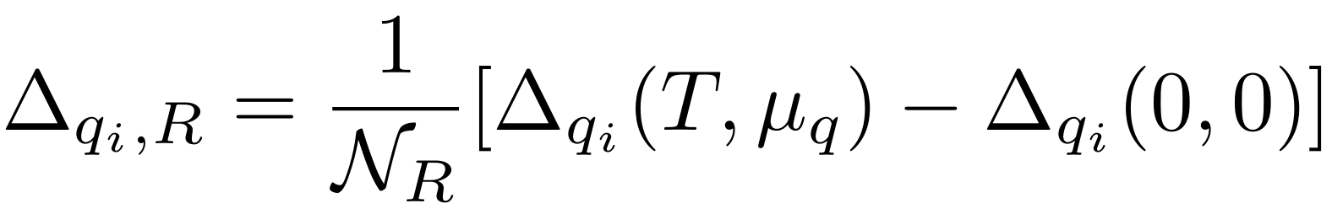
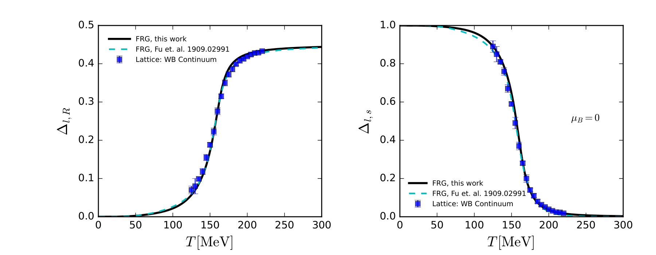
The light and reduced chiral condensate
Preliminary
Wuppertal-Budapest Collaboration: JHEP 09 (2010) 073

Slide 14
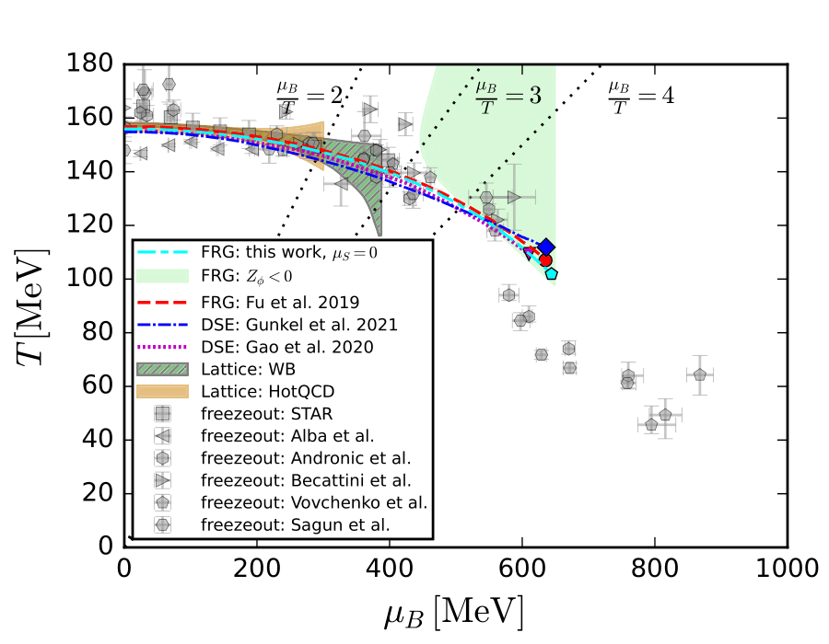



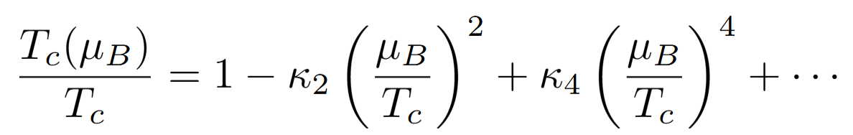
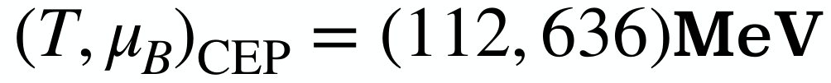


Phase diagram with $μ_{s}=0$
$$T_{pc}=156 MeV$$
HotQCD Collaboration
Phys. Lett. B, 2019, 795:15-21.
$$κ_{2}\left(μ_{s}=0\right)=0.0145(2)$$
Preliminary
H. T. Ding, et.al. arXiv:2403.09390
S. Borsanyi, et.al. Phys. Rev. Lett. 125, 052001 (2020),
$\left(T_{CEP}=102MeV,μ_{B}=644MeV\right){, μ}_{s}=0$
fRG: W-j Fu, Pawlowski, Rennecke, PRD 101 (2020), 054032
DSE (fRG): Gao, Pawlowski, PLB 820 (2021) 136584
DSE: Gunkel, Fischer, PRD
104 (2021) 5, 054022

Slide 15
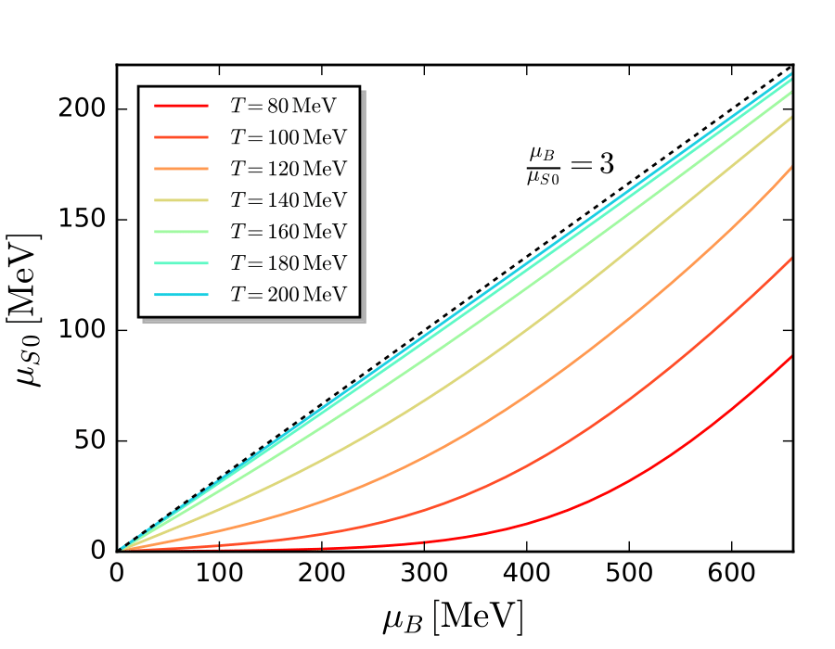
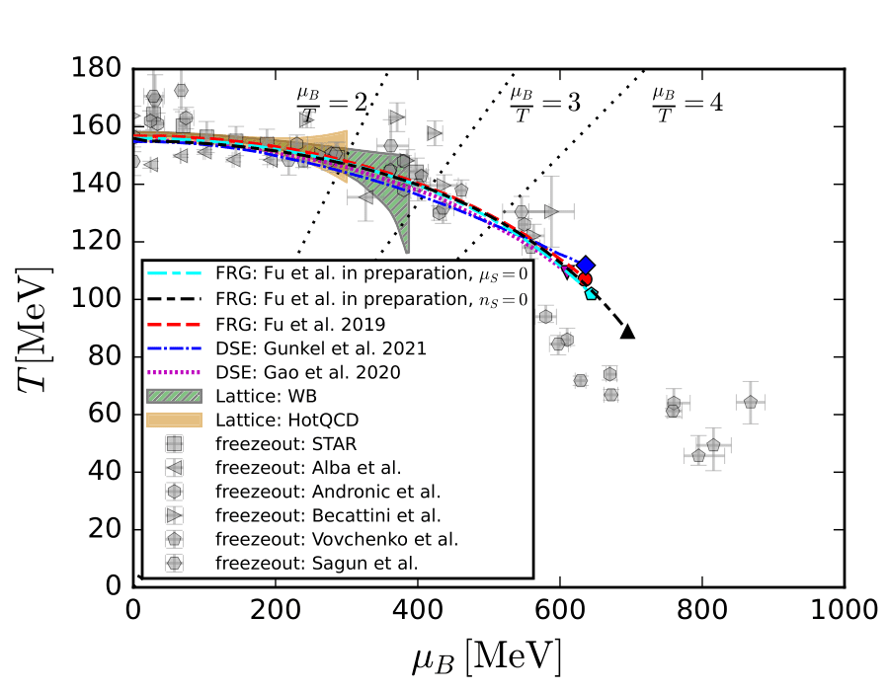
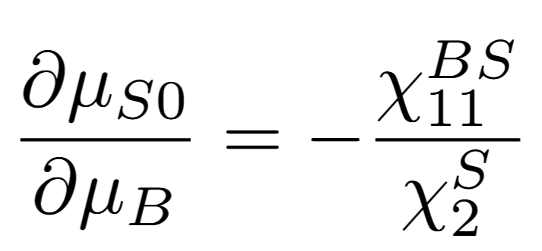
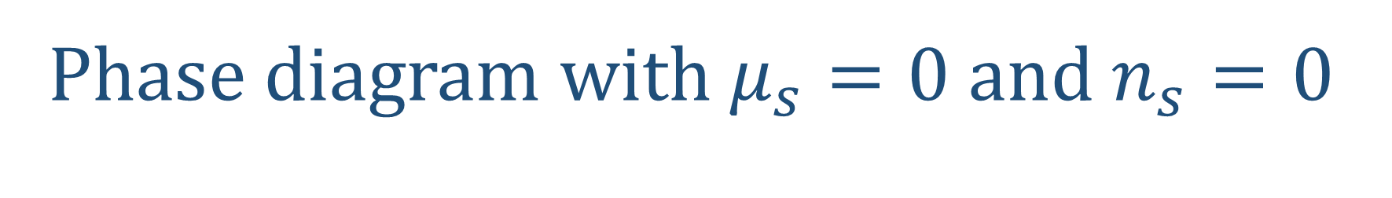
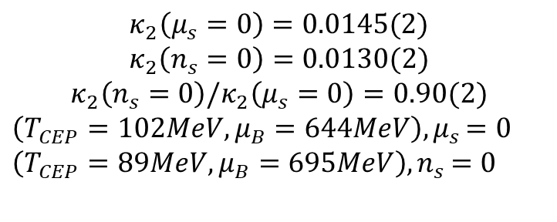
Phase diagram with $μ_{s}=0$ and $n_{s}=0$
Preliminary
Preliminary
$$κ_{2}\left(μ_{s}=0\right)=0.0145(2)$$
$$κ_{2}\left(n_{s}=0\right)=0.0130(2)$$
$$κ_{2}\left(n_{s}=0\right)/κ_{2}\left(μ_{s}=0\right)=0.90(2)$$
$\left(T_{CEP}=102MeV,μ_{B}=644MeV\right){, μ}_{s}=0$
$\left(T_{CEP}=89MeV,μ_{B}=695MeV\right){,n}_{s}=0$
H. T. Ding, et.al. arXiv:2403.09390

Slide 16
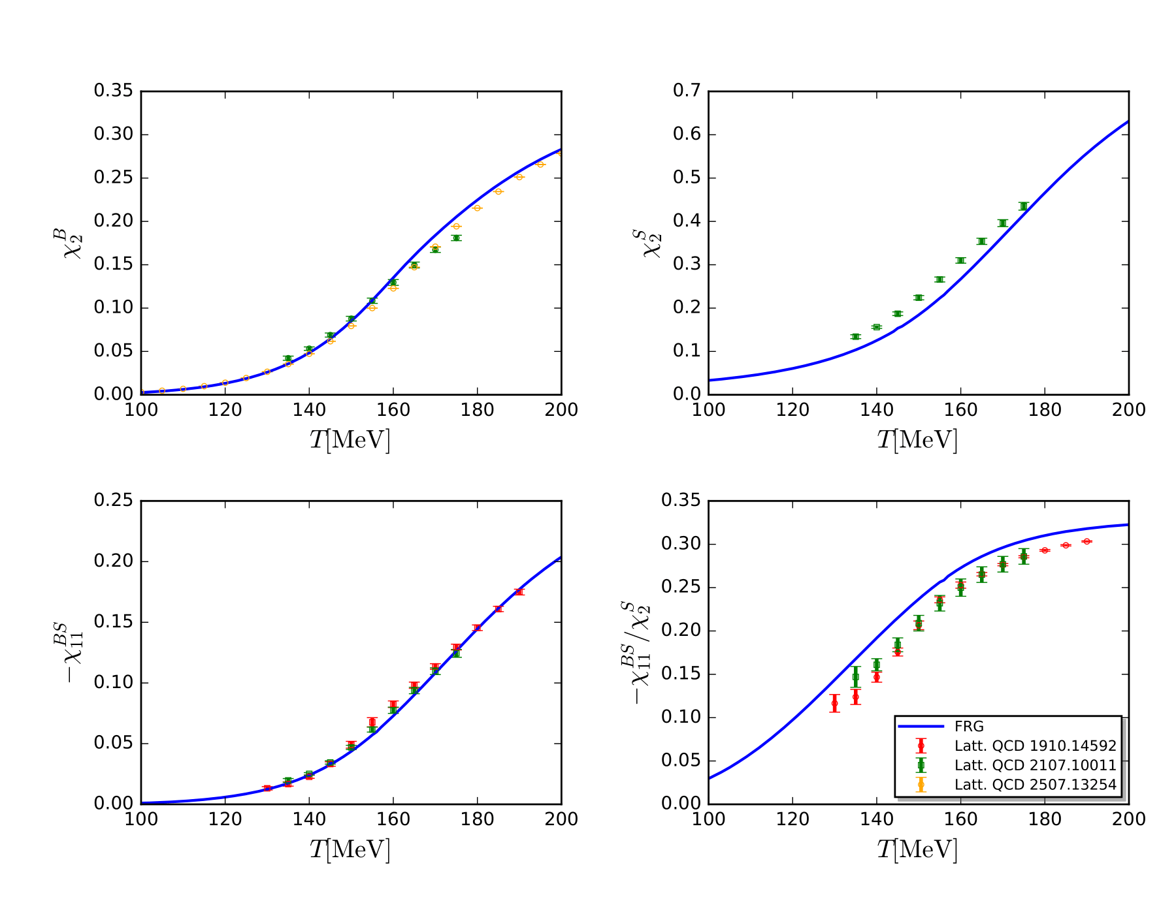
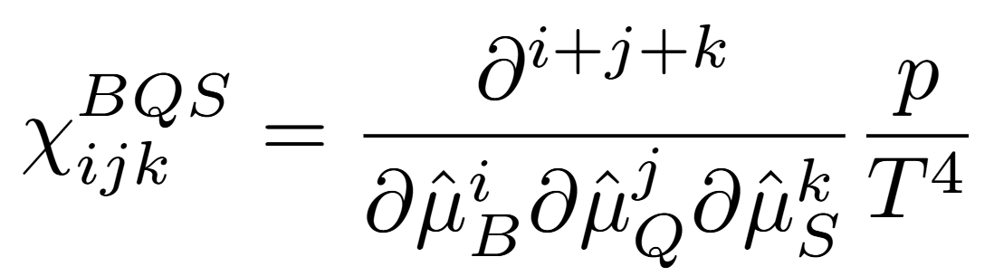
The 2nd order susceptibilities
Preliminary

Slide 17
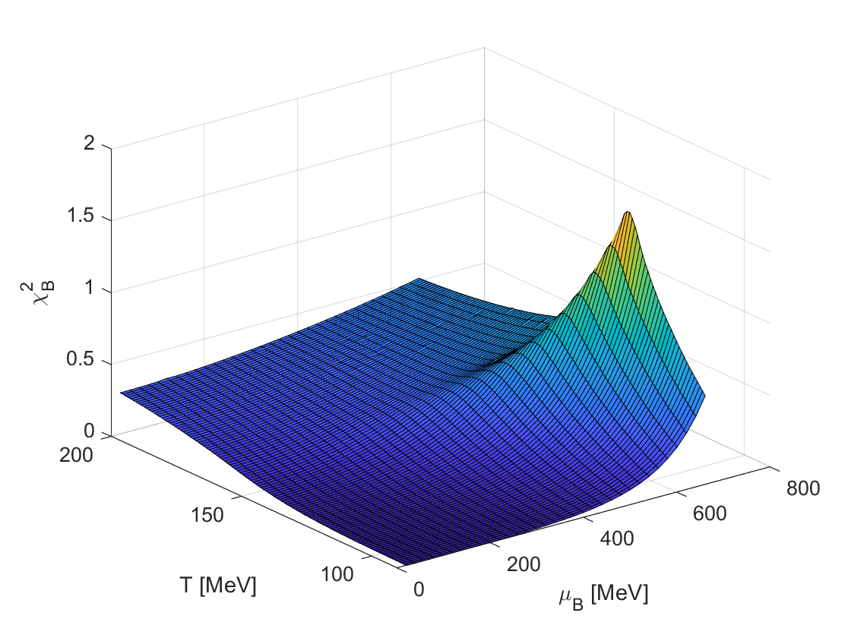
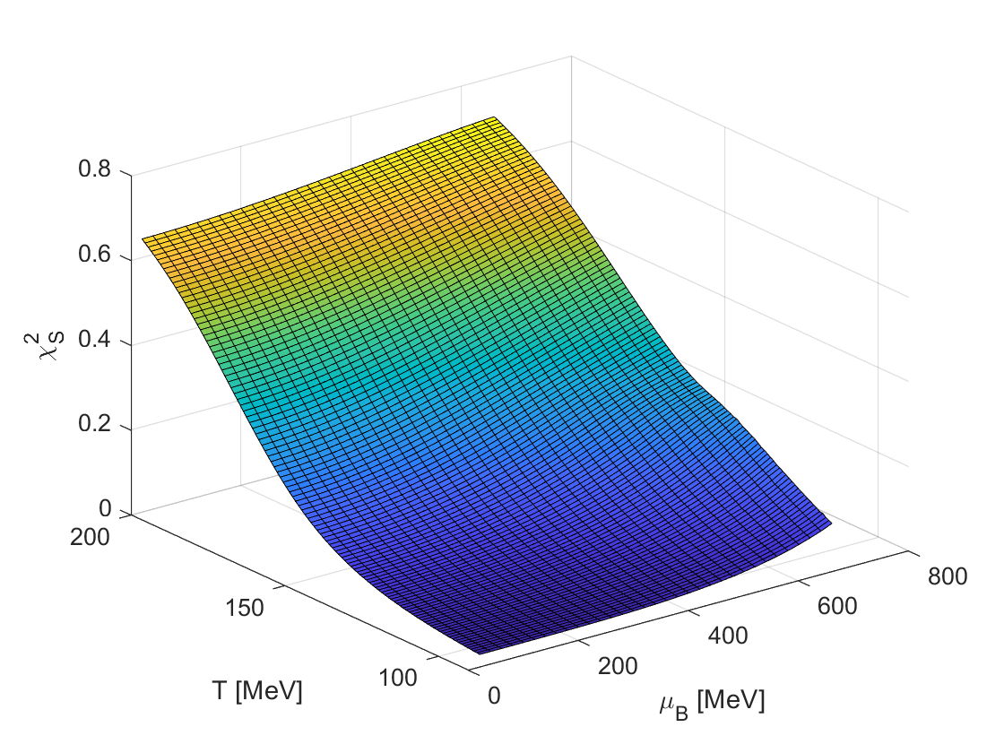
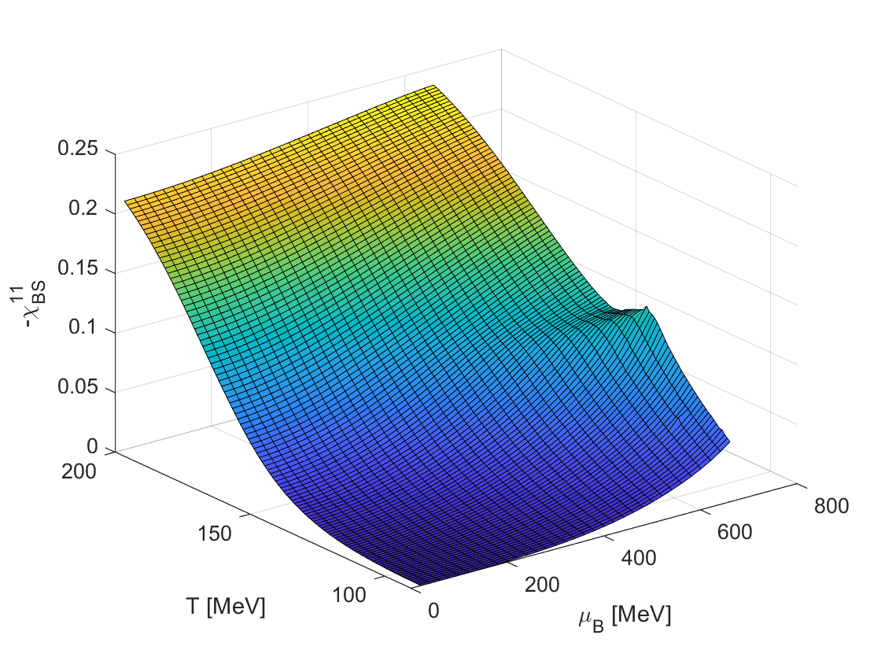


The 2nd order susceptibilities
$n_{s}=0$
Paolo Parotto’s Talk
Preliminary

Slide 18



B-S Correlation
W.-j. Fu, X.f. Luo, J.M. Pawlowski F. Rennecke, R. Wen,Y. Shi
Phys.Rev.D 104 (2021) 9, 094047
Preliminary

Slide 19



The 2nd order susceptibilities $χ_{B}^{2}/χ_{S}^{2}$
$n_{s}=0$
Paolo Parotto’s Talk
Preliminary

Slide 20

Summary
We build the 2+1 flavor QCD theory within FRG approach. The light and reduced chiral condensate, the 2nd order susceptibilities are in good agreement with the Lattice results.
The curvature of the phase boundary
$$κ_{2}\left(n_{s}=0\right)/κ_{2}\left(μ_{s}=0\right)=0.90(2)$$
and the $μ_{B,CEP}(n_{S}=0)$ is slightly larger than $μ_{B,CEP}(μ_{S}=0)$.
The 2nd order baryon-strangeness correlation functions are monotonic changed with the collision energy.
The ratio $χ_{B}^{2}/χ_{S}^{2}$ is also potential signal for CEP detection.
Thanks for your attention

Slide 21

Backup

